Slide 1
Unraveling Implosion Physics in Inertial Confinement Fusion: Direct-drive Simulations, Experiments, and Physics-Informed Data Science
P. B. Radha
Distinguished Scientist
Laboratory for Laser Energetics
University of Rochester
Seminar at MIPSE
University of Michigan
Nov 16, 2022

Slide 2
Progress in direct drive implosion performance is being made through feedback between experiments and codes, and physics-informed data science techniques
Summary
Direct drive applications include studies related to high-energy density plasmas, nuclear astrophysics etc.
Several approaches in parallel are being pursued in parallel to improve performance in proof-of-principle DT-layered OMEGA implosions (kJ scale)
─ Surrogate implosions, targeted science experiments to guide design of cryogenic implosions and
improve simulation predictability
─ Improved tools for postprocessing simulations to identify signatures and potential
failure metrics
─ Data driven models incorporating failure metrics to improve performance
Modern computing is permitting large scale simulations with improved models.

Slide 3
Collaborators
Laboratory for Laser Energetics, University of Rochester
General Atomics, San Diego
Lawrence Livermore National Labs
Plasma Science and Fusion Center, MIT
Los Alamos National Labs
Naval Research Labs, Washington DC
AWE, United Kingdom
University of Bordeaux

Slide 4
Outline
Direct drive on OMEGA
Improving implosion performance by improving models
─ 1D physics – e.g. role of cross beam energy transfer and mitigation using laser bandwidth – evidence from the NIF – upgrade to ray-trace models in hydrodynamic simulations
─ multi-D physics – Role of perturbations - modeling and diagnosing nonuniformity
─ Postprocessing tools, new signatures identifying failure mechanisms
Improving implosion performance using physics informed data-science models
Scaling to Mega-Joule facilities

Slide 5
Two primary laser driven approaches are being studied in the US
Review papers/books

Slide 6
OMEGA implosion studies are based on hydrodynamic scaling between OMEGA and an ignition facility like the National Ignition Facility
E~R³
M~R³
P~R²
T~R

Slide 7
The aim is drive implosions to develop conditions for a robust hotspot and propagating burn

Slide 8
Lasers are used to set up the conditions for a hotspot and propagating burn

Slide 9
Design parameters (adiabat and implosion velocity) are varied by varying targets and pulse shapes
Ice thickness is varied for
different implosion velocities

Slide 10
A range of diagnostics are used to study the hot spot
ρR~α^{-0.5}

Slide 11
Several measures of target performance indicating how close an implosion is to ignition have been identified

Slide 12
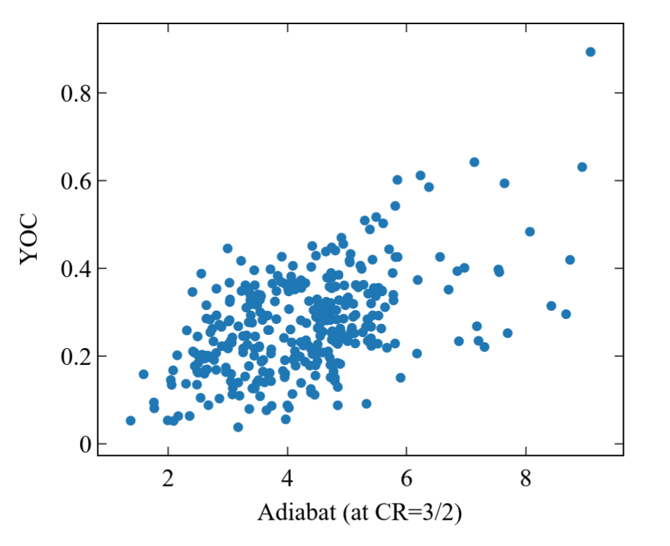
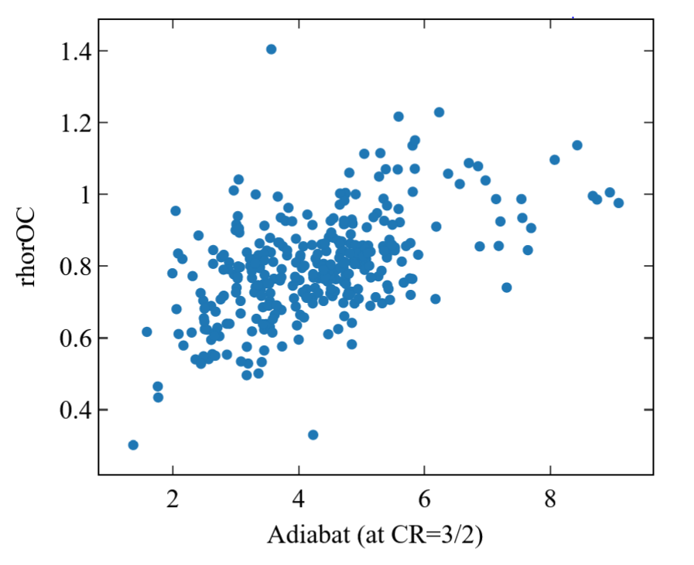
Observations deviate from simulations with increasing convergence or decreasing adiabat
Yield degradation
(Measured yield/Simulated yield)
Areal density degradation
(Measured ρR/Simulated ρR)
Increasing convergence
Increasing convergence

Slide 13
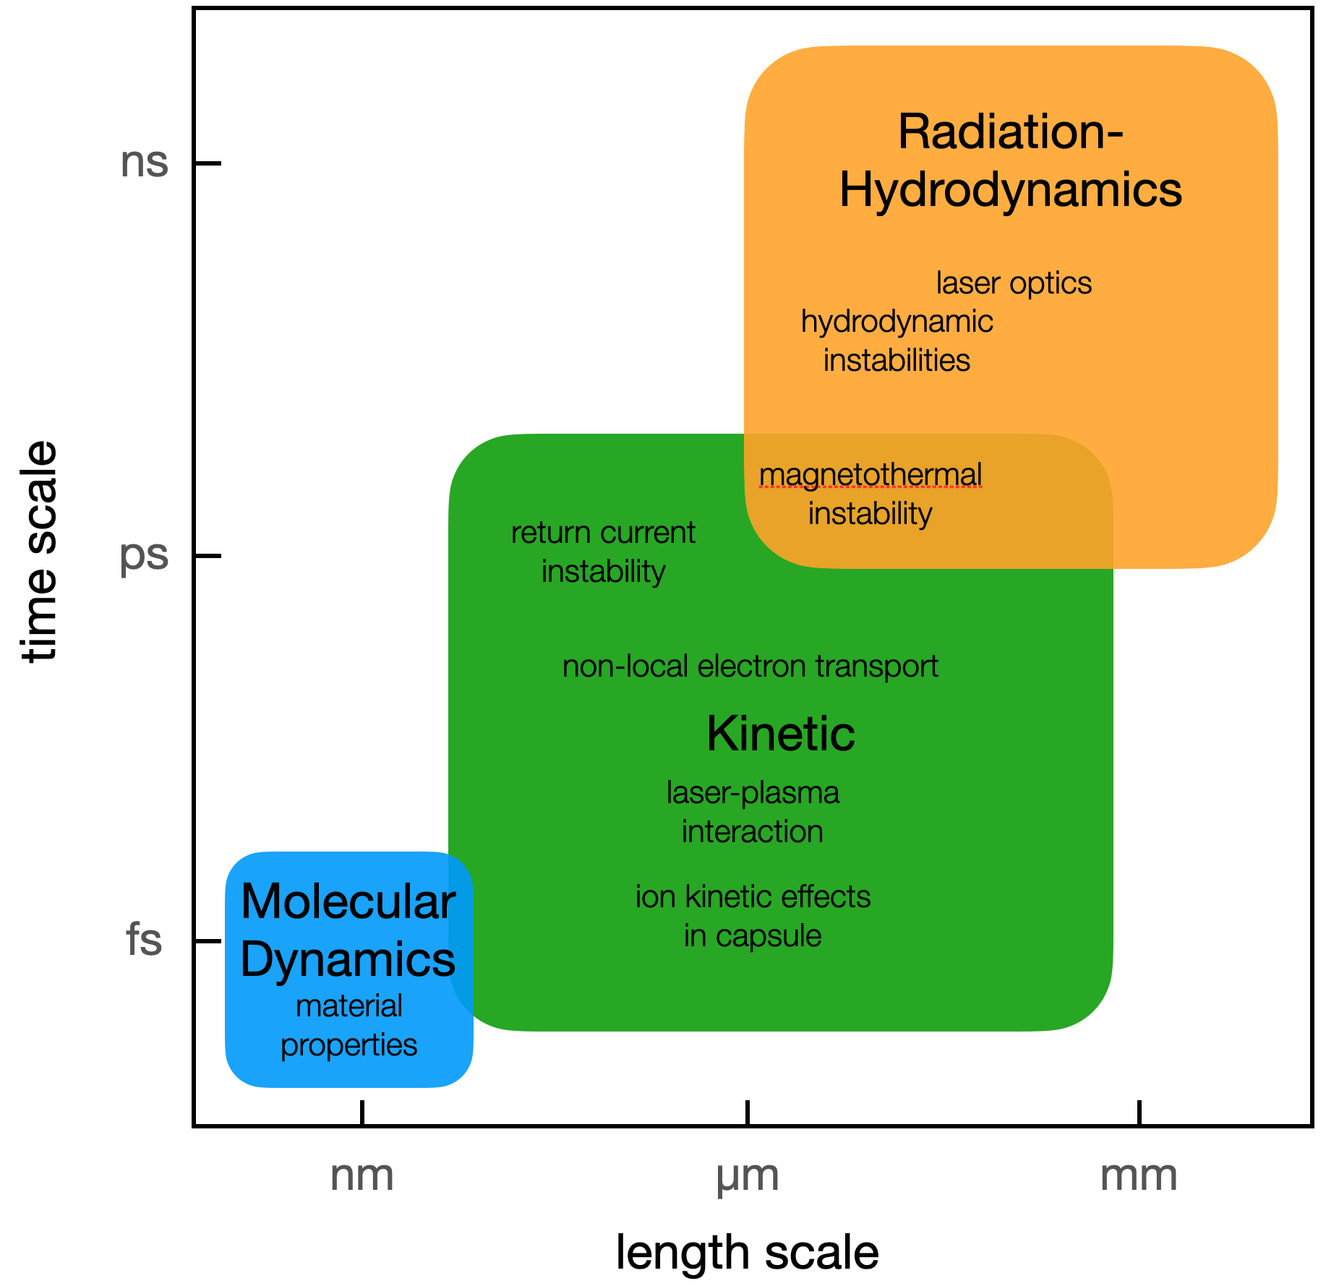
Implosion predictions are challenging because of the multi-scale and multi-physics involved

Slide 14
Limited simulation predictability can be due to modeling errors, uncertainties in input to codes or engineering aspects not captured by codes

Slide 15
Outline
Direct drive on OMEGA
Improving implosion performance by improving models
─ 1D physics – e.g. role of cross beam energy transfer and mitigation using laser bandwidth – evidence from the NIF – upgrade to ray-trace models in hydrodynamic simulations
─ multi-D physics – Role of perturbations - modeling and diagnosing nonuniformity
─ Postprocessing tools, new signatures identifying failure mechanisms
Improving implosion performance using physics informed data-science models
Scaling to Mega-Joule facilities

Slide 16
Cross beam energy transfer can significantly reduce the ablation pressure
P_{hs} = Hot spot pressure
P_{a} = Ablation pressure

Slide 17
Laser deposition models in rad-hydro codes have been improved to include the effect of CBET

Slide 18
Detuning the wavelengths of the crossing beams can improve ablation pressure as demonstrated on the NIF
J. Marozas et al, Phys. Rev. Lett (2018).

Slide 19
NIF’s wavelength detuning capability has been used to demonstrate mitigation of CBET in proof-of-principle experiments

Slide 20
Outline
Direct drive on OMEGA
Improving implosion performance by improving models
─ 1D physics – e.g. role of cross beam energy transfer and mitigation using laser bandwidth – evidence from the NIF – upgrade to ray-trace models in hydrodynamic simulations
─ multi-D physics – Role of perturbations - modeling and diagnosing nonuniformity
─ Postprocessing tools, new signatures identifying failure mechanisms
Improving implosion performance using physics informed data-science models
Scaling to Mega-Joule facilities

Slide 21
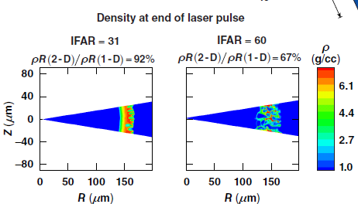
Laser speckle can reduce the areal density for high IFAR implosions
15
30
P. B. Radha (DRACO - 2011)

Slide 22
Highly resolved 3D simulations are now possible to model the effect of laser imprint
I. Igumenschev, PRL (2019)

Slide 23
Outline
Direct drive on OMEGA
Improving implosion performance by improving models
─ 1D physics – e.g. role of cross beam energy transfer and mitigation using laser bandwidth – evidence from the NIF – upgrade to ray-trace models in hydrodynamic simulations
─ multi-D physics – Role of perturbations - modeling and diagnosing nonuniformity
─ Postprocessing tools, new signatures identifying failure mechanisms
Improving implosion performance using physics informed data-science models
Scaling to Mega-Joule facilities

Slide 24
Hot spot flow, diagnosed by the Doppler shift in the DT neutron peak, can result in an inefficient conversion of the shell kinetic energy into hot spot energy

Slide 25
Implosions with large flows also indicate asymmetries in the measured width of the neutron spectrum (apparent ion temperature variations)
NtoF detectors
Flow
O. Mannion (2019)

Slide 26
Outline
Direct drive on OMEGA
Improving implosion performance by improving models
─ 1D physics – e.g. role of cross beam energy transfer and mitigation using laser bandwidth – evidence from the NIF – upgrade to ray-trace models in hydrodynamic simulations
─ multi-D physics – Role of perturbations - modeling and diagnosing nonuniformity
─ Postprocessing tools, new signatures identifying failure mechanisms
Improving implosion performance using physics informed data-science models
Scaling to Mega-Joule facilities

Slide 27
Yield degradation mechanisms have been quantified through a multi-variate regression model with observed and simulated dependencies

Slide 28
Multi-variate regression techniques are being used in parallel to identify quantities that determine implosion performance

Slide 29
The statistical model predicts yield accurately and is used to design higher performing
implosions
The remaining scatter is due to
shot-to-shot variations in laser
delivery, target quality, and any
other design-dependent physics
that is not accounted for.

Slide 30
Hydrodynamic scaling requires a modest increase in yield and areal density
C. Williams, Phys. Plasmas (2022).

Slide 31
Outline
Direct drive on OMEGA
Improving implosion performance by improving models
─ 1D physics – e.g. role of cross beam energy transfer and mitigation using laser bandwidth – evidence from the NIF – upgrade to ray-trace models in hydrodynamic simulations
─ multi-D physics – Role of perturbations - modeling and diagnosing nonuniformity
─ Postprocessing tools, new signatures identifying failure mechanisms
Improving implosion performance using physics informed data-science models
Scaling to Mega-Joule facilities

Slide 32
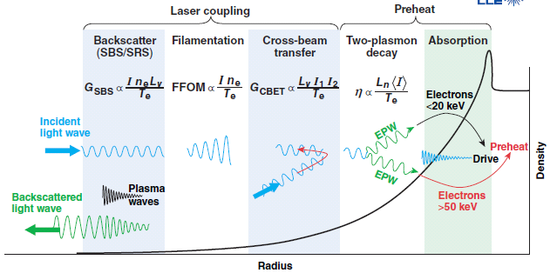
Many coronal processes influence laser energy deposition and electron transport to the ablation surface

Slide 33
Progress in direct drive implosions is being made through feedback between experiments and codes, and physics-informed data science techniques
Summary/Conclusions
Direct drive applications include yield, studies related to stockpile stewardship, nuclear astrophysics, studies of matter under extreme conditions etc.
Several approaches in parallel are being pursued in parallel to improve performance in proof-of-principle DT-layered OMEGA implosions (kJ scale)
─ Surrogate implosions, targeted science experiments to guide design of cryogenic implosions and
improve simulation predictability
─ Improved tools for postprocessing simulations to identify signatures and potential
failure metrics
─ Data driven models incorporating failure metrics to improve performance
Modern computing is permitting large scale simulations with improved models.

Slide 34
Coasting Phase

Slide 35
Maintaining ablation pressure till the implosion bang time is key to improving compression

Slide 36
The improved compression by maintaining ablation pressure has been demonstrated in OMEGA implosions
Measured proton spectrum
DD
α
He3
n
p (12-17 MeV)
Lines – Synthetic spectrum (IRIS)

