Slide 1
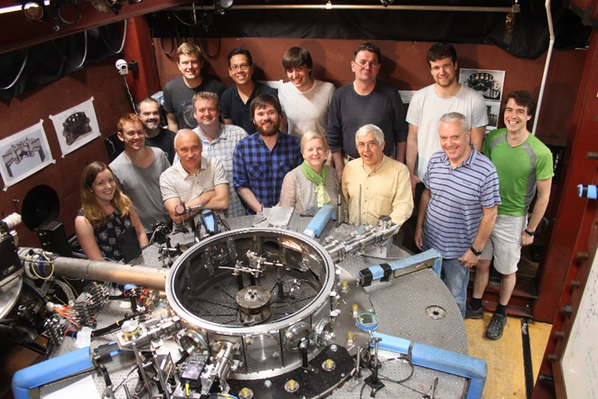
High Energy Density Physics Experiments at Imperial College – Mega-amps and Megabars
Simon Bland
Senior Lecturer in Plasma physics and Shock Physics

Slide 2
A Huge Number of Colleagues & Collaborators
S. V. Lebedev, J.P. Chittenden, D.J. Ampleford, S.C. Bott, G. Burdiak, A. Ciardi, T. Clayson, B. Dangor, P. de Grouchy, G. N. Hall, J. Hare, A. Harvey-Thompson, C. Jennings, E. Khoory, J. MacDonald, A. Marocchino, J.B.A. Palmer, L. Pickworth, J. Rapley, J. Skidmore, L. Suttle, F. A. Suzuki-Vidal, G. Swadling, S. Theocharous, E. Tubman, D. Yanuka and M.G.Haines
Imperial College London
D. Hammer, B. Kusse, J. Greenly, C. Seylor, K. Chandler, M. Mitchell, J. D. Douglass, J. Banasek, K. S. Bell, I. Blesener, T. Byvank, A. Cahill, D. A. Chalenski, P. Duselis, P.A. Gourdain, C.L. Hoyt, P. Knapp, M. Martin, R. McBride, W. M. Potter, P.C. Schrafel, D.B. Sinars
Cornell University
T. Shelkovenko & S.A. Pikuz
P.N. Lebedev Institute / Cornell University
Ya. E. Krasik, A. Rososhek,, A. Virozub, S. Efimov, S. Gleizer
Technion, Israel
F. Zucchini, C. Chauvin, P. Combes, D. Sol, A. Loyen, B. Roques, J. Grunenwald
CEA Gramat
A. Rack, M. Olbinado
ESRF
This work was supported by multiple organizations, including
EPSRC, NNSA, DoE, AFOSR, Sandia National Labs, First Light Fusion

Slide 3
Outline
1) A little background

Slide 4
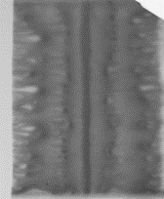
Outline
1) A little background
2) What are wire array z-pinches and how do they work

Slide 5
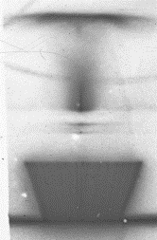
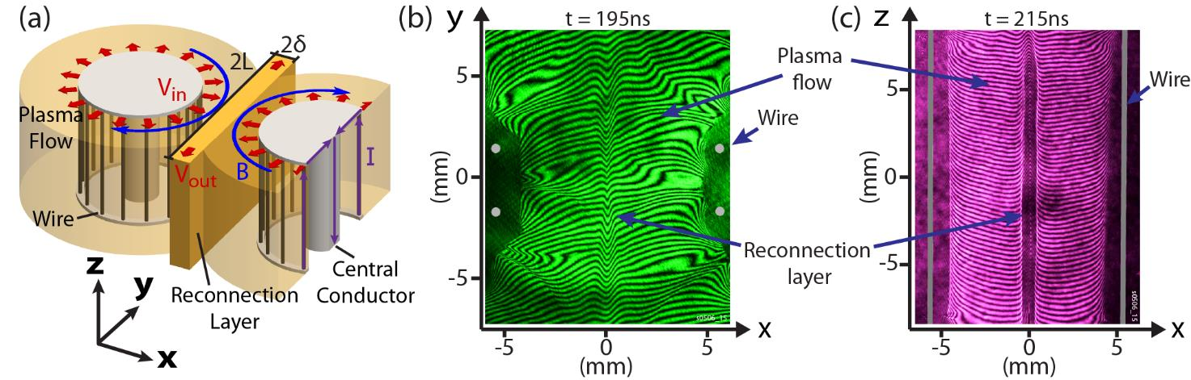
Outline
1) A little background
2) What are wire array z-pinches and how do they work
3) Using ablated plasmas – hydrodynamics, astrophysical jets and reconnection experiments

Slide 6
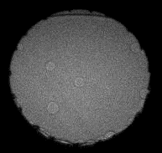
Outline
1) A little background
2) What are wire array z-pinches and how do they work
3) Using ablated plasmas – hydrodynamics, astrophysical jets and reconnection experiments
4) Warm dense matter with magnetic drives and convergent shockwaves

Slide 7
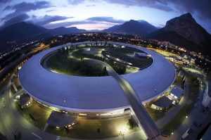
Outline
1) A little background
2) What are wire array z-pinches and how do they work
3) Using ablated plasmas – hydrodynamics, astrophysical jets and reconnection experiments
4) Warm dense matter with magnetic drives and convergent shockwaves
5) Cutting edge diagnostics

Slide 8
Pulsed Power Driven
High Energy Density Physics

Slide 9
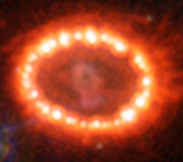
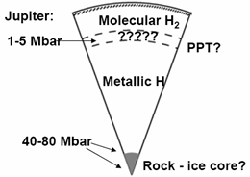
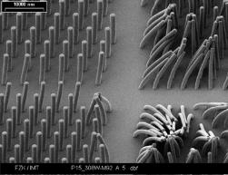
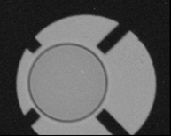
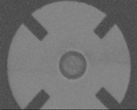
High Energy Density Physics
Materials in extremes of temperature (> 10⁵ K), pressure (> KBar), & density.
Not just fundamental physics research – there are many applications
Supernova shock wave
Planetary Science
High resolution X-ray
X-ray lithography
Implosion of fusion test capsule

Slide 10
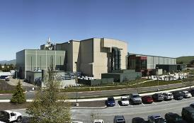
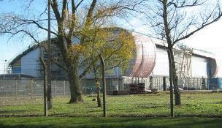
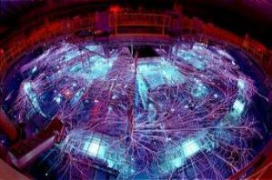
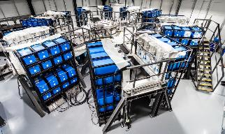
HEDP faciliies
Rapidly expanding field – many new national facilities
National Ignition Facility at LLNL
Orion laser facility at AWE
Z at Sandia
Facilities concentrate Mega-Joule energies to create HEDP conditions
Big operating budgets and ‘armies’ of exceptional researchers
M3 at First Light Fusion

Slide 11

What is the role of universities ?
It would be difficult to compete like for like with a large national facility
In my lab I cannot create same high pressures tomorrow using same techniques
University collaborate continually with National labs – through both experiments / sims
And students from Universities doing HEDP go on to work for National Labs
Notes:
Mention could be used/scaled to universities

Slide 12

What is the role of universities ?
It would be difficult to compete like for like with a large national facility
In my lab I cannot create same high pressures tomorrow using same techniques
But as a university we are a lot more flexible than large facilities
Can rapidly change diagnostics / experiments to pursue interesting effects
Also we’re sneaky – we can use different techniques to get HEDP – still perform cutting edge experimental and computational work
And this is well recognised
Many facilities have good academic access programs, excellent collaborations
Universities are principle pipeline for facility staff
University collaborate continually with National labs – through both experiments / sims
And students from Universities doing HEDP go on to work for National Labs
Notes:
Mention could be used/scaled to universities

Slide 13
A Huge Number of Colleagues & Collaborators
S. V. Lebedev, J.P. Chittenden, D.J. Ampleford, S.C. Bott, G. Burdiak, A. Ciardi, T. Clayson, B. Dangor, P. de Grouchy, G. N. Hall, J. Hare, A. Harvey-Thompson, C. Jennings, E. Khoory, J. MacDonald, A. Marocchino, J.B.A. Palmer, L. Pickworth, J. Rapley, J. Skidmore, L. Suttle, F. A. Suzuki-Vidal, G. Swadling, S. Theocharous, E. Tubman, D. Yanuka and M.G.Haines
Imperial College London
D. Hammer, B. Kusse, J. Greenly, C. Seylor, K. Chandler, M. Mitchell, J. D. Douglass, J. Banasek, K. S. Bell, I. Blesener, T. Byvank, A. Cahill, D. A. Chalenski, P. Duselis, P.A. Gourdain, C.L. Hoyt, P. Knapp, M. Martin, R. McBride, W. M. Potter, P.C. Schrafel, D.B. Sinars
Cornell University
T. Shelkovenko & S.A. Pikuz
P.N. Lebedev Institute / Cornell University
Ya. E. Krasik, A. Rososhek,, A. Virozub, S. Efimov, S. Gleizer
Technion, Israel
F. Zucchini, C. Chauvin, P. Combes, D. Sol, A. Loyen, B. Roques, J. Grunenwald
CEA Gramat
A. Rack, M. Olbinado
ESRF
= National Lab; = University; = Company exploring HEDP
This work was supported by multiple organizations, including
EPSRC, NNSA, DoE, AFOSR, Sandia National Labs, First Light Fusion

Slide 14
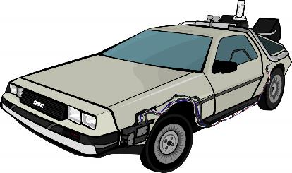
Understanding the physics of wire array z-pinches (1997…)

Slide 15

Understanding the physics of wire array z-pinches (1997…)

Slide 16
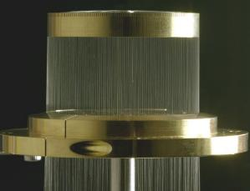
Why wire arrays ?
X-ray emission from wire array z-pinch loads can be used to drive HEDP experiments
40mm diameter, 240 wire tungsten array on Z

Slide 17
Why wire arrays ?
X-ray emission from wire array z-pinch loads can be used to drive HEDP experiments
I
40mm diameter, 240 wire tungsten array on Z

Slide 18
Why wire arrays ?
X-ray emission from wire array z-pinch loads can be used to drive HEDP experiments
B_{θ}
40mm diameter, 240 wire tungsten array on Z

Slide 19
Why wire arrays ?
X-ray emission from wire array z-pinch loads can be used to drive HEDP experiments
JxB_{θ}
40mm diameter, 240 wire tungsten array on Z

Slide 20
Why wire arrays ?
X-ray emission from wire array z-pinch loads can be used to drive HEDP experiments
40mm diameter, 240 wire tungsten array on Z

Slide 21
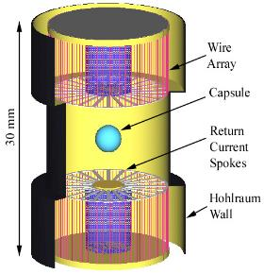
Why wire arrays ?
X-ray emission from wire array z-pinch loads can be used to drive HEDP experiments
Double ended hohlraum design
But how do they work?

Slide 22
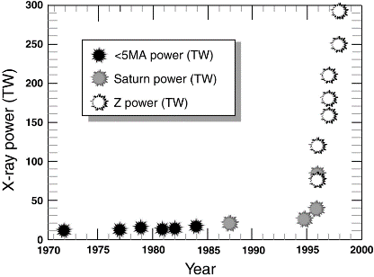
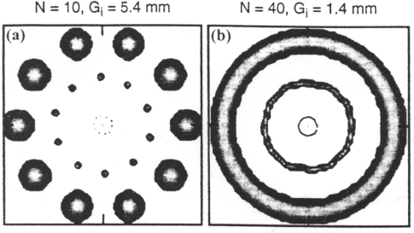
Why wire arrays ?
X-ray emission from wire array z-pinch loads can be used to drive HEDP experiments
Interest in using arrays for HEDP and ICF increased rapidly after 1996 when large number of wires used in array
Why did X-ray power improve?
At the time almost a black box
Initial simulations suggested with many wires, wires would explode and plasma merge into imploding shell

Slide 23
Imperial College MAGPIE
An international collaboration paved the way for understanding wire array z-pinches. Key were university scale machines
– Imperial, Lebedev, Cornell
Mega
Ampere
Generator for
Plasma
Implosion
Experiments
1.5MA, 240ns rise time pulsed power facility in Blackett Laboratory
Good diagnostic access

Slide 24
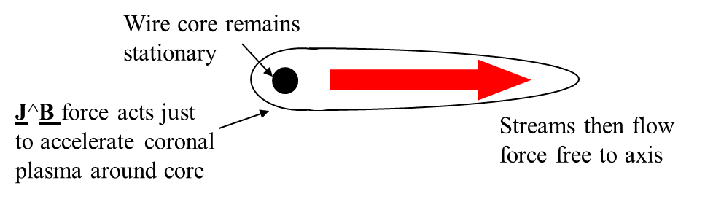
What the collaboration found…
No matter how many wires are used or how high a current is applied:
Wire arrays are dominate by long time scale ablation
Plasma shells are not formed (probably a good thing!); instead wires form core-corona plasma systems

Slide 25
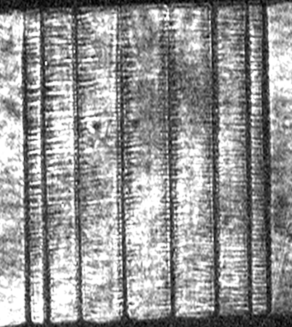
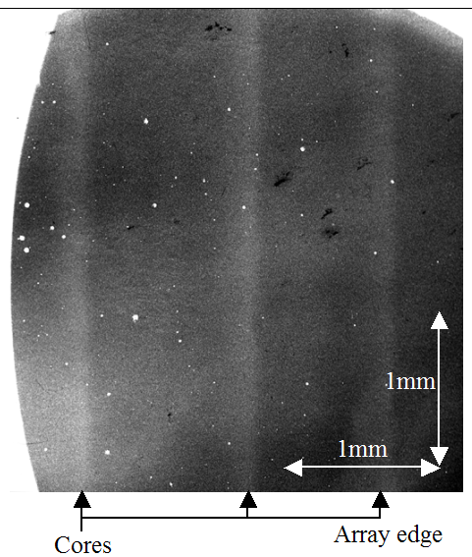
Core – corona plasma structure
16mm
1ns, 10μm
hν ~ 3-5keV
X-ray probing demonstrated even close to the start of implosion wire cores remained ~ liquid/gas mix
Side on laser probing arrays showed long lived ablation sources at original wire positions

Slide 26

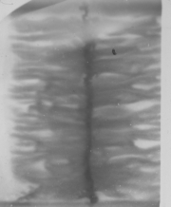
The jigsaw comes together…
Trajectory of wire array
Implosion
Implosion
Stagnation
0.8
ablation
Radius (mm)
0.6
0.4
X-ray
pulse
0.2
Precursor column
0.0
0
20
40
60
80
100
%
of implosion time
Coronal plasma pre-fills array
Wire cores run start to run out of mass
Current – that was pinned close to cores – sweeps up coronal plasma in snowplough
Implosion stagnates on precursor
Trailing mass left behind
3D resistive MHD simulation
The same physics was observed by colleagues on Angara 5, then 5 years later on Z

Slide 27
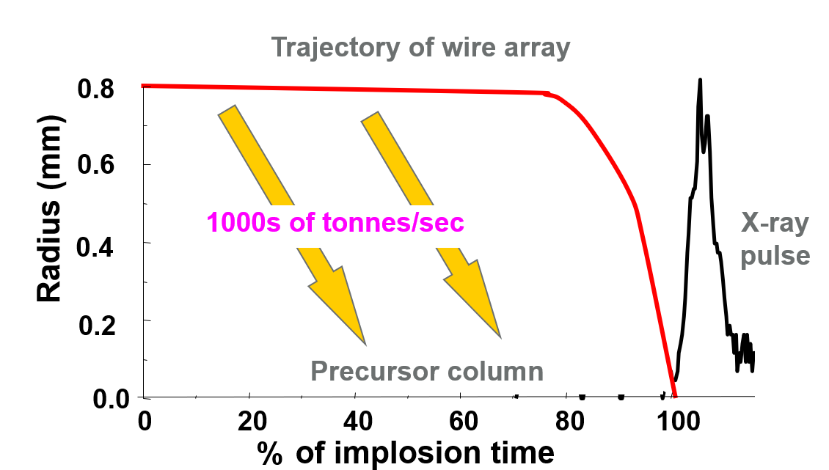
But not just X-rays…
Wire arrays are now an efficient X-ray source with that we understand, can control
But:
Pulsed power driven HEDP does not have to be about X-rays
We use the ablated plasma
We can use magnetic fields

Slide 28
Ablated plasma driven experiments:
Hydrodynamics and lab astrophysics

Slide 29
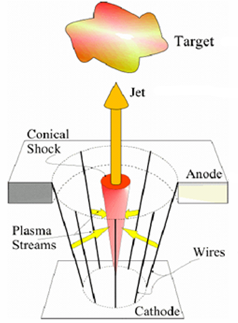
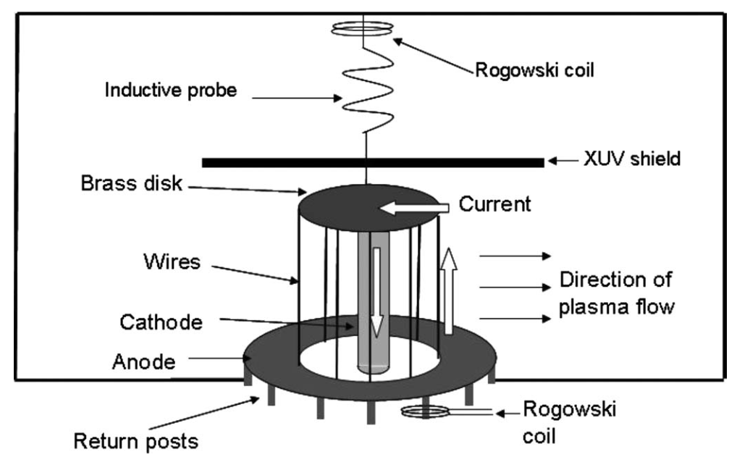
Redirecting plasma flows
Altering the geometry of a wire array z-pinch, changes the direction / concentration of the plasma flow
In a conical array, there is an axial component to the plasma flow – a standing shock then redirects plasma as a jet out of the end of the array
An inverse or exploding array has a local current return on axis – the J^B force and plasma flow are then directed outwards

Slide 30
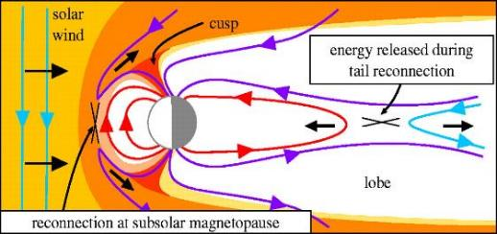
Magnetic reconnection expts
Plasma in solar wind and earths magnetosphere have opposite magnetic field directions
Advected fields form inverse arrays can be used to study magnetic reconnection:
End-on
Side-on

Slide 31
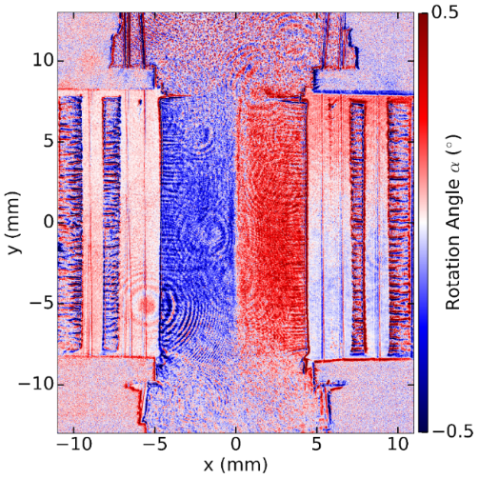
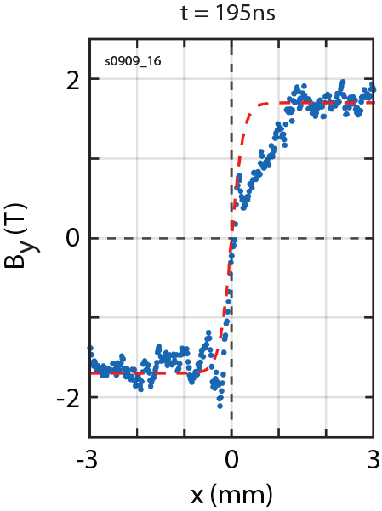
Magnetic reconnection expts
Counter-streaming magnetized plasma flows with oppositely directed fields
Detect annihilation of magnetic flux inside reconnection layer (current sheet)
Side on Faraday rotation measurement
z (mm)
Data
Fit
Δz average

Slide 32
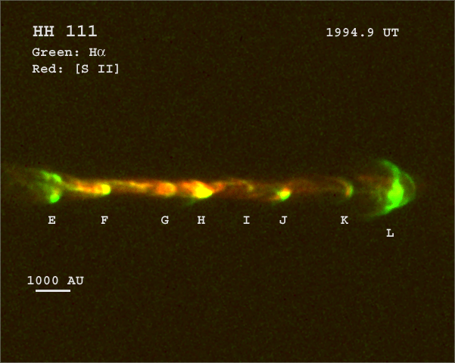
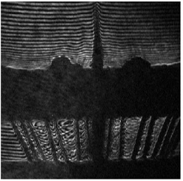
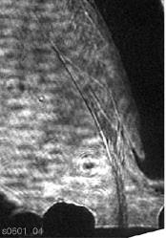
Astrophysical jets
Plasma jets are ubiquitous throughout the universe
Multiple theories underlying formation, structure and interaction with surroundings
Ablated plasma and magnetic fields from a wire array can be used to create ‘scaled’ astrophysical jets
Can redirect precursor out of an array into a high Mach, radiativley cooled jet
Interaction of jet with cloud of plasma (‘interstellar crosswind’) can be examined
Plasma jet
Plasma jet
‘crosswind’ (dense cloud of plasma)
Conical array
Laser interferogram

Slide 33
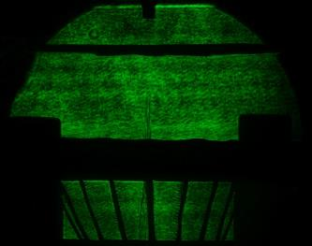
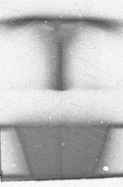
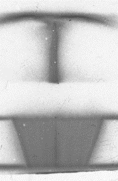
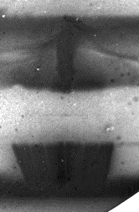
Using a jet to apply high pressures
Velocimetry probe
It takes time for the ablating plasma to form a jet
Before arrival of jet ablated plasma gathers on foil
Once formed jet speed 200kms⁻¹
Arrival of jet launches shocks
Target foil
Plasma jet
Electrode
Wires
Laser probing image @ 264ns
1cm
XUV images
165ns
195ns
215ns
334ns

Slide 34
Using a jet to apply high pressures
Velocimetry probe
It takes time for the ablating plasma to form a jet
Before arrival of jet ablated plasma gathers on foil
Once formed jet speed 200kms⁻¹
Arrival of jet launches shocks
Target foil
Plasma jet
Electrode
Wires
Laser probing image @ 264ns
Pressures ~15Kbar measured from jet
But far less than predicted (100s of Kbar)
=> 3D sims suggest jet is very concentrated – off axis by ~100µm, 10x drop in pressure
But it got us thinking more about high pressures in solids and liquids

Slide 35
Getting to very high pressures – magnetic drive and convergent shocks

Slide 36
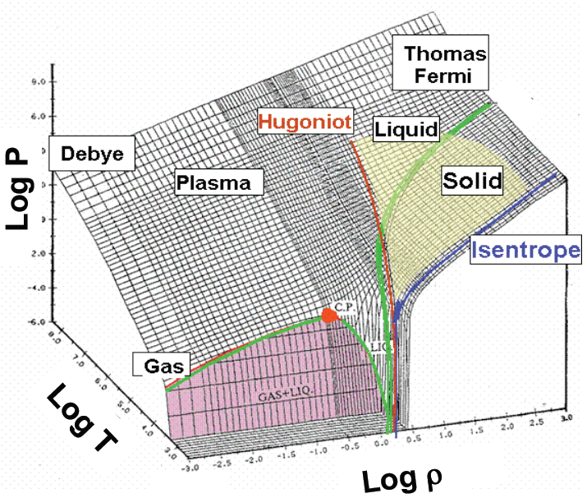
Warm dense matter…
Really fun stuff
Under high pressures / densities coupling become important in plasmas.
Similarly, under high temperatures/pressures condensed matter will ionise
=> Warm dense matter breaches the gap
Log Pressure
We are here
Log Temp
Log Density
MAGPIE IS VERY BUSY
- NEEDS NEW FACILITY

Slide 37
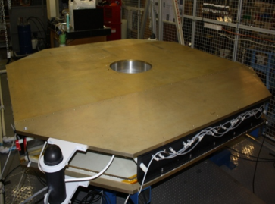
The MACH facility (built 2012)
Built on cutting edge pulsed power technology
(US capacitors, Russian switches, UK triggers)
MACH cavity generates currents of up to 2MA with rise times ~450ns. Energy ~30kJ.
20 sets of capacitors and switches – pulse shaping
50cm load region can use air, liquid, gas or vacuum
Air insulated – no nasty gases, no oil
Easy(ish) to maintain – ran by 2-3 students and researchers
Capacitor
Core
switch

Slide 38
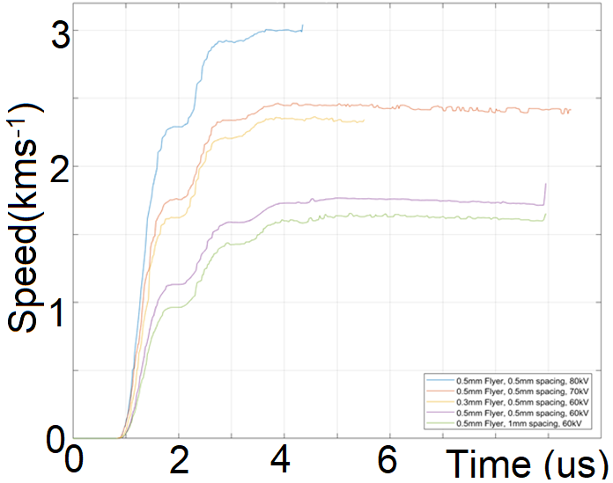
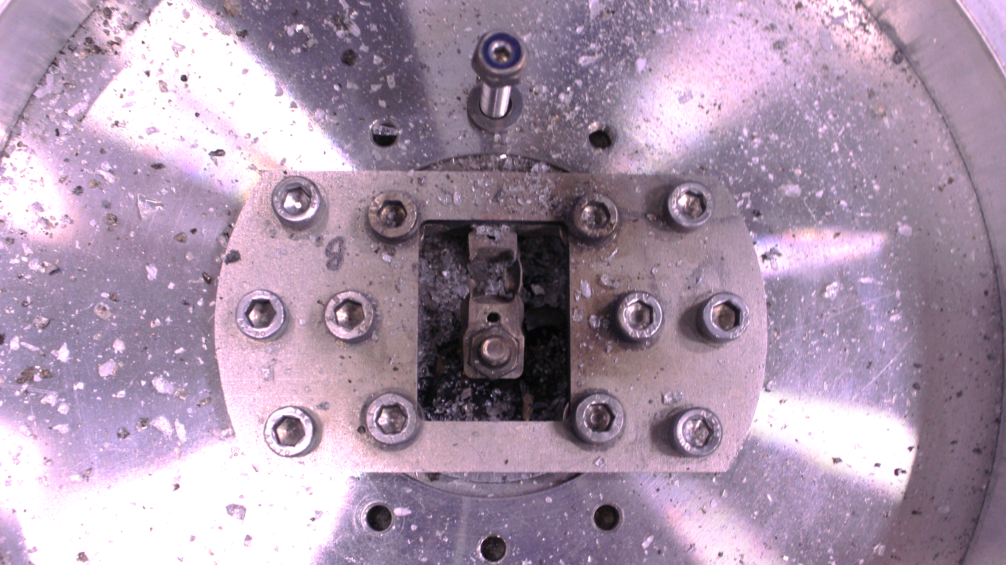
Magnetically driven compression
Magnetic fields generated using pulsed power can drive pressures uniformly over large areas (cm)
Using a stripline load:
Control over current profile
=> Compression without creating shocks
- reduces heating in experiments
allows fast flyer launch for impacts
Pressure on target material
‘strip line’ load configuration
Velocity diagnostic
I
MACH
B
Many cm scale expts with Flyer speeds to 3kms⁻¹ >100KBar shock pressures

Slide 39
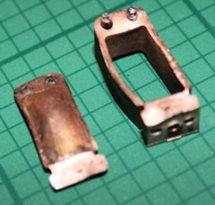
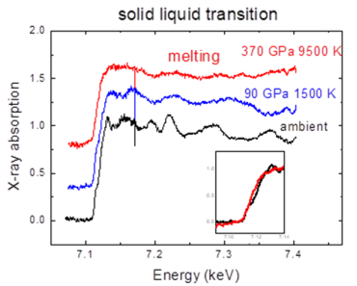
Can we concentrate energy ?
In magnetically driven compression experiments:
The coupling of energy to load is often inefficient
Energy is sacrificed to planarity of stripline/flyers
Timescale
Some really stupid maths:
If we could put just 20kJ of MACHs energy in 10mm³ we would get 20MBar pressures
Even 10% of this would be a huge improvement… and diagnostics are viable
Multi-Mbar iron with 30J laser
- 5µm probing beam

Slide 40
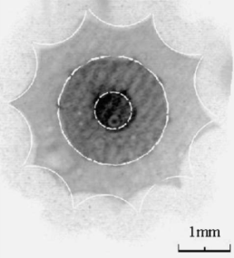
Pulsed power driven water shocks
Don’t rely on magnetic compression - resistively explode wires in water bath
Very rapid expansion of wires on change to gas/plasma state
Put the wires into an array
Shock waves from adjacent wires merge
Convergent shockwave heads towards axis, creating very high pressures
Frame 1
Frame 2
Frame 3
Wires too heavy to move via JXB but explode resistively
Multiple frame exposures end on to array with 12 wires – 2ns per frame, overlaid

Slide 41
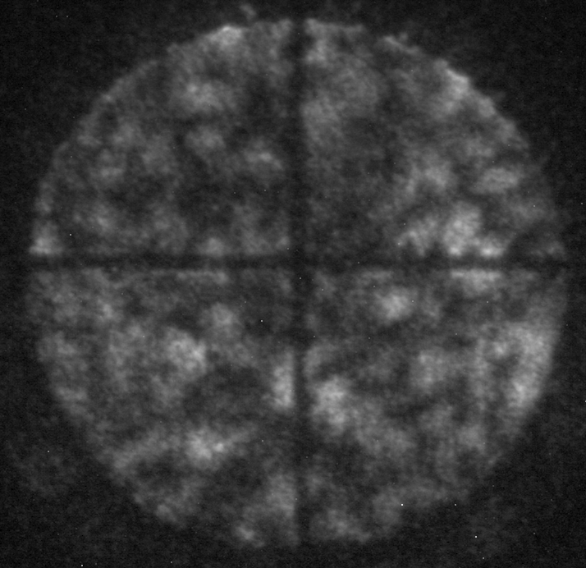
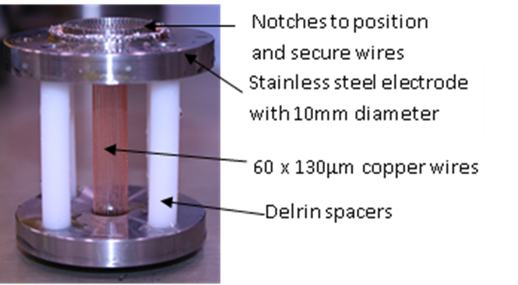
Convergent Shock waves
1. Exploding wires in array launch strong shocks into water (or other media)
2. Shocks merge and converge onto axis
3. Optical probing traces stable shockwave to diameters of <100µm
10mm

Slide 42
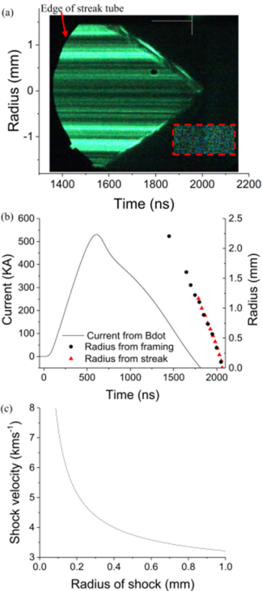

Shock waves in wire arrays
Images and streaks show shockwave stable until at least 0.1mm radius
=> a convergence ratio 50:1
As shockwave approaches axis, velocity rapidly increases (pressure behind the shock front increases with decreasing area)
=> at 0.1mm radius, velocity ~7.5kms⁻¹
So what conditions are created on axis?

Slide 43
Simulations of experiments
Close to axis, water behind shock front:
Pressure >1Mbar/100GPa
Density > 3g/cc
Temperature many 1000K
Energy density 30-40MJ/kg
QEOS suggests ionisation fraction 0.7
A new, highly efficient way to get to warm dense matter states

Slide 44
Simulations of experiments
Close to axis, water behind shock front:
Pressure >1Mbar/100GPa
Density > 3g/cc
Temperature many 1000K
Energy density 30-40MJ/kg
QEOS suggests ionisation fraction 0.7
A new, highly efficient way to get to warm dense matter states
How do we diagnose if these states exist – need precise X-ray diagnostics
Radiography, Absorption spectrometry and diffraction

Slide 45
High precision X-ray diagnostics

Slide 46
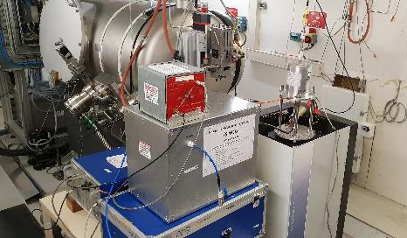
1st Synchrotron / pulsed power expts
ESRF is the worlds most advanced 3rd generation synchrotron
Pulses 20-30KeV, 0.1ns long, 500-704ns in between pulses
Phase contrast highlights edges
Miniature pulser ~30-40kA, 1µs risetime Wires in small water container in beam
Beam propagates to scintillator and framing camera

Slide 47
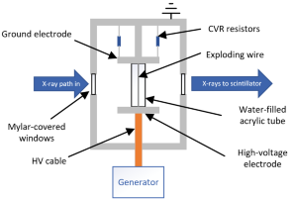
1st Synchrotron / pulsed power expts
ESRF is the worlds most advanced 3rd generation synchrotron
Pulses 20-30KeV, 0.1ns long, 500-704ns in between pulses
Phase contrast highlights edges
Miniature pulser ~30-40kA, 1µs risetime Wires in small water container in beam
Beam propagates to scintillator and framing camera

Slide 48
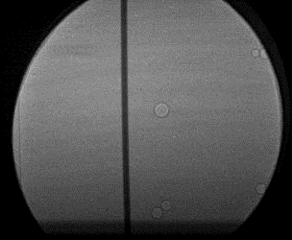
Single wire with synchrotron
Low mag images of 200µm wire copper explosion show more details on shockwave
+ explosion of acrylic cylinder
I, V diagnostics enable explosion of wire to be monitored and energy into wire to be calculated (~250J)

Slide 49


Single wire with synchrotron
Shock
Low mag images of 200µm wire copper explosion show more details on shockwave
+ explosion of acrylic cylinder
Wire
Data from several (3) experiments allows complete pictures of shockwave and wire material motion
- Compared to simple 2D hydro codes of wire explosion assuming 80% input power to wire

Slide 50



Overheat /Electrothermal instability
@285ns into current pulse showed no obvious expansion of wire – wire still in solid state starts to expand ~500ns
1mm
Exploded wire @989ns shows striations on 40µm wavelength
@1693ns wire is now freely expanding – striations become less prominent
Conductivity measurements usually assume uniform expansion – will skew conductivity tables

Slide 51
End-on: Wire array with synchrotron
20 x 63µm copper wires on 6mm diameter

Slide 52
End-on: Wire array with synchrotron
We can see wire explosion, shocks merging towards axis, increase in density and shock reflection
Absolute density measurements of shock on way to axis and after reflection axis in good agreement with hydrodynamic codes.

Slide 53
End-on: Wire array with synchrotron
We can see wire explosion, shocks merging towards axis, increase in density and shock reflection
Absolute density measurements of shock on way to axis and after reflection axis in good agreement with hydrodynamic codes.
But we don’t all have a synchrotron… and some facilities don’t fit on a beamline ☺

Slide 54
‘Portable’ X-pinches for diagnosing external experiments

Slide 55



X-pinches
An x-pinch consists of 2 of more crossed wires. With ~1kA/ns magnetic field at cross over causes implosion and local hotspot
2 high yield sources of X-ray – soft from hotspot, few microns in size, harder radiation from larger microdiode
Miniature X-pinch ‘Nene’ 50kA, 50ns, 250kV
Portable, high voltage design… but how usable is it ?

Slide 56

X-pinch radiography
Radiographs of pinholes show good soft and hard X-ray emission
<3µm and ~50µm source size

Slide 57
X-pinch radiography
Radiographs of pinholes show good soft and hard X-ray emission
<3µm and ~50µm source size
Obligatory insect picture – Bee @ 3KeV showing
phase contrast effects

Slide 58


X-pinches – use in external experiments
Larger marx based X-pinch ‘big sister’ (100kA, 70ns) on loan to first light fusion to backlight gas gun and pulsed power driven shock physics experiments
12.7mm projectile at 5.4kms⁻¹ hits PMMA target. Radiography shows forward and reverse shocks
25x10⁶ photons/mm² at 300mm – directly comparable to synchrotron

Slide 59



An ultra portable X-pinch
At Imperial we are developing a new X-pinch
0.3 x 0.3m x 1metre long with a stalk for insertion into other experimental chambers
Weight ~50kg
No oil, no water, no SF6
UKs first ultra low inductance air switches
Charging, triggering and safety system

Slide 60

An ultra portable X-pinch
At Imperial we are developing a new X-pinch
0.3 x 0.3m x 1metre long with a stalk for insertion into other experimental chambers
Weight ~50kg
No oil, no water, no SF6
140-160kA, 200ns, ~90kV
A little slow (Shelkovenko condition, 1KA/ns would be better) but still being improved
Already soft X-rays, <5ns, Spot size, <15µm
Hard X-ray Spot size ~150µm

Slide 61


Aims for ultra portable X-pinch
There is a lot more we can do apart from radiography…
XANES – X-ray Absorption Near Edge Spectrometry provides direct measure of density of states (sensitive to valence, magnetisation and local shape)
EXAFS – Extended X-ray Absorption Fine Structure – provides measure of bond distances, atoms themselves and number of atoms
X-pinch generated Laue diffraction pattern through 1mm single crystal LiF
And possibly even X-ray Thomson scattering…

Slide 62

Summary
Pulsed power is highly versatile way of obtaining HEDP conditions
What was once interesting for X-rays for ICF has spun out to include:
Hydrodynamics research
Hypersonics research
Planetary – solar wind Physics
Scaled astrophysics experiments
High pressure materials / warm dense matter research
New X-ray diagnostics
Small scale facilities at universities lead much of this research, often in collaboration with other universities and nationals laboratories

Slide 63


Driving Richtmyer-Meshkov
Interface between 2 different density materials, if shocked any perturbations on interface will grow – RM instability
Frames from experiments in gas tube at LANL
RM controls mix in ICF implosions and supernova explosions…
Left ICF form Sakagami et al
Right supernova from Hachisu et al

Slide 64
Driving Richtmyer-Meshkov
Sequence of two 160µm Cu wires 2.5mm apart
Each wire expands with overheating/ET instability whilst shockwave launched
Shockwave reflected back to expanding surface
Drives Richtmyer–Meshkov instability
2.5mm

Slide 65

Reconnection: Plasmoids
Velocity of enhanced density region ~ 130kms⁻¹
But we also see accelerated electrons

