Slide 1
Ion Propulsion and the Job-Creating Power of the Rocket Equation
Jet Propulsion Laboratory
California Institute of Technology
January 17, 2018
John Brophy
Jet Propulsion Laboratory
California Institute of Technology
© 2018 California Institute of Technology. Government sponsorship acknowledged.

Slide 2
The tyranny of the rocket equation
Donald Pettit

Slide 3
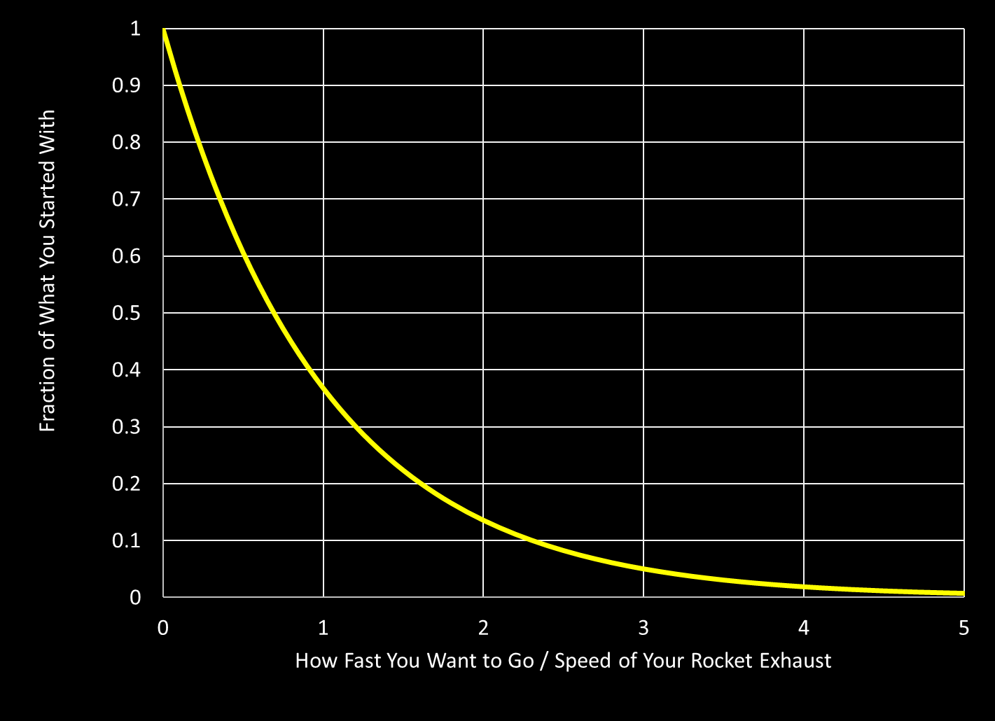
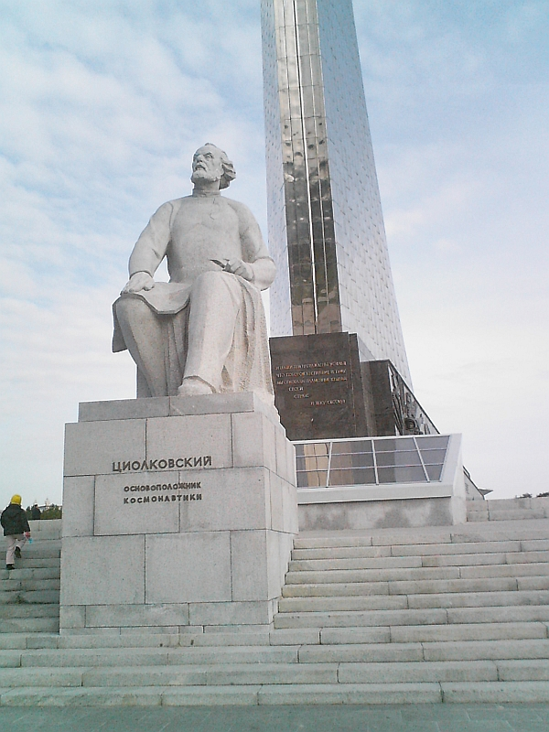

Rocket Equation
$$\frac{m_{f}}{m_{i}}=e^{− \frac{v_{s/C}}{v_{ex}}}$$
If your exhaust velocity is about the same speed
you want your spacecraft to go then nearly 2/3rds
of your initial mass is propellant

Slide 4

Specific Impulse
$$\frac{m_{f}}{m_{i}}=e^{− \frac{∆V}{I_{sp}g}}$$

Slide 5





Specific Impulse
For a propellant mass that weighs 1 N at the Earth’s surface,
How long can you sustain a thrust of 1 N?
$$Thrust: T=\dot{m}v_{ex}$$
$$Time to exhaust all the propellant: t=\frac{M_{p}}{\dot{m}}$$
$$W_{p}=M_{p}g→M_{p}=\frac{W_{p}}{g}$$
$$t=\frac{W_{p}v_{ex}}{Tg}$$
$$for W_{p}=T=1, then t=\frac{v_{ex}}{g}≡I_{sp}$$

Slide 6
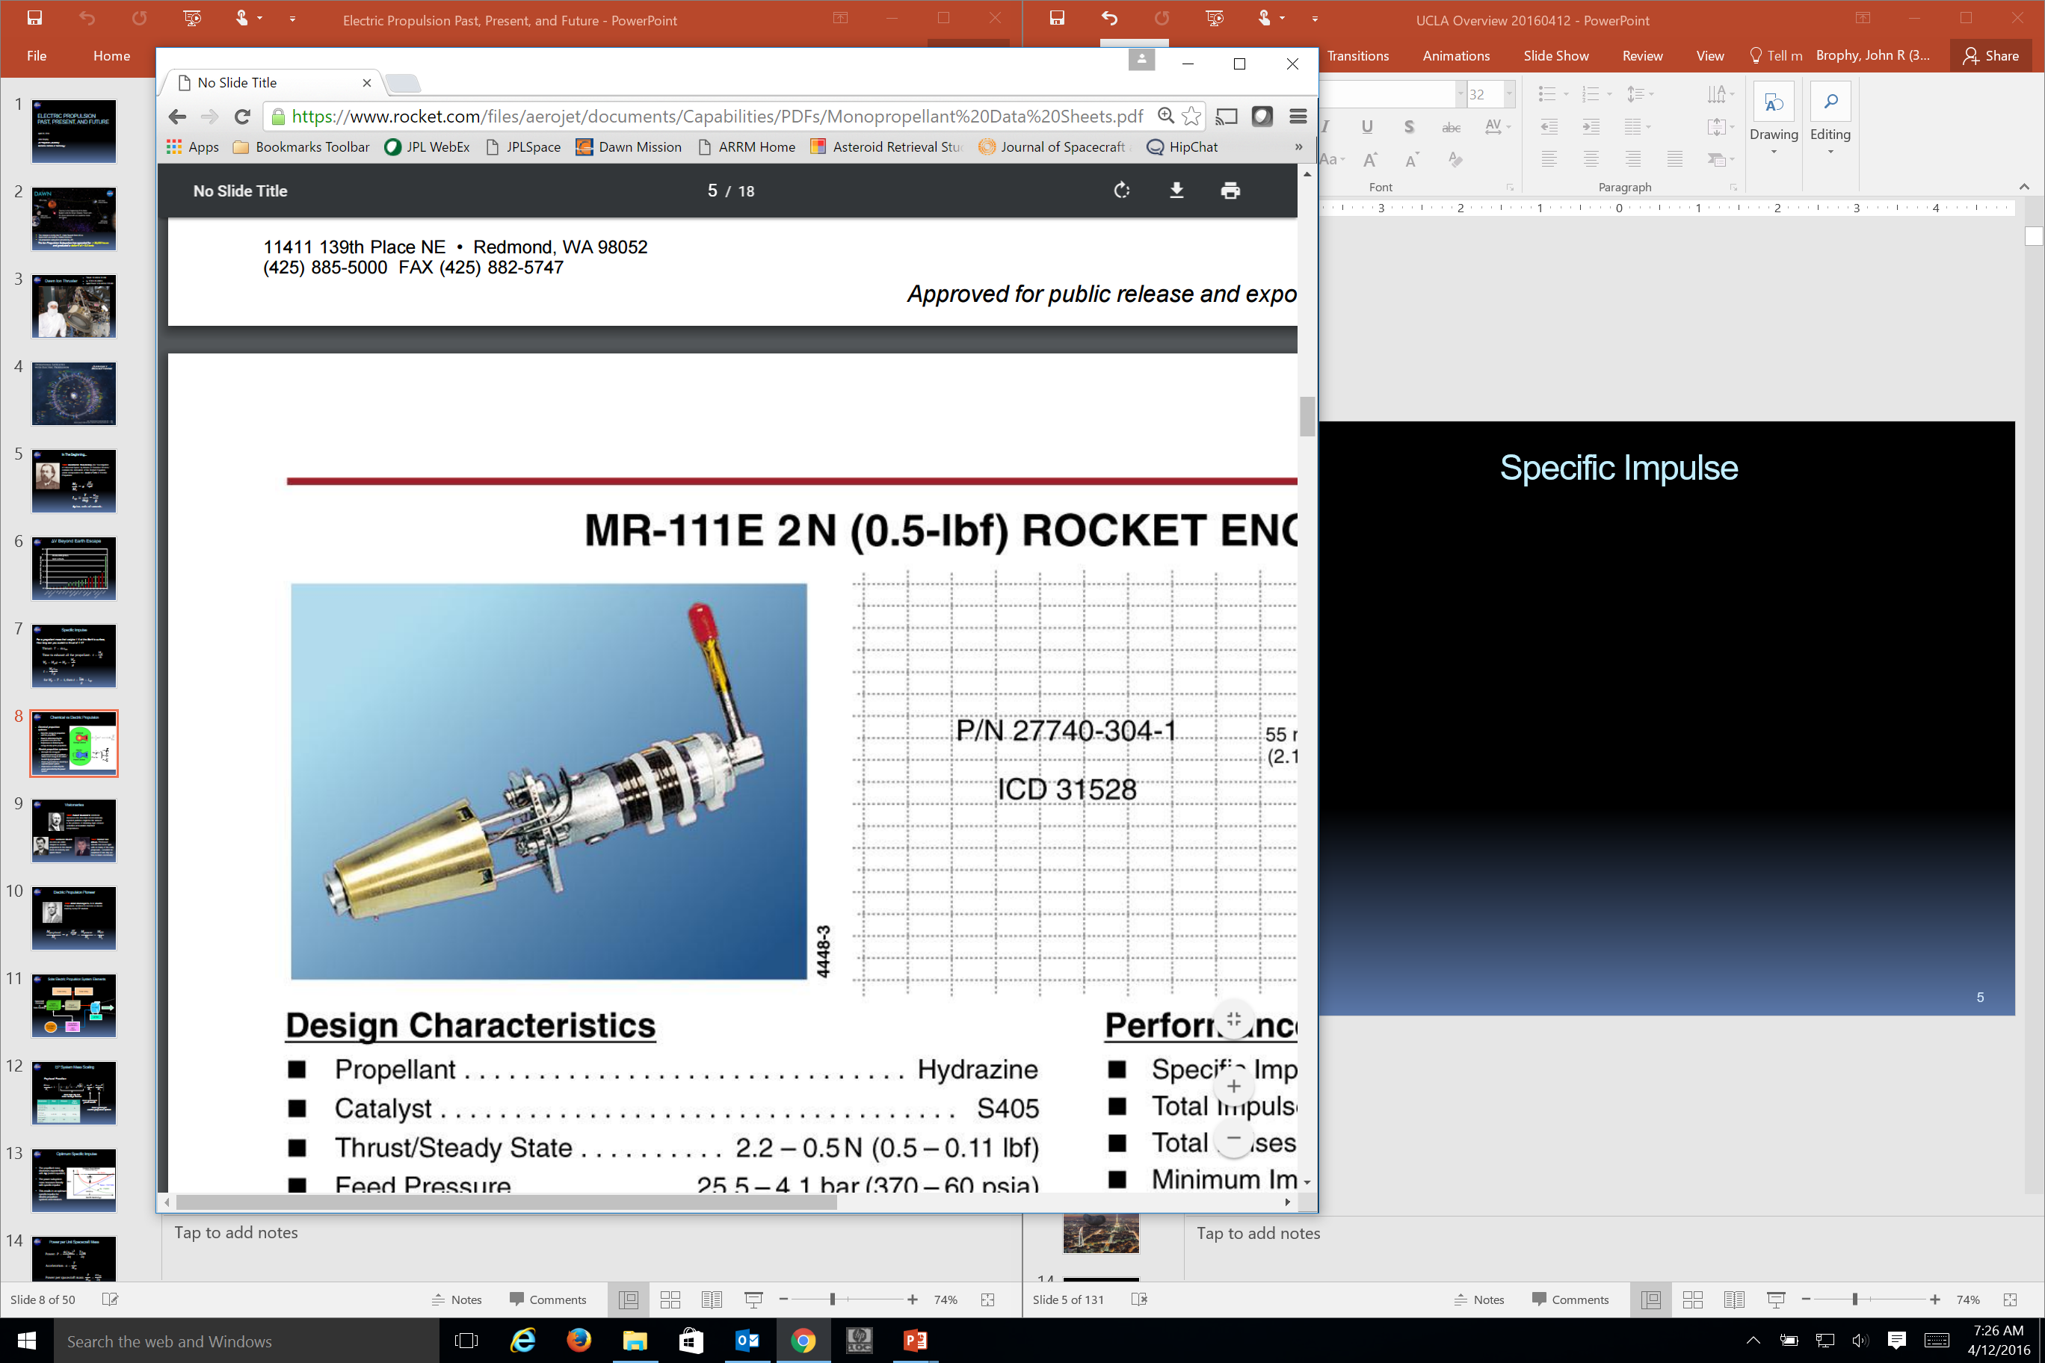
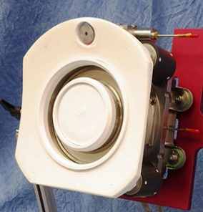
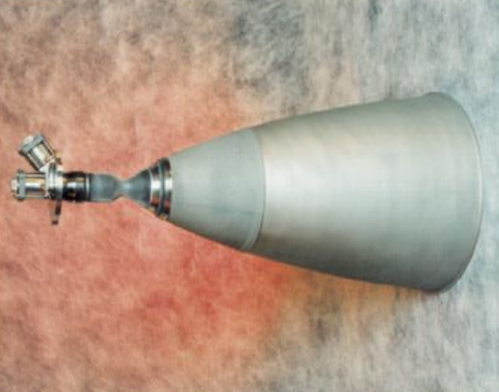
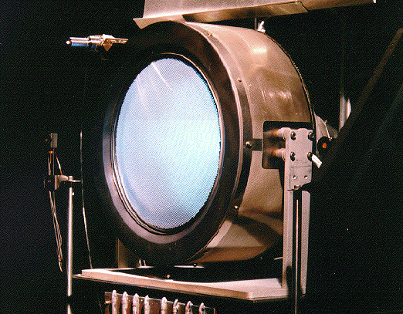
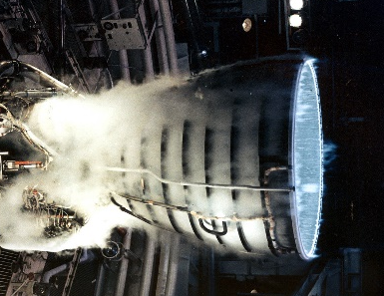
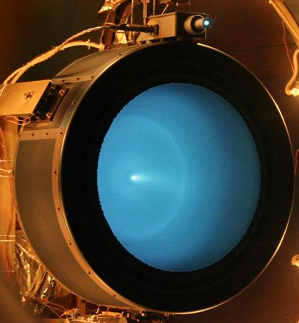
Specific Impulse
Mono-propellant hydrazine thruster
Aerojet XR5 Xenon
Hall Thruster
Isp = 220 s
Isp = 2000 s
Bi-propellant NTO/MMH
Xenon Ion Thruster (Dawn)
Isp = 320 s
Isp = 3100 s
Bi-propellant LOX/LH2
Xenon Ion Thruster (NEXT)
Isp = 450 s
Isp = 4000 s

Slide 7
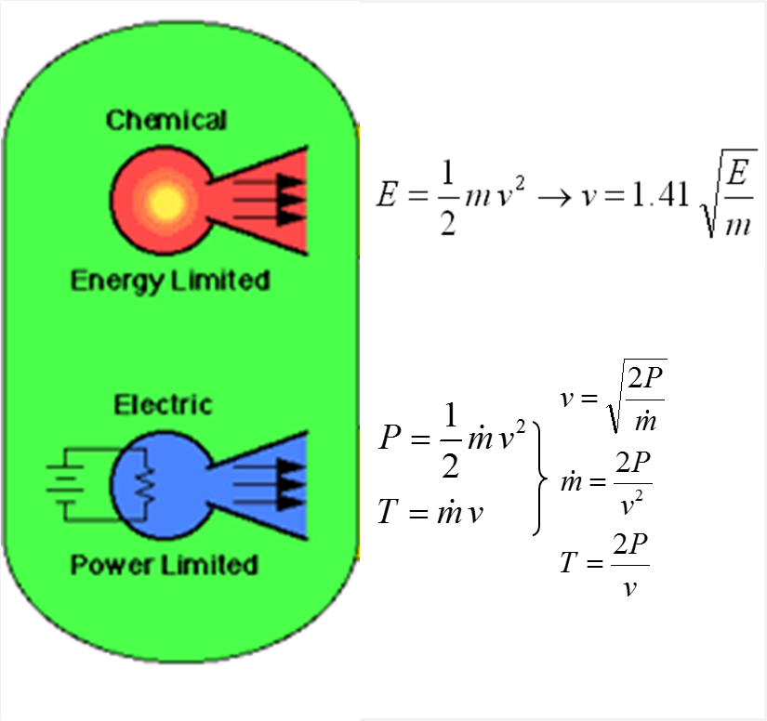
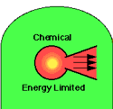
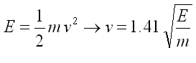
Chemical vs Electric Propulsion
Chemical propulsion systems:
  Carry the energy for propulsion with the propellant
  Power is determined by the propellant mass flow rate
  Performance is limited by the energy density of the propellants
Electric propulsion systems:
  Decouple the energy for propulsion from the propellants – allows more energy to be added to each kg of propellant
  Power is generated on-board by a separate power system
  Performance is limited by the power generated by the power system

Slide 8
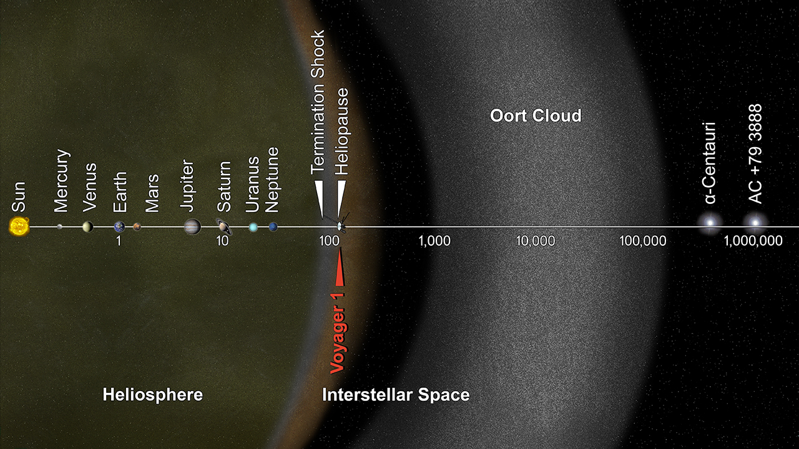
Space is BIG
Ceres
Solar Gravity Lens
3.6 AU/year
Pre-Decisional Mission Concept

Slide 9
Specific Impulse
Aerojet XR5 Xenon
Hall Thruster
Isp = 2000 s
4.2 AU/year
Xenon Ion Thruster (Dawn)
Isp = 3100 s
6.5 AU/year
Xenon Ion Thruster (NEXT)
Isp = 4000 s
8.4 AU/year

Slide 10
Commercial Spacecraft

Slide 11
Commercial Satellites with EP
Lev, D., et al, “The Technological and Commercial Expansion of Electric Propulsion in the Past 24 Years, IEPC-2017-242, Presented at the 35th International Electric Propulsion Conference, Georgia Institute of Technology • Atlanta, Georgia • USA, October 8 – 12, 2017

Slide 12
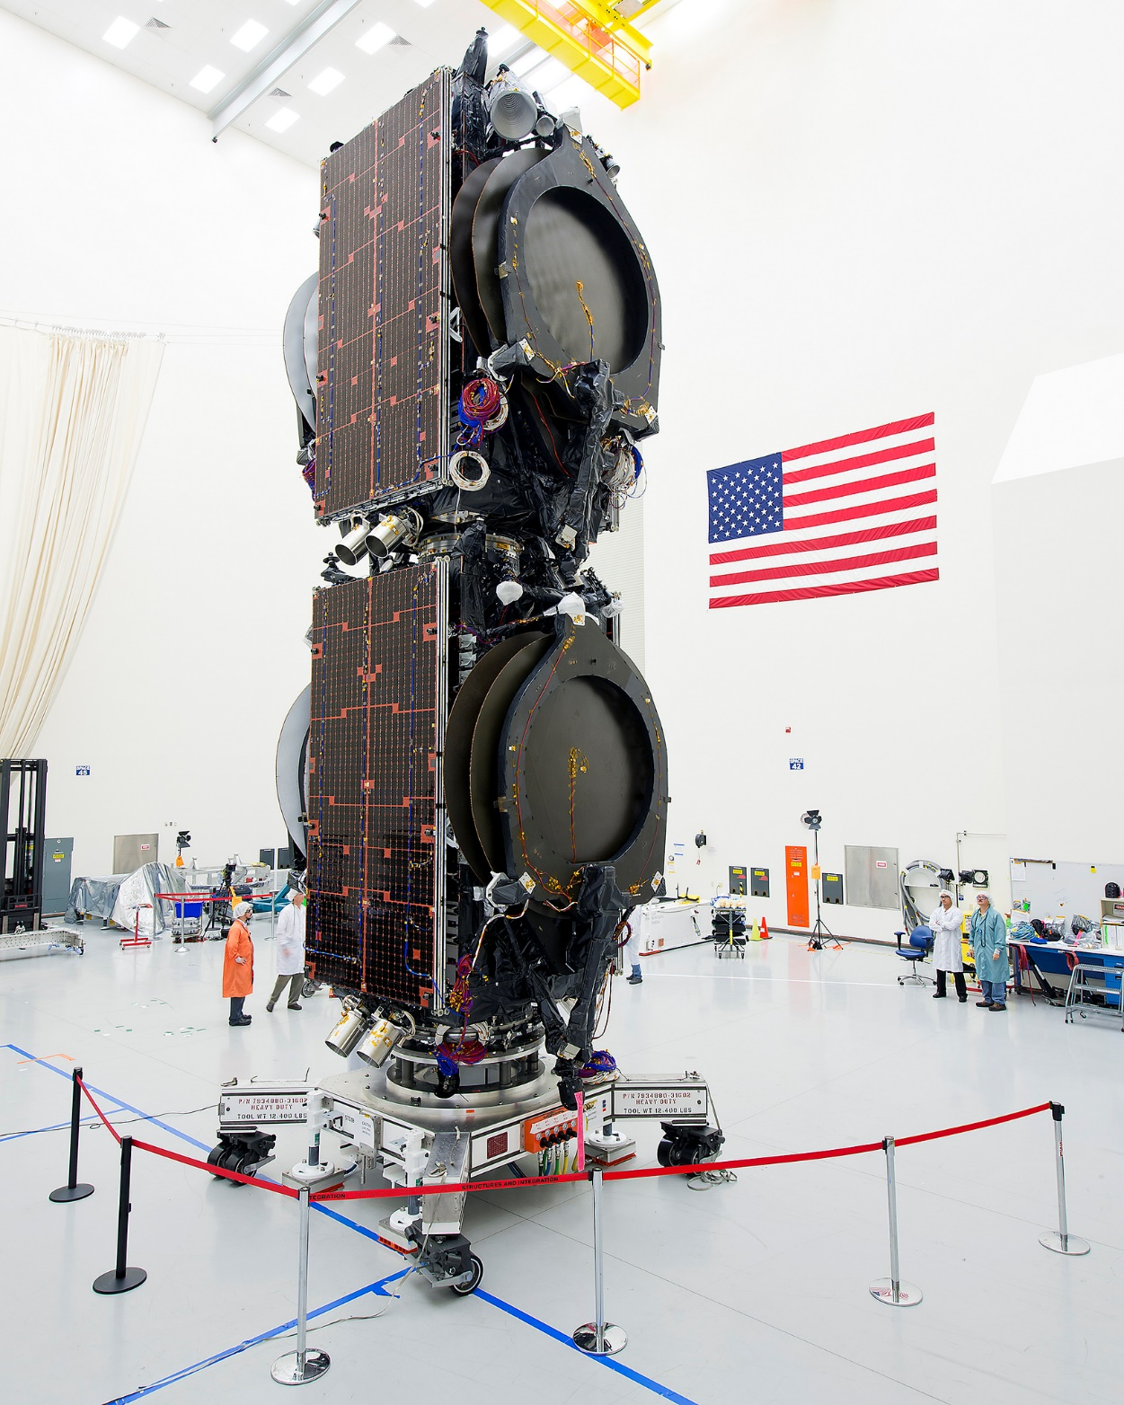
Boeing All Electric Satellites

Slide 13
Deep Space Missions

Slide 14
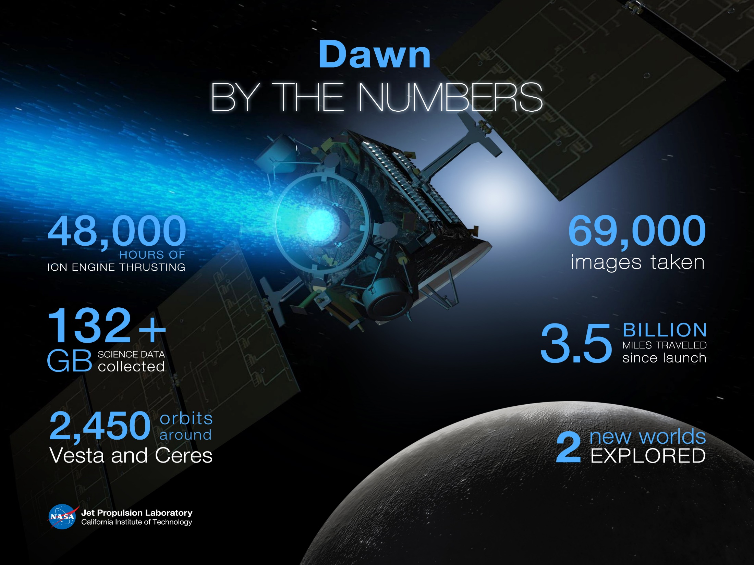
11 km/s ΔV

Slide 15
ΔV Beyond Earth Escape
3.0
2.5
2.1
1.7
AU/year
1.3
0.8
0.4
0.0

Slide 16
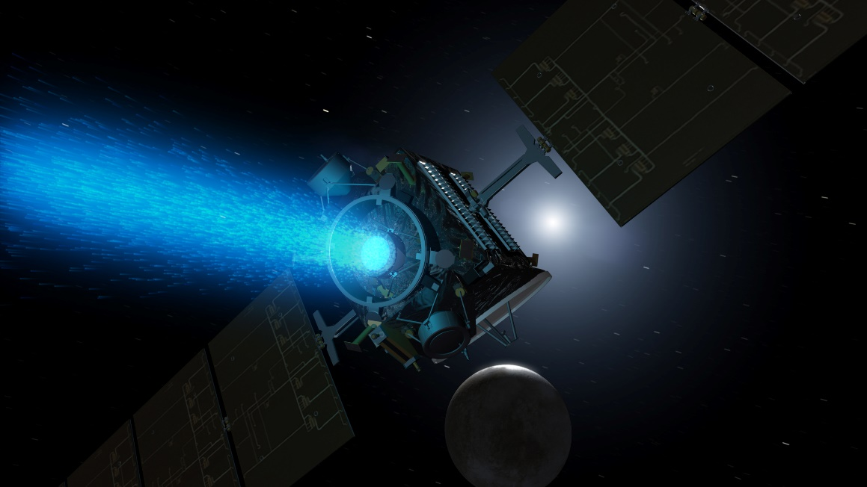
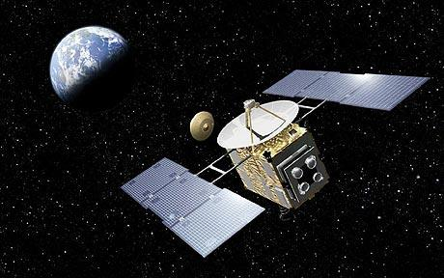
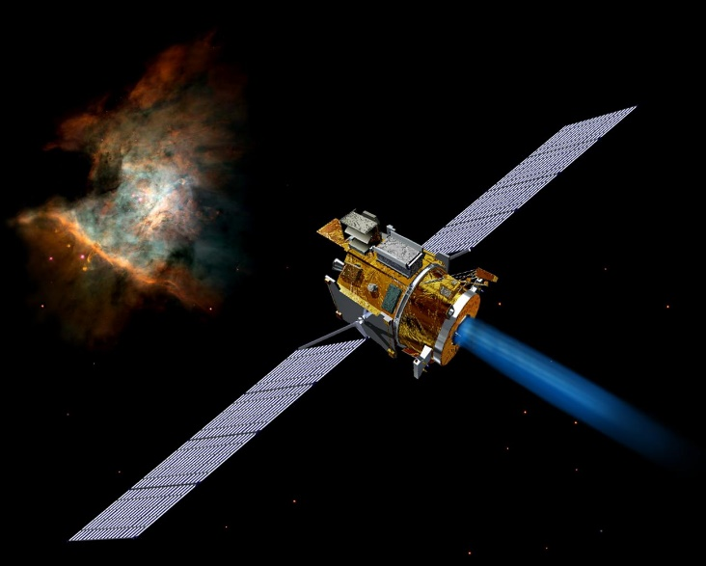
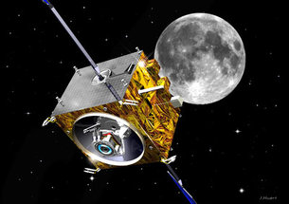
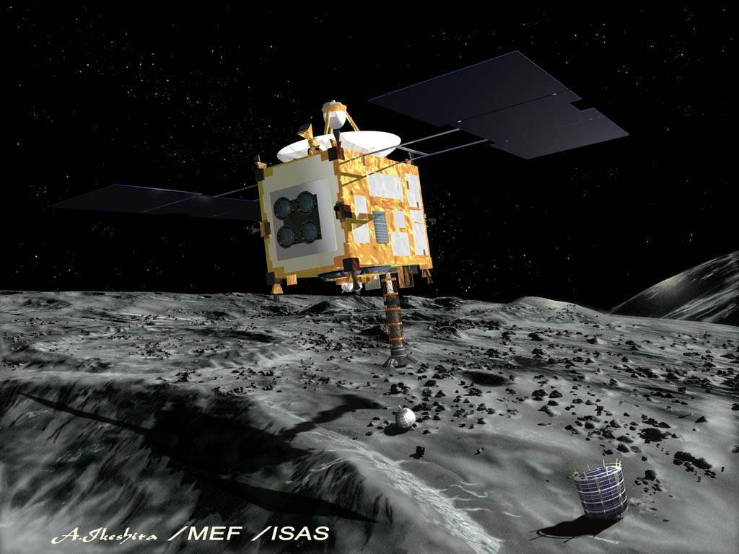
Dawn
Hayabusa 1
Deep Space 1
SMART-1
Hayabusa 2

Slide 17
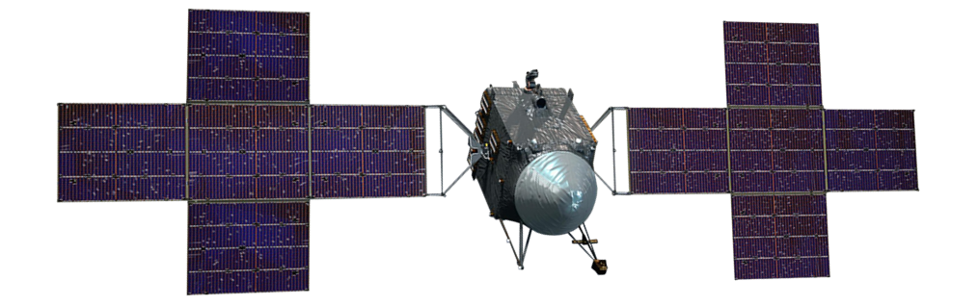
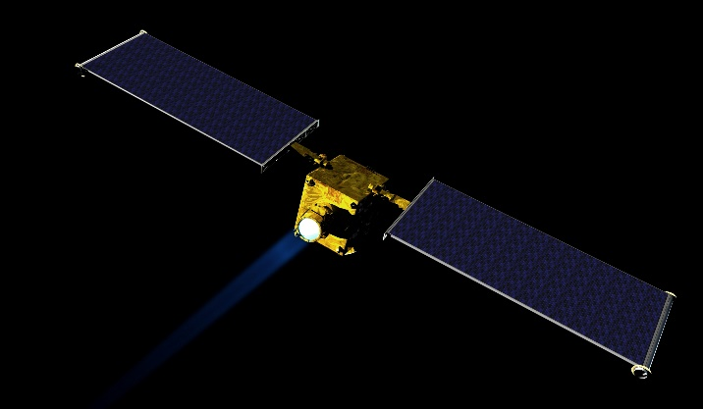
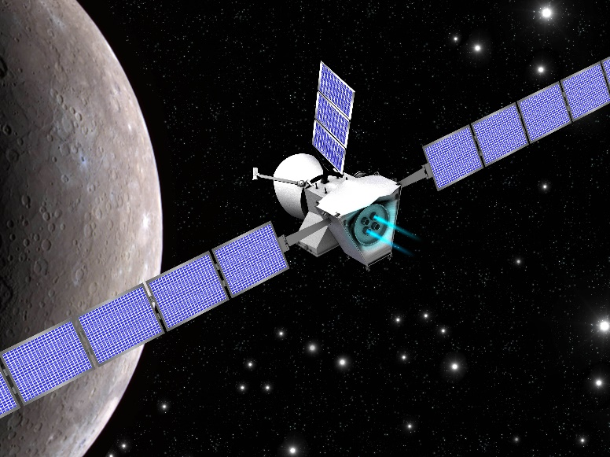
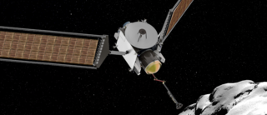
Near-Term Potential Future Missions
Psyche
DART
Bebicolombo
CAESAR
Pre-Decisional Mission Concepts

Slide 18
NEXT
Under development since 2001
Possible flight application on DART and CAESAR
Life qualification is the key issue for the thruster
Long-duration test results clouded by facility effects
Using 2D and 3D ion optics codes to extract as much information from the long-duration test as possible

Slide 19
Low-Power Hall Thrusters
500-W Hall thruster
Magnetically-shielded Miniature (MASMI) Hall Thruster
  With a centrally-mounted hollow cathode
Key Issues
  Performance
  Life Qualification
Targeted for deep-space science missions with small spacecraft (~100 kg)

Slide 20
Human Exploration Beyond Low-Earth Orbit

Slide 21
It’s All About Power
Space Solar Power History
X
ARM

Slide 22
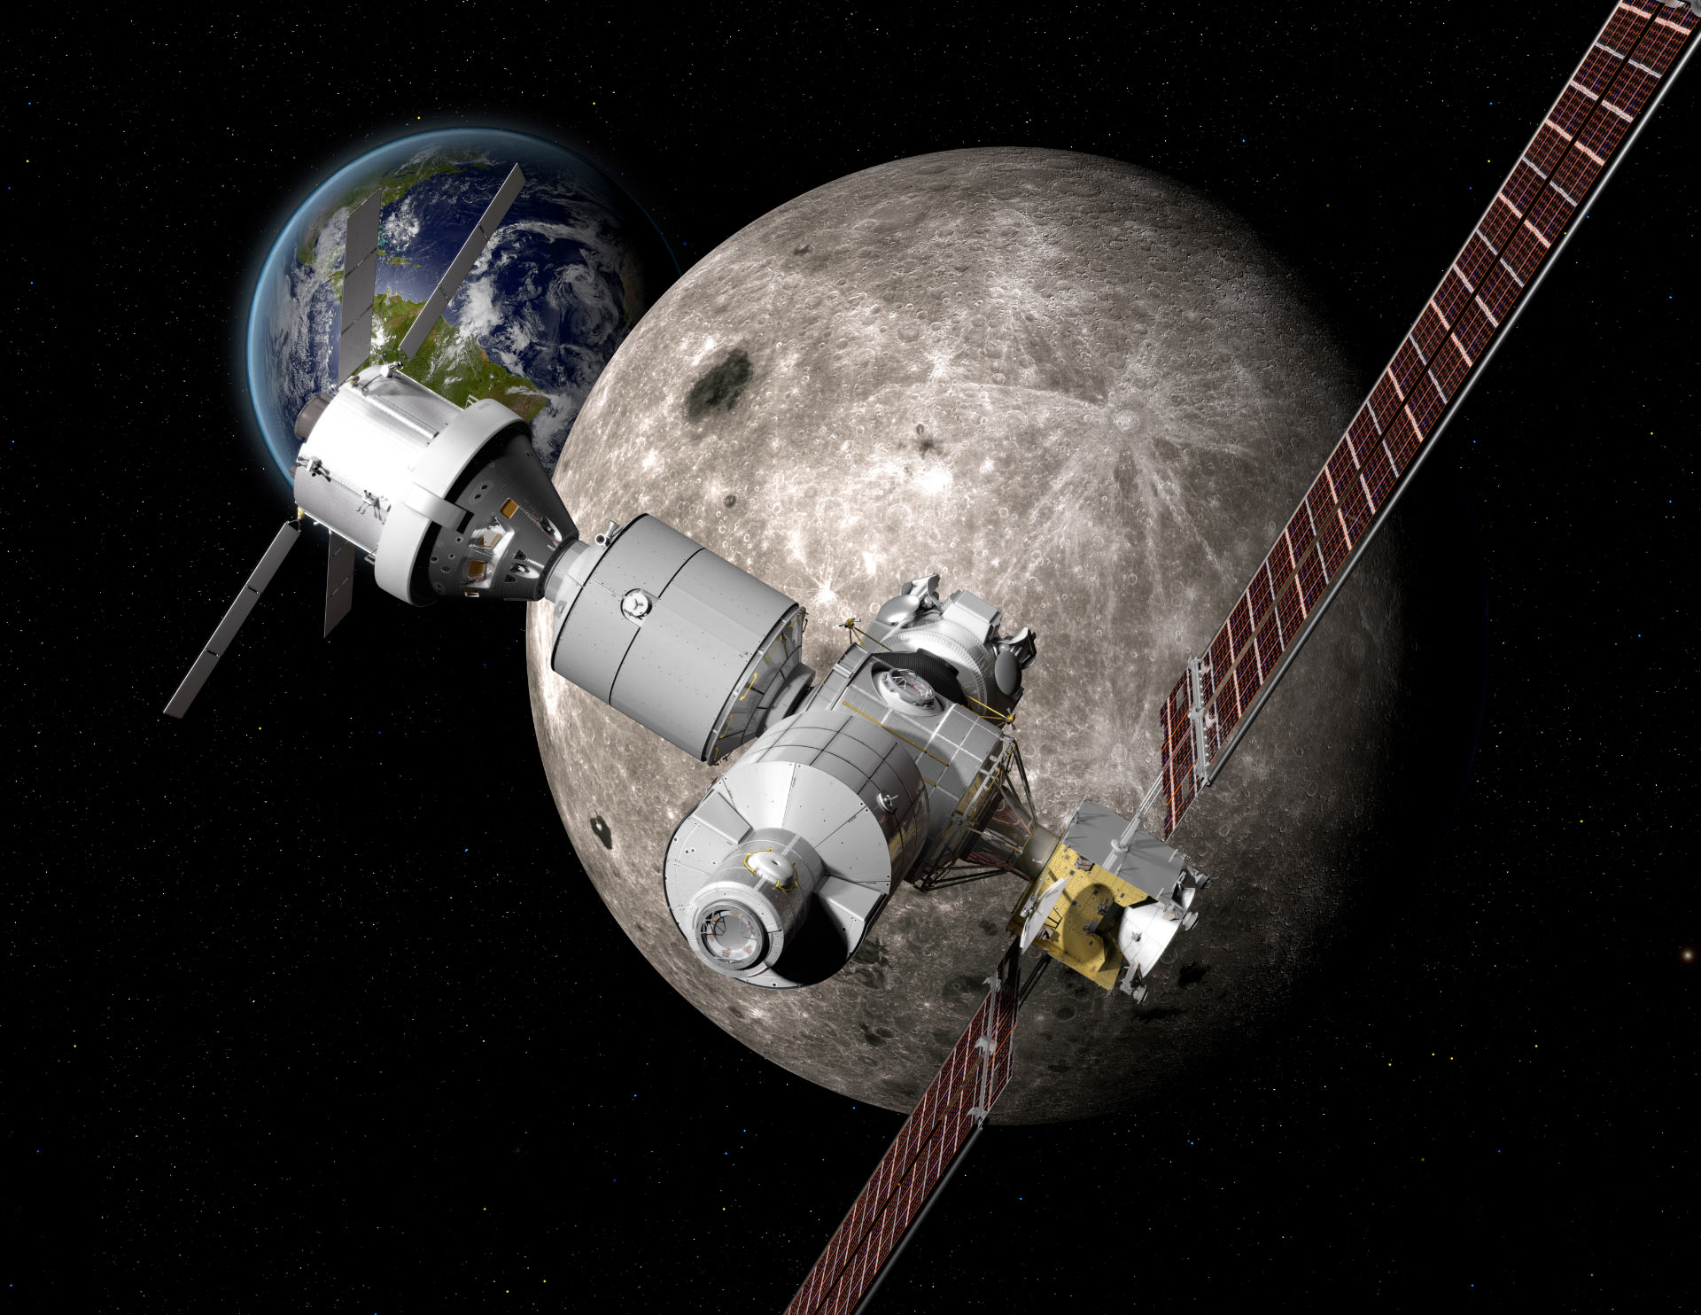
NASA’s Deep Space Gateway Concept
Power & Propulsion Element
Pre-Decisional Mission Concept

Slide 23
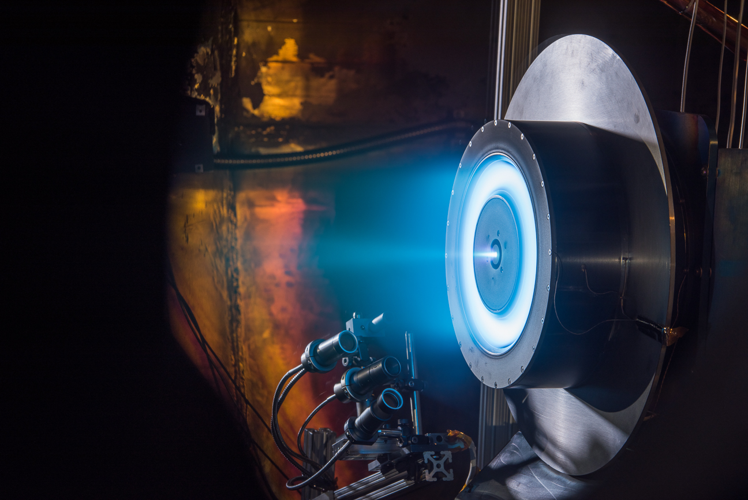
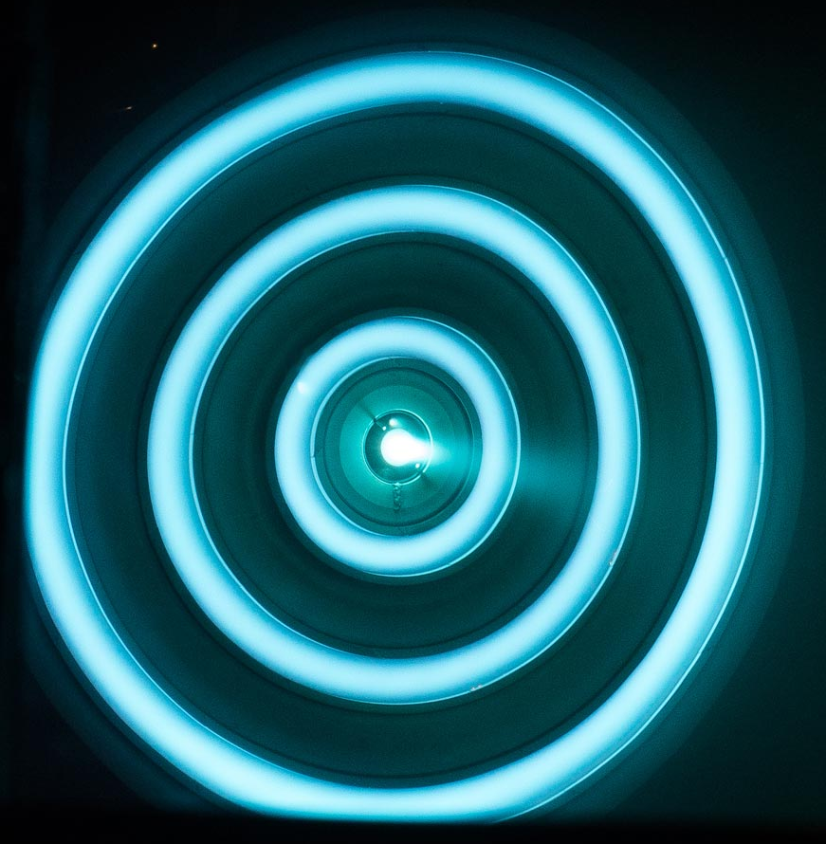
High-power Hall Thrusters
HERMES
12.5-kW, 2600-s Hall Thruster
Key Issues
  Performance
  Life Qualification
  Spacecraft Interactions
NEXTStep 100-kW Hall
Operate for 100 hrs at 100 kW

Slide 24
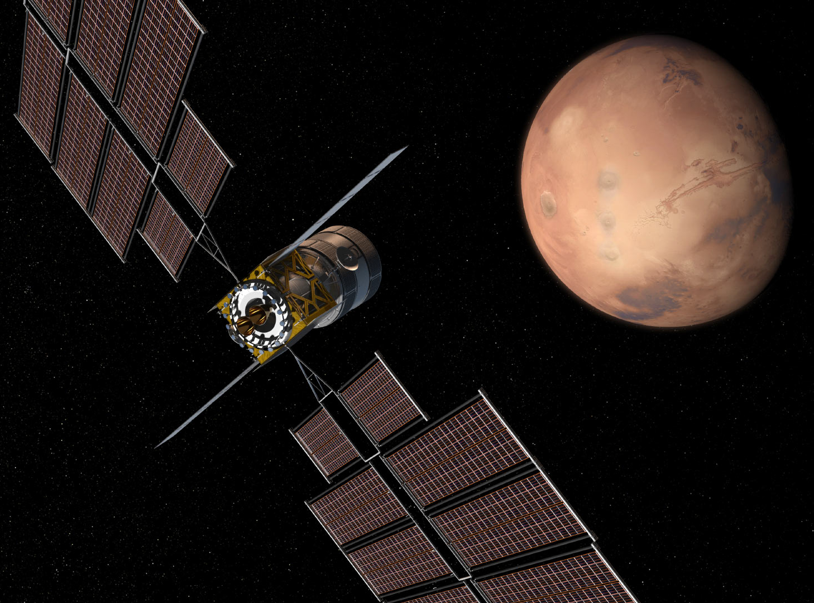
Deep Space Transport Vehicle
(image from Boeing)
Pre-Decisional Mission Concept

Slide 25
Extreme SEP
Damon Landau (JPL) and Nathan Strange (JPL)
Pre-Decisional Mission Concept

Slide 26
Planetary Defense
After discovery, this becomes primarily a propulsion problem
What size asteroids do we need to be concerned with?

Slide 27
NEA Size-Frequency Distribution
Hiroshima
Boslough, M., Brown, P., and Harris, A., “Updated Populsion and Risk Assessment for Airburst from Near-Earth Objects (NEOs),” 2015 IEEE Aerospace Conference, Big Sky, MT.

Slide 28
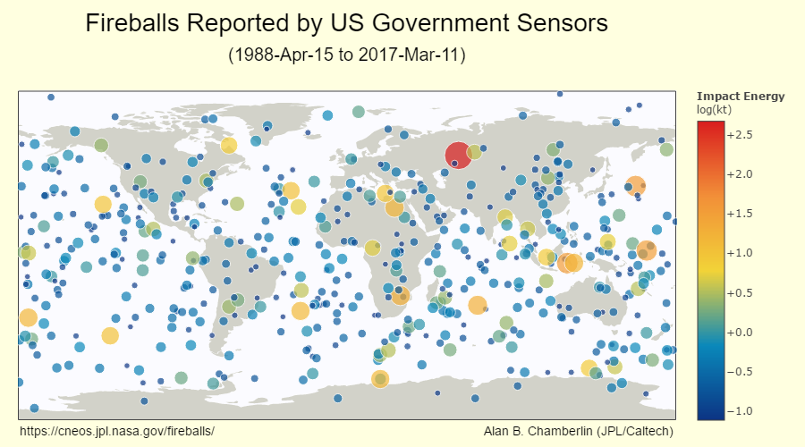
Most likely threat objects may turn out to be in the 50 m to 140 m size

Slide 29
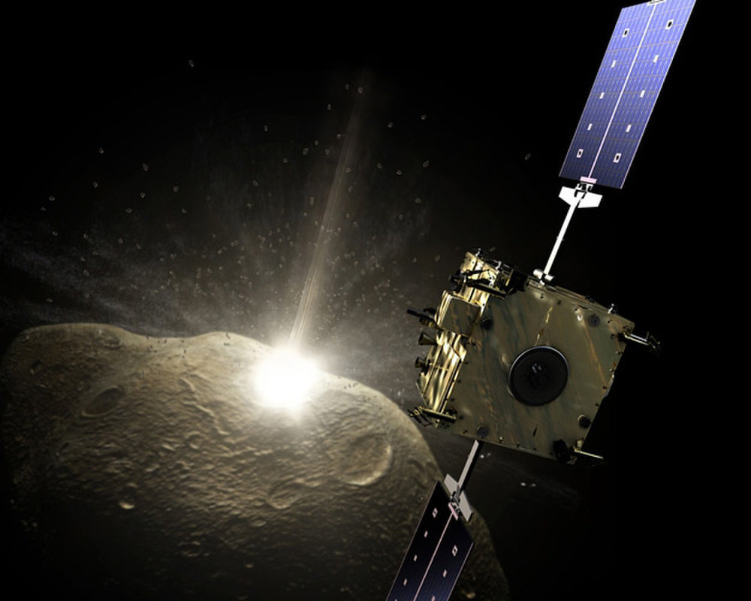
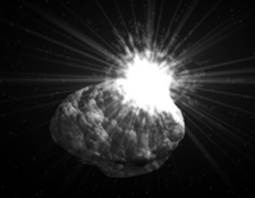
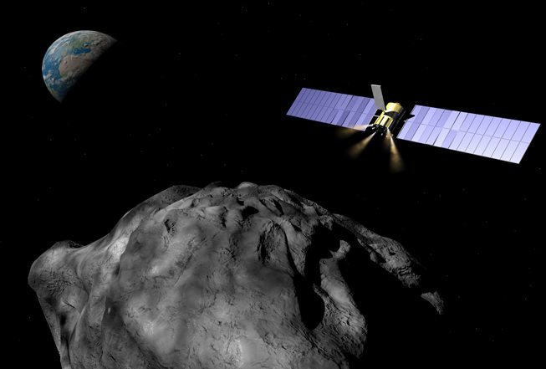
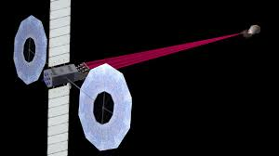
Planetary Defense Techniques
Kinetic Impactor
Nuclear Blast
Gravity Tractor
Laser Ablation
Pre-Decisional Mission Concepts

Slide 30
Ion Beam Deflection
Key Features
Applied force is essentially independent of the asteroid characteristics
Ions act as kinetic impactors
Can engineer the applied force (power) and propellant usage (specific impulse)
Must thrust in opposite directions simultaneously
Enables large stand-off distance from the asteroid
  Requires small ion beam divergence angle
Key Technology is to design ion optics to provide < 3 degree ion beam divergence

Slide 31
Asteroid Mining
Has long been recognized as a propulsion problem
Probably only feasible in the long run if you can use asteroid-derived propellants
Past proposals include:
Water
Mass drivers (throwing rocks)
Even billards (colliding one NEA with another)

Slide 32
What are Asteroids Made of?
Hutchison, R., “Meteorites, A Petrologic, Chemical and Isotopic Synthesis,” Cambridge University Press, 2004, ISBN 0 521 47010 2.

Slide 33
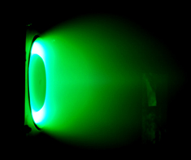
Asteroid-Derived Hall Thruster Propellants
State-of-the-art flight Hall thrusters use xenon as the propellant, but laboratory tests have also demonstrated operation on argon, krypton, iodine, and bismuth.
What about magnesium?
A magnesium-fueled Hall thruster from Michigan Technological University

Slide 34
Ultra-High ΔV Missions

Slide 35
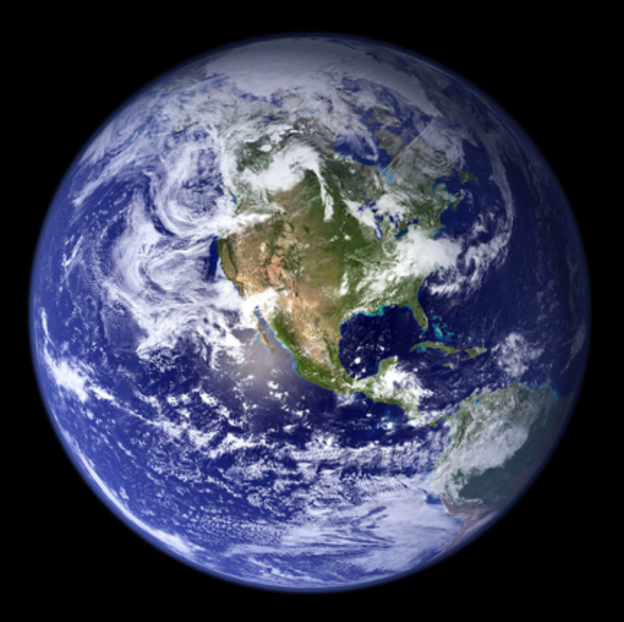
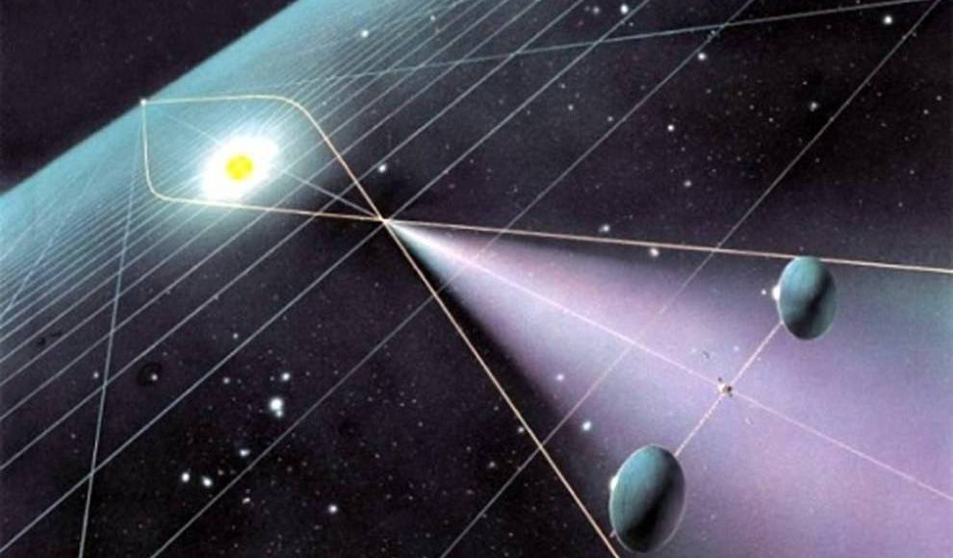
Solar Gravity Lens Mission Concept
Want to go to > 550 AU in less than 15 years (~40 AU/year)
550 AU
Pre-Decisional Mission Concept

Slide 36
Space is BIG
Ceres
Solar Gravity Lens
> 40 AU/year
3.6 AU/year
Pre-Decisional Mission Concept

Slide 37
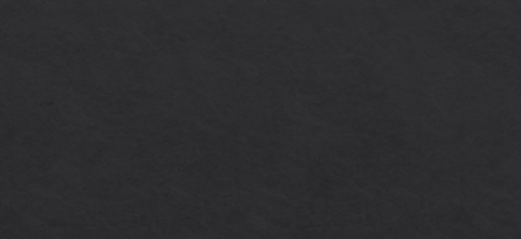
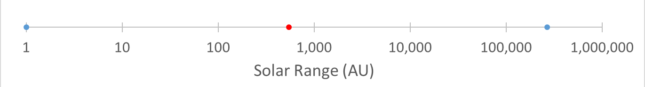
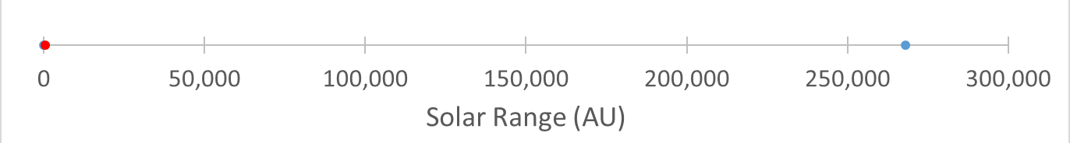
Solar Gravity Lens Focus
Solar Gravity Lens Focus

Slide 38
How Fast Do We Want to Go?
Faster than a speeding bullet? 0.8 km/s
A speeding bullet would take > 3000 years to get the solar gravity lens location
325X
NASA’s Dawn spacecraft has an ion propulsion system on board. It is the best on-board propulsion system ever flown in deep space.
How fast did Dawn go? 11 km/s
NASA’s Voyager 1 spacecraft used Jupiter and Saturn gravity assists to make it the fastest spacecraft ever flown
How fast is Voyager 1? 17 km/s
If we want to go to the solar gravity lens location in 10 years.
How fast do we have to go? 260 km/s

Slide 39
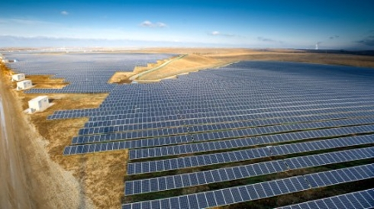
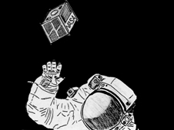
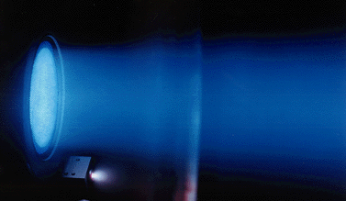
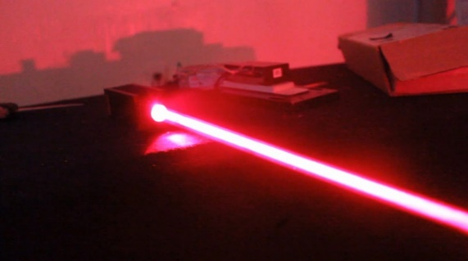
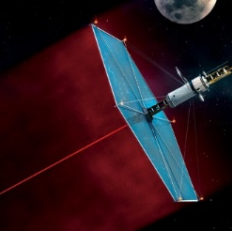
Three Key Features of Our Proposed Architecture to Go Fast
1
2
3
High Power
Small Dry Mass
Small Propellant Mass
v_{ex}
Don’t carry the power source—laser beam power to the spacecraft
Collect the laser power and convert it to electricity to power the ion drive system
Increase the exhaust velocity, v_{ex} by a factor of 10 over the best ion engines today
Artist’s concepts
Pre-Decisional Mission Concept

Slide 40
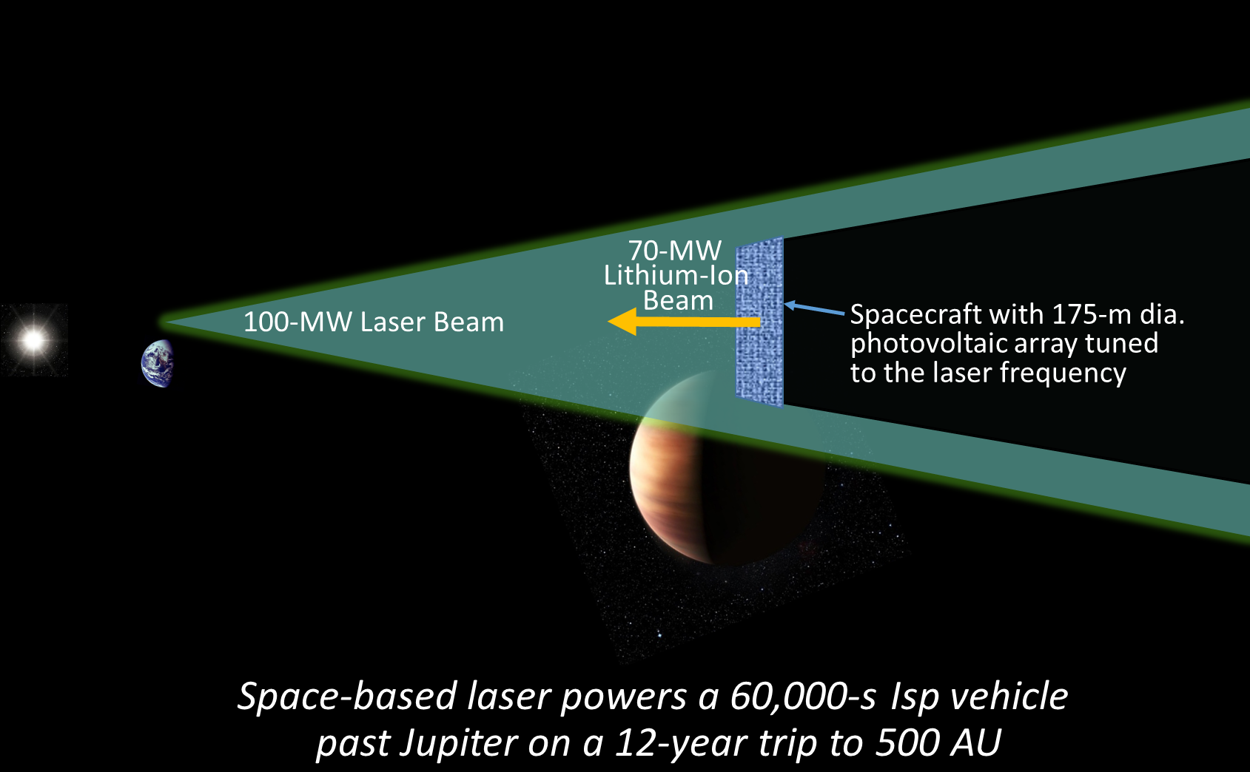
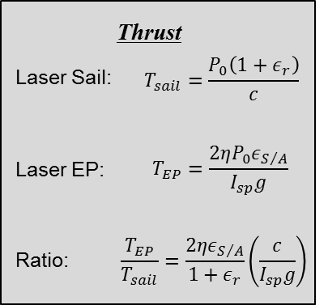
Laser Electric Propulsion (LEP) Concept
Artist’s concept
Pre-Decisional Mission Concept

Slide 41
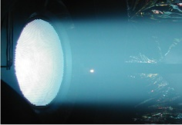
Lithium-fueled Ion Thruster
Xenon ion thrusters have 10X the exhaust
velocity of the best chemical rockets today
A lithium ion thruster would have 10X the
exhaust velocity of the best ion engines today
Parameter | State of the Art | Lithium Thruster
Propellant | Xenon | Lithium
Exhaust Velocity | 50 km/s | 500 km/s
Input Power | 16 kW | 7,000 kW
Thrust | 0.4 N | 26 N
Efficiency | 0.74 | 0.95
Xenon-fueled ion thruster
Pre-Decisional Mission Concept

Slide 42
Xenon vs Lithium Plasmas
Lithium is much easier to ionize than xenon
Lithium also has a much larger excitation cross section than xenon
The first ionization potential for lithium is 5.39 eV and the second ionization potential is 75.64 eV
  For low voltage discharges, lithium will be nearly impossible to doubly ionize

Slide 43
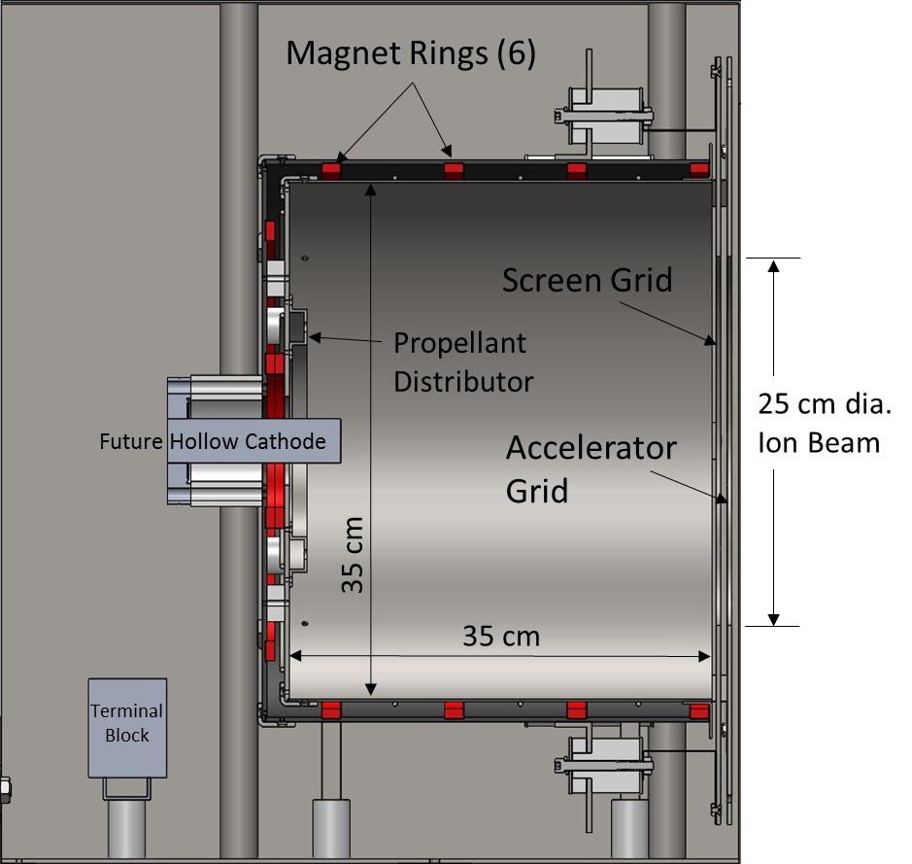
Discharge Chamber
Configuration
Discharge Performance Curve

Slide 44
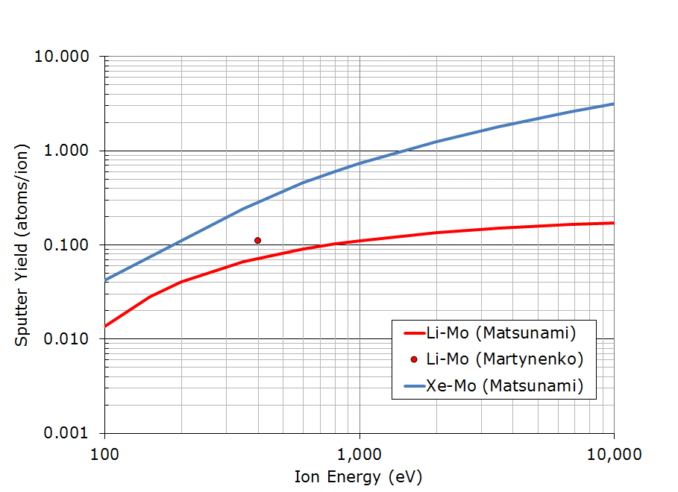
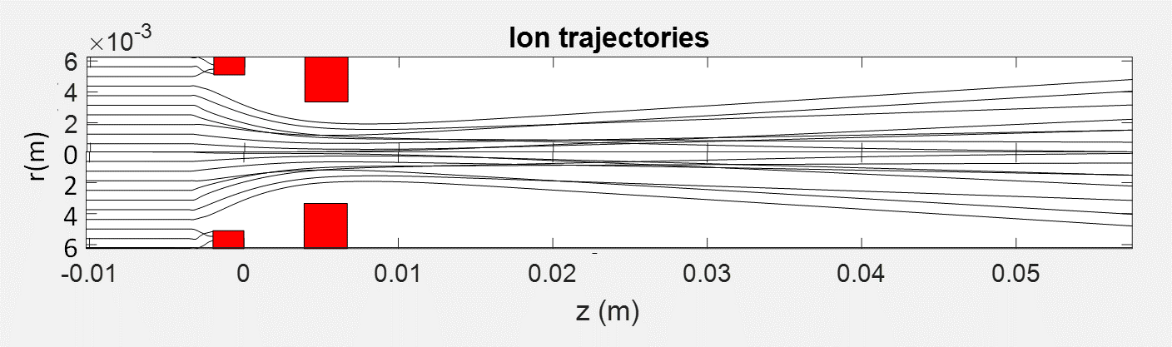
Ion Optics
Charge Exchange Collision Cross Sections
Sputter Yield

Slide 45
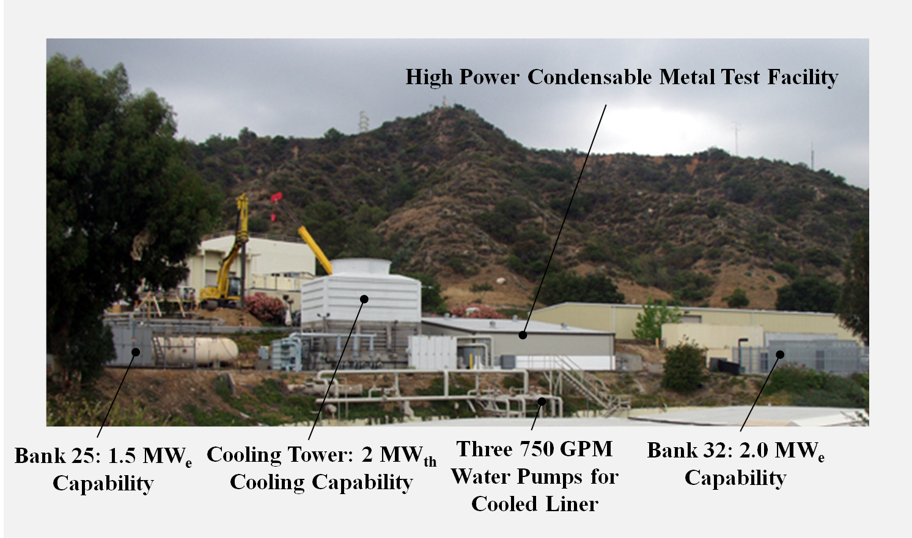
Lithium-Test Facility

Slide 46
Lithium-Test Chamber
3 m diameter x 8 m long
Conical Liner
  1.68 m to 2.44 m
  5.16 m long
  38 m² surface area
Lithium Pumping Speed
  9,000,000 L/s

Slide 47
Why Lithium?
Lithium is way cool!
An ion thruster with a specific impulse of 50,000 s would enable deep space missions with characteristic velocities in the range 100 km/s to 200 km/s (> 40 AU/year).
Lithium enables specific impulses of tens of thousands of seconds at voltages less than 10 kV.
Discharge chamber modeling suggests that it may be possible to operate the discharge chamber at a propellant efficiency of 99%.
  Minimize charge-exchange erosion of the accelerator grid
  Minimize CEX plasma interaction with a high-voltage PV array
Lithium is much easier to store on a spacecraft than hydrogen or helium.

Slide 48
Summary
The Rocket Equation drives the need for Electric Propulsion
  Has resulted in 20 countries around the world developing this technology
Electric Propulsion is in widespread use on Commercial Communication Satellites
Electric Propulsion is expanding its footprint on deep space robotic science missions
Electric Propulsion is currently the technology of choice for human missions to Mars
Electric Propulsion is applicable to most Planetary Defense techniques (KI, nuclear deflection, gravity tractor, laser ablation)
  It’s largest contribution may be through ion beam deflection
Electric Propulsion may play a dominant role in asteroid mining
Electric Propulsion, in combination with power beaming, may enable fast transportation throughout the solar system up to approximately the solar gravity lens location

