Slide 1
The Schwinger plasma:
An experimental program to study the plasmas that exist inside the vacuum
Philip Bucksbaum
Stanford PULSE Institute
SLAC National Accelerator Laboratory,
Stanford University
Menlo Park, California, USA
Work supported by the DOE Office of Science, Fusion Energy Sciences Division

Slide 2
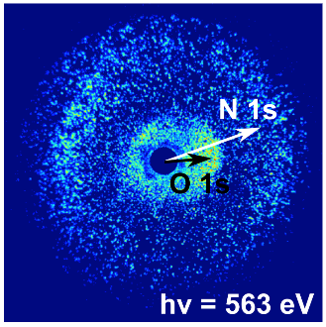

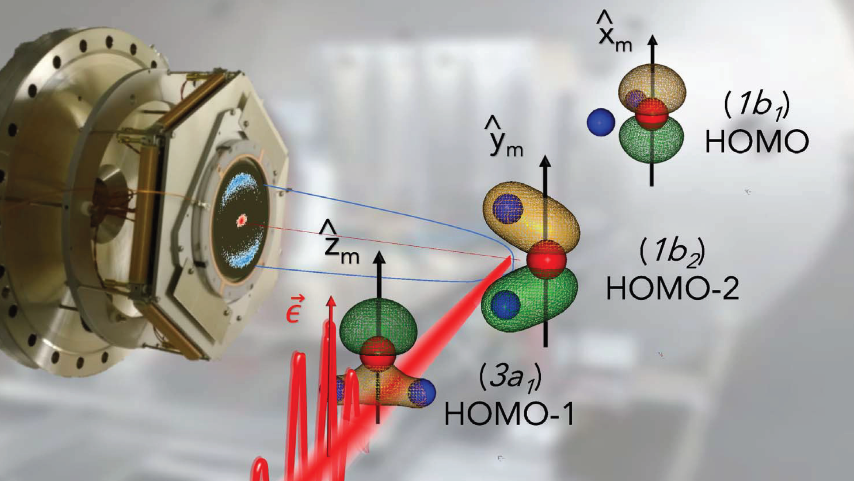
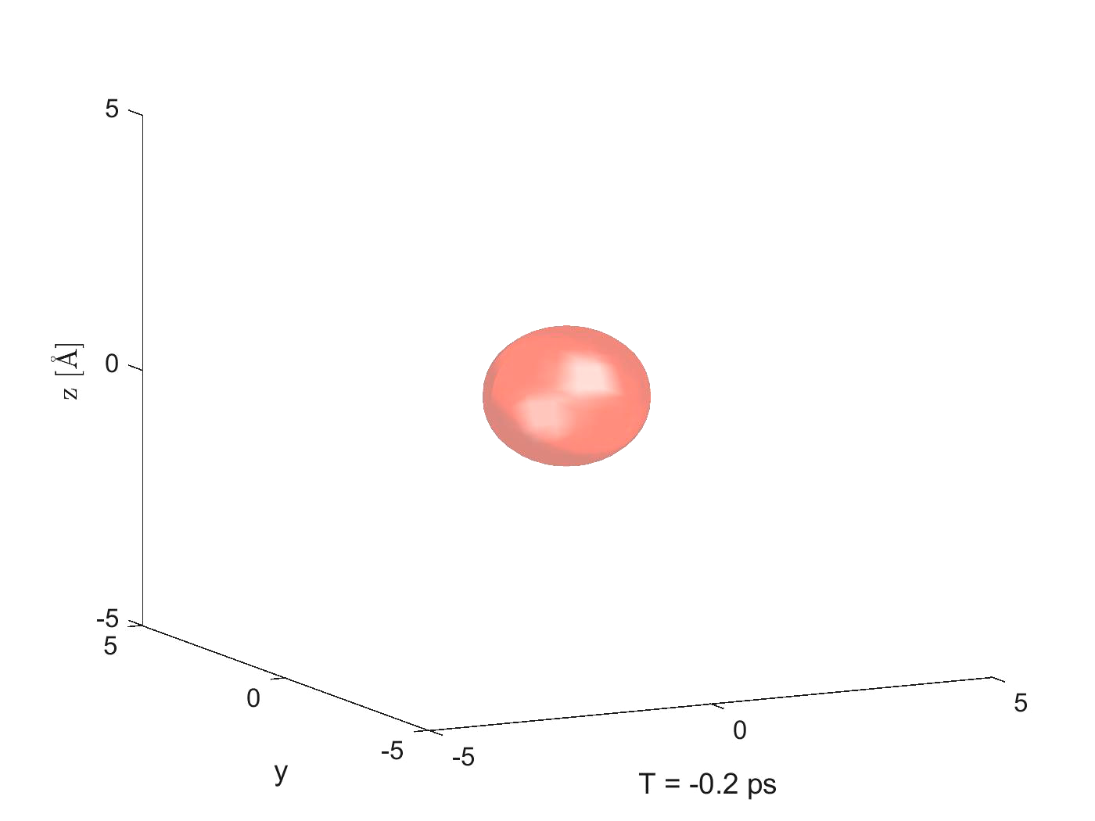

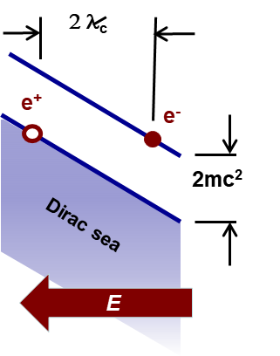
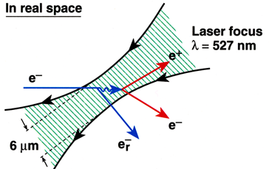
The Bucksbaum Group studies motion on the quantum-scale induced and controlled by strong fields
Δt
Attosecond electron motion across molecules induced by x rays or strong fields
  James Cryan, Ruaridh Forbes, Andrei Kamalov, Jordan O'Neal,Nick Werby, Anna Wang: Supported by DOE-BES-CSGB
Strong-field femtosecond laser-molecule quantum control
  Ruaridh Forbes, Andy Howard, Greg McCracken, Chelsea Liekhus-Schmaltz; Supported by NSF
Ultrafast X-ray diffraction for molecular movies
  Adi Natan, Matt Ware, Mike Glownia, James Cryan, Ian Gabalski; Supported by DOE-BES-CSGB
Strong-fields beyond the Schwinger limit
  Sebastian Meuren, David Reis; Supported by DOE-FES
Work supported by DOE Office of Basic Energy Science, Chemical Sciences, Geosciences, and Biosciences Division
Come to the Ford Distinguished Lecture in UM Physics on February 12, 2020 to hear about this.

Slide 3
What is the vacuum? Not exactly nothing…
Occupies all space
Has no charge
Has no angular momentum (isotropic)
Has no preferred origin (homogeneous)
Non-dispersive (c(λ)=constant)
Maxwell's Equations for fields in the vacuum:
Both Lorentz and
gauge invariant
Energy density = ?Zero?? Maybe not…

Slide 4
All particles and fields in quantum mechanics have "Zero Point Energy"
Example: Harmonic Oscillator
Light has it, too
How much? I did the math: 50 visible-wavelength photons / μ³;
Or about 100 kW of visible ZPE entering and leaving your eyes
-- in the dark.

Slide 5
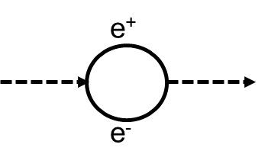
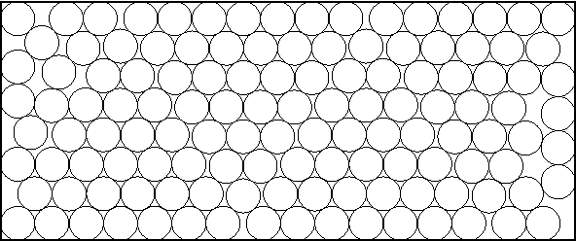
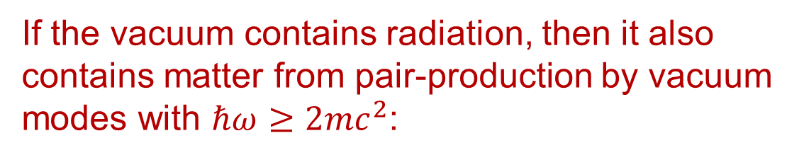
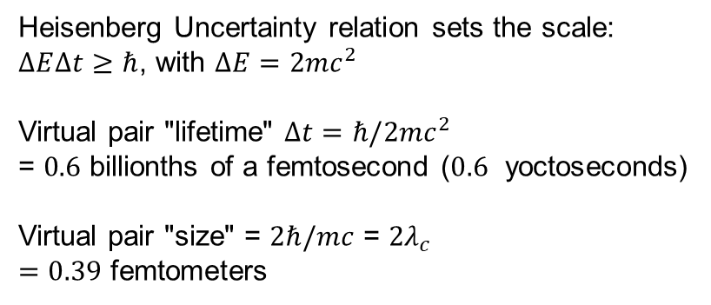
If the vacuum contains radiation, then it also contains matter from pair-production by vacuum modes with $ℏω≥2mc^{2}$:
Heisenberg Uncertainty relation sets the scale:
$∆E∆t≥ℏ$, with $∆E=2mc^{2}$
Virtual pair "lifetime" $∆t=ℏ/2mc^{2}$
= $0.6$ billionths of a femtosecond ($0.6$ yoctoseconds)
Virtual pair "size" = $2ℏ/mc$ = $2λ_{c}$
$=0.39$ femtometers
Dirac's View: Vacuum is like an insulator with a negative energy "sea" filled with electrons.
Quantum fluctuations create virtual electron-"hole" pairs --
A PLASMA
IN THE QUANTUM VACUUM
E
mc²
E=0
-mc²
x

Slide 6
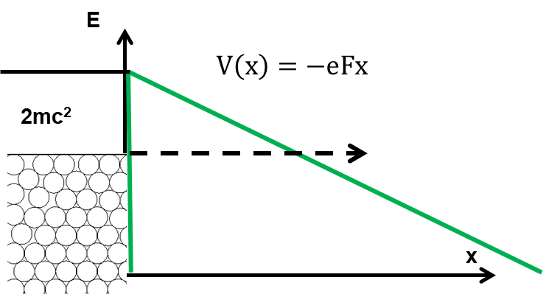
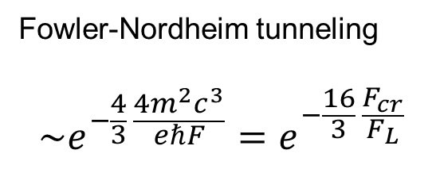
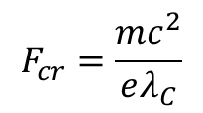
Interrogating the quantum vacuum plasma with an external field F
Fowler-Nordheim tunneling
$$\sim e^{−\frac{4}{3} \frac{4m^{2}c^{3}}{eℏF}}=e^{−\frac{16}{3} \frac{F_{cr}}{F_{L}}}$$
$$F_{cr}=\frac{{mc}^{2}}{eλ_{C}}$$

Slide 7
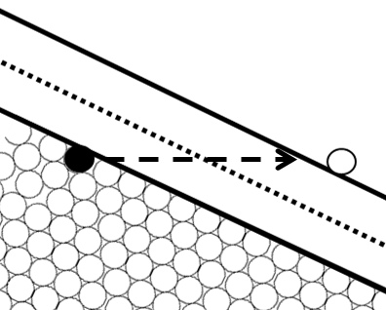

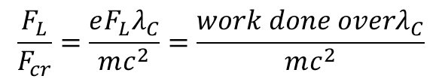
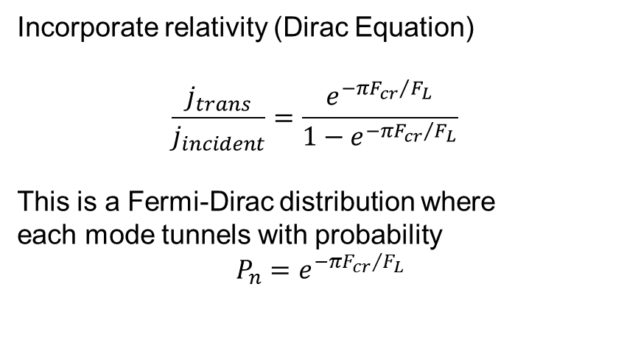
Interrogating the quantum vacuum plasma with an external field F
E
Incorporate relativity (Dirac Equation)
$$\frac{j_{trans}}{j_{incident}}=\frac{e^{−{πF_{cr}}/{F_{L}}}}{1−e^{−{πF_{cr}}/{F_{L}}}}$$
This is a Fermi-Dirac distribution where
each mode tunnels with probability
$$P_{n}=e^{−{πF_{cr}}/{F_{L}}}$$
$$V\left(x\right)=−eFx$$
x
J. Schwinger, Physical Review 82, 664 (1951).
$$\frac{F_{L}}{F_{cr}}=\frac{eF_{L}λ_{C}}{mc^{2}}=\frac{work done overλ_{C}}{mc^{2}}$$
$F_{cr}=\frac{m^{2}c^{3}}{eℏ}=1.3×{10}^{16}V/{cm}$, the Schwinger critical field
$I_{cr}=\frac{F_{cr}^{2}}{4π}=2.2×{10}^{29}W/{cm}^{2}$. So how big is that?

Slide 8
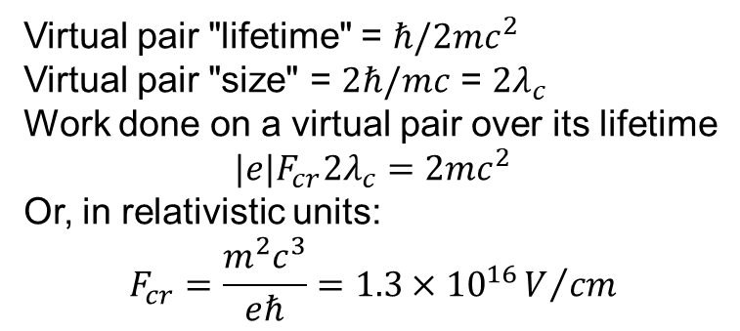
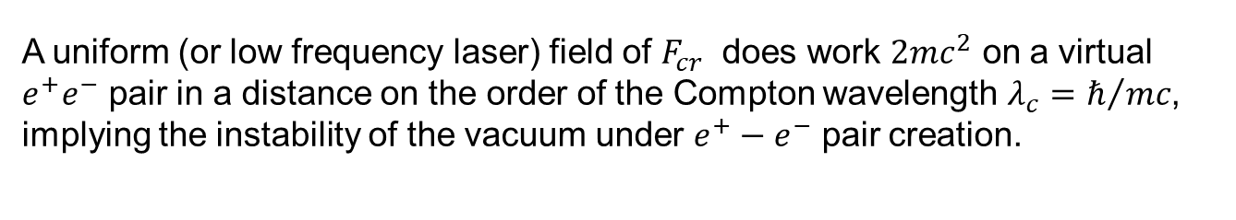

Big enough to pull electrons out of the vacuum during quantum fluctuations:
Virtual pair "lifetime" = $ℏ/2mc^{2}$
Virtual pair "size" = $2ℏ/mc$ = $2λ_{c}$
Work done on a virtual pair over its lifetime
$${|e|F}_{cr}2λ_{c}=2mc^{2}$$
Or, in relativistic units:
$$F_{cr}=\frac{m^{2}c^{3}}{eℏ}=1.3×{10}^{16}V/{cm}$$
$$I_{cr}=\frac{F_{cr}^{2}}{4π}=2.2×{10}^{29}W/{cm}^{2}$$
A uniform (or low frequency laser) field of $F_{cr}$ does work $2mc^{2}$ on a virtual $e^{+}e^{−}$ pair in a distance on the order of the Compton wavelength $λ_{c}=ℏ/{mc}$, implying the instability of the vacuum under $e^{+}−e^{−}$ pair creation.
A. Di Piazza, C. Müller, K. Z. Hatsagortsyan, and C. H. Keitel, Rev. Mod. Phys. 84, 1177 (2012).

Slide 9
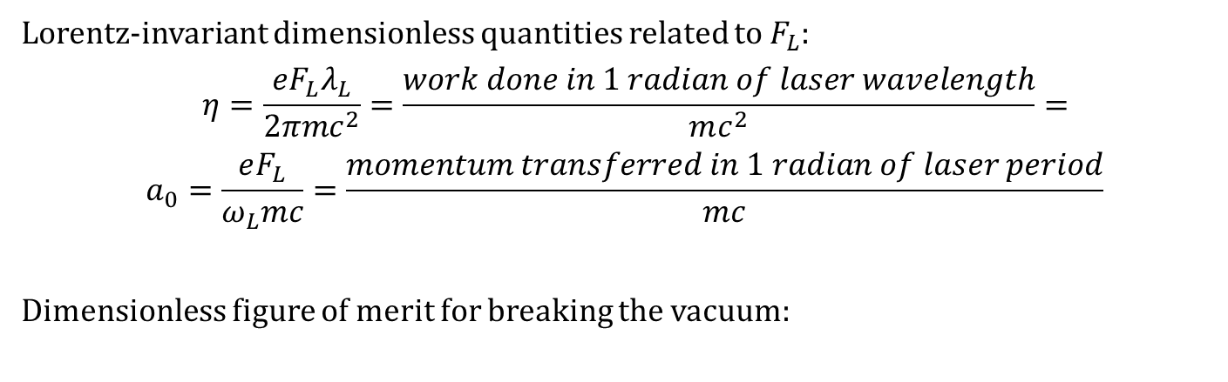

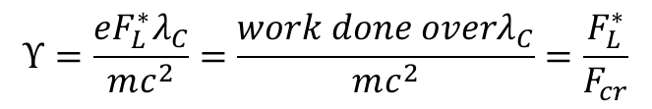
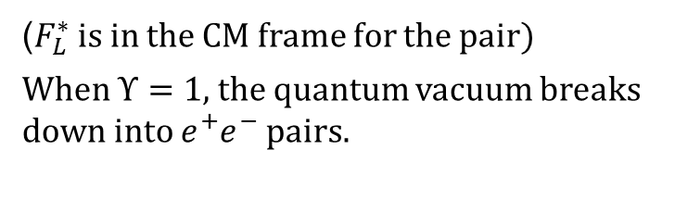
What laser properties really matter for this application? Laser field amplitude $F_{L}$
Lorentz-invariant dimensionless quantities related to $F_{L}$:
$$η=\frac{eF_{L}λ_{L}}{2πmc^{2}}=\frac{work done in 1 radian of laser wavelength}{mc^{2}}=$$
$$a_{0}=\frac{eF_{L}}{ω_{L}mc}=\frac{momentum transferred in 1 radian of laser period}{mc}$$
Dimensionless figure of merit for breaking the vacuum:
$$Υ=\frac{eF_{L}^{∗}λ_{C}}{mc^{2}}=\frac{work done overλ_{C}}{mc^{2}}=\frac{F_{L}^{∗}}{F_{cr}}$$
2 λ_{c}
($F_{L}^{∗}$ is in the CM frame for the pair)
When $Υ=1$, the quantum vacuum breaks down into $e^{+}e^{−}$ pairs.
e⁺
e⁻
2mc²
Dirac sea
E

Slide 10
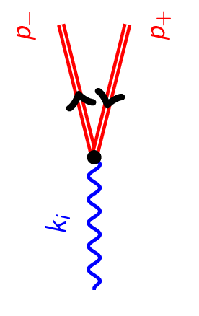




Paradigm shift from QED to SFQED
Breit-Wheeler
Multiphoton
Breit-Wheeler
$$e^{−}$$
$$e^{+}$$
$$γ+{\vec{A}}_{L}\left(\vec{x},t\right)→e^{+}+e^{−}+{\vec{A}}_{L}\left(\vec{x},t\right)$$
Dressed state
Breit-Wheeler
$$γ$$

Slide 11

Non-linear/non-perturbative QED
Dressed state (Furry, Volkov, …)
Photon emission
Multi-photon Compton
Quantum radiation reaction
…
Photon decay
Multi-photon Breit-Wheeler Pair production
“Schwinger Assisted” pair production
…

Slide 12

Magnetars are spinning neutron stars that contain B fields above the Schwinger critical value
$$B_{crit}$$
Surface magnetic fields (inferred from $P and \dot{P}$)
S. A. Olausen and V. M. Kaspi, ApJS 212, 6 (2014).
Map of magnetars detected in our galaxy

Slide 13
Dense e+e- plasmas produced by Breit-Wheeler pair production at a surface create a dense beam of gamma rays
C. P. Ridgers, C. S. Brady, R. Duclous, J. G. Kirk, K. Bennett, T. D. Arber, A. P. L. Robinson, and A. R. Bell, Phys. Rev. Lett. 108, 165006 (2012).
Notes:
In simulations of a 10 PW laser striking a solid, we demonstrate the possibility of producing a pure electron-positron plasma by the same processes as those thought to operate in high-energy astrophysical environments. A maximum positron density of 1026 m−3 can be achieved, 7 orders of magnitude greater than achieved in previous experiments. Additionally, 35% of the laser energy is converted to a burst of γ rays of intensity 1022 W cm−2, potentially the most intense γ-ray source available in the laboratory. This absorption results in a strong feedback between both pair and γ-ray production and classical plasma physics in the new “QED-plasma” regime.

Slide 14
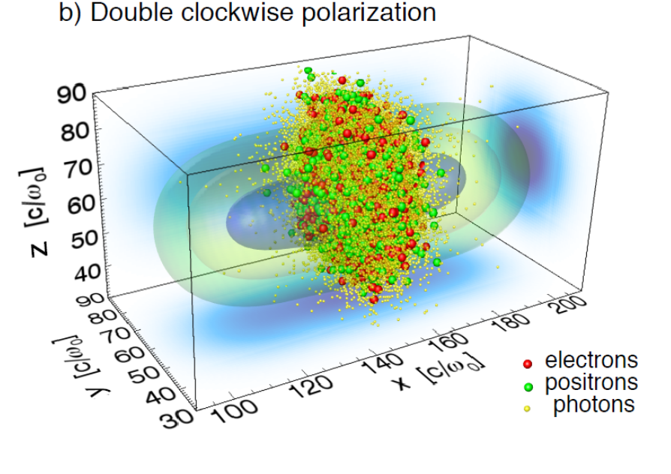
Above the Schwinger threshold colliding laser beams decay into a cloud of e+e- plasma, a "QED Cascade."
T. Grismayer, M. Vranic, J. L. Martins, R. A. Fonseca, and L. O. Silva, Physical Review E 95, (2017).

Slide 15
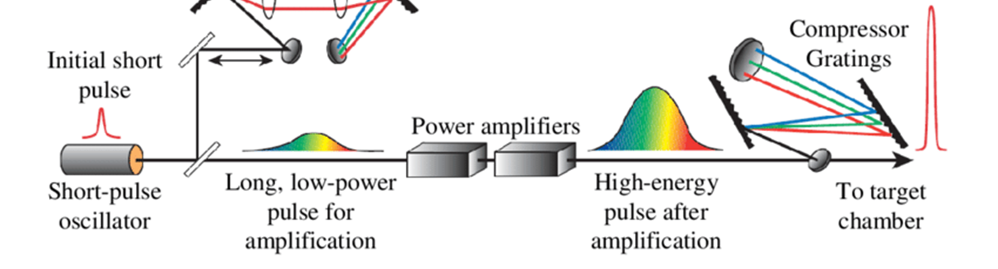
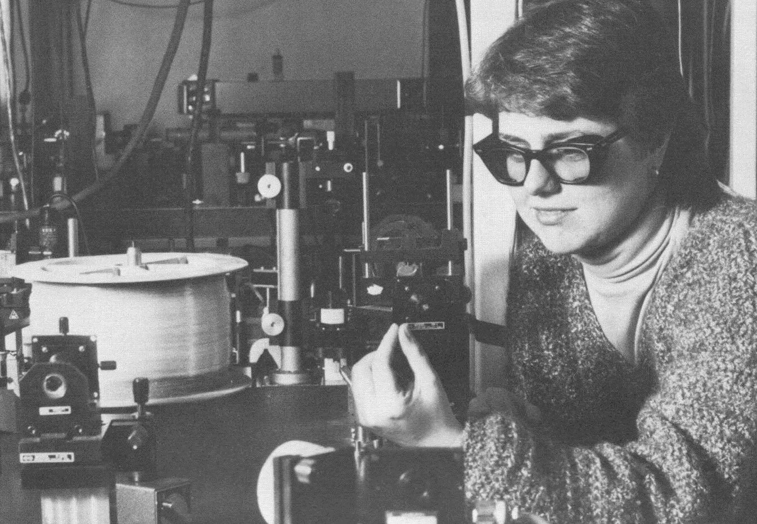
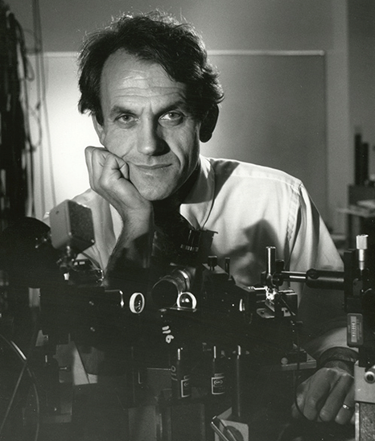
Breaking the vacuum in the lab: First breakthrough: CPA, circa 1985, started with the "Table-top Terawatt" laser
Fiber
Stretcher
D. Strickland and G. Mourou, “Compression of amplified chirped optical pulses”, Opt. Commun. 56, 219 (1985)

Slide 16

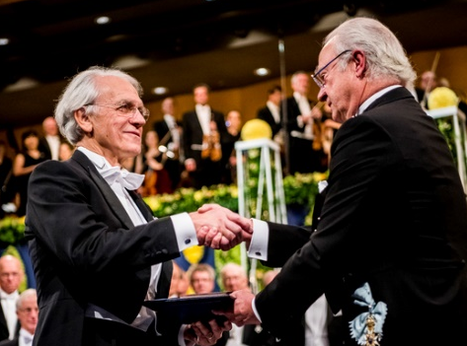
First breakthrough: CPA, circa 1985, started with the "Table-top Terawatt" laser
Fiber
Stretcher
Two happy people in Stockholm last year:
D. Strickland and G. Mourou, “Compression of amplified chirped optical pulses”, Opt. Commun. 56, 219 (1985)

Slide 17
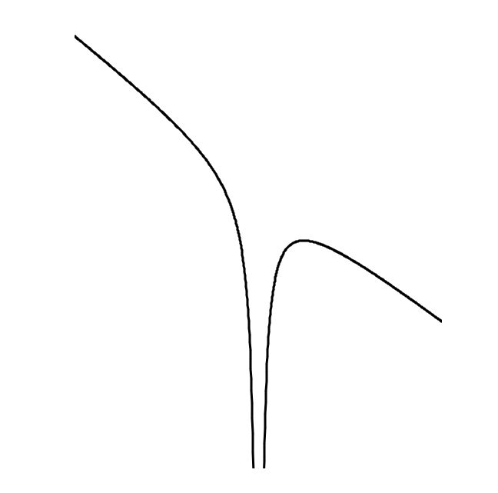

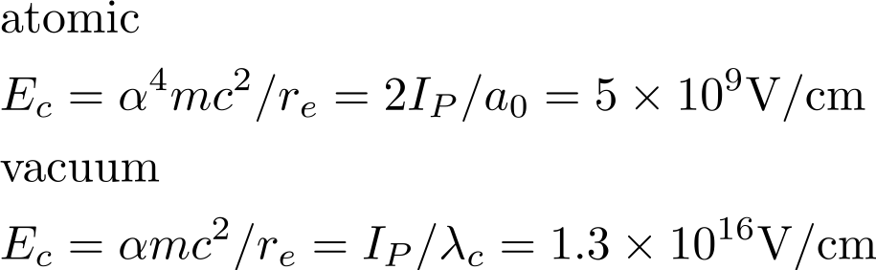
That T³ laser (in Rochester, not Michigan) was used to pull electrons out of atoms. It was a start…
- I_{p}
S. Augst, D. Strickland, D. D. Meyerhofer, S. L. Chin, and J. H. Eberly, Phys. Rev. Lett. 63, 2212 (1989).

Slide 18
Where is high intensity physics going?
Schwinger limit
- I_{p}
10²⁵ W/cm², Fully stripped U
10²⁰ W/cm², Fully stripped Ar

Slide 19
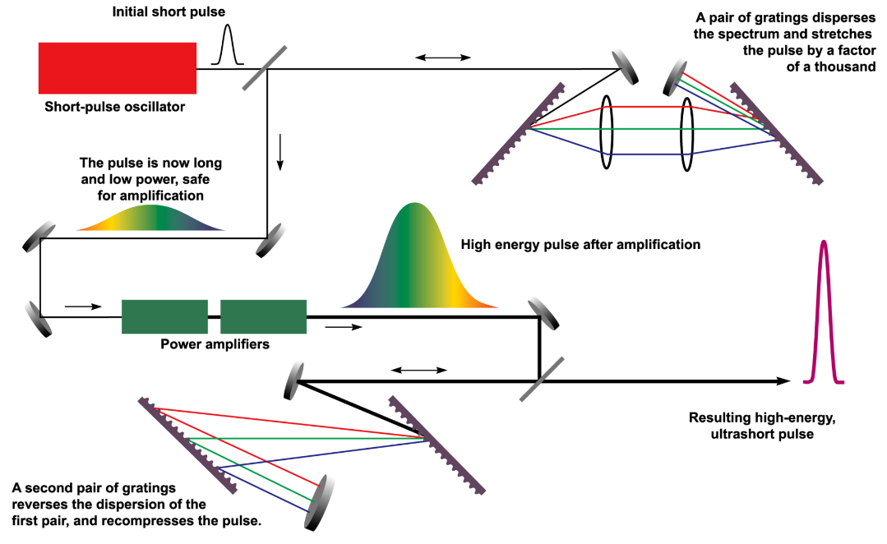
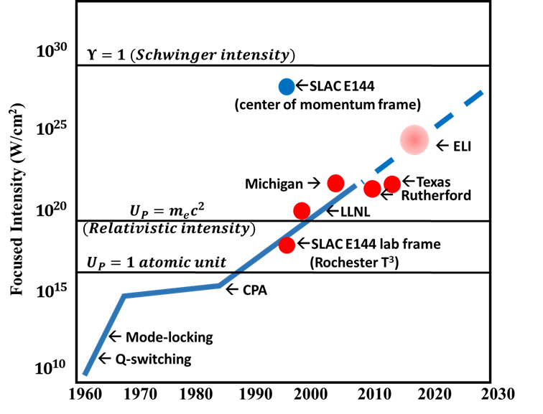
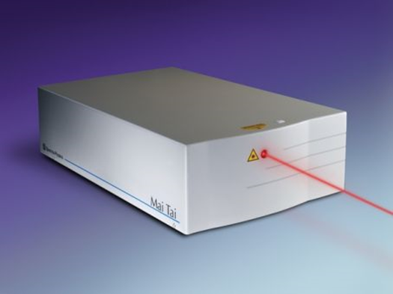
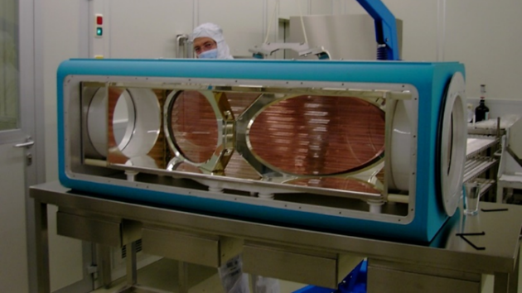
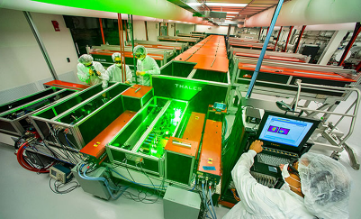
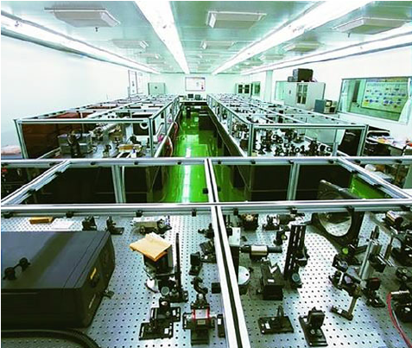
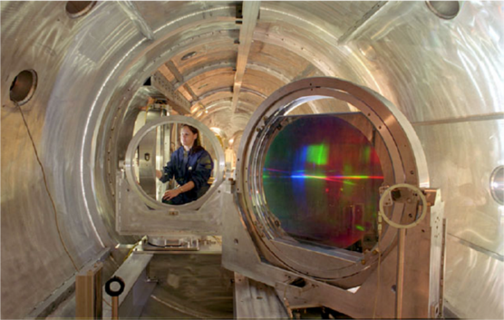
Later refinements have brought us to the petawatt frontier illustrated by the Mourou plot
Nd:Glass
Ti:sapphire
OPCPA

Slide 20
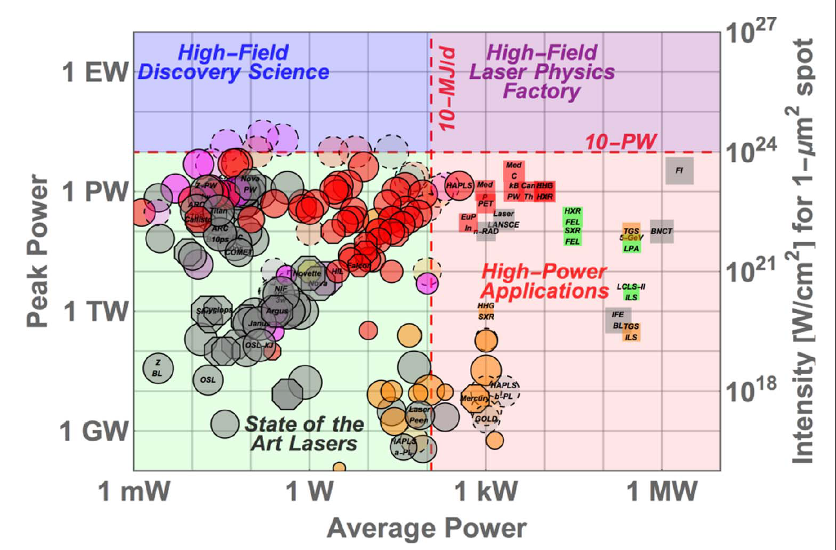
Most of these lasers are being built for high field discovery science
C. N. Danson, et al., High Pow Laser Sci Eng 7, e54 (2019).
Ti:Sapphire
Nd:X
OPCPA
In operation (solid line)
Planned (dashed line)

Slide 21
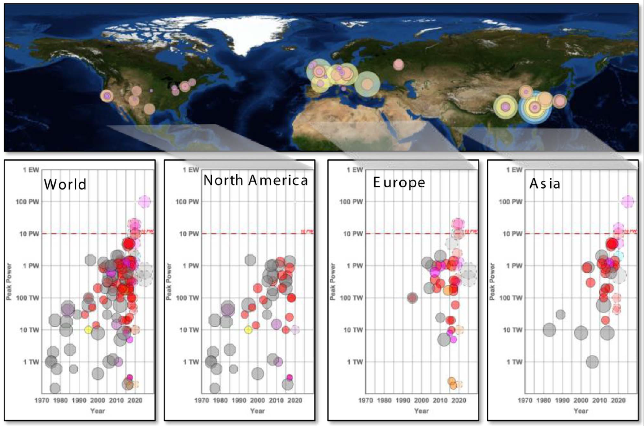
The comprehensive Mourou plot:
C. N. Danson, et al., High Pow Laser Sci Eng 7, e54 (2019).
Notes:
C. N. Danson, et al., High Pow Laser Sci Eng 7, e54 (2019).

Slide 22
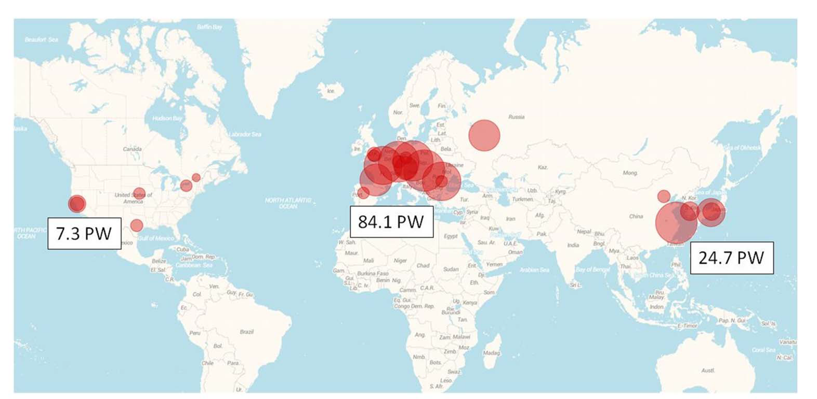
PW-class lasers: concentrated in Europe

Slide 23
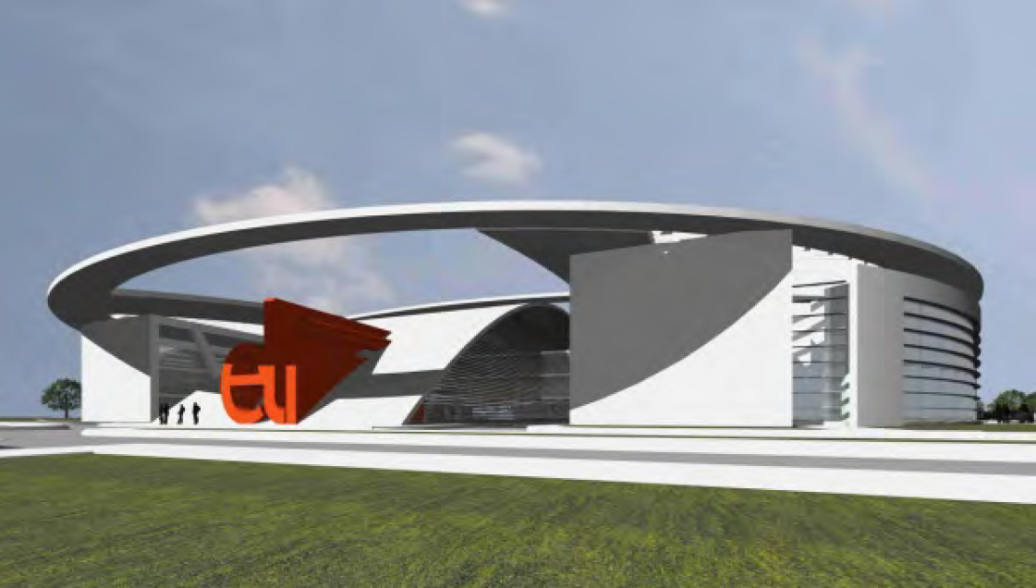


European ELI project (~$1B)
Attosecond Light Pulse Source (Szeged, Hungary)
-Ultrafast light sources, and coherent x-ray sources
-PW drive laser
-Several beam lines, from 10KHz 100 mJ to 0.1 Hz 300J
High Energy Beam-Line Facilitiy (Prague, Czech Republic)
Beam lines from -200mJ to 1.3kJ lasers, including 2 10PW lasers;
Six experimental areas, including exotic physics, acceleration, x-rays, materials science.
Nuclear Physics Facility (Magurele, Romania)
2 multi-petawatt, 200J, 0.1Hz, <30fs lasers
Compton backscatter gamma ray source
Experiments aimed at nuclear physics.
10²³ ⁻ ²⁴ W/cm²
@Beamlines and NP

Slide 24
China plans to dominate this technology, and probably will, with plans for a 100 PW system based on Optical Parametric CPA:
Ruxin Li, SIOM

Slide 25
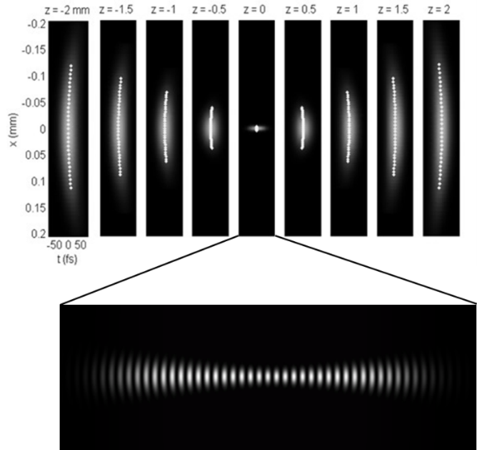
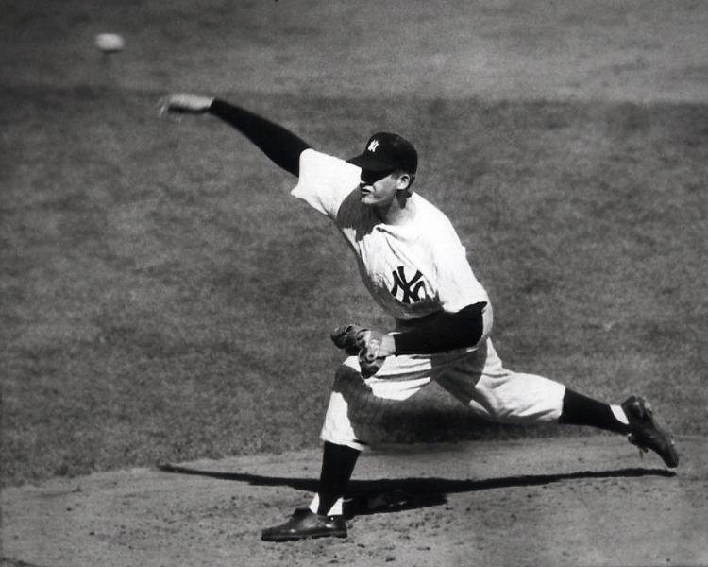
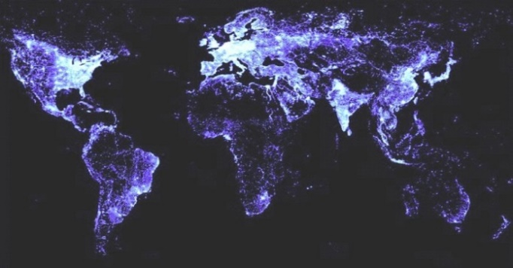
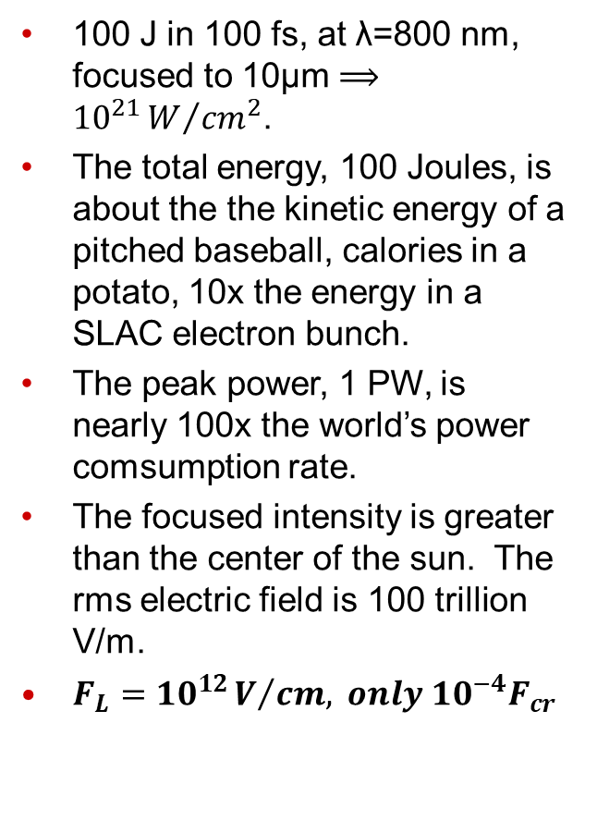
What's one Petawatt after all? Not enough for our needs.
100 J in 100 fs, at λ=800 nm, focused to 10µm $⟹{10}^{21}W/{{cm}^{2}}$.
The total energy, 100 Joules, is about the the kinetic energy of a pitched baseball, calories in a potato, 10x the energy in a SLAC electron bunch.
The peak power, 1 PW, is nearly 100x the world’s power comsumption rate.
The focused intensity is greater than the center of the sun. The rms electric field is 100 trillion V/m.
$F_{L}={10}^{12}V/{cm,} only {10}^{−4}F_{cr}$
What is a petawatt laser pulse?
ENERGY
POWER
INTENSITY
Report Box 1.1
Notes:
At the center of the sun, T is 15 million degrees. Intensity is sigma*T^4/pi and Stefan Boltzman sigma is 5.7e-8 in SI, so that's about 1e21/W/m^2.
1e-9C / (1.6e-19 C/e) x (1.5e10 eV) x (1.6e-19 J/eV) = 1e-9C x 1.5e10 eV = 15J

Slide 26
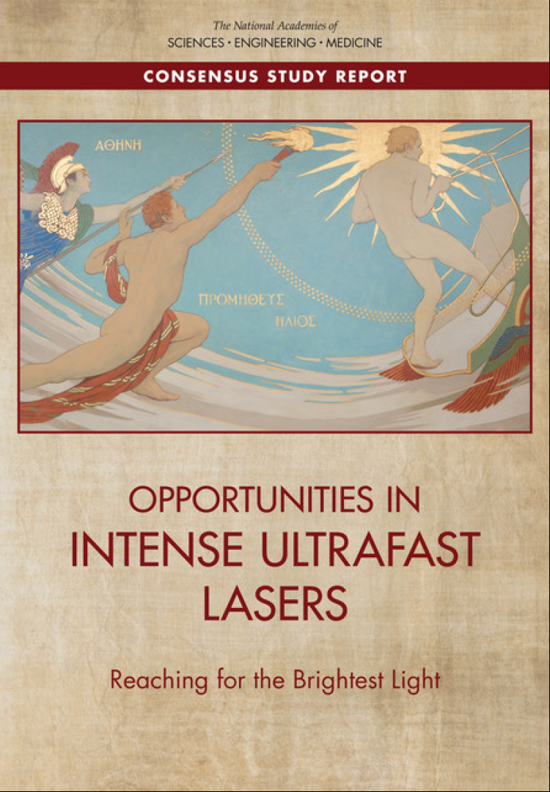
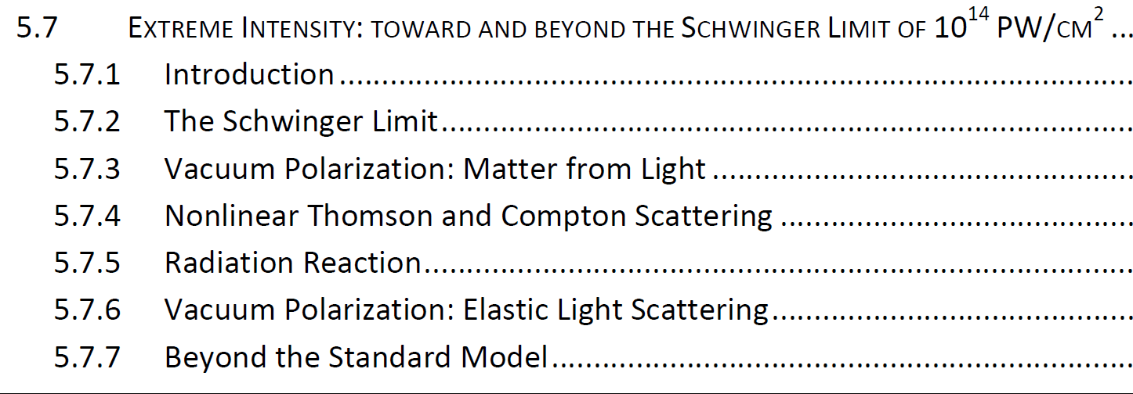

SFQED is featured prominently in the recent NAS "Reaching for the Brightest Light" PW laser report.
Full report
http://nap.edu/24939

Slide 27
Study conclusions
The science is important.
Applications exist in several areas.
The community is large but fragmented.
No cross-agency stewardship exists.
The US has lost its previous dominance.
Co-location of intense lasers with existing infrastructure is essential; key US advantage over ELI
University/Laboratory/Industry cooperation is necessary to retain and renew the talent base.

Slide 28
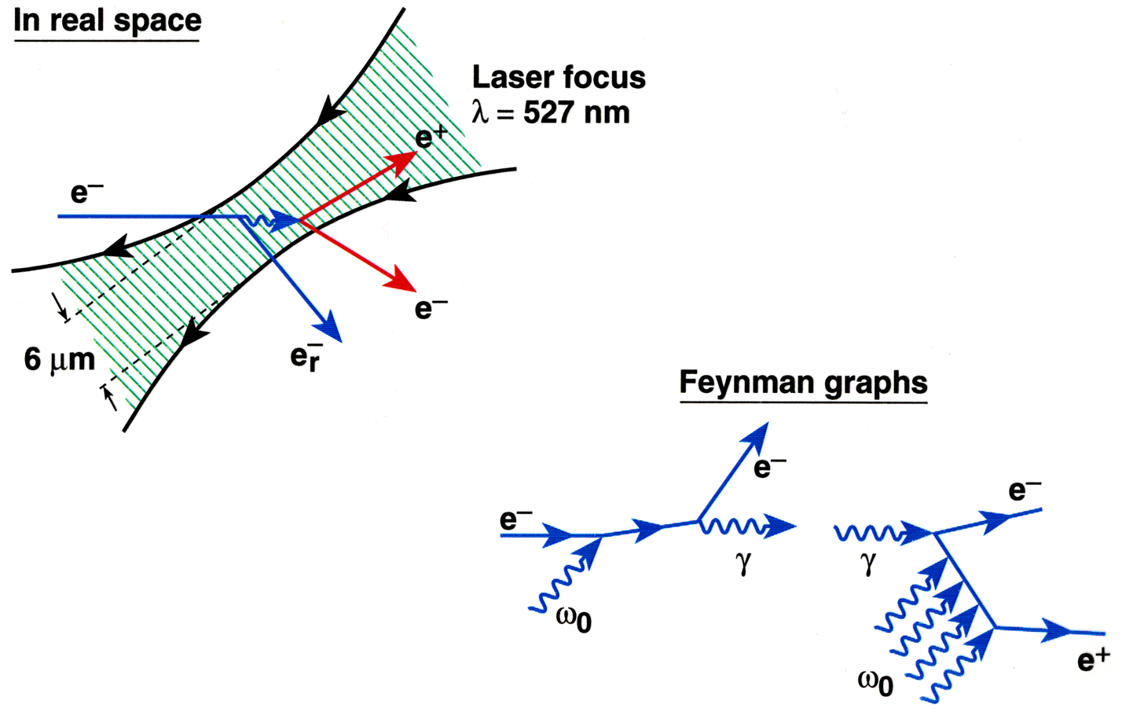
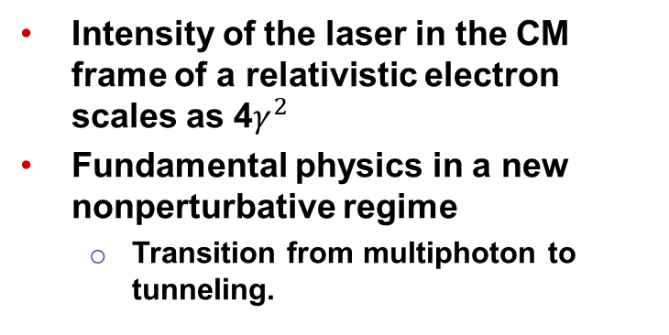
Here's what makes collocation essential:
(CM frame
15 Gev e-)
(lab frame)
Intensity of the laser in the CM frame of a relativistic electron scales as 4$γ^{2}$
Fundamental physics in a new nonperturbative regime
  Transition from multiphoton to tunneling.

Slide 29
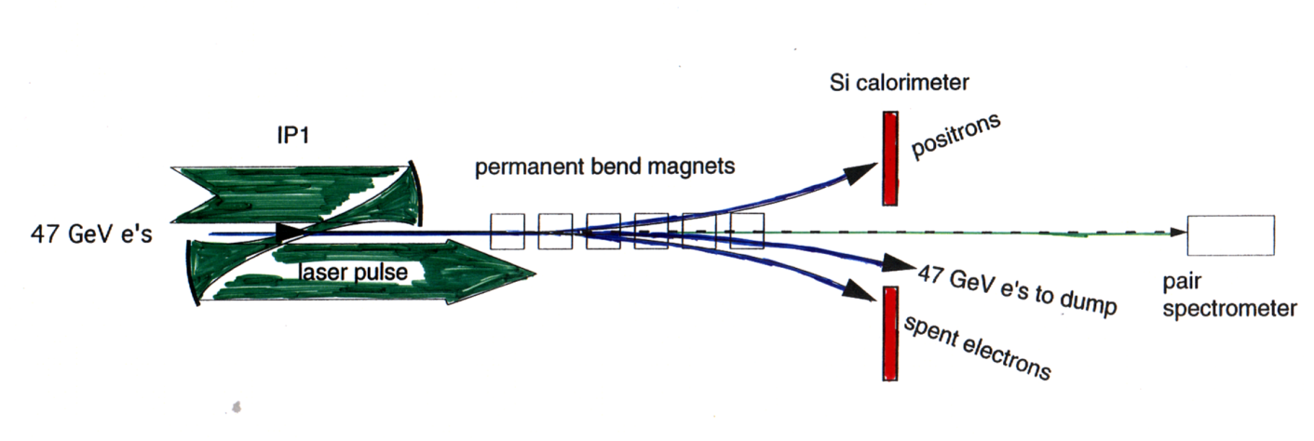
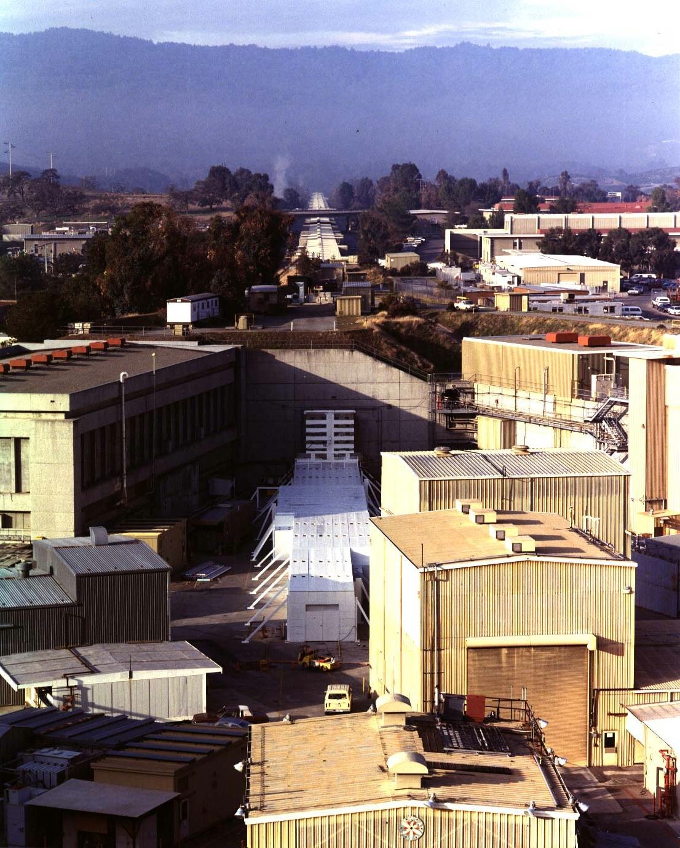
The highest intensity experiment to date is SLAC E144, which pushed lasers off the Mourou plot trend line:
FFTB (now LCLS transport)
Near head-on collisions of TW laser (ħω = 2.34 eV) with backscattered photons, ħω ~ 28 GeV, from 46.6 GeV SLAC beam.
Need ≥ 4 photons to produce a pair (1.02 MeV in COM)
Intensity in COM frame approaching Schwinger limit (~10²⁹ W/cm²) and QED critical field.

Slide 30
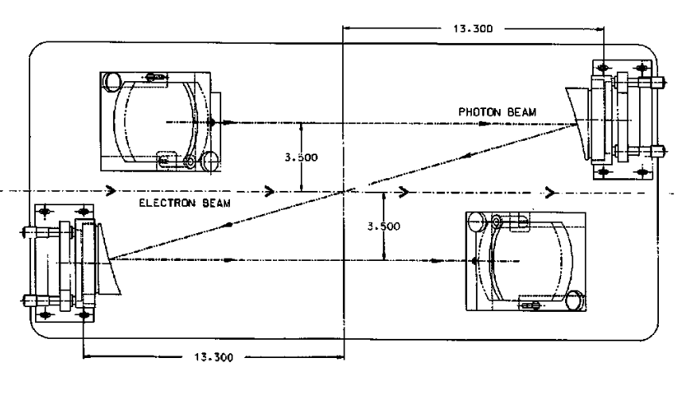
The laser: T³:table-top-TW,
Chirped Pulse Amplification Nd: glass laser
Mode-locked Nd:YLF syncrhonized
to rf cavities to few ps
Fiber and grating stretcher
Multi-stage amplification
Zig-zag SLAB amplifier
~1J, 1.5ps, 0.5 Hz
1054 nm fundamental
527 nm (KDP)
f/# 6 focusing 2X diffraction limit
~10¹⁸ W/cm²

Slide 31


E144 Measured in transition regime
Tunneling Picture (Schwinger)
Υ = E/E_{c}
Multi-photon picture

Slide 32


Reaching strong-field regime @FACET-II
Baseline: 20 TW, 13 GeV

Slide 33

Focused Intensity Frontier
20TW/13GeV
FACET-II (E320)
50 GeV
Y >1 possible now
with current facilities (SLAC/DESY…)
…and modest laser
20TW
(lab frame)

Slide 34


FACET-II E-320 collaboration
SFQED theory & simulation | A. DiPiazza, F. Fiuza, T. Grismayer, C.H. Keitel, S. Meuren, L.O. Silva, D. Del Sorbo, M. Tamburini, M. Vranic
SLAC E144 | D.A. Reis (SF AMO/xray), T. Koffas (HEP)
LWFA SFQED experiments | G. Sarri, M. Zepf
Crystal SFQED experiments | R. Holtzapple, U. I. Uggerhoj
Strong-field AMO/x-ray science | P.H. Bucksbaum, M. Fuchs, C. Rödel
Laser-plasma interaction, HEDP | F. Albert, S. Corde, S. Glenzer, C. Joshi, M. Litos, W. Mori
Accelerator physics | G. White
Detectors | A. Dragone, C. J. Kenney
High intensity lasers | A. Fry
Collaborating Institutions: Carleton University (Canada), Aarhus University (Denmark). Ecole Polytechnique (France) Max-Planck-Institut für Kernphysik (Germany), Helmholtz-Institut Jena (Germany), Friedrich-Schiller-Universität Jena (Germany), Universidade de Lisboa (Portugal), Queen's University Belfast (UK), California Polytechnic State University (CA USA), Lawrence Livermore National Laboratory (CA USA), Princeton University (NJ USA), SLAC National Accelerator Laboratory (CA USA), University of California Los Angeles (CA USA), University of Colorado Boulder (CO USA), University of Nebraska - Lincoln (NE USA)

Slide 35


E-320 can test various aspects of SFQED
Tunneling pair production/vacuum breakdown
Pair production inside quasi-static field
Nonperturbative tunneling exponent
Much higher statistics: >10³ positrons/shot
Strong-field synchrotron radiation
Reduced radiation probability, spectrum: redshift
Coherent interaction with ~10² laser photons
Emission of high harmonics (up to 8Gev photons
Simulations: Tamburini, Vranic, E-320 collaboration

Slide 36

E-320 can test various aspects of SFQED
Breakdown of the Local Constant Field Approximation (LCFA)
Applicability of the LCFA: vital for numerical codes
Formation region depends on photon frequency
LCFA faild: suppression of low-frequency radiation
Quantum radiation reaction (QRR) -energy
Stochasticity: broadening of the energy distribution
Quenching: some electrons don't radiate at all
Quantum corrections to Landau-Lifshitz
Simulations: Tamburini, Vranic, E-320 collaboration

Slide 37



“New” physics: re-collisions.
$$η≫1, Υ∼1,$$
Stationary phase approximation,
Tunneling, classical trajectories, re-collisions similar to SF-AMO
Possiblity for $μ^{+}+µ^{−}, π^{+}+π^{−}; π^{0}$… productions well below threshold
S. Meuren, 2015

Slide 38


Summary: Plasmas inside the vacuum
The vacuum is filled with quantum fluctuations of radiation and particles
The quantum vacuum is a fundamental plasma frontier
The entry point for study is fields that exceed the Schwinger threshold of ${mc^{2}}/{eλ_{c}}$
Experimental studies are enabled by locating petawatt-class lasers together with relativistic particle accelerators
Above the Schwinger threshold, CPA lasers can generate copious quantities of electron-positron pairs emulating conditions in the most energetic parts of the universe.

Slide 39





Thanks!
Parts of this work were supported by the U.S. Department of Energy, Office of Science, Chemical Sciences, Geosciences, and Biosciences Division

