Slide 1


Plasma Lens for Active Optical Path Difference Control
T. Corke, B. Neiswander, E. Matlis
University of Notre Dame
Institute for Flow Physics and Control
Aerospace and Mechanical Engineering
Notre Dame, IN
University of Michigan Institute for Plasma Science and Engineering
December 11, 2013
University of Notre Dame
Notes:
Introduce myself.

Slide 2
Background
The topic of this seminar lies at the intersection of three generally independent disciplines: aerodynamics, plasma dynamics, and optics.
Aero-
dynamics
Plasma
Dynamics
PAO
Optics
PAO: Plasma Adaptive Optics

Slide 3
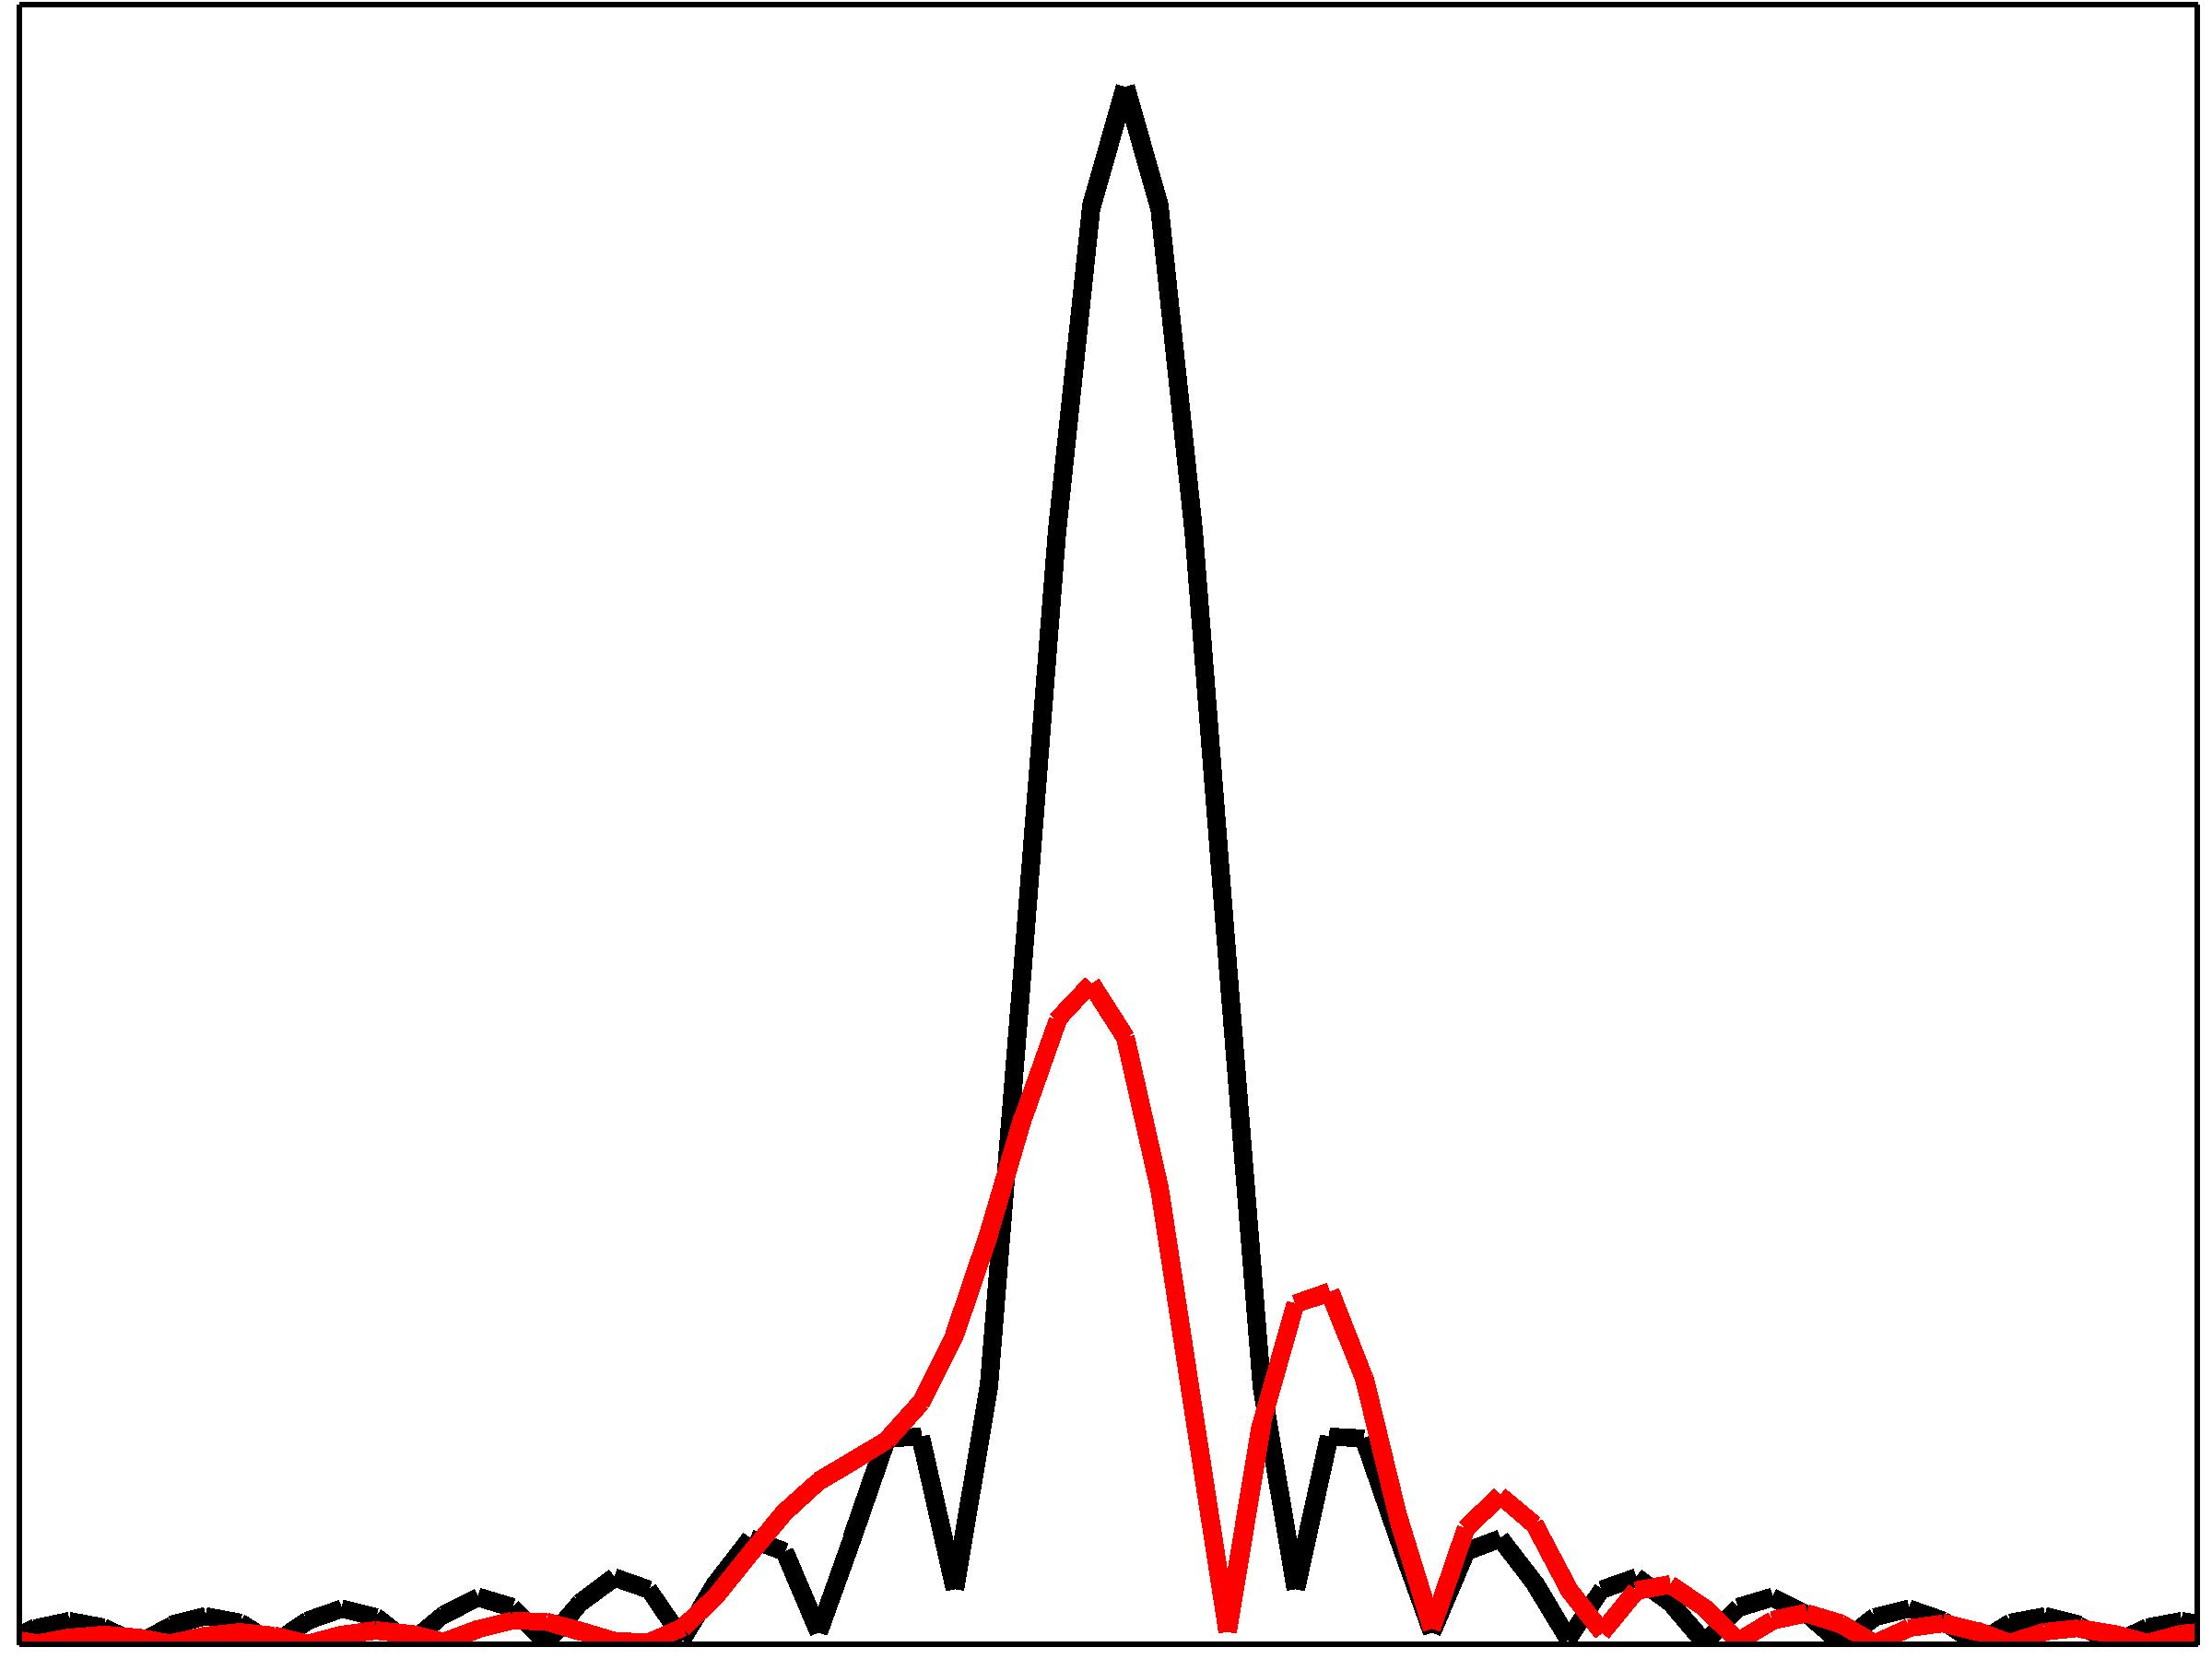
Motivation: Aero-Optic Problem
Laser Beam Aberrations
Applies to laser communication and directed energy from moving aircraft
Time-dependent density gradients in the boundary layer over the aircraft results in wave-front aberrations in the laser beam
Aberrations cause a significant reduction in the on-target intensity (up to 70%).
Fluid Density Gradients
Planar
Aberrated
Near-field
Far-field
Far-field Irradiance
Planar
Aberrated

Slide 4

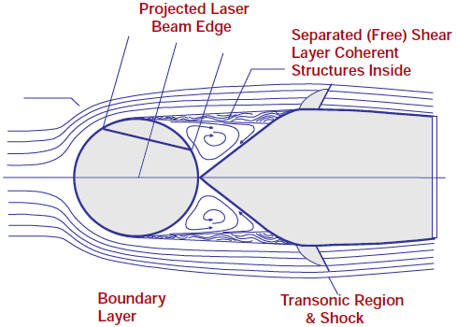
Aerodynamic Configuration
Nose Turret
Separated flow imparts severe aero-optic disturbances to projected laser beam

Slide 5
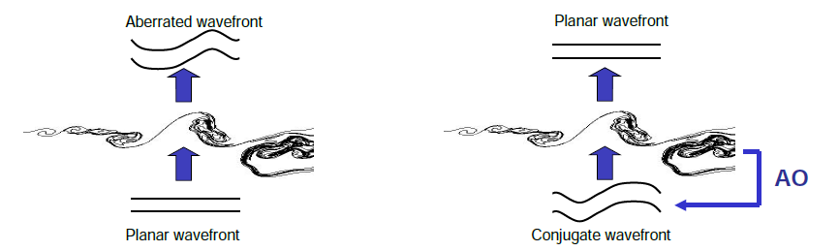
Aero-Optics Correction Approach
Correction involves generating a conjugate waveform of the optical wavefront prior to its transmission through the aberrating fluid layer
The optical wavefront exiting the aberrating fluid layer is then transformed into a planar wavefront
Real-time correction requires 100kHz bandwidth!
Probing Beam

Slide 6
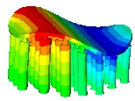
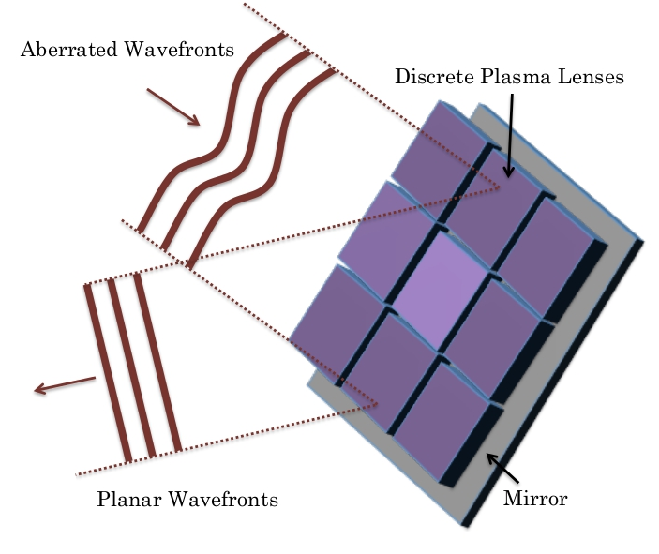
Adaptive Aero-Optics
Reference
Signal
Far-field
Near-field
Aero-Optic
Disturbance
Sampler
Laser
Deformable
Mirror
Wave-front
Sensor
Computer

Slide 7
Optics of Plasma
Gas discharge plasmas contain free electrons, neutrals, metastables, and ions
Consider neutrals, metastables and ions as “heavy particles”
Refractive index of plasma to electromagnetic radiation is

Slide 8
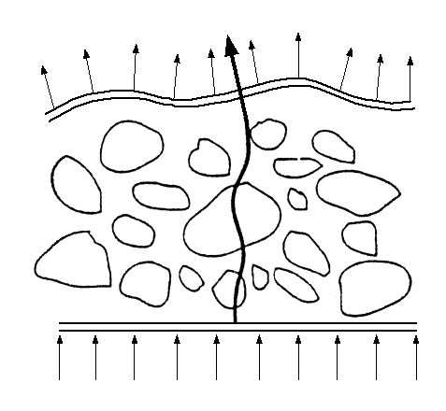
Plasma Induced OPD
Optical path difference (OPD) is the equivalent length that an EM wave’s phase is advanced or lagged.
The maximum OPD determines how much adaptive optic correction is required
Plasma induced OPD depends on the length of the plasma, electron density, EM wavelength, gas composition, and heavy particle density
Fast electron OPD, slow heavy particle OPD

Slide 9
Plasma Induced OPD
Aero-optic goal: 1μm OPD_{e} at λ=1μm
Necessary plasma length
High electron density plasma
Minimize heavy particle OPD

Slide 10
Plasma Adaptive Optic (PAO) Lens
Borosilicate tube
Transparent borosilicate tube of uniform wall thickness.

Slide 11
Plasma Adaptive Optic (PAO) Lens
Borosilicate tube
Optical glass
Optical glass attached and sealed to each end.
Gas pressure inside the tube is lowered.

Slide 12
Plasma Adaptive Optic (PAO) Lens
Electrode
Electrode
Borosilicate tube
Optical glass
Copper tape electrodes wrapped around the tube.

Slide 13
Plasma Adaptive Optic (PAO) Lens
Electrode
Electrode
Borosilicate tube
Electrode
Optical glass
Dielectric (borosilicate)
Low Pressure Gas
Copper tape electrodes wrapped around the tube.

Slide 14
Plasma Adaptive Optic (PAO) Lens
Electrode
Electrode
Borosilicate tube
Optical glass
Copper tape electrodes wrapped around the tube.

Slide 15
Plasma Adaptive Optic (PAO) Lens
Electrode
Electrode
Borosilicate tube
Optical glass
AC signal
AC voltage applied across the electrodes.

Slide 16
Plasma Adaptive Optic (PAO) Lens
Electrode
Electrode
Borosilicate tube
Plasma
Optical glass
AC signal
Low pressure air breaks down and forms plasma.

Slide 17
Plasma Adaptive Optic (PAO) Lens
Electrode
Electrode
Borosilicate tube
Plasma
Optical glass
AC signal
Dielectric barrier discharge (DBD): delayed transition to arcing,
operates in the glow regime.
Not a thermal plasma. Ionization is sustained by electron collisions.

Slide 18
Plasma Adaptive Optic (PAO) Lens
Electrode
Electrode
Borosilicate tube
Plasma
Optical glass
AC signal
Plasma is an optically dispersive medium due to the interactions with
free electrons.
The refractive index is related to electron density and can be
controlled with the applied voltage potential.
.

Slide 19
Plasma Adaptive Optic (PAO) Lens
Electrode
Electrode
Borosilicate tube
Plasma
Laser
Optical glass
AC signal
The PAO lens is an optical device with a controllable refractive index.
The optical path difference (OPD) created
depends on the length of plasma and the applied voltage.

Slide 20
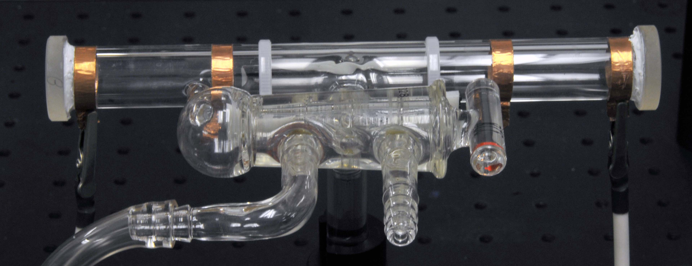
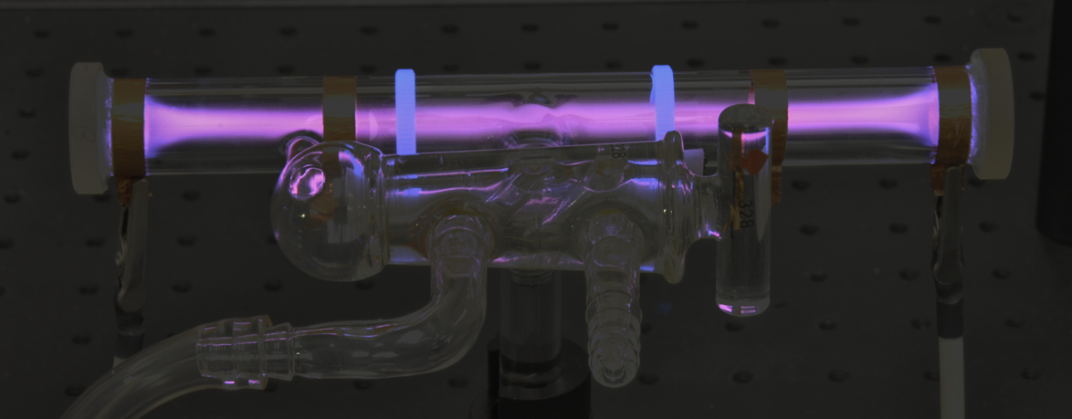
PAO Experimental Setup

Slide 21
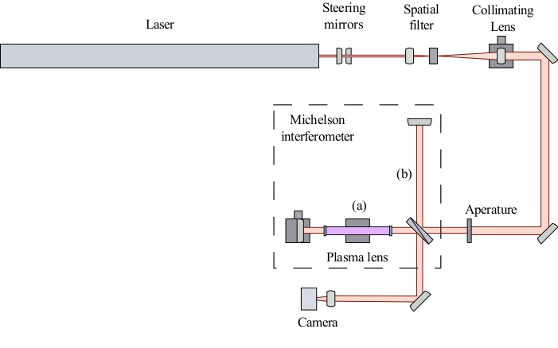
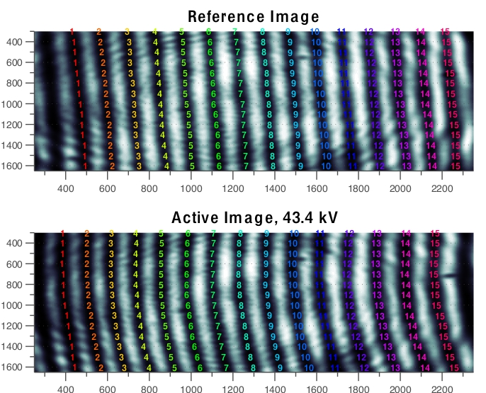
PAO Experimental Setup

Slide 22
PAO Experimental Setup
A shift in the position of a specific interference fringe corresponds to OPD (in pixels):
Physical OPD takes into account the laser wavelength, λ:
For the interferometer, the average refractive index of the plasma lens with electrode spacing, d is:
Neglecting heavy particles, the dispersion eq. is:
Therefore an expression for the electron density is :
Finally, using a Buckinham-Pi analysis, an expression that relates electron density with the plasma lens input power, P, and pressure:

Slide 23
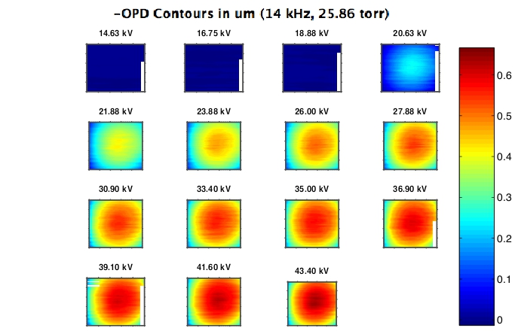
Results: OPD Measurements
OPD Contours as a Function of Voltage
14kHz AC, 25.86 torr
10⁻⁶ m

Slide 24
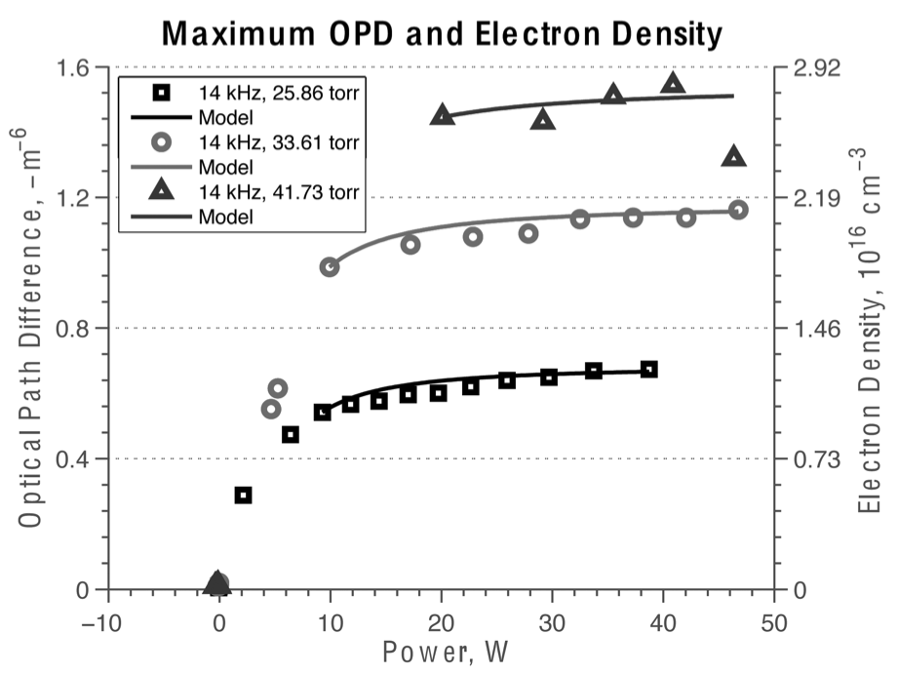
Results: OPD Measurements

Slide 25
Plasma Adaptive Optic (PAO) Lens
The PAO lens could be modular.
Multiple cells added to the PAO lens generates large OPD with low power consumption.
Array of multiple PAO lenses used for spatial wave-front correction.

Slide 26
PAO Scaling
A desire to miniaturize the PAO lens for lower power consumption and better modularity.
Two plasma regimes occur depending on the d/D ratio.

Slide 27
PAO Scaling
A desire to miniaturize the PAO lens for lower power consumption and better modularity.
Favored regime
Is there a critical d/D ratio for a centered plasma?

Slide 28
PAO Scaling: Experimental Setup
Acrylic block
Borosilicate tube
Movable
electrode
Fixed electrode
Optical window
Digital Camera
Plasma
Position
adjustment knob
Lead screw
PAO lens with a variable electrode gap, d
Air inside lens at 0.5 psi (25.9 torr)
3 kV pk-pk, 14 kHz sine wave
Images acquired with 6 megapixel, 12-bit digital camera
Tested 12 different gap distances corresponding to 12 unique d/D ratios
Notes:
ADD dashed line of sight

Slide 29
PAO Scaling: Experimental Conditions
d, mm | d/D | p*d, Torr-cm | Voltage, kV
2.7 | 0.3 | 7.0 | 1.8
3.6 | 0.4 | 9.3 | 2.3
4.5 | 0.5 | 11.6 | 2.2
5.4 | 0.6 | 14.0 | 3.0
6.3 | 0.7 | 16.3 | 3.2
7.2 | 0.8 | 18.6 | 3.5
8.1 | 0.9 | 20.9 | 3.5
9.0 | 1 | 23.3 | 3.5
9.9 | 1.1 | 25.6 | 3.5
10.8 | 1.2 | 27.9 | 3.5
11.25 | 1.25 | 29.1 | 3.5
12.6 | 1.4 | 32.6 | 3.5
List of gap distances, d/D ratios, pd values, and
applied voltage potentials used in the experiment.

Slide 30
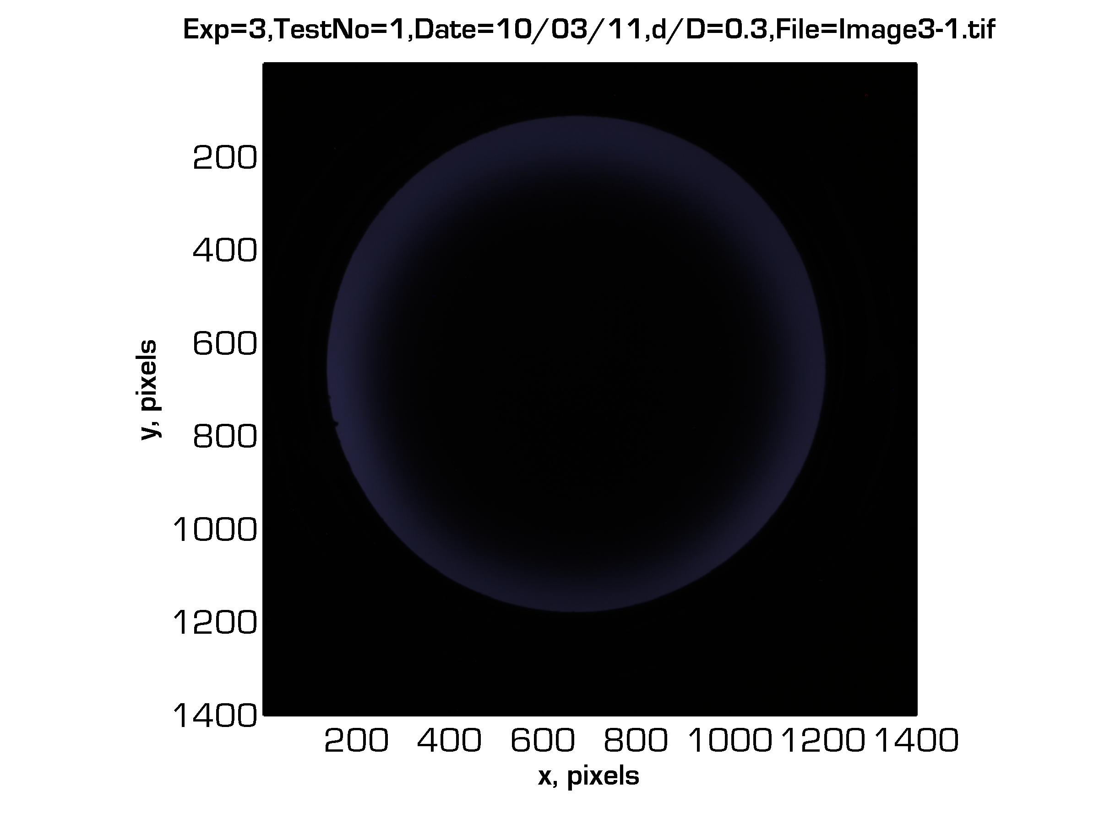
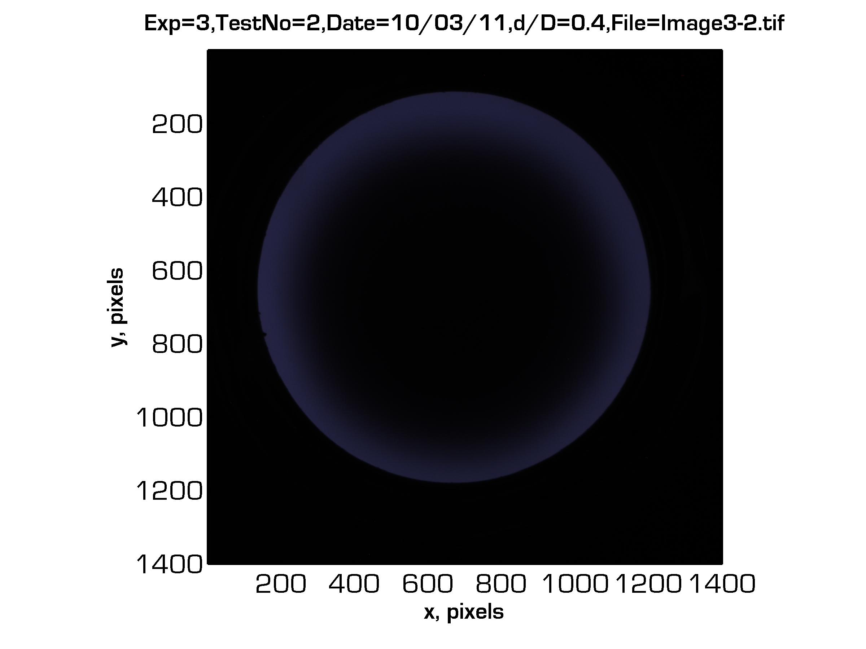
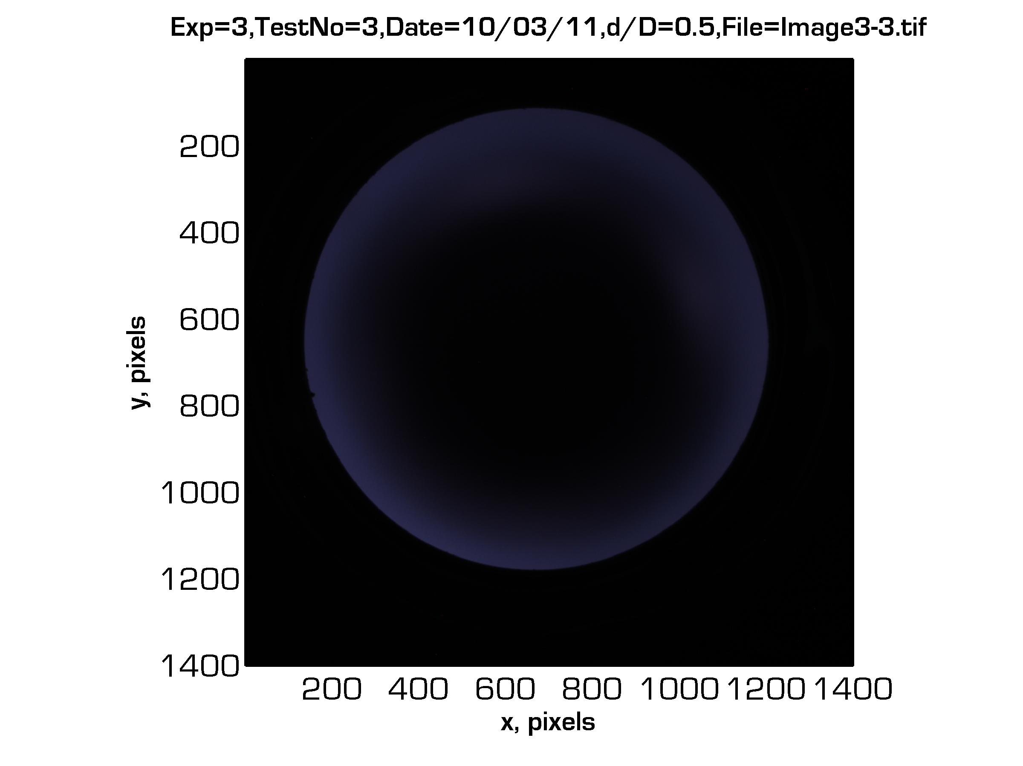
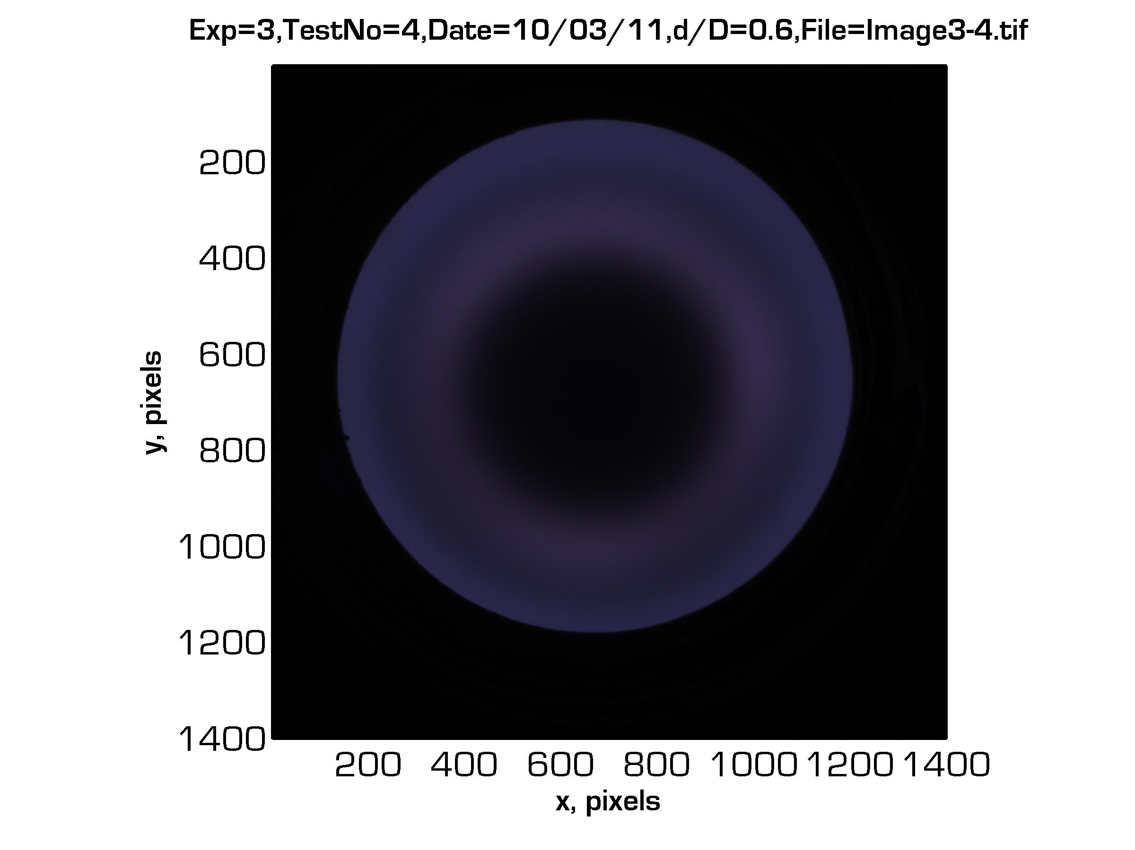
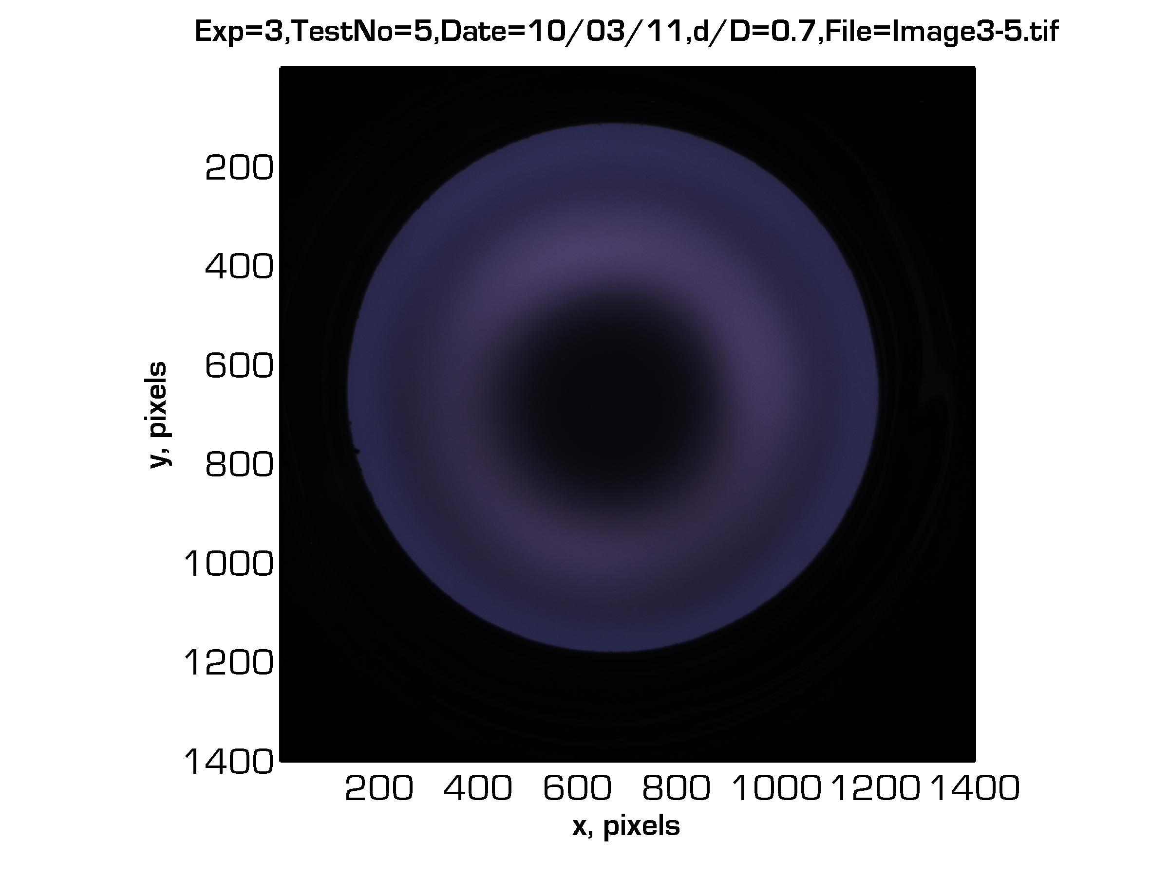
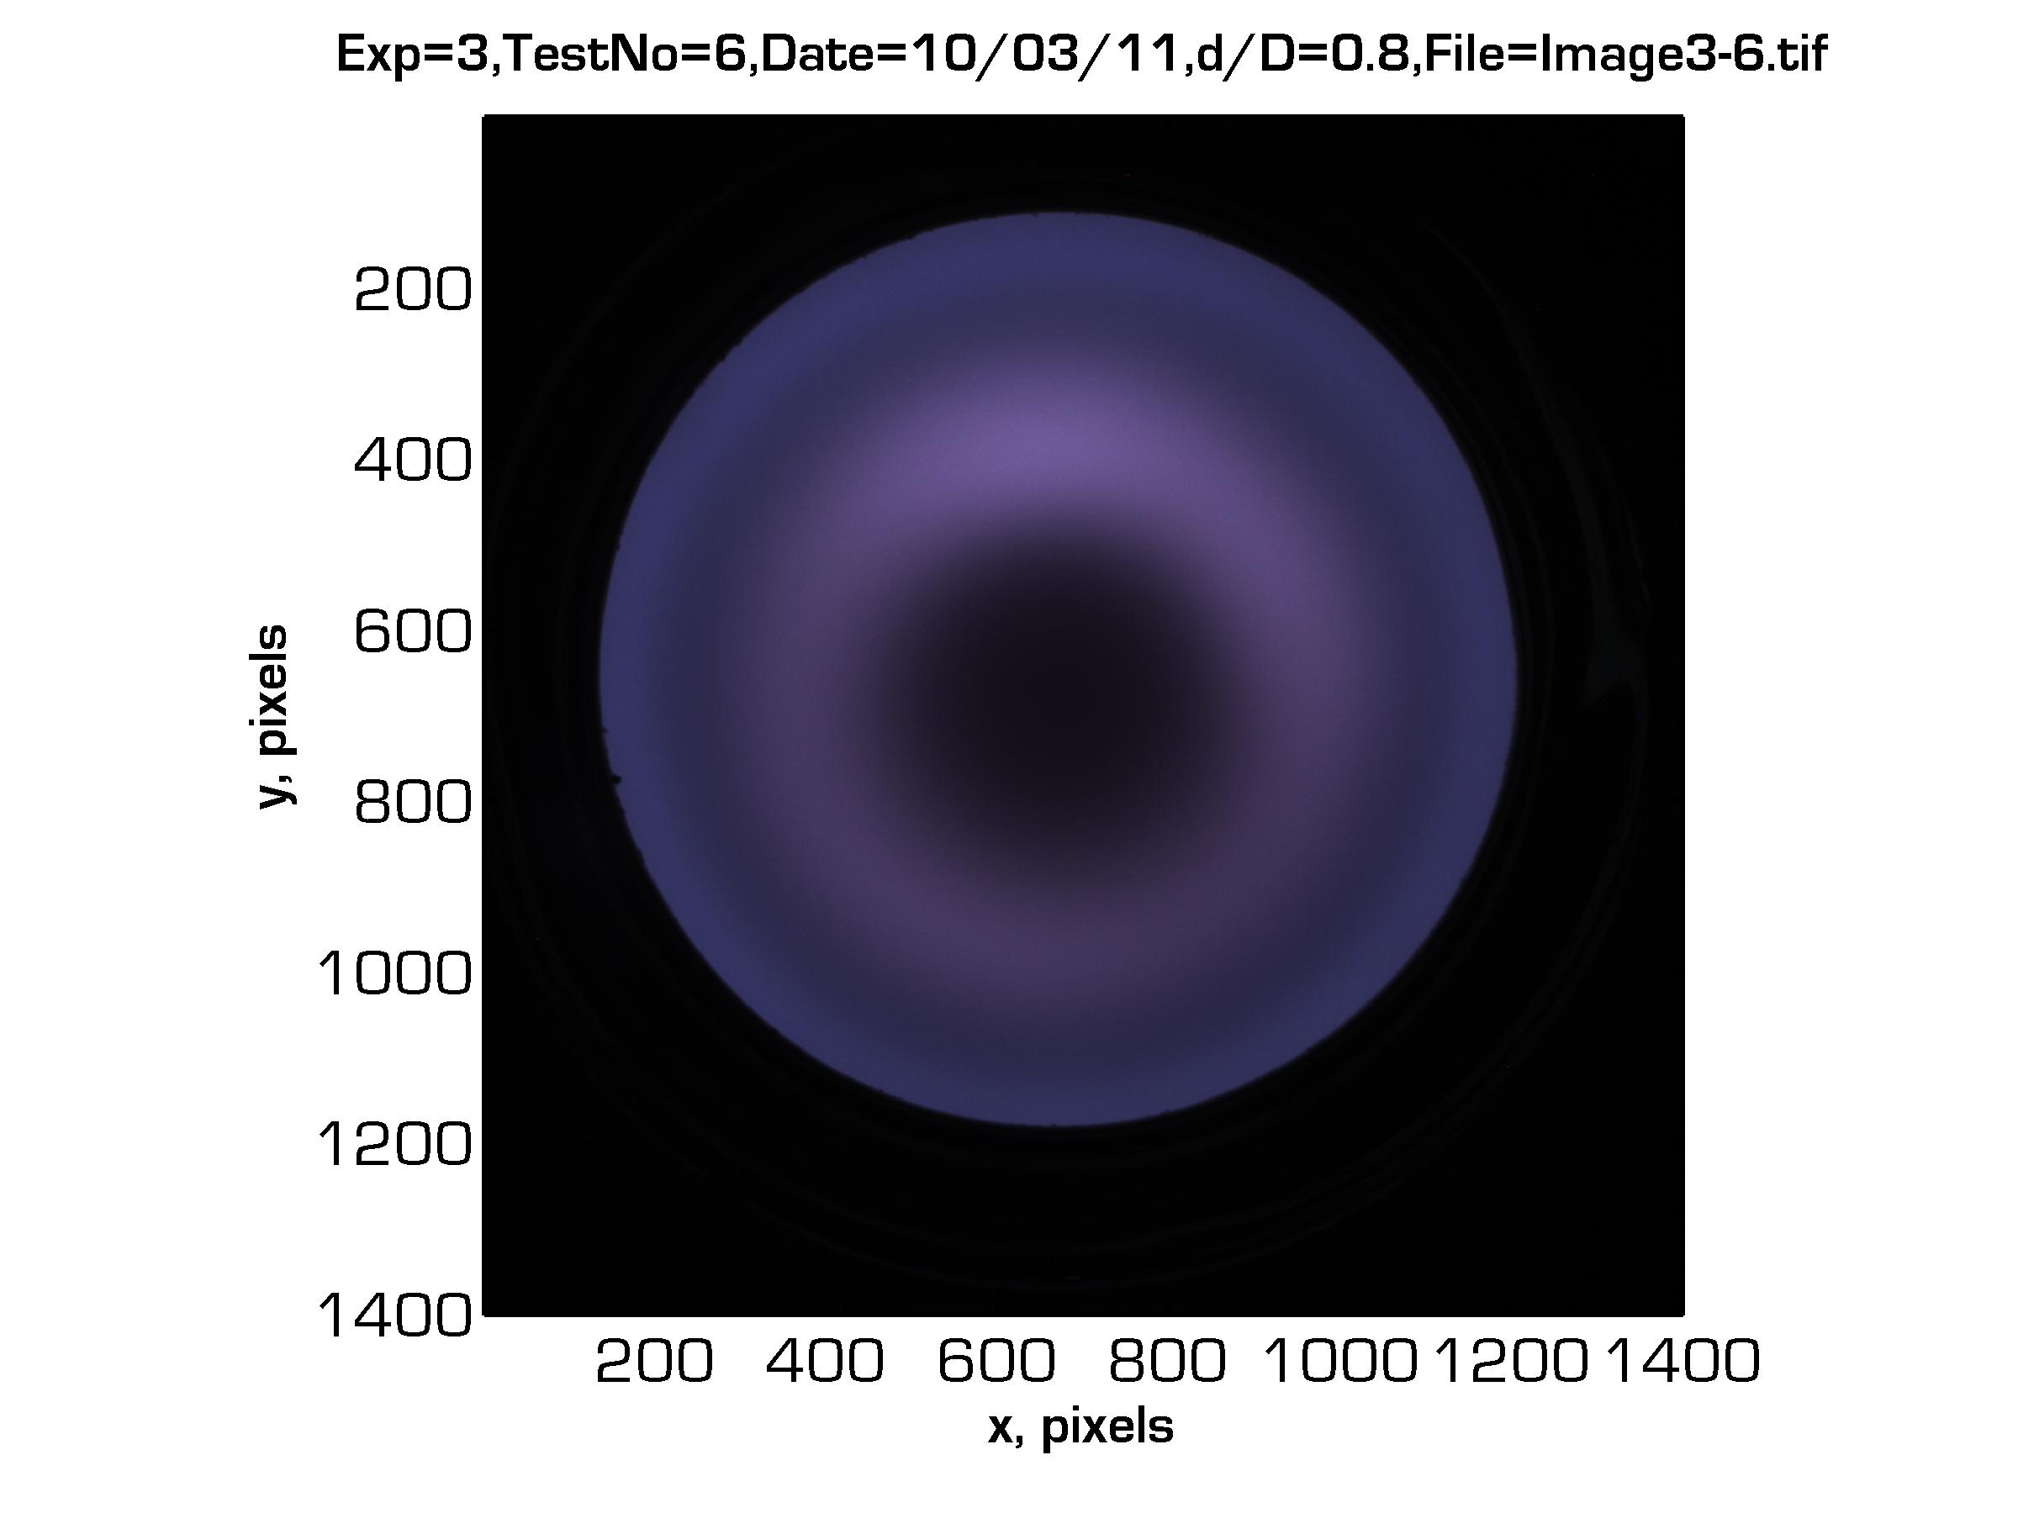
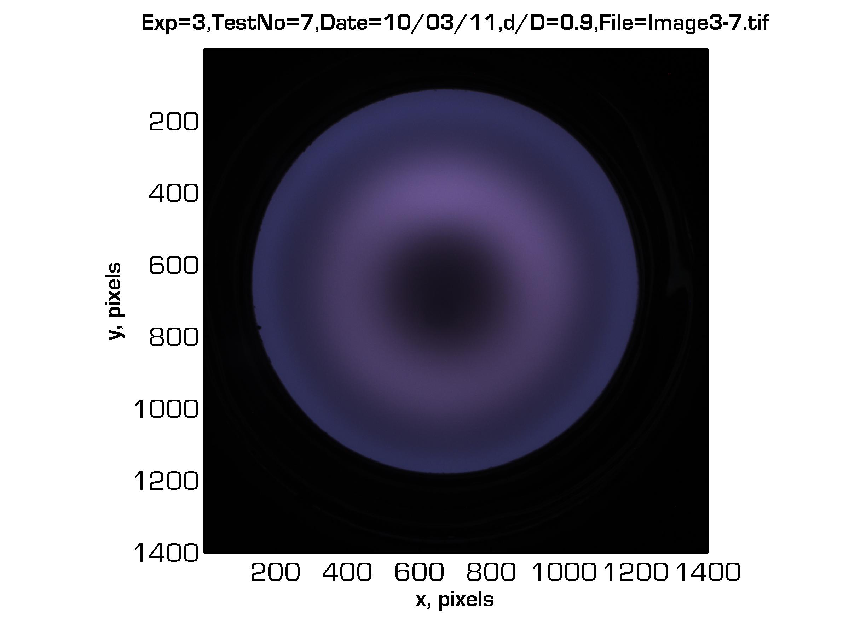
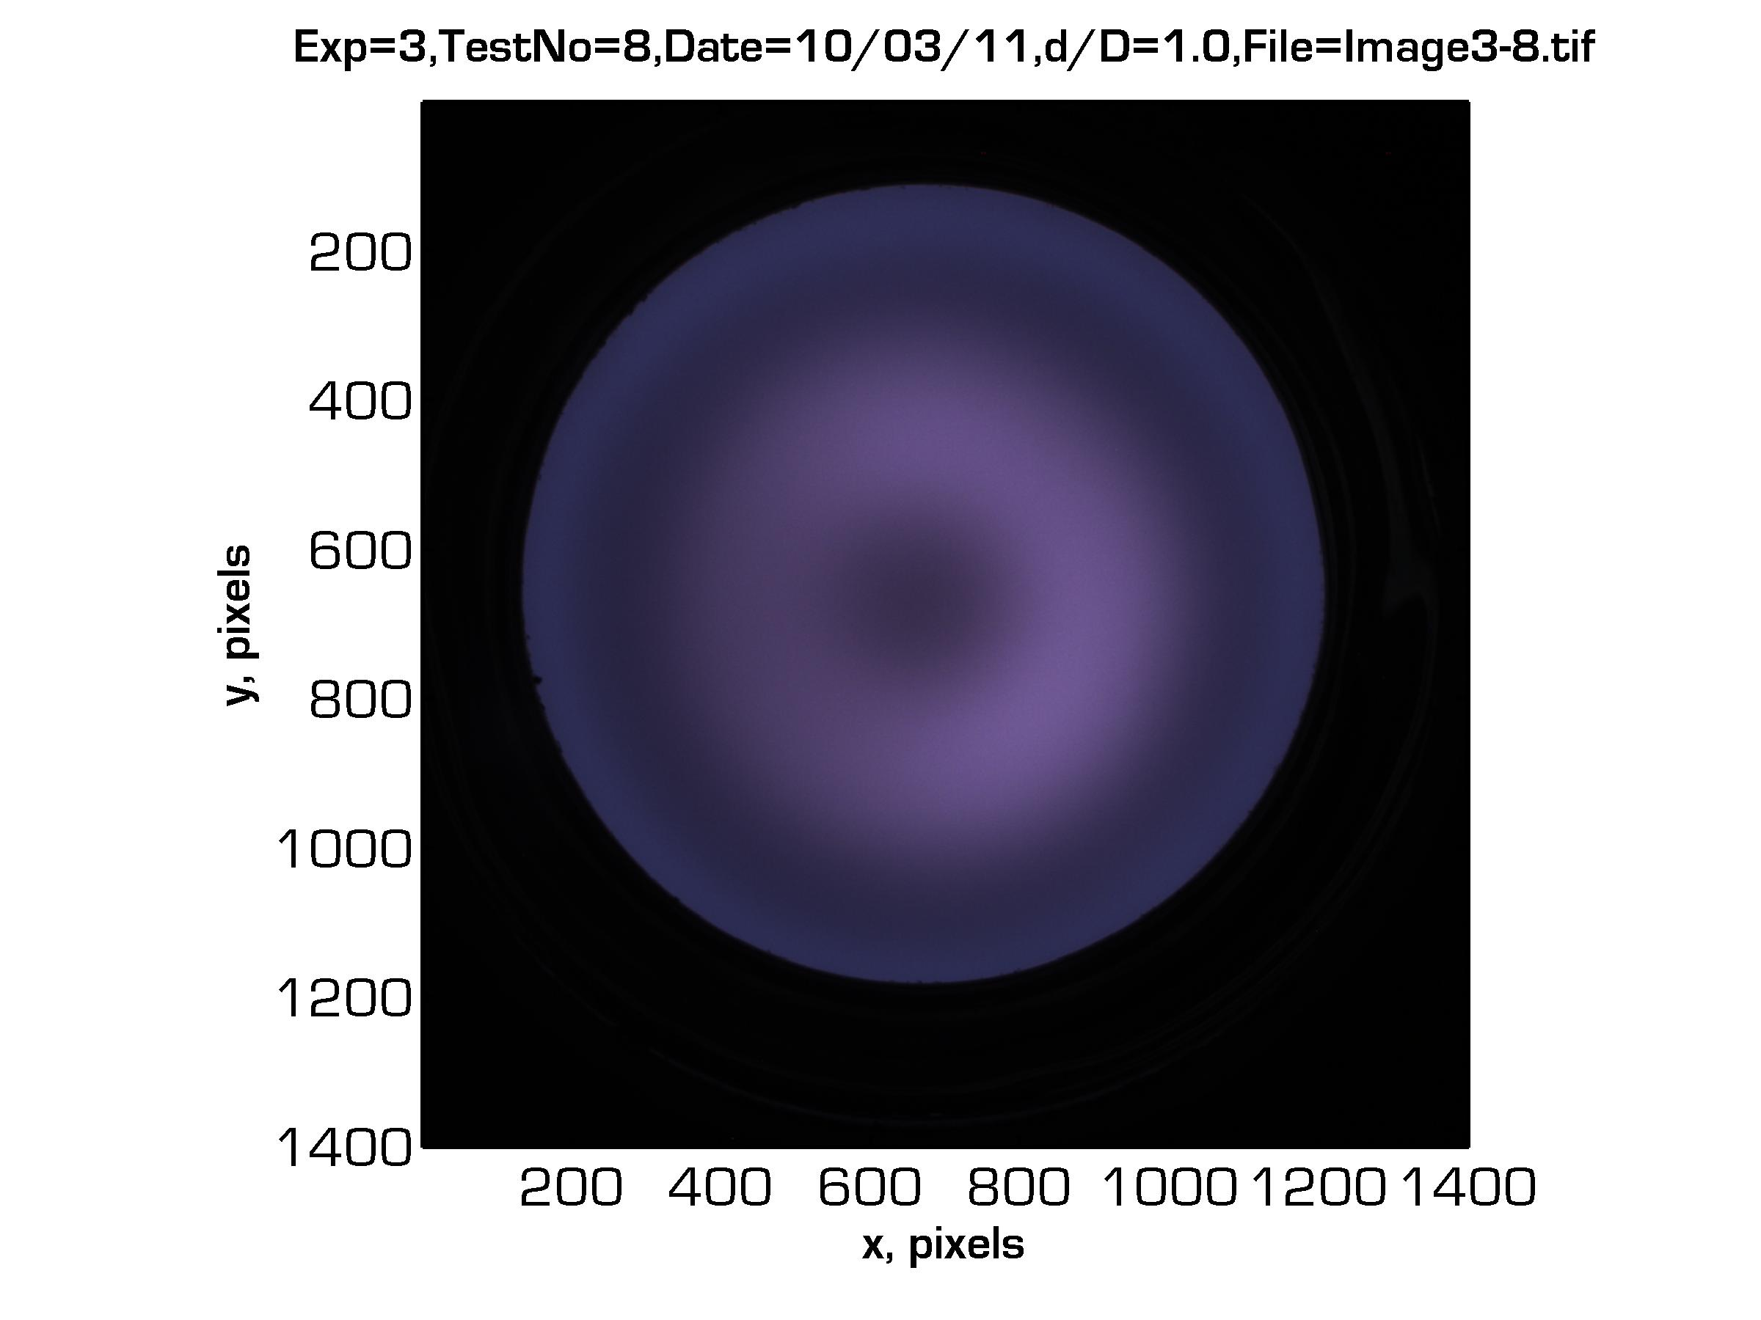
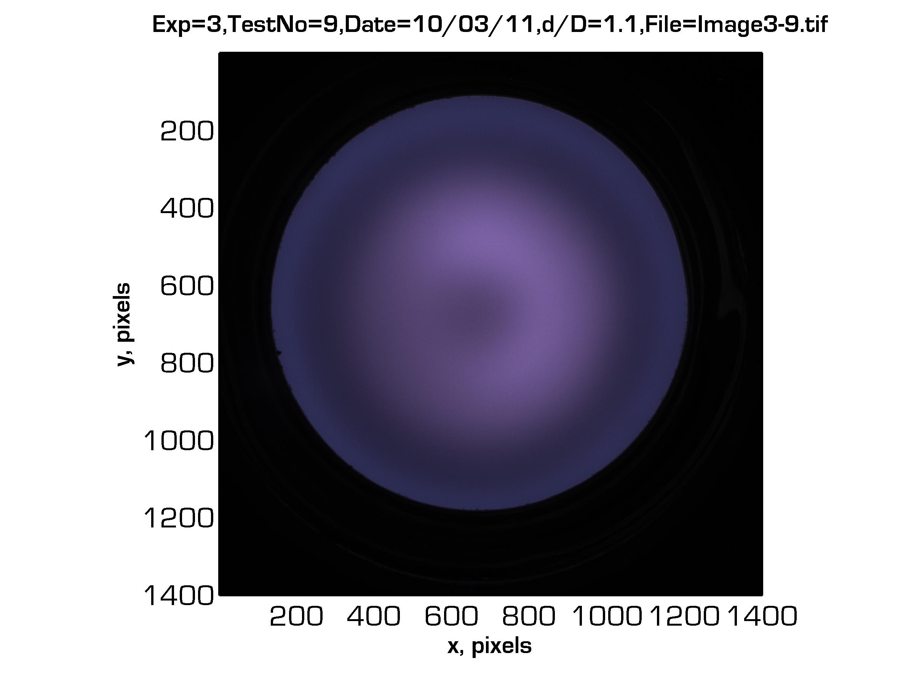
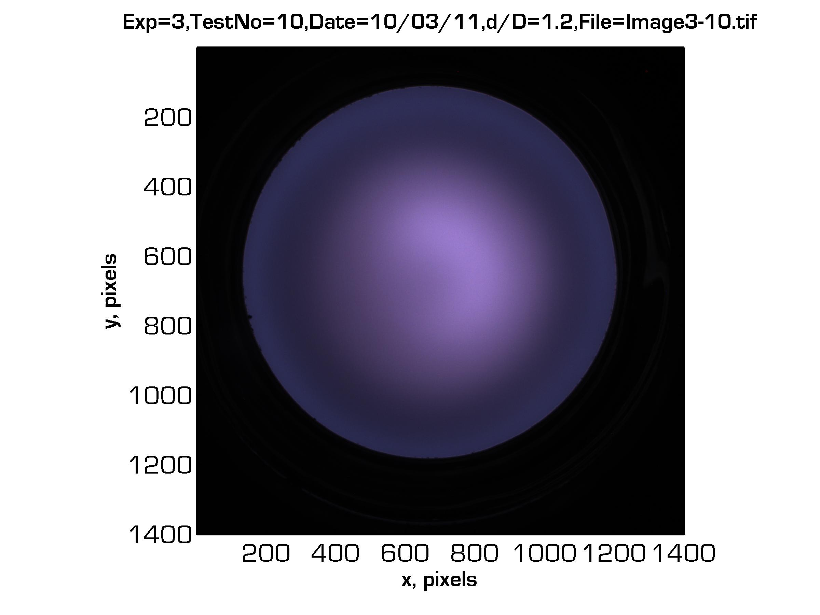
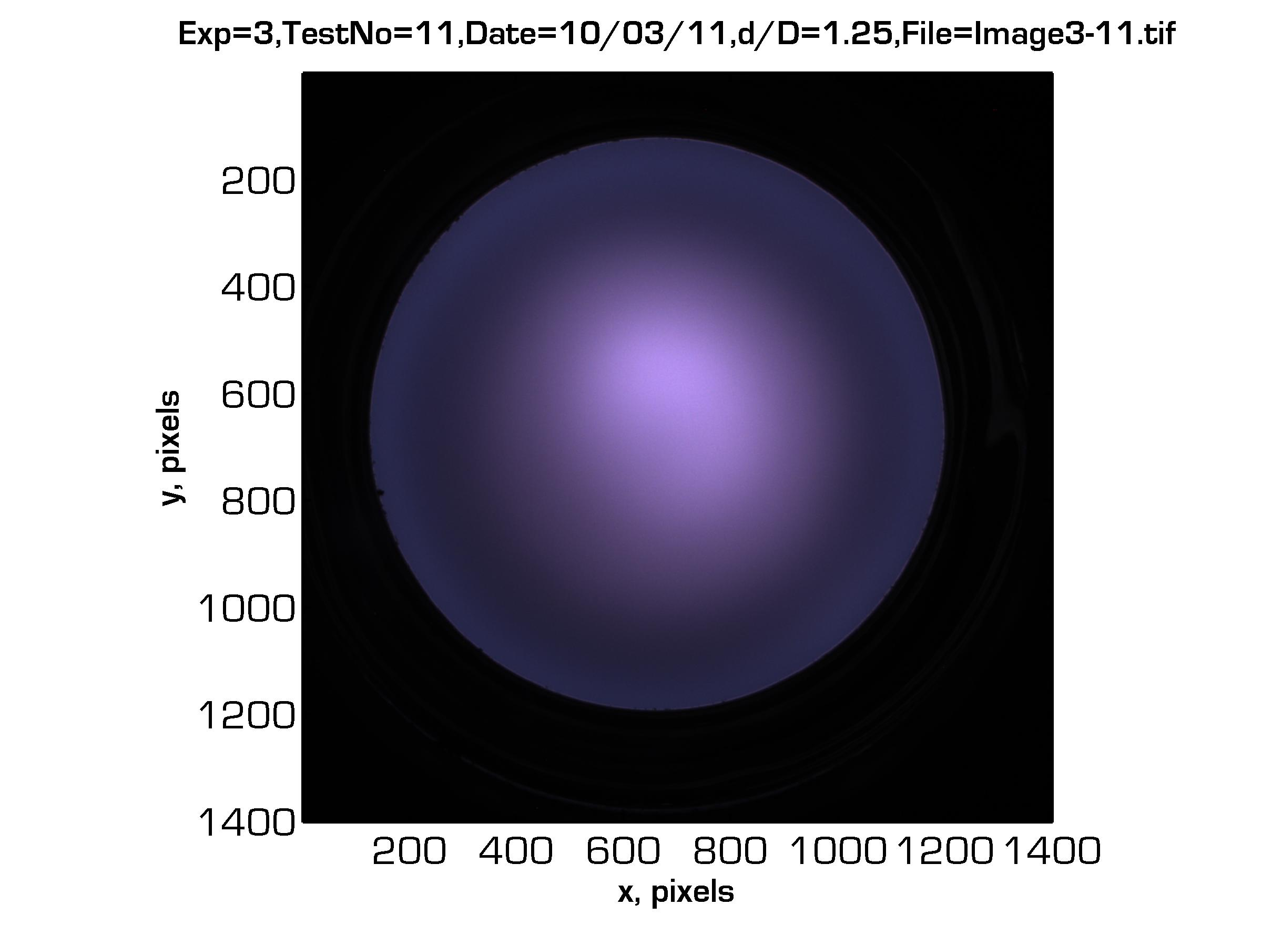
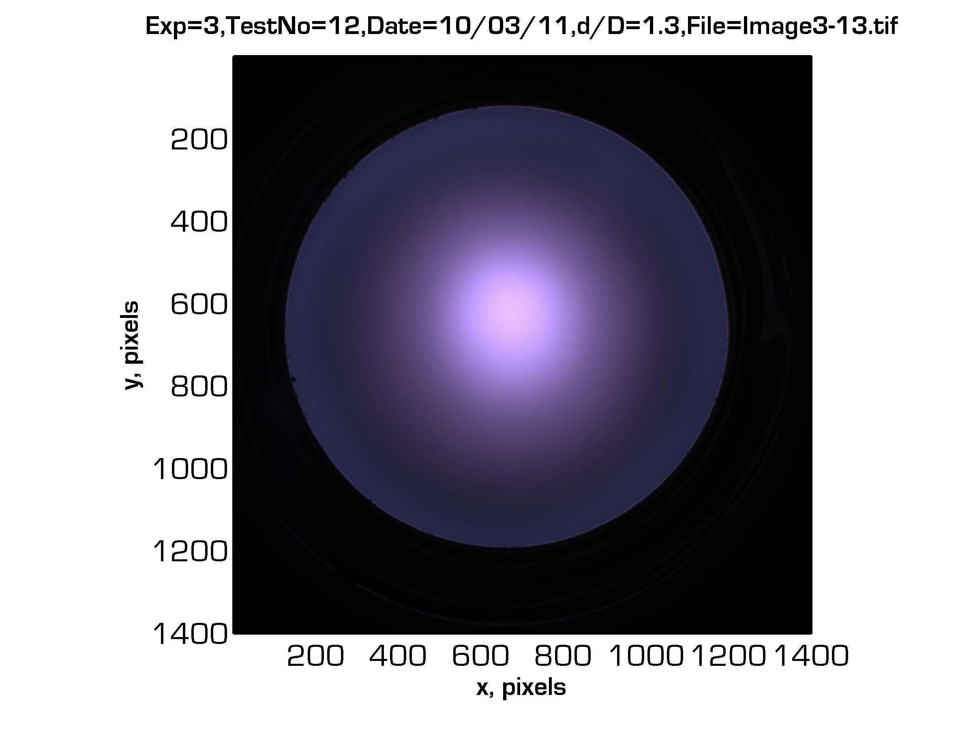
PAO Scaling: Experiment Images
Plasma Luminescence
d/D = 0.3
0.4
0.5
0.6
0.7
0.8
0.9
1.0
1.1
1.2
1.25
1.4

Slide 31
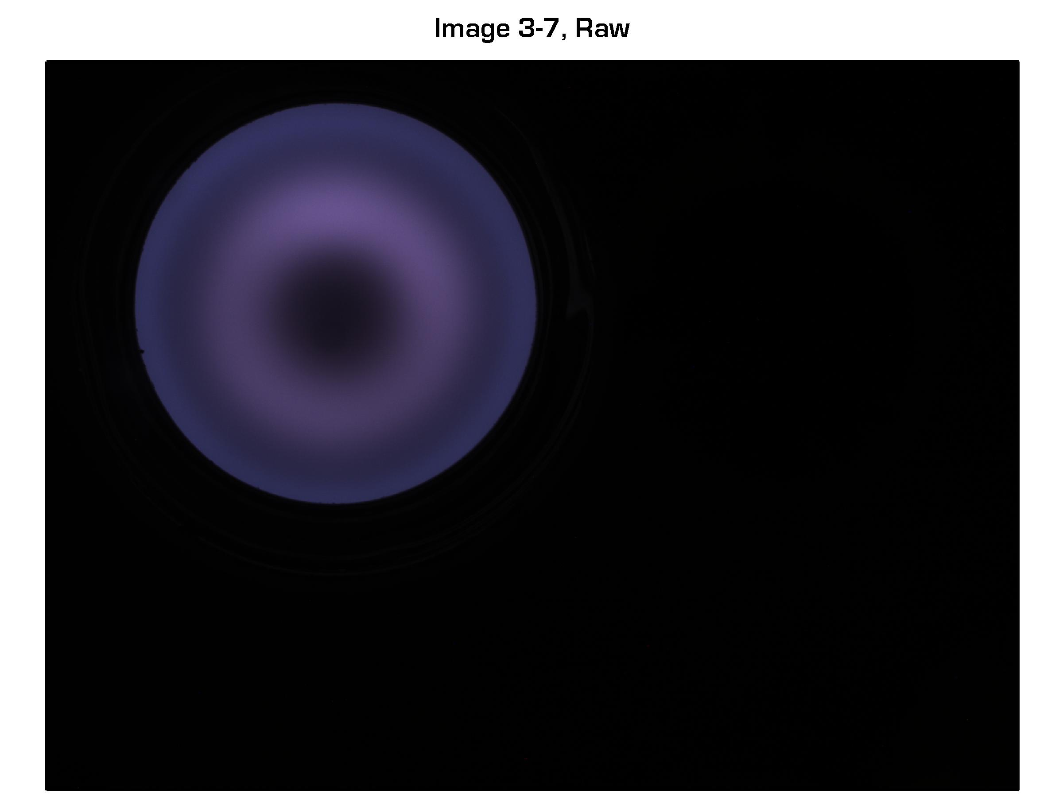
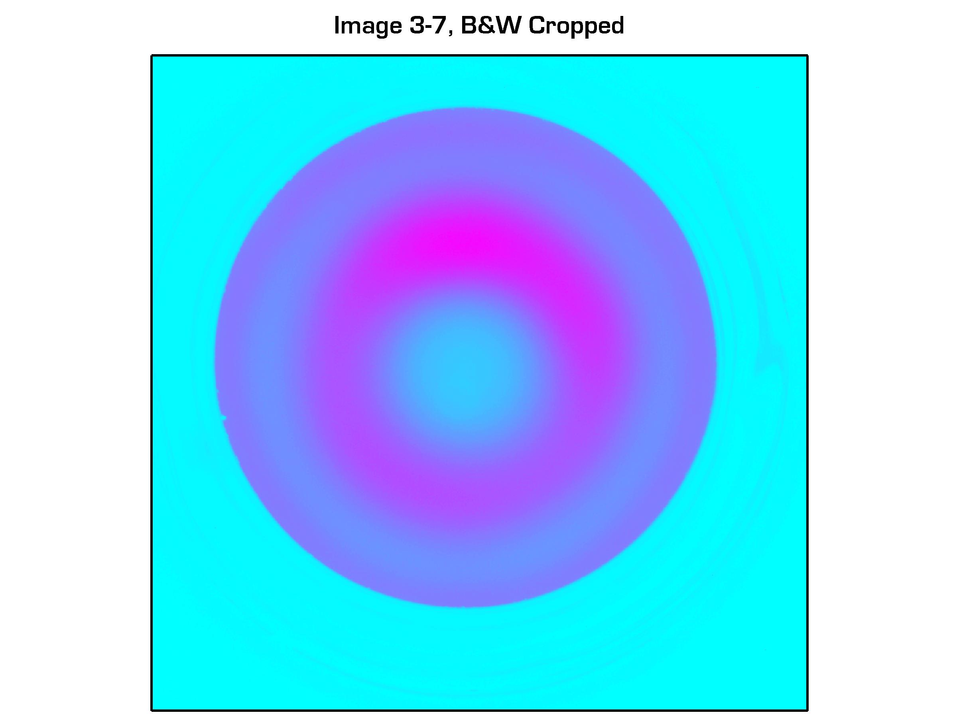
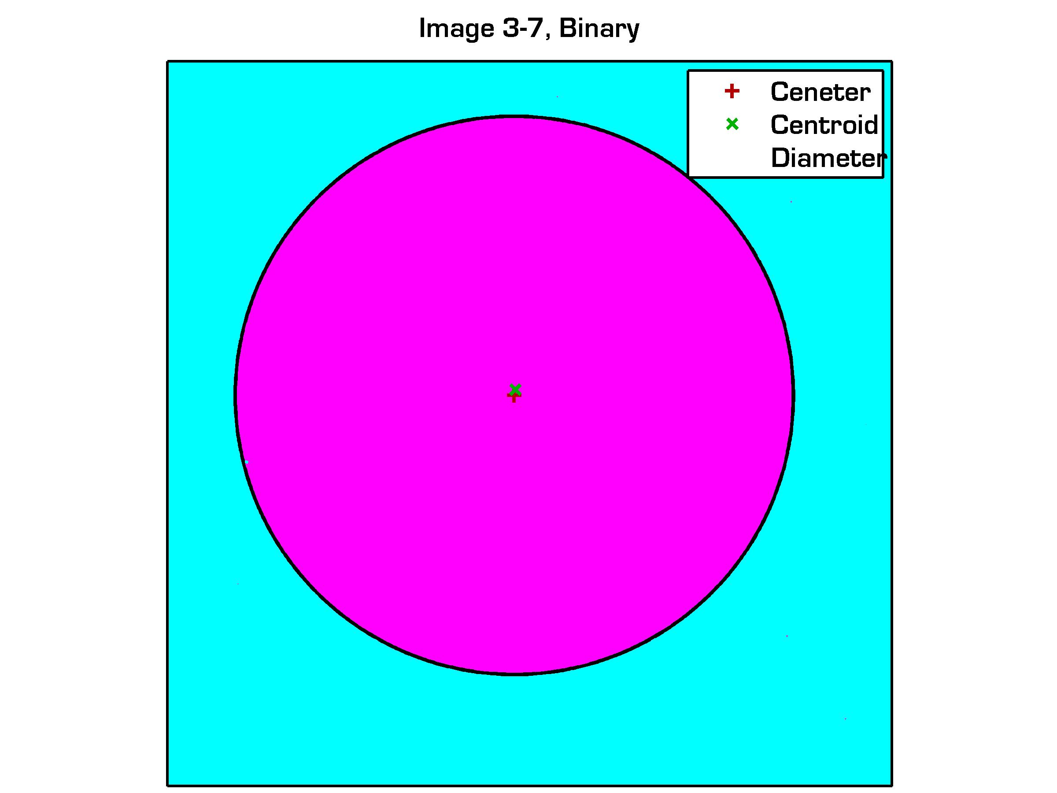
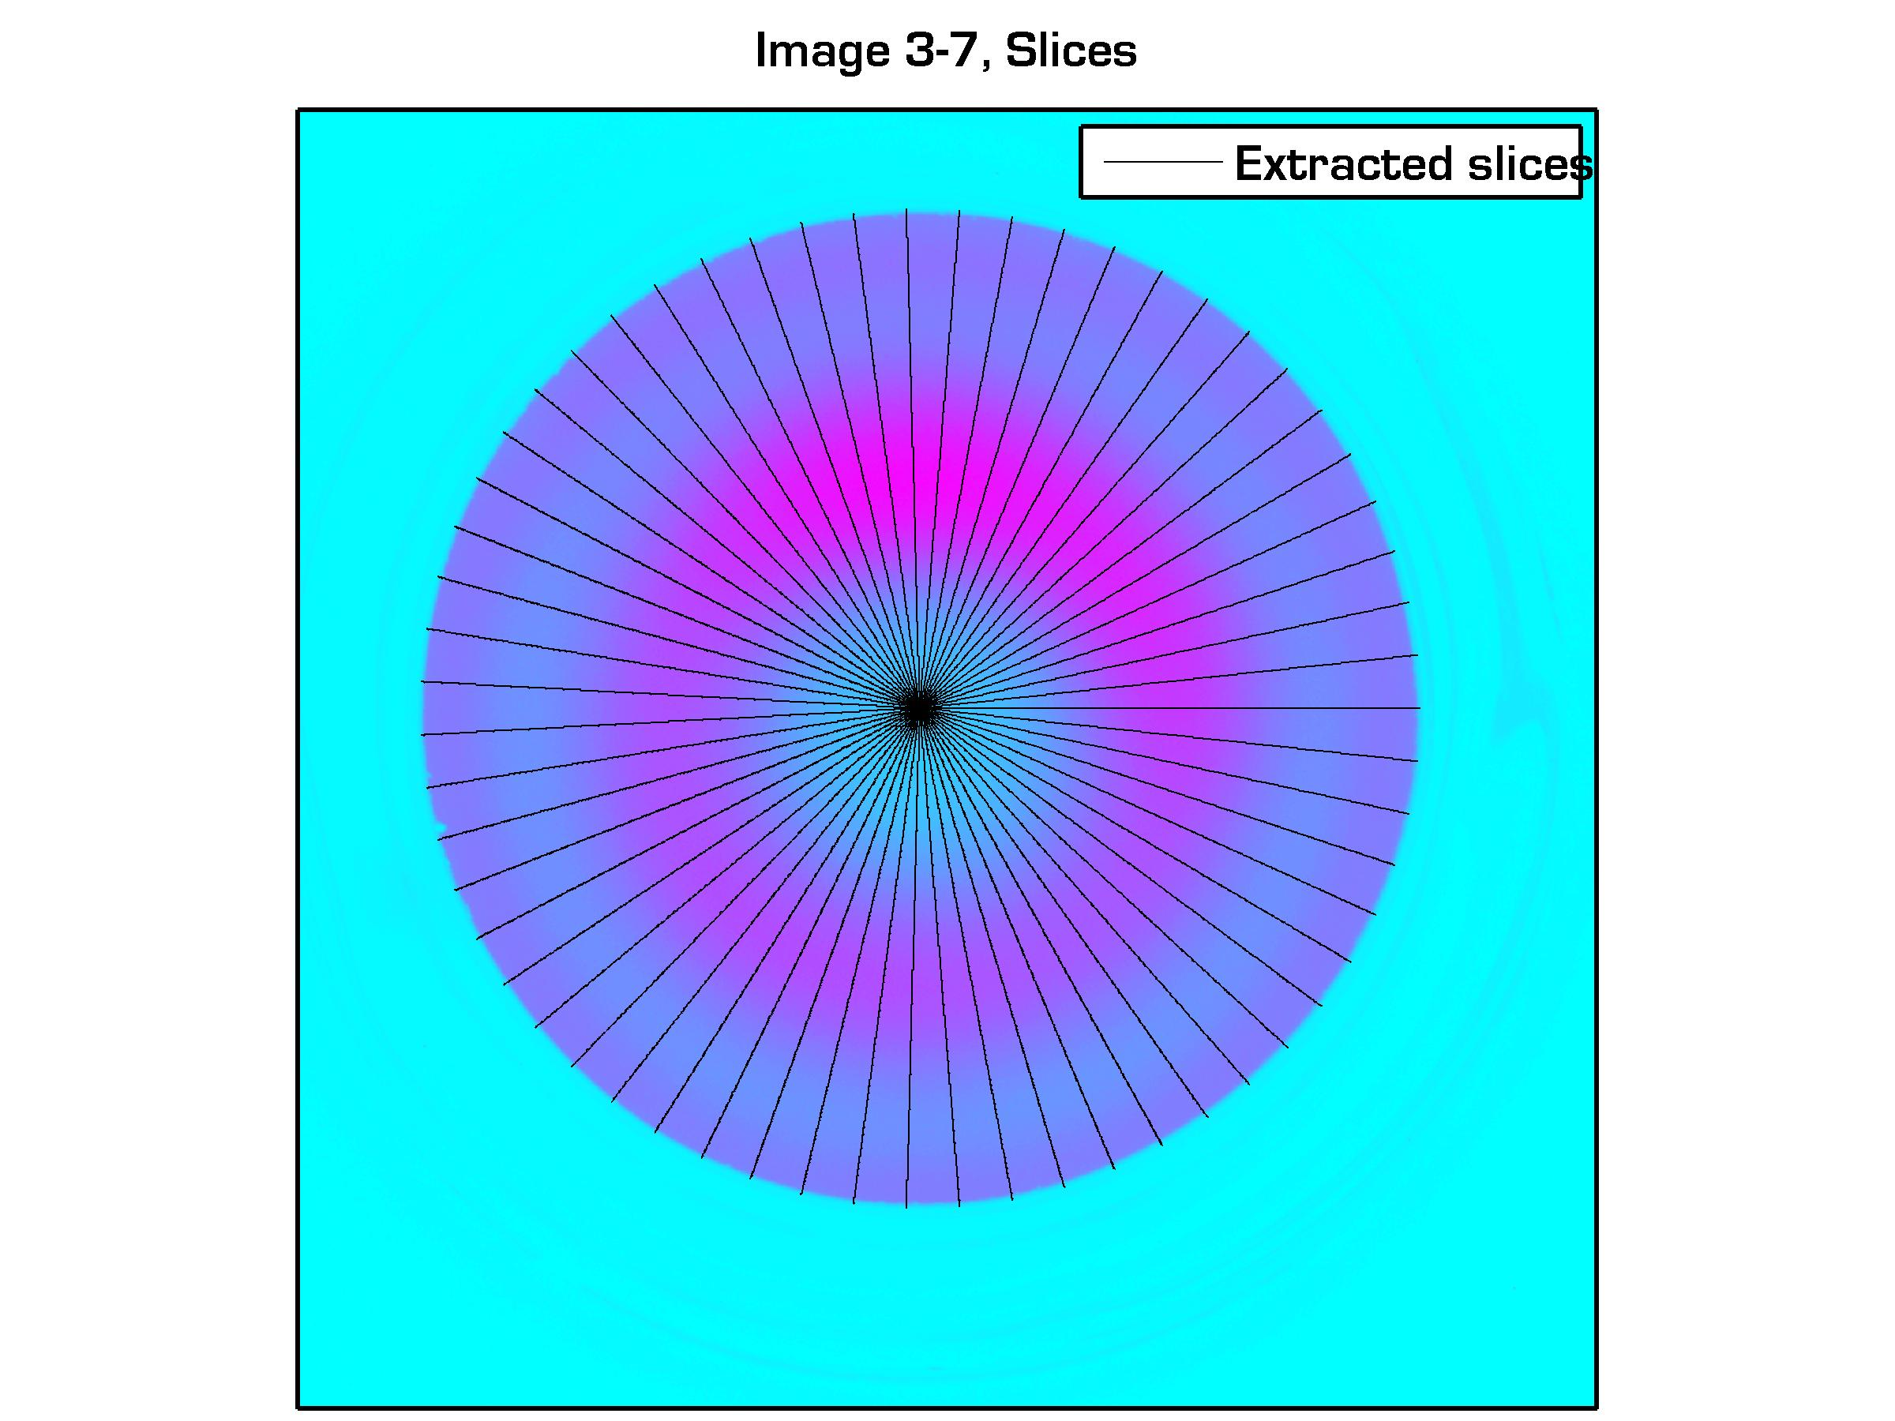
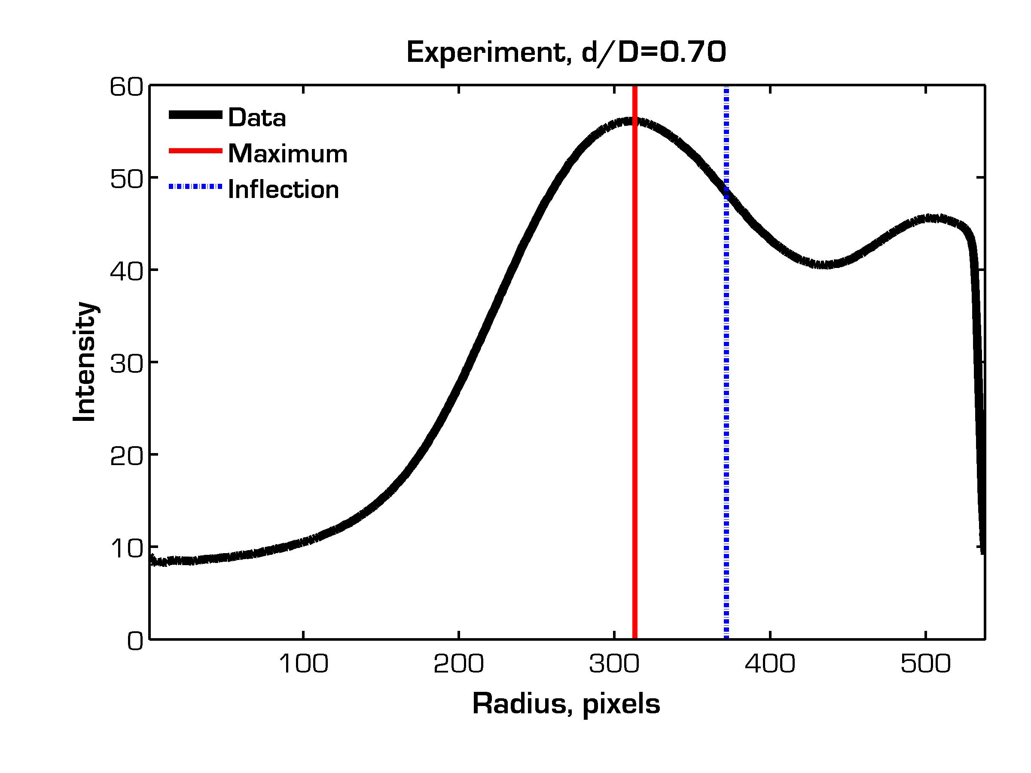
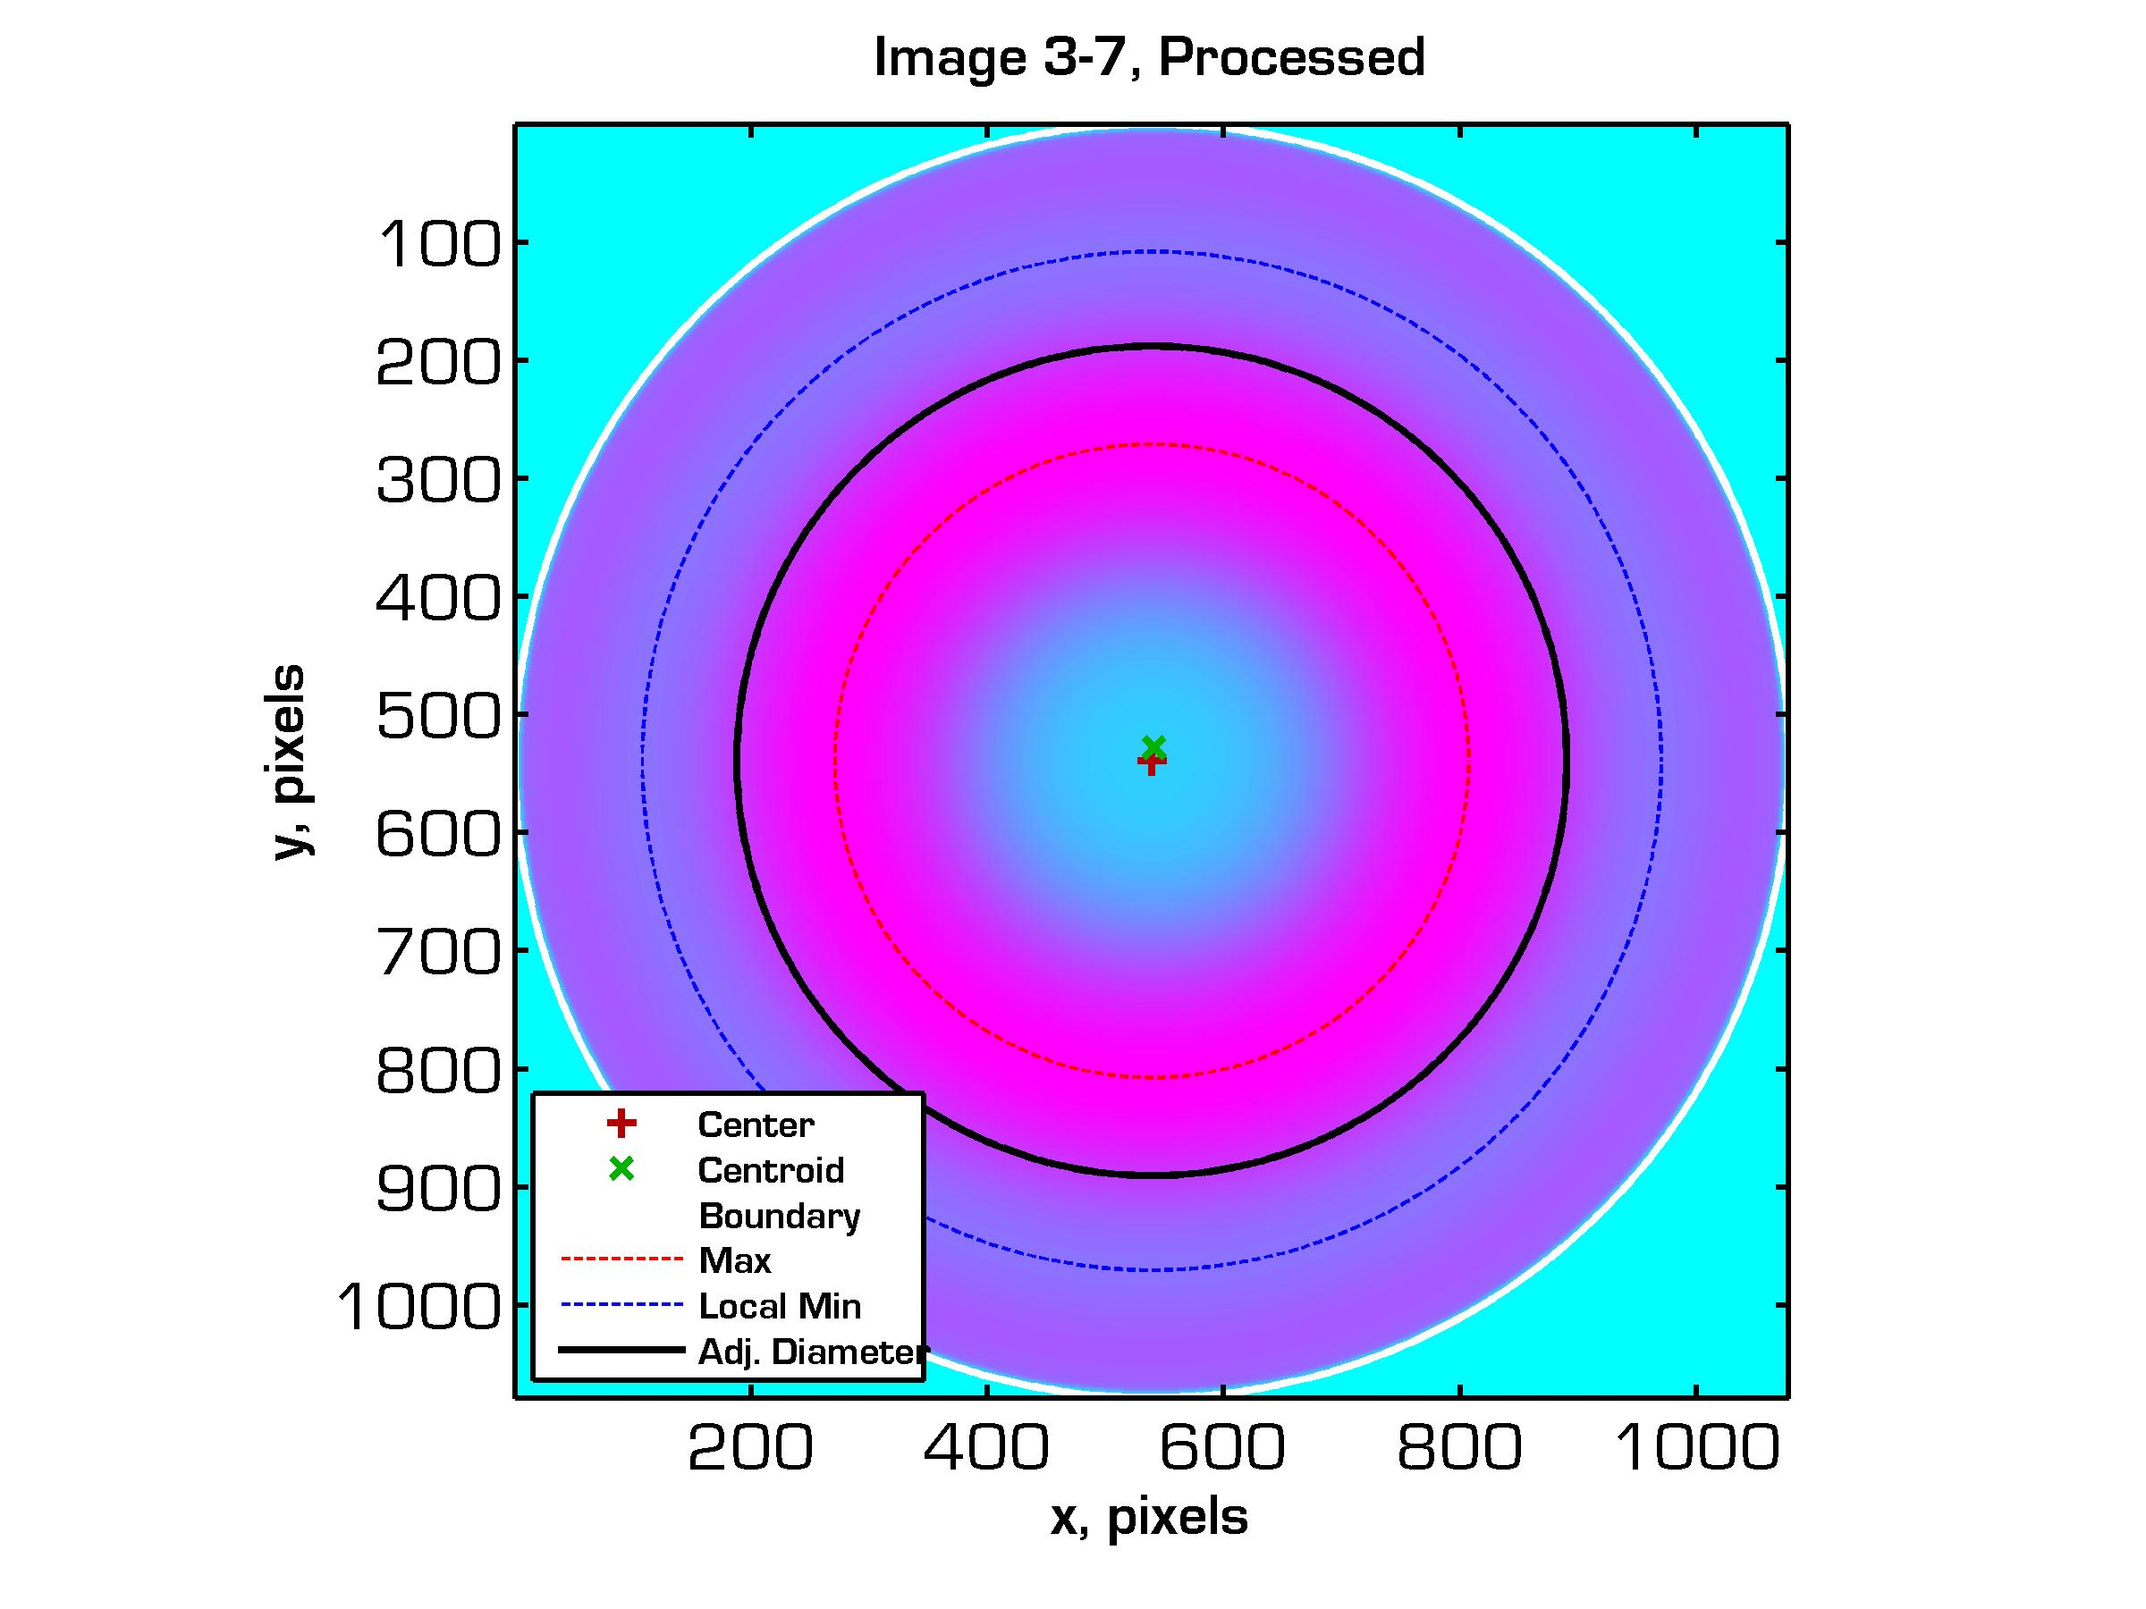
PAO Scaling: Image Processing
(1) Load raw tiff image.
(2) Crop and remove color
channels.
(3) Threshold image. Detect diameter and center.
(4) Extract 360° radial slices
(5) Average slices, calculate
max, min, inflection locations
(6) Form radially averaged
image

Slide 32
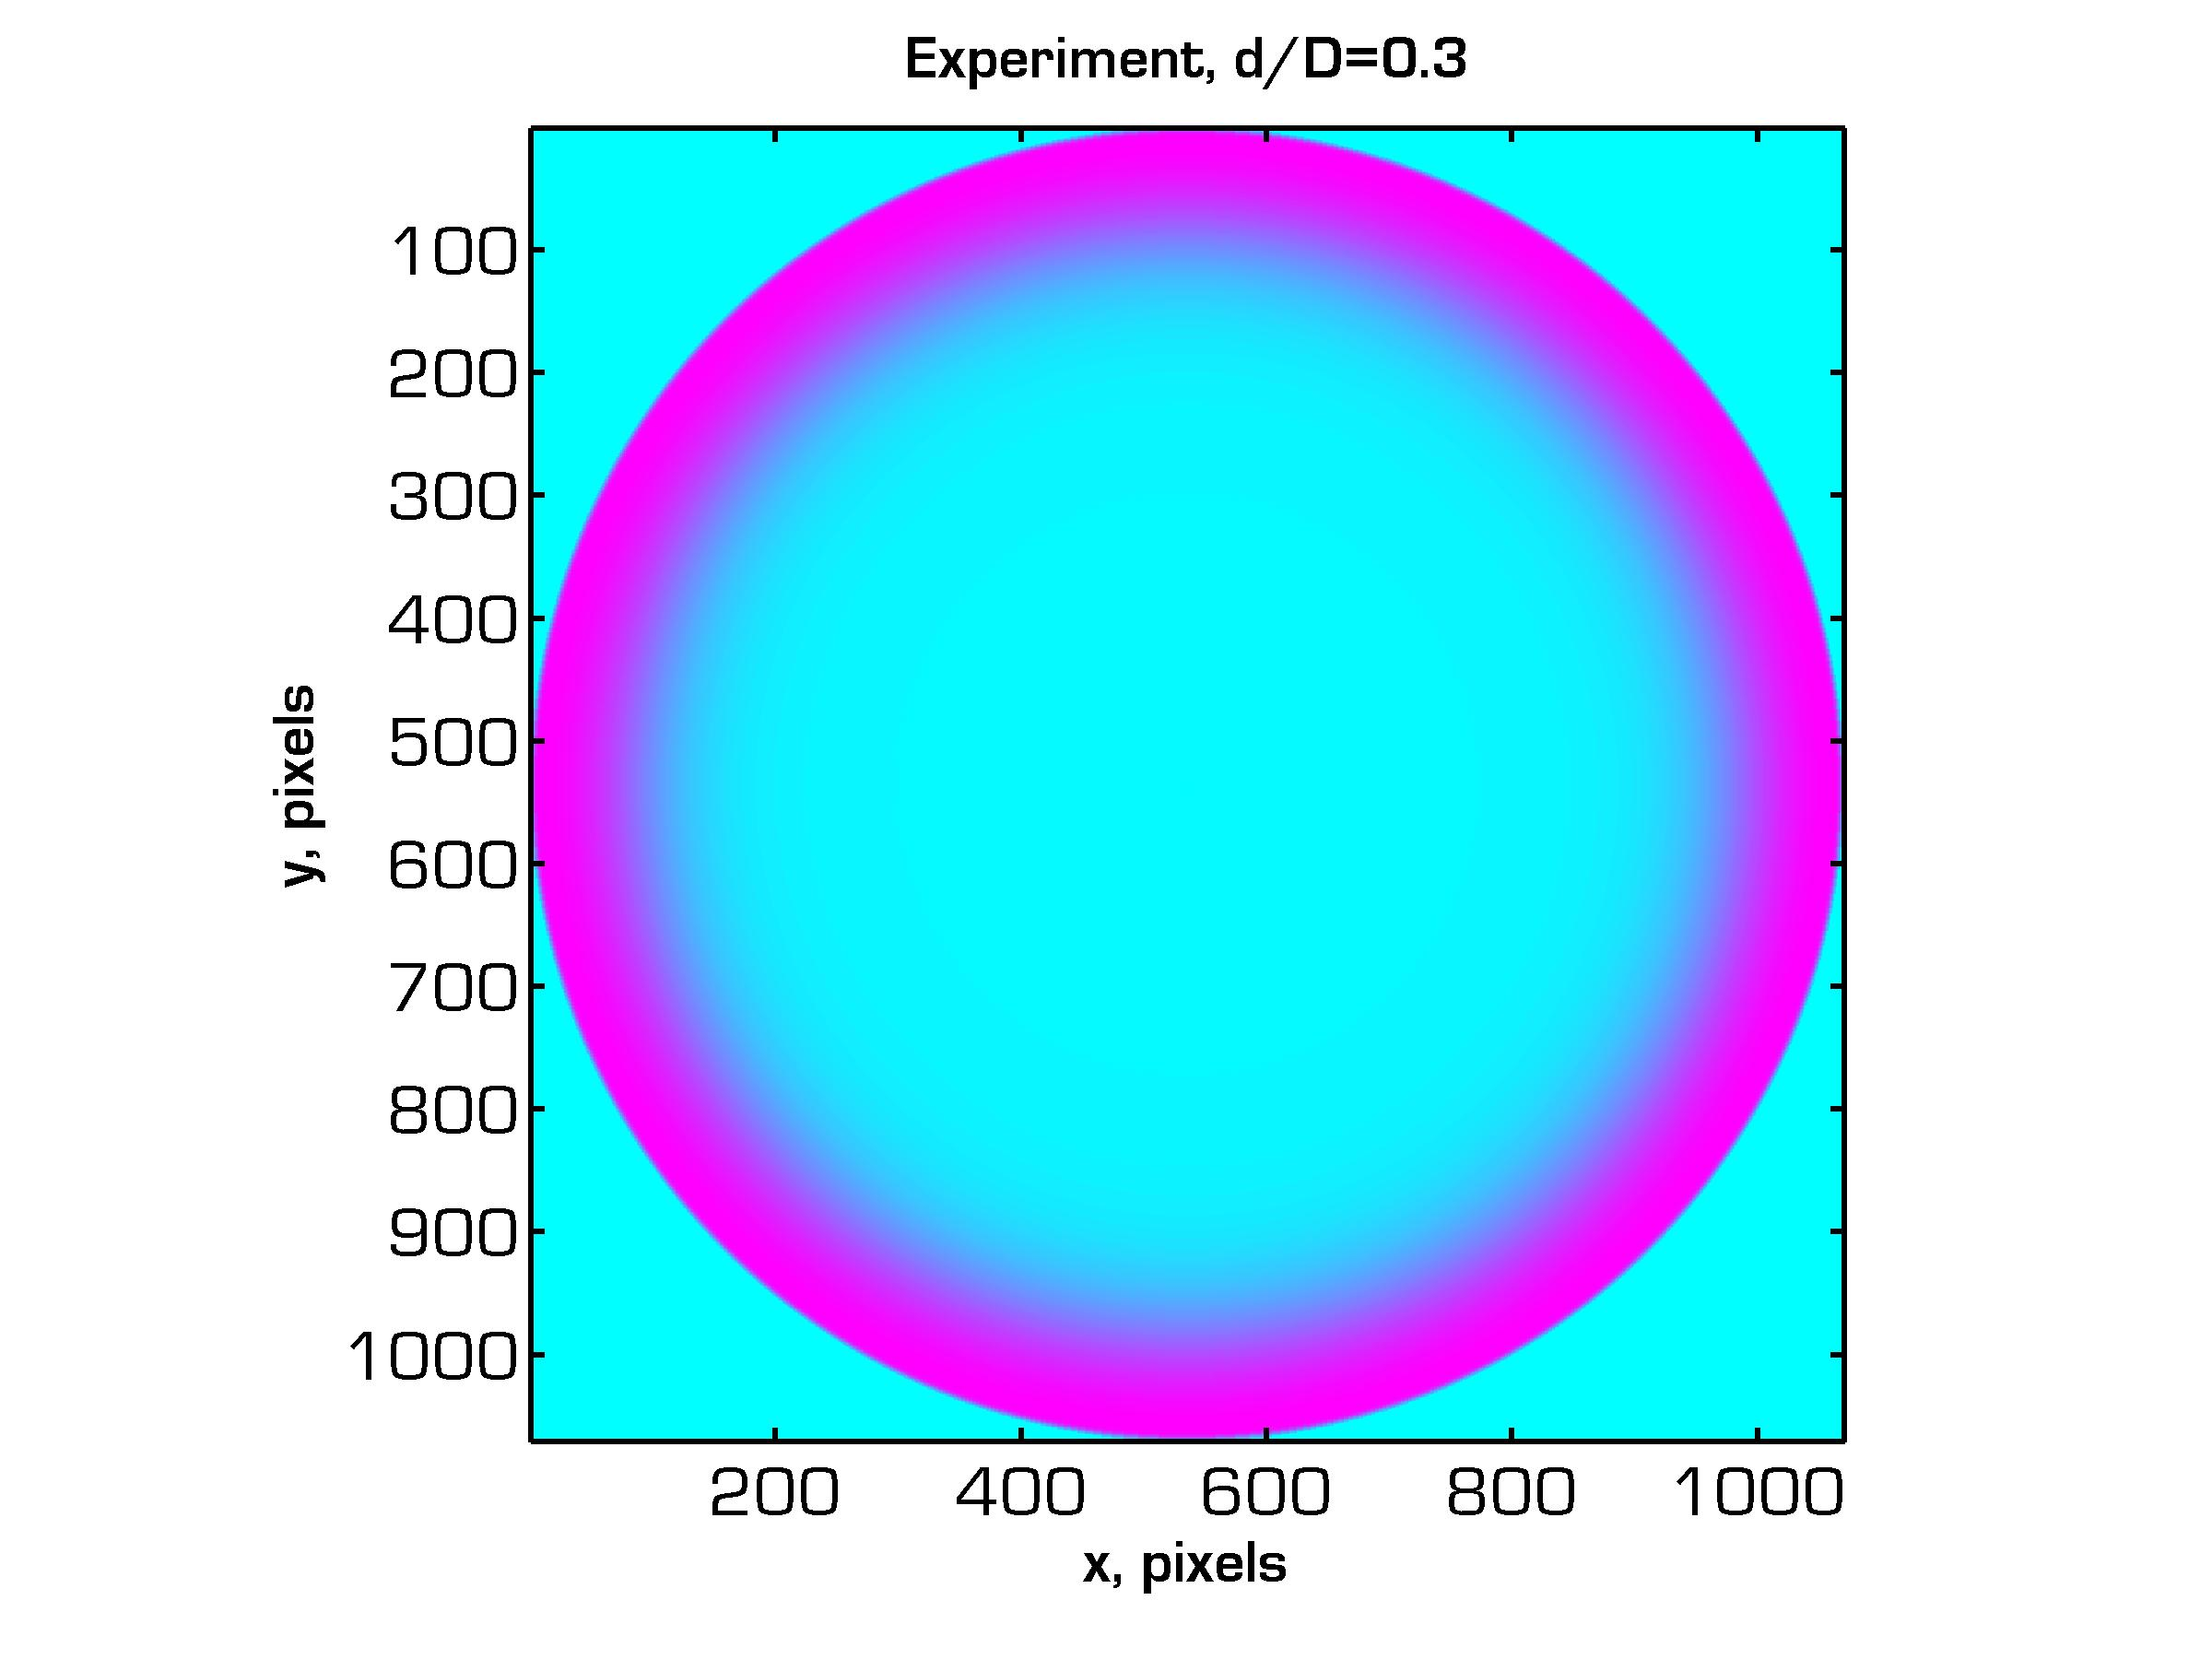
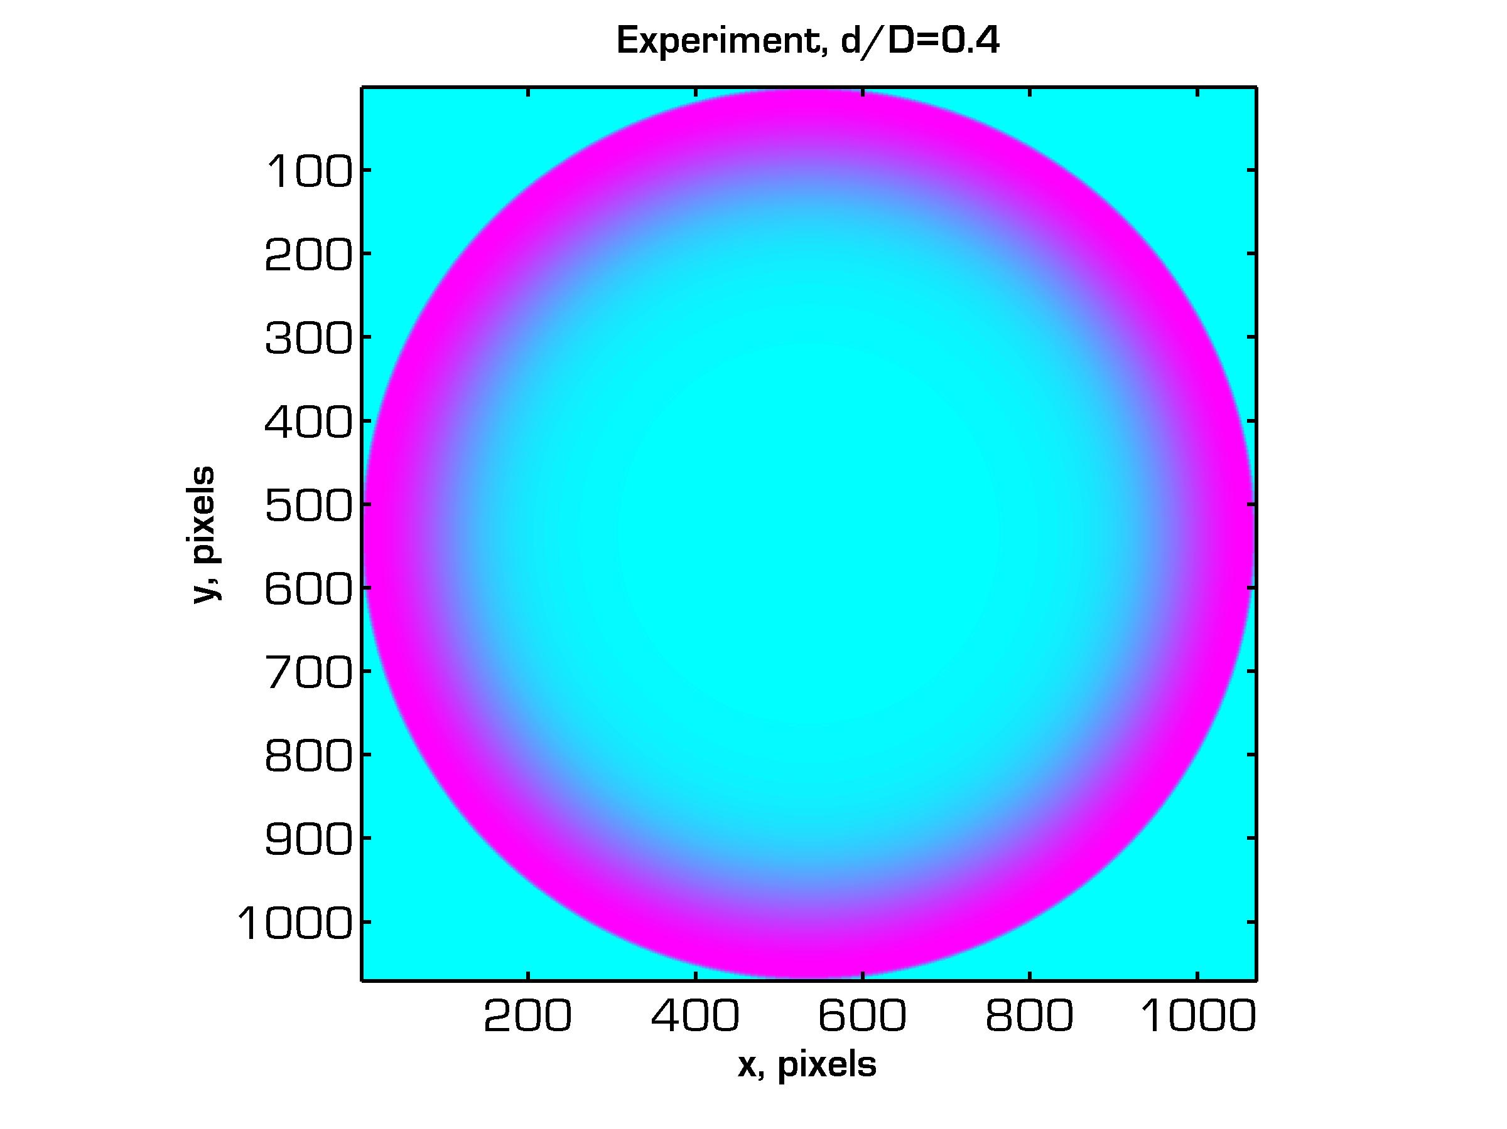
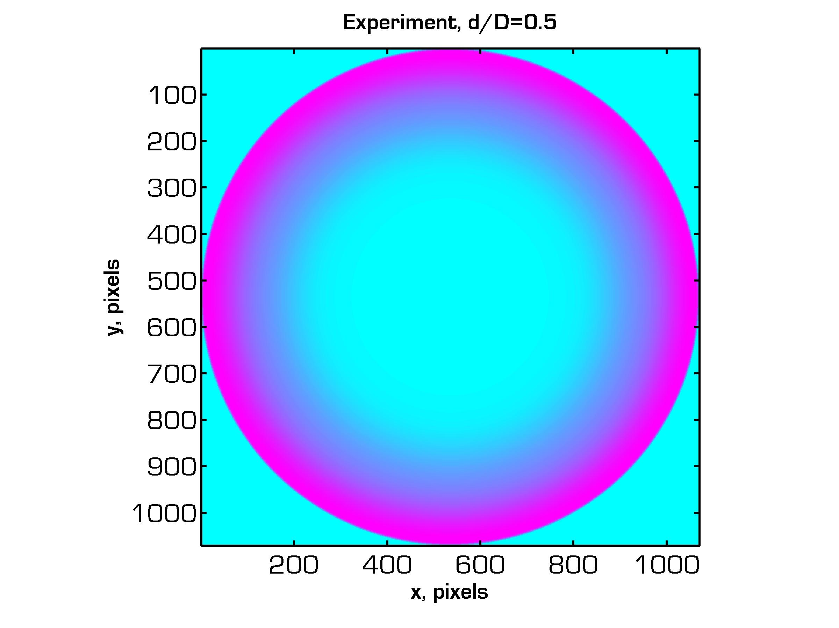
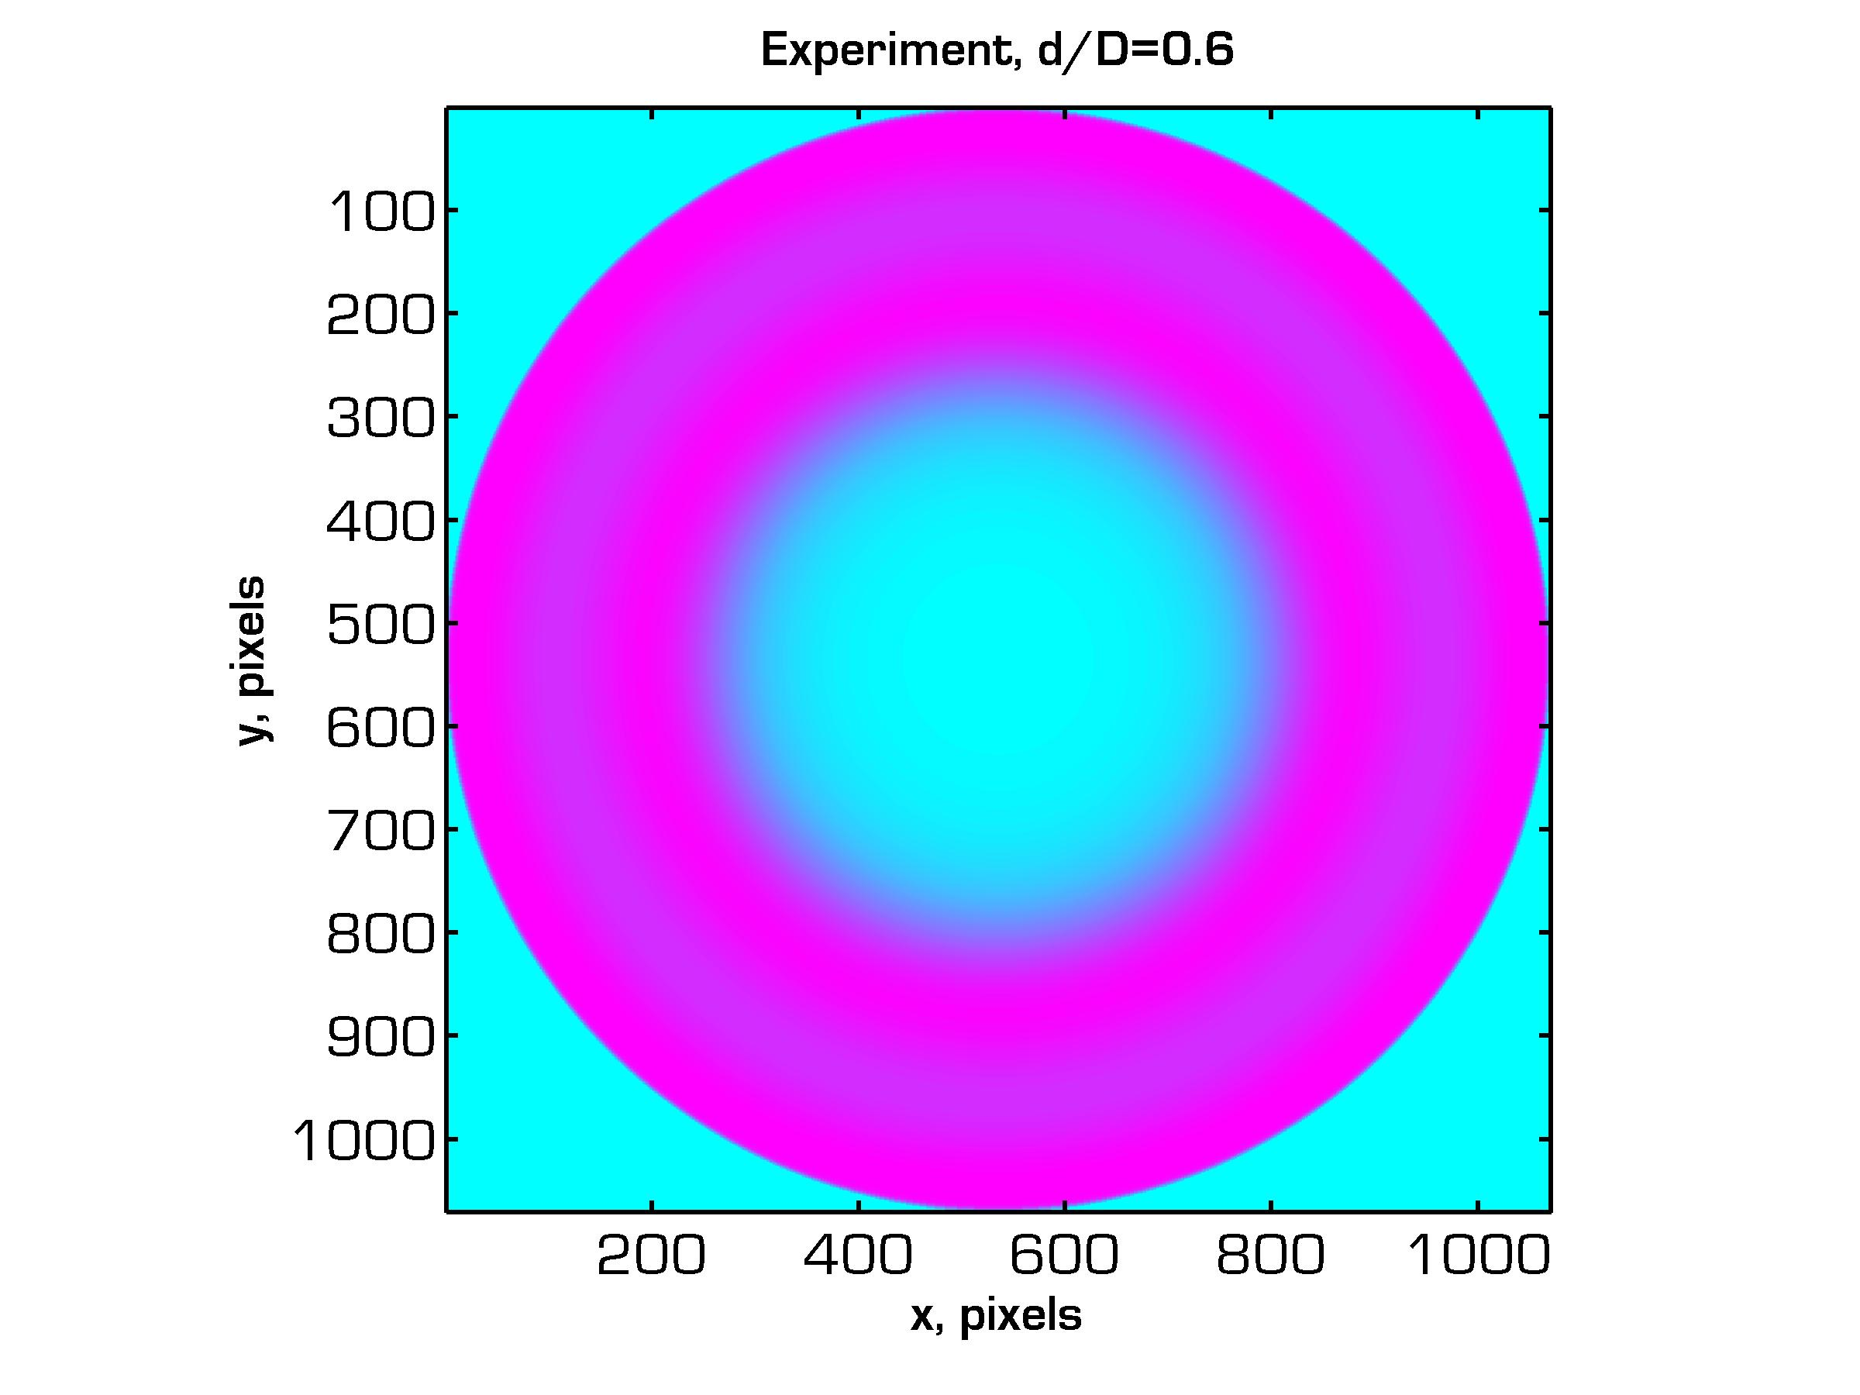
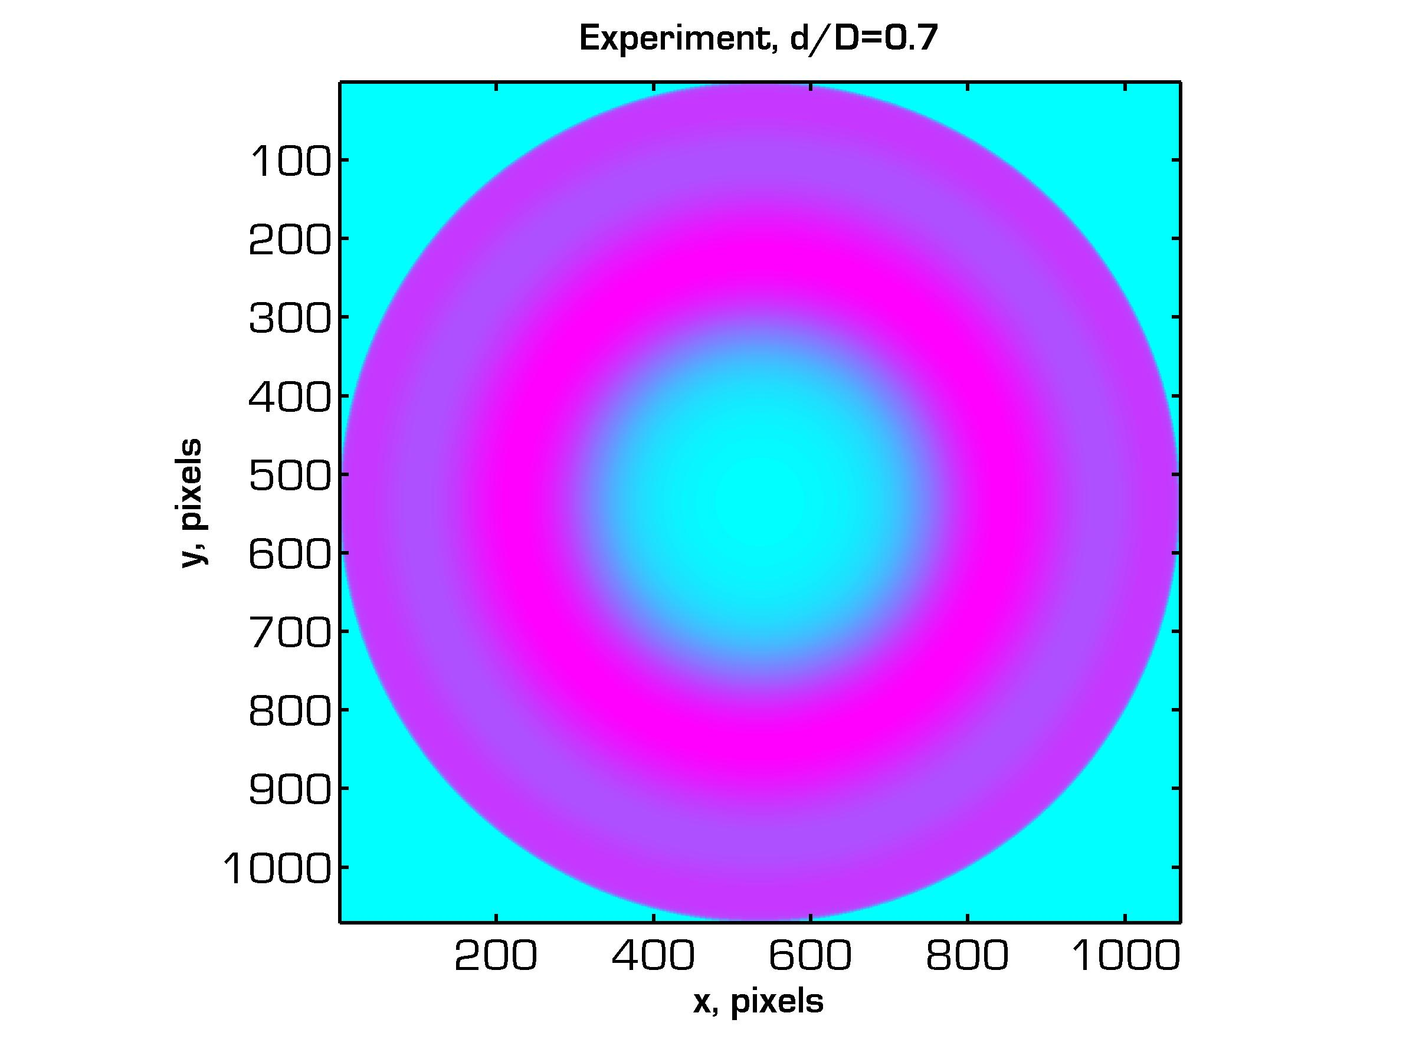
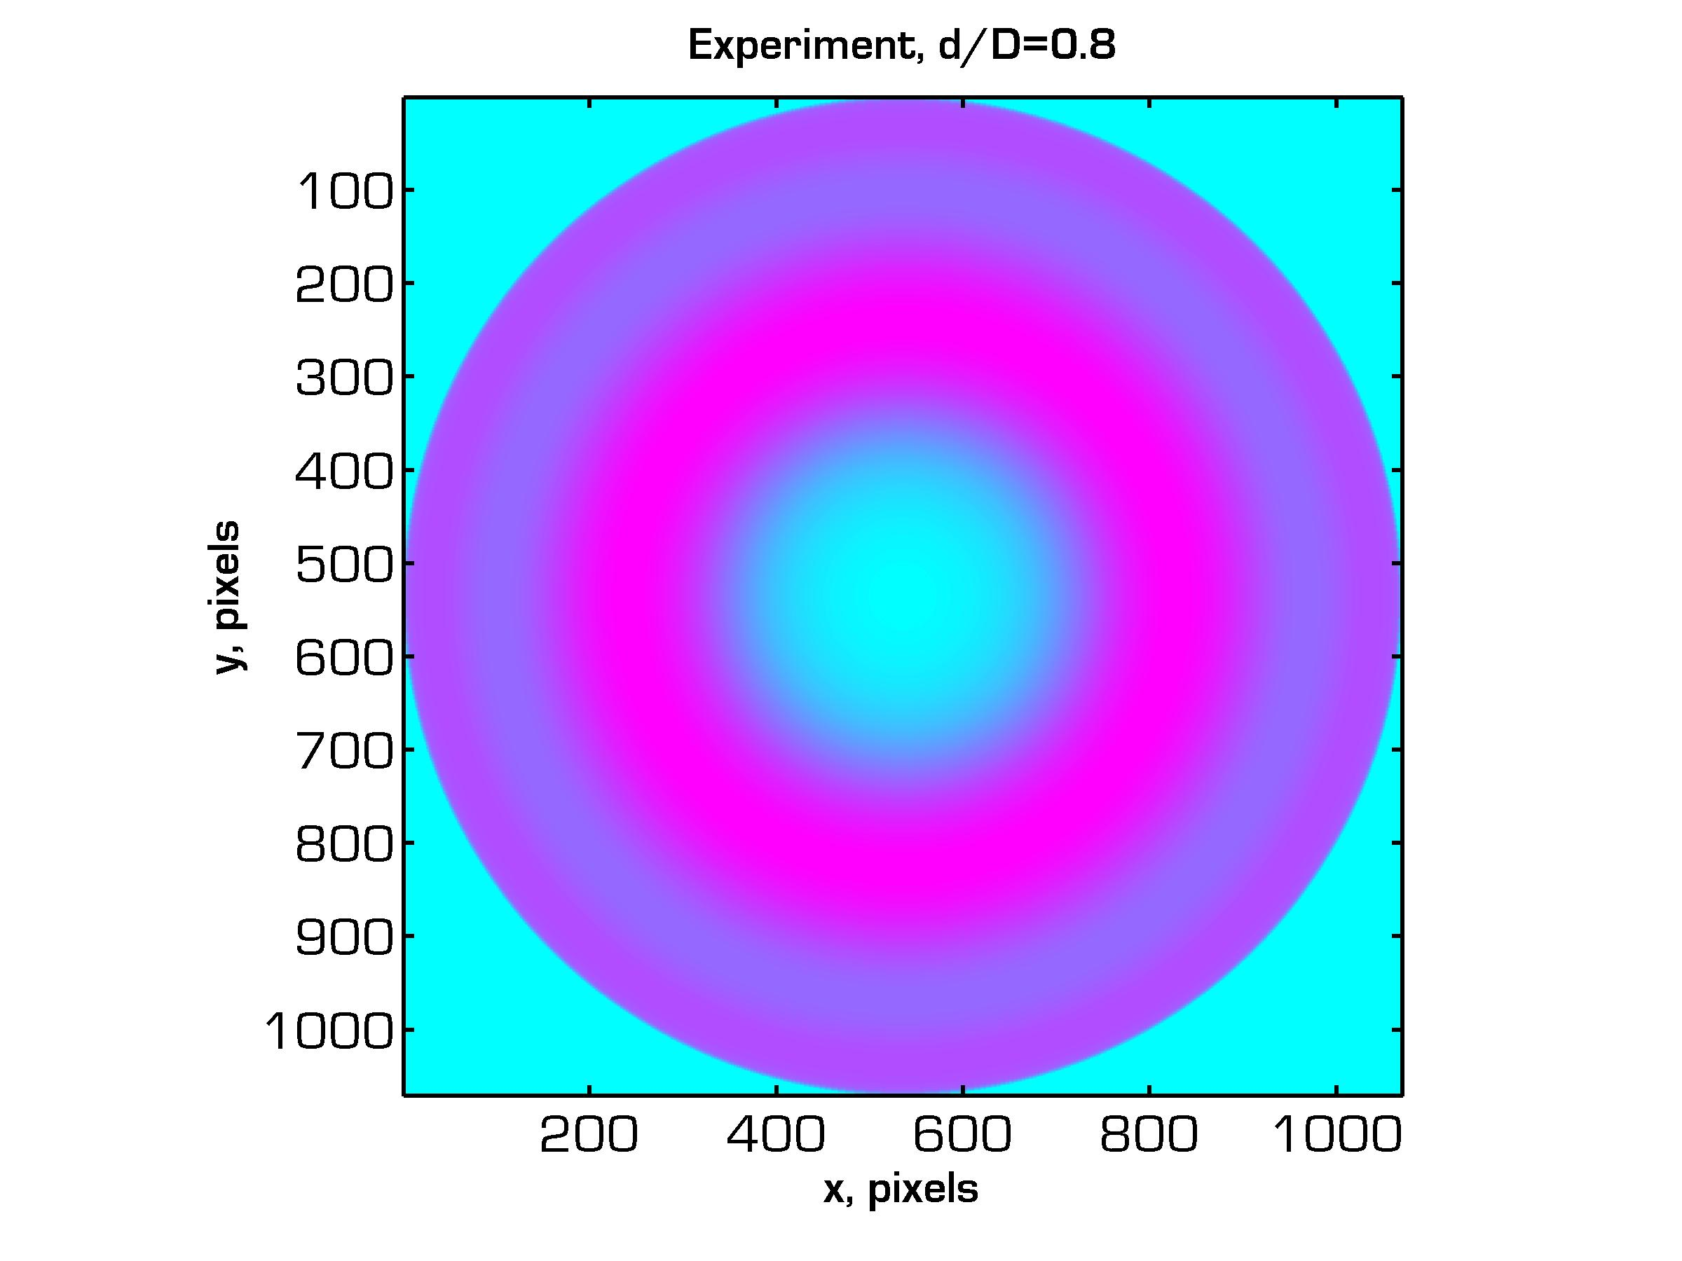
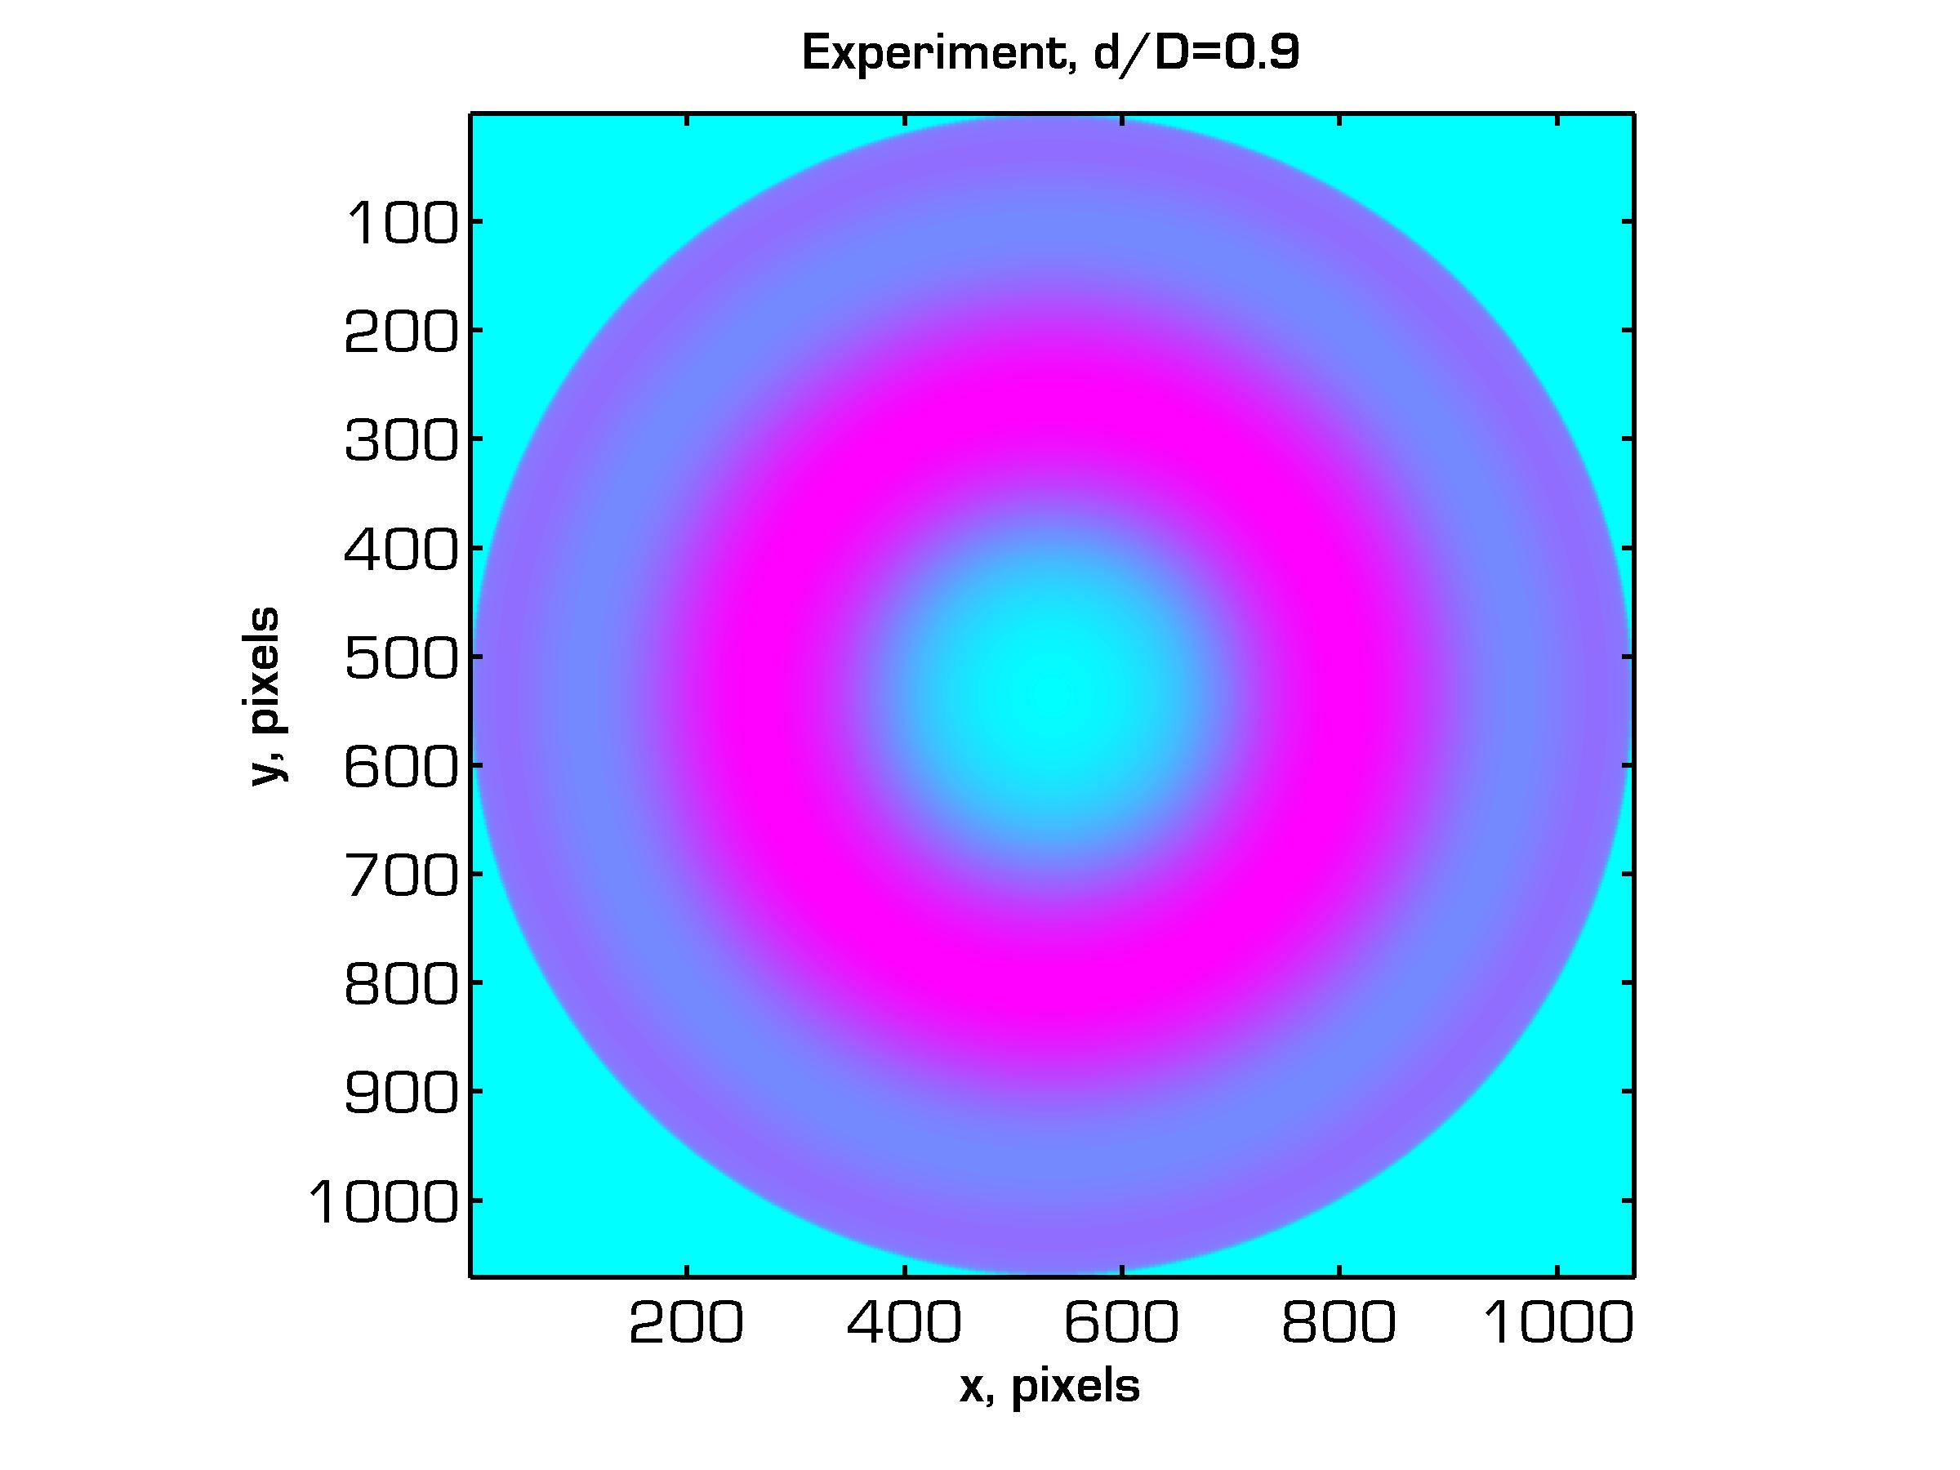
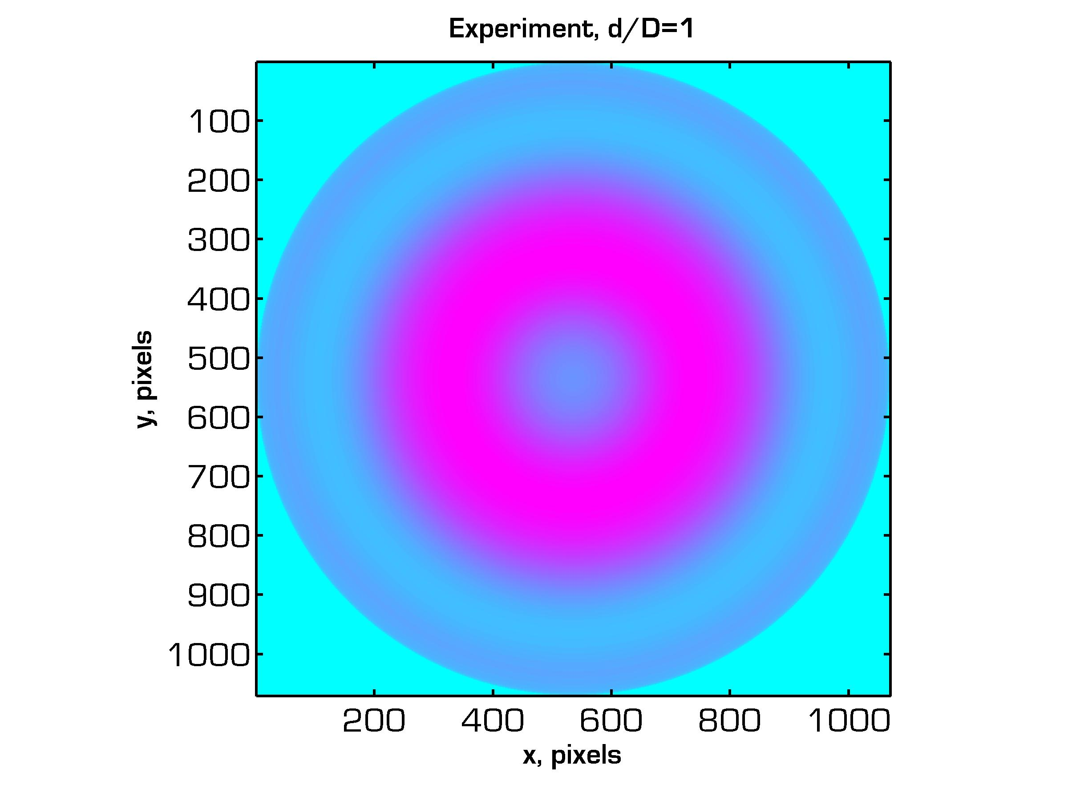
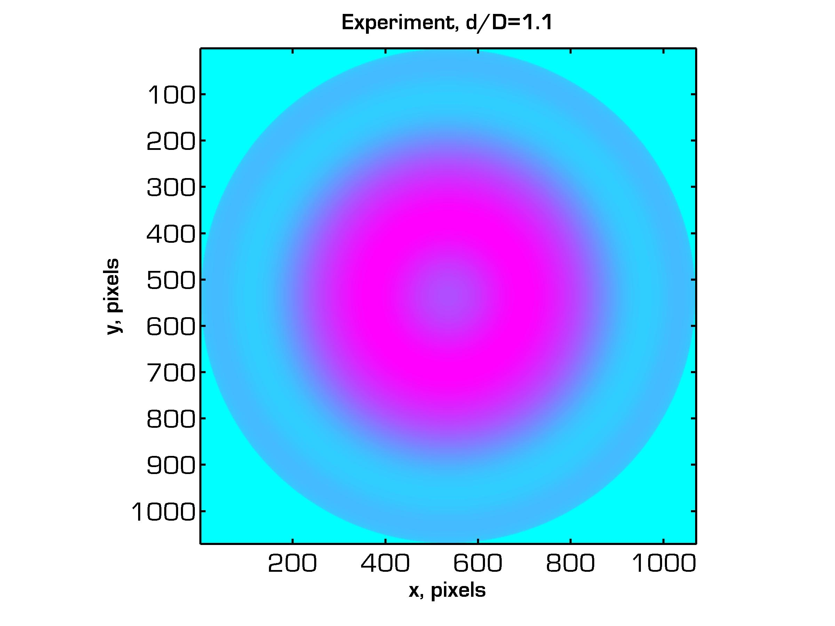
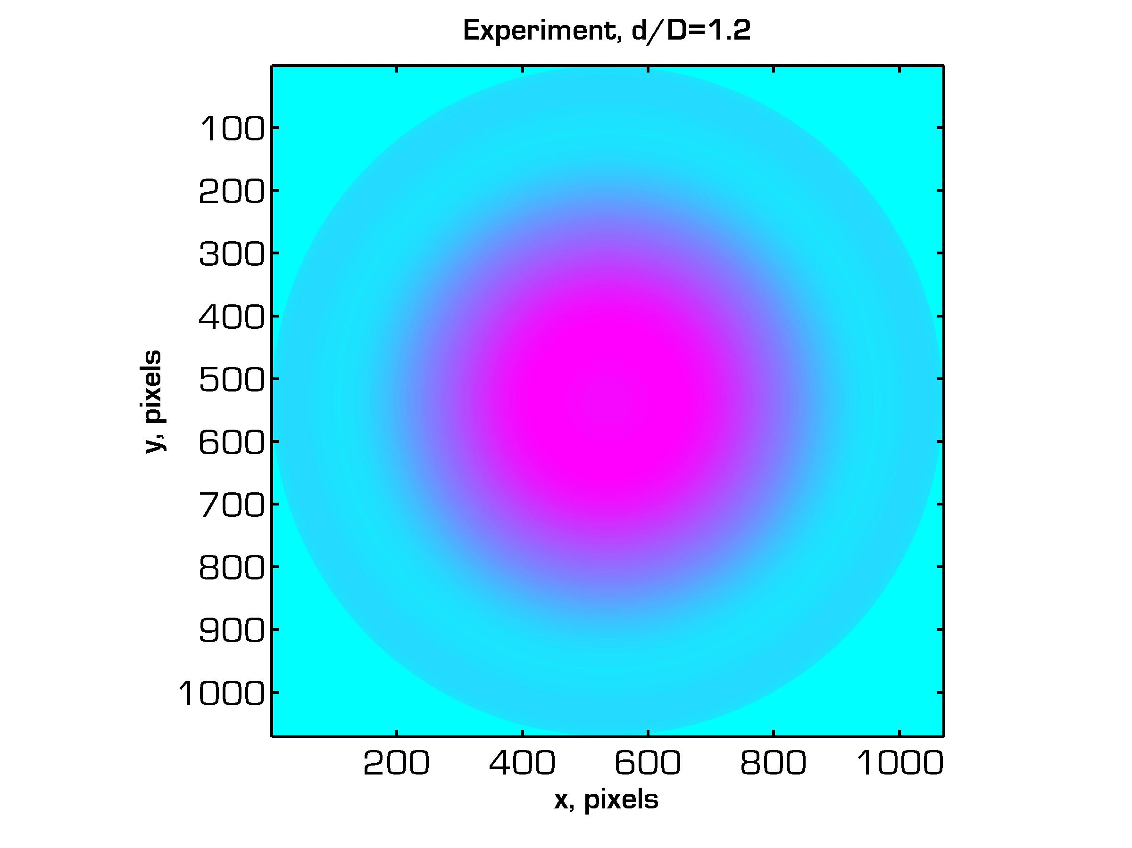
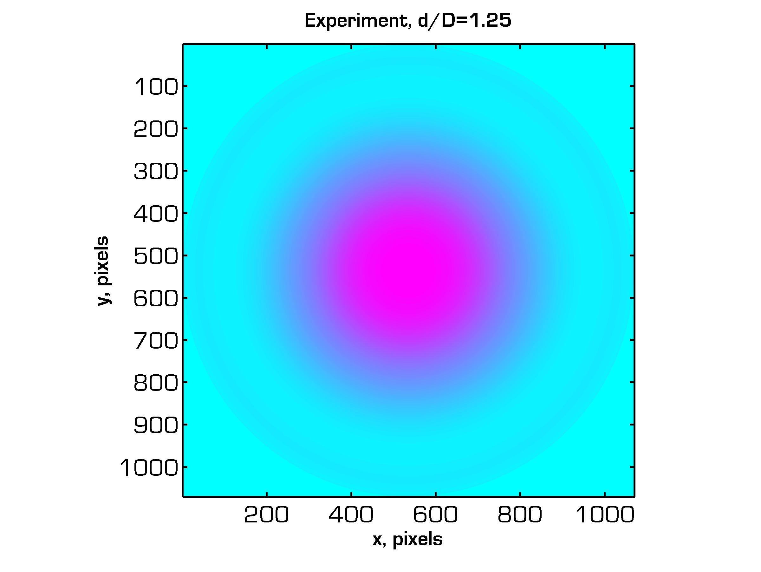
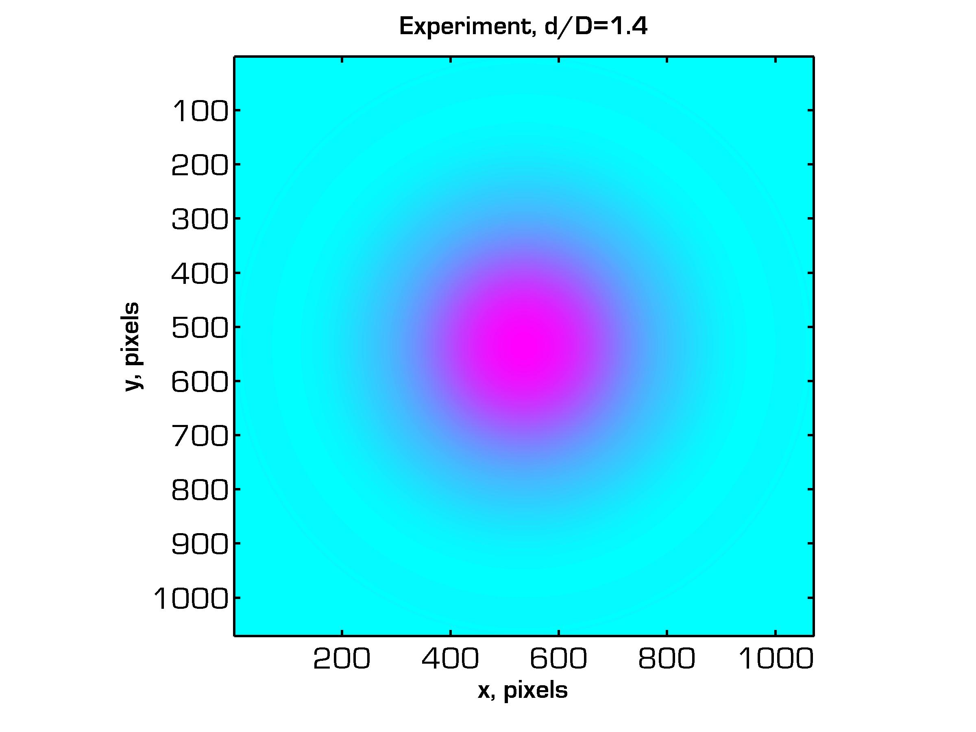
PAO Scaling: Image Results
Azimuthally Averaged Plasma Luminescence
d/D = 0.3
0.4
0.5
0.6
0.7
0.8
0.9
1.0
1.1
1.2
1.25
1.4

Slide 33
PAO Scaling: Electrostatic Analysis
Electrostatic equations for the voltage and electric field in the x-z plane induced by a charged ring lying in the x-y plane.
Voltage Potential:
Electric Field Components:

Slide 34
PAO Scaling: Electrostatic Analysis
Superposition of two oppositely charged rings of diameter D a distance d apart.
Positive ring at
z = d/2.
Solution
domain (z=0)
PAO Lens Model:
Negative ring at
z = -d/2.
Model neglects dielectrics, space charges, electrode length, and AC.

Slide 35
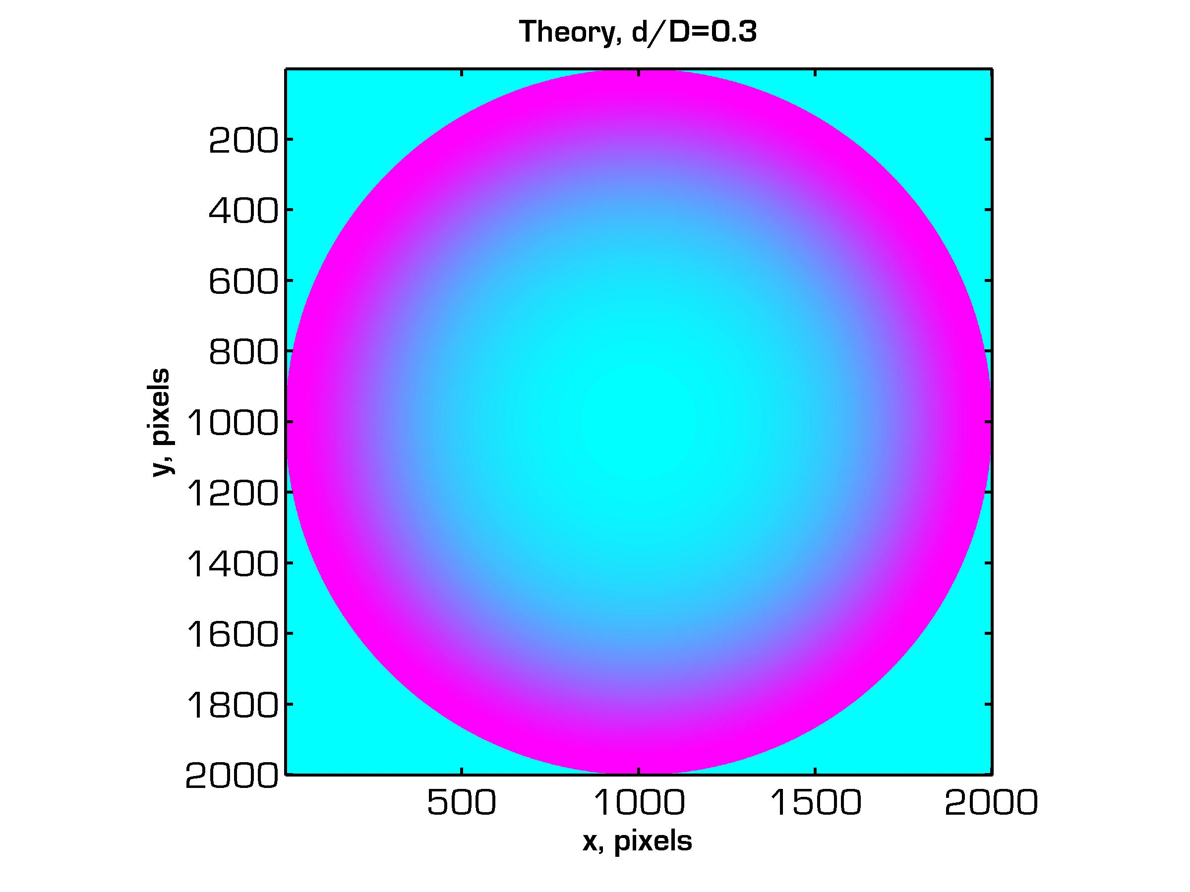
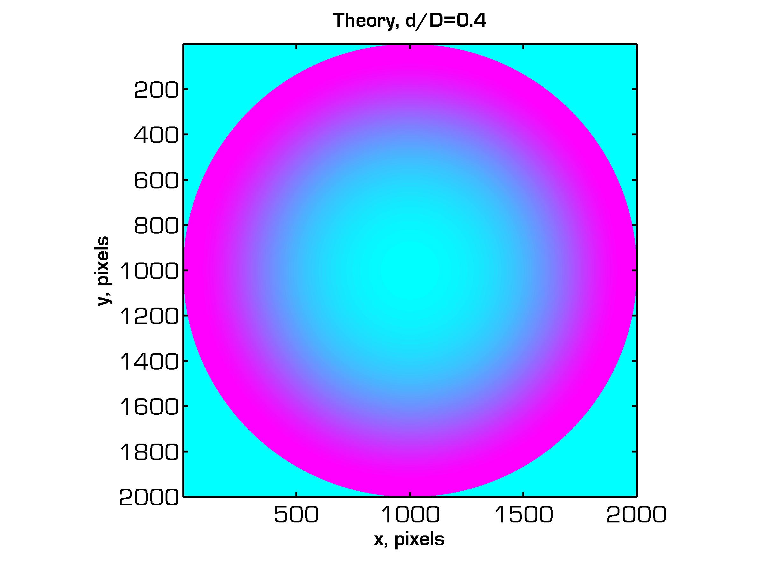
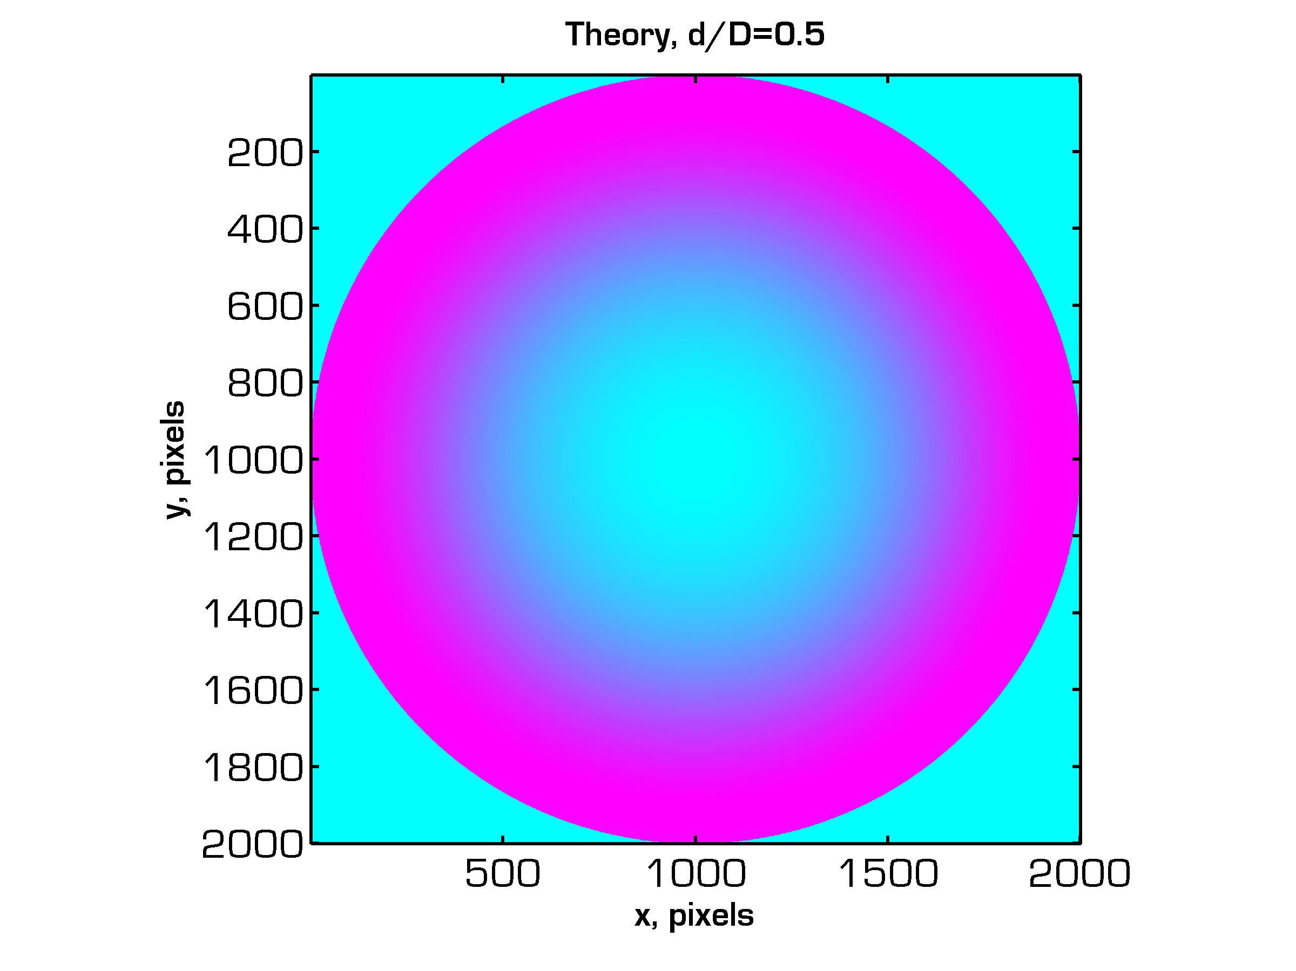
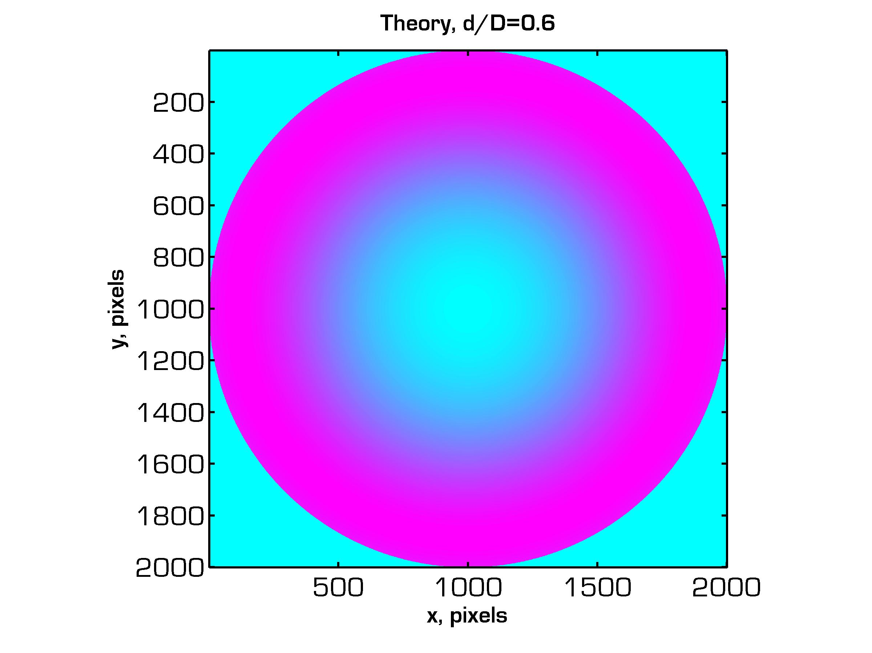
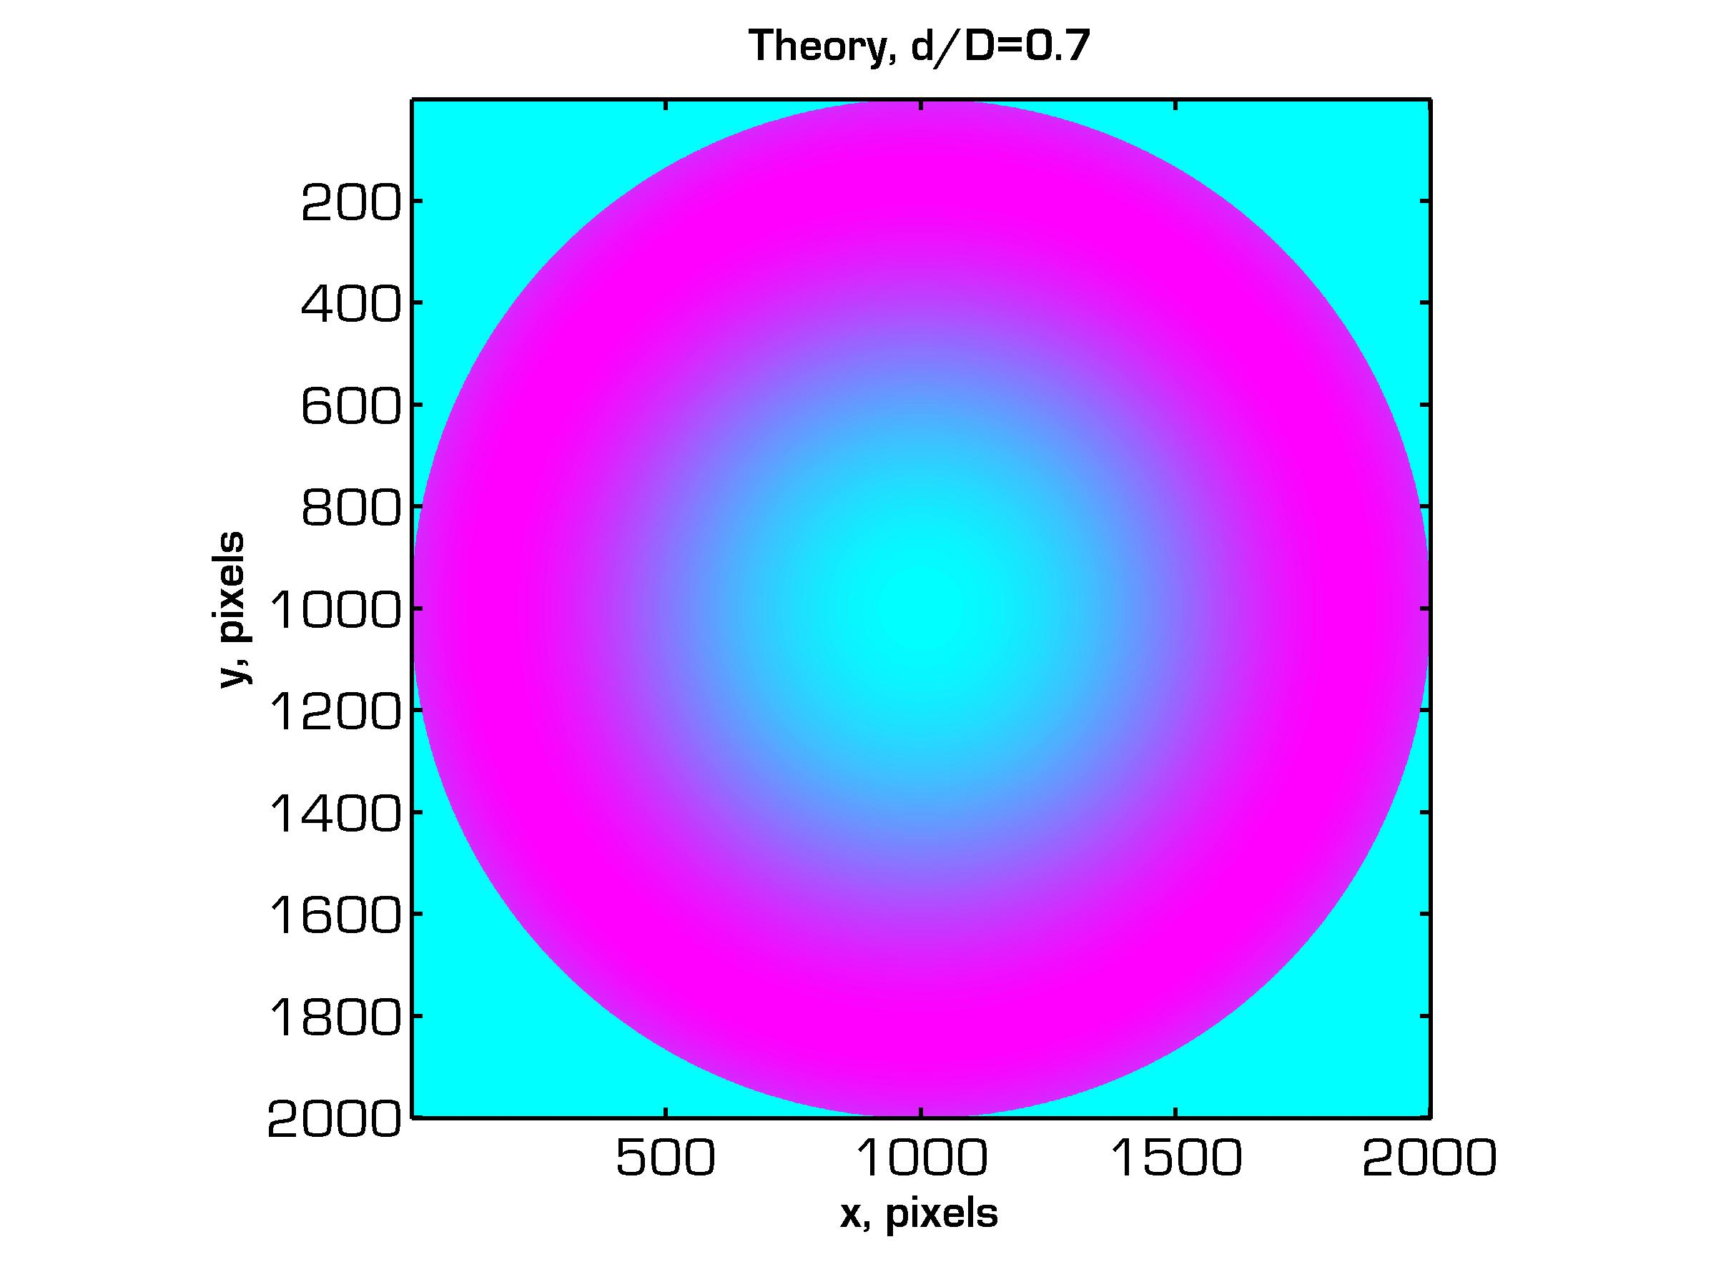
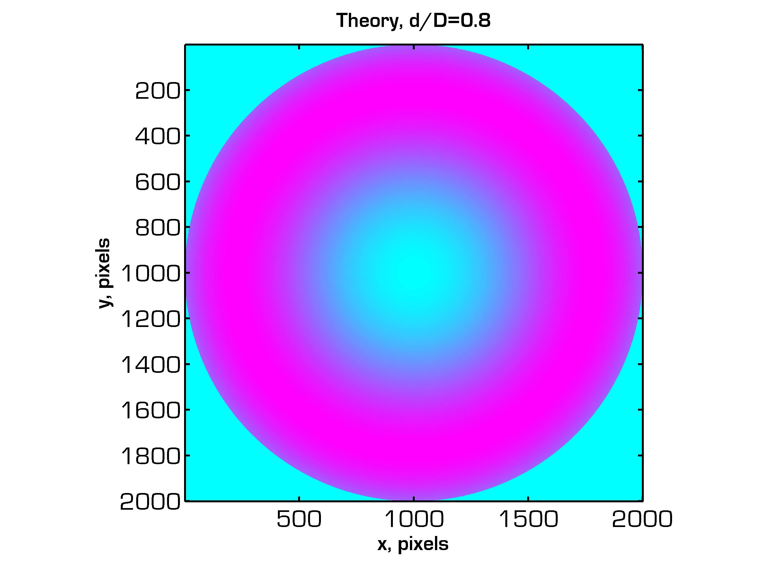
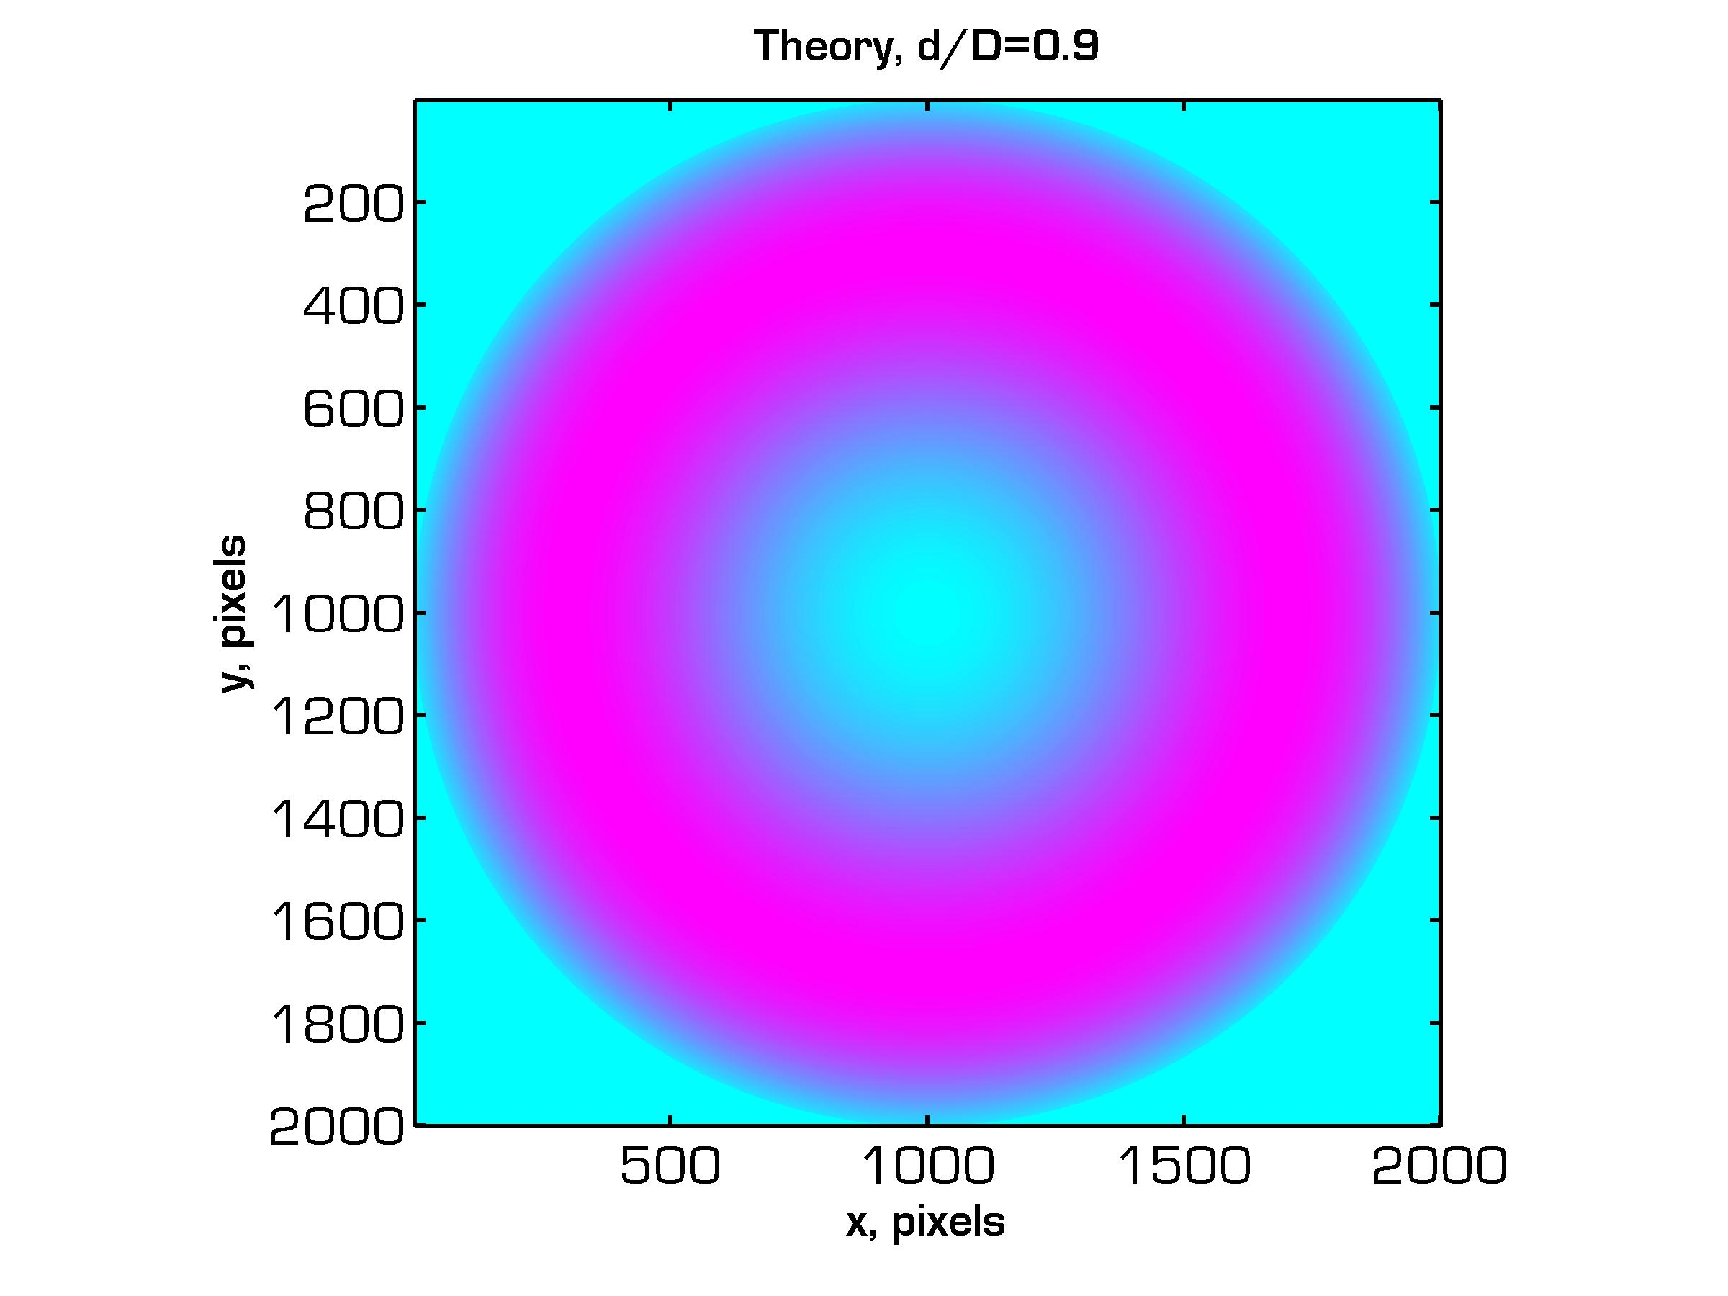
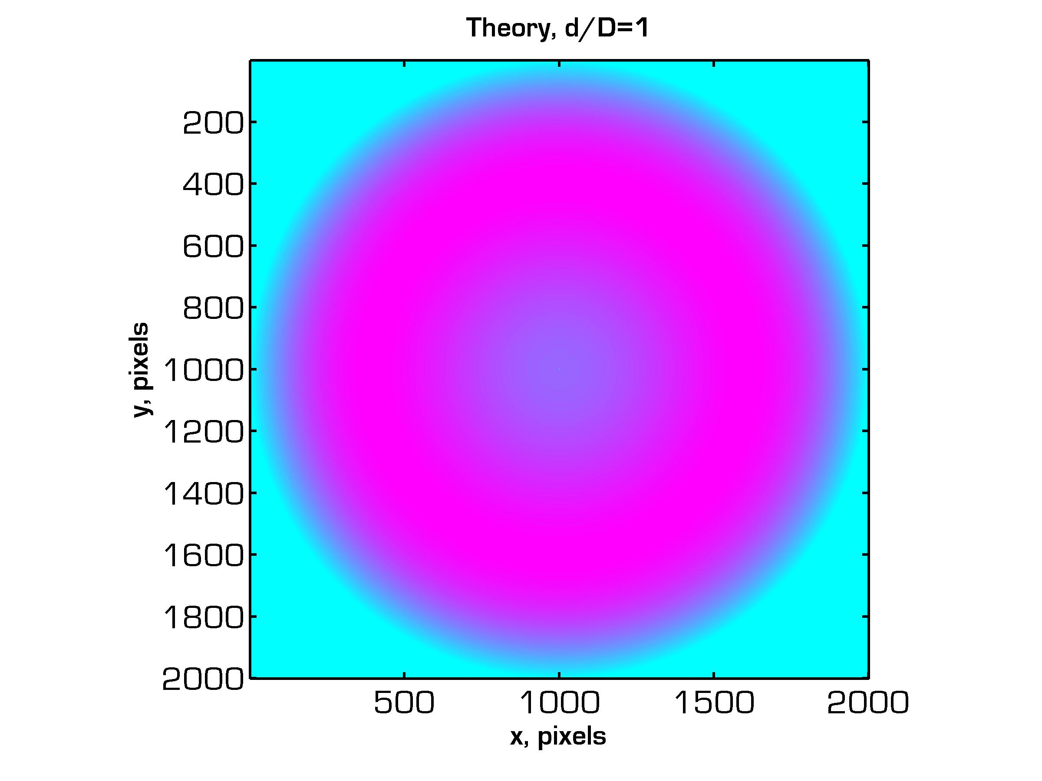




PAO Scaling: Electrostatic Analysis
Contours of Electric Field Magnitude
d/D = 0.3
0.4
0.5
0.6
0.7
0.8
0.9
1.0
1.1
1.2
1.25
1.4

Slide 36
PAO Scaling: Validation
Experiment
Theory
Plasma
Luminescence
Electric Field
Magnitude
0.7
0.7
Experiment gave profiles of plasma luminescence.
Theory gave profiles of electric field magnitude.
Regions of high electric field are presumed to be associated with high plasma ionization and luminescence.
We compare the locations of maximum plasma luminescence and maximum electric field magnitude.

Slide 37
PAO Scaling: Validation

Slide 38

PAO Scaling: Validation
Extract radial profile,
Normalize by total radius.

Slide 39

PAO Scaling: Validation
Extract radial profile,
Normalize by total radius.
Determine the location
of maximum, .

Slide 40
PAO Scaling: Validation
Extract radial profile,
Normalize by total radius.
Determine the location
of maximum, .
We obtain a single point,

Slide 41

PAO Scaling: Validation
Critical d/D = 1.22.

Slide 42

PAO Scaling: Theory
Critical d/D = 1.22.

Slide 43

PAO Scaling: Theory
Critical d/D = 1.22.

Slide 44

PAO Scaling: Theory
Critical d/D = 1.22.

Slide 45

PAO Scaling: Theory
There is some discrepancy between experiment and theory comparison.
Extra inflections are found in the experimental data.
Extra
Inflection

Slide 46

PAO Scaling: Theory
Renormalize experimental data by first inflection point.

Slide 47

4. Discussion
Comparison
New normalization
improves agreement.
Critical d/D = 1.22.

Slide 48
Summary
Optimized a dielectric barrier plasma geometry plasma lens and directly measured OPD
The experiment validated an electron density model that neglected the effect of heavy particles
A simple charged ring electric field model reproduced the experimental results of a critical d/D=1.22 for a centered plasma in the cylindrical plasma lens design.
Developing a new plasma diagnostic technique (Phase Sensitive FTIR Interferometry) to determine the contributions of electron and heavy particle contributions to the OPD.
B. Neiswander, E. Matlis and T. Corke, AIAA J., 50, 1, 123-130 (2012).
B. Neiswander, E. Matlis and T. Corke, AIAA J., 51, 3, 657-664 (2013).

Slide 49
Phase Sensitive FTIR Interferometry
Blackbody source emits broadband infrared spectrum
Michelson interferometer with motorized moving mirror
Mirror location amplified and attenuates certain wavelengths
700-1250cm⁻¹ (8-12μm), 4cm⁻¹ resolution
Measures absorption spectroscopy, dispersion profile, OPD, electron and heavy particle density

Slide 50
Phase Sensitive FTIR Interferometry Analysis

Slide 51
Phase Sensitive FTIR Interferometry Simulation

Slide 52
References
B. Neiswander, E. Matlis and T. Corke, AIAA J., Vol 50, No. 1, pp. 123-130 (2012).
B. Neiswander, E. Matlis and T. Corke, AIAA J., Vol 51, No. 3, pp. 657-664 (2013).

Slide 53
Plasma Optics
Assumptions:
Optical probing frequency >> plasma frequency
Attenuation of probing beam is negligible (probing frequency >> collision frequency)
Probing wave is monochromatic
Unity relative permittivity.
Optical Probing Frequency
Plasma Frequency
Refractive Index
Free Electrons
Heavy Particles

Slide 54
PAO Scaling
A desire to miniaturize the PAO lens for lower power consumption and better modularity.
D
d
Small d/D:
Surface plasma
regime
Large d/D:
Centered plasma
regime
Gap-Diameter Ratio: d/D
Two plasma regimes occur depending on the d/D ratio.

Slide 55
PAO Scaling
Center plasma regime produces coalesced area of concentrated plasma.
Favored regime
Small d/D:
Surface plasma
regime
Large d/D:
Centered plasma
regime
Objective:
Determine the critical d/D ratio
between a surface and center plasma.

