Slide 1
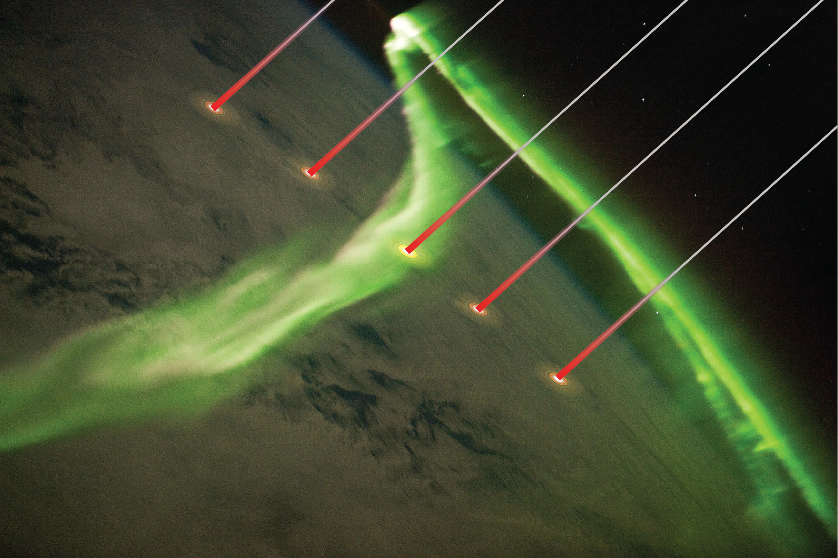
Active space experiments with relativistic electron accelerators
Gian Luca Delzanno
Los Alamos National Laboratory
Acknowledgements: J. Borovsky (SSI), F. Lucco Castello (KTH), G. Miars, O. Leon, B. Gilchrist (U. Michigan), V. Roytershteyn (SSI) + CONNEX team

Slide 2
Outline
I. Electron beams for space physics
II. Magnetic-field-line connectivity
    CONNEX mission concept
    Spacecraft-charging
III. Wave-generation
    Beam-plasma coupling efficiency
    Beam-PIE rocket experiment
IV. Summary

Slide 3
There is renewed interest in space experiments with e-beams, driven by new technological developments
Rich history of active space experiments with e-beams [from 70s to early 90s]: ~10s keV, <~1 A
  Vehicle charging: CHARGE, SCATHA, STS 3
  Beam-environment interactions: ARAKS, POLAR, APEX
  VLF emissions: SEPAC, SPACELAB 1-2
  Magnetospheric (radiation belt) physics: ECHO
Vehicle charging is an issue
  All these experiments (but SCATHA) were in the high-density ionosphere
  6 mA beam on SCATHA caused permanent failure of 3 payloads
New emerging applications would require operating e-beams in the low-density magnetosphere.
  Catastrophic spacecraft charging is a major concern
  Called for as unsolved problem in the Decadal Survey of Space Physics

Slide 4
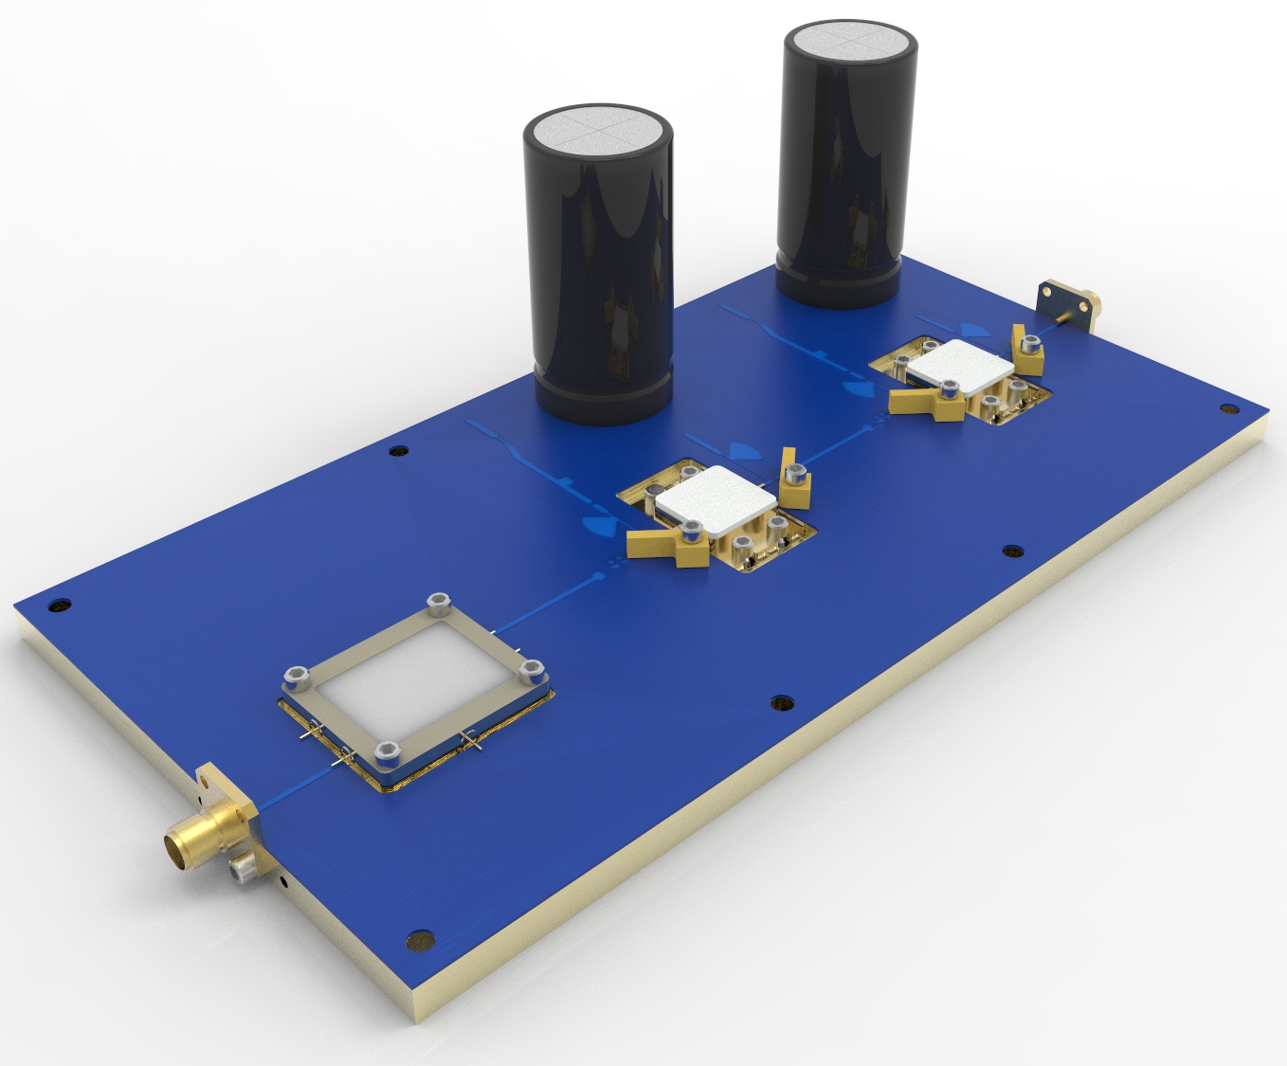
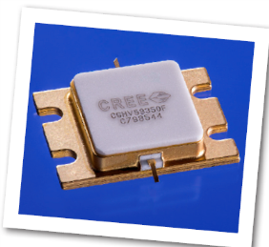
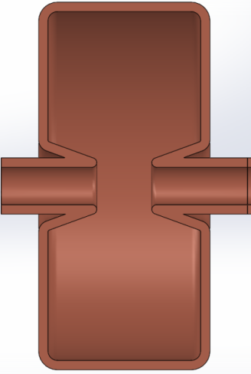
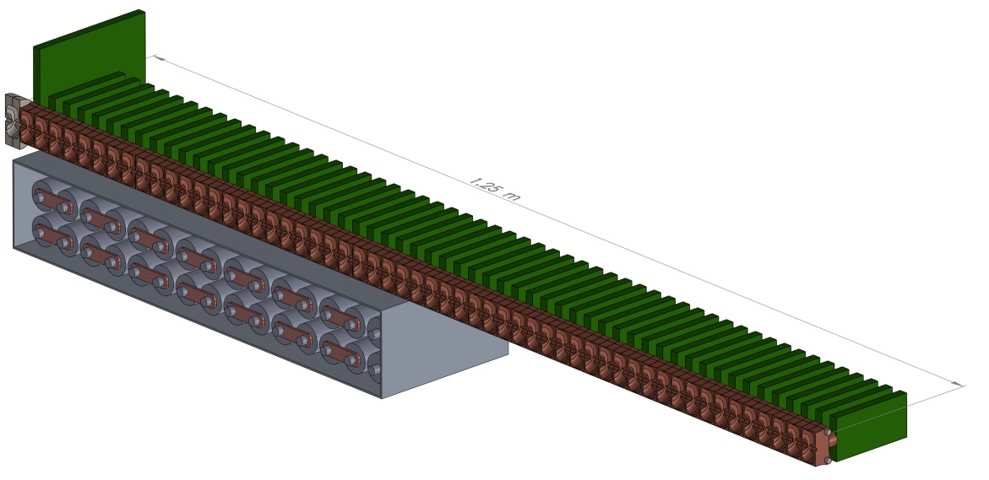
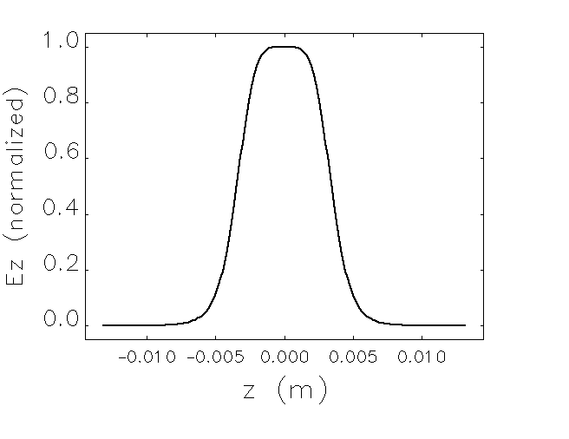
Enabling technology: compact relativistic e- accelerators
Substantially reduce spacecraft-charging problems
  Less current for the same amount of power
We are currently testing low-voltage, high-power 5.1-GHz solid-state amplifiers (HEMTs) driving accelerator cavities
Accelerator | Estimates
Total Beam Energy | 1 MeV
Length | 1.25 m
Weight | 31 kg
Beam Power | 10 kW peak 1 kW average
Number of Cells | 55
Voltage per Cell | 18 kV
Each cell driven by 500-W High-Electron Mobility Transistor (HEMT)
5.1-GHz accelerator cell
POC:
Dinh Nguyen, LANL
dcnguyen@lanl.gov

Slide 5
e-beam could be used to establish magnetic field line connectivity unambiguously and address longstanding magnetosphere-ionosphere coupling questions

Slide 6
When geomagnetic activity turns on, auroral arcs emerge, migrate, become unstable and turn into chaos

Slide 7
Connecting the dynamic magnetosphere and the auroral ionosphere:
How? When? Where?
Aurora: most-visible manifestation of complex processes operating in the distant MS
If we understood the processes that produce arcs, we could use the aurora to visualize the processes ongoing in MS
Long-standing mysteries
  How do the magnetospheric processes produce conditions where auroras can occur?
  How accurately can ionospheric and auroral observations specify the state of the magnetosphere?
We could solve these mysteries by measuring critical MS gradients (pressure, anisotropy, flow and magnetic shear, field-strength) at the site of auroral arcs

Slide 8
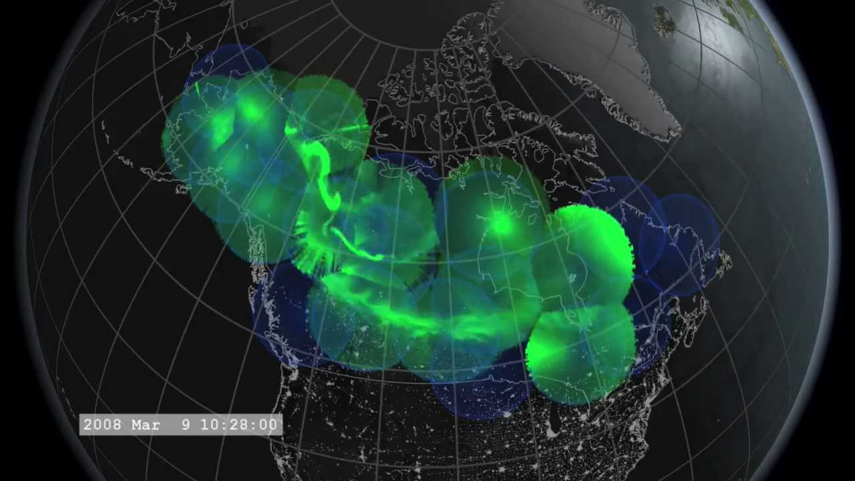
Unfortunately, so far, we cannot determine when our spacecraft are in the equatorial source region of auroral arcs
Magnetosphere-Ionosphere (MI) connections are determined by the magnetic field
The ionosphere can be used as a monitor of magnetospheric activity only if magnetic field configuration is known accurately
Unfortunately, the magnetic field in the near-Earth environment is very dynamic and magnetic field models can be very different from the instantaneous field configuration in the dipole-tail transition, making accurate MI connections impossible
Thus, we don’t know where or how the magnetosphere connects to the auroral ionosphere

Slide 9
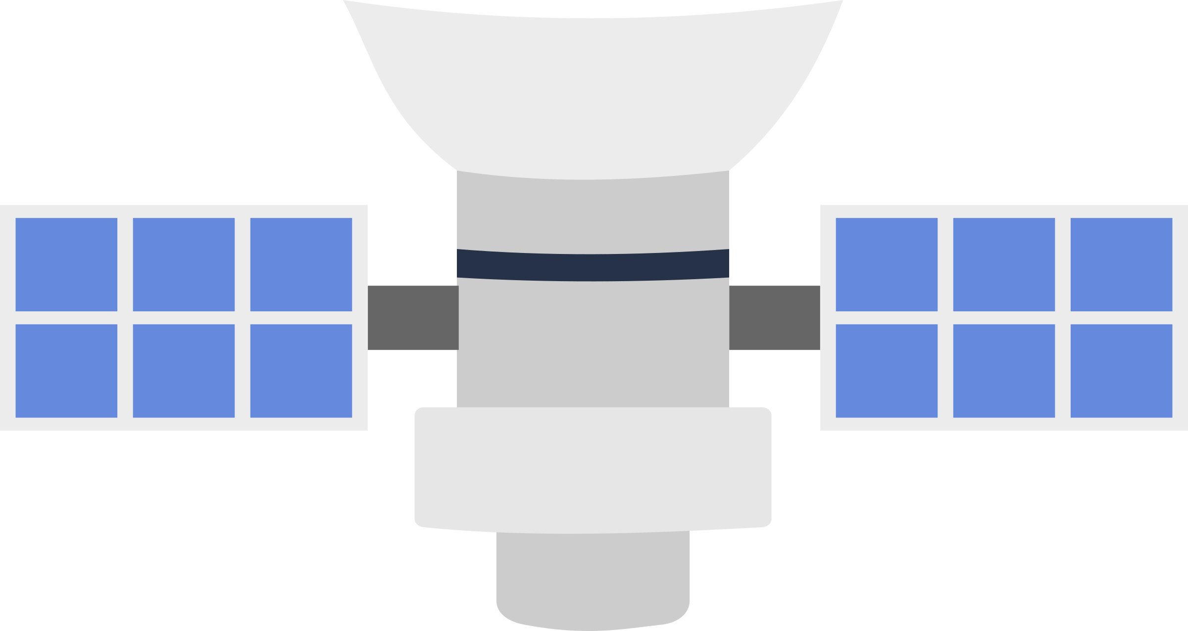
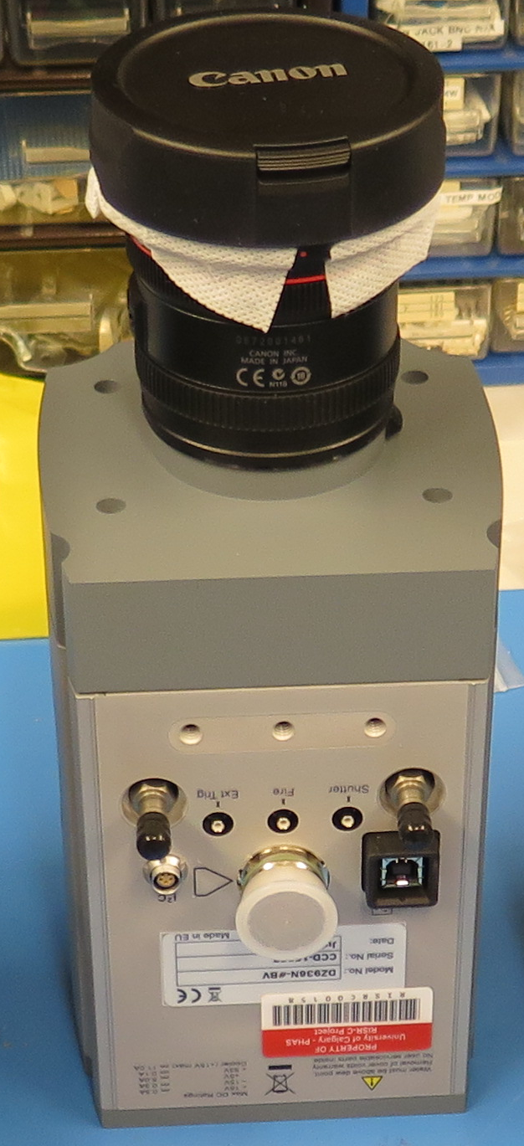
How to solve the magnetic-connectivity problem and answer MI coupling questions? 1. Record Magnetospheric and Ionospheric Context
CONNection EXplorer (CONNEX)
Daughter Spacecraft x4
  Magnetic Field
  Plasma Moments (n, T, P)
  Plasma Gradients (n, T, P)
Mother Spacecraft
  Magnetic field
  Relativistic Accelerator
  Plasma Contactor
  Electric Fields (EDI)
  Ground Array
    All-sky camera (TREX Array)
    RADAR
    Riometer
NASA/Goddard Space Flight Center- Conceptual Image Lab

Slide 10
2. A mapping sequence is triggered through a timed command plan or scientist in the loop activation
CONNection EXplorer (CONNEX)
Mother Spacecraft
  Determine magnetic field direction
  Point Spacecraft
  Activate plasma contactor
  Initiate beam generation sequence
NASA/Goddard Space Flight Center- Conceptual Image Lab

Slide 11
3. A beam burst arrives at ionosphere at regular intervals providing real-time assessments of spacecraft location in ionospheric coordinates.
Beam traverses magnetic field line
  Stability
  Deposition and detection
Beam deposits energy creating light
Beam is detected by all-sky cameras in auroral context
Investigating RADAR possibilities incoherent scatter, SuperDARN

Slide 12
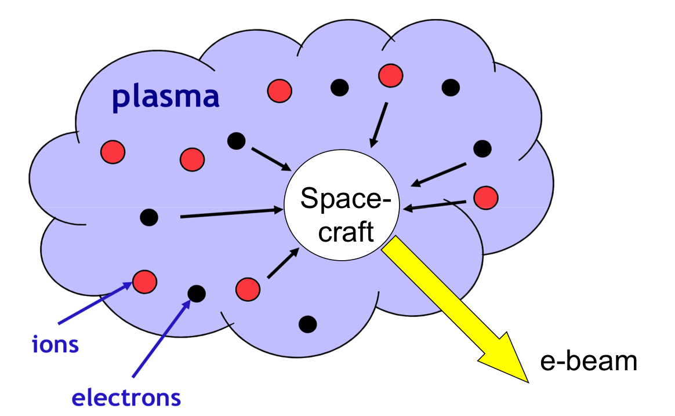
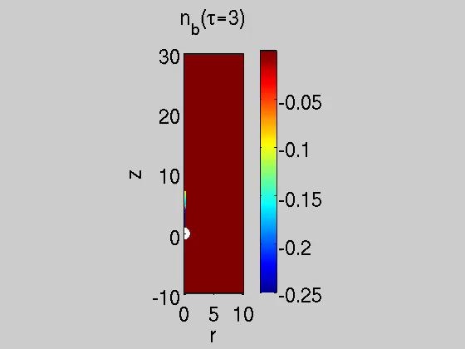
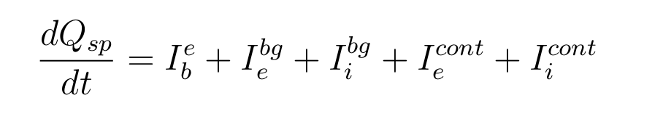


Spacecraft charging is the major obstacle to operating high-power e-beams in the low-density magnetosphere
Spacecraft charging equation:
Beam current
Contactor currents
Background currents
  Can we emit the beam?
  Non-relativistic beam E~10 keV, I~0.1 A
  Relativistic beam (never flown in space) E~1 MeV, I~1 mA
  I_{e,th}~10 μA from the environment, what gives the return current?
  Needs a charging-mitigation scheme
E. Munch,
The scream (1893)

Slide 13
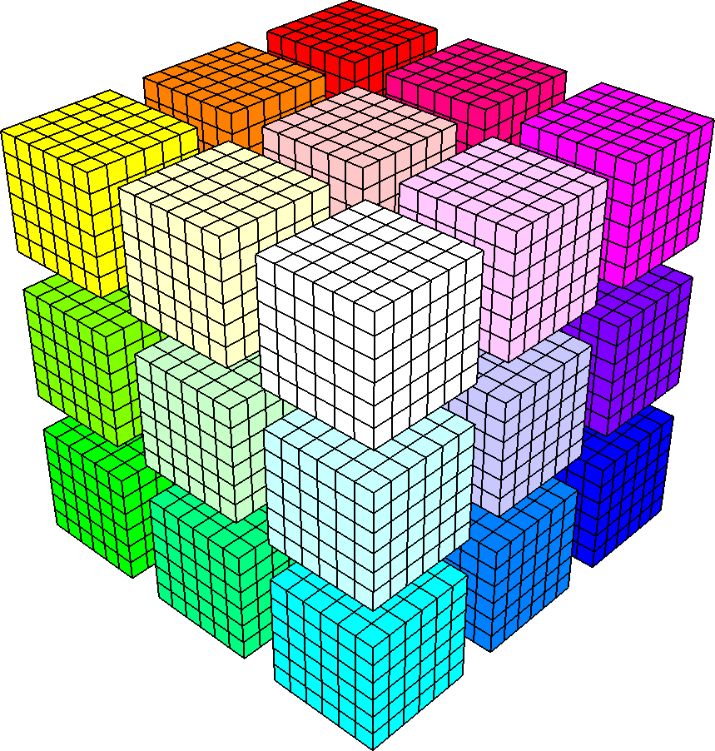
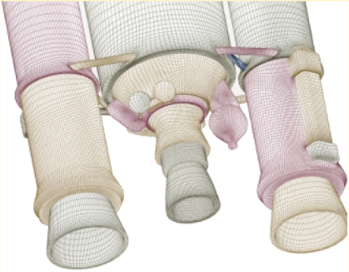
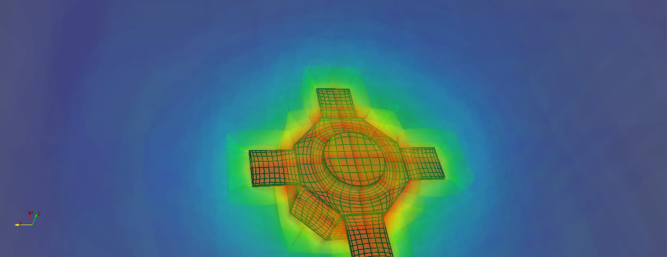
Charging studies with Curvilinear PIC (CPIC)
Solves kinetic equations in the electrostatic limit: Particle-In-Cell technique
Mesh: multiple structured, connected blocks
Avoids inefficiencies of unstructured-mesh PIC
Estimated speed-up: >5x (particle mover)
Highly-parallelized
Delzanno et al., IEEE (2013)
Meierbachtol et al., JCP (2017)
mapping
VAP charging simulation

Slide 14
A mitigation strategy based on plasma contactor as electron collector …
Plasma contactor: provides a high density plasma reservoir
Km-sized
cloud
I_{b}/I_{cont}>1

Slide 15
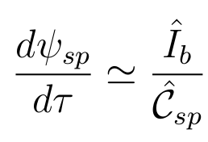
… would not work!
I_{b}/I_{cont}=2
PIC simulations:
contactor, spacecraft and beam
Contactor fired before beam
  3 initial configurations with different size of contactor cloud
Fire electron beam
  with contactor on
Contactor fails to draw a large current from background
8 keV
4 keV
2 keV
G.L. Delzanno, J.E. Borovsky, M.F. Thomsen, J.D. Moulton, E.A. MacDonald, Future beam experiments in the magnetosphere with plasma contactors: How do we get the charge off the spacecraft?, Journal of Geophysical Research, 120 (5), 3647 (2015)
G.L. Delzanno, J.E. Borovsky, M.F. Thomsen, J.D. Moulton, Future beam experiments in the magnetosphere with plasma contactors: The electron collection and ion emission routes, Journal of Geophysical Research, 120 (5), 3588 (2015)

Slide 16
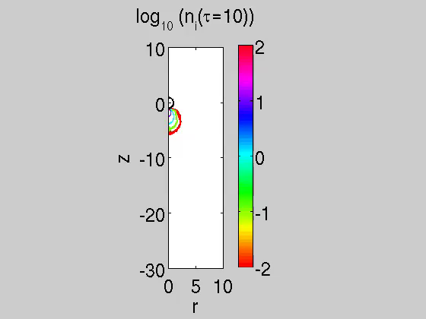
In a different parameter regime, I_{b}/I_{cont}<1, the beam can be emitted
0.5 keV
Evolution of
ION density
I_{b}/I_{cont}=0.5
G.L. Delzanno, J.E. Borovsky, M.F. Thomsen, J.D. Moulton, E.A. MacDonald, Future beam experiments in the magnetosphere with plasma contactors: How do we get the charge off the spacecraft?, Journal of Geophysical Research, 120 (5), 3647 (2015)
G.L. Delzanno, J.E. Borovsky, M.F. Thomsen, J.D. Moulton, Future beam experiments in the magnetosphere with plasma contactors: The electron collection and ion emission routes, Journal of Geophysical Research, 120 (5), 3588 (2015)

Slide 17
The contactor can be used to emit ions (and not to collect electrons!)
Interpretation in terms of Child-Langmuir (CL) law in spherical geometry
Early time:
Low sc potential
small cloud
I^{emit}<I_{beam},
sc potential goes up
Late time:
Higher sc potential
larger cloud
I^{emit}>I_{beam},
sc potential goes down
CL current
Beam
current
I^{emit} = I^{emit} (spacecraft potential,
plume geometry, ion drift velocity)
early-vs-long time evolution?
role of simulation boundary?
<1/100 of real
experiment

Slide 18
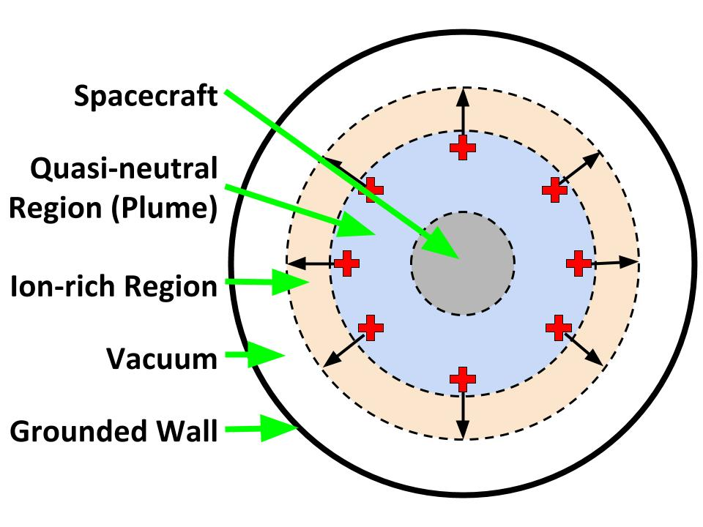
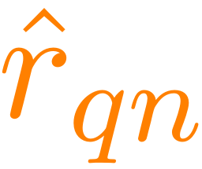
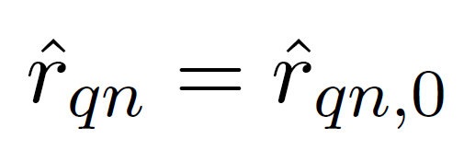



A simple semi-analytical model for the transient of the sc potential in response to e-beam emission has been developed
Main assumptions of the model:
  Perfect spherical symmetry → 1D
  Focus on contactor ion dynamics → slow → I_{b}=I_{i}, I_{e}=0
  e-beam leaves system instantaneously
Model’s parameters
  Radius of the quasi-neutral cloud, : If I_{i} = I_{b} the plasma electron current is zero and is constant
  Radius of the ion front,
  Potential of the ion front,
  Spacecraft potential,
Sc initially emits only a neutral contactor plasma. After some time, it also emits an e-beam
Runs in secs/minutes on laptop
vs weeks of PIC on IC clusters

Slide 19

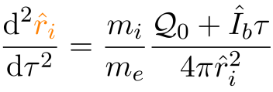
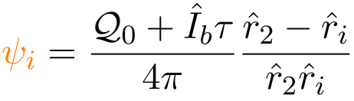
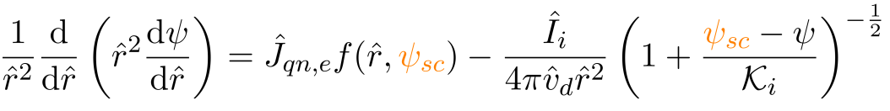



Model summary
Model:
c.f. Child-Langmuir law
Initial conditions taken from PIC, we need to define r_{qn,0}, r_{i,0}, v_{i,0} and

Slide 20
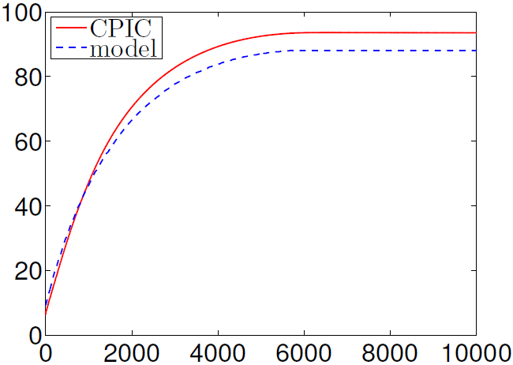
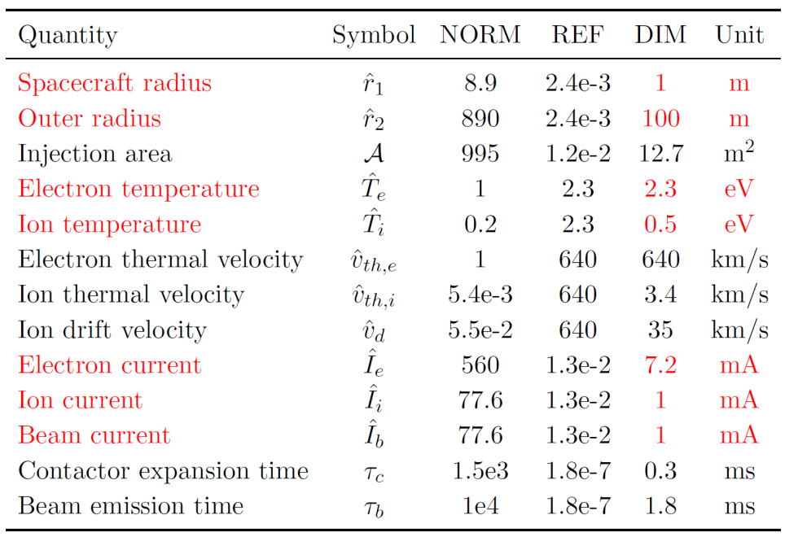

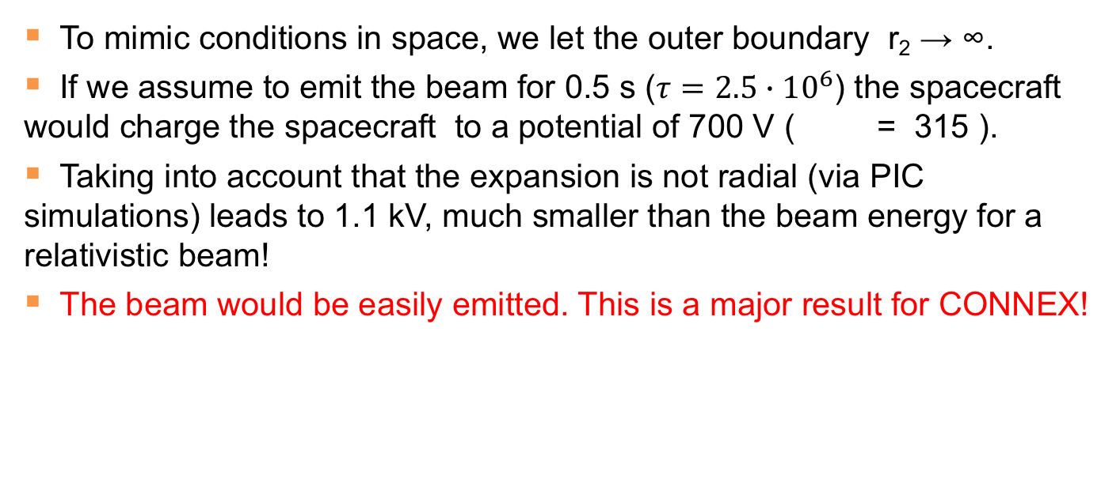
Good agreement between model and simulations
Normalized Spacecraft Potential
Normalized Time
Table 1: Parameters used to test the models
To mimic conditions in space, we let the outer boundary r₂ → ∞.
If we assume to emit the beam for 0.5 s ($τ=2.5∙{10}^{6}$) the spacecraft would charge the spacecraft to a potential of 700 V ( = 315 ).
Taking into account that the expansion is not radial (via PIC simulations) leads to 1.1 kV, much smaller than the beam energy for a relativistic beam!
The beam would be easily emitted. This is a major result for CONNEX!

Slide 21
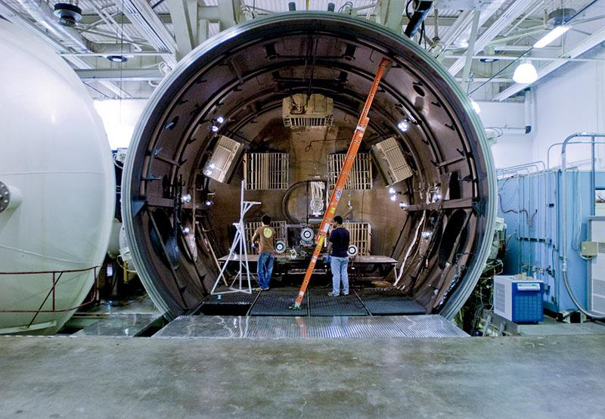
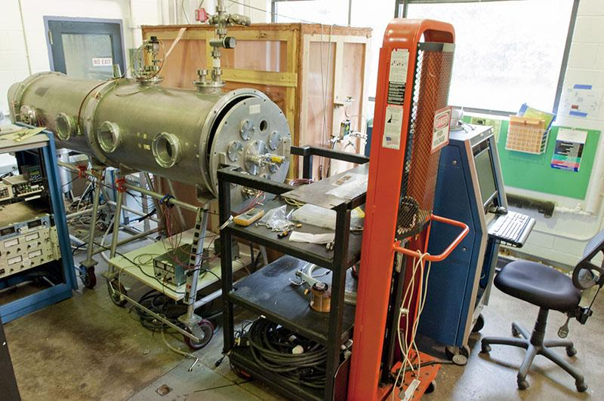
Experimental design: testing ongoing at U. Michigan
Large Vacuum Test Facility (LVTF)
6 meter x 9 meter cylinder
Largest of its kind in academia
Cathode Test Facility (CTF)
0.7 meter x 1.5 meter cylinder
Cost effective and good availability
Objective: laboratory validation of contactor-based ion emission
I^{emit}=I^{emit} (spacecraft potential, plume geometry, ion injection velocity)
Team: G. Miars, O. Leon, B. Gilchrist

Slide 22
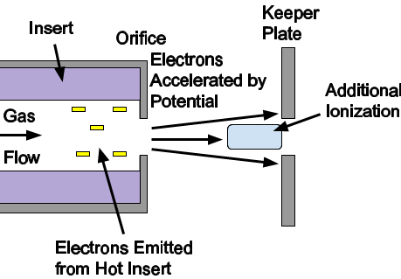
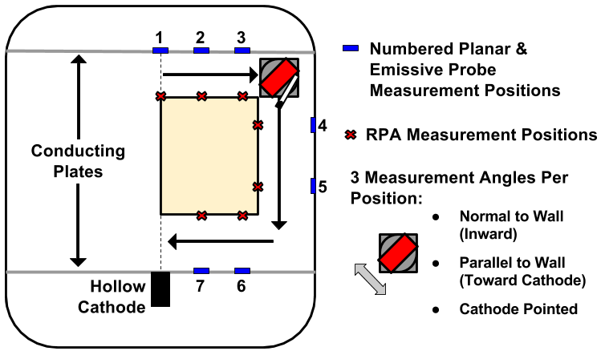
Experimental results summary
Extensive measurements solidify and extend interpretation of the ion emission model
Ion emission from quasi-neutral plasma appears space-charge-limited
Discrepancy attributed to fast electrons
I^{emit} = I^{emit} (spacecraft potential, plume geometry,
ion drift velocity)

Slide 23
Other challenges
Beam propagation. POC: Ennio Sanchez, SRI, ennio.sanchez@sri.com
  Modification of the loss cone for relativistic electrons
  Ballistic propagation to the ionosphere
Beam deposition. POC: Bob Marshall, UCo, Robert.Marshall@colorado.edu
  How much energy can be deposited in the atmosphere? Needs ~10 kW
  Prediction of generated signal
  Prediction of ground detection performance (optical and radar)
  Indicates that the beam spot is detectable
Accelerator maturation. POC: Dinh Nguyen, LANL, dcnguyen@lanl.gov
  Successfully demonstrated 20 keV energy gain in single cavity
  Building/testing 10 cavity prototype by summer 2018 (LANL/SLAC)
We are making progress in mitigating all these challenges!
CONNEX PI: Eric Dors, LANL, edors@lanl.gov

Slide 24
e-beam could be used for radiation-belt-remediation

Slide 25
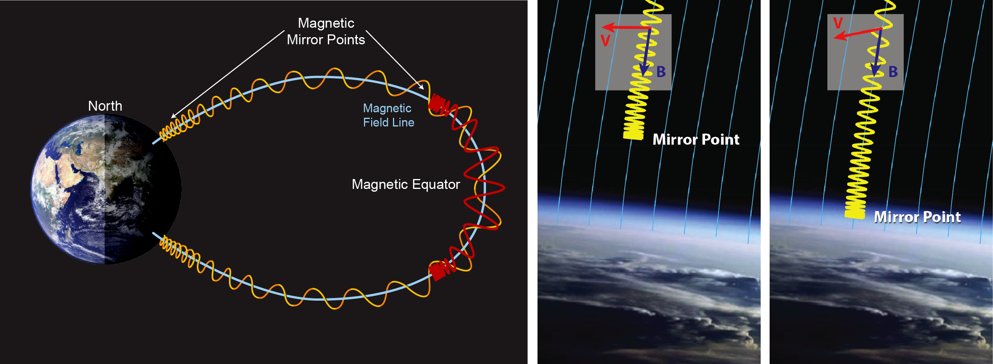
e-beams could be used for radiation belt remediation
Natural radiation belt: MeV
Gyro, bounce and drift motion
Artificial radiation belt. Remediation
Wave-particle interaction (pitch-angle scattering) to precipitate energetic particles
Use e-beams to stimulate wave emission
  Cherenkov or cyclotron emission
  Beam-plasma instabilities
In the following we will take a look at Cherenkov (mostly) radiation theory

Slide 26
Radiation theory: pulsed beam aligned to B
Developed in the 60s [McKenzie, 63; Mansfield, 67; Harker&Banks, 84+]
Beam point pulses act as a current source
Plasma responds with characteristic frequencies driven by resonances
  Resonance
  Linear response: cold plasma theory
Radiated power
Spatial
coherence
Temporal
coherence
Farrell&Goertz 90
Harker&Banks 84, …

Slide 27




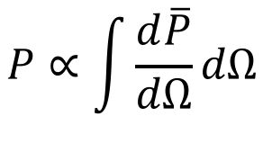
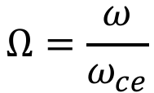

Two coupling regimes
Whistler and X modes
  Whistler energy-range is limited
  Space nomenclature: X→slow Z
Resonances
  Lower-hybrid frequency
  Upper-hybrid frequency
Yields logarithmic singularities for field-aligned beam
The total power diverges
$$ω_{uh}$$
$$ω_{lh}$$
$$ω_{ce}$$
$$ω_{pe}$$
$$Ω=\frac{ω}{ω_{ce}}$$
$$P∝\int{\frac{d\overline{P}}{dΩ}dΩ}$$
𝜔_{pe}/𝜔_{ce}=2, m_{i}/m_{e}=1836

Slide 28
Finite pitch angle yields finite total radiated power
Several mechanisms can yield a finite radiated power:
  Finite pitch angle, nonlinearities, kinetic physics, collisions …
  Finite pitch angle: resonances are still present, but are now integrable
Z(X) mode
whistler mode
α pitch angle
Can we really trust total radiated power with finite pitch angle? In general NO!
Cold-plasma theory breaks down at resonances. Need simulations!

Slide 29

Simulations
SpectralPlasmaSolver (SPS): solves kinetic equations with spectral expansion of the distribution function in moments [Delzanno, JCP 15; Vencels et al, J. Physics 16]
Velocity discretization: Hermite or Legendre
Spatial discretization: Fourier or Finite Elements
Fully-implicit time discretization
Naturally bridges between fluid (few number of moments) and kinetic (large number of moments). Optimal way to include microscopic physics in large-scale simulations (?)
To test radiation theory:
  Stop expansion at 4 Hermite modes: fluid treatment
  Consider low beta: cold plasma
  Regularization of resonances achieved by non-linear effects

Slide 30
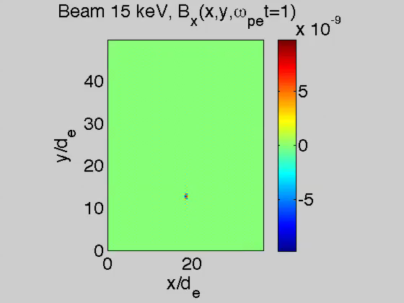
SPS simulations (used as a 2-fluid solver)
𝜔_{pe}/𝜔_{ce}=2,
m_{i}/m_{e}=1836,
𝛽_{||e}=10⁻⁴,
T_{||e}/T_{⟘e}=1,
T_{e}/T_{i}=1
B₀
Point pulse
SPS more
efficient
than PIC
(statistical
noise!)

Slide 31
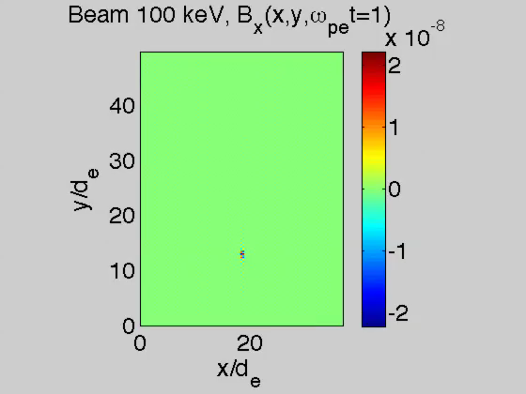
100 keV beam
B₀

Slide 32
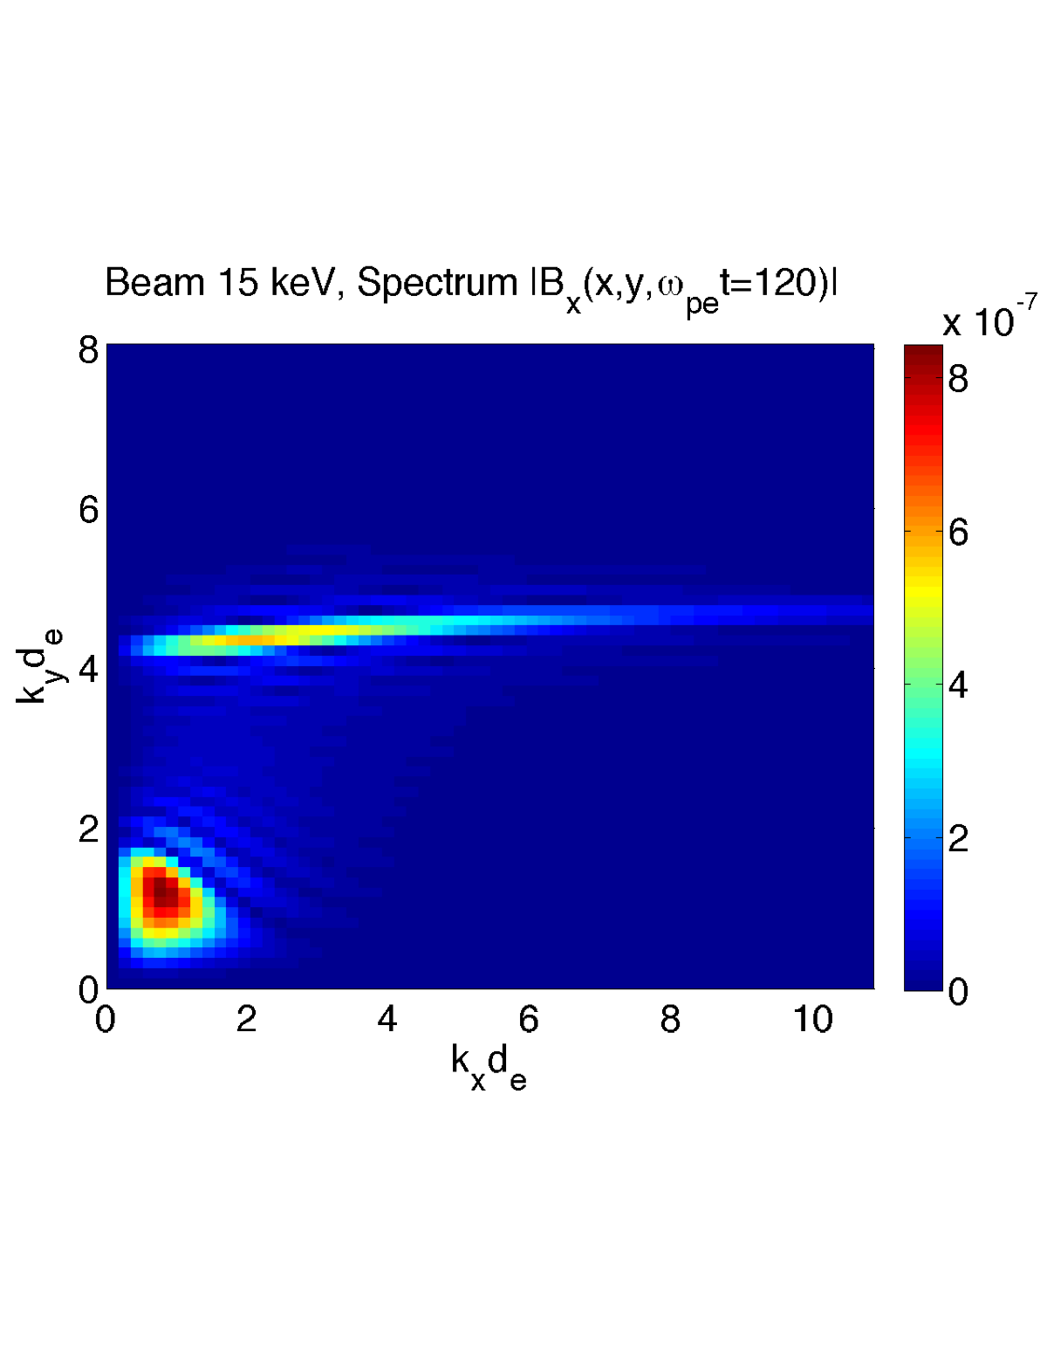
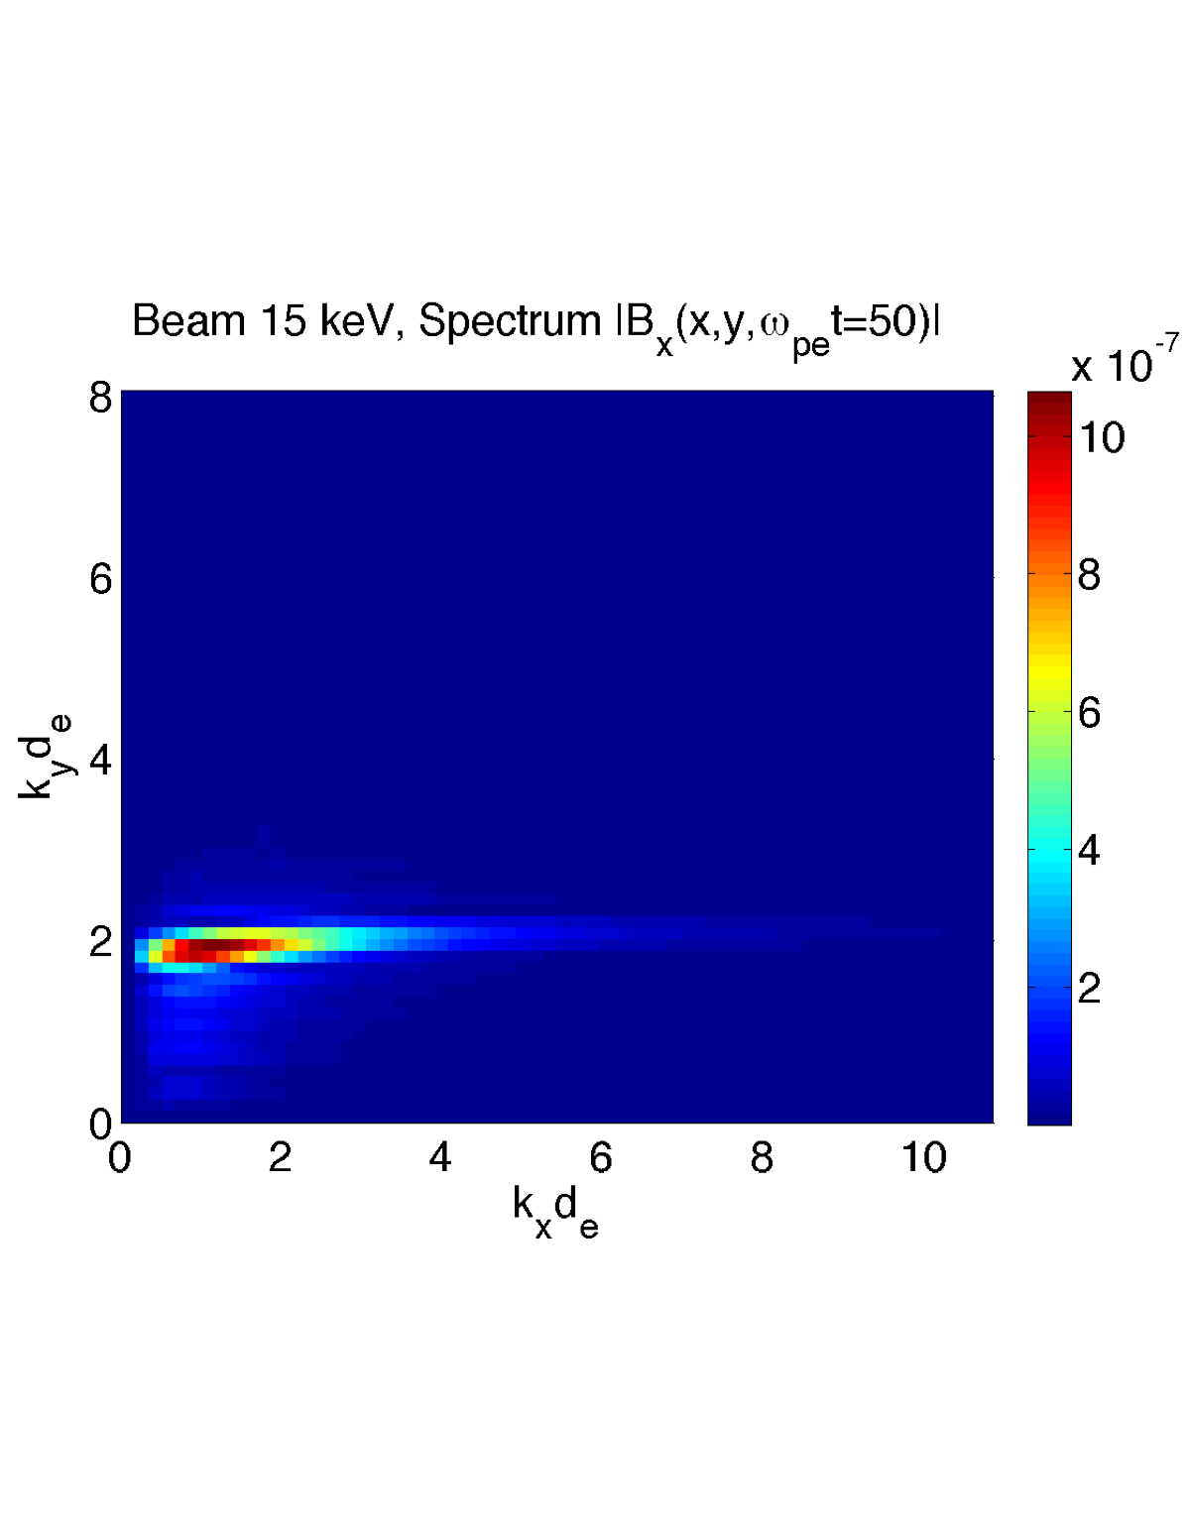
Spectra: 15 keV and 100 keV
100 keV
Z(X)
Z(X)
X
whistler
Small amplitude for large k_{x}=k⊥
Theory might overestimate radiated power

Slide 33
Total radiated power
Whistler: good agreement between theory and simulations
  Contribution around resonance not important
Z(X)-mode: theory overestimates radiated power
Simulations confirm that Z(X) mode dominates radiation (20-100 higher)
  Many rocket/shuttle experiments focused on whistler

Slide 34
Coherence effects are important: beam modulation or pitch angle allow one to select between the 2 regimes
Minipulse: T_{mini}=1 µs. V_{beam}T_{mini}=71 m
100 pulses suitably separated
5 kHz modulation
Theory with
finite pitch angle
selects whistler
selects X

Slide 35

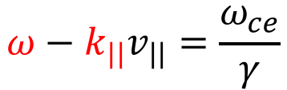
Wave-particle interaction
Test particle simulations in a prescribed wave field
Single, monochromatic wave: fix B_{rms}=60 nT, use cold-plasma theory to fix other amplitudes. Fix background B_{z}=45,000 nT
Objective: reduce pitch angle by 3 deg to induce precipitation
  Particles lost in the atmosphere (100 km) have pitch angles 66∘ at 500 km and 61∘ at 700 km
  Particles mirroring at 200 km have pitch angles 69∘ at 500 km and 64∘ at 700 km
Move 500 electrons with given initial energy and pitch angle, and random initial position and gyro-phase
For a given pitch angle, energy is computed from the first cyclotron resonance:
$$ω−k_{||}v_{||}=\frac{ω_{ce}}{γ}$$
beam
Background particle

Slide 36
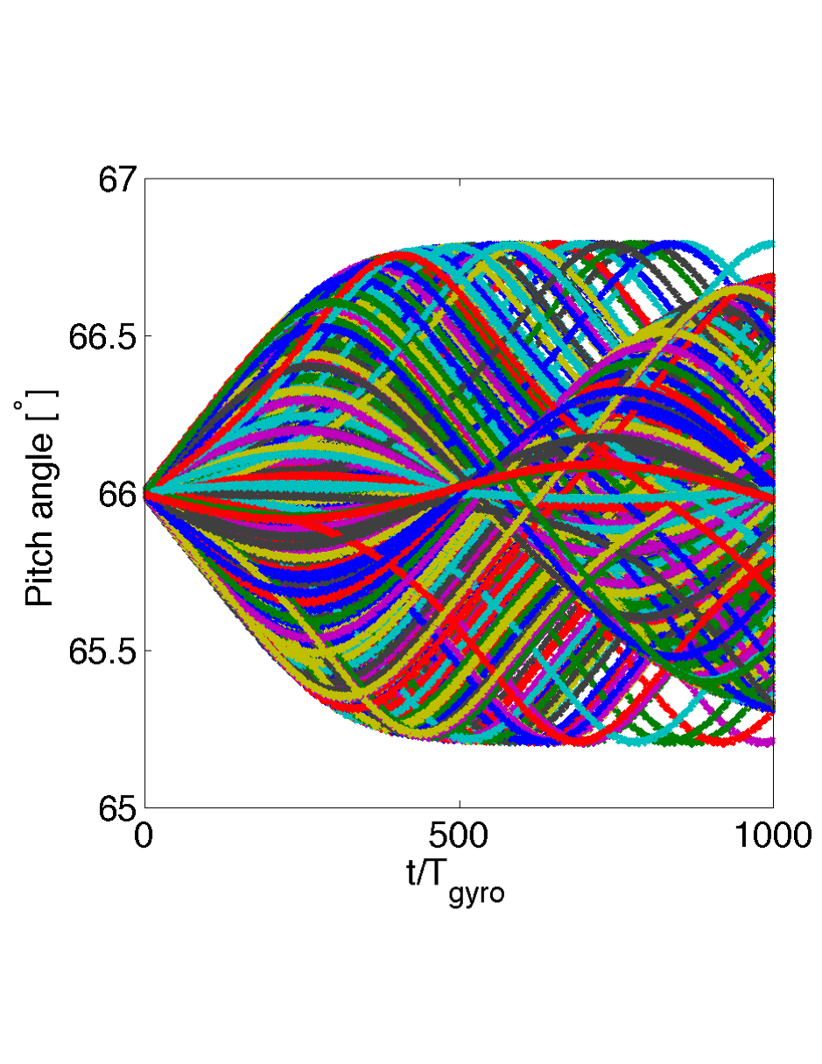

Whistler mode:
E(0)=3.7 MeV; ⍺(0)=66∘; 𝜔=0.045𝜔_{ce}
With these parameters, can’t get 3 deg changes in pitch
angle necessary for precipitation

Slide 37
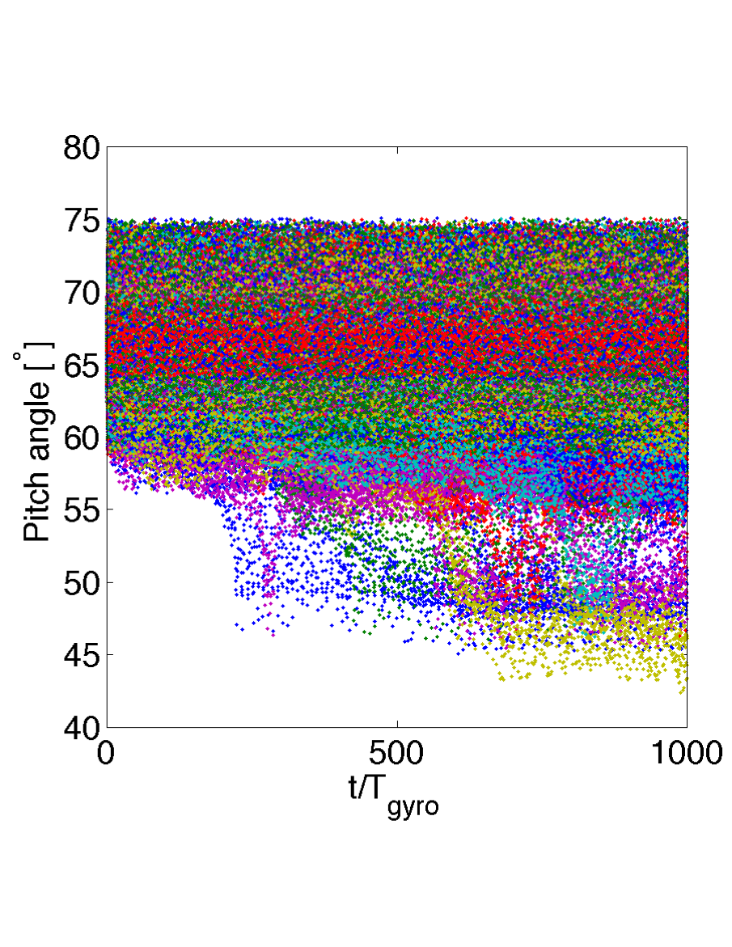
Z(X) mode:
E(0)=31 keV; ⍺(0)=66∘; 𝜔=2.2𝜔_{ce}
With these parameters, 20% of the particles experience a
change in PA greater than 3 deg in the right direction

Slide 38
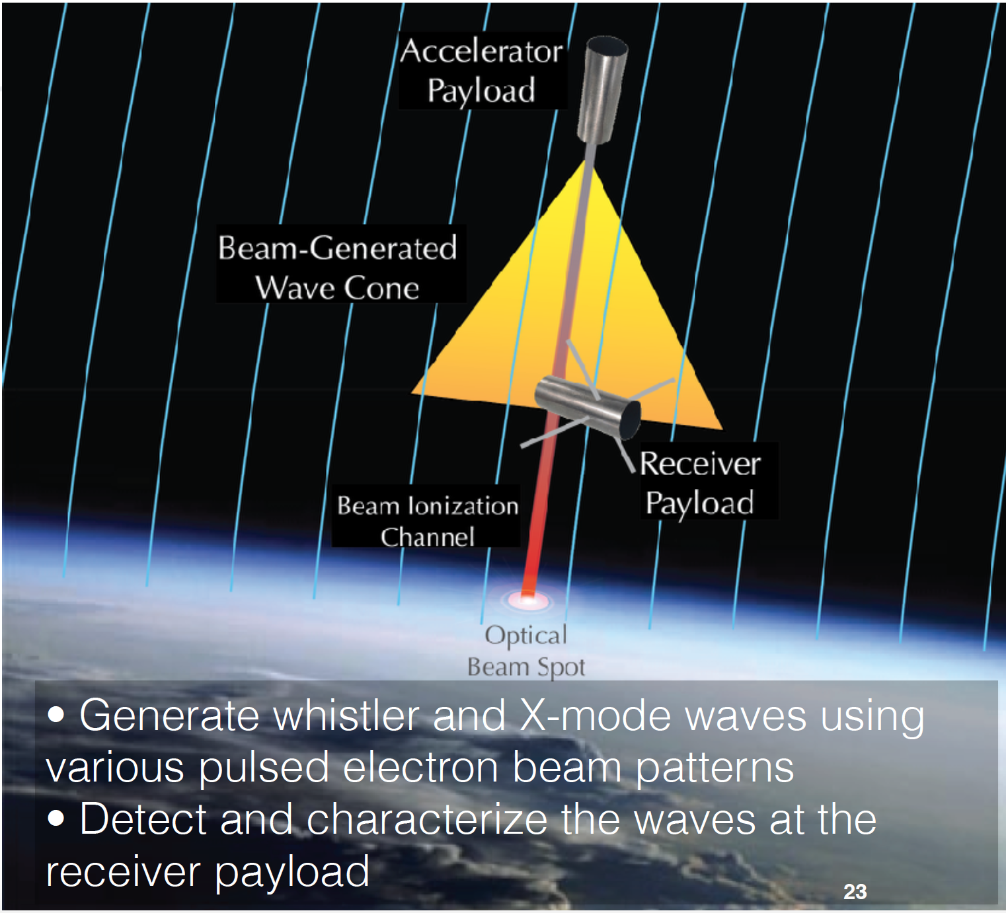
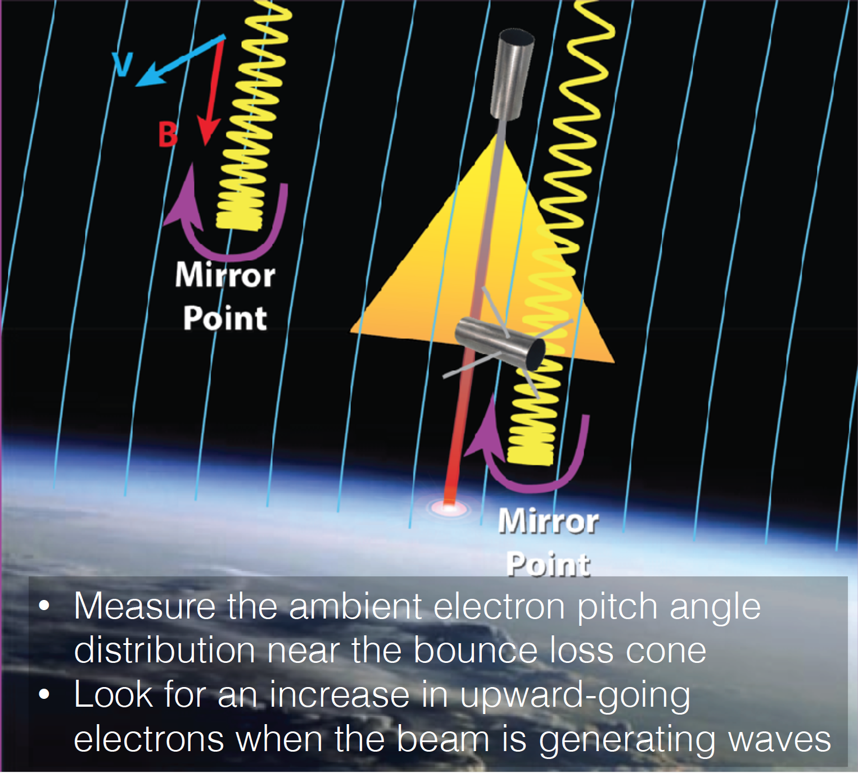
Beam Plasma-Interaction Experiment (Beam PIE)
+ Raise TRL on accelerator
LCAS proposal selected last week!

Slide 39
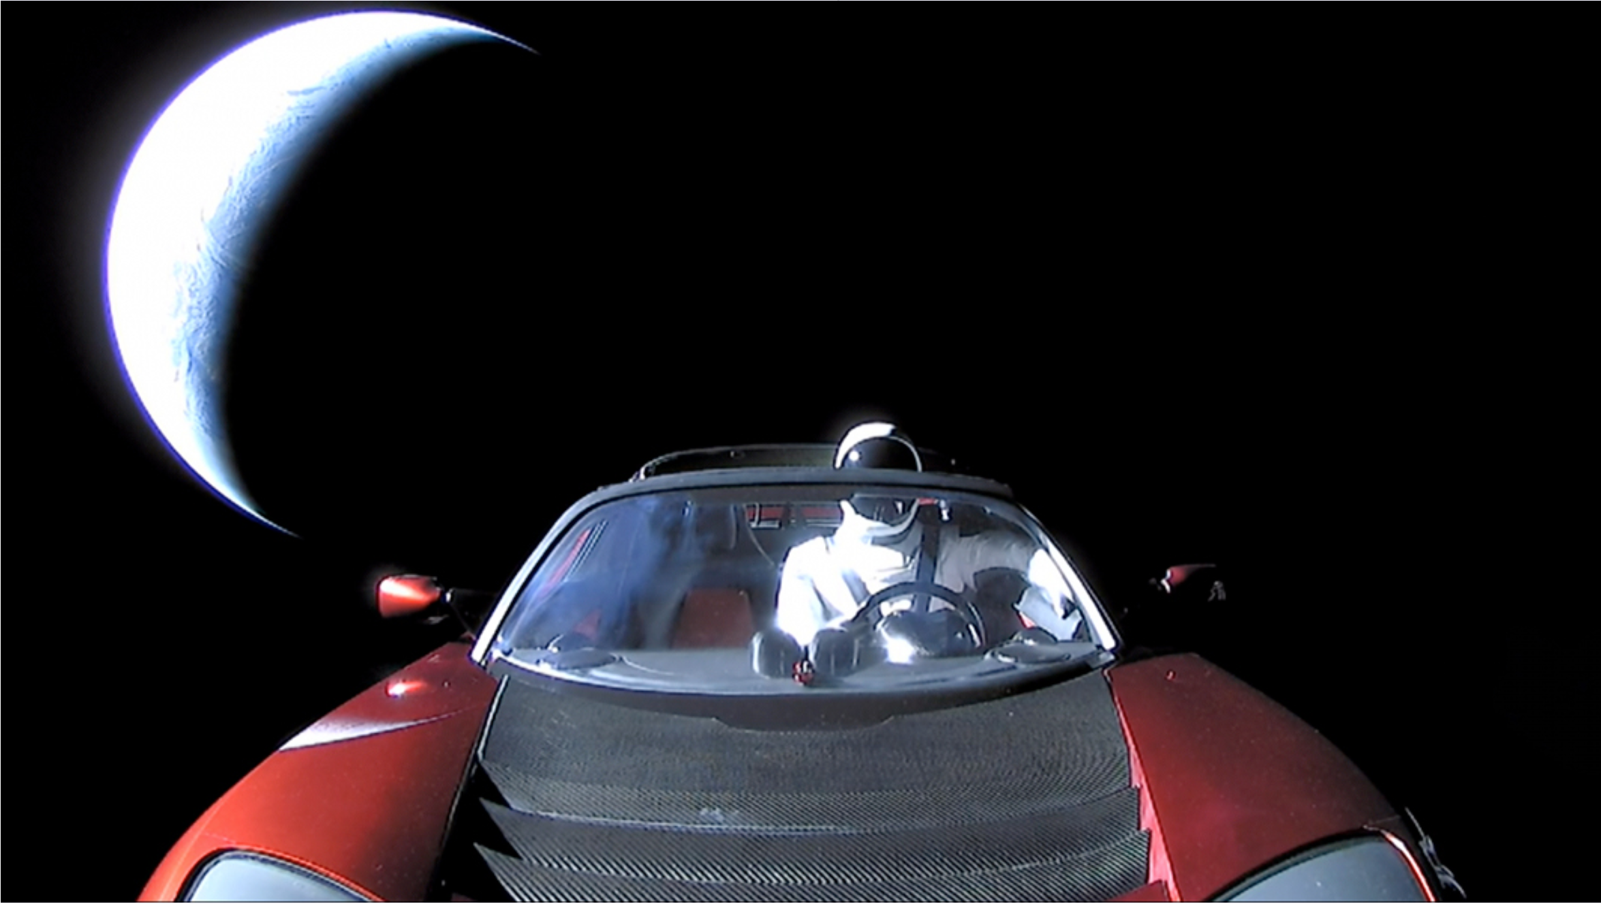
V. Conclusions
It’s a very exciting time for space research!

Slide 40
Teams
CONNEX:
LANL: E. Dors (PI), G. Reeves, G.L. Delzanno, M. Henderson, B. Carlsten, D. Nguyen, J. Lewellen
GSFC: E.A. MacDonald, L. Kepko
SLAC: J. Neilson
U. Calgary: E. Spanswick, E. Donovan
U. Colorado: R. Marshall
U. Michigan: B. Gilchrist
U. New Hampshire: H. Vaith
SRI: E. Sanchez
SSI: J.E. Borovsky
PSI: M.F. Thomsen
Beam PIE:
LANL: G. Reeves (PI), G.L. Delzanno, B. Carlsten, D. Nguyen, J. Lewellen, P. Fernandez, M. Holloway
GSFC: R. Pfaff, W. Farrell, D. Rowland, M. Samara
U. Calgary: E. Spanswick, E. Donovan
SRI: E. Sanchez
SSI: J.E. Borovsky

