Slide 1
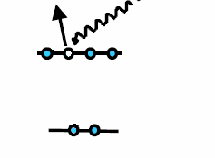
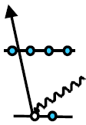



wavelength scaling intense laser-atom interactions
Louis DiMauro
optical ionization
x-ray ionization
2s²2p⁶
Keldysh
scaling
1s²
menu:
low-frequency regime
  quasi-classical view of strong field atomic physics
  scaling in strong field atomic physics
  measurements of scaling
high-frequency regime
Notes:
Look at strong field laser interactions at two extremes (1) optical (2) x-ray
Most of our discussion will focus on the low-freq regime and the virtues of longer wavelengths
Most SF experiments have been conducted at 0.8 or 1 um, +> BEST LASERS
The landscape is changing due to advances in optical engineering, especially in the mid-infrared
My group has been motivated to understand the scaling at long wavelengths

Slide 2

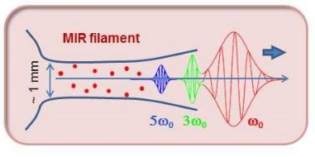
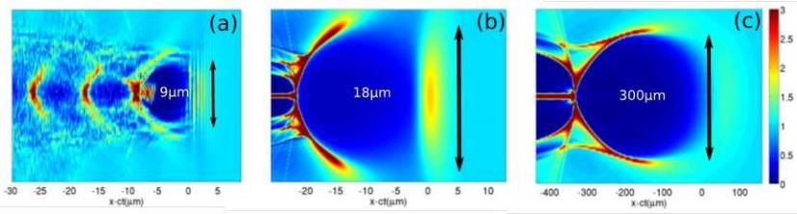
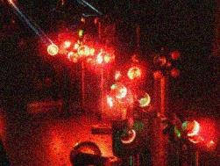
mid-infrared (1-5 µm) opens new opportunities
filamentation and damage
HHG in solids
intense MIR sources
electron & ion acceleration
intense MIR interactions have resulted in fundamental discovery
intense MIR interactions have open new research areas
intense MIR interactions are enabling new applications
Notes:
Let me stress that scaling is a fundamental property in physics that drives new discovery and applications..
For example, for propagation of light filaments, the critical power for self focusing scales as lambda^2 => channels carry more energy
For secondary sources like Electron acceleration: the shocks and wakes dependent upon the laser strength parameter which scales with lambda.
Thus, the MIR produces larger bubbles who volume grows as lambda^3 (use figure) Allowing for more detailed diagnostics and easy of injection.

Slide 3
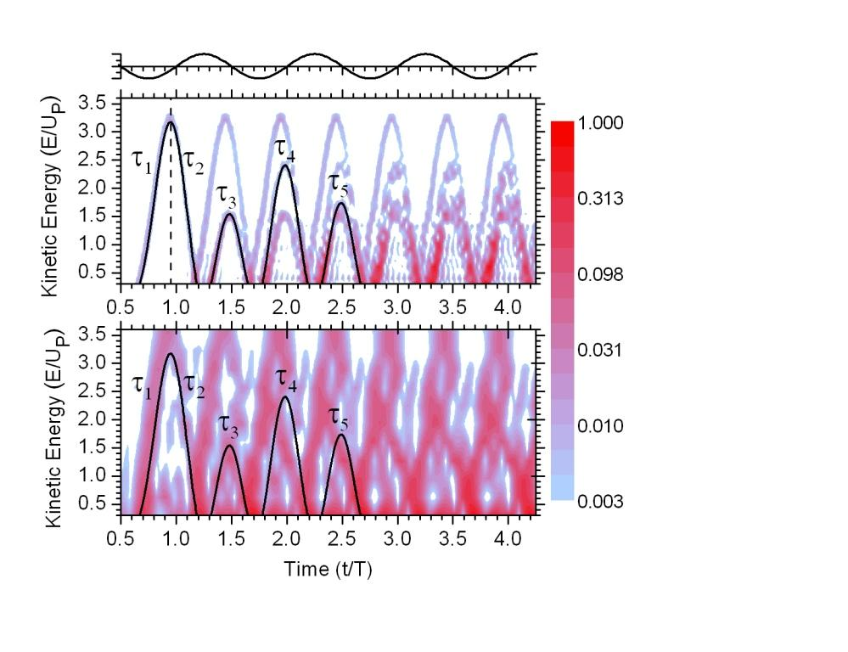
realization of the semi-classical behavior
a quantum view: argon, 200 TW/cm²
0.8 μm
the quantum picture mimics the classical behavior
2 μm
@ longer wavelength
the picture coalesces around
the classical result
Tate et al. PRL 98, 013901 (2007)
Notes:
Understanding and exploiting the semi-classical view has been a major thrust in my group.
Some early calculations supplied us with some insight.
Here what happens when you generate HHG from argon using ti:sapp
You see that the max energy is 3Up but what is Up

Slide 4
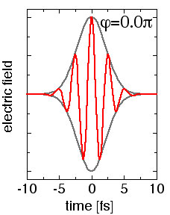
what is a strong-field?: the atomic gauge
r = 5×10⁻⁹ cm
Coulomb law:
E= q/r² ~ 5×10⁹ V/cm ≡ 1 au
+
-
what laser intensity gives an equivalent field strength?
Notes:
My definition of strong field is the Coulomb field
Easy for lasers and XFELs? But insignificant to explain the interactions

Slide 5
basics: motion of the free electron
classical equations:
F = mx = -eΕ sin(ωt + φ_{o})
mx = (eΕ/ω) cos(ωt + φ_{o}) + mv_{o}
cycle-averaged energy
U_{p} ≡ <E_{k}> = 1/T∫½mx²dt = (eΕ)²/4mω²
⋅⋅
⋅
2α
ponderomotive or quiver energy: U_{p} ∝ λ² Ι /4
displacement: a ∝ λ ² E
for 0.8 μm (2 μm) laser at 1 PW/cm²
U_{p} = 60 eV (360 eV)
a = 25 A (150 A)
think in ponderomotive units !!!
Notes:
Describe motion (Field dominates motion ⇒ tailoring could be effective)
The size of this potential exceeds the electron’s binding energy and the quiver amplitude >> atomic scale
the previous figure showed that the Q systems behaves classically at longer λ but the quiver motion at longer wavelengths also couples large energy

Slide 6
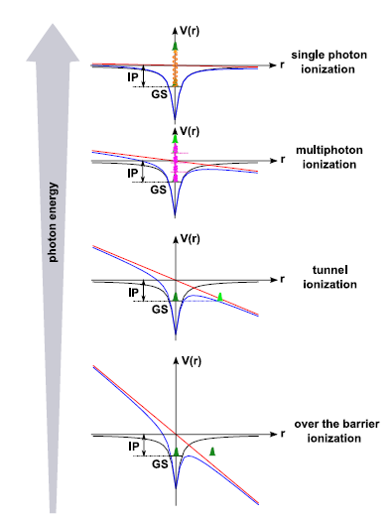

Keldysh evolution of ionization mode
γ > 1
Keldysh (1963)
optical frequency
tunneling frequency
γ = 1
γ ≡
= (I_{p}/2U_{p})^{1/2} ∝ λ⁻¹ Ι^{-1/2}
$$\sim I_{p}/eE$$
intensity
γ < 1
Notes:
Keldysh provided a gauge of thinking about the escape (ionization)

Slide 7
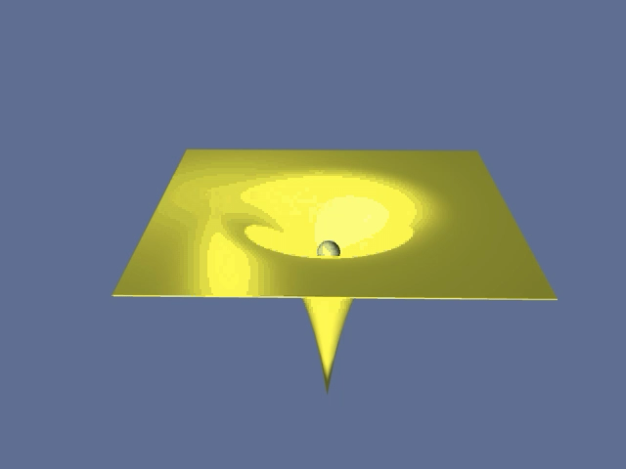
rescattering or 3-step model: the cartoon
Schafer, Yang, DiMauro & Kulander, PRL, 70, 1599 (1993)
Corkum, PRL, 71, 1994 (1993)
tunneling + propagation + interaction
classical trajectories have different release time (phase), propagation time and harmonic emission times & energy
maximum return energy is 3.17U_{p}
maximum electron energy 10U_{p}
physics is inherently sub-cycle
Notes:
Put the elements together to define a semi-classical view: tunneling followed by quivering
Up depends on Intensity and Wavelength, I have a knob to promote tunneling and increase electron energy
Electron can recombine (hhg), elastic scatter (10Up) or inelastic scatter (multiple ionization)

Slide 8
λ-scaling for strong-field parameters
Keldysh
optical frequency
tunneling frequency
γ ≡
= (I_{p}/2U_{p})^{1/2} ∝ λ⁻¹ Ι^{-1/2}
experimental tools
titanium sapphire (0.8 μm): 2-10 cycles, CEP
opa & opcpa (2 μm): 2-10 cycles, CEP
Cr:ZnSe (2.4 μm): 5-15 cycles.
opa (4 μm): 8 cycles, 10¹⁴ W/cm²
ponderomotive potential
U_{p} ∝ λ² Ι
strong-field regime
attochirp
∂²φ/∂²ω ∝ τ_{f} /U_{p} ∝ λ⁻¹
bound-state & continuum intensity parameters
(Krainov, Reiss, Smirnov)
z₁ ≡ γ⁻² ∝ λ² and z ≡ U_{p}/hν ∝ λ³
strong-field condition: γ < 1 and z₁ & z >> 1
Notes:
Keldysh: if frequency is low or the field amplitude is high then electron can tunnel (establishes the deterministic view)
Potential potential: energy coupling into WP
Attochirp: the WP dispersion
More complete metrics based on SFA:
SO ESTABLISHING THE SF CONDITION REQUIRES
Just state have coverage from 1-4 um

Slide 9
perturbative limit for optical frequencies
1 au
bound
continua
pert. limit
z₁ = z ≡ 1
wavelength is a continuous experimental control for strong-field studies
near-visible light expect perturbative breakdown ≥ 10¹² W/cm²
strong-field limit at higher intensity defined by z₁ (bound)
Notes:
Plot z1 & z = 1
Observe continuum states breaks down first (define pert break down as 10%)
Break down occurs for a field value < atomic unit
Not much I can do with the intensity because of saturation (depletion).
Wavelength is a continuous knob

Slide 10
time-dependence of classical trajectories
electron position
x
x(t_{i})=0
v(t_{i})=0
0
1
time (T_{L})
return
energy
3U_{p}
short traj.
long traj.
chirp > 0
chirp < 0
2U_{p}
1U_{p}
0
return time (t_{e})
*modified from talk by B. Mahieu (CEA)
Notes:
LETS LOOK A LITTLE DEEPER
Illustrate the difference between short and long trajectories
Chirp (atto) has an impact on our ability to form atto pulse
Can impose some degree of control on these trajectories

Slide 11
time-dependence of classical trajectories
return
energy
3U_{p}
short traj.
long traj.
chirp > 0
chirp < 0
2U_{p}
1U_{p}
0
return time (t_{e})
Notes:
This the connection to the quantum picture

Slide 12
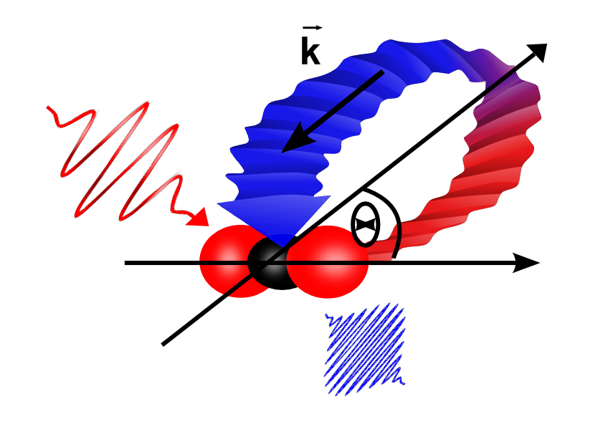


measurements in strong fields
intense MIR
elastic & inelastic scattering
[A”(ω), P(θ_{E},θ_{M})]
attosecond burst
[A(ω), φ(ω,θ_{M})]
e
photoelectron spectroscopy
e⁻ momentum analysis
RABBITT/streaking measurement
spectral amplitude & phase

Slide 13
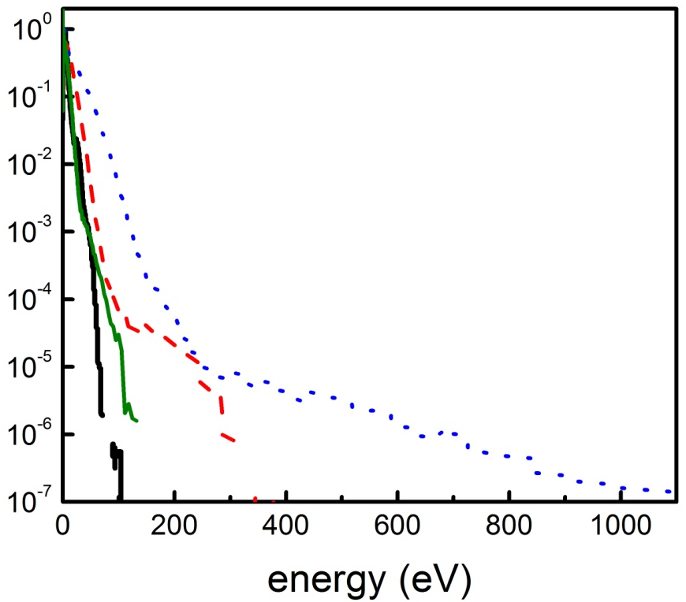
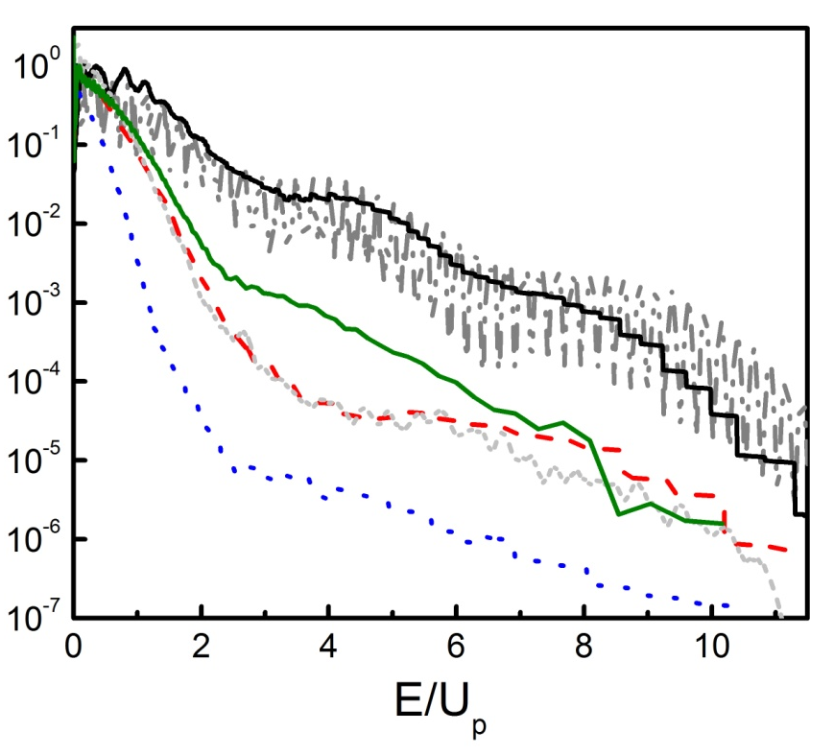
production of high-energy electrons
ponderomotive potential:
U_{p} ∝ λ² Ι
measured xenon photoelectron energy distributions @ constant Ι
0.8 μm
1.3 μm
2.0 μm
4.0 μm
tdse
γ = 1.3
electron counts (au)
γ = 0.3
classical limit
(no interaction)
classical limit
(elastic scatter)
longer wavelength promotes classical behavior
longer wavelengths produce higher electron energies!
P. Colosimo et al. Nat. Phys. 4, 386 (2008)
Notes:
In scaled units, as I move from large gamma to γ<1 the distribution takes on classical signature

Slide 14
wavelength dependence: fixed U_{p} (~ 15 eV)
measured xenon photoelectron energy distributions
1.7 μm, 70 TW/cm²
2.0 μm, 48 TW/cm²
2.3 μm, 36 TW/cm²
in fact, γ = 0.6 is constant!
Notes:
Now let’s see the beauty of the invariance at long wavelength.
If the field dominates then the electron dynamics become invariant to Up

Slide 15
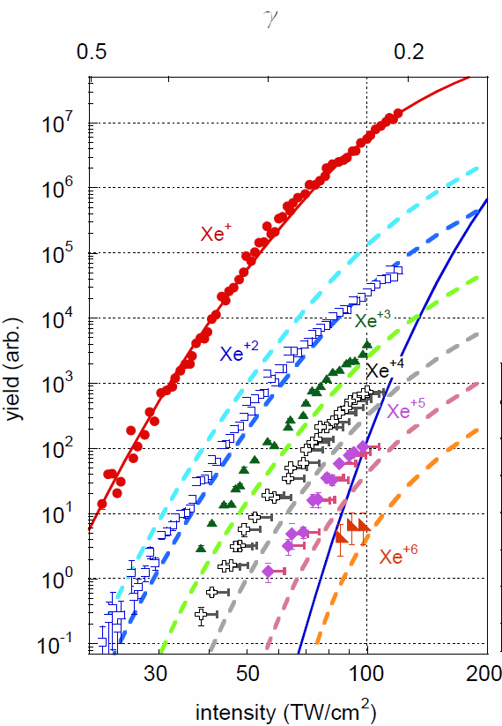
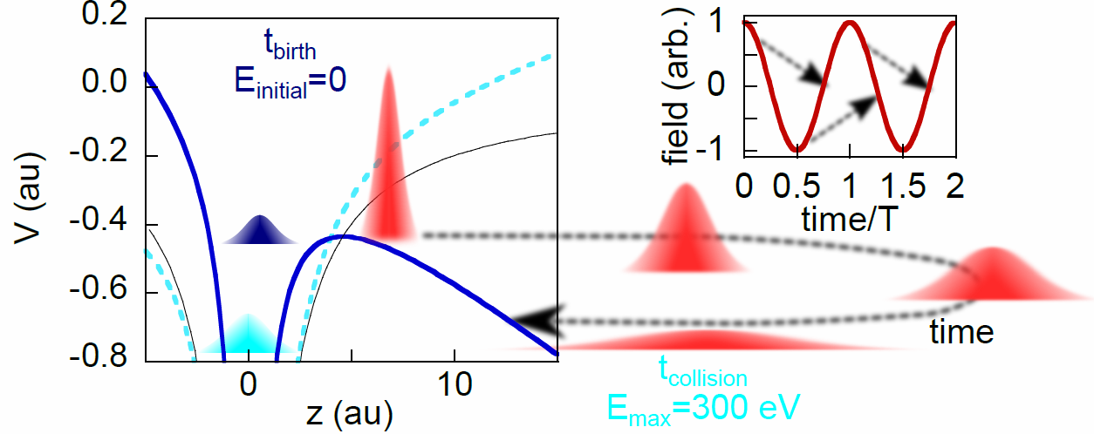
inelastic rescattering: (e,ne) multiple ionization
γ
xenon, 4 μm
ADK (Xe)
E_{m} = 300 eV
@ 4 μm
inelastic (e,ne) collisions results in multiple ionization of xenon
maximum return energy:
3U_{p} ∼ 300 eV > ΣI_{p}(O shell) ∼ 244 eV (800 photons)
@ 4 μm
highly charged ion (n = 2-6) production before neutral depletion
ADK (Xe⁺)
A. DiChiara et al. PRL 108, 033002 (2012)
Notes:
Discuss sequential in the context of tunnel ionization
Xe ionize agrees with ADK but ADK severely underestimates Xe+ ionize
In fact, the experiment shows that 6e can be ripped off
Use rescatter cartoon to explain inelactic e-ne inelastic scattering

Slide 16
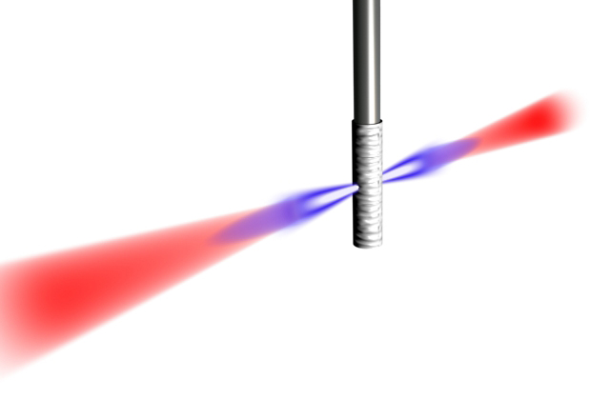
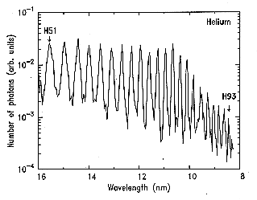
high harmonic generation in gases
nonlinear frequency conversion: ω_{q} = qω_{f}
helium
H51
bandwidth
H79
800 nm
40-5 fs
1 PW/cm²
Saclay, Chicago, 1987
16
14
12
10
8
wavelength (nm)
the coherent frequency comb is the Fourier transform of a periodic train of attosecond pulses in the time domain
access to spectral amplitude and phase

Slide 17
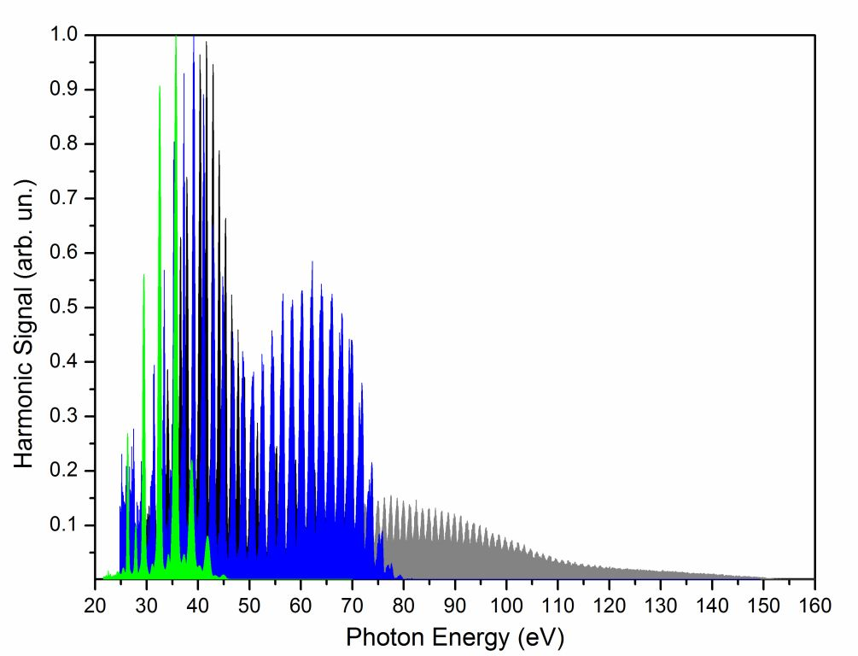
production of high-energy photons: HHG
argon HHG
110 TW/cm²
0.8 μm
1.3 μm
2 μm
λ²-scaling produces sufficient number of photons ~200 eV
P. Colosimo et al. Nat. Phys. 4, 386 (2008)
Notes:
The cutoff extends
The comb becomes spectral denser

Slide 18
scaling to kilovolt harmonic energies
3.9 μm driver pulses produces hard x-rays
JILA + Vienna TU
Notes:
Murnane/Kapetyn and Balkuska

Slide 19
origin of single-atom dispersion: attochirp
electron position
x
x(t_{i})=0
v(t_{i})=0
the energy dispersive
electron wave packet
0
1
time (T_{L})
harmonic
order
short traj.
long traj.
chirped high harmonic emission
21
chirp > 0
chirp < 0
19
17
15
0
emission time (t_{e})
*modified from talk by B. Mahieu (CEA)
Notes:
First thing, select one trajectory class
Minimize the chirp using MIR

Slide 20
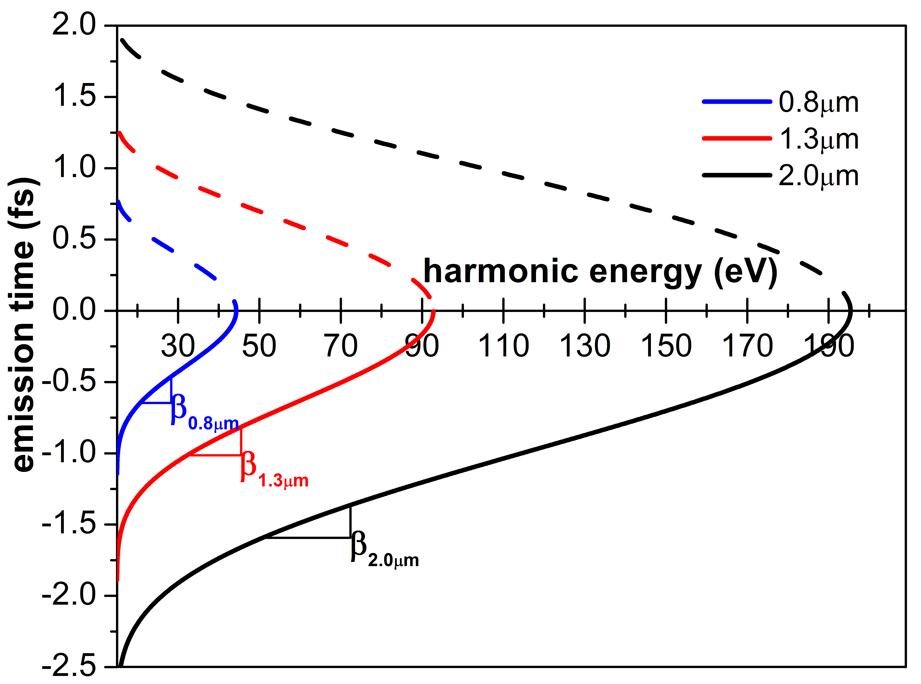
λ-dependence of the attochirp
classical scaling: chirp ∝ τ_{f} /U_{p} ∝ λ/ λ² = λ⁻¹
verified by quantum calculations (Tate et al. PRL)
longer-λ produces inherently shorter attosecond bursts

Slide 21
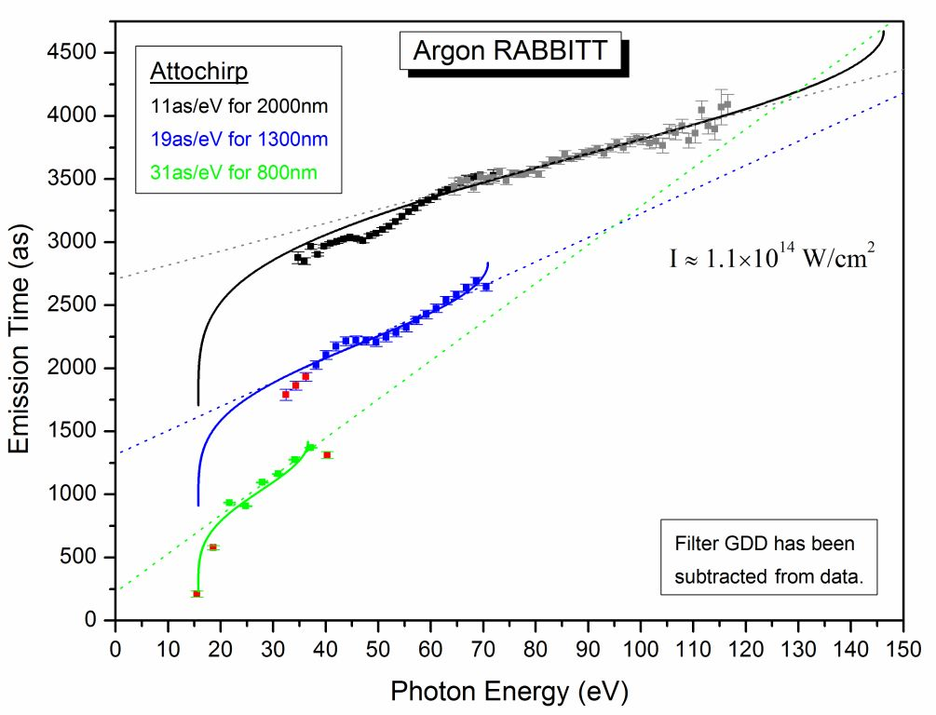
RABBITT: λ-dependence of the attochirp
2 μm
1.3 μm
0.8 μm
the attochirp decreases with λ at constant intensity
the spectral phase is more complex than classical predictions
can produce 100 as pulses from 30-150 eV
Doumy et al. PRL 102, 093002 (2009)
Notes:
Briefly describe that the metrology measures the amp and phase => reconstruct the temporal domain

Slide 22
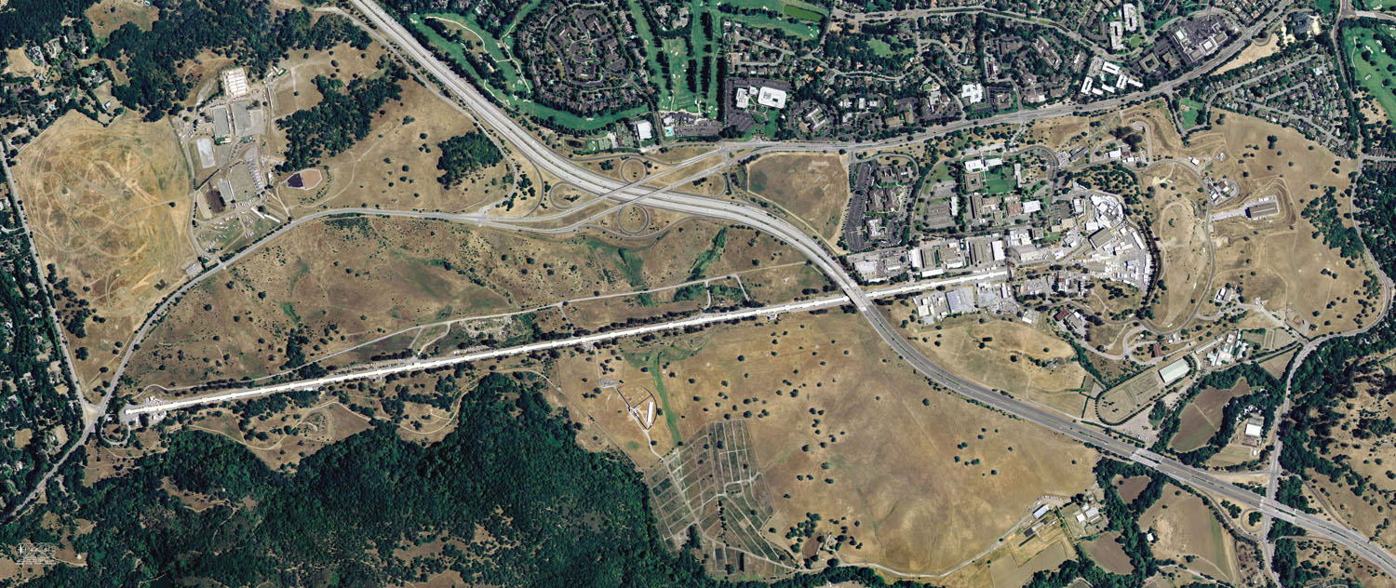

what happens at high frequency?
in 2009 the world’s first x-ray laser became operational at SLAC
3 kilometers
SLAC site, Menlo Park, CA
Notes:
Briefly describe XFEL
Wiggle relativistic electrons that they lose energy as x-rays

Slide 23
LCLS XFEL parameters
photon energy: 0.8-8 keV
number of photons: 10¹³/shot
pulse energy: 1 mJ
peak power: 5 GW
focused spot size: 1 μm
flux: 10³³ cm⁻² s⁻¹
fluence 10⁴ photons/A²
intensity: 10¹⁸ W/cm²
duration 200-0.5 fs
LCLS in atomic units
@ 10¹⁸ W/cm², E ≅ 5
@ 1 keV photon energy, ω ≅ 37

Slide 24
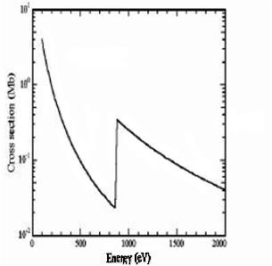
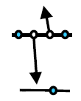
contrast optical and x-ray ionization
laser ionization neon
neon photoabsorption
n=2
x-ray ionize inner-shell electrons
hole formation is an excited state
hole is filled by Auger or fluorescence decay
2s²2p⁶
n=1
1s²
x-ray ionization
valence electrons absorb optical photons
single active electron approximation is good
neon inner-shell excitation
K-edge: 870 eV
Auger yield 98%
Auger clock - τ_{1s}: 2.4 fs
fs
Auger
Notes:
Laser at least 1 electrons
X-ray at least 2 electrons

Slide 25
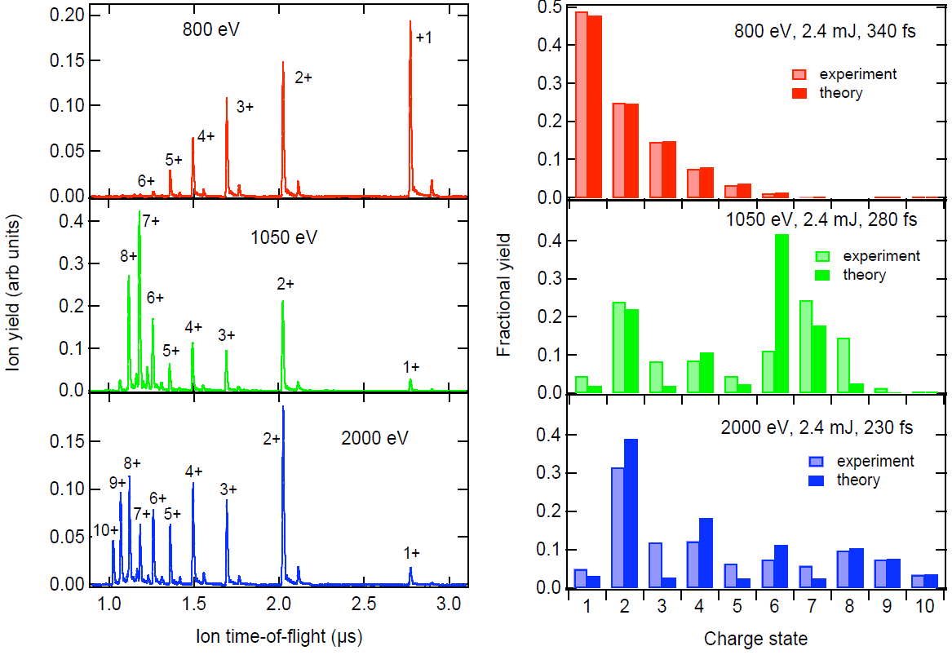
theory models intense x-ray-atom interaction
10¹⁷ W/cm² !!!
conclusion, simple perturbative 1-photon absorption is sufficient
L. Young et al. Nature (2010)
Notes:
Use Rohringer/Santra rate equations.
Implement intensity averaging.
Fluence set by Ne 9+/10+ ratio at 2000 eV. Gives the absolute yields as well.
Fluence set by charge state ratios at 800 eV.

Slide 26
strong-field metrics: global plot
optical
x-rays
1 au
core
bound
pert. limit
continua
1 au (lcls)
pert. limit
@ x-ray frequencies
distortion of the bound state dominates
non-perturbative 10¹⁹⁻²¹ W/cm²
@ optical frequencies
distortion of the continuum dominates
non-perturbative > TW/cm²
Notes:
At these intensities, the valence is not really transparent
The real surprise, is that correlated electron motion is possible
All current theory is irrelevant

Slide 27
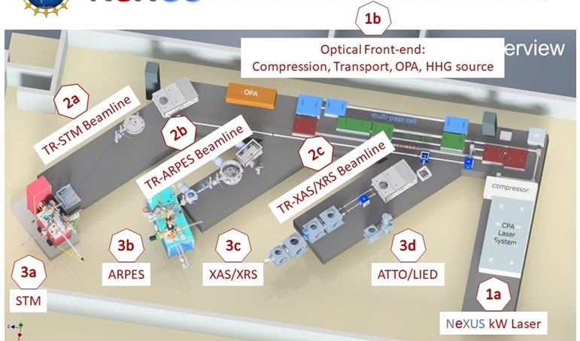
NSF NeXUS: mid-scale femto/atto XUV user facility
kW-class fiber laser drives XUV HHG sources (10-200 eV) at 0.1-2 MHz
3 beamlines deliver tailored light to users
5 end-stations provide different time-resolved capabilities
STM: Scanning Tunneling Microscope
ARPES: Angle-resolved photoemission spectroscopy
XAS/XRS: X-ray absorption- reflection spectroscopy
ATTO: attosecond spectroscopy
LIED: Laser-induced electron diffraction
Notes:
Our understanding of the low-frequency regime is sufficient robust that mid-scales facilities are being developed
Mid-scale that was awarded at the same time as the UM ZEUS facility

Slide 28
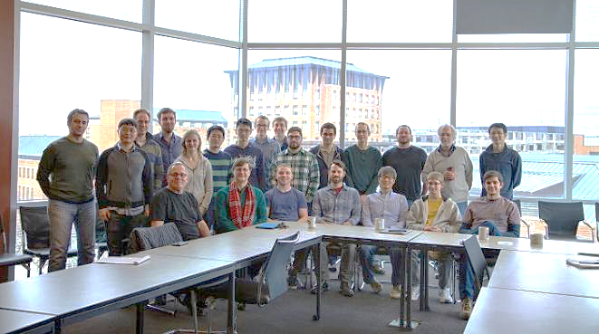


Agostini/DiMauro group
post-docs
Greg McCracken
Lisa Li
Yaguo Tang
Abraham Camacho
Slava Leshchenko
graduate students
Kent Talbert Andrew Piper
Bryan Smith Dan Tuthill
Eric Moore Joey Liu
Dina Eissa Zifan Wang
Aziz Alqasem
OSU: Pierre Agostini
Postdoc openings in attosecond science
Contact DiMauro at dimauro.6@osu.edu

Slide 29
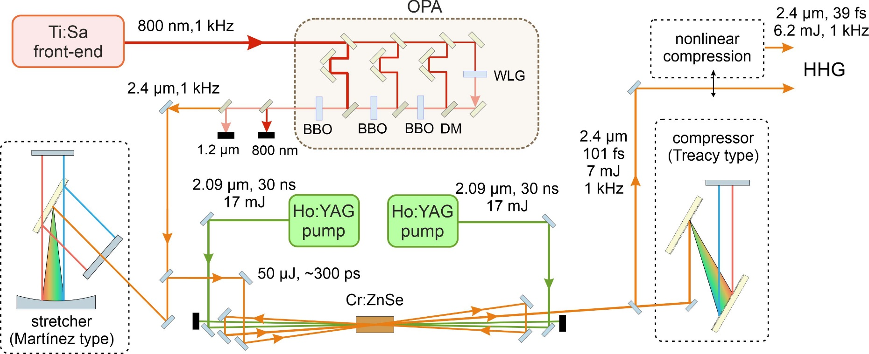
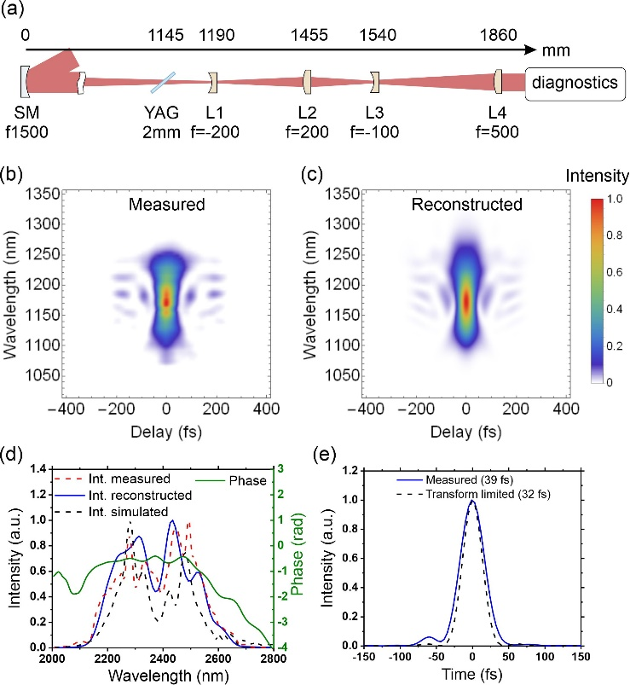
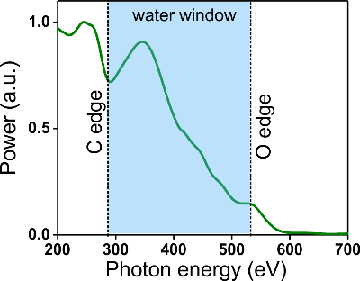
kilohertz rep rate direct amplification in the MIR
nonlinear compressor
gas-phase HHG
MIR laser systems based on direct material pumping are emerging and are competitive with CPA titanium sapphire
neon
HHG
2.4 μm
Notes:
Why do we use ti:sapph? Because it is a robust material capable of amplifying UF pulses to the PW-level!
But one size does not fit all and in certain application being at longer wavelength is preferred.
When I started MIR sources were mainly based on parametric processes but over the last decade we have seen tremendous progress in direct amplification in the 1-10 um range
We recently developed a laser based on Cr:ZnSe at 2.4 um, 1 KHz that is competitive with Ti:sapp but at longer wavelength

Slide 30
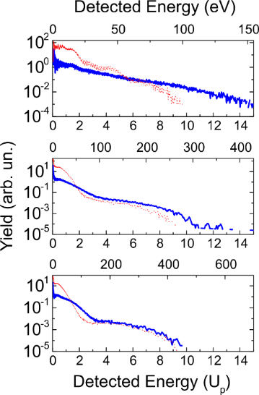
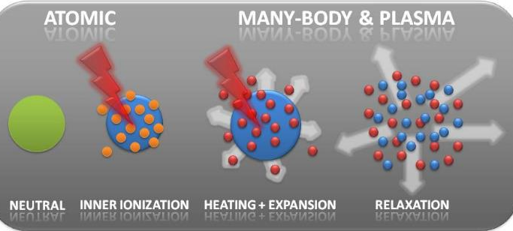
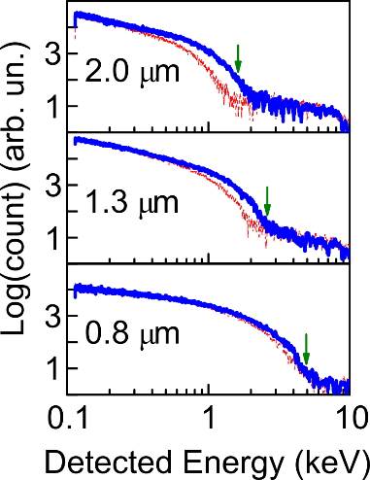
how about MIR interaction with argon nanoparticles
electrons
ions
0.8 μm
10 nm Ar
Ar atom
1.3 μm
increasing λ @ constant Ι
e distribution ⇒ classical
e energy increases
2.0 μm
ion energy decreases
ion distribution ⇒ asymmetric
Notes:
Elections (red is atomic Ar and blue is 10 nm clusters)
At ti:sapp: cluster produces higher energy electrons, this has been understood in terms of inverse bermshallung
At longer wavelengths the cluster looks more and more like the atom ➔ rescattering is important
In addition, at longer wavelength the electron energy increases (atom like but not a simple λ2 scaling)
Ions
As λ increases the ion energy decreases
As λ increases the emission becomes anisotropic => process is driven along field (column formation)

Slide 31




types of diffraction configurations
monochromatic beam
CED, LIED (timing)
broadband wave packet
FABLES, not CED

Slide 32
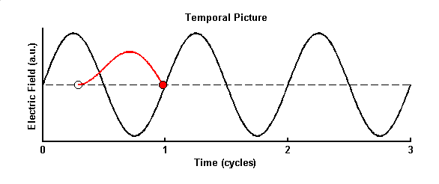
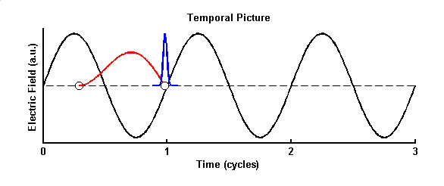
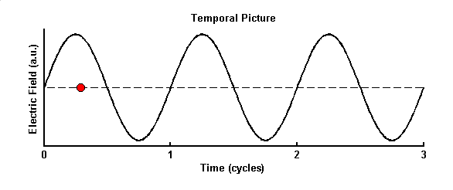
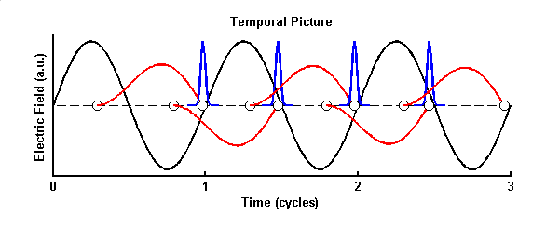
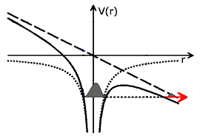
semi-classical description of high harmonic emission
e⁻ in Coulomb + laser fields
I
The electron tunnels through the
distorted Coulomb barrier
II
The free electron is accelerated
by the field, and may return to the
atomic core
III
The electron recombines with the atom, emitting
its energy as a photon
Notes:
Foreign concept for thinking about an atom interacting with light
However the classical physics emerges from the strong field dominating the continuum motion

Slide 33
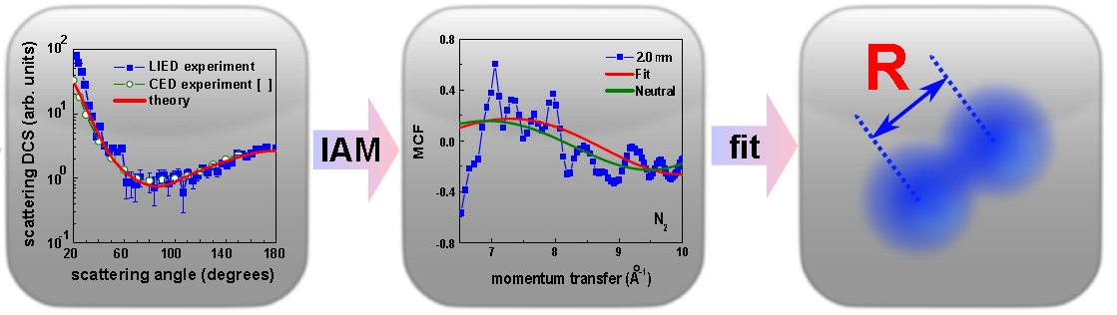
gas-phase electron diffraction
DCS
MCF
typical parameters
high-energy (10-100 keV) cw e-beam promote hard collisions
invoke independent atom model
momentum exchange (q) determines spatial resolution
small-angle scattering (q ∝ p_{i}sinθ/2) ⇒ large initial momentum
q-range (θ → 0°) 2-30 Å⁻¹
Notes:
Momentum exchange Q prop p_{i}sin(O/2)
Spatial resolution is 1/Q, typically 1 pm resolution

Slide 34
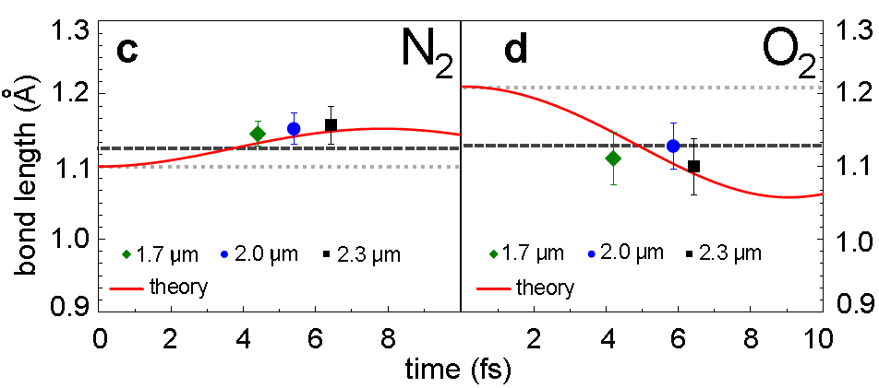
LIED is time-resolved
neutral
ion
ion
neutral
direct observation of a bond change
estimate 5 pm spatial & 2-3 fs (?) timing resolution
C. Blaga et al., Nature 483, 194 (2012)
Notes:
Sigma electron in O2 (anti-bond)

Slide 35
what is a strong-field?: the atomic gauge
r = 5×10⁻⁹ cm
Coulomb law:
E= q/r² ~ 5×10⁹ V/cm ≡ 1 au
+
-
what laser intensity gives an equivalent field strength?
Notes:
Easy for lasers and XFELs? But insignificant to explain the interactions

