Slide 1


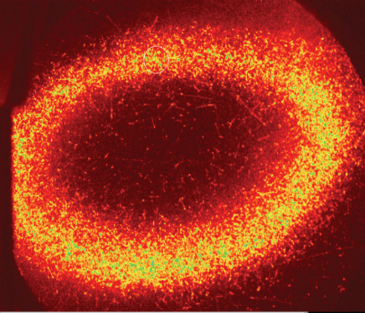


Fundamental Tests with Antihydrogen Atoms
Joel Fajans
U.C. Berkeley
and the ALPHA Collaboration
Work supported by:
NSF/DOE Partnership in Basic Plasma Science
Also supported by CNPq, FINEP/RENAFAE (Brazil), ISF (Israel), MEXT (Japan), FNU and the Carlsberg Foundation (Denmark), VR (Sweden), NSERC, NRC/TRIUMF AIF FQRNT(Canada), and EPSRC, the Royal Society and the Leverhulme Trust (UK).
Hollow antiproton plasma
ALPHA 2012
Researchers have been interested in antihydrogen since at least the 1980’s.
Interest in antihydrogen stems from tests of fundamental physics:
  Charge-Parity-Time (CPT) invariance:
    Is the spectrum of antihydrogen the same as the spectrum of hydrogen?
  Weak Equivalence Principle (WEP):
    Does antimatter gravitate in the same fashion as normal matter?
Violation of CPT or WEP would revolutionize fundamental physics.
  Both CPT and WEP are very likely to hold, and yet…

Slide 2
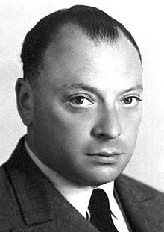
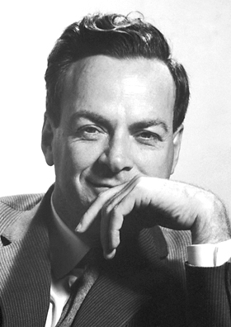
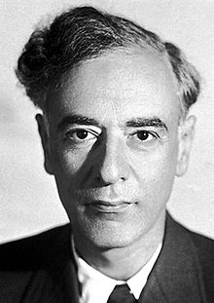
Could CPT Be Violated?
Physicists have been wrong before…
  P violation---Wolfgang Pauli:¹
  "I do not believe that the Lord is a weak left-hander, and I am ready to bet a very high sum that the experiments will give symmetric results.”
  CP violation---Lev Landau:²
  “If CP is violated, I will hang myself.”
Wolfgang Pauli
Richard Feynman
Lev Landau
Hints that CPT and WEP might not hold come from the Baryogenesis problem:
  Why is there so little antimatter in the universe?
  Both CPT and WEP violation could solve the Baryogenesis problem.
  Dark matter…
¹Pauli in a letter to Victor Weisskopf, quoted in the Ambidextrous Universe, by Martin Gardner.
² Oral history, as related by Dima Budker.

Slide 3
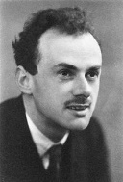
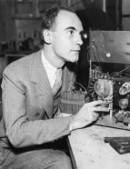
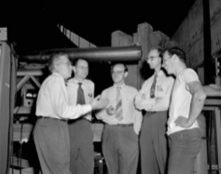
Antihydrogen Research History
1928: The existence of positrons was predicted in a series of papers by Dirac.
1933: The positron was discovered by Anderson at Caltech.
1955: The antiproton was discovered by Chamberlain, Segrè, Wiegand, and Ypsilantis in Berkeley.
1996: Antihydrogen was produced at accelerator scale energies at CERN and at Fermilab (1998).
  This antihydrogen was too energetic to be used to measure physics properties.
2000: Antiprotons were decelerated to 5.3MeV at CERN’s then new Antiproton Decelerator (AD) facility.
2002: Low energy (eV scale) antihydrogen was produced by the ATHENA and ATRAP collaborations at CERN.
  Hundreds of millions of antiatoms have been made to date.
  The antihydrogen atoms were untrapped, and lived for a few milliseconds before annihilating on the apparatus walls.
  Many researchers believe that antiatoms are best studied when trapped, not transitory.
Dirac
Anderson
Bevatron Team
Fermilab Experiment
ATHENA Antihydrogen Event
G. Baur, et al, Production of antihydrogen, Phys. Lett. B, 368, 251 (1996).
G. Blanford, D. C. Christian, K. Gollwitzer, M. Mandelkern, C. T. Munger, J. Schultz, and G. Zioulas, Observation of Atomic Antihydrogen, Phys. Rev. Lett. 80, 3037 (1998).
ATHENA, Production and detection of cold antihydrogen atoms, Nature 419, 456 (2002).
ATRAP, Background-free observation of cold antihydrogen with field-ionization analysis of its states, Phys. Rev. Lett. 89, 213401 (2002).

Slide 4
Antihydrogen Research History
2010: ALPHA trapped 38 antihydrogen atoms.
  Progress has been rapid since 2010.
    In 2011, we trapped approximately 500 antiatoms, and held some for as long as 1000s.
    ALPHA now can trap about 20 antiatoms in five minutes, as opposed to the 38 antiatoms total in 2010.
    In 2017, we trapped over 70,000 antiatoms.
ALPHA, Trapped Antihydrogen, Nature 468, 673 (2010).
ALPHA, Confinement of antihydrogen for 1000s, Nature Physics 7, 558 (2011).
ALPHA, Antihydrogen Accumulation For Fundamental Symmetry Tests, Nature Comm. 8, 681 (2017).
ALPHA, Enhanced Control And Reproducibility Of Non-Neutral Plasmas, Phys. Rev. Lett. 120, 0025001, (2018).
Annihilation Locations of Previously Trapped
Antihydrogen Atoms After Release

Slide 5
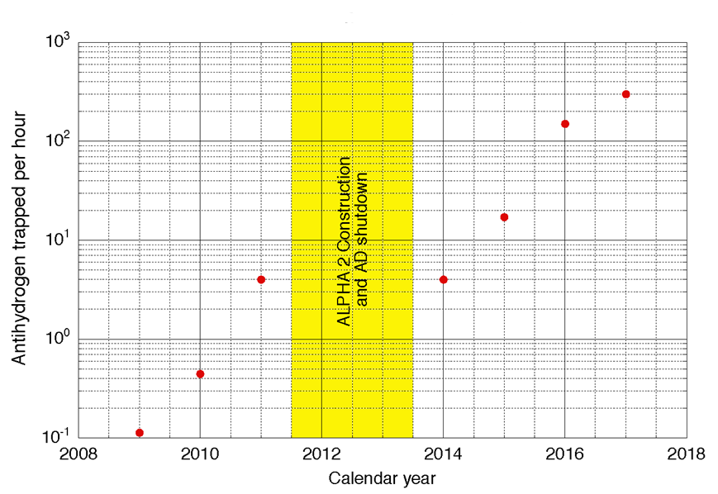
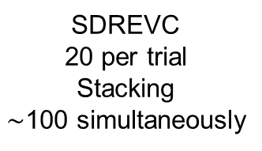
Milestones in Antihydrogen Trapping
>1000 trapped
simultaneously
>70 000 total
1 per trial
SDREVC
20 per trial
Stacking
$\sim$100 simultaneously
Plasma Techniques:
Octupole trap
Radial compression
Electron kickout
Autoresonance mixing
Evaporative cooling
Ion cleanout
Faster plasma cycles
SDREVC
Smerge mixing
Adiabatic expansion cooling
Stacking
Publish
1 in 10 trials
38 total
1 in 35 trials
6 total
J. Fajans and A. Schmidt, NIM A, 521: 318, (2004).
J. Fajans, et al., Phys. Rev Lett. 95, 155001 (2005).
ALPHA, Phys. Rev. Lett, 100, 203401 (2008).
LS2 Shutdown 2019-2021
ALPHA, Phys. Rev. Lett. 106, 025002 (2011).
ALPHA, Phys. Rev. Lett. 105, 013003 (2010)
ALPHA, Nat. Commun., 8, 681, (2017).
ALPHA, Antihydrogen accumulation for fundamental symmetry tests, Nat. Commun., 8, 681, (2017).
ALPHA, Phys. Rev. Lett,, 120, 025001 (2018).

Slide 6
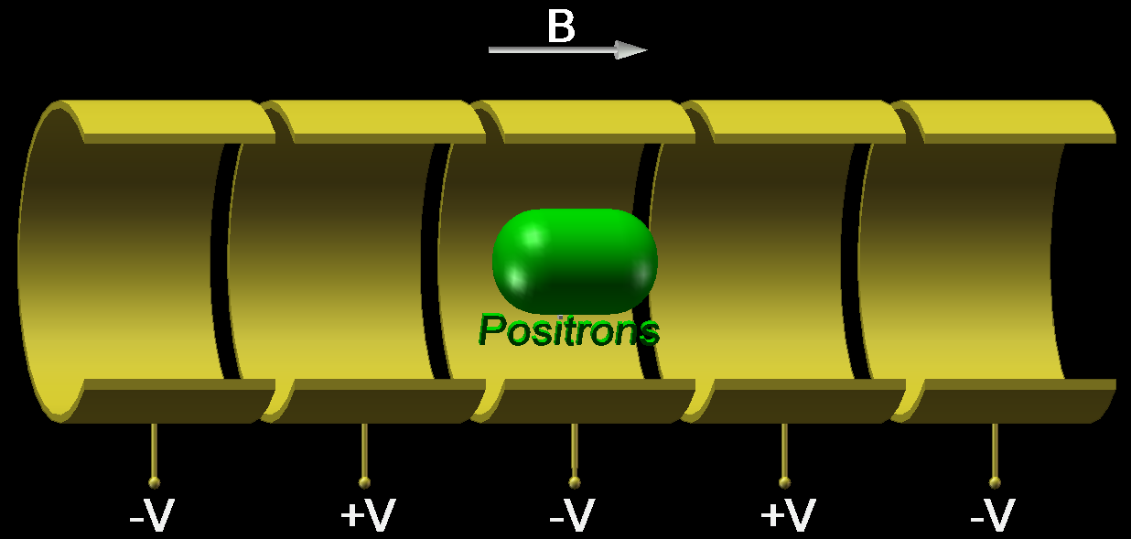
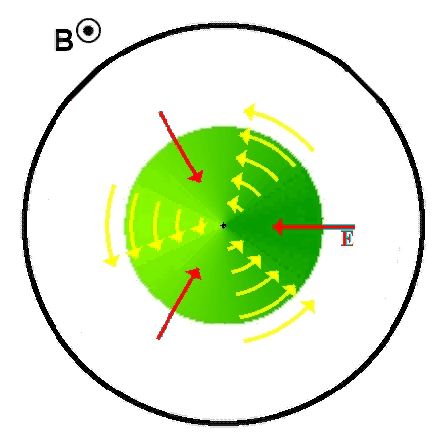

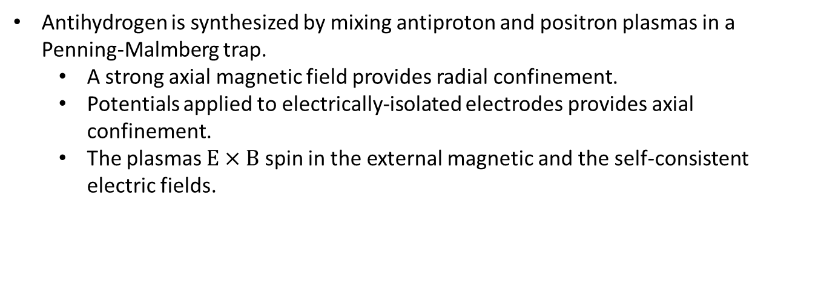
Antimatter Plasmas
Antihydrogen is synthesized by mixing antiproton and positron plasmas in a Penning-Malmberg trap.
  A strong axial magnetic field provides radial confinement.
  Potentials applied to electrically-isolated electrodes provides axial confinement.
  The plasmas $\text{E}×\text{B}$ spin in the external magnetic and the self-consistent electric fields.
B

Slide 7
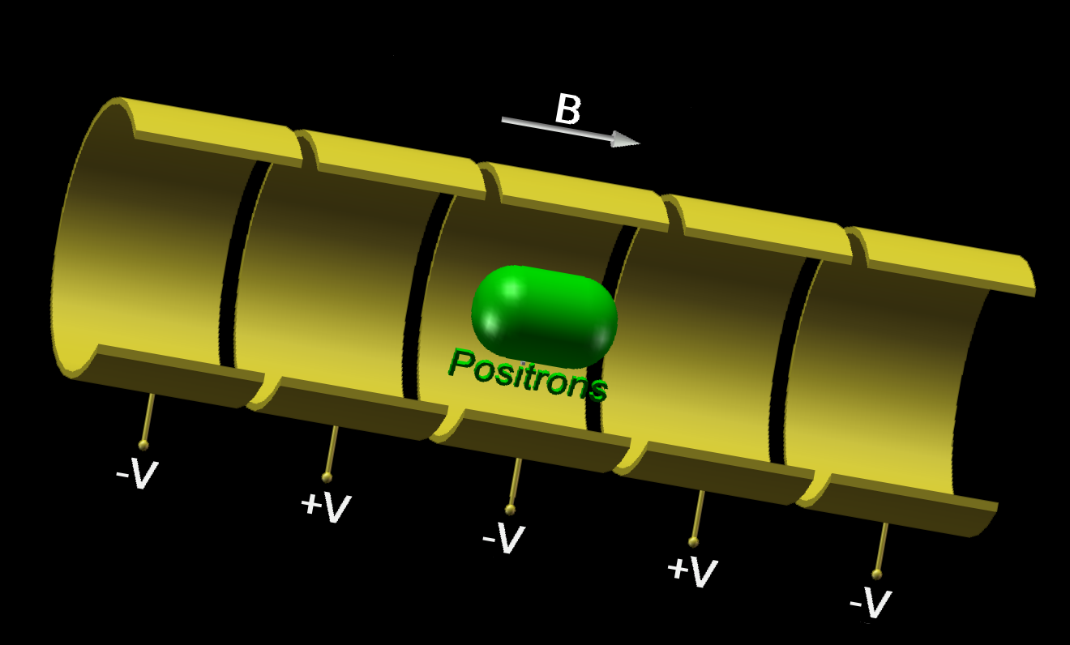





Plasmas and Mixing
Antihydrogen is synthesized by mixing antiproton and positron plasmas in a Penning-Malmberg trap.
  The positrons come from a Surko-style positron accumulator.
    Positron plasma parameters:
      N = 20M
      r = 1mm
      L = 10mm
      n = 10⁸ cm⁻³
      T = 10K
  The antiprotons come from the AD at CERN.
    Antiproton plasma parameters:
      N = 20k
      r = 1mm
      T = 100K
Once these plasmas are made, they are mixed together, and antihydrogen forms by three-body recombination.
Antihydrogen is charge neutral, so it is not trapped by the Penning-Malmberg trap fields, and would annihilate on the trap wall without additional magnetic fields.
B
$$\overline{\text{H}}$$
$$\overline{\text{H}}$$
$$\overline{\text{H}}$$
$$\overline{\text{H}}$$

Slide 8
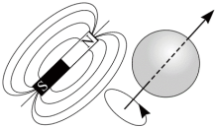
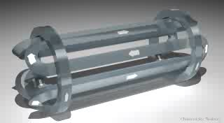
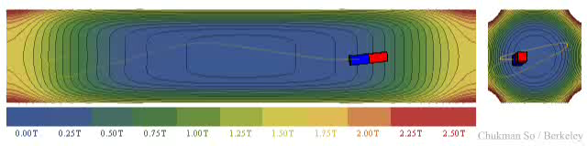
Antihydrogen Trapping
Antihydrogen has a small magnetic moment.
Consequently, antihydrogen can be confined in a magnetic minimum (Ioffe-Pritchard trap.)
  Mirror coils can be used to create an axial minimum.
  Multipole (quadrupole, octupole etc.) coils can be used to create a radial minimum.
Force on a magnet moment from a magnetic gradient:
Magnetic Field Magnitude

Slide 9
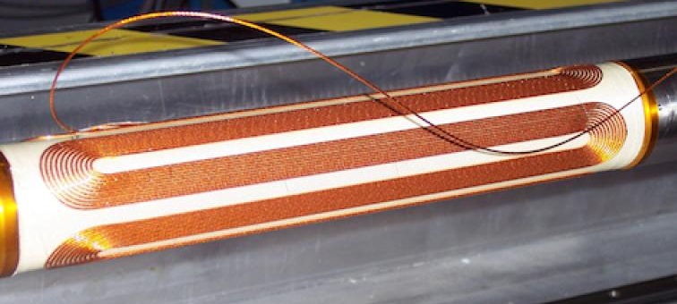
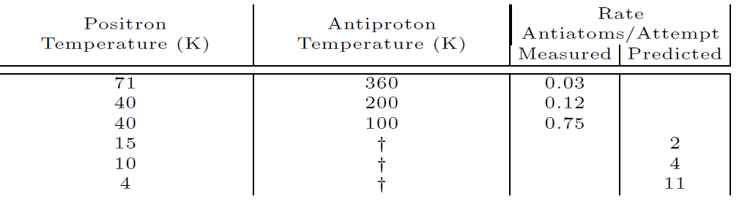
Antihydrogen Trap
Our octupole is a state-of-the art superconducting magnet fabricated at the Brookhaven National Lab.
The octupole produces a maximum field of ~1.54T.
Unfortunately, the magnetic moment of (anti)hydrogen is weak.
  The octupole creates a well depth of only about ~0.54K, or 40µeV.
The natural energy scale of the mixing process is the plasma potential, which is on the order of a ~10000K, or 1eV.
  We need to create antihydrogen at an energy of less than 40µeV for it to be trapped.
Producing antihydrogen cold enough to be trapped requires very cold positron plasmas.
ALPHA, A magnetic trap for Antihydrogen confinement, Nucl. Instr. Meth. Phys. Res. A 566, 746, 2006.

Slide 10
Lepton Cooling
Positrons cool by cyclotron radiation.
  At 1T, the predicted cooling time is 3.8s.
3T
The particles should cool to the temperature of the surrounding walls…but they don’t.
  Typical final temperature is ~100K, observed across many experiments.
The mechanisms that arrest the cooling are not well understood.
  Electrode amplifier noise.
  Higher temperature black body radiation “leaking” into the mixing region.
  Asymmetry driven plasma expansion.

Slide 11
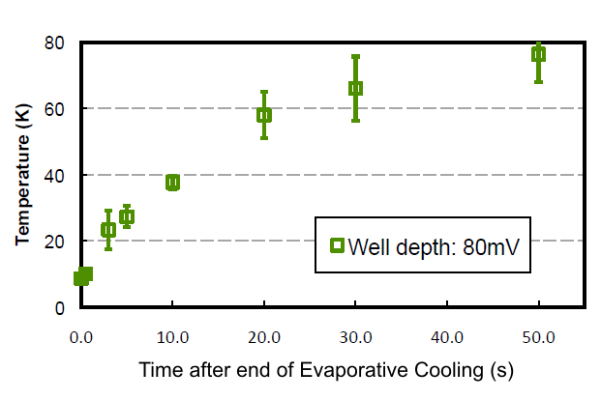
Positron Evaporative Cooling
We need temperatures well below 100K.
By making the positron well very shallow on one side, we allow the hottest positrons to escape.
  This cools the remaining positrons.
  Typically, we can get to ~10K temperatures.
This is a temporary effect; after evaporative cooling, the positrons quickly warm back up.
  Consequently, we need to use the cold positrons quickly.
    This sets constraints on our positron-antiproton mixing procedures.
ALPHA, 2010
ALPHA, Evaporative Cooling of Antiprotons to Cryogenic Temperatures, Phys. Rev. Lett., 105 013003, (2010).

Slide 12
Cavity Cooling
Recently, we have been exploring cavity cooling in Berkeley.
Noninteracting leptons are known to undergo enhanced cooling in cavities.
  Cooling of equilibrium plasmas had never been observed directly.
Cooling is sometimes best near a cavity node.
A.P Povilus, N.D. DeTal, L.T. Evans, N. Evetts, J. Fajans, W.N. Hardy, E.D. Hunter, I. Martens, F. Robicheaux, S. Shanman, C. So, X. Wang and J.S. Wurtele, Electron plasmas cooled by cyclotron-cavity resonance, Phys. Rev Lett. 117, 175001 (2016).
A. Povilus, Ph.D. thesis, Berkeley (2015).
L. Evans, Ph.D. thesis, Berkeley (2016).
E. D. Hunter, N. Evetts, J. Fajans, W. N. Hardy, H. Landsberger, R. Mcpeters, and J. S. Wurtele, Low Magnetic Field Cooling of Lepton Plasmas via Cyclotron-Cavity Resonance, Phys. Plasmas 25, 011602 (2018).
E. Hunter, Ph.D. thesis U.C. Berkeley (2019).

Slide 13
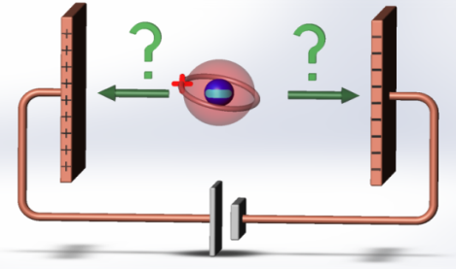
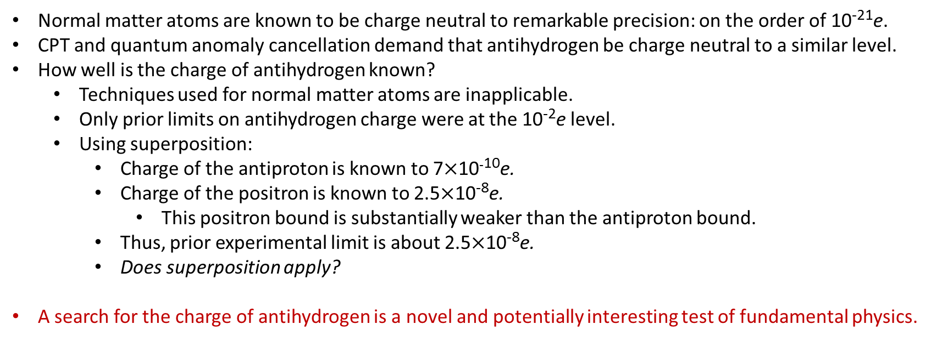
Antihydrogen Charge
Normal matter atoms are known to be charge neutral to remarkable precision: on the order of 10⁻²¹e.
CPT and quantum anomaly cancellation demand that antihydrogen be charge neutral to a similar level.
How well is the charge of antihydrogen known?
  Techniques used for normal matter atoms are inapplicable.
  Only prior limits on antihydrogen charge were at the 10⁻²e level.
  Using superposition:
    Charge of the antiproton is known to 7$×$10⁻¹⁰e.
    Charge of the positron is known to 2.5$×$10⁻⁸e.
      This positron bound is substantially weaker than the antiproton bound.
    Thus, prior experimental limit is about 2.5$×$10⁻⁸e.
    Does superposition apply?
A search for the charge of antihydrogen is a novel and potentially interesting test of fundamental physics.
Bressi, G. et al. Testing the neutrality of matter by acoustic means in a spherical resonator. Phys. Rev. A 83, 052101 (2011).
Greenland, P. T. Antimatter, Contemporary Physics 38, 181 (1997).
Olive, K. A. et al. Review of particle physics. Chinese Phys. C 38, 090001 (2014).
Fee, M. S. et al. Measurement of the positronium 1 ³S₁–2 ³S₁ interval by continuous-wave two-photon excitation. Phys. Rev. A 48, 192 (1993).
Hori, M. et al. Two-photon laser spectroscopy of antiprotonic helium and the antiproton-to-electron mass ratio. Nature 475, 484 (2011).
Hughes, R. J. & Deutch, B. I. Electric charges of positrons and antiprotons. Phys. Rev. Lett.69, 578 (1992).

Slide 14
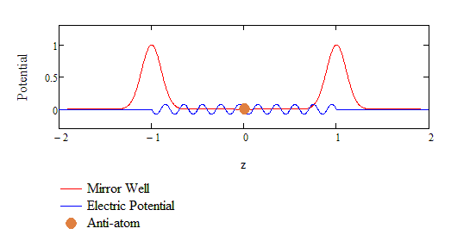
Determining the Antihydrogen Charge Bound Using Stochastic Acceleration
Stochastic acceleration (Fermi acceleration) can eject putatively charged antiatoms from the trap.
  Stochastic acceleration: the acceleration of a charged particle by randomly time-varying electric fields.
    This is a “textbook” problem in nonlinear dynamics.
M. Baquero-Ruiz, Studies on the neutrality of antihydrogen. Ph.D. thesis, University of California, Berkeley, 2013.
M. Baquero-Ruiz and A. E. Charman and J. Fajans and A. Little and A. Povilus and F. Robicheaux and J.S. Wurtele and A. I. Zhmoginov, Measuring the electric charge of antihydrogen by stochastic acceleration, New J. Phys. 16 083013, (2014).

Slide 15
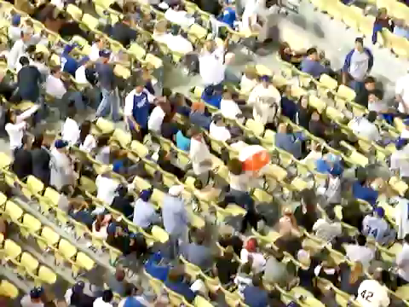
Improving the Antihydrogen Charge Bound Using Stochastic Acceleration
Stochastic acceleration (Fermi acceleration) can eject putatively charged antiatoms from the trap.
  Stochastic acceleration: the acceleration of a charged particle by randomly time-varying electric fields.
    This is a “textbook” problem in nonlinear dynamics.
https://youtu.be/fkVf4-1whuc

Slide 16
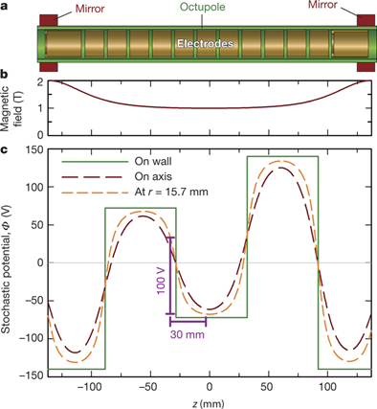


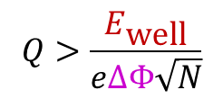
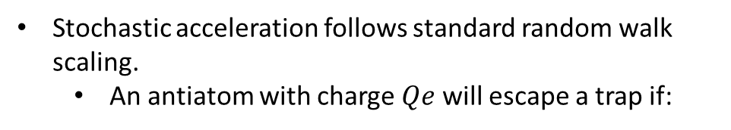
Stochastic Acceleration Scaling
Stochastic acceleration follows standard random walk scaling.
  An antiatom with charge $Qe$ will escape a trap if:
$$E_{\text{well}}$$
$$Q>\frac{E_{\text{well}}}{eΔΦ\sqrt{N}}$$
where $N$ is the number of potential oscillations.
$$ΔΦ$$
M. Baquero-Ruiz and A. E. Charman and J. Fajans and A. Little and A. Povilus and F. Robicheaux and J.S. Wurtele and A. I. Zhmoginov, Measuring the electric charge of antihydrogen by stochastic acceleration, New J. Phys. 16 083013, (2014).
ALPHA, An improved limit on the charge of antihydrogen from stochastic acceleration, Nature, 529, 373 (2016).

Slide 17
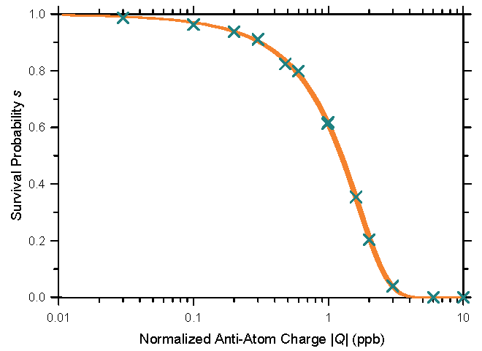
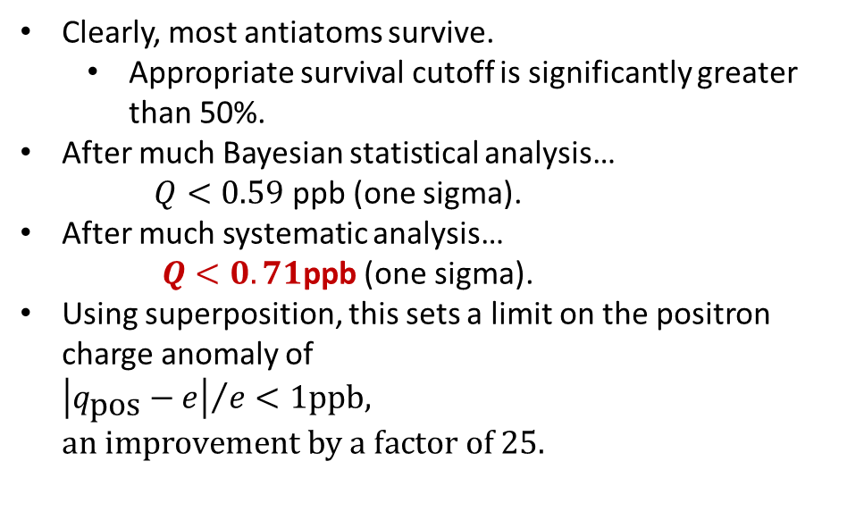
Stochastic Acceleration Experimental Results
 | Number of Trials | Observed Antiatoms
Stochastic Trials | 10 | 12
Null Trials | 10 | 12
Cosmic background is negligible.
Clearly, most antiatoms survive.
  Appropriate survival cutoff is significantly greater than 50%.
After much Bayesian statistical analysis…
$Q<0.59$ ppb (one sigma).
After much systematic analysis…
$Q<0.71$ppb (one sigma).
Using superposition, this sets a limit on the positron charge anomaly of ${\left|q_{\text{pos}}−e\right|}/e<1ppb, an improvement by a factor of 25.$
ALPHA, An experimental limit on the charge of antihydrogen, Nature Comm, 5, 3955 (2014).
ALPHA, An improved limit on the charge of antihydrogen from stochastic acceleration, Nature, 529, 373 (2016).
Capra, A. Testing CPT and antigravity with trapped antihydrogen at ALPHA, Ph.D. Thesis, York University (2015).
L. Evans, Phenomenology of creation of antihydrogen and measurement of antihydrogen properties, Ph.D. thesis, Berkeley (2016).

Slide 18
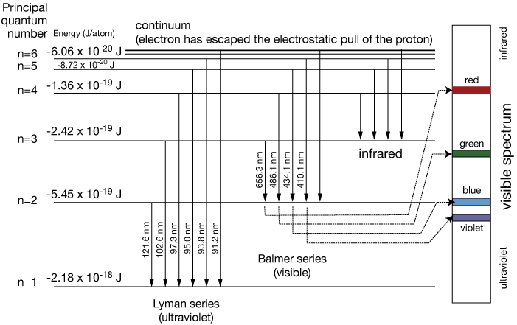
Laser Spectroscopy of Antihydrogen
Antihydrogen spectroscopy is complicated because the Lyman series is in the ultraviolet.
  The least energetic spectral line is the 1S-2S transition at 121.6nm.
    This is a forbidden transition, but can be excited by two 243nm photons.
      This two photon transition is Doppler free.
    As a two photon process, the excitation requires high laser power.
http://www.drcruzan.com

Slide 19
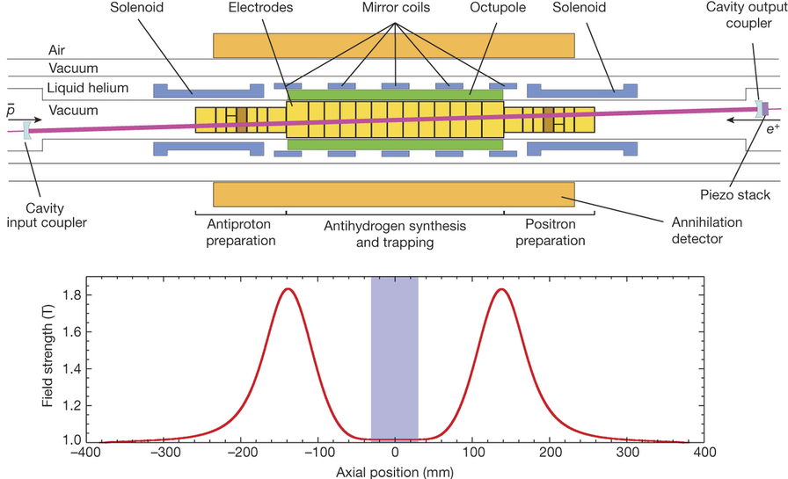
Experimental Schematic with Laser Cavity
A laser cavity is required to get to high intensity.
  Mirrors are not on an optical table.
  Mirrors spaced by over 90cm.
  Mirrors are at cryogenic temperatures.
  Mirrors are in vacuum, limiting material choice.
  243nm mirrors are not lossless.

Slide 20
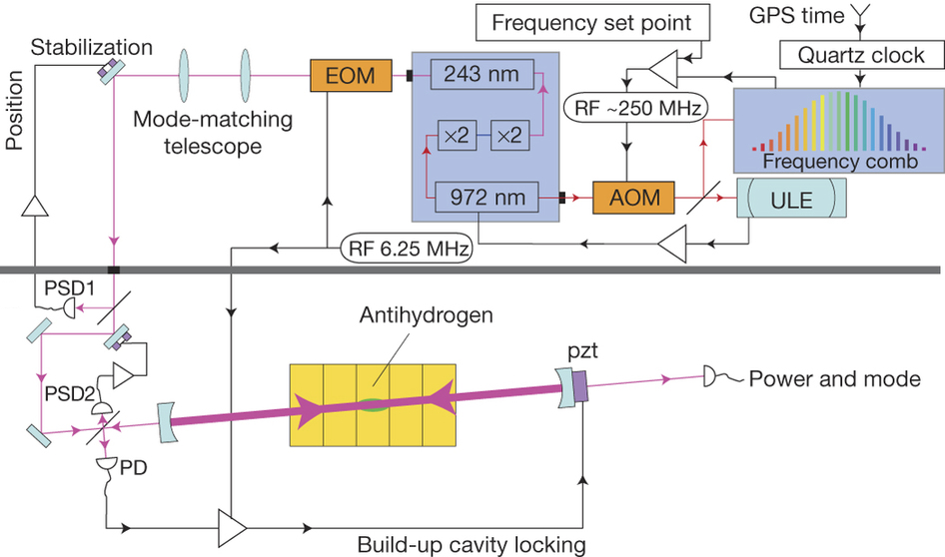
Laser Cavity and System
Laser:
  Toptica.
  2.5W at 972nm.
  150mW at 243nm.
Cavity:
  Design finesse 417.
  Achieved finesse >200.
  Pound Drever Hall (PDH) locking.
  Circulating power >1W.
Wavelength Stabilization:
  Menlo frequency comb.
  GPS disciplined.
  Linewidth <10kHz (short-term).

Slide 21
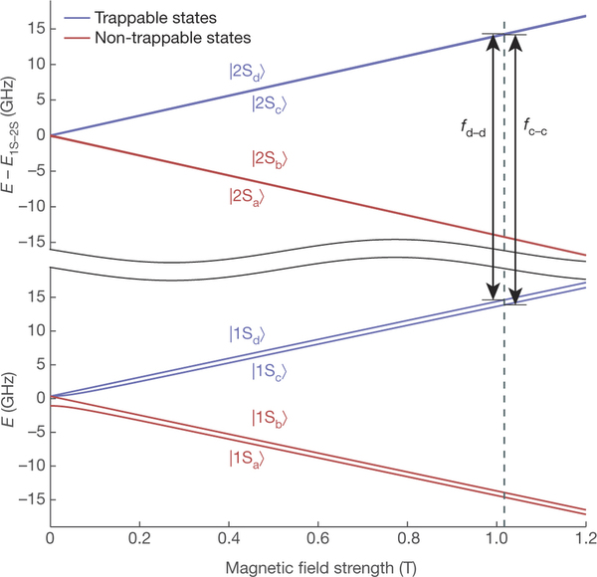
Antiatom States
Trapped antiatoms can be in one of two S states depending on the antiproton spin : the c or the d state.
The excitations to the 2S states are split by 600MHz.
  Thus, to probe both states, we must use light at two wavelengths split, at 243nm by 300MHz.
Split by ~600MHz

Slide 22
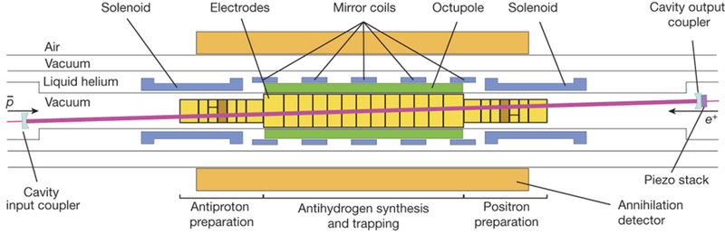
Detecting the Transitions
Almost futile to look for emitted photons:
  The nearest detectors would be no nearer than 0.5m.
  Only a few photons would be emitted over the 600s exposure.
  Conceivably, some of the photons could come from hydrogen, not antihydrogen.

Slide 23

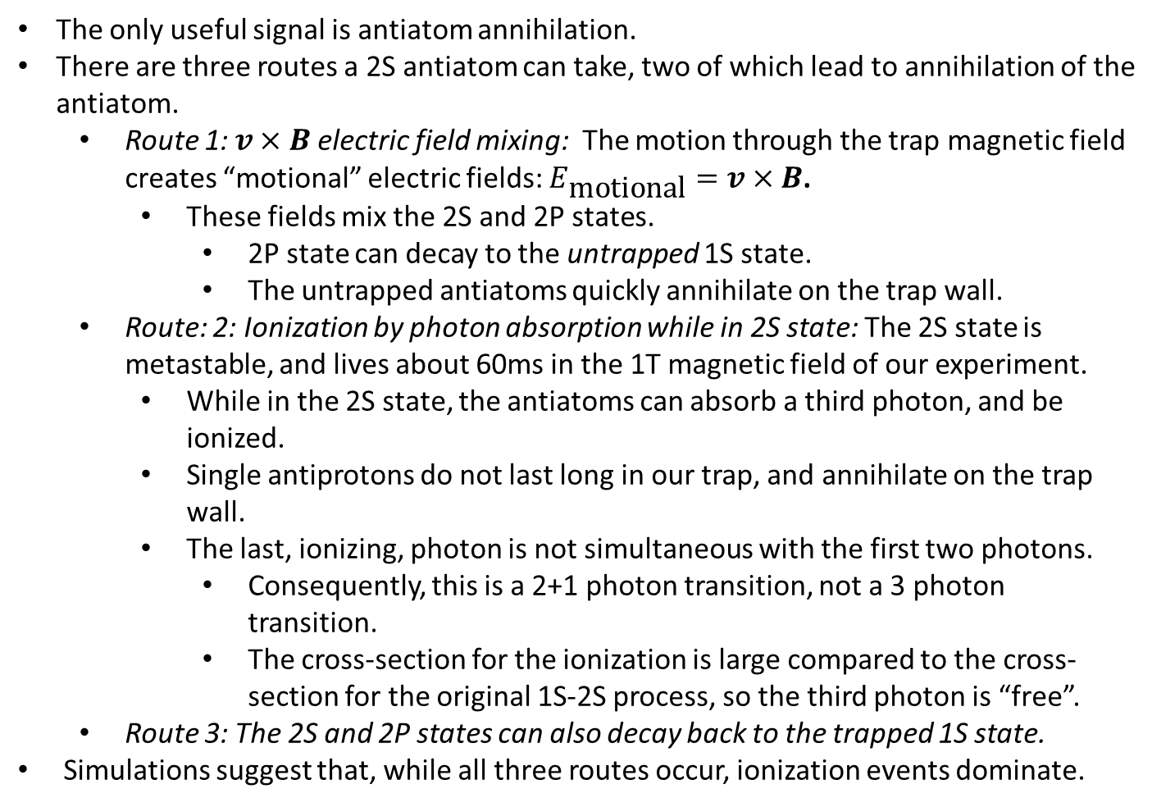
Detecting the Transitions
The only useful signal is antiatom annihilation.
There are three routes a 2S antiatom can take, two of which lead to annihilation of the antiatom.
  Route 1: $v×B$electric field mixing: The motion through the trap magnetic field creates “motional” electric fields: $E_{\text{motional}}=v×B$.
    These fields mix the 2S and 2P states.
      2P state can decay to the untrapped 1S state.
      The untrapped antiatoms quickly annihilate on the trap wall.
  Route: 2: Ionization by photon absorption while in 2S state: The 2S state is metastable, and lives about 60ms in the 1T magnetic field of our experiment.
    While in the 2S state, the antiatoms can absorb a third photon, and be ionized.
    Single antiprotons do not last long in our trap, and annihilate on the trap wall.
    The last, ionizing, photon is not simultaneous with the first two photons.
      Consequently, this is a 2+1 photon transition, not a 3 photon transition.
      The cross-section for the ionization is large compared to the cross-section for the original 1S-2S process, so the third photon is “free”.
  Route 3: The 2S and 2P states can also decay back to the trapped 1S state.
Simulations suggest that, while all three routes occur, ionization events dominate.
243nm
2S
2P
243nm
122nm
243nm
1S
trapped
untrapped

Slide 24
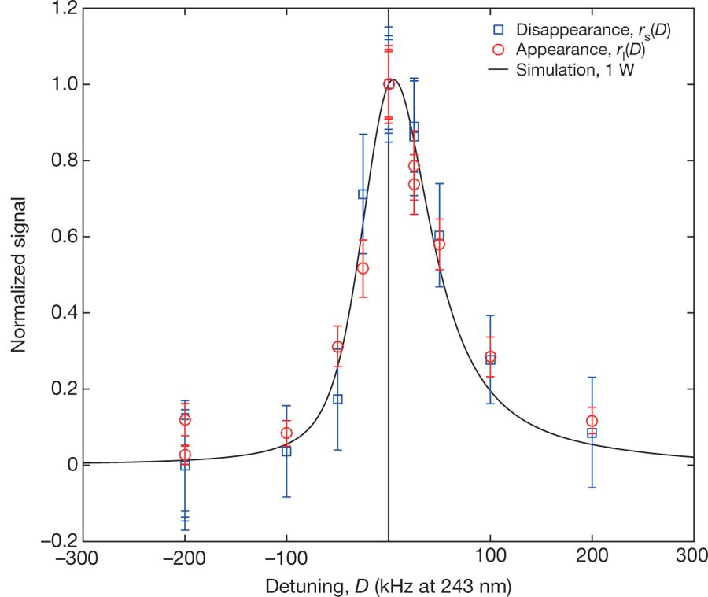
1S-2S Measurements
In early 2017, we published an on-off resonance measurement of the 1S-2S line.
  This measurement was accurate to 200ppt.
In 2018, we published the full lineshape of the 1S-2S transition.
  The line center is accurate to 2ppt.
Type of uncertainty | Estimated size (kHz) | Comment
Statistical uncertainties | 3.8 | Poisson errors and curve fitting to measured data
Modelling uncertainties | 3 | Fitting of simulated data to piecewise-analytic function
Modelling uncertainties | 1 | Waist size of the laser, antihydrogen dynamics
Magnetic-field stability | 0.03 | From microwave removal of 1S_{c}-state atoms
Absolute magnetic-field measurement | 0.6 | From electron cyclotron resonance
Laser-frequency stability | 2 | Limited by GPS clock
d.c. Stark shift | 0.15 | Not included in simulation
Second-order Doppler shift | 0.08 | Not included in simulation
Discrete frequency choice of measured points | 0.36 | Determined from fitting sets of pseudo-data
Total | 5.4
1S-2S Spectrum of Antihydrogen
ALPHA, Observation of the 1S–2S transition in trapped antihydrogen, Nature, 541, 506 (2017).
ALPHA, Characterization of the 1S–2S transition in antihydrogen, Nature 557, 71 (2018).

Slide 25
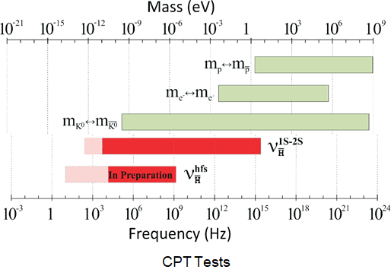
Conclusions: CPT Tests
Both our new 1S-2S and hyperfine measurements are now more precise, on an absolute energy scale, than the kaon system test, which is commonly regarded as the “best” CPT test.
Our tests are model independent tests.

Slide 26
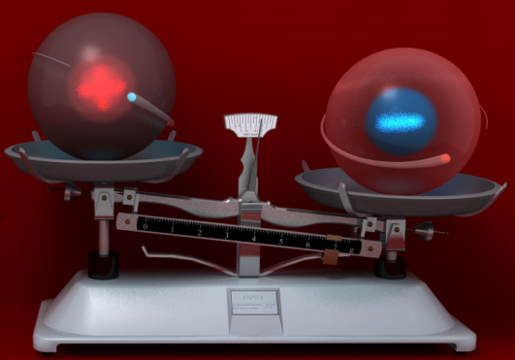
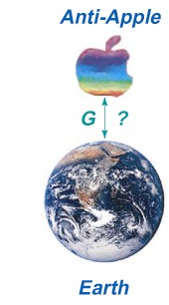
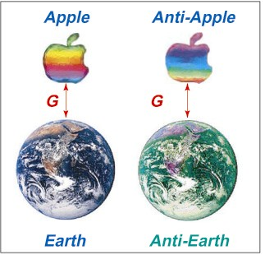
Gravity
Will antimatter fall under gravity the same way that
normal matter falls?
The weak equivalence principle asserts that it will.
There are many theoretical arguments that support this contention:
  Arguments based on energy conservation (Morrison).
  Arguments based on quantum field theory (Schiff).
  Arguments based on CP violation (Good).
Weak Equivalence
After Thomas Phillips

Slide 27
Gravity
Will antimatter fall under gravity the same way that
normal matter falls?
The weak equivalence principle asserts that it will.
There are many theoretical arguments that support this contention.
There are also many indirect experimental observations that support this contention:
  Invariance of g with isotope number (Eöt-Wash)
  Kaon oscillations (Kenyon, CPLEAR).
  Antiproton and positron cyclotron frequencies (Hughes and Holzscheiter, Gabrielse, BASE).
  Neutrino arrival times after SN1987a (LoSecco and others).
  Dropping positrons (Witteborn and Fairbank).
Weak Equivalence
After Thomas Phillips

Slide 28
Gravity
Will antimatter fall under gravity the same way that
normal matter falls?
The weak equivalence principle asserts that it will.
There are many theoretical arguments that support this contention.
There are also many indirect experimental observations that support this contention.
The evidence from the indirect tests is compelling, but all such indirect tests have assumptions which just might not hold (Fischler, Lykken and Roberts).
  For example, tests based on the invariance of g with isotope number assume that virtual and real particles gravitate identically.
Weak Equivalence
After Thomas Phillips

Slide 29
Gravity
Will antimatter fall under gravity the same way that
normal matter falls?
The weak equivalence principle asserts that it will.
There are many theoretical arguments that support this contention.
There are also many indirect experimental observations that support this contention.
The evidence from the indirect tests is compelling, but all such indirect tests have assumptions which just might not hold (Fischler, Lykken and Roberts).
Until very recently, there had been no “free fall” tests.
Weak Equivalence
After Thomas Phillips

Slide 30

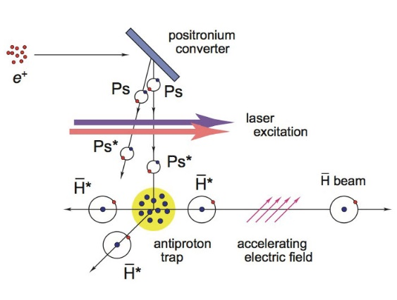
Gravity
Average energy of the antiatoms: ~300mK.
Typical velocity: 90m/s.
Equivalent height: 410m.
  Fountain is impossible at this energy.
    Gbar collaboration intends to trap antihydrogen⁺ ions, cool and strip the ions, and make a fountain.
Downward deflection in 1m: 0.6mm
  A deflection measurement is possible, but difficult.
    AEgIS collaboration intends to make a much lower energy antihydrogen beam.

Slide 31
Gravity
ALPHA traps antiatoms between mirror magnets.
B_{mir}=1T

Slide 32
Gravity
ALPHA traps antiatoms between mirror magnets.
We can let that antiatoms escape by slowly lowering the field.
B_{mir}=0.9T.

Slide 33
Gravity
ALPHA traps antiatoms between mirror magnets.
We can let that antiatoms escape by slowly lowering the field.
B_{mir}=0.8T.

Slide 34
Gravity
ALPHA traps antiatoms between mirror magnets.
We can let that antiatoms escape by slowly lowering the field.
B_{mir}=0.7T.

Slide 35
Gravity
ALPHA traps antiatoms between mirror magnets.
We can let that antiatoms escape by slowly lowering the field.
B_{mir}=0.6T.

Slide 36
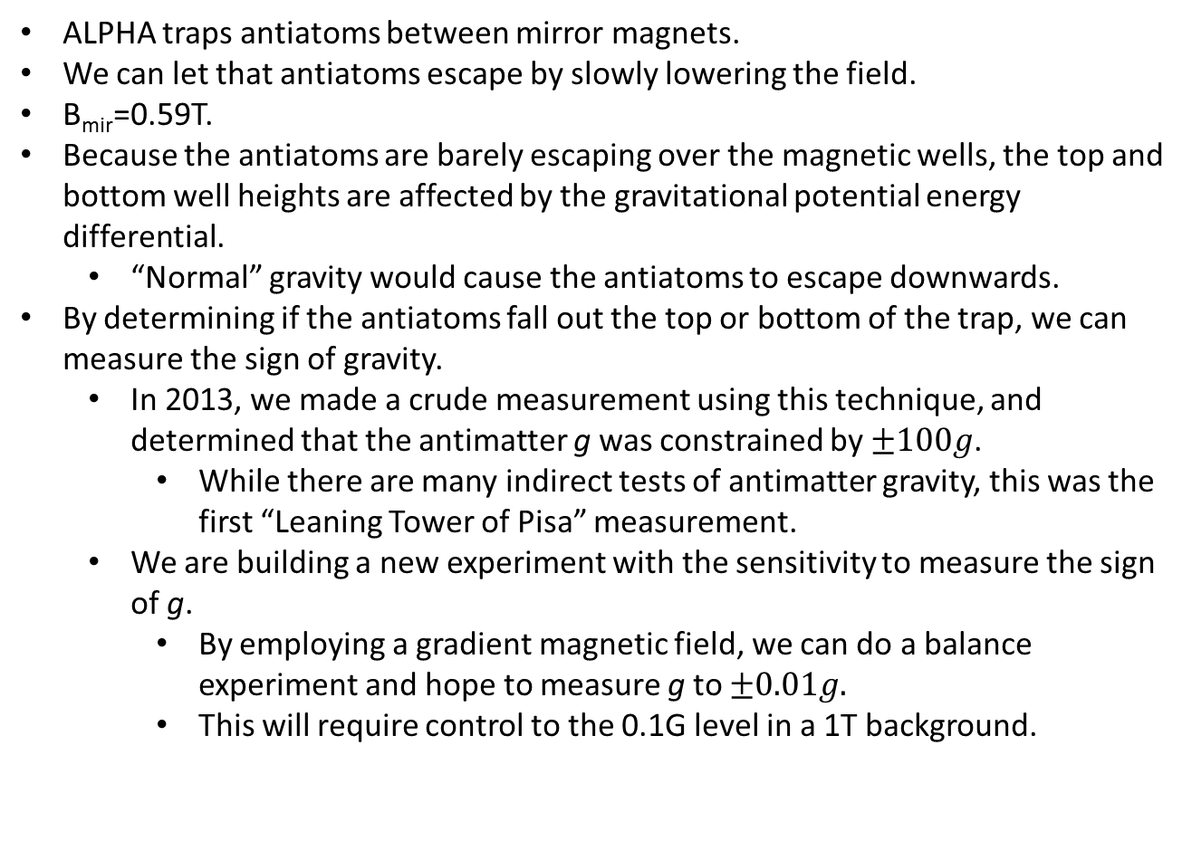
Gravity
ALPHA traps antiatoms between mirror magnets.
We can let that antiatoms escape by slowly lowering the field.
B_{mir}=0.59T.
Because the antiatoms are barely escaping over the magnetic wells, the top and bottom well heights are affected by the gravitational potential energy differential.
  “Normal” gravity would cause the antiatoms to escape downwards.
By determining if the antiatoms fall out the top or bottom of the trap, we can measure the sign of gravity.
  In 2013, we made a crude measurement using this technique, and determined that the antimatter g was constrained by $±100g$.
    While there are many indirect tests of antimatter gravity, this was the first “Leaning Tower of Pisa” measurement.
  We are building a new experiment with the sensitivity to measure the sign of g.
    By employing a gradient magnetic field, we can do a balance experiment and hope to measure g to $±0.01g.$
    This will require control to the 0.1G level in a 1T background.
ALPHA, Description and first application of a new technique to measure the gravitational mass of antihydrogen, Nature Comm 4, 1785 (2013).
A I Zhmoginov, A E Charman, R Shalloo, J Fajans, J S Wurtele, Nonlinear dynamics of anti-hydrogen in magnetostatic traps: implications for gravitational measurements, Class. and Quantum Grav., 30 205014 (2013).

Slide 37
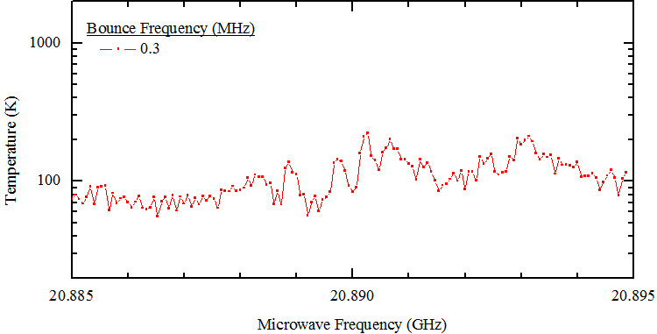
Plasma Electron Cyclotron Resonance (ECR) Magnetometry
Technique: Scan a plasma with microwaves, and look for the resonance heating peak.
  This heating peak “defines” the electron cyclotron frequency, from which we determine the magnetic field.
Often many peaks in the ECR spectrum.
  One peak is stationary as the plasma particle bounce frequency is increased.
-10 0 -10
-50 0 -50
Builds on work by R. Gould and by Affolter, Anderegg, and Driscoll.

Slide 38
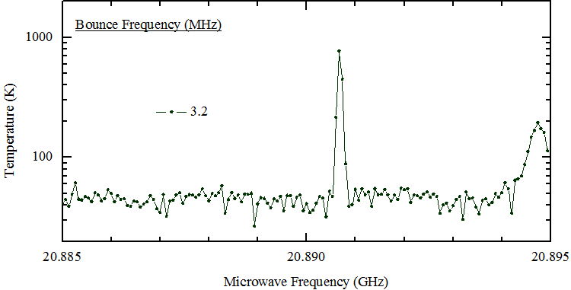
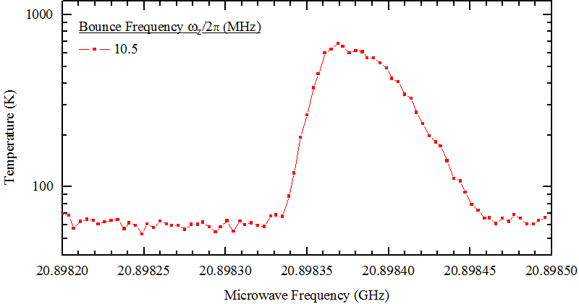
Magnetometry: Sidebands
Often many peaks in the ECR spectrum.
  Stationary peak can be split further.
E.D. Hunter, A. Christensen, J. Fajans, T. Friesen, E. Kur, and J.S. Wurtele, Electron cyclotron resonance (ECR) magnetometry with a plasma reservoir, Phys. Plasmas 27, 032106 (2020).

Slide 39
Magnetometry: Sidebands
Often many peaks in the ECR spectrum.
  Stationary peak can be split further.
  Magnetometer accuracy: 1ppm absolute, 30ppb relative.
  Accuracy needed for spectral and gravity measurements.
Peak center can be located
to 20kHz, or 0.006G.
E.D. Hunter, A. Christensen, J. Fajans, T. Friesen, E. Kur, and J.S. Wurtele, Electron cyclotron resonance (ECR) magnetometry with a plasma reservoir, Phys. Plasmas 27, 032106 (2020).

Slide 40
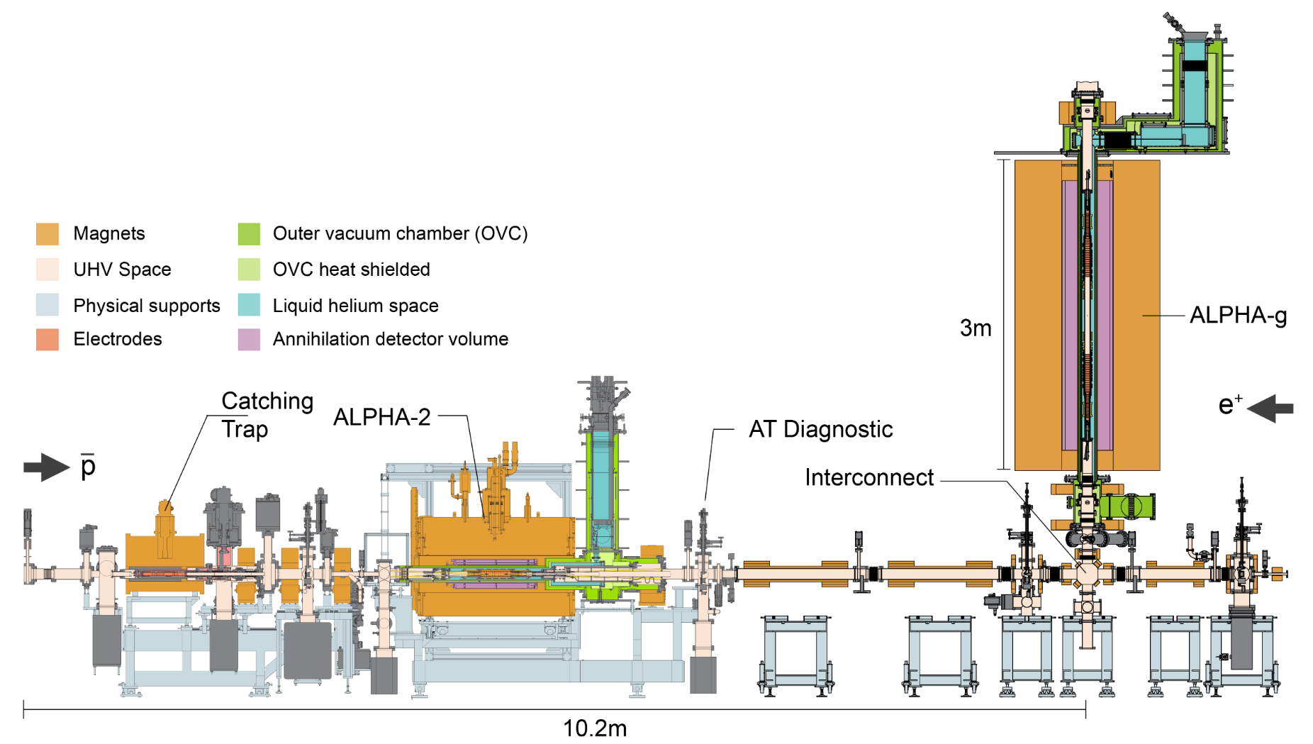
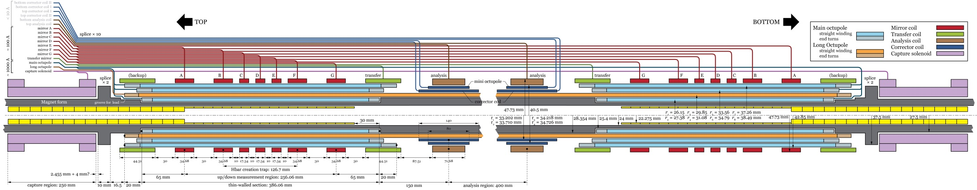
Gravity

Slide 41
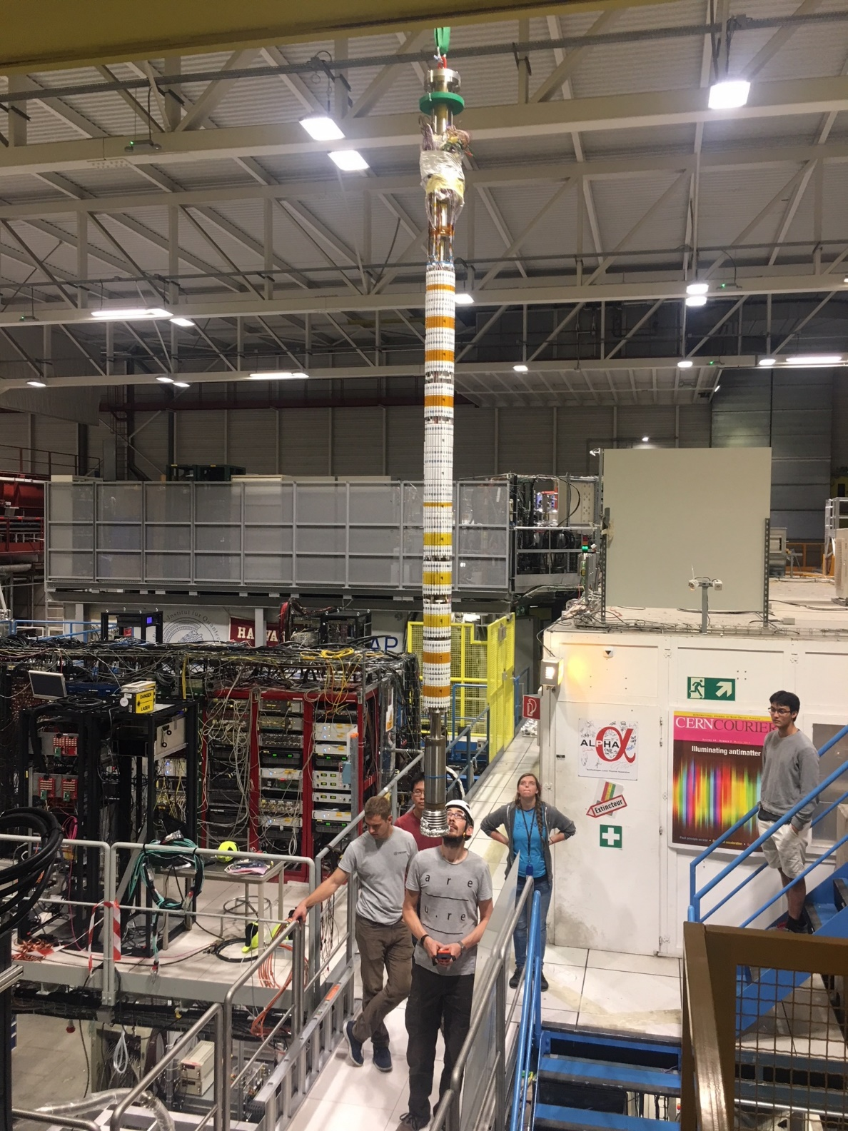
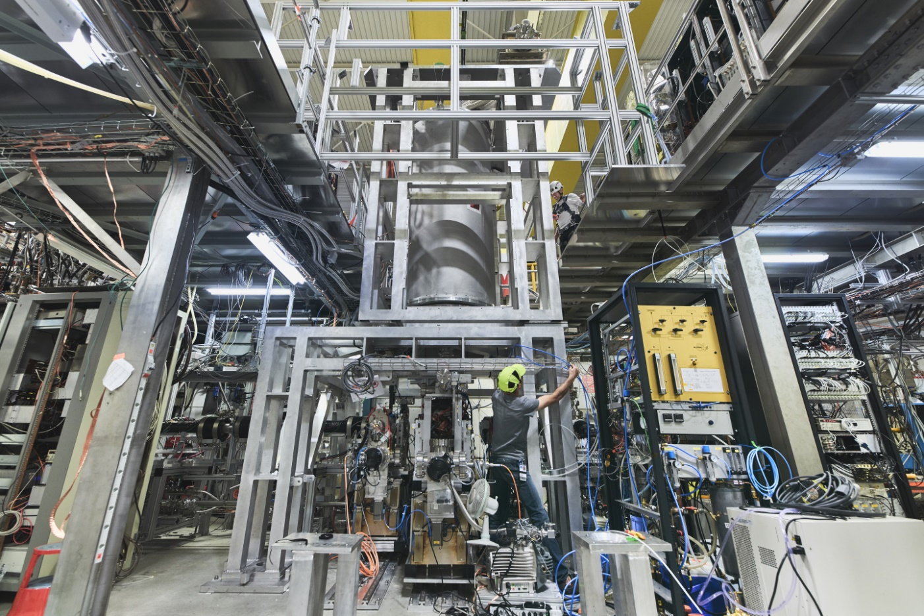
Gravity

Slide 42
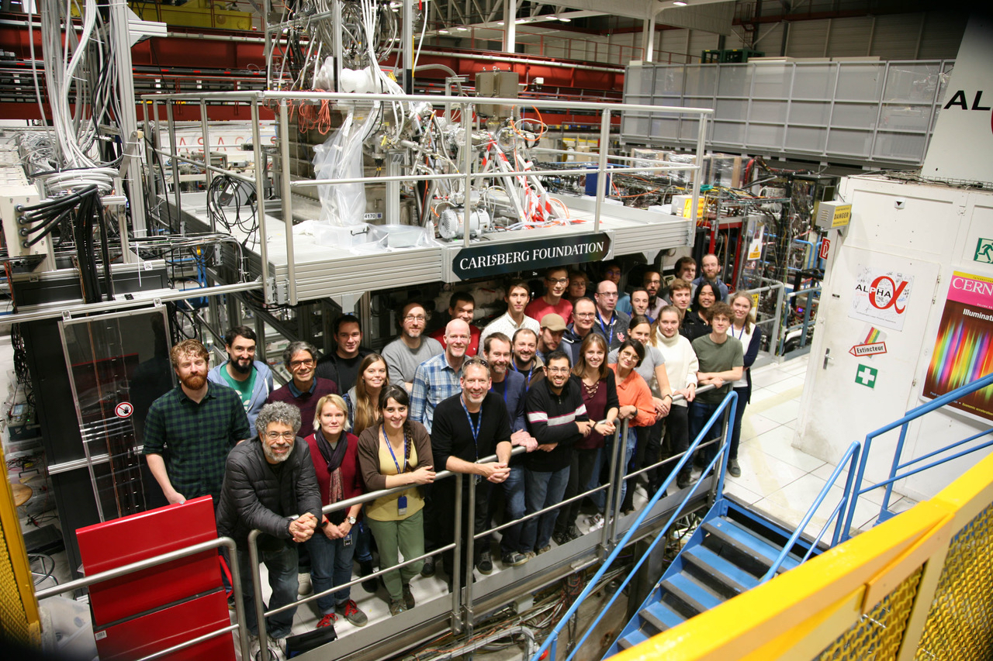
Huws
Landsberger
Mike
Davis
Celeste
Carruth
Andrew
Christensen
Dana
Zimmer
Will
Bertsche
Dalila
Robledo
Eric
Hunter
Jonathan
Wurtele

Slide 43
Conclusions
Since 2010, ALPHA has significantly improved our ability to trap antihydrogen atoms.
Currently we trap about 20 antiatoms per five minute trapping attempt.
We have trapped over 1000 antiatoms in our trap simultaneously.

Slide 44
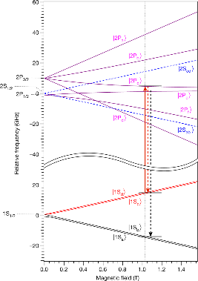





Antihydrogen Measurement Summary
ALPHA has made several significant physics measurements on antihydrogen.
  2012: Measurement of the microwave spin flip frequency to 0.1%: a CPT test, and a start to measuring the antiproton radius.
  2013: Crude direct measurement of the antimatter g to within a factor of 100: a WEP test.
  2014 and 2016: Bounded the charge of antihydrogen to 1ppb: a CPT and charge anomaly test, and sets a new bound on the positron charge.
  2016 and 2018: Measured the 1S-2S transition of antihydrogen to about 2ppt; by some measures this is the leading CPT test.
  2017: Measured the hyperfine structure of antihydrogen to about 1kHz.
  2018: Measured the 1S-2P Lyman-α transition in antihydrogen: precursor to laser cooling.
  2021: Demonstrated laser cooling of antihydrogen atoms.
ALPHA, Resonant quantum transition in trapped antihydrogen atoms, Nature 483, 439 (2012).
ALPHA, Description and first application of a new technique to measure the gravitational mass of antihydrogen, Nature Comm 4, 1785 (2013).
A I Zhmoginov, A E Charman, R Shalloo, J Fajans, J S Wurtele, Nonlinear dynamics of anti-hydrogen in magnetostatic traps: implications for gravitational measurements, Class. and Quantum Grav., 30 205014 (2013).
ALPHA, An experimental limit on the charge of antihydrogen, Nature Comm, 5, 3955 (2014).
M. Baquero-Ruiz, A. E. Charman, J. Fajans, A. Little , A. Povilus, F. Robicheaux, J.S. Wurtele and A. I. Zhmoginov, Measuring the electric charge of antihydrogen by stochastic acceleration, New J. Phys. 16 083013, (2014).
ALPHA, An improved limit on the charge of antihydrogen from stochastic acceleration, Nature, 529, 373 (2016).
ALPHA, Observation of the 1S–2S transition in trapped antihydrogen, Nature 541 506 (2017).
ALPHA, Characterization of the 1S-2S transition in antihydrogen Nature 557, 71 (2018).
ALPHA, Observation of the hyperfine structure of antihydrogen, Nature 548, 66 (2017).
ALPHA, Observation of the 1S-2P Lyman-α transition in antihydrogen, Nature 561 211 (2018).
ALPHA, Laser cooling of antihydrogen atoms, Nature 592, 211 (2021).

Slide 45


Conclusions
The chance that we will observe something “interesting” is very small.
The reward for observing something interesting is enormous.
What is the expected return for this line of research?
$$0 × ∞= ?$$
We are looking for postdocs.
Contact me if interested.

Slide 46
Antihydrogen Measurement Summary
ALPHA has made several significant physics measurements on antihydrogen.
  2012: Measurement of the microwave spin flip frequency to 0.1%: a CPT test, and a start to measuring the antiproton radius.
  2013: Crude direct measurement of the antimatter g to within a factor of 100: a WEP test.
  2014 and 2016: Bounded the charge of antihydrogen to 1ppb: a CPT and charge anomaly test, and sets a new bound on the positron charge.
  2016 and 2018: Measured the 1S-2S transition of antihydrogen to about 2ppt; by some measures this is the leading CPT test.
  2017: Measured the hyperfine structure of antihydrogen to about 1kHz.
  2018: Measured the 1S-2P Lyman-α transition in antihydrogen: precursor to laser cooling.
  2021: Demonstrated laser cooling of antihydrogen atoms.
ALPHA, Resonant quantum transition in trapped antihydrogen atoms, Nature 483, 439 (2012).
ALPHA, Description and first application of a new technique to measure the gravitational mass of antihydrogen, Nature Comm 4, 1785 (2013).
A I Zhmoginov, A E Charman, R Shalloo, J Fajans, J S Wurtele, Nonlinear dynamics of anti-hydrogen in magnetostatic traps: implications for gravitational measurements, Class. and Quantum Grav., 30 205014 (2013).
ALPHA, An experimental limit on the charge of antihydrogen, Nature Comm, 5, 3955 (2014).
M. Baquero-Ruiz, A. E. Charman, J. Fajans, A. Little , A. Povilus, F. Robicheaux, J.S. Wurtele and A. I. Zhmoginov, Measuring the electric charge of antihydrogen by stochastic acceleration, New J. Phys. 16 083013, (2014).
ALPHA, An improved limit on the charge of antihydrogen from stochastic acceleration, Nature, 529, 373 (2016).
ALPHA, Observation of the 1S–2S transition in trapped antihydrogen, Nature 541 506 (2017).
ALPHA, Characterization of the 1S-2S transition in antihydrogen Nature 557, 71 (2018).
ALPHA, Observation of the hyperfine structure of antihydrogen, Nature 548, 66 (2017).
ALPHA, Observation of the 1S-2P Lyman-α transition in antihydrogen, Nature 561 211 (2018).
ALPHA, Laser cooling of antihydrogen atoms, Nature 592, 211 (2021).

