Slide 1
Stars Disks and Jets The View From Telescopes, Computers and the Lab Adam Frank University of Rochester

Slide 2
A Cast Of Lots and Lots
AstroBEAR development: J. Carroll, B. Lui, M. Huarte-Espinosa, S. Li, E. Hanson, E. Kaminski, K. Yirak*, A. Cunningham*
Observations: Hartigan
Lab Experiments, Pulsed Power (JetPac): Lebedev, Ciardi. Chittenden, Bott, Amplerford, et al.
Lab Experiments, Laser: Foster, Rosen, Wilde, Douglas, Blue, Hansen, Drake, et al.

Slide 3
Section I The Problem
An introduction to the general problem of studying star formation and stellar “death” using both traditional and newly available tools and platforms.

Slide 4
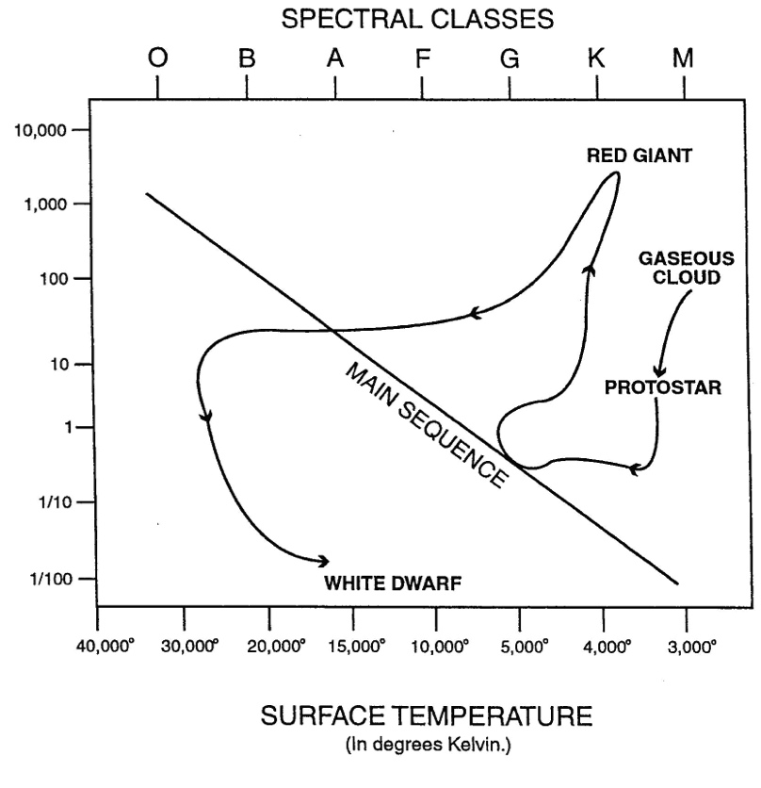
The Problem: Radiation MHD of Star Formation and Late Stages of Stellar Evolution
1. Collapse of clouds under self-gravity to form stars
2. Mass-loss and binarity in penultimate stages of evolution.
Inherently Multi-physics:
Gravity, MHD, radiation, microphysics
Inherently Multi-dimensional.
Inherently Time-dependent.
Inherently non-linear

Slide 5
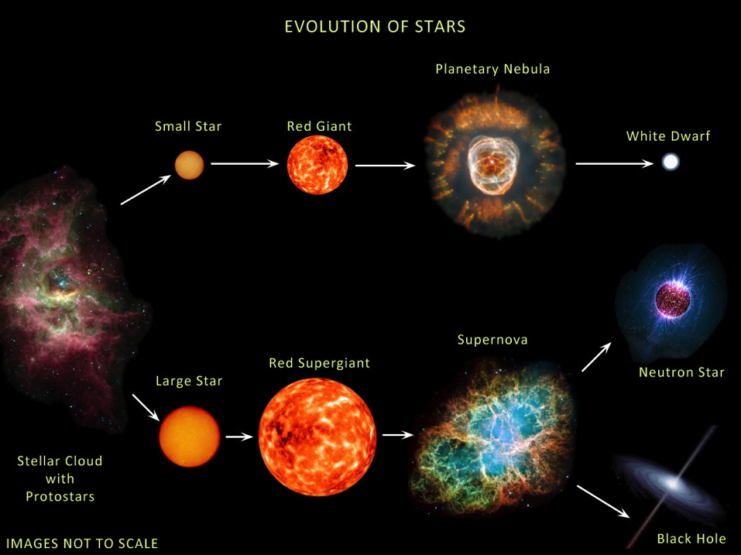
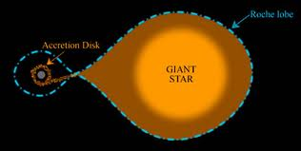
The Problem: Radiation MHD of Star Formation and Late Stages of Stellar Evolution (LSSE)
Star Formation
LSSE: Low vs High Mass

Slide 6
The Tools. Old to New(*)
Telescopes: High rez (ALMA) All wavelength bands.
System time dependence?
Projection ?
Analysis: Stability, Low Dimensional dynamics (self-similarity)
f(x,t) = f*g(s); s = h(x,t)
*Simulations; HPC = Multi-D, multi-physics, full non-linearity.
Resolution in space (and time) still an issue
**Laboratory Studies: macro-scopic volumes of plasma brought to astrophysical condition.
Similarity allows relevance across scales

Slide 7
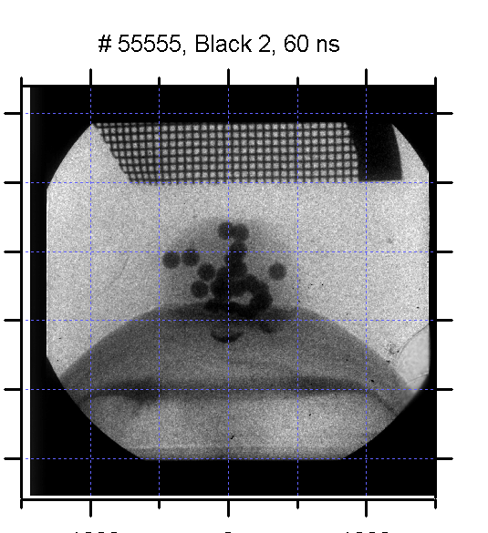
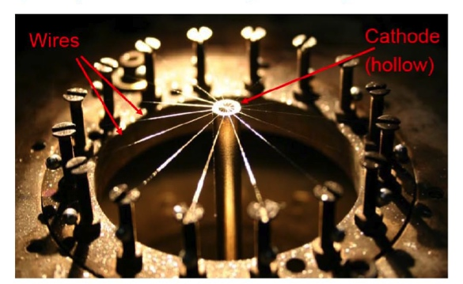
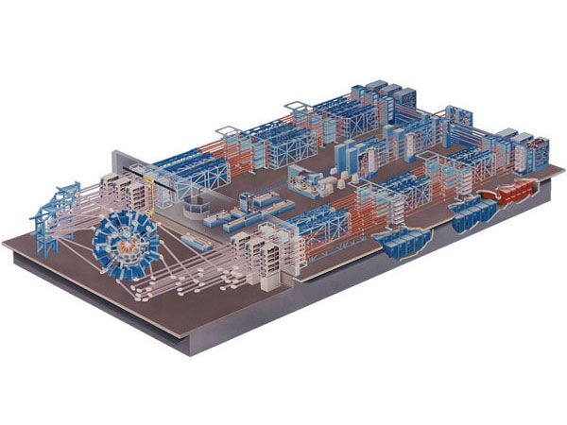
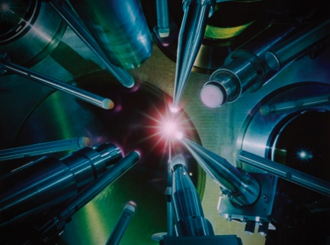
How to do High Energy Density Laboratory Astrophysics (HEDLA)
Lasers: Inertial Confinement Fusion systems (Omega, NIF).
Pulsed Power: Current driven wire ablation creates MHD plasma systems.
Drake, Remington & Ryutov 2006 RvMP
Key: Scaling via dimensionless #s

Slide 8
Section II AstroBEAR 2.0
An introduction to our primary tool. A highly parallelized Adaptive Mesh Refinement (AMR) MHD Multi-physics code for astrophysical fluid dynamics.

Slide 9
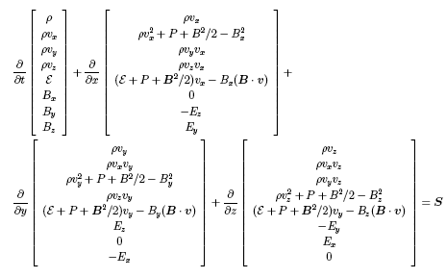
Solve hyperbolic PDE with elliptic constraints: MHD
Source terms for energy loss/gain, ionization dynamics, Real EOS
Operator splitting: gravity, heat conduction (HYPRE)
Sink Particle/Particle Dynamics

Slide 10
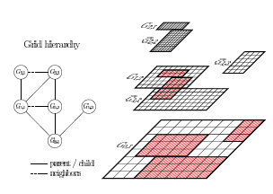
Adaptive Mesh Refinement AMR
Different AMR Methods:
Patch based regridding
Cell based regridding
AstroBEAR: patch
Divergence Issue: Use CT
Require Prolongation/Restriction Operators (MHD Toth & Roe 02, Balsara 01)
Carry data from one grid level to another
Prolongation (Corse to Fine)
Restriction (Fine to Corse)
R. Deiterding

Slide 11
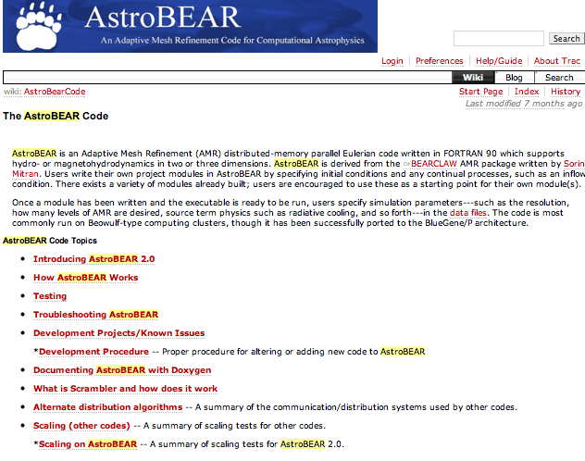
AstroBEAR 2.0 (Carroll et al 2012)
Now public code
Extensive “live” online documentation
Ticketing system for technical support
Favor collaborative models if possible

Slide 12
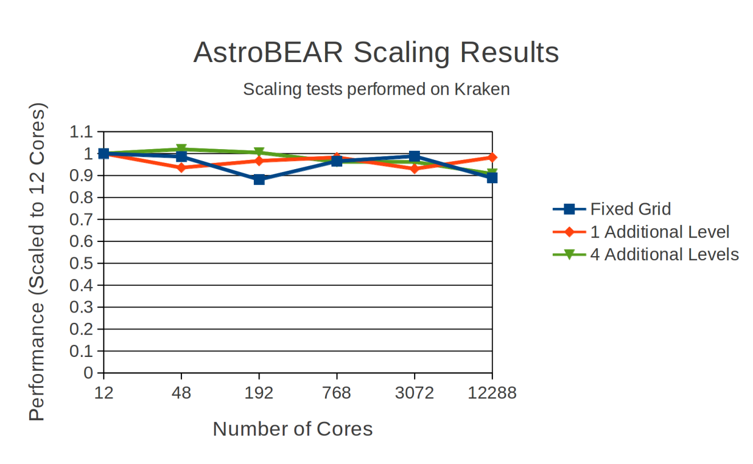
AMR Engine redesigned with a peer to peer model for parallelization. It utilized a distributed tree to manage AMR structure, and advance threads to overlap computation with communication.

Slide 13
Multi-Physics Example: Thermal Conduction
(Li et al 2012)
Official release only supports explicit conduction, though implicit version has been developed and is currently being tested.
Explicit version does not currently sub-cycle, so hydro time step is limited to diffusion time.

Slide 14
Magneto-Thermal Instability
Hydrostatic equilibrium with cold material on top of warm material.
Small velocity perturbation.
As field lines bend, heat is able to flow upward, causing material to become buoyant.
As buoyant material moves upward, it amplifies field line perturbations.

Slide 15
Section III Stars and Star Formation
The problem of molecular cloud and star formation in colliding galactic streams with a laboratoray astrophysics analogue.

Slide 16
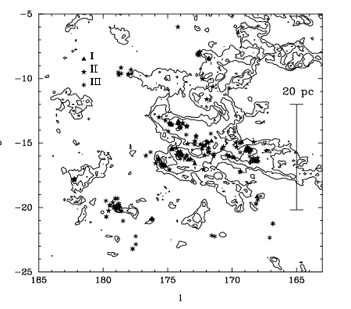
Colliding Flows and Molecular Clouds Basic Idea
Star formation occurs before global collapse.
Less than a sound crossing time
Observed Turbulent flows
Observed Filamentary structure
Model for Molecular Clouds
Colliding Supersonic Stream
Essentially transient process

Slide 17
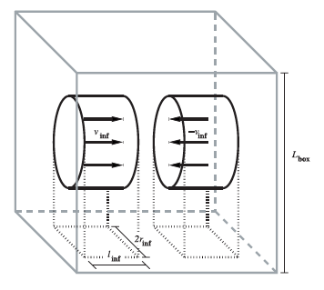
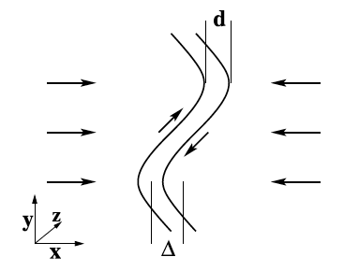
Colliding Flows and Molecular Clouds Basic Idea
Colliding Supersonic Streams
SN blastwaves
Galactic rotation
NTSI
Thermal Instablity
Gravitational Collapse
Vazquez-Semadeni et al 2007

Slide 18
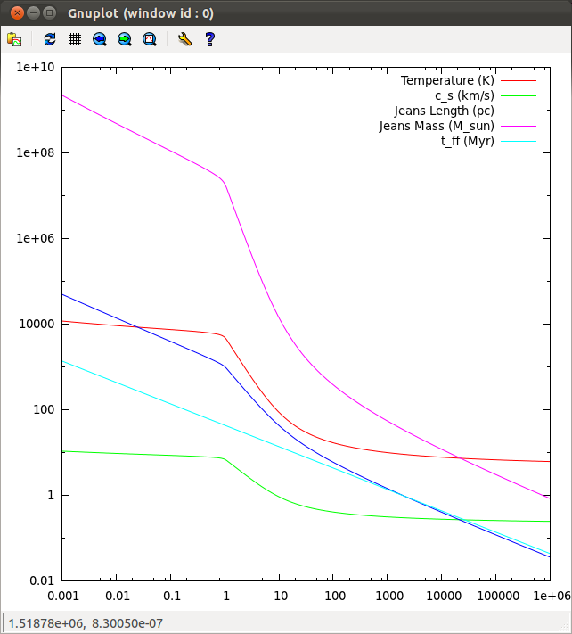
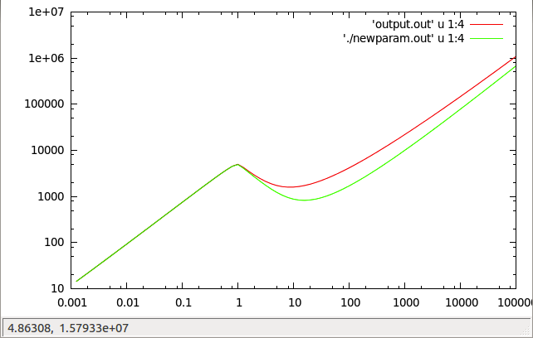
Thermal Instability: From WNM to “Clouds”
Cooling/Heating Curve
KI 2002: Analytic Fit to Multiple Processes
Pressure
density
density

Slide 19
Cloud Formation and Colliding Flows Axial View (Carroll et al 2013)

Slide 20
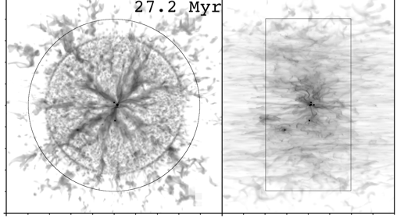
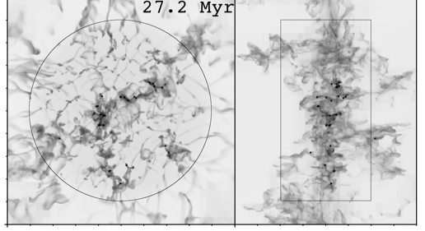
Cloud Formation and Colliding Flows Thermal Instability
Flows provide a reservoir of mass.
As mass accumulates clumps become gravitationally unstable.

Slide 21
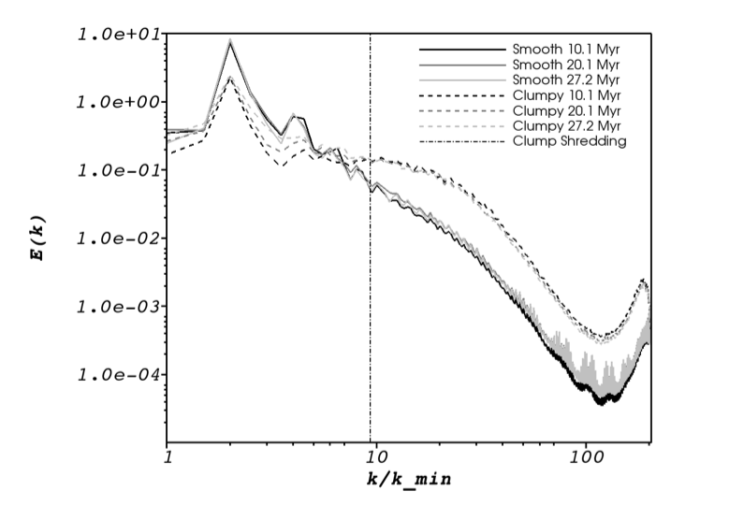
Clumps and Turbulence

Slide 22
PPower Lab Exps for Colliding Flows (for lasers see Krauland et al 2012)
No gravity but…
NTSI
Kelvin-Helmholtz
Cooling
MHD
Key… Make jets!

Slide 23
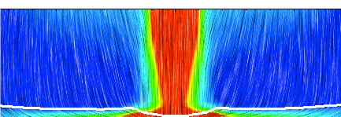
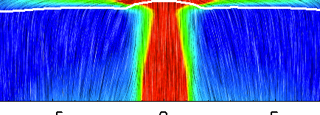
Lab Experiments for Colliding Flows
Colliding beams of magnetized plasma
NLTS; Kelvin-Helmholtz; Cooling
Shock bounded cold slab
Supersonic flow (jet)
to diagnostics

Slide 24
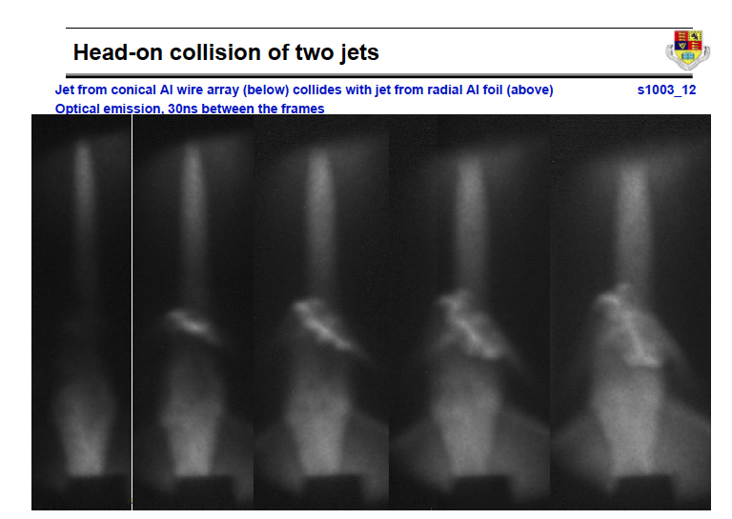
Lab Experiments
No gravity but…
NLTS
Kelvin-Helmholtz
Cooling
MHD
Shock bounded cold slab
Supersonic flow (jet)
to diagnostics

Slide 25
Section IV Disks
Disk formation in wind capture binary systems and new limits on Bondi-Hoyle accretion

Slide 26
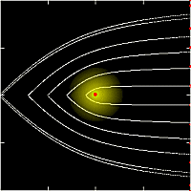
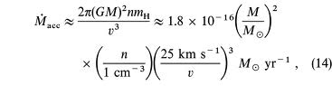
Bondi-Hoyle Accretion
Gravitational point source moving through background medium.
Many open questions:
What is accretion rate?
Is flow stable
When do disks form?

Slide 27
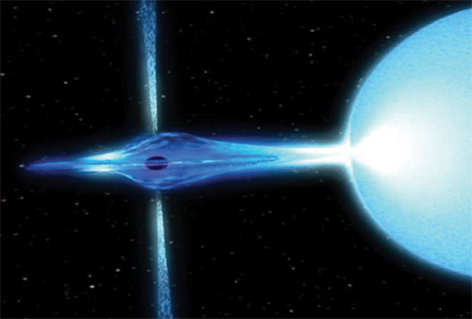
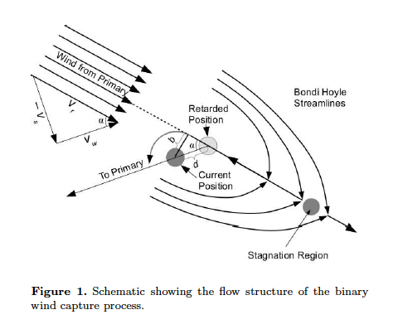
BH Accretion in Binary System Huarte-Espinosa et al (2013)
Critical for understanding evolution
Do disks form?
Do jets form?
Step 1: Resolution is critical.
Must capture impact parameter b

Slide 28
Computational Set-Up
Move into rotating frame.
“Tune” AMR Focus on accreator.

Slide 29
Disk Formation

Slide 30
Disks Properties vs Orbital Distance

Slide 31
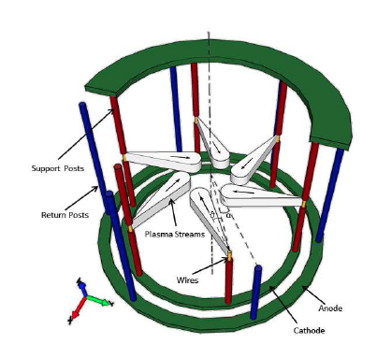
HEDP Disk project: Bocchi et al 2012
Based on proposal by Ryutov et al.
Use lasers or Pulsed Power to drive off-axis streams towards axis
Collsions generate rotational flow
MHD = field “winding”.
Dynamo? MRI?

Slide 32
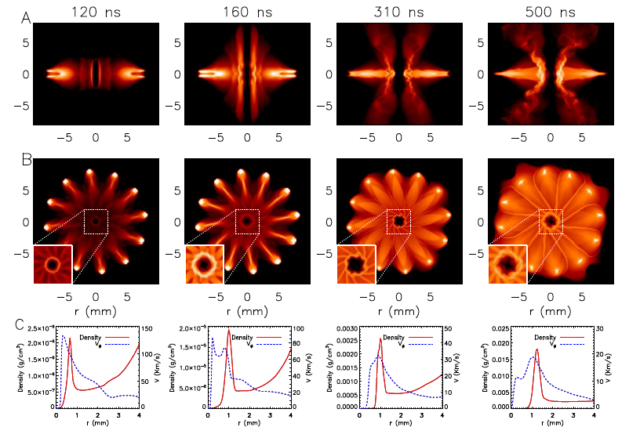
Simulations show “disk” formation. Stable for 4 to 5 “orbits”

Slide 33
Section V Jets
Collimated beams of plasma are ubiquitious in astrophysics. Magnetic fields are likely key to launching. In Poynting Flux Dominated (PFD) flows the field energy overwhelms kinetic flux. We study propagation and stability of PDF jets.

Slide 34
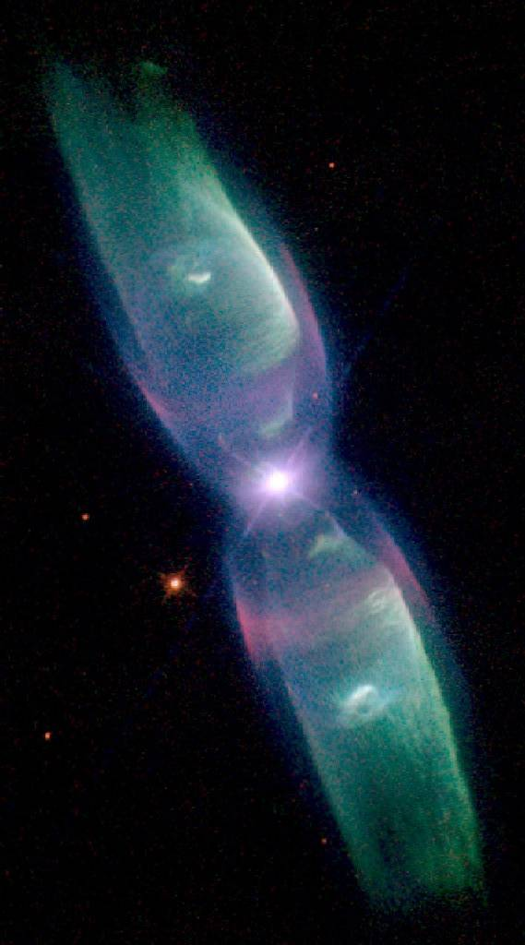
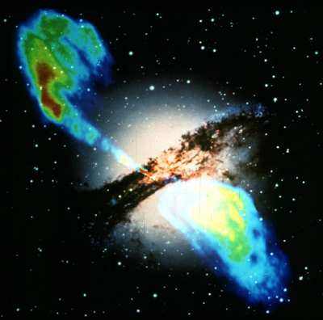
Plasma Jets Ubiquitous Astrophysical Phenomena
Extra-galactic Jet: Cen A (PFD)
Planetary Nebula
M2-9 (B, PFD)
HH Jet
HH 111
Micro-quasar (B, PFD)

Slide 35
Poynting Flux Dominated (PFD)Flows: What Does it Mean
Kinetic Energy Dominated Jets
F_{kin} > F_{ExB}
V_{j} > V_{A}
PDF Jets
F_{kin} < F_{ExB}
V_{j} < V_{A}

Slide 36
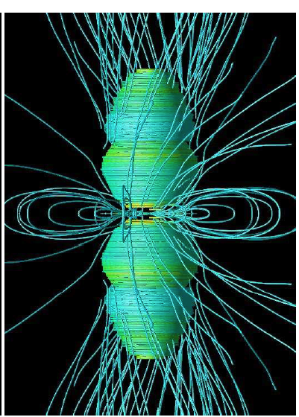
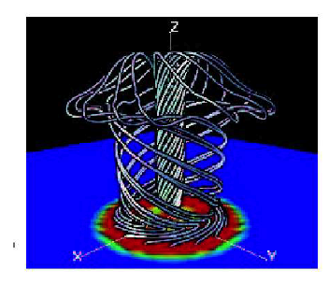
Magnetic Towers
PFD jets also known as Magnetic Towers.
(Lynden-Bell 1996)
Need
Differential Rotation
Accretion (?)
(GRB: Wheeler et al)
(YSO: Kato et al)

Slide 37
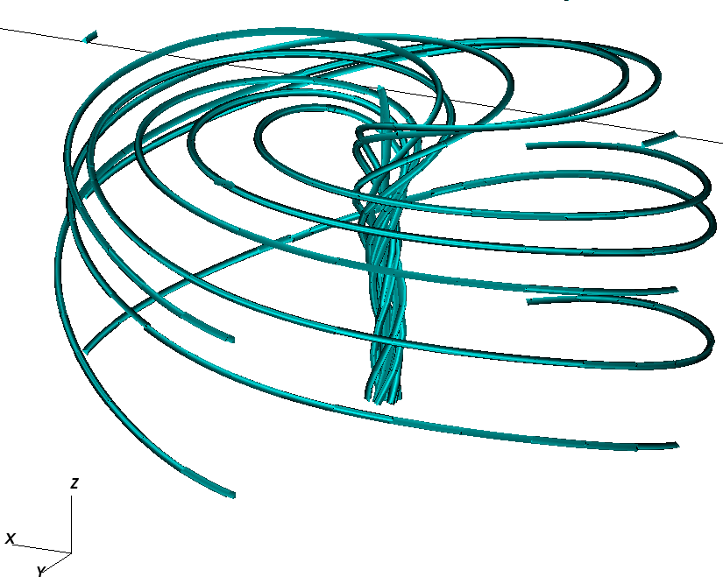
Huarte-Espinosa et al 2012
Initial Conditions

Slide 38
Results 1: Density and Plasma Beta
Poynting flux injected at base drives expansion
Hoop stresses maintain collimation
Ambient plasma swept up becomes visible via radiative shocks
Central matter domatinate “spine”

Slide 39
Results 2: Field Structure
Features:
Central spine with β >
Outer Cavity β << 1
Cylindrical symmetry lost as evolution progresses

Slide 40
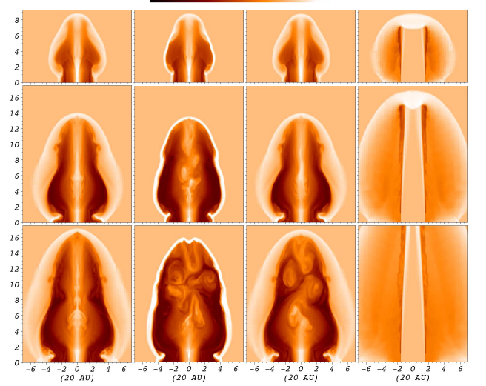
Magnetic Towers and Internal Physics:3 Cases
Adiabatic
Rad Cooling
Rotation
Hydro Jet

Slide 41
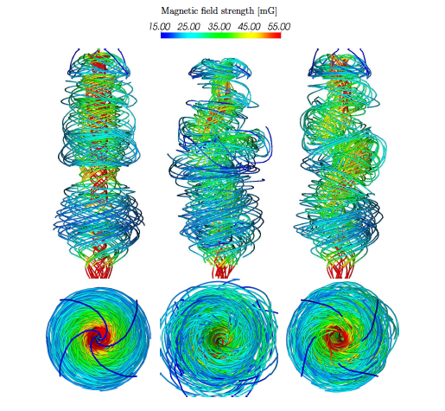
Results 3. Stability
Magnetic Tower:
Current Driven Instabilities (CDIs)
M= 0 pinch mode
M=1 kink Mode
Kink Mode:
Kruskal-Shafranov condition
Cooling: Lowers β
Rotation: Raises B_{φ}

Slide 42
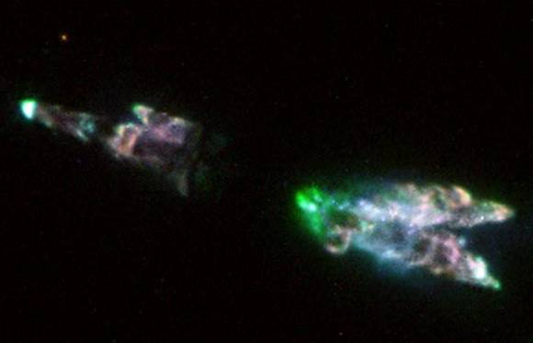
Instabilities and Clumpy Flows
Flows evolve into series of weakly magnetized clumps
CRL 618

Slide 44
HEDLA Magnetic Tower Exps.

Slide 47
Conclusions
AstroBEAR up to the challenge! Massively parallel Multi-physics AMR
Colliding flows offer explanation for star forming cloud formation
Bondi-Hoyle Accretion in binary systems leads to stable disks (and jets?)
MHD jets are likely to be unstable to kink modes
HEDLA studies can access parts of the physics in all these systems.

Slide 48
Scaling and Physics
Hydro/MHD equations admit scale free solutions
=> Dimensionless numbers determine “similarity” of systems with different scales.
Dimensionless numbers also determne unimportant physical processes (dissipation, conduction etc.)
Reynolds #: Viscosity
Collisionality
Peclet #; Heat cond.
Mach #
Jet density ratio
Cooling Parameter
Mag. Reynolds #: resist.
Plasma Beta:

Slide 49
Scaling
 | Re | Γ | Pe | M | ε | χ | Re_{M} | β
YSO Jet | ~ 10⁷ | ~10⁻³ | >10¹⁰ | 10 | 10 | 10⁻³ | >10¹⁹ | ~1
PP Exp | 10⁴ | 10⁻⁵ | 10 | 5 - 10 | > 10 | 10⁻³ | 10 - 200 | 1 - .01

