Slide 1
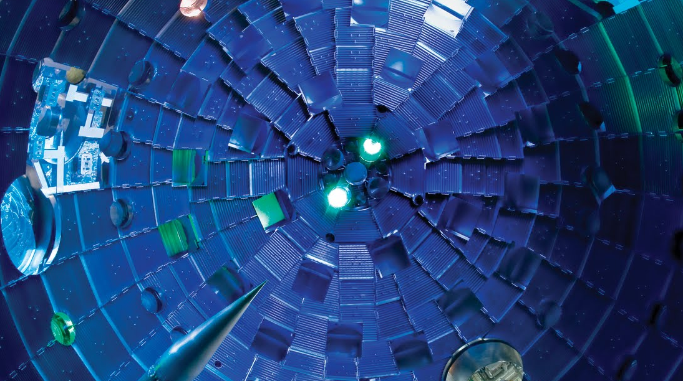

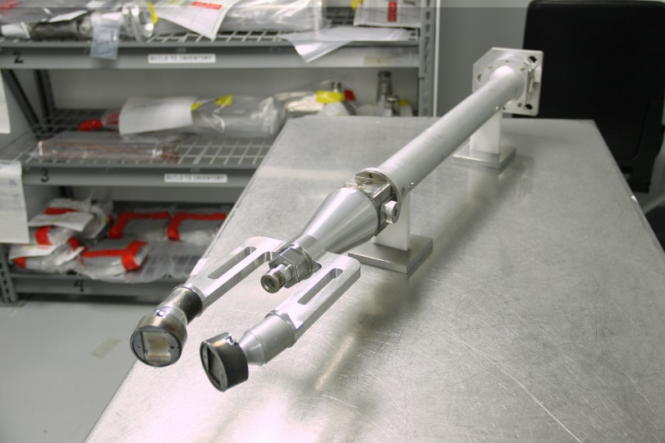
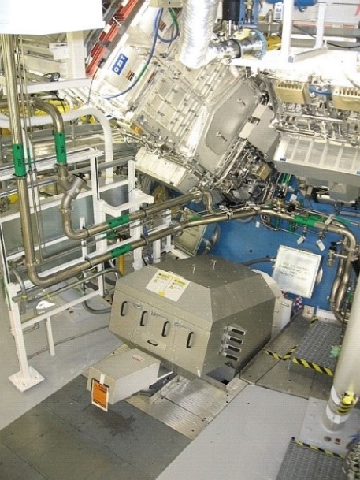
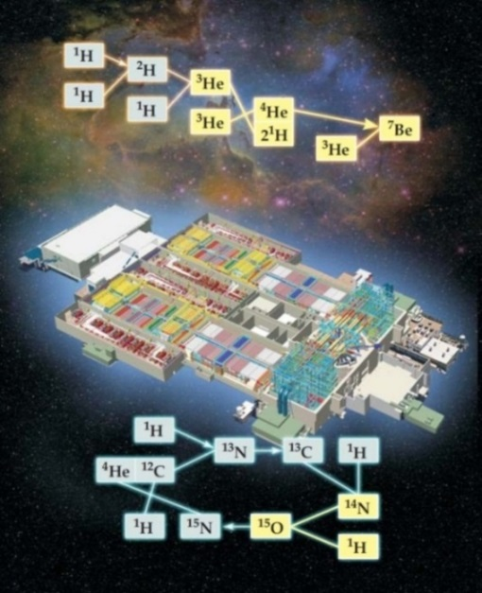
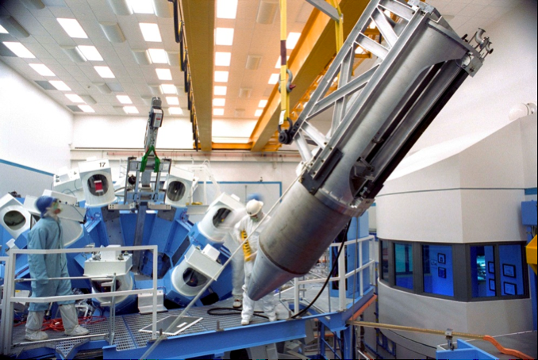
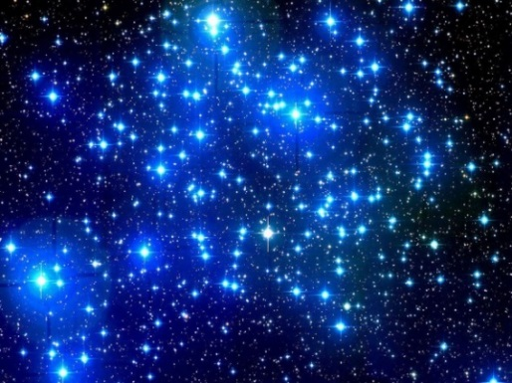
Using high energy density plasmas for nuclear experiments relevant to nuclear astrophysics
5 cm
NIF laser
Proton-proton chain
Proton spectrometers
NIF
CNO cycle
OMEGA laser
Maria Gatu Johnson
Massachusetts Institute of Technology
MIPSE seminar
Jan 17, 2024
Notes:
Obviously what we’re looking at here is the inside of the NIF target chamber, which is used for this work.
The pictures on the right are examples of some of the enabling nuclear diagnostics that we use
The goal of these experiments is to probe nuclear astrophysics-relevant nuclear reactions in a stellar-like environment, as I will show in the talk.

Slide 2
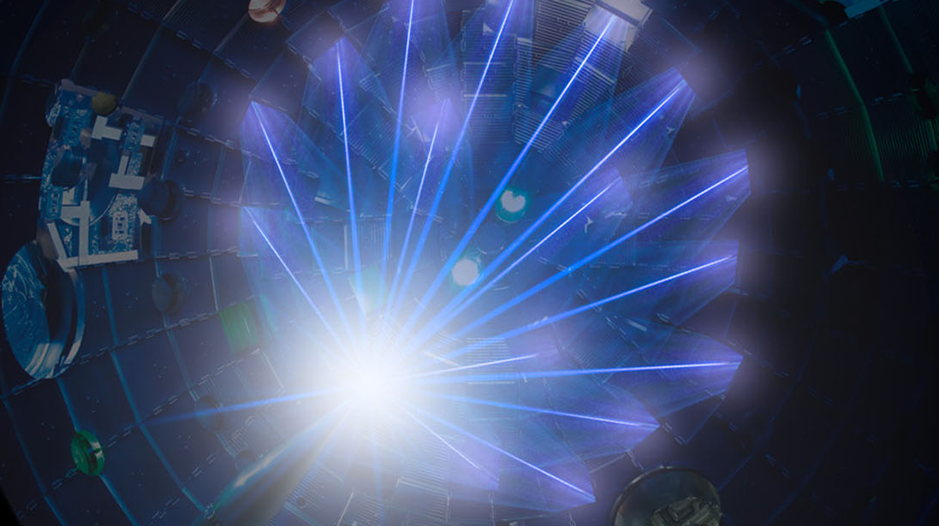
Using high energy density plasmas for nuclear experiments relevant to nuclear astrophysics
5 cm
NIF laser
Proton-proton chain
Proton spectrometers
NIF
CNO cycle
OMEGA laser
Maria Gatu Johnson
Massachusetts Institute of Technology
MIPSE seminar
Jan 17, 2024
Notes:
Obviously what we’re looking at here is the inside of the NIF target chamber, which is used for this work.
The pictures on the right are examples of some of the enabling nuclear diagnostics that we use
The goal of these experiments is to probe nuclear astrophysics-relevant nuclear reactions in a stellar-like environment, as I will show in the talk.

Slide 3










Collaborators
MIT
P. Adrian
S. Dannhoff
J. Frenje
T. Johnson
N. Kabadi
J. Kunimune
B. Lahmann
C. Li
C. Parker
J. Pearcy
R. Petrasso
F. Séguin
H. Sio
G.D. Sutcliffe
LLNL
A. Zylstra
D. Casey
M. Hohenberger
J. Caggiano
C. Cerjan
J. Despotopulos
L. Ellison
J. Escher
E. Hartouni
R. Hatarik
M. Hohensee
D. Holunga
J. Jeet
S. Khan
L. Masse
LLNL cont’
D. McNabb
A. Nikroo
W. Ong
J. Pino
B. Remington
H. Robey
M. Rubery
J. Sanchez
D. Sayre
P. Springer
I. Thompson
B. Tipton
H. Whitley
S. Quaglioini
C. Yeamans
UR
C. Forrest
R.S. Craxton
E.M. Garcia
V. Glebov
R. Janezic
J. Knauer
P. McKenty
P.B. Radha
H. Rinderknecht
M. Rosenberg
T. Sangster
W. Seka
C. Stoeckl
LANL
G. Hale
H. Herrmann
Y. Kim
A. McEvoy
Z. Mohamed
M. Paris
M. Schmitt
GA
M. Farrell
M. Hoppe
J. Kilkenny
M. Schoff
Ohio Univ.
C.R. Brune
Indiana Univ.
A. Bacher
AWE
W. Garbett
CEA
J.-L. Bourgade
O. Landoas
Imperial College
B. Appelbe
A. Crilly
I. Garin-Fernandez
Notes:
This is a large and growing collaboration – if you are interested in joining, please reach out to me afterwards

Slide 4
Summary
Exploration of Basic Nuclear Science and Nuclear Astrophysics using HED plasmas is a nascent field with much potential
High-Energy Density (HED) plasmas generated in laser-driven implosions provide a unique environment for studying stellar-relevant nuclear reactions
Recent experiments have provided the first exciting results on the solar ³He+³He, BBN-relevant T+³He and complementary T+T reactions
Ongoing efforts focus on probing the solar ³He³He→α+p+p reaction at more stellar-relevant conditions (OMEGA EG=165 keV, solar EG=21 keV) and at lower proton energy
Future work includes developing the platform for CNO-relevant measurements (e.g., the p+¹⁵N-α/γ branching ratio) and for electron screening and s-process-relevant neutron capture experiments

Slide 5
Summary
Exploration of Basic Nuclear Science and Nuclear Astrophysics using HED plasmas is a nascent field with much potential
High-Energy Density (HED) plasmas generated in laser-driven implosions provide a unique environment for studying stellar-relevant nuclear reactions
Recent experiments have provided the first exciting results on the solar ³He+³He, BBN-relevant T+³He and complementary T+T reactions
Ongoing efforts focus on probing the solar ³He³He→α+p+p reaction at more stellar-relevant conditions (OMEGA EG=165 keV, solar EG=21 keV) and at lower proton energy
Future work includes developing the platform for CNO-relevant measurements (e.g., the p+¹⁵N-α/γ branching ratio) and for electron screening and s-process-relevant neutron capture experiments

Slide 6
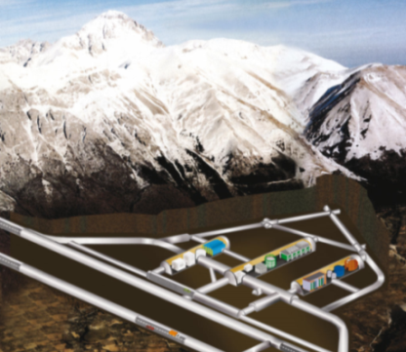
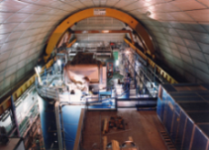
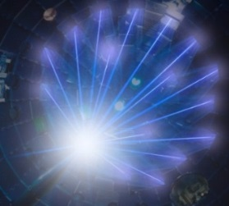
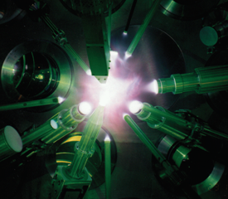
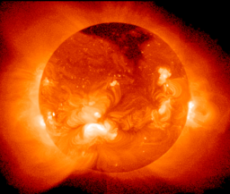
Motivation
In contrast to accelerators normally used for nuclear physics experiments, lasers create conditions similar to stellar cores
D(³He,p)⁴He
Accelerator experiments
Cold Target
Screening potential
enhanced to match data
Bound electron screening
Ions
Bound electrons
Bound
screening
Bare nucleus
Monoenergetic ion
Dense and hot plasma
NIF
OMEGA
Debye screening
Sun
Thermal ions
Thermal electrons
M. Aliotta et al, NP A (2001).
U. Schröder et al, NIM B (1989).
H. J. Assenbaum et al, ZP (1987).
Notes:
This is an example screening analysis from Aliotta et al. They found that they had to use a significantly higher bound electron correction than theoretically predicted to explain their D+3He data from the LUNA accelerator

Slide 7
Motivation
Capsule implosions at the OMEGA and NIF lasers create HED-plasma conditions that are similar to the interior of a star
10⁸
10⁸
1 MSun
10 MSun
1 MSun
10 MSun
10⁶
10⁶
10⁴
Shell Burn
10⁴
Time
40 MSun
Core Helium Burn
40 MSun
10²
10²
NIF CH
Main Sequence
NIF ignition
10⁰
10⁰
OMEGA CH
Time
Time
10⁻²
10⁻²
10⁷
10⁸
10⁹
10⁷
10⁸
10⁹
Stellar evolution simulations by Dave Dearborn (LLNL).
NIF simulations Harry Robey and Bob Tipton (LLNL).
OMEGA simulation P. B. Radha (UR).

Slide 8



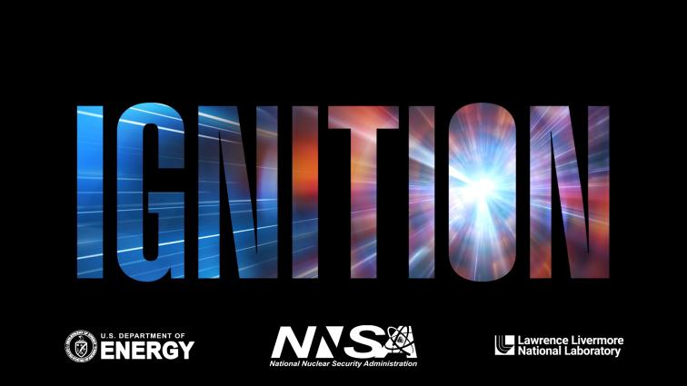
Motivation
Neutron fluxes achieved at the NIF are higher than anywhere else on earth by several orders of magnitude
Example:
4e17 neutrons/implosion¹
Burn duration <100 ps
→ 4e27 n/s
Burn region size ~100μm
→ ~10³⁰ n/s/cm² in capsule
Hohlraum radius ~3mm
~10²⁷ n/s/cm² on hohlraum wall
Such fluences are directly relevant for s- and/or r-process studies^{2,3}
capsule
10 µm fill-tube
¹H. Abu-Shawareb et al., Phys. Rev. Lett. 129, 071001 (2022); A. Zylstra et al., Nature 601, 542 (2022).
²S. LePape et al., Phys. Rev. Lett. 120, 245003 (2018)
³C. Cerjan et al., J. Phys. G: Nucl. Part. Phys. 45, 033003 (2018)
Notes:
This is an aspect of HED experiments that we will not really get into in the talk today, but I still wanted to mention it to illustrate the possibilities
This should be compared to core collapse supernovae neutron densities of 10^22 n/s/cm^2

Slide 9
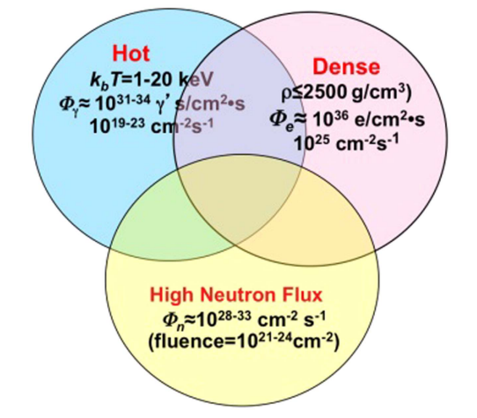
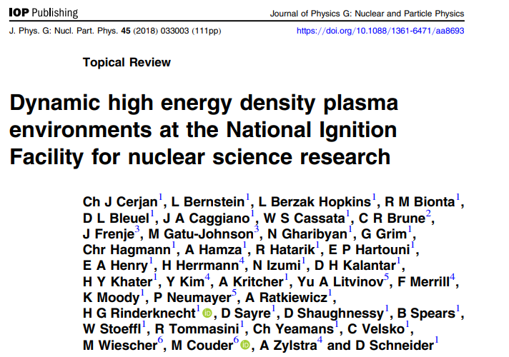
Motivation
At the NIF in particular, all these conditions come together in one experiment
Illustration from Cerjan et al., J. Phys. G: Nucl. Part. Phys. 45 (2018):
Existing and future nuclear diagnostics at the laser facilities enable exploitation of these plasmas for study of reactions relevant to stellar and big bang nucleosynthesis

Slide 10
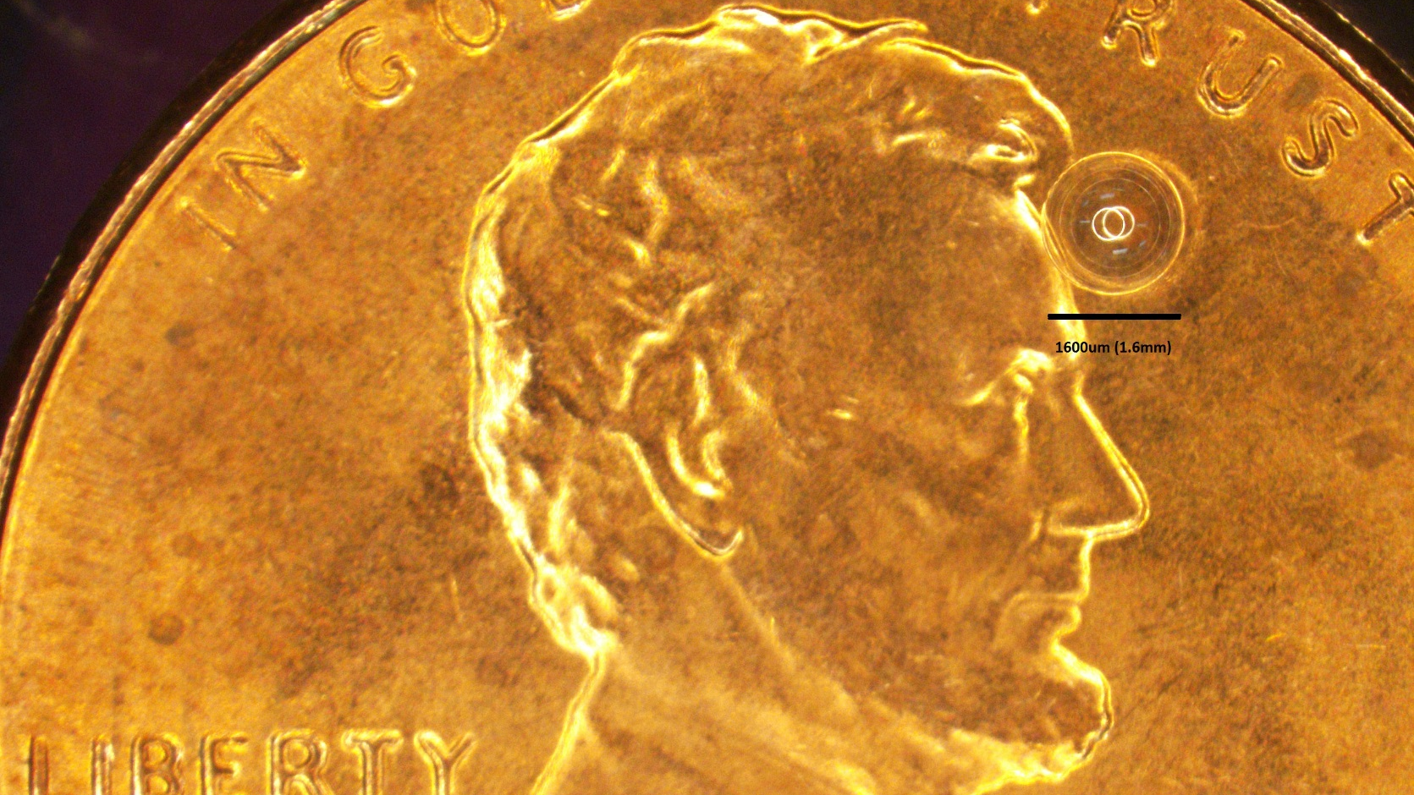
Background
Stellar-like conditions are reached by imploding capsules containing the relevant fuels
D+T
D+³He
Basic platform requirements:
Low areal density (for charged particles)
High enough yield to allow probing
Achievable plasma conditions determine astrophysical relevance
T+T
³He+³He
T+³He
D+D
p+D
Gatu Johnson et al., Phys. Plasmas 24, 041407 (2017)
Notes:
Challenge: Because of the dramatic reduction in reactivity towards lower temperature, it is much harder to produce sufficient yield at low temperature

Slide 11
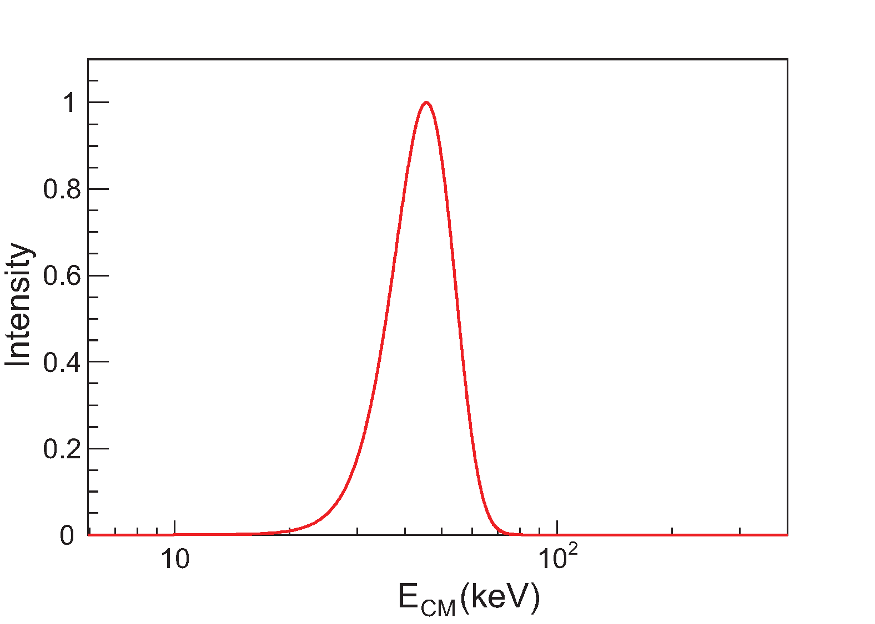
Background
Gamow-peak energies are directly related to HED-plasma ion temperatures and S-factors are directly related to cross sections
Gamow factor
³He³He, Tion= 4 keV
Gamow-peak energy (average c-m energy):
Gamow peak energy
EG=45 keV
S-factor:
Notes:
For a plasma at a certain ion temperature, you are going to have a rather broad distribution of center-of-mass energies of the reacting particles. This is exemplified in this plot for a 3He plasma at an ion temperature of 4 keV….
We call the mean energy of that distribution the “Gamow peak energy”.

Slide 12
Summary
Exploration of Basic Nuclear Science and Nuclear Astrophysics using HED plasmas is a nascent field with much potential
High-Energy Density (HED) plasmas generated in laser-driven implosions provide a unique environment for studying stellar-relevant nuclear reactions
Recent experiments have provided the first exciting results on the solar ³He+³He, BBN-relevant T+³He and complementary T+T reactions
Ongoing efforts focus on probing the solar ³He³He→α+p+p reaction at more stellar-relevant conditions (OMEGA EG=165 keV, solar EG=21 keV) and at lower proton energy
Future work includes developing the platform for CNO-relevant measurements (e.g., the p+¹⁵N-α/γ branching ratio) and for electron screening and s-process-relevant neutron capture experiments

Slide 13
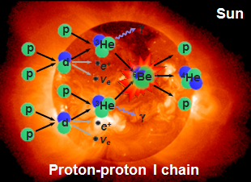
Experiments
Initial experiments have focused on probing the complementary ³He+³He, T+³He and T+T reactions
³He+³He
T+³He
T+T
³He+³He → α + p + p is responsible for nearly half the energy generation in our sun:
The ³He³He S-factor determines the pp-I/(pp-II + pp-III) branching ratio and is important for neutrino oscillation physics¹⁾
T+³He can proceed through several different branches:
T+³He → α + p + n
T+³He → α + d
T+³He → ⁶Li + γ
An anomalously high S-factor for the gamma branch has been hypothesized to explain ⁶Li abundance in primordial material – this was ruled out (Zylstra et al., PRL 117, 035002 (2016))
T+T → α + n + n is a mirror reaction to ³He³He
Basic nuclear physics governing few-body reactions with 3 particles in final state not well understood
Also important for ICF (contributes to the neutron spectrum)
The unique ensemble of T+T, T+³He and ³He+³He spectra provides insight into final-state interactions in six-nucleon systems
¹⁾ Adelberger et al., Rev. Mod. Phys 83, 2011
Notes:
Studying the tt reaction provides information about the 3He3He reaction, as mirror reactions have similar nuclear behavior (after correcting for the difference in the Coulomb potential and isospin)

Slide 14
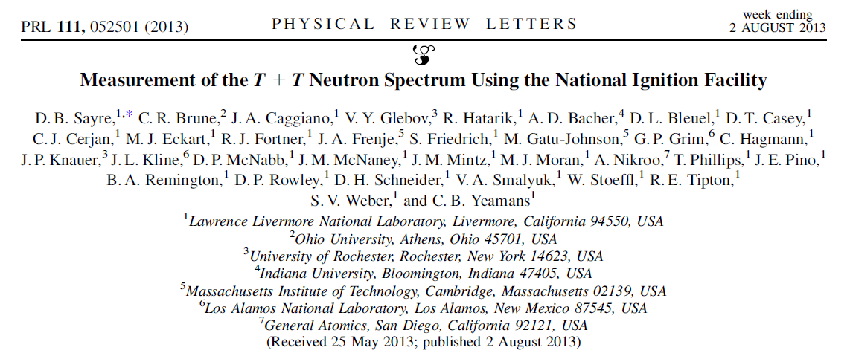
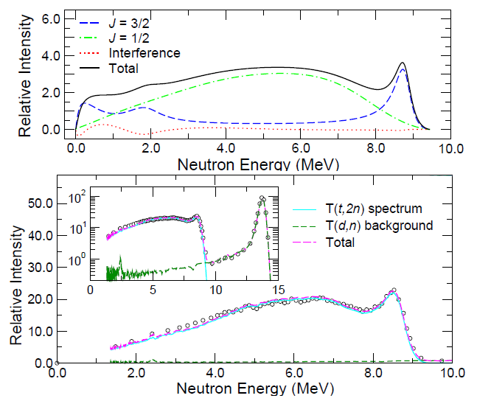
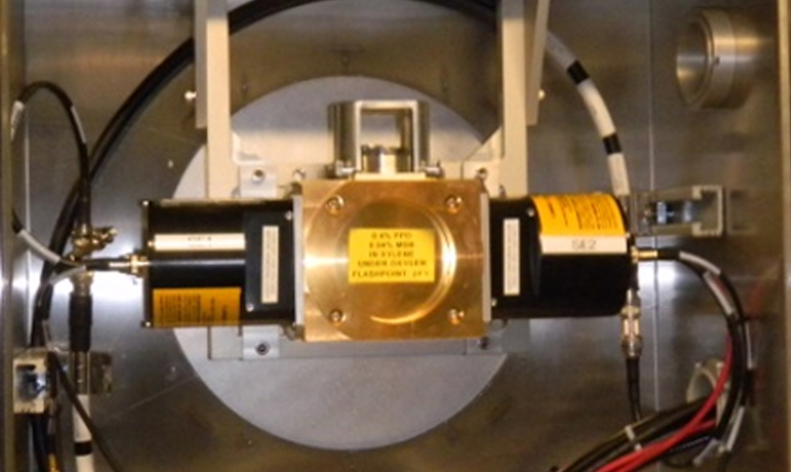
T+T
A NIF measurement of the T+T neutron spectrum at EG = 16 keV
provided new insights about the T+T reaction …
~230 µm CH
The basic physics governing this 6-nucleon reaction are not well understood:
4 atm at 32 K
T2
T + T → ??? → ⁴He + n + n
⁵He + n
⁵He* + n
(nn)
R-matrix modeling
Tion ~ 3.4 keV
EG ~ 16 keV
nTOF
(Ref. 1)
⁵He resonance
Conclusive evidence of n-α interactions at EG = 16 keV
R-matrix modeling indicates that interference between final-state particles matters
¹Neutron time-of-flight spectrometer, Clancy et al., SPIE proceedings (2014)
Notes:
Understanding the T+T reaction has important implications for:
Basic nuclear physics
Stellar Nucleosynthesis
Inertial Confinement Fusion

Slide 15
T+T
…but left some questions unanswered: The NIF result at EG = 16 keV is different from Wong’s result² at ECM = 160 keV
Wong at 90° (1965)
Sayre (2013)
⁵He resonance
R-matrix modeling (Hale)
R-matrix modeling (Brune)
The Sayre and Wong spectra may indicate that the reaction mechanism is changing with EG (ref 3), or the difference might be explained by an angular-distribution effect
¹Sayre et al, PRL (2013).
²Wong et al, NP (1965).
³Bacher et al, FewBody Meeting (2015)

Slide 16
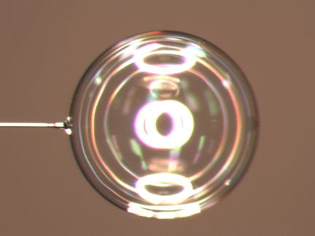
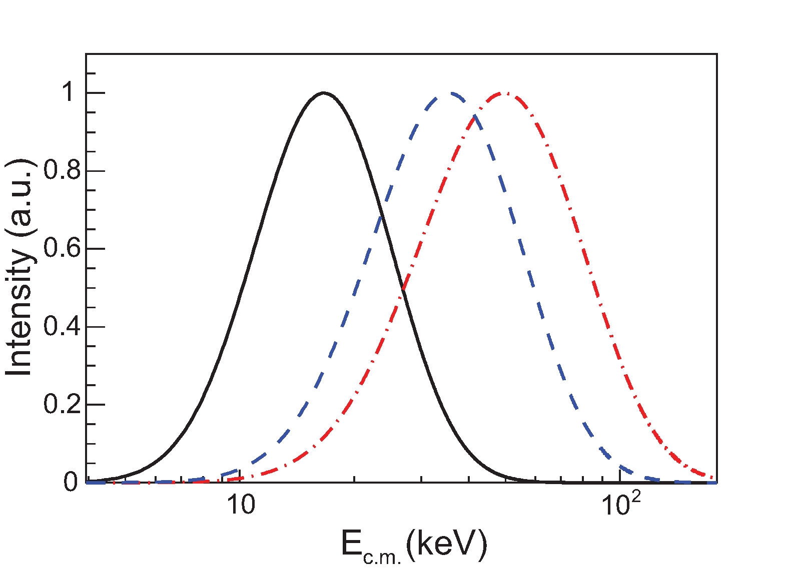
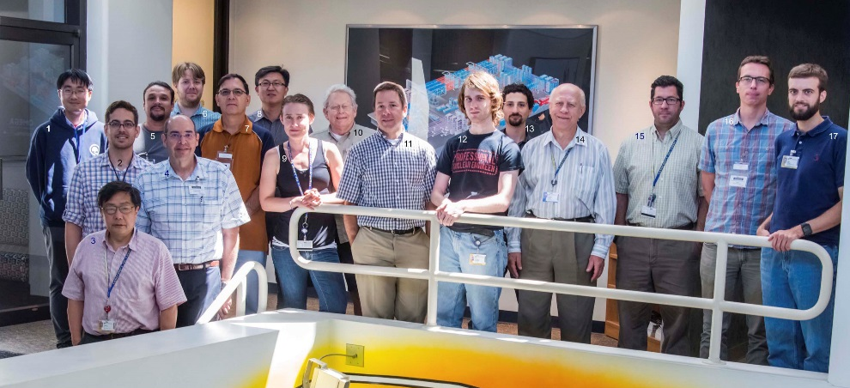
T+T
To address these questions, an OMEGA experiment was designed to probe the T+T spectrum over a range of Gamow-peak energies from 16 to 50 keV
9 atm fill
0.6 ns square laser pulse
All beams to TCC
~3.0 μm SiO2
9 atm fill
2 ns ramped laser pulse
defocused beams
3 atm fill
0.6 ns square laser pulse
All beams to TCC
~1.0 mm
T(99.8%)
D(0.2%)
∼3-9 atm
Tion=4 keV
Tion=18 keV
TT experiment team at LLE, July 2015
Tion=11 keV
EG=16 keV
EG=50 keV
EG=36 keV
Gatu Johnson et al., Phys. Plasmas 24, 041407 (2017)

Slide 17
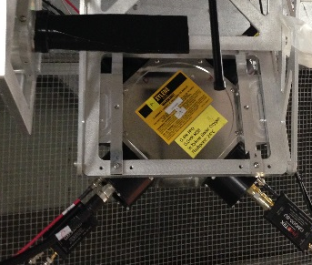
T+T
The data set clearly indicates a difference in spectral shape as a function of Gamow peak energy¹⁾
3 μm SiO2
Neutron energy (MeV)
3-9 atm
T2
10
8
6
4
⁵He ground state interaction
Raw data
E_{G}∼50 keV
nTOF
(Ref. 2)
E_{G}∼16 keV
¹Gatu Johnson et al., PRL (2018)
²Neutron time-of-flight spectrometer, Forrest et al., RSI (2012, 2016)

Slide 18
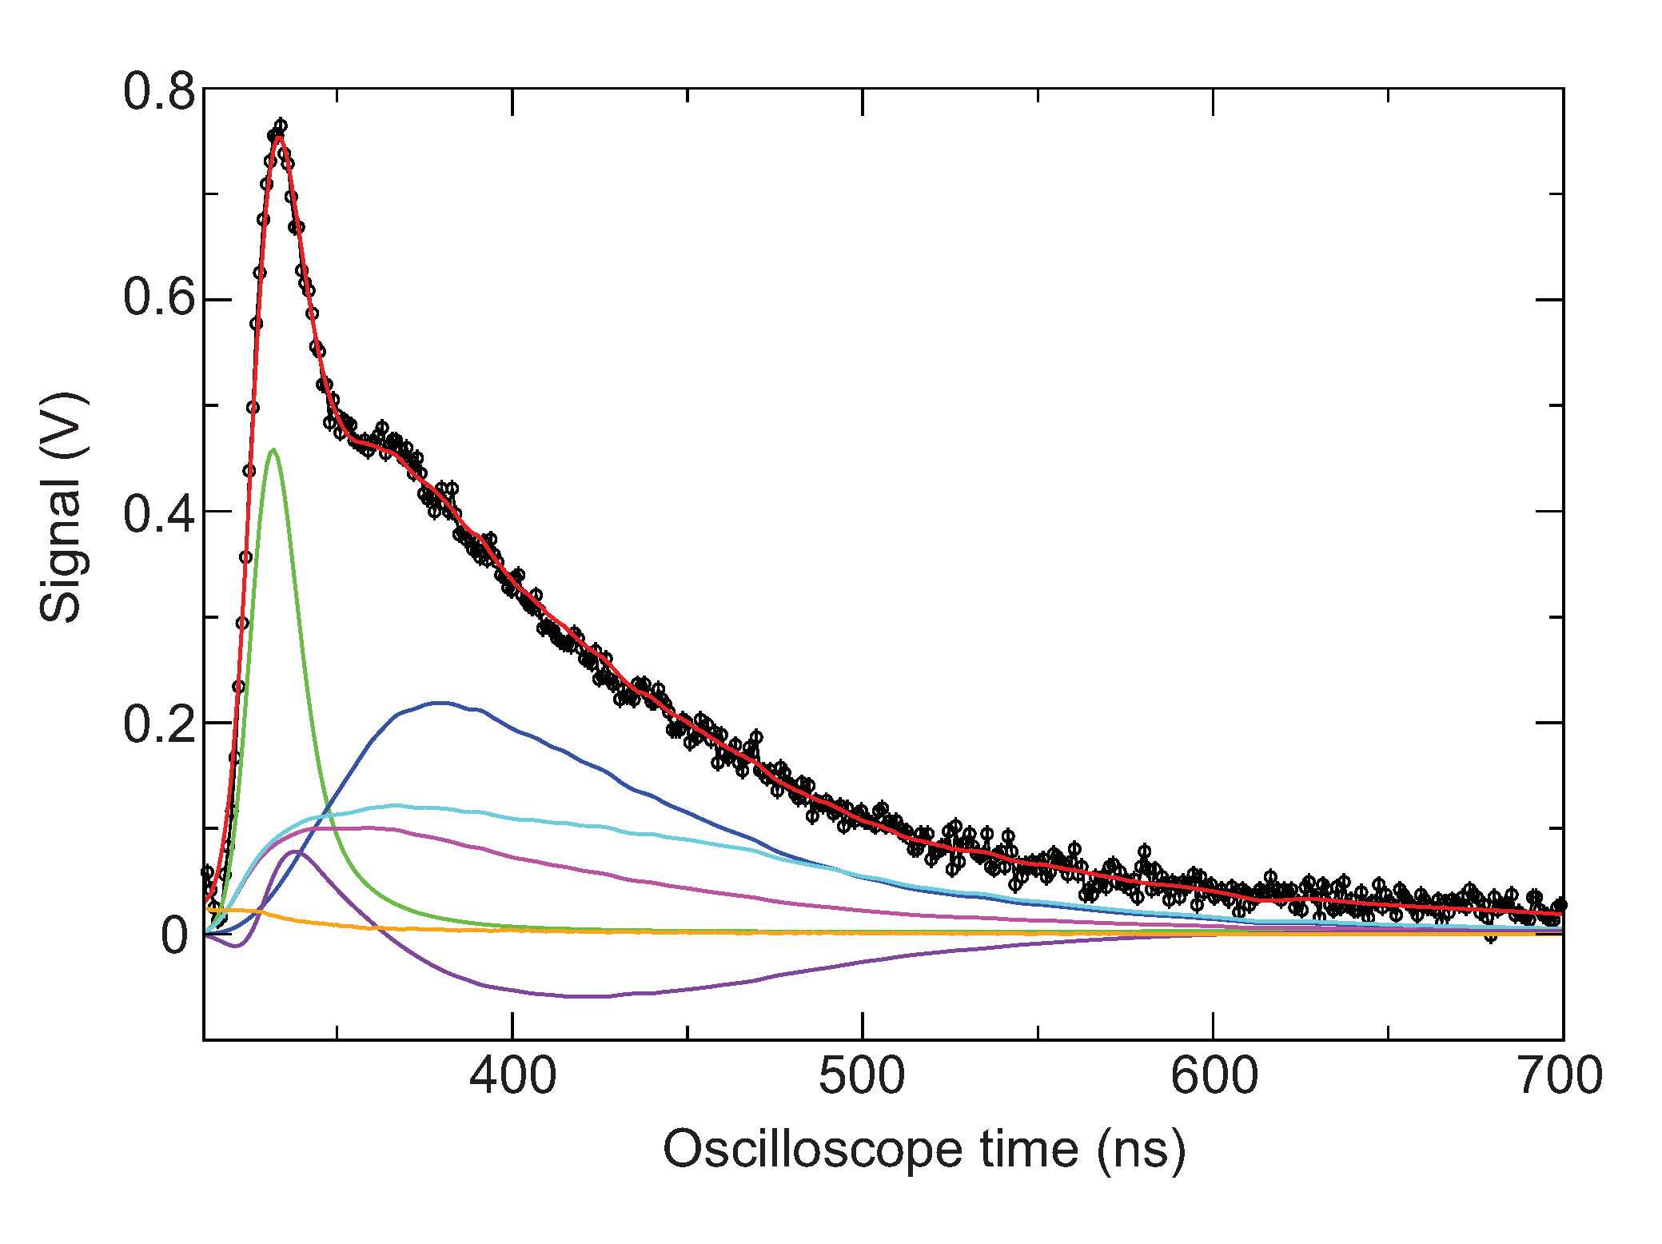
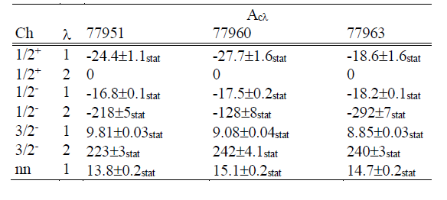
T+T
The data set clearly indicates a difference in spectral shape as a function of Gamow peak energy¹⁾
3 μm SiO2
3-9 atm
T2
R-matrix fit to E_{G}∼50 keV data
E_{G}=50 keV
E_{G}=36 keV
E_{G}=16 keV
3/2⁻ partial wave
nTOF
(Ref. 2)
⁵He ground state peak strength increases as a function of energy
Neutron time-of-flight (ns)
¹Gatu Johnson et al., PRL (2018)
²Neutron time-of-flight spectrometer, Forrest et al., RSI (2012, 2016)

Slide 19
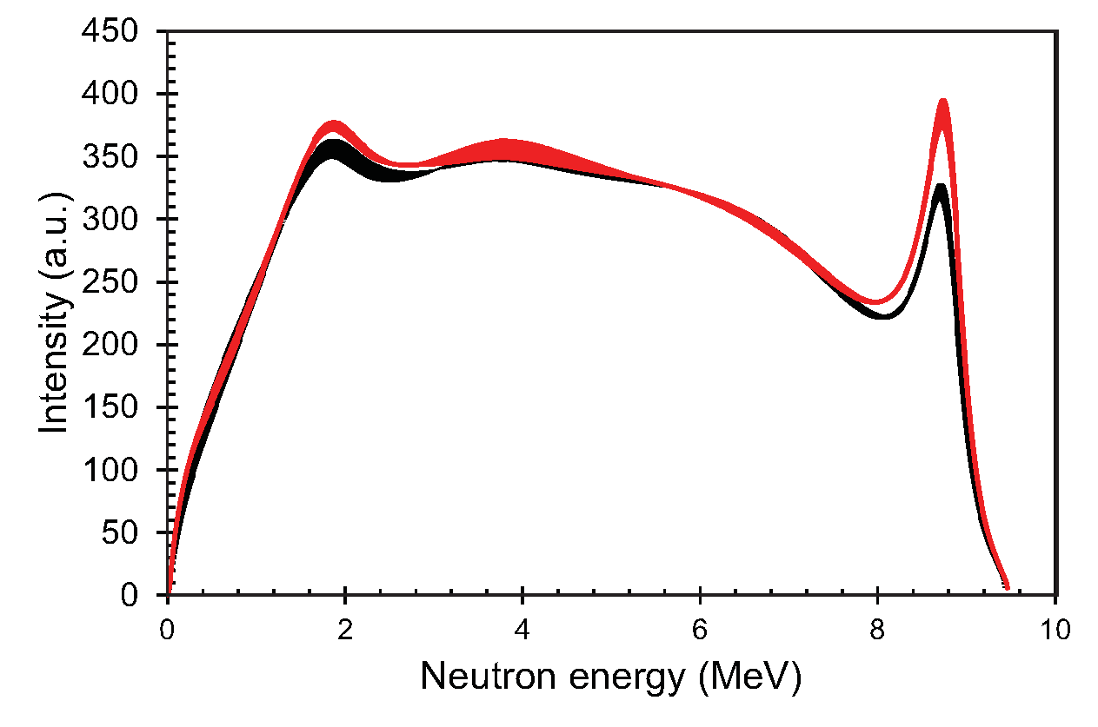
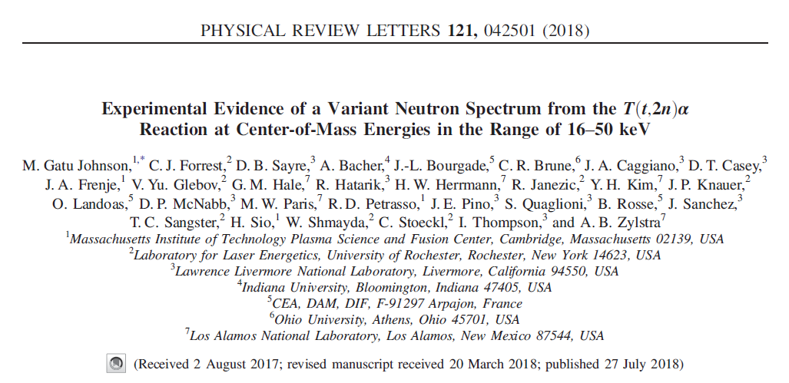
T+T
The data set clearly indicates a difference in spectral shape as a function of Gamow peak energy¹⁾
3 μm SiO2
R-matrix fits to OMEGA T+T data
3-9 atm
T2
E_{G}∼50 keV
E_{G}∼16 keV
nTOF
(Ref. 2)
R-matrix analysis assumes contributions from 0+ state (s-wave) only; p-wave may also contribute
If this is the explanation, then it is likely that an energy dependence will exist also for the mirror ³He+³He reaction
¹Gatu Johnson et al., PRL (2018)
²Neutron time-of-flight spectrometer, Forrest et al., RSI (2012, 2016)

Slide 20
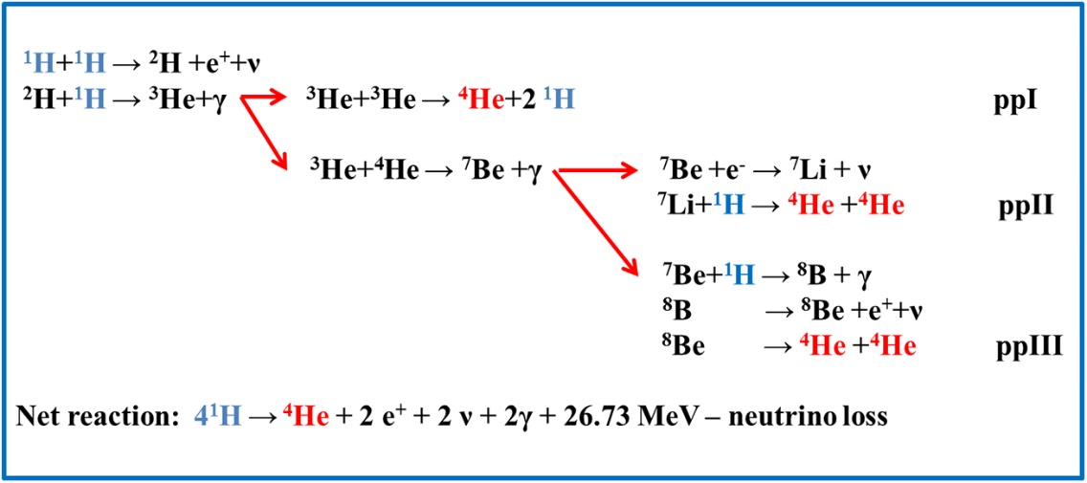
³He+³He
The S-factor for the ³He³He reaction impacts the ppI/(ppII+ppIII) branching ratio, and provides an important constraint on neutrino physics¹⁾
Uncertainty in the ³He³He S-factor directly impacts uncertainty in calculated neutrino fluxes from solar models
¹⁾Vinyoles, Ap. J 2017
²⁾Brune, Solar Fusion III workshop, 2022
Notes:
The ³He+³He rate is important to fully characterizing the solar proton-proton chain, and for neutrino physics
Accelerator measurements of the S-factor exist down to solar energies, but they require corrections for bound electron screening, and assume a spectral shape that we now believe is inaccurate.
Our experiments will …
… address if a spectral shape change is present for ³He³He between E_{c.m.}=165 keV probed at OMEGA and solar energies, and how it would impact S-factors inferred from accelerator data.
… address if a direct S-factor measurement can be made using the ICF platform.

Slide 21
³He+³He
The S-factor for the ³He³He reaction impacts the ppI/(ppII+ppIII) branching ratio, and provides an important constraint on neutrino physics¹⁾
Adelberger et al., Rev. Mod. Phys 83, 2011
Bound electron screening – cannot be avoided in accelerator measurements
ECM (MeV)
Uncertainty in the ³He³He S-factor directly impacts uncertainty in calculated neutrino fluxes from solar models
Solar Gamow peak
Accelerator S-factor measurements assume a spectral shape for the ³He+³He proton spectrum which is most likely inaccurate²⁾
¹⁾Vinyoles, Ap. J 2017
²⁾Brune, Solar Fusion III workshop, 2022
Notes:
The ³He+³He rate is important to fully characterizing the solar proton-proton chain, and for neutrino physics
Accelerator measurements of the S-factor exist down to solar energies, but they require corrections for bound electron screening, and assume a spectral shape that we now believe is inaccurate.
Our experiments will …
… address if a spectral shape change is present for ³He³He between E_{c.m.}=165 keV probed at OMEGA and solar energies, and how it would impact S-factors inferred from accelerator data.
… address if a direct S-factor measurement can be made using the ICF platform.

Slide 22
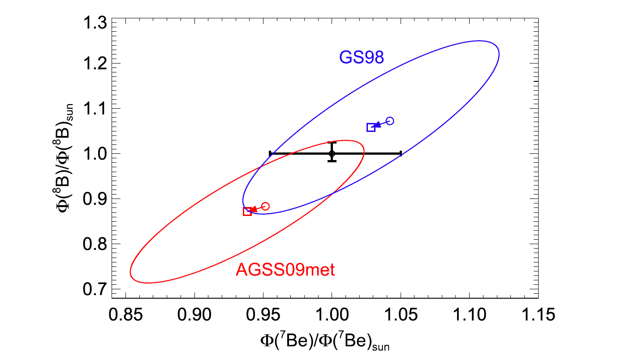
³He+³He
The S-factor for the ³He³He reaction impacts the ppI/(ppII+ppIII) branching ratio, and provides an important constraint on neutrino physics¹⁾
Vinyoles, Ap. J 2017
Adelberger et al., Rev. Mod. Phys 83, 2011
Bound electron screening – cannot be avoided in accelerator measurements
ECM (MeV)
Solar Gamow peak
Current assumed ±5.2% uncertainty on solar ³He³He S-factor has a 2.3% impact on the calculated solar neutrino flux
Accelerator S-factor measurements assume a spectral shape for the ³He+³He proton spectrum which is most likely inaccurate²⁾
¹⁾Vinyoles, Ap. J 2017
²⁾Brune, Solar Fusion III workshop, 2022
Notes:
The ³He+³He rate is important to fully characterizing the solar proton-proton chain, and for neutrino physics
Accelerator measurements of the S-factor exist down to solar energies, but they require corrections for bound electron screening, and assume a spectral shape that we now believe is inaccurate.
Our experiments will …
… address if a spectral shape change is present for ³He³He between E_{c.m.}=165 keV probed at OMEGA and solar energies, and how it would impact S-factors inferred from accelerator data.
… address if a direct S-factor measurement can be made using the ICF platform.

Slide 23
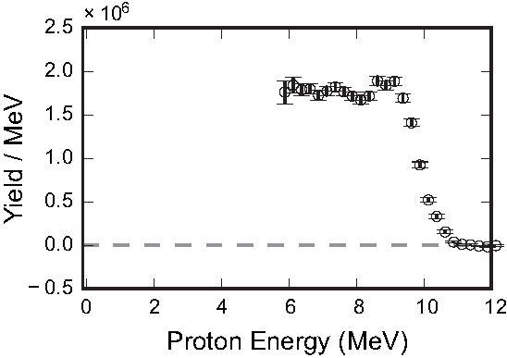
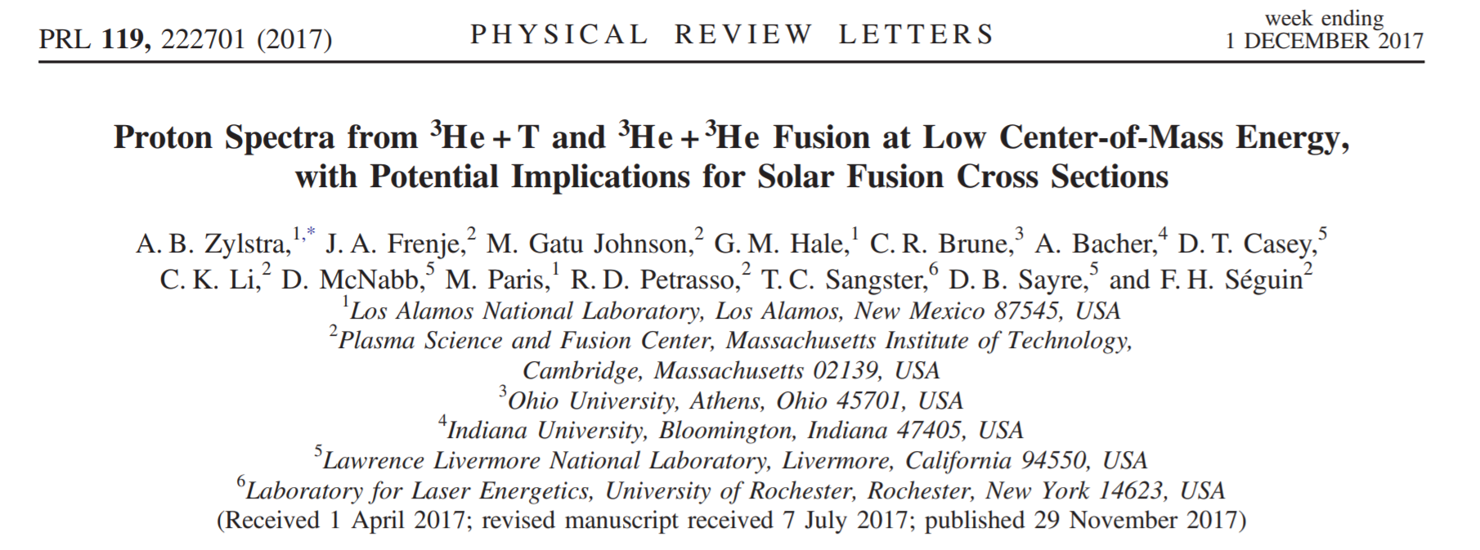
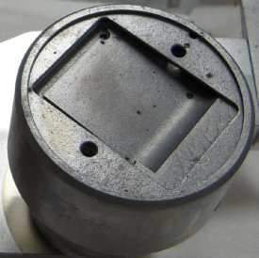
³He+³He
Initial measurements of the ³He+³He proton spectrum have been made at OMEGA at EG=165 keV
2-3 μm SiO2
³He+³He→α+p+p
proton spectrum
EG=165 keV
20 atm
³He
Yield / MeV
5 cm
WRF
Proton energy (MeV)
¹Zylstra et al., PRL (2017)
²Wedge-Range Filter proton spectrometer, Séguin et al., RSI (2003)
³Magnetic Recoil Spectrometer, Frenje et al., RSI (2008)
⁴Charged Particle Spectrometer, Hicks, MIT PhD thesis (1999)

Slide 24
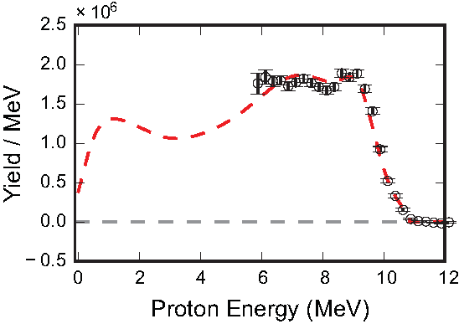
³He+³He
These initial ³He+³He OMEGA measurements indicate differences compared to T+T results
³He+³He→α+p+p
EG=165 keV
Yield / MeV
Proton energy (MeV)
R-matrix analysis with feeding factors based on Wong T+T data
Notes:
We’ve analyzed this data using what we know about the T+T reaction

Slide 25
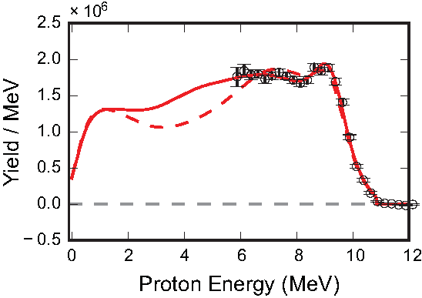
³He+³He
These initial ³He+³He OMEGA measurements indicate differences compared to T+T results
³He+³He→α+p+p
EG=165 keV
Yield / MeV
Proton energy (MeV)
R-matrix analysis with feeding factors based on Wong T+T data

Slide 26
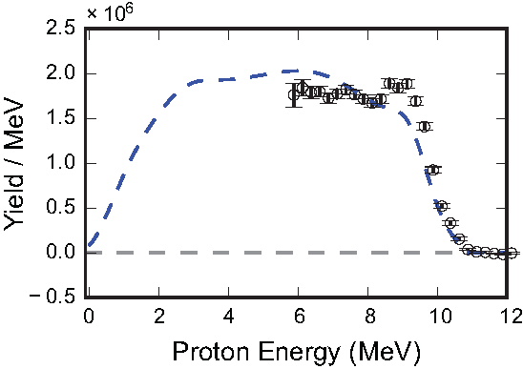
³He+³He
These initial ³He+³He OMEGA measurements indicate differences compared to T+T results
R-matrix analysis with feeding factors based on Sayre T+T data
³He+³He→α+p+p
EG=165 keV
Yield / MeV
Proton energy (MeV)

Slide 27
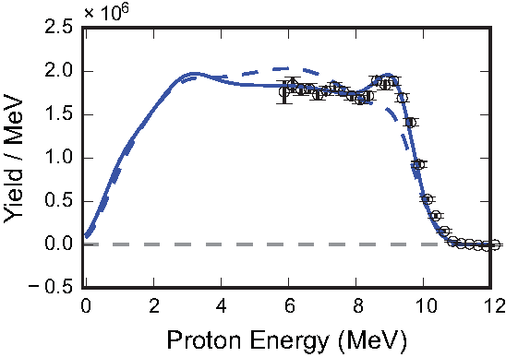
³He+³He
These initial ³He+³He OMEGA measurements indicate differences compared to T+T results
R-matrix analysis with feeding factors based on Sayre T+T data
³He+³He→α+p+p
EG=165 keV
Yield / MeV
Proton energy (MeV)

Slide 28
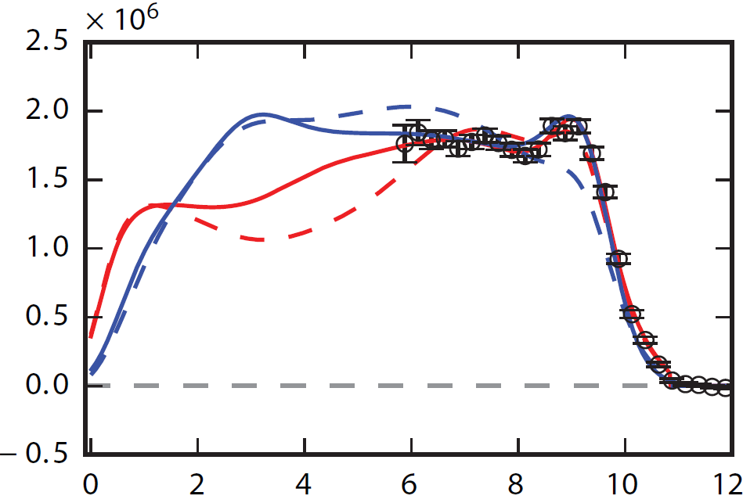
³He+³He
These initial ³He+³He OMEGA measurements indicate differences compared to T+T results
There are also differences between the two R-matrix models
Yield / MeV
Proton energy (MeV)
These results illustrate the poor understanding of few-body reactions.
Are the differences due to an EG dependence?
If so, what would this imply for the ³He³He cross section?
S-factor inferred from accelerator data can vary 8% depending on spectral model used
Notes:
Two important things to note: If we fit an elliptical spectrum vs the bottom red curve to the black data points, we would get a very different total 3He3He yield
Based on the T+T data, we would expect that the spectral shape will vary with energy

Slide 29
Summary
Exploration of Basic Nuclear Science and Nuclear Astrophysics using HED plasmas is a nascent field with much potential
High-Energy Density (HED) plasmas generated in laser-driven implosions provide a unique environment for studying stellar-relevant nuclear reactions
Recent experiments have provided the first exciting results on the solar ³He+³He, BBN-relevant T+³He and complementary T+T reactions
Ongoing efforts focus on probing the solar ³He³He→α+p+p reaction at more stellar-relevant conditions (OMEGA EG=165 keV, solar EG=21 keV) and at lower proton energy
Future work includes developing the platform for CNO-relevant measurements (e.g., the p+¹⁵N-α/γ branching ratio) and for electron screening and s-process-relevant neutron capture experiments

Slide 30
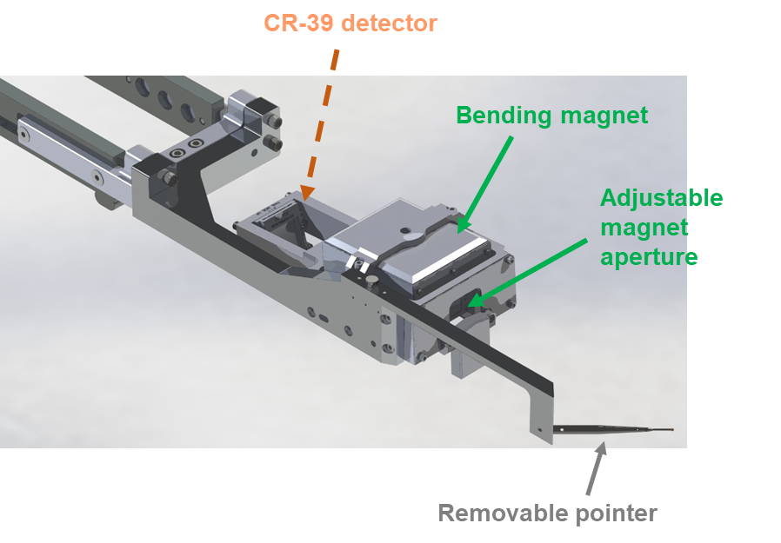
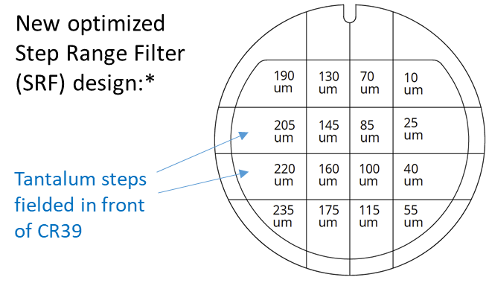
³He+³He
Next steps in the ³He+³He effort are to push to more solar-relevant energies, and to measure the proton spectrum at lower energy
A DS experiment leverages NIF to push towards solar-relevant Gamow-peak energies:
An OMEGA experiment leverages new detector technology to push to lower proton energy:
Adelberger et al., Rev. Mod. Phys 83, 2011
Yield / MeV
Bound electron screening – cannot be avoided in accelerator measurements
Proton energy (MeV)
ECM (MeV)
OMEGA ³He³He experiment (EG=165 keV)
Solar Gamow peak
MagSpec

Slide 31
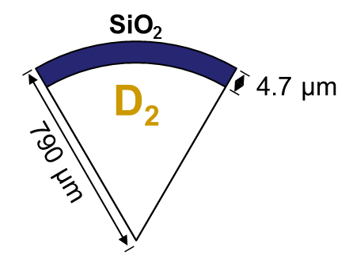
³He+³He
The NIF experiments leverage the higher laser energy available at NIF to drive larger capsules, producing enough yield at lower Tion/Ecm
CH
18 µm
D2
1500 µm
Y ∼ n1 × n2 × <σv(Tion)> × V × t
Gatu Johnson et al., Phys. Plasmas (2018)

Slide 32
³He+³He
The NIF experiments leverage the higher laser energy available at NIF to drive larger capsules, producing enough yield at lower Tion/Ecm
CH
18 µm
D2
1500 µm
Tion=7.3-7.8 keV
20x
Tion=8-11 keV
Y ∼ n1 × n2 × <σv(Tion)> × V × t
Gatu Johnson et al., Phys. Plasmas (2018)

Slide 33
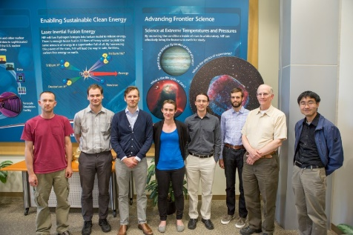
³He+³He
The NIF experiments leverage the higher laser energy available at NIF to drive larger capsules, producing enough yield at lower Tion/Ecm
Adelberger et al., Rev. Mod. Phys 83, 2011
CH
18 µm
D2
Bound electron screening – cannot be avoided in accelerator measurements
1500 µm
Y ∼ n1 × n2 × <σv(Tion)> × V × t
ECM (MeV)
OMEGA ³He³He experiment (EG=165 keV)
Solar Gamow peak
NIF measurements
Experiments relied on WRF as the primary diagnostic
Gatu Johnson et al., Phys. Plasmas (2018)

Slide 34
³He+³He
The more recent OMEGA experiments were specifically intended to obtain proton data at lower energy using new detectors
SiO2
Implosion platform optimized for high yield and minimal spectral distortion¹⁾
³He
3 µm
³He³He spectrum
500 µm
Shot # | Fill type | 6-11 MeV yield* | D³He yield* | DD yield** | DD T_{ion} (keV)
101917 | ³He | 2.0e7 | - | -
101918 | ³He | 2.2e7 | - | -
101919 | ³He | 1.0e8 | - | -
101921 | ³He | 7.4e7 | - | -
101922 | D³He | - | 2.4e10 | ~1e9
101923 | D³He | - | 2.7e10 | ~1e9 | 16.5±0.5
SiO2
D³He
3 µm
Tion
500 µm
TIM | Diag (3He/D3He)
TIM1 | Framing camera
TIM2 | Trident: WRFx2, SRF
TIM3 | MagSpec
TIM4 | WRF
TIM5 | SRF/PXTD
TIM6 | SRF/Clear LOS
*Based on average of TIM2 POS4 and POS12 WRF data, fielded 26cm from TCC
**Yield lower than predicted → larger uncertainty, and Tion measurement only worked on 101923
¹⁾Gatu Johnson et al., Phys. Plasmas (2017)

Slide 35
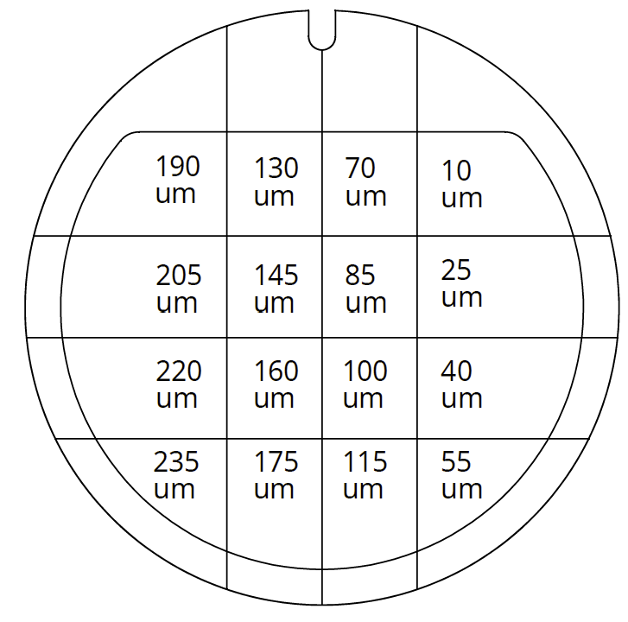
³He+³He
Three high-efficiency proton spectrometers are being leveraged to measure the ³He+³He proton energy spectrum
Wedge-range-filters (WRF)
Step-range-filters (SRF)
Magnetic Spectrometer (MagSpec)
Low-energy cut-off: ∼5 MeV
New optimized Step Range Filter (SRF) design:*
Tantalum steps fielded in front of CR39
WRF
WRF analysis for NIF shots: Brandon Lahmann and Justin Kunimune

Slide 36
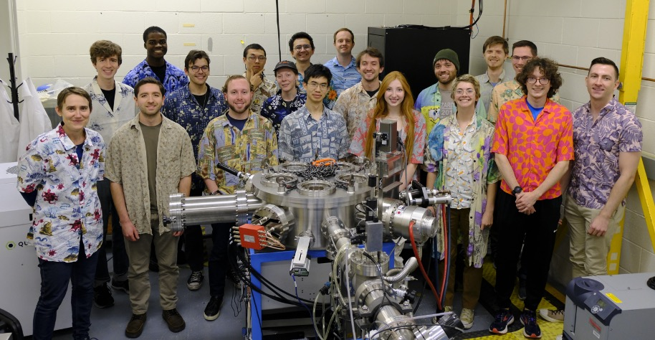
³He+³He
Proton spectrometer response is being tested on our MIT HED accelerator

Slide 37
³He+³He
WRF spectrometers have been used as a workhorse for many years, but recent data raise questions about impact of x-rays on response
26cm
Shot 77957
10.5cm
WRF analysis for NIF shots: Brandon Lahmann and Justin Kunimune
Notes:
Pre-shot, dose had been estimated based on FFLEX data, which led to a conclusion of no impact

Slide 38
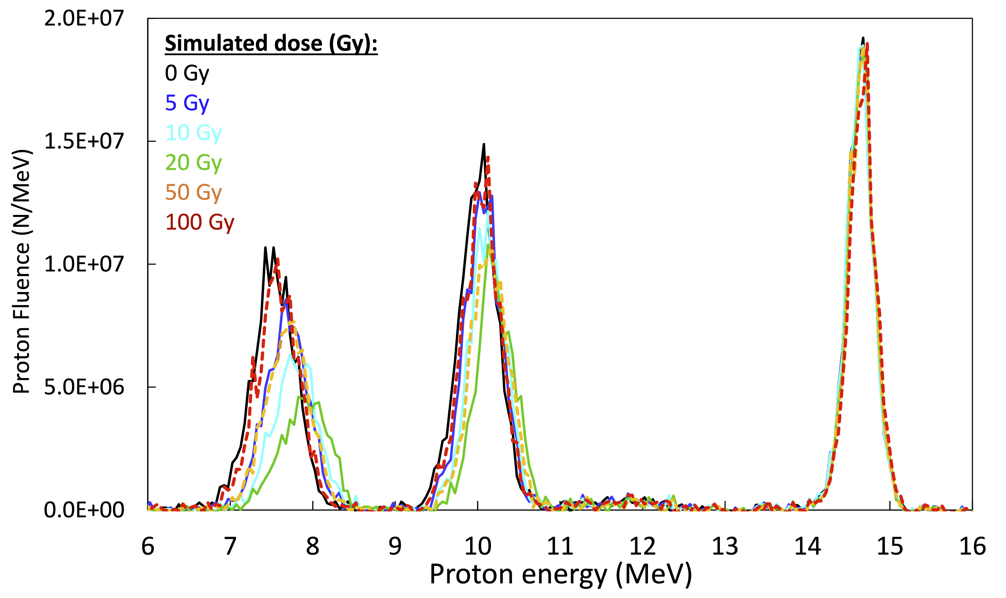
³He+³He
WRF spectrometers have been used as a workhorse for many years, but recent data raise questions about impact of x-rays on response
26cm
Shot 77957
10.5cm
Rinderknecht et al., RSI 86, 123511 (2015):
WRF analysis for NIF shots: Brandon Lahmann and Justin Kunimune
Notes:
Pre-shot, dose had been estimated based on FFLEX data, which led to a conclusion of no impact

Slide 39
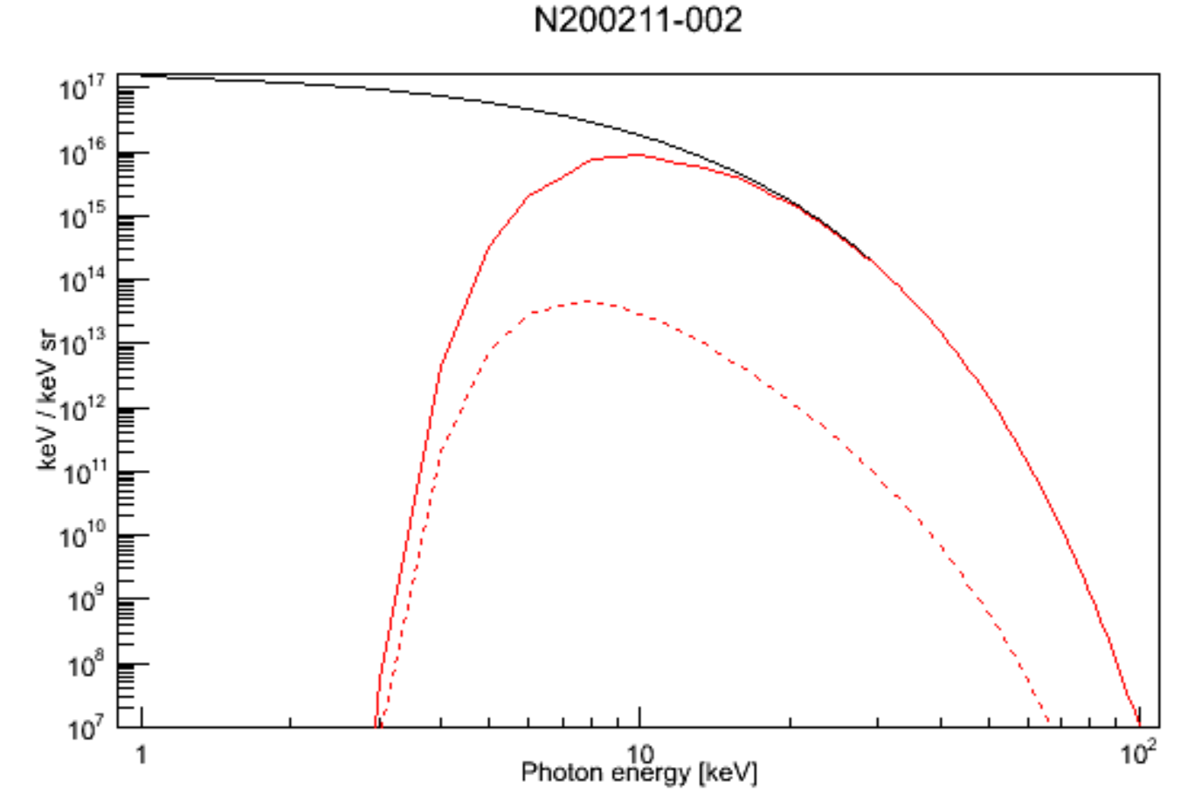
³He+³He
WRF spectrometers have been used as a workhorse for many years, but recent data raise questions about impact of x-rays on response
X-ray dose and energy spectrum inferred from x-ray penumbral imaging (PCIS) data obtained on NIF shots:
26cm
Shot 77957
750 Ti
600 Ti
Dose at 50cm
10.5cm
PCIS spectrum
After 100μm Al
400 Ti
500 Ti
Rinderknecht et al., RSI 86, 123511 (2015):
Absorbed in CR39
Total dose 11.0 Gy
(Total dose at 10cm: 275 Gy)
WRF analysis for NIF shots: Brandon Lahmann and Justin Kunimune
Notes:
Pre-shot, dose had been estimated based on FFLEX data, which led to a conclusion of no impact

Slide 40
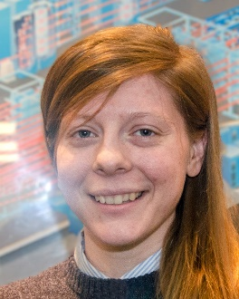
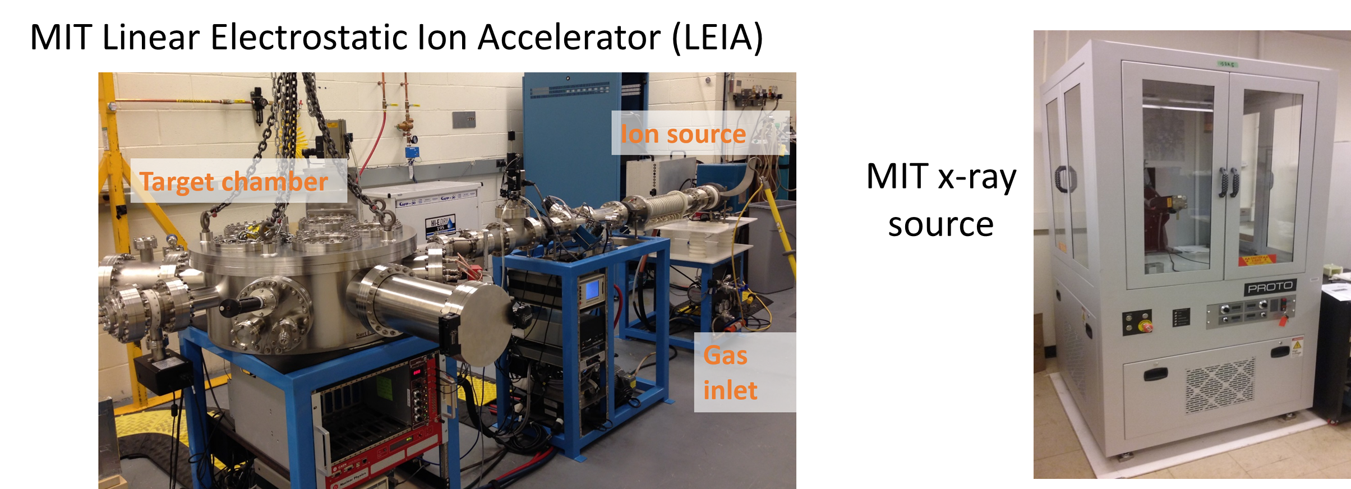
³He+³He
Question about x-ray impact on WRF response is being addressed in the MIT accelerator lab
Use x-ray source to expose assembly to x-rays
Use accelerator to add protons at three different energies
Critical to know x-ray dose
Skylar is working on this using a ²⁴¹Am source, image plates, and a new image plate scanner
Notes:
Use x-ray source (Cu, Ti, Mo anode, energies <40 keV) to expose assembly to x-rays
Use accelerator to add D³He protons at three different energies (nominal and ranged down)

Slide 41

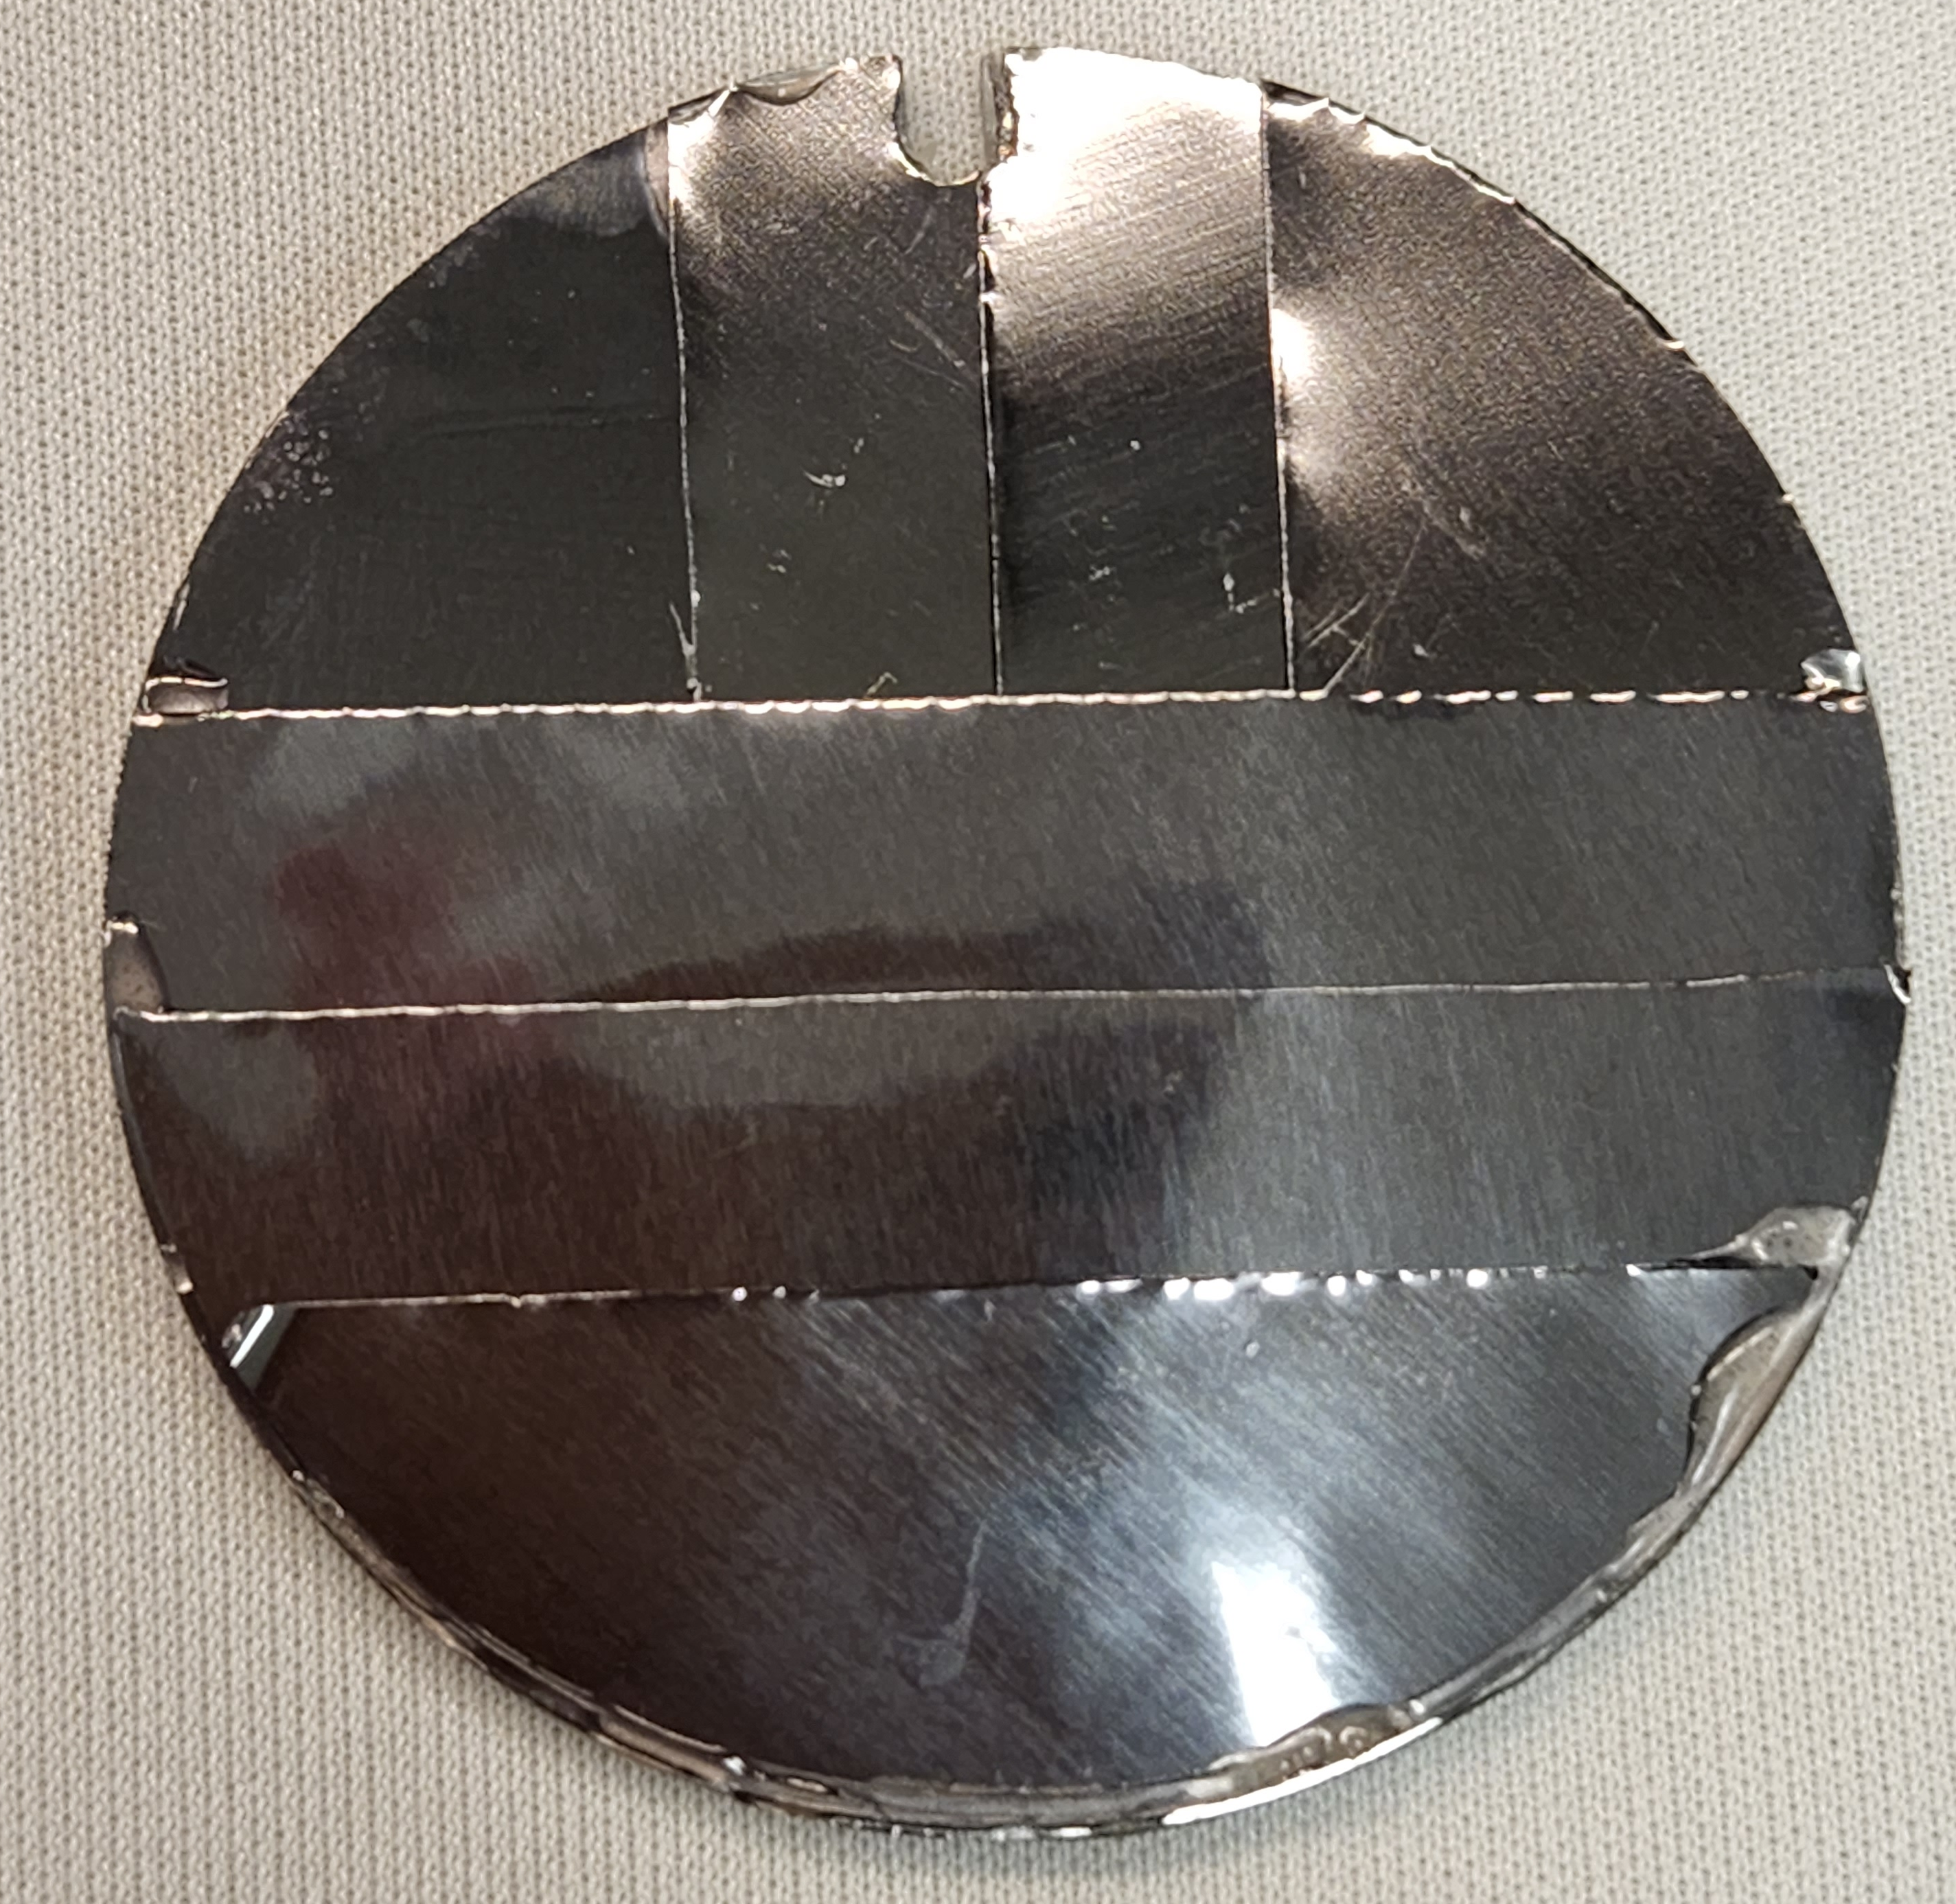


³He+³He
An SRF design optimized for ³He+³He proton measurements was developed for the OMEGA campaign; its response is being characterized
A 16-step filter design is used for maximal energy coverage
A Monte Carlo simulation toolkit was developed to simulate SRF response
Results are being compared to accelerator exposures for validation
*T.M. Johnson et al., in preparation for Rev. Sci. Instrum. (2023)

Slide 42





³He+³He
The new MagSpec* detector is now available for use at both OMEGA and the NIF, with in-situ calibration efforts ongoing at OMEGA
Adrian et al., Rev. Sci. Instrum. (2022)
MagSpec was first fielded on the 2020 NIF DS campaign, but due to a design problem the D³He protons interfere with the ³He³He spectrum for that initial implementation
*J. Pearcy et al., to be submitted to Rev. Sci. Instrum. (2023)

Slide 43



NIF
Measured proton spectra, differentially filtered x-ray penumbral imaging, and x-ray burn history are being used¹⁾ to constrain NIF implosion conditions
Average WRF Measurements for N200211-003 (19% D content)
750 Ti
600 Ti
400 Ti
500 Ti
¹⁾ P.J. Adrian, PhD thesis, MIT (2023)

Slide 44








NIF
The penumbral x-ray images are used to constrain the hot-spot volume (Vhs), and the SPIDER burn history data gives the burn duration (τ)
$$B$$
$$210 μm$$
(a) (b)
$$30\%$$
$$A$$
$$238 μm$$
Polar View
$$B$$
$$210 μm$$
(c) (d)
$$30\%$$
18 $μm$
CH Ablator
³He 10.2 atm
$$C$$
$$225 μm$$
Equator
View
¹⁾ P.J. Adrian, PhD thesis, MIT (2023)

Slide 45

NIF
The brightness (PSL) of each image is then used to constrain ne and Te given measurements of Vhs and τ
¹⁾ P.J. Adrian, PhD thesis, MIT (2023)

Slide 46


NIF
Finally, D³He Tion is inferred by using inferred ne and Te to calculate ranging of the D³He protons and matching to the measured spectrum
Birth spectra Tion = 15.6 keV
Plasma Stopping + WRF inst. Response
WRF Data
¹⁾ P.J. Adrian, PhD thesis, MIT (2023)

Slide 47



NIF
With this, implosion conditions for N200211-002/3 are constrained
$$E_{G} \left(Sun\right)$$
22 keV
$$E_{G} \left(NIF\right)$$
113 keV
$$E_{G} (OMEGA)$$
165 keV
Star plots Dave Dearborn
10⁸
1 MSun
10 MSun
10⁶
PRELIMINARY
Shell Burn
10⁴
Core Helium Burn
40 MSun
10²
Main Sequence
These implosions
10
Time
10⁻²
10⁷
10⁸
10⁹
Notes:
Tion∼1.8e8 K
Density: calculate based on initial fill density and initial to final volume
Initial density: ?? Let’s say 1.3 mg/cc → final density 0.4 g/cc
Initial volume: 1.3e10; Final volume: 4.7e7 um3

Slide 48

³He+³He
Recent Step Range Filter detector advances enabled measurement of the ³He+³He spectrum down to 2 MeV at OMEGA on Sept 16, 2021
OMEGA shot 101919, E_{CM}∼165 keV
Synthetic Hale spectrum
χ²_{red}=6.6
SRF data
Synthetic Brune spectrum
χ²_{red}=12
PRELIMINARY!!
Proton energy (MeV)
*T.M. Johnson et al., in preparation for Rev. Sci. Instrum. (2023)

Slide 49
Summary
Exploration of Basic Nuclear Science and Nuclear Astrophysics using HED plasmas is a nascent field with much potential
High-Energy Density (HED) plasmas generated in laser-driven implosions provide a unique environment for studying stellar-relevant nuclear reactions
Recent experiments have provided the first exciting results on the solar ³He+³He, BBN-relevant T+³He and complementary T+T reactions
Ongoing efforts focus on probing the solar ³He³He→α+p+p reaction at more stellar-relevant conditions (OMEGA EG=165 keV, solar EG=21 keV) and at lower proton energy
Future work includes developing the platform for CNO-relevant measurements (e.g., the p+¹⁵N-α/γ branching ratio) and for electron screening and s-process-relevant neutron capture experiments

Slide 50
CNO
Early efforts have focused on low-Z ion reactions; platform development has started for studies of CNO-relevant mid-Z ion reactions
First test: Can high enough Tion be maintained with mid-Z gas fill in the capsules?
Tion inferred from DD-n peak broadening:
7 μm CH
7 μm CH
4 atm
D2
4 atm
N2/D2
430 μm
430 μm
Gatu Johnson et al., “Impact of mid-Z gas fill on dynamics and performance of shock-driven implosions at the OMEGA laser”, submitted to Phys. Rev. E (2023).
Jeet et al., “Development of a platform for studying solar CNO reactions in an ICF plasma”, in preparation (2023)

Slide 51
CNO
Adding N2 in the fill does come with a yield reduction, but on a manageable level
Factor 4 difference in yield expected due to lower D content in N2D2 implosions
Factor 7.2 observed
Difference is reproduced in hydro and kinetic simulations
Arises due to a lower fraction of D getting hot enough to burn
OMEGA data
Kinetic sims
Hydro
sim
<2x
Expected from difference in D content

Slide 52
CNO
Adding N2 in the fill does come with a yield reduction, but on a manageable level
Factor 4 difference in yield expected due to lower D content in N2D2 implosions
Factor 7.2 observed
Difference is reproduced in hydro and kinetic simulations
Arises due to a lower fraction of D getting hot enough to burn
OMEGA data
Kinetic sims
Hydro
sim
<2x
Expected from difference in D content
Not considering the CH in the simulation → over-estimated D diffusion in the N2D2 case

Slide 53

Screening
An ongoing NIF experiment is addressing the impact of bound electron screening
D + ³He→ α + p
M. Aliotta et al, NP A (2001).
S. Engstler et al., Phys. Lett. B (1988).

Slide 54
Screening
An ongoing NIF experiment is addressing the impact of bound electron screening
D + ³He→ α + p
Working to probe this range at NIF
M. Aliotta et al, NP A (2001).
S. Engstler et al., Phys. Lett. B (1988).

Slide 55


Screening
The first step is to measure the bare nuclear cross section, but longer term, we want to measure plasma screening user higher density plasmas
An experiment to probe plasma screening requires that the effect is larger than the experimental yield uncertainty
Higher charge Z
Lower temperature kT
Higher density n
Lower Tion → lower yield
Higher density → charged particles won’t escape
Proposed path forward: Increase Z to get high screening in a feasible experiment
Design calculations under way to find the right regime
Effort to minimize experimental uncertainties in progress
Simplest plasma screening model¹⁾:
→ larger screening effect:
$$\frac{σ_{screened}}{σ}≈e^{Z_{1} Z_{2}{ \tilde{z} Λ}_{0}}$$
$$Λ_{0}= {\left(4π\right)}^{1/2}{ e}^{3}{{ n}^{1/2}}/{{\left(kT\right)}^{3/2}}$$
We are working on designing an experiment where plasma screening effects will be directly measureable
¹Salpeter, E. E., Aust. J. Phys. 7, 373. (1954)

Slide 56



Screening
Design calculations suggest that this might be achievable
Λ0=10⁰
10⁻¹
Layered
implosions
Gas filled
implosions
(higher-Z)
10⁻²
10⁻³
Can we move here?
1 MSun
4 MSun
10 MSun
40 MSun
10⁻⁴
Density [g/cc]
10⁻⁵
Layered
implosions
Gas filled
implosions
10⁻⁶
10⁻⁷
Gas filled
implosions
Temperature [K]
$$\frac{σ_{screened}}{σ}≈e^{Z_{1} Z_{2}{ \tilde{z} Λ}_{0}}$$
Requires development of a new higher-efficiency gamma detector
D. Casey et al., Front. Phys. 10:1057603. (2023)
Notes:
Λ0 is the so called chargeless plasma parameter
One reason why plotting it this way is convenient because the star’s effective Z’s are changing through the burn but this takes that dimension out. We just have to remember that Zeff is not constant so screening increases with age as stars build up higher Z, and obviously higher Z reactions are screened more strongly.

Slide 57




Excited states
Proposed work aims to address neutron capture cross sections on s-process branch point nuclei in plasma environment
B. Appelbe DS project
Coat inner shell with ¹⁷¹Tm (~10¹⁵ atoms) and ⁸⁹Y (~10¹⁶ atoms)
Measure reaction products using solid radiochemistry
¹⁷¹Tm(n,γ)¹⁷²Tm
⁸⁹Y(n,γ)⁹⁰Y (monitor reaction)
3 mm diameter CH capsule
Polar DIM
(0,0)
4 collectors
Solid debris collection
250 um copper fill tube
Large collector
DIM 90-315
VADER collector
DIM 90-78
Vary plasma conditions to tune ¹⁷¹Tm ground state/1st excited state ratio
Large area solid radiochemistry collector, 1-5%
Collection of noble gas products
RadChem:
J. Despotopulos
Challenge: accurate knowledge of neutron spectrum
Radiochemical Analysis of Gaseous Species (RAGS)

Slide 58

Kinetic effects?
Work is ongoing to address impact (if any) of non-Maxwellian ion velocity distributions on the nuclear emission from these implosions
~5e19 cm⁻³
Thomson scattering used to study ion velocity distributions
Thomson data will be contrasted to nuclear emission results, with the kinetic code iFP used in interpretation
Pre-shot hydro simulations (FLASH) suggest implosion-relevant conditions are achieved
Pre-shot kinetic simulations (iFP) suggest highly non-Maxwellian ion velocity distributions
5mm
OMEGA experiment Feb 15, 2023

Slide 59

Future
There is a rich set of opportunities to study nuclear reactions using HED plasmas at OMEGA and the NIF
Charged-particle induced reactions:
T(t,2n)⁴He (analogue to ³He(³He,2p)⁴He) [1]
T(³He,np)⁴He, T(³He,d) ⁴He, T(³He,γ)⁶Li (BBN) [2]
³He(³He,2p)⁴He (pp-I) [3]
D(p,γ)³He (Brown dwarfs, protostars) [4]
T(d,γ)⁵He [5]
⁴He(D,γ)⁶Li (BBN)
⁴He(T,γ)⁷Li (BBN)
⁴He(³He,γ)⁷Be (Solar)
⁶Li(p,α)³He (BBN)
⁷Li(p,α)⁴He (BBN)
⁷Be(p,γ)⁸B (Solar)
⁷Be(α,γ)¹¹C (BBN)
¹¹B(p,α)⁸Be (Basic nuclear)
¹⁵N(p,α)¹²C/ ¹⁵N(p,γ)¹⁶O (CNO)
¹⁰B(p,α)⁷Be [8]
¹²C(p,γ)¹³N [8]
¹⁴N(p,γ)¹⁵O [8]
Neutron-induced reactions:
n-d and n-T at 14 MeV [6]
D(n,2n) at 14 MeV [7]
T(n,2n) at 14 MeV
Various (n,γ) processes
Li(n,2n), Be(n,2n), other (n,2n) processes
Plasma effects:
Screening
NEET/NEEC
s-process relevant reactions
r-process relevant reactions
Proton-proton chain
Published
Ongoing
Proposed
Near future?
1: Casey et al., PRL 2012; Sayre et al., PRL 2013; Gatu Johnson et al., PRL 2018
2-4: Zylstra et al., PRL 2016; Zylstra et al., PRL 2017
5: Kim et al., PoP and PRC (2012)
6: Frenje et al., PRL 2011
7: Forrest et al., NIM A 2018
8: Wiescher et al., Front. Phys 2022
Proposed for NIF
CNO cycle
Notes:
Lessons learned from studies of these reactions together with new enabling diagnostics will be used to conduct HED experiments to probe other light-ion reactions in the future

Slide 60


Future
A recent Frontiers in Physics “Research Topic” collects articles on ongoing work at this new frontier
https://www.frontiersin.org/research-topics/29357/using-high-energy-density-plasmas-for-nuclear-experiments-relevant-to-nuclear-astrophysics

Slide 61
Summary
Exploration of Basic Nuclear Science and Nuclear Astrophysics using HED plasmas is a nascent field with much potential
High-Energy Density (HED) plasmas generated in laser-driven implosions provide a unique environment for studying stellar-relevant nuclear reactions
Recent experiments have provided the first exciting results on the solar ³He+³He, BBN-relevant T+³He and complementary T+T reactions
Ongoing efforts focus on probing the solar ³He³He→α+p+p reaction at more stellar-relevant conditions (OMEGA EG=165 keV, solar EG=21 keV) and at lower proton energy
Future work includes developing the platform for CNO-relevant measurements (e.g., the p+¹⁵N-α/γ branching ratio) and for electron screening and s-process-relevant neutron capture experiments

