Slide 1
RF Plasma Cathodes and Other Research Activities in the Plasma Propulsion Group at NRL
Michigan Institute for Plasma Science
April 09, 2025
  Dr. Marcel Georgin
  U.S. Naval Research Laboratory, Washington, D.C.
DISTRIBUTION A. Approved for public release: distribution unlimited.
Notes:
Thanks for the introduction. So the title of my talk today is …

Slide 2
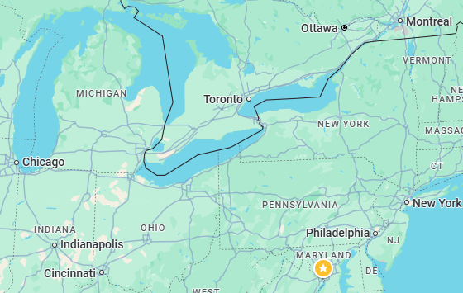
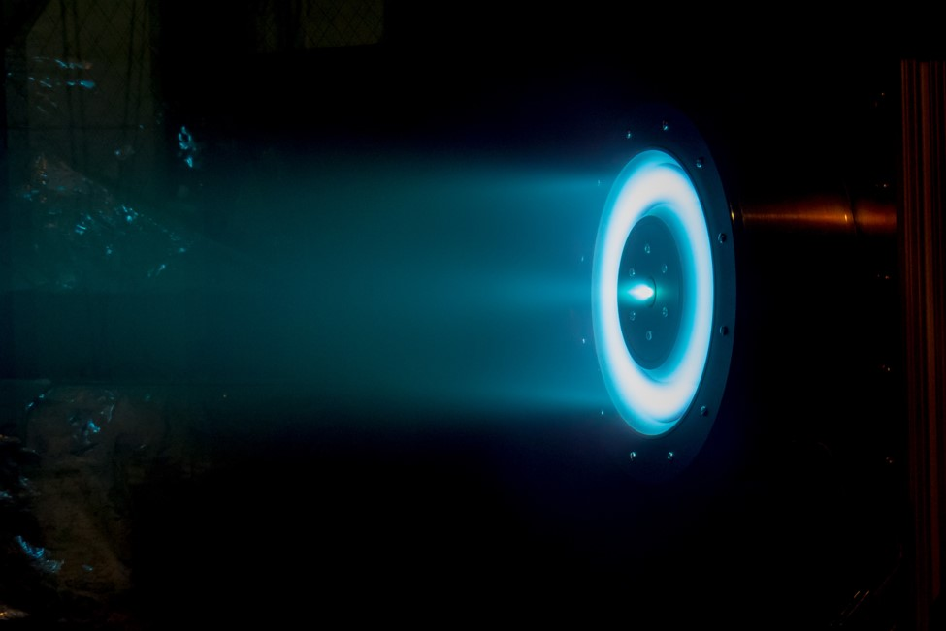

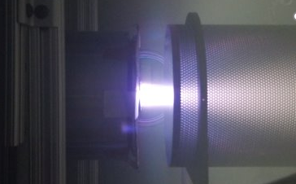
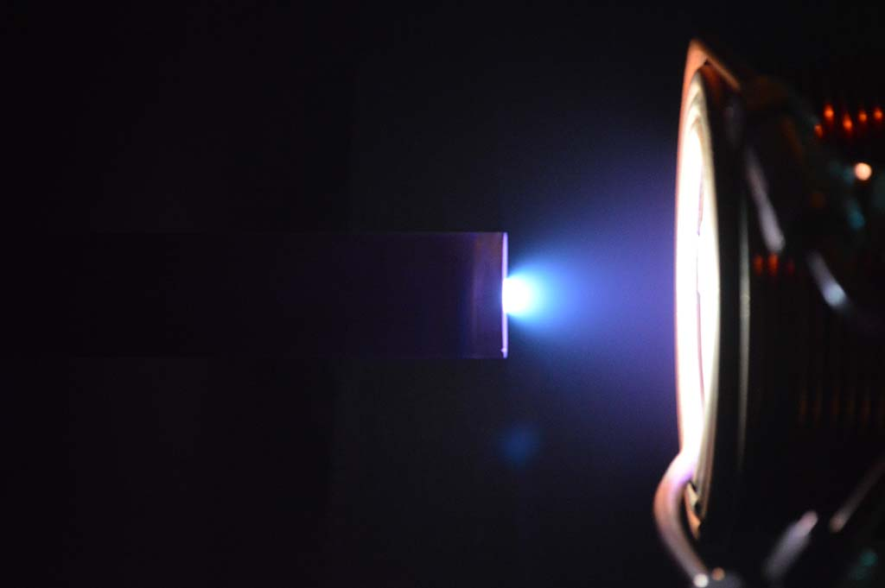
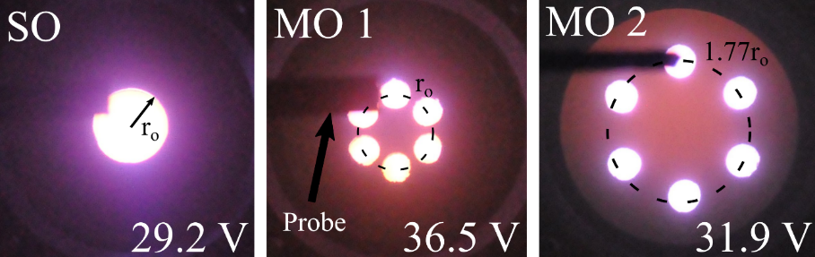




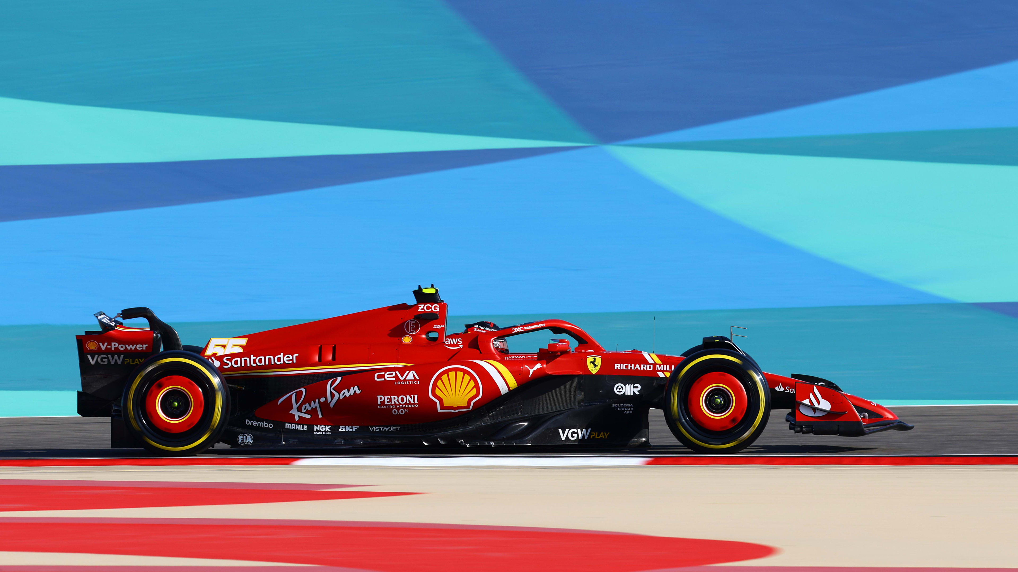

About Me:
B.Sc Physics -
Ph.D. Applied Physics -
NRC Postdoctoral Fellow -
Karles’ Fellow -
Aerospace Engineer -

Slide 3
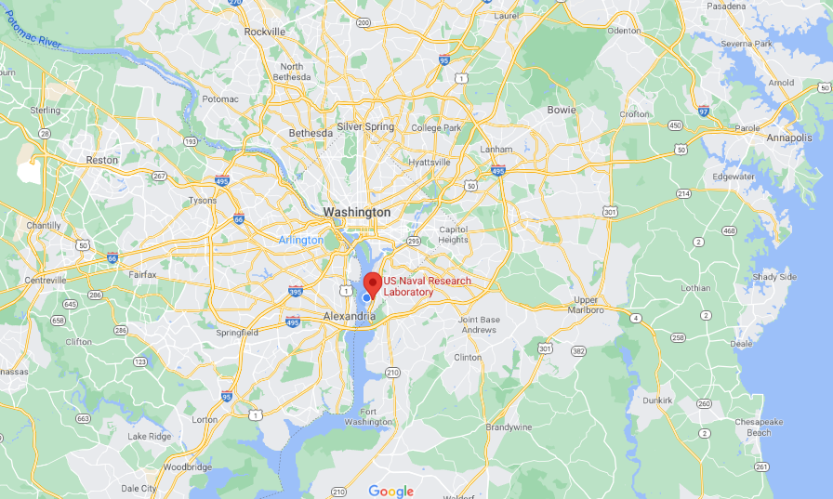
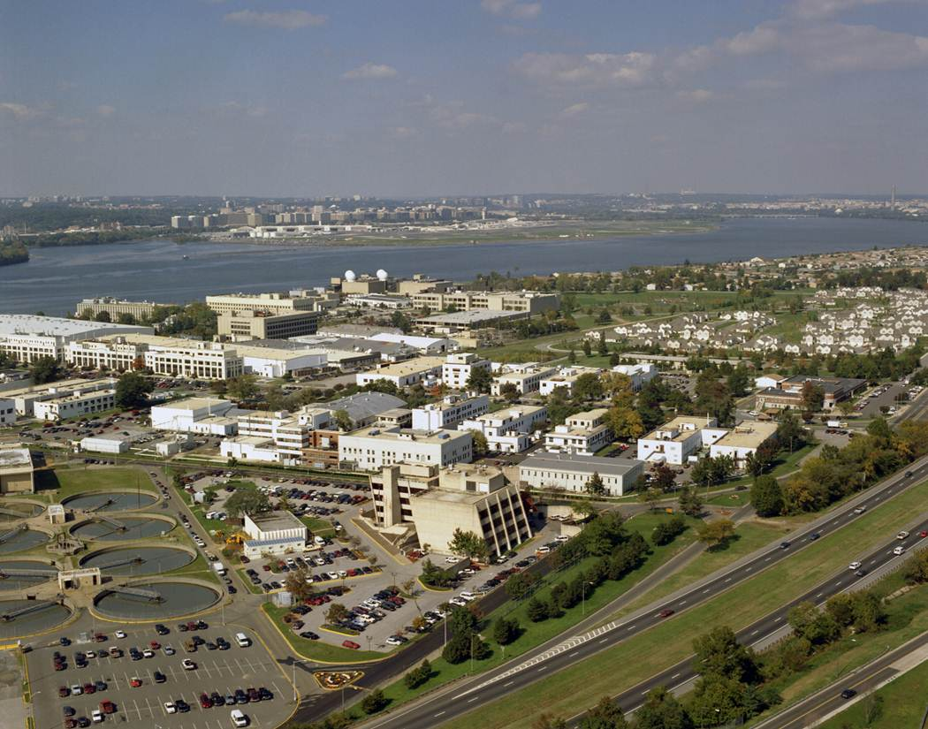
The United States Naval Research Laboratory
NRL is in SW Washington, DC 15 minutes from downtown.
Notes:
Lets start off with where is NRL? The NRL campus is located on the banks of the Potomac in SW Washington DC about 15 minutes (by car) from downtown. Its a great place to work and live with all culture and energy of DC at your fingertips. So how did NRL come to be?

Slide 4
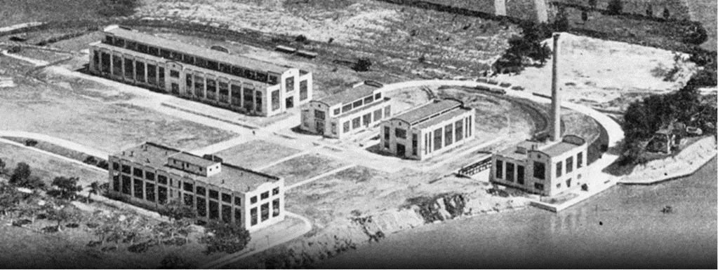
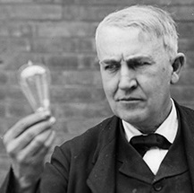
NRL Mission:
"The Government should maintain a great research laboratory... In this could be developed...all the technique of military and naval progression without any vast expense."
Naval Research Laboratory Founded 1923
Meet S&T needs of the US Navy and Marines
NRL is a $1B organization employing over 1600 S&Es, over 50% PhDs, conducting basic and applied research spanning the depths of the ocean to the far reaches of space
Notes:
Thomas Edison played a fairly important role. He believed that “”. The Navy saw the value in this and founded NRL in 1923 to meet the science and technology needs of the Navy but also the Marines. Hence Naval not Navy research lab. It also turns out NRL is the first national laboratory. Since its founding the lab has grown to over a 1B$ organization with facilities in DC, Mississippi, and California, employing researchers with an mandate to conduct basic and applied research from the depths of the ocean to the far reaches of space.

Slide 5
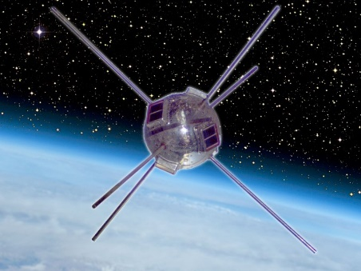
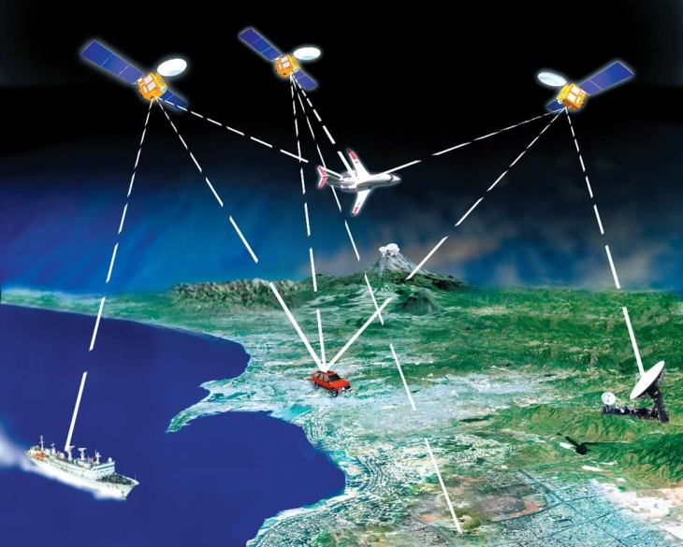
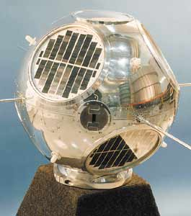
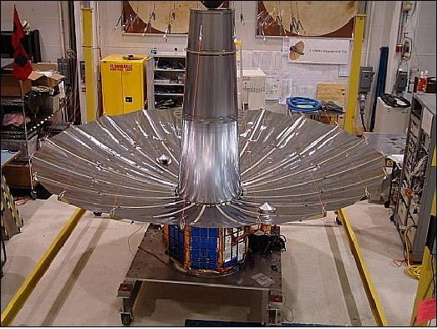
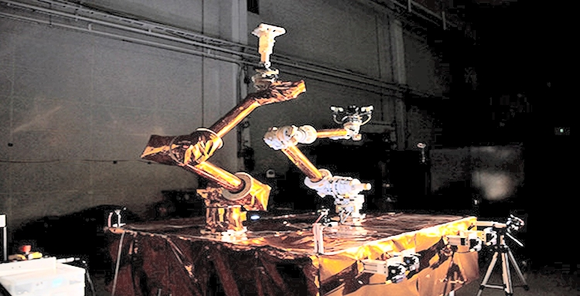
Naval Center for Space Technology
50’s: Project Vanguard put the first US satellite in orbit.
60’s: GRAB1 first surveillance satellite
70’s-80’s: Developed initial GPS
2000’s: TacSat tactical communications
2010’s: Robotic Servicing of Geostationary Satellites (RSGS)
Notes:
Keying in on the space element, one of the major components of NRL is the Naval Center for Space Technology. It has been active since the 1950’s where it was responsible in part for putting the first US satellite in orbit. Since then the center has been involved in many advancements in space technology, including surveillance, GPS, tactical comms, and robotic servicing of satellites.

Slide 6
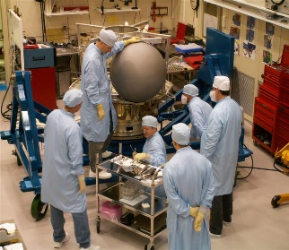
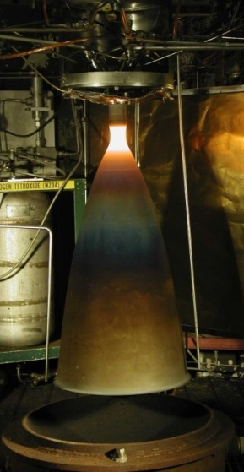
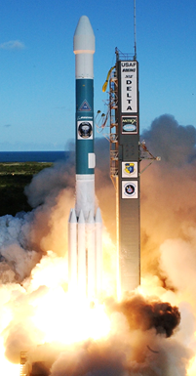
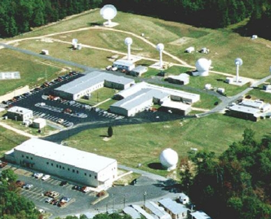
NRL Space Propulsion Overview
The Naval Center for Space Technology at NRL is a spacecraft subsystem specialist with over 300 federal employees, a dedicated ground station, and a history of over 100 launches in the last 50 years
  The Propulsion Section (Code 8232) focuses on satellite component technology development, including…
  Cathodes electron sources for Hall and ion thrusters
    New thermionic emitter materials
    Instability reduction and lifetime improvement
  Thruster Testing
    Hall thrusters
    Advanced concepts
  Plasma diagnostic development
    Exquisite, high-accuracy probes
    Flight diagnostics
  Environmental simulation and materials testing
    Space
    Hypersonics
Notes:
Probably don’t need this unless you want to highlight 8232 specifically.
From Caruso BrownBag:
Code 8232
Program Support
Spacecraft Design and Development Requiring Propulsion Systems
System Development & Analysis
Propulsion System Fabrication, Integration, and Testing.
Component Development
Investigate Advanced Chemical and Electric Propulsion Technologies.
LOWTEMP Base Program
Low-Temperature Thermionic Emitter Material Performance Demonstration Cathode.

Slide 7



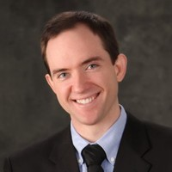


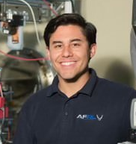







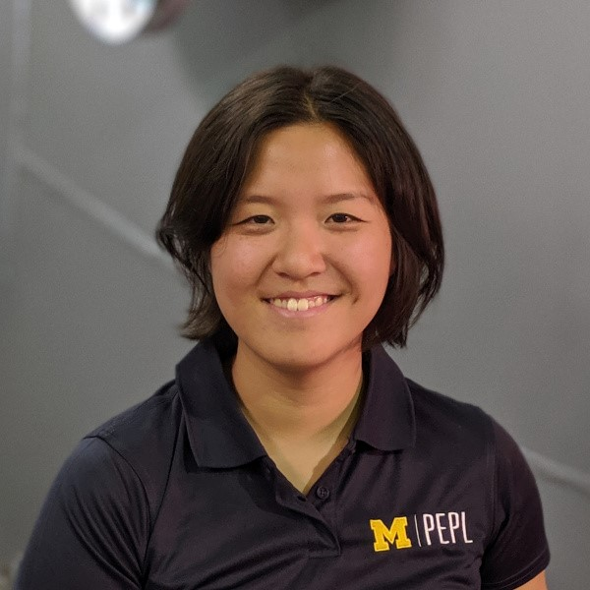
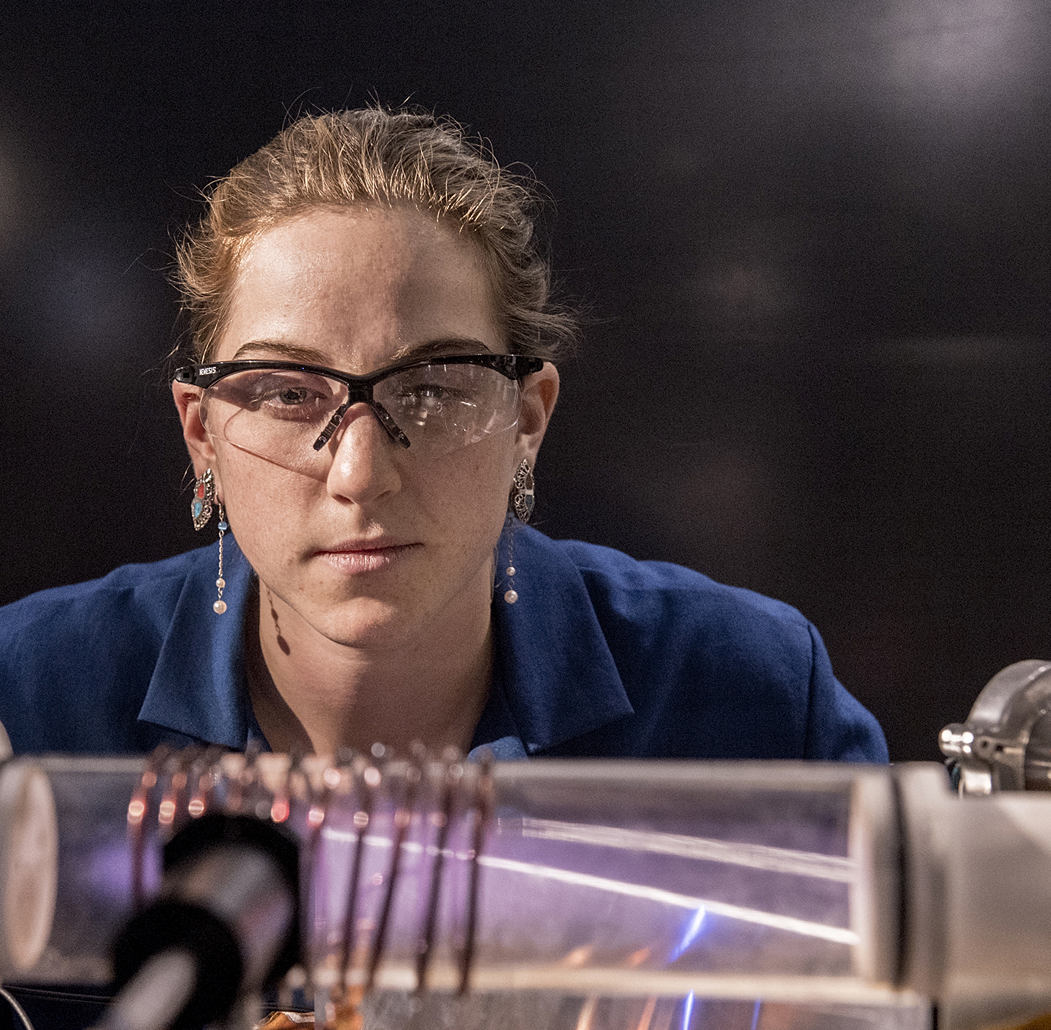








Plasma Propulsion Personnel
NRL Spacecraft Propulsion
Intern Alumni:
  Ally Leeming (UIUC)
  Kal Monroe (UC Boulder)
  Jacob Freeze (WVU)
  Hannah Hutton (Smith)
  Douglas Adams (WMU)
  Matt Paliwoda (UIUC→NRL)
  Margaret Mooney (WMU)
  Hannah Watts (WMU→Aerojet)
  Hannah Sargent (WMU)
  Anil Bansal (UM)
  Anna Sheppard (UW→JPL →NRL)
  Jacob Halpern (Purdue→Columbia)
  Emil Broemmelsiek (UIUC)
  Austen Thomas (WMU)
  Adrian Vicente La Lande (GT)
  Henry Shi (SUNY)
  Jose Orozco (UC Davis→Intel)
  Moises Angulo-Enriquez (UIUC→UM)
  Roxanne Pinsky (UM)
  Arega Margousian (GT)
  Toyofumi Yamauchi (UIUC)
  Nate Allwine (WMU)
  Grace Klang (WMU)
  Emily Ku (Colo State)
  Reed Thompson (UIUC)
  Enrique Medici (UFL)
  Vik Ailiani (Columbia)
Mike McDonald
Logan Williams
Marcel Georgin
Jack Brooks
Nolan Uchizono
Jeff Bynum
Logan Fernandez
Leanne Su
(NRC Postdoc)
Anna Sheppard
Notes:
Updated 3/18/24
Interns included since 2019 class

Slide 8
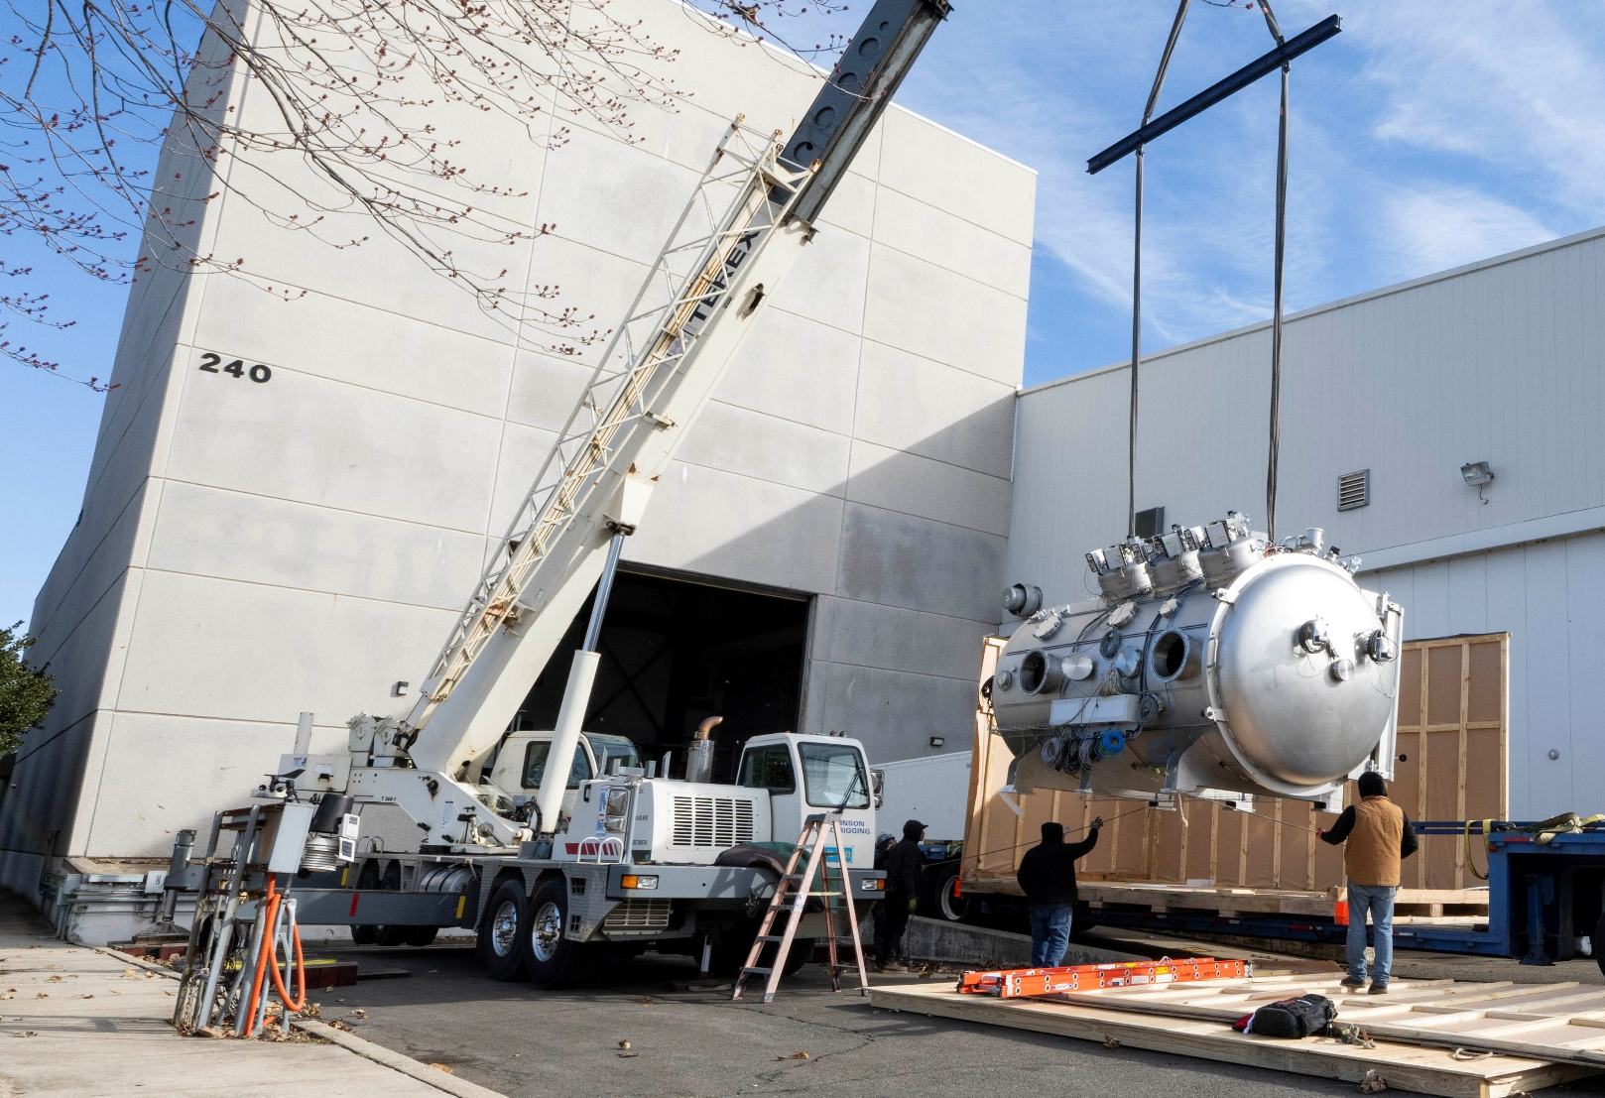
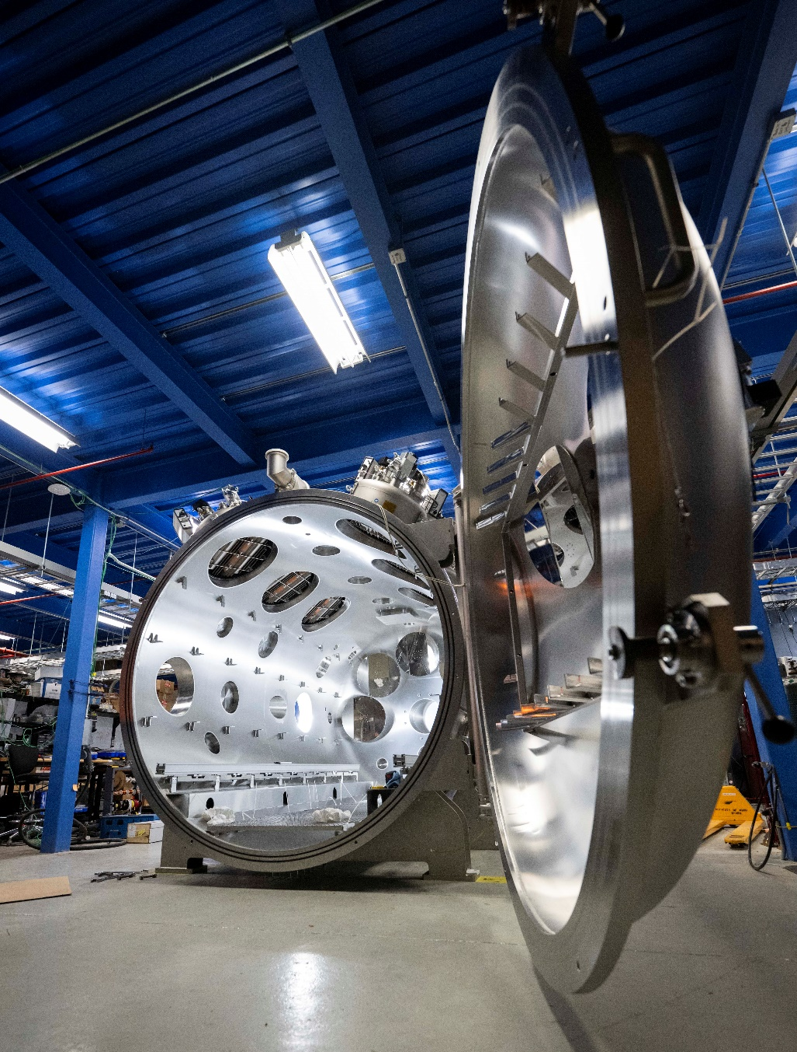
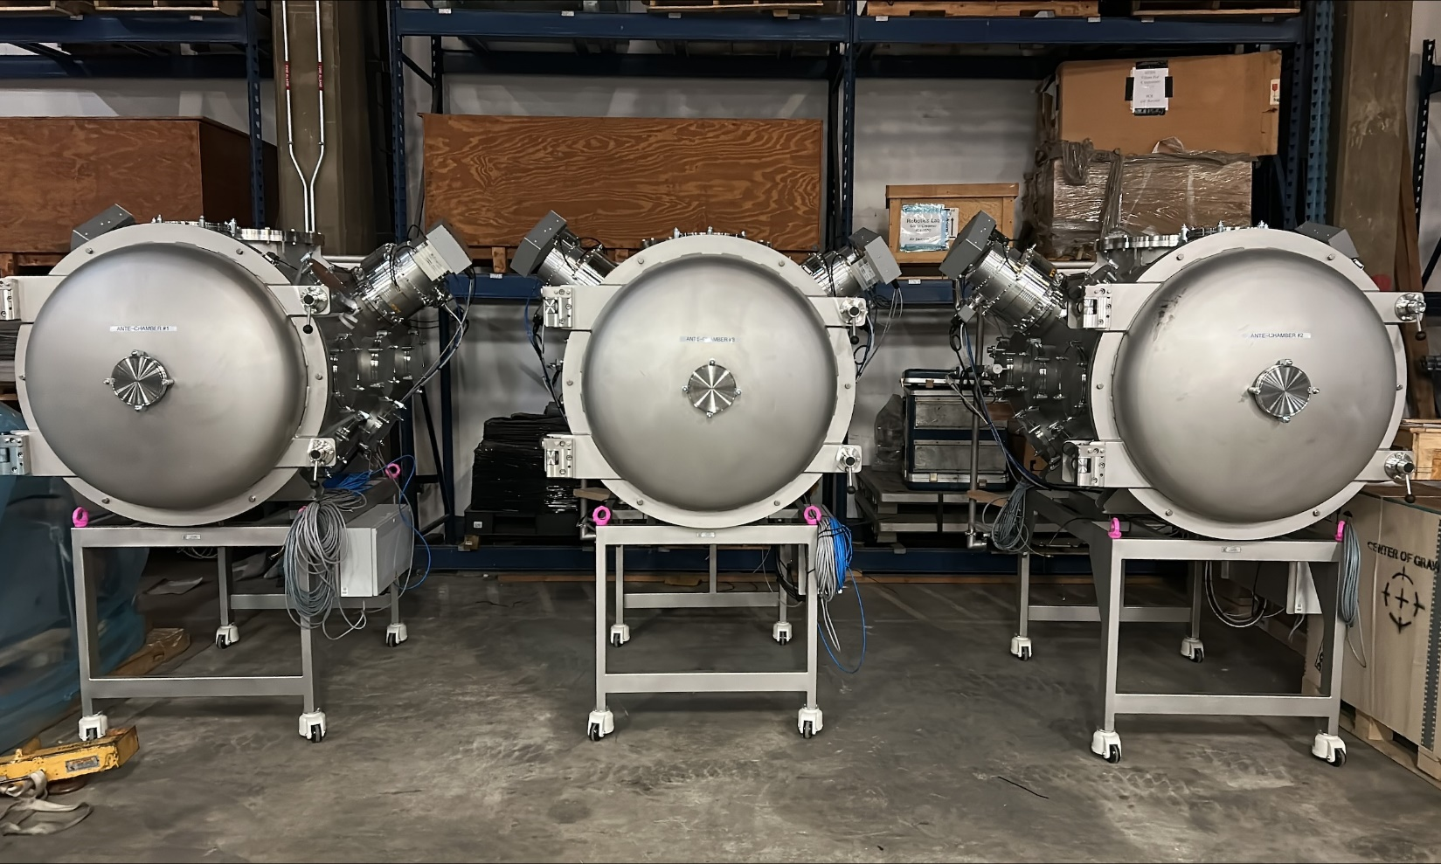
Large Plasma Test Facility

Slide 9
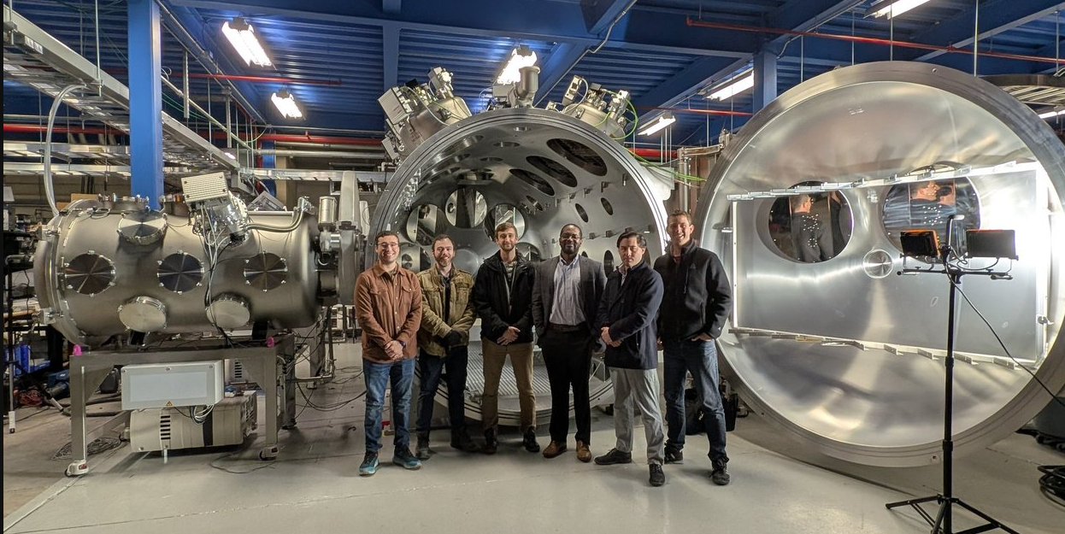
Large Plasma Test Facility
a

Slide 10
RF Plasma Cathodes for In-Situ Resource Utilization

Slide 11
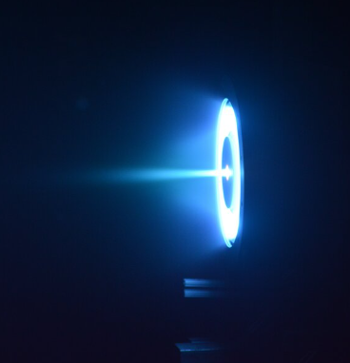
Electron Sources for Electric Propulsion
Ion Beam
-
Ion Beam
Notes:
So with that picture in mind, which I’ve condensed here, lets look at cathode technology

Slide 12


Electron Sources for Electric Propulsion
$$\dot{m}$$
$$\vec{v}$$
Xe is a typical EP propellant
Ion Beam
Propellant
-
Ion Beam
Notes:
So with that picture in mind, which I’ve condensed here, lets look at cathode technology

Slide 13
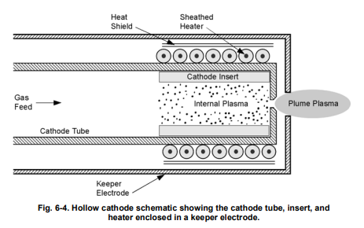
Electron Sources for Electric Propulsion
Xe is a typical EP propellant
Ion Beam
Propellant
-
Ion Beam
Gas Feed
Thermionic
Material
Workfunction: 2eV energy cost
Notes:
Here we’re showing the conventional approach to supplying electrons to a Hall thruster…
This is called a thermionic cathode
It has several components

Slide 14
Electron Sources for Electric Propulsion
Xe is a typical EP propellant
Ion Beam
Propellant
-
Ion Beam
Apply Heat
Gas Feed
Thermionic
Material
Apply Heat
Workfunction: 2eV energy cost
Notes:
The way it works is:

Slide 15
Electron Sources for Electric Propulsion
Xe is a typical EP propellant
Ion Beam
Propellant
-
Ion Beam
Heat generates electrons
Apply Heat
Gas Feed
Thermionic
-
-
-
-
Current
-
-
-
-
-
-
-
-
Material
Apply Heat
Workfunction: 2eV energy cost
Notes:
Electrons are generated through thermionic emission

Slide 16
Electron Sources for Electric Propulsion
Xe is a typical EP propellant
Ion Beam
Propellant
-
Ion Beam
Heat generates electrons
Apply Heat
What if we wanted to use an alternative propellant?
Gas Feed
Thermionic
-
-
-
-
Current
-
-
-
-
-
-
-
-
Material
Apply Heat
Workfunction: 2eV energy cost
Notes:
Electrons are generated through thermionic emission

Slide 17
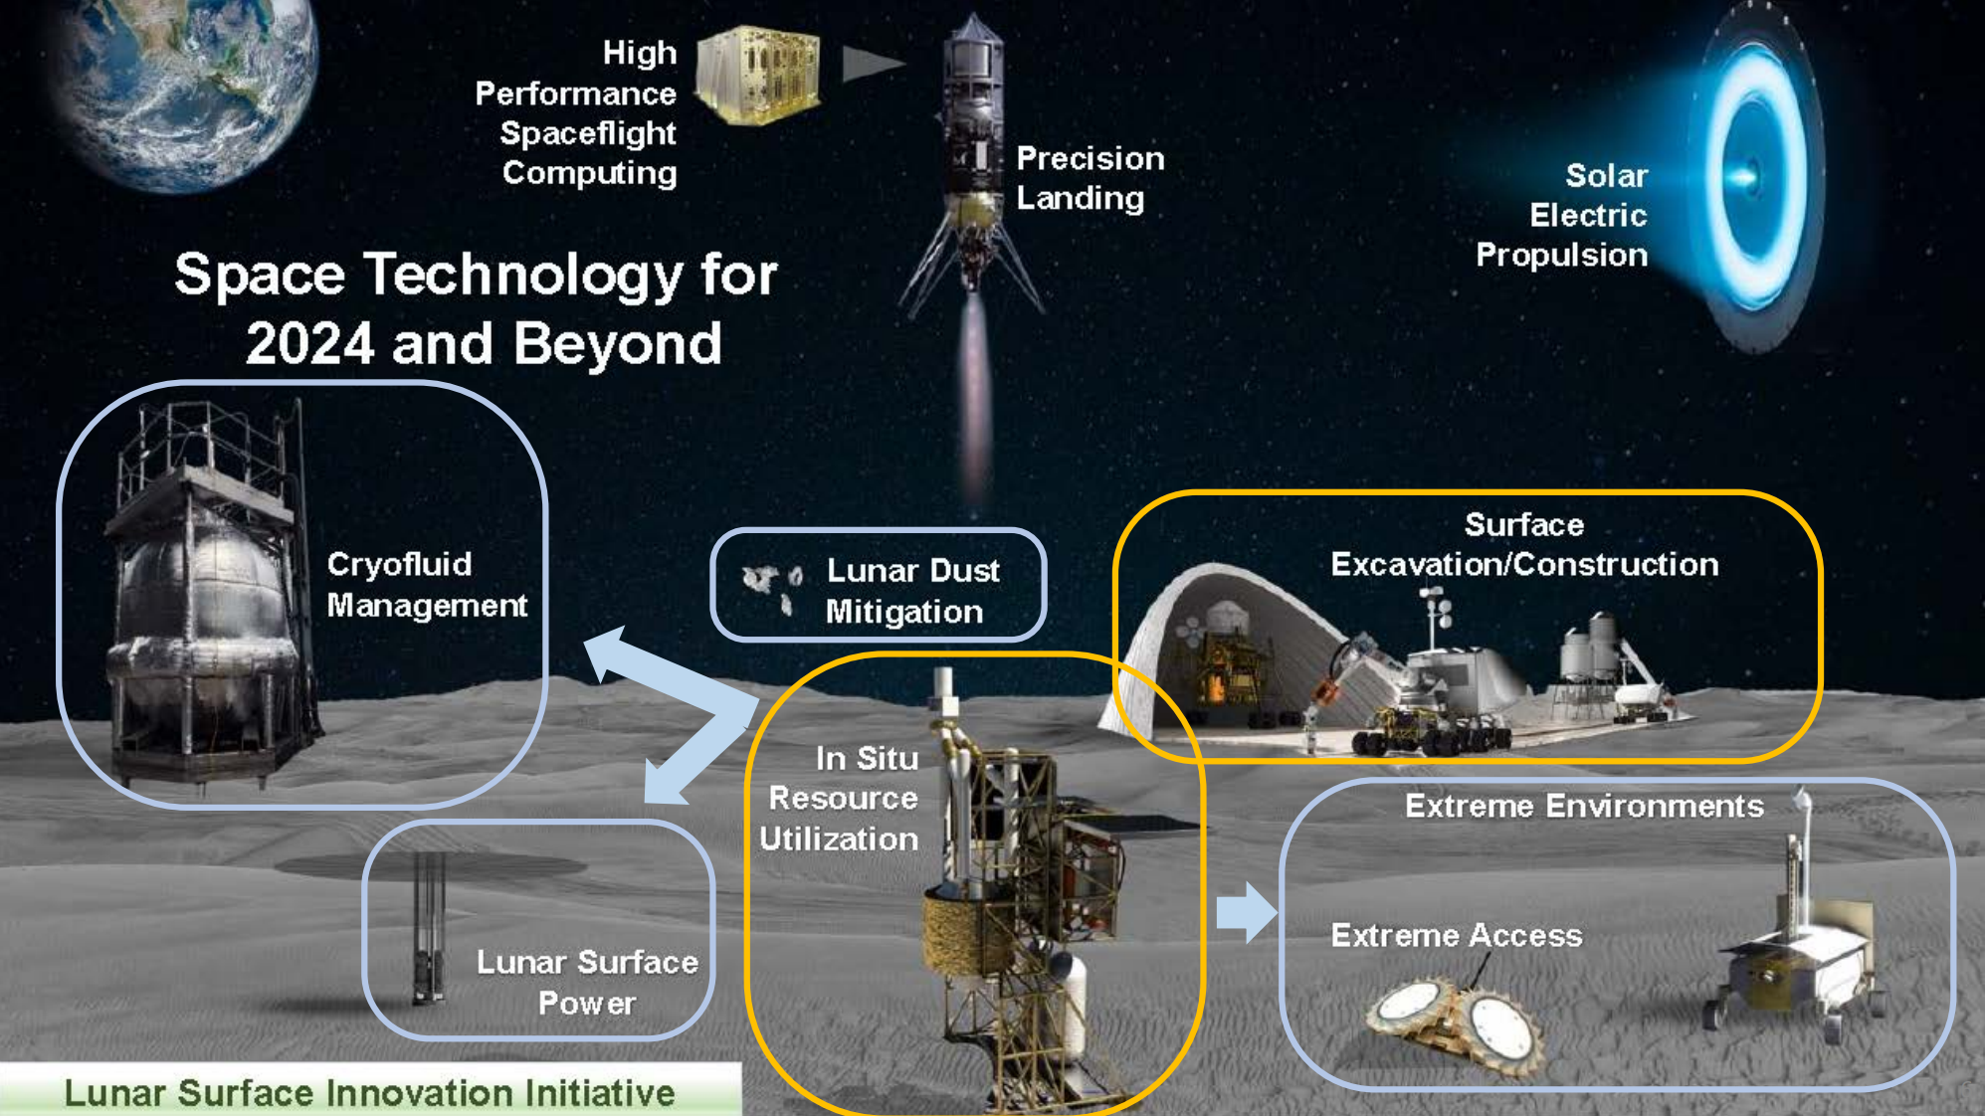
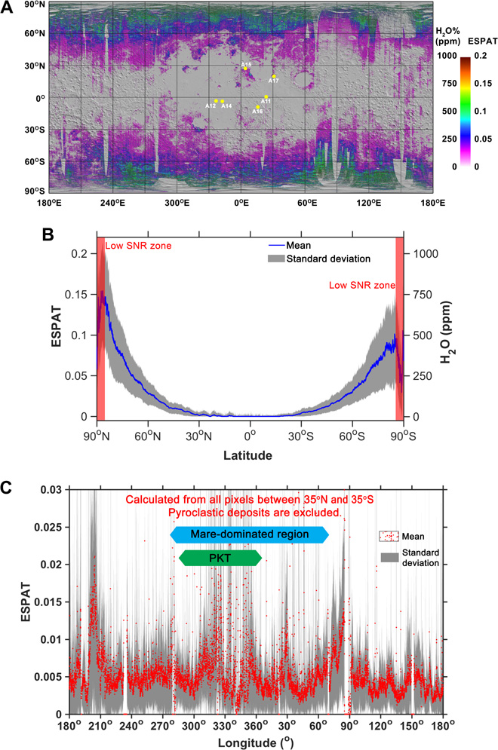
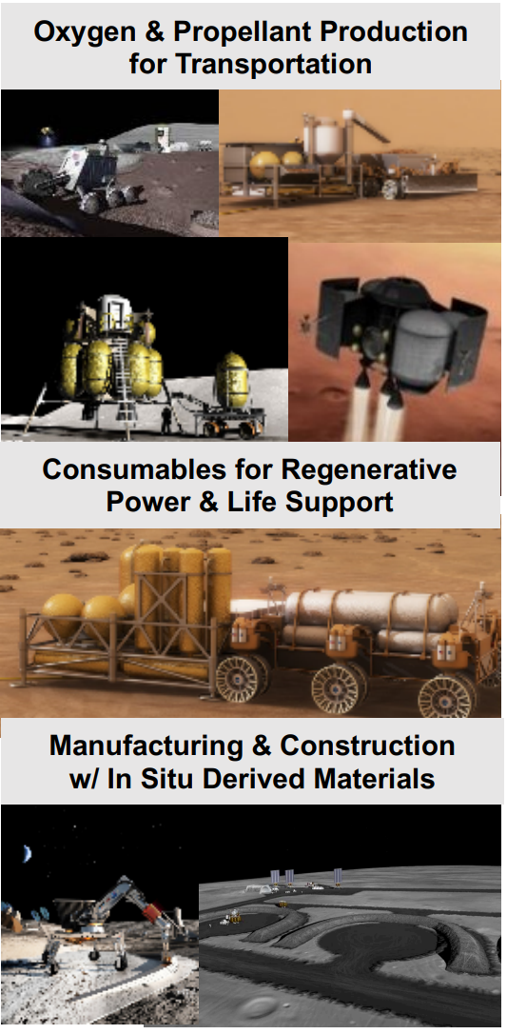
In-situ Resource Utilization
Li, Shuai, and Ralph E. Milliken. Science advances 3.9 (2017)
Can we make today’s go-to propulsion technologies ISRU compatible?
?
Photo Credit: NASA
Notes:
ISRU is a strategy where rather than bringing all our food with us, we want to live off the land. For the moon, what we have is water! We can take that water and do lots of useful things… Life support, rover fuel, chemical propellant… EP propellant?

Slide 18
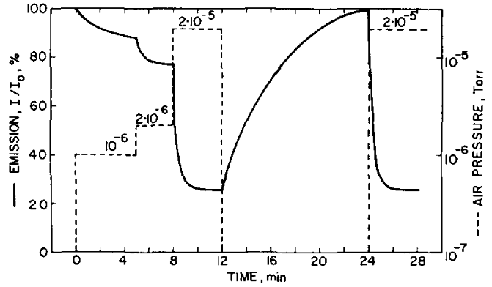

Electron Sources for Electric Propulsion
20 ppm of O2 $→$ 75% current loss
Xe is a typical EP propellant
Ion Beam
H2O?
-
Ion Beam
Heat generates electrons
We need a whole new class of technology to enable this type of mission!
Apply Heat
Gallagher, H. E. "Poisoning of LaB6 cathodes." Journal of Applied Physics 40.1 (1969): 44-51.
What if we wanted to use an alternative propellant?
H2O?
Thermionic
-
-
-
-
Current
-
-
-
-
-
-
-
-
Material
Apply Heat
Materials compatibility issue with H2O
Notes:
Electrons are generated through thermionic emission

Slide 19
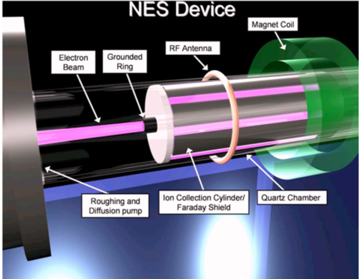
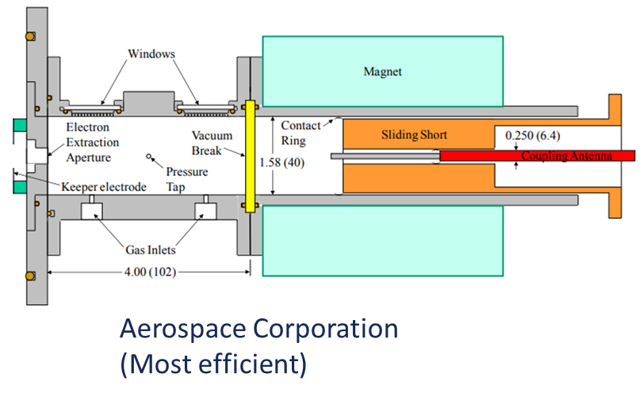
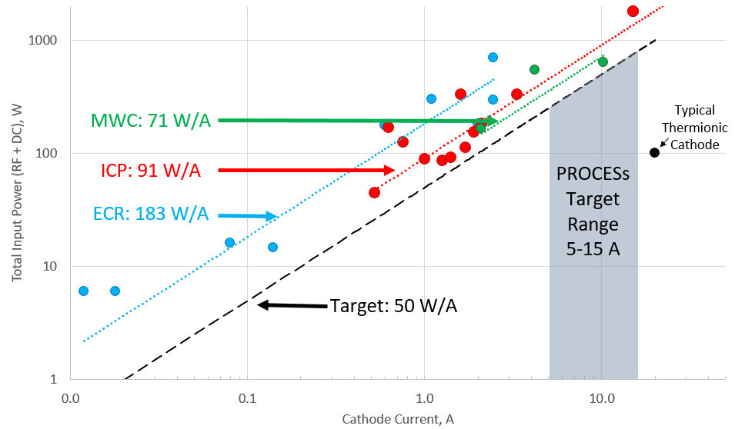
Propellant Agnostic Electron Sources
Inductively Coupled Plasma (ICP) Cathodes
  Power hungry but low technical risk
  Best literature performance:
    30 A (@3 sccm Xe) → 80 W/A
    10 A (@3 sccm Ar) → 155 W/A
    Above cases at 1200 W 13.56 MHz RF
Electron Cyclotron Resonance (ECR) Cathodes
  Potentially better efficiency but complex
    Require large magnetic fields (800+ Gauss)
  Best literature performance (Diamant “MWC”):
    5 A (@few sccm Xe) → ~70 W/A
    Above cases at 100 W 2.45 GHz RF

Slide 20



Propellant Agnostic Electron Sources
Inductive Coil
To thruster
Cathode
$$\vec{B}$$
RF Plasma
Anode
$$I_{AC}$$
Notes:
Consider the RF cathode as an asymmetric double probe
Symmetric double probes require only two parameters (ne, Te) to describe the IV trace
Asymmetric double probes add an area ratio

Slide 21
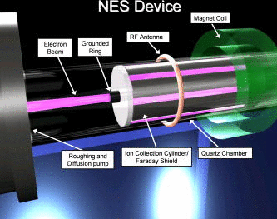
Propellant Agnostic Electron Sources
Propellant agnostic drop in replacement for thermionic cathode
Power hungry (pay $U_{iz}$ for every electron)
Previous studies focus on performance on Ar and Xe
Some limited existing theory (see Ref)
Essential question for RF Cathodes:
Can we develop theoretical tools to describe and predict performance?
Longmier, Benjamin, and Noah Hershkowitz. "Improved operation of the nonambipolar electron source." Review of Scientific Instruments 79.9 (2008): 093506.

Slide 22
The ICP Cathode as Asymmetric Double Probe
Asymmetric Double Probe
RF Cathode
Cathode
RF Plasma
RF Plasma
Anode
Cathode
Anode
Notes:
Consider the RF cathode as an asymmetric double probe
Symmetric double probes require only two parameters (ne, Te) to describe the IV trace
Asymmetric double probes add an area ratio

Slide 23
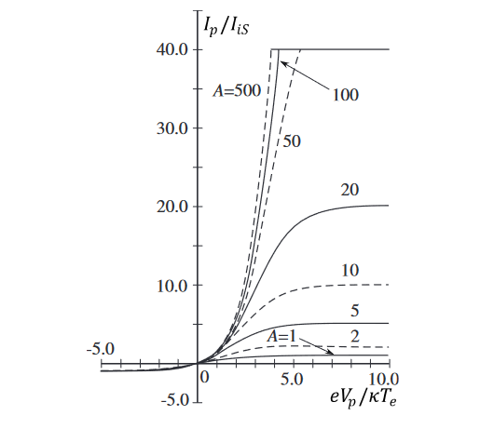

The ICP Cathode as Asymmetric Double Probe
Asymmetric Double Probe
RF Plasma
Anode
Cathode
$A=A_{c}/A_{a}$
$I_{p}=$ Probe current
$I_{iS}=$ Ion saturation currents
$φ_{p}=V_{p}/T_{e}$
Notes:
Standard asymmetric double probe curves look like this and follow the expression above.

Slide 24
The ICP Cathode as Asymmetric Double Probe
Asymmetric Double Probe
RF Cathode
Cathode
RF Plasma
RF Plasma
Anode
Anode
Cathode
$$V_{dc}=T_{e}\ln\left(\frac{ANI+1}{1−I}\right)$$
$A=A_{c}/A_{a}$
$I=I_{dc}/I_{sat}$
$$N=n_{c}/n_{o} ∼1$$
$T_{e}=$ e- Temp.
Adopting a similar approach for the ICP…
Notes:
In our paper we outline this theory in detail, where we’ve explicitly listed assumptions. The final expression looks like this…where we’ve normalized the discharge current to the ion saturation current.
This shows that the electron temperature is a critical parameter determining the discharge voltage for a given current draw. Second we see that the discharge voltage diverges as we approach the ion saturation current, which physically limits the current we can extract from the device.

Slide 25
The ICP Cathode as Asymmetric Double Probe
RF Cathode
Cathode
Key Result:
Expect that for fixed geometry ($A$) normalized current-voltage traces collapse to single curve, regardless of plasma composition.
$$Φ=\ln\left(\frac{ANI+1}{1−I}\right)$$
RF Plasma
Anode
$A=A_{c}/A_{a}$
$I=I_{dc}/I_{sat}$
$N=n_{c}/n_{o} ∼1$
$$Φ=V_{dc}/T_{e}$$
$$V_{dc}=T_{e}\ln\left(\frac{ANI+1}{1−I}\right)$$
$A=A_{c}/A_{a}$
$I=I_{dc}/I_{sat}$
$$N=n_{c}/n_{o} ∼1$$
$T_{e}=$ e- Temp.
Notes:
A key result from this theory is that if we further normalize the discharge voltage by the temperature, we expect that the family of curves produced by different Te and Isat collapses onto a single curve for fixed geometry.

Slide 26
The ICP Cathode as Asymmetric Double Probe
How do we get these plasma properties?
RF Cathode
Cathode
Key Result:
Expect that for fixed geometry ($A$) normalized current-voltage traces collapse to single curve, regardless of plasma composition.
$$Φ=\ln\left(\frac{ANI+1}{1−I}\right)$$
RF Plasma
Anode
$A=A_{c}/A_{a}$
$I=I_{dc}/I_{sat}$
$N=n_{c}/n_{o} ∼1$
$$Φ=V_{dc}/T_{e}$$
$$V_{dc}=T_{e}\ln\left(\frac{ANI+1}{1−I}\right)$$
$A=A_{c}/A_{a}$
$I=I_{dc}/I_{sat}$
$$N=n_{c}/n_{o} ∼1$$
$T_{e}=$ e- Temp.
Notes:
A key result from this theory is that if we further normalize the discharge voltage by the temperature, we expect that the family of curves produced by different Te and Isat collapses onto a single curve for fixed geometry.

Slide 27
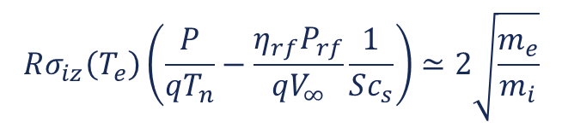
New Theory Work:
Argon Global Model
Ionization Energy
Geometrical Factors
$$P_{rf}≃\frac{\left(U_{iz}+\frac{5}{2}T_{e}\right)}{η_{rf}}\left(\frac{S}{A_{c}}\right)I_{sat}$$
Power Balance:
Pressure
RF Power
$$Rσ_{iz}\left(T_{e}\right)\left(\frac{P}{qT_{n}}−\frac{η_{rf}P_{rf}}{qV_{∞}}\frac{1}{Sc_{s}}\right)≃2\sqrt{\frac{m_{e}}{m_{i}}}$$
Particle Balance:
Ionization cross-section
Key Takeaways
$$n∝I_{sat}∝P_{rf}$$
$$T_{e}∼C$$
Notes:
To leverage this DC sheath model, we combined it with a global model for Ar, where we have used a power balance and a particle balance to determine the plasma density and temperature as a function of input parameters. They key takeaways here are…

Slide 28
Simulations:
RF Cathode Sheath Theory + Global Model (Ar)
Cathode
Global Model
Inputs to sheath + global model:
$η_{rf}$: RF coupling efficiency
$γ$: scaling factor to account for effective temperature due to capacitive coupling
$A$: Cathode and orifice SA ratio
$N$: Cathode and orifice density ratio
RF Plasma
Anode
Input parameter | $$η_{rf}$$ | $$γ$$ | $$A$$ | $$N$$
Value | 0.2 | 2 | 755 | 1
Global Model
Power Balance
Particle Conservation
SOLVE
$$n_{i},T_{e}$$
Notes:
To close this model we need a few inputs, such as efficiency, accounting for capacitive coupling effects in the sheaths, and geometry

Slide 29
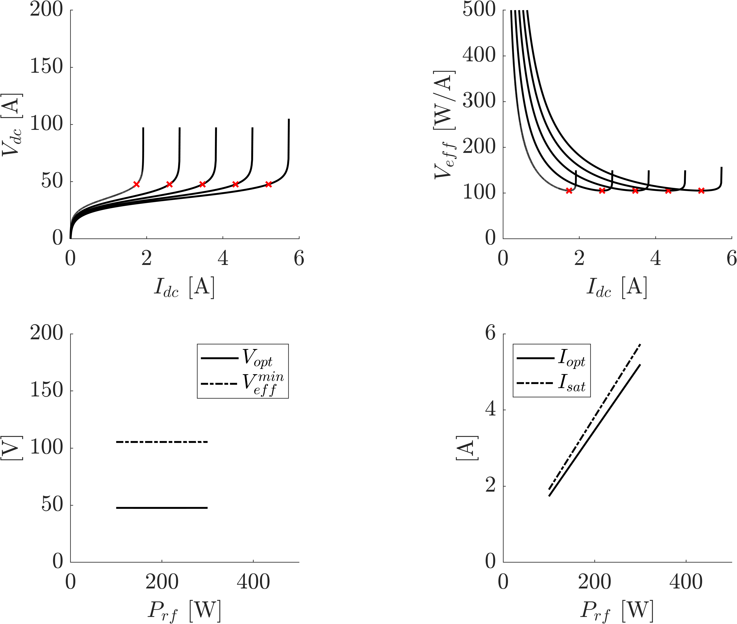

Simulations:
RF Cathode Sheath Theory + Global Model (Ar)
Cathode
Current-voltage
Voltage Cost
Global Model
$$\frac{P_{rf}+P_{dc}}{I_{dc}}$$
RF Plasma
Anode
Output
Control Parameters:
$\dot{m}=$20 sccm
$P_{rf}=$100 W – 500 W
Voltage Cost
Extraction Current
Notes:
With this combined model, we can now vary experimental inputs. For example he we show changes in the expected I-V curve at different rf input power.
Next we show how the voltage cost changes. The red x is the optimal operating point. Note that the effective voltage is approximately constant as shown in the next plot. We also find that the ion saturation current is proportional to the RF power. Physically this is tied to the fact that the electron temperature is approximately constant (because of exponential dependence of ionization on temperature) while the plasma density increases linearly with power at fixed temperature.

Slide 30
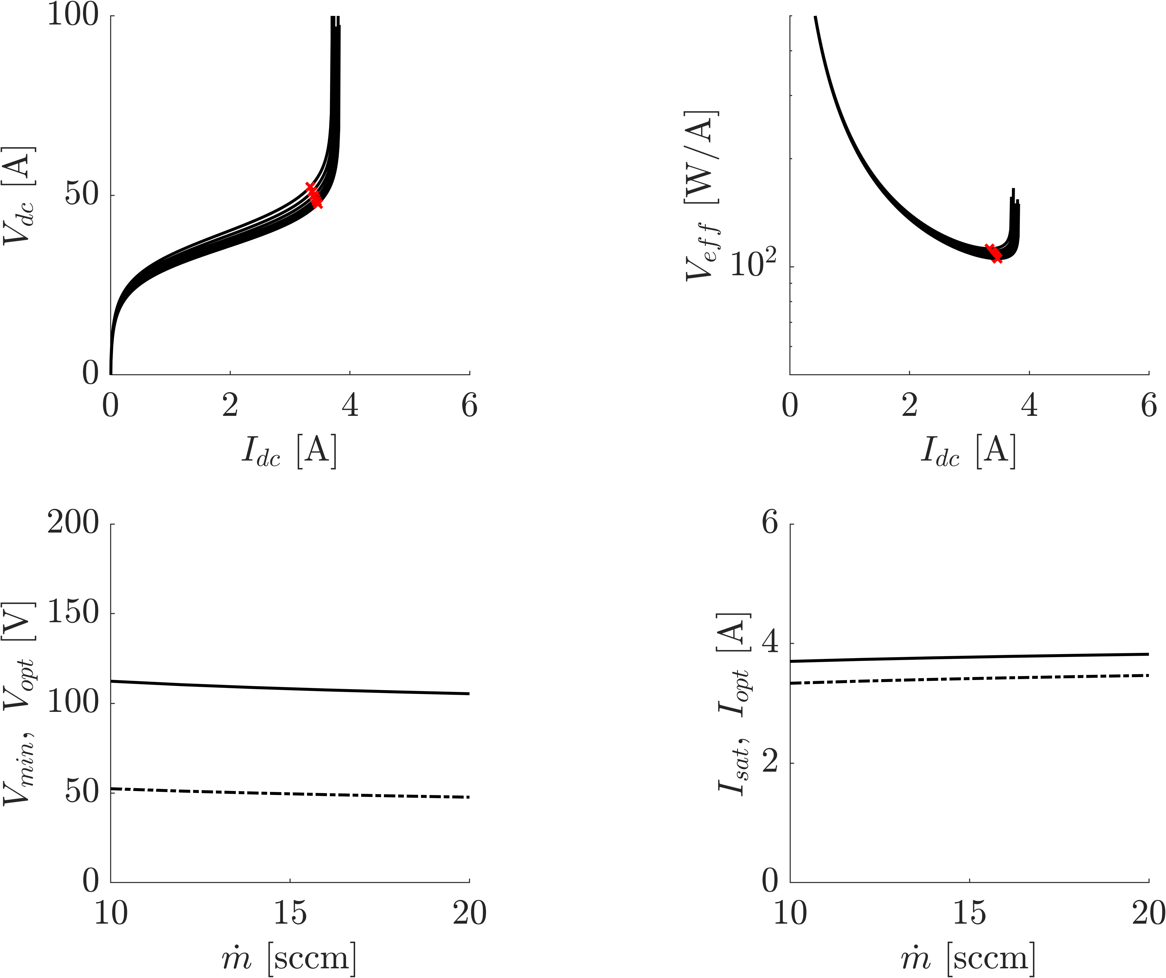
Simulations:
RF Cathode Sheath Theory + Global Model (Ar)
Current-voltage
Cathode
Voltage Cost
Global Model
RF Plasma
Anode
Output
Control Parameters:
$\dot{m}=$15 sccm-20 sccm
$P_{rf}=2$00 W
Voltage Cost
Extraction Current
Notes:
Varying the flow rate we find that all the parameters are varying only weakly. This is because we are in a regime where there are many neutral particles available for ionization. Therefore changes in gas pressure only weakly affect electron temperature, which in turn affects the plasma density.

Slide 31
Simulations:
RF Cathode Sheath Theory + Global Model (Ar)
Current-voltage
Cathode
Voltage Cost
Global Model
RF Plasma
Anode
Output
Lets put our theory to the test!
Control Parameters:
$\dot{m}=$15 sccm-20 sccm
$P_{rf}=2$00 W
Voltage Cost
Extraction Current
Notes:
Varying the flow rate we find that all the parameters are varying only weakly. This is because we are in a regime where there are many neutral particles available for ionization. Therefore changes in gas pressure only weakly affect electron temperature, which in turn affects the plasma density.

Slide 32
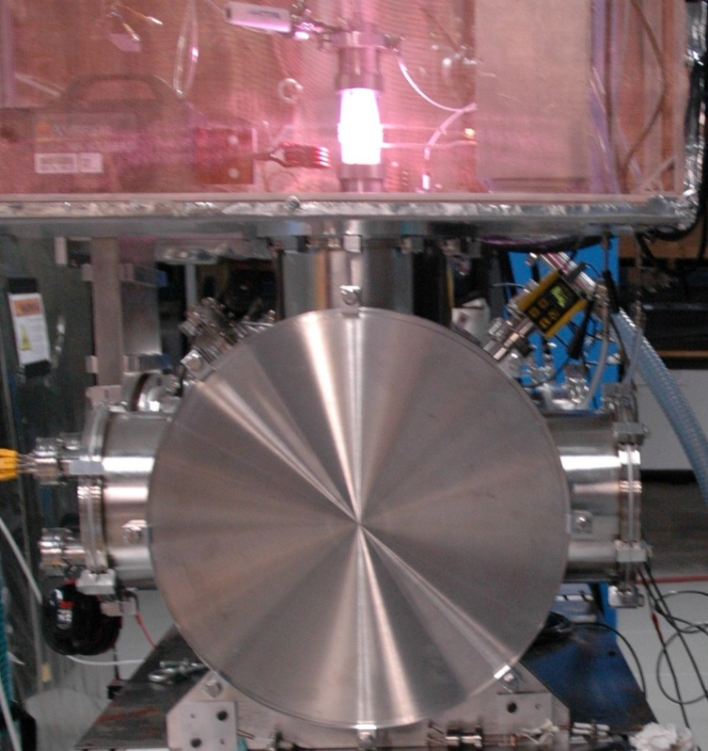
Experiments: Test Facility
RF Power
Cathode
Inductive Antenna
Vacuum chamber
Notes:
We used a new facility at NRL (PTF2) that is intended for operating molecular gases. We provide greater details on our cathode design in the text, but we have chosen a threaded rod design to maximize the cathode area while attempting to minimize RF coupling to the rods.

Slide 33
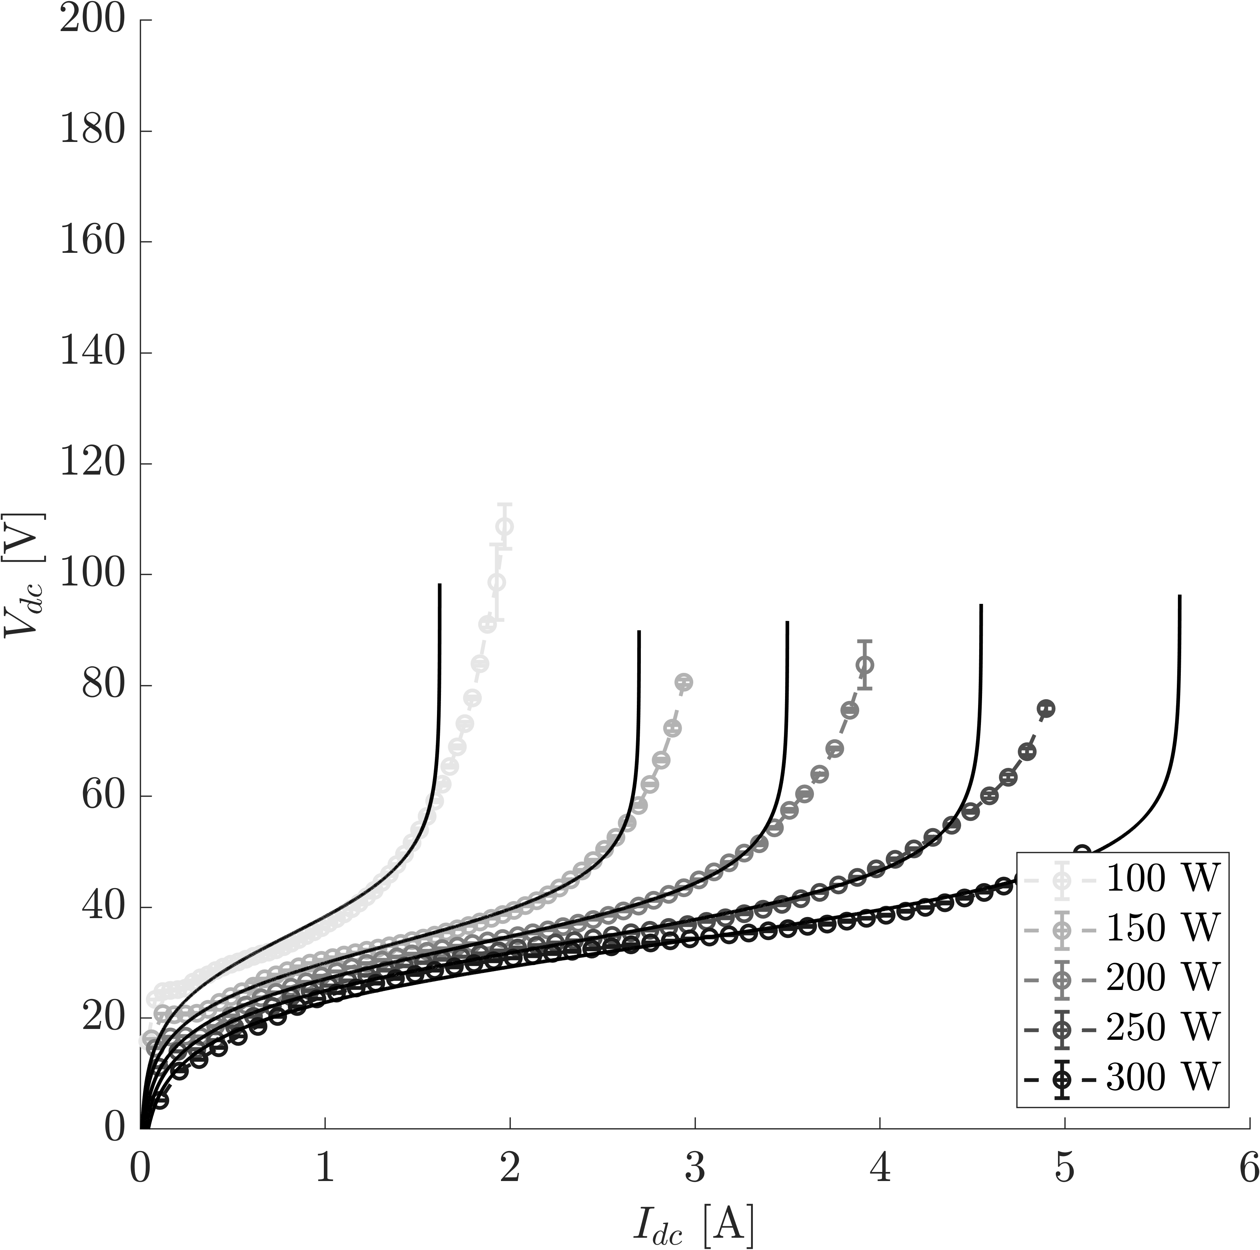
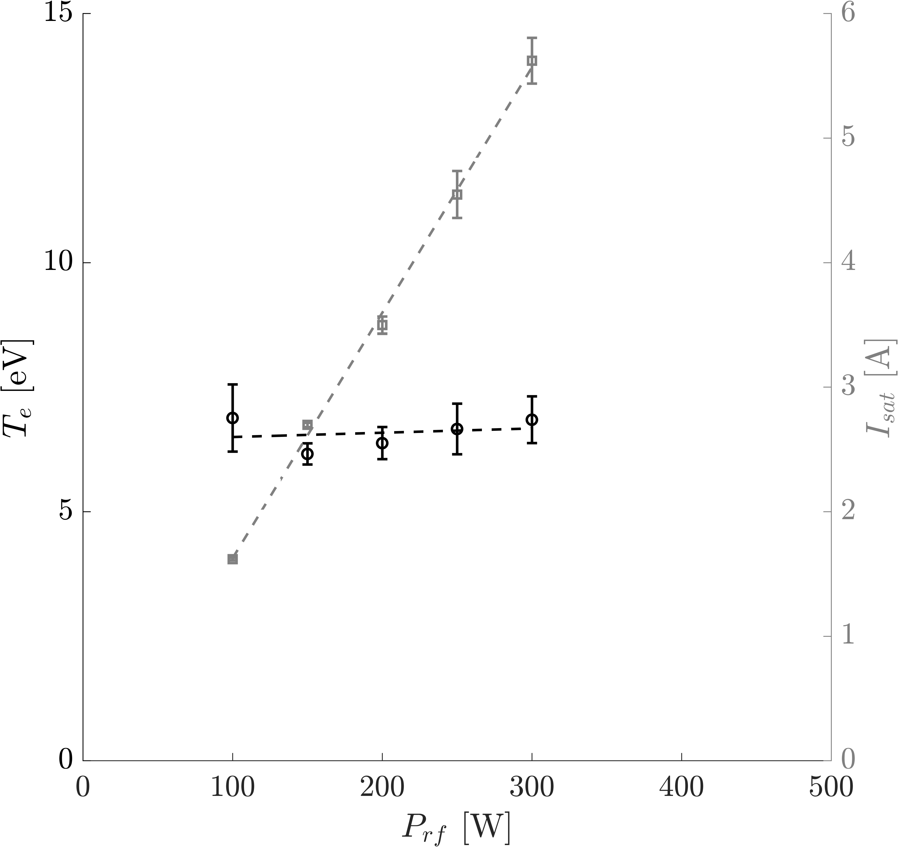
Experimental Results (Ar) for theory comparison
Treat the cathode as a probe!
Solid: Curve fit to sheath model
Curve fit params
$T_{e}$ is approximately constant (✓)
$I_{sat}$ increases linearly with RF power (✓)
Notes:
Operating on Ar, we first varied power. We curvefit the I-V data to our sheath model. There is quite good agreement over the majority of the trace, with exception of high voltages where sheath expansion takes place. From these fits we extract an electron temperature and ion saturation current. We find that the temperature is approximately constant while the ion saturation current increases linearly with power. Both these features were expected by our theory.

Slide 34
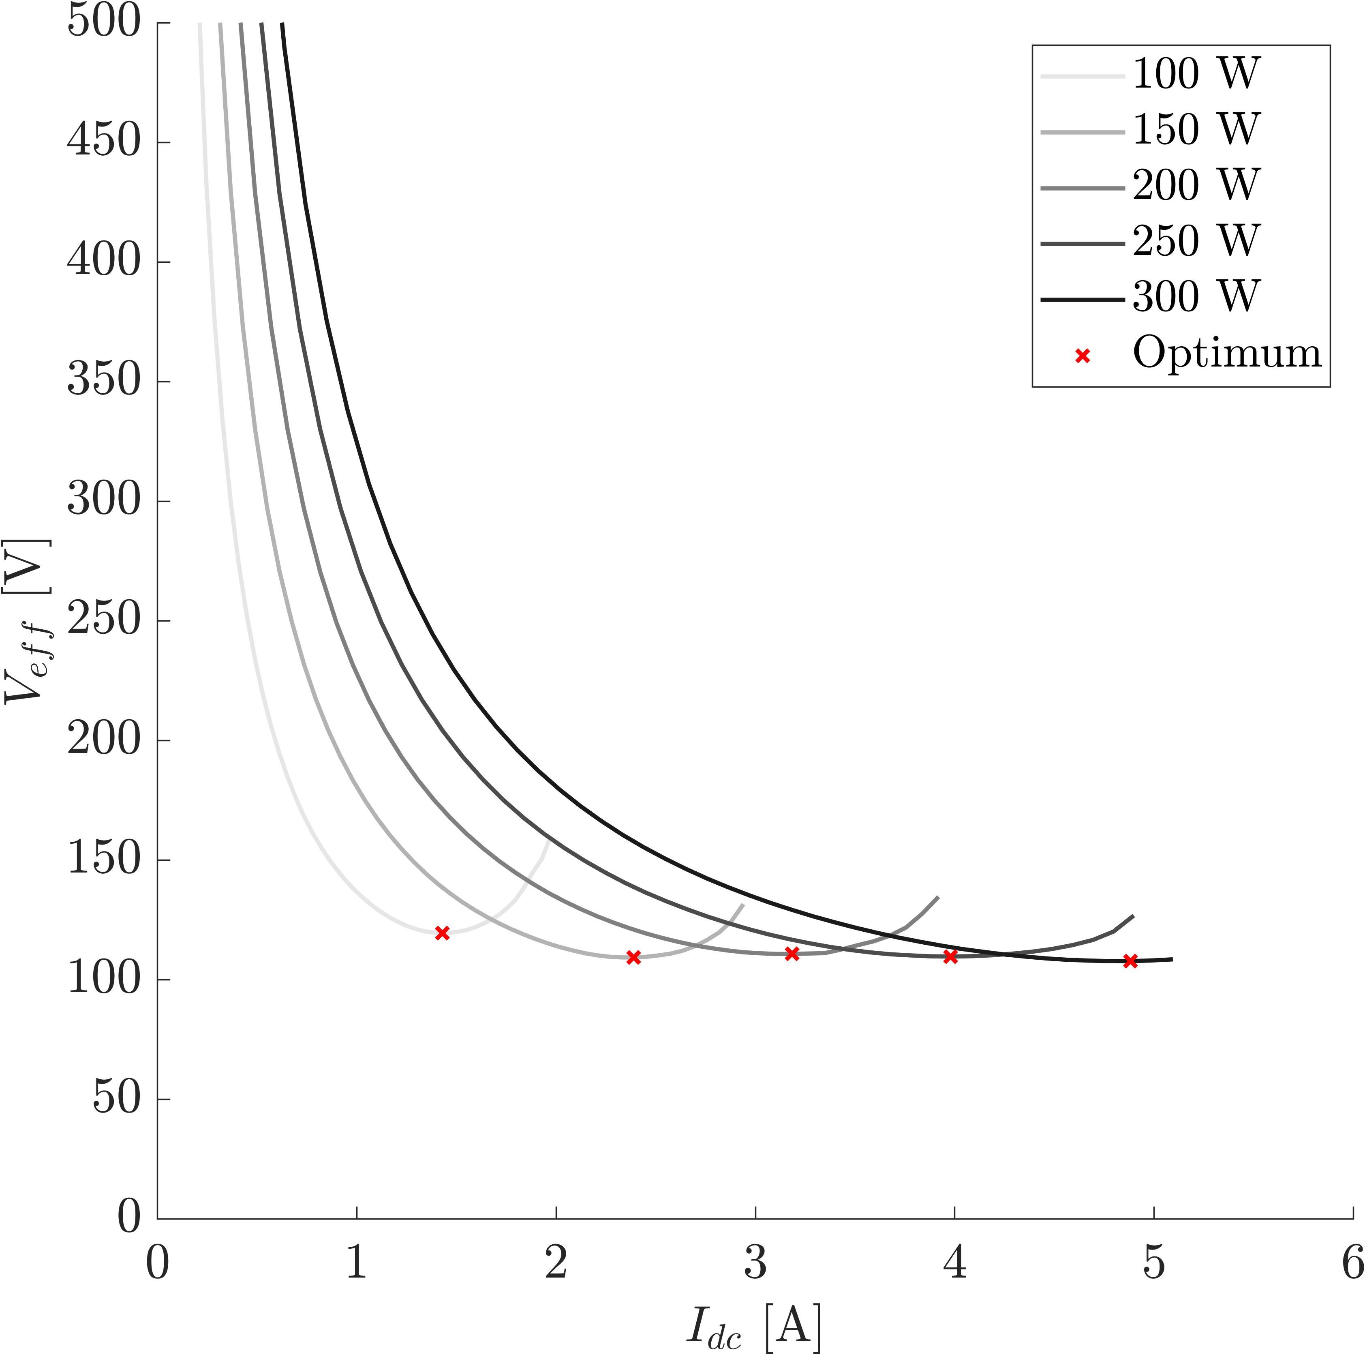
Experimental Results (Ar) for theory comparison
Solid: Curve fit to sheath model
Voltage Cost
$$∼110 W/A$$
Voltage cost is constant (✓)
Notes:
Looking at the effective voltage cost, we show the most efficiency points in the red x’s. Overall, we find that with varying power the voltage is relatively insensitive, which agrees with the expectations of our model.

Slide 35
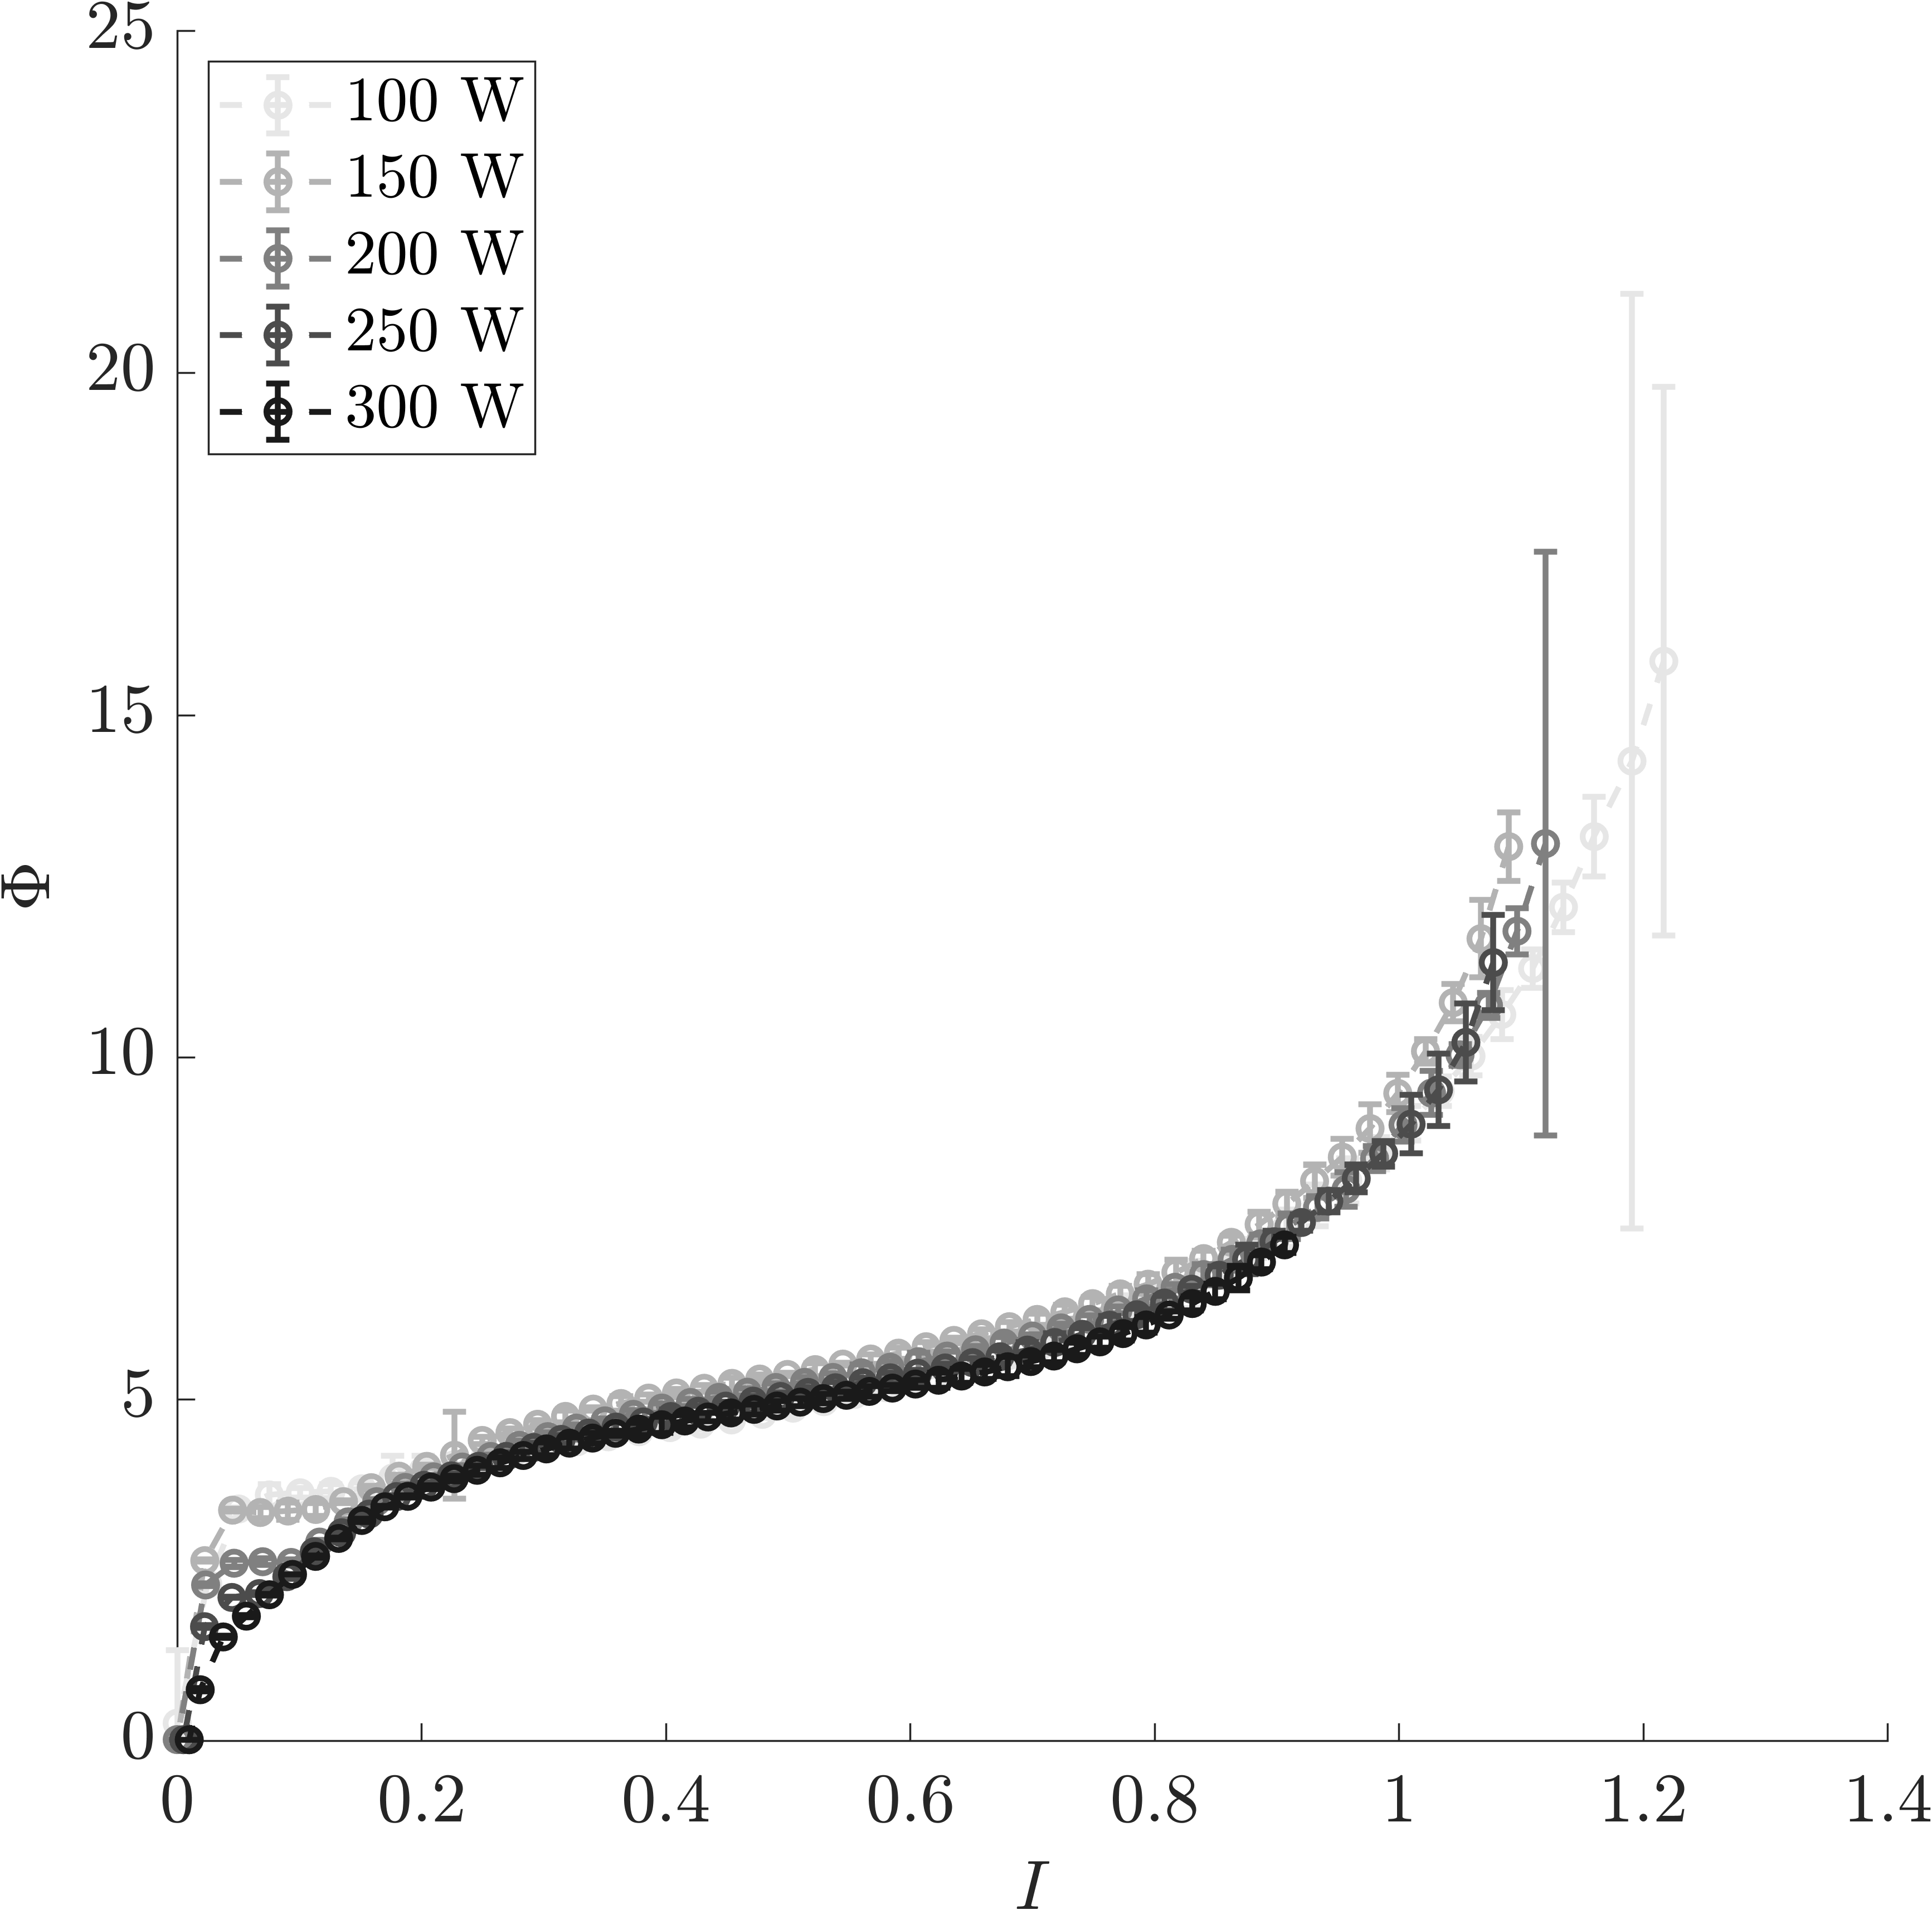
Experimental Results (Ar) for theory comparison
Solid: Curve fit to sheath model
Normalize
Collapses onto a single curve under normalization (✓)
Notes:
Lastly we use the predicted Isat and Te to normalize the curves. Indeed we find that the I-V traces collapse onto a single curve as we expected with our theory.

Slide 36
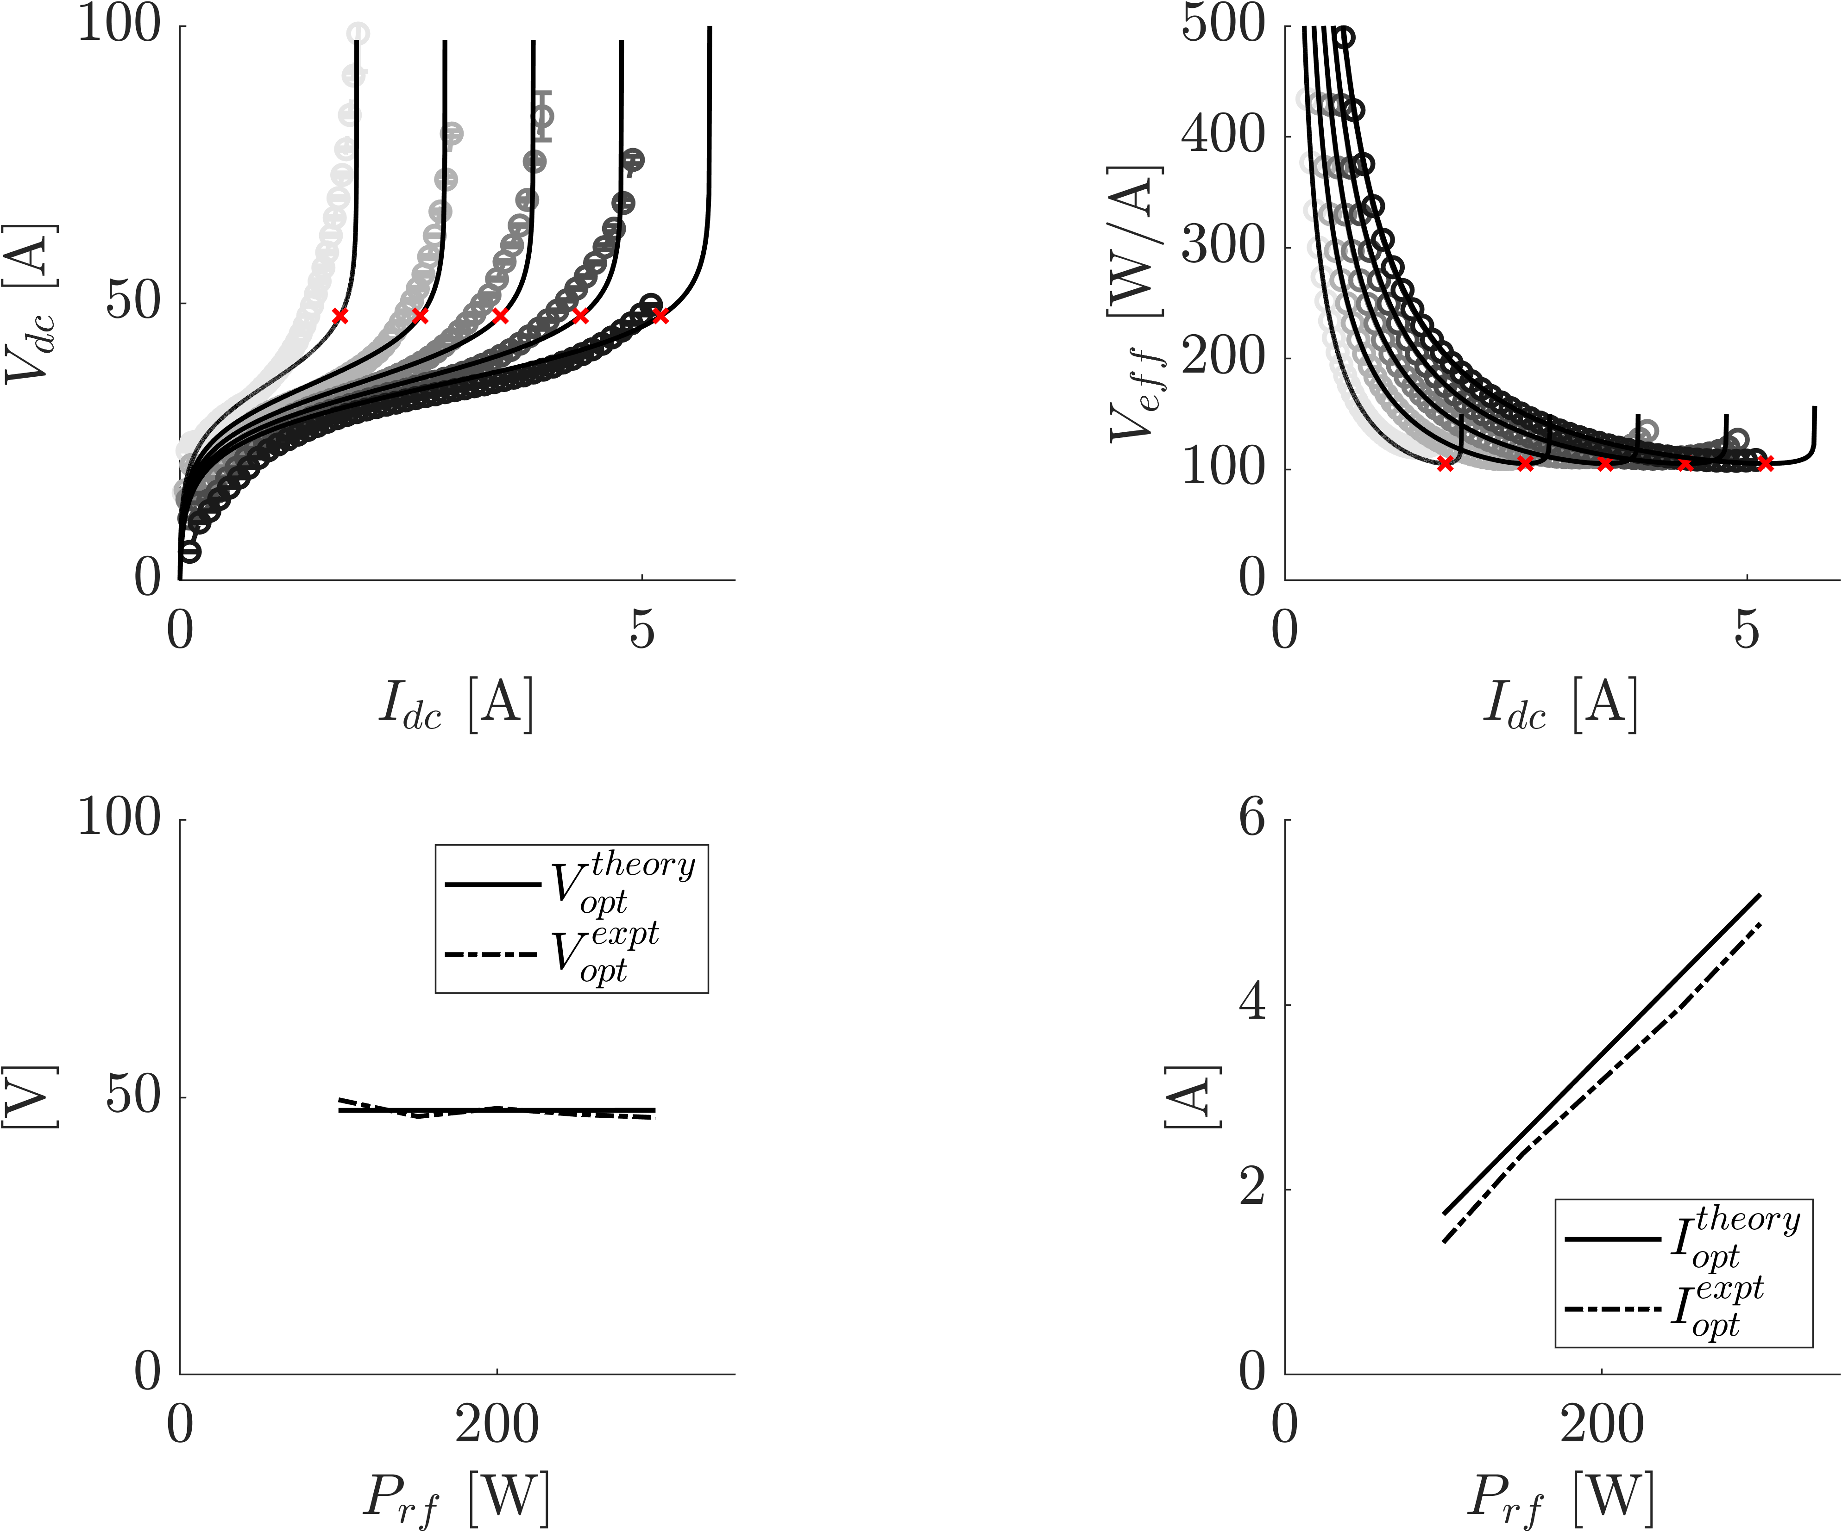
Experimental Results (Ar) for theory comparison
Plotting like conditions for numerical model and experiment
Can determine optimal $V_{dc}$ and $I_{dc}$ to a reasonable degree of accuracy.

Slide 37
Takeaway
The Ar global model + the sheath theory accurately describes many of the features of our experimental data.
However the model is not predictive because it relies on estimates of coupling efficiency and capacitive coupling effects on the temperature.
What about water?

Slide 38
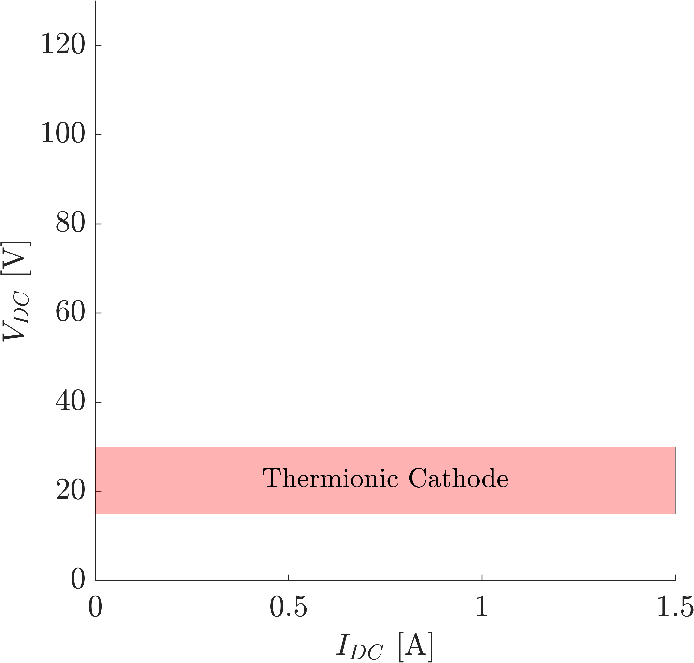
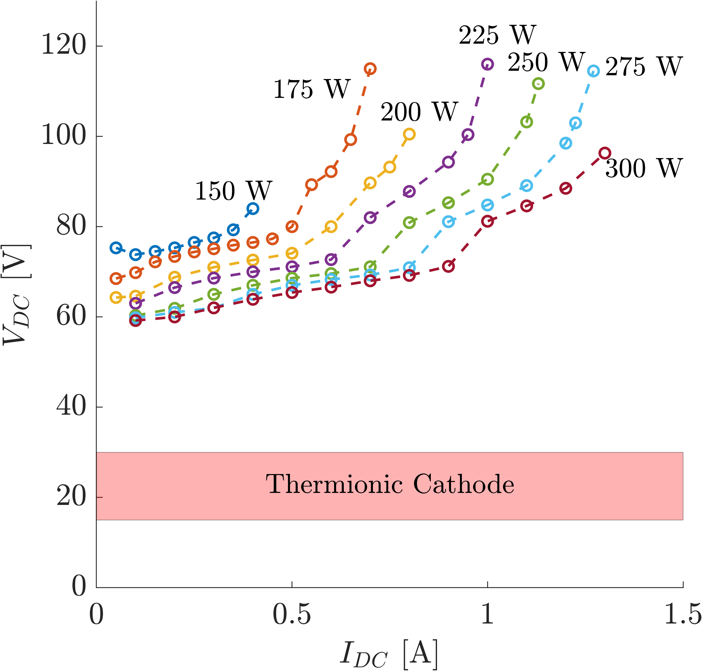

Repeat experiment using water vapor
ISRU?
✓
The device works!
$$×$$

Slide 39
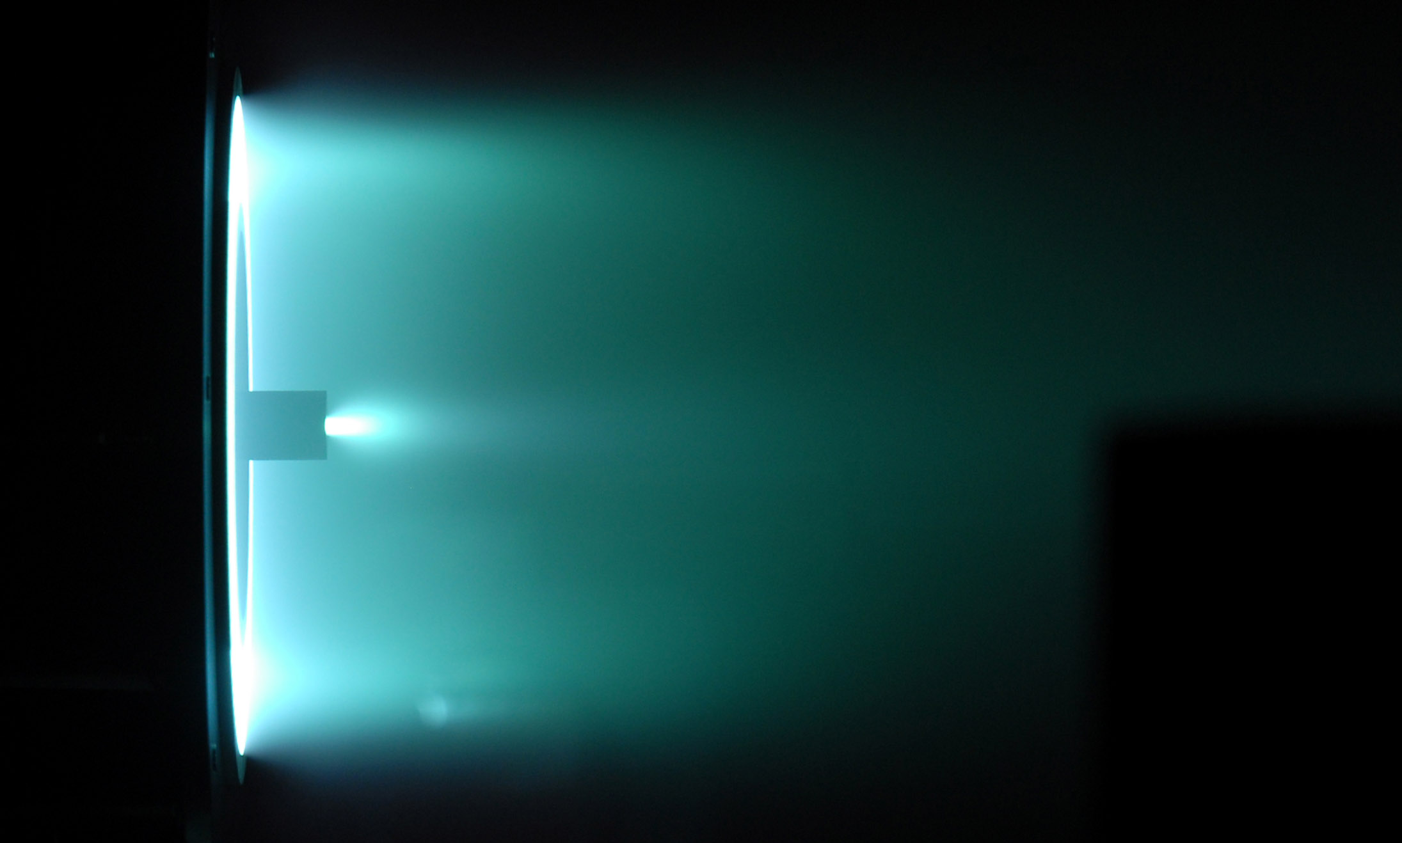





Analysis: Extrapolation of Performance to Hall Thruster
What level of Hall thruster performance can we expect from our results?
Anode
All other typical Hall thruster losses [2]
$$η_{other}∼0.6$$
$$H_{2}O$$
Magnetic Circuit
Higher cathode discharge voltages mean lower voltage utilization for ion acceleration
$$η_{V}∼0.60$$
Using $H_{2}O$ adds “frozen flow” losses [3]
$$η_{ff}∼0.78$$

Slide 40


Analysis: Extrapolation of Performance to Hall Thruster
Analysis of a 2.5 kW and 5 kW Hall thruster
$I_{dc}$ (A) | $V_{cc}$ (V) | $V_{dc}^{HET}$ (V) | $V_{eff}$ (W/A) | $$η_{ff},η_{other}$$ | $P_{rf}$(kW) | $T$ (mN) | $I_{sp}$(ks) | mN/kW | $η_{HET}^{H_{2}0}$(%)
5 | 100 | 300 | 312 | 0.78,0.6 | 1.05 | 29.7 | 4.7 | 11.6 | 18.3
10 | 100 | 300 | 311 | 0.78,0.6 | 2.11 | 53.9 | 4.7 | 11.6 | 18.3
Isp is high because of low MW
Large RF power will likely be required $∼50\%$of total
Thrust is low because of low MW
Xe HET = 75 – 150 mN
Efficiency is low. Xe HET = 50 %
T:P is low due to H2O and RF power penalty
Xe HET = 50 mN/kW

Slide 41
Fast Forward a Few Years…
(Abridged works for Drs. Nolan Uchizono and Leanne Su)

Slide 42

Changes in Equipment
Externally Mounted
Internally Mounted
RF Engineering

Slide 43





Changes to the Model
Sun, Jinhai, et al. Scientific Reports 12.1 (2022): 4655.
$$n$$
Ar
Xe
$$nd_{eff}$$
Account for variations between core and wall

Slide 44


Nobel Gas Propellant Scaling Laws
$$\frac{n_{e,1}}{n_{e,2}}∝\frac{\sqrt{m_{i,1}{U_{iz,2}}^{3}}}{\sqrt{m_{i,2}{U_{iz,1}}^{3}}}$$
$$\frac{T_{e,1}}{T_{e,2}}∝\frac{U_{iz,1}}{U_{iz,2}}$$
Take-away:
Easier to ionize propellant requires lower electron temperature
Take-away:
Easier to ionize propellant makes more plasma
Heavier propellant has lower wall losses.

Slide 45

Experimental setup
RF cathode
  Propellant: argon, krypton
  Pressure: 300 mTorr
  Power: 100 W
Facility
  Operating pressure:
  100 uTorr
Probes
  Langmuir probes
  Retarding potential analyzer
  ExB probe (developed in-house)
Notes:
Graphite-coated anode with mesh grid
Base pressure of 1 uTorr

Slide 46
Cathode in operation
Argon
23 sccm
70 V
Krypton
15 sccm
60 V

Slide 47



Model Inputs and Expectations
Propellant Properties
Expect $n_{e}^{kr}$ to be $∼\sqrt{2}$ greater
Expect $T_{e}$ to be similar

Slide 48

Model Inputs and Expectations
Propellant Properties
Test Properties / Model Parameters

Slide 49



Model Outputs
Propellant Properties
Now let’s compare to real data!
Global Model Results
✓ $T_{e}∼C$
✓ $n_{e}^{Kr}∼\sqrt{2} n_{e}^{Ar}$

Slide 50

Comparing Experiment to Theory
Low-current:
Why is I-V so different from before?
Why does our model fail at low current?
High-current:
Decent model agreement
Improved performance meets expectations
What did our probes say??

Slide 51


What do our Eyes... Errhm… Organic Optical Sensors Find?
High-current
“Extended” mode
Above 30-40 V
Good $I_{d}$ extraction,
bright glow
Low-current
“Retracted” mode
Below ~20 V
Poor $I_{d}$ extraction,
dim glow

Slide 52



Plume Measurements
✓ $T_{e}∼C$
✓ $n_{e}^{Kr}∼\sqrt{2} n_{e}^{Ar}$
Mode Hop
Mode Hop

Slide 53

Plume Measurements
Plasma Potential Rises
The Sheath + Global Model approach isn’t sufficient to predict this behavior…
We need to extend our description!
Mode Hop

Slide 54

Physical explanations
Improper current extraction at low voltages
  Bright plasma downstream only at higher voltages
  Would be associated with higher electron temperatures (excitation energy range)
Double layer sheath formation [3]
  If $λ_{d}≫d_{o}$, electron emission
  only occurs through potential
  barrier in front of orifice
  When $λ_{d}≈d_{o}$, emission is through
  both potential barrier and open surface
$$λ_{d}≫d_{o}$$
$$λ_{d}≈d_{o}$$
$$λ_{d}≪d_{o}$$
[3] Oks, E., “Physics and technique of plasma electron sources,” Plasma Sources Science and Technology, Vol. 1, No. 4, 1992, p. 249.
Notes:
Cite Oks

Slide 55



Conclusion: In-situ Resource Utilization
Notes:
ISRU is a strategy where rather than bringing all our food with us, we want to live off the land. For the moon, what we have is water! We can take that water and do lots of useful things… Life support, rover fuel, chemical propellant… EP propellant?

Slide 56
A Few Other Research Topics At NRL:
High-speed Plasma Diagnostics
Circuit Effects on Emissive Sheaths

Slide 57


Langmuir Probe vs Plasma Impedance Probe
Langmuir Probe
Plasma Impedance Probe
Plasma density and temperature information is encoded into the plasma DC response.
Plasma density and temperature information is encoded into the plasma spectral response.
Notes:
A Langmuir probe is essentially an electrostatic probe. A bias voltage on the probe is either fixed to measure the current response at high speed or swept relatively slowly.
An alternative strategy is to use frequency swept RF excitation of the plasma through a plasma impedance probe.
The plasma’s impedance as a function of frequency can be measured from reflected waves.
Resonances are spectral shape can be analyzed to estimate the electron density and temperature.

Slide 58

How do the PIP Density Results Compare to Isat?
PIP density measurements look qualitatively different from Isat
Notable differences in spectral properties

Slide 59


Comparing Isat measured to Isat from PIP
PIP Isat look qualitatively similar to measured Isat
$$I_{sat}^{PIP}=0.61qAn√((qT_{e})/m_{i} )$$
Now captures harmonics in the spectrum
Takeaways
PIP and Isat agree out to 600 kHz
Electron temperature variations are critical to account for Isat below 600 kHz
Unclear if high frequency content differences are due to errors in PIP or Isat

Slide 60




Sheath Model – Conceptual Picture
$$←I_{wall}$$
Body current loop
$$←I_{dc}$$
$$I_{beam}→$$
$$←I_{body}$$
Cathode-Tied
Notes:
To think about what happens to the sheaths, Lets break this complex system down

Slide 61

Sheath Model – Conceptual Picture
$$←I_{wall}$$
Body current loop
$$←I_{dc}$$
THRUSTER BODY
CATHODE EMITTER
$$I_{beam}→$$
$$←I_{body}$$
Cathode-Tied
Notes:
There are two surfaces, cathode emitter and thruster body

Slide 62




Sheath Model – Sheath Physics
Space-charge limited
$$J_{th}≃J_{e}^{em}$$
THRUSTER BODY
CATHODE EMITTER
$←$Sheath is suppressed to balance currents
But this effects the balance currents $→$
The emitter clearly effects the collector sheath.
But can the collector sheath effect the emitter?

Slide 63
All Done with Science

Slide 64

Undergraduate and Graduate Opportunities
We are always looking for talented undergraduate and graduate students with interests in:
Plasmas
Propulsion
Space Technology
Data Fusion
Diagnostics
NREIP opportunities for undergrads and grads:
https://www.onr.navy.mil/en/Education-Outreach/undergraduate-graduate/NREIP-naval-internship
STEM Student Employment Program:
Summer/Part time/Full employment for undergrads and grads
https://www.nrl.navy.mil/Careers/Students/SSEP/

Slide 65

Postdoctoral Opportunities
We are always looking for talented people with interests in:
Plasmas
Propulsion
Space Technology
Data Fusion
Diagnostics
Currently we’re actively looking for Postdocs for a variety of plasma-related topics!
Postdoctoral Fellowships:
https://sites.nationalacademies.org/PGA/RAP/index.htm
https://nrl.asee.org/

Slide 66

Faculty Opportunities
Summer faculty programs can be a great way to:
Get funded
Share expertise
Gain access to facilities
Numerical modeling
Summer faculty through ONR:
https://www.nrl.navy.mil/careers/faculty/

Slide 67

Questions?
Contact info:
Marcel Georgin: marcel.p.georgin.civ@us.navy.mil
Michael McDonald: michael.s.mcdonald80.civ@us.navy.mil
Jack Brooks: john.w.brooks197.civ@us.navy.mil
Nolan Uchizono: nolan.m.uchizono.civ@us.navy.mil

