Slide 1
Nanosecond Pulsed Power-Generated Transient Plasma for Energy and Environmental Applications
Research includes:
    Transient Plasma Ignition and Combustion.
    Plasma Remediation of Emissions
    Why transient plasma (corona, streamers) vs DBD, other
      Works –– and is efficient. But the physics is hard. And requires short (nsec) pulses
Pulsed Power Research Role?
  Required to enable short pulses
    Bioelectrics, apoptosis, therapeutic applications
    Wine Production, Educational Outreach
USC Pulsed Power Group including Martin Gundersen
Research has been supported the AFOSR, DOE, ONR, NIH, Nissan Corp., the Alfred Mann Institute, TCC Group, NumerEx, ISSI, LLNL, LANL, and others.
Presentation for U. Michigan MIPSE, Sept 20, 2017 Martin Gundersen

Slide 2
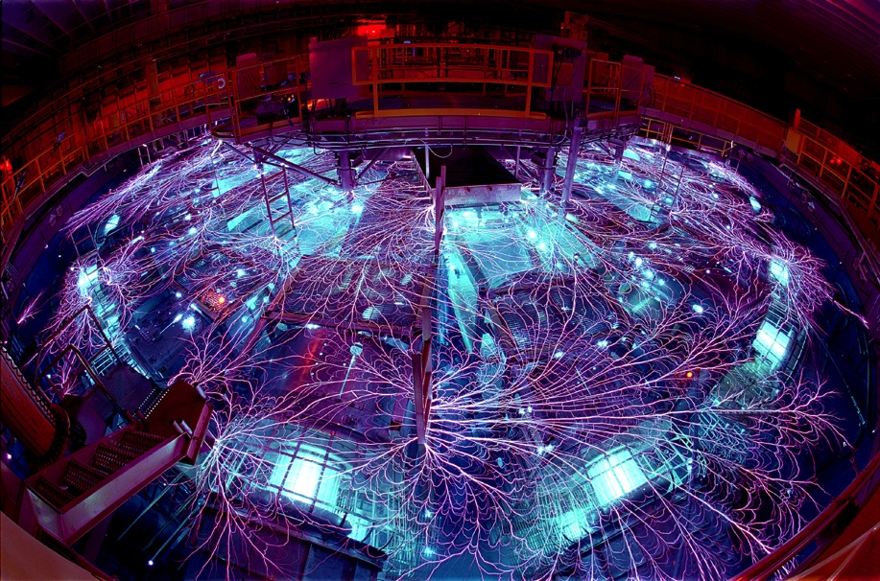
What is Pulsed Power? Example: The Sandia National Labs “Z” Machine
Swimming pool-sized pulse generator. (Could have used UM “Z”)

Slide 3
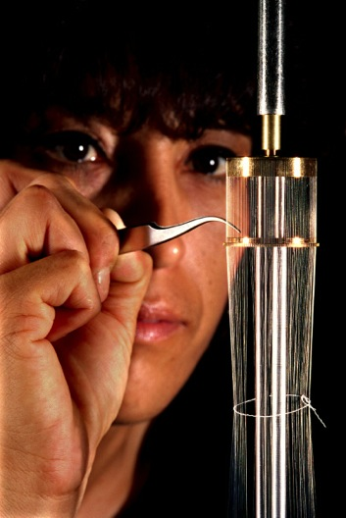
What is Pulsed Power?
Often Misunderstood Potential
There are many roles and applications for pulsed power –potential of uses still not fully understood.
Liner for the “Z” Machine (right); with current passing through, phenomenon called Z Pinch.
Fusion Research Application:
    All energy is conducted through the Liner creating a ‘pulse’.
        Sandia National Laboratory Fusion Program: Goal is to drive sufficient current through the Liner to compress & induce fusion.
Source: SNL

Slide 4
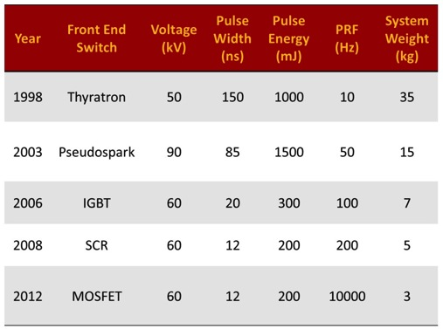
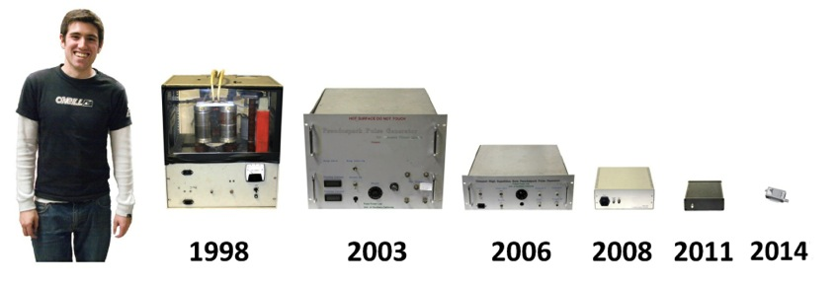
Our Pulsed Power: Exploring Miniaturized Applications
Applications such as transportation require low-power, lightweight and compact systems
Size decreasing as high-voltage switch technology advances
Pulse width decreasing
    Reduces energy consumption
    And--Increases effectiveness

Slide 5
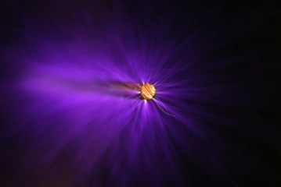
Our Pulsed Power
Ignition, Combustion, and Remediation
Nanosecond Pulsed Power Enables High Power with Low-Energy
Transient plasma flame ignition
  Applications: fuel flame ignition, combined cycle, pulse detonation engine, internal combustion engine, flame holding, high altitude relight
  Source: Short (ns), high power, low energy pulses were observed to be effective for plasma chemistry – through true non-thermal processes.
  Nomenclature: Streamer, transient plasma, corona
  Distinctive element: True non-thermal electron energy distribution
Short pulse generation to produce streamers.
Contributors:
    Dan Singleton, Bill Schroeder, Ram Srinivasan, Sanjana Kerketta, Scott Pendleton, Fei Wang,Tao Tang, Andras Kuthi, Charles Cathey, Jianbang Liu & Paul Ronney (USC)
    Chris Brophy and Jose Sinibaldi (NPS)
    Ron Hanson, Jay Jeffries, Ethan Barbour (Stanford)
    M. Kushner (UI, UM, BLT Melt)
    Fred Schauer (WPAFRL)
    Effie Gutmark (U. Cincinnati)
    Joe Shepherd (Caltech)
Notes:
1

Slide 6
Diode sharpened Magnetic Compression Pulser
Resonant Charging
Magnetic reactor
DOS sharpening
Magnetic Compression, takes a low voltage long pulse, and compresses it through a series of LC resonant stages.
Novel diode sharpening of the pulse
57 kV, 20 ns (FWHM) pulse
Used to explore advantages of a shorter pulse length for ignition applications
Also design, build and use pseudsopark-based pulsers
These are analogous to thyratron (or SCR) based, ‘line-type’ but faster rise, higher current than thyratron.
Tao Tang, A. Kuthi, F. Wang, C. Cathey, and M. A. Gundersen, “Design of 60kV 20ns solid state pulse generator based on magnetic reactor driven diode opening switch ,” 27th International Power Modulator Conference 2006, Washington D. C., District of Columbia, May 14-18th, 2006.

Slide 7

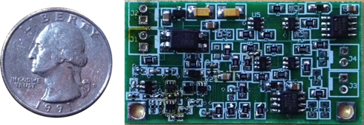
Typical Pulsed Power Design (cont.)
Managing Electromagnetic Compatibility
Goal: Keep High Current Transient Signals Confined to Pulse Generator and Cable
Differential Output Cable / Electrodes
  Keep high currents from flowing through system ground.
Embedded Power and Trigger Signals
  Minimize exposed wires that can pick up noise.
Isolated Power Supplies
  Provide isolation from noise sensitive equipment.
  All internal modules are shielded
Optically Isolated Controller with Feedback Control
Features:
Optical Isolation
Variable width and amplitude
External Trigger Capability
Feedback regulates rep rate to keep it below a maximum
Opto-isolator
Timing Circuit
Feedback Circuit
Output Drive

Slide 8
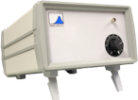
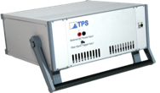
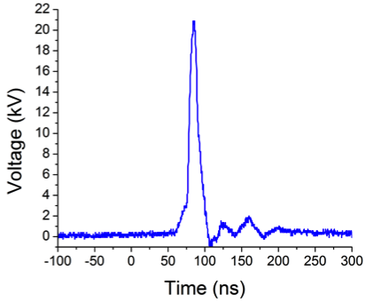
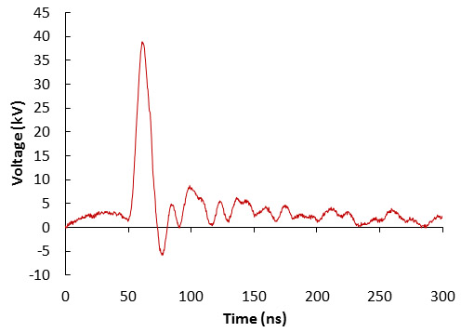
New Pulse Generators for Combustion and Medicine
Specifications:
40 kV into 200 Ω
12 ns Full-Width-Half-Max Pulse Duration
5 ns Pulse Risetime
10 kHz Pulse Repetition Rate (Burst)
Specifications:
20 kV into 50 Ω
15 ns Full-Width-Half-Max Pulse Duration
4 ns Pulse Risetime, dV/dt = 5 × 10¹² V/s
20 kHz Pulse Repetition Rate (Burst)

Slide 9
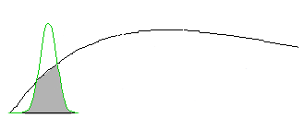
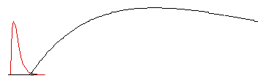

Why? Transient Plasma → Energetic Electrons
During a transient phase, prior to arc formation, there are relatively more energetic electrons -- while there is still a high voltage across the gap
Reaction rate proportional to overlap. Large overlap during this time.
EDF f(E)
σ(E)
For first T<10 ns
There is a Transient Plasma and
Hot, energetic
electrons
Typical cross section for ionization, dissociation, etc.
Typical electron distribution function, f(E), and cross section, σ(E), during first 10 ns of the discharge
Transient Discharge, High temperature electrons. No significant change in gas temperature
10
30
40
60
100
110
120
130
140
150
20
50
70
80
90
Electron Energy (eV)
After transient, or hot phase,
T>100 ns,
Arc Discharge – with Cold
electrons
Typical electron distribution function, f(E), and cross section, σ(E), after first 100 ns of the discharge
σ(E)
EDF f(E)
Equilibrated Discharge, Electron and gas temperature are both less than a few eV
10
20
30
50
60
70
80
90
100
110
120
130
140
150
40
Electron Energy (eV)
Small overlap = small reaction rate
Reaction Rate α $\int{f\left(E\right)σ\left(E\right)dE}$
Notes:
You can isolate and observe the nonequilibrium events if you can cut off power to the discharge before things equilibrate.

Slide 10
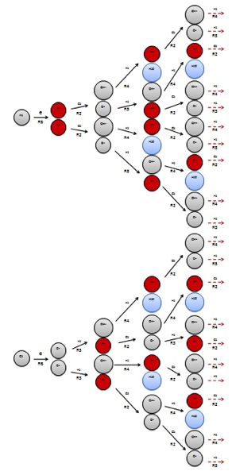
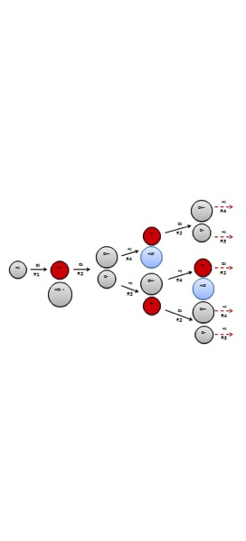
The Associated Reactive Chemistry
Example: H₂-O₂ combustion started with non-thermal (transient plasma)
Excited species production with
transient plasma
With spark discharge
H•
O₂
H₂
e
H•
O₂
Transient plasma dissociates molecules via electron impact
Produces very reactive excited species, Increases chain branching and propagation reactions
O•
H₂
O₂
e
O•
H₂
Atomic oxygen
is highly reactive and accelerates combustion and improves stability
S. M. Starikovskaia, “Plasma Assisted Ignition and Combustion,” J. Phys. D: Appl. Phys. 39 (2006) R265–R299.
Notes:
Intro: Transient Plasma generates electrons of excited states that begin a cascade of ionization reactions…
Key Objective: The magnitude of combustion efficiency is much greater with transient plasma vs. conventional spark discharge combustion.
Outro: This ‘cascade of chemical reactions’ is applicable for emissions remediation as well; instead of a combustion reaction, we have an oxidation reaction of NOx and SOx.

Slide 11
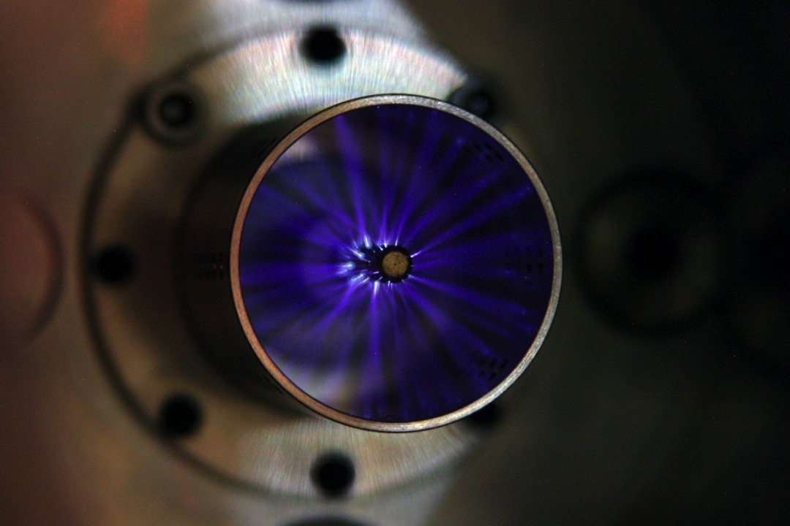
Streamer Image (Canon EOS 10D, 80 mm Lens, 15 sec exposure)
Single Pulse
Pseudospark Pulse Generator
61 kV, 54 ns Pulse (1000 mJ)
15 mm Gap
110 kV/cm (440 Td)
Stainless Steel Porous Cathode
Stainless Steel Threaded Anode (8-32)

Slide 12
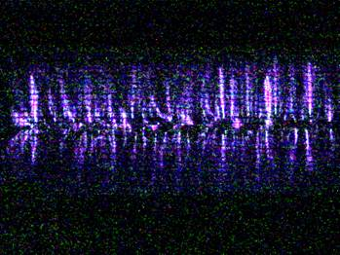
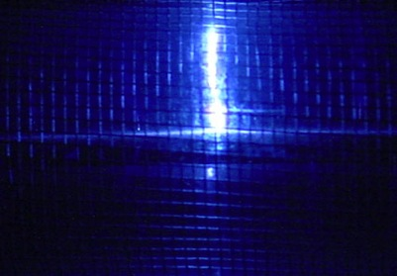
Transient Plasma Introduction
TP Corona Discharge
Arc Discharge
Streamers formed over ½ m distance, 5 cm width tube, center electrode, using pulse ≈ 50 ns at ≈ 40 kV.
Same setup, but with >100 ms pulse.
The streamers, which have higher energy electrons, and which fill the volume tube (left image), have degenerated into a single constricted arc, with low electron energy (right image).
Streamer and arc images taken at Seaver Science Center, Los Angeles, CA
Support provided by US Air Force Office of Scientific Research (US-AFOSR)

Slide 13

Two Important Areas for Use of
Transient Plasma
Exhaust remediation
Ignition and combustion enhancement

Slide 14
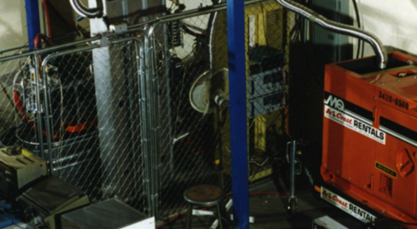
Remediation with Transient Plasma: NOx, SOx, Soot
Mid 90s (ONR, DOE, ARO)
Diesel, reactor, nsec pulses
Key result: Efficient remediation enabled by using short pulses (<50nsec)
97-98 Program
USC engine: 10 eV/molecule
Energy cost
Achieved <10ev/molecule!
<5% engine energy requirement.
V. Puchkarev and M. Gundersen, "Energy efficient plasma processing of gaseous emission using short pulses," Appl. Phys. Lett. 71 (23), 3364 (1997) + patent 1997

Slide 15
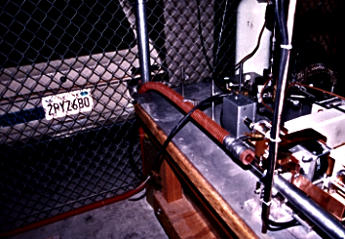
Transient Plasma Remediation History of NOx (cont.)
Volkswagen Rabbit Experiment
Co-Axial Diesel Rabbit Set-up at USC
Reported CNN Future Watch
Ticketed by Campus police
Simple early test set-up
Explored surface, corona, and silent barrier discharge cells
Allowed modification of pulsed power
Promise with corona, short pulse seen
Notes:
Intro: First direct attempt on a real civilian application.
Key Takeaway: Started with car emissions, and continued since the 90s till today.
Outro:

Slide 16
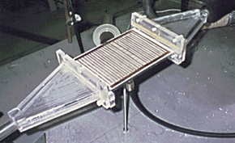
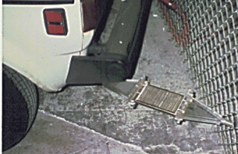
Transient Plasma Remediation History of NOx (cont.)
Volkswagen Rabbit Experiment (cont.)
Cell Types
Corona
Silent Discharge
Surface Discharge
Plasma mufflers:
Above: Various cell types investigated.
Best results were achieved with corona (transient plasma)
Right: Surface discharge plasma cell attached to diesel Volkswagen Rabbit.
Notes:
Intro: First direct attempt on a real civilian application.
Key Takeaway: Started with car emissions, and continued since the 90s till today.
Outro:

Slide 17
Transient Plasma Remediation History of NOx (cont.)
Efficiency & eV/Molecule of Various Cells
NO
removal
x
(ppm)
100
16 eV/mol
80
12
400
30
50
60
240
500
4
40
18
300
3
20
6
2
4
6
8
10
40
80
120
Joules/lit
Data (approximate) showing energy/molecule under various conditions, differing cell configurations. Data are for 100 ppm initial conditions NO_{x}.
Efficiency for data within ellipse corresponds to requirement of approximately 2% engine power.
Low current density, transient processes, lead to efficiency
V. Puchkarev and M. Gundersen, "Energy efficient plasma processing of gaseous emission using short pulses," Appl. Phys. Lett. 71 (23), 3364 (1997) + patent 1997
Notes:
Intro: Further data collection showed that emissions remediation for NOx is energetically favorable.
Key Takeaway: Further tests showed that energetic costs for remediation relative to engine power output can be obtained at 2% or less.
Outro: Technology just needed to advance further before application became reality.

Slide 18
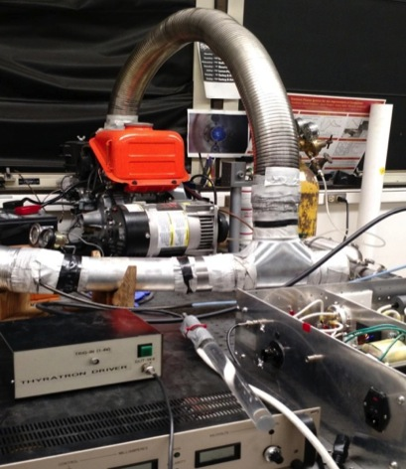
USC 5 kW Engine Setup
Experimental setup showing Kubota diesel engine, thyratron pulser and plasma reactor.

Slide 19
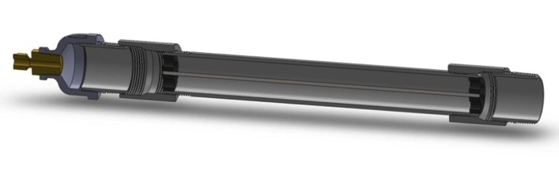
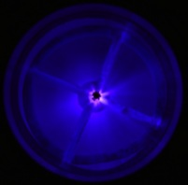
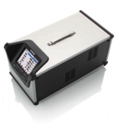
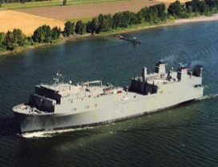

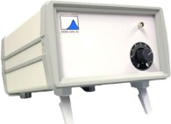

Transient Plasma Emission Remediation
Slip-Stream Experimental Setup
Exhaust
Exhaust
Horiba® PG350 Exhaust Analyzer
Engine
Reactor
TPS® Pulser
TSI DustTrak® Particle Analyzer
Teledyne® UF Particle Analyzer
Notes:
Intro:
Now I’ll be explaining the beginnings and results of all our NSPP studies.
Main Points:
Experimental flow (how the experiment is done).
Equipment that we used.
Explain what slip stream is (and how it’s valid compared to full flow).
Outro:
This is essentially the basis of all our experiments.

Slide 20
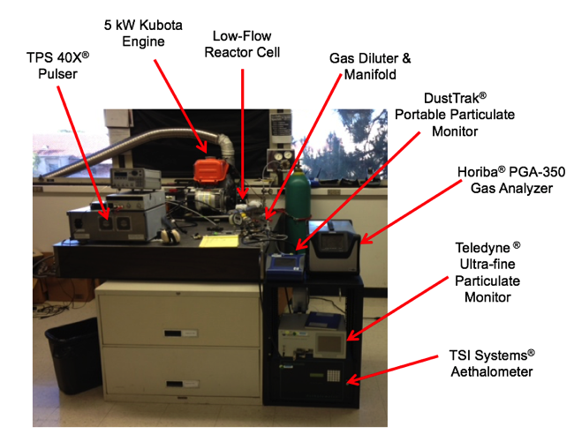



Slip-Stream USC Test Experimental Setup
TPS® SSPG-40X Pulse Generator (100W)
Particle monitoring instrumentation generously provided by the South Coast Air Quality Management District (SC-AQMD) through active collaboration on research for emissions reduction.
All instrumentation and methodology comply with US EPA and California Air Resources Board (CARB) protocols.
Photo taken at Seaver Science Center
University of Southern California, Los Angeles, CA
Notes:
Intro:
So this is what the physical setup looks like in our lab.
Main Points:
Going through the equipment and what the purpose of each equipment is for.
Gas sampling manifold and how we collect the data.
Outro:
All the equipment we use and methodology of data collection is compliant and approved by all the regulatory agencies (EPA) in USA.

Slide 21
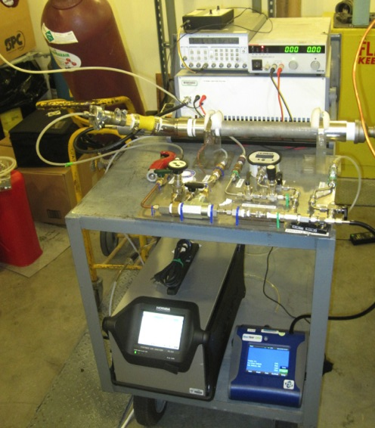

Slip-Stream Field Test Experimental Setup
Trigger Generator
DC Power Supply
TPS® SSPG-40X Pulse Generator (100W)
TPER Mk.I Plasma Reactor
Gas Sampling Manifold
Horiba® PGA-350 Portable Gas Analyzer
TSI® DustTrak Particle Analyzer
Photo taken during field tests at the Naval Postgraduate School - Monterey, CA
Notes:
Intro:
So this is what the physical setup looks like for field tests.
Main Points:
Going through the equipment and what the purpose of each equipment is for.
Gas sampling manifold and how we collect the data.
Outro:
This is a well refined and dependable data collection system (which is EPA approved) and tested on multiple platforms.

Slide 22
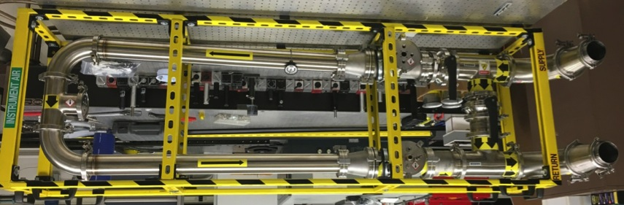
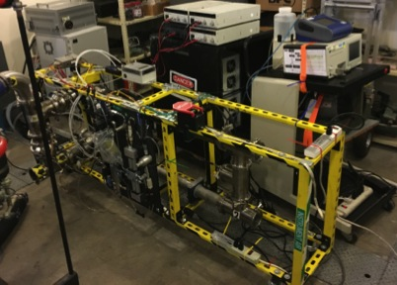
USC Laboratory Full-Flow Setup
USC TPER Mk.II Plasma Reactor
TSI DustTrak ® Particle Monitor
USC Mk.II Reactor Provides 5000X Increase in Scale-Up!
Teledyne ® Ultrafine Particulate Monitor
TPS® SSPG-20X Pulse Generator 1 kW (x2)
Transient Plasma Reactor (x2)
Gas and Particulate Analysis Sampling Manifold
Notes:
Intro:
With all the data and science pointing towards a successful scaleup (?) …
Main Points:
Built this from scratch on campus.
This was a 5000x increase in scale-up (capable of handling 5000x more mass flowrate).
Customized reactor for testing multiple flow configurations (ie. series and parallel).
Increased sophistication of gas and particle analysis, and still EPA approved.
Now we can specifically study the efficiency accurately and precisely.
Outro:
First step in scale-up is a success! (by 5000x).

Slide 23
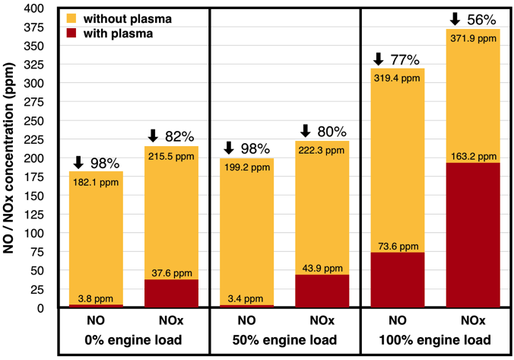
(Slip-stream Data)
5 kW Engine Load Testing
935 rpm
1650 rpm
2300 rpm
Testing carried out in 2.54 cm diameter cell (1.27 cm discharge gap).
Relative uncertainty in measurement = ±3%
Notes:
Intro:
Basis the outstanding results from the conceptual tests on the seatrial in October 2015, we realized that we needed to study this in greater detail.
Main Points:
Wanting to see the effectiveness of NOx reduction at multiple engine loads.
Observed that effectiveness remains high at high loads.
This was part of us determining the effectiveness at different physical parameters.
Outro:
Basis these results of NOx treatment under loaded conditions, we wanted to see the viability of scaling up.

Slide 24
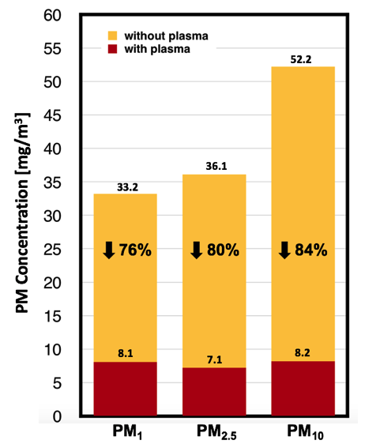
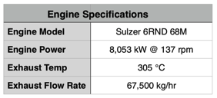
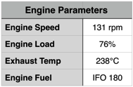
PM Remediation Results
Notes:
Intro:
Even though NOx and SOx is currently the focus in all industries, the effectiveness of PM reduction is too significant to ignore.
This table shows the initial study of transient plasma impact on full distribution of particles.
Main Points:
Effective remediation for small and larger particles.
First time seeing effective remediation for submicron particulates.
Outro:
Truly is three birds with one stone.
There is no other PM reduction technology that produces results anywhere near the results we’ve produced.

Slide 25
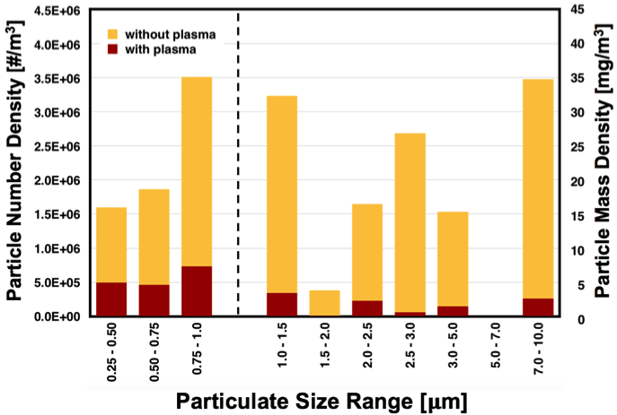
Preliminary PM Remediation Results
Relative uncertainty in measurement = ±6%
Notes:
Intro:
Even though NOx and SOx is currently the focus in all industries, the effectiveness of PM reduction is too significant to ignore.
This table shows the initial study of transient plasma impact on full distribution of particles.
Main Points:
Effective remediation for small and larger particles.
First time seeing effective remediation for submicron particulates.
Outro:
Truly is three birds with one stone.
There is no other PM reduction technology that produces results anywhere near the results we’ve produced.

Slide 26

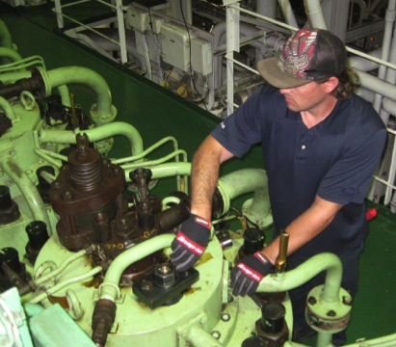
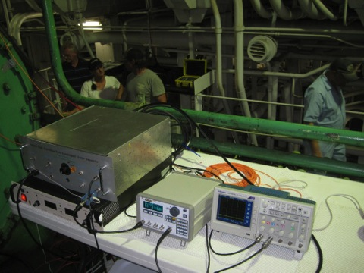
Plasma Assisted Combustion Efficiency
Transient Plasma Relief Valve Electrode for Sulzer 6RND
Photograph of TP relief valve being inserted into cylinder of Sulzer 6RND engine aboard MARAD vessel.
Photograph of nanosecond high voltage pulser and associated equipment used to generate plasma inside cylinder of Sulzer 6RND engine aboard MARAD vessel.
Left – Engineer …....
Right – (From left to right) Dr. Andras Kuthi, Galia Kaplan, Engineer, Captain Vinay Patwardhan.
Notes:
Intro:
Main Points:
Outro:

Slide 27
Ignition Snapshots
Gasoline, natural gas, other fuels
Various engine types: ICE, PDE, etc.

Slide 28
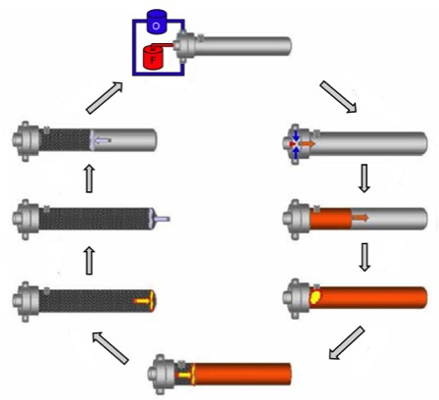
The Rocket Part: Pulse Detonation Engines (PDE)
Collaborations with the Naval Postgraduate School (NPS, Brophy), WPAFRL (Schauer et al), Stanford (Hanson et al)
PDE Cycle
C. Cathey, et.al., “Transient Plasma Ignition for Delay Reduction in Pulse Detonation Engines,” 45th AIAA Aerospace Sciences Meeting and Exhibit, Reno, Nevada, 8-11 Jan 2007
PDE at the NPS Rocket Lab

Slide 29
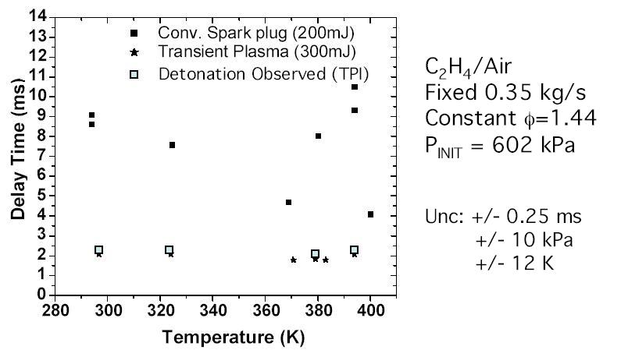
Greatly Improving Thrust in a PDE at the NPS
Traditional spark ignition
9 ms delay
USC
Transient plasma ignition
2 ms delay
Transient plasma in the NPS PDE
  Reduced delay (shortened DDT) by ≈ factor >4
  Created a detonation without added oxygen (propane-air)
  Increased peak pressure
  4X Higher repetition rate of the PDE means > 4X thrust
Operated at high flow rates (1/3 kg/sec)
C. Cathey, et.al., “Transient Plasma Ignition for Delay Reduction in Pulse Detonation Engines,” 45th AIAA Aerospace Sciences Meeting, Reno, Nevada, 2007

Slide 30

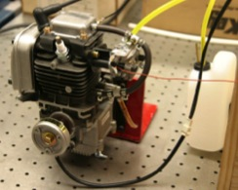
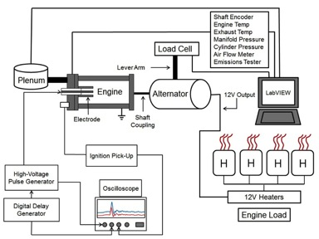
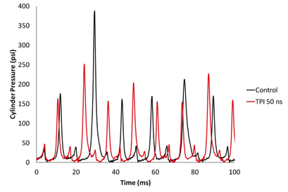
Ignition: Small Engine Experiment
AFOSR Undergraduate Capstone Project
Non-resistive spark plug with uniform gap size used for both TPI and spark
Pressure transducer installed above spark plug
TPI produced 25% increase in RPM, same throttle setting indicating higher efficiency
AFOSR Capstone Project, C. Li, Program Manager,
Dan Singleton, Max Reynolds, Jared Fleitman, David Kingman, P Ronney, M Gundersen WPAFRL F. Schauer and J. Hoke

Slide 31
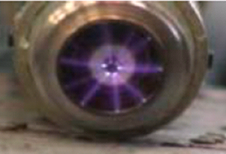
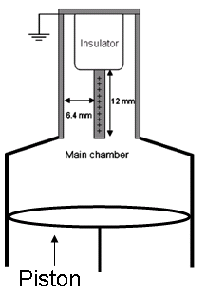
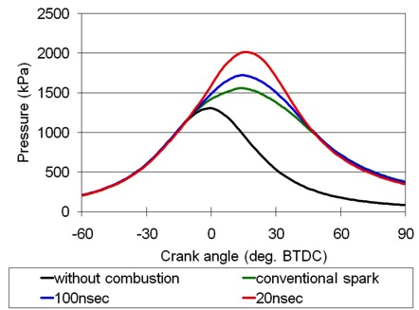
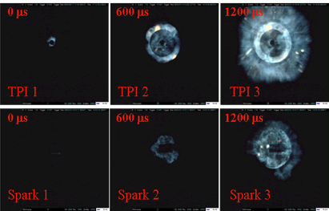
Nissan Gasoline Ignition: Increased Pressure
Streamers generated via a 60 kV, 20 ns pulse, using a modified spark plug
Data taken in collaboration at Nissan, Yokohama Japan
Pressure vs. crank angle, for a spark, 100 ns pulse, and 20 ns pulse, ф=.72.
Using TPI in an ICE resulted in
  20% increase in peak pressure using less energy (57 mJ vs 80 mJ)
  Faster flame propagation
1200 rpm, 100 mm-Hg, ADV: 20 deg BTDC, iso-octane-air combustion, each frame is 200 µs long.
C. Cathey, T. Tang, T. Shiraishi, T. Urushihara, A. Kuthi, and M. A. Gundersen, “Nanosecond Plasma Ignition for Improved Performance of an Internal Combustion Engine,” IEEE Trans on Plasma Sci, Dec. 2007.
Notes:
Transient plasma applications to internal combustion engines are at not as well developed as that of the PDE.
The technological challenges are greater for an internal combustion engine, specifically insulation, electrode-engine interface, and pulse generator design.
The challenge is that the transient plasma operates at 50-60 kV whereas in a spark ignition system the voltage is typically 25 kV - 40kV. This presents some material problems in selecting an insulator able to hold off the required voltage. The feed through for most car engines are 14mm in diameter, however, in modern cars space is a commodity and the sparkplug interface is shrinking, with some designs calling for a 10 mm feed through.
The spark ignition system has been around for a century and is extremely well developed. In order for transient plasma ignition to catch on in the automotive industry size, efficiency, reliability, and interoperability must be optimized to create a viable automotive ignition system.
A collaborative effort between USC and Nissan research laboratories used both a long pulse ( 85 ns ) and a short pulse ( 20 ns ) in a single cylinder iso-octane engine.
It is well understood in the combustion community that combusting under a lean condition will result in higher thermal efficiency and reduced NO^{x} production
Both the lean burn capability and the volumetric effect of the transient plasma gives it an inherent advantage over spark ignition, in particular, the reduction of NO^{x} production.
By combusting fuel in lean conditions NO^{x} production is reduced, which is important as NO^{x} is an important factor in the production of smog.
It was found that by using transient plasma ignition that the ignition delay period, which is an index of performance in a conventional gasoline engine, can be improved relative to a spark plug.
Additionally stable lean combustion was shown to occur at levels not realizable by spark ignition when a 20 ns pulse is used.
Additionally it is thought that the electron impact is the primary mechanism for molecular dissociation. The results indicate that transient plasma ignition is a viable ignition methodology with current engine design, and suggest that by going to a shorter pulse and overvolting the gap to a greater extent will further extend stable lean combustion while reducing the total amount of heat lost to the walls.
BTDC Before Top Dead Center

Slide 32
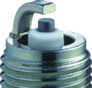
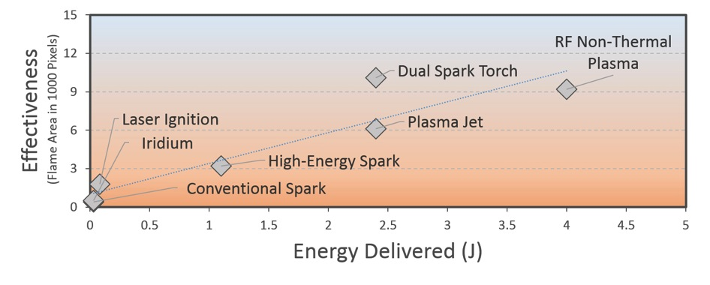
High-Energy Ignition Comparison
High-Energy Ignition
10x conventional spark energy
  Frequent replacement of spark plugs
Transient Plasma
Briggs, T., Alger, T., and Mangold, B., "Advanced Ignition Systems Evaluations for High-Dilution SI Engines," SAE Int. J. Engines 7(4):1802-1807, 2014, doi:10.4271/2014-01-2625.

Slide 33
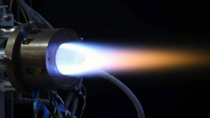


Engine Ignition Experiments: Typical Results
Engine Type | Location of Testing | Typical Result
Single-cylinder gasoline ICE | Sandia National Labs Combustion Research Facility | 20% improvement in fuel efficiency and increased stability
Single-cylinder gasoline ICE | Nissan Research Center | 30% increase in combustion efficiency
Natural gas ICE | Argonne National Lab, several industrial locations | Important improvement in ignition at high pressures
Pulse Detonation Engine | Air Force Research Lab and Office of Naval Research Lab | More than 3 times improvement in thrust
Continuous Detonation Engine | Pratt & Whitney Rocketdyne | 30% improvement in combustion efficiency

Slide 34




The Role of O, H₂O During Transient Plasma Ignition
Completed Work
Measured ignition delay in a PDE with
  transient plasma and spark discharges
Simulated OH and O₃ produced
  in a transient plasma discharge
  (John Luginsland)
Measured density of OH and O₃ produced in a
transient plasma discharge
(Cam Carter)
  Upcoming Work
Measure ignition delay in a combustion chamber
with transient plasma and spark discharges
{
{
{
{
Notes:
Koox 8/11 -
Intro:
Key Takeaway:
Outro:

Slide 35




Thermal vs. Non-Thermal? Energy Distribution Studies with CARS
Laser ROI
(250um x 250um)
8mm
8mm
Recent work by USC has demonstrated that ignition occurs primarily in regions of highest E/N and active species production.
We investigated the region nearest a sharp anode in a point-plane configuration with CARS and TALIF experiments.
Collaboration with Aaron Montello and Prof. Walter Lempert, in labs at tOSU
Notes:
Koox 8/11 -
Intro:
Key Takeaway:
Outro:
35

Slide 36


Experimental Setup: Two-photon Absorption Laser Induced Fluorescence
Dobele, H.F., T. Mosbach, K. Niemi, and V. Shulz-von der Gathen, 2005. Laser-Induced Fluoresence Atomic Densities: Concepts and Limitations. Plasma Sources Science and Technology. 14 S31-S41.
O/Xe Conversion
Collaboration with Sherrie Bowman and Prof. Walter Lempert, tOSU
Notes:
Koox 8/11 -
Intro:
Key Takeaway:
Outro:
36

Slide 37
Challenges
Transient plasma, DBD
Physics – streamer-head role in production of excited species and pathways to efficient remediation and ignition
Technology of ns pulsed power

Slide 38


Nano-Bio-Med Summary
Nanosecond pulses penetrate the intracellular environment
Phosphatidylserine inversion–induced apoptosis
Cancer cell Studies
In vivo experiments with tumors show promise
New venture: Pulse Biosciences
Cardiomyocyte Studies
Cold plasma
Images: Top: Quantum dots in lymphocyte
Below: Internal response of jurkat cell to nsec pulsed electric field
Thomas Chen KSoM Neurology
Cheryl Craft KSoM
Edward Garon MD, UCLA
Phil Koeffler Cedars, UCLA, MD
Laura Marcu UC Davis
David Sawcer KSoM Dermatology
Miguel Valderrabano UCLA
Tom Vernier Res. Assoc Prof. USC

Slide 39






NanoElectroPulse Therapy for Cancer: in vivo study
Treatment of human pancreatic cancer tumor grown on nude mice at Cedars Sinai, Koeffler group collaborating
Typical results compliments of Mouse 1 (cage 154937) below:
5x4x3.5
200px5
Mark
0.5x1x0
1 week
2 weeks
06/30/09
7/7/09
7/14/09
Garon, E. B., et. al., “In vitro and in vivo evaluation and a case report of intense nanosecond pulsed electric field as a local therapy for human malignancies”, Int. J. Cancer 121:675-682, 2007

Slide 40
Translational Outcomes
Pulse Biosciences
Transient Plasma Systems
Integrated Applied Physics

Slide 41

Pulsed Electric Field treatment of wine grapes
Increase
Decrease
Juice yield (~30%)
Yeast digestible nitrogen
  (prevents “atypical aging note of the wine”*)
Tanning substances
Taste (wine)
Total processing time
Total acid
Notes:
*Phenolics are the single most important quality parameter contributing to final wine flavor, mouthfeel, color, and aroma.

Slide 42



Wine Treatment with Repetitive Pulsed Power
Control
PEF Treated
  Study of semillion and sauvignon blanc grape crush
  Average juice yield increase after PEF treatment ≈30%
  Beneficial compounds (antioxidants) increased
  M. Anderson, M. A. Gundersen, J. M. Sanders, D. R. Singleton, and A. Waterhouse, "Effects of Pulsed Energy Field Treatments on White Wine Grapes,” Annual Meeting of the American Society for Enology and Viticulture, Napa, 2009

Slide 43









Acknowledgements
SPONSORS
PARTNERS
Air Force Office of Scientific Research (AFOSR)
Office of Naval Research (ONR)
Tai Chong Cheang Steamship Co. HK, Ltd (TCC)
Amergent Techs (AT)
Transient Plasma Systems (TPS)
Naval Postgraduate School (NPS)
Citrus College
Current USC PULSED
POWER GROUP
COLLABORATORS
Prof. Martin Gundersen
Dr. William Schroeder
Dr. Alisha Lewis
Dr. Andras Kuthi
Sriram Subramanian
Sanjana Kerketta
Alec Nystrom
James Williams
Fernando Sierras
Prof. Tom Huiskamp
Technical University of Eindhoven
Prof. Mariano Rubio
Citrus College
Prof. Douglas Seivwright
Naval Postgraduate School

