Slide 1
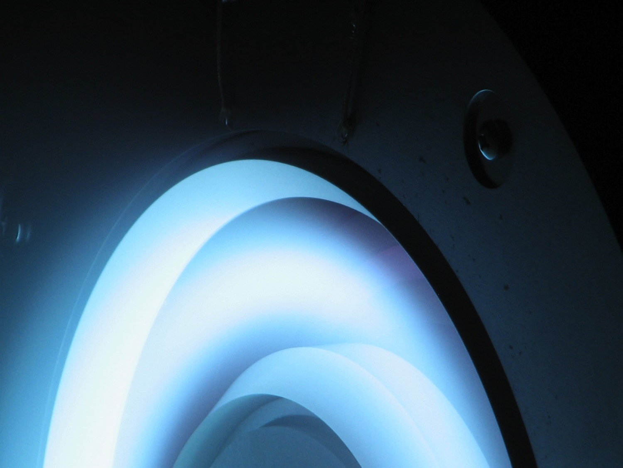

Magnetic Shielding in Hall Thrusters: Breakthrough Space Propulsion Technology for the 21st Century
Richard Hofer Jet Propulsion Laboratory, California Institute of Technology
Presented at the Michigan Institute for Plasma Science and Engineering (MIPSE) Seminar Series at the University of Michigan, Ann Arbor, MI
March 20, 2013
National Aeronautics and Space Administration
Jet Propulsion Laboratory
California Institute of Technology
Pasadena, California

Slide 2
Acknowledgements
The research described here is the result of a multi-year investigation of magnetic shielding in Hall thrusters conducted by the Electric Propulsion group at JPL.
Modeling: Ioannis Mikellides, Ira Katz
Experiments: Dan Goebel, Jay Polk, Ben Jorns
The research described here was carried out at the Jet Propulsion Laboratory, California Institute of Technology, under a contract with the National Aeronautics and Space Administration. Program sponsorship includes:
JPL R&TD program
JPL Spontaneous Concept program
NASA In-Space Propulsion project in the Space Technology Mission Directorate (STMD)

Slide 3
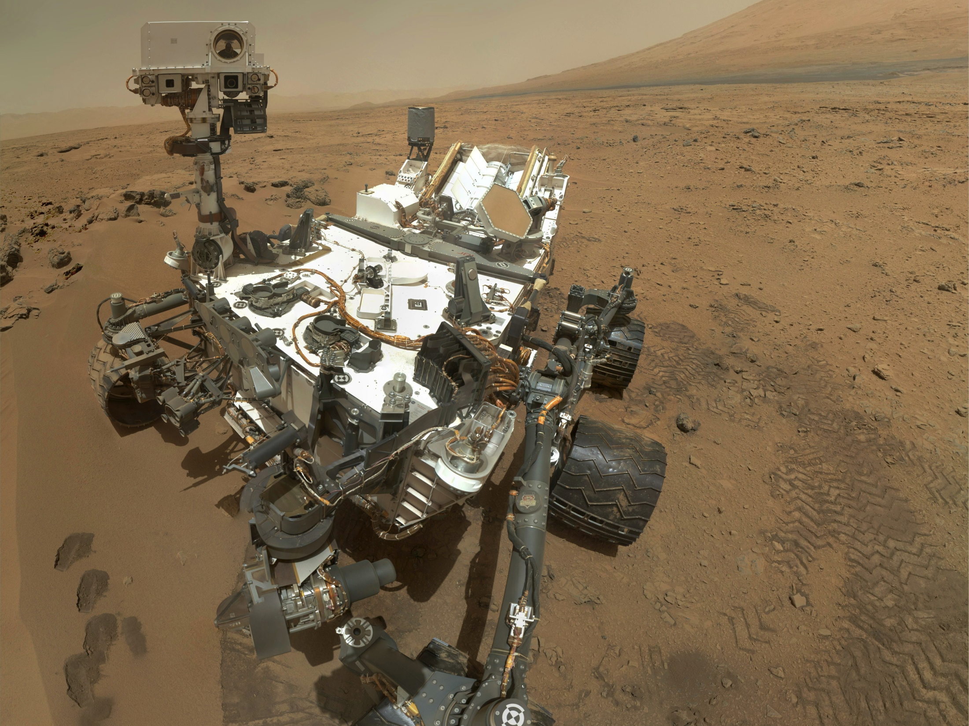
MSL

Slide 4
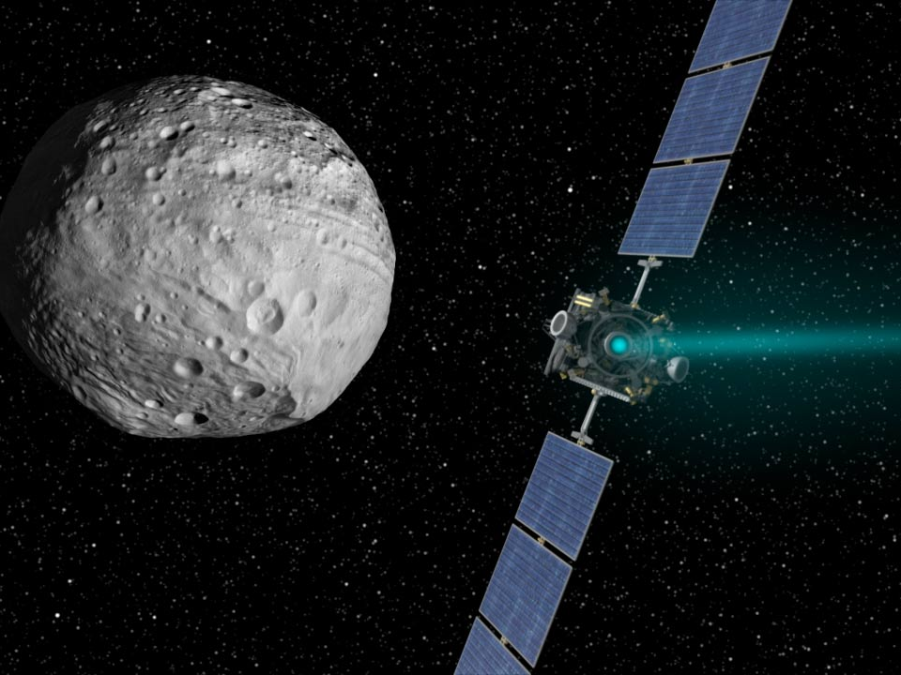
Dawn

Slide 5
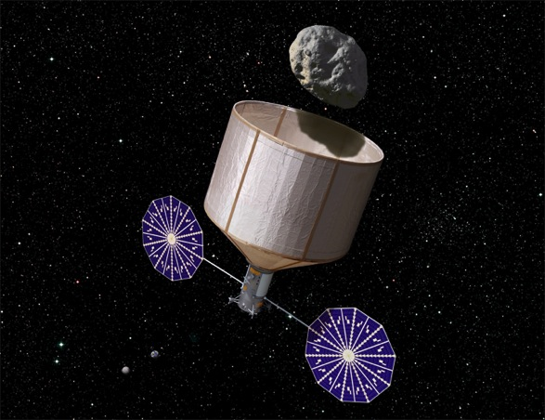
Asteroid Retrieval Mission

Slide 6
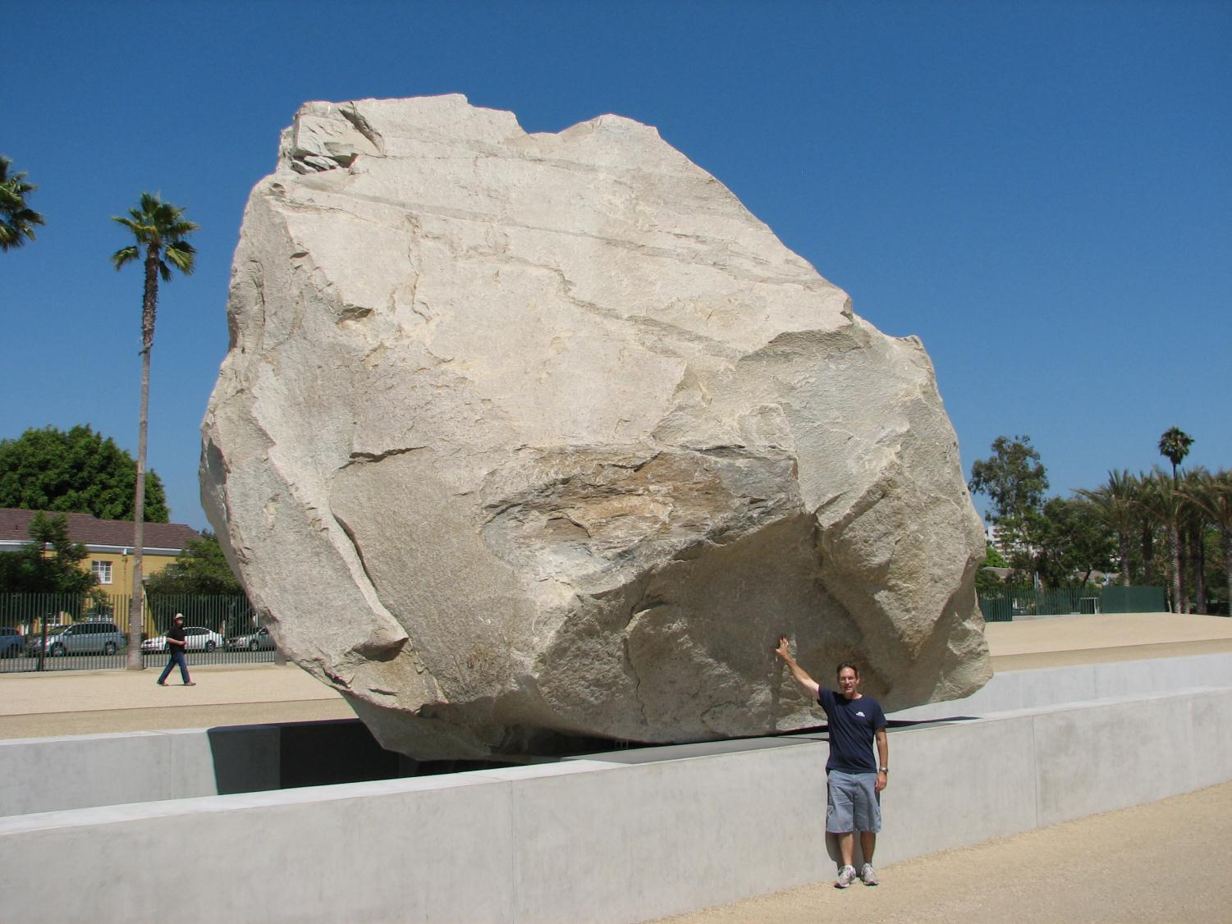
Asteroid Retrieval Mission
KISS Study
Concept
About the same mass
as the International
Space Station
6.5-m dia. 340-t “Levitated Mass”
at the LA County Museum of Art
40-kW SEP
is enabling
Brophy, J. and Oleson, S., "Spacecraft Conceptual Design for Returning Entire near-Earth Asteroids," AIAA-2012-4067, July 2012.

Slide 7
Historical Perspective
Electric Propulsion Missions
Notes:
New Horizons was launched on an Atlas V 551 with a Star 48 third stage. Wet mass of NH was 478 kg.

Slide 8
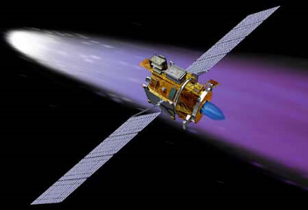
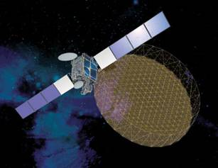
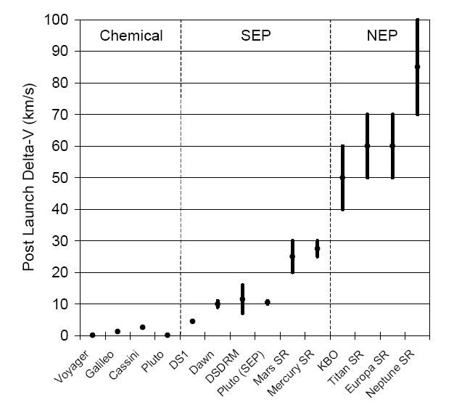
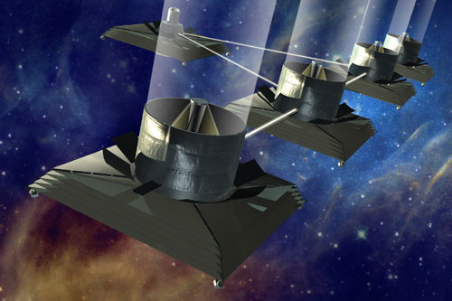
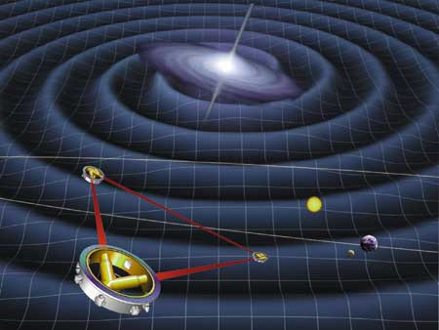
Uses for Electric Propulsion
High ΔV space missions
Low-disturbance station keeping
High precision spacecraft control

Slide 9
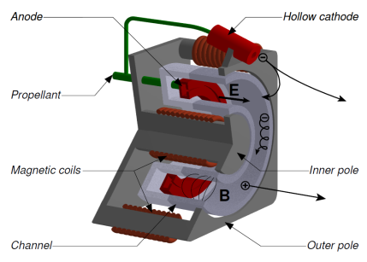
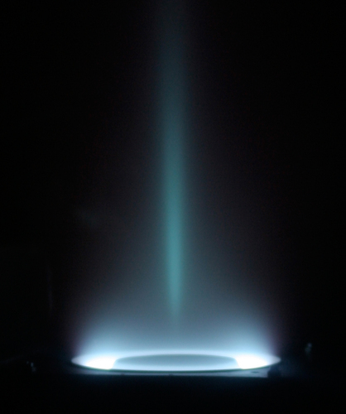
Hall Thruster Operation
Electrons from the cathode are trapped in an azimuthal drift by the applied electric (E) and magnetic fields (B).
Neutral propellant gas is ionized by electron bombardment.
Ions are accelerated by the electric field producing thrust.
Electrons from the cathode neutralize the ion beam.

Slide 10
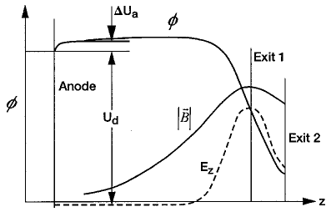
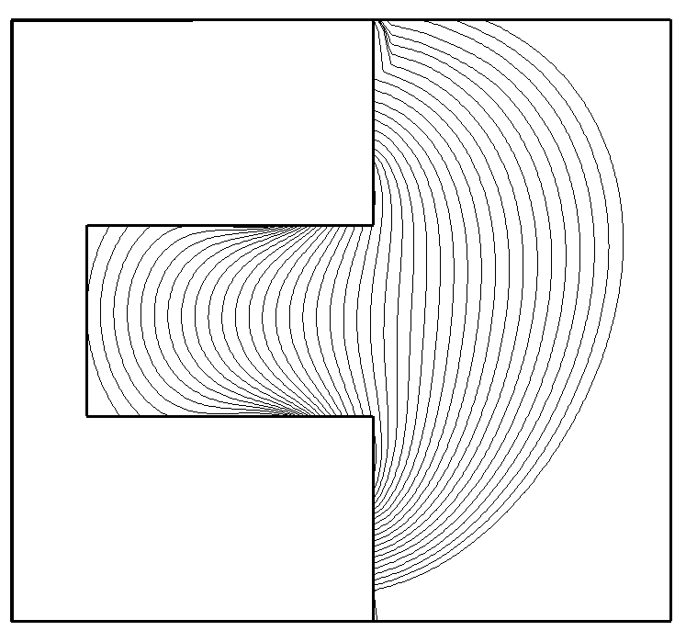
Conceptual Framework
Hall thrusters use an axial electric field and a radial magnetic field to accelerate ions and confine electrons.
The magnetic field intensity is sufficient to magnetize electrons while the cross-field configuration induces an azimuthal electron drift in the ExB direction.
These conditions severely restrict the axial electron mobility allowing for efficient ionization of the neutral propellant and the establishment of the self-consistent electric field, which must sharply rise in the region of maximum magnetic field intensity in order to maintain current continuity.
Due to their much greater mass, ions are unimpeded by the magnetic field but are accelerated by the electric field to produce thrust.
B_{r}
E_{z}
Distribution of E & B along the channel
(Kim, JPP 1998)
Magnetic field lines

Slide 11
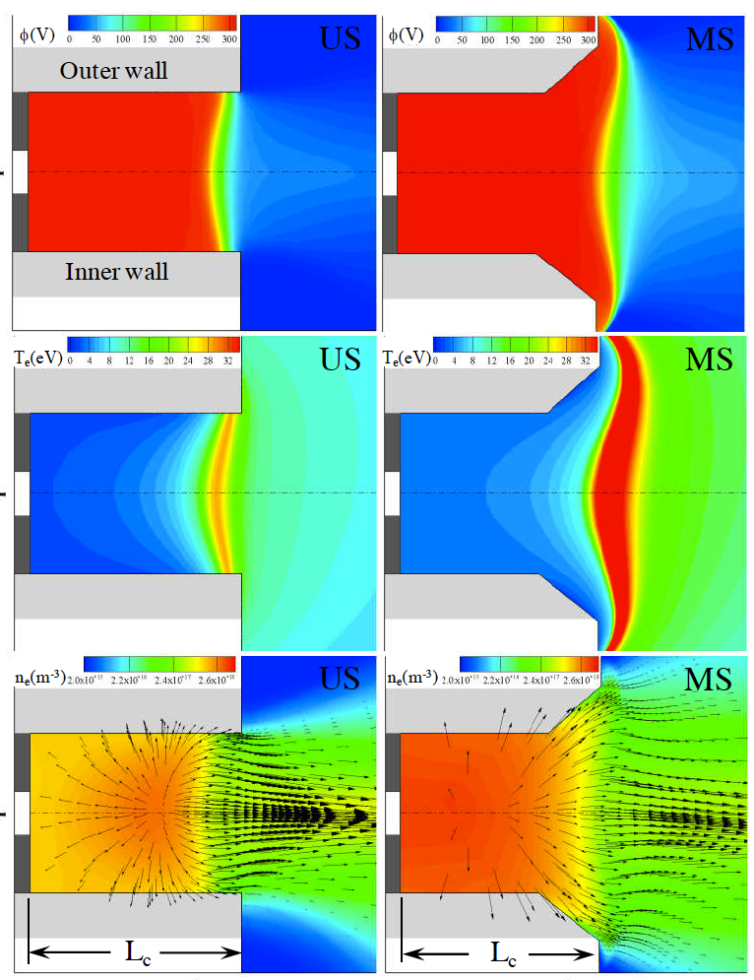
Fundamental properties of the Hall thruster discharge
Along field lines electrons stream freely
and the electric field is balanced by the electron pressure
The transverse B and ExB configuration implies a high Hall parameter
with the cross-field mobility reduced by ~1/Ω²
Isothermality
ϕ
“Thermalized Potential”
T_{e}
n_{e}

Slide 12
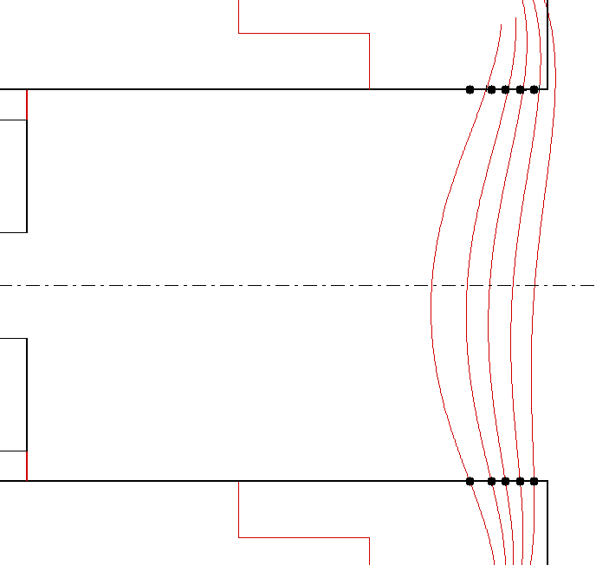
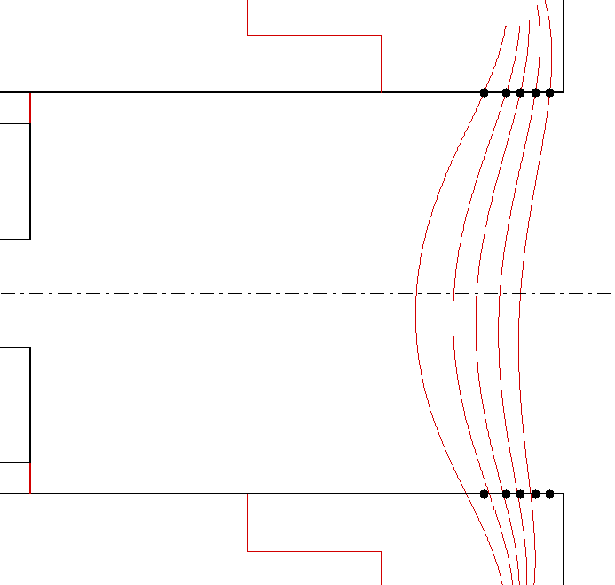
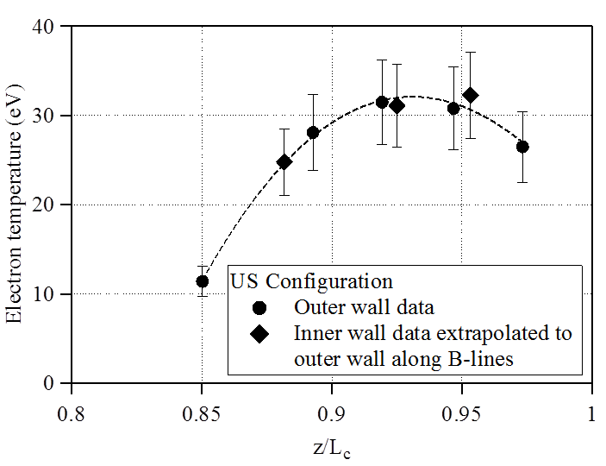

Experimental evidence demonstrating the isothermality of lines of force
Outer wall probe locations
Measured magnetic field lines
Inner wall probe locations
AIAA-2012-3789

Slide 13
Two big problems in Hall thruster research have remained unresolved for over 50 years
Cross-field e- mobility limiting performance
Still don’t understand, but we can measure it and model it in an ad hoc fashion
Developed design strategies to regulate the electron current and achieve high-performance
Discharge chamber erosion limiting life
Magnetic shielding essentially eliminates the primary failure mode
Advanced magnetic field topologies vastly improved the performance at high-Isp.
Hofer, R. R. and Gallimore, A. D., "High-Specific Impulse Hall Thrusters, Part 1: Influence of Current Density and Magnetic Field," Journal of Propulsion and Power 22, 4, 721-731 (2006).

Slide 14
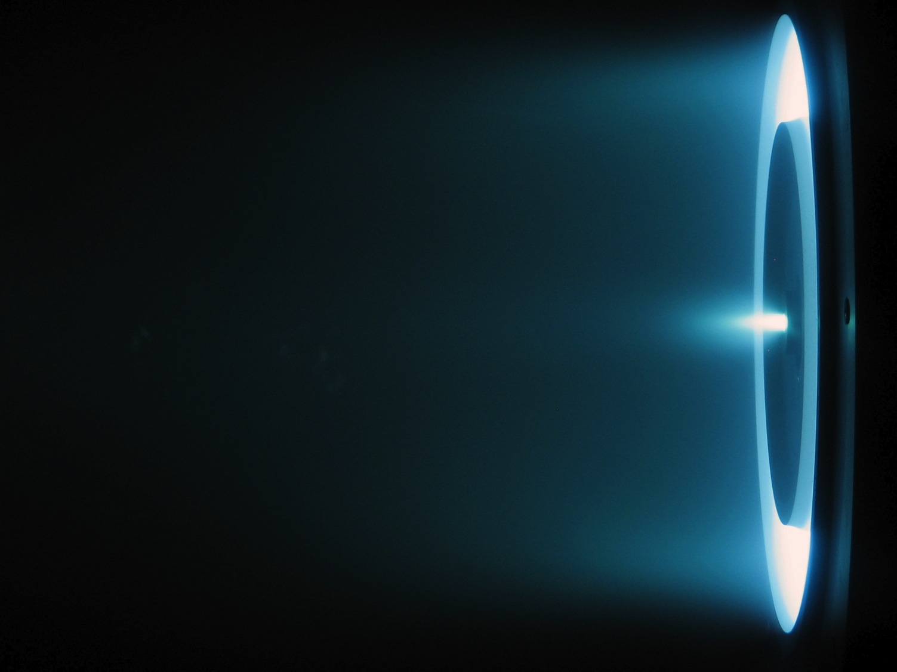
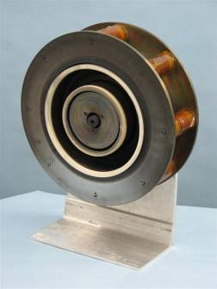
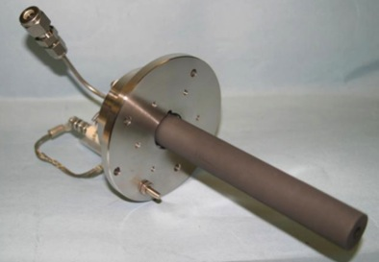
H6 Hall Thruster World’s Most Efficient Xenon Hall Thruster
The H6 is a 6 kW Hall thruster designed in collaboration with AFRL and the University of Michigan
The thruster was designed to serve as a high-performance test bed for fundamental studies of thruster physics and technology innovations
High-performance is achieved through advanced magnetics, a centrally-mounted LaB6 cathode, and a high uniformity gas distributor
Throttleable from 2-12 kW, 1000-3000 s, 100-500 mN
At 6 kW, 300 V (unshielded): 0.41 N thrust, 1970 s total Isp, 65% total efficiency
At 6 kW, 800 V (unshielded): 0.27 N thrust, 3170 s total Isp, 70% total efficiency
Highest total efficiency of a xenon Hall thruster ever measured.
H6
LaB₆ Hollow Cathode

Slide 15
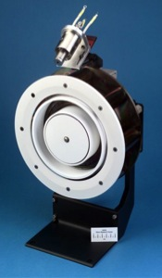
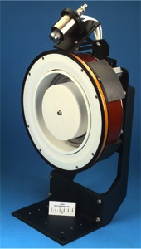
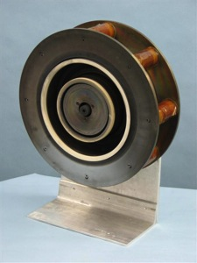
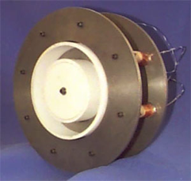
Performance has improved by ~40% since 1998
P5 (1998)
Haas, Gulczinski, Gallimore
NASA-173Mv1 (2001)
Hofer, Peterson, Gallimore
NASA-173Mv2 (2003)
Hofer, Gallimore
H6 (2006)
Hofer, Brown, Reid, Gallimore

Slide 16
Thruster life has been the major technology challenge in electric propulsion since 1959
Thruster life is a fundamental constraint on mission performance affecting
ΔV capability
NASA’s Dawn spacecraft carries 2 prime + 1 redundant thruster strings in order to meet the mission requirements.
Spacecraft dry mass
Cost
Reliability
Xenon propellant | 450 kg
Specific Impulse | 3100 s
Thrust | 92 mN
Burn time | 41.3 kh
Burn time through wear test | 30.4 kh
Life margin | 1.5
Allowable burn time per thruster | 20.2 kh
Number of required thrusters | 2

Slide 17
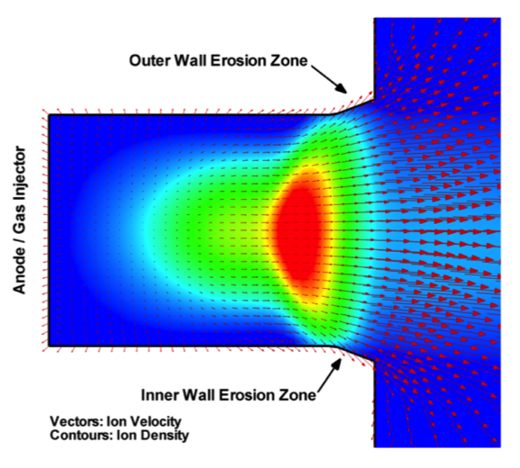
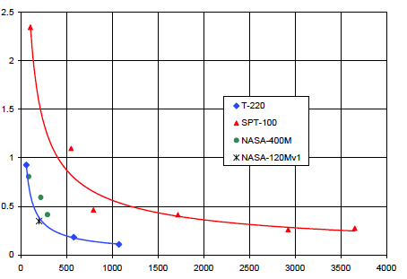
Discharge chamber erosion from high-energy ion impact is the primary life limiting failure mode in (unshielded) Hall thrusters
Redeposition Zone
Erosion Zone
As a fundamental constraint on mission performance, thruster life has been the major technology challenge in electric propulsion since 1959.
In Hall thrusters, high-energy ions sputter erode the ceramic walls of the discharge chamber, eventually exposing the magnetic circuit and leading to thruster failure.
The erosion rate decreases with time as the walls recess causing the angle of the ions with respect to the wall to become increasingly shallow. However, the erosion never stops and eventually the walls erode away and expose the magnetic circuit.
Until recently, thruster lifetime has always been the major hurdle towards widespread adoption of Hall thrusters on deep-space missions
AIAA-2005-4243
Volumetric Wear Rate (Arb)
Volumetric erosion rate decreases with time as the ion incidence angle becomes increasingly shallow. In traditional (unshielded) Hall thrusters, the erosion rate never decreases enough to avoid failure.
Time (h)
Notes:
Life chart: Two major problems in Hall thrusters: e- transport and erosion
E- transport unsolved, but methods to deal with it devised
Erosion continues to limit the application of Hall thrusters in deep-space applications

Slide 18
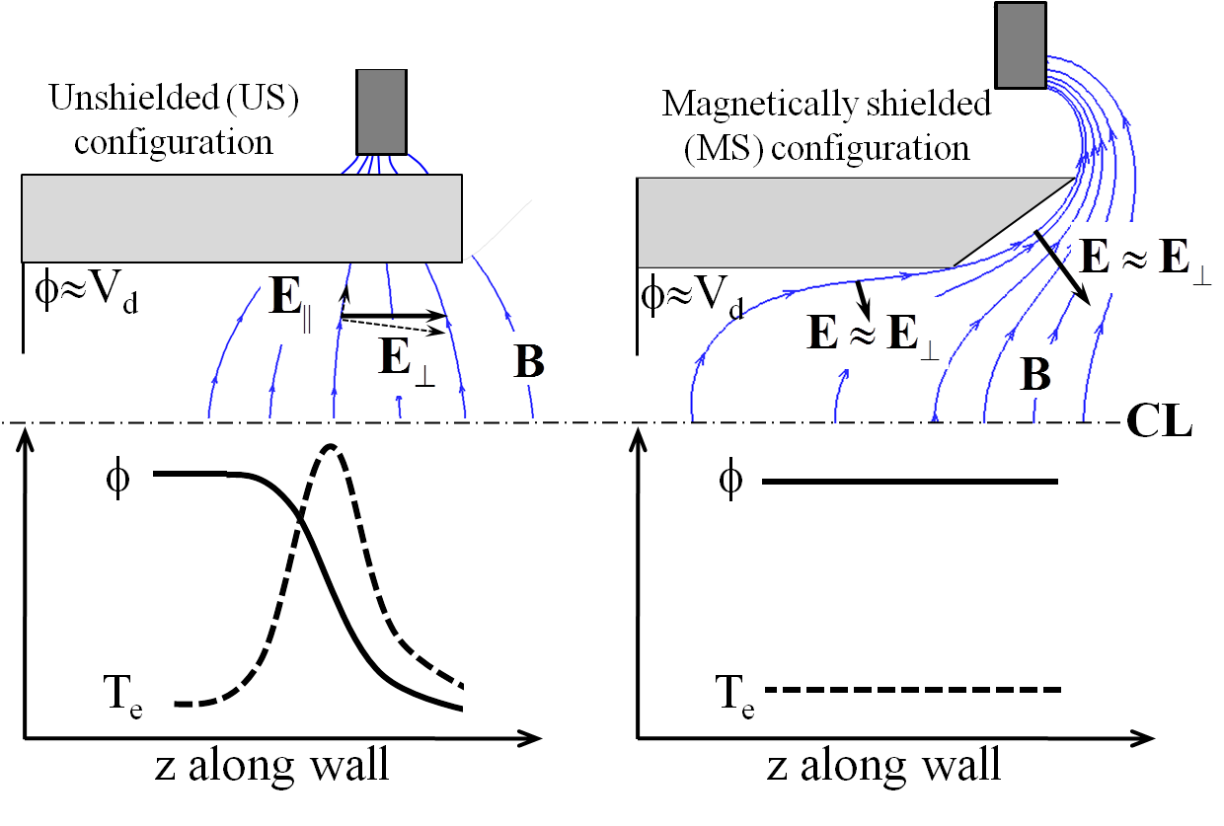
Magnetic Shielding in Hall Thrusters
What does it do? It eliminates channel erosion as a failure mode by achieving adjacent to channel surfaces:
high plasma potential
low electron temperature
How does it do it? It exploits the isothermality of magnetic field lines that extend deep into the acceleration channel, which marginalizes the effect of T_{e}×ln(n_{e}) in the thermalized potential.
Why does it work? It reduces significantly ALL contributions to erosion: ion kinetic energy, sheath energy and particle flux.
Status? Peer-reviewed, physics-based modeling and laboratory experiments have demonstrated at least 100X reductions in erosion rate.
Isothermal field lines
Thermalized potential
Mikellides, I. G., Katz, I., Hofer, R. R., and Goebel, D. M., "Magnetic Shielding of Walls from the Unmagnetized Ion Beam in a Hall Thruster," Applied Physics Letters 102, 2, 023509 (2013).

Slide 19
Physics-based design methodology utilized to modify the H6 in order to achieve magnetic shielding
Design modifications achieved through virtual prototyping
JPL’s Hall2De used to simulate the plasma and erosion
Infolytica’s Magnet 7 used to design magnetic circuit
Goal was to achieve magnetic shielding while maintaining high performance
Mikellides, I. G., Katz, I., Hofer, R. R., and Goebel, D. M., "Design of a Laboratory Hall Thruster with Magnetically Shielded Channel Walls, Phase III: Comparison of Theory with Experiment," AIAA-2012-3789, July 2012.

Slide 20
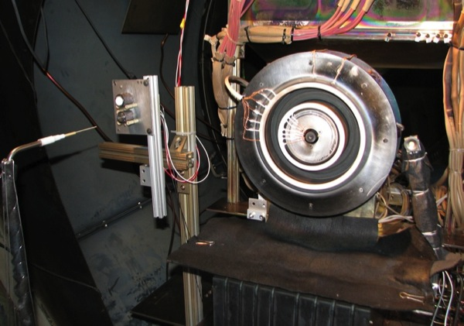
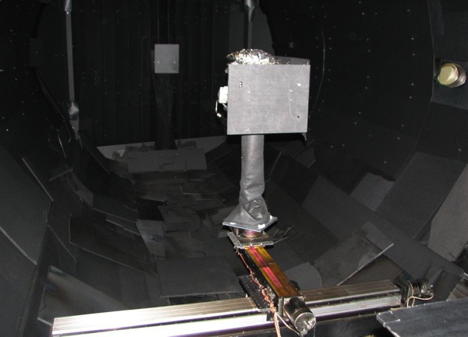
Experimental Apparatus
H6 Hall thruster
Owens Chamber at JPL
3 m diameter X 10 m long
Graphite lined
P ≤ 1.6x10⁻⁵ Torr
Sixteen diagnostics for assessing performance, stability, thermal, and wear characteristics
Thrust stand
Current probes for measuring discharge current oscillations
Thermocouples & thermal camera
Far-field ExB, RPA, & emissive probes
Near-field ion current density probe
High-speed discharge chamber Langmuir and emissive probes (φ,T_{e})
Flush-mounted wall probes (φ,T_{e}, j_{i})
Coordinate measuring machine (CMM) for wall profiles
Quartz Crystal Microbalance (QCM) for measuring carbon backsputter rate
Residual Gas Analyzer (RGA)
3-axis Gaussmeter
Digital camera

Slide 21
Discharge chamber configurations

Slide 22
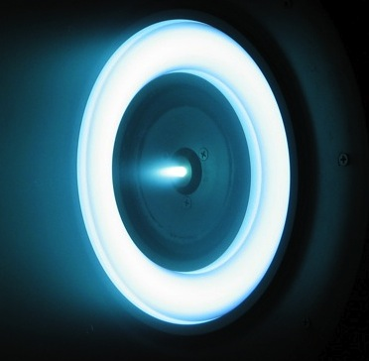
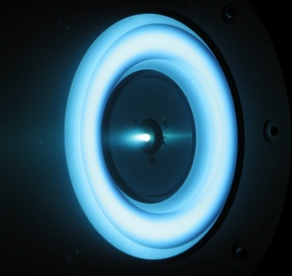
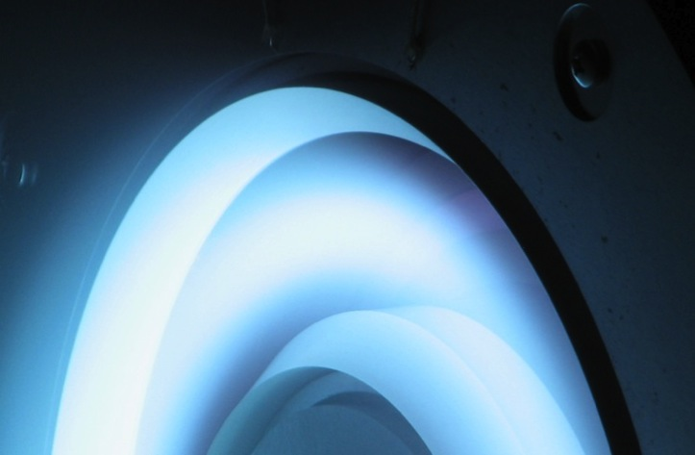
Visual observations provide qualitative evidence of reduced plasma-wall interactions
US
MS
Distinct differences in the structure of the plasma in the discharge chamber were observed.
These qualitative observations, were our first indication that plasma-wall interactions were reduced and magnetic shielding had been achieved.
MS
Anode is visible when viewed along the wall.

Slide 23
High-performance maintained in the magnetically shielded configuration
US: 401 mN, 1950 s, 63.5%
MS: 384 mN (-4.2%), 2000 s (+2.6%), 62.4% (-1.7%)
Efficiency analysis shows:
Thrust decreased due to higher plume divergence angle (+5°)
Isp increased due to higher fraction of multiply-charged ions (Xe⁺ decreased from 76% to 58%)
Stability: Discharge current oscillation amplitude increased 25%. Global stability of the discharge maintained
Thermal: Ring temperatures decreased 60-80 °C (12-16%).

Slide 24
Stable operation maintained in the magnetically shielded configuration
Discharge current oscillation amplitude increased 25%
Global stability of the discharge maintained
80 kHz modes observed, possibly linked to cathode oscillations

Slide 25
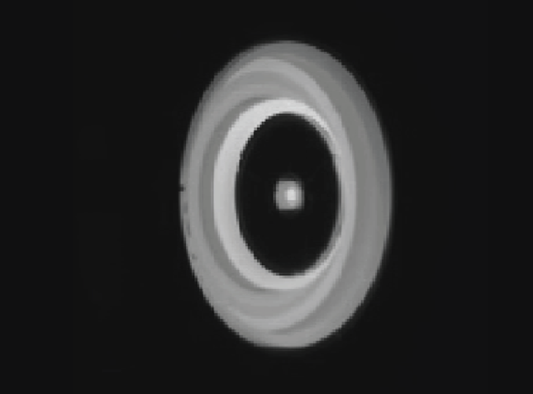
Decreased insulator ring temperatures measured with the magnetically shielded configuration
Thermal characteristics essentially unchanged and may have been improved as indicated by a 60-80 °C (12-16%) decrease in insulator ring temperatures.
Thermal camera imagery

Slide 26
Plasma conditions measured at the wall are consistent with the predictions of magnetic shielding theory
In the MS configuration, plasma potential was maintained very near the anode potential, the electron temperature was reduced by 2-3X, and the ion current density was reduced by at least 2X.

Slide 27
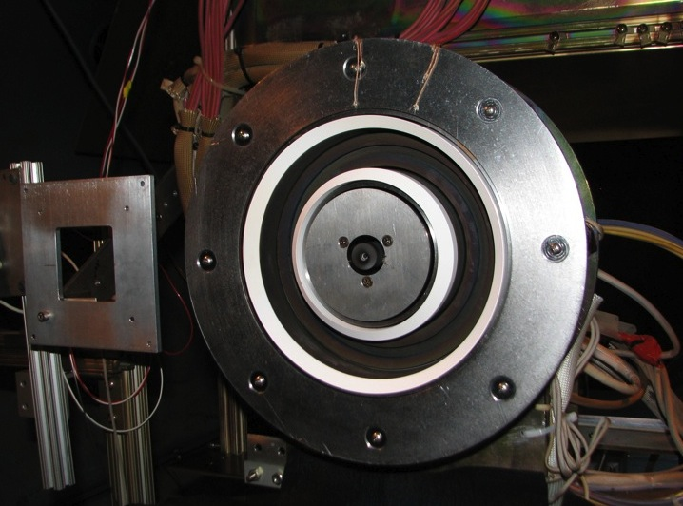
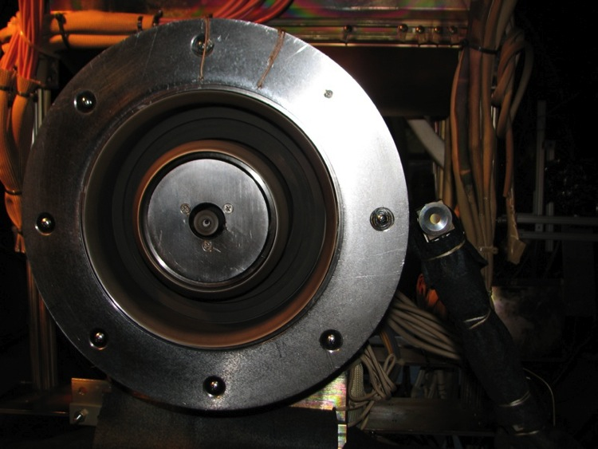
After MS testing, insulator rings mostly covered in carbon deposits
MS Before Testing
MS After Testing
QCM measured carbon backsputter rate of 0.004 μm/h (~2000X less than US erosion rates)
Second qualitative observation that magnetic shielding had been achieved.

Slide 28
Inner insulator rings from the various trials
US magnetic circuit with MS wall geometry
Wall chamfering was NOT the sole cause of the MS case erosion rate reduction

Slide 29
Wall erosion in Hall thrusters
Erosion of the boron nitride walls in Hall thrusters is due to high-energy ion bombardment
Ions gain energy through potential drops in the bulk plasma and through the wall sheath
Xe+
Boron nitride wall
Potential
BN
Sheath
Pre-Sheath/Bulk Plasma

Slide 30
Carbon deposition and erosion rates
Carbon backsputter rate
O(1-10) over 50-200 eV
“Undisturbed”
erosion rate
Xe+
C
C
BN
BN (w/ C)
Interpretation of carbon deposits complicated by uncertainty in the sputter yields of carbon and BN under low-energy Xe impact
BN and C thresholds are in the range of 25-50 eV. The maximum ion energy for the MS case was 36 eV.
If Y_{BN}/Y_{C} is O(1-10) near threshold, erosion rate was less than or equal to 0.004 – 0.08 μm/h, a reduction of 100-2000X from the US case.

Slide 31
Coordinate Measuring Machine (CMM) Erosion Rates
8.5 μm/h
US case
Net deposition
MS case
US rates are typical of Hall thrusters at beginning-of-life (BOL).
MS rates are below the noise threshold of the CMM.

Slide 32
Wall erosion rates reduced by 1000X as computed from directly measured plasma properties at the wall
1000X
(min)
Uncertainty dominated by the ion current density (50%) and sputter yield (30%), resulting in a combined standard uncertainty of 60%.
Within this uncertainty, US erosion rates are consistent with the CMM data.
For MS case, ion energy is below 30.5 eV threshold (Rubin, 2009) for all but two locations on the inner wall where 10-13 eV electron temperatures were measured.
Still, the MS erosion rates are at least 1000X below the US case.
Erosion rates calculated this way are independent of facility effects!

Slide 33
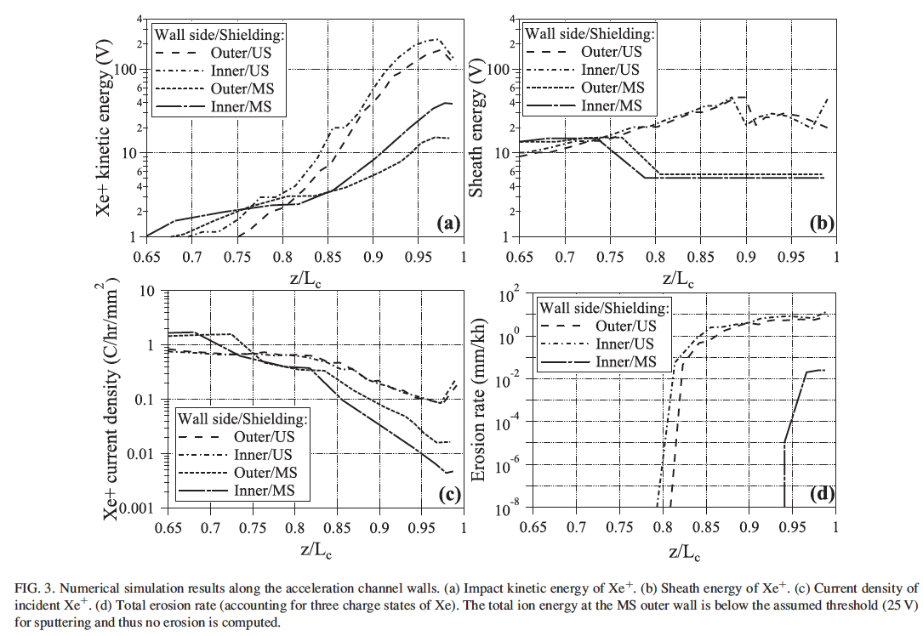
2D numerical simulation results
Mikellides, I. G., Katz, I., Hofer, R. R., and Goebel, D. M., "Magnetic Shielding of Walls from the Unmagnetized Ion Beam in a Hall Thruster," Applied Physics Letters 102, 2, 023509 (2013).

Slide 34
Various rates encountered in these experiments and other relevant cases

Slide 35
Throughput range achievable with magnetically shielded Hall thrusters
Throughput capability of magnetically shielded Hall thrusters is literally off the charts
Possible cathode limitations can be addressed with redundant cathodes
Only magnetically shielded Hall thrusters have the throughput capability to meet the most demanding deep-space missions without flying extra strings
H6MS: from erosion rate measurements scaled relative to lower SPT-100 limit of 30 kg/kW.
NEXT: 113 kg/kW demonstrated to date. 141 kg/kW estimated.
NSTAR: 102 kg/kW demonstrated.
BPT-4000: 100 kg/kW demonstrated. 400 kg/kW estimated by vendor.
SPT-100: poles exposed at 30 kg/kW. 93 kg/kW demonstrated.

Slide 36
Summary of MS Investigations at 2000 s Isp
In a controlled A/B comparison, sixteen diagnostics were deployed to assess the performance, thermal, stability, and wear characteristics of the thruster in its original and modified configurations.
Practically erosion-free operation has been achieved for the first time in a high-performance Hall thruster
Plasma measurements at the walls validate our understanding of magnetic shielding as derived from the theory. The plasma potential was maintained very near the anode potential, the electron temperature was reduced by a factor of 2 to 3, and the ion current density was reduced by at least a factor of 2.
Measurements of the carbon backsputter rate, wall geometry, and direct measurement of plasma properties at the wall indicate the wall erosion rate was reduced by 1000X relative to the unshielded thruster and by 100X relative to unshielded Hall thrusters late in life.
Collectively, these changes effectively eliminate wall erosion as a life limitation or failure mode in Hall thrusters, allowing for new space exploration missions that could not be undertaken in the past.

Slide 37
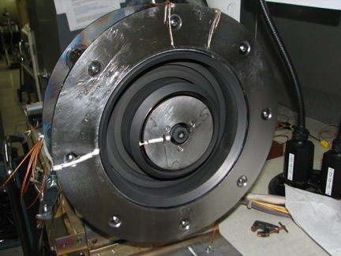
Magnetic Shielding Investigations
2010-2011 program established the first principles of magnetic shielding through a rigorous program of physics-based modeling and detailed laboratory experiments
Mikellides, I. G., Katz, I., Hofer, R. R., and Goebel, D. M., "Magnetic Shielding of Walls from the Unmagnetized Ion Beam in a Hall Thruster," Applied Physics Letters 102, 2, 023509 (2013).
Success of this program implied substantial growth capability for this technology to advanced Hall thruster designs
Metallic wall thrusters – demonstrated late 2011. Patent pending.
High-power thrusters – NASA-300MS re-design (in progress)
High-voltage thrusters – 2012-2013
High-power density
H6C

Slide 38
Metallic-walled hall thrusters

Slide 39

H6MS experiments implied significantly reduced plasma-wall interactions. Is the wall material still important?
An extensive set of modeling and experiments have shown that magnetic shielding radically reduces plasma-wall interactions
If the plasma is not interacting with the walls, then why make them out of boron nitride?
Boron nitride was originally chosen for low secondary electron yield and low sputtering yield
If these are negligible, then why bother with BN?
We obtained funding from JPL R&TD to investigate other wall materials
Selected graphite for the first demonstration
Simple, lightweight, strong, easy to make, …..
Alternative materials will likely also work, provided the material can tolerate wall temperatures 400-600 C.

Slide 40
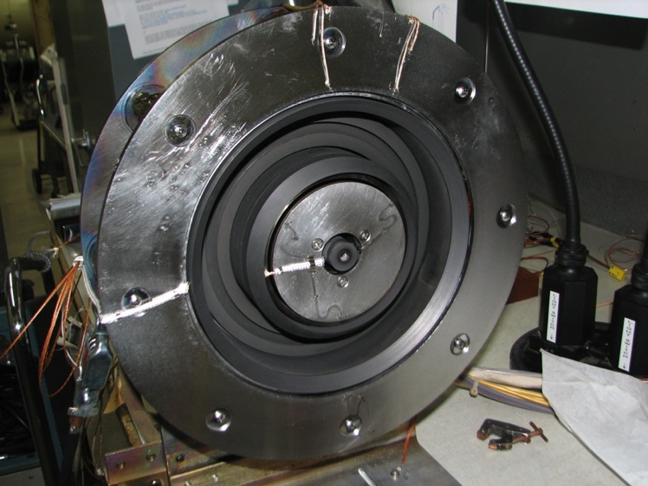
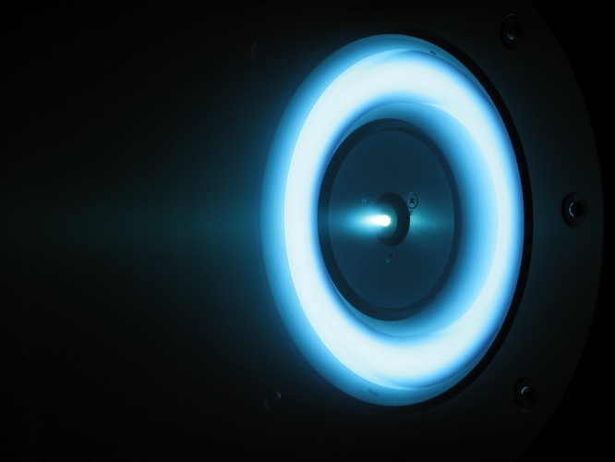
Carbon Wall Thruster (H6C)
The Black Edition

Slide 41
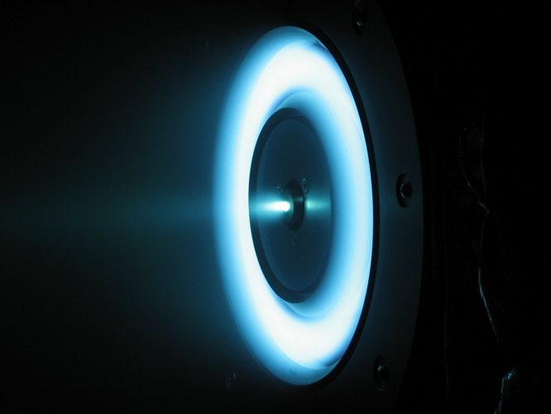
H6C Operation
Looks identical to the H6MS
- plasma is still off the walls

Slide 42
H6C Performance
Performance within 1-2% of BN wall results
Rings float at 5-10 V below the anode potential
Stable operation identical to the H6MS with BN rings observed

Slide 43
Discharge current oscillations unchanged with wall material

Slide 44
Reduction in wall temperature observed due to emissivity increase with graphite and a lower deposited power

Slide 45
H6C Implications
Elimination of the boron nitride rings has many advantages for existing Hall thrusters
Lower cost
Simpler thruster fabrication….especially for large high power thrusters
Easier structural design for vibe/launch loads
This innovation could lead to higher power densities
Thruster power level likely now limited by anode dissipation (radiation)
Entire channel can now be made of a single piece of material at anode potential
(large radiator)
Anticipate factor of 2 to 3 times higher power in a given thruster size
Same 5 kW thruster today turns into a 10-15 kW thruster when needed
New thruster designs and capabilities need to be explored

Slide 46
High-Voltage, magnetically-shielded hall thrusters

Slide 47
Pathfinding studies of high-voltage operation demonstrated discharge stability, performance, and thermal
Studies conducted in 2012 at JPL were the first to operate a magnetically-shielded thruster at discharge voltages >400 V
Demonstrated stable discharges up to 800 V, 12 kW
Performance mappings demonstrated high-efficiency operation
Thermal capability demonstrated over time scales of a few hours

Slide 48
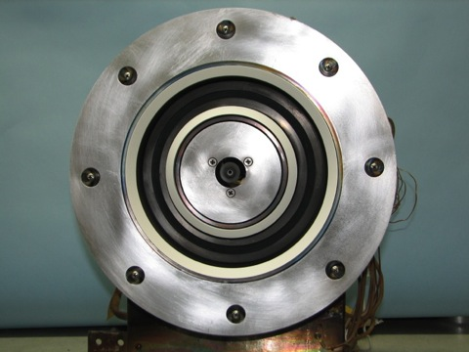
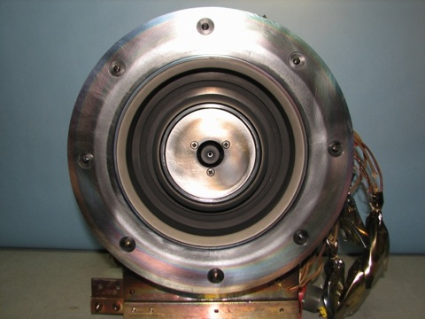
Magnetic shielding at 3000 s Isp demonstrated after 100 h wear test
MS Before Testing
MS After Testing
Insulator rings largely coated with backsputtered carbon after 113 h wear test at 800 V, 9 kW
QCM measured carbon backsputter rate of 0.0025 μm/h
Erosion rates ~100-1000X lower than unshielded Hall thrusters

Slide 49
backup

Slide 50
The H6 Design Process (or, How Most Hall Thrusters are Designed)
In 2006, the H6 design process was a combination semi-empirical design rules and physics-based design.
Plasma-based solvers were not used to design for performance or life.

Slide 51
Towards an End-to-End Physics-Based Hall Thruster Design Methodology
Insertion of plasma and erosion models is a major step forward in the design process that will lead us to an end-to-end physics-based design methodology

Slide 52
What does eliminating life as a constraint on mission performance enable?
Reduce mission risk by eliminating the dominant thruster failure mode
Provides the game changing performance required to enable missions that cannot otherwise be accomplished
HEOMD missions: human exploration of NEOs and Mars, reusable tugs for cargo transportation and pre-deployment of assets
SMD missions: Mars Sample Return, Comet Sample Return, Multiple Asteroid Rendezvous and Return, and Fast Outer Planet missions.
DoD Operationally Responsive Space missions
All-electric orbit transfers from GTO to GEO (commercial, DoD)
Reduce propulsion system costs by at least one third relative to the State-of-the-Art (>$20M per string)
Offers the possibility to realize ultra-high-performance systems
Increase power density by 2-10X
Increase specific impulse from 2,000 to 4,000-10,000 s

Slide 53
Near-field ion current density
Wider plume but higher ion current

Slide 54
Multiply-charged ion content significantly increased in the MS configuration

Slide 55
Multiply-charged ions
Charges states greater than 4 possibly detected for the first time

Slide 56
Performance Model

Slide 57
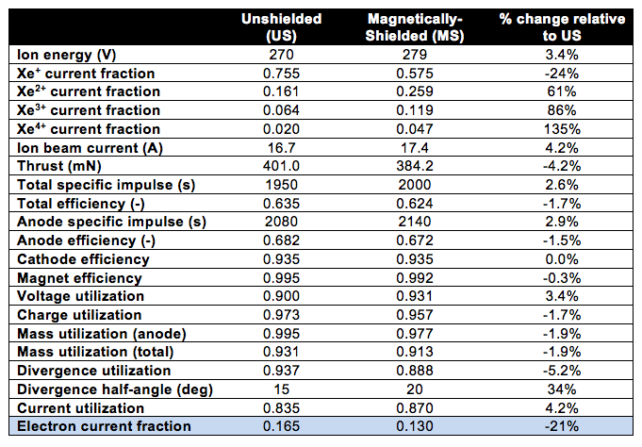
Efficiency Analysis
Large increases in multiply-charged ion content and decreased plasma-wall interactions resulted in a 21% reduction in the cross-field electron transport in the magnetically-shielded configuration.

Slide 58
Centerline Plasma Diagnostics
Plasma potential and electron temperature inside the discharge chamber

Slide 59
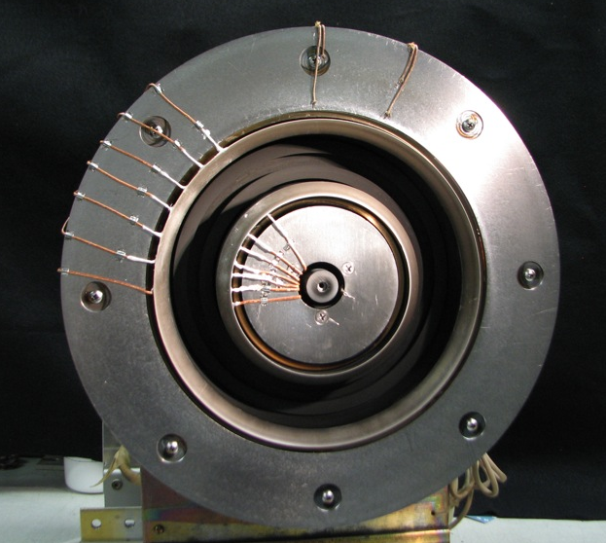
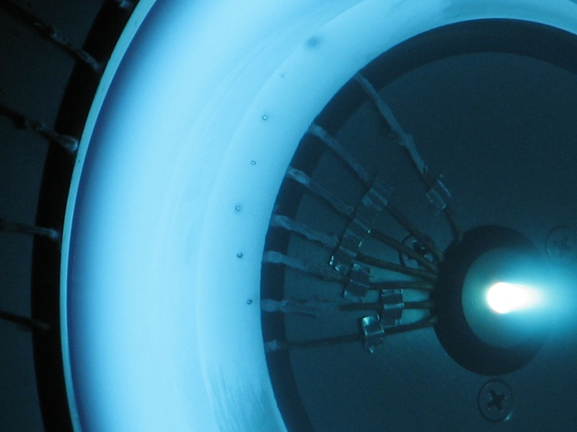
Wall Probes

Slide 60
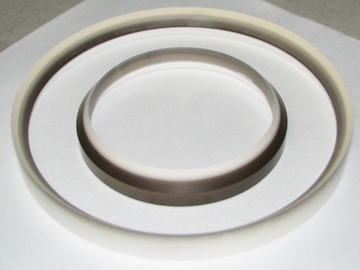
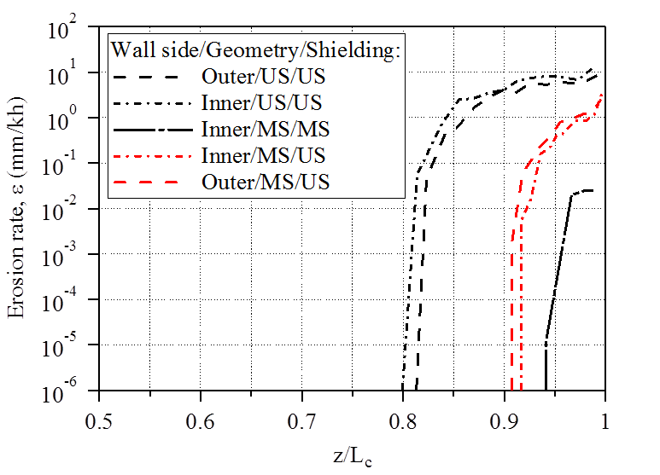
Insulator rings after testing with the US magnetic circuit and MS geometry rings
Simulation results
Geometry changes alone were not the sole contributor to the orders of magnitude reduction in erosion rate
Simulations show only a 4-8X reduction for this case relative to the US configuration (consistent with US erosion rates over life of thruster)

Slide 61
References
Hofer, R. R. and Gallimore, A. D., "High-Specific Impulse Hall Thrusters, Part 1: Influence of Current Density and Magnetic Field," Journal of Propulsion and Power 22, 4, 721-731 (2006).
Hofer, R. R. and Gallimore, A. D., "High-Specific Impulse Hall Thrusters, Part 2: Efficiency Analysis," Journal of Propulsion and Power 22, 4, 732-740 (2006).
Goebel, D. M., Watkins, R. M., and Jameson, K. K., "LaB₆ Hollow Cathodes for Ion and Hall Thrusters," Journal of Propulsion and Power 23, 3, 552-558 (2007).
Mikellides, I. G., Katz, I., Hofer, R. R., Goebel, D. M., De Grys, K. H., and Mathers, A., "Magnetic Shielding of the Acceleration Channel in a Long-Life Hall Thruster," Physics of Plasmas 18, 033501 (2011).
Goebel, D. M., Jameson, K. K., and Hofer, R. R., "Hall Thruster Cathode Flow Impact on Coupling Voltage and Cathode Life," Journal of Propulsion and Power 28, 2, 355-363 (2012).
Mikellides, I. G., Katz, I., and Hofer, R. R., "Design of a Laboratory Hall Thruster with Magnetically Shielded Channel Walls, Phase I: Numerical Simulations," AIAA Paper 2011-5809, July 2011.
Hofer, R. R., Goebel, D. M., Mikellides, I. G., and Katz, I., "Design of a Laboratory Hall Thruster with Magnetically Shielded Channel Walls, Phase II: Experiments," AIAA-2012-3788, 2012.
Mikellides, I. G., Katz, I., Hofer, R. R., and Goebel, D. M., "Design of a Laboratory Hall Thruster with Magnetically Shielded Channel Walls, Phase III: Comparison of Theory with Experiment," Presented at the 48th AIAA Joint Propulsion Conference, AIAA-2012-3789, Atlanta, GA, July 29 - Aug. 1, 2012.
Hofer, R. R., Goebel, D. M., and Watkins, R. M., "Compact High-Current Rare-Earth Emitter Hollow Cathode for Hall Effect Thrusters," United States Patent No. 8,143,788 (Mar. 27, 2012).
Goebel, D. M., Hofer, R. R., and Mikellides, I. G., "Metallic Wall Hall Thrusters," US Patent Pending, 2013.
Mikellides, I. G., Katz, I., Hofer, R. R., and Goebel, D. M., "Magnetic Shielding of Walls from the Unmagnetized Ion Beam in a Hall Thruster," Applied Physics Letters 102, 2, 023509 (2013).

