Slide 1
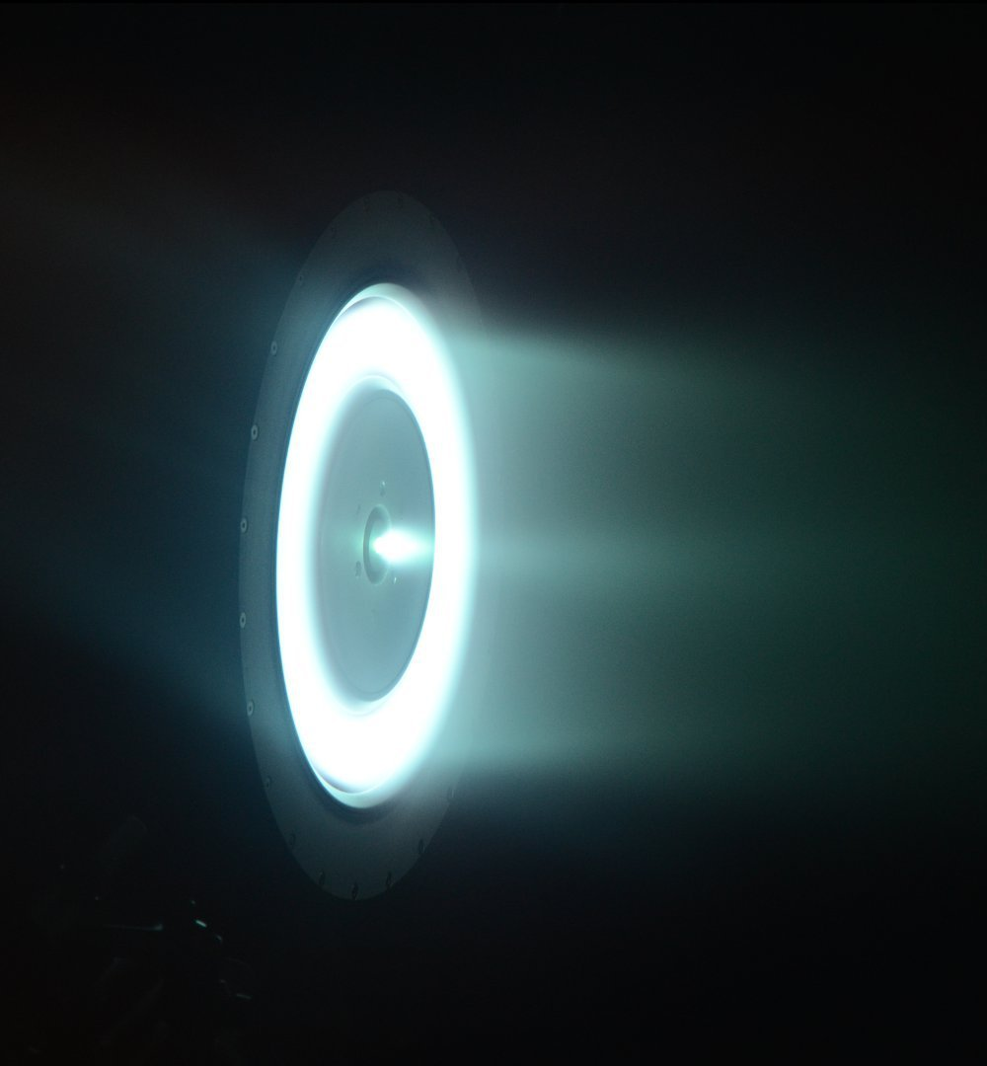

Plasma Diagnostics Package (PDP) for Studying High-Power Hall Thrusters in Flight
National Aeronautics and Space Administration
Wensheng Huang
PDP Principal Investigator / Sensor Lead
NASA Glenn Research Center
Present at Michigan Institute for Plasma Science and Engineering (MIPSE)
Ann Arbor, Oct 2, 2019
www.nasa.gov
Approved for public release; distribution is unlimited

Slide 2
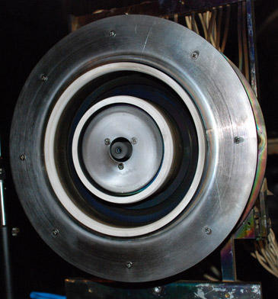
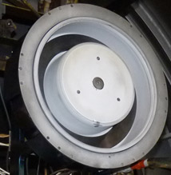
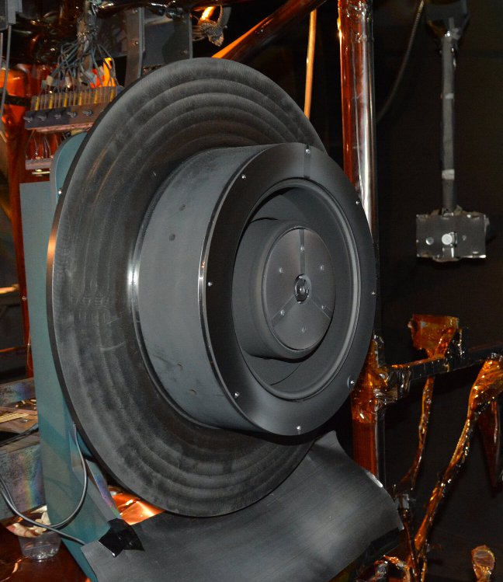
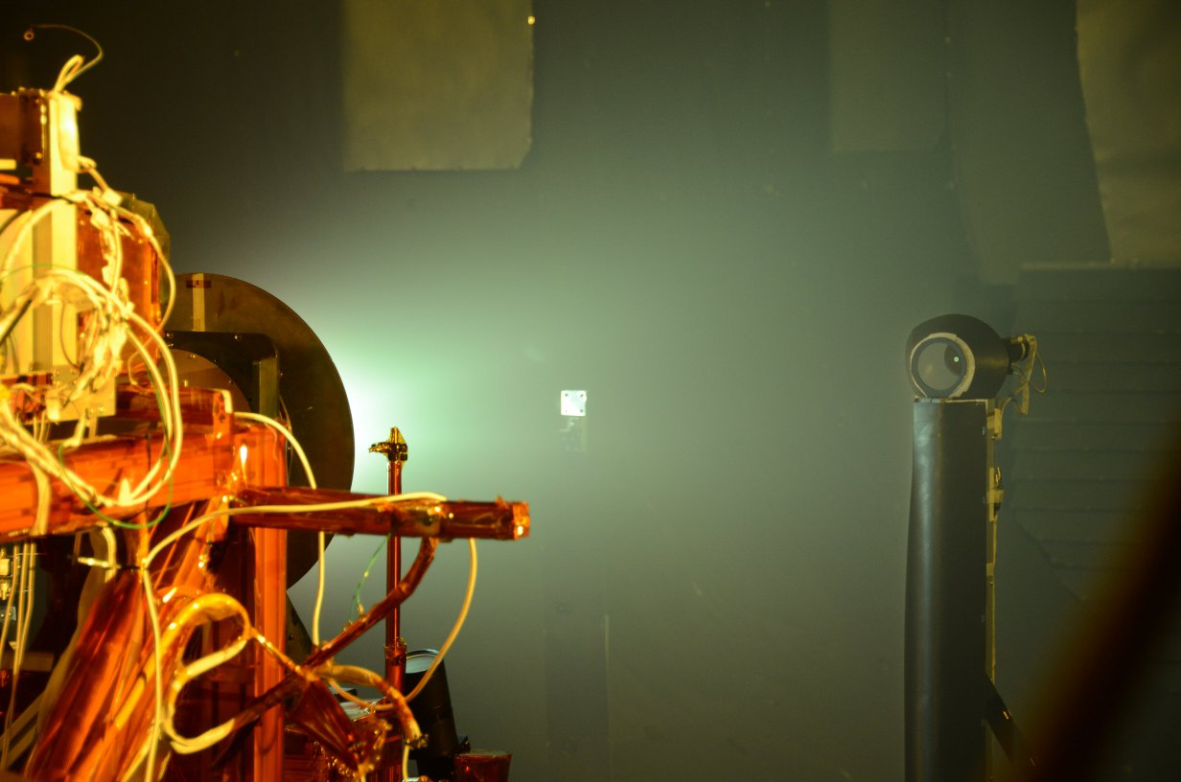
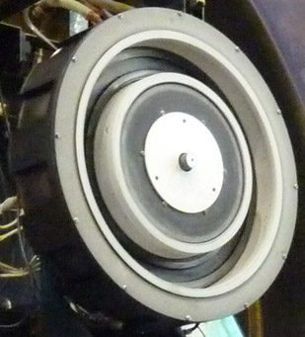
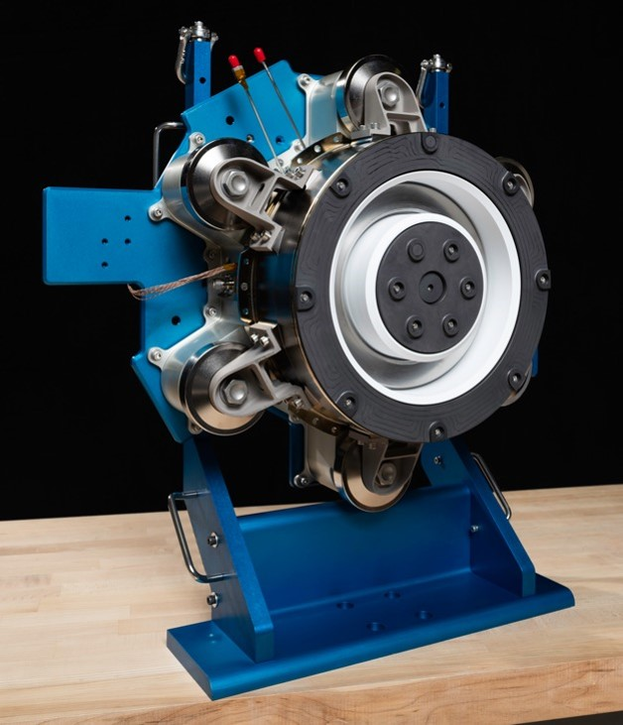
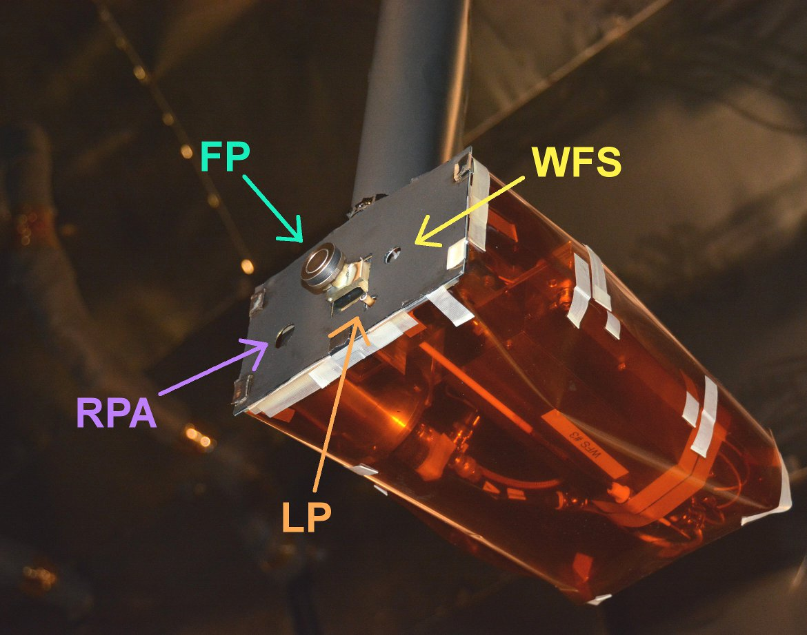
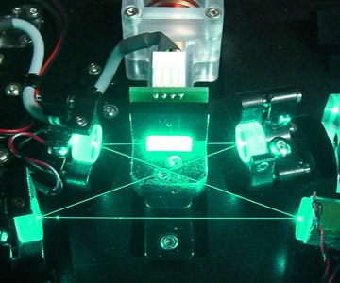
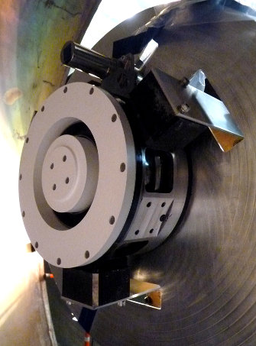
About Me

Slide 3
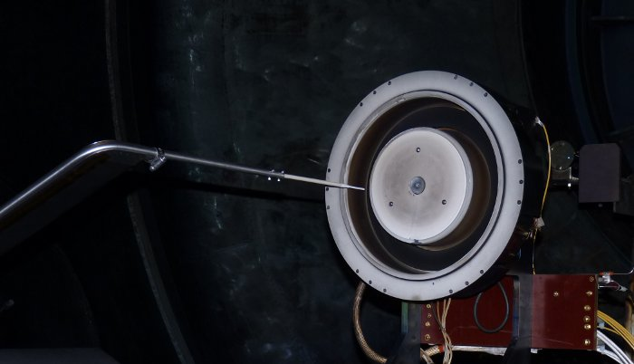
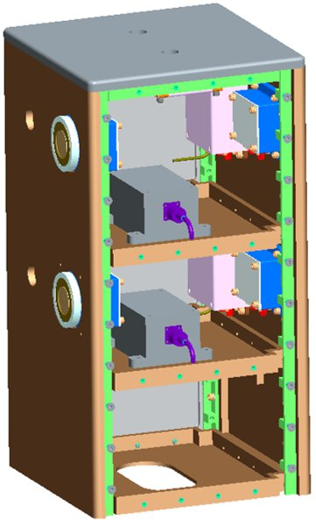
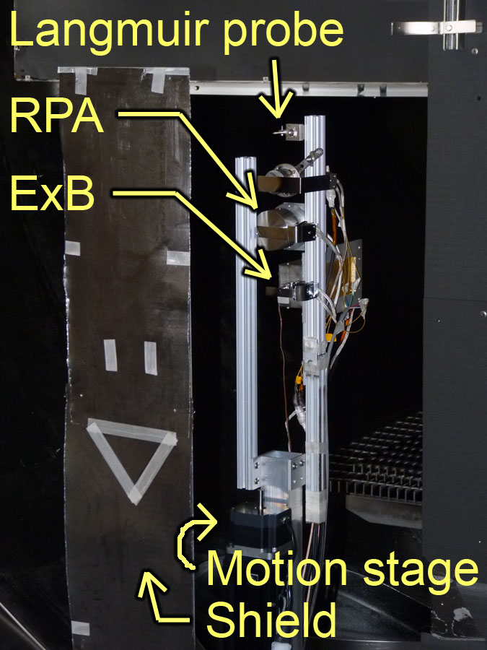
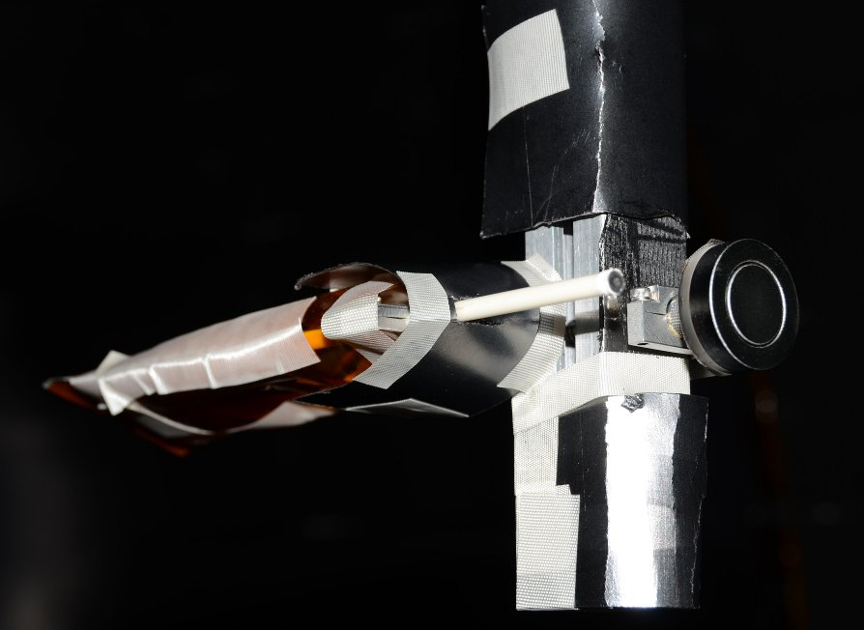
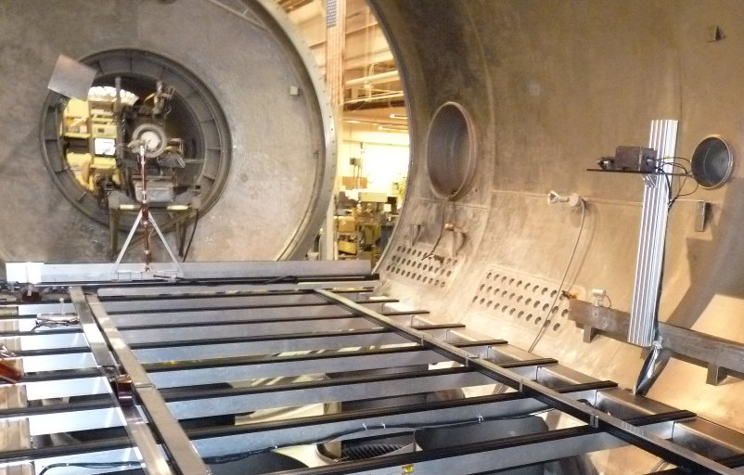
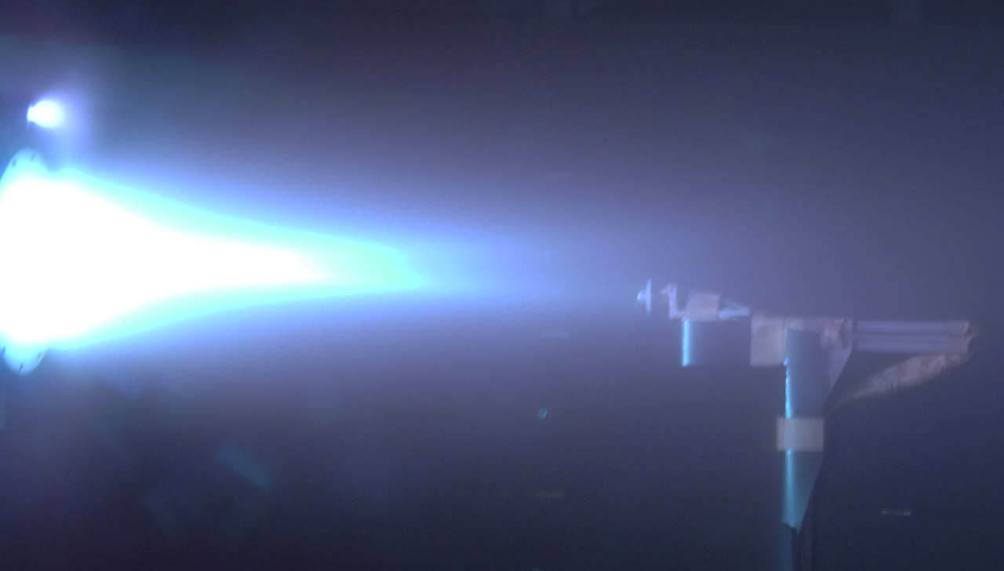
The path to PI
PI = Principal Investigator, a.k.a. the person with the burning question that needs to be answered
2011
2017+
2011-2018

Slide 4

Part 1 Outline
What is Plasma Diagnostics Package?
  How did it come about?
  What question does it answer?
  What are the measurements and approach?
  Where are we going to measure?
  How will we use PDP?

Slide 5
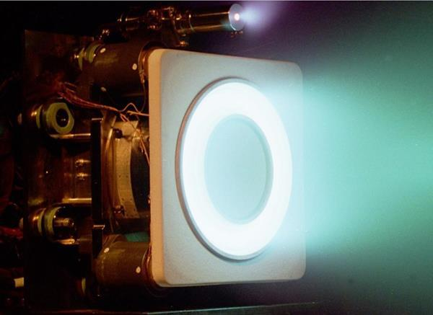
The story started with HERMeS
In 2012, NASA Space Technology Mission Directorate initiated the development of high-power long-life Hall thruster: 12.5-kW HERMeS
  3x power and 50% higher discharge voltage compared to state-of-the-art thruster (XR-5)
  Many times longer wear life
Must be developed with extensibility to higher power thruster (Mars transport)
  Need on-orbit data to provide feedback for the next design
HERMeS
XR-5

Slide 6
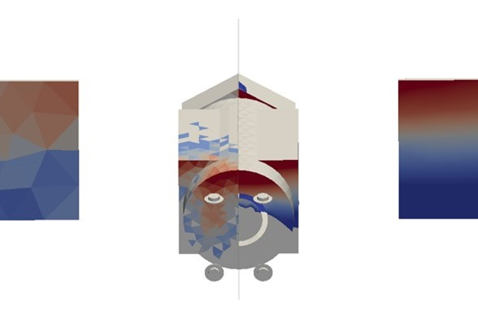
What will the plasma plume of HERMeS do to the spacecraft?
Flight thruster system has built-in basic telemetry but no plume data
Large uncertainties in plasma plume predictions
  Leads to large stay out zones and protective shielding
Strong evidence from earlier probe packages of differences between ground test and on-orbit behaviors
Need to fly a probe package:
Solar Electric Propulsion (SEP) Plasma Diagnostics Package
HallPlume2D
/ Coliseum
TURF

Slide 7
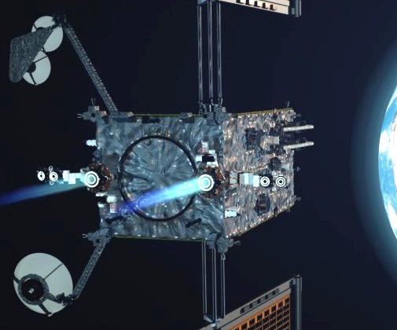
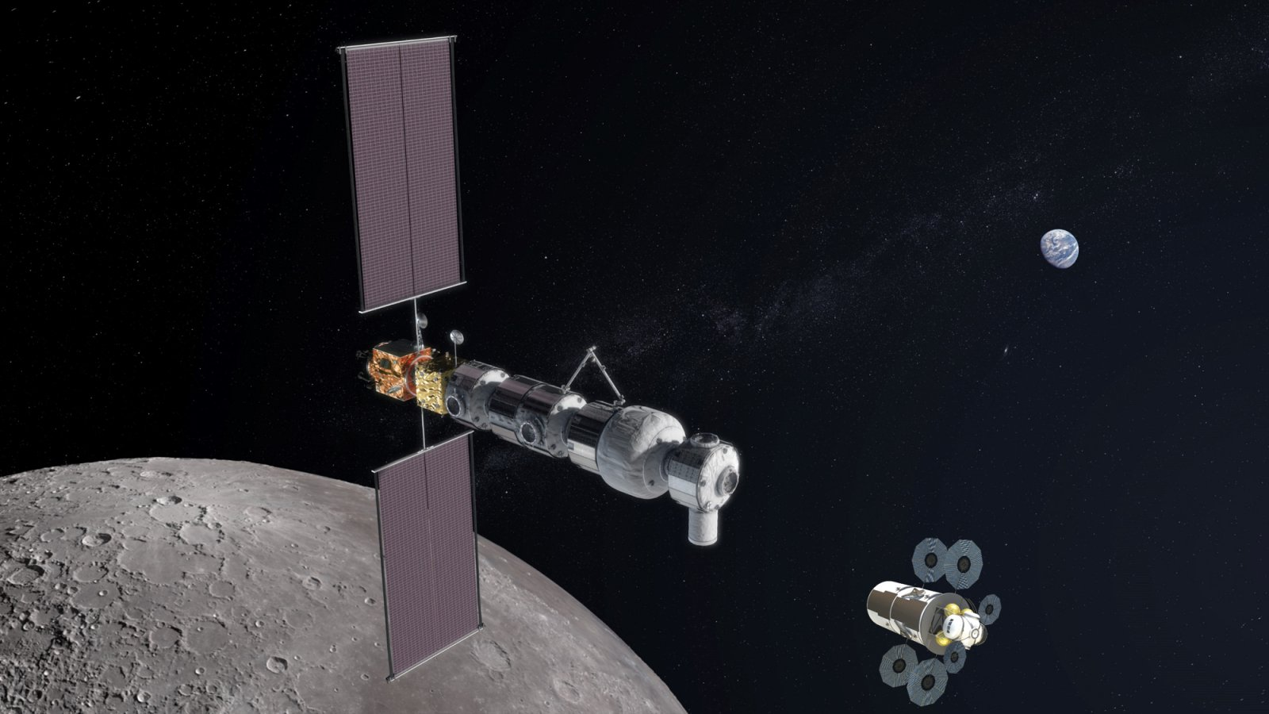
Then came the Power and Propulsion Element
PPE, the first element of a Lunar Gateway for return of human presence to the Moon
  Provides power and propulsion to the rest of Gateway
Feature two AEPS Hall thrusters (flight version of HERMeS) and four lower power Hall thrusters
Gateway
Maxar PPE Concept

Slide 8
And a partnership was born
SEP and PPE have common interest: we both want to know what will the plume of the Hall thrusters do to the spacecraft
  SEP wants to know more about the science for future Hall thruster design
  PPE wants to know if any changes to spacecraft operation may be needed

Slide 9
What are we going to measure?
(Audience exercise)

Slide 10


Stakeholder Exercises
Initial set:
33 pieces of data
33 instruments

Slide 11
What is PDP going to measure?
# | Name of Data | Location | Notional Sensor
1 | Discharge current waveforms | IPS PPU | Discharge current sensor
2 | Time-resolved ion flux, electron temperature, plasma potential | TPA | Planar probe (PP)
3 | Ion energy distribution | TPA | RPA and WAPA
4 | Ion charge state | TPA | Charged species spectrometer (ground test only)
5 | Time-resolved/energy-filtered ion characteristics | TPA | HS-RPA
IPS: Ion Propulsion System
PPU: Power Processing Unit
TPA: Thruster Probe Assembly
HS-RPA: High Speed Retarding Potential Analyzer
WAPA: Wide-Angle Potential Analyzer
Focus on data that improve plasma model so we can make better predictions
Want data at different time and angular locations with respect to the thruster
Want data in ground test to serve as baseline

Slide 12
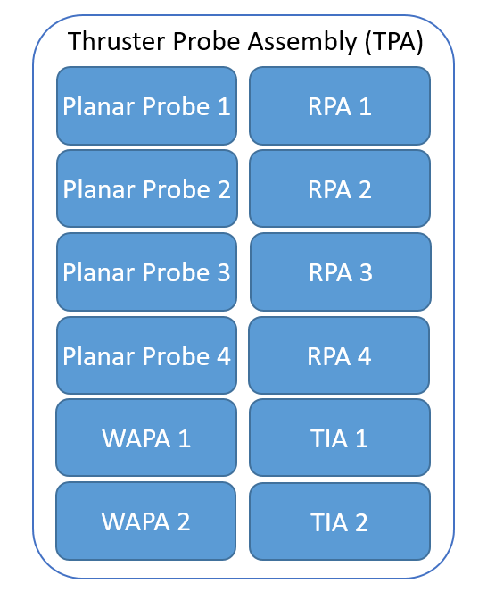
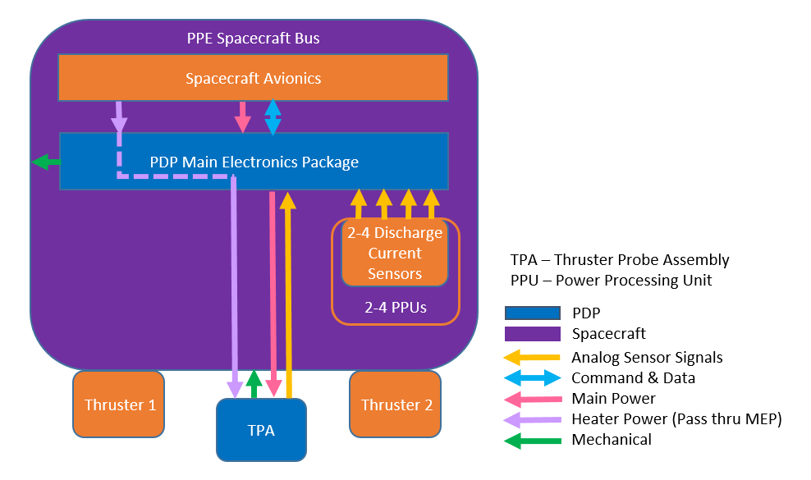
Architecture: What is PDP’s approach to taking the measurements?
TIA: Trans-Impedance Amplifier, let’s you take high speed RPA measurements
MEP: Main Electronics Package, the brain

Slide 13
Where are we going to measure?
Let’s have a closer look at the thruster
Advanced Electric Propulsion System (AEPS)
  Built by Aeroject Rocketdyne using HERMeS as a blueprint
  Four main throttle points from 300 V to 600 V
  Magnetic shielding topology
  Centrally mounted cathode, 7% cathode flow fraction
  Cathode tied to thruster body
Discharge voltage, V | Discharge power, kW
300 | 6.25
400 | 8.33
500 | 10.42
600 | 12.50

Slide 14
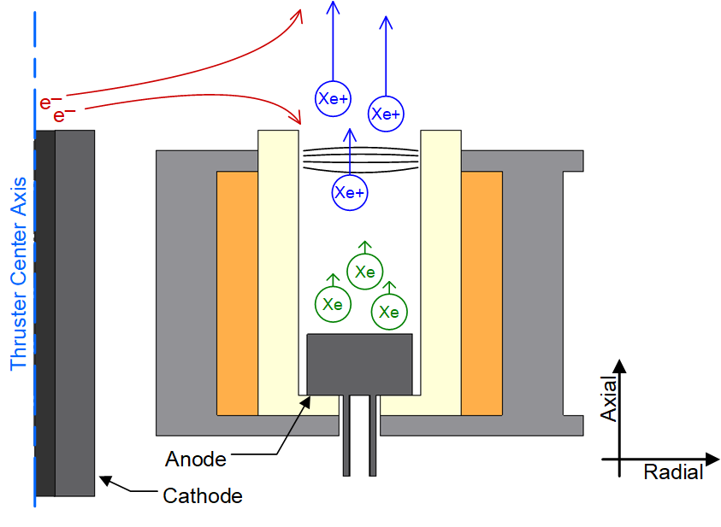
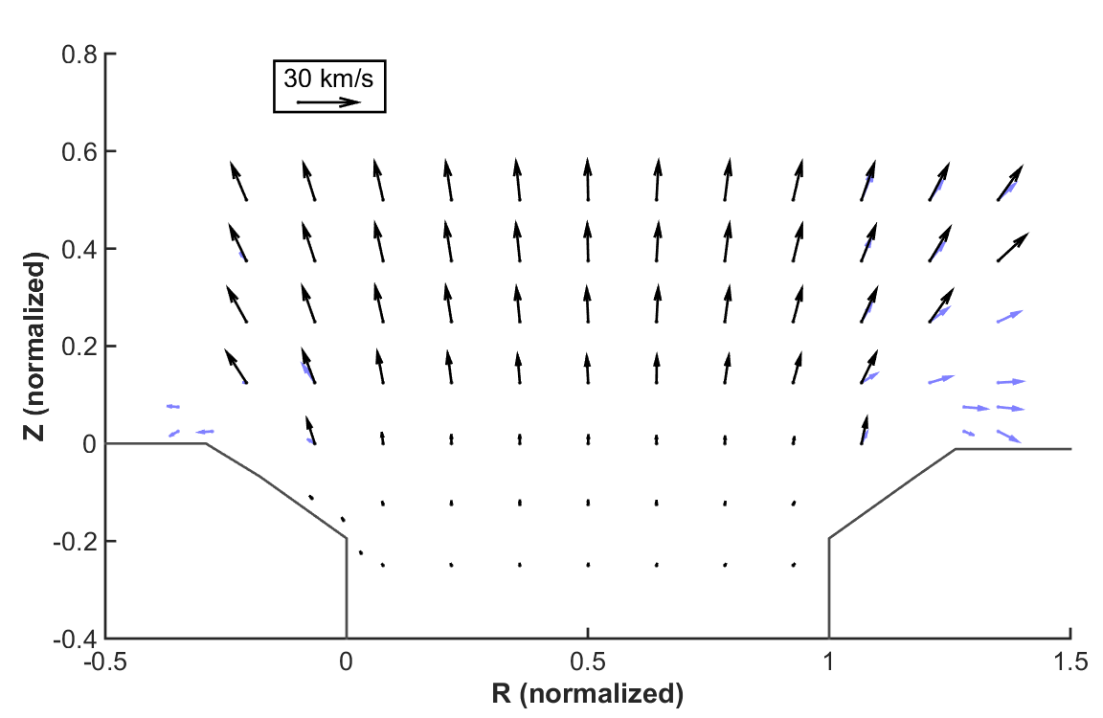
Hall thrusters can spray plasma side ways
Simple diagram of Hall thruster
Ion Velocity Vector from HERMeS
300 V, 6.25 kW
Generally a cold plasma: Ions and electrons are not thermalized with each other

Slide 15
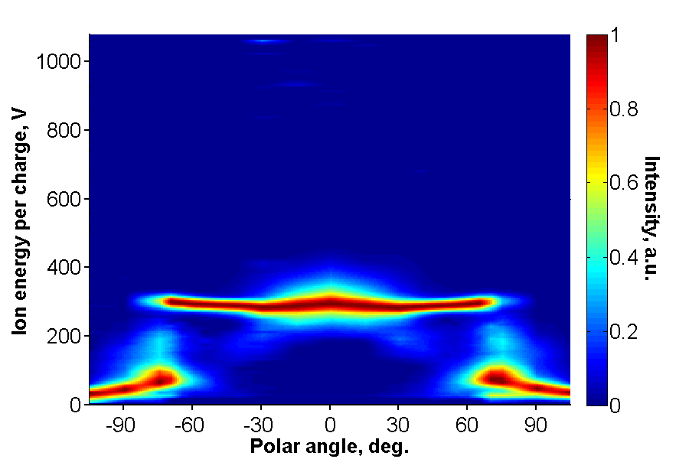
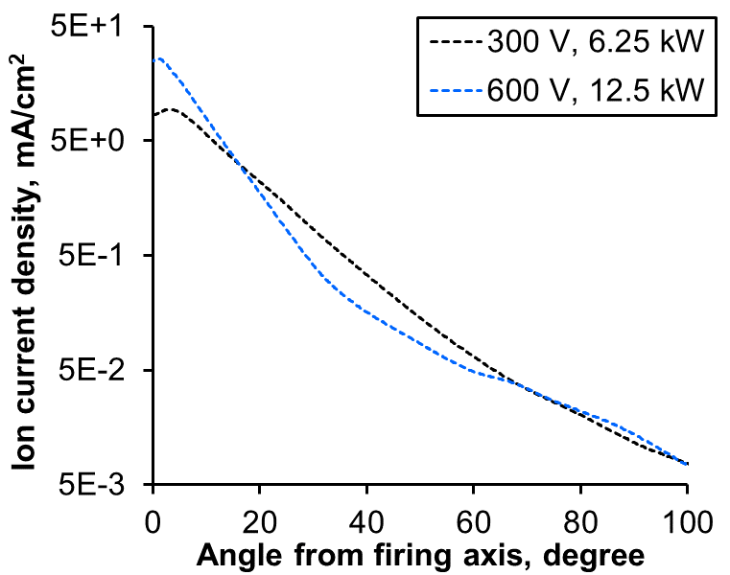
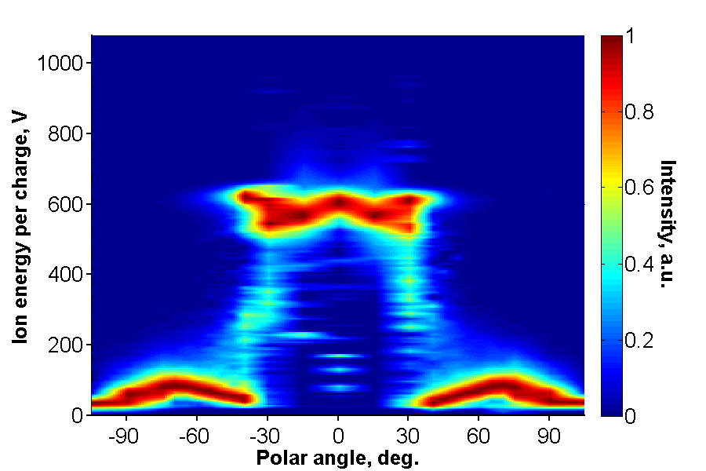
What does that plasma plume look like?
300 V, 6.25 kW
600 V, 12.5 kW

Slide 16
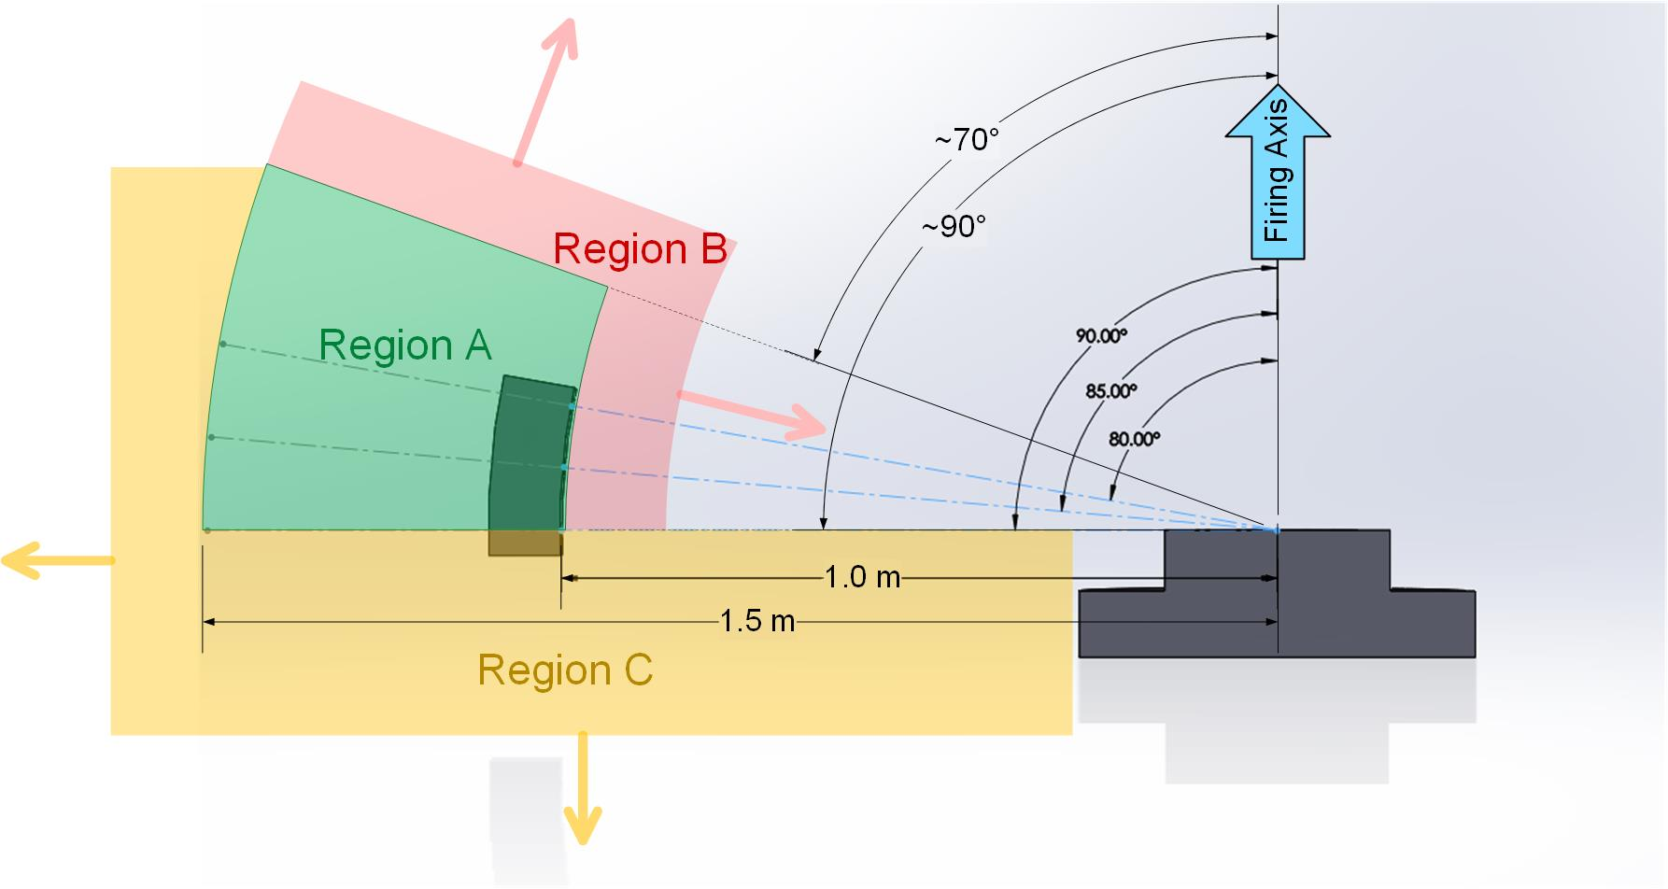
Where are we going to measure? Ideally..

Slide 17
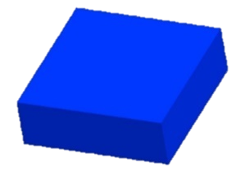
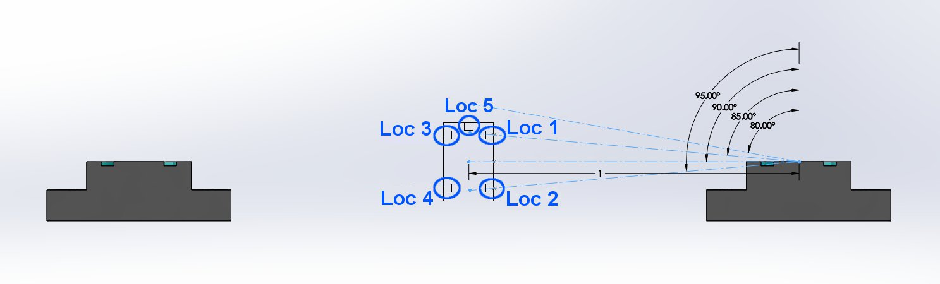
Where are we really going to measure?
MEP
Loc 1-4: 1 RPA, 1 PP each
Loc 5: 2 WAPA
TPA

Slide 18
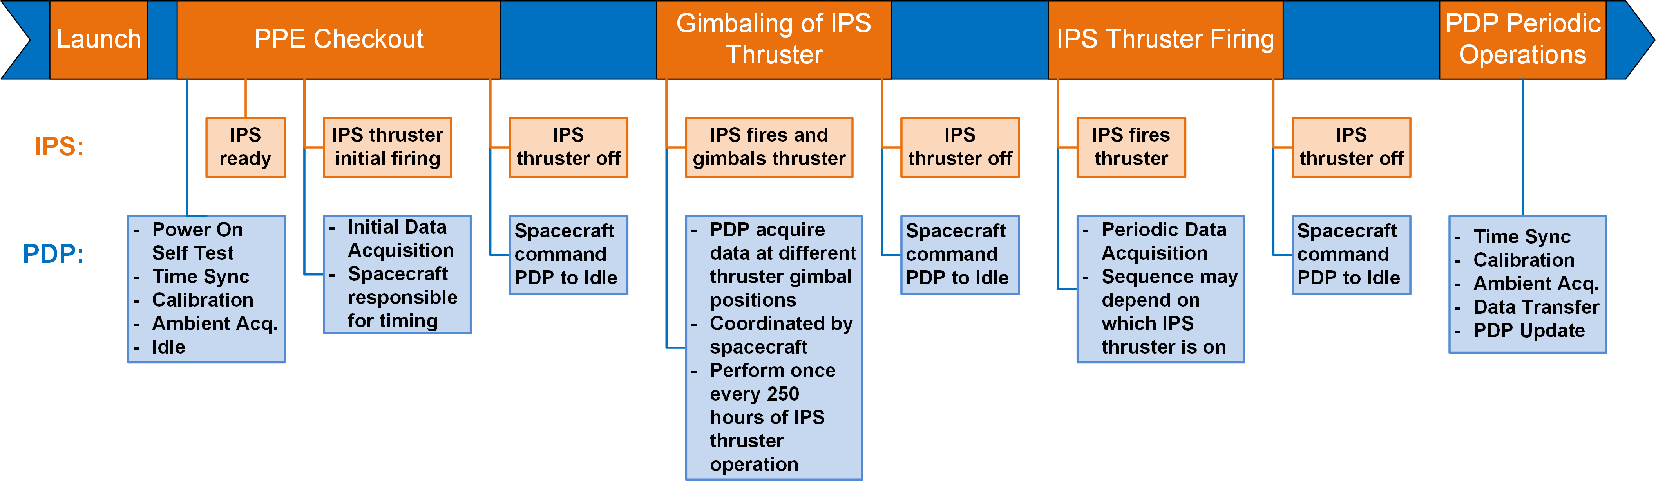
Concept of Operations:
How will we measure?
Every once in a while:
Gimbal thruster towards sensors
Several angles
Repeat regularly
After initial firing:
Take data whenever any thruster is on
Every 6 hr until forever
During initial thruster firing:
Every 10 min for 2 hr
Every hr for 22 hr

Slide 19
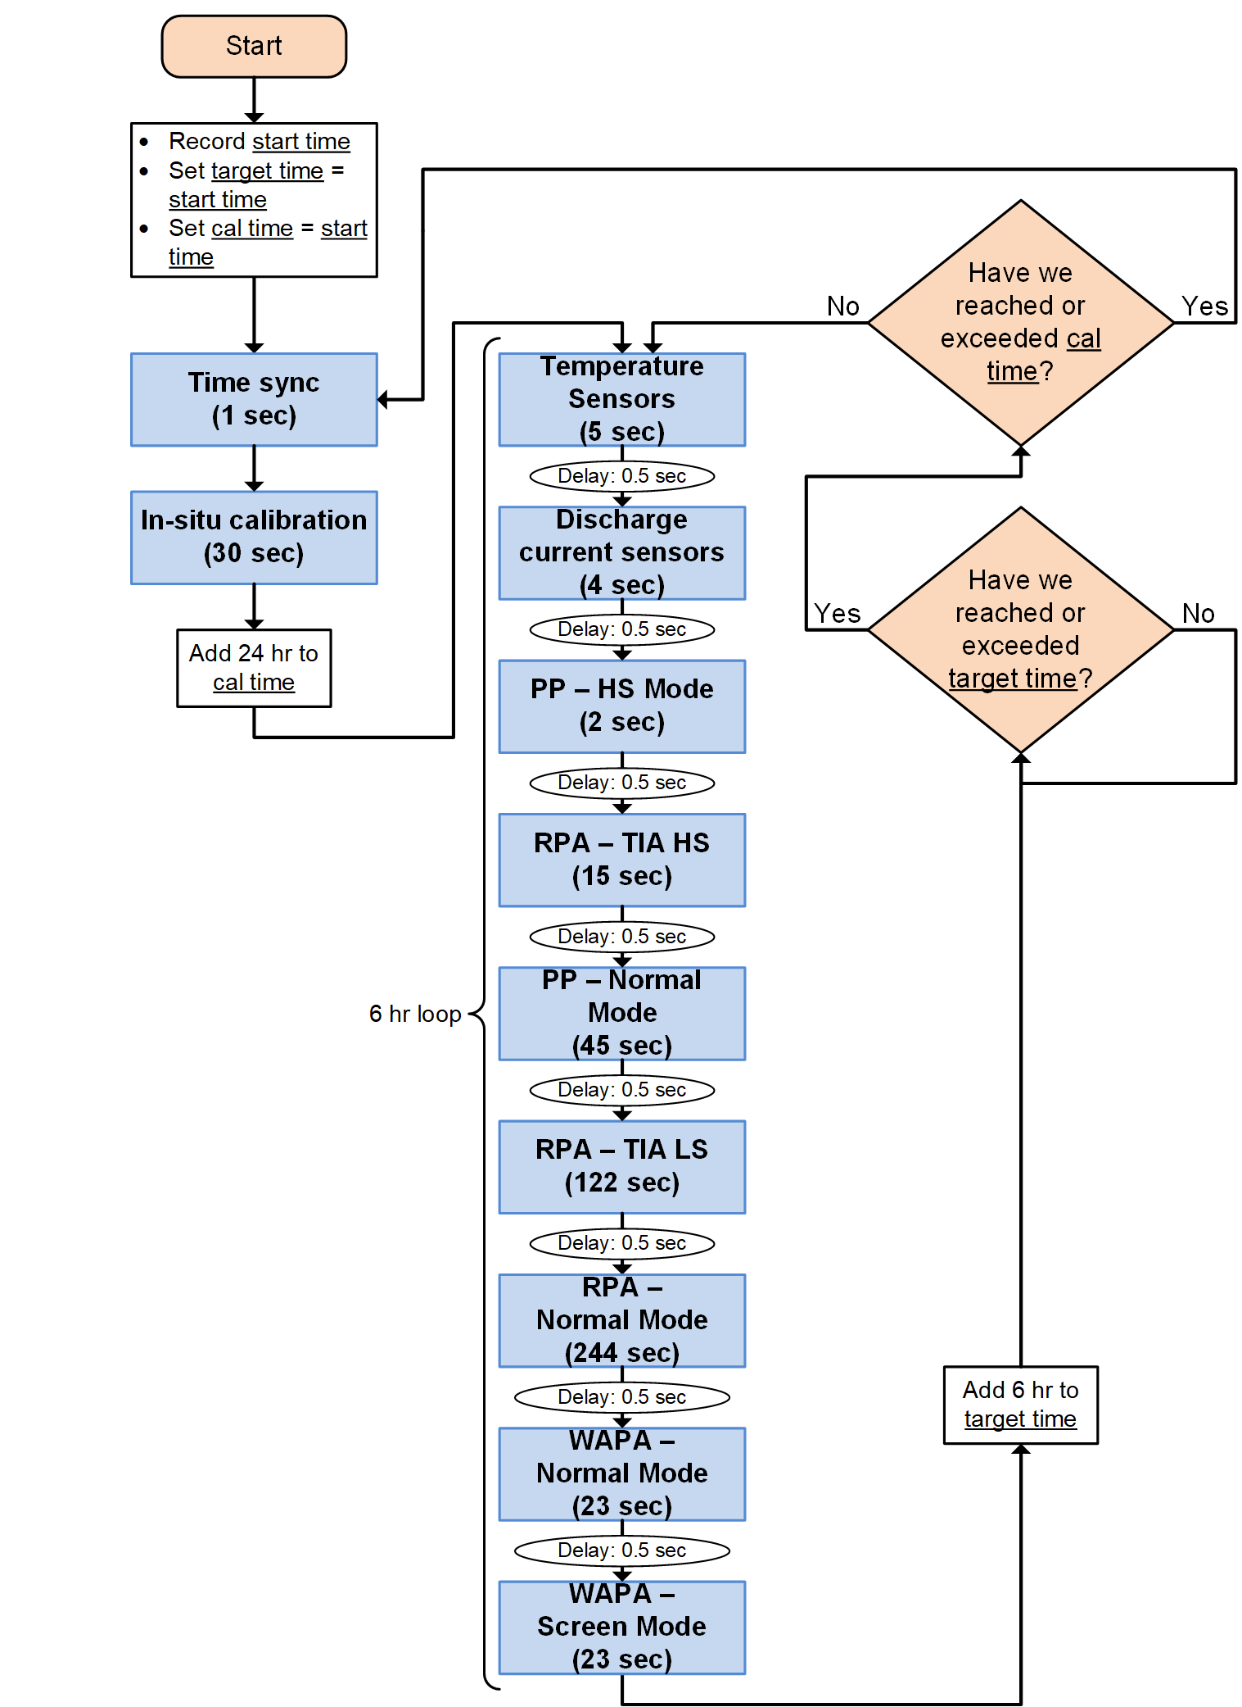
Typical Data Set
Discharge current sensors (500 kHz)
  Discharge current waveform
High speed planar probes (500 kHz, w/DCS)
  Ion current density fluctuations
High speed RPAs (500 kHz, w/DCS)
  4-5 bias voltages
  Separate beam ion oscillations from low energy ion oscillations
Planar probes
  Plasma potential, electron temperature, plasma density
RPA and WAPA
  Ion energy per charge

Slide 20
Part 2 Outline
How do PDP sensors work?
  Discharge Current Sensor
  RPA
  WAPA
  Planar Probe

Slide 21
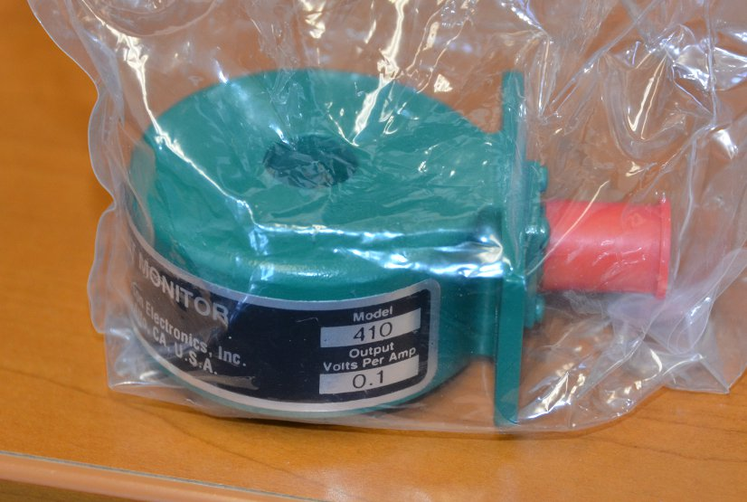
Discharge Current Sensor
Precision transformer measuring AC component of thruster discharge current via magnetic induction
  Strictly speaking not part of PDP but part of IPS PPU
Cannot instrument thruster directly
DCS allow us to capture the “state” of the thruster
  Captures oscillation frequency and magnitude
  Time-lagged phased portrait

Slide 22
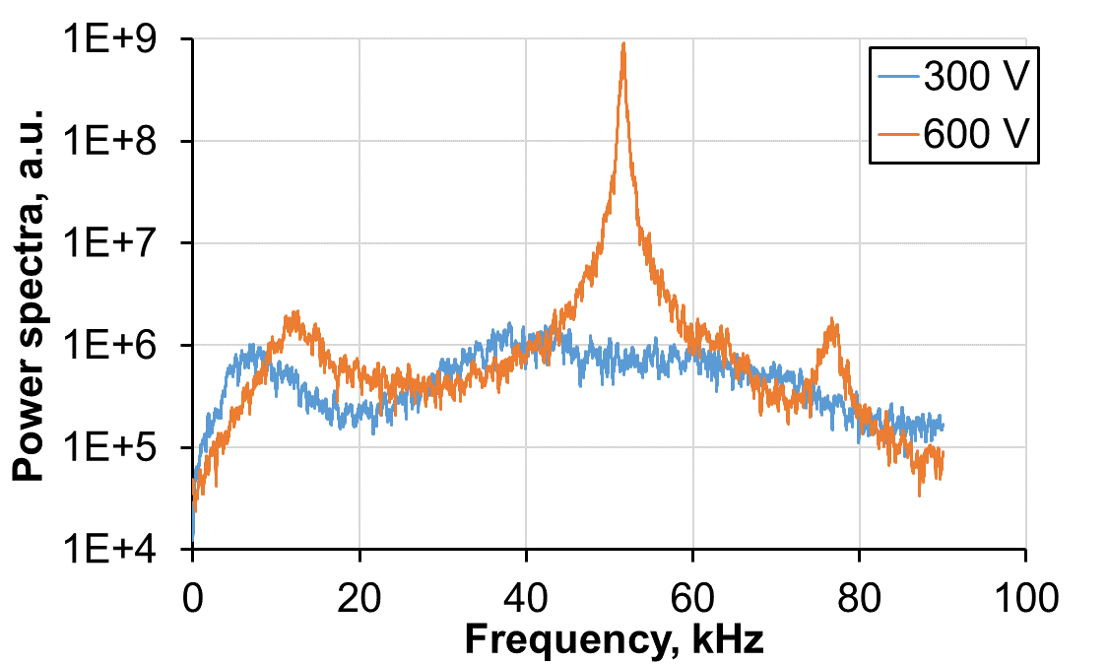
Discharge Current Sensor Usage
HERMeS TDU Data

Slide 23
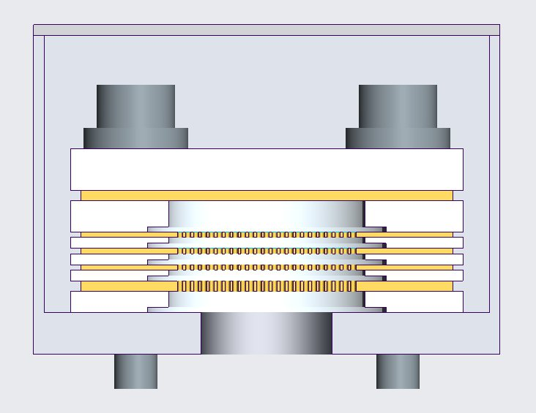
Retarding Potential Analyzer
Standard 4-grid design
Key design parameters:
  Aperture diameter
    Electron backstream
  Grid gap
    Space charge build up
  Grid thickness
    Survive being constantly blasted
  Acceptance angle
    Defined by aperture diameter versus stack height
  Backsputter protection

Slide 24
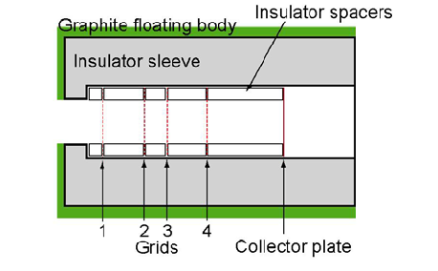
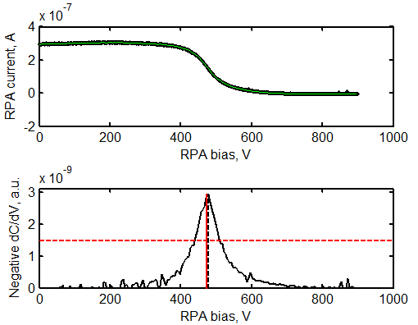

RPA Usage
Picoameter
High voltage DC supply (0 to 1 kV wrt Vp)
-30 V wrt Vp
In high-speed mode, use grid 3 as an ion filter and measure collector at high speed

Slide 25
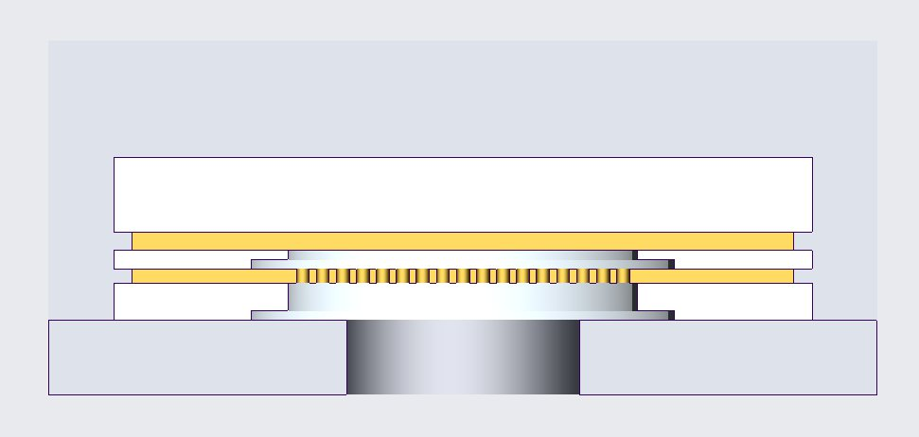
Wide-Angle Potential Analyzer
2-grid design
Compared to RPA, much wider angle of acceptance but lower energy resolution
Key design parameters:
  Aperture diameter
    Electron backstream
  Grid gap
    Space charge build up
  Grid thickness
    Survive being constantly blasted
  Backsputter protection

Slide 26
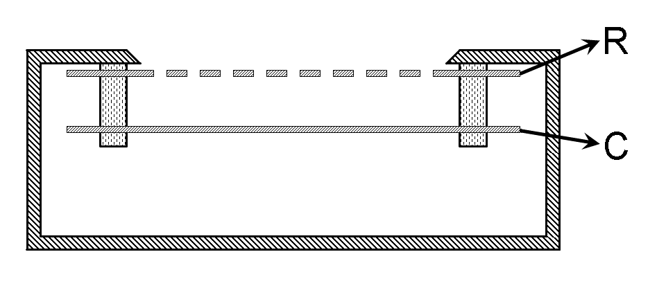
WAPA Usage
-30 V wrt Vp
Shunt
Digitizer
Shunt
Digitizer
High voltage supply (0 to 200 V wrt Vp)
Bias supply (-30 to 30 V wrt Vp)
Normal Mode
Screen Mode

Slide 27
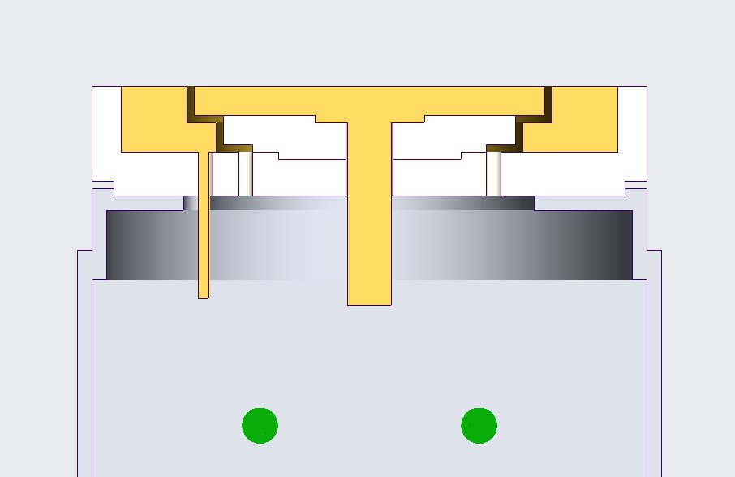
Planar Probe
Planar design with guard
  Better for directed ions
Key design parameters:
  Collection area
    Need to measure 4.5 orders of magnitude variation in density
  Collector-guard gap
    Minimize sheath distortion without shorting
  Backsputter protection

Slide 28
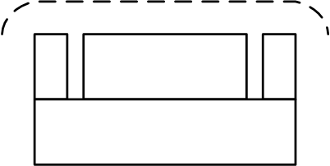
PP Usage
Shunt
Digitizer
Shunt
Digitizer
Bias supply (-30 to 30 V wrt Vp)
Bias supply (-30 V wrt Vp)
Normal Mode (Langmuir)
High Speed Mode (Faraday)

Slide 29
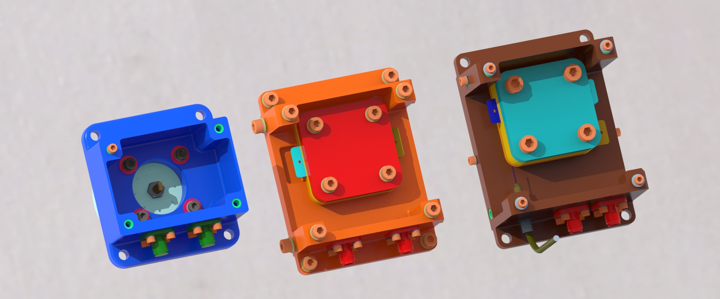
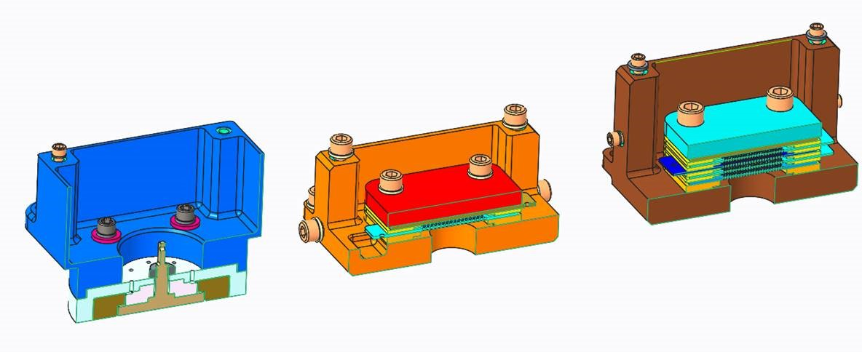
Design completed, starting fabrication!

Slide 30
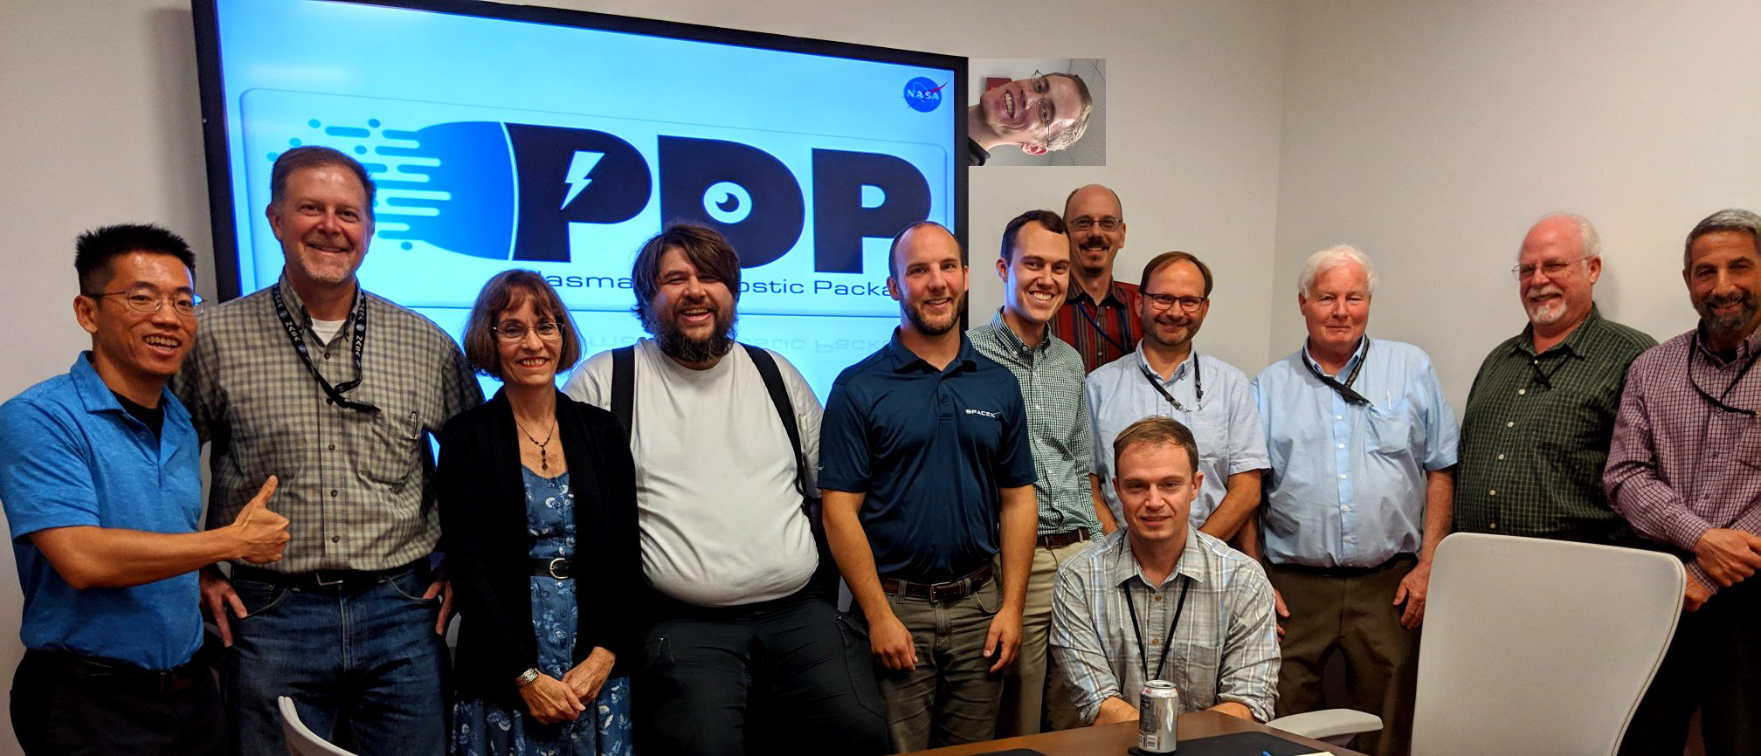
The PDP Team

Slide 31
PPE to launch in 2022, look forward to results!

Slide 32
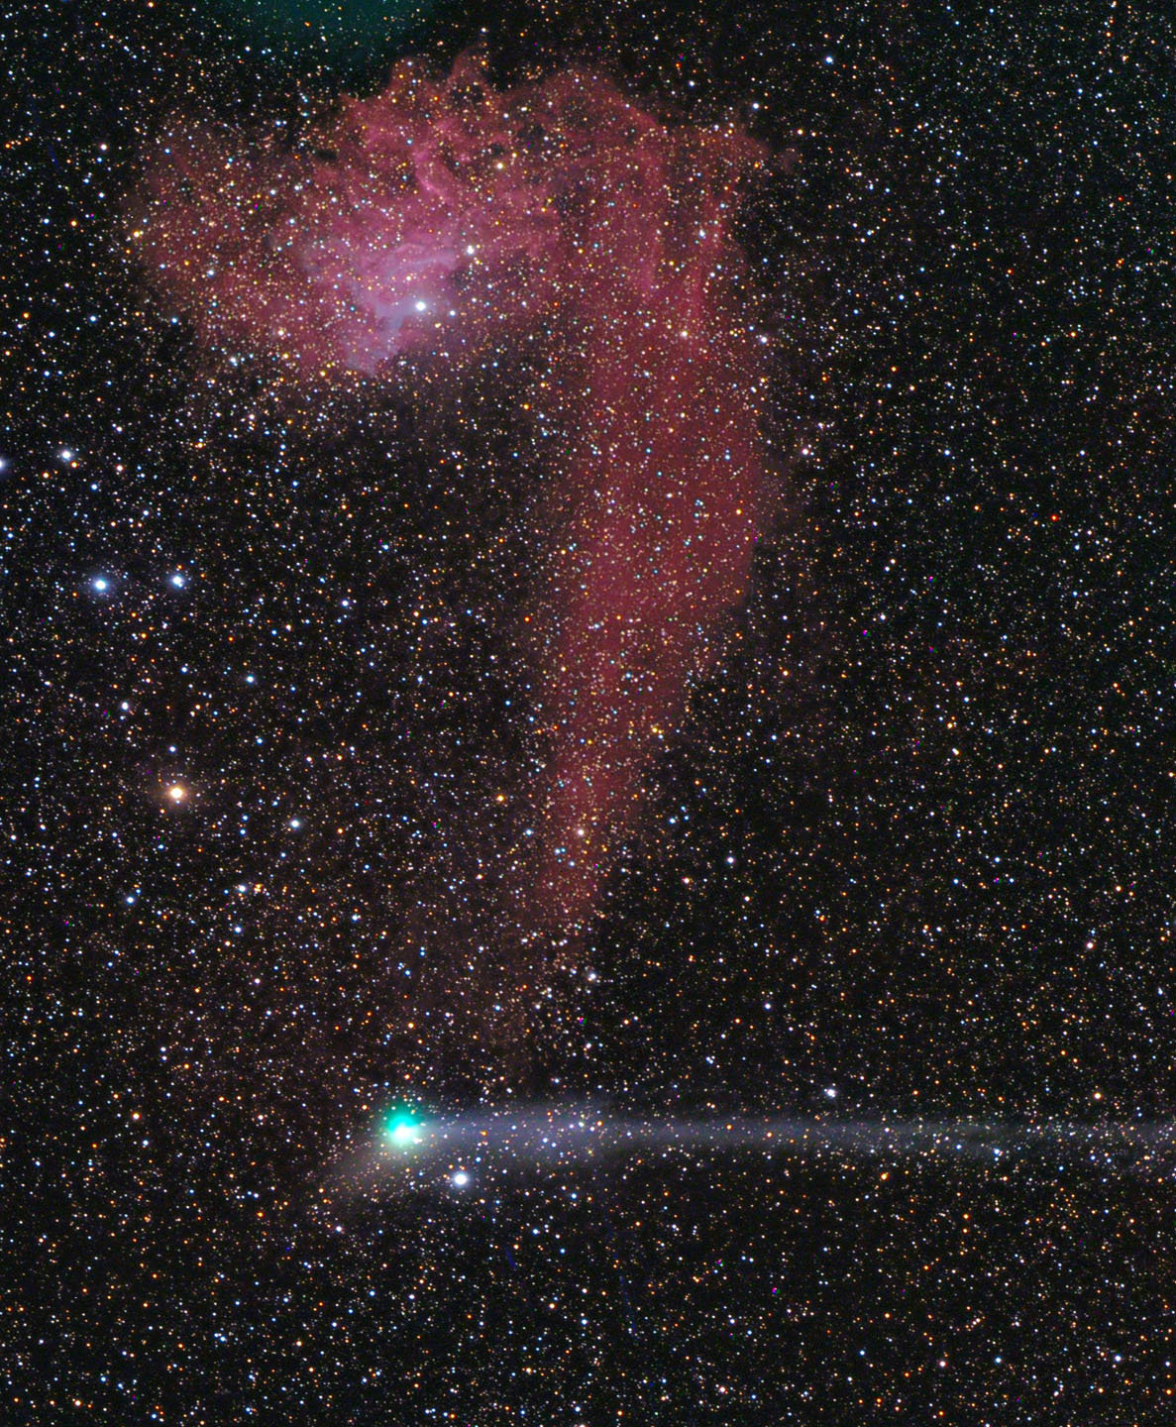
Questions?

