Slide 1
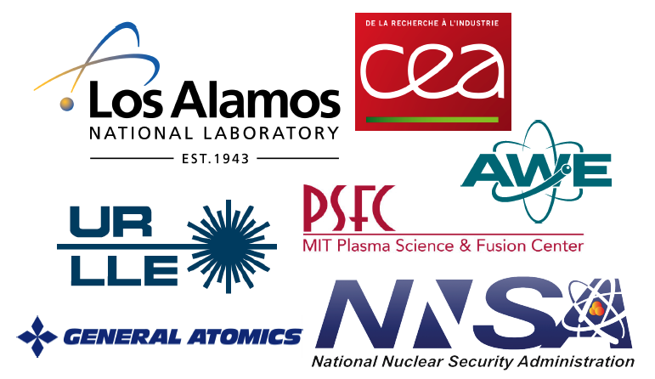

How ignition and target gain > 1 was achieved in inertial fusion
O. A. Hurricane (Indirect Drive ICF Collaboration)
MIPSE
Wednesday, March 8st, 2023
3:30 pm, Ann Arbor Michigan

Slide 2
Recent NIF ICF experiments are an “existence proof” of laboratory ignition and “target gain” (G_{target}>1)
No mystery physics obstacle stands in the way of ignition (explosive thermodynamic instability) or gain (energy out > energy in)
The theoretical prediction of the physics parameter regime (e.g. Lawson triple product) where ignition was expected is consistent with our results
Additional laser energy (at fixed power) was very beneficial
Implosion physics was more sensitive to engineering control of the laser and targets than originally thought
So far, very high gain (high compression) target designs have not worked as expected. All break-throughs over the past decade have used low gain designs
Remarkable that we can now talk about burning plasmas, ignition, and scientific breakeven in the past-tense!

Slide 3

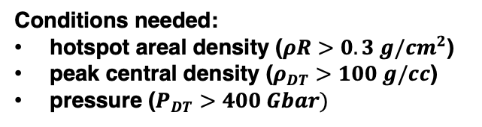
In order to get high fusion yields, we need to assemble the fusion fuel into a configuration that can stop alpha’s in the fusion plasma
$$\left\langle σv\right\rangle \sim T^{3−4}$$
Fusion reaction:
helium-4 nuclei
approximation to DT reaction-rate
$$D+T →n \left(14.1 MeV\right)+α (3.5 MeV)$$
70-80% α’s stopped in “hotspot” increasing T
Reaction-rate
$$2R \sim 100 μm$$
DT
heat
20-30% α’s ablate fuel increasing hotspot mass
heat
“Self-heating”
Conditions needed:
hotspot areal density ($ρR>0.3 g/{cm}^{2}$)
peak central density ($ρ_{DT}>100 g/cc$)
pressure ($P_{DT}>400 Gbar)$
If these condition are met, a thermal feed-back loop, “ignition,” is generated

Slide 4
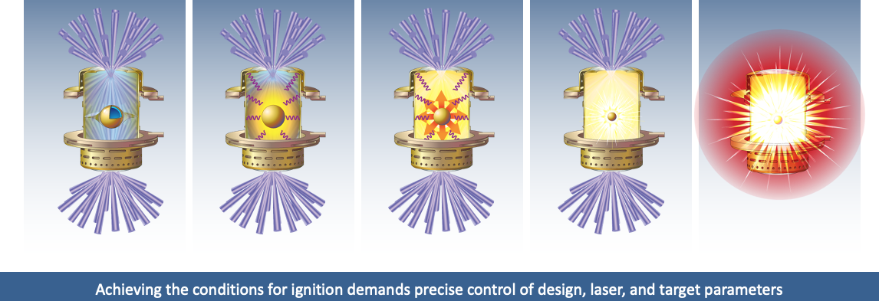
Indirect drive inertial confinement fusion (ICF) uses x-rays to ablate and accelerate a capsule of fusion fuel to extreme velocity
Lasers deposit energy into hohlraum
A bath of x-rays is created as the hohlraum heats
The capsule surface ablates at ~150 Mbar
Capsule accelerates inwards doing pdV work
Kinetic energy is converted into internal energy
“Implosion”
“Stagnation”
e.g. Nuckolls, et al, Nature, 1972; Lindl, Phys. Plasma, 1995; Haan, et al., PoP, 2011

Slide 5
Often conflated, the terms “burning plasma,” “ignition,” and “gain” all mean something physically different
Burning plasma*
ICF: Self-heating energy exceeds external “pdV work” to heat and compress the DT
MFE: Self-heating energy exceeds external heating of the DT
Ignition (i.e. Lawson Criterion† )
Self-heating power exceeds all DT plasma power losses
Losses are radiative, electron heat conduction, negative pdV work
Results in thermodynamic instability (explosive increase in T, Y, etc).
Target Gain
Fusion yield exceeds laser energy into target
1997 NAS committee used this as “ignition” in a report & the U.S. DOE adopted this definition
*Betti, et al, PRL, 2015; †Lawson, J.D., Proc. Phys. Soc., B, 1957

Slide 6
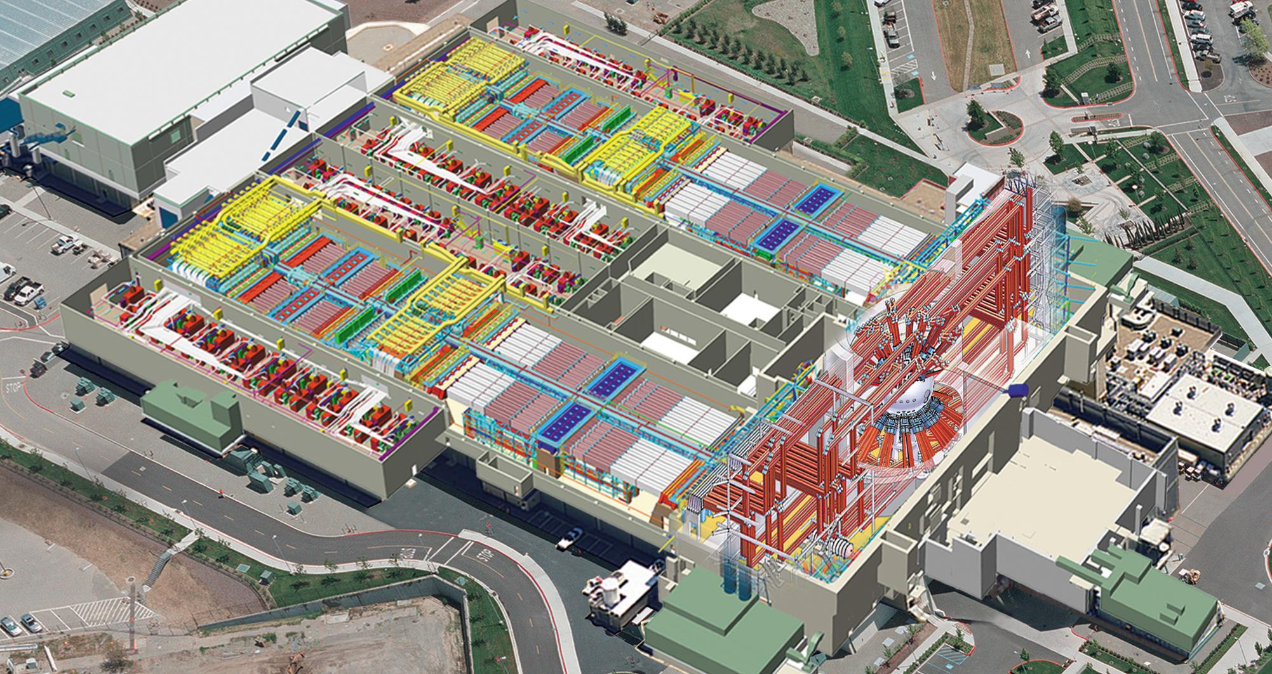
96 laser beams
The National Ignition Facility (NIF)
96 laser beams
300-400 MJ electrical energy into capacitor banks
Notes:
Should say 1 or 2 sentence about mission of NIF -- stockpile stewardship

Slide 7
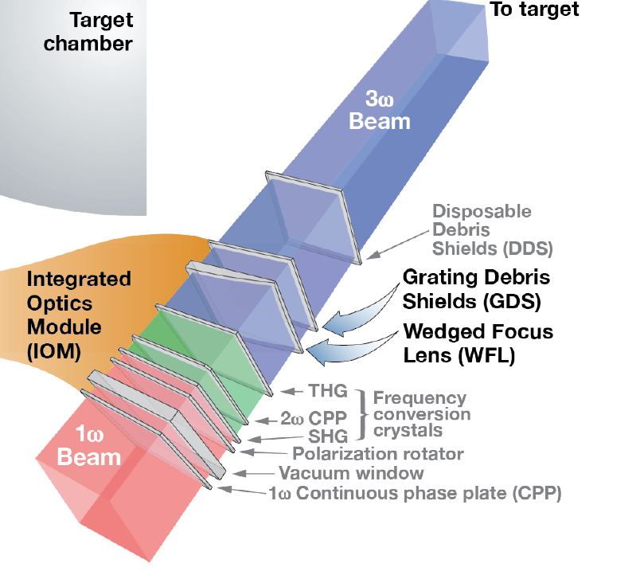
96 laser beams
The NIF delivers delivers frequency tripled (3⍵) laser light into the target chamber
96 laser beams
3 MJ of red light just before target chamber
Notes:
Should say 1 or 2 sentence about mission of NIF -- stockpile stewardship

Slide 8
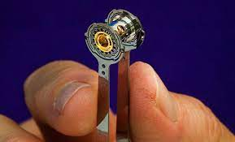
96 laser beams
The 3⍵ light is what enters the ICF target
2 MJ of blue light→
96 laser beams
Notes:
Should say 1 or 2 sentence about mission of NIF -- stockpile stewardship

Slide 9
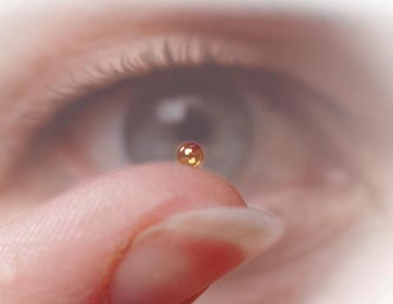
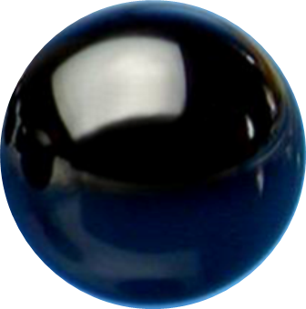
96 laser beams
Laser light is converted into a bath of x-rays that ablate the capsule
96 laser beams
250 kJ x-ray absorbed by capsule
↓
300-400 MJ electrical energy into capacitor banks
Notes:
Should say 1 or 2 sentence about mission of NIF -- stockpile stewardship

Slide 10
96 laser beams
Inertial fusion sacrifices energy for energy density
2 MJ of blue light→
96 laser beams
250 kJ x-ray absorbed by capsule
↓
300-400 MJ electrical energy into capacitor banks
20 kJ internal energy into DT fuel inside capsule
Most of the initial energy is lost before any gets to the fusion fuel
Notes:
Should say 1 or 2 sentence about mission of NIF -- stockpile stewardship

Slide 11
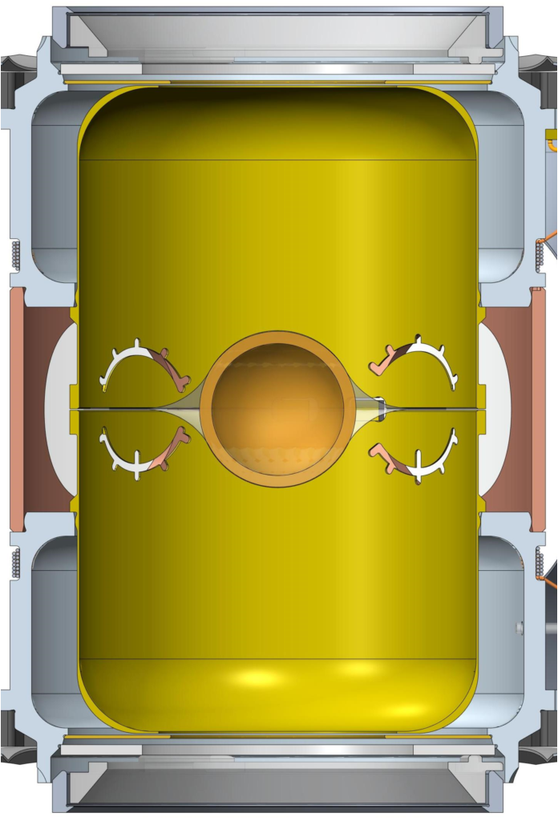


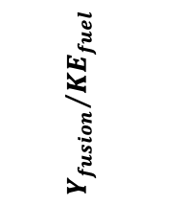





There are several energy gain metrics in ICF, all increased by approximately 5000x over the past decade on the NIF
N221204
$$G_{target}\sim 1$$
(end 2022)
N210808
After 10 years and as of Dec. 5, 2022
G_{target} ~ 1.5
G_{capsule} ~ 12
G_{fuel} ~ 160
Capsule/Ablator
$$G_{capsule}\sim 1$$
(mid 2021)
$$G_{capsule}=\frac{Y}{E_{absorbed}}$$
$${Y_{fusion}}/{{KE}_{fuel}}$$
$$G_{fuel}\sim 1$$
(early 2014)
Fuel
~1 cm
ignited
$$G_{fuel}=\frac{Y}{E_{fuel}}$$
Theory*
N120422
Target
$$G_{target}=\frac{Y}{E_{laser}}$$
$$0.0195\frac{pτT^{1.6}}{1+\frac{E_{fuel}}{E_{hs}}}$$
Generalized Lawson Criterion (GLC) – atm-s & keV units
*Hurricane, et al, RMP in press, 2023
G_{target} > 1 is not “net energy gain,” because of facility energy consumption

Slide 12
It took a decade of work to tackle several key target physics challenges that frustrated our progress
Instability control
Symmetry control
Sufficient energy coupling
Target quality
Ultra-high compression

Slide 13
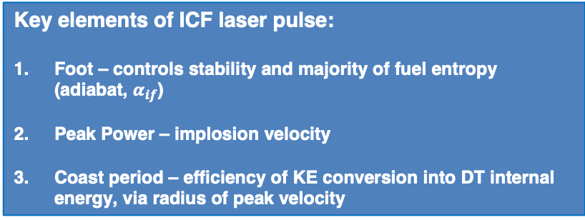

In indirect-drive, the hohlraum, ablator, and laser pulse determine the ablation pressure that drives the implosion
Key elements of ICF laser pulse:
Foot – controls stability and majority of fuel entropy (adiabat, $α_{if}$)
Peak Power – implosion velocity
Coast period – efficiency of KE conversion into DT internal energy, via radius of peak velocity
2
3
Hohlraum and laser pulse-shape
Ablation pressure on implosion:
$$p_{abl}\sim {\left(\frac{\overline{A}}{\overline{Z}+1}\right)}^{\frac{1}{2}}T_{rad}^{\frac{7}{2}}(1−albedo)$$
1
Ablator material that forms capsule

Slide 14
2010-12: Plastic ablator “Low-foot” implosions were designed to be high yield ( > 1 MJ), but underperformed for many reasons*
*Edwards, et al, PoP, 2013; Ma, et al., PoP, 2013; Regan et al, PRL, 2013; Lindl, et al., PoP, 2014; Clark, et al, PoP, 2016

Slide 15
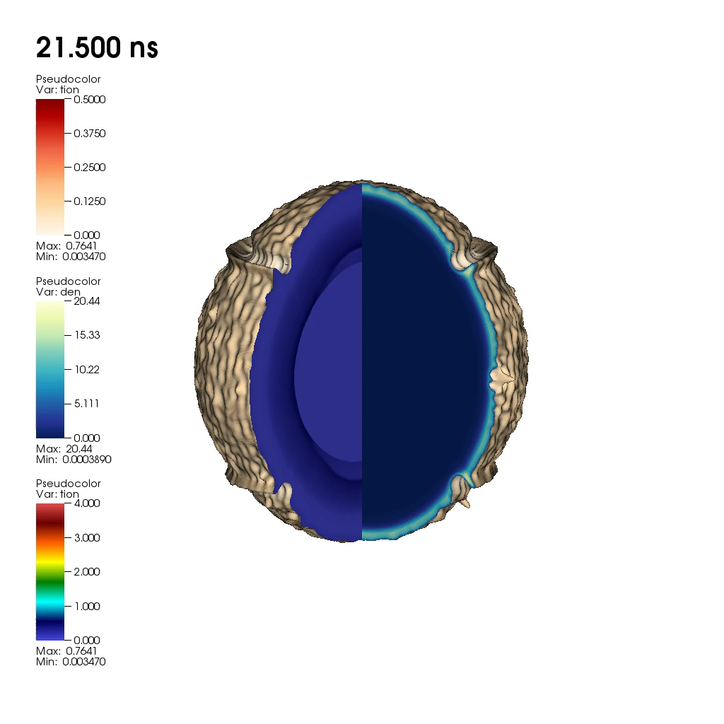
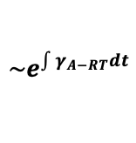
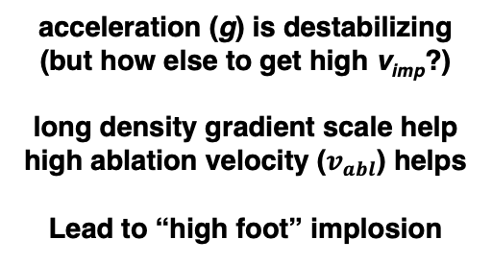
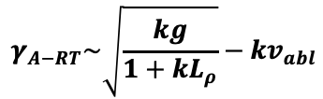

Hydro-dynamic instability defeats density and temperature gradients and is more challenging with higher compression
“Takabe” formula for linear growth rate:
D. Clark et al., Phys. Plasmas 23, 056302 (2016)
“Rayleigh-Taylor” (RT)
$$γ_{A−RT}\sim \sqrt{\frac{kg}{1+kL_{ρ}}}−kv_{abl}$$
acceleration (g) is destabilizing
(but how else to get high v_{imp}?)
long density gradient scale help
high ablation velocity ($v_{abl}$) helps
Lead to “high foot” implosion
Numerous forms: e.g. Bodner, Betti, Kilkenny, Takabe, etc.
Exponential perturbation growth:
$$\sim e^{\int{γ_{A−RT}dt}}$$
T_{ion}
⍴
wavelength, $λ=\frac{2π}{k}$

Slide 16
2013-2015: High-foot implosions tested if better controlling hydrodynamic instability would improve performance
Hinkel, et al. PPCF, 2013; Dittrich, et al. PRL, 2014; Park, et al., PRL, 2014; Hurricane, et al., Nature, 2014

Slide 17
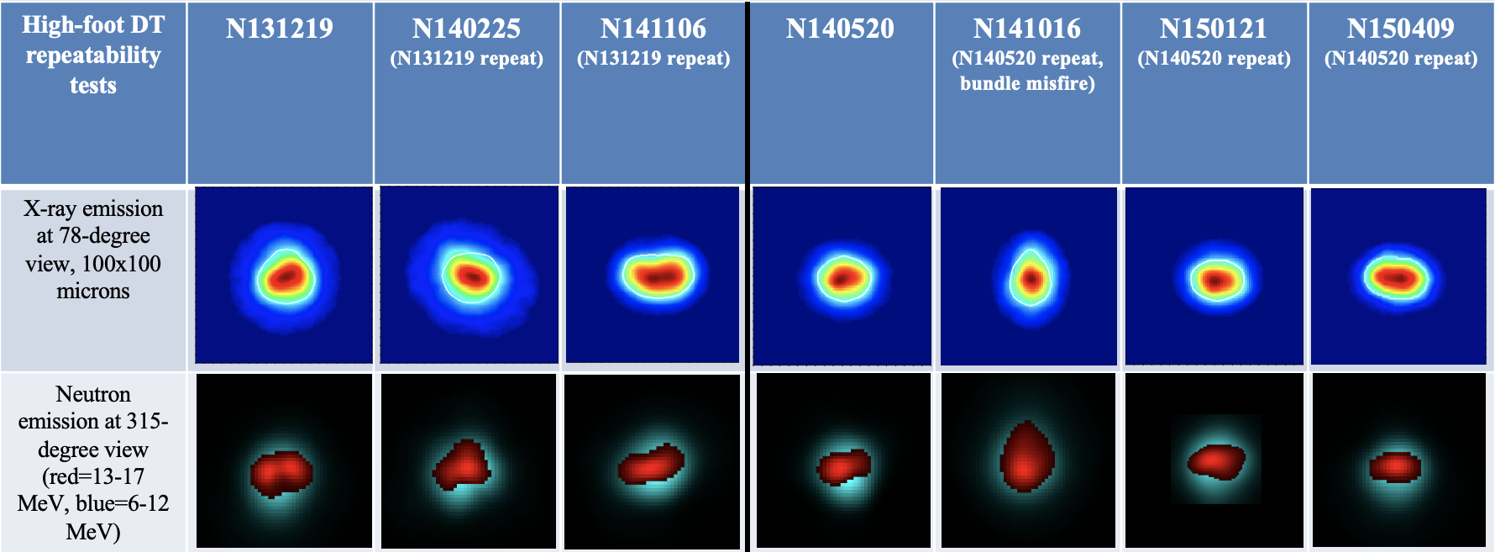
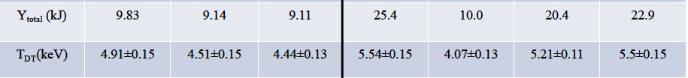
While the high foot implosions increased fusion yield by 10x and had repeatable behavior, symmetry control was an issue
350 TW & 1.6 MJ
390 TW & 1.8 MJ
Spears, et al., PoP, 2014; Ma, et al, PRL, 2016; Hurricane, et al, Nat. Phys, 2016

Slide 18
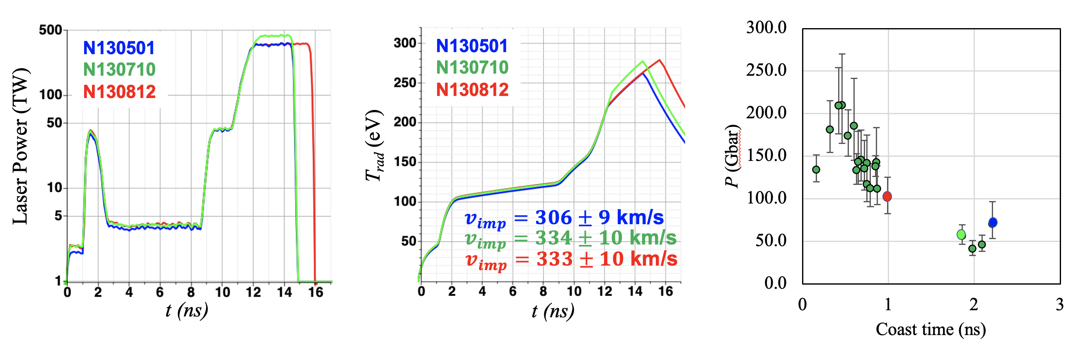
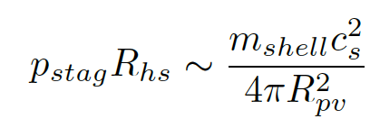
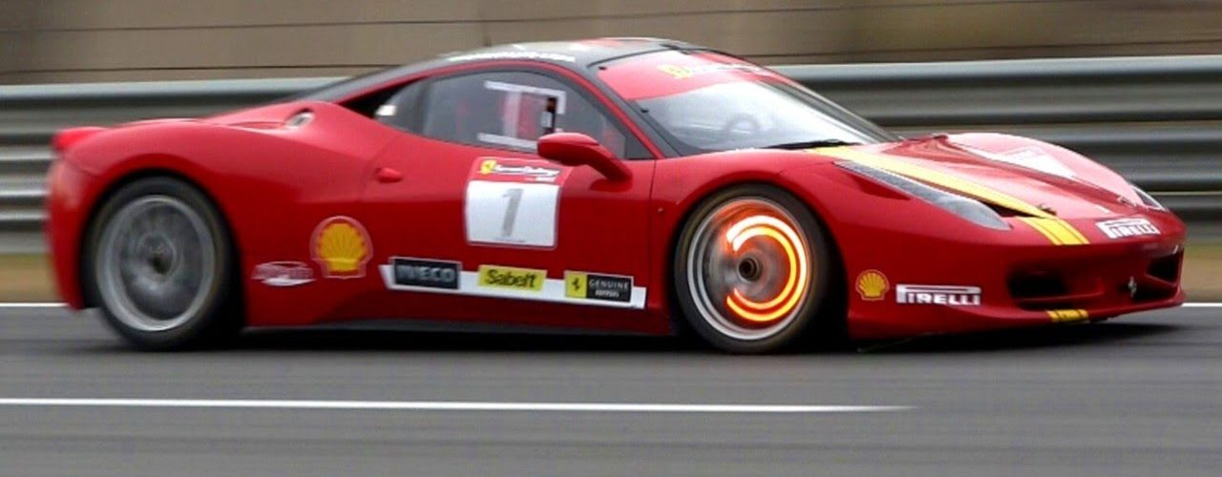
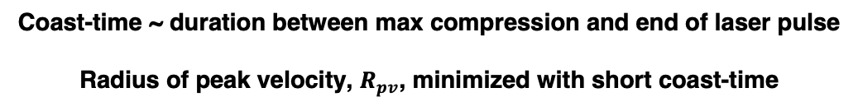
Series of high-foot experiments revealed the importance of “coast-time” in maximizing mechanical power transfer
Coast-time ~ duration between max compression and end of laser pulse
Radius of peak velocity, $R_{pv}$, minimized with short coast-time
“Late braking”
Hurricane, et al, PoP, 2017; Hurricane, et al, PoP, 2022

Slide 19
2015-2018: Higher pressures achieved using high density carbon ablators and low gas-fill hohlraums
Divol, et al, PoP, 2017; LePape, et al, PRL, 2018; Berzak-Hopkins, et al, PPCF, 2018; Casey, et al, PoP, 2018; Baker, et al, PRL, 2018; Thomas, et al., PoP, 2020

Slide 20
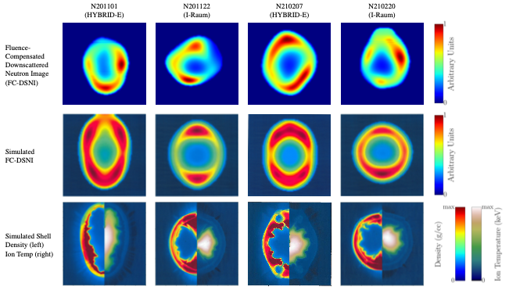
Symmetry control was improved with HDC ablators and low gas-fill hohlraums, but control is still challenging, even today
Data
Synthetic data from simulation
HYDRA*
Simulation
e.g. Kritcher, et al., Nature Phys. 18, 251 (2022)
*Marinak, et al., PoP, 2003

Slide 21
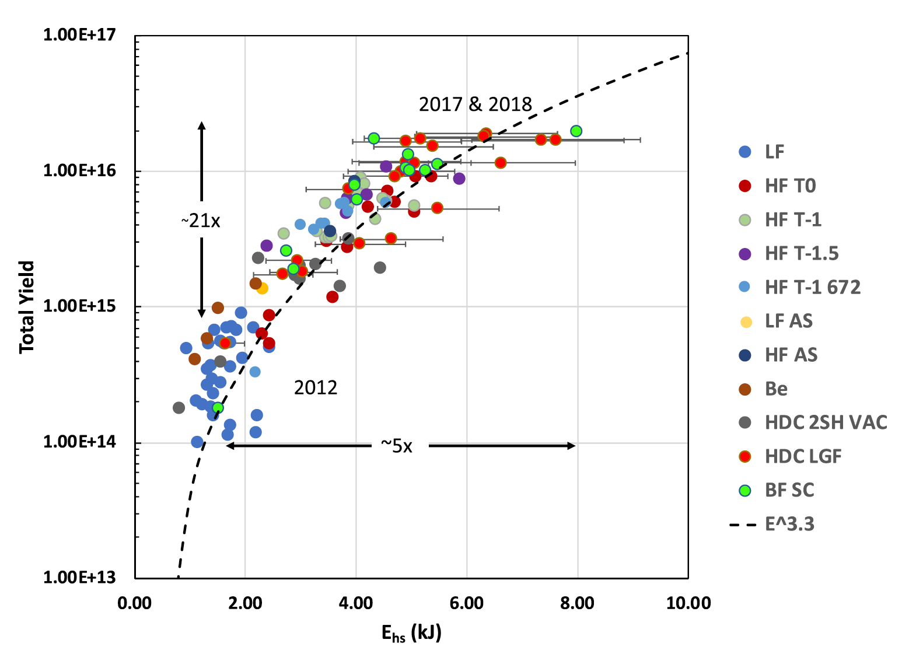





In ICF, it is essential to maximize the conversion of implosion kinetic energy into hotspot internal energy
Experimental scaling of fusion yield with hotspot energy, Y ~ E^{3.3}
Degradation of fusion yield with asymmetry, Y ~ (1-nRKE)^{3.3}
Simulations:
▲ Burn-off LF from Kritcher, et al., PoP, 2014
◼︎ Burn-on LF from Kritcher, et al., PoP, 2014
⚫️ Burn-on HF from Kritcher, et al., PoP, 2016
Total Fusion Neutron Yield
$$\frac{Y}{Y_{1D}}$$
Burn-off piston model
$$\frac{Y}{Y_{1D}}={\left(\frac{ρδR_{WHM}}{ρδR_{ave}}\right)}^{a}={\left(1−\frac{RKE}{0.66KE}\right)}^{a}$$
$$\left\langle σv\right\rangle \sim T^{a}$$
Burn-on piston model
E_{hs}(kJ)
Decreased asymmetry
$$\frac{RKE}{0.66KE}$$
Increased asymmetry
$$E_{hs}=\frac{c\left(a_{if}\right)}{2}m_{shell}v_{imp}^{2}(1−nRKE)$$
E_{hs}, KE, & symmetry connected:
KE split into hotspot, $c\left(α_{if}\right) \sim 0.66$
“HYBRID” strategy: [Hurricane, et al., PPCF 61, 014033 (2018); PoP 26, 052704 (2019)]

Slide 22
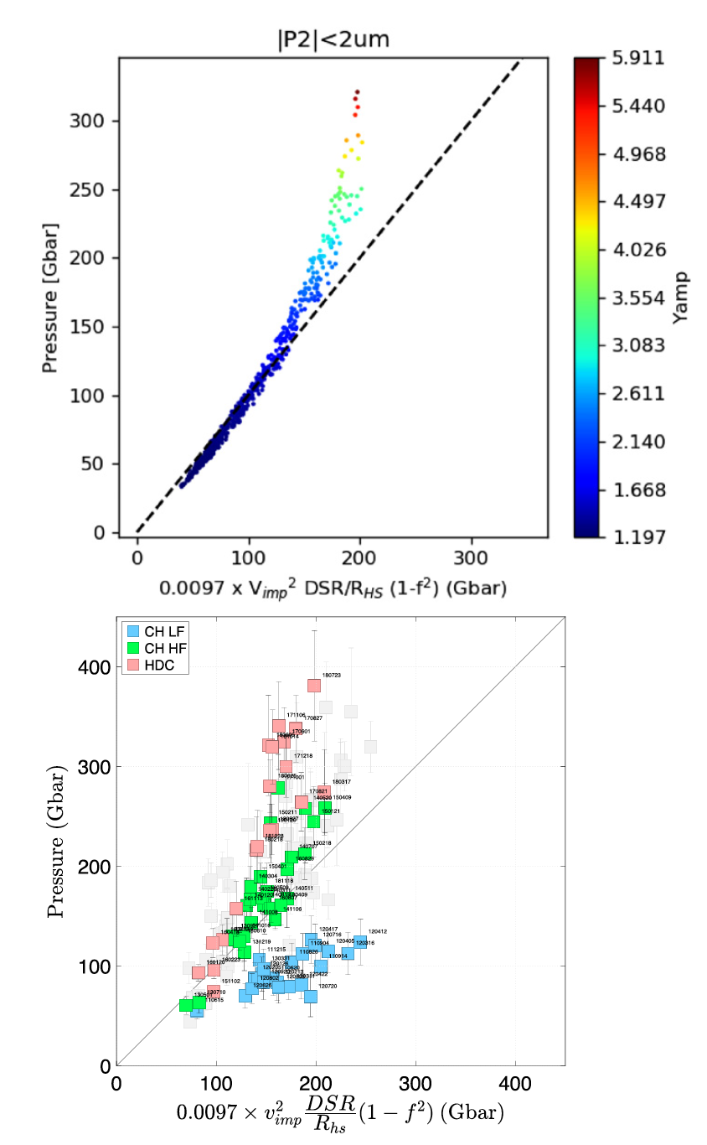

Implosion symmetry control is important, because it wastes kinetic energy, that could have heated the fusion fuel
Asymmetric implosion abstracted to pistons
$$pV^{γ}\sim const$$
Mode-1:
hot
plasma
$$v_{imp}$$
$$v_{imp}$$
$$p$$
Center-of-mass motion
$$v_{COM}$$
From conservation of energy and momentum:
$$p=\frac{1}{3}\frac{m_{pistons}v_{imp}^{2}}{V}\left(1−\frac{v_{com}^{2}}{v_{imp}^{2}}\right)$$
Wasted KE = “residual kinetic energy (RKE)”
minimum hot volume
“wasted” KE
Hurricane, et al, PoP, 2020, Casey, et al, PRL, 2021; MacGowan, et al, HEDP, 2022

Slide 23
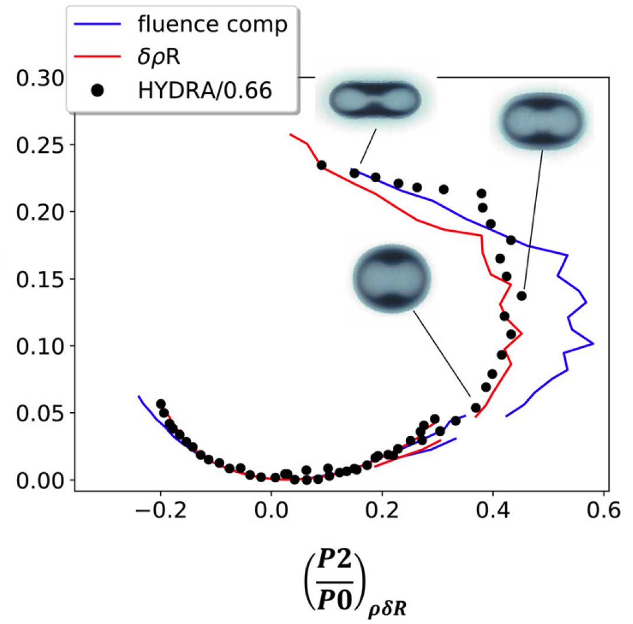
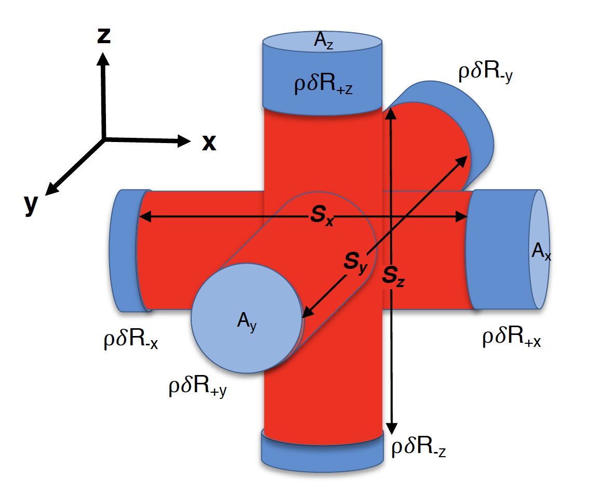
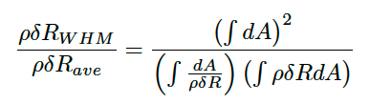

Asymmetry wastes kinetic energy, even when there is no net center of mass motion – geometry is a reflection of energy
Mode-2:
$$\frac{RKE}{c\left(α_{if}\right)KE}=1−\frac{ρδR_{WHM}}{ρδR_{ave}}$$
Key parameter for 3D asymmetry:
Legendre mode 2
WHM = weighted harmonic mean* of shell areal density
*Hurricane, et al, PoP, 2022; Betti & Woo, PoP, 2021

Slide 24
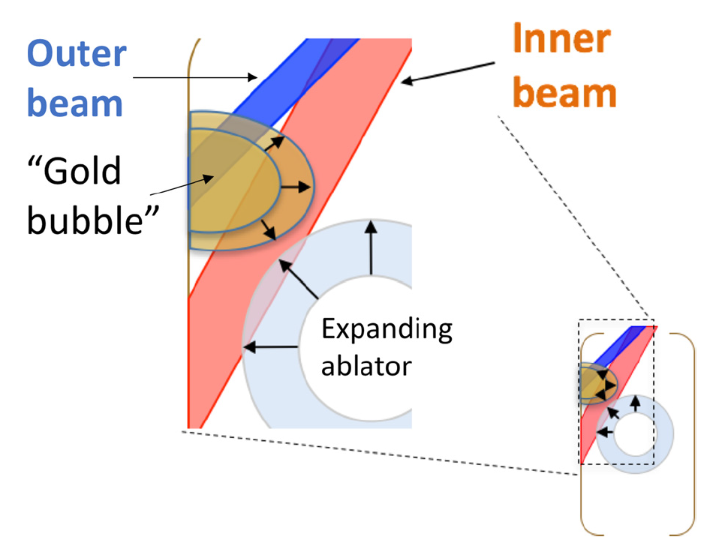
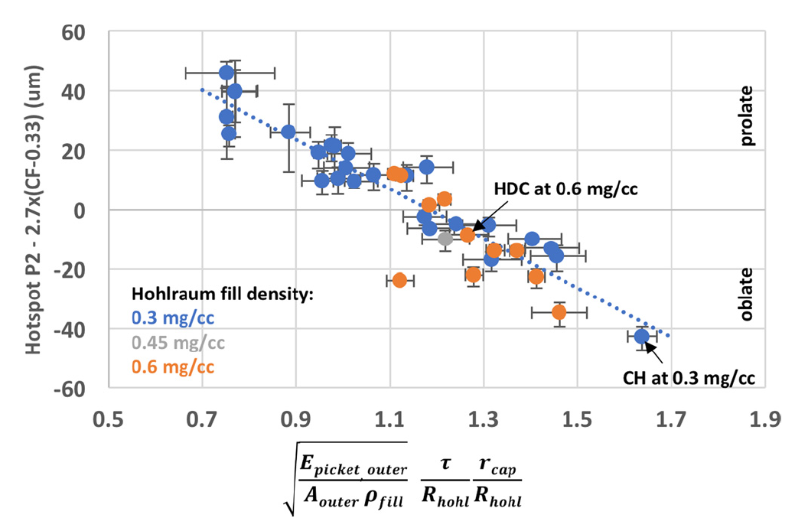


Significantly improved understanding of the levers controlling implosion symmetry obtained during the 2015-2018 period
Legendre mode-2 (“P2”) scaling:
Callahan, et al., PoP, 2018;
Ralph, et al, PoP, 2018
Cross-beam energy transfer with low gas-fill:
$∆λ=0$Å
$∆λ=1$Å
Beam pointing has limited control
A. L. Kritcher, et al Phys. Rev. E 98, 053206 (2018); L. Pickworth, et al, PoP (2020)

Slide 25
2018-2020: With a better understanding of the levers on capsule and hohlraum control, we scaled up capsule radius, but ...
HyE 1100: Zylstra, et al, PRL, 2019; Kritcher et al., PoP, 2020
I-raum: Robey, et al, PoP, 2018; Ross, et al, arXiv, 2021
... initially this strategy struggled

Slide 26
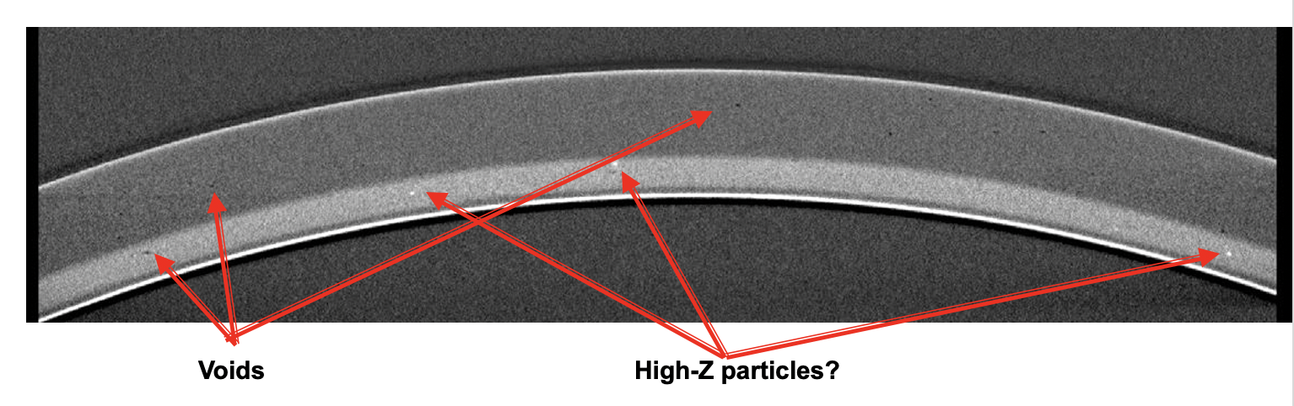
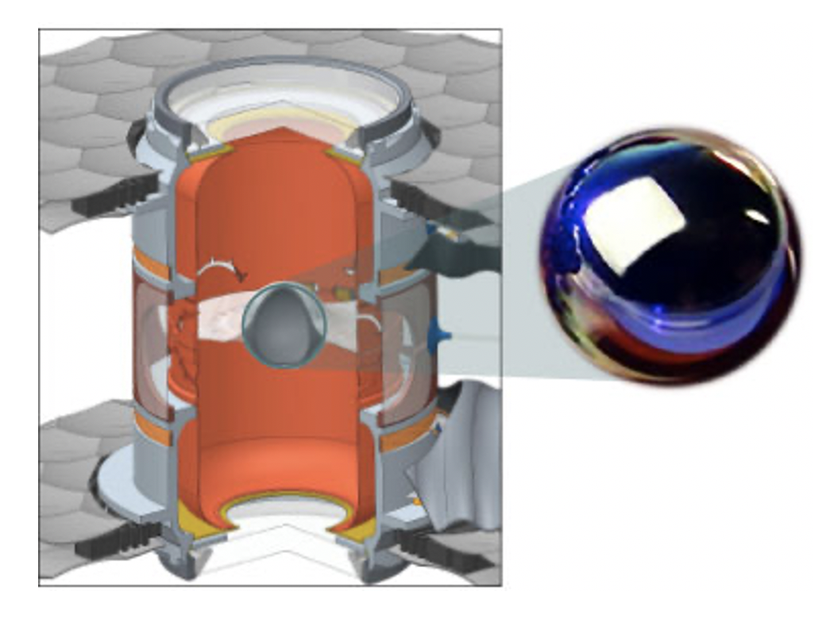
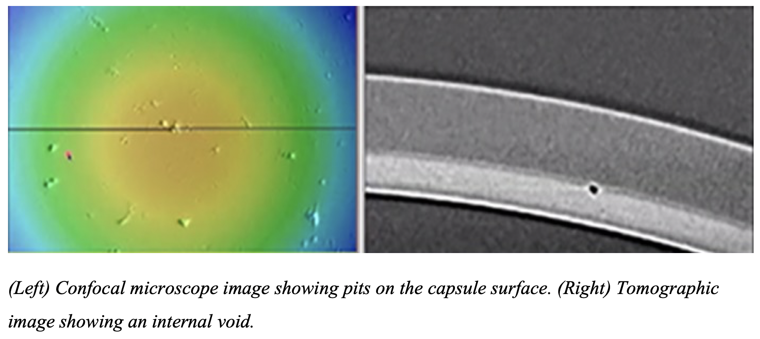
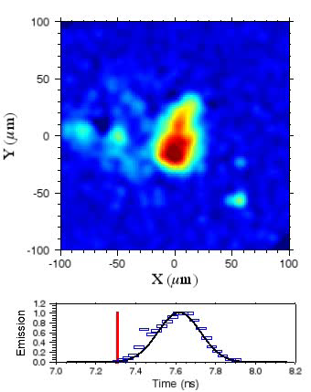
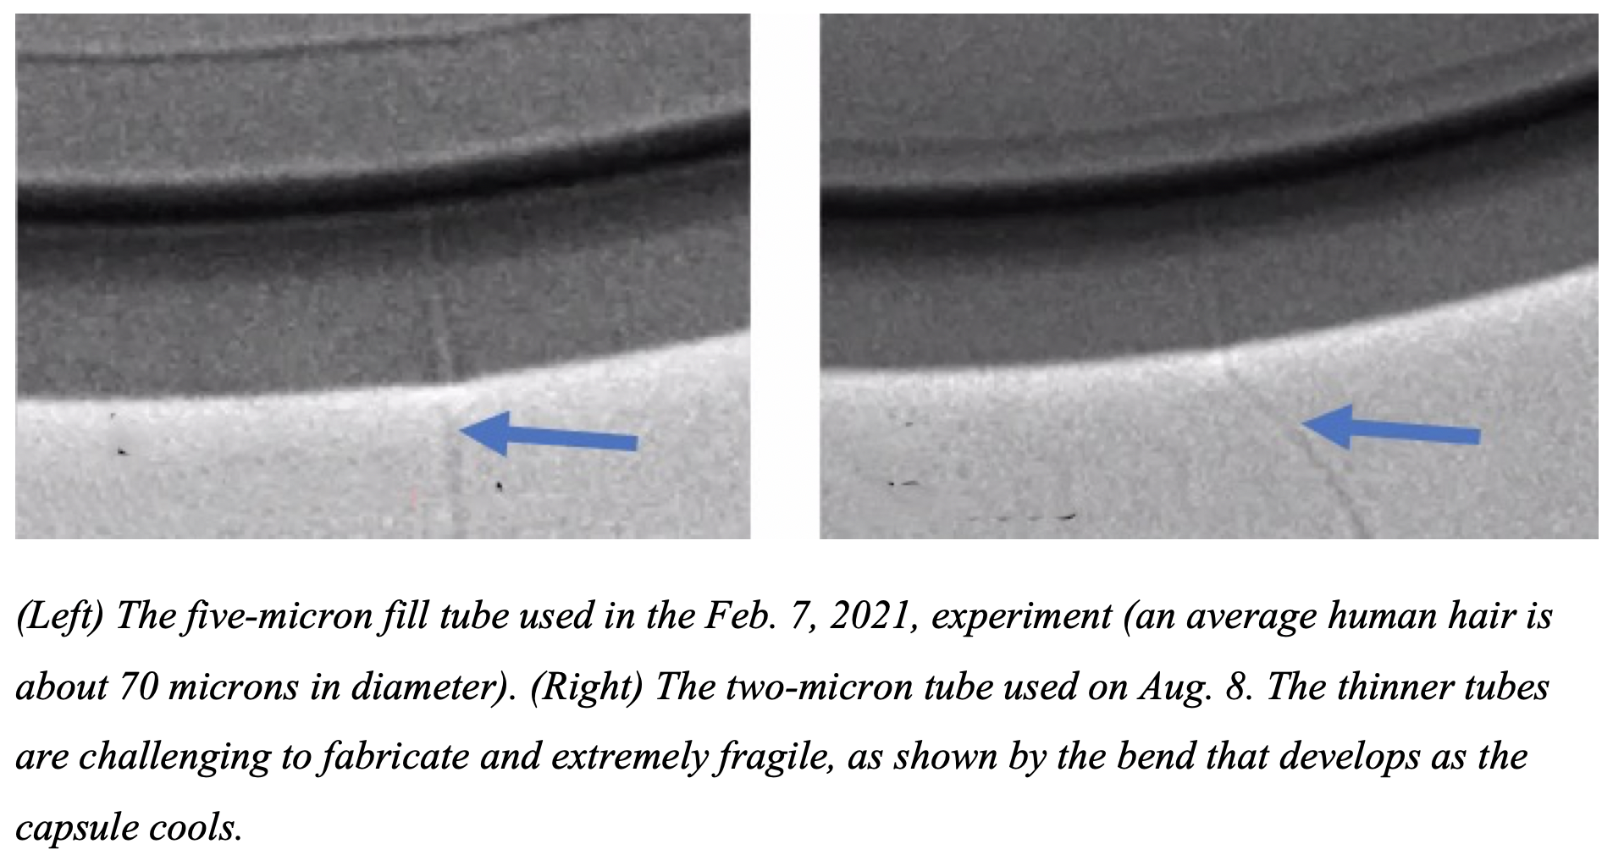
We got surprised by numerous capsule defects when we increased capsule radius ... problems identified (as shown) and eventually resolved
Slide courtesy T. Braun, LLNL target fabrication
Braun, et al., Nuclear Fusion, 63, 2022; Zylstra, et al., Phys. Plasmas, 2020 (Hybrid-B)

Slide 27
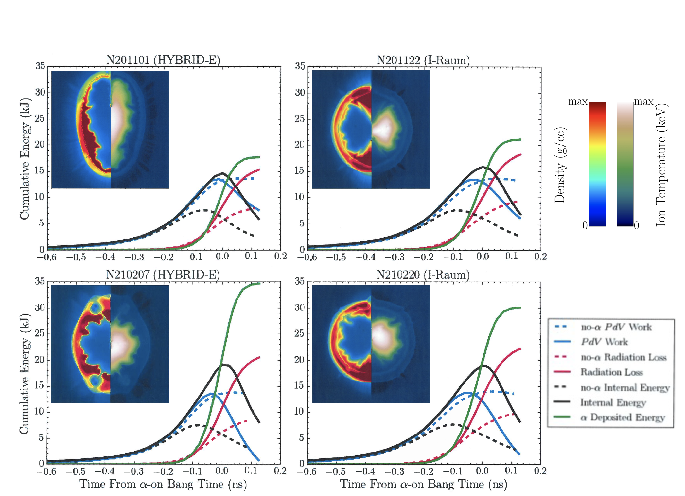









Like asymmetry, more mixing (from capsule defects + hydro) costs energy, putting more demands upon the driver
Compressed
DT fuel with hot central core
Brems x-ray loss
$Q_{B}=3.1×{10}^{7}ρ\sqrt{T_{e}}$ in $\frac{GJ}{g∙s}$
Re-radiation
$${\overline{Z}}^{2}=1$$
depends upon $\overline{Z}$
Energy “cost”
$${\overline{Z}}^{2}=1.2$$
$${\overline{Z}}^{2}=1.4$$
No mix
Alpha-heating
Mix
e⁻
DT mass ablation
More Mix
$Q_{α}=8.2×{10}^{24}ρ\left\langle σv\right\rangle$ in $\frac{GJ}{g∙s}$
For ignition:
$${KE}_{mix}≈{KE}_{no−mix}{\overline{Z}}^{0.6}$$
Spitzer thermal conduction
$$Q_{e}\sim T^{7/2}/\left(ρR^{2}\right)$$
Density
Temperature

Slide 28

After years of effort, we got more energy from the NIF laser (1.9 MJ → 2.05 MJ) and had reasonable capsule quality, enabling the most recent success
$$Y_{Best−fit}=6×{10}^{13}T_{DD,keV}^{4.053}$$
Pressure limited by explosion-phase
By addressing problems in steps and using a basic principles understanding, coupled with design optimization and finesse, went from 1.5 kJ to 3.15 MJ fusion yield

Slide 29
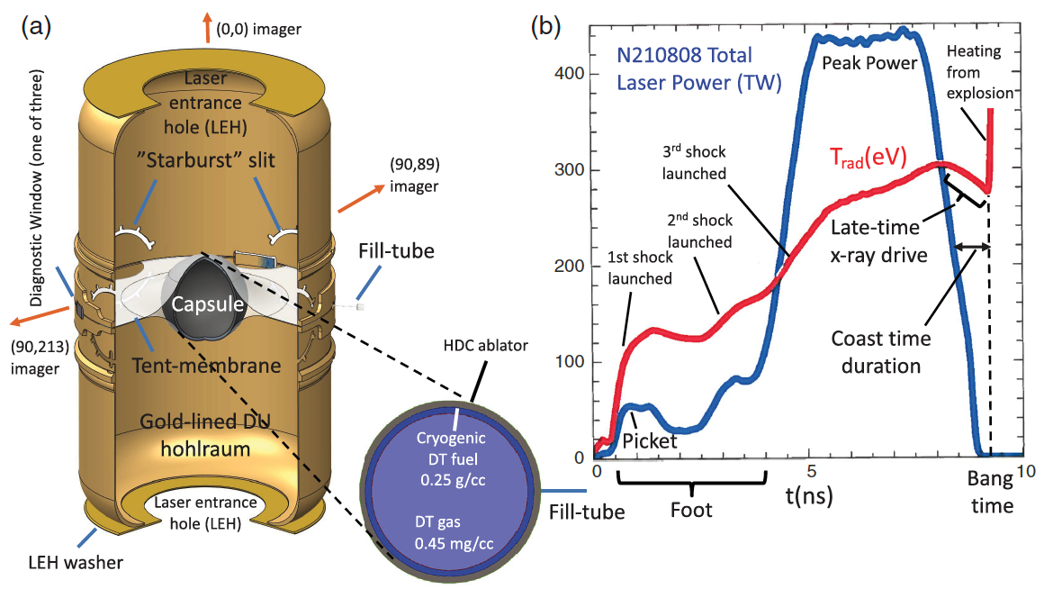
HYBRID-E is the first ICF design to obtain a burning plasma¹ and ignition² in the laboratory
Key elements:
Up to 20% larger radius capsule than previous HDC ablator designs
Reduced LEH size, for better x-ray confinement³, with symmetry control via CBET⁴/pointing
Lower laser peak power, but an extended duration of peak power in order to reduce “coast time” duration⁵
All resulting in increased hotspot energy and pressure
²Abu-Shawareb, et al (Indirect Drive ICF Collaboration), PRL, 2021; Kritcher, et al, PRE, 2021; Zylstra, et al, PRE, 2021
¹Zylstra, et al., Nature, (2022); Kritcher, et al., Nature Phys. (2022); ³Ralph, et al. ”Hohlraum Scans Project,” APS-DPP (2021); ⁴Kritcher, et al., PRE (2018); ⁵Hurricane, et al. PoP, (2017)

Slide 30
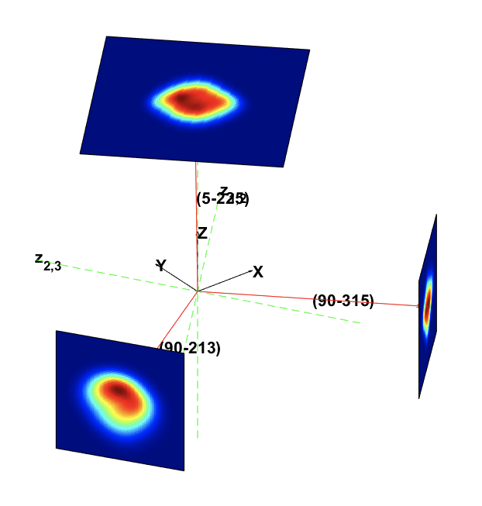
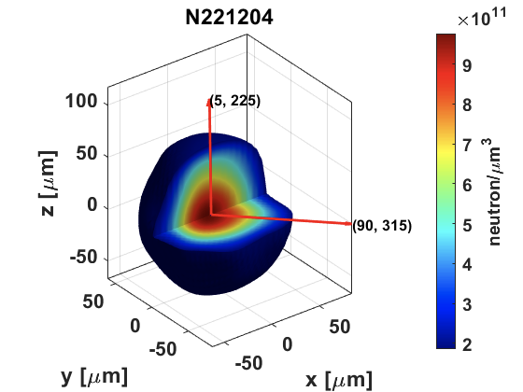
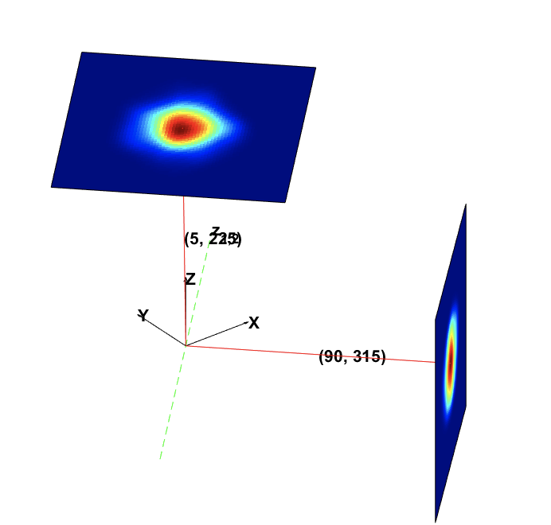
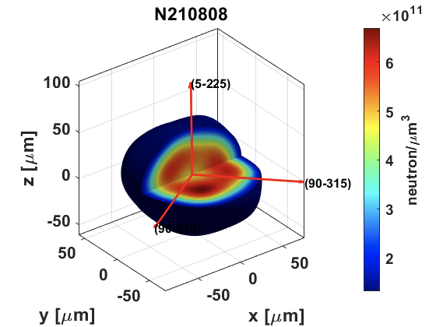
8% thicker ablator (m_{shell}), with +8% more laser energy, and improved symmetry pushed the 1.37 MJ result to 3.15 MJ
Time integrated neutron imaging
1.37 MJ
3.15 MJ
Neutron Imaging System; Vologev, et al., RSI, (2014)

Slide 31
Increasing laser energy and capsule thickness by +8%,while maintaining symmetry control, obtained G_{target} > 1 Dec. 5, 2022
Lawson Metric Space
Delivered Laser Pulse
N221204
N220919
1.2 MJ
N221204
3.15 MJ
N210808
p𝝉 (atm-s)
N210808
1.37 MJ
N211107
0.7 MJ
Lawson
ignition boundary
DD T_{ion} (keV)
Story of success by “incremental” evolutionary improvements

Slide 32

Outstanding problem: materials appear stiffer than models expected and higher compression is needed for increased burn efficiency
theory
Fraction of DT fuel burned:
Measured compression
$$φ≈\frac{{ρR}_{fuel}}{{ρR}_{fuel}+7}$$
Fraley, et al., Phys. Fluids, 17, 1974
Figure from: Landen, et al., PoP, 28, 042705 (2021)
Expected compressibility based on entropy
The end of the beginning...there is more work to do!

Slide 33
Remarkable that we can now talk about burning plasmas, ignition, and scientific breakeven (G_{target} > 1) in the past-tense!
No mystery physics obstacle stands in the way of ignition (explosive thermodynamic instability) or gain (energy out > energy in)
The theoretical prediction of the physics parameter regime (e.g. Lawson triple product) where ignition was expected consistent with our results
Additional laser energy (at fixed power) was very beneficial (”low coast time”)
Implosion physics was more sensitive to engineering control of the laser and targets than originally thought
So far, very high gain (high compression) target designs have not worked as expected. All break-throughs over the past decade have used low gain designs

Slide 34
Disclaimer
This document was prepared as an account of work sponsored by an agency of the United States government. Neither the United States government nor Lawrence Livermore National Security, LLC, nor any of their employees makes any warranty, expressed or implied, or assumes any legal liability or responsibility for the accuracy, completeness, or usefulness of any information, apparatus, product, or process disclosed, or represents that its use would not infringe privately owned rights. Reference herein to any specific commercial product, process, or service by trade name, trademark, manufacturer, or otherwise does not necessarily constitute or imply its endorsement, recommendation, or favoring by the United States government or Lawrence Livermore National Security, LLC. The views and opinions of authors expressed herein do not necessarily state or reflect those of the United States government or Lawrence Livermore National Security, LLC, and shall not be used for advertising or product endorsement purposes.

Slide 35
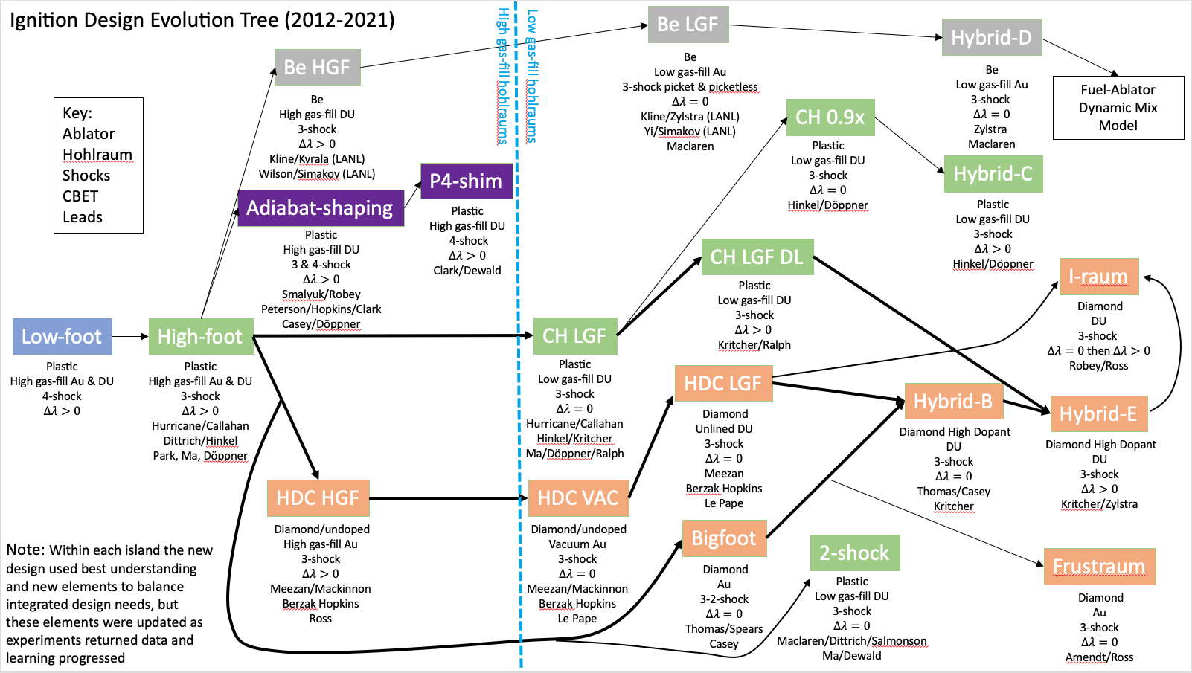
Coast-time slide

