Slide 1
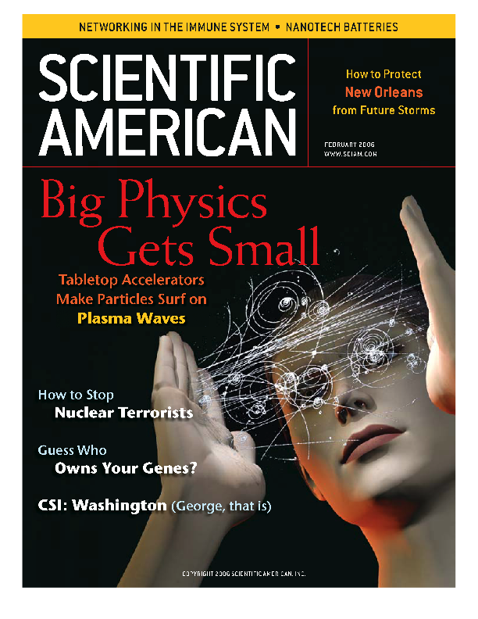


Wakes and Shocks in Plasmas
Chan Joshi
UCLA
Supported by DOE and NSF
MIPSE Colloquium U. Michigan

Slide 2
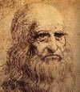
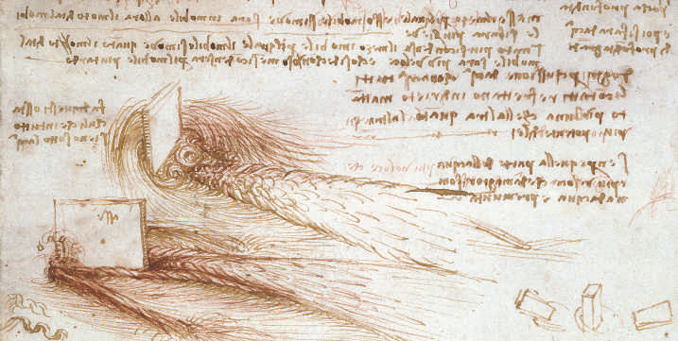
What is a Wake?
Structure of the displaced fluid behind an object causing disturbance
Leonardo deVinci: Study of Wakes-1509
Notes:
Before I get to plasma wakes let me explain what a wake is. A wake is a disturbance left behind an object that is moving through a fluid.Alternately a wake can also be generated by the flow of the fluid around a stationary object.In fact Leonardo deVinci ,as far as we know was the first person to systematically study the natute of wakes produced when a solid plate of metal was placed in flowing water.He also observed that when the rectangular plate was moved in a stationary fluid such that it’s direction of propagation was at a right angle to the plate ,the wake was symmetric on either side of the plate but when the plate was held at an angle the wake became quite asymmetric.
Half a milenium later these asymmetric wakes would lead to the sport of wake surfing.

Slide 3
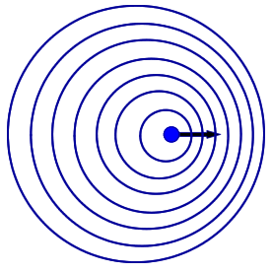
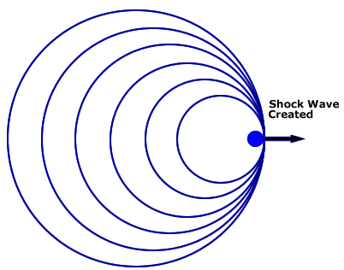
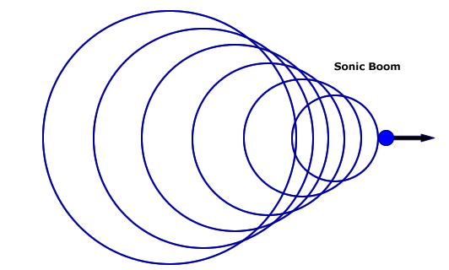

What is a Shock?
A disturbance that travels at supersonic speeds through a medium
Subsonic
Sonic
Supersonic
Object
At supersonic speeds, pressure will build at the front of a disturbance forming a shock
Characterized by a rapid change in pressure (density and/or temperature) of the medium
In a plasma, a shock wave is characterized by a propagating electric field at speeds useful for ion acceleration (V_{sh} > 0.01c)
Neptune Laboratory

Slide 4
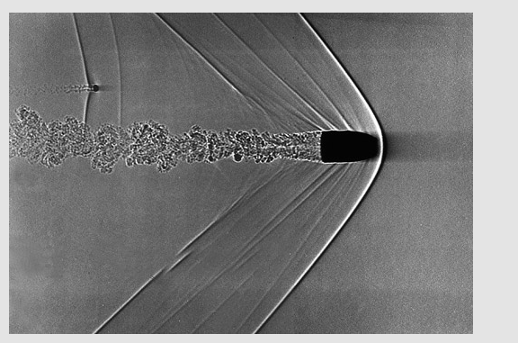
Supersonic Disturbance in a Fluid can
Produce both a wake and a shock
Bow Shock
Wake
Density
Cavitation
Density Pile up
Bullet at Mach 1.5 through air produces both a wake and a shock

Slide 5
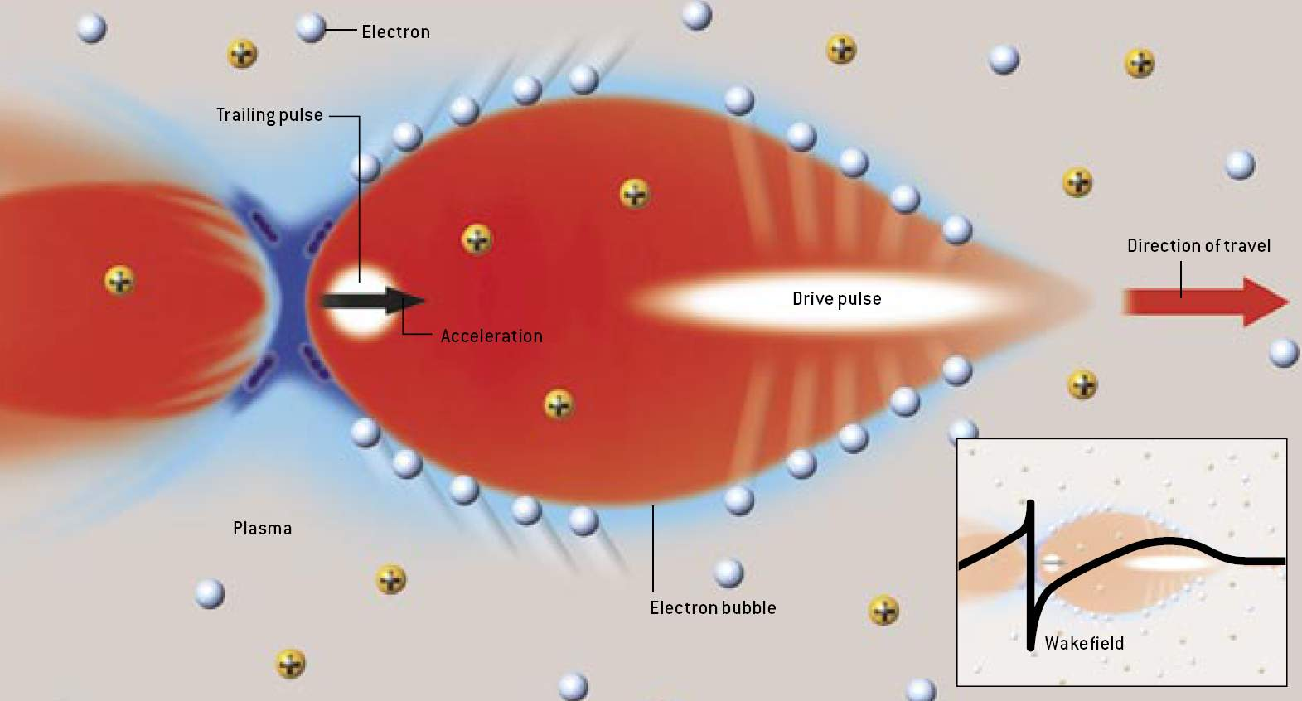
Wakes in Plasmas Excited by
Passage of a Relativistic Electron Beam
Relativistic
Electron Bunch
Decelerating
Accelerating
V_{g} = V_{ph} ~ c
C. Joshi Scientific American Feb 2006

Slide 6
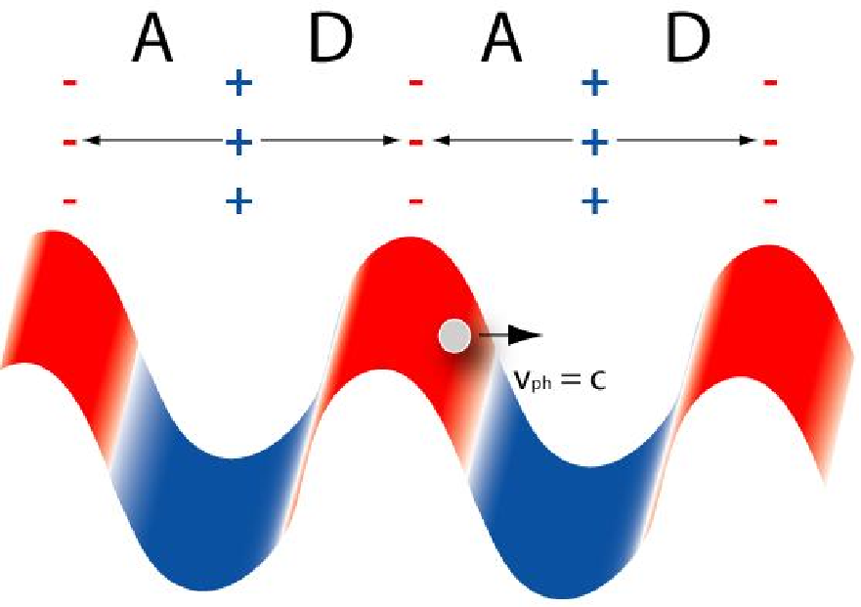

Wakes in Plasmas: Microscopic Capacitors
Moving at Light Speed
A Accelerating
D Decelerating
0.5
Change in Density
0
Position
-0.5
Accelerating Field= 30GeV/m(10¹⁷/n_{o})^{1/2}
Notes:
In some respects the process of an electron gaining energy from a plasma wake is similar to surfing down an ocean wave. The short laser pulse shooting through the plasma disturbs the plasma electrons and sets up a wake that looks like a wave as I have already mentioned. This wake can be thought of as a periodic variation of plasma electron density.In this figure the red regions are where the electron density has increased above it’s background value and the blue regions are where the density is lower than the background value. Furthermore because the laser pulse that produced this disturbance is moving through the plasma at close to light speed the wake structure also moves at this speed.
This wave can be thought of as a series of microscopic capacitors.Near the crest of the wake there is an excess of electrons and therefore we can think of this as the negative plate.Near the trough of the wake there is a deficit of electrons which means an excess of ions.So this is the positive plate of the capacitor.The electric field in a parallel plate capacitor points from the positive plate to the negative plate.Now if one were to place a free electron near the crest of the wave it would be accelerated by this electric field .Th do this the electron has to somehow be preaccelerated to the speed of the wave in analogy with the surfer trying to catch the ocean wave.Of course the acceleration will stop once the electron reaches the trough.But because the wave is moving near c and so is the particle,it takes a long time for the electron to outrun the wave. The increase in electron energy is due to an increase in it’s mass according to the special theory of relativity.
The advantage of using a plasma is that the accelerating field can be a thousand times larger than that in a conventional accelerator bur the downside is that the whole plasma structure is microscopically small ephemeral.The typical size of the structure is 0.1mm and it lasts just a trillionth of a second.It is for this reason that many prominent scientists remained skeptical that this method of accelerating particles could ever be made to work.

Slide 7
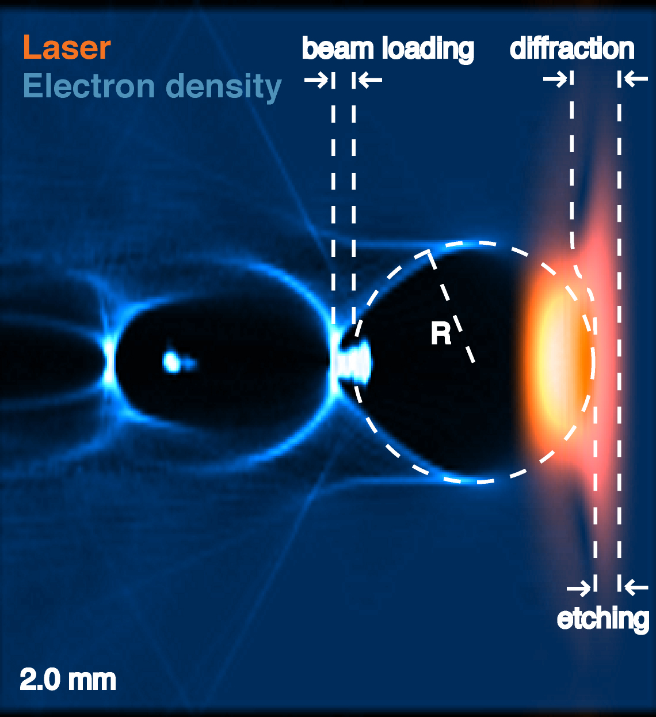
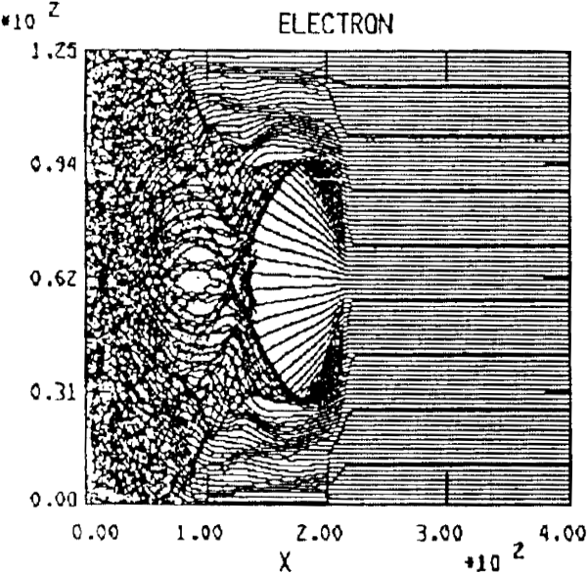
Intense Laser Pulses can Excite both Wakes & Shocks in Plasmas
Rosenzweig et al. 1990 Pukhov and Meyer-te-vehn 2002
Dilute Plasma v_{g,laser} ~ c
Dense Plasma v_{g,laser} < c
Bow shock
Turbulent
Plasma
Wake
2D PIC
3D PIC
P =.2 PW, τ =30fs
P=5 TW, τ=30 fs
W. Lu, M. Tzoufras et al., UCLA
V_{g}=c(1-n_{e}/2n_{c})
Notes:
Particle Accelerator Conference, 1991.
'Accelerator Science and Technology'_
5/06/1991 - 05/09/1991_ay 6-9, 1991,
San Francisco, CA, USA
Abstract
The UCLA and LLNL (Lawrence Livermore National
Laboratory) nonlinear laser wake field scheme is discussed.
The authors find advantages to operating in the limit where
the laser pulse is narrow enough to expel all the plasma
electrons from the focal region. A description of the
experimental program for the short pulse 10-TW laser facility
at LLNL is presented

Slide 8
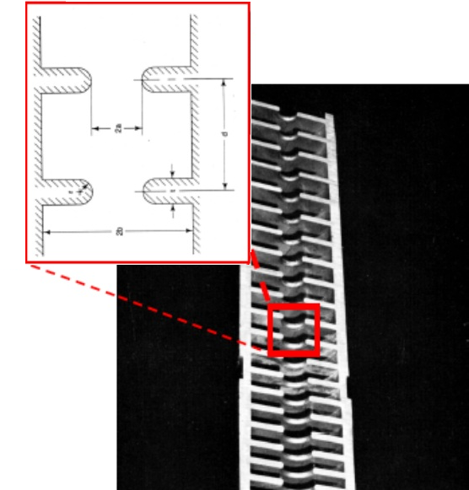
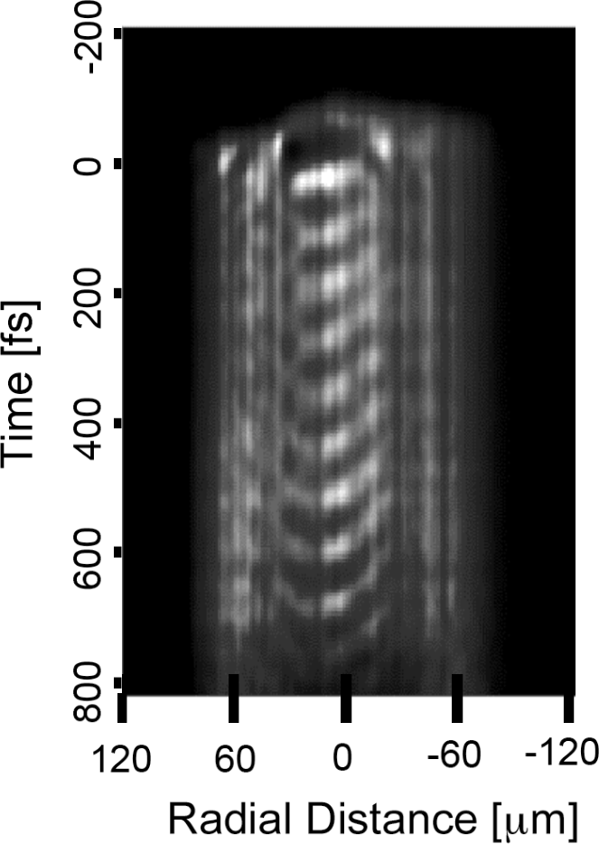
Conventional Accelerator
Plasma Accelerator
Copper Structure with irises Ionized Gas
Powered by microwaves Powered by a Laser or
electron beam pulse
Energy Gain 20 MV/m Energy Gain 20 GV/m
Structure Diameter 10cm Diameter 1mm
Lifetime one picosecond
.3
mm
1 m
N. Matlis et al
Nature Physics

Slide 9
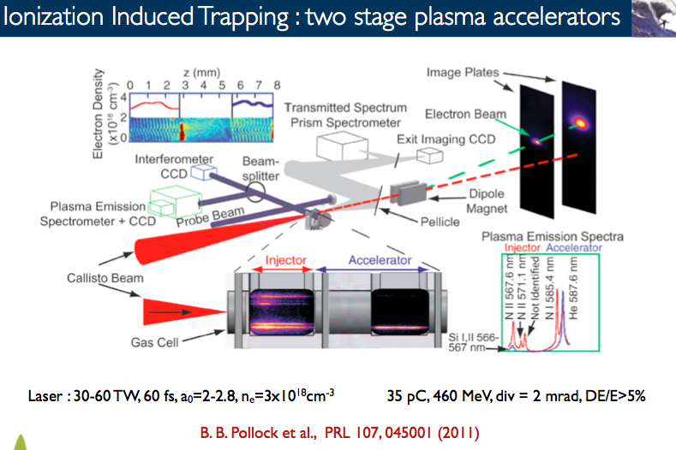
Typical Laser-Wakefield Acceleration Experiment circa 2013
UCLA/UCSD/LLNL Collaboration

Slide 10
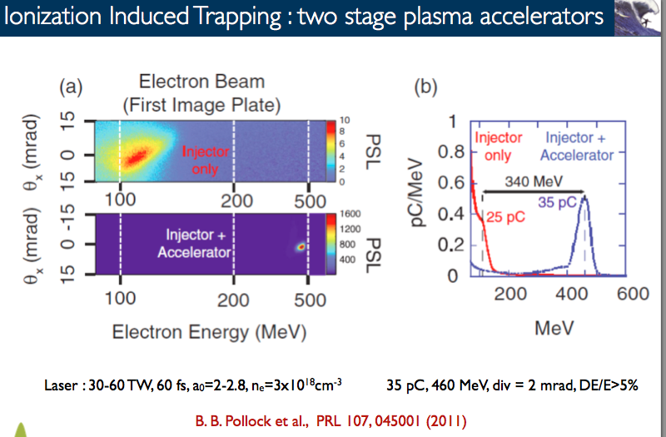
Injector-Accelerator Configuration Produces Narrow Energy Spread e⁻ Beam (UCLA/LLNL/UCSD Collaboration)

Slide 11
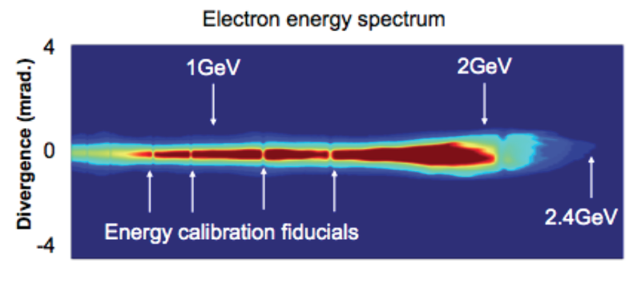
High Quality Electron Beams Accelerated at 100 GeV/m in Laser Wakefield Accelerator
Laser pulse
f/40
95 – 125 J
150 fs
7 cm unifom
gas cell
1T magnet
GeV class beams produced at U.T. Austin
Courtesy M. Downer; unpublished results
laser
polarization
GeV Electron Beams in just a cm-scale
plasma accelerator!!!
Beam
dump
e⁻
Image plate for GeV e⁻

Slide 12
Beam-Driven Wakefield Accelerators
(Blowout Regime)
Rosenzweig et. 1990 Pukhov and Meyer-te-vehn 2002 (Bubble)
40 GeV Beam
60 kA in 50 fs
1 PW
-
-
-
-
-
-
-
-
-
-
-
-
-
-
-
-
-
-
-
-
-
-
-
-
-
-
-
-
-
-
-
-
-
-
-
-
-
-
-
-
-
-
-
-
-
-
-
-
-
-
-
-
-
-
-
-
-
-
-
-
-
-
-
-
-
-
-
-
-
-
-
-
-
₊
₊
₊
₊
₊
₊
₊
₊
₊
₊
₊
₊
₊
₊
₊
₊
₊
₊
₊
₊
₊
₊
₊
₊
₊
₊
-
-
-
-
₊
₊
₊
₊
-
-
-
-
-
-
drive beam
₊
₊
₊
₊
₊
₊
₊
₊
₊
₊
₊
₊
₊
₊
₊
₊
-
-
₊
₊
₊
₊
₊
-
₊
₊
₊
₊
₊
-
₊
₊
₊
₊
₊
₊
₊
₊
₊
₊
₊
₊
-
-
-
-
₊
₊
₊
₊
₊
₊
₊
₊
₊
₊
₊
₊
₊
₊
₊
₊
₊
₊
-
-
-
-
-
-
-
-
-
-
-
-
-
-
-
-
-
-
-
-
-
-
-
-
-
-
-
-
-
-
-
-
-
-
-
-
-
-
-
-
-
-
-
-
-
-
-
-
-
-
-
-
-
-
-
-
-
-
-
-
-
-
-
Ez
Space charge of the beam displaces plasma electrons
Plasma ion channel exerts restoring force => space charge oscillations
  Linear focusing force on beams (F/r=2πne²/m)
UCLA,USC,SLAC E 167 Collaboration

Slide 13
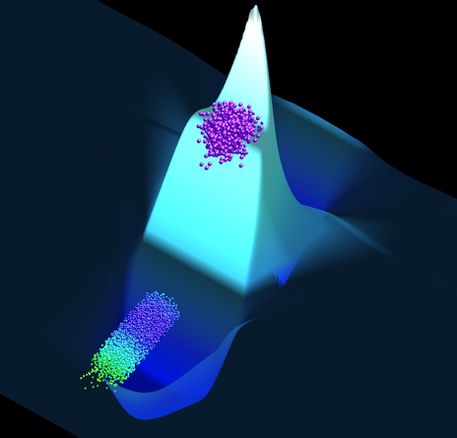
Big-Wave Surfing on a Plasma Wake
Electric
Field
Accelerating
Beam
Drive Beam
Propagation
Direction

Slide 14
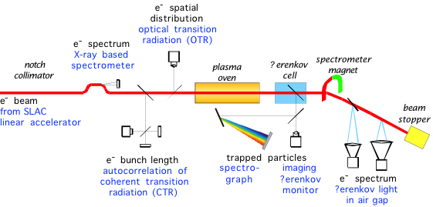
Electron Beam Drivers Enable Meter-Scale Wakefield Acceleration
Initial Energy
30-40 GeV
Final Energy
10-100 GeV

Slide 15
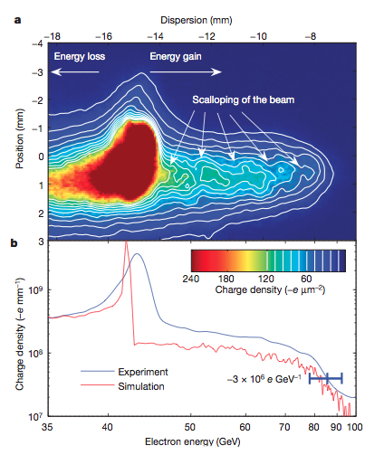


Beam-Driven Wakefield Acceleration from
42 GeV-85 GeV in 85 cm.
Talk by T. Katsouleas Duke U
V 445 p741 (2007)
Experiment
Simulations
35
Energy (GeV)
100
UCLA/USC/SLAC Collaboration E167
I. Blumenfeld et al Nature 2007

Slide 16
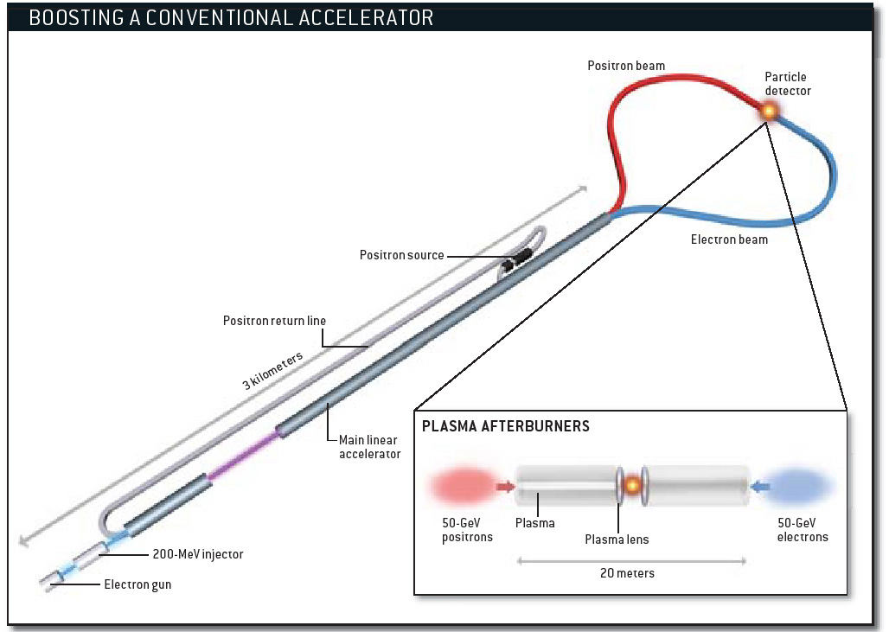
Plasma Afterburner for a Linear Collider
C. Joshi and T. Katsouleas
Physics Today 2005

Slide 17
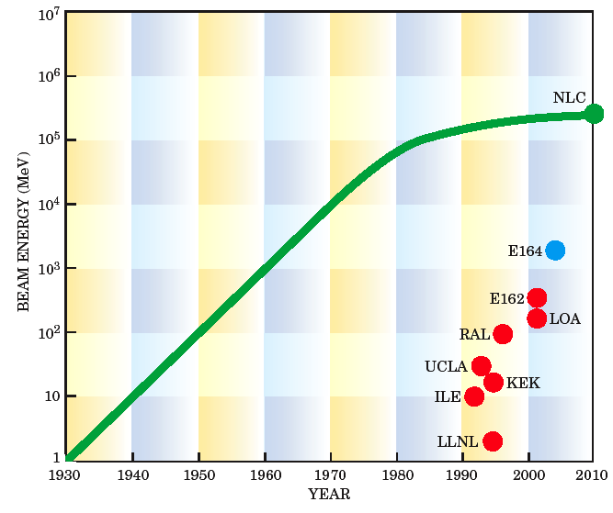
Plasma Accelerator Progress
“Accelerator Moore’s Law”
Electron beam driven
Laser beam driven
ILC
Working Machines
Doing physics
E167
E164X
LBNL
RAL
LBL Osaka
Max.Energy in
Experiments
C. Joshi and
T. Katsouleas
Physics Today 2005
UCLA
ANL

Slide 18


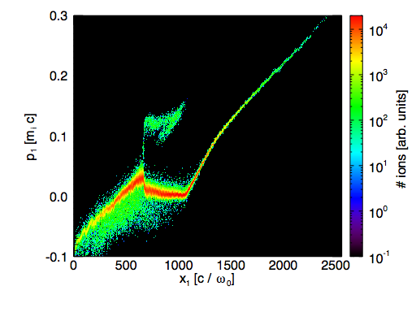
Laser Acceleration of Ions
Shock
acceleration
Shock
acceleration
e⁻
Target
Normal
Sheath
Acceleration
Momentum
TNSA
High-intensity
laser pulse
Hot Cold
Position
Applications of Laser Accelerated Ions
Medical isotopes
Cancer therapy
Proton radiography
Fast ignition fusion
Fast electron travel
through the target
Mechanisms Leading to Shock
And Target Normal Sheath Acceleration
L. Silva et al PRL

Slide 19
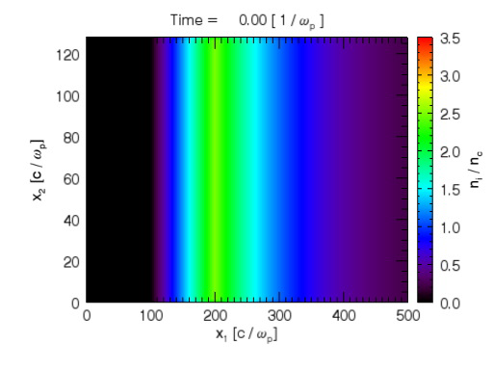
Detached Supersonic shocks can be launched by a laser pulse in an over-dense plasma
Although laser beam filaments,
Refluxing of heated electrons
Launches a planar shock
Extended
Exponential
Plasma
Steepened
Plasma
Shock continues to propagate long after laser piston is removed
a₀ = 2.5, τ = 2080/ω_{p}
Laser Pulse (piston) stops near critical density and strongly heats electrons

Slide 20
In the frame of the shock we have interpenetrating plasmas
  Interpenetrating plasmas with dissimilar densities (n_{p1} > 3n_{p0}) form a shock
  Shock speed increases with :
    T_{e}
    V_{drift}
  T_{e1}/T_{e0} not important for
  Relativistic temperatures
  V_{drift} > V_{max} shock not formed
  Increasing V_{drift} towards V_{max} increases the % of reflected protons
Plasma 1
n_{p1} = 2n_{cr}
T_{e1}
Cold Ions
V₁ →
Plasma 0
n_{p0}
T_{e0}
Cold Ions
Reflected Ions
Downstream
Ions
Upstream
Ions

Slide 21
Excitation of Collisionless Shocks
Downstream to upstream density ratio Γ
Downstream to upstream temperature ratio Θ
Relative drift velocity v_{drift}
What determines the shock velocity?
V_{drift} and electron temperature ( C_{s} )
Linearly polarized light better than circular.
Mechanism not to be confused with hole boring RPA
Collisionless if λmfp e-e, e-i, i-i << _{few λD}

Slide 22
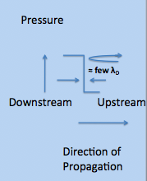
Shock Excitation and Reflection of Ions
Motion of an ion in the potential well of an ion wave can be written in terms of the Sagdeev potential
Shocks excited in plasmas when the nonlinear
Sagdeev (quasi) potential
Ψ(φ) = {P_{i}(φ, M) –P_{e1}(φ, Θ, Γ) – P_{e0}(φ, Θ, Γ)} < 0
P_{i}(φ, M) = ion pressure for cold ions & Maxwellian e⁻
P_{e1}(φ, Θ, Γ) =downstream e⁻ pressure
P_{e0}(φ, Θ, Γ)= upstream e⁻ pressure
M = V_{sh}/C_{s} with Cs = (kT_{e0}/m_{i})^{1/2}
Φ = eφ/kT_{e2} electrostatic potential energy difference
Φ plays role of space and ξ=x/λ_{D} plays role of time
Ions will be reflected when
eϕ > ½ m_{i}V²_{sh} which gives eϕ _{crit} = M²_{crit}/2

Slide 23
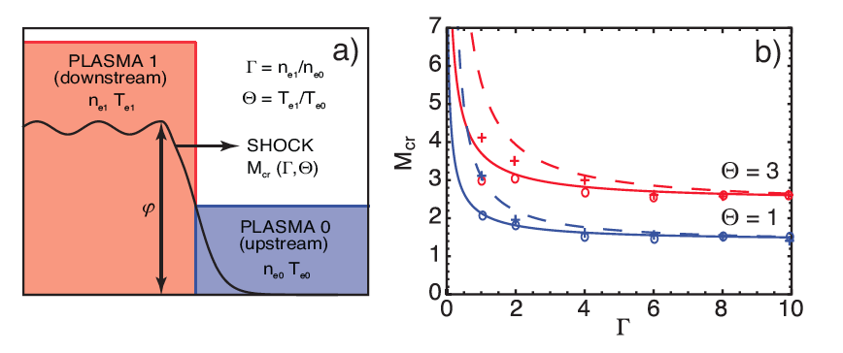
Critical Mach Number Needed for Ion Reflection as a Function of Γ and Θ
Experimental
Parameter
Regime
1 keV
1 MeV
1keV
1MeV
EXPERIMENTS
Nonrelativistic
Relativistic
PIC simulations
F. Fiuza et al Submitted for publication

Slide 24
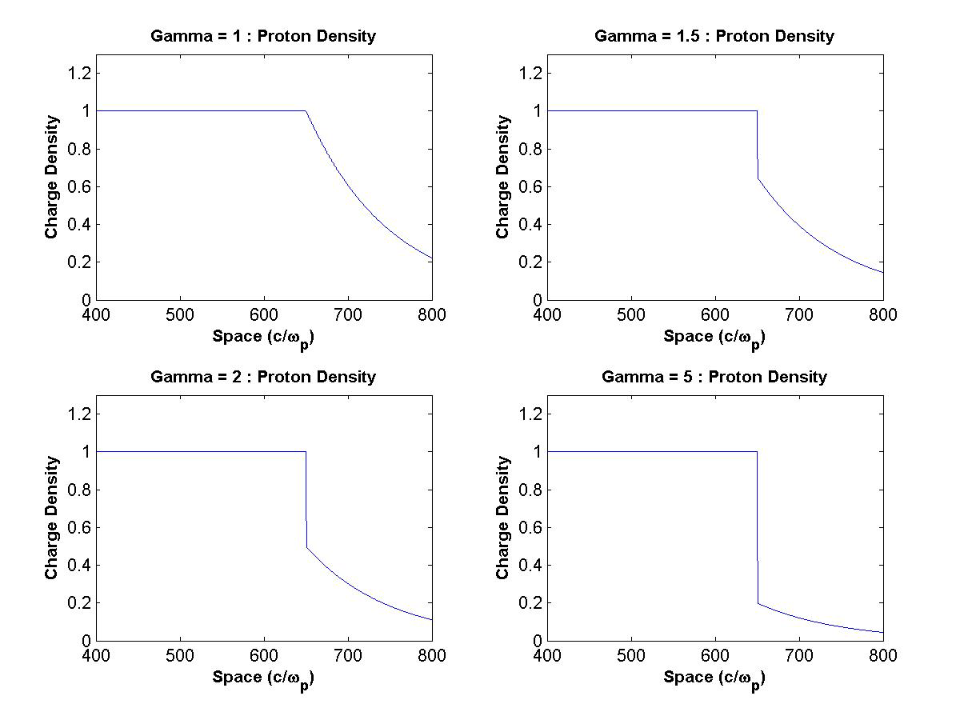
Density Ratio Γ= n_{d}/n_{u} Threshold of Shocks
(ion density evolution)
Expansion of a dense plasma into a rarefied exponential plasma
E _{TNSA} ~ 1/L
Γ=1
Γ=1.5
Plasma1
Constant
Density
Plasma2
Exponential
profile
Γ=2
Γ=5
1D OSIRIS

Slide 25
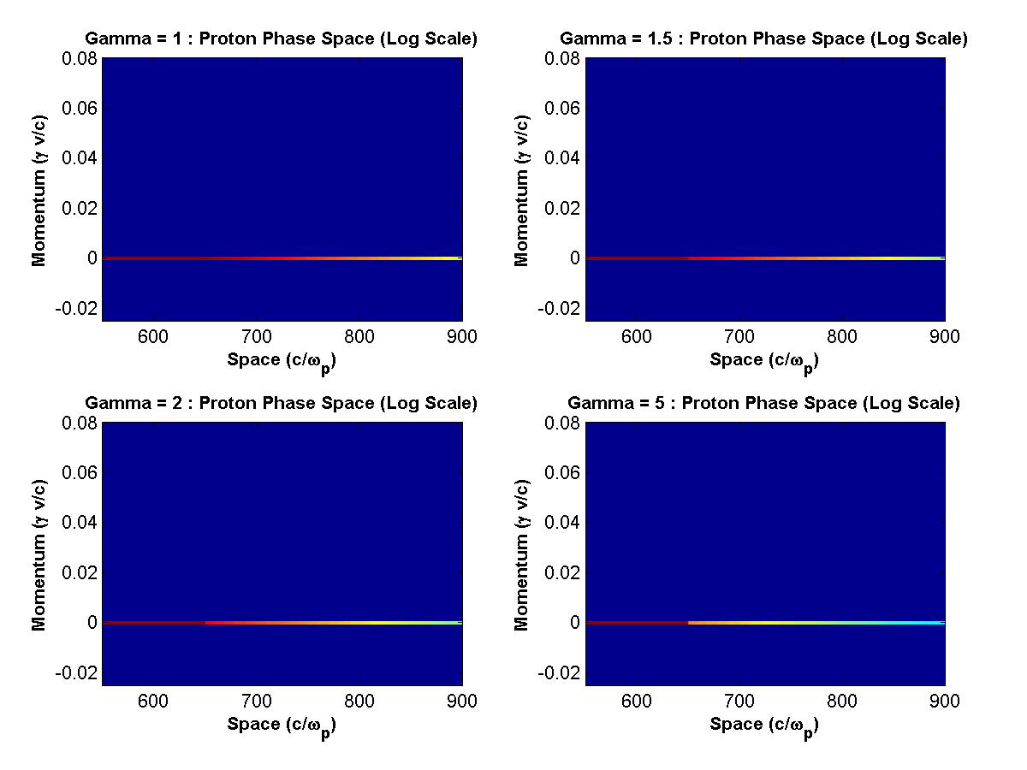
Density Ratio Γ Threshold of Shock Formation
(ion momentum evolution)
Γ=1
Γ=1.5
Γ=2
Γ=5
V _{refl} = 2V _{shock}- V _{up}

Slide 26
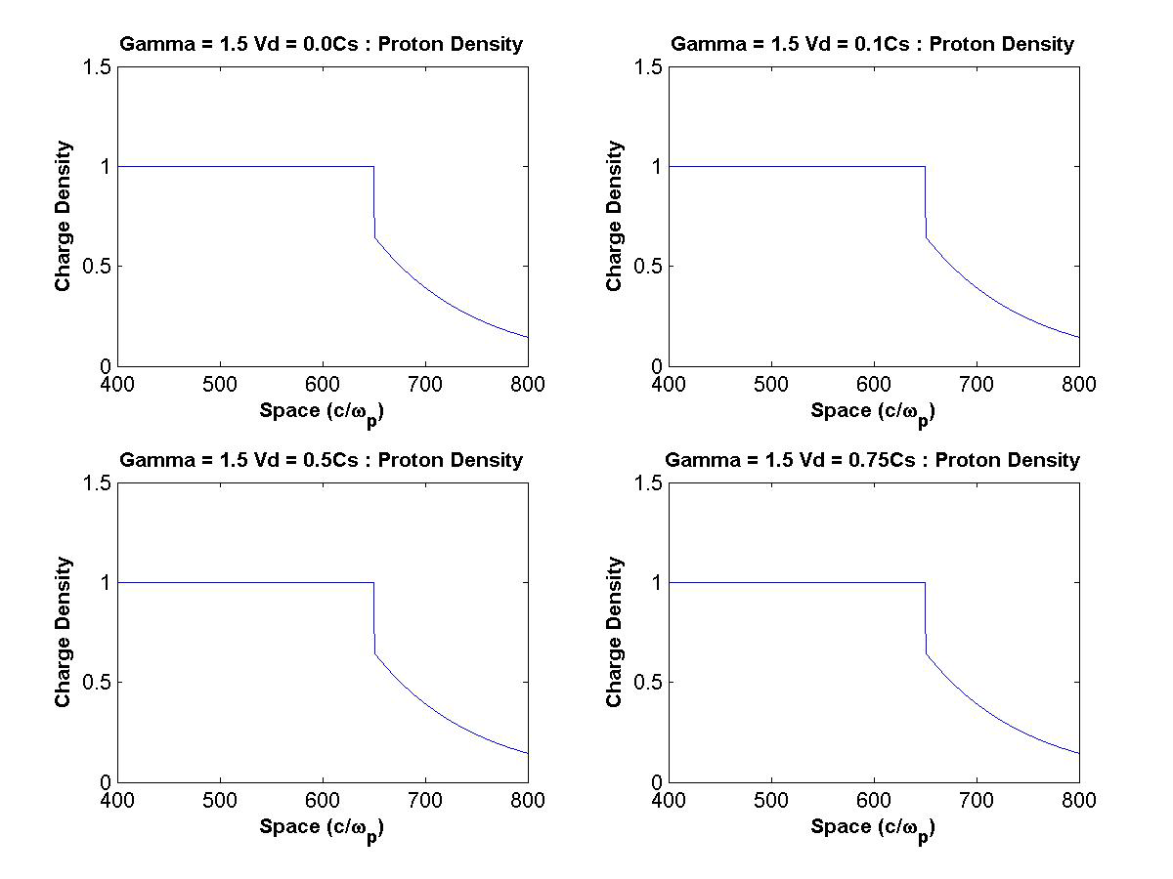
Drift Velocity Helps Shock Formation
(ion density evolution)
Γ=1.5 v_{d}=0
Γ=1.5 v_{d}= 0.1C_{s}
Γ=1.5 v_{d}= 0.5C_{s}
Γ=1.5 v_{d}= 0.75C_{s}

Slide 27
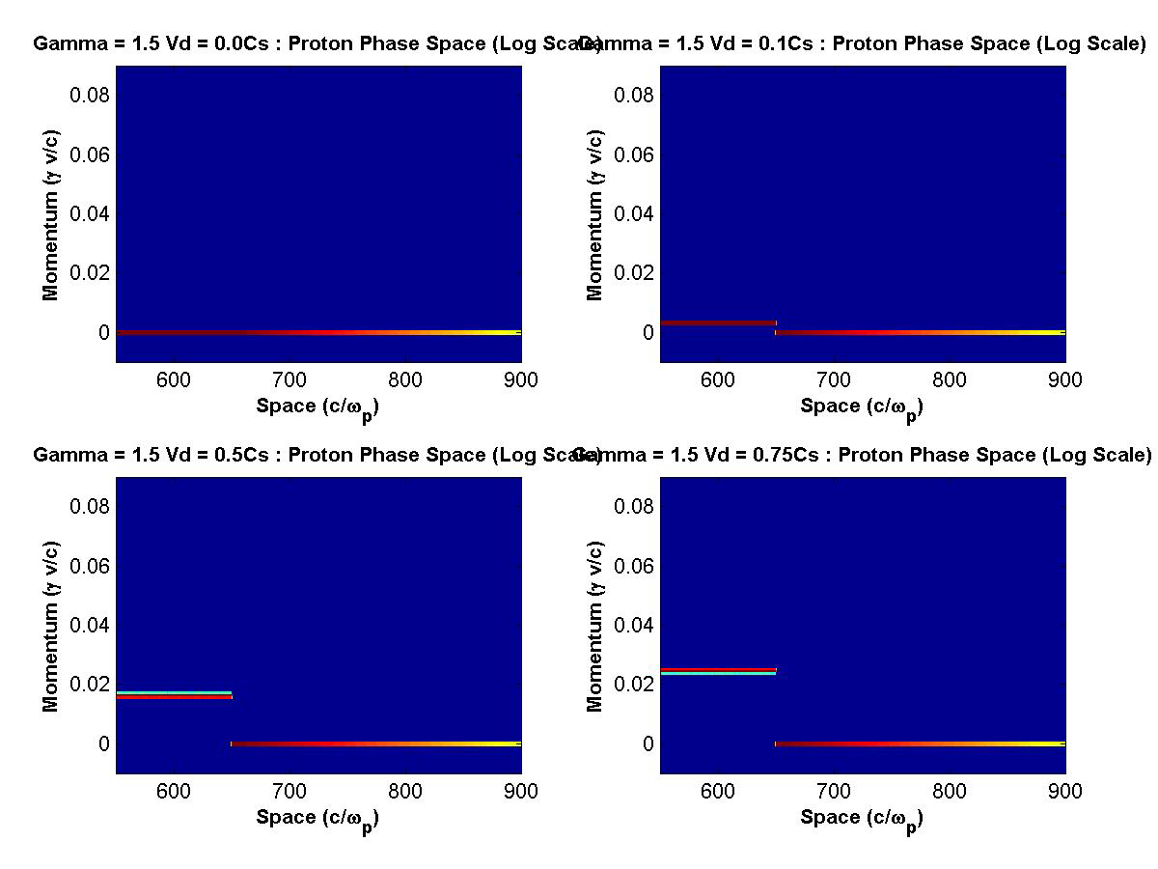
Drift Velocity Helps Shock Formation
(ion momentum evolution)
Γ=1.5 v_{d}=0
Γ=1.5 v_{d}= 0.1C_{s}
T_{e} = 1MeV
T_{i} = 100 eV
Γ=1.5 v_{d}= 0.5C_{s}
Γ=1.5 v_{d}= 0.75C_{s}

Slide 28
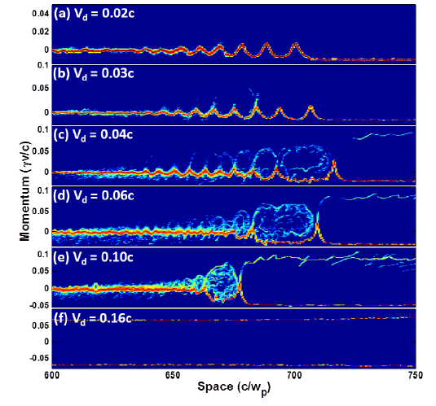
Transition from Ion Acoustic Wave to Shock in Two Drifting Interpenetrating Plasmas
Classic Ion Acoustic Wave
V _{drift} too small : No Shock
Nonlinear IAW onset of Ion Trapping
V _{drift} just right : Shock Onset
Strong Ion Trapping
Shock
V _{refl} = 2V _{shock}- V _{up}
Beam Loading damps IAW
Ion reflection Upstream
and ion trapping downstream
High Efficiency
Reflection from Shock
V _{drift} too Large
Plasmas pass through one another

Slide 29
Formation of Collisionless shocks
Two interpenetrating plasmas with dissimilar densities and in addition a relative drift expand through one another.
The sheath field of the higher density plasma which expands with C_{s} seeds an ion acoustic wave behind it.
When the conditions of density and drift velocity are right the Sagdeev potential becomes –ve and the nonlinear ion wave morphs into either a soliton (no dissipation) or a shock with ion reflection (upstream) and ion trapping (downstream) acting as the dissipation mechanisms.

Slide 30
Ion Acceleration by Collisionless Shocks: Reduction to Practice
Need two colliding plasmas with a density ratio of at least 1.5 and a relative drift velocity of < 0.5C_{s}
Need strong electron heating to get a large corresponding shock velocity
Longer pulses better: allow refluxing of electrons and homogenize any filamentation imprint left by the laser
Need few times critical density and linear polarization for strong electron heating

Slide 31
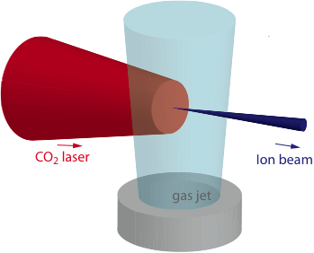
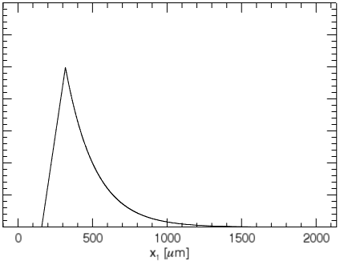
NEPTUNE: Most Powerful CO₂ Laser in the World
Physical Parameters
Gas jet
Laser
Plasma
λ0 = 10 μm
I0 = 10¹⁶ - 10¹⁸ Wcm⁻²
τ0 = 3 ps/ 100 ps
W0 = 60 μm
Lg = 20 μm
ne0 =4x 10¹⁹ cm-3 (4 nc)
mi/me = 1836
Launch collisionless shock in a supercritical plasma by pushing on it to induce v_{drift} and strong heating to get a large c_{s .}
Minimize TNSA fields by shock propagation in extended plasma
Steepened
Plasma
ni
Extended Plasma
hybrid
PIC
E _{TNSA} ~ 1/L

Slide 32
Plasma Density Profile at Peak of Laser Macropulse
Density Cavity
Neutral
profile
Plasma Layer Heated and
Pushed by the laser
Plasma
Profile

Slide 33

Experimental Arrangement
Time Structured Laser Pulse
Neptune Laboratory
Source Size : d = 120µm
Beam Size (RMS) : σ_{x} ̴ 5.7mm
σ_{y} ̴ 2.2mm
Divergence : θ_{x} ̴ 37mrad
θ_{y} ̴ 14mrad
Emittance : ε_{x} = d.θ_{x} = 4.6mm.mrad
ε_{y} = d.θ_{y} = 1.7mm.mrad

Slide 34
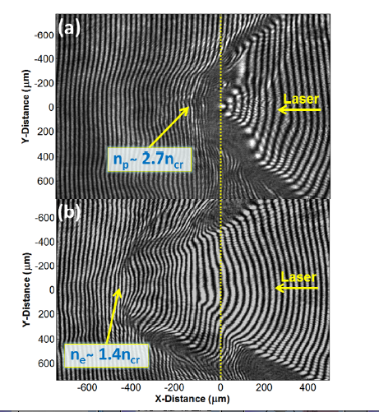

Overdense Penetration and Radiation Pressure Lead to “Hole-Boring”
Radiation Pressure Induced
Cavitation Leads to
Both density pile up and a drift
t= 33ps
Measured Average Hole boring (shock propagation velocity) ~0.015c
Max ion energy ~ 100 keV
t=131 ps
Theoretical Maximum V_{hb} = 0,041c for a₀= 2.5 and n= 2n_{cr}. Max Ion Energy = 800 keV

Slide 35
Measured Proton spectra
Energy spreads measured to be FWHM ΔE/E ̴ 1%
Noise Floor
Source Size : d = 120µm
Beam Size (RMS) : σ_{x} ̴ 5.7mm
σ_{y} ̴ 2.2mm
Divergence : θ_{x} ̴ 37mrad
θ_{y} ̴ 14mrad
Emittance : ε_{x} = d.θ_{x} = 4.6mm.mrad
ε_{y} = d.θ_{y} = 1.7mm.mrad
N ~ 10⁶
Neptune Laboratory

Slide 36
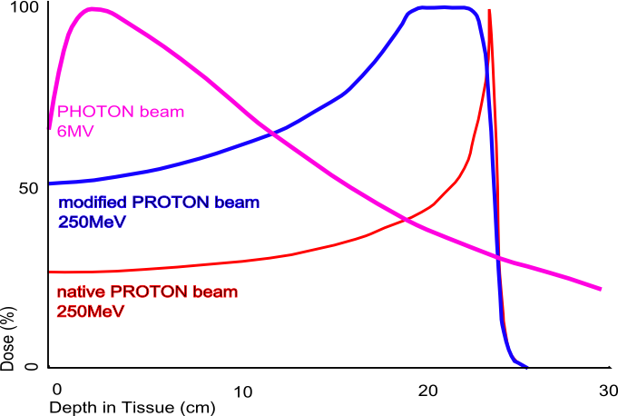
Energy Deposition : Ions & Photons
Bragg Peak for ions results
in localized energy deposition
TUMOR

Slide 37
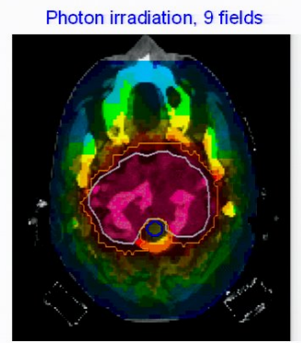
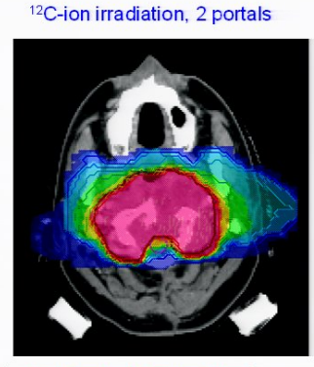
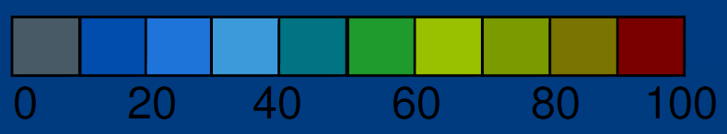
Multiple Beams Used to Irradiate Tumor
Multiple X-Ray Beams
T
Tumor
Organ
Eight X-ray Beams
Two Carbon Ion beams
Simulations of Irradiating the Human Skull with Multiple Beams
Radiation dose relative to peak (100%)
Adapted from GSI Helmholtz Centre for Heavy Ion Research in Darmstadt

Slide 38
What is Needed for Tumor Therapy?
Treatment dose: 2 Gy/ 10min , Volume 1 Litre
~ 1-5 X10⁹ particles/s
Energy requirements: 50 MeV (superficial tumors)
> 200 MeV (deep tumors)
ΔE/E ~5% ( Proven to be challenging to-date)
Dose Accuracy
Isocentric Delivery
Low Cost
Notes:
I Gray =1 J/Kg or 100 Rad, 10 000 x-rays to chest

Slide 39
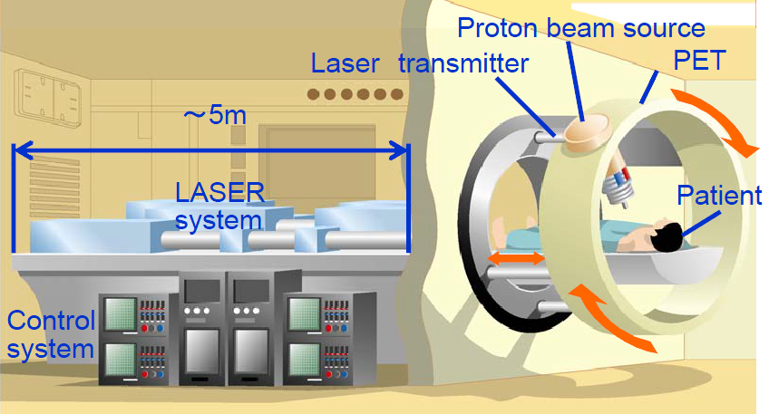
Laser-Based Ion Accelerator
Goal Cost : 10-20 million USD
Table top laser system (developing)
Transportation : Mirrors
Only has focusing magnet
Gantry : small, protons generated in direction of patient
M. Murakami, et al., AIP Conf. Proc. 1024 (2008) 275, doi:10.1063/1.2958203

Slide 40
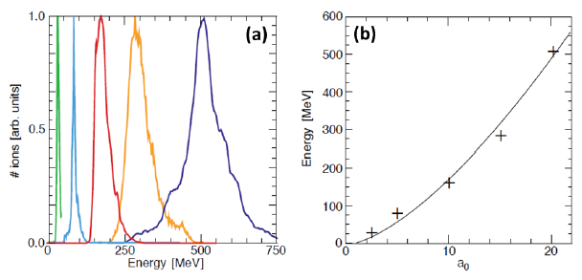
Scaling of Energy and Energy Spread with a₀
OSIRIS 2D Simulations : F. Fiuza et al
5
15
20
10
a_{o}=2.5
Energy Spectrum Scaling with a₀
Scaling of Maximum Energy with a₀

Slide 41
Conclusions
Shocks and wakes are produced by intense laser or particle beams in plasmas
Strong electric fields are associated with these shocks and wakes.
Wakes typically propagate at c and are useful for accelerating electrons to very high energies
Collisionless shocks are detached from the disturbance that initially pushes and heats the plasma.
Such shocks propagate at supersonic speeds and can accelerate ions to high energies.

Slide 42
ACKNOWLEDGEMENTS
All my collaborators at LLNL including B.Pollock, J.Ralph, A. Pak, F. Albert, S. Glenzer, D.Froula (U. Rochester)
C.Clayton, K. Marsh, D. Haberberger, S. Tochitsky, C.Gong
F.Fiuza, L. Silva, W.Mori
All my collaborators on E167 experiment at SLAC
And anyone I may have inadvertently missed.

Slide 43
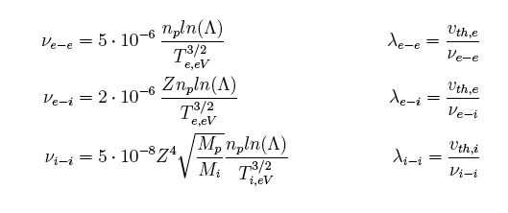
Collisionless Shocks formed when
Shock Thickness << Collisional mfp(s)
Pressure
≈ few λ_{D}
Downstream
Upstream
Direction of
Propagation
Energy Dissipation through reflection of upstream ions

Slide 44
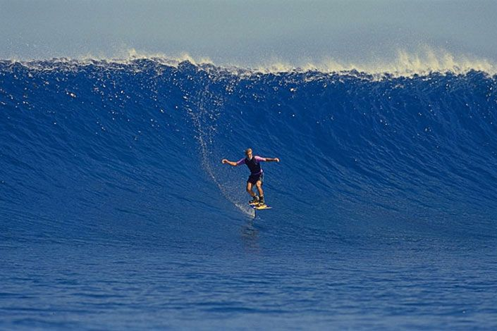
Gaining Kinetic Energy by Riding a Wave
Laird Hamilton:Hydrofoil Surfing in Hawaii
Notes:
In some ways the process of energy gain by electrons from the plasma wake is similar to the process of catching and riding an ocean wave.In the simplest case the surfer must first catch the wave.To do this he has to be moving nearly at the same speed as the wave.He will then ride down the wave gaining kinetic energy in the process until he reaches the very bottom but because the wave is moving with the surfer can enjoy the ride for some considerable time.
In the picture we see the legendary surfer Laird Hamilton surfing down a giant wave using a hydrofoil in Hawaii. These waves are much too big and fast catch by peddling in the direction of the wave as the wave approaches.instead the surfer is towed by a motor boat and released on the surface of the wave with just the right speed.it’s an art form more than a sport and one is reminded of Byron who said, “Once more…his rider”.

