Slide 1




Electrospray from Magneto-electrostatic Instabilities
December 9, 2015
Lyon B. King, Kurt Terhune, Brandon Jackson, Amanda O’Toole, Stephan den Hartog, Nathan Ford
Brian Hawkett, Nirmesh Jain
Juan Fernandez de la Mora, Aaron Madden, Javier Cubas
Deborah Levin, Neil Mehta

Slide 2


Slide 3
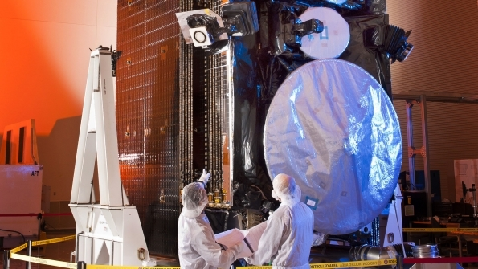

Slide 4
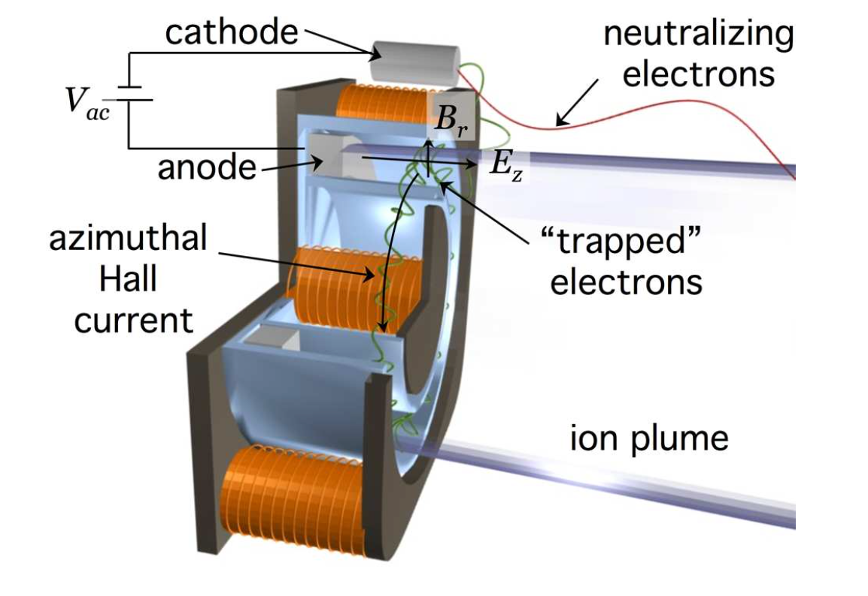
r
Gas density:
Magnetic field:

Slide 5
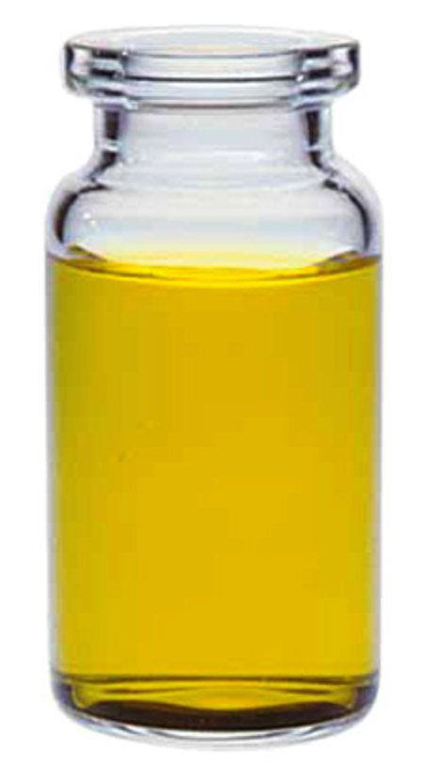
Electrospray: plasma in a bottle

Slide 6
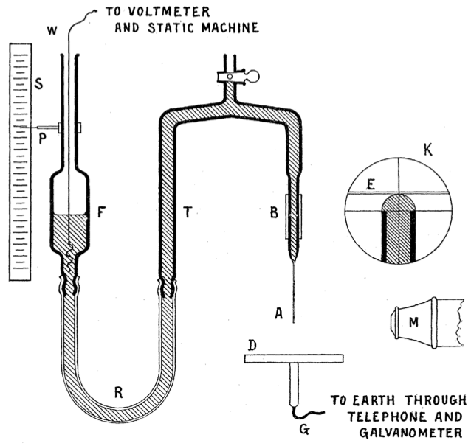
Zeleny, J., "The electrical discharge from liquid points, and a hydrostatic method of measuring the electric intensity at their surfaces," Physical Review, 3(2), 1914, 69-91.
Jean-Antoine Nollet – 1750:
“a person, electrified by connection to a high-voltage generator, would not bleed normally if he were to cut himself; blood would spray from the wound.”

Slide 7



Neutral Fluid
Surface tension is balanced by fluid pressure

Slide 8

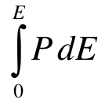
Neutral Fluid
Electrohydrodynamic
Stress
- - - - - - - - - - - - - - - -
+
+
+
+
+
-
+
-
+
+
+
+
-
+
-
+
-
+
-
+
+
+
+
-
+
-
+
-
+
+
-
+
-
+
-
+
-
+
-
+
-
+
-
+
-
+
-
E
-
-
E
Surface tension is balanced by fluid pressure
+
-
+
-
+
-
+
-
-
-
-
+
-
+
-
-
-
-
-
-
-
+ + + + + + + + + + + +

Slide 9


Neutral Fluid
Electrohydrodynamic
Stress
Ferrohydrodynamic
Stress
- - - - - - - - - - - - - - - -
S S S S S S S S S S S S S
+
N
S
N
S
+
+
+
+
-
+
-
+
N
S
N
S
N
S
N
S
+
+
+
-
+
-
+
-
+
-
+
+
N
S
N
S
N
S
N
S
+
+
-
+
-
+
-
+
+
-
+
-
+
-
N
S
N
S
N
S
N
S
+
-
+
-
+
-
+
-
+
-
+
-
N
S
N
S
N
S
N
S
E
-
-
E
H
N
S
H
Surface tension is balanced by fluid pressure
+
-
+
-
+
-
+
-
N
S
N
S
N
S
-
-
-
+
-
+
-
-
-
-
N
S
N
S
-
-
-
+ + + + + + + + + + + +
N N N N N N N N N N

Slide 10
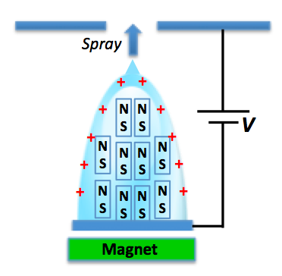

Explore new fluid mechanics of combined ferro- and electrohydrodynamic spray emission
500 microns
Increasing E
Magnet

Slide 11

New material: Ionic liquid ferrofluid
Collaboration between and
2011
2012
2013
Present
Huang and Wang ⁷ :
EMIM-ethylsulphate with CoFe₂O₄
EMIM-NtF₂
Sulfolane + EAN
Triglyme
Glycerol
(all with Sirtex MNPs)
Jain et al ⁶ :
EAN with Fe₂O₃
EMIM-Ac with Fe₂O₃
EMIM-SCN with Fe₂O₃
EAN with Sirtex nanoparticles
⁶ Jain, N. et at., Stable and Water-Tolerant Ionic Liquid Ferrofluid. Applied Materials and Interfaces 2011 (3): p. 662-667
⁷ Huang, W. and Wang, X., Stuy on the properties and stability of ionic liquid-based ferrofluids. Colloid Polym Sci, 2012 290: p. 1695-1702
11

Slide 12
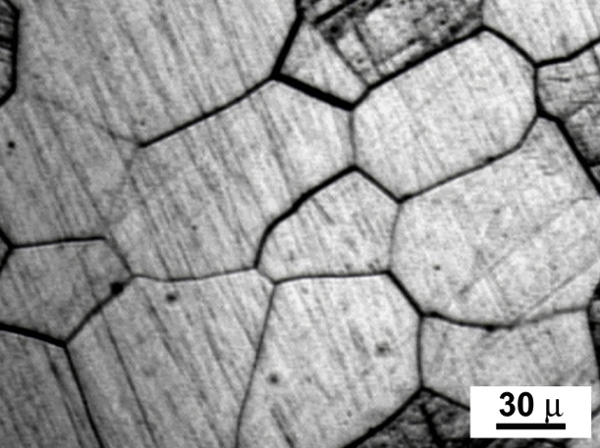

How to make a Ferrofluid
T ~ Room Temp
No applied field
M_{net} = 0
T ~ Room Temp
Applied Field
M_{net} > 0
T > Curie Temp
Applied Field
M_{net}~ 0
T > T_{lliquid}
M_{net} = 0
Melting a Ferromagnetic
Substance Doesn’t Work:
H
H
H

Slide 13
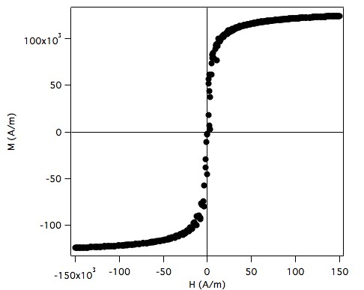
How to make a Ferrofluid
T ~ Room Temp
No applied field
M_{net} = 0
T ~ Room Temp
Applied Field
M_{net} > 0
T > Curie Temp
Applied Field
M_{net}~ 0
T > T_{lliquid}
M_{net} = 0
Melting a Ferromagnetic
Substance Doesn’t Work:
H
H
H
Because the particles are free to rotate
The M-H curve does not display hysteresis
M_{net} > 0
Solid-state ferromagnetic particles
small enough to contain only
a single magnetic domain (10s of nm)
A Ferrofluid is a Superparamagnetic Colloid:
M (A/m)
Carrier liquid
H
H (A/m)

Slide 14
Ionic liquid ferrofluid: a truly magnetized plasma
Magnetohydrodynamics
Electrohydrodynamics
Ferrohydrodynamics
Lorentz Force
Coulomb Force
Kelvin Force
Momentum:
Quasi-static Maxwell:
Young-Laplace:
Notes:
One interesting effect is a spray instability that we can induce with E and B.

Slide 15
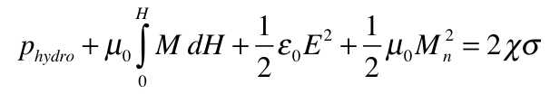
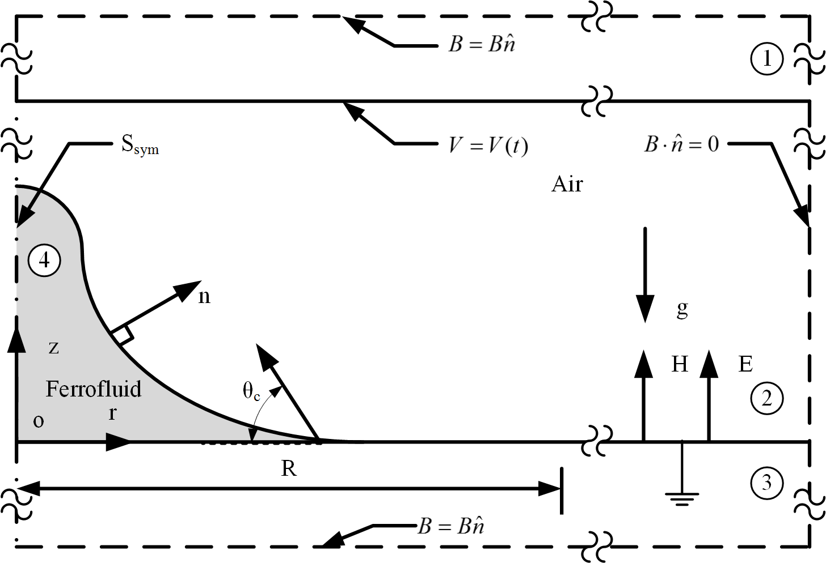
Determine Critical Fields for Spray Onset
Fluid meniscus geometry is non-linear equilibrium
+
+
+
N
S
N
S
+
Magnetic
Stress
+
+
N
S
N
S
N
S
N
S
+
+
+
N
S
+
N
S
Electric
Stress
Fluid interface
geometry
Capillary
Stress
N
S
N
S
N
S
N
S
N
S
N
S
Magnet
Hydrostatic
Pressure
N
S
N
S
N
S
N
S
N
S
N
S
N
S
N
S
Numerical Simulation of Ferrofluid Droplet
N
S
N
S
COMSOL Microfluidics with electromagnetic stress
Two-phase transient flow with moving mesh (ALE)
Experimentally determined M-H characteristic for fluid
Experimentally determined fluid-solid contact angle

Slide 16
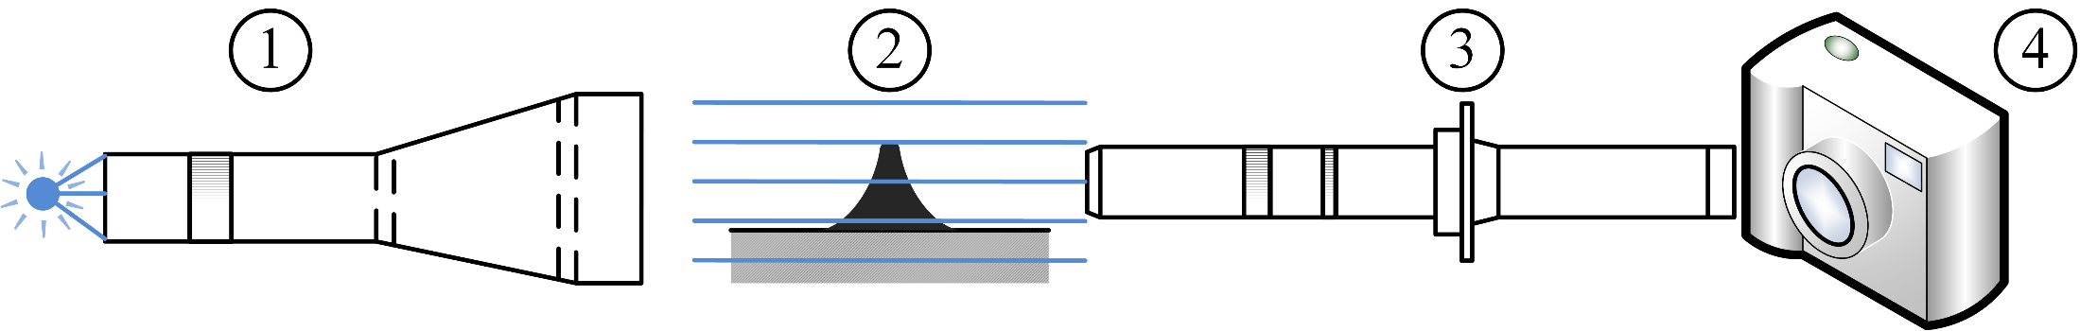
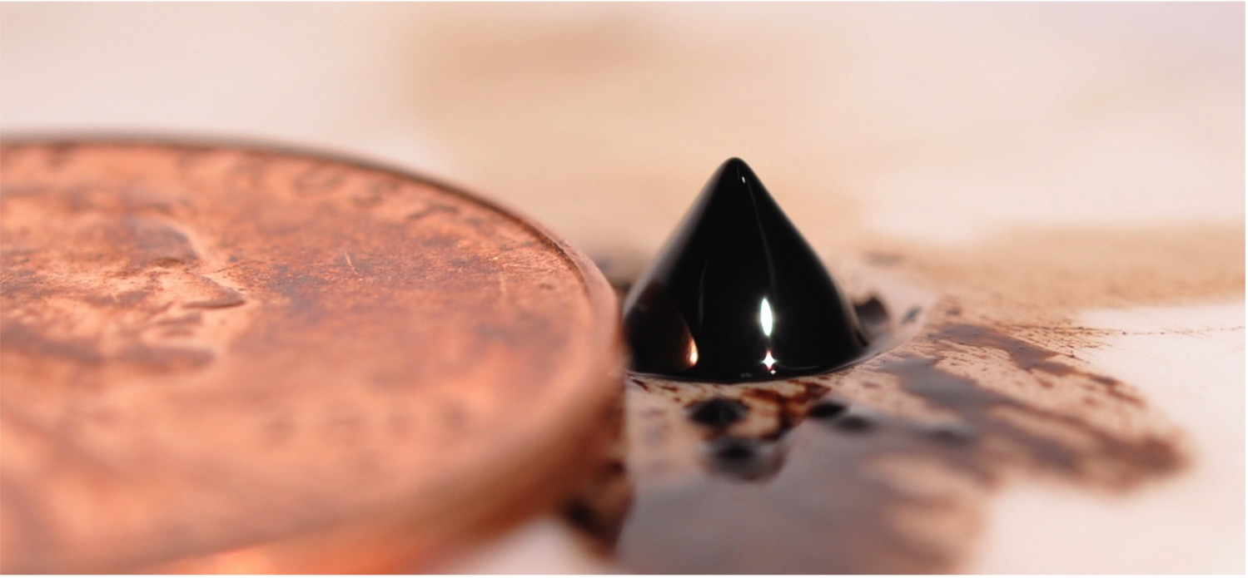
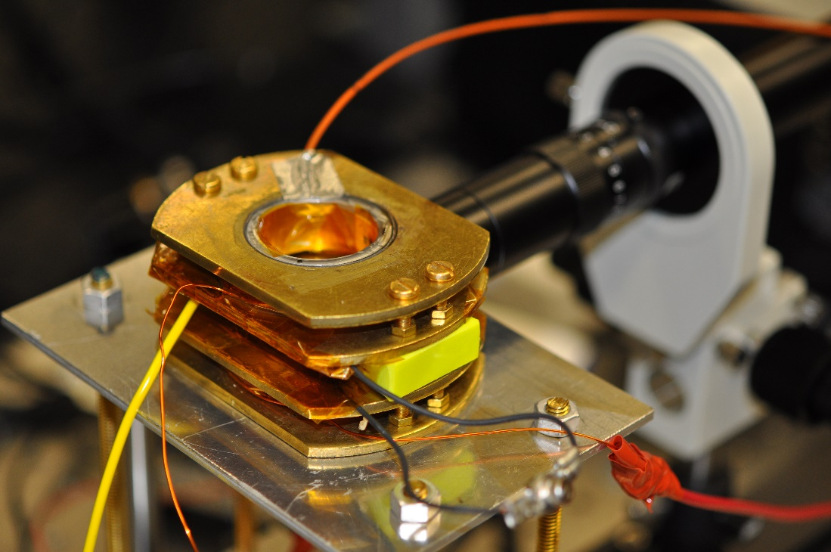

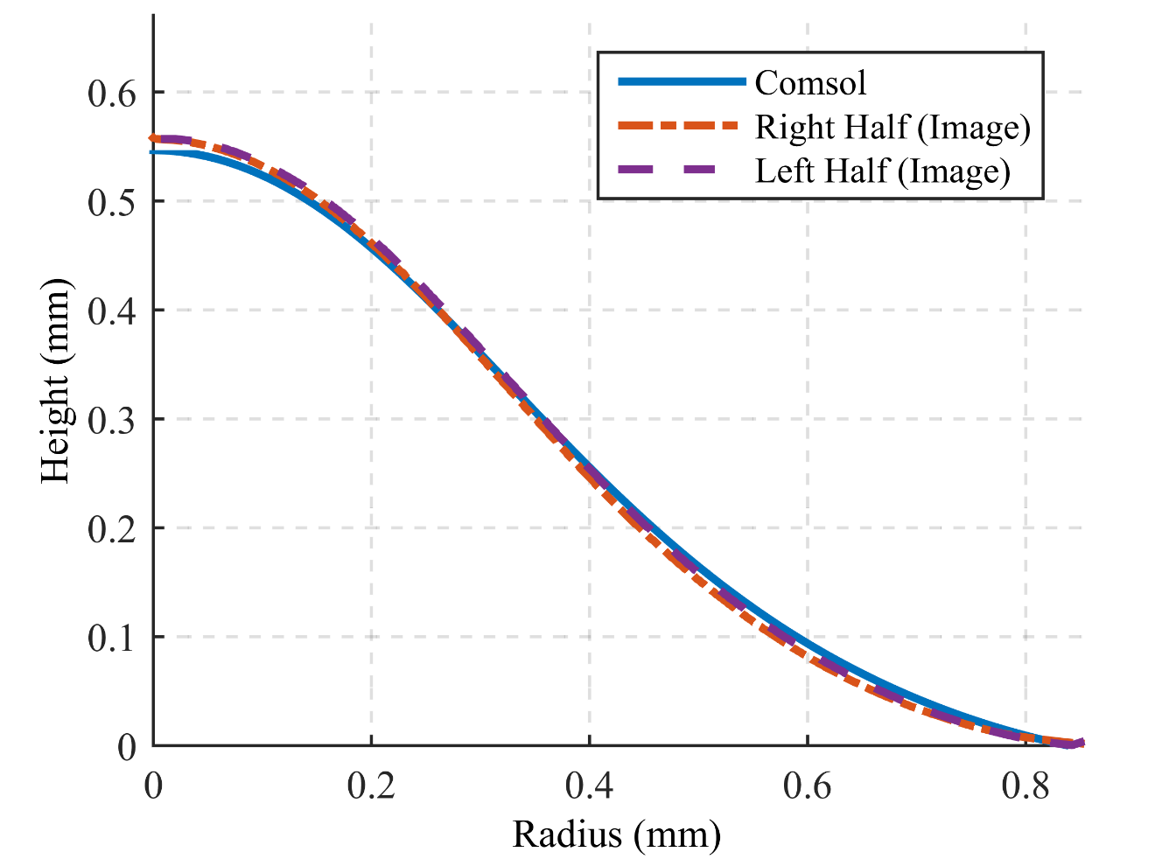
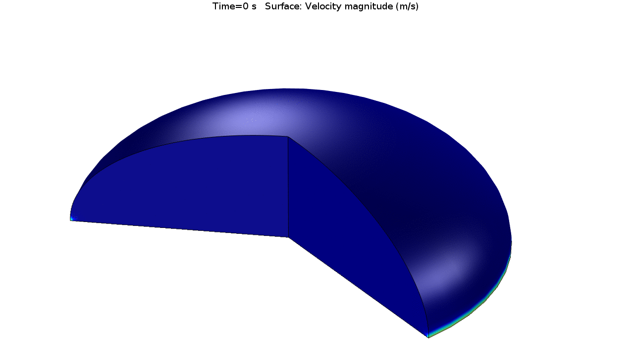
Numerical Model Validation
Collimated Backlight Imager
Droplet on Flat Plate in Helmholtz Coil
Transient Droplet Dynamics
Silhouette Image
Model Validation
Ferrotec EFH-1 on
Brass slide

Slide 17
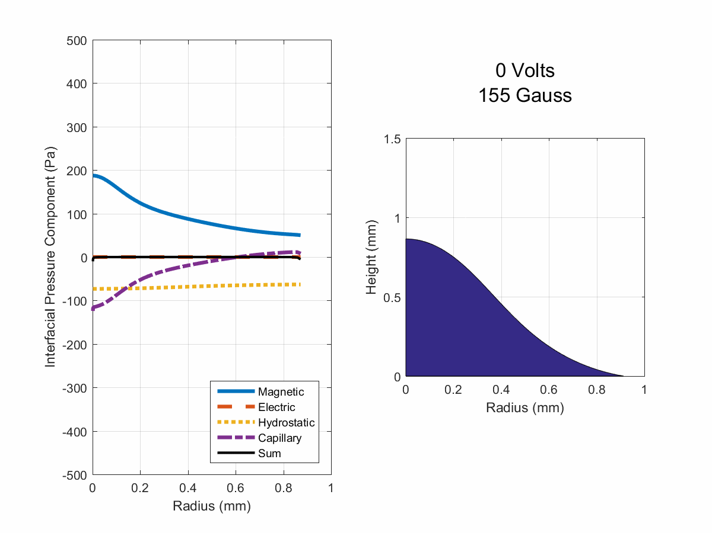
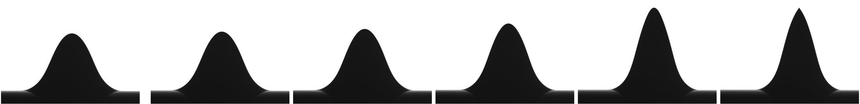
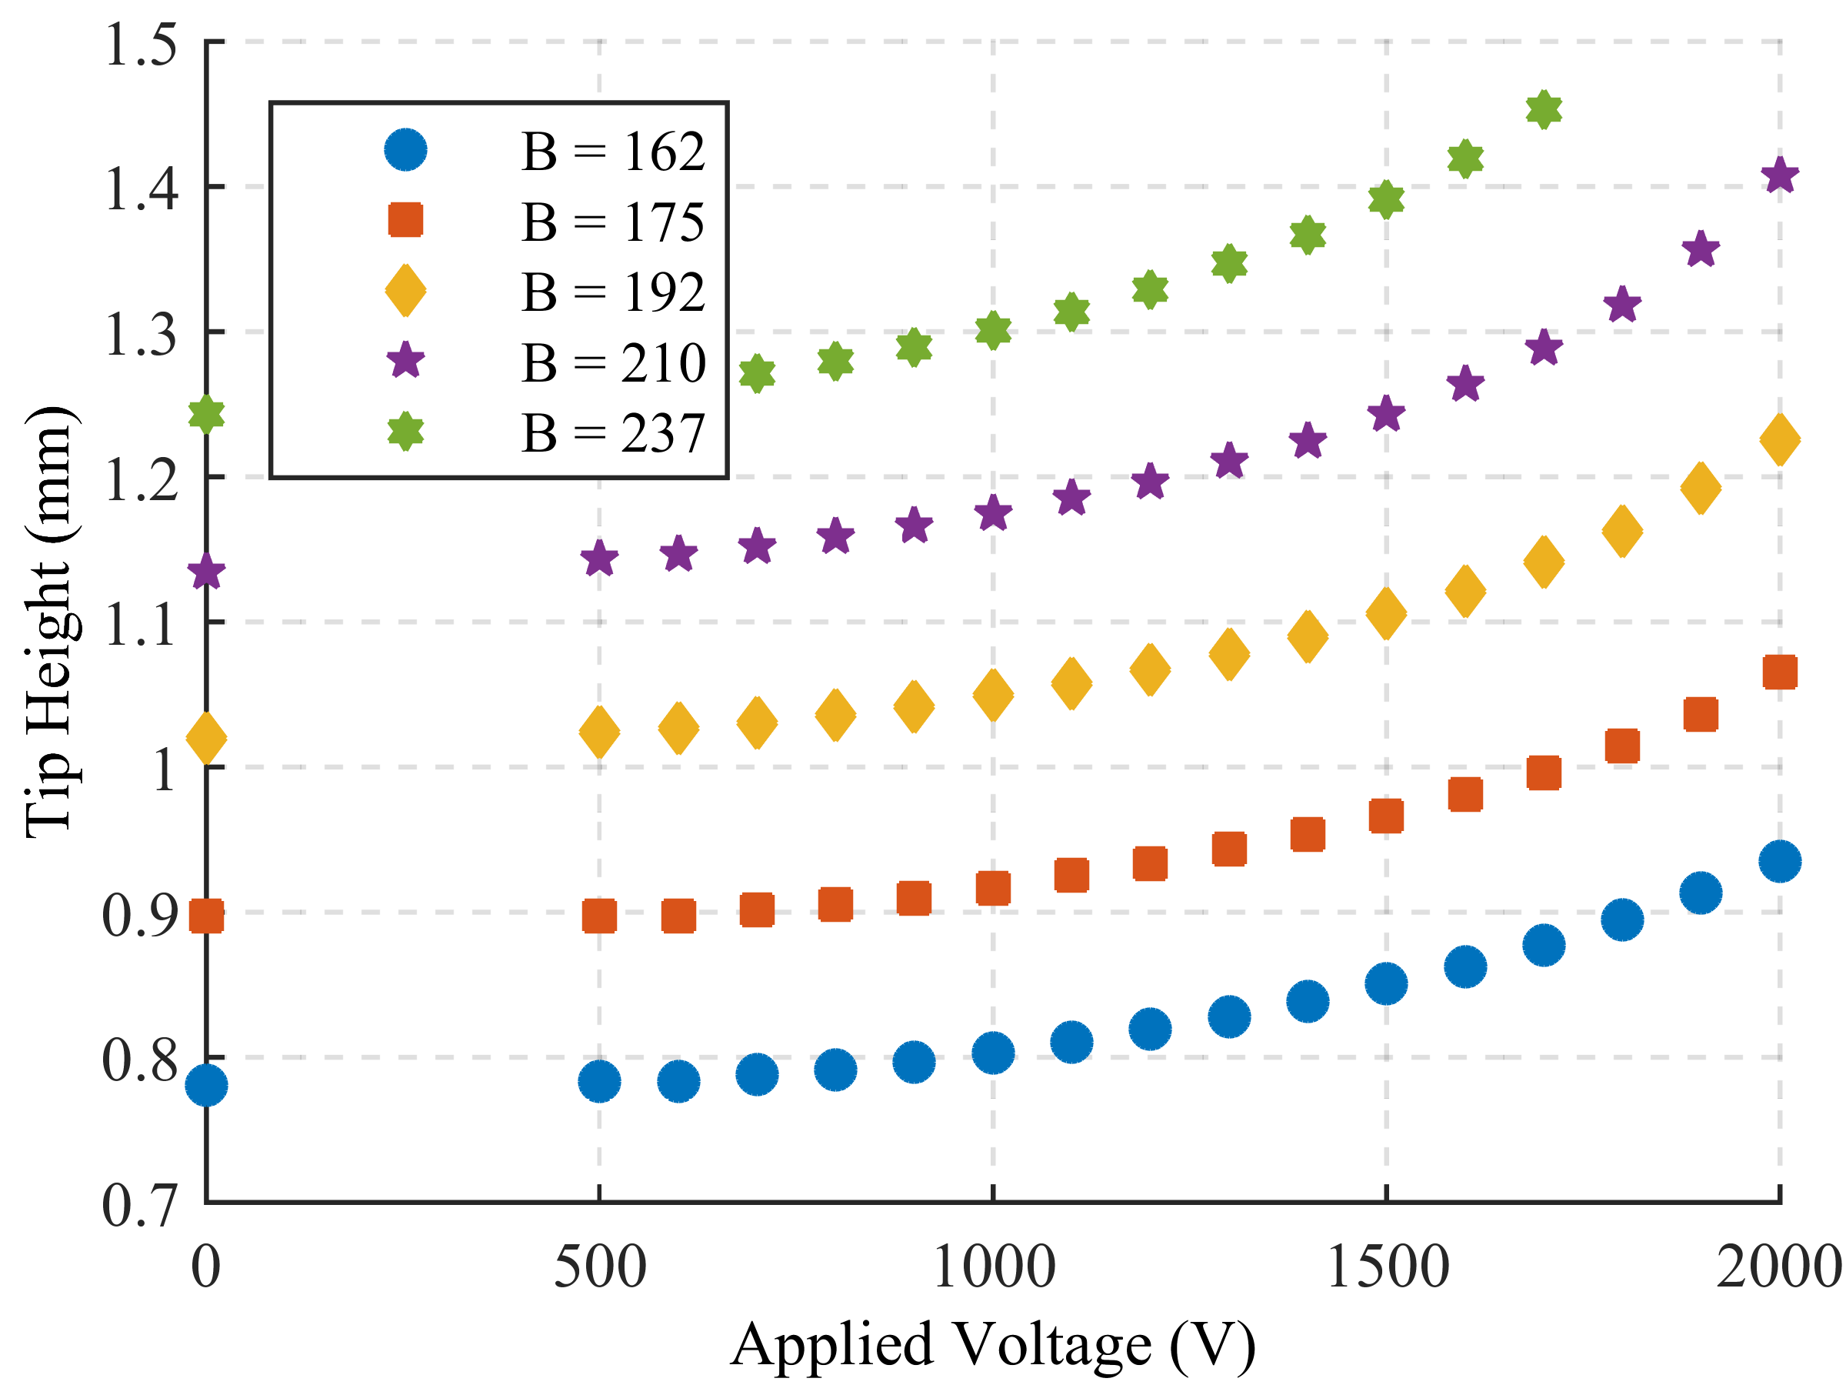
Interfacial Magneto-electrostatic Stress
Experimental Silhouette Images
Numerical Simulation

Slide 18
Compare with Established Theory: Capillary Electrospray
Zeleny, J., "The electrical discharge from liquid points, and a hydrostatic method of measuring the electric intensity at their surfaces," Physical Review, 3(2), 1914, 69-91.

Slide 19
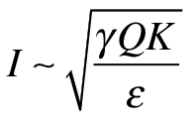
Capillary Studies: Motivation and Approach
Existing Electrospray Theory
(over 400 citations):
Surface tension
Flow rate
Conductivity
Fernandez de la Mora, J., and Loscertales, I.G., “The current emitted by highly conducting Taylor cones,” J. Fluid Mech. 260, 155-184, 1994.
Spray current
Permittivity

Slide 20
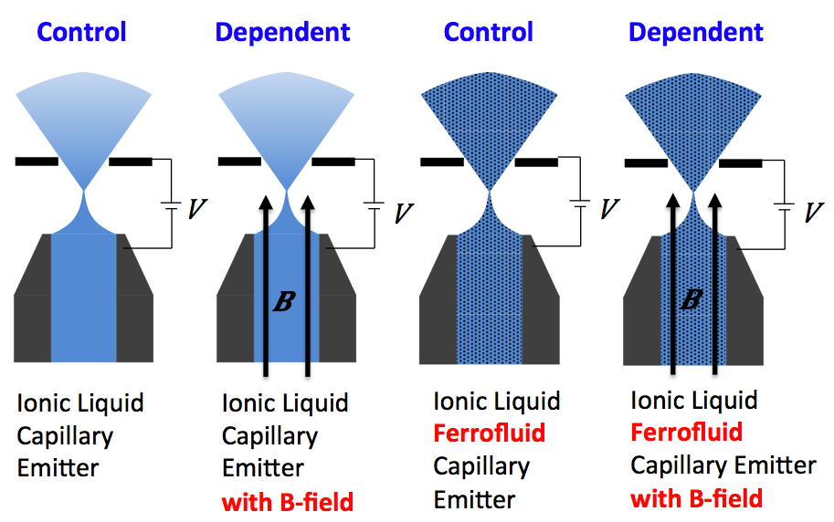
Capillary Studies: Motivation and Approach
Existing Electrospray Theory
(over 400 citations):
Surface tension
Flow rate
Conductivity
Fernandez de la Mora, J., and Loscertales, I.G., “The current emitted by highly conducting Taylor cones,” J. Fluid Mech. 260, 155-184, 1994.
Spray current
Permittivity
Sprayed in atmosphere
Sprayed in vacuum
Ferrofluid base | Sulfolane + 0.1% EAN | Sulfolane + 1% EAN | Sulfolane + 10% EAN | EMIM-NTf2
Conductivity (S/m) | 0.012 | 0.033 | 0.324 | 0.57
Ferrofluids synthesized by University of Sydney Key Centre for Polymers and Colloids (Hawkett and Jain) by stabilizing ~ 50-nm-diameter maghemite particles supplied by Sirtex Medical, Ltd.

Slide 21
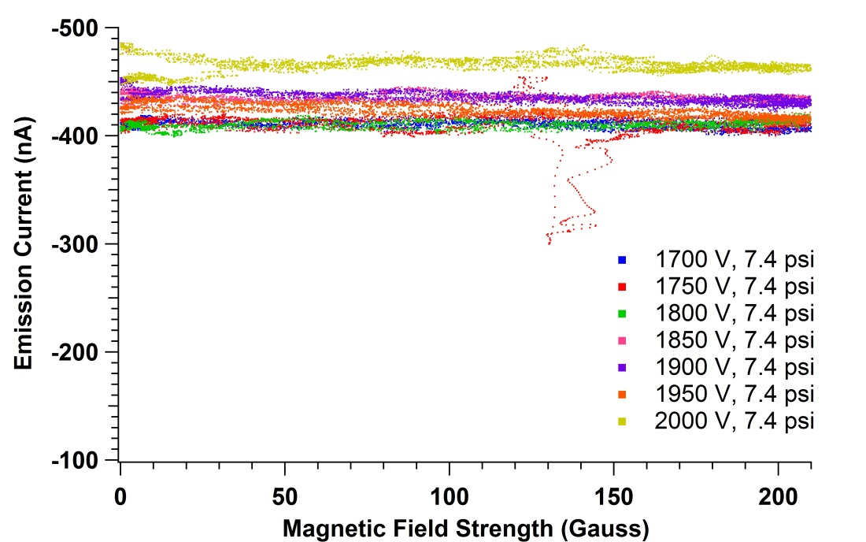
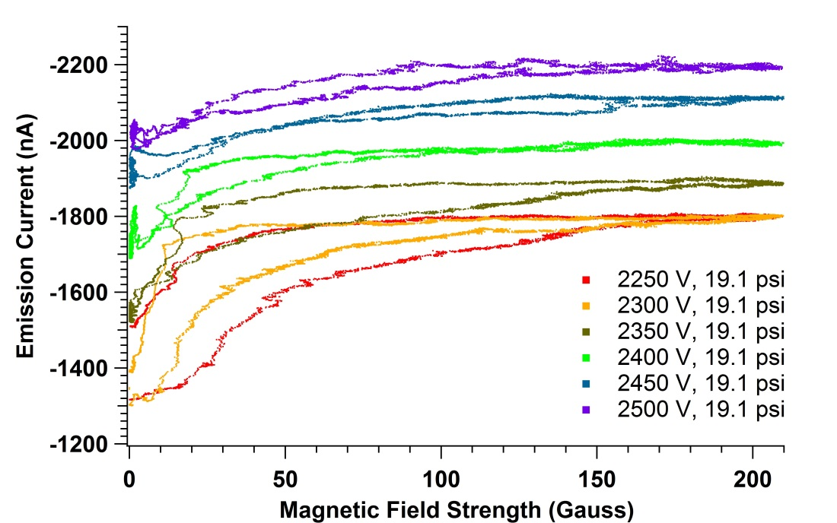
Capillary Spray Results
Existing Electrospray Theory
(over 400 citations):
Surface tension
Flow rate
Conductivity
Fernandez de la Mora, J., and Loscertales, I.G., “The current emitted by highly conducting Taylor cones,” J. Fluid Mech. 260, 155-184, 1994.
Spray current
Permittivity
Pure EMIM-NTf2
EMIM-NTf2 Ferrofluid
Decreasing B
Increasing B
Magnetic effects increase current by ~ 40%

Slide 22
Capillary Spray Results
Existing Electrospray Theory:
Current still scales with square root of flow rate, but magnetic field increases the magnitude

Slide 23
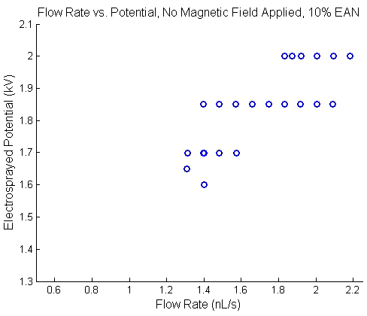
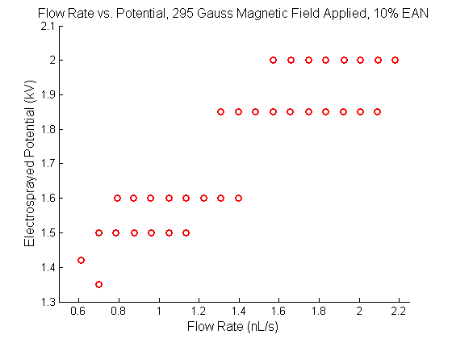
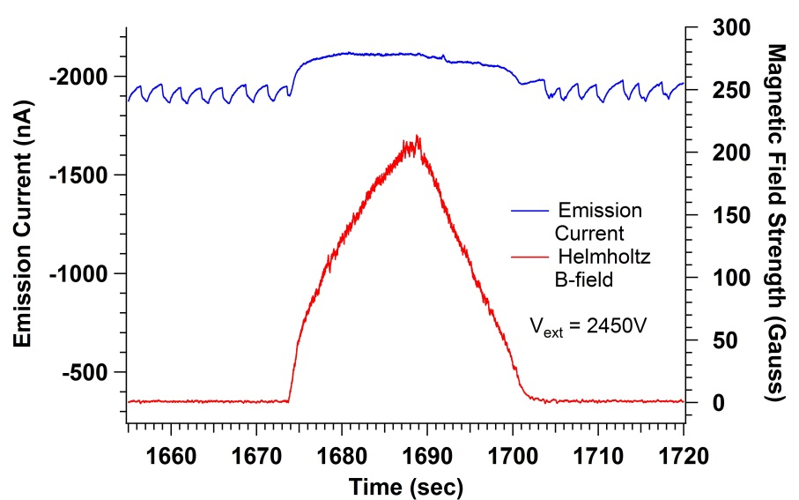
Magnetic Stress Extends Spray Stability Range
B = 0 G
B = 295 G
Sulfolane
Ferrofluid
Sulfolane
Ferrofluid
Magnetic Field Damps Oscillations
EMIM-NTf2
Ferrofluid
Sulfolane
Ferrofluid
Lower stable flow rates will enable smaller droplet sizes

Slide 24
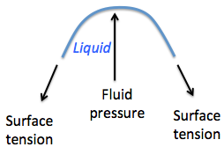
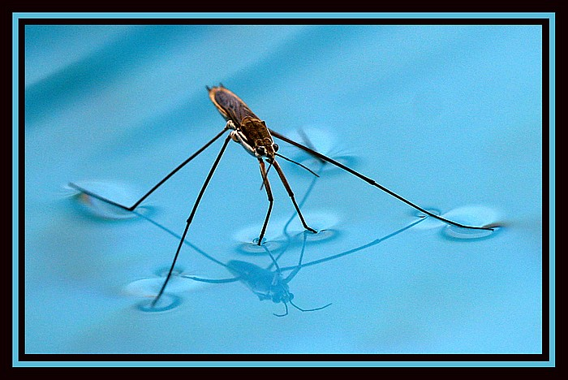
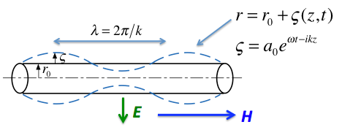
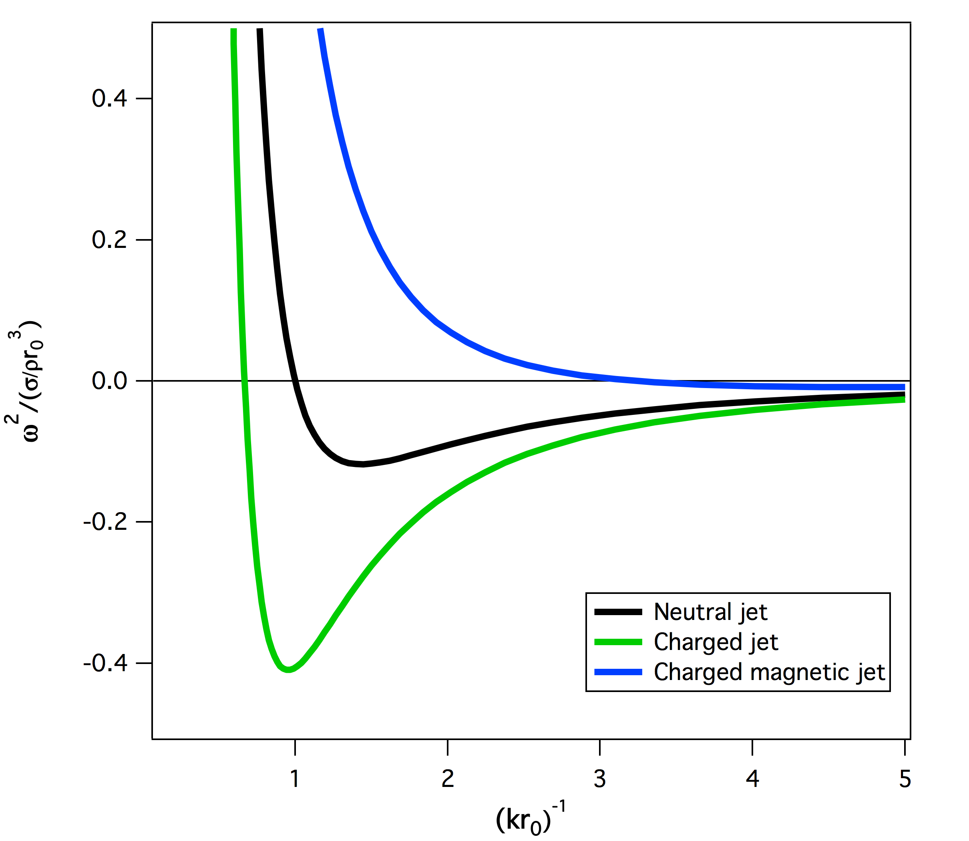

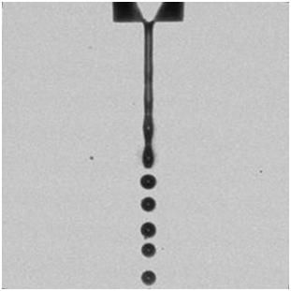
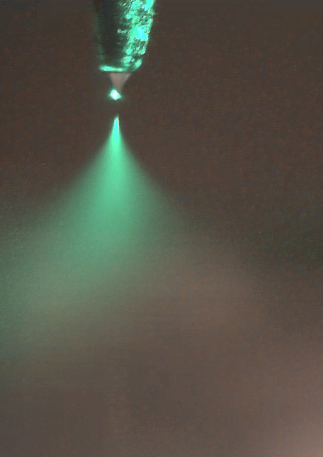

Theoretical Model of Jet Stability
Dispersion Relation for Surface Waves
m=0 mode
H = 300 G
E = 200 V/mm
Theoretical model of fluid cylinder stability against surface perturbation
Liquid is electrically conducting ferrofluid
Axial magnetic field has a stabilizing effect against surface perturbations
Dipole alignment augments surface tension
Stable
Unstable

Slide 25
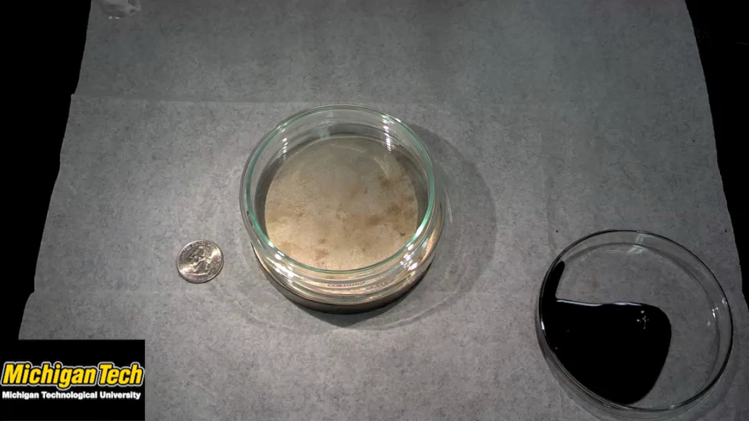
Gravitational
Surface Tension
Magnetic
Notes:
Single mountain does not minimize energy.

Slide 26
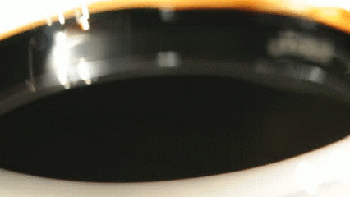
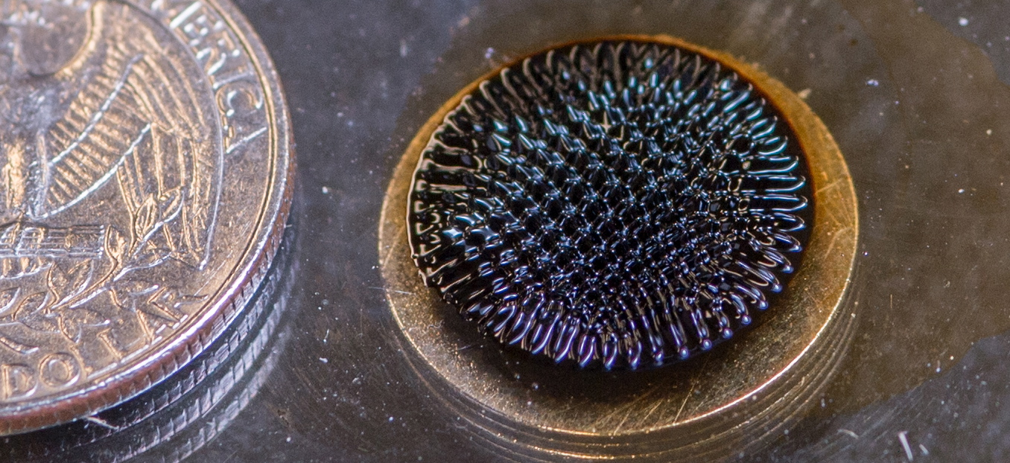
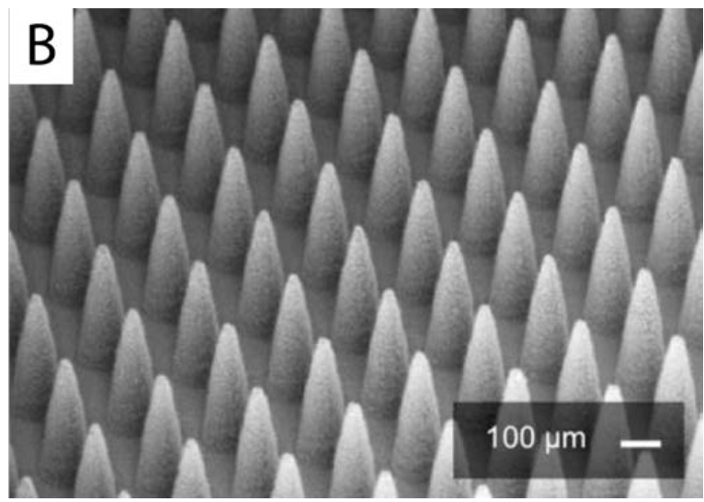
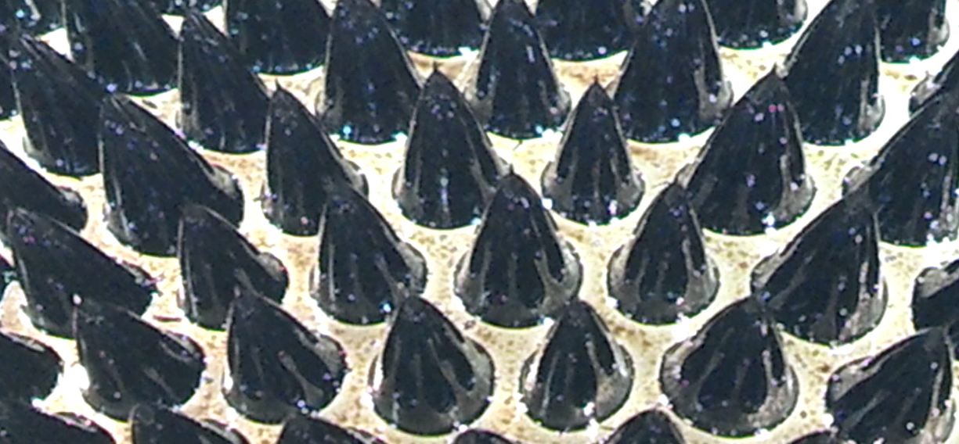

Self-assembling Array of Electrospray Emitters Fabricated from the Propellant Itself
Emitter array fabricated in silicon
Rosensweig instability in ionic liquid ferrofluid

Slide 27
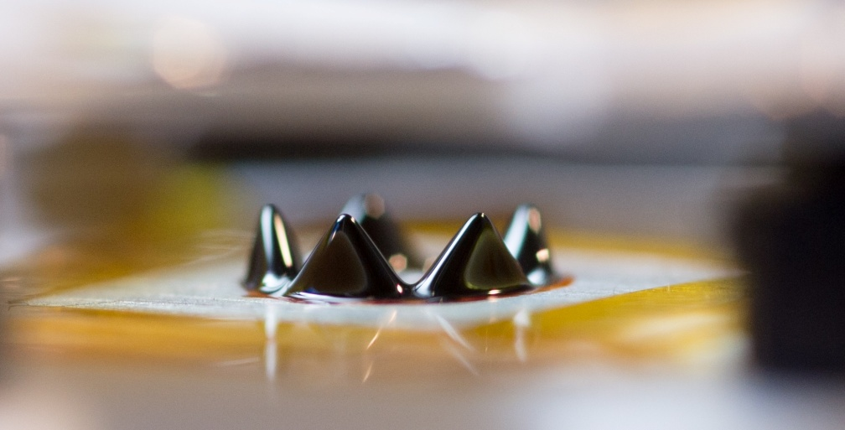
Extraction Electrode and Current Collector
5mm
Aluminum Fluid Holder
E
B
Rosensweig Instability in Ionic liquid with Sirtex nanoparticles

Slide 30
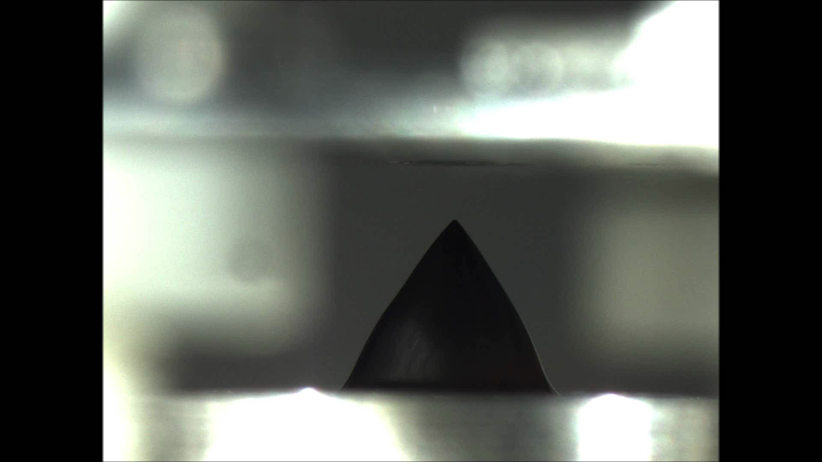
Permanent Magnet
M
M

Slide 31
Where we’re going…

Slide 32
