Slide 1
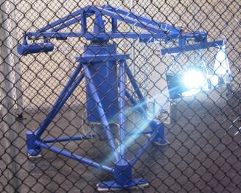
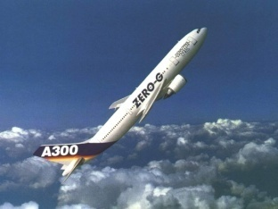
Complex plasmas under varying gravity conditions
J. Beckers, D. Trienekens, A.B. Schrader, T, Ockenga,
M. Wolter, H. Kersten, and G.M.W. Kroesen
Contact: j.beckers@tue.nl

Slide 2
RF discharge
Plasma sheath
RF plasma
Powered electrode

Slide 3
Outline
Introduction / Background
Research objective
PART I: Centrifuge Experiments
PART 2: Parabolic flights
Notes:
Outline

Slide 4
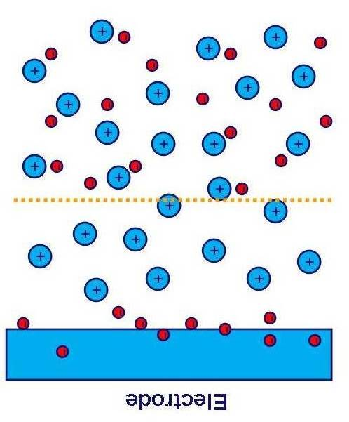
The RF plasma sheath
Background | Objective | Method & Procedure | Exp. Setup | Results | Conclusions
electron
+
ion
Electrode
Positive space charge in front of the electrode
Potential drop
High electric fields in plasma sheath!
Notes:
Principe plasma sheath

Slide 5
Measuring the sheath electric field
Background | Objective | Method & Procedure | Exp. Setup | Results | Conclusions
Langmuir probes
Stark broadening / Stark shift
Issues: Local disturbance and spatial resolution
Notes:
Velden zijn gemeten, maar problemen met spatial resolution (Stark) en local disturbances (Langmuir). Daarom de ‘need’ voor onze research goal …

Slide 6
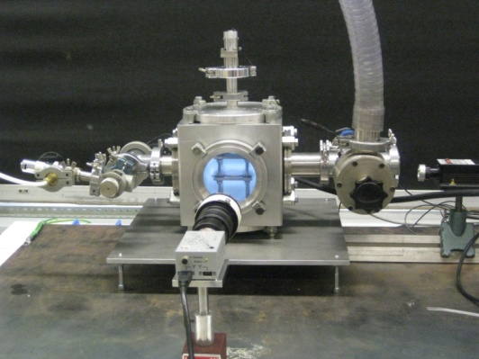
Research objective
Background | Objective | Method & Procedure | Exp. Setup | Results | Conclusions
“Development of a diagnostic tool to measure the electric field profile within the RF plasma sheath”
Spatially resolved
Without disturbing the plasma
By using microparticles confined in the sheath
Notes:
Oplezen. Straks uiteggen waarom die centrifuge er staat.

Slide 7
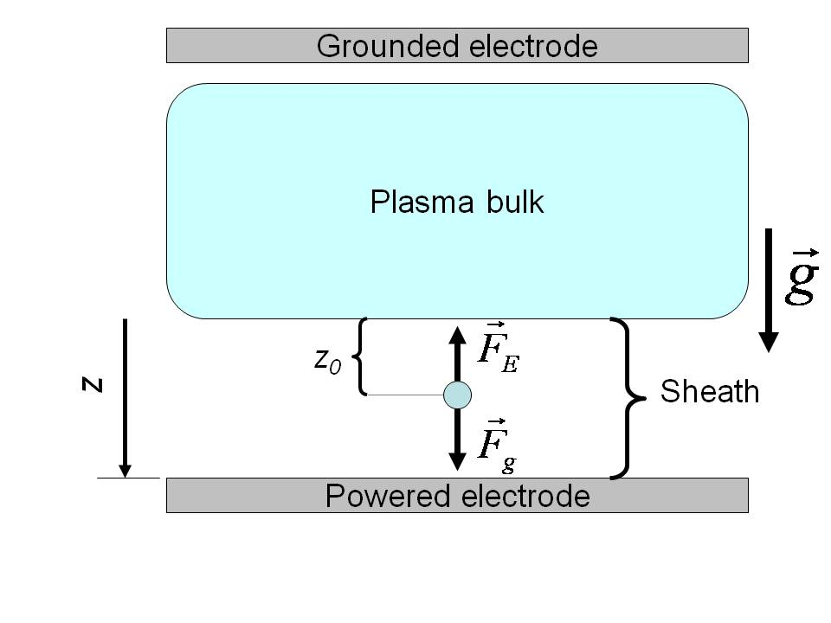
Particle trapping (1g)
Background | Objective | Method & Procedure | Exp. Setup | Results | Conclusions
Particle inserted in plasma
becomes highly negatively charged.
Particle confined at z₀ in sheath
due to equilibrium of forces working
on it.
Dominant forces:
Gravitational force:
Electrostatic force:
Notes:
Deeltje in plasma wordt getrapped door evenwicht van krachten. Ook andere krachten noemen, maar uitleggen waarom we die verwaarlozen en alleen Fg en Fe meenemen.

Slide 8
Electric field
Background | Objective | Method & Procedure | Exp. Setup | Results | Conclusions
This would identify the electric field
at only one position: E(z₀)
Particle charge unknown and a function
of position in the sheath
Notes:
Uit krachtenbalans volgt E wanneer we Q weten. Maar het is niet zo triviaal. We weten dan slechts E op 1 positie. Bovendien is Q niet bekend en een functie van positie in de sheath. Het eerste punt lossen we als volgt op:

Slide 9
Changing equilibrium position z₀
Background | Objective | Method & Procedure | Exp. Setup | Results | Conclusions
Forcing the particle into lower equilibrium
positions by increasing gravity
Notes:
We stoppen het hele zaakje in de centrifuge, vergroten de schijnbare zwaartekracht en trekken het deeltje naar een andere positie en lossen opnieuw de krachtenbalans op.

Slide 10
Background | Objective | Method & Procedure | Exp. Setup | Results | Conclusions
This would identify the electric field
at only one position: E(z₀)
Particle charge unknown and a function
of position in the sheath
Notes:
Voor tweede ‘issue’ nemen we drie basisvergelijkingen als uitgangspunt.

Slide 11
Change of mindset
Gravitational constant g
Gravitational variable g(z₀)

Slide 12
Three basic equations
Background | Objective | Method & Procedure | Exp. Setup | Results | Conclusions
(1) Force balance:
(2) Poisson:
(n_{e} << n_{i})
(conservation of ion flux)
(3) Collision dominated
sheath:
(At 20 Pa, sheath thickness >> λ_{mfp,i})
Notes:
Bespreken.

Slide 13
Governing differential equation for Q_{p}
Background | Objective | Method & Procedure | Exp. Setup | Results | Conclusions
The Q_{p} profile and thus, via the force balance, also the E profile
can be obtained:
By measuring the gravitational level (g(z_{E}))
necessary to force the particle in equilibrium position z_{E}
By Finding proper boundary conditions, e.g. for Γ_{i,sh}
e.g. from Langmuir probe measurements
Notes:
Eindresultaat bespreken. Met genoeg info over plasma parameters (die wij uit Langmuir probe metingen uit de plasma bulk krijgen) is dit op te lossen en profiel te bepalen.

Slide 14
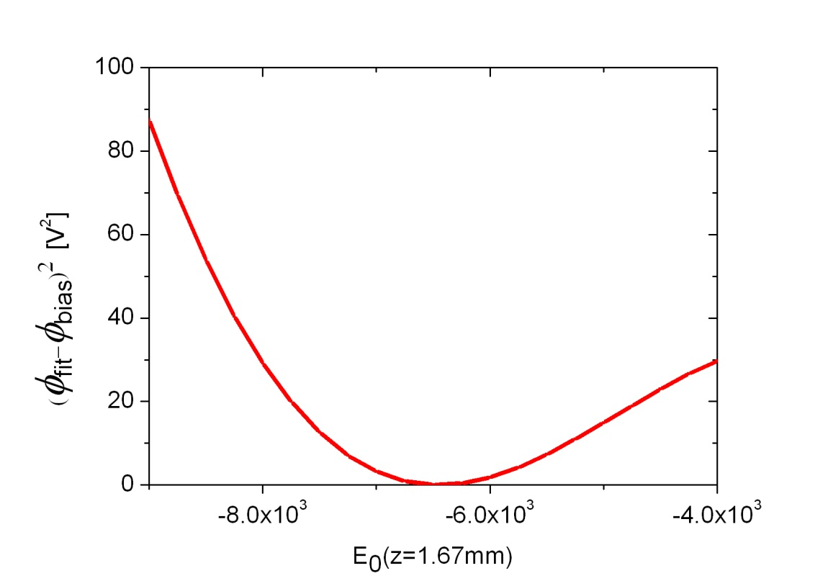
Boundary condition procedure (at z₀ @ 1g)
Background | Objective | Method & Procedure | Exp. Setup | Results | Conclusions
Measure electrode bias potential (-82 V)
Ansatz for E(z_{E} =0)
From model calculate the potential at the electrode
Now optimize start value for
E(z_{E} =0) and thus for Q_{p}
such that the fitted value
of the potential at the
electrode meets the
bias potential

Slide 15
Experiment
Background | Objective | Method & Procedure | Exp. Setup | Results | Conclusions
microparticle
Function generator
RF Amplifier
Match-box
CCD Camera
Interference
filter
RF powered
Bottom electrode
mirror
532nm diode laser
Beam expander

Slide 16
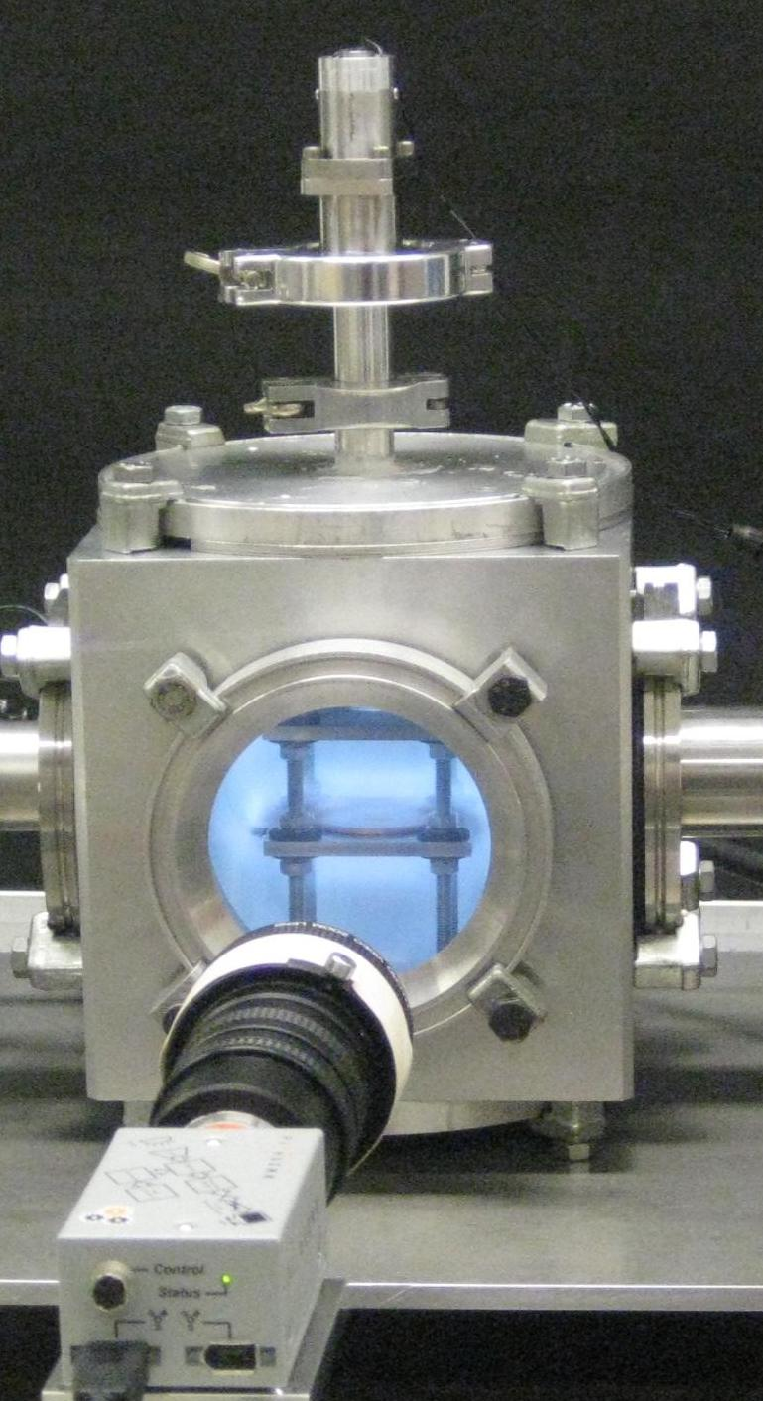
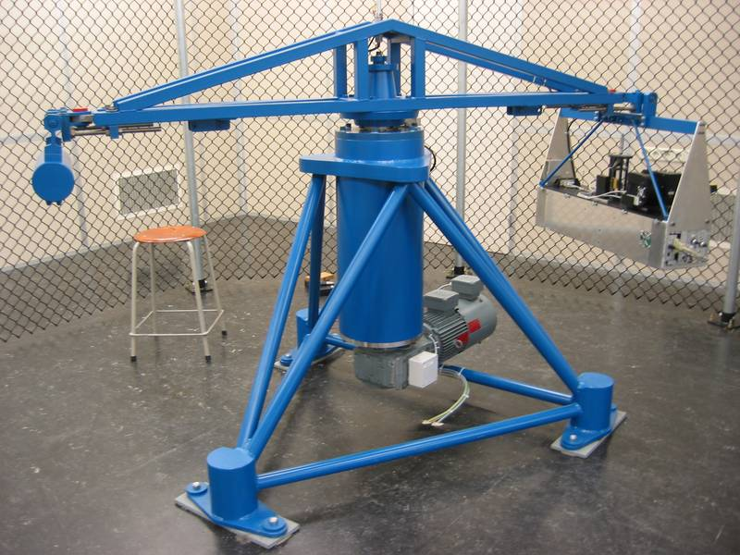
Experiment
Background | Objective | Method & Procedure | Exp. Setup | Results | Conclusions
5 Watt, 13.56MHz Argon plasma
Argon @ 20 Pa
Particles (10.4μm) illuminated by 532nm laser
equilibrium position particles
measured by CCD camera
Notes:
Experiment uitleggen.

Slide 17
Experiment
Background | Objective | Method & Procedure | Exp. Setup | Results | Conclusions
Notes:
Filmpje centrifuge

Slide 18
Background | Objective | Method & Procedure | Exp. Setup | Results | Conclusions
RESULTS
Notes:
Typische CCD camera pictures. We zien dat ze omlaag gaan met toenemende g’s en dat de positie met hoge resolutie te bepalen is.

Slide 19
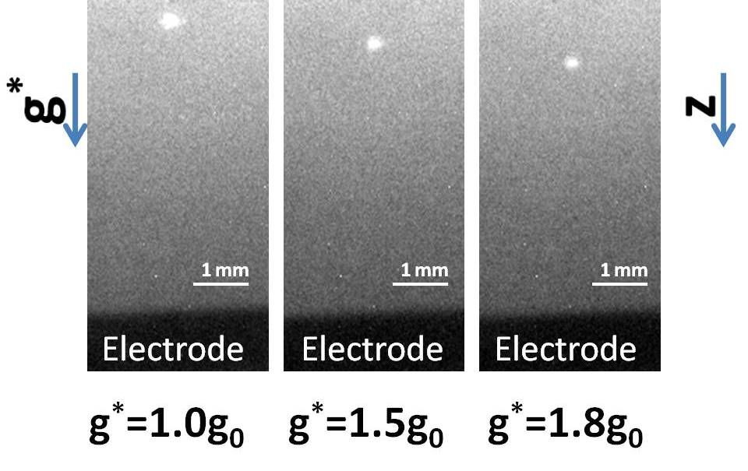
CCD camera images
Background | Objective | Method & Procedure | Exp. Setup | Results | Conclusions
Notes:
Typische CCD camera pictures. We zien dat ze omlaag gaan met toenemende g’s en dat de positie met hoge resolutie te bepalen is.

Slide 20
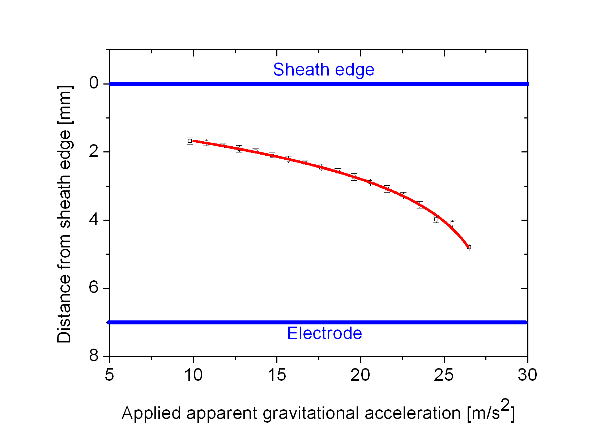
Equilibrium height versus gravity
Background | Objective | Method & Procedure | Exp. Setup | Results | Conclusions
Notes:
Meer punten. We missen punten voor g < 1. Boven 2.8 g raken we ze kwijt Fg wint van Fe.

Slide 21
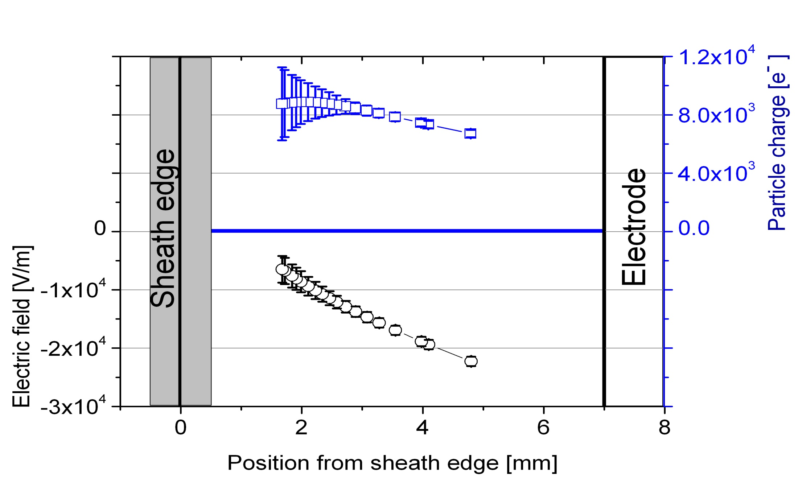
Results for charge and field profile
Background | Objective | Method & Procedure | Exp. Setup | Results | Conclusions
Notes:
De uiteindelijke resultaten.

Slide 22
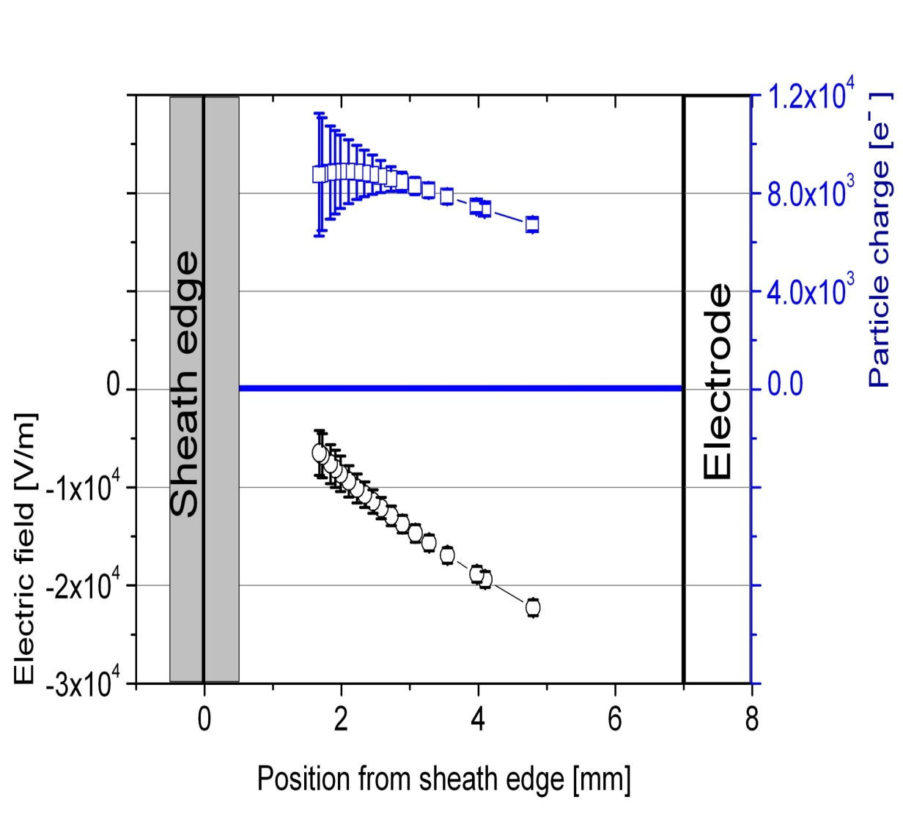
Results for charge and field profile
Background | Objective | Method & Procedure | Exp. Setup | Results | Conclusions
Particle charge:
Indication of a max. in the
particle charge.
Electric field:
Absolute values agree well with
literature values
Field slightly non-linear
Notes:
Bespreken van Q en E profiel apart. Voor Q: grote foutenbalken, dus niet eerlijk om conclusies te trekken over linker deel. Toch de indicatie van een maximum. Als we daarop speculeren zouden we dit kunnen verklaren met afnemende ion capture door toenemende ionen snelheid (linkerkant van max.) en afnemende tijdsgemiddelde ne (reachterkant). (by the way voor Gerrit. Dat betekent dus dat de aannames in de afleiding. ni>>ne niet geldt links van het max. Gelukkig hebben we grote foutenmarge.. Ben benieuwd naar parabooldata.)
Voor E: Absolute waarden kloppen met literatuur. Lichte kromming (dus modellen die slechts een lineair verband voor de sheath nemen niet helemaal waar.)

Slide 23
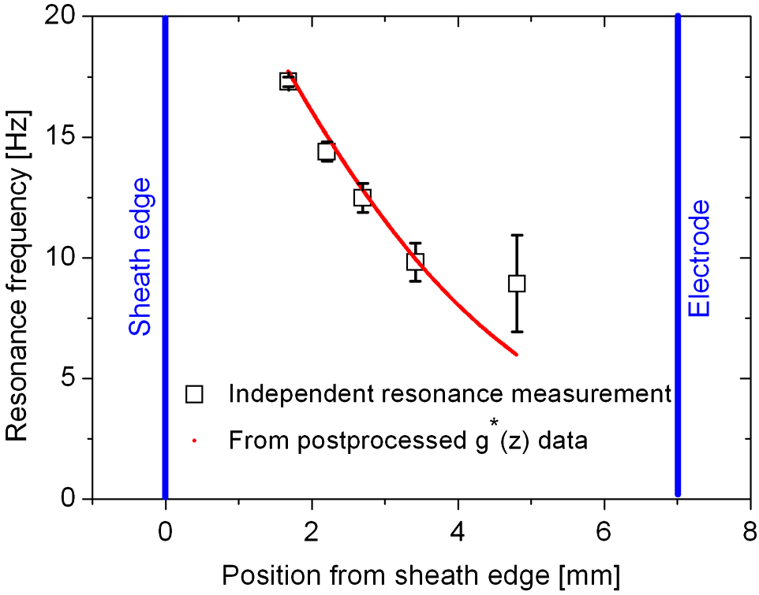
Particle resonance frequency

Slide 24
Conclusions Centrifuge Experiments
Background | Objective | Method & Procedure | Exp. Setup | Results | Conclusions
Succeeded in developing a novel diagnostic tool
that is able to measure the electric field in the
plasma sheath and particle charge profile.
Large error bars on charge measurements. (indication of maximum in the sheath)
Electric field slightly non-linear.
Notes:
Puntjes achter elkaar behandelen.

Slide 25
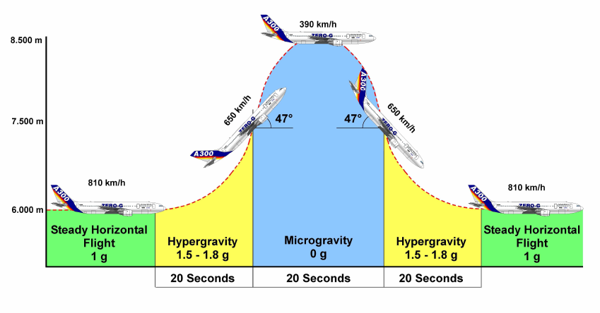
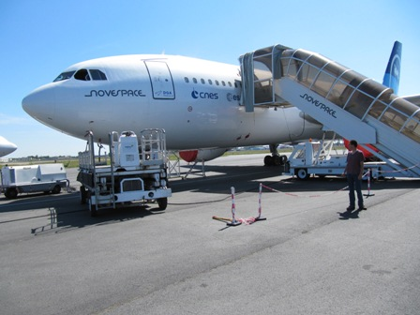
54th ESA Parabolic flight campaign
May 2011, Bordeaux, France
Adapted Airbus A300
Each flight day 31 sequences of hyper – micro – hyper gravity
3 flight days

Slide 26
Experiment
microparticle
Function generator
RF Amplifier
Match-box
Webcam 60 fps
Interference
filter
RF powered
Bottom electrode
mirror
532nm diode laser
Beam expander

Slide 27
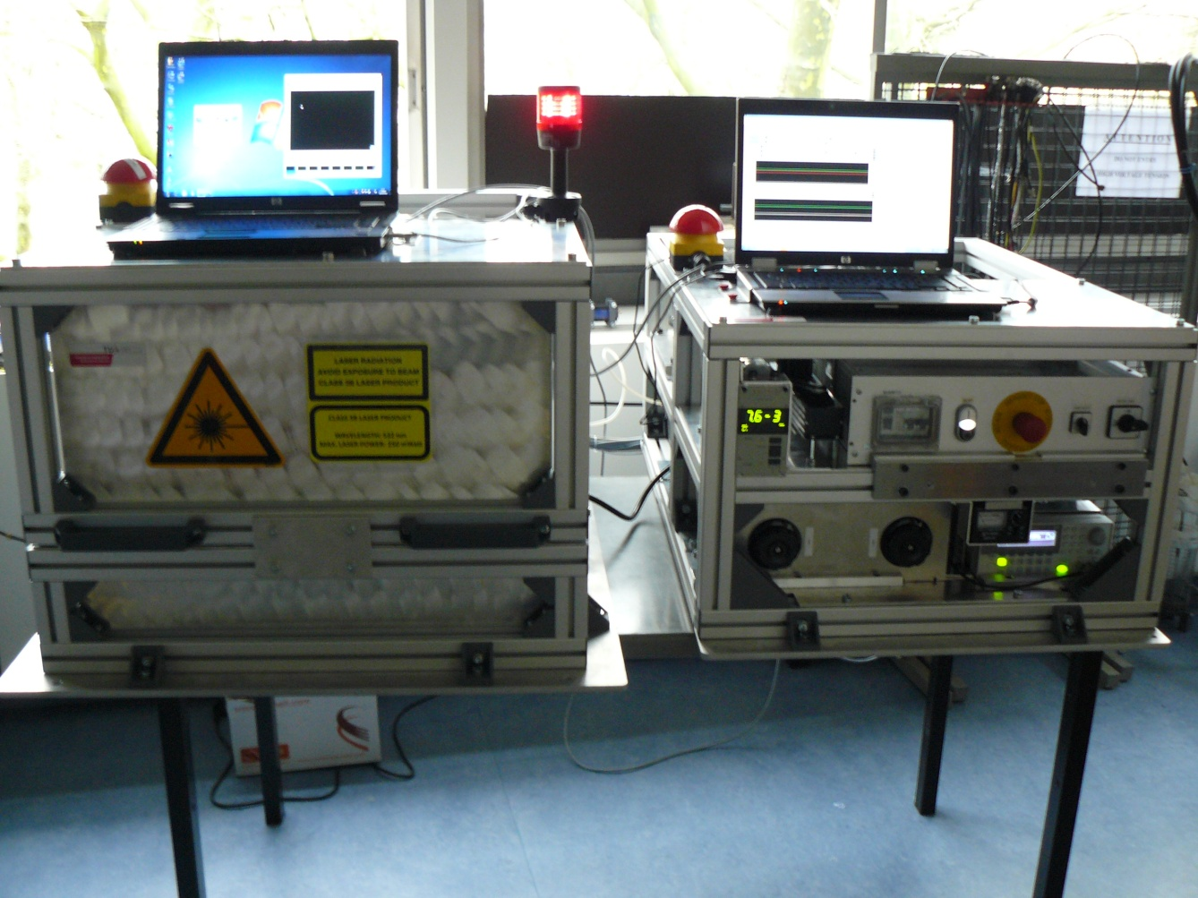
Experiment
Rack #1 and Rack #2

Slide 28
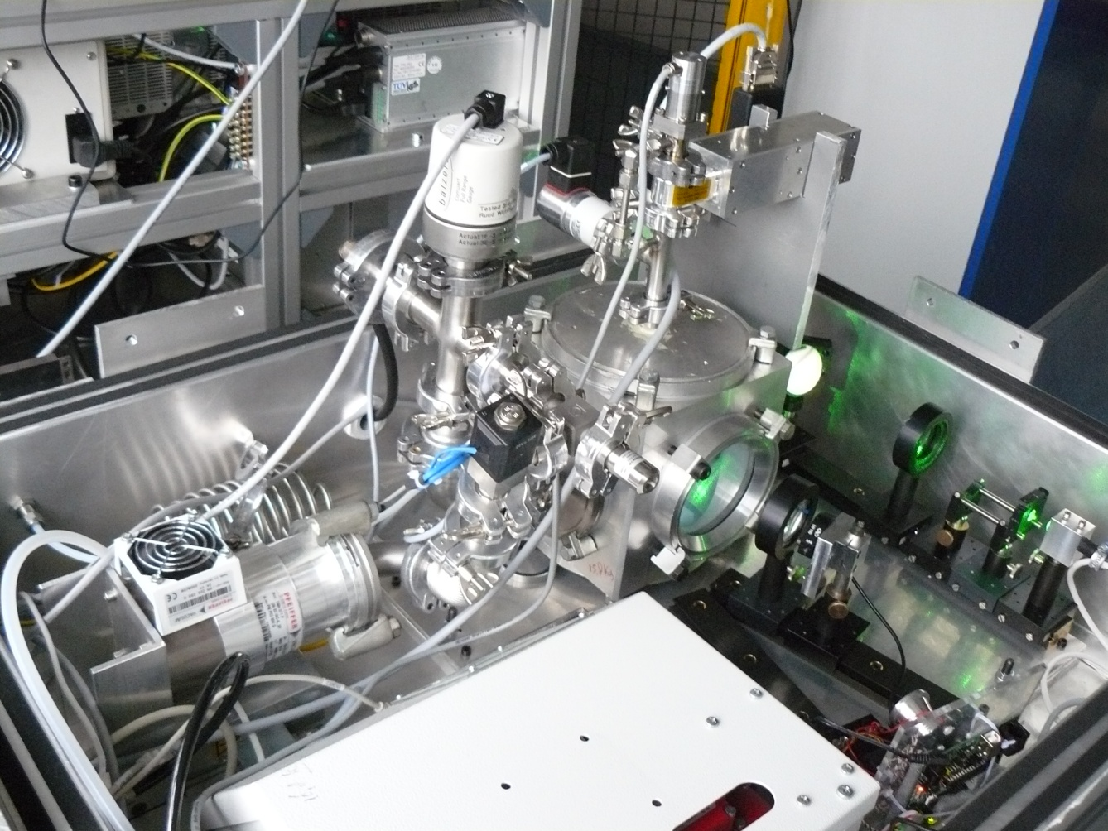
Experiment
Inner side Rack #1

Slide 29
Time line
Proposal – Accepted in November 2009
Experiment design
Start building experiment in November 2010
Start writing Experiment Safety Data Package
Flight campaign originally planned for March 2011
Postponed until May 2011

Slide 30
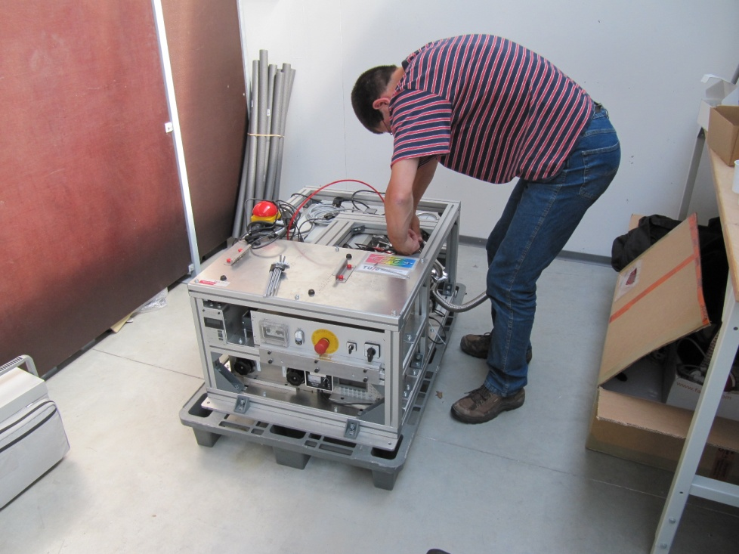
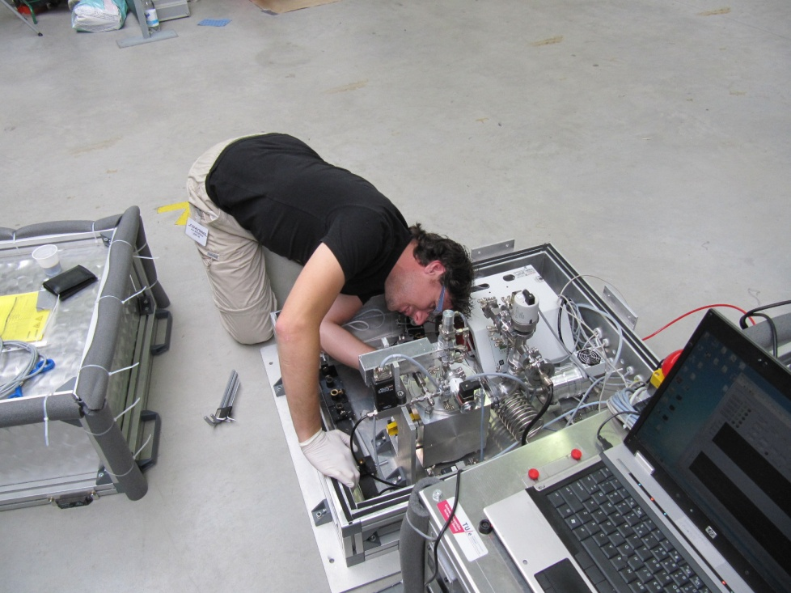
Preparation of the experiment for the safety check …

Slide 31
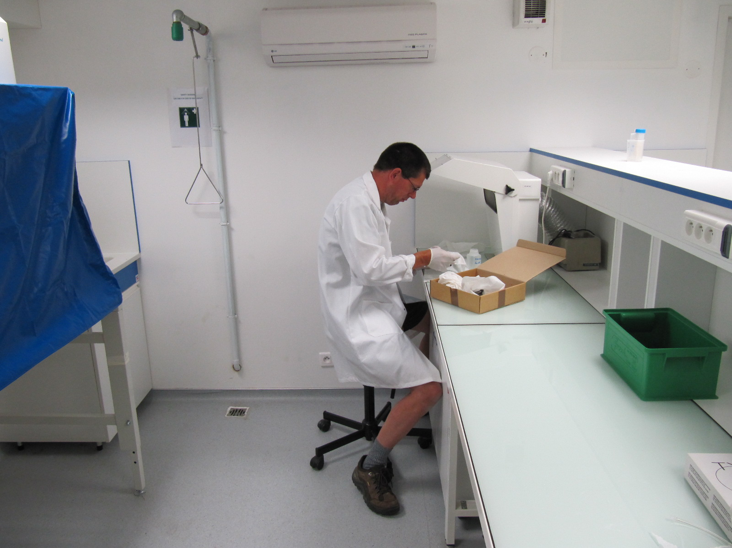

Slide 32
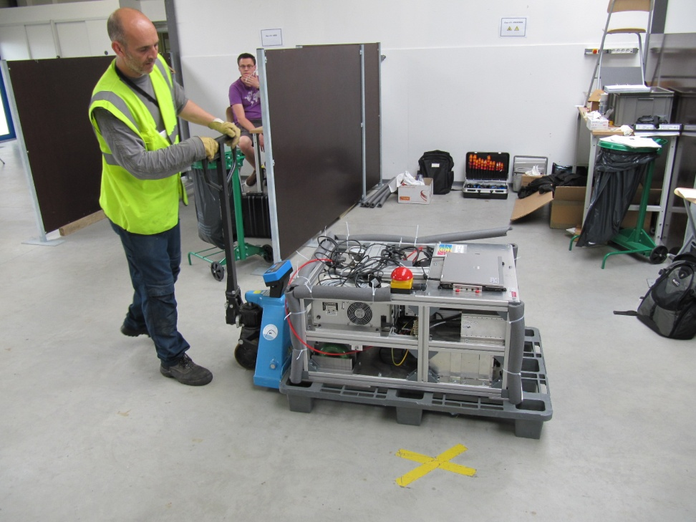
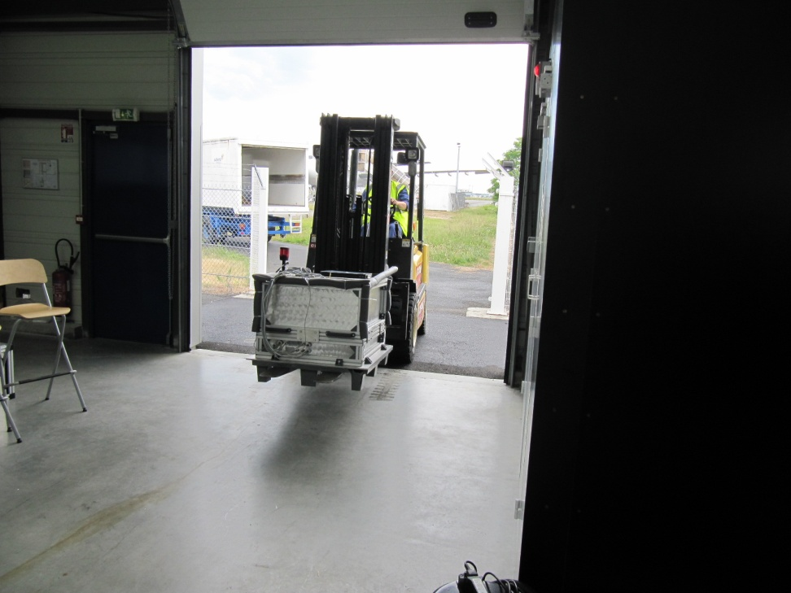
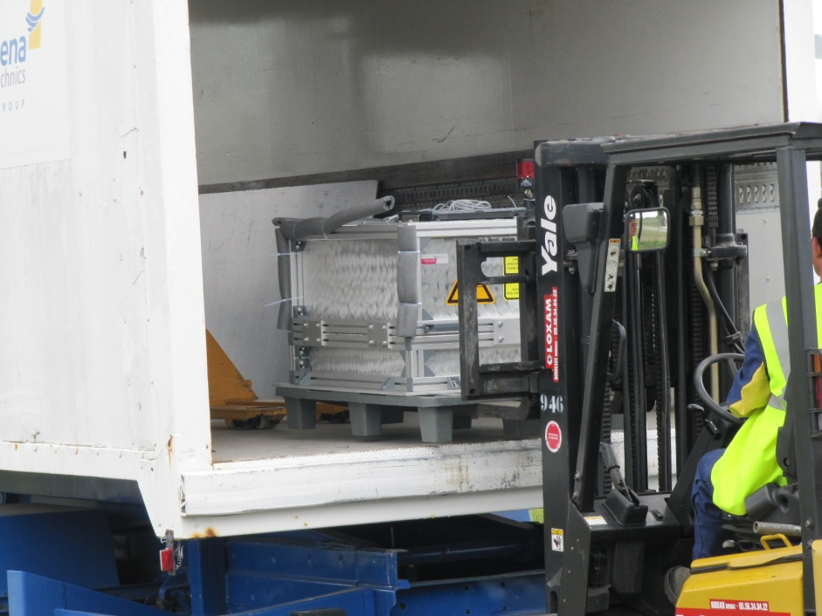
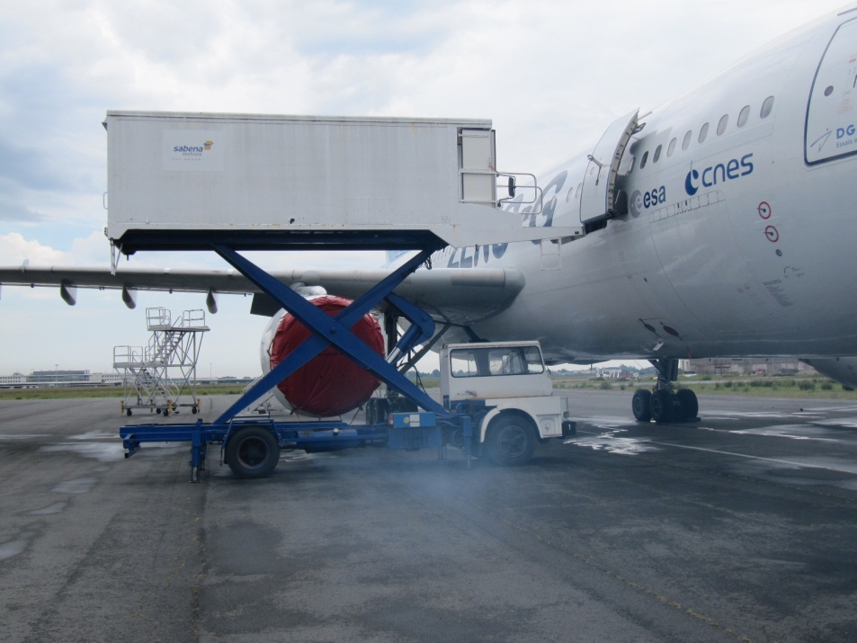
Loading the experiment
Loading the experiment

Slide 33
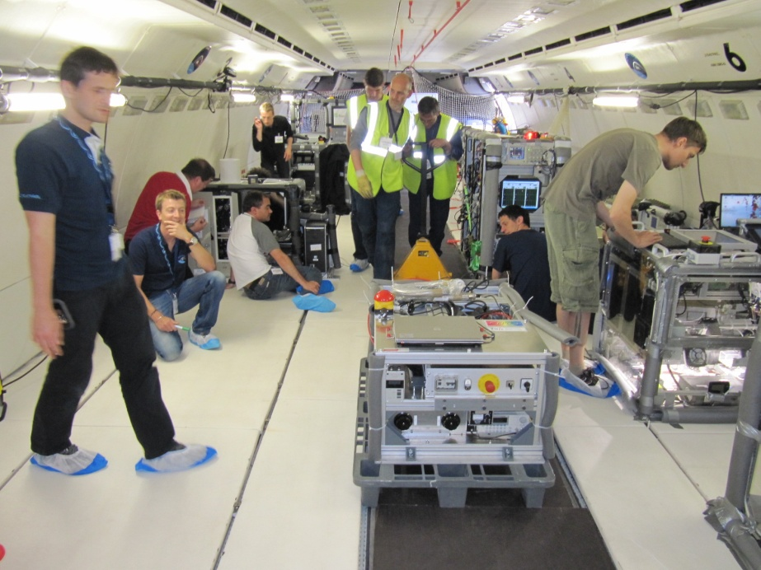
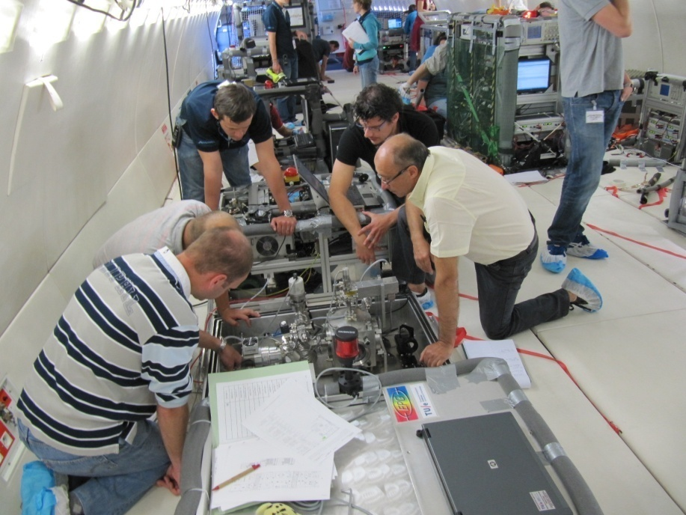
Safety first
Final safety check with people from Novespace, ESA, CNES

Slide 34
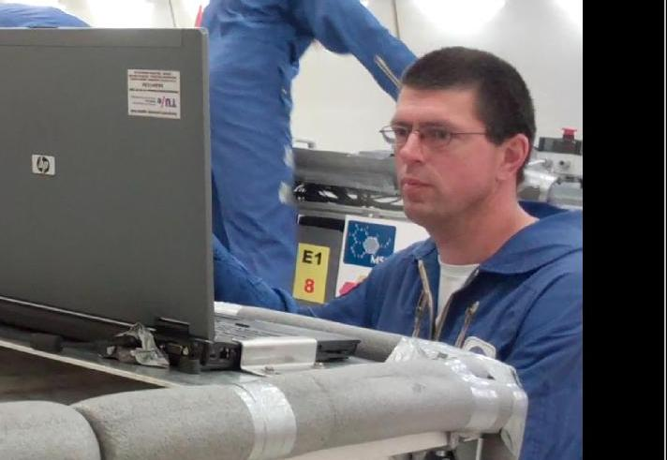
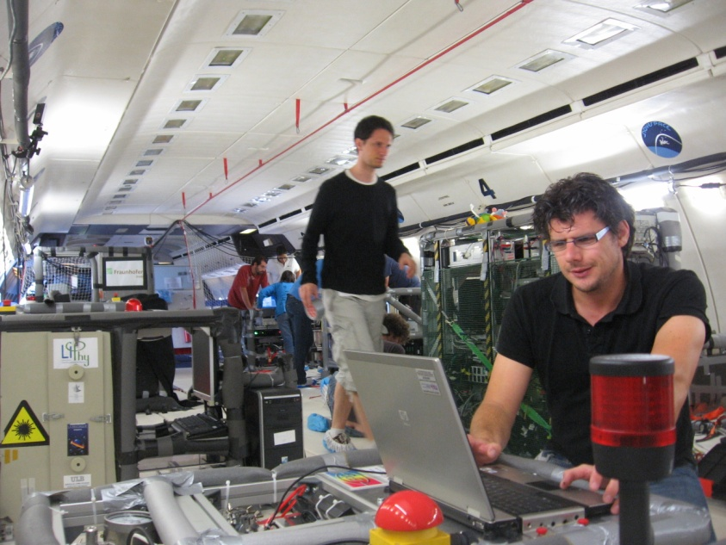
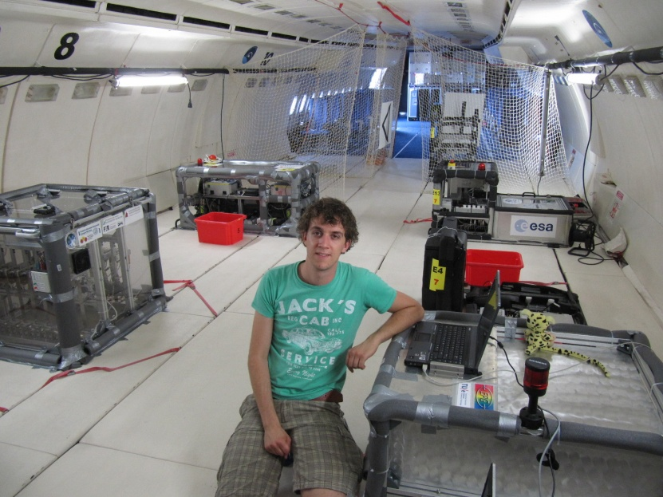
Training … training … training …

Slide 36
Results:

Slide 37
Typical camera image
Microparticles
Electrode

Slide 38
Varying gravity conditions
1 g
1.8 g
0.5 g
0.1 g

Slide 39
Results
Measuring equilibrium position, two types of behavior observed
Behavior for p < 25 Pa
Behavior for p > 25 Pa

Slide 40
p < 25 Pa
Particles lost from confinement
microgravity
hypergravity
hypergravity

Slide 41
p > 25 Pa
Particles remain confined in the
pre-sheath
Possible explanation: Ion drag force
microgravity
hypergravity
hypergravity
ions
-
-
-
-
-
-
-
-
+

Slide 43
20 Pa: particles lost

Slide 44
20 Pa: particles lost

Slide 48
Comparison with centrifuge measurements

Slide 49
Conclusions Parabolic flights
Two types of behavior, dependent on gas pressure, observed.
Smooth agreement between centrifuge and parabolic flight measurements.
Interpretation of data is underway: pre-sheath model

Slide 50
Future
Data analysis
Measuring particle charge by rotating experiment (group talk Dirk Trienekens)
Langmuir probe measurements in plasma bulk

Slide 51
Acknowledgements
Group: elementary processes in gas discharges (EPG)
Evert Ridderhof, Loek Baede, Eddie van Veldhuizen, Huib Schouten.
Gemeenschappelijke Technische Dienst (GTD)
Jan van Heerebeek, Rob de Kluijver, Samu Oosterink, Patrick de Laat, Erwin Dekkers, Jovita Moerel.
ESA
Vladimir Pletser, Mikhail Malyshev, Astrid Orr.
Novespace
Brian Verthier, Frederique Gai.

