Slide 1

Plasmas For Propulsion: Alternative Propellants And (Some) Emerging Concepts
Trevor Lafleur
University of New South Wales Canberra, Australia
MIPSE Seminar, Ann Arbor, 4 October 2023

Slide 2




COLLABORATORS (1/2)
Lui Habl, Elena Zorzoli Rossi, Dmytro Rafalskyi
ThrustMe, France
Anne Bourdon, Pascal Chabert, Benjamin Esteves
Laboratoire de Physique des Plasmas, Ecole Polytechnique, France
Oliver Jia-Richards
Department of Aerospace Engineering, University of Michigan, USA
Javier Martinez Martinez
Independent, Germany

Slide 3

COLLABORATORS (2/2)
Ash Pascale and Cormac Corr
Research School of Physics, Australian National University, Australia

Slide 4
SEMINAR “SCOPE”
Plasmas play a critical role in the force generation or propulsion process
Plasma Propulsion
Generation of a force for moving a spacecraft

Slide 5
SEMINAR OVERVIEW
1. Electrostatic propulsion
Challenges with conventional propellants and emerging alternatives
2. Inductive electrothermal propulsion
A novel propulsion technology for an identified market gap
3. Propellantless plasma propulsion
Utilization of the natural background plasma in the ionosphere

Slide 6
1. ELECTROSTATIC PROPULSION

Slide 7
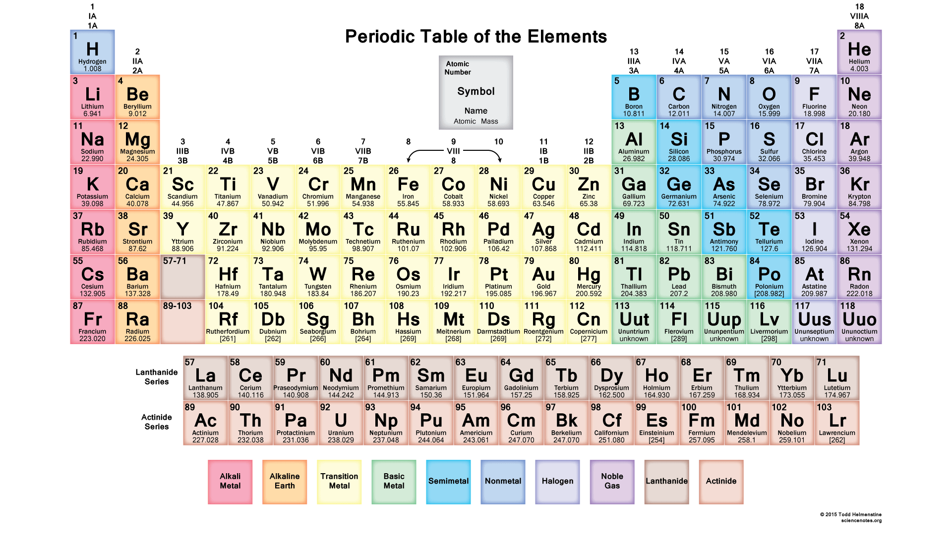
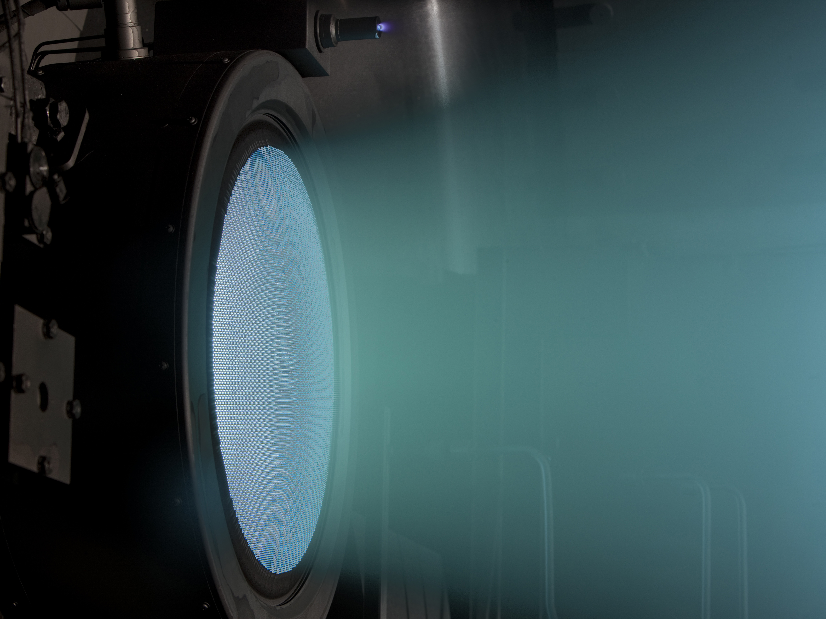
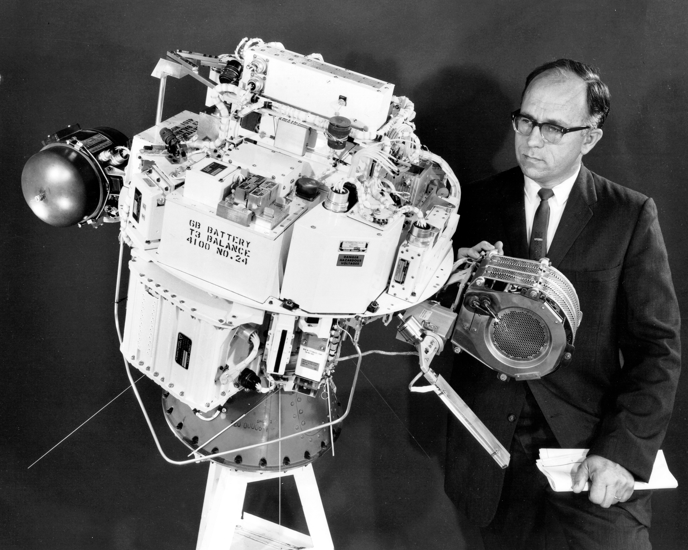
WHAT PROPELLANT SHOULD WE PICK?
NEXT
Credit: NASA
SERT-1
Credit: Science Notes
Credit: NASA
Answer: It depends on the propulsion technology and mission…

Slide 8
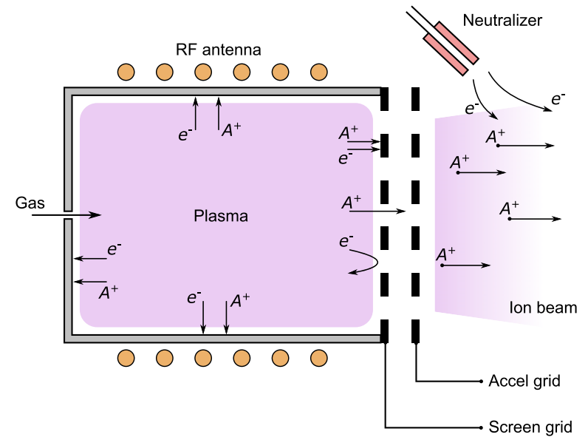
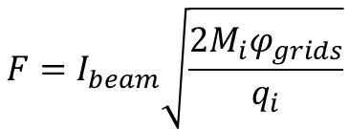


EXAMPLE: GRIDDED ION THRUSTERS (GITS)
$$F=I_{beam}\sqrt{\frac{2M_{i}φ_{grids}}{q_{i}}}$$
Thrust:
Power:
$$P=I_{beam}\left(ε_{beam}+φ_{grids}\right)$$
$$\frac{F}{P}∝\sqrt{\frac{M_{i}}{q_{i}}}$$
Thrust-to-power ratio:
Lower particle mass
Low voltage, high current thruster
Larger thruster size/mass
Higher particle mass
High voltage, low current thruster
Smaller thruster size/mass*
Answer (for GITs): Pick a convenient heavy propellant
*E. Stuhlinger, Ion propulsion for space flight (McGraw-Hill, 1964)

Slide 9
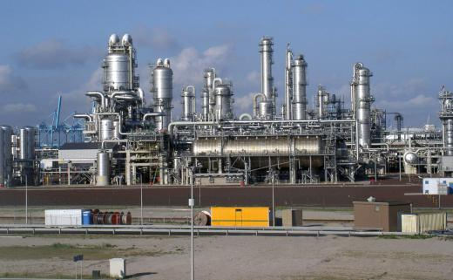
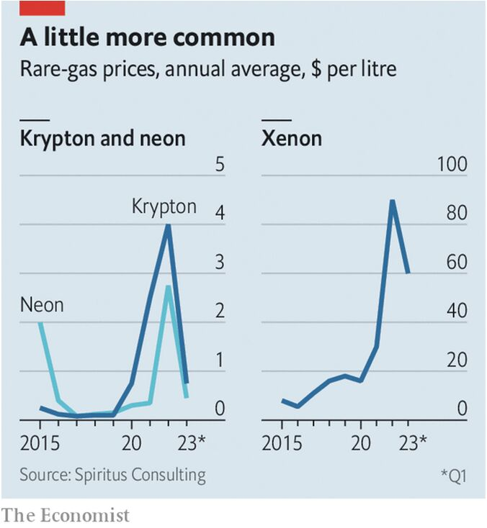
XENON
Produced through fractional distillation of air
Low concentration (1 part per 11.5 million) but not “rare”
For every 1000 tons of O₂ produced, only 1.2 kg of Xe are collected
Cost can be as high as $3000/kg
Credit: Frank Stahl
Challenge: Xe is expensive
Challenge: The Xe market is susceptible to strong fluctuations
Short-term solution: Adopt Kr and Ar as alternatives?
D.A. Herman and K.G. Unfried, “Xenon acquisition strategies for high-power electric propulsion NASA missions”, JANAF SPS Subcommittee Meeting, GRC-E-DAA-TN23198

Slide 10
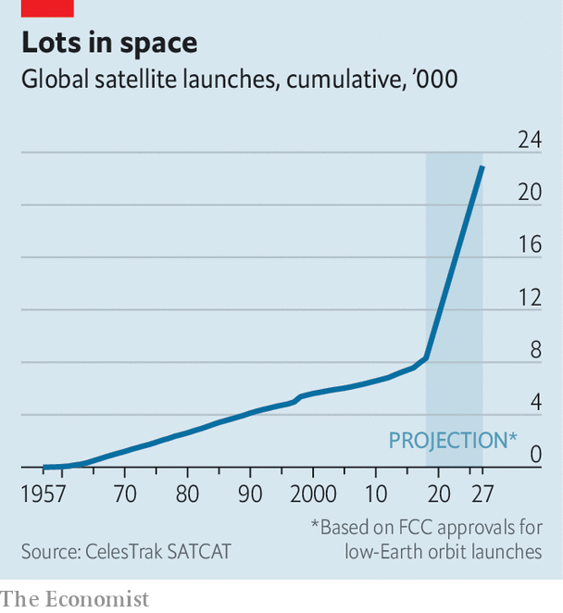
SPACE INDUSTRY GROWTH
Between 17,000 – 300,000 satellites could be launched over the next 10 years with an average satellite mass of ~300 kg
Satellite Mass Distribution
5.7% (> 500 kg)
16.8% (1 –100 kg)
2000 satellites/year
x 30 kg of propellant
= 60 metric tons/year
77.5% (100 – 500 kg)
Challenge: Global Xe production is only ~60 metric tons/year
”Satellites to be built and launched by 2029”, market research report, Euroconsult, 2021
“Global satellite manufacturing and launch market”, market research report, Northen Sky Research, 2022
A. Lawrence et al, “The case for space environmentalism”, Nature Astronomy 6, 428 (2022)

Slide 11
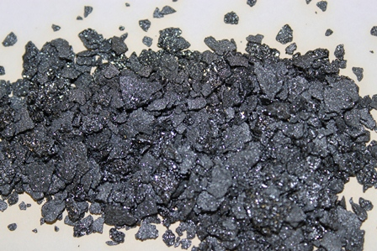
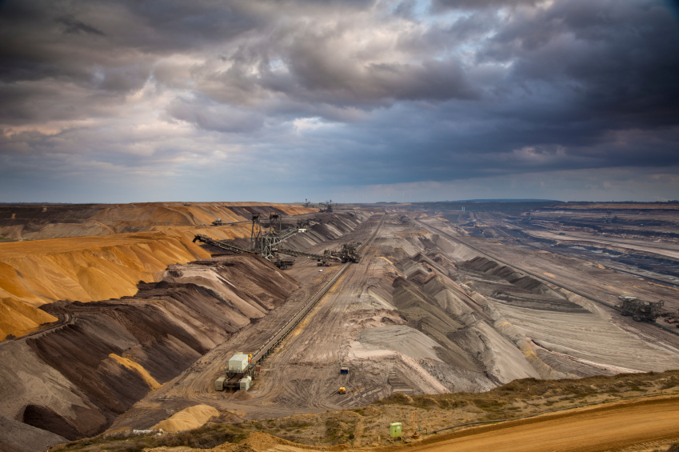
IODINE AS AN ALTERNATIVE PROPELLANT
Advantage: Low cost
Advantage: High global production output
Advantage: Easy handling and transport
Credit: Iochem
Extracted from caliche ore or underground brines
Global iodine production estimated to be almost 30,000 metric tons (500x higher than Xe)
Cost can be as low as $50-$100/kg (50-100x cheaper than Xe)
Credit: Ajay-SQM Group
*Other alternatives: Zn, Bi, Mg?
K. Hora, “Iodine production and industrial applications”, IDD Newsletter, 2016
*V.G. Tirila et al, “Review of alternative propellants in Hall thrusters”, 2Acta Astronautica 212, 284 (2023)

Slide 12
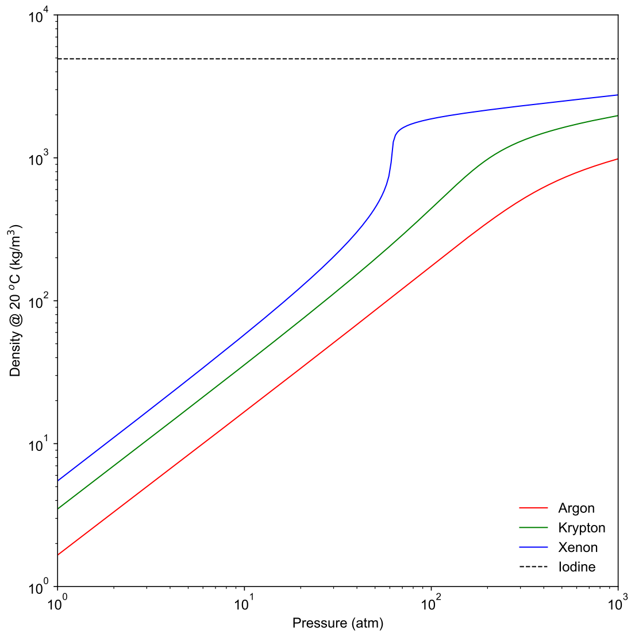
STORAGE DENSITY
Relative Storage Tank Size (200 atm, 20 ºC)
x1
I₂
x2.3
Xe
x5
Kr
x14
Advantage: I₂ needs a smaller tank
Advantage: I₂ needs a lighter tank
Ar
NIST Chemistry WebBook, 2023

Slide 13
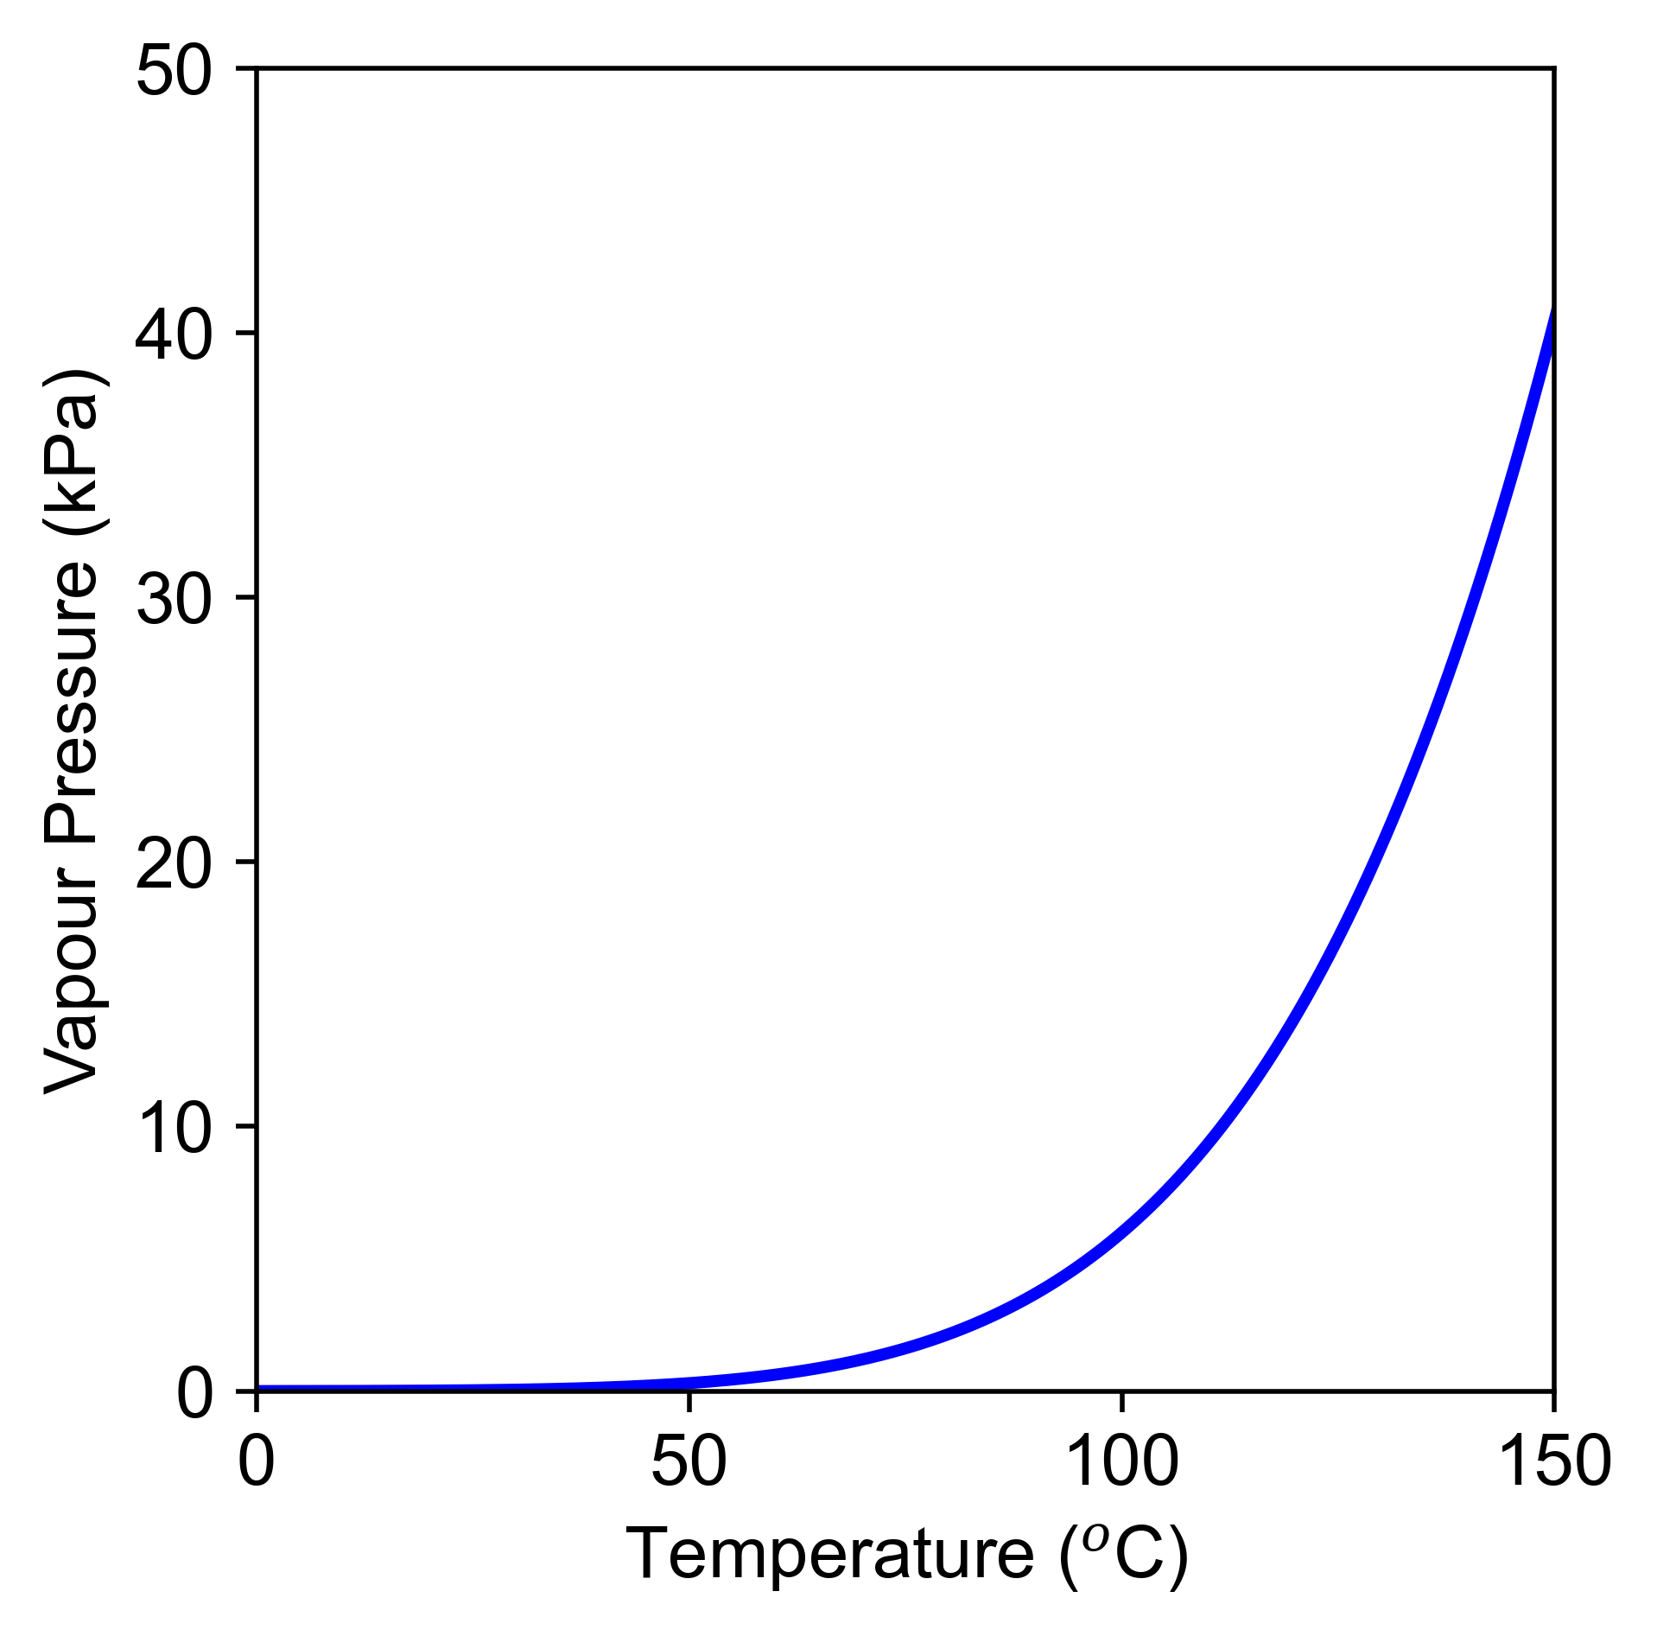
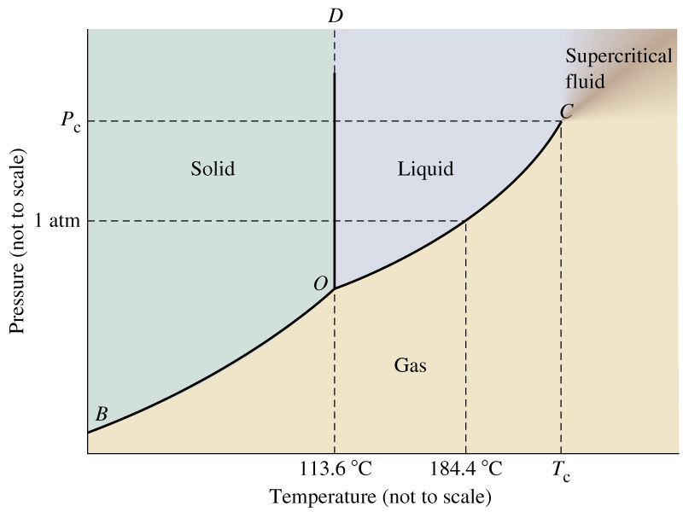


IODINE FLOW CONTROL
$${\dot{m}}_{sub}$$
I₂(s)
I₂(g)
$${\dot{m}}_{sub}$$
Thermal control system (heater, temperature sensor, control algorithm)
Challenge: Solid iodine flow control
~114 ºC
Solution: Controlled sublimation
NIST Chemistry WebBook, 2023
D. Rafalskyi et al, “In-orbit demonstration of an iodine electric propulsion system”, Nature 599, 411 (2021)

Slide 14
IODINE PROPULSION “TIMELINE”
1962
Recognition of cost/availability problems of xenon in the future and the proposal of iodine as a primary propellant
2012
First in-space demonstration of an iodine propulsion system (cold/warm gas thruster; ThrustMe)
2020
Further launches of iodine electric propulsion systems (ThrustMe, T4i, Busek)
Investigation of negative iodine ions as an alternative to electrons for neutralization
First(?) ground-based demonstration of an iodine-fueled electric propulsion system (Hall thruster; Busek)
First in-space demonstration of an iodine electric propulsion system (gridded ion thruster; ThrustMe)
2000
2019
2021-
W. Dong et al, “Negative iodine formation on metal hexaboride surfaces”, ARS Electric Propulsion Conference, 1962
R. Dressler, Y.-H. Chiu, and D. Levandier, “Propellant alternatives for ion and Hall effect thrusters”, 38th Aerospace Sciences Meeting and Exhibit, AIAA-2000-0602, 2000
O. Tverdokhlebov and A. Semenkin, “Iodine propellant for electric propulsion-to be or not to be”, 37th Joint Propulsion Conference and Exhibit, AIAA-2001-3350, 2001
J. Szabo et al, “Performance evaluation of an iodine-vapor Hall thrusters”, Journal of Propulsion and Power 28, 848 (2012)
J. Martinez Martinez, D. Rafalskyi, E. Zorzoli Rossi, and A. Aanesland, “Development, qualification and first flight data of the iodine based cold gas thruster for CubeSats”, 5th IAA Conference on University Satellite Missions and CubeSat Workshop, 2020
D. Rafalskyi et al, “In-orbit demonstration of an iodine electric propulsion system”, Nature 599, 411 (2021)

Slide 15
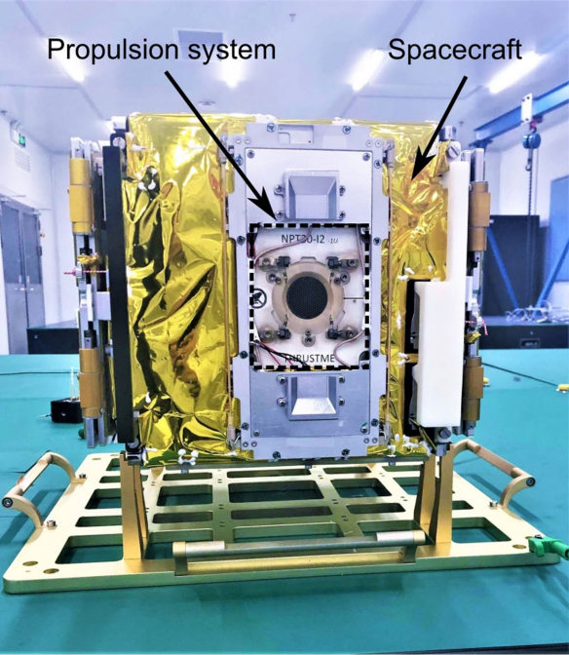
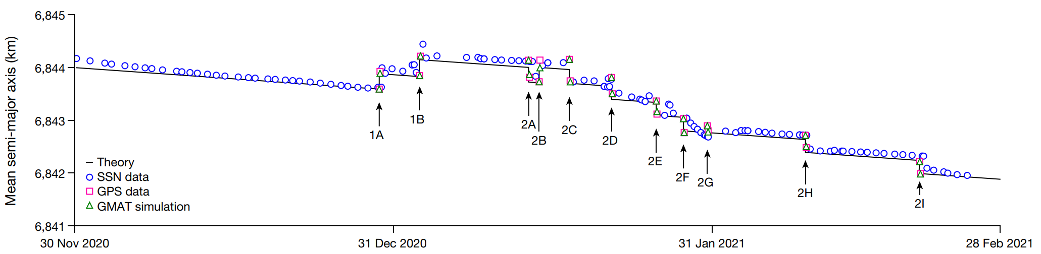
FIRST IN-ORBIT DEMONSTRATION
ThrustMe NPT30-I2 first launched into space on 6 November 2020 onboard the Beihangkongshi-1 satellite
480 km circular Sun-synchronous orbit
In-space testing between 2020-2021 with first ignition 29 December 2020
D. Rafalskyi et al, “In-orbit demonstration of an iodine electric propulsion system”, Nature 599, 411 (2021)

Slide 16
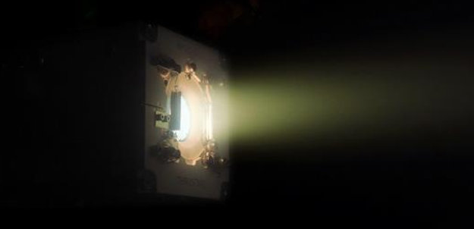
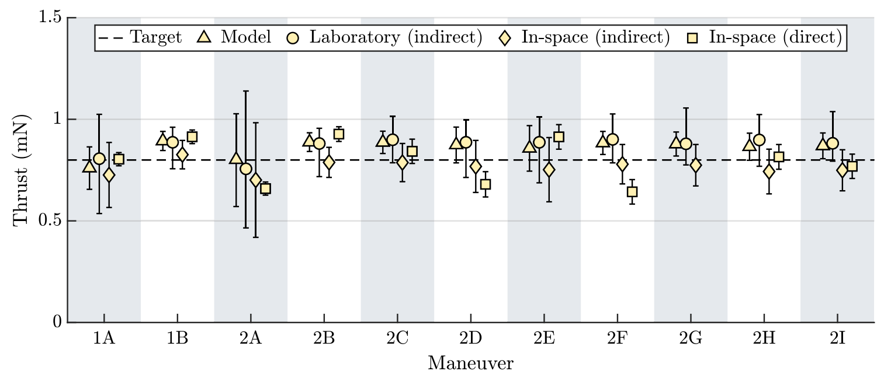
THRUST AUDIT
Credit: ThrustMe
Thrust audit of the ThrustMe NPT30-I2 propulsion system
O. Jia-Richards and T. Lafleur, “Iodine electric propulsion system thrust validation: from numerical modelling to in-space testing”, Journal of Propulsion and Power, articles in advance, 2023

Slide 17
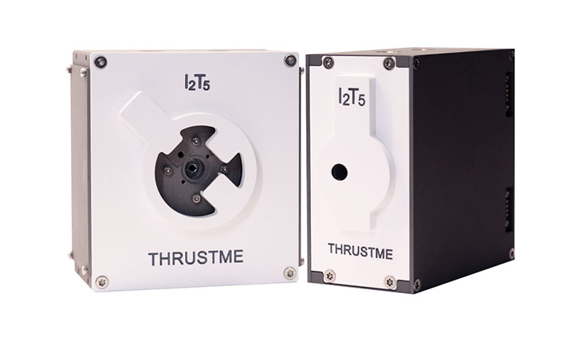
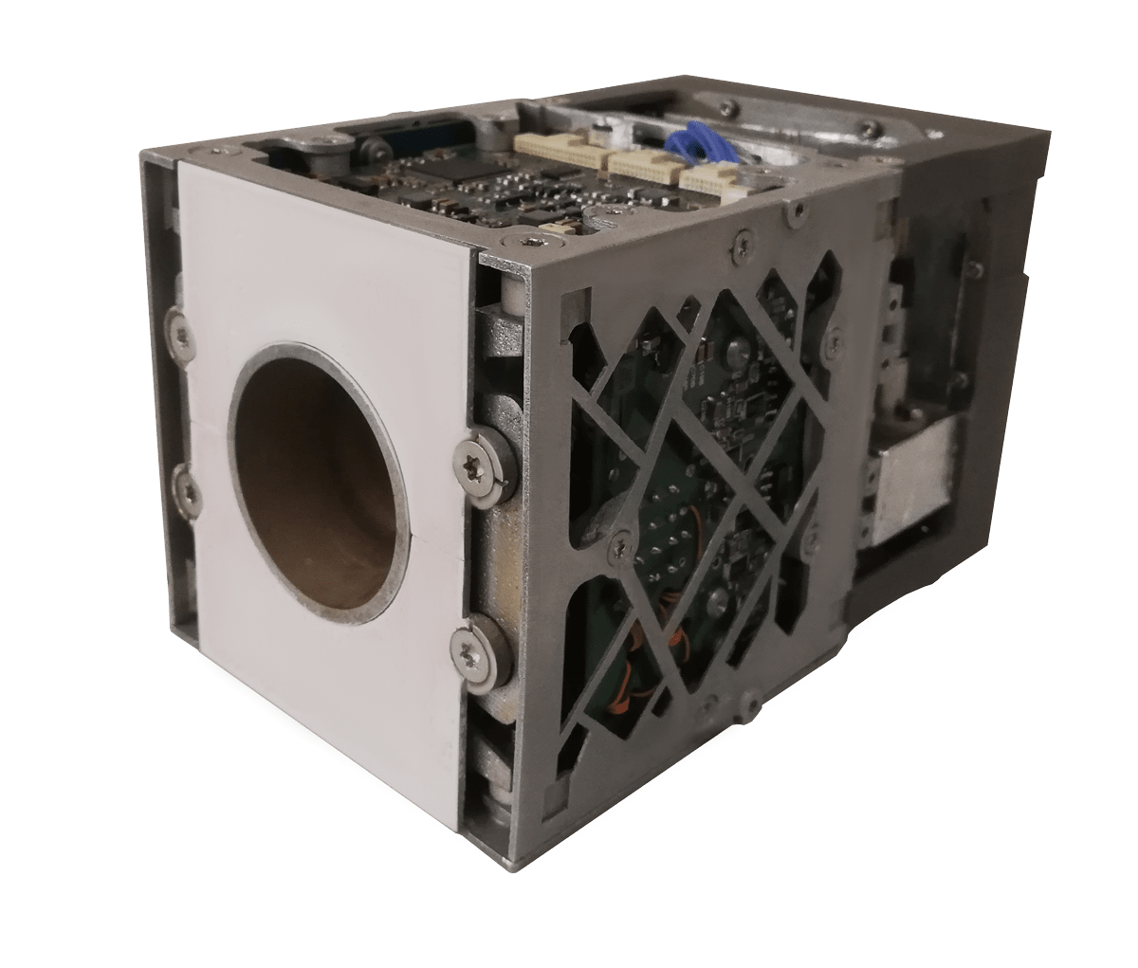
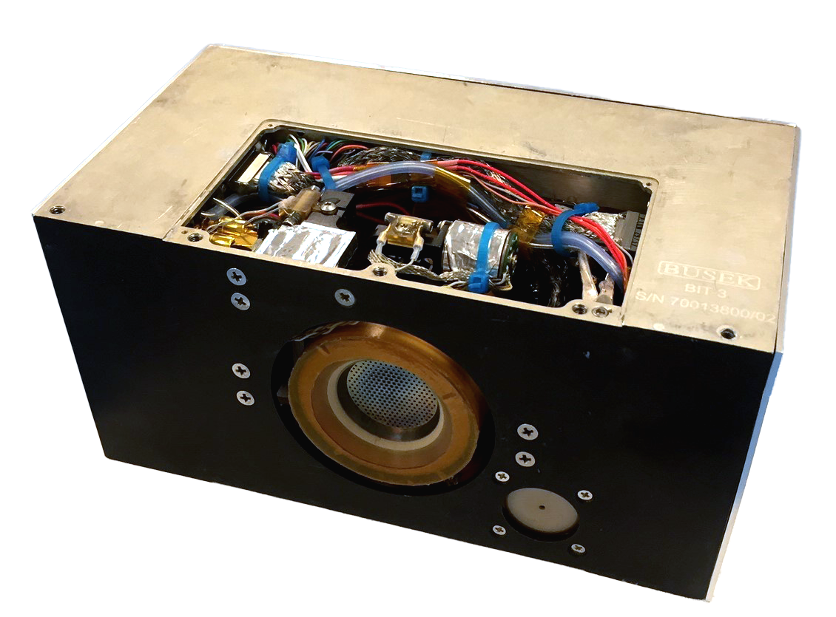
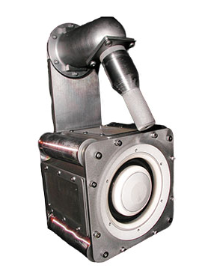
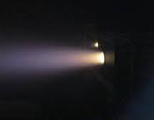
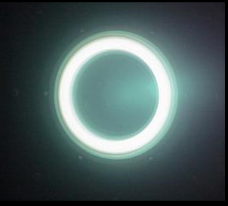
OTHER IODINE PROPULSION SYSTEMS
Ambipolar Thruster (T4i)
Gridded Ion Thruster (ThrustMe)
Cold/Warm Gas Thruster (ThrustMe)
RF Neutralizer (Busek)
Gridded Ion Thruster (Busek)
Hall Thruster (Busek)

Slide 18
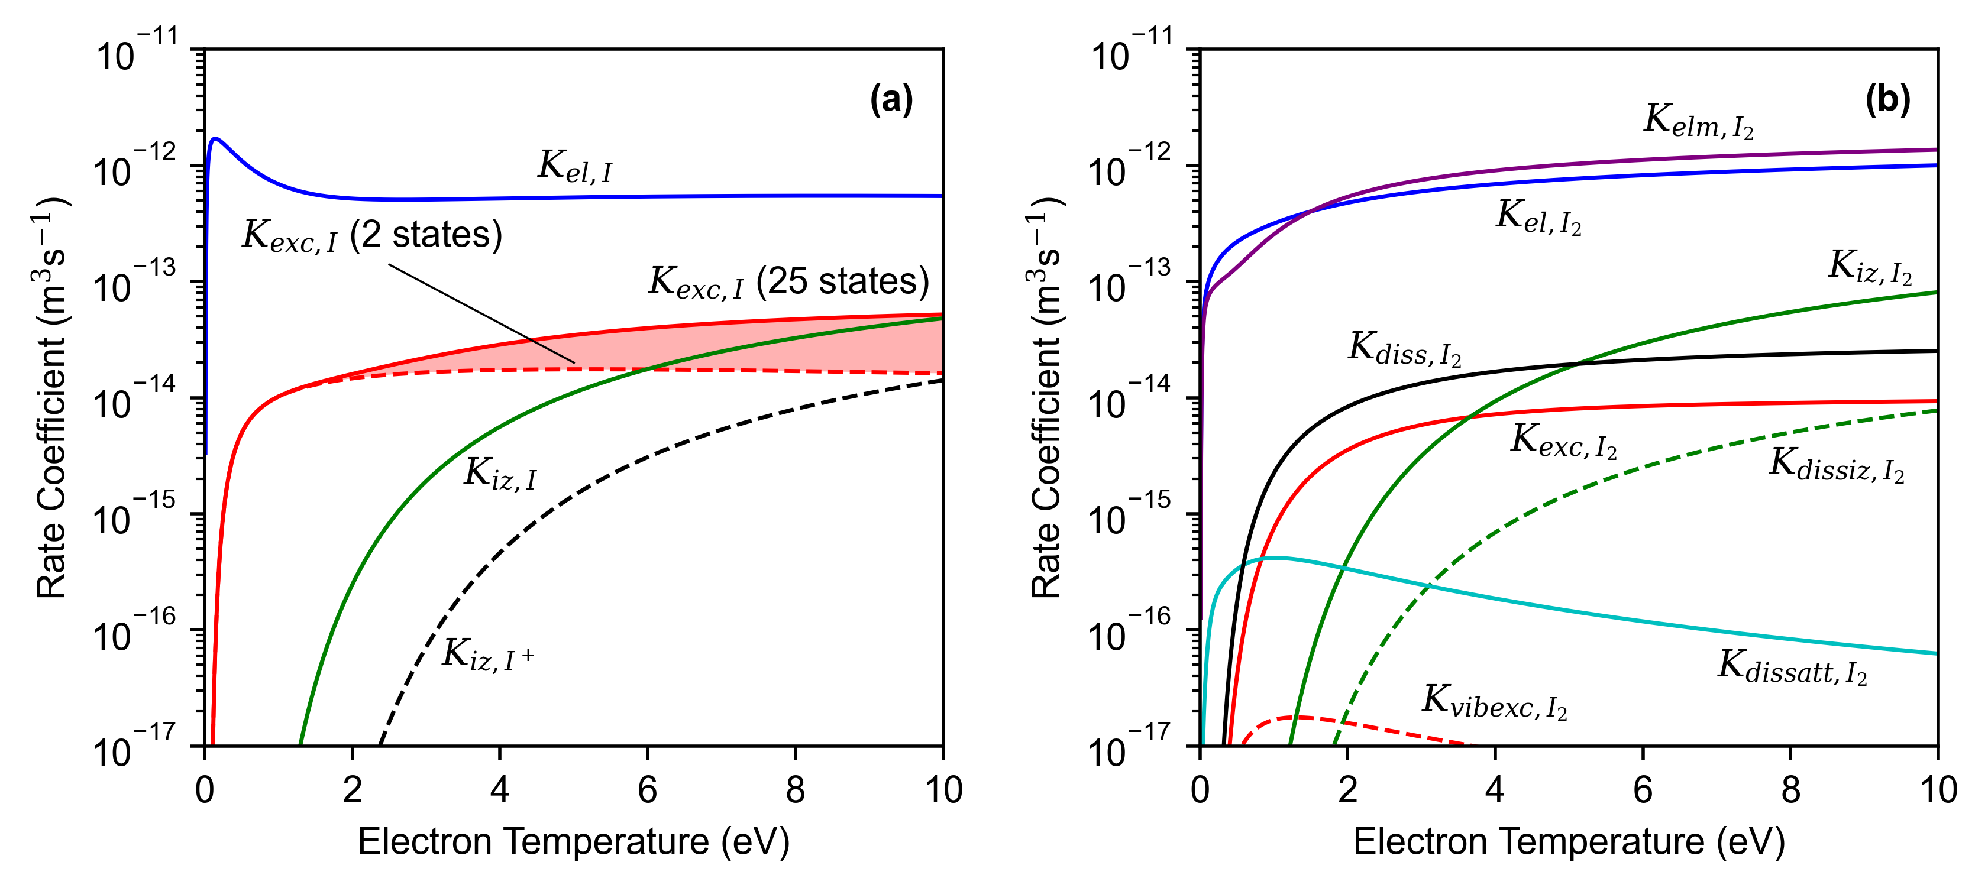
IODINE PLASMA CHEMISTRY
Xenon (Xe)
Atomic Iodine (I)
Molecular Iodine (I₂)
H.B. Ambalampitiya et al, “Electron scattering cross-section calculations for atomic and molecular iodine”, Atoms 9, 103 (2021)
J.R. Hamilton and J. Tennyson, “Iodine: I2 molecular and I atom”, technical report, Quantemol, 2015
T. Lafleur et al, “Development and validation of an iodine plasma model for gridded ion thrusters”, Plasma Sources Sci. Technol. 31, 114001 (2022)

Slide 19
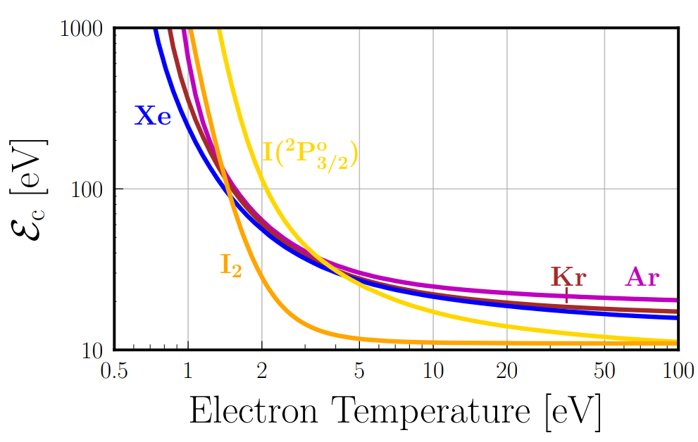
EXCITATION REACTIONS
Xenon (Xe)
Configuration | Energy (eV)
5p⁶ | 0.00
5p⁵(²Pº_{3/2})6s | 8.32
5p⁵(²Pº_{3/2})6s | 8.44
5p⁵(²Pº_{1/2})6s | 9.45
5p⁵(²Pº_{1/2})6s | 9.57
Advantage: Collisional energy loss is lower in iodine (T_{e} > ~4 eV)
Atomic Iodine (I)
Configuration | Energy (eV)
5s²5p⁵ | 0.00
5s²5p⁵ | 0.94
5s²5p⁴(³P₂)6s | 6.77
5s²5p⁴(³P₀)6s | 6.95
5s²5p⁴(³P₁)6s | 7.55
NIST Atomic Spectra Database, 2023
T. Lafleur et al, “Development and validation of an iodine plasma model for gridded ion thrusters”, Plasma Sources Sci. Technol. 31, 114001 (2022)
B. Esteves, “Investigation of iodine plasmas for space propulsion applications”, PhD thesis, Ecole Polytechnique, 2022
K. Holste et al, “Performance of an iodine-fueled radio-frequency ion-thruster”, Eur. Phys. J. D 72, 1 (2018)

Slide 20
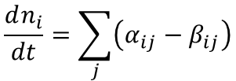


PLASMA MODELLING (1/3)
Continuity equation for each species:
$$\frac{dn_{i}}{dt}=\sum_{j}{\left(α_{ij}−β_{ij}\right)}$$
Global electron power balance:
$$\frac{d}{dt}\left(\frac{3}{2}n_{e}k_{B}T_{e}\right)=\frac{P_{abs}−\sum_{j}{P_{loss,j}}}{V}$$
Global neutral gas heating equation:
$$\frac{d}{dt}\left(\frac{3}{2}n_{g}k_{B}T_{g}\right)=\frac{\sum_{j}{\left(P_{gain,j}−P_{loss,j}\right)}}{V}$$
Iodine | I₂, I, I₂⁺, I⁺, I²⁺, I⁻, e⁻
Electromagnetic ICP model:
Ground state (and some excited states)
P. Grondein et al, “Global model of an iodine gridded plasma thruster”, Phys. Plasmas 23, 033514 (2016)
T. Lafleur et al, “Development and validation of an iodine plasma model for gridded ion thrusters”, Plasma Sources Sci. Technol. 31, 114001 (2022)
B. Esteves, “Investigation of iodine plasmas for space propulsion applications”, PhD thesis, Ecole Polytechnique, 2022
D. Levko and L.L. Raja, “Fluid modelling of inductively coupled iodine plasma for electric propulsion conditions”, J. App. Phys. 130, 173302 (2021)
S. Andrews et al, “Coupled global and PIC modelling of the REGULUS cathode-less plasma thrusters operating on xenon, iodine and krypton”, Acta Astronautica 207, 227 (2023)

Slide 21
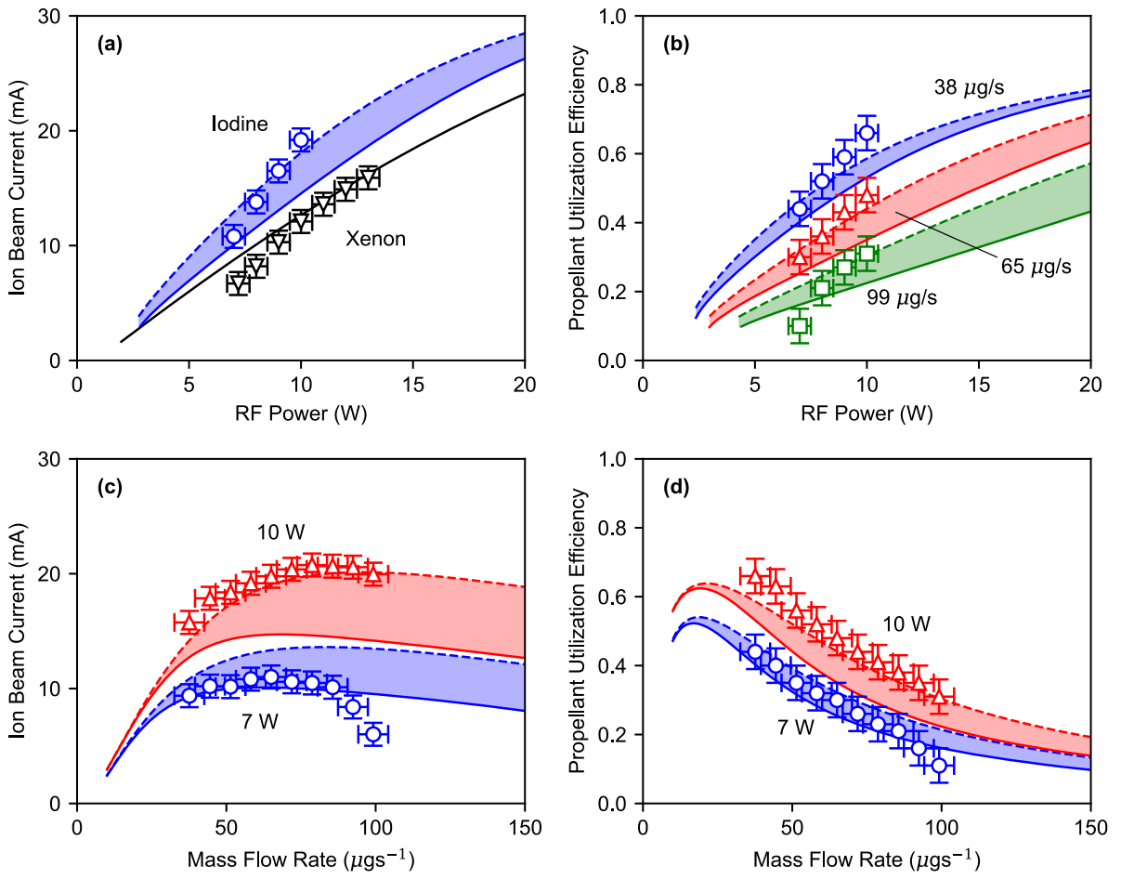

PLASMA MODELLING (2/3)
Credit: ThrustMe
$$η_{m}=\frac{{\dot{m}}_{i}}{\dot{m}}$$
T. Lafleur et al, “Development and validation of an iodine plasma model for gridded ion thrusters”, Plasma Sources Sci. Technol. 31, 114001 (2022)

Slide 22
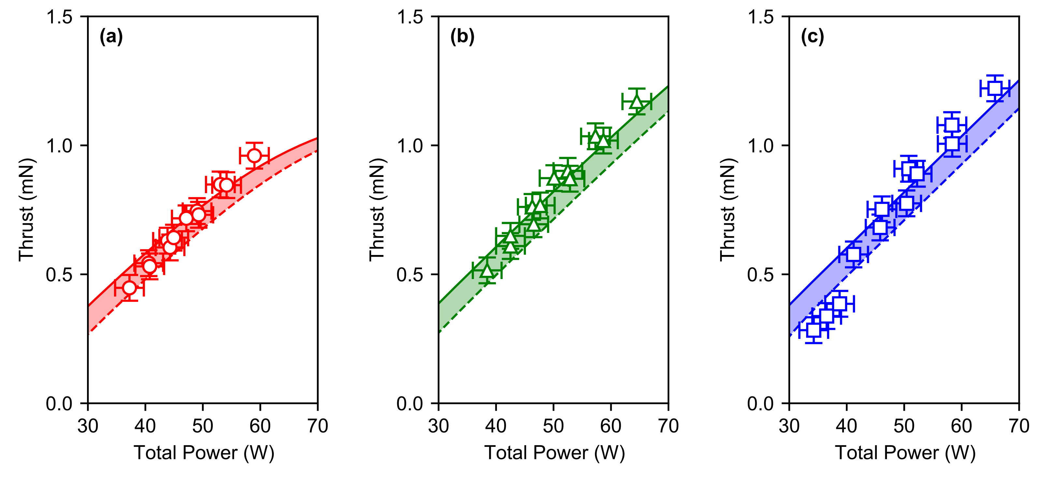
PLASMA MODELLING (3/3)
Credit: ThrustMe
38 μg/s
58 μg/s
99 μg/s
Current iodine reaction set seems quite good!

Slide 23
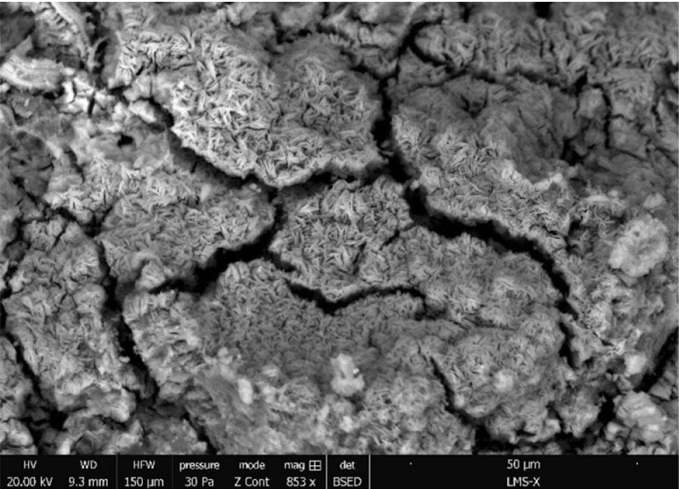
IODINE MATERIAL COMPATIBILITY
Challenge: Iodine is reactive with many materials!
Solution: Careful material selection
High Chemical Reactance With Iodine
Aluminium and aluminium alloys
Stainless steel and stainless-steel alloys
Copper
Tin
Low Chemical Reactance With Iodine
Refractory metals
Technical ceramics
Polymers and polymer coatings
Al 6082 SEM micrography
J. Martinez Martinez and D. Rafalskyi, “Design and development of iodine flow control systems for miniaturized propulsion systems”, CEAS Space Journal 14, 91 (2022)
D. Zschatzsch et al, “Corrosion of metal parts on satellites by iodine exposure in space”, Journal of Electric Propulsion 1, 1 (2022).

Slide 24
2. INDUCTIVE ELECTROTHERMAL PROPULSION

Slide 25
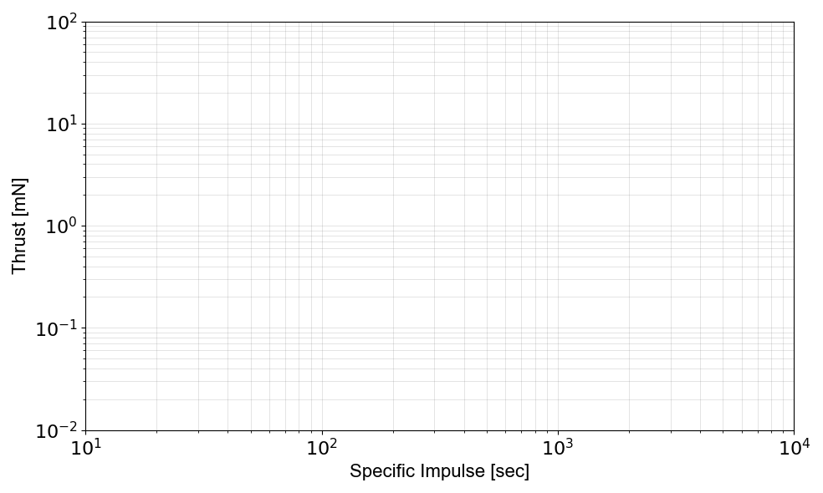
PROPULSION COMPARISON
RF ICP Plasma “Torch”
Chemical Propulsion
Thrust (“Maneuver Time”)
Resistojet
Target
F/P = 100-200 mN/kW
I_{sp} = 300-1000 s
Electrothermal Propulsion
Cold Gas
Hall Thruster
Ambipolar Thruster
Gridded Ion Thruster
Specific Impulse (“Fuel Efficiency”)

Slide 26
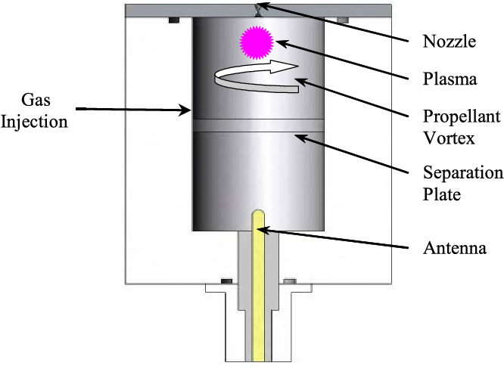
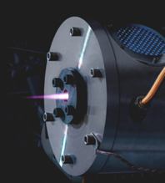
ELECTROTHERMAL THRUSTERS
Arcjet
Microwave (MET)
RF ICP
DC discharge
Immersed electrodes
Flight heritage
Microwave discharge
No immersed electrodes
Resonant cavity device
Limited flight heritage
RF discharge
No immersed electrodes
Non-resonant device
No flight heritage
Significant heritage in the plasma torch community
Y. Shen et al., Chin. Journal Aeronaut. 33, 3011 (2020)
M.M. Micci, S.G. Bilén and D.E. Clemens, Prog. Propul. Phys. 1, 425 (2009)
T. Fujino and M. Yamauchi, J. Appl. Phys. 128, 173302 (2020)
M.M. Micci, Encyclopedia of Aerospace Engineering (Wiley, 2010)

Slide 27
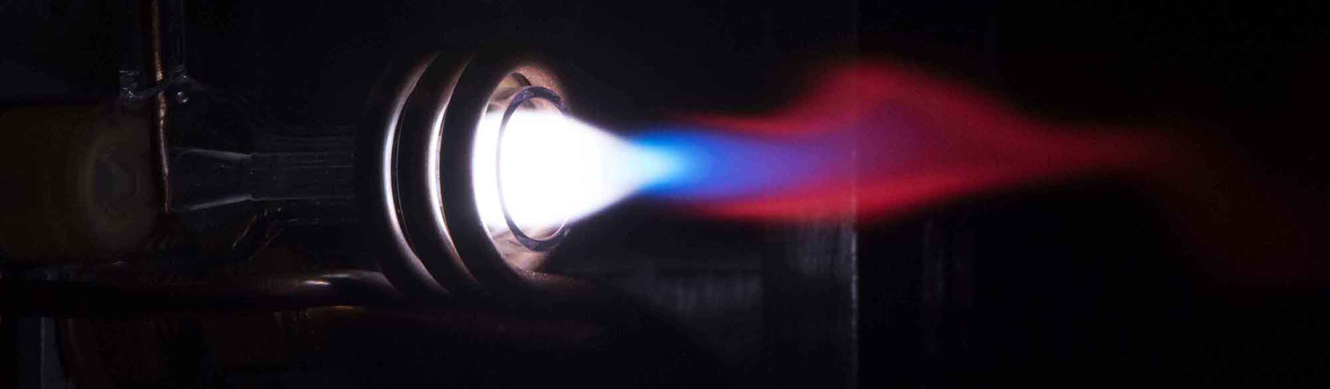
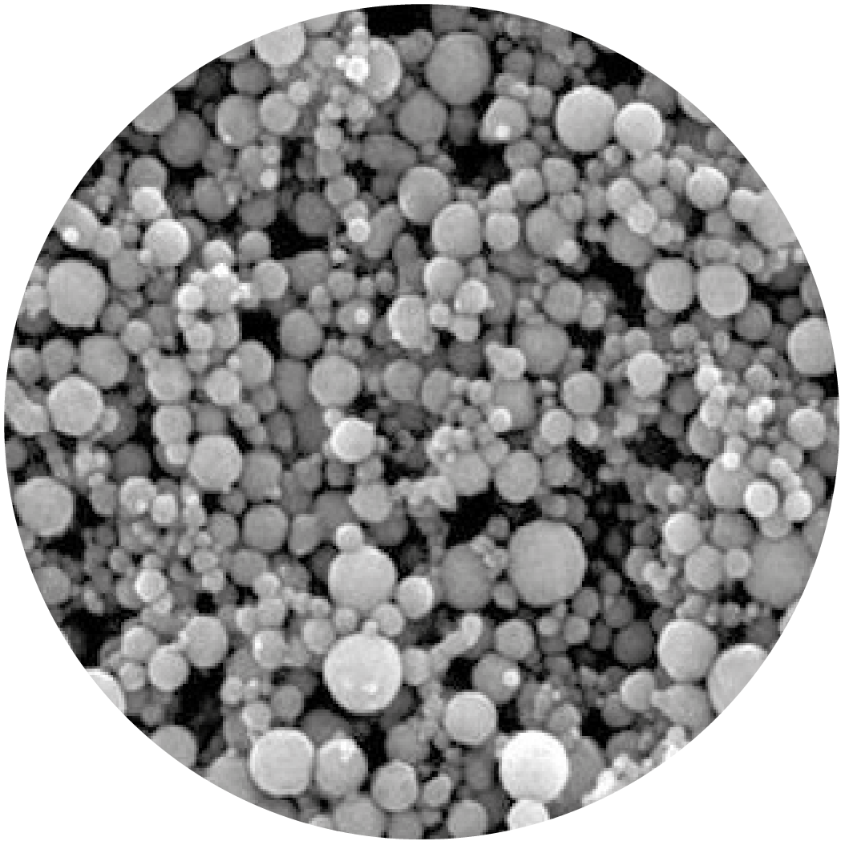
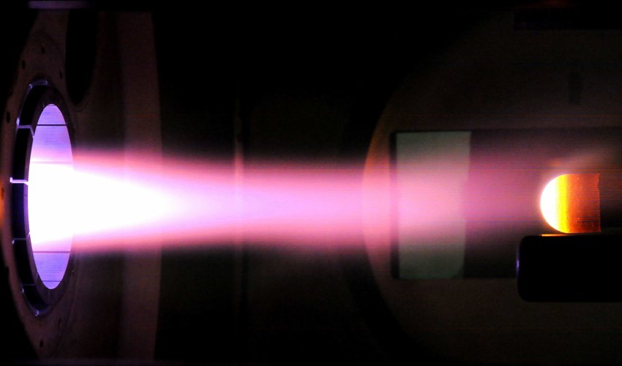
INDUCTIVELY COUPLED PLASMAS (ICPs)
Credit: University of Toronto
Analytical Chemistry
Heat Losses
Credit: Tekna
Advanced Manufacturing
Credit: von Karman Institute
High-Enthalpy Flows and Aerothermodynamics

Slide 28
THE BIDIRECTIONAL VORTEX
Credit: ORBITEC
G. Sharma and J. Majdalani, Phys. Fluids 33, 093607 (2021)
A.B. Vyas, J. Majdalani, and M.J. Chiaverini, “The bidirectional vortex. Part 1: An exact inviscid solution”, 39th AIAA/ASME/SAE/ASEE Joint Propulsion Conference and Exhibit, AIAA 2003-5052

Slide 29





POWER TRANSFER PROCESS
$$η_{rf}=\frac{P_{abs}}{P_{rf}}$$
Circuit Losses
Plasma-Wall Losses
$$η_{th}=\frac{P_{H}}{P_{abs}}$$
Excitation, etc.
Ionization
Gas-Wall Heat Losses
Nozzle Losses
RF Power
Power Coupled to Plasma
Power Transferred to Gas
Power Leaving ICP
Enthalpy Flow
$$P_{rf}$$
$$P_{abs}$$
$$P_{H}$$

Slide 30
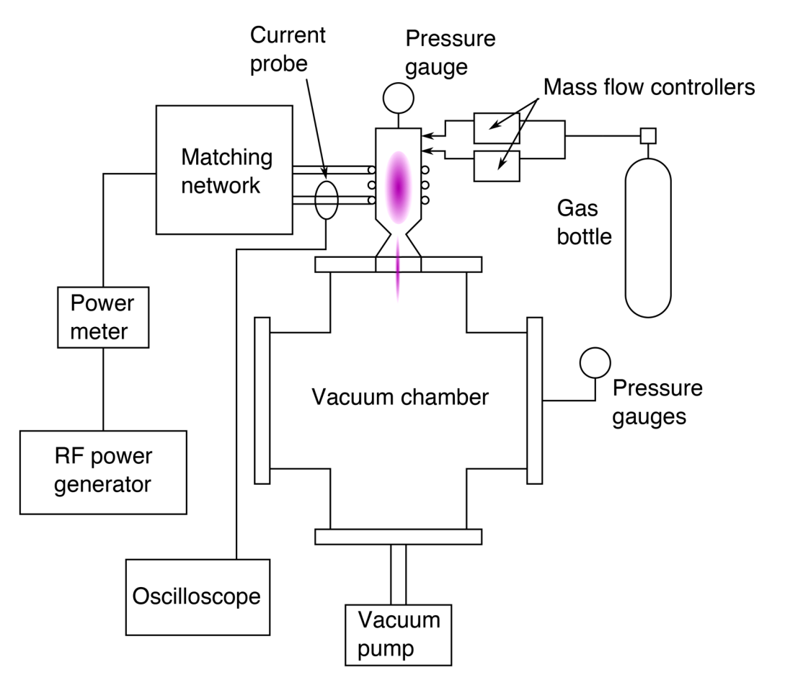
EXPERIMENTAL SETUP
T. Lafleur and C. Corr, “Characterization of a radio-frequency inductively coupled electrothermal plasma thruster”, J. Appl. Phys. 130, 043304 (2021)

Slide 31
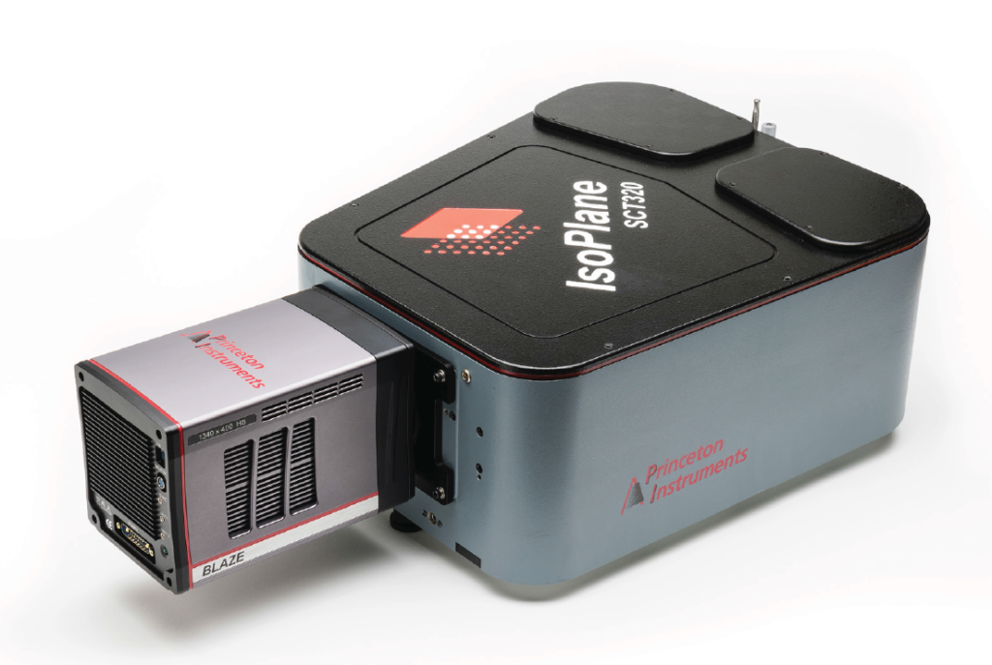
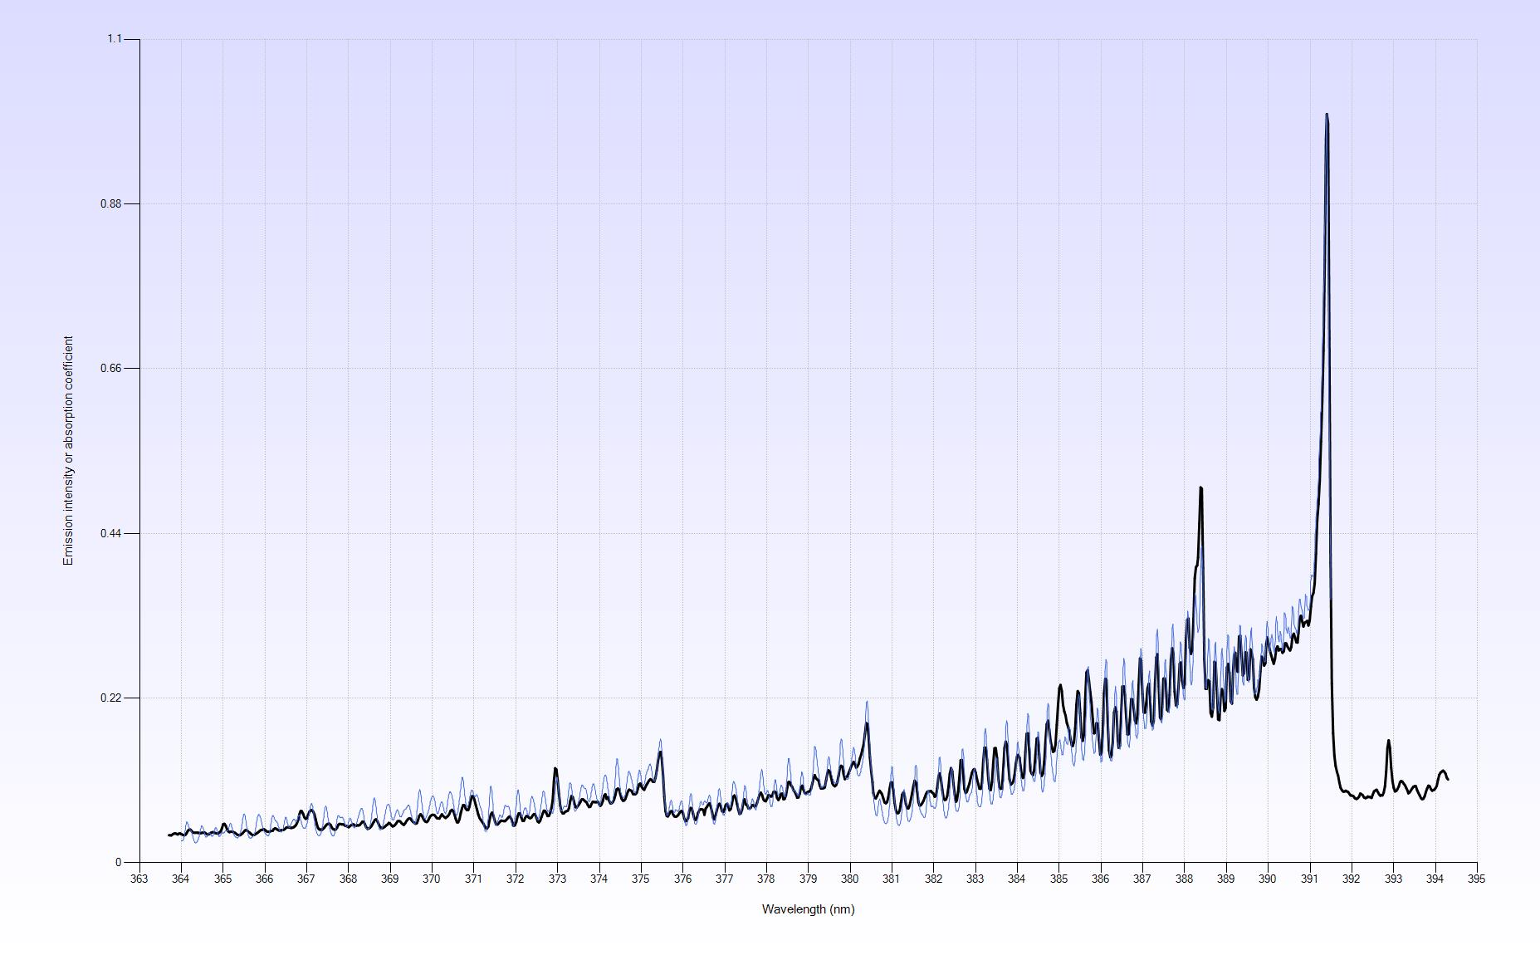
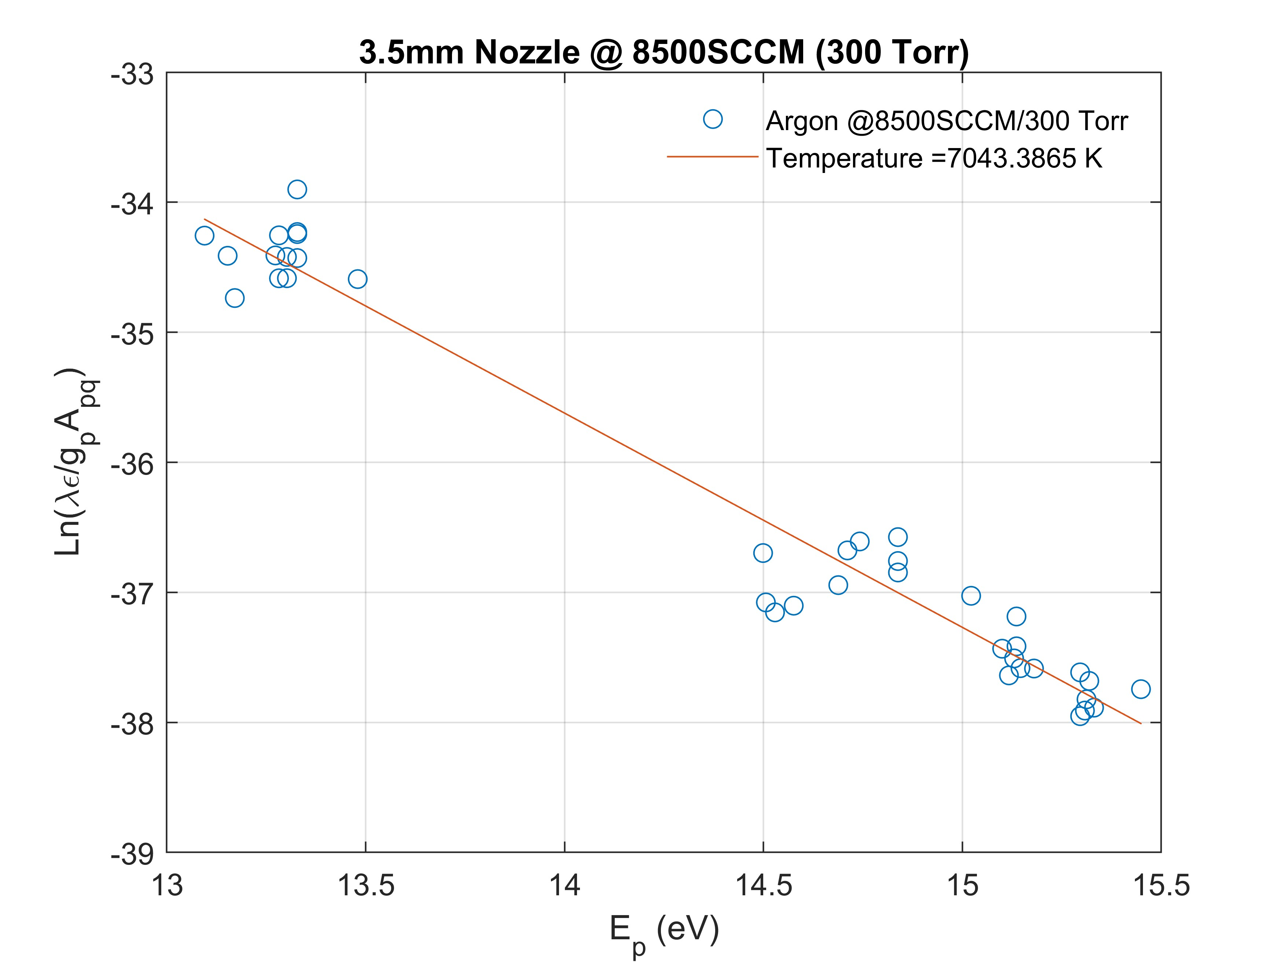

OPTICAL EMISSION SPECTROSCOPY
Rovibronic N2 Bands
Boltzmann Plot Method
$$T_{e}≥T_{exc}≥T_{vib}≥T_{rot}≥T_{g}$$
Peak Gas Temperature (K) | 10,000
Electron Density (m⁻³) | 10²⁰ - 10²¹

Slide 32
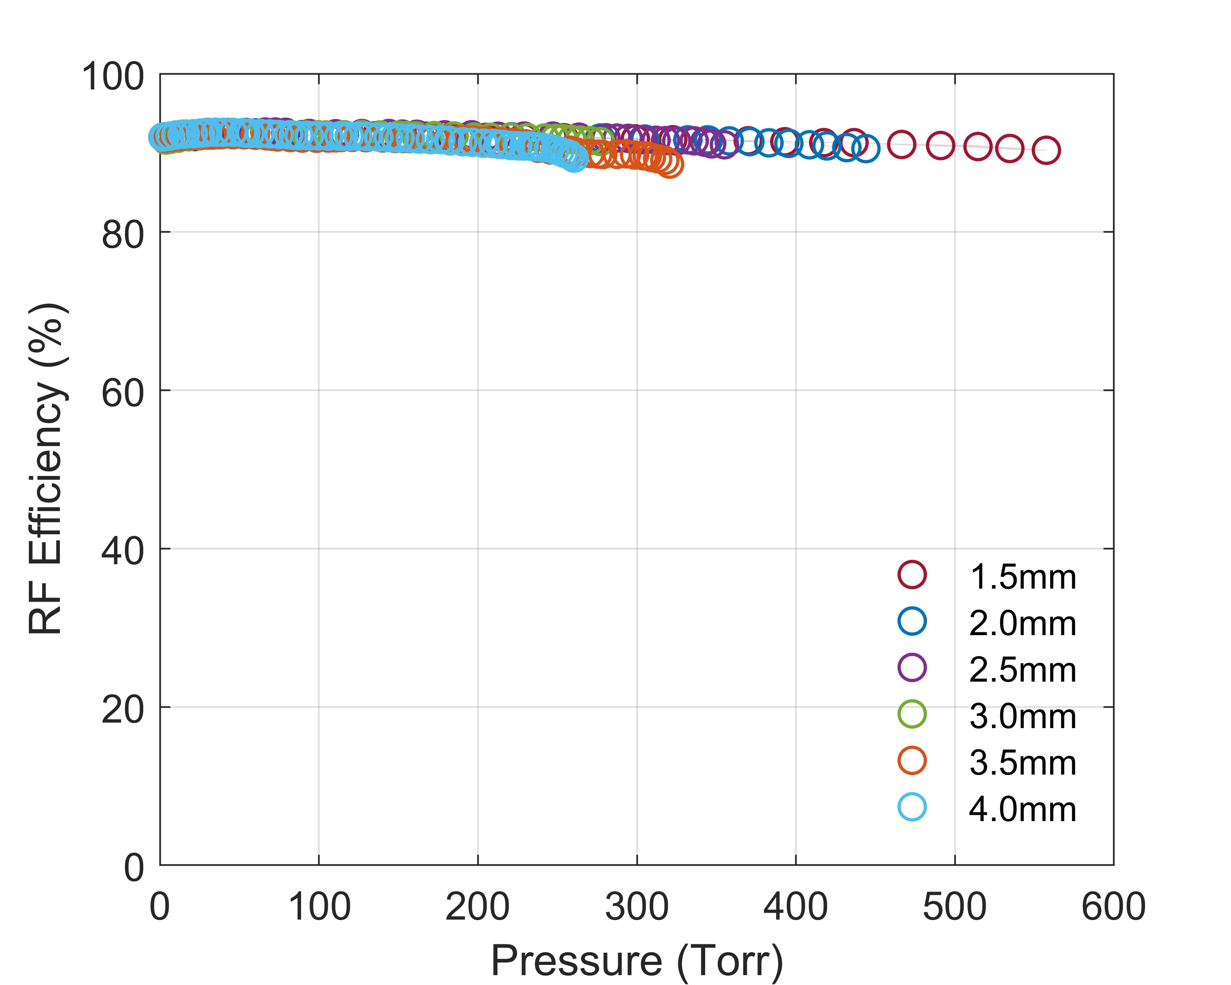
RF POWER TRANSFER EFFICIENCY

Slide 33
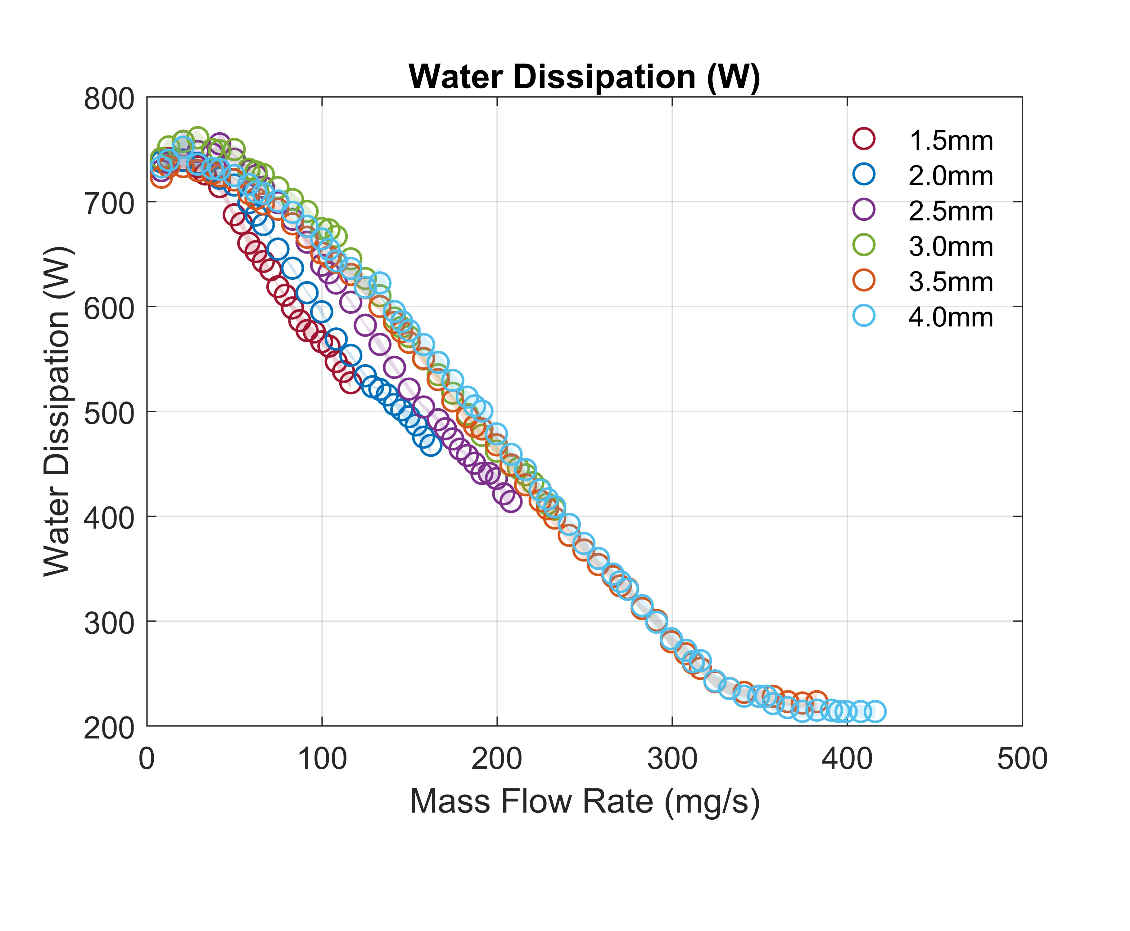
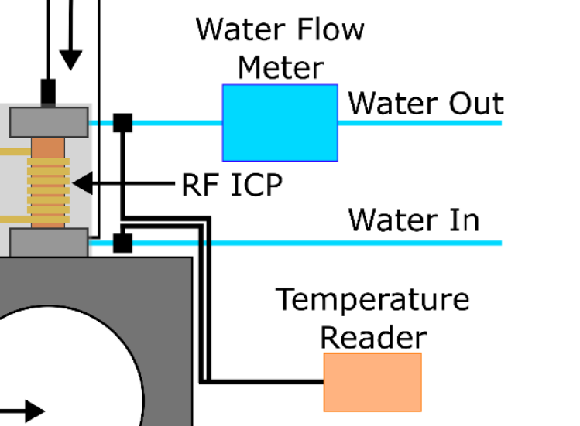


WATER CALORIMETRY
$$P_{H}≈P_{rf}−P_{diss}$$
$$P_{diss}=Qc_{p}ρ∆T$$

Slide 34
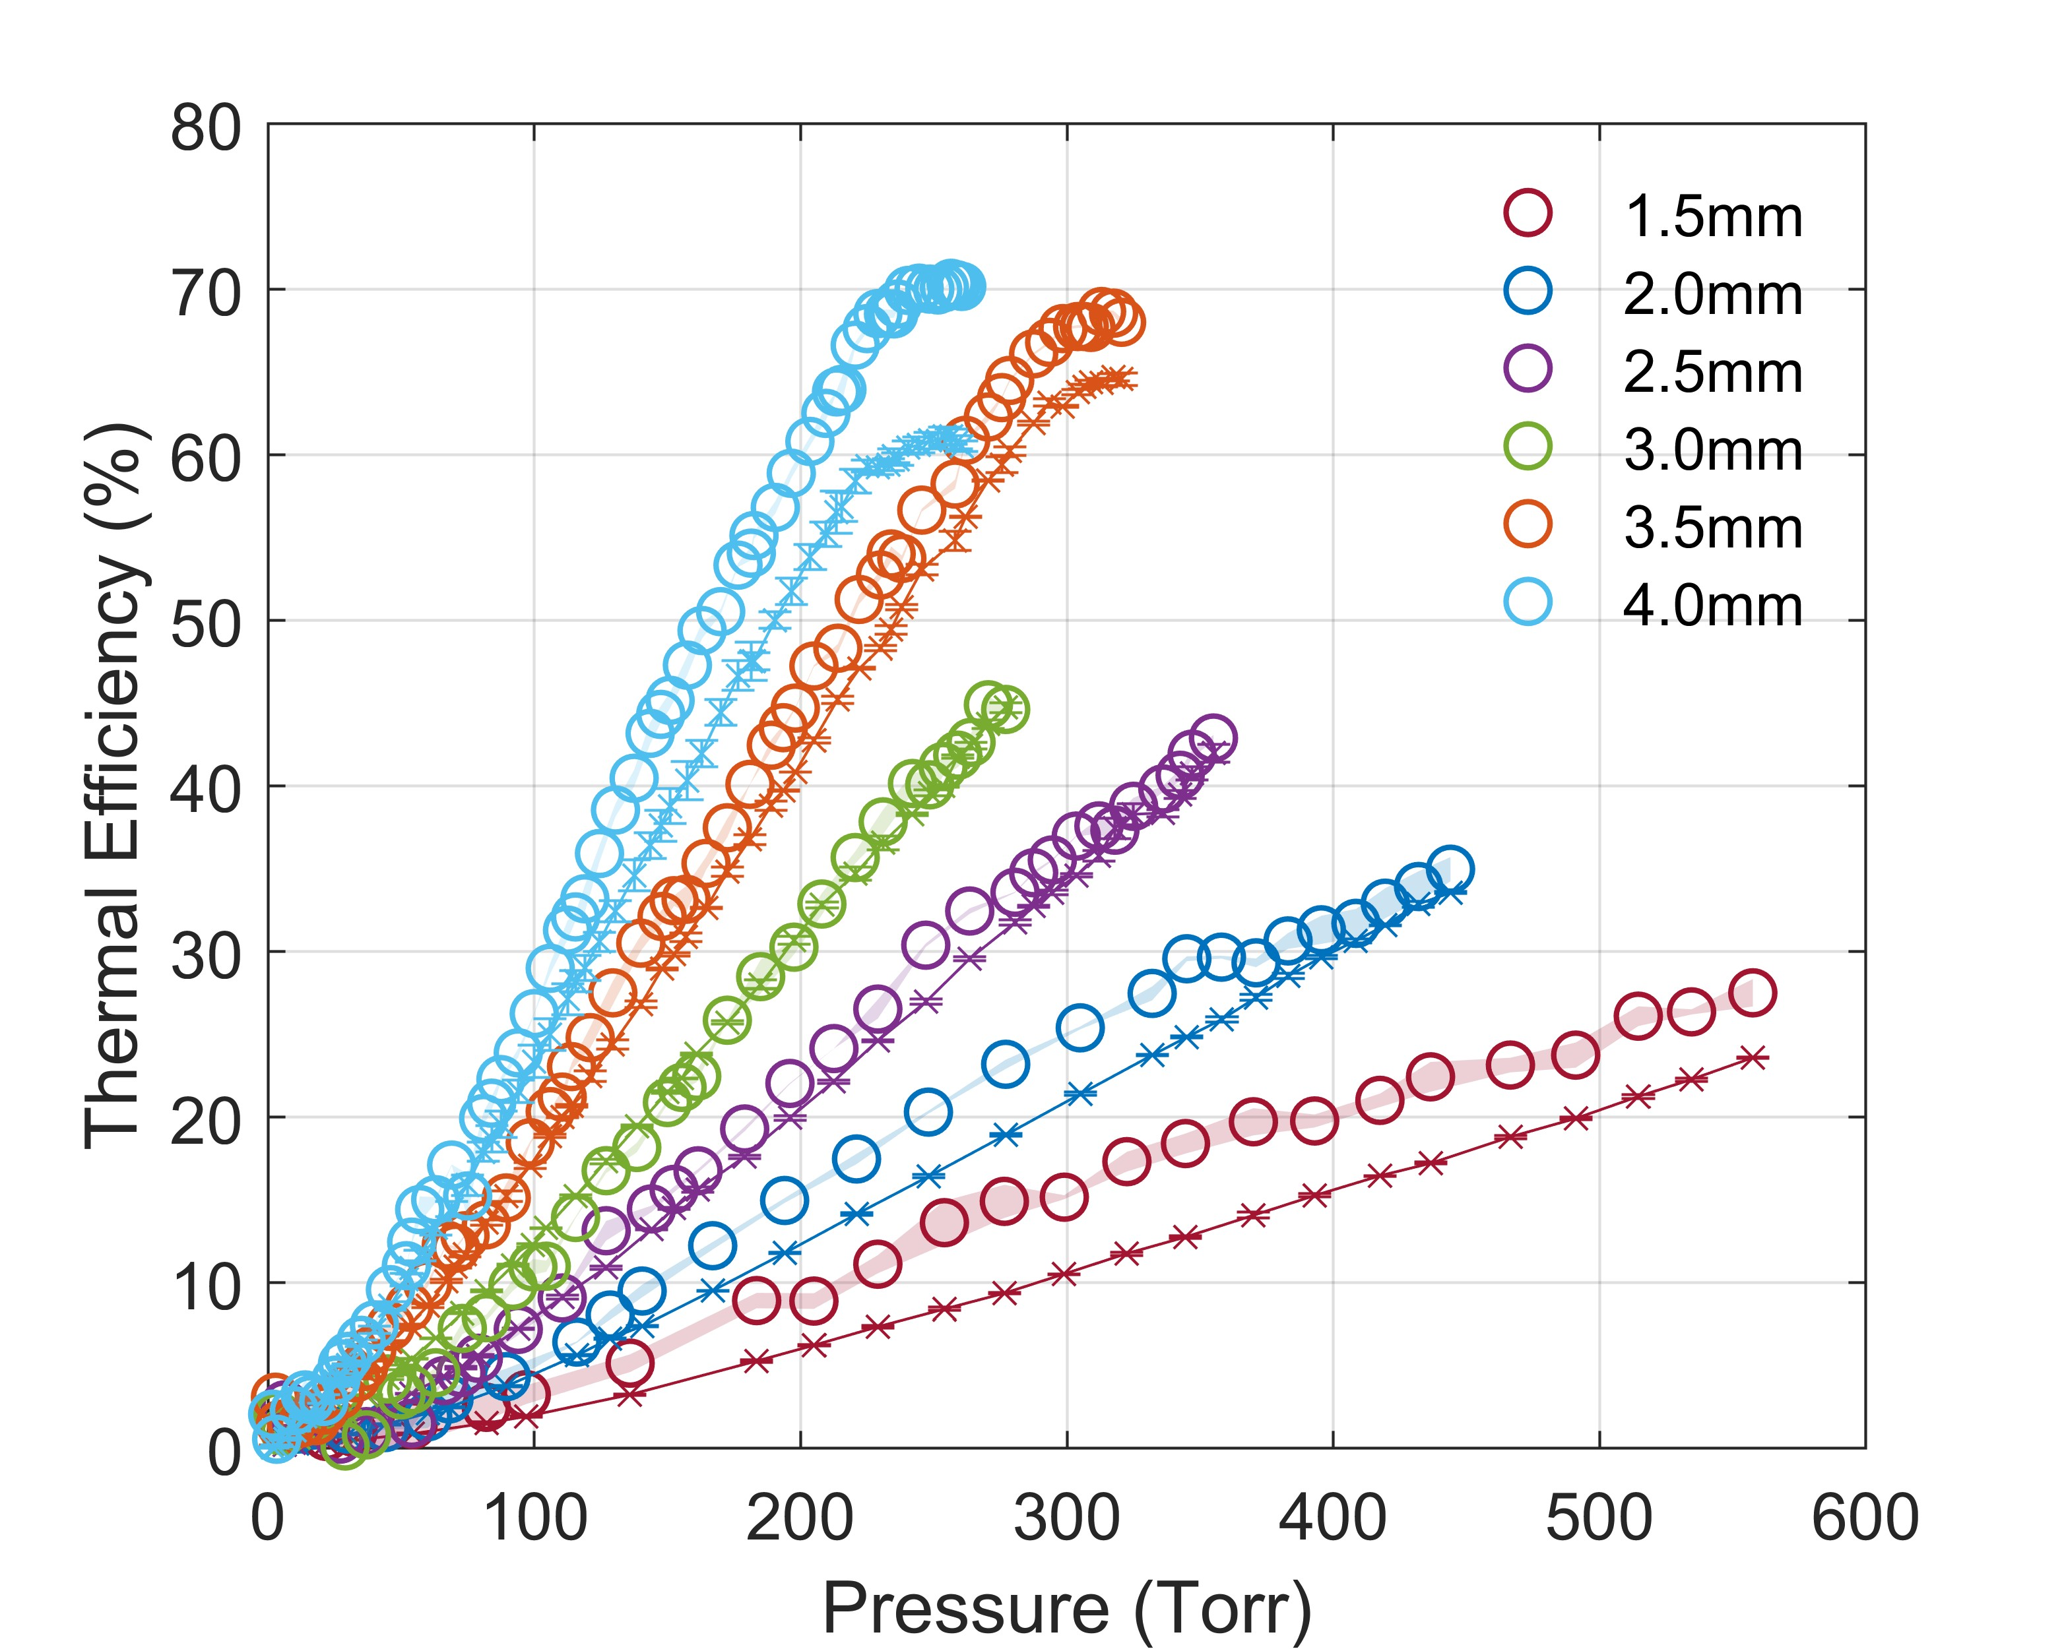
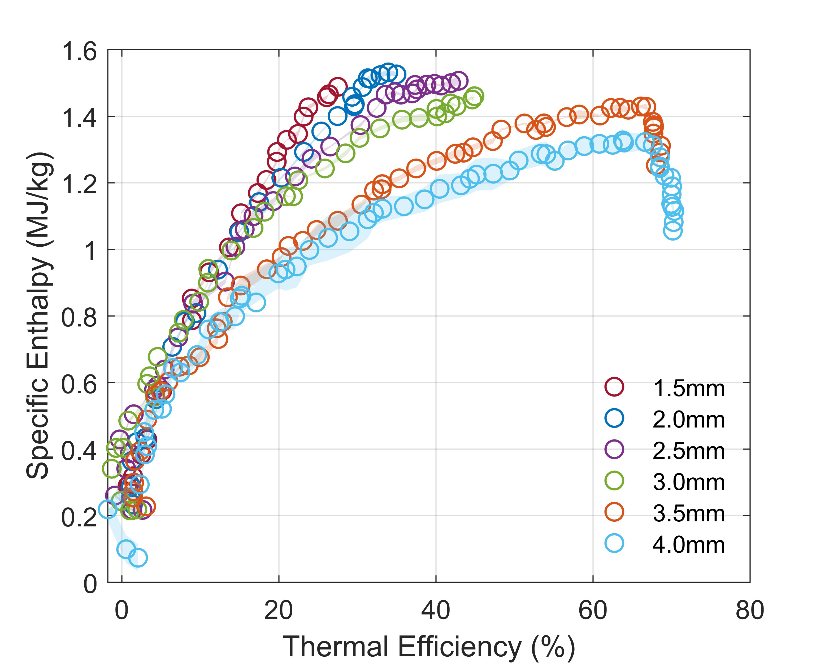

PERFORMANCE METRICS
$$h=\frac{P_{H}}{\dot{m}}$$

Slide 35
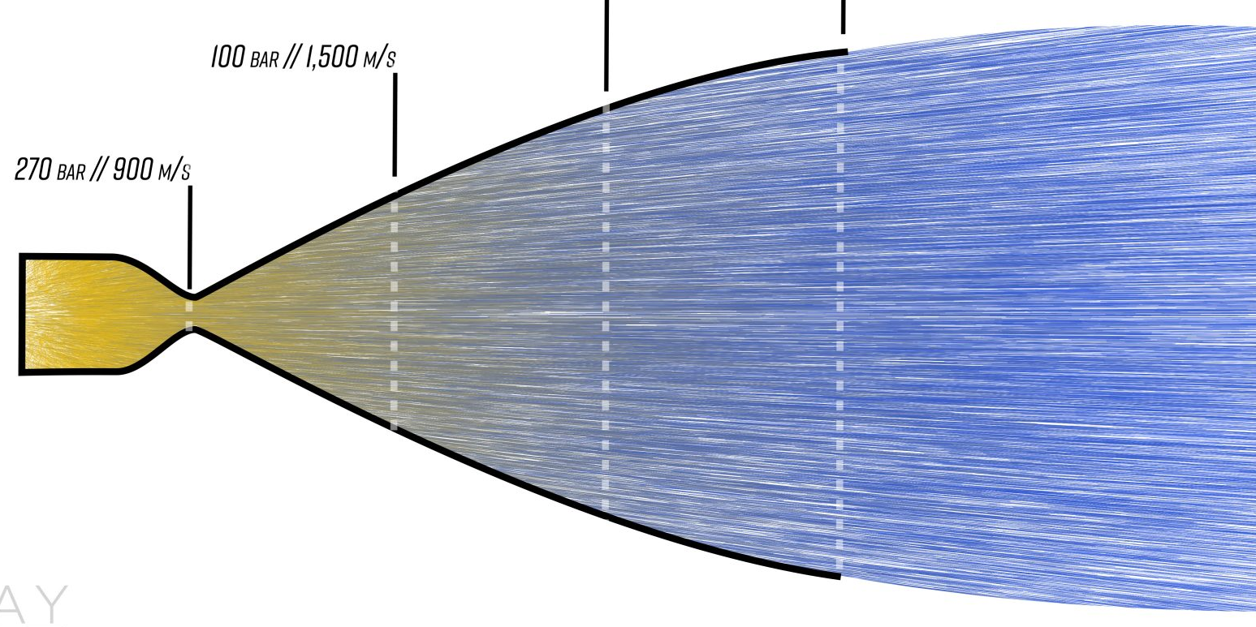


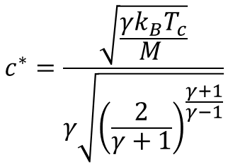

ISENTROPIC NOZZLE THEORY
A nozzle converts thermal/internal energy into directed energy:
$$h_{1}+\frac{v_{1}^{2}}{2}=h_{2}+\frac{v_{2}^{2}}{2}$$
Credit: Everyday Astronaut
$$c^{∗}=\frac{\sqrt{\frac{γk_{B}T_{c}}{M }}}{γ\sqrt{{\left(\frac{2}{γ+1}\right)}^{\frac{γ+1}{γ−1}}}}$$
Characteristic velocity:
Maximize T_{c}
Minimize M
Minimize γ
$$I_{sp}=\frac{C_{F}c^{∗}}{g_{0}}$$
Thrust coefficient:
$$C_{F}=C_{F}(γ)$$

Slide 36
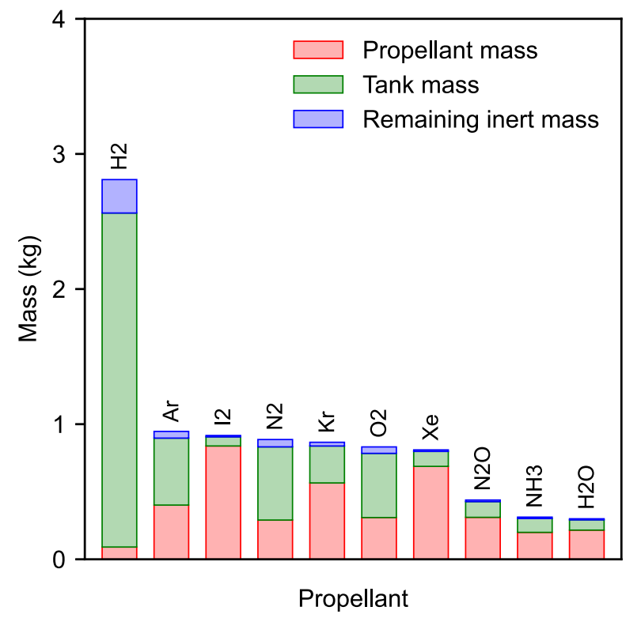


WHAT IS THE BEST PROPELLANT TO USE?
$$I_{sp}=\frac{I_{T}}{m_{p}g_{0}}$$
Conventional specific impulse:
Effective specific impulse:
$$I_{sp}^{∗}=\frac{I_{T}}{m_{wet}g_{0}}$$
Considers the entire propulsion system mass and propellant storage state
J. Martinez Martinez and T. Lafleur, “On the selection of propellants for cold/warm gas propulsion systems”, Acta Astronautica 212, 54 (2023)

Slide 37
3. PROPELLANTLESS PLASMA PROPULSION

Slide 38
THE LEO SPACE ENVIRONMENT
Solar radiation pressure:
Atmospheric drag:
Ionospheric drag:
Electron temperature (K) | 1000 - 3000
Average Ion Mass (umu) | 5 - 20
R. Jastrow and C. Pearse, “Atmospheric drag on the satellite”, Journal of Geophysical Research 62, 413 (1957)
Mass Spectrometer and Incoherent Scatter radar (MSIS; 2000 version)
International Reference Ionosphere (IRI; 2016 version)

Slide 39
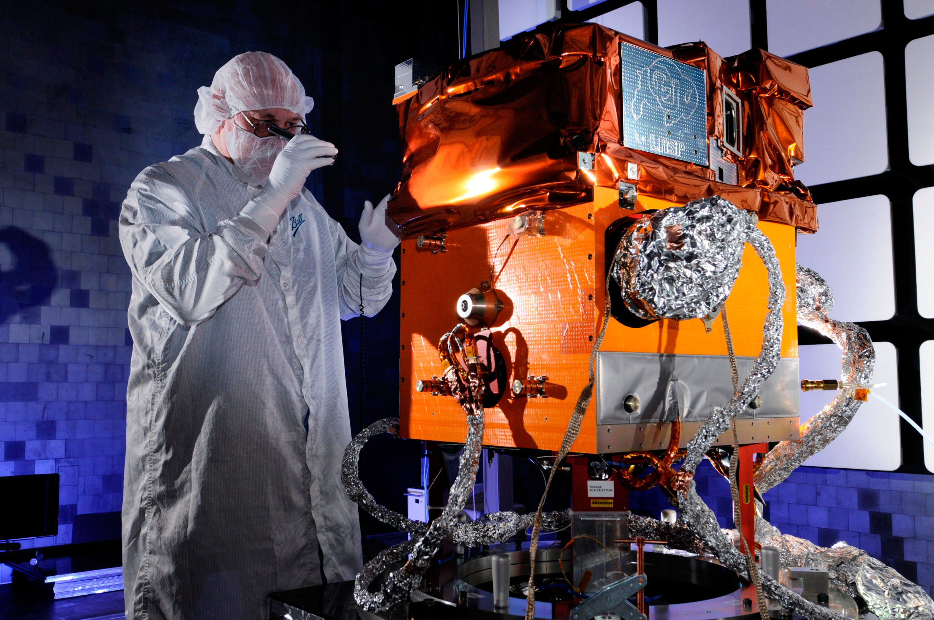
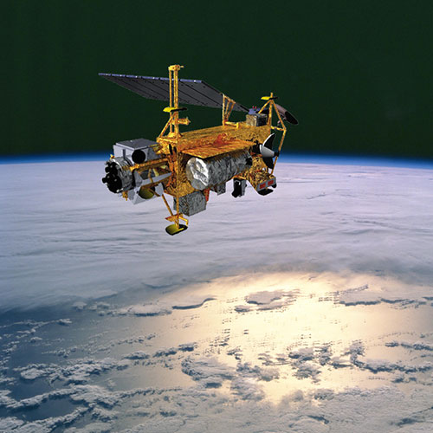

SPACECRAFT POTENTIAL
STPSat-3: -35 V to -25 V
Credit: Ball Aerospace
Upper Atmosphere Research Satellite (UARS): -90 V
Credit: NASA
Charged Hazards and Wake Studies (CHAWS): -5000 V
Credit: NASA

Slide 40








TOY MODEL
$$φ=0$$
$$b^{∗}$$
$$2R_{0}$$
$$φ=φ_{B}$$
Energy conservation:
$$\frac{1}{2}Mv_{0}^{2}−qφ_{B}=\frac{1}{2}Mv_{s}^{2}$$
Angular momentum conservation:
$$Mv_{0}b^{∗}=Mv_{s}R_{0}$$
$$F_{c}=Mn_{0}v_{0}^{2}π\left(1 − \frac{2qφ_{B}}{Mv_{0}^{2}}\right)$$
Intercepted momentum flow:
$$F_{c}=Mn_{0}v_{0}^{2}πb^{∗2}$$

Slide 41
IONOSPHERIC DRAG MODEL
Method 1: Numerical Trajectory Calculation
Method 2: Analytical Solution
Effective (spherical) potential:
Drag force:
Deflection
Direct collection
T. Lafleur, “Charged aerodynamics: Ionospheric plasma drag on objects in low-Earth-orbit”, Acta Astronautica 212, 370 (2023)

Slide 42
ION TRAJECTORIES

Slide 43


DRAG FORCES
J. Praks et al, “Aalto-1 – An experimental nanosatellite for hyperspectral remote sensing”, 2011 IEEE International Geoscience and Remote Sensing Symposium, Vancouver, Canada, 24-29 July 2011.
C. Capon et al, “Numerical predictions for on-orbit ionospheric aerodynamics torque experiment”, IEEE Aerospace Conference, 2020.

Slide 44
SUMMARY
Iodine as a propellant
Emerging alternative to xenon with attractive physical and plasma properties that has been successfully demonstrated in space
RF ICP electrothermal plasma thruster
Promising propulsion technology to meet industry needs and with the potential to use a wide range of conventional and non-conventional propellants (including reactive substances)
Propellantless plasma propulsion
Active spacecraft biasing can be used as a “solid-state” and propellantless mechanism for formation flying, deorbiting, collision avoidance, and attitude control

Slide 45


PHD PROJECT AVAILABLE!
Topic: “Plasma CFD” simulations of vortex-enhanced supersonic inductively coupled plasmas
Candidate profile: Strong mathematical, programming (C++, Python, and Linux ideally), and communication skills
Collaborators: Research School of Physics at ANU and the von Karman Institute (VKI) for Fluid Dynamics in Belgium
Get to visit VKI in Belgium for several months as part of your PhD!
Credit: VKI

