Slide 1
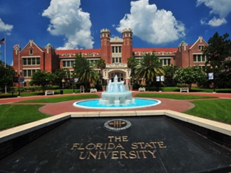


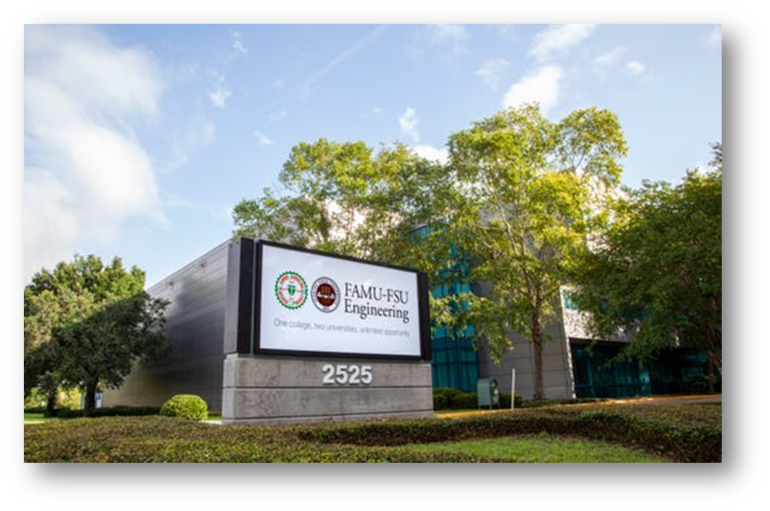
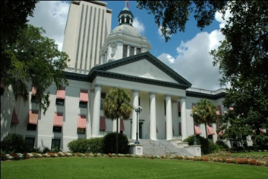
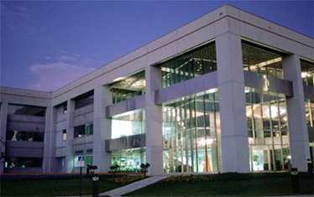
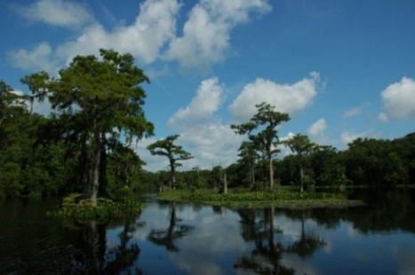
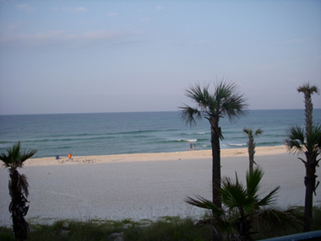
Florida State University
Founded 1851, Enrollment 44,000
Ranked 18 of US Public Research Universities (USNWR)
Florida A & M University
Founded 1887, Enrollment 10,000
Public HBCU in Florida
FAMU-FSU College of Engineering
Founded 1982
Shared by FSU and FAMU
Chemical and Biomedical Engineering
Enrollment: 500 undergraduates, 50 graduates
18 tenure track faculty members
National High Magnetic Field Lab

Slide 2
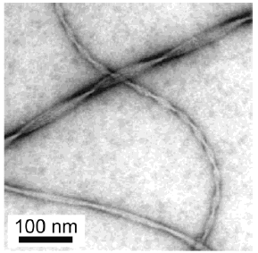
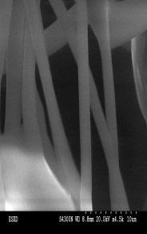
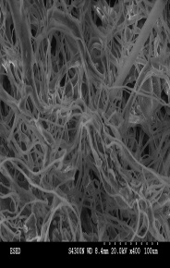
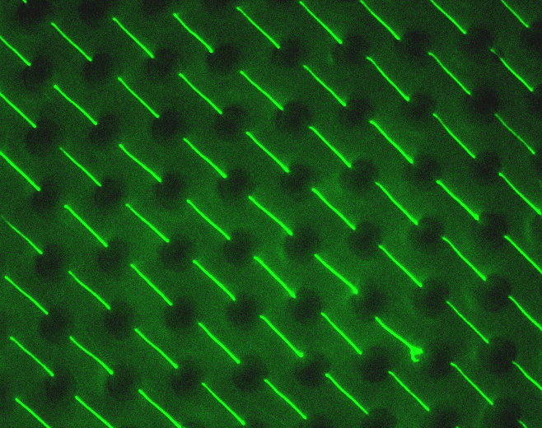
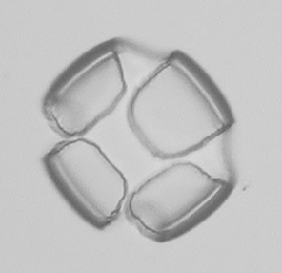
General Department Research Areas - Department of Chemical and Biomedical Engineering -
Biomedical Engineering
Imaging (NMR,MRI) - Grant, Li, Holmes, Mohammadigoushki
Cellular and Tissue Engineering – Grant, Li, Holmes
Biomaterials - Ali, Guan, Holmes, Ramakrishnan
Materials
Polymers - Alamo, Arnett, Chung, Hallinan, Ricarte
Complex Fluids - Mohammadigoushki, Ramakrishnan
Electronic Materials - Siegrist
Nano - Materials – Ali, Grant, Guan, Hallinan, Kalu, Ramakrishnan, Siegrist
Chemical Engineering
Catalysis – Chung
Chemical Reaction Engineering – Locke
Energy storage – batteries – Hallinan, Kalu

Slide 3



Hydroxyl Radicals in Gas-Liquid Water Plasma Reactors
Professor Bruce R. Locke
Florida State University
Department of Chemical and Biomedical Engineering
Tallahassee, FL
Funding
National Science Foundation CBET – 1236225, 1702166
Czech Fulbright Commission, Florida State University

Slide 4
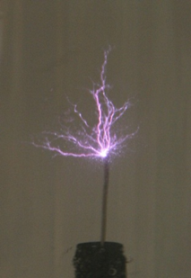
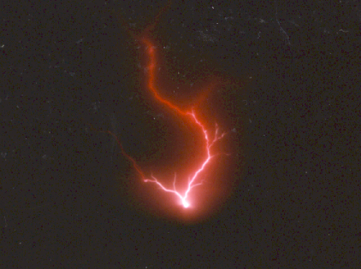
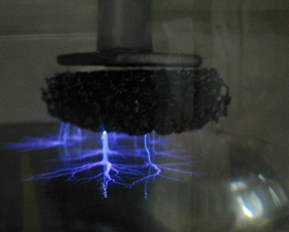
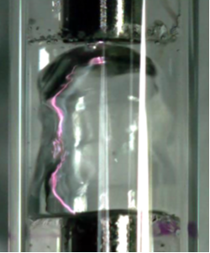
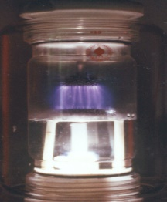
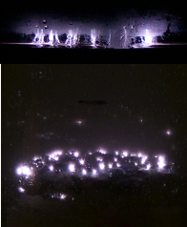
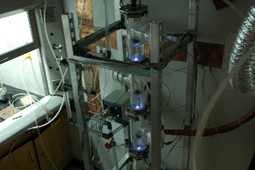
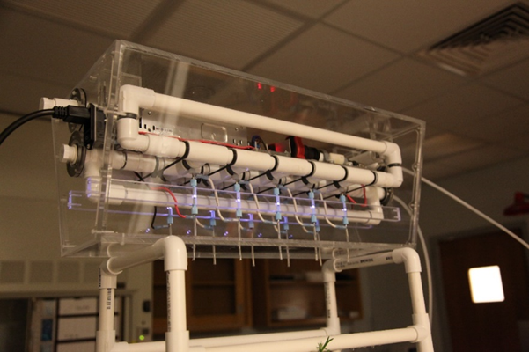

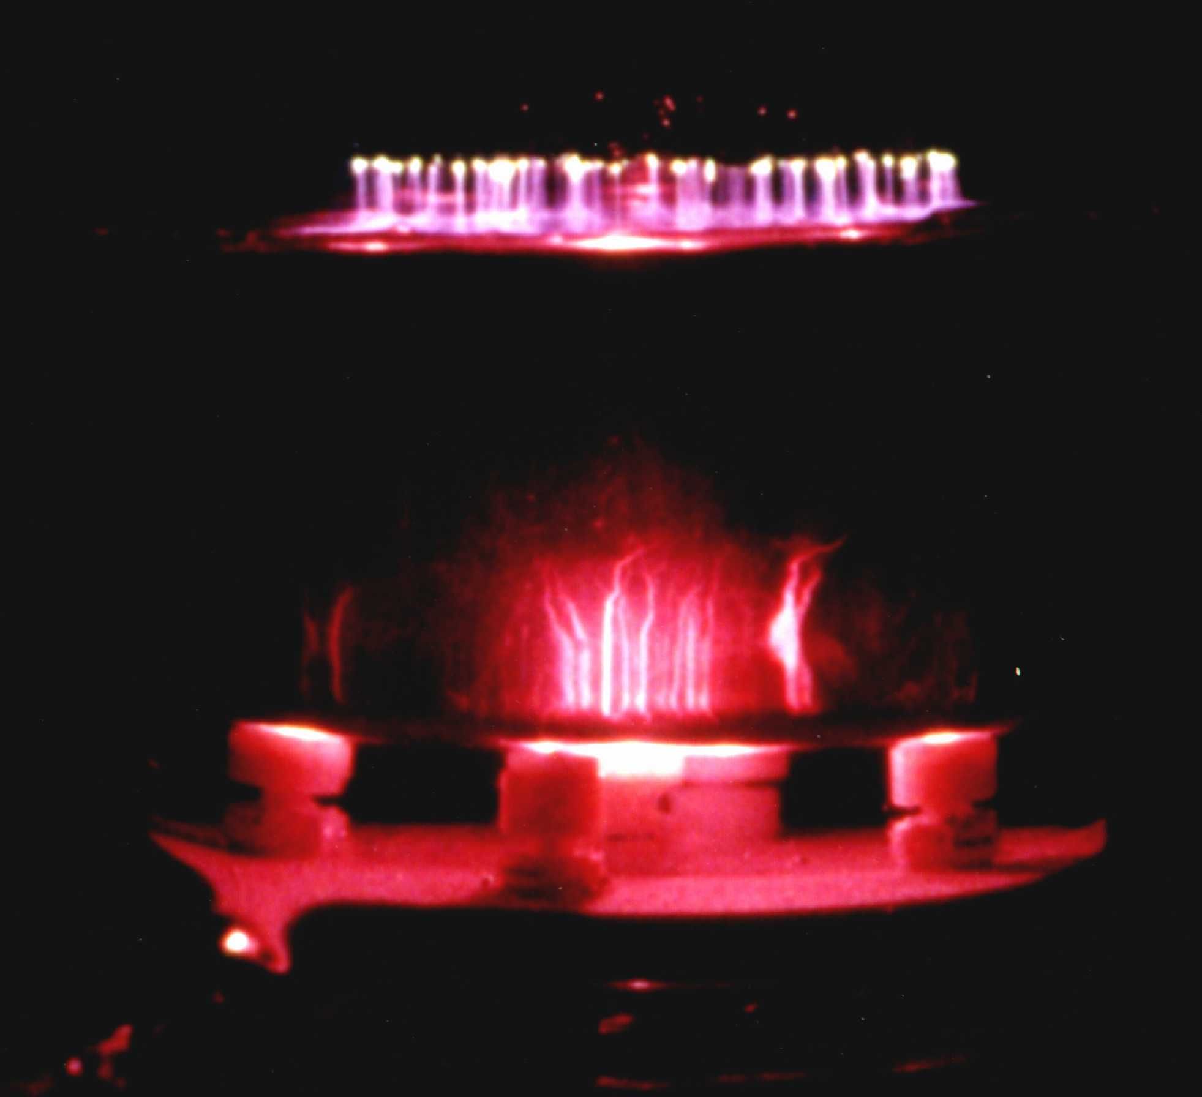
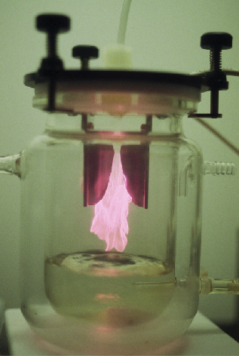
Contacting Plasma with Liquid Water
Underwater
Electrical discharge underwater (pulsed, RF, microwave)
- 10⁻³ to 1 J/pulse (also ns to μs pulses possible)
- up to kJ/pulse - electrohydraulic discharge,
arc formation, exploding wire
- breakdown underwater: 1 MV/cm
Gas-liquid Interface
(AC, DC, or pulsed)
Discharge in gas
- plasma in gas
- gas phase breakdown
- plasma touches water
surface
- liquid properties can
be important (conductivity)
Gliding arc
Planar
Bubbles
Films
Scaled prototypes
Water spray
Combined gas/liquid
Notes:
Examples from our work – not meant to be exhaustive – there are other methods as well, diaphragm discharge etc.

Slide 5
Applications of Plasma with Liquid Water
Water pollution treatment
Wide range of organic and some inorganic compounds – emerging contaminants – perfluorinated species, antibiotics, personal care products
Air pollution treatment (wet plasma – water sprays and films)
Nitrogen and sulfur oxides, volatile organic compounds (VOCs)
Disinfection and biomedical
Bacteria, yeast, viruses
Biomedical – wound healing, cancer treatment
Chemical synthesis
Partial oxidation – alcohols, aldehydes…
Nanoparticle synthesis
Polymer coatings
Plasma activated water for agriculture uses – nitrates/nitrites, seed germination…
Many reviews on this subject published in last 10 years: Akiyama, Malik, Locke, Sunka,
Sato, Bruggeman, Lukes, Thagard, Weltmann, Brandenburg,…..
P. Bruggeman, M.J. Kushner, B.R. Locke, et al., Plasma-Liquid Interactions:
A Review and Roadmap, Plasma Sources Science and Technology, 2016
Notes:
Recent review of the fundamental aspects of this topic will be published based upon the Lorentz Workshop held in Leiden Netherlands summer of 2014.

Slide 6
Complexities of Gas-Liquid Water Plasma Chemistry
(With air or argon)
Chemistry strongly dependent on gas composition (air, N₂, O₂, Ar, He)
Not all factors equally important or occur in all types of gas-liquid plasma
P. Bruggeman, M.J. Kushner, B.R. Locke, et al., Plasma Sources Science and Technology, 2016
Notes:
Gas –liquid plasma and the interactions of plasma at the surface of a liquid can be quite complex
Here we are not dealing with underwater discharges per se – have published extensively on that subject in previous work.

Slide 7
Key Chemical Species from Electrical Discharge with Water
Standard oxidation potentials
Electron dissociation
•OH = 2.80 V
O = 2.42 V
O₃ = 2.07 V
H₂O₂ = 1.77 V
•HO₂ = 1.7 V
H₂O +e⁻ → H + ·OH + e⁻
Thermal dissociation
H₂O + M → H + ·OH + M
Possible Products and active species
Molecules: (stable)
H₂, O₂, H₂O₂, (O₃)
Radicals and atoms: (short life)
O, ·H, ·OH, HO₂
Ions:
H⁺(H₃O⁺), O⁺
H⁻, O⁻, O_{2·}⁻, OH⁻
e_{aq}⁻
Disinfection, chemical destruction
Stable molecular carrier for OH radicals
May be important for reduction reactions
Notes:
Key species – simplified with oxygen and hydrogen only – not air.

Slide 8
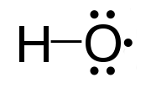
Hydroxyl Radical Generation from Water
Yields* (molecules/100 eV)
Thermodynamic limit
(from ΔH_{r})
H₂O → ∙OH + ∙H
20
H₂O + hν → ∙OH + ∙H
2 to 3 (in liquid)
5 to 6 (in gas with vapor)
UV light
(120 to 190 nm, depends on quantum yields and lamp efficiencies)
H₂O + e⁻ → ∙OH + ∙H + e⁻
2 to 4 (in liquid)
7 to 9 (in gas with vapor)
Radiation
(electron beams, gamma radiation)
Plasma
H₂O + e⁻ → ∙OH + ∙H + e⁻
Subject of this talk
* -note: yields estimated from literature where data was obtained under wide range of different operating conditions and measurement methods
Notes:
What is the hydroxyl radical – electrically neutral, unpaired electron, when discovered etc. (throughout consider differences between gas and liquid phase reactions)
Why is the hydroxyl radical important – reaction rate constant – diffusion limits in gases and liquids – kinetics - fast rates lead to mass transfer limits
Where is the hydroxyl radical important – atmospheric chemistry, cellular biology, combustion, extraterrestrial space
How do you make hydroxyl radicals – thermal, photo, electrical, radiative – homogeneous vs heterogenous sources
What are the limitations on energy yields for hydroxyl radicals and therefore their reactions with targets?
How do you efficiency utilize hydroxyl radicals – since rate so fast can lose quickly, competing reactions
How to measure hydroxyl radicals – chemical, physical-optical-laser etc.
Role of hydroxyl radicals in plasma contacting liquid water
- other competing reactions and processes - complications
- comparison to radiation processes
- oxidation/reduction processes – oxidation vs reduction – should they balance in plasma?
- OH reactions in the liquid phase
- OH reactions in the gas phase

Slide 9
Note on Importance of Hydroxyl Radical - Gas Phase -
Provides insight into oxygen and water chemistry in intersteller space: 10⁴-10⁶ cm⁻³ (low temperature and density)
Earth atmosphere:
Formed in stratosphere by UV: 10⁶ cm⁻³
Cleans nitrogen oxides, organics from troposphere, 0.01 to 1 s
Indoor air – similar chemistry as in atmosphere
Clean air: 10⁴ to 10⁵ cm⁻³
Photolysis of HONO: 10⁶ cm⁻³
With air cleaners: 10⁷ to 10⁸ cm⁻³
Combustion – main reactant: 10¹⁴ to 10¹⁶ cm⁻³, high temperature and pressure (1 to 5% of species)
Gas phase plasma reactors (with water vapor):10¹³-10¹⁵ cm⁻³, atmospheric pressure and temperature
Notes:
1 – OH first observed in interstellar space by Weinreb in 1966

Slide 10
Note on Importance of Hydroxyl Radical - Liquid Phase -
Close coupling of ∙OH with H₂O₂ in the liquid phase
Natural water:
UV photolysis of nitrate, dissolved organic matter
H₂O₂: 50-1000 nM
Natural seawater – ∙OH: 10⁻⁹ to 10⁻⁶ nM
Acid mine water – ∙OH: 10⁻⁵ to 10⁻³ nM
Found in biology
Cells: H₂O₂ 1 to 10 nM
Advanced oxidation technologies (∙OH based processes)
O₃, O₃/H₂O₂, O₃/H₂O₂/UV, Fenton(H₂O₂/Fe)
∙OH: 10⁻⁴ to 10⁻¹ nM (quasi steady-state due to very high reactivity)
Plasma contacting liquid water
∙OH: 10⁻¹ nM (quasi steady-state due to very high reactivity)
Notes:
Difficult to measure OH in liquid

Slide 11
Reaction Rate Constants (Second order M⁻¹s⁻¹, Tarr (2003))
 | ·OH | O₃ | pH | e_{aq}⁻ | ·H
Benzene | 7.8x10⁹ | 2 | 2-3 | 9.0x10⁶ | 9.1x10⁸
Phenol | 6.6x10⁹ | 1300 2x10⁶ | 2 7 | 2.0x10⁷ | 1.7x10⁹
Chloro-phenol | 12x10⁹ | 1600 | 2
Formic acid | 0.13x10⁹ | 5 | 2-4
Trichloro-ethylene | 4x10⁹ | 17 | 2 | 1.9x10⁹
·OH reactions near diffusion limits 10¹⁰ M⁻¹s⁻¹ in liquids
Competing (reduction) reactions with ·H and e_{aq}⁻ (depends upon species)
O₃ can be important if [O₃]>>[·OH] (ozone solubility range 10⁻⁵ to 10⁻³ M)
Rate(·OH)/Rate(O₃) = 1 (chlorophenol); = 100 (others) (for max O₃)
Notes:
Rate = k (OH)(organic) = 1 s-1 (organic) (OH 10⁻¹ M)
Rate = k (O3)(organic) = 0.01 s-1 (organic) for ozone = 0.001 M k =10 – ozone solubility 1 to 100 mg/l

Slide 12
Idealized Reaction Pathways (with H₂O only)
Desired reactions in/near plasma
(very fast reactions)
H₂O → H∙ + ∙OH
^{(Primary yield -}
^{radiation chemistry)}
∙OH + organic → products
Undesired reactions in/near plasma
∙OH + ∙OH →H₂O₂
∙OH quenching…
H∙ + ∙OH → H₂O
(Absolute quenching - Fridman)
∙OH + H₂O₂ → prods
→
∙H + ∙H →H₂
….→ O₂
Molecular products
(stable)
H₂, O₂, H₂O₂
(Ideal quenching - Fridman)
Used outside of plasma
H₂O₂ – in liquid
H₂ and O₂ – in gas
Notes:
Primary yield – concept from radiation chemistry, accessible with chemical probes to stop reactions to other products…

Slide 13
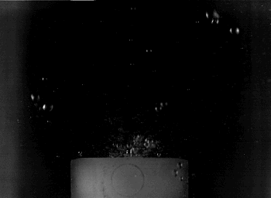
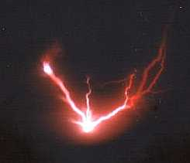
Underwater Discharge
Cooler recombination zone
Discharge Reactions
High T core
H₂O +e⁻ → ·H + ·OH + e⁻
H₂O + M → ·H + ·OH + M
Water
level
Recombination Reactions
HV
·OH + ·OH → H₂O₂
·O + ·O → O₂
·H + ·H → H₂
·H + O₂ → HO₂∙
HO₂∙ ←→O₂∙⁻ + H⁺
Overall (Bulk) Reaction
(Experimental Observations)
6H₂O → 4H₂ + 2H₂O₂ + O₂
(Joshi et al. 1995; Grymonpre et al. 1998, 1999, 2001;
Kirkpatrick and Locke, 2005)
(Mededovic and Locke, 2008, 2009, 2012)
Notes:
We also measured OH and total reducing species.

Slide 14
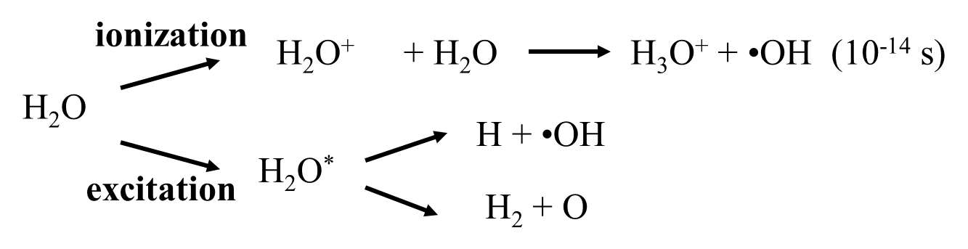
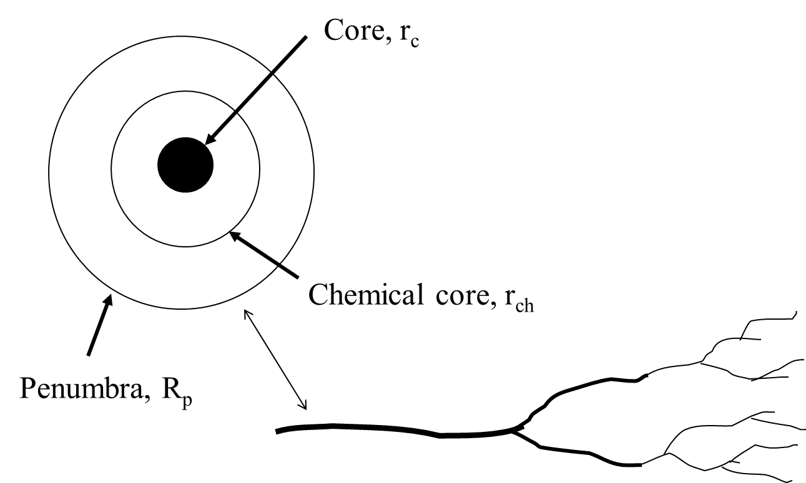
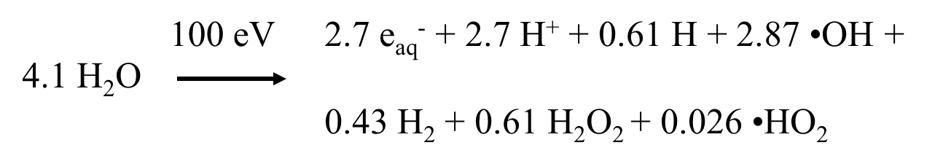
Comments from Radiation Chemistry (Buxton, 1987; Magee and Chatterjee, 1987)
Radiation track structure
Primary Products
Geometrical patterns of energy deposition from high energy electrons
Chemical probes used to determine primary yields – products formed in the chemical core
Note: O and O₂ not typically found in underwater radiation reactions
Non-homogeneous energy deposition, fast time scales
Kinetics in spur leads to homogeneous kinetics at 10⁻⁷ s

Slide 15
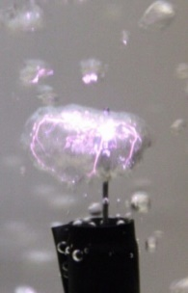
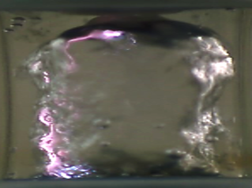

Discharges at Gas-Liquid Interface
Plasma propagates in gas phase along the gas/liquid interface
Requires lower electric field to generate plasma than inside water
More efficient generation of plasma
Planar Surface
Bubbles
Water film reactor
electrode
Gas phase
H₂O_{liq}
H₂O_{liq}
electrode
Vapor
bubble
Flow direction
Gas flow
4 mm
H₂O_{liq}
5 cm
1 cm
electrode
(Grymonpre et al., 2004)
(Shih and Locke, 2009)
(Wandell and Locke, 2014)
Continuous flow system
Batch, semi-batch systems
Flow system useful to control gas, liquid, and plasma contacting, fluid residence times, and to measure gas and liquid products and reactants.
Notes:
Here are a few of the many ways to generate plasma at the interface with liquid water.
focus on the continuous flow small reactor since we can control the gas and liquids (semi-independently) and can focus on a small section of the plasma at the gas-liquid interface.
Show where electrodes are placed.

Slide 16
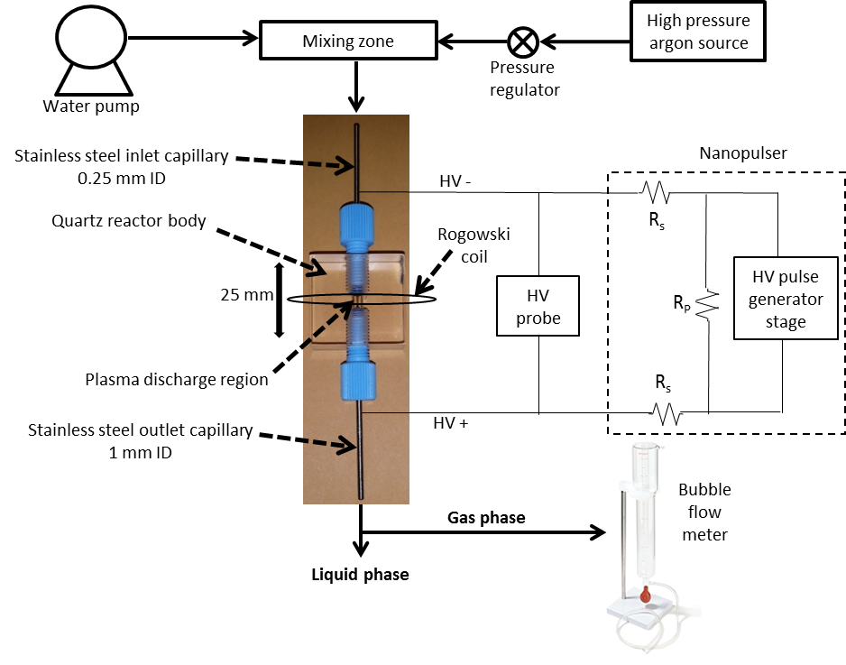
Flowing Film Plasma Reactor System
Gases
Optical emissions
Spectrometer
(w/ optical fiber)
Eagle Harbor
Nanopulser
Gas samples:
FTIR (on-line)
GC, GC/MS,
NMR
Liquid samples:
GC, GC/MS, NMR,
UV spectroscopy
Notes:
Small reactor – control input conditions, measure output products, in situ plasma diagnostics. Nanopulser power supply Eagle Harbor
Shows one of two different power supplies used.

Slide 17
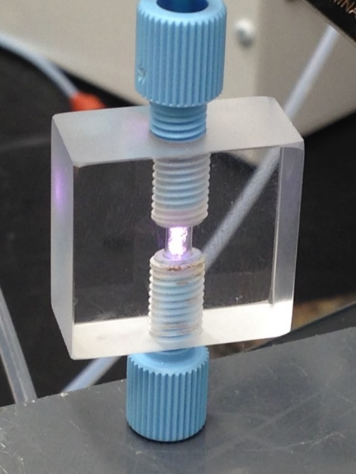
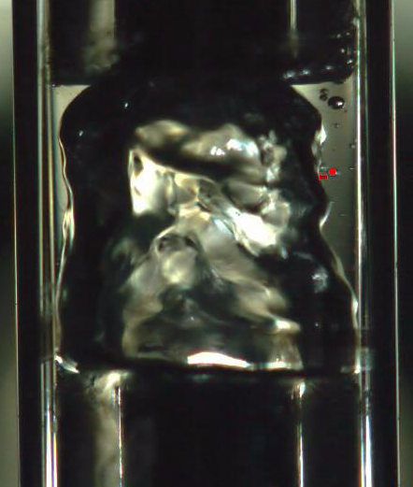
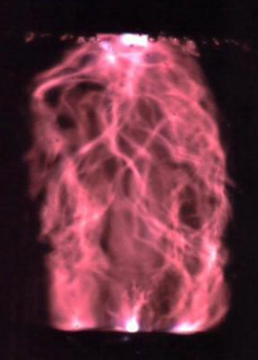
High Speed Imaging
3 mm
Liquid film flow region
4 mm
Flow direction
Gas flow region
Gas-liquid interface / Plasma discharge region
*4,000 fps
Deionzed water with argon carrier.
*1/60 sec. shutter speed
*1/12,000 sec. shutter speed
Notes:
Images show liquid flow characteristics and plasma channel propagation.
Plasma propagates along the interface between the gas and liquid. Plasma covers surface with multiple pulses – single channel per pulse. These are with the ignition coil power supply (next).

Slide 18
Connecting Physical and Chemical Processes
Input waveform properties
Peak voltage
Frequency
Pulse width and shape
Rise time
Reactor configuration
Electrode gap distance
Nozzle size
Reactor volume, shape
Liquid flow rate
Gas flow rate
Feed species
Gas composition
Liquid composition
pH, conductivity
Discharge waveform properties
Breakdown voltage
Peak current
Total current
Energy per pulse
Transport Processes
Hydrodynamics
Gas volume
Liquid volume
Residence times, mixing patterns
Mass and energy transport processes
Plasma properties
Plasma gas temperature
Electron density
Electron energy (distribution)
Size (diameter, volume) plasma channel
Chemical species formation
∙OH, H₂O₂, etc. - reaction and production rates
∙OH, H₂O₂, etc. - energy yield

Slide 19
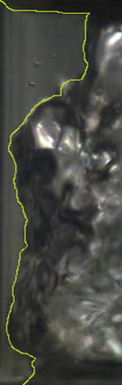
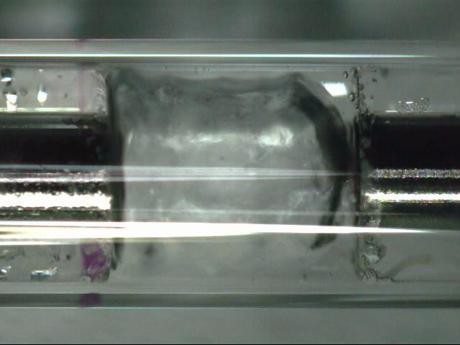
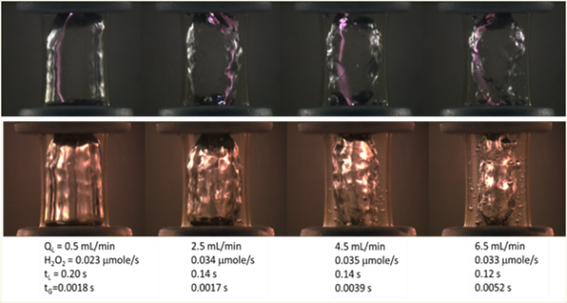
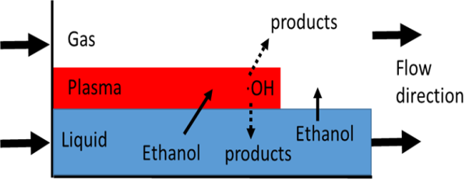
Reactor Characterization
Geometrical Properties (Wandell et al., 2018)
Volumes of liquids and gases
Interfacial area (gas-liquid and plasma-liquid)
Residence times of liquids and gases
100-250 ms (liquid), 2–5 ms (gas); nozzle size dependent
Hydrodynamics (Wandell et al., 2018)
Roles of nozzle size, gas and liquid flows
Flow patterns and regimes (annular flow)
Pressure in reactor (choked flow) higher pressure forces liquid to form film on walls
No evidence of plasma discharge affecting hydrodynamics
Mass and energy transfer (Hsieh et al., 2016)
Liquid and gas (film theory)
Liquid and plasma
Notes:
Geometrical properties affect flow and transport.
Residence time has strong affect on chemical reactions. Today only discuss some aspects of mass transfer at the interface, which make this reactor advantageous.

Slide 20
Electrical and Plasma Properties
Waveforms
Ignition coil (microsecond pulser)
Nanopulsers
Plasma properties
Plasma gas temperature
Electron density
Electron energy
Plasma volume
Effects of reactor conditions (Wang et al. 2018, 2019)
Effects of carrier gas composition
Effects of gas and liquid flows
Effect of pulse properties
Effects of solution conductivity

Slide 21
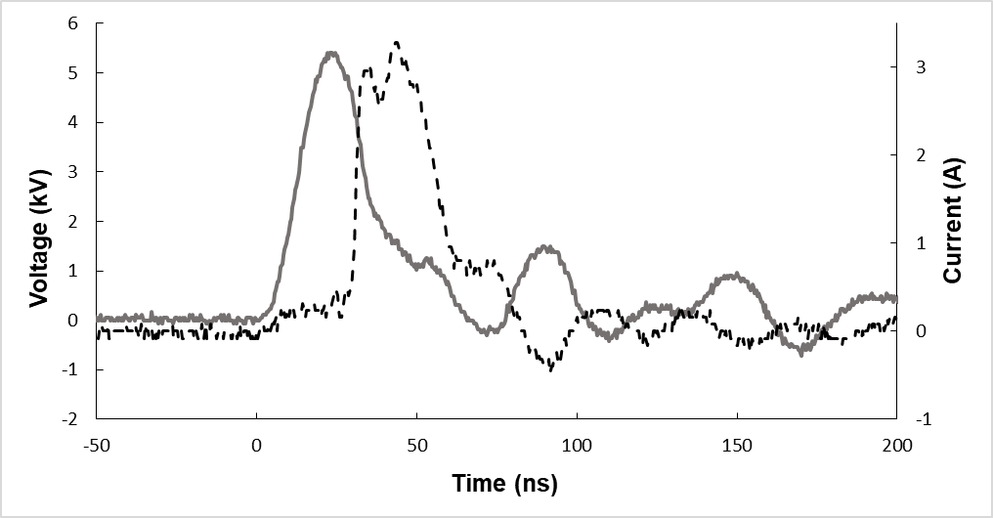
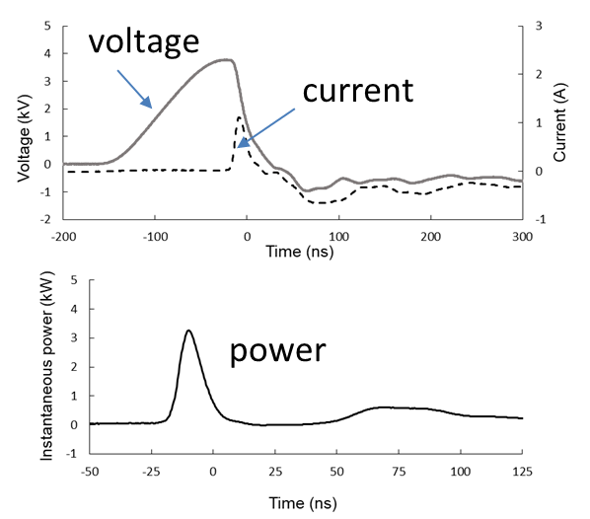
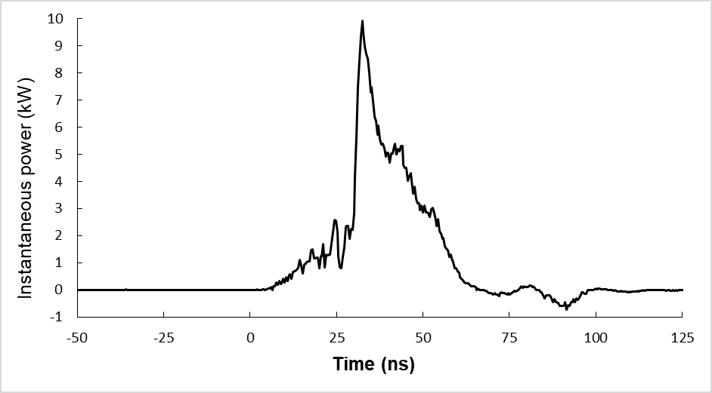
Power Supplies - Nanopulsers
1) Airity Technologies (custom)
2) Eagle Harbor Technologies (commercial)
1 kHz, 3.8 kV peak, 140 ns (rise)
130 μJ/pulse, 0.13 W, argon
2 kHz, 5.5 kV peak, 20 ns (rise), 0.3 kV/ns,
150 μJ/pulse, 0.30 W, argon
voltage
voltage
current
current
power
power
Energy: 80 to 140 μJ/pulse
Frequency Ranges: to > 60 kHz
Frequency range: to 10 kHz
Pulse width range: 20 to 260 ns

Slide 22
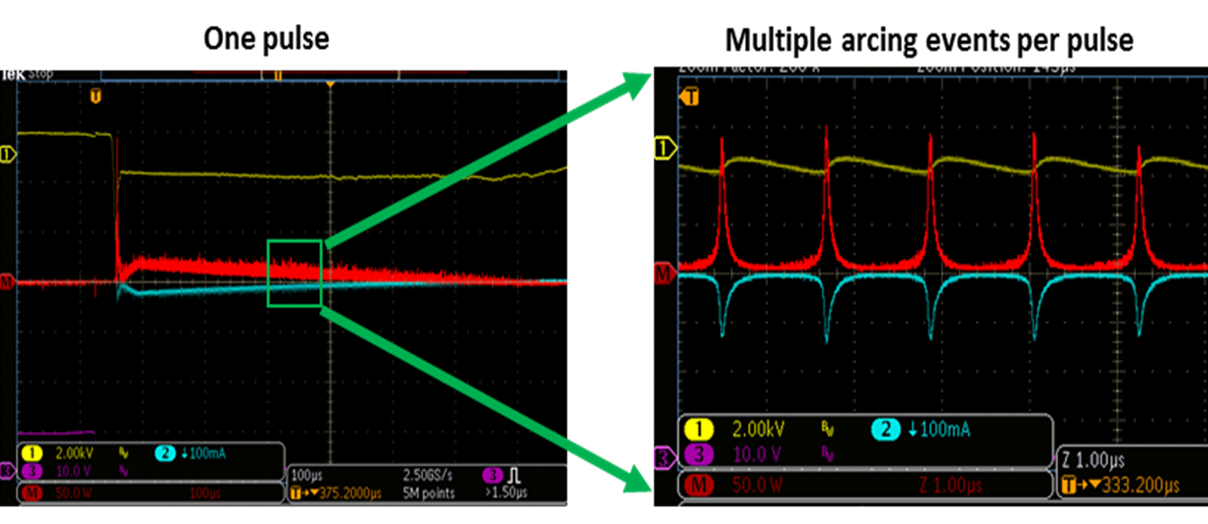
Power Supplies – Microsecond Pulsers
3) Ignition Coil Based (Professor Radu Burlica – Iasi, Romania)
High efficiency ignition coil
Audi
DC power supply
input voltage (12 V)
BK Precision 1740B
Frequency generator
500 Hz, 40% duty cycle
BK Precision 4010A
Characteristics:
Inexpensive, small
Microsecond pulses
Robust
Limited control, Waveforms noisy
Restricted range of liquid
conductivities (500 μS/cm)
(200 μs)
500 Hz pulse, argon
with deionized water
Yellow = voltage
Red = power
Blue = current (~ 200 μs)
Notes:
Comments – other power supplies under investigation including the power supply in Prague and a custom made nanopulser from California (Airity)
Nano-pulser – for lab can be expensive

Slide 23
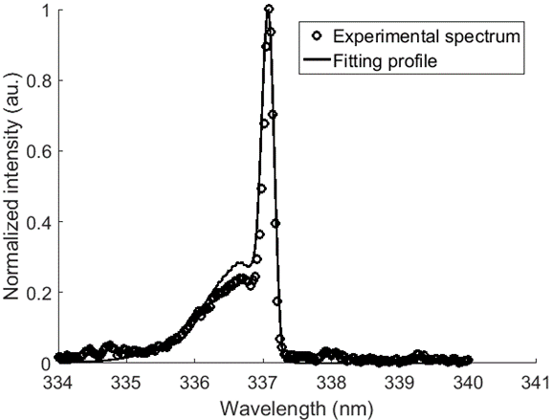
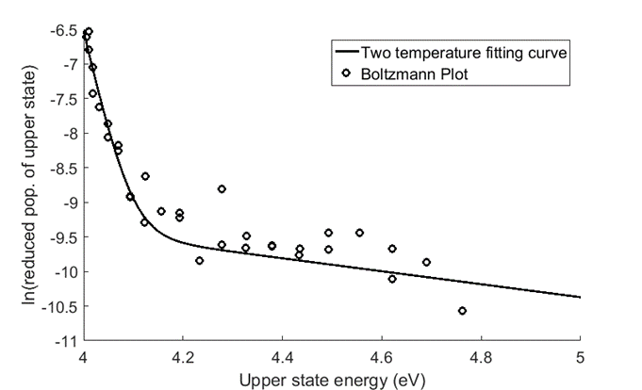
Temperature Measurement Methods
Example: (Eagle Harbor nanopulser)
Power setting: 12kV 20ns 2kHz
Water flow rate: 2 ml/min
Helium
Trace N₂ added
N₂ (C-B)
Specair fitting
Two temperature fitting Boltzmann plot of OH (A-X)
Program from Dr. Jan Vorec (Masaryk University)
(Wang, Wandell, Locke, 2018)
Notes:
Two methods – N2 and OH

Slide 24
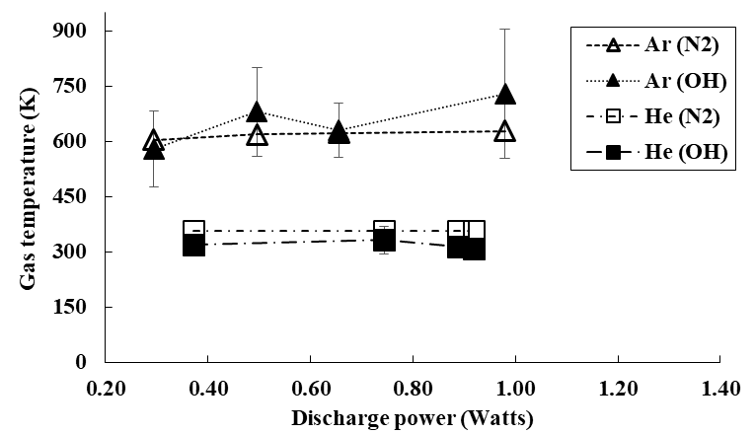
Plasma Gas Temperature Results (Eagle Harbor nanopulser)
Method of measurement, N₂ or OH, gives similar results.
Helium significantly cooler than argon.
Temperature independent of discharge power.
(Wang, Wandell, Locke, 2018)

Slide 25
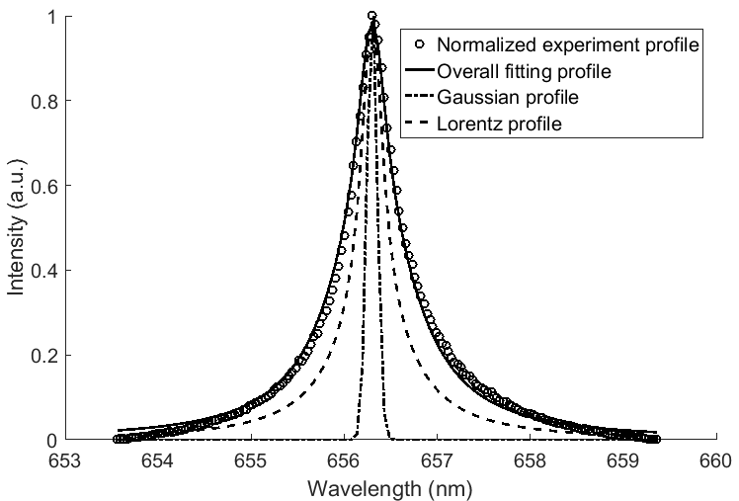
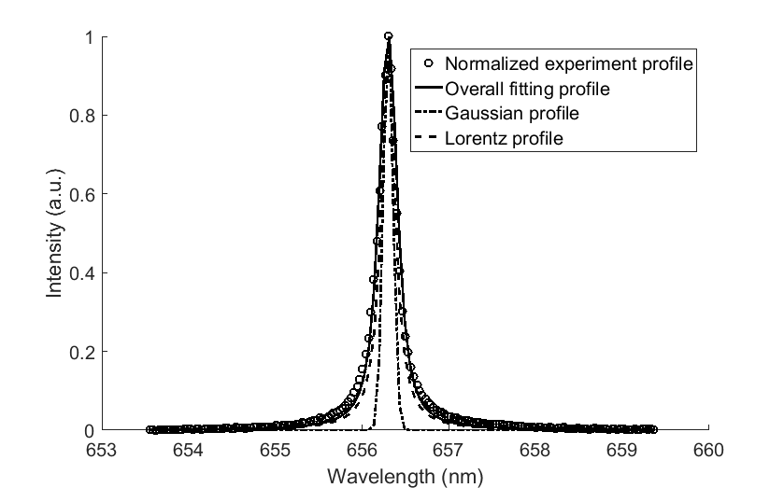
Electron Density Measurement (Eagle Harbor nanopulser)
H_{α} fitting: example, 18 kV, 20 ns, 2 kHz
Argon
Helium
(Wang, Wandell, Locke, 2018)

Slide 26
Electron Density Results (Eagle Harbor nanopulser)
Electron density in helium 1 order of magnitude lower than in argon.
Electron density in helium relatively more sensitive to discharge power.
Discharge power varied by changing voltage.
(Wang, Wandell, Locke, 2018)

Slide 27
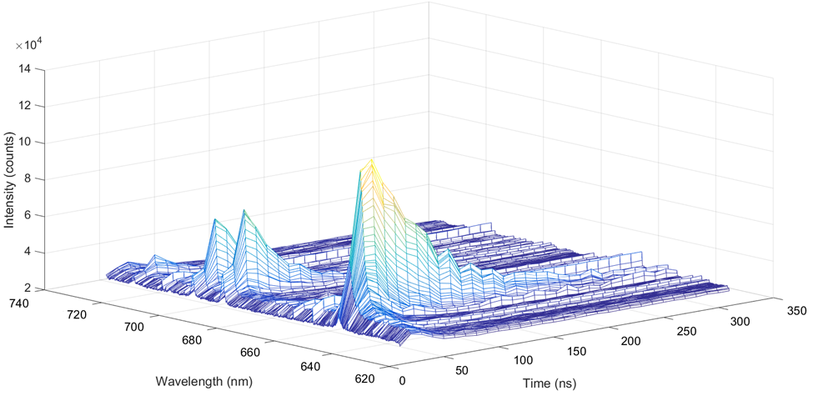
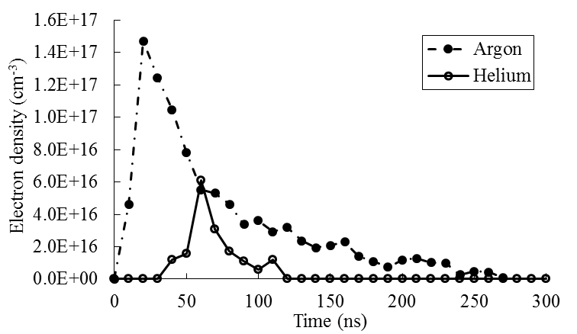
Time Resolved Electron Density (Eagle Harbor nanopulser)
(argon)
Wavelength (nm)
Time (ns)
(20 kV, 1 kHz, and 20ns, DI water liquid flow rate 2 mL/min)
Note time decay of electron density longer than current/voltage pulse in argon.
(Wang, PhD dissertation, 2018)

Slide 28
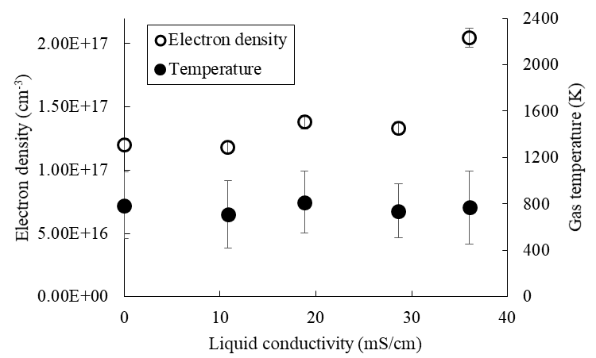
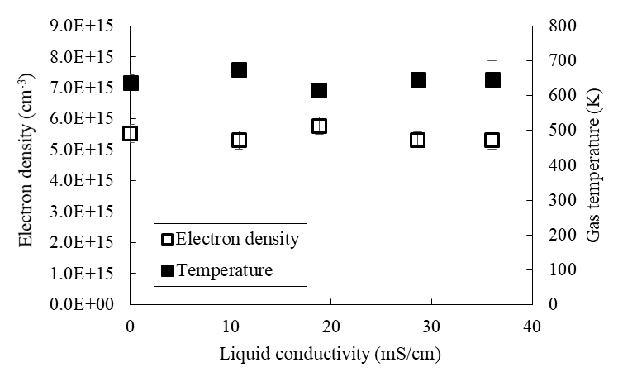
Influence of Liquid Conductivity (Eagle Harbor nanopulser)
Argon
Helium
Plasma properties relatively unaffected by large changes in liquid conductivity.
(Discharges effectively in near seawater, (seawater = 50 mS/cm), conductivity.)
Unique for EH nano-pulser (not found with microsecond pulser), fast rise time.
Some effects of conductivity above 36 mS/cm seen for argon, but not helium.
(Wang et al., 2019)

Slide 29
Chemical Processes Analyzed - role of hydroxyl radicals -
A simple model of hydroxyl radical formation (Wang et al., 2018)
Hydroxyl radical formation from probes (ignition coil, nanopulser)
Methylene Blue (non-volatile, liquid phase) (Hsieh et al., 2016)
Ethanol probe (volatile, liquid phase) (Hsieh et al., 2017)
Carbon dioxide probe (gas phase) (Hsieh et al., 2017)
Effect of frequency (EH and Airity nanopulsers)
Hydrogen peroxide formation (EH nanopulser)
Effects of flow and carrier gas (Wang et al., 2018a)
Effects of solution conductivity (Wang et al., 2018b)
Effect of pulse properties (Wandell et al., 2018)
Hydrocarbon partial oxidation (Bresch et al., 2015, PCPP)
Dioxane oxidation with plasma + bioreactor (Yiong et al., 2019)
Nitrogen oxide formation (Wandell et al., 2019; Bulusu et al. 2019)
Hydroxyl radicals with gas phase probes (NO and CO)
Gas phase NO/NO₂ measurements, liquid phase NO₂⁻, NO₃⁻

Slide 30






Reaction Model Based upon Fast Quenching in Film
Cross section of plasma channel
Plasma core
l=(2D_{i}t_{p})^{1/2}
$$V_{film}=Lπ\left(R_{p}^{2}−{\left(R_{p}−l\right)}^{2}\right)$$
= 1 μm
Plasma film
Hydrogen peroxide mass balance in film: neglect diffusion and spatial variation in film
$\frac{dC_{H2O2}}{dt}=k_{f}C_{OH}^{2}−k_{d}C_{H2O2}$
$C_{OH}=C_{OH}^{0}e^{−bt}$
Decreasing with pulse
$C_{OH}^{0}=concentration of ∙OH in core$
$$k_{d}=k_{d}^{′}e^{−bt}$$
Production Rate
$${{P_{H2O2}=C}_{H2O2 }(t_{p})V}_{film}f$$
Notes:
All OH formed in core – all H2O2 formed in film, total H2O2 is that remaining at end of pulse. OH in core only fitting parameter.

Slide 31
Reaction Model Based upon Fast Quenching
Reactions: (k_{f} and k_{d}’)
H₂O₂ formation from ∙OH in film
H₂O₂ degradation by ∙OH, ∙H, O, e⁻
rapid quenching of ∙OH in film
formation
degradation
Notes:
Add details and figure showing time quenching… spatial quenching could be added later.

Slide 32
Model ∙OH Predictions
argon
helium
Smaller size argon plasma has higher ∙OH concentration in core during pulse.
Slight increase in ∙OH with discharge power for both gases.
Data on H₂O₂ used to determine ∙OH in plasma using model.
<OH> = 4x10¹⁴ cm⁻³ in argon and 2x10¹⁴ cm⁻³ in helium (time averaged in pulse)
For comparison in combustion – 10¹⁴ to 10¹⁶ cm⁻³
(Wang, Wandell, Locke, 2018)
Notes:
Again, OH in core is the only fitting parameter.

Slide 33

Other Model Results
H₂O₂ model data comparison
Calculated H₂O₂ degradation rates
Eagle Harbor
Airity PS (frequency)
Relative H₂O₂ degradation rates by electrons and ∙OH
More H₂O₂ degradation in argon
Argon – higher rates with electrons
Helium – higher rates with ∙OH
Degradation strongly affects net formation of H₂O₂
Role of liquid water is to sequester H₂O₂ and suppress degradation in plasma
(Wang et al., 2018)

Slide 34


Effects of Frequency on Hydroxyl Radical (data for input to model, Airity Nanopulser)
H₂O₂
Electron density
(with varying input phenol concentration)
(time and space averaged electron density)
Airity power supply, 2 mL/min, 0.25 mm inlet nozzle, 70 V delivered
Energy per pulse ranges from 80 to 140 mJ/pulse
H₂O₂ data: V. Babicky, M. Clupek, V. Jirasek , P. Lukes

Slide 35

Effects of Frequency on Hydroxyl Radical (model results compared with ∙OH from OES)
OES Data
From model
Variation in ·OH with frequency correlated with electron density variation.
∙OH measurements with time and space in progress (Vorac & Dvorak – Masaryk U.).
Airity power supply, 2 mL/min, 0.25 mm inlet nozzle, 70V delivered

Slide 36

Molecular Hydrogen Production
In Helium
H₂:O₂ = 3.4
under water
H₂:O₂ = 4
in Ar
H₂
in He
(Airity power supply,
S. Bresch, IPP)
in He
in Ar
H₂O₂
Trend for H₂ formation similar to those for ∙OH; H₂ may rapidly escape plasma region.
H₂O₂ levels off at high frequency, likely due to degradation reactions.
Formation of O₂ demonstrated from water in argon and helium carrier gases.

Slide 37



Influence of Liquid Conductivity: H₂O₂ (Eagle Harbor nanopulser)
Production rate
Energy yield
Helium
Helium
Argon
Argon
Microsecond power supply
Relatively small changes in H₂O₂ formation with large changes in liquid conductivity for nanopulser.
Large range of operation possible with nanosecond pulser but not microsecond power supply.
100x lower

Slide 38
Liquid phase ·OH Scavenger (Methylene Blue – a water soluble organic dye)
OH• production rate | (mol/s)
H₂O₂ from dI H₂O | 2.40 ± 0.25 x 10⁻⁷
H₂O₂ from 0.1 mM MB | 2.57 ± 0.12 x 10⁻⁷
MB decoloration | 2.30 ± 0.13 x 10⁻⁹
MB mineralization | 1.38 ± 0.67 x 10⁻⁸
Complete MB decoloration has little effect on ·OH (H₂O₂) production.
MB complete degradation requires 57 moles of ·OH.
Notes:
MB – liquid phase probe – concentration too low to affect H2O2 production, but OH radicals from plasma can degrade and fully oxidize MB
Problem with increasing MB concentration since it affects the conductivity of the solution which affects the discharge (at least with the ignition coil)

Slide 39


Hydroxyl Radicals in Liquid Phase
Based upon non-volatile organic dye decoloration in liquid
Ignition coil data with argon carrier gas. (Hsieh, 2015)
$ln\frac{\left[MB\right]}{{\left[MB\right]}_{0}}\text{ =} −tk\left[OH\right]$_{pss}
[OH]_{pss} = 1.2 to 4.3 x10⁻¹⁰ M
For comparison - Advanced Oxidation Technologies
∙OH: 10⁻⁴ to 10⁻¹ nM (quasi steady-state due to very high reactivity)

Slide 40
OH Radical Attack with Liquid Scavenger (Methylene Blue)
gas phase
plasma
zone
liquid phase
Ar
e⁻
H₂O
Ar*
e⁻
MB
e⁻
∙H ∙OH
MB-OH
∙OH + ∙OH → H₂O₂
H₂O₂
Not drawn to scale.
mass transfer
∙OH reacts in the liquid phase (near interface) with MB
MB does not affect H₂O₂ formation (in plasma zone)
Some ∙OH is able to go from plasma to liquid interface to degrade MB
Notes:
Not enough MB to conclude – need to look at other probes

Slide 41

OH Radicals from Ethanol
Overall 2 moles of ·OH to convert ethanol to acetaldehyde.
Number of ·OH independent of specific pathway.
Measure reaction product of acetaldehyde.
Underestimate due to further oxidation of acetaldehyde.
Notes:
Ethanol introduced in the liquid phase – without plasma about 5% of ethanol ends up in the gas phase.

Slide 42

·OH Production Rate from Ethanol
Gas phase,
product
·OH + ·OH → H₂O₂ C₂H₆O + ·2OH → C₂H₄O + 2H₂O
H₂O₂ completely depleted by ethanol.
Acetaldehyde accounts for same amount of ∙OH as H₂O₂.
H₂O₂ likely formed in plasma zone near plasma-liquid interface.
Notes:
Mass transfer results shown earlier indicate that most of the ethanol goes to the plasma from the liquid, but some 7% of the ethanol can transfer directly into the gas.

Slide 43
·OH Attack with Gas/Liquid Scavenger (Ethanol)
gas phase
plasma
zone
liquid phase
Ar
e⁻
H₂O
Ar*
e⁻
e⁻
EtOH
∙H ∙OH
AA
AA
∙OH + ∙OH → H₂O₂
Major product acetaldehyde, primarily collected in the gas phase.
Ethanol can deplete H₂O₂ by competing fully for ∙OH.
Ethanol can transfer into the plasma zone (unlike MB which stays in liquid).

Slide 44
OH Radicals from Carbon Monoxide (Gas phase reactions and probe)
CO + OH• → CO₂ + H•
•OH + •H
H₂O
_{(and other loss reactions)}
•OH + •OH
→ H₂O₂
Significant gas phase ·OH that does not form H₂O₂.
·OH available for reactions with gaseous species as well as liquid.
Requires high CO to affect H₂O₂.

Slide 45
OH Radical Attack with Gas Scavenger (Carbon Monoxide)
gas phase
plasma
zone
liquid phase
Ar
e⁻
H₂O
CO
Ar*
e⁻
e⁻
∙OH ∙H
∙OH + ∙H
→ H₂O
CO₂
∙OH + ∙OH
→ H₂O₂
H₂O₂
CO may be reacting with ∙OH that goes to form other species like H₂O.
Large amounts of CO needed to affect H₂O₂ production. Supports idea that
most H₂O₂ is formed in plasma zone near liquid interface.
Notes:
The reactions that form OH may be dependent upon the plasma properties
And the reactions that form H2O2 for example may be more dependent upon the quenching processes.

Slide 46
Hydroxyl Radical Generation from Water
Yields* (molecules/100 eV)
Thermodynamic limit
(from ΔH_{r})
H₂O → ∙OH + ∙H
20
2 to 3 (in liquid)
5 to 6 (in gas with vapor)
UV light
H₂O + hν → ∙OH + ∙H
(120 to 190 nm, depends on quantum yields and lamp efficiencies)
H₂O + e⁻ → ∙OH + ∙H + e⁻
2 to 4 (in liquid)
7 to 9 (in gas with vapor)
Radiation
(electron beams, gamma radiation)
Over water
H₂O + e⁻ → ∙OH + ∙H + e⁻
2 to 5 (exp, probes, ignition coil)
3 to 7 (exp, probes, nanopulser)
2 to 4 (model,H₂O₂, nanopulser)
Plasma
Underwater: (Sahni and Locke, 2006)
10⁻² (primary) 2x10⁻¹ (w/ H₂O₂)
Advanced Oxidation Processes
(O₃, O₃/UV, H₂O₂/O₃, H₂O₂/UV, H₂O₂/Fenton)
2 to 8 (in liquid)
Notes:
What is the hydroxyl radical – electrically neutral, unpaired electron, when discovered etc. (throughout consider differences between gas and liquid phase reactions)
Why is the hydroxyl radical important – reaction rate constant – diffusion limits in gases and liquids – kinetics - fast rates lead to mass transfer limits
Where is the hydroxyl radical important – atmospheric chemistry, cellular biology, combustion, extraterrestrial space
How do you make hydroxyl radicals – thermal, photo, electrical, radiative – homogeneous vs heterogenous sources
What are the limitations on energy yields for hydroxyl radicals and therefore their reactions with targets?
How do you efficiency utilize hydroxyl radicals – since rate so fast can lose quickly, competing reactions
How to measure hydroxyl radicals – chemical, physical-optical-laser etc.
Role of hydroxyl radicals in plasma contacting liquid water
- other competing reactions and processes - complications
- comparison to radiation processes
- oxidation/reduction processes – oxidation vs reduction – should they balance in plasma?
- OH reactions in the liquid phase
- OH reactions in the gas phase

Slide 47

Hexane Oxidation
(Ignition coil, gas phase reactant)
Experiments and modeling show products due to ∙OH and ∙H reactions
Hexane fed as gas – dilute amount to prevent polymerization.
Products in liquid and gas
Quantum chemical calculations using Gaussian 03
(Bresch et al., 2015)
Notes:
Complex set of products observed from hexane, hexane remains in the gas primarily, but concentration used is relatively small.
Use low hexane to water ratio to prevent over oxidation and polymer formation

Slide 48
Initial Reaction Steps
Although both ∙OH and ∙H reactions possible
∙OH reactions generally more likely based upon ΔG
(and products – see next slide)
(Bresch et al., 2015)
Notes:
Formation of hexyl radicals by ∙H abstraction through ∙OH or ∙H. All reactions are exothermic and exergonic and will proceed at room temperature. Red enumeration: Carbon-hydrogen bond that is broken in the subsequent reaction. Calculations at B3LYP 6-311++G(d,p) level
Liquid water provides the source of OH radicals, but also provides the sink for collection of many of the reaction products. The high ratio of water to organic prevents over oxidation of organic, but still leads to wide range of products with low selectivity.

Slide 49
Hexane production
Distribution
Colored boxes –
products observed
(NMR, GCMS)
∙OH products observed
(Bresch et al., PCPP, 2015)
Notes:
All reactions proceed through formation of hexyl radicals
All pathways due to OH radicals.

Slide 50

Post-plasma Considerations -1,4 dioxane degradation-
Example Application
Partial degradation of 1,4 dioxane by plasma
1, 4 dioxane highly water soluble, non-volatile
Emerging groundwater contaminant found in combination with chlorinated contaminants
Mineralization in bioreactor after plasma reactor
Seeking to improve overall efficiency by reducing overall energy cost by combining plasma for initial degradation with bioreactor for complete mineriization of products from plasma.
(Xiong et al., 2019)

Slide 51
Plasma/Bioreactor Treatment Performance
Plasma reactor performance
Bioreactor performance
Optimum HRT in plasma reactor occurs when majority of dioxane is converted to intermediates in plasma reactor, but organic products remain
Plasma degrades 1, 4 dioxane; bioreactor degrades remaining products.
Plasma/bioreactor utilizes 5 times less power than plasma alone
and bioreactor is about 5 times faster than without plasma.
Bioreactor alone can only partially remove 1, 4 dioxane and organic carbon.
Notes:
Starts from case 6 dioxane-TOC-comparision between these two

Slide 52

Dioxane Plasma Degradation Pathway (liquid phase, ·OH based)
(boxed products detected
By GC/MS and NMR)
Products from 1, 4 dioxane suggest oxidation by ·OH.

Slide 53

Formation of Nitrogen Oxides in Ar/N₂ Liquid Phase Results
Increasing N₂
NO₃⁻ saturates and NO₂⁻ continues to increase gradually w/ N₂
Limitation of ∙OH supply likely
Increasing N₂ in argon up to 3% reduces H₂O₂ about 25%.
Note ∙OH is still present to form H₂O₂, but H₂O₂ not largely suppressed by high N₂ (like CO probe shown previously).

Slide 54

Gas Phase CO as ∙OH Scavenger in Ar/N₂
Increasing CO:
Does not affect NO formation
Lowers NO₂, H₂O₂, NO₂⁻, and NO₃⁻
Reactions: CO + •OH → CO₂ + •H
•OH + •OH → O + H₂O (more likely source of O for NO formation)
NO + •OH → HNO₂ (decreased due to CO quenching ∙OH)
NO₂ + •OH → HNO₃ (decreased due to CO quenching ∙OH

Slide 55

Hydroxyl Radicals in Ar/N₂ Plasma CO scavenging ·OH
CO to CO₂
NO
(via O from OH)
H₂O₂
Significantly more ∙OH in CO reactions than in total H₂O₂ and NO_{x}.
Implies room for improvement in plasma oxidation reactions
•OH energy yield 6.7 eV/100 molecules provides information on “primary” formation of ∙OH

Slide 56



Hydroxyl Radicals in Ar/N₂ Plasma NO scavenging of ∙OH
$$\text{NO}\text{2}\text{ + •}\text{OH} \text{→} \text{HNO}\text{3}$$
3:1 OH:HNO₃
NO + •OH → HNO₂
1:1 OH:HNO₂
•OH+ •OH → H₂O + O
$$\text{NO}\text{ + }\text{O} \text{→} \text{NO}\text{2}$$
2:1 OH:NO₂
•OH+ •OH → H₂O₂
2:1 OH:H₂O₂
Experimental data suggests ∙OH controls formation of HNO₂, HNO₃ and atomic oxygen
HNO₂ and HNO₃ production limited by back reactions with increase in inlet NO

Slide 57








Summary of Nitrogen Species Reaction Pathways
Gas Phase
Plasma zone
Liquid phase
$$Ar/NO$$
$$e^{−}$$
$$\text{H}\text{2}\text{O}$$
$$\text{•}\text{OH}\text{ + }\text{H}\text{•}$$
•OH+•OH→H₂O+O
NO+O →NO₂
Flow direction
$\text{•}\text{OH}$+•OH→H₂O₂
$$\text{H}\text{2}\text{O}\text{2}$$
NO+•OH→HNO₂
NO₂+•OH→HNO₃
$$\text{HNO}\text{2}$$
$$\text{HNO}\text{3}$$
NO₂
Degradation
H₂O₂+e⁻→•OH+•OH+e-
HNO₂+•OH→H₂O+NO₂
HNO₃+•OH→H₂O+NO₃
NO₃+•OH→HO₂+NO₂

Slide 58
Conclusions
Gas-liquid reactor utilized here characterized with respect to
Geometry of gas and liquid volumes and interface
Hydrodynamic flow patterns, pressure, and mass transfer characteristics
Effects of power supply type (microsecond vs nanopulser)
Plasma gas temperature, electron density, and electron energy
Effects of solution conductivity, pulse frequency, power supply type
Nanopulser (fast rise) operates to near seawater conductivity without large drop in H₂O₂.
Formation of hydroxyl radicals, hydrogen peroxide, oxidation products of several organic compounds including liquid phase, gas phase, and volatile compounds
Relatively high efficiency for ∙OH formation demonstrated
·OH (primary) energy yields comparable to all other AOPs
·OH reactions/reaction products found in both gas phase and liquid phase
·OH reactions
Reactions of many organic compounds in the liquid and gas phases
Control formation of nitrogen oxides, particularly formation of acids
Control formation of hydrogen peroxide
Degradation reactions (reverse and others) can reduce efficiencies
Notes:
Nano pulse power supply provides a good system to study these factors.
Still do not know how plasma properties fully affect the measured chemical reactions.
Trade off between production rate and efficiency has the same (opposite) trends as the other systems discussed in this conference including results for CO2.

Slide 59












Recent Collaborators
Dr. Kevin Hsieh
(ChE PhD 2015)
Dr. Stefan Bresch
(Chem PhD 2015)
Robert Wandell
(ChE PhD 2016)
Huihui Wang
(ChE PhD 2018)
Yi Xiong
(CEE PhD candidate)
Radha Bulusu
(ChE PhD candidate)
Prof. Igor Alabugin
(Chem/Biochem)
Prof. Youneng Tang
(Civil Envir. Engr.)
Prof. Radu Burlica
(Iasi Univeristy)
Kosuke Tachibana
(PhD, Tokyo Inst. Tech.
Oita University)
Dr. Jan Voráč
(Masaryk University)
Undergraduates
Basiel Makled
Parastou (Mandy) Shahzeidi
David Reece
Rachel Gallan
Qiao Zhang (BS/MS)
Others
Eagle Harbor Technologies
Patrick Breslend, FSU
Dr. Pavel Dvorak, Masaryk Univ.
Institute of Plasma Physics, Prague
Dr. P. Lukes, Dr. V. Jirasek
Dr. V. Babicky, Dr. M. Clupek
Dr. M. Simek

Slide 60
Thank you for your interest.

Slide 61
Hydroxyl Radicals in N₂/Ar Plasma
CO to CO₂
NO
(via O from OH)
H₂O₂
Significantly more ∙OH in CO reactions than in total H₂O₂ and NO_{x}.
Implies room for improvement in plasma oxidation reactions
•OH energy yield 6.7 eV/100 molecules provides information on “primary” formation of •OH

Slide 62

Water Plasma (electron) Interactions
Molecules
e⁻ + H₂O → e⁻, O, H, OH
Electron interaction with
one water molecule.
Plasma/gas
continuous
phase
Clusters
e⁻ +
H₂O_{liq}
Electrons interact
with groups of water
molecules
Aerosols
H₂O_{liq}
e⁻ +
Surfaces
e⁻ +
H₂O_{liq}

Slide 63




Water Plasma (electron) Interactions
Bubbles
Thermal or
Injected bubble
H₂O_{liq}
Liquid is
continuous
phase
Vapor bubble
e⁻
Increasing photographic time exposure
Fine bubbles
formed
Plasma Channels
e⁻
H₂O_{liq}

Slide 64
Treatability Ranges (adapted from Tarr, 2003)
Non thermal plasma
Thermal plasma
INCINERATION
SUPERCRITICAL
OXIDATION
BIOLOGICAL
OXIDATION
ADVANCED
OXIDATION
10⁻² 10⁻¹ 1 10¹ 10² 10³
Chemical oxygen demand (COD) g/l

Slide 65
Predicted generation of ·OH by various AOPs
assumed
estimated
Process | O₃ | H₂O₂ | UV | O₃ | UV | H₂O₂ | OH yield
 | g/kWh | g/kWh | eV/photon | mole O₃/ mole OH | mole photon/ mole OH | mole H₂O₂/ mole OH | molecules/ 100 eV
O₃ | 50 |  |  | 1.5 |  |  | 1.9
O₃ | 100 |  |  | 1.5 |  |  | 3.7
O₃/UV | 50 |  | 1 | 1.5 | 0.5 |  | 1.8
O₃/UV | 50 |  | 6 | 1.5 | 0.5 |  | 1.8
O₃/UV | 100 |  | 1 | 1.5 | 0.5 |  | 3.6
O₃/UV | 100 |  | 6 | 1.5 | 0.5 |  | 3.3
O₃/H₂O₂ | 50 | 50 |  | 1 |  | 0.5 | 2.1
O₃/H₂O₂ | 100 | 50 |  | 1 |  | 0.5 | 3.3
H₂O₂/UV |  | 50 | 1 |  | 0.5 | 0.5 | 7.6
H₂O₂/UV |  | 50 | 6 |  | 0.5 | 0.5 | 6.4
H₂O₂ Fenton |  | 50 |  |  |  | 1 | 3.9
H₂O₂ Fenton |  | 100 |  |  |  | 1 | 7.9
Stoichiometry taken from Glaze, 1987
Does not account for low O₃ solubility and mass transfer
Idealized view due to solution (pH, scavengers, etc.) conditions

Slide 66
Hydroxyl Radicals from AOPs
Process | Overall reactions
O₃ | Molecular: O₃ + reactant → product Radical: O₃ …→ ·OH
H₂O₂ - Fenton | H₂O₂ + Fe²⁺ → Fe³⁺ + ·OH + OH⁻
O₃/H₂O₂ | H₂O₂ + 2O₃ → 2 ·OH + 3O₂
UV | Reactant + hν → products
O₃/UV | O₃+H₂O + hν → 2 ·OH + O₂
UV/H₂O₂ | H₂O₂ + hν → 2 ·OH
O₃/UV/H₂O₂ | 2O₃ + H₂O₂ + hν→ 2 OH + 3 O₂
Key species: input – O₃, H₂O₂, UV major reactant - ·OH
Notes:
Water pollution problem – emerging areas – endocrine disrupters, pharmaceuticals, personal care products, surface active species, etc….

Slide 67
Ozone Reactions in Water
1) O₃ + reactant → products
2) O₃ …→ ·OH
(net 1.5 moles O₃ to 1 mole ·OH)
·OH + reactant → products
Limitations
Ozone solubility in water
Mass transfer
Solution properties, e.g. scavengers
(Staehlin and Hoigne, 1985)
Notes:
Ozone chemistry in liquids…. Hoigne, Bader, etc.

Slide 68
UV and Chemical Pathways
Ozone + UV
H₂O₂ + UV
O₃+H₂O + hν → 2 ·OH + O₂
H₂O₂ + hν → 2 ·OH
(Peyton/Glaze 1988)
(Peyton 1990)

Slide 69


Scaled-up Prototype

Slide 70


Oxygen Addition
Ozone production
Hydrogen peroxide formation
Oxygen addition leads to significant ozone formation in the gas phase.
Oxygen addition only slightly decreases H₂O₂ formation.
Oxygen addition has no effect on MB decoloration in liquid.
Suggests ozone transfer to liquid and reactions is liquid slow.
Notes:
Effect on MB data not shown here.

Slide 71


Dye Removal
Reactor | Energy Yield g/kWh
Pulsed discharge in water | 0.08 to 0.2
DC discharges in air over water film | 4.9
Plasma jet discharge with argon | 0.4
PCD in water with O₂ bubbling | 0.59
Water film reactor with argon (this work) | 2.3 to 4.0
_{Laminar jet with bubbling} _{(Thagard)} | 11.4
Water spray in PDBD with O₂ | 45
UV/H₂O₂ | 0.1
Ultrasound | 0.2
Photocatalysis | 0.2
Ozonation | 0.3
Total Organic Carbon Removal

Slide 72
Key issues
Can we control the chemical reactions by changing the input conditions?
How affect efficiency and selectivity?
Do the input pulse parameters affect plasma properties such as electron density, electron temperature, and plasma temperature?
Do these plasma properties affect chemistry?
What is the role of liquid water?
Source of reactants: from liquid to plasma
H₂O: ∙OH oxidant, H reductant
Interface and transport of mass and energy
Second phase improves plasma, thermal, and chemical quenching and increases gradients at phase boundary
Magnitudes of the gradients in temperature and concentration at interface
How do gradients affect chemical reactions?
Which reactive species transfer between plasma and liquid?
Collects products: from plasma to liquid
H₂O₂, alcohols, aldehydes,...
Notes:
First three in common with gas phase plasma systems - well studied in gas phase, but can be different with liquid phase
Last part with liquid water different – is there a difference when adding or contacting a liquid phase?
Known unknowns

Slide 73
Summary
gas phase
plasma
zone
liquid phase
Ar
e⁻
H₂O
Ar*
e⁻
e⁻
∙OH + Organic → prod
Organic+ ∙OH
→ prod
∙OH ∙H
∙OH + ∙OH → H₂O₂
∙OH + H₂O₂ → HO₂∙ + H₂O
∙OH + ∙OH → H₂O + O∙
H∙ + ∙OH → H₂O
mass transfer
H₂O₂
H₂O₂
Organic compounds in gas phase: hexane, CO, ethanol
Organic compounds in the liquid phase: MB, ethanol

Slide 74




Electrical Circuit Model for Conductivity Effects (Eagle Harbor nanopulser)
$$R_{p}\left(t\right)≈\frac{l}{Aeμ_{e}N_{e}\left(t\right)}$$
Applied voltage:
V(t)
R₁
L
-
Supply
Pulser
R₂
V_{d}(t)
+
R₃
R_{w}
R_{p}(t)
C_{p}
R₄
Eagle Harbor Power Supply
Water Film Reactor
$R_{p}$, $R_{w}$, $R_{1,2,3,4}$: Resistance of plasma, water film, and resistors in the circuit
$C_{p}$: Capacitance of reactor
$A$: Cross-section area of plasma channel
$e$: Elementary charge
$μ_{e}$: Mobility of electron
$N_{e}$: Electron density
$l$: Electrode gap
$L$: Inductance of wire
N_{e}(t) – assumed to follow current pulse.
(Wang et al., 2019)

Slide 75


Simulating Discharge Voltage and Current (Eagle Harbor nanopulser)
20 ns
30 ns
Breakdown voltage
DI water
DI water
7.5 kV
(Power Supply: 20 kV, 2kHz, 50ns; DI water 1mL/min; Argon)

Slide 76


Liquid Conductivity and Breakdown Voltage (Eagle Harbor nanopulser)
40mS/cm KCl Solution
Breakdown voltage
5 kV
Power Supply: 20 kV, 2kHz, 50ns; 40 mS/cm, 1mL/min; Argon
Breakdown voltage drops with liquid conductivity
(Wang et al., 2019)

Slide 77

Influence of Applied Voltage on Breakdown
Conditions/Assumptions:
40mS/cm KCl solution
Carrier gas: Argon
Electron density was assumed unchanged with applied voltage
Two applied voltages with different pulse rise time were used
Breakdown voltage
40mS/cm KCl Solution
5 kV
3 kV
Longer rise times lead to lower breakdown voltages.
Ignition coil power supply rise time 4 μs insufficient to generate discharge at high conductivity.
Eagle Harbor power supply rise time 20 ns works very well.

