Slide 1
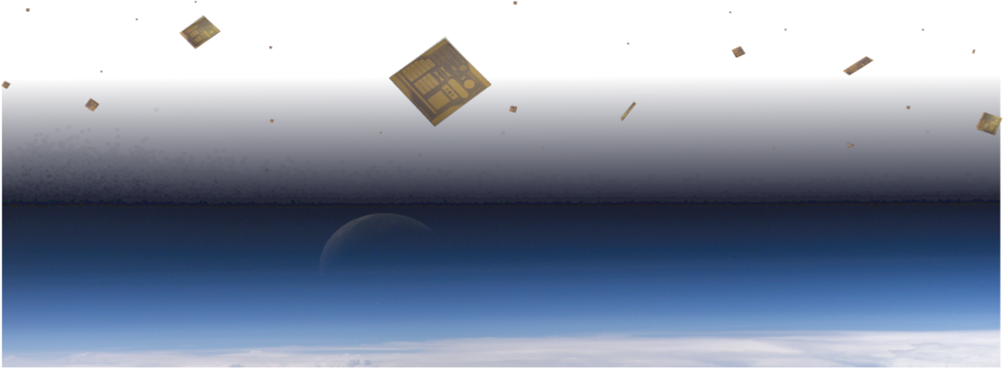
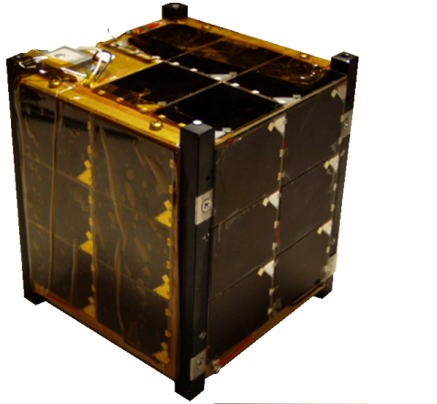
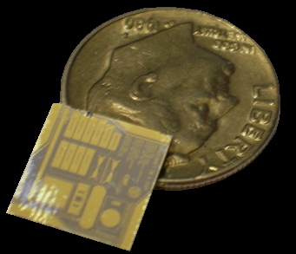
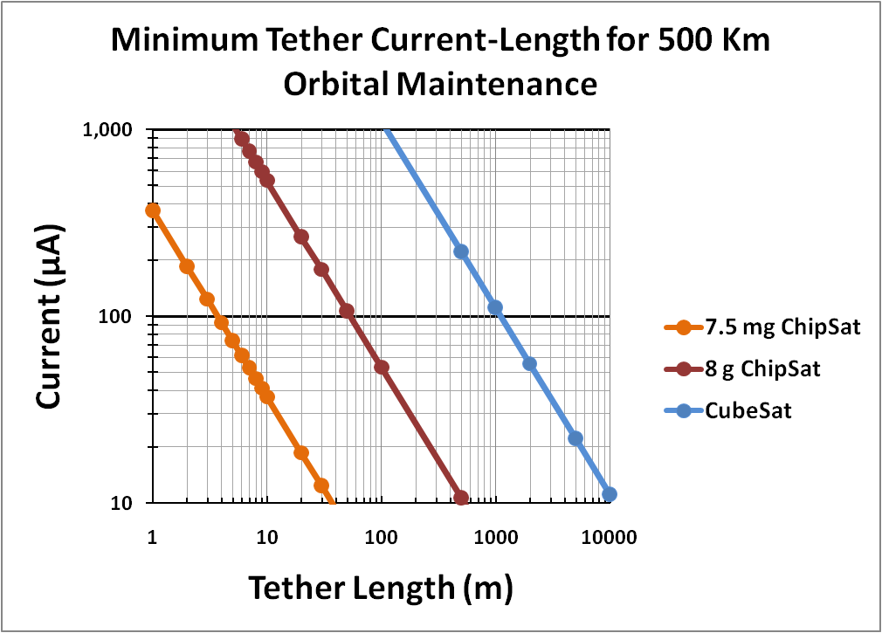
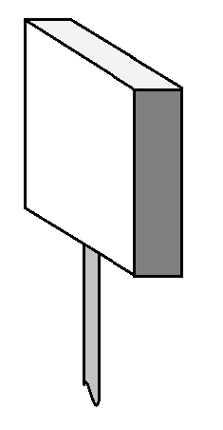
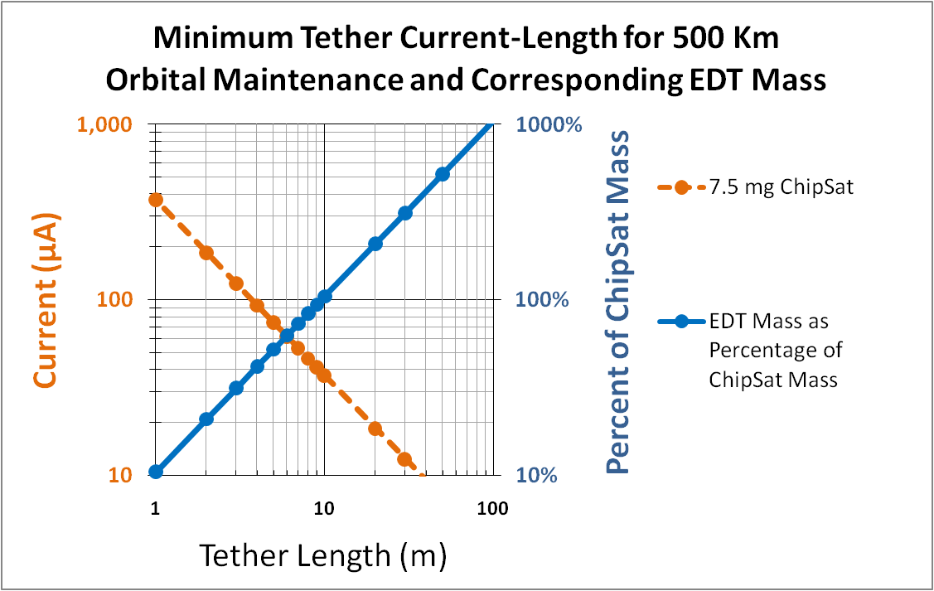
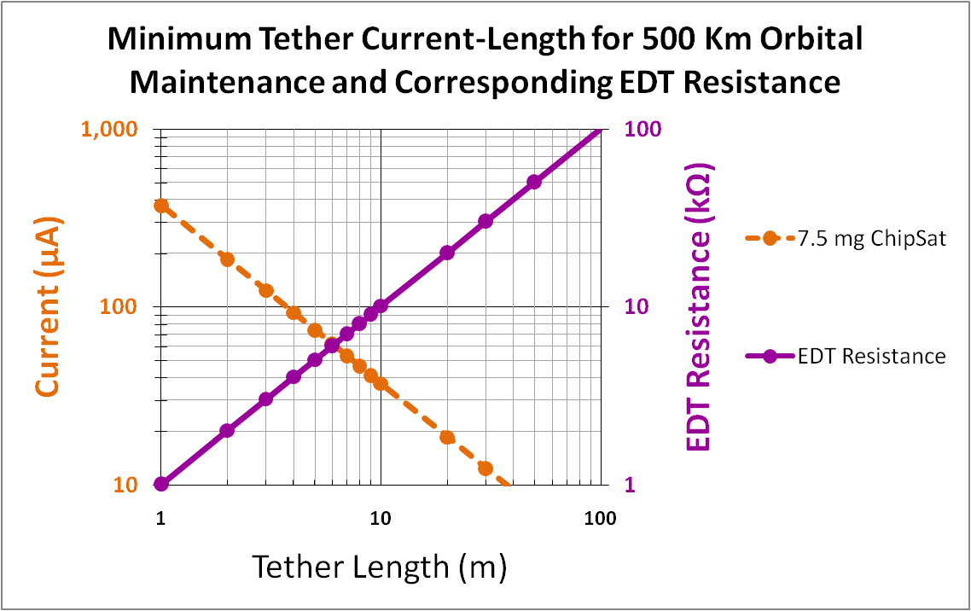
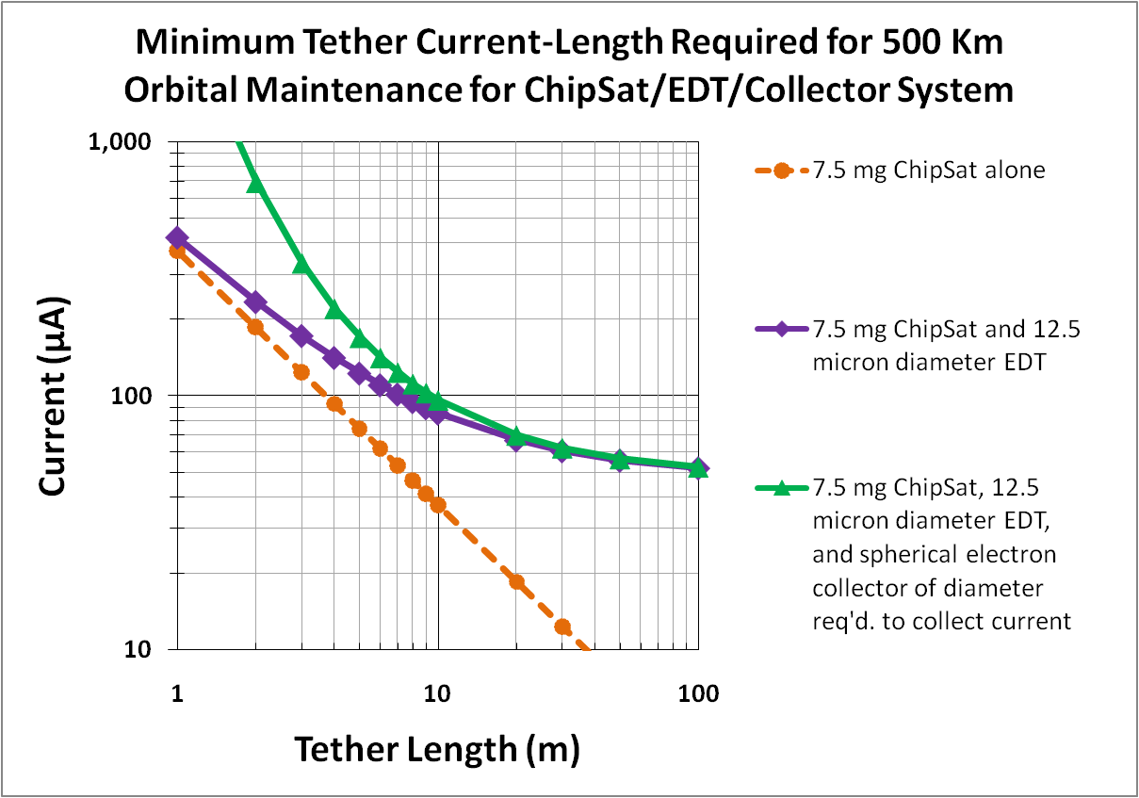
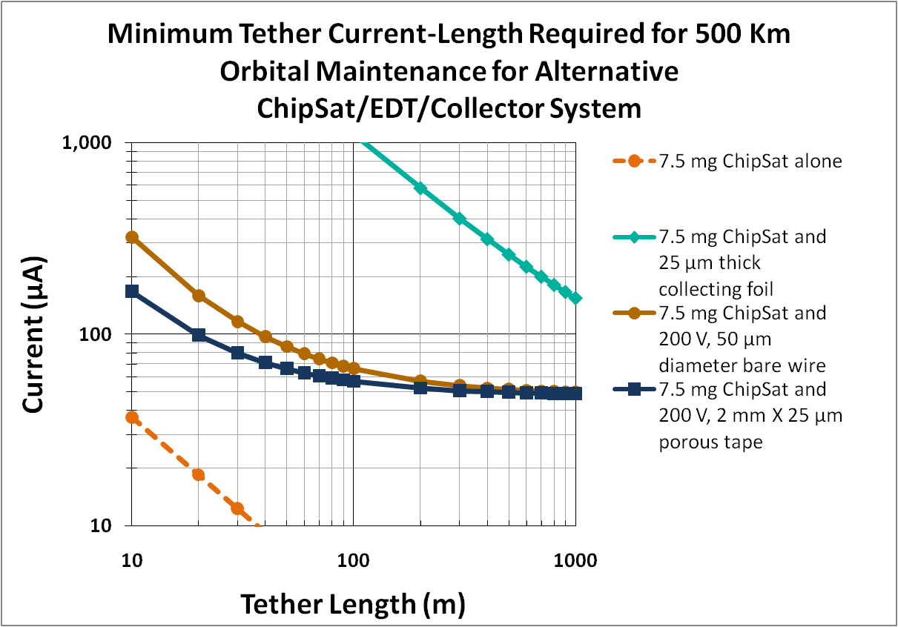
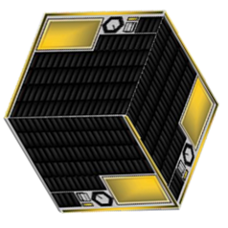
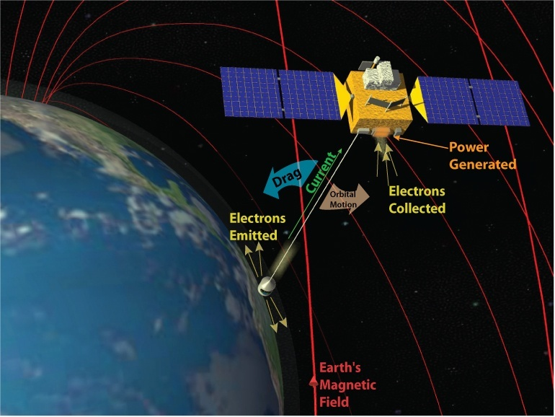
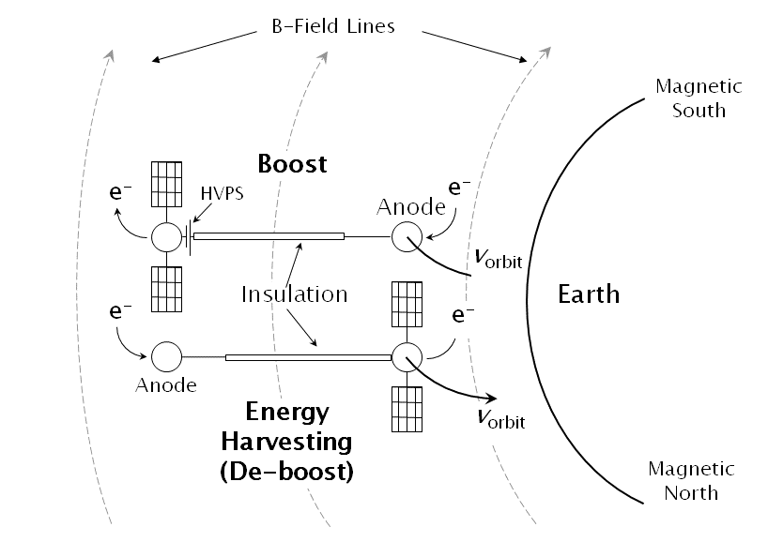
Electrodynamic Tethers for ChipSats and Nanospacecrafts
Brian Gilchrist and Iverson Bell, III
The University of Michigan
Sven Bilén and Jesse McTernan
The Pennsylvania State University
Nestor Voronka and Robert Hoyt
Tethers Unlimited, Inc.
Background
Trade Study
Results
ChipSat and Nanospacecraft
Orbital Lifetime Limitations
Research Question
Example System Concept
Performance Modeling
Using TEMPEST evaluation software
Future Work
References
Nanospacecraft is a class of spacecraft ~1-10 kg
ChipSats are the next generation of miniaturization scaled down to the microchip level (~grams)
Potential Benefits:
- Utilize MEMS technology
- Inexpensive to transport to orbit
- Quick fabrication
-Capable of swarm data collection
ChipSat Tether System Concept Parameters
ChipSat Dimensions | 7.5 mg, 1cm x 1cm x 25 µm
Altitude | 500 Km
ChipSat Orientation | “Ram”, i.e. large dimension perpendicular to velocity
Tether Width | ~13 µm
Tether Current | ~100 µA
Tether Resistance | 10 kΩ
Collector V_{bias} | +200 V
Electron Collector | 6.6 mm diameter sphere
Tether Lengths Required for Orbital Maintenance
Tether Mass and Resistance
Current Collection and Drag
Electron emitter
Solar panel
An electrodynamic tether (EDT) can exploit the Lorentz force in the ionosphere to generate an electromotive force
The force required to overcome atmospheric drag involves a trade-off between current and length
Power supply
Estimated Operated Conditions
Solar Cell Area | 1 cm²
Cell Efficiency | 25%
Available Power | 10 mW
I²R loss in tether | 100 µW
V_{­emf} *I | 200 µW
10 m
insulated
tether
Electron collector
Early ChipSat concepts have no propellant and a high Area/Mass ratio, so the orbital lifetime is very short
velocity for reduced drag orientation
Tethers 1-100 meters can provide propulsion for currents in the 10-1000 microampere range
EDT can be used for ChipSat lifetime enhancement and maneuverability
velocity for high drag orientation
A Rough Estimate of Satellite Lifetime due to Atmospheric Drag
Parameters | 3 kg CubeSat | 8 g ChipSat |  | 7.5 mg ChipSat
Configuration | 3-1000 cm³ cubes, stacked upright | Low drag | High Drag | Low Drag | High Drag
Ballistic Coeff. | 45 | 95 | 2.5 | 13.6 | 0.03
Alt = 300 km | a month | a month | hours | several days | ~
Alt = 400 km | several months | several months | days | several weeks | hours
Alt = 500 km | ~1 year | ~1-2 years | weeks | several months | hours
Tether
Cross Section
9 µm diameter Silica core
1.8 µm Nickel coating
~ 1 µm insulation
2 m Tether: Altitude vs. Time
10m Tether: Altitude vs. Time
A 10-m EDT has the same mass as the ChipSat
A 10-m EDT has 10 kΩ of resistance
To limit the tether mass and resistance, the tether should be less than 10 m
The minimum length estimate is too conservative. The 2-m EDT maintains orbit while the 10-m EDT increases altitude
^{z}
Can propellantless EDT technology provide lifetime enhancement and maneuverability?
( assuming the electron density is 10⁵ cm⁻³ )
ChipSat EDT material study
Further electron collection and emission studies
Micro-energy storage
Tether libration (TetherSim)
Boosting strategy to maintain circular orbits
6.6 mm diameter sphere
8.5 m bare wire
16x16 cm² foil
90 cm porous tape
[1] Barnhart, D., Vladimirova, T ., and Sweeting, M . “Satellite-on-a-Chip: A Feasibility Study. “ Not published, University of Surrey.
[2] Peck, M. “A Vision for Milligram-scale spacecraft,” Presentation at ChipSat Workshop 2010, Brown University. 2010.
[3] Wertz , J. and Larson, W., eds. Space Mission and Analysis and Design. 3rd Ed. Microcosm Press, 1999, pp .145.
[4] Fuhrhop, K. “Theory and Experimental Evaluation of Electrodynamic Tether Systems and Related Technologies,” University of Michigan Ph.D. Dissertation 2007, pp. 17-53.
[5] Laframboise, J. and Sonmor, L. “Current Collection by Probes and Electrodes in Space Magnetoplasmas: A Review,” Journal of Geophysics, Vol. 98 No. A1 , 1993, pp 337-357.
[6] Thompson, D., Bonifazi, C., Gilchrist, B., et al. “The Current-Voltage Characteristics of a Large Probe in Low Earth Orbit: TSS-1R Results,” Geophysics Research Letters, 1998 , pp. 413-416.
[7] Choiniere, E., Bilen, S., and Gilchrist, B. “Experimental Investigation of Electron Collection to Solid and Slotted Tape Probes in a High Speed Flowing Plasma” IEEE Transactions on Plasma Science ,Vol. 33 No. 4 , 2005, pp. 1310-1322.
[8] Fuhrhop, K. and Gilchrist B. “Optimizing Electrodynamic Tether System Performance“ AIAA Space Conference and Exposition, 2009, pp 1-17.
Short tethers require more current and a larger collection area, so a minimum length of 9 m is set by the collector size, which is a ~7 mm diameter sphere ( given n_{e} = 10⁵ cm⁻³ )
We gratefully acknowledge support from AFOSR grant FA9550-09-1-0646

