Slide 1
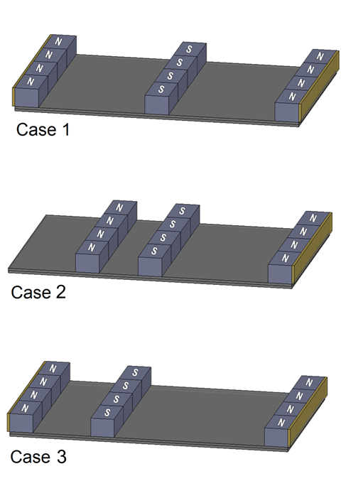
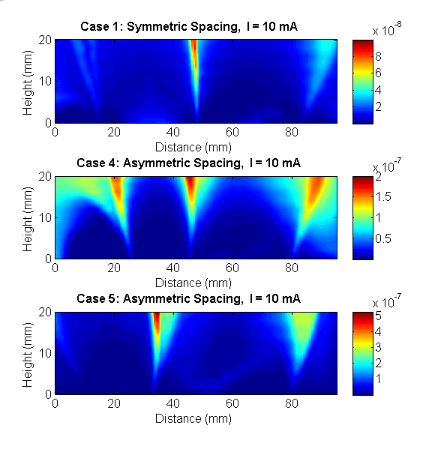
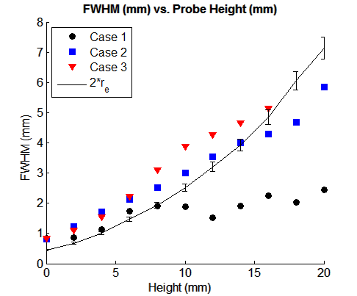
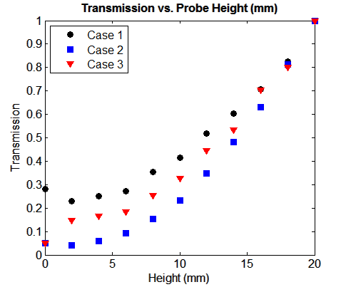
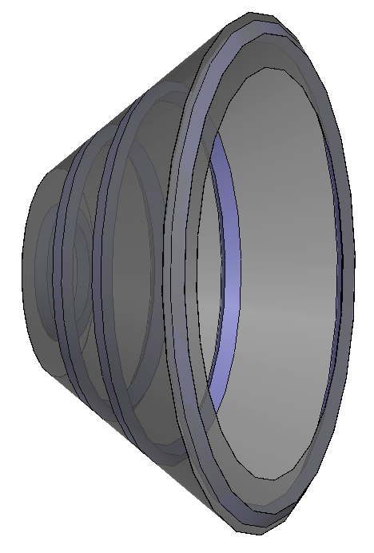
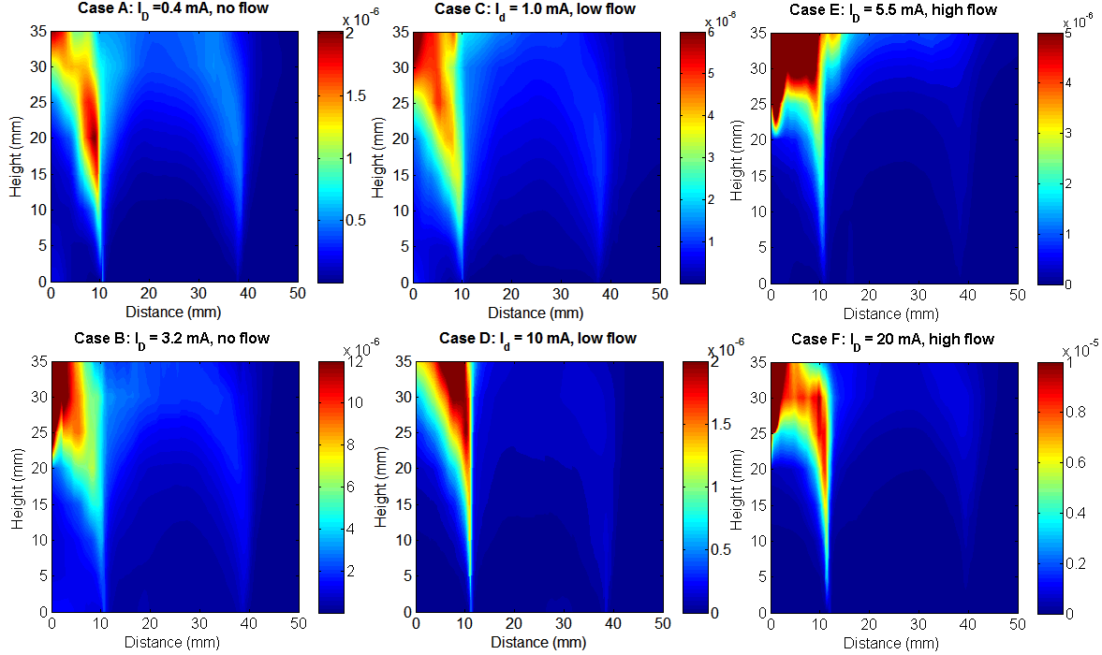
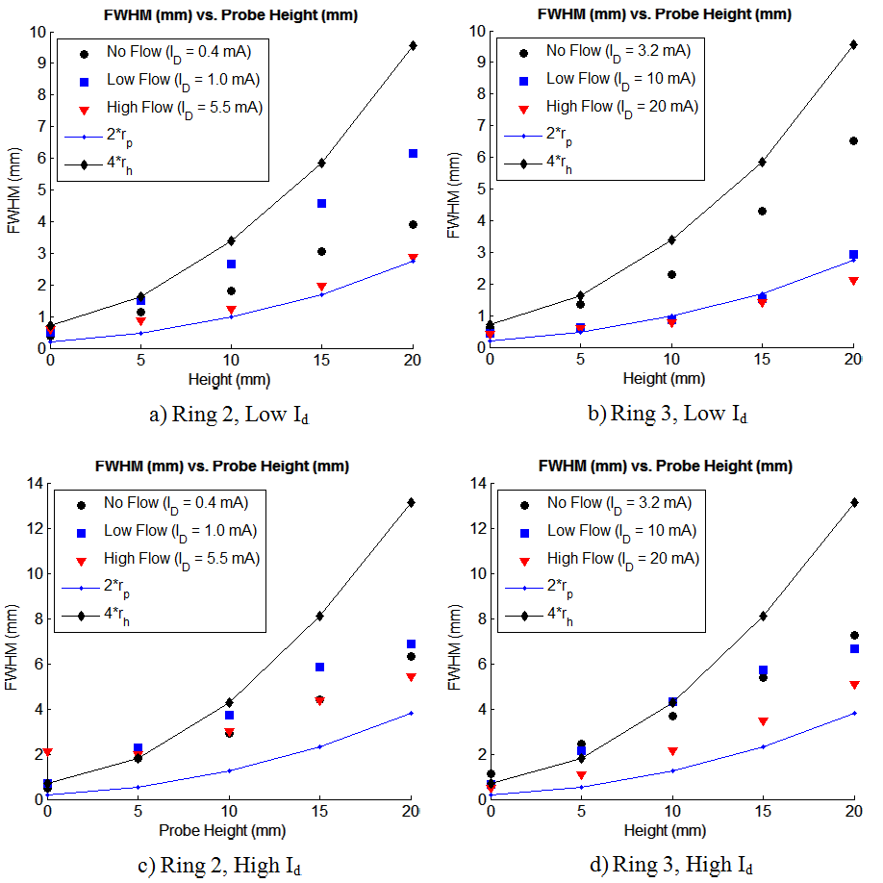
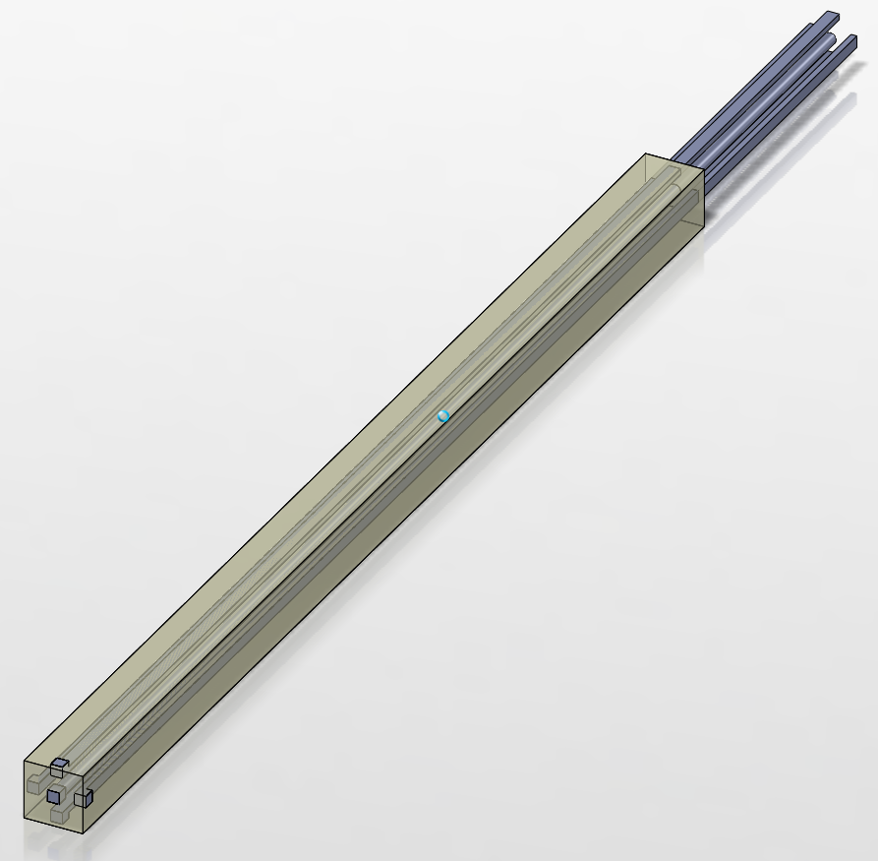
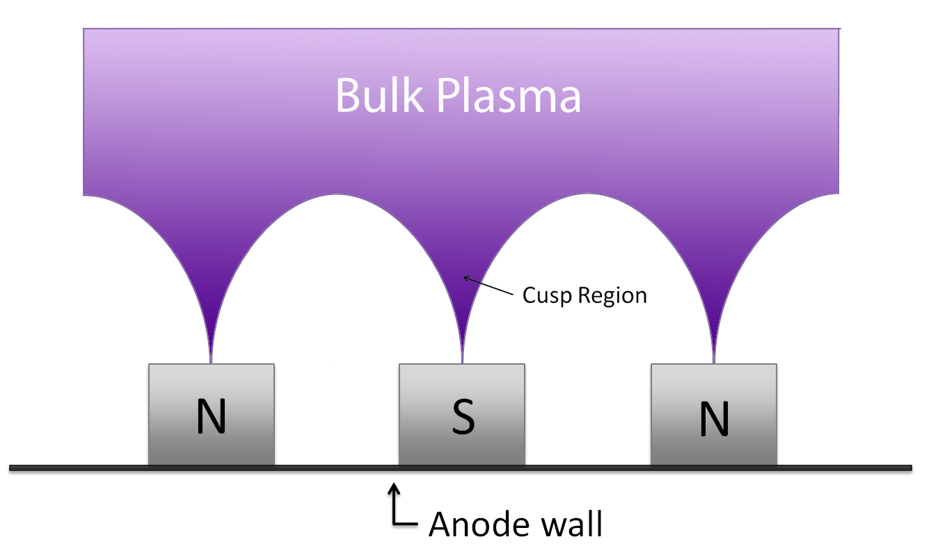
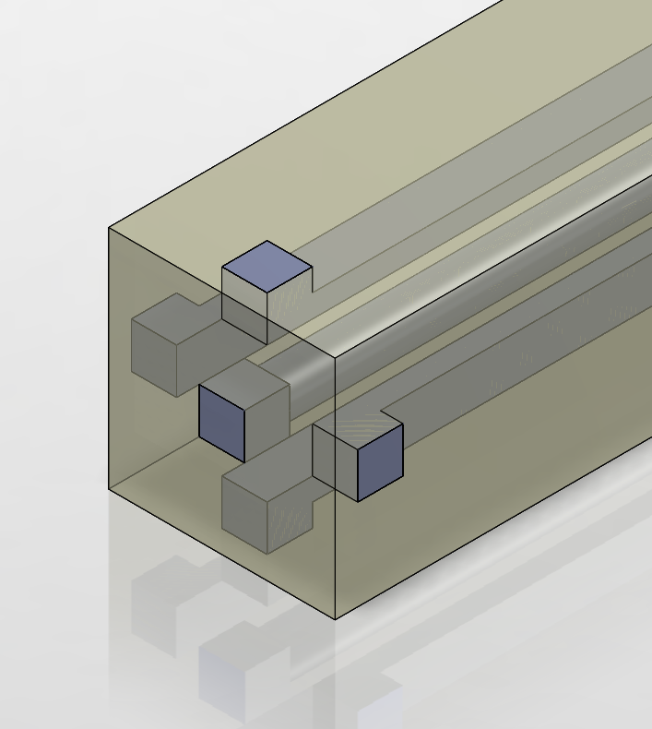
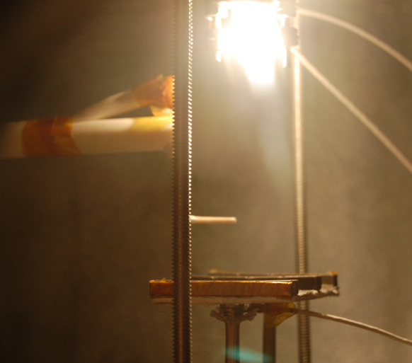
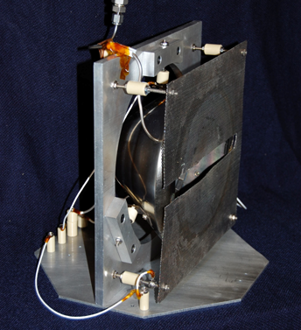
Spatially Resolved Study of Inter-Cusp Transport and Containment of Primary Electrons
Aimee A. Hubbleª, John E. Foster^{b}
a) University of Michigan, Department of Nuclear Engineering and Radiological Sciences (aahubble@umich.edu)
b) University of Michigan, Department of Nuclear Engineering and Radiological Sciences (jefoster@umich.edu)
Abstract
Electron current density profiles were obtained in the region above two magnetic cusps in a 20 cm partial conic ring cusp ion thruster discharge chamber. The density profiles were obtained by use of a translatable Langmuir probe and an automated motion stage and data collection system. These high-resolution density profiles allowed for the study of electron collection mechanics in the absence of gas flow and plasma production, as well as at varying levels of gas flow. An internal pressure sensor mounted in the discharge chamber allows for accurate measurements of chamber collisions. This is the second stage in a series of experiments aimed at better understanding collection physics at the magnetic cusps during discharge chamber operation. The current density maps allow for particle transport through the cusps to be visualized, and see how discharge chamber geometry plays a role in collection. Attenuation coefficients and loss widths as a function of probe distance above the anode were calculated from the current density data, and compared at a variety of discharge currents. In addition, these current density maps were compared to those obtained using a planar and line cusp source geometry, to study how source geometry affects particle collection. Results will be compared to a line-cusp source to evaluate the effect of cusp symmetry on collection.
Experiments
Two experiments were performed. The first involved the planar line cusp source, consisting of three permanent magnet line cusps arranged on a 7.5 x 5 cm steel plate. This was used to study the effect of filament position and magnet row spacing on collection. A 20-cm conic discharge chamber featuring four permanent magnet rings was also investigated. This represents a more thruster-like magnetic configuration. A tungsten filament served as the cathode in both tests. Langmuir probe current was measured in the region above the magnetic cusps. This produced a 2D high-resolution current density map that allowed for visualization of particle transport to the cusps. From these maps a transmission coefficient and a leak width can be measured.
Motivation
The physics of plasma losses at magnetic cusps remains a fundamental yet poorly understood problem. The losses at the cusps in multipole sources control discharge efficiency. Losses of primary electrons are particularly important since they drive ionization in the chamber. Plasma loss area is determined by cusp physical geometry and particle interactions within the cusp.
It is desirable to minimize the effective loss area, particularly for primary electrons. In past studies, the effective loss area has been related to the leak width at the anode wall, which is proportional to the hybrid radius:
For primary electrons leak width is proportional to the primary electron Larmor radius. However, leak width may not give a complete accounting of losses to the discharge chamber walls. Past work shows attenuation in particle flux during transport through the cusp to the wall. Transmission coefficient and leak width together quantify losses.
This work is part of an ongoing effort to obtain a fundamental understanding of the role of the magnetic circuit on discharge performance.
Future Work
In future work, the sheath in the cusp region will be measured by the use of a small emissive probe. These measurements will be made in both the 20-cm discharge chamber as well as a slightly larger planar source. This larger source will have at least four line cusps to allow for further study of the effects of inter-cusp spacing and filament placement on collection. The effect of filament placement on collection will also be studied in the 20-cm discharge chamber.
In addition, Langmuir probe measurements will be repeated in both sources with a five-component Langmuir probe, pictured at right. This probe will allow for the measurement of particle flux in five directions in the cusp region. The probe faces will be very small (on the order of 10⁻⁸ m²) in order to make highly resolved spatial measurements of particle flux.
Conclusions
Planar Line Cusp Source:
In general, profile width corresponded closely to twice the primary Larmor radius. The filament placement did not have a strong effect on spatial distribution of collected current, but asymmetry in inter-cusp spacing has a strong effect on cusp shape and transmission.
20-cm Conic Discharge Chamber:
Current was collected predominantly at one of the two rings studied. The leak width was measured as a function of both discharge current and gas flow rate and was found to lie between the primary electron leak width (2*r_{p}) and the hybrid leak width (4*r_{h}).
Goal of study is experimentally determine the primary electron transmission coefficient of the magnetic cusp and leak width at the anode wall.
Acknowledgements:
I am supported by the Department of Defense (DoD) through the National Defense Science & Engineering Graduate Fellowship (NDSEG) Program.
Check out my research blog at:
www.thepstl.blogspot.com

