Slide 1
Nonlinear Oscillations of Levitated Gas Bubbles and Their Impact on Plasma Formation in Water
Bradley S. Sommersª
John E. Foster^{b}
(a) Dept. of Nuclear Engineering, University of Michigan, Ann Arbor, USA, bsso@umich.edu
(b) Dept. of Nuclear Engineering, University of Michigan, Ann Arbor, USA, jefoster@umich.edu
Presented at the 2nd Graduate Symposium of the Michigan Institute for Plasma Science and Engineering
Tuesday, May 21st, 2011

Slide 2
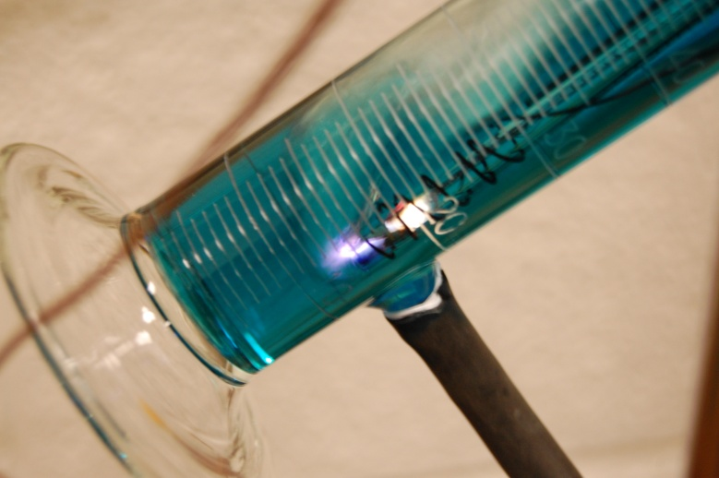
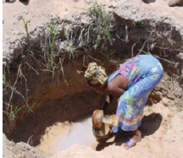
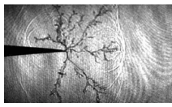
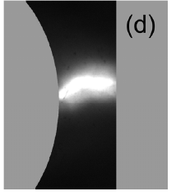
Liquid Plasma: Applications & Issues
Strong chemical reactivity
UV radiation
radicals (OH⁻, ozone)
energetic electrons
Applications
water purification
industrial processing
Issues
water is a very good insulator
(E_{holdoff} > 1 MV/cm)
electrode erosion (contamination)
small throughput
shot-to-shot variability
thin electrode tips
small electrode spacing
400 μm
These issues stand as a barrier to practical implementation

Slide 3
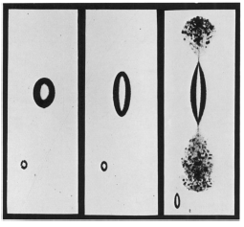
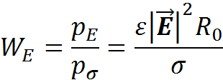
Electric Field Effects in Water
Water acts as a “leaky dielectric”²
dielectric permittivity (bound charge)
finite conductivity (free charge)
Macroscopic effect of electric stress
electric stress:
surface tension stress:
Weber Number:
bubble interior
boundary depressed by p_{E}
p_{E}
undisturbed boundary
Ē
For 16 kV/cm, 3 mm, W_{E} ~ 1 (applied field)
For 100 kV/cm, 3 mm, W_{E} ~ 25 (streamer)
²Garton, Krasucki, Proc. Royal Soc. Lon.., Vol. 280, No. 1381, July 21, 1964.

Slide 4
A Single Bubble under an A.C. Field
Conditions
voltage: 5kV A.C.
frequency: 600 Hz
electrode gap: 2.3 mm
bubble diameter: 0.64 mm
t = 0.0 ms
Figure 5. A single oscillation cycle of a levitated bubble being driven by an A.C. electric field.

Slide 5
Observations
dramatic shape change
oscillation frequency ~ 600 Hz
W_{E} ~ 0.17
t = 1.7 ms
top electrode
E
bottom electrode

Slide 6
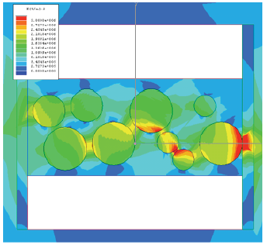
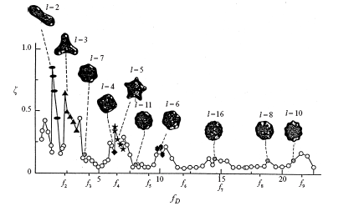
Lowering the Breakdown Threshold
Bubble shape distortion: increase E/N
Shape effect: The permittivity gradient near the dielectric boundary refocuses and intensifies fields at areas of high curvature.
Volume effect: Under a sufficiently fast expansion of the bubble volume, the internal gas pressure decreases according to an equation of state, (pV^{γ} = constant)
field enhanced at dielectric boundary
drop curvature can be drastically distorted
Conditions for plasma formation inside the bubble can be varied through externally driven distortion
¹Azuma, H., J. Fluid Mech., Vol. 393, 1999

Slide 7
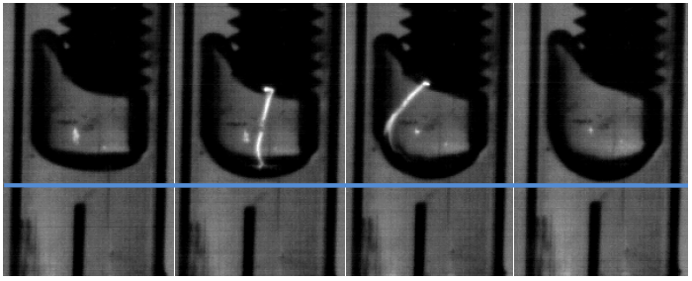
Previous Work
t = 0.0 ms
t = 2.5 ms
t = 5.0 ms
t = 7.5 ms
minimum deformation
expansion with streamer
maximum deformation
bubble attached to electrode, driven by 5 kV A.C. voltage
bubble oscillates near natural frequency (50 Hz)
streamer excited inside bubble
Achieved large bubble deformation, including area increase of up to 20%

Slide 8
Bubble expands in response to the increasing field
Deformation closely resembles L =2 mode

Slide 9
At the extremum, bubble curvature becomes sharp, indicating higher order modes. The electric field here is predicted to be intense
As the field is reduced, the bubble’s inertia compresses it beyond its equilibrium shape.

Slide 10
Overview
Plasmas are promising for a host of environmental applications but are limited by large voltage and energy requirements.
The reduced field inside a gas bubble submerged in water can be enhanced when it undergoes severe distortions.
shape effect: field intensification near distorted dielectric surface
volume effect: internal pressure drop accompanying expansion
Precise levitation of air bubbles has been achieved via ultrasonic levitation
Intense distortion of suspended air bubbles driven by A.C. fields has been observed with implications for the internal reduced field
severe curvature at bubble “tips” indicates field amplification
substantial volume increases indicate decreases in internal pressure

Slide 11
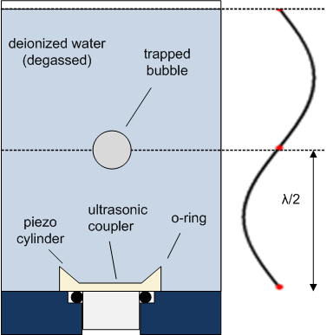
Experimental Approach Part I: Ultrasonic Levitation
Purpose: study isolated bubble under repeatable conditions
Physical Mechanism
piezoelectric ceramic transfers electrical energy into acoustic energy
acoustic standing wave established in 3-D rectangular cell
bubble trapped at node
coupler provides lateral stability³
wave mode: [1,1,2]
Figure 1. Water filled bubble levitation chamber
³ Trinh, E.H., Thiessen, D.B., J. Fluid Mech., Vol. 364, 1998

Slide 12
(a)
Piezo specs
operating frequency: 26.4 kHz
Absorbed power: 2.3 Watts
maximum acoustic pressure: ~ 1 atm above ambient
(b)
Maximum power is absorbed where the piezoelectric impedance is minimized
Figure 3. Piezoelectric resonance curves showing the (a) total impedance and (b) absorbed power as a function of frequency

Slide 13
Shape Mode Analysis
Bubble oscillations decompose naturally into spherical harmonics⁴
equation of surface:
spherical harmonic coeffcients:
Image Analysis
convert RGB images to binary
apply edge tracing algorithm to obtain bubble surface data
numerially integrate to find mode coefficients
original image binary image
⁴ Trinh, E.H., Thiessen, D.B., J. Fluid Mech., Vol. 364, 1998

Slide 14
baseline volume increases over several cycles
approximate applied voltage signal overlayed
equilibrium area line
Figure 6. Percentage increase in cross sectional area of oscillating bubble as measured from image analysis. Volume expands under the action of the applied electric field.

Slide 15
Experimental Approach Part II: Bubble Deformation
Purpose: measure shape distortion from an applied electric field
Setup
bubble injection via syringe
degassed, deionized water
(κ = 10 μS/m)
A.C. voltage: 5 kV
frequency: 100-1000 Hz
Diagnostics
fast camera: 5000 frames per second
Pearson coil / H.V. probe
hydrophone
Translatable electrodes
Figure 2. Photo of electrodes submerged in bubble levitation chamber

Slide 16
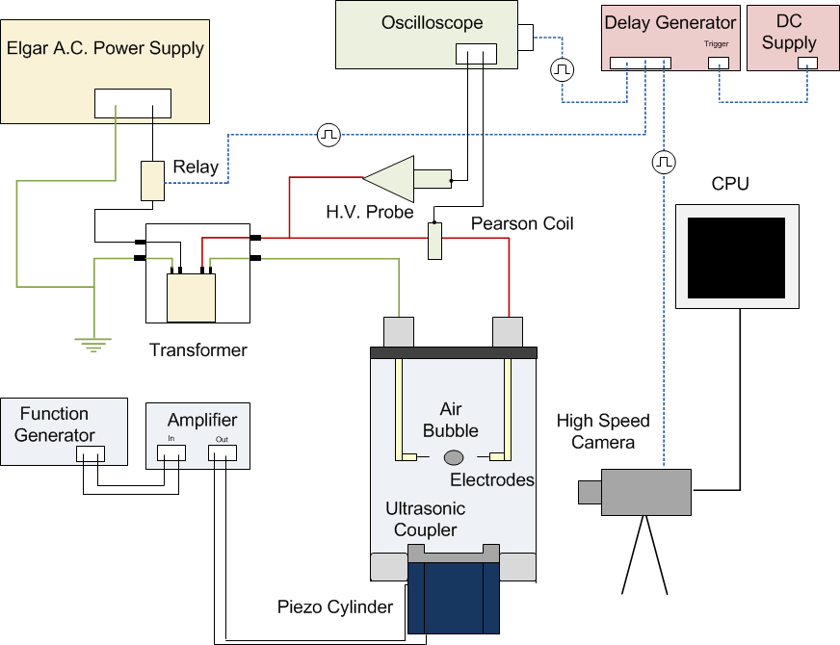
Figure 4. Full setup used to drive and document suspended bubble oscillations

Slide 17
Dominant Mode: L = 2
previously observed under under uniform D.C. field⁵
behaves like an ellipse to 1st order
Higher order modes
at extreme deformation, bubble tips display sharp curvature
Indicates the presence of higher order modes
(a) A₂ = 0.0
(b) A₂ = 0.3
(c) A₂ = 0.6
sharp curvature indicates higher order modes
⁵Grigor, Zharov, Tech. Phys., Vol. 44, No. 8, 1999

Slide 18
L = 2 mode is observed to be dominant
Higher order modes are not observed
Figure 7. Spherical harmonic mode decomposition of oscillating bubble. Modes L = 2 - 6 shown.

Slide 19
Acknowledgments
I would like to thank the National Science Foundation (NSF, grant # 1033141), particularly the CBET for supporting this research. I would also like to thank my advisor John Foster.
For further information
Please contact bsso@umich.edu. More information can be found at the Plasma Science and Technology Lab’s website,
http://www-ners.engin.umich.edu/lab/pstlab/

