Slide 1
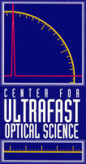
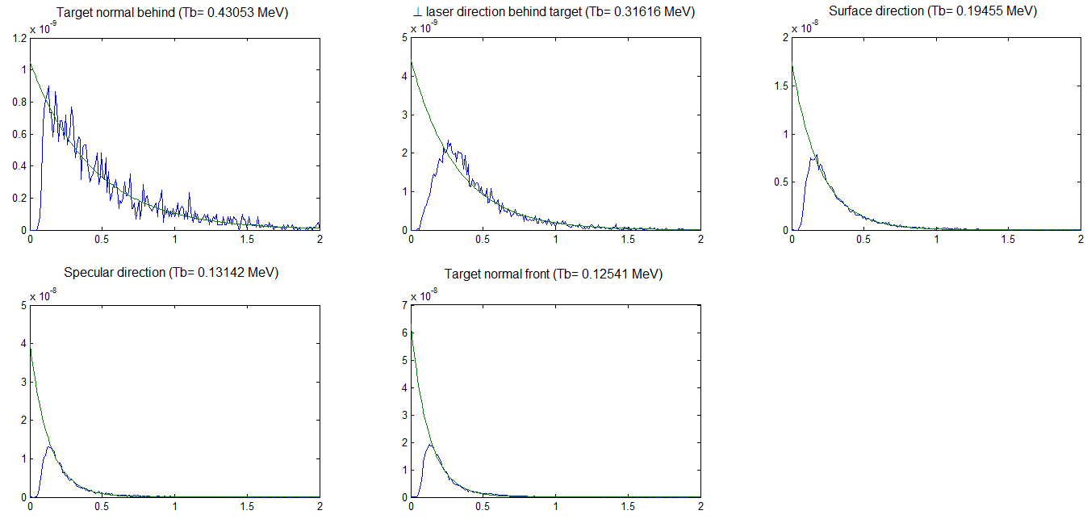
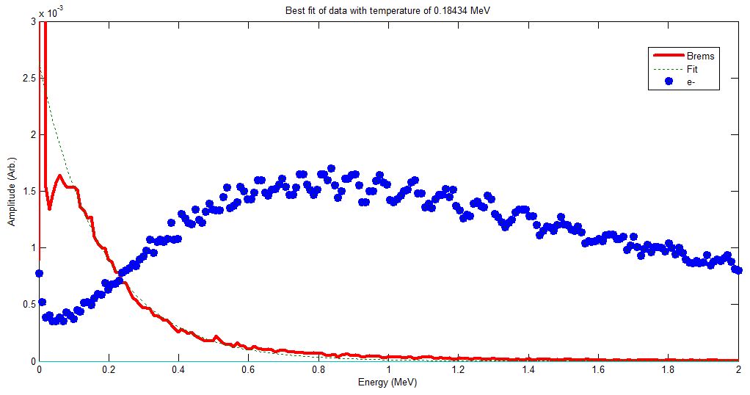
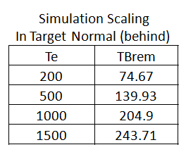
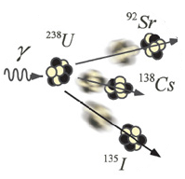
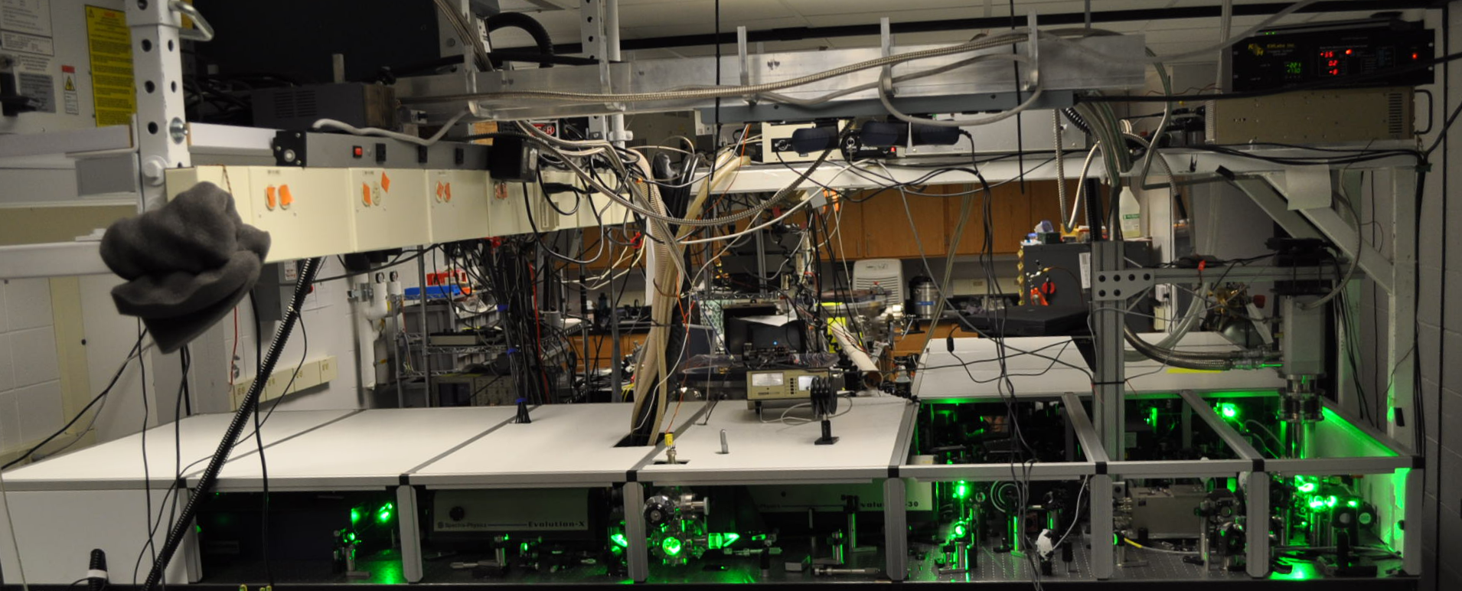
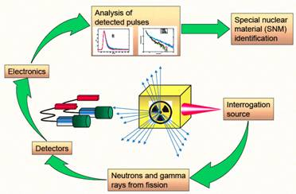
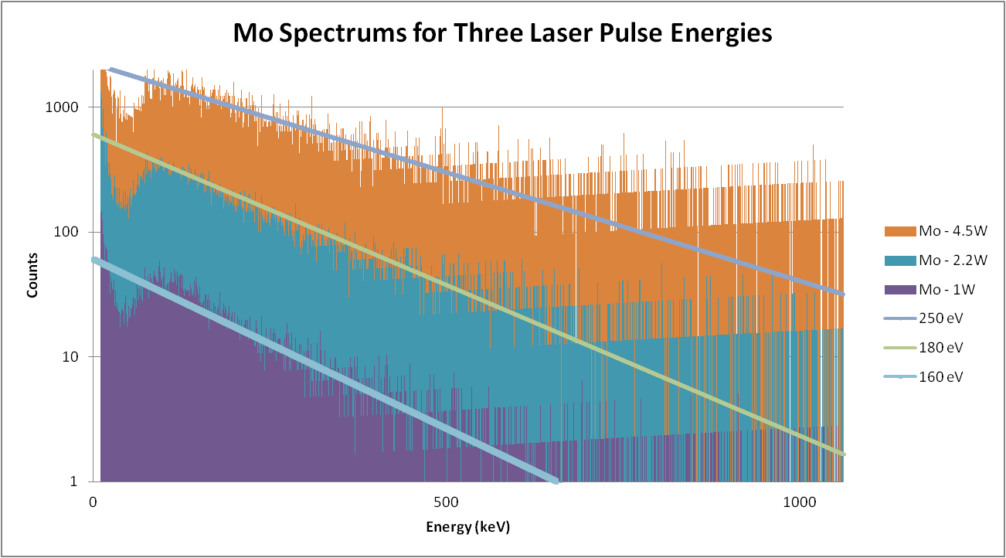
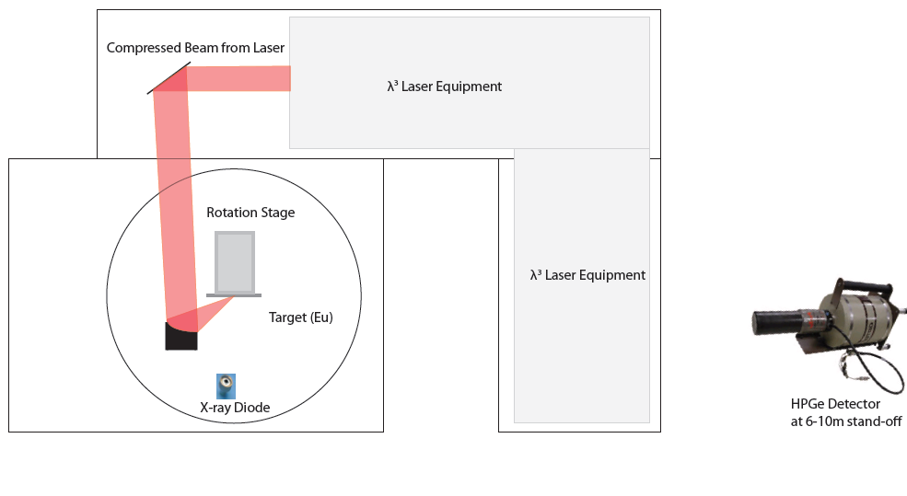
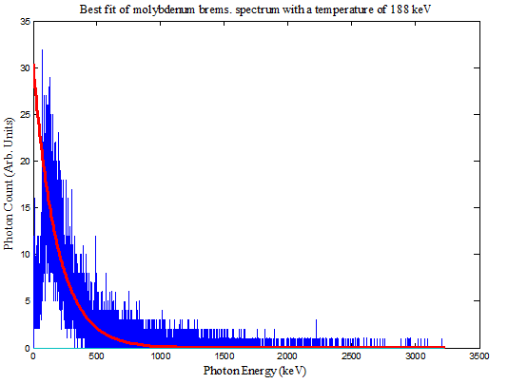
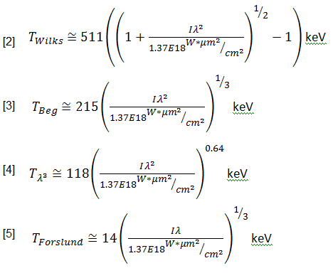
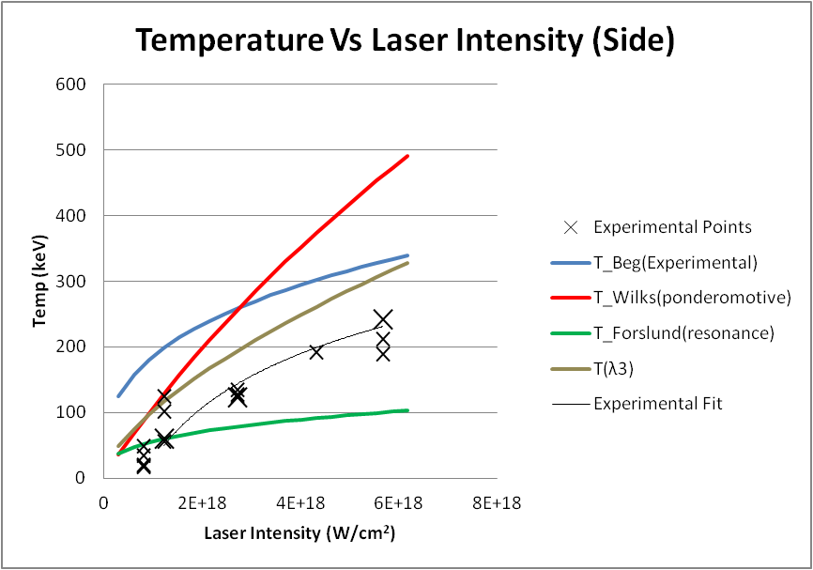
Bremsstrahlung Temperature Scaling in Ultra-Intense Laser-Plasma Interactions
C. Zulick, B. Hou, J. Nees, A. Maksimchuk, A. Thomas, K. Krushelnick
Center for Ultrafast Optical Science, University of Michigan, Ann Arbor
Abstract: The absorption of laser energy during ultra-intense (I < 10¹⁸ W/cm²) laser-plasma interactions results in the production of a hot electron current, which can subsequently generate energetic protons, ions, and photons. The energetic photons are of particular interest in isomer excitation, positron production, and homeland security applications.
Experiments were performed on the high repetition rate (500 Hz) Lambda Cubed laser (I ≈ 5 ∙10¹⁸, duration 50 fs) allowing high resolution (λ/Δλ = 300) spectroscopy of bremsstrahlung photons in the 20 keV to 3 MeV energy range. The effective bremsstrahlung temperature was measured over a range of laser energies and detection angles. Additionally, simulations (MCNP) were used to correlate experimental bremsstrahlung temperatures with hot electron temperatures, which were compared to existing electron temperature scaling laws.
Hot Electrons and MCNP: Hot electrons are generated through relativistic laser-plasma interactions by a number of mechanisms. These include wave-breaking of resonant plasma waves, direct acceleration of electrons through vacuum absorption, inverse bremsstrahlung, and j X B acceleration. Once the electrons are generated they propagate through the target and interact with the fields of the atomic nuclei. When the electrons are accelerated in the these fields they emit radiation, known as braking radiation, free-free radiation, or bremsstrahlung.
Relativistic bremsstrahlung radiation has an analytic form as shown above[6]. The cross section varies with θ, the angle of photon emission, and becomes increasingly forward directed for high relativistic energies. For complex incident electron energy spectrums the use of a modeling code such as MCNP provides useful insight into the relationship between the electron and bremsstrahlung spectrums. The Monte Carlo N-Particle code (MCNP) is a general purpose code capable of simulating the passage of neutrons, photons, and electrons through matter and a large variety of associated nuclear and atomic physics processes. MCNP was used to model the experimental setup and examine the relationship between the electron and bremsstrahlung temperatures and the angular distribution of the bremsstrahlung radiation (shown above).
Experimental Setup and Background: The Lambda Cubed laser at UM is a Chirped-Pulse Amplified (CPA) laser which produces relativistic laser-plasma interactions at 500 Hz [1]. Each pulse contains 10 to 12 mJ of energy and is focused, with a deformable mirror, to a spot size of ~1.8 μm² producing focused intensities of up to 8E18 W/cm². This intensity is in the “relativistic” regime, meaning an electron gains enough kinetic energy during a cycle of the laser pulse to travel at relativistic velocities. The λ³ laser is pictured below.
Bremsstrahlung Temperature Measurements: The bremsstrahlung spectrum was compiled over >150,000 shots while operating in a “single-hit” regime with the HPGe detector. This was achieved by limiting the effective count rate to 100 cps, or, equivalently, limiting the number of detection events to 20% of the laser shots, thereby reducing the probability of multiple photon pileup. The laser energy was varied from 2 to 12 mJ, producing different bremsstrahlung spectrums at each energy (see below).
Applications of Laser Produced Bremsstrahlung: The use of laser bremsstrahlung sources in the field of homeland security offer the potential for active interrogation with compact, economical accelerators. We are investigating this application on the λ³ laser as a step towards practical implementations with high repetition rate systems. The reactions of interest include (γ,f), (γ,n), and isomer excitation. Each reaction produces particles with characteristic energies that uniquely identify materials of interest.
Images from Pozzi et. al.
The effective temperature of the bremsstrahlung was determined by fitting an exponential function (Γ(E)=E_{o}e^{(-E/T}_{b}⁾ to the data using a least squares algorithm. The fit is measured over energies of 100 keV to minimize the effect of bremsstrahlung attenuation in the chamber wall, target, and room air at low energies.
Summary: A laser produced bremsstrahlung spectrum was measured on the λ³ laser using a HPGe detector operating in “single-hit” mode.
The observed bremsstrahlung temperatures scaled with intensity in a manner consistent with Beg scaling, but differing by a temperature coefficient of approximately 2.
MCNP simulations show the temperature coefficient is expected to be approximately 4 times lower for the bremsstrahlung temperature than for the electron temperature.
MCNP simulations show the bremsstrahlung temperature is expected to be higher in the laser direction due to relativistic effects.
Angularly resolved spectral measurements will be taken on the λ³ laser system to determine the angular temperature distribution.
Photonuclear experiments, utilizing the highest temperature bremsstrahlung spectrum, will be performed for homeland security applications.
The effective bremsstrahlung temperature is plotted below as a function of laser intensity and is compared to several scaling laws for hot electron temperature. The overall shape of the curve appears to best agree with Beg’s experimental scaling, but with different temperature coefficient. In order to investigate this discrepancy MCNP (see above) simulations have been performed.
The experimental configuration is shown above. The compressed laser pulse is focused onto a rotating disc target. A high purity germanium (HPGe) detector is located at a sufficient stand-off distances to avoid EMP and detector saturation.
References:
[1] Hou, B., App. Phys. B. 83, 1 (2006)
[2] Wilks, S.C., et.al., PRL 69, 9 (1992)
[3] Haines, M.G., et. al., PRL 102 (2009)
[4] Mordovanakis, A. G., et.al., APL 96 (2010)
[5] Gibbon, P. “Short Pulse Laser Interactions with Matter” (2005)
[6] Jackson, J.D. “Classical Electrodynamics” (Third Edition, 1999)
This work was supported by the National Science Foundation (NSF) through the FOCUS Physics Frontier Center PHY-0114336, and by the Department of Homeland Security and NSF through grant EECS-0833499.

