Slide 1


Plasma Formation in Deformed Gas Bubbles
Bradley S. Sommersª
John E. Foster^{b}
(a) Dept. of Nuclear Engineering, University of Michigan, Ann Arbor, USA, bsso@umich.edu
(b) Dept. of Nuclear Engineering, University of Michigan, Ann Arbor, USA, jefoster@umich.edu
Presented at the 3rd MIPSE Graduate Symposium
East Lansing, MI, USA
Wednesday, October 3rd , 2012

Slide 2
Overview
The electric field in a gas bubble can be actively enhanced by distorting the bubble’s shape. This may lead to a practical means of producing plasma in isolated bubbles for a variety of environmental applications
An experimental device has been developed to trap single bubbles, excite them into violent nonlinear distortions and characterize them with a high speed camera.
Evaluation of bubble images to date indicates moderate enhancement of the field (2.3) for observed bubbles with the potential to be as high as 10-50 with further deformation.
Early experiments of streamer formation in liquids indicate that bubbles have a strong influence on the ignition and propagation of liquid streamers, with violent energy transfer occurring between the two.
Special thanks the National Science Foundation (NSF, grant # 1033141), particularly the CBET for supporting this research.

Slide 3
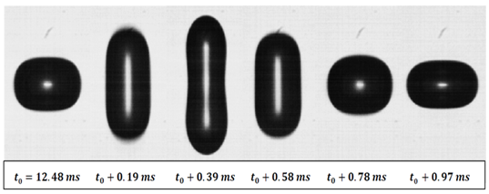
Exciting the Spherical Harmonic Modes
Excitation of specific modes can be used to produce high curvature distortion of the bubble shape
The L =2 mode can be excited with an uniform A.C. field
In this example, a 0.2 mm bubble is driven close to the natural L = 2 mode (1 kHz) at 14 kVcm⁻¹
Voltage (kV)
Current (mA)
p_{E} oscillates at f_{press} = 2f_{volt}
Weber Number
Time (ms)

Slide 4
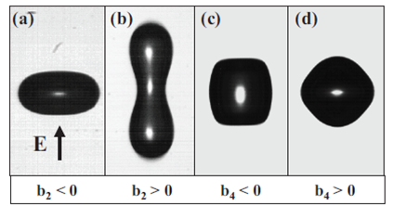
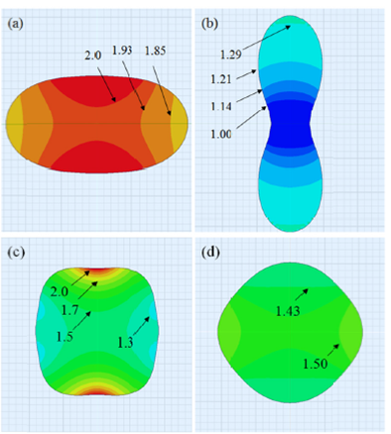
Electrostatic Modeling of the Electric Field Inside the Distorted Bubble
Use electrostatic solver to estimate the field inside deformed bubbles
Conditions
  uniform D.C. field
  ε_{r}= 80, κ = 20 μS m⁻¹
  define G₀ = 1.5 (case of a sphere)
  symmetry → quarter model
  solutions with energy error < 0.005%
Observations
  field enhanced for negative b_{l}(t)
  field depressed for positive b_{l}(t)
  Max enhancement = 2.3

Slide 5
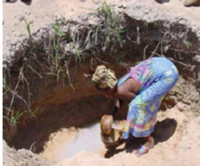
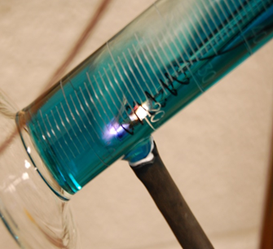
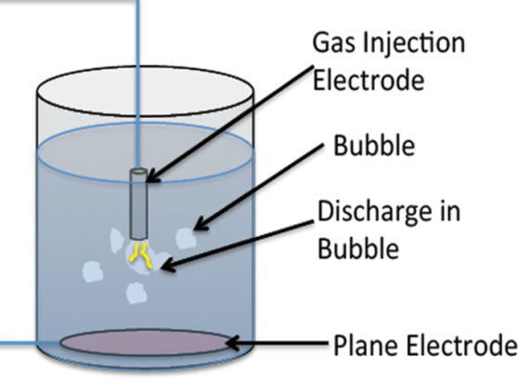
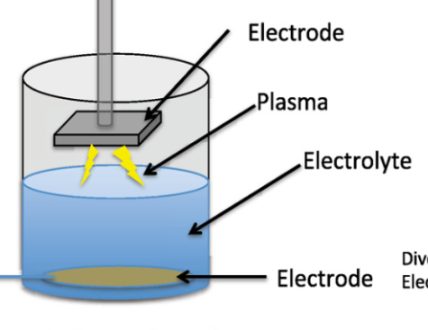

Atmospheric Discharges in/near water…
…produce strong reactivity in liquids through the production of radicals (OH⁻, HO₂●, O₃*, H₂O₂) and UV radiation for applications in water purification, waste processing, and materials synthesis
…but suffer from a number of limitations
  Indirect discharges produce plasma in a secondary gas phase with high reduced field, but have low processing throughputs
  Bubble discharges offer a promising way to inject radicals deeper into the processing volume, but remain limited due to the difficulty in transporting high fields across the dielectric fluid.

Slide 6
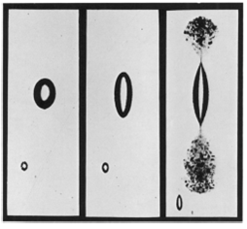



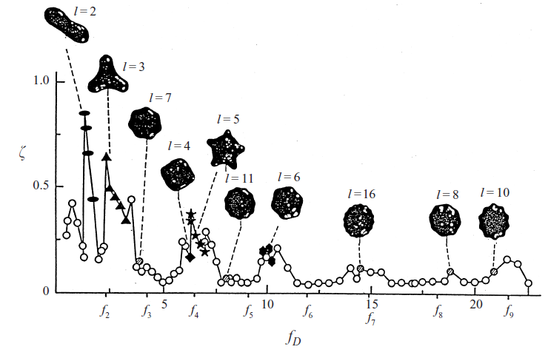


Shape Distortion Can be Achieved with Intense Electric Fields
“Leaky” fluid dielectrics, like water, are susceptible to electric stress determined by the Maxwell stress tensor,
D.C. fields stretch and destabilize bubble shape
(normal stress)
For a gas bubble³³
  electric stress:
  surface tension stress:
  Weber number:
Garton, Krasucki, Proc. Royal Soc. Lon. 1964.
A.C. fields couple to natural oscillating modes
Ex. R₀ = 0.5 mm
E₀ = 5 kV/cm, in water
W_{e} ~ 1
Azuma H, Jour. Fluid Mech. 1999

Slide 7
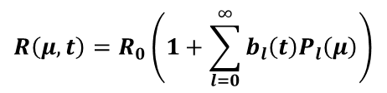
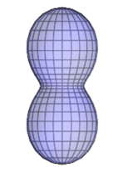
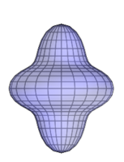
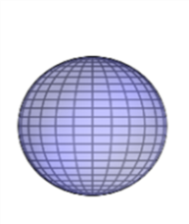
Mode Decomposition
Excited Bubble can be decomposed into Legendre polynomials
Even Shape Modes (l = 2,4,6)
Odd Shape Modes (l = 1,3,5)
b₂
b(t)
b₄
b(t)
b₆
Time (ms)
Volume Mode (l = 0)
Bubble Volume (normalized)
b(t)
V(t)
b₀
l = 0
l = 2
l = 4
Time (ms)
Time (ms)

Slide 8
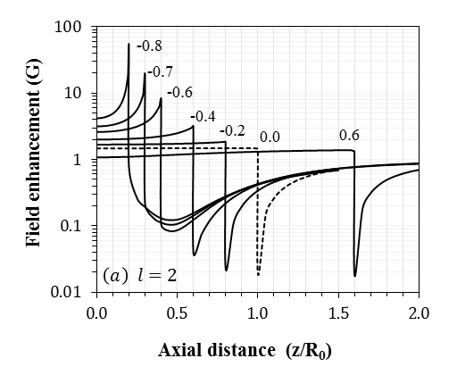
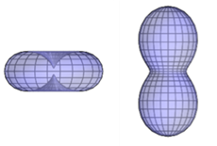
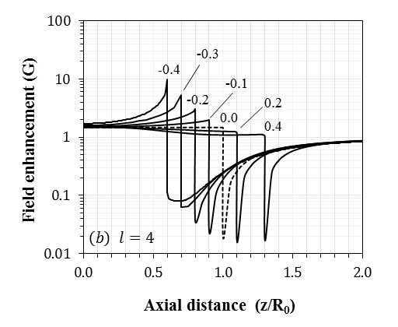
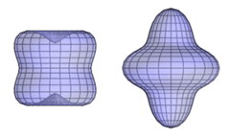
Extrapolating to More Extreme Deformation
Estimate field enhancement for extreme deformation
Conditions
  isolate pure modes, l = 2,4
  measure axial field along axis of symmetry
Observations
  field enhanced for negative b_{l}
  field depressed for positive b_{l}
  dramatic increase in field enhancement as shape contracts
E₀ z
b₂ = -0.8-0.6
b₂ = -0.8
b₂ = 0.8
b₄= -0.4-0.4
E could be enhanced by a factor of 10-50 in the bubble!!
b₂ = -0.4
b₂ = 0.4

Slide 9

Plasma Ignition in Gas Bubbles can be Aided by Enhancing the Electric Field in The Bubble
Field distortion can be achieved by distorting the dielectric boundary between the bubble gas and fluid.
Field enhancement is dramatically increased near high curvature boundaries
The enhancement for a gas sphere in water is 3/2
Azuma H, Jour. Fluid Mech. 1999
ε_{out}
ε_{in}
Large curvature at the boundary can dramatically enhance the local field
shape distortion
Shape 1
Shape 2

Slide 10
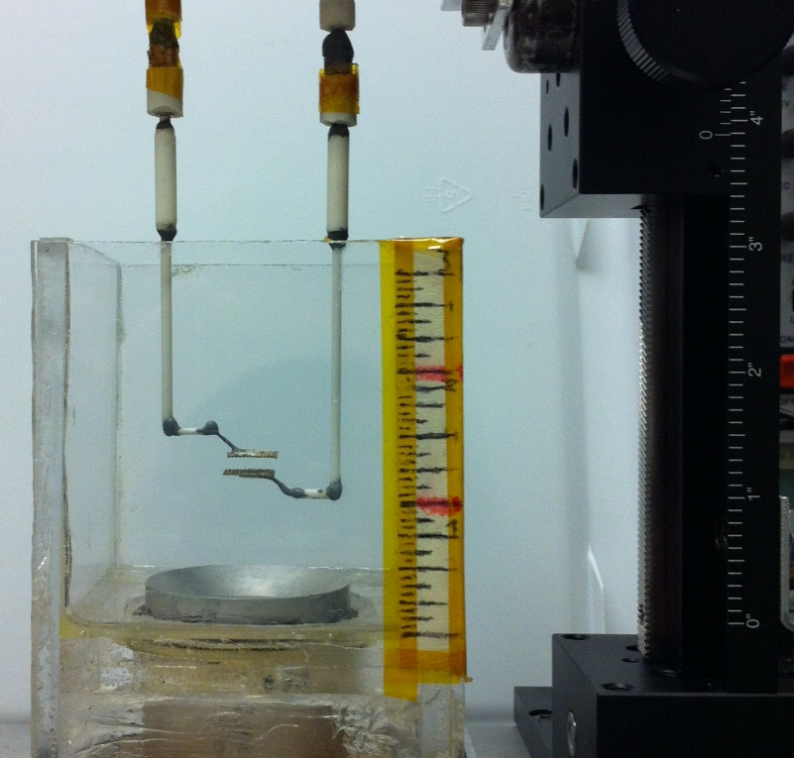
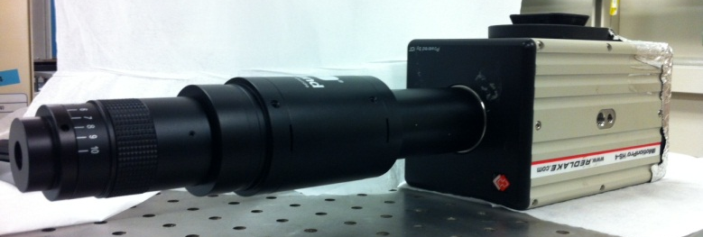
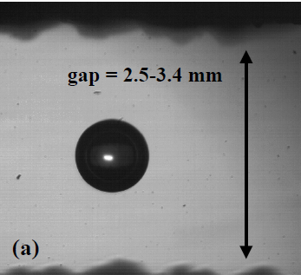
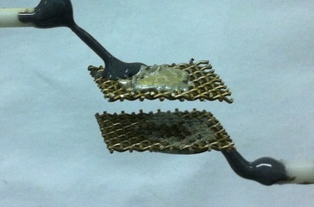
Experimental Approach
Purpose:
  study isolated bubble under repeatable conditions
  measure shape distortion from an applied electric field
  Ignite plasma in isolated bubbles
Approach
  Acoustic wave excited by ultrasonic transducer
  Bubble trapped in the node of a 26.4 kHz sound field
  Electrodes placed around bubble and used to drive shape distortions with electric field
2-D positioning stage
ultrasonic transducer
telescoping lens + high speed camera
wire mesh electrodes

Slide 11
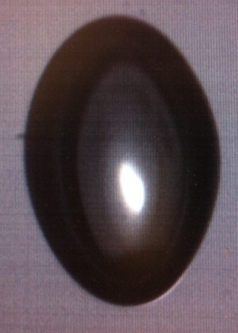
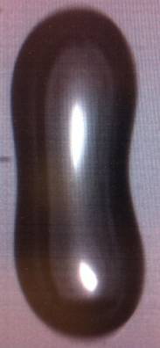
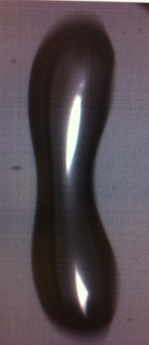
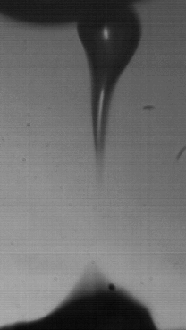
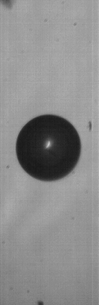
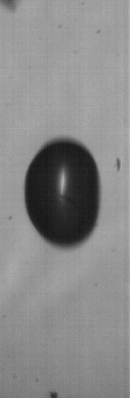
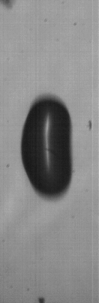
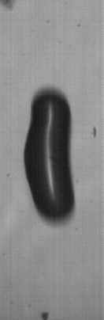
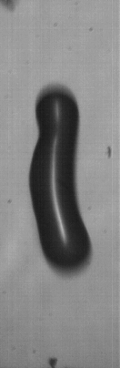
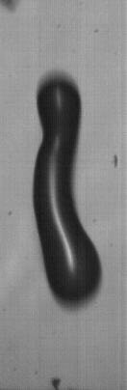
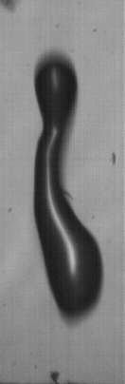
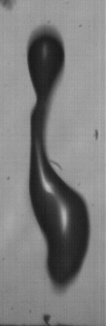
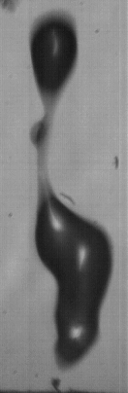
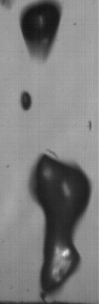
Bubble Breakup at High Field Strengths
Field enhancement should be intense in highly contracted areas
E = 7.3 kV cm⁻¹
W_{e} = 2.6
E = 14.6 kV cm⁻¹
W_{e} = 9.7
E = 21.2 kV cm⁻¹
W_{e} = 22
E = 25 kV cm⁻¹
W_{e} = 28
40 us per frame
3.0 mm
E = 25 kV cm⁻¹
3.0 mm
0 us
160 us
360 us

Slide 12
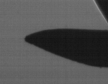
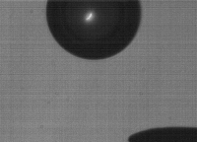
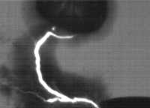
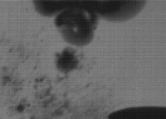
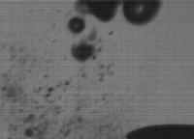
Liquid Streamer-Bubble Interactions
R_{tip} ~ 100 um
Liquid streamers can be ignited by intense fields (~ 1MV/cm) at sharp electrode tips
streamer-bubble interactions are characterized by violent, anisotropic energy transfer
E_{tip} ~ V/R_{c}
E_{tip} ~ 1.2 MV cm⁻¹
streamer bends to make contact with bubble
bubble is immediately destabilized
0.9 mm
0 us
56 us
112 us
168 us
V = 12 kV, τ_{pulse} = 1 μs, τ_{rise} = 100 ns

Slide 13
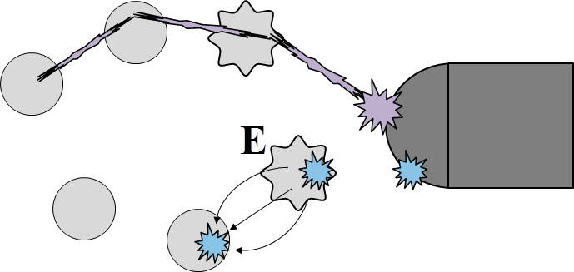
Towards plasma in isolated bubbles...
Goal: enhance plasma production in liquids by igniting plasma in isolated bubbles
Isolated bubbles offer…
  high E/N medium
  increased penetration of radicals
  minimized erosion effects
plasma ignited via one of two mechanisms
  Bubble directed liquid streamer
  Plasma “hopping” between isolated bubbles
bubble directed streamer plasma
bubble “hopping” plasma
In both cases, field enhancement resulting from shape distortion aids in plasma ignition

Slide 14
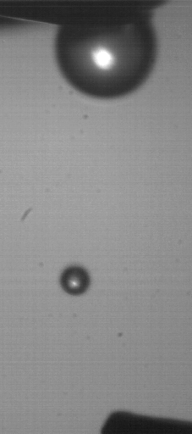
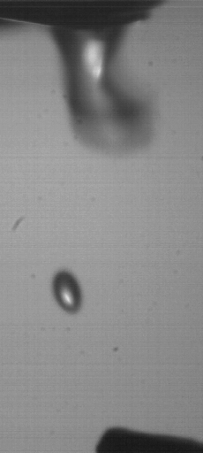
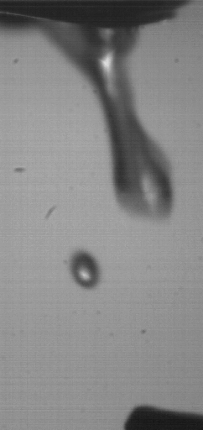
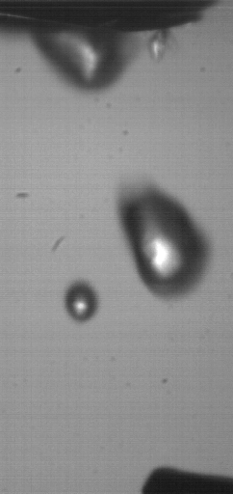
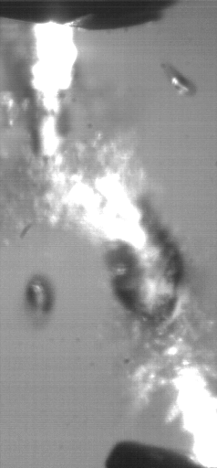
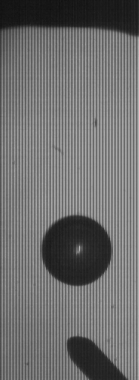

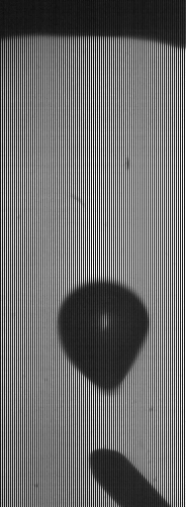
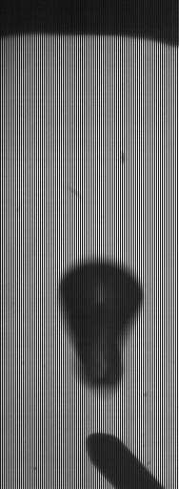
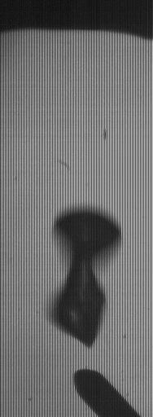


Influence of Bubble Shape on Streamer Ignition & Propagation
Distorted bubble shapes can be used to extend liquid streamers (and radical production) far into processing volume
Operating conditions
  Point to plane geometry
  voltage: 11.2 kV
  pulse length: 1 ms
3.0 mm
0 us
150 us
300 us
450 us
600 us
distorted dielectric geometry induces spark between electrodes
Intense fields deform bubbles
3.0 mm
0 us
75 us
150 us
225 us
300 us
375 us
450 us

Slide 15







Plasma Formation in Gas Bubbles
Intense field pressure at streamer head (100s kV cm⁻¹) excites local distortions
streamer excites high k oscillations on bubble surface (capillary waves)
Capillary oscillations are characteristic of streamers excited in bubbles attached to an electrode
V = 12 kV
bubble stretches in response to field
high k ( < 10 um) oscillations spontaneously excited
Observation of similar behavior in pulsed detached bubbles indicates the successful ignition of plasma in isolated bubbles
0 us
200 us
400 us
600 us
800 us
1000 us
V = 12 kV

Slide 16




0.0 us
160 us
320 us
480 us
0.5mm gap
streamer leaves “abscess” track along the bubble’s body
streamer bridges gas bubble and H.V. electrode

