Slide 1
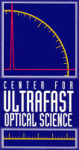
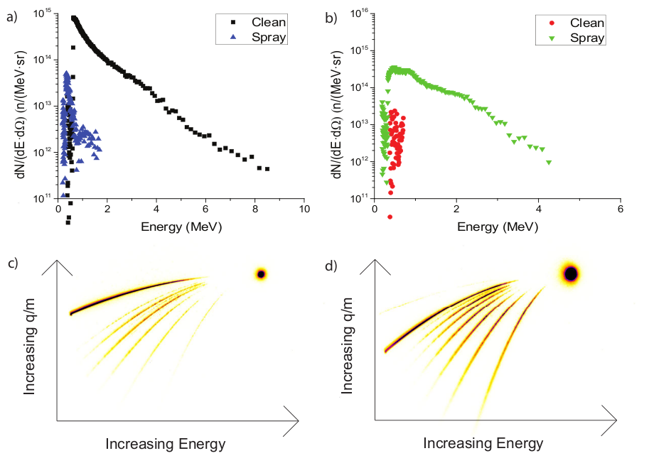
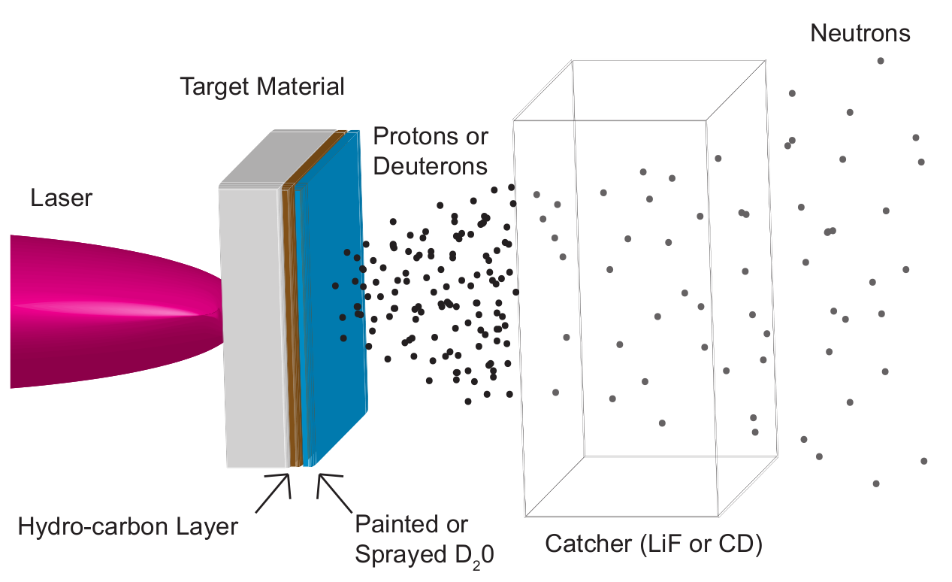
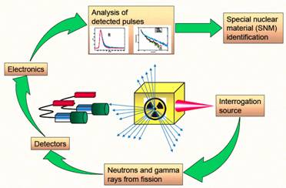
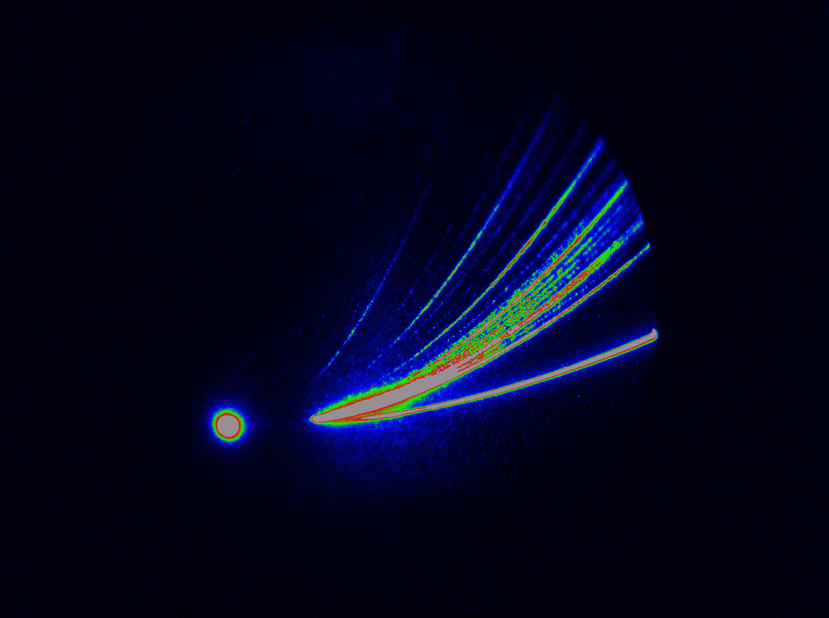
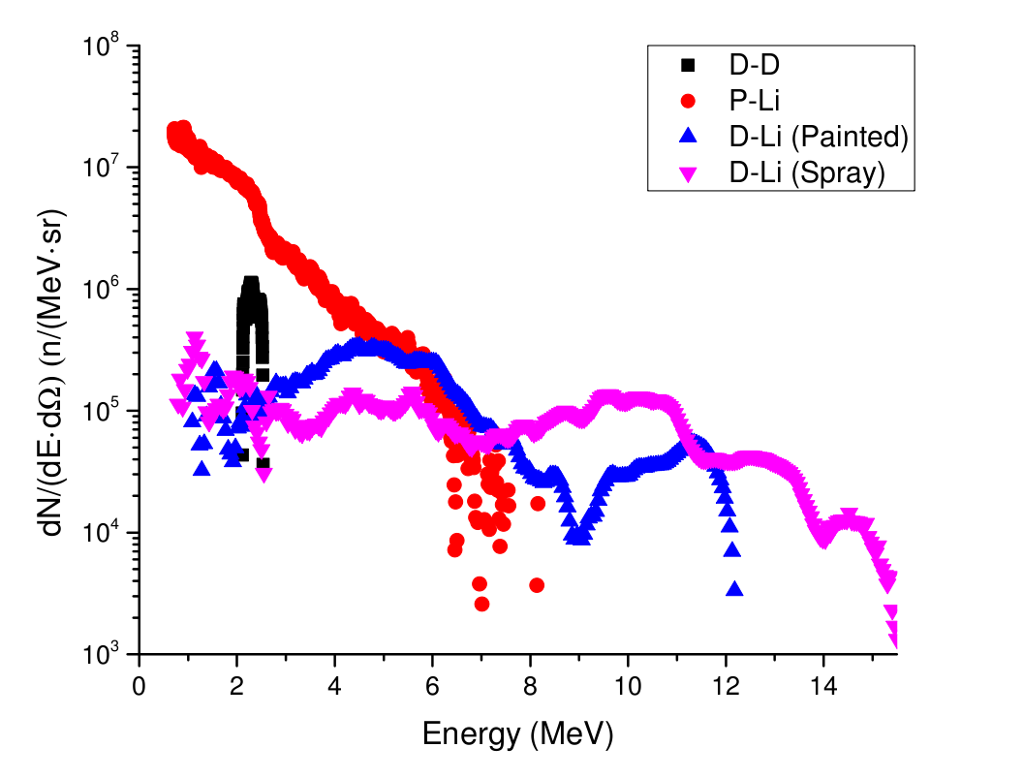
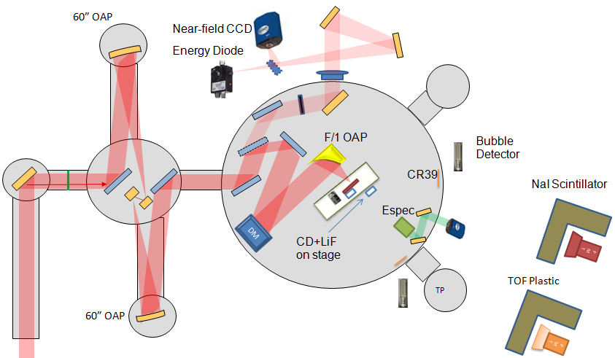
Neutron Generation Using Ultra-Intense Laser Plasma Interactions
C. Zulick¹ , F. Dollar¹ , J. Davis² , V. Chvykov¹ , G. Kalintchenko¹ , A. Maksimchuk¹ , G. M. Petrov² , A. G. R. Thomas¹ , L. Willingale¹ , V. Yanovsky¹ , and K. Krushelnick¹
¹Center for Ultrafast Optical Science, University of Michigan
²Plasma Physics Division, Naval Research Laboratory
Abstract: Fast neutrons (> 1 MeV) have important applications in biological imaging, materials testing, and active interrogation for homeland security. The generation of energetic neutrons is non-trivial since they are uncharged (no E-M acceleration) and require nuclear reactions to generate isolated neutrons (t1/2 = 881 s). Additionally, nuclear reactions tend to be isotropic, but directionality of the neutron beam is preferred for the efficient and selective use of neutrons. Experiments at the HERUCLES laser facility produced neutrons with energies up to 15 MeV in directional beams utilizing ²d(d,n)³ He, ⁷Li(p,n)⁷ Be, and ⁷Li(d,n)⁸ Be reactions. The neutrons were produced in a two-stage pitcher-catcher configuration by accelerating protons and deuterons from micron scale solid targets into bulk CD and LiF. The neutron yield was measured to be 2.3 (+/- 1.1) x 10⁷ neutrons / sr.
Applications of Laser Produced Neutrons: The generation of directional neutron beams using laser based acceleration mechanisms offers an alternative means to RF accelerators for the generation of fast neutrons. The primary advantage of laser based techniques is the reduction of the charged particle acceleration distance from meter scale to millimeter scale due to the high electrical fields supported by plasmas. Fast neutron beams can be used for neutron radiography [1], imaging [2], fast neutron therapy [3], and active interrogation. Neutron beams are of special interest for the detection of shielded Special Nuclear Material because neutrons can penetrate the high Z shielding materials used to masking gamma ray signals from passive radiation detectors and induce fission events which produce a detectable neutron signal.
Proton and Deuteron Acceleration: Ions are accelerated during laser-plasma interactions through Target Normal Sheath Acceleration (TNSA). During TNSA an accelerating sheath field is established by hot electrons which preferentially accelerates light ions on the rear surface of the target. Organic contaminants present on all targets (which have not undergone extensive cleaning techniques) supply protons for typical experiments. In this experiment the target material (2 μm Al) was cryogenically cooled and D₂0 was sprayed into the chamber to form a thin heavy water ice layer on the surface of the target. The resulting ion spectra are shown to the right.
Protons Deuterons
Images from Pozzi et. al.
Neutron Generation: Neutrons were generated with the fusion reactions listed in Table 1. The deuteron reactions have the advantage of positive Q values (energy is released during the reaction) which provides an additional source of kinetic energy to the neutrons. The expected ⁷Li(d,n)⁸Be neutron spectra exhibits two energy peaks which are a result of the “traditional” two body interaction and a “stripping” reaction of the loosely bound deuteron which results in a neutron energy of E_{d}/2 [5].
Neutron Diagnostics: The primary neutron diagnostics were neutron time-of-flight (nToF) detectors comprised of organic scintillators coupled to photo-multiplier tubes. A combination of Ø16 cm and Ø35.5 cm scintillators were used at distances of 2.75, 3.28, 5.63, and 9.19 meters from the target interaction to allow the nToFs to measure neutrons with energies from 0.5 to >20 MeV. The neutron flux was measured with BD-PND bubble detectors from Bubble Technology Industries. The bubble detectors contain droplets of superheated liquid which are suspended in an inert gel. The detectors were sensitive to neutrons with energies between 200 keV and 15 MeV.
Experimental Setup and Background: The experiment was performed using the HERCULES laser facility at the University of Michigan. HERCULES is a Ti:sapphire system (λ = 800 nm) producing laser pulses with t = 40 fs duration full width at half maximum and an amplified spontaneous emission intensity contrast of 10⁻¹¹ [4]. An additional contrast improvement to <10⁻¹⁵ is provided by a pair of antireflection coated BK7 glass substrates that act as plasma mirrors. The laser delivered 2 (0.75) J to the target with 55% of the energy in a 1.3 μm FWHM focal spot via an f /1 off-axis parabolic mirror. This results in an average on-target intensity of 1x10²¹ W/cm² (a₀ = 27). A near diffraction limited spot size with a Strehl ratio of 0.6-0.75 was attained by using a deformable mirror (Xinetics) and a Shock-Hartmann wave front sensor, which were used to correct aberrations predominantly from the off-axis parabolic mirror.
Separation by q/m
Inert matrix (polymer or gel)
B
Neutrons can provide nucleation trigger
The neutron spectrum (pictured below) illustrates the differences between the various nuclear reactions. The highest energies (15 MeV) were observed with the positive Q value ⁷Li(d,n)⁸Be reaction and the shape was similar to simulated spectra. The ⁷Li(p,n)⁷Be reaction produced the highest yield as a result of the robust, and well developed, proton acceleration techniques, while the deuteron acceleration can still be optimized (layer thickness, temperature).
B
Increasing energy
Droplets of superheated liquid (e.g. Freon)
E
Bubbles of trapped vapor
Laser Diagnostics
Summary: Laser produced neutrons have been characterized on the HERCULES system.
Deuterons have been accelerated through the formation of a heavy ice layer.
Neutron energies up to 15 MeV and fluxes up to 1.3 (+/- 0.6) x 10⁶ n/sr have been measured.
Neutron spectral shapes agree with the predicted and simulated spectra .
Future experiments will utilize the neutron beam for (n,f) interrogation of ²³⁸U.
Particle Diagnostics
Plasma mirrors
References:
[1] L. J. Perkins, et.al., Nucl. Fusion 40,1 (2000)
[2] M. Borghesi, et. al., PPCF 12A (2001)
[3] L. H. Gray, J. Read, Nature (London) 3845, 53 (1943)
[4] V. Chvykov, et.al., Opt. Lett. 31 10 (2006)
[5] P. Pereslavtsev, et. al., NIMPR B 266 3501 (2008)
This work was supported by the National Science Foundation (NSF) through the FOCUS Physics Frontier Center PHY-0114336, and by the Department of Homeland Security and NSF through grant EECS-0833499.

