Slide 1
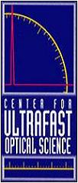
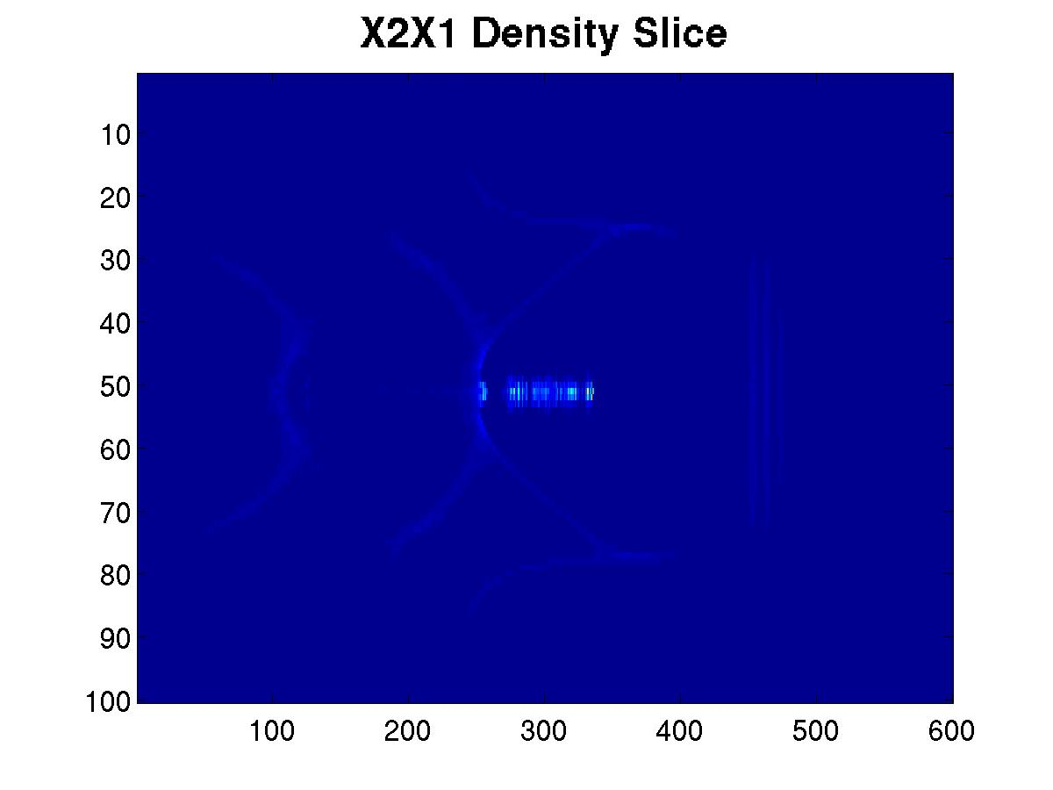
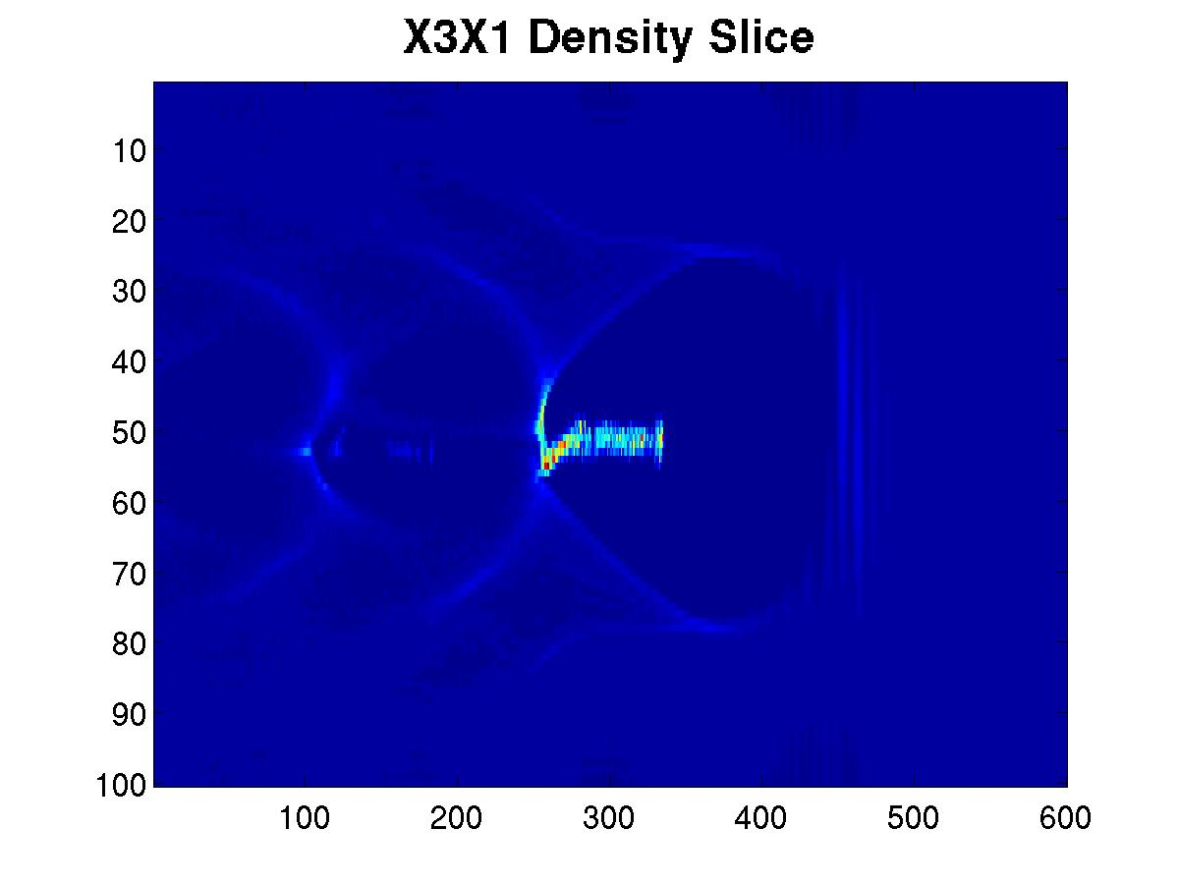
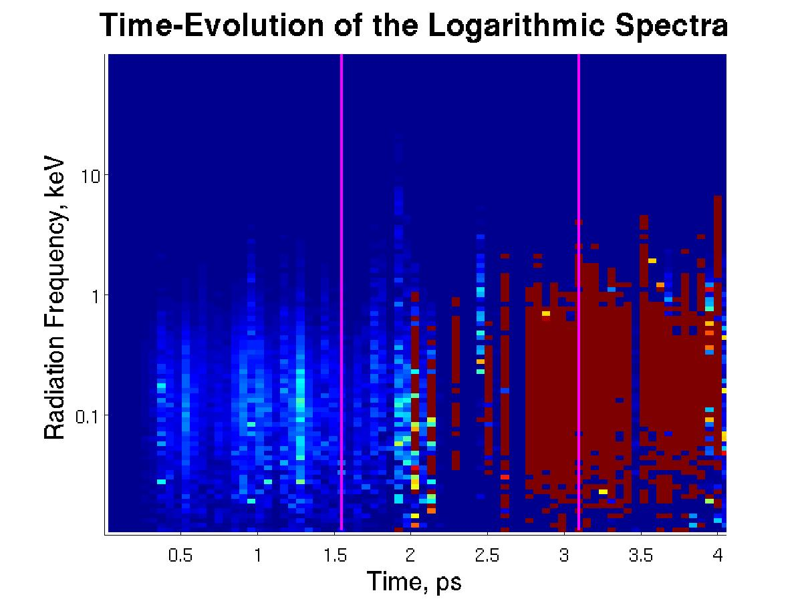
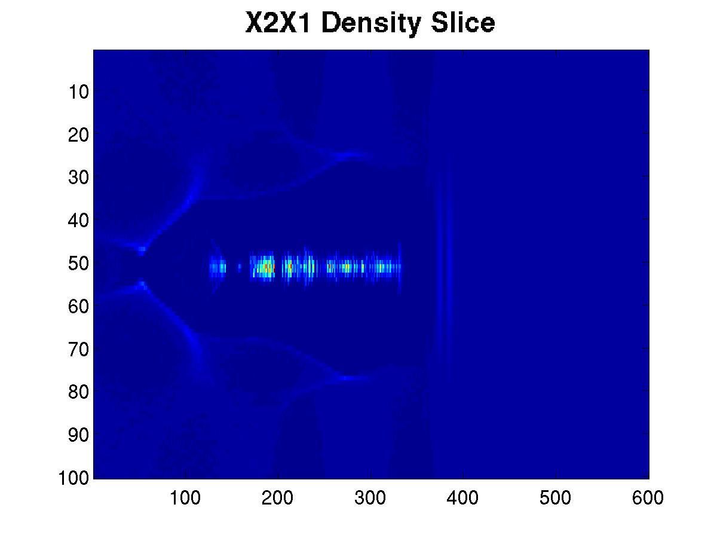
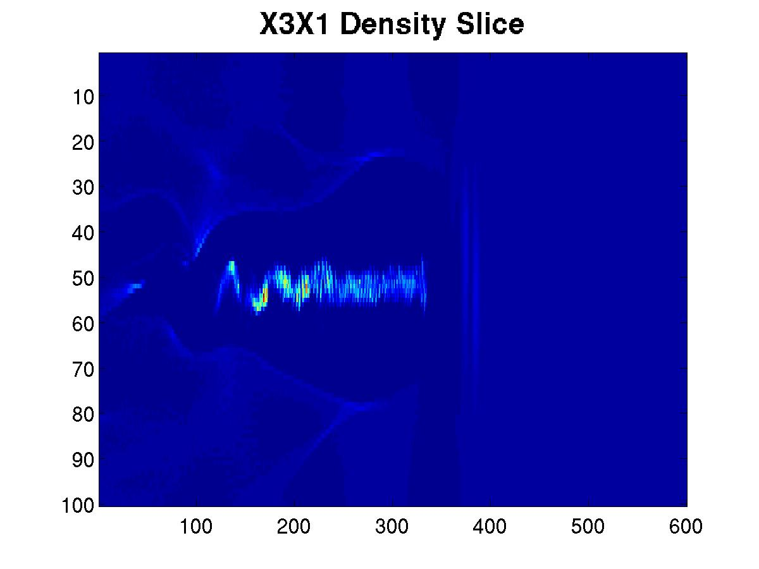
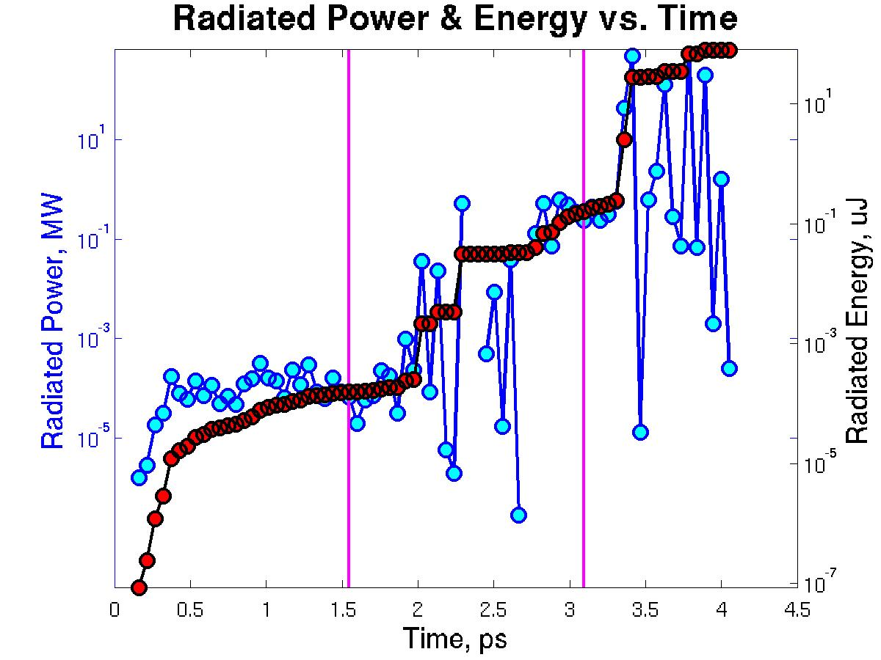
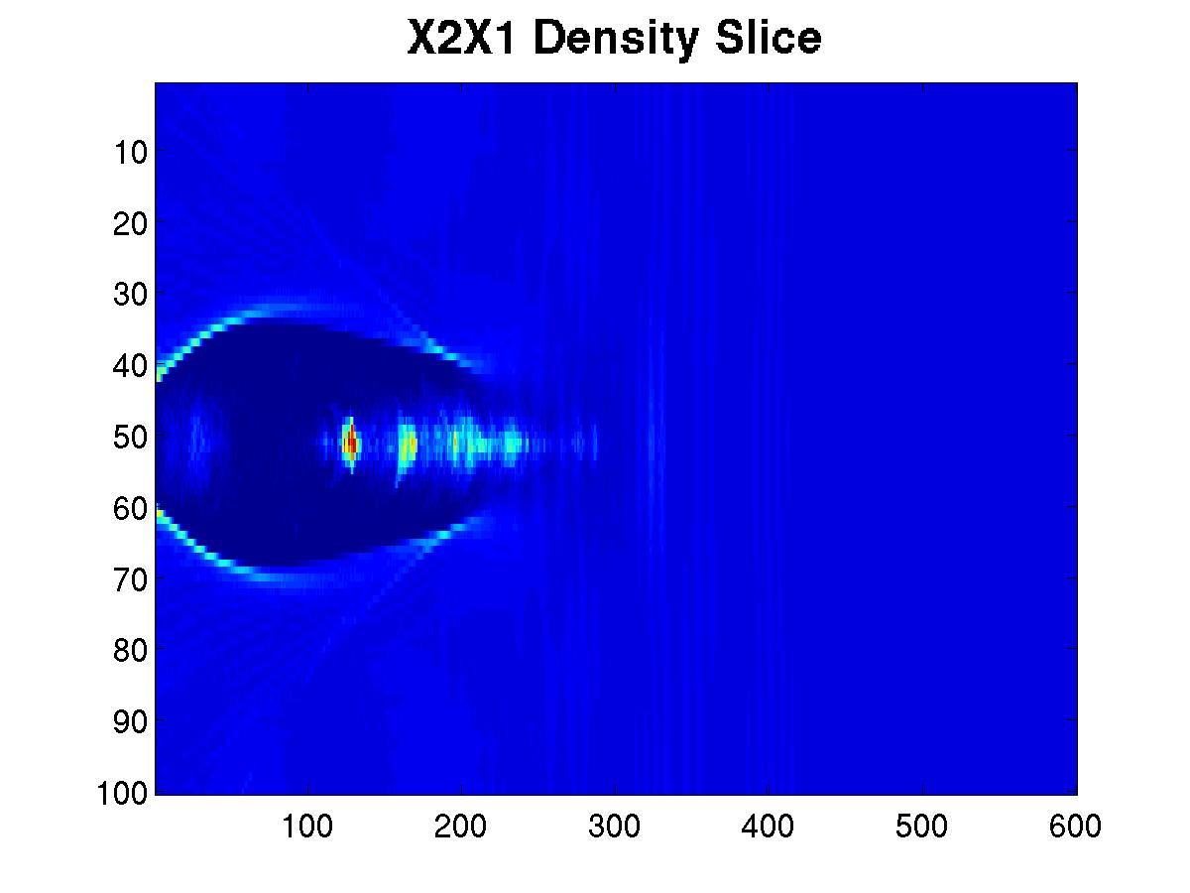
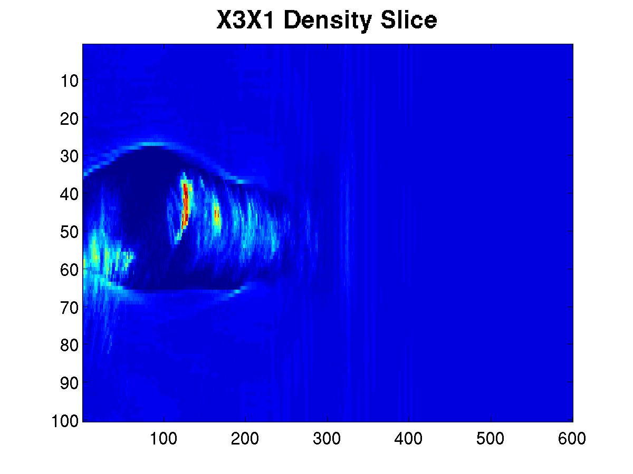
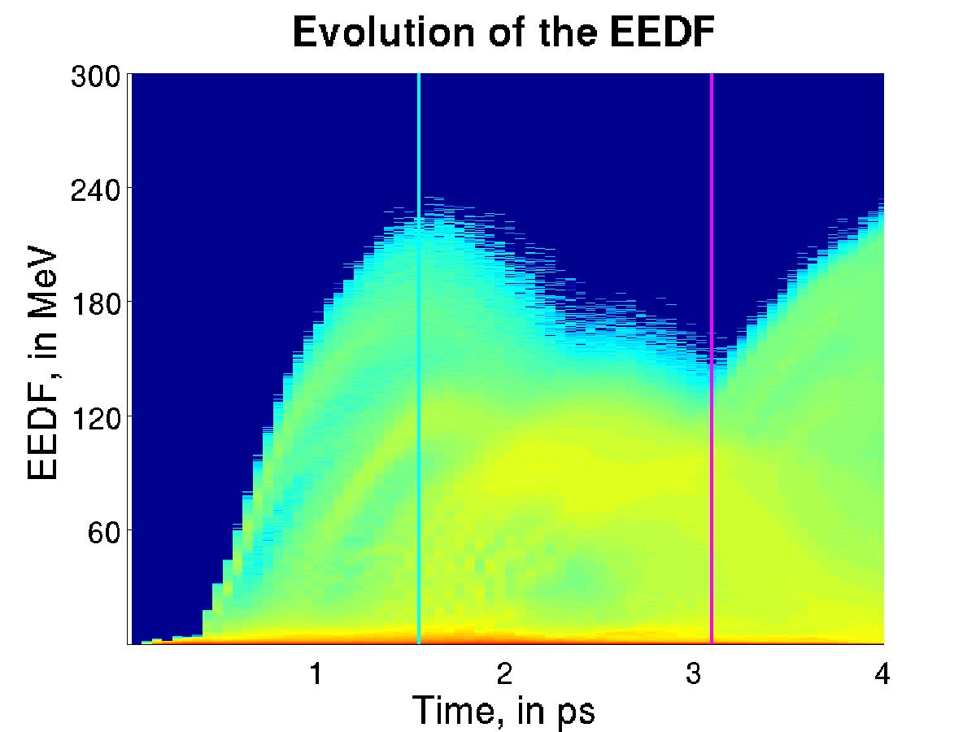
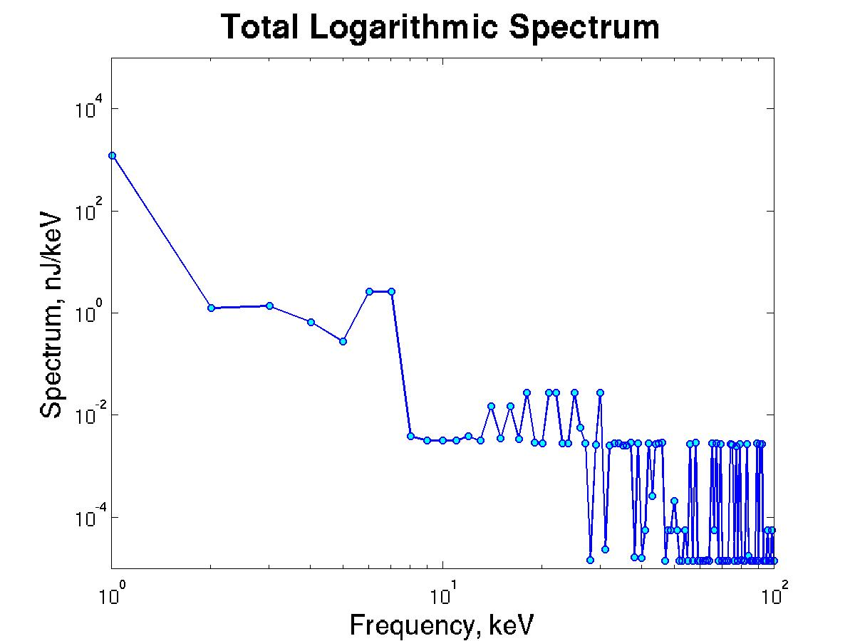
SIMULATIONS FOR THE ELUCIDATION OF ELECTRON BEAM PROPERTIES IN LASER-WAKEFIELD ACCELERATION EXPERIMENTS VIA BETATRON AND SYNCHROTRON-LIKE RADIATION
P. G. Cummings, A. G. R. Thomas
Center for Ultrafast Optical Science, University of Michigan, Ann Arbor, MI, USA
Abstract
Simulation Results
A promising application of laser-wakefield acceleration (LWFA) technology is as a tunable source of x-ray and gamma radiation via synchrotron radiation. Such a source could have many potential applications, including microscale imaging of advanced composite materials. Consequently, the generation of synchrotron radiation in LWFA experiments is investigated computationally using the particle-in-cell simulation code OSIRIS 2.0. In LWFA systems, electrons are accelerated by an electrostatic “bubble” structure established by the propagating laser pulse, over a distance known as the dephasing length, L_{d}. The bubble structure’s fields not only accelerate, but axially focus the beam; consequently the electron beam naturally undergoes betatron oscillations while being accelerated within the bubble. Once the beam passes the dephasing length, it eventually re-enters the plasma and undergoes a hosing instability. This instability causes a dramatic increase in the magnitude of the beam's betatron oscillations. Consequently, radiation emission in LWFA experiments can be controlled by varying the propagation distance of the laser pulse. The particle-in-cell code OSIRIS 2.0 was modified with a novel model for explicitly simulating synchrotron radiation to investigate this phenomena computationally. A parameter sweep was performed, varying the propagation distance of the simulation from 0.75L_{d} to 4.0L_{d}. The results from this parameter sweep are presented and discussed.
X2X1 Slices
X3X1 Slices
Radiation Data
The evolution of the radiation spectrum produced by the system’s betatron radiation.
Note that, as the system passes the dephasing length and undergoes a hosing instability, the peak energy decreases while the total energy emitted increases.
Frame 24, 1.28 ps
Laser Wake-Field Acceleration
Frame 42, 2.24 ps
a
The evolution of the radiation spectrum produced by the system’s betatron radiation.
Note that, as the system passes the dephasing length and undergoes a hosing instability, the peak energy decreases while the total energy emitted increases.
Gas jet
Ultrashort (~10-100 fs) laser pulse
Generated X-Ray beam
-In LWFA, an ultrashort (~10-100 fs), high-intensity (10²⁰-10²² W/cm²) laser pulse is focused onto a gas jet
-The nonlinear plasma wake traps an accelerates electrons to high energies (~100-1000 MeV)
-The accelerating fields also provide a focusing effect
-Consequently, the electrons undergo betatron motion as they are accelerated
-The system emits synchrotron-like radiation from this process
Frame 71, 3.79 ps
The evolution of the system’s betatron motion in both the X2 and X3 planes, showing three distinct regimes of betatron amplitude
Time Evolution of the EEDF
Simulation Parameters
Future Work
Grid: 1200 x 200 x 200 cells
Box Size: 300 x 200 x 200 normalized length units
Box Size: 39 x 26 x 26 μm
Particles Per Cell: 2
Moving Box
Pulse Peak Normalized Vector Potential: 4.0
Spot Size (FWHM): 5.2 μm
Pulse Duration (FWHD): 28 fs
Peak Intensity: 3.38 x 10¹⁹ W/cm²
Peak Power: ~30 TW
Pulse Energy: ~0.8 J
-Additional parameter sweeps will be performed, looking at the relationships between the emitted radiation and other LWFA parameters
-Parameter sweeps over the normalized vector potential a0 and electron momentum phase-space are both currently being investigated
In the above plot, the blue line shows the point where the system passes the dephasing length L_{d}, and the magenta line shows the point where the system passes twice the dephasing length, 2L_{d}

