Slide 1
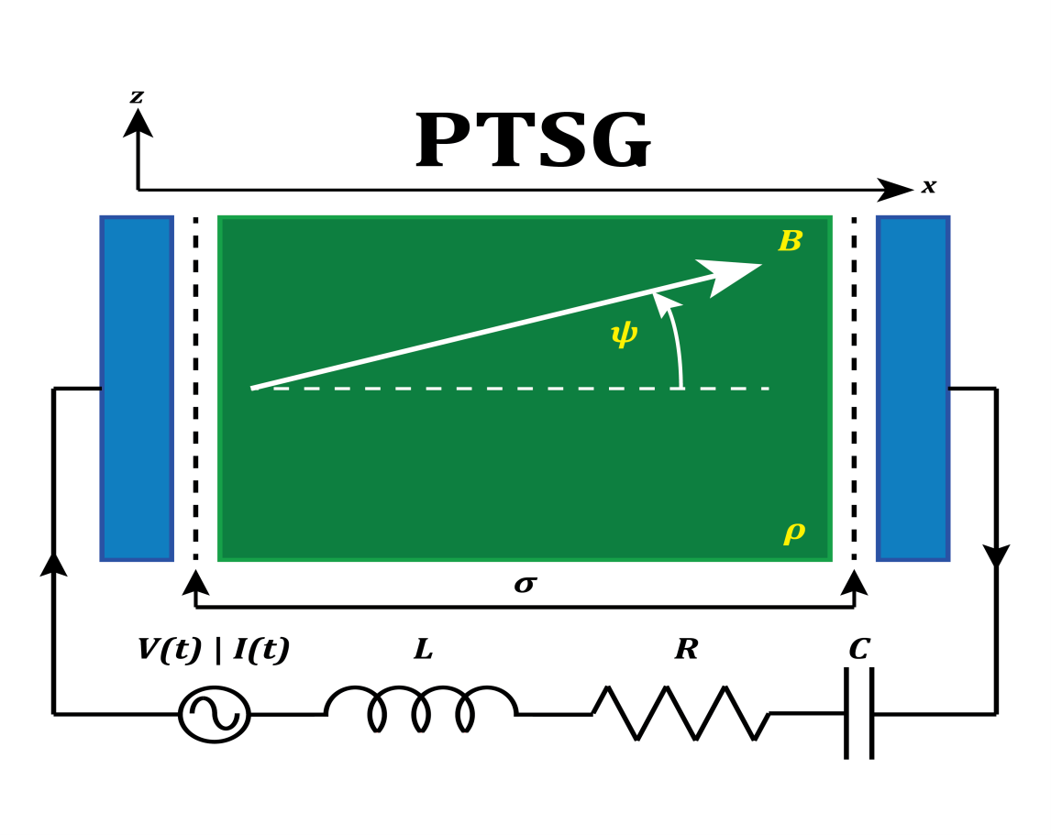
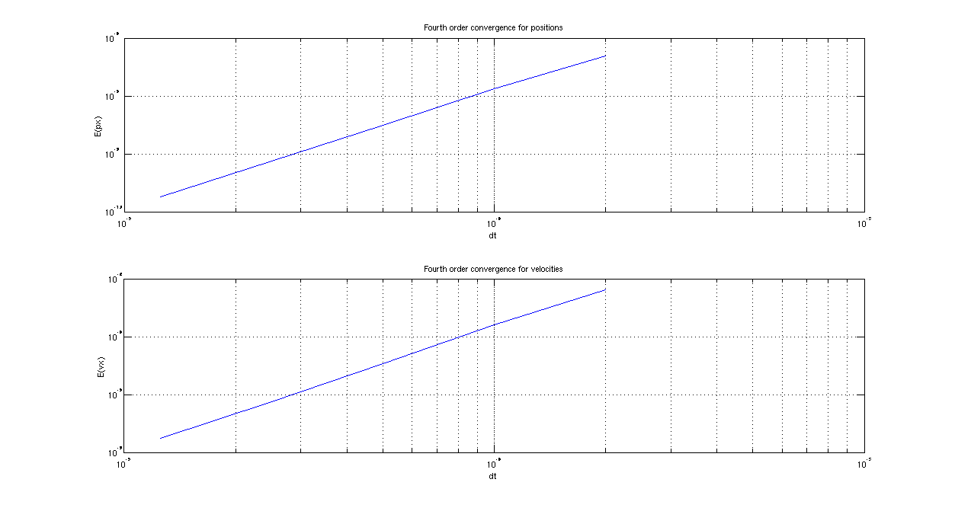
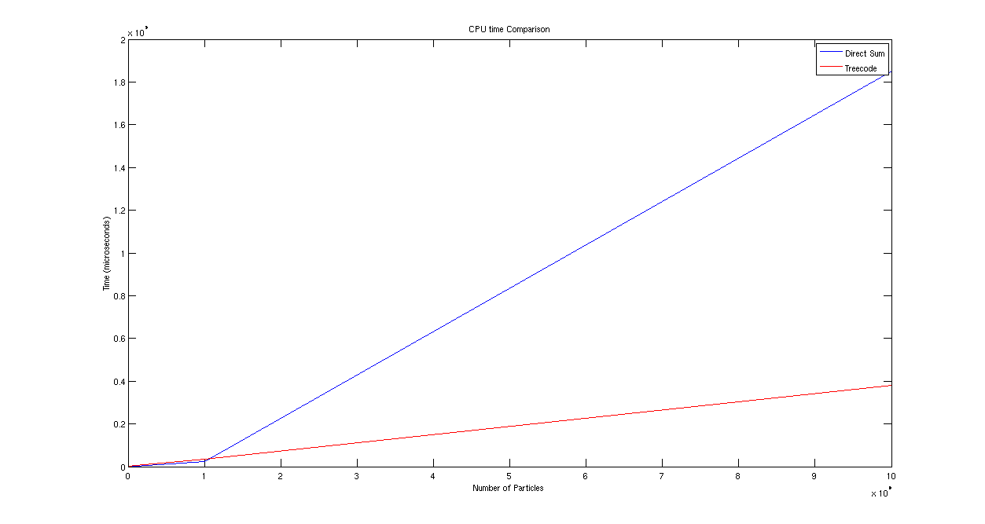
Modeling and Simulation of Strongly Coupled Plasmas
Mayur Jain, John Verboncoeur, Andrew Christlieb
[jainmayu, johnv, christli]@msu.edu
Supported by AFOSR
Abstract
Point Cluster Interaction :
The potential ϕ_{P}(y) is first expressed as
Cr = x_{j}|x_{j} ∈ C_{r} and x_{j} ∈ {∪_{s} C_{s} \ C_{r} } denotes a cluster of particles and ϕ_{i} (y,C_{r} ) is the potential at point y due to cluster C_{r} .
Green’s function Taylor expanded about cluster center x_{cr}
p order of approximation
T_{l} (x_{cr} , y) lth Taylor coefficient of the Green’s function.
M_{l} (C) lth moment of the cluster.
Cluster moments independent of y, while the T_{l} (x_{cr} , y) independent of number of particles in C_{r}
Present Work :
Treecode:
Barnes-Hut treecode clever groups together nearby bodies.
Recursively divide set of bodies into groups, store in trees.
Topmost node is whole space, children quadrants of space.
Entire space subdivided into quadrants.
Each subdivision contains fewer than a chosen maximum.
Empty quadrants acceptable.
Net force calculated by traversing nodes from root.
If internal node’s center of mass far, consider single body at group’s center of mass and weighing total mass.
Fast because individual bodies not examined.
If internal node too close, recursively traverse each of its subtrees.
To determine if node far away, compute r / d, where r width of internal node, d , distance between body and node’s center-of-mass.
Compare against threshold value θ.
If r / d < θ, internal node far away.
Adjusting θ , changes speed and accuracy.
Also, Direct summation method O(N² ) for the N body problem has been studied with the Runge Kutta 4 system
Fourth order convergence for RK4 integrator:
Cpu time comparison between direct sum and treecode:
This work focuses on the development of new modeling and simulation tools for studying strongly coupled plasmas (SCP) as strongly coupled plasmas differ from traditional plasmas in that the potential energy is larger than the kinetic energy. A standard quasi neutral plasma approximation is inadequate in this case.
In addition to the possibility of quantum effects, the standard quasi neutral plasma model does not account for two major effects in SCP:
The change in the permittivity for modeling electromagnetic waves.
The impact on relaxation of charged particles undergoing Coulomb collisions in a system with weakly shielded long range interactions.
Our objectives will be met through the development of:
Electrostatic particle based models based on PIC and the Boundary integral Treecode (BIT) methods.
Electromagnetic particle based models based on PIC and new implicit particle methods based on treecodes.
Continuum models where long range correlation is incorporated through fractional derivatives in time.
Electrostatic particle based models
Developing Boundary Integral Treecode (BIT) models for ultra cold SCP:
Simulating resolved SCP with boundary conditions.
BIT is mesh free.
Resolved PIC needs fine mesh with boundary conditions.
Treecode algorithm reduces O(N²) to O(N log N).
Particles divided into a hierarchy of clusters.
Particle-particle replaced by particle-cluster interactions.
Evaluated using multipole expansions.
Barnes and Hut used monopole approximations and divide-and-conquer evaluation.
BIT, ideal for SCP, only consists of 10⁸ atoms.
BIT – Grid Free Approach:
One to one representation of ultra cold SCP.
Each particle representing physical particle.
Naturally resolves long range interactions.
Grid free approach starts by casting the Poisson's equation in integral
where y ∈ Ω\∂Ω and G(x|y) is the free space Green’s function.
volume integral ϕ_{P}(y) : particular solution
boundary integral ϕ_{H}(y) : homogeneous solution
So, ϕ(y) = ϕ_{P}(y) + ϕ_{H}(y).
Depending on boundary conditions, ϕ_{H}(y) can be modeled as a single layer or double layer potential.
Future Work
Regularization of the kernels to avoid singularity of the electrostatic potential as the distance becomes zero.
Studying electron-electron, ion-ion and electron-ion correlation functions.
Employing Taylor expansion coefficients of order p for the multipole approximation of the treecode for better accuracy
Including momentum dependent potentials based on Pauli potential and Heisenberg potential in the treecode and comparing it with the direct summation method with Coulomb’s law.
r
d
References
[1] J.Barnes and P. Hut. A hierarchical o(nlogn) force-calculation algorithm. Nature 324,(1986)
[2] A.J. Christlieb, R. Krasny, J.P. Verboncoeur, J.W. Emhoff, and I.D. Boyd, Grid-free plasma simulation techniques, IEEE Transactions on Plasma Science 34 (2006).
[3] W. Dehnen, A hierarchical (n) force calculation algorithm, Journal of Computational Physics 179 (2002).

