Slide 1
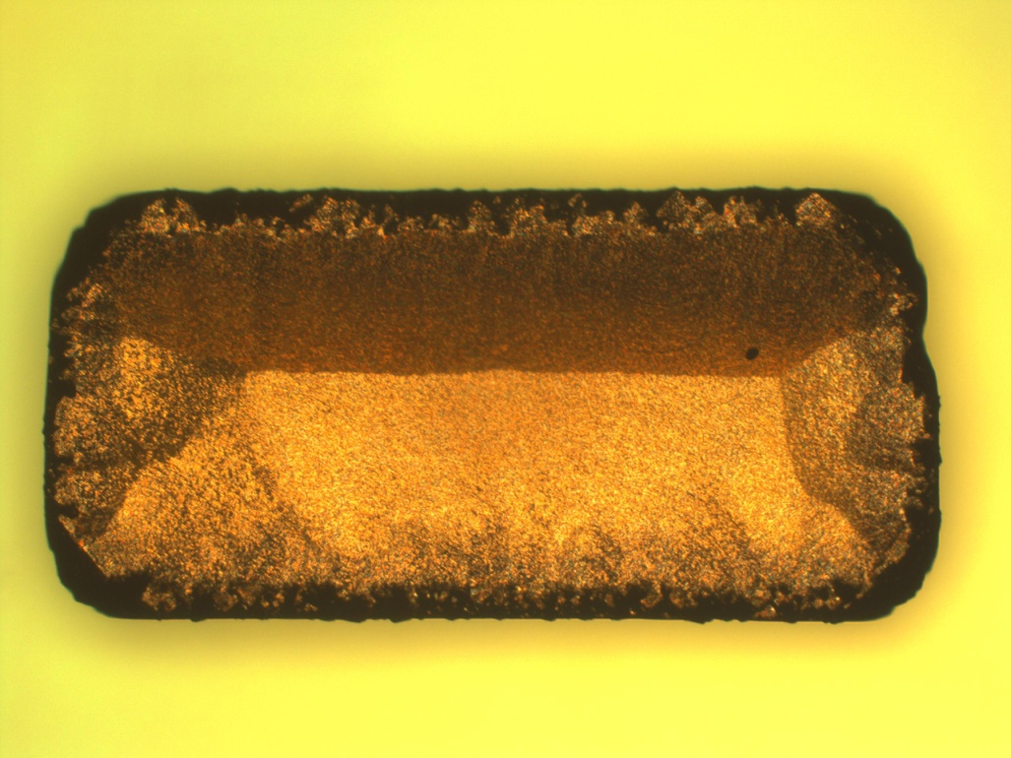
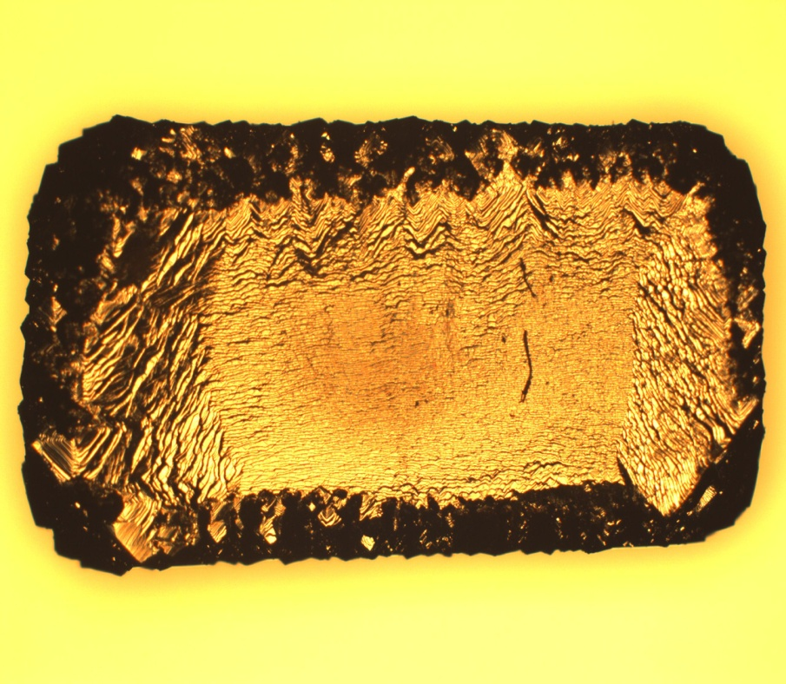
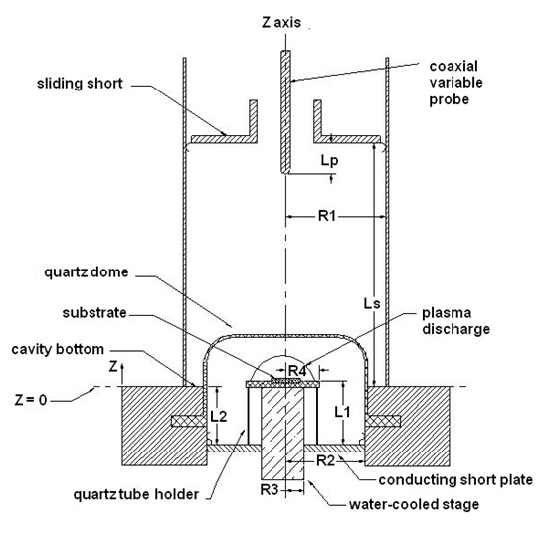
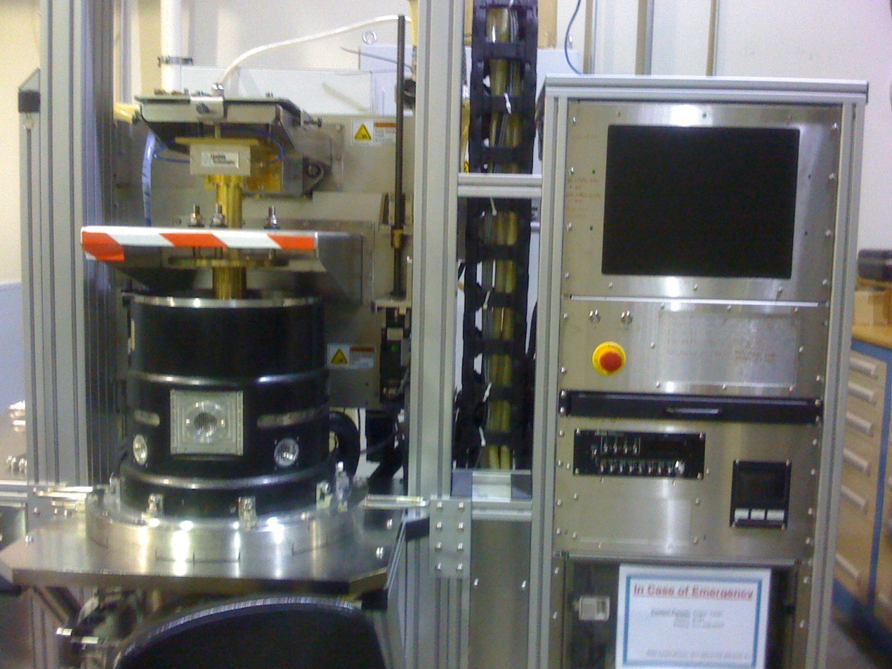
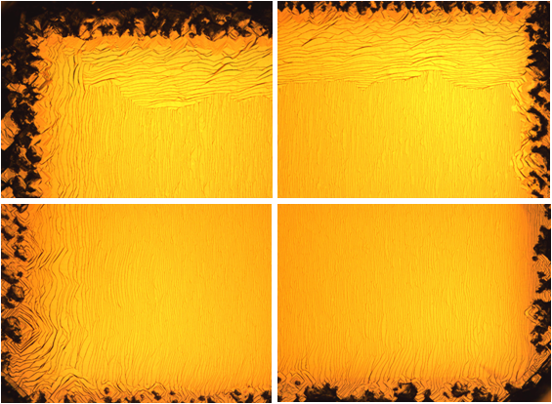
Growth and Analysis of Large Undoped Single Crystal Diamond Substrates Using Microwave Plasma-Assisted Chemical Vapor Deposition (MPACVD)
Shreya Nadª, Yajun Guª, Jes Asmussen^{a.b},
a) Michigan State University, East Lansing, MI 48824, USA;
b) Fraunhofer USA Inc., Center for Coatings and Laser Applications, East Lansing, MI 48824, USA
Introduction:
Single crystal diamonds (SCDs) play an important role in the electronic and semiconductor industries. Characteristics of SCDs like high thermal conductivity, high electric breakdown field and a wide bandgap makes them attractive for applications in high power electronics, as heat spreaders and radiation detectors. It is thus important to synthesize large single crystal diamond substrates for future applications.
Experimental Variables:
Fixed variables – (short length) Ls ≅ 21.6 cm, (probe Length) Lp ≅ 3.6 cm, L2 ≅ 5.86 cm, L1 ≅ 5.411 cm and (substrate position) Zs ( = L1 – L2) ≅ -4.49 mm, H₂ flow rate = 400 sccm
Internal Variables – Pressure = 240 Torr, % CH₄/H₂ = 5-7 %, growth time = 8-12 hours in reactor B and 72 hours in reactor C.
Objective:
Currently commercially available SCDs are limited in size (<1 cm²) and quality. The long-term objective of this project is to synthesize high quality (< 50 ppb nitrogen concentration impurity levels, without threaded dislocations and other defects), low birefringence, freestanding (> 400 µm) SCD substrates with a grown area of > 1cm². We are presently exploring the process of synthesizing high quality SCD on top and on the sides of HPHT seeds. These two steps are necessary in order to grow large single crystal diamond substrates with minimum defects.
Main Idea: Flip-growth method –
This method entails flipping the growth surface by 90° while keeping the <100> growth direction as described in figure 3. It will prevent propagation of threaded dislocations originating from the HPHT seed. The first step is to grow high quality SCD.
Dislocations minimized
No N₂
Fig. 3 – Flip-growth method
Results:
1. Side seed growth –
Initial experiments explored the possibility of depositing uniform and smooth SCD on the side of HPHT seeds. Figure 4 shows some results from reactor B with p = 240 T, %CH₄/H₂ = 5%, growth time = 10 hours and growth rate = 30–35 µm/hr.
Systems Used:
Fig.4 – single crystal diamond on side of HPHT seeds
2. Top surface growth –
Figure 5 shows SCD grown at 240 T, with 5% CH₄ and a growth time = 8 hours. The surface shows a step-like growth of SCD implying the high uniformity and smoothness of SCDs. The growth rates are 21–28 µm/hr.
3. Long term growth –
We have successfully grown thick (~1.8mm) uniform SCDs in reactor C with similar conditions, growth time = 72 hours and a growth rate ~25 µm/hr. Characterization and analysis of these substrates using Raman spectroscopy, SIMS, UV -
Fig.1 – Cross-sectional view of reactor B [1]
Fig.2 – Reactor C [3]
Fig. 5 – Uniform step growth of SCD on 3.5x3.5 mm² HPHT seed with a growth time of 8 hours at 240 T and with 5 % CH₄ concentration.
Single crystal diamond growth via MPACVD has been carried out in MSU designed reactors B and C [1,2]. Figure 1 shows a cross-sectional view of reactor B. Figure 2 shows the entire setup of reactor C. Although the substrate holder/ cooling stage size is the same in the two reactors, the major difference lies in the increase in dome and applicator size in reactor C which enables the plasma discharge to move away from the quartz walls.
VIS, FTIR and birefringence are in process. New substrate holders are being fabricated for future experiments.
Conclusion:
We have demonstrated excellent growth of SCD on the top and side surface of HPHT seeds. Our initial experiments show the feasibility of growing large SCDs. Further analysis is being done in this regard. The flip-growth method will enable us to grow large single crystal diamond substrates with minimum defects/dislocations.
Experimental Details:
Single crystal diamonds have been grown on 3.5x3.5x1.5 mm³ Sumitomo HPHT type Ib seeds. The experimental procedure is as follows:
• Analysis of seed under optical microscope Nikon 5000D
• Careful measurements of thickness and weight of each seed
• Pre-cleaning seeds with acids followed by a base and solvents
• 1 hour hydrogen etching followed by deposition of diamond on HPHT seed in reactor B/
reactor C while maintaining process conditions to make results reproducible.
References:
[1] J. Lu, Y. Gu, T.A. Grotjohn, T. Schuelke, J. Asmussen, Diamond & Relat. Mater. 37 (2013) 17–28
[2] Y. Gu, J. Lu, T. Grotjohn, T. Schuelke, J. Asmussen, Diamond Relat. Mater. 24 (2012) 210.
[3] Y. Gu, The new generation microwave plasma assisted CVD reactor for diamond synthesis (PhD Thesis) Michigan
State University, 2011.
Notes:
Plasma density (10^11-10^12), gas temp (3000-4000K)-french, plasma size (diameter = 2.48 cm, volume = 63.89 cm3), some things on plasma, jings thesis backgrd, power density = 80-475 W/cm3, electric breakdown field = 10000 kV/cm), bandgap = 5.45 eV, thermal conductivity = 22 W/cm-K

