Slide 1
VUV PHOTON SOURCE OF A MICROWAVE EXCITED MICROPLASMAS AT LOW PRESSURE*
Peng Tian^{a)}, Mark Denning^{b)} and Mark J. Kushner^{a)}
^{a)}University of Michigan, Ann Arbor, MI 48109 USA
tianpeng@umich.edu, mjkush@umich.edu
^{b)}Agilent Technologies, 5301 Stevens Creek Blvd, Santa Clara, CA
mark.denning@agilent.com
* Work supported by Agilent Technologies.

Slide 2
AGENDA
Microplasma UV/VUV photon sources
Split Ring Microwave Micro-plasma
Description of model
Photon generation
Pressure
Pd Scaling
Pulsing with Ar/He gas mixtures
Concluding Remarks
University of Michigan
Institute for Plasma Science & Engr.
MIPSE_2013 P.T.

Slide 3
UV/VUV PHOTON SOURCES BY MICROPLASMA
Rare gas microplasmas are efficient and discretely tunable UV/VUV light sources.
Compact, inexpensive microplasma light sources have many applications ranging from analytical chemistry, mass spectrometry and surface analysis.
Controlling metastable fluxes, light wavelengths and ion, VUV photon fluxes are important to achieving chemical selectivity.
Microwave excited microplasmas can provide lower excitation voltage, high power efficiency and longer life time of the devices compared with DC microplasmas.
In this project, a microwave excited microplasma light source by a split-ring resonator (SRR) antenna will be studied as discretely tunable VUV source.
University of Michigan
Institute for Plasma Science & Engr.
MIPSE_2013 P.T.

Slide 4
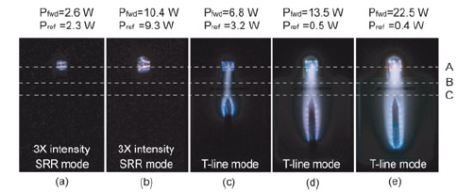
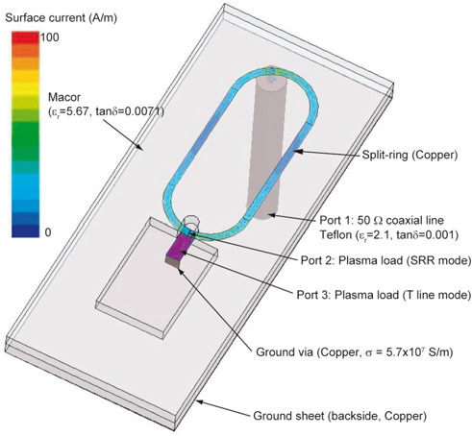
SPLIT-RING-RESONATOR (SRR) MICROPLASMA CAVITY
A microstrip split-ring resonator was investigated to ignite and sustain a RF microplasma proposed by N. Miura and J. Hopwood.
This concept was further developed as a SRR microplasma cavity as VUV light source.
University of Michigan
Institute for Plasma Science & Engr.
MIPSE_2013 P.T.
Notes:
Recently, N. Miura and J. Hopwood in Tufts University proposed a microstrip split-ring resonator to ignite and sustain RF microplasma. This concept was then further developed as a SRR microplasma cavity as a VUV light source.

Slide 5
SRR-GEOMETRY BASE CASE
Main focus: production of VUV photons and metastable states at the collection plane.
Microwave capacitively coupled plasma excited by push-pull electrodes.
Quartz coated electrodes.
Base Condition:
Ar, 4 Torr, 3 sccm
2.5 GHz CW power, 2 W.
Cavity width: 2 mm
University of Michigan
Institute for Plasma Science & Engr.
MIPSE_2013 P.T.
Notes:
The geometry of the light source is a micro-cavity, which is shown in this slide. The cavity is about 2 mm in width and 1.5 mm in height, with side wall formed by alumina. Two electrodes are sitting at the bottom driven by microwave, and operated in a push-pull mode. Quartz is used to coat the electrode. Two openings on the cavity, with gas flows in from the bottom, and plasma/photon come through from the top opening.
In this setup, different species are collected on the top plane in the diffusion region, while the plane is considered metal and grounded.
The base case, plasma is ingnited and sustained in pure Argon, 4 Torr and 3 sccm. Frequency is 2.5 GHz.

Slide 6
ATOMIC MODEL FOR Ar
Ar⁺
Argon Species:
Ar(3s), Ar(¹s_{2,3,4,5}),
Ar(4p), Ar(4d),
Ar⁺, Ar₂⁺, e
Electron impact excitation and super-elastic collisions between all levels.
Radiation transport for Ar(¹s₂) (106 nm), Ar(¹s₄) (105 nm) and Ar₂* (121 nm).
Ar(4d)
Ar(4p)
Ar(¹s₂)
Ar(¹s₃)
Ar(¹s₄)
Ar(¹s₅)
λ = 105, 106 nm
Ar(3s)
University of Michigan
Institute for Plasma Science & Engr.
MIPSE_2013 P.T.
Notes:
This is the atomic model of Argon. Excited states are resolved, excimer ions are also resolved.

Slide 7
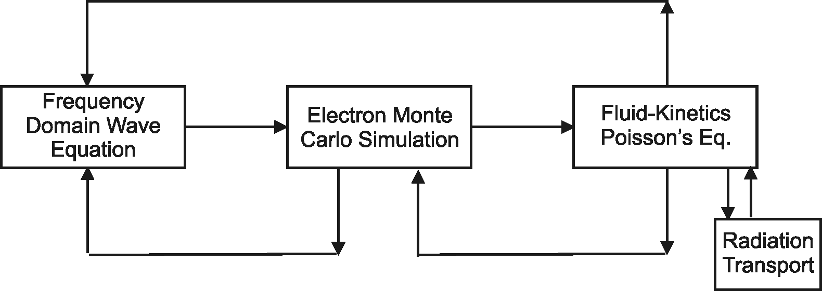
HYBRID PLASMA EQUIPMENT MODEL
Surface
Chemistry
Module
The Hybrid Plasma Equipment Model (HPEM) is a modular simulator that combines fluid and kinetic approaches.
Radiation transport is addressed using a spectrally resolved Monte Carlo simulation.
University of Michigan
Institute for Plasma Science & Engr.
MIPSE_2013 P.T.

Slide 8
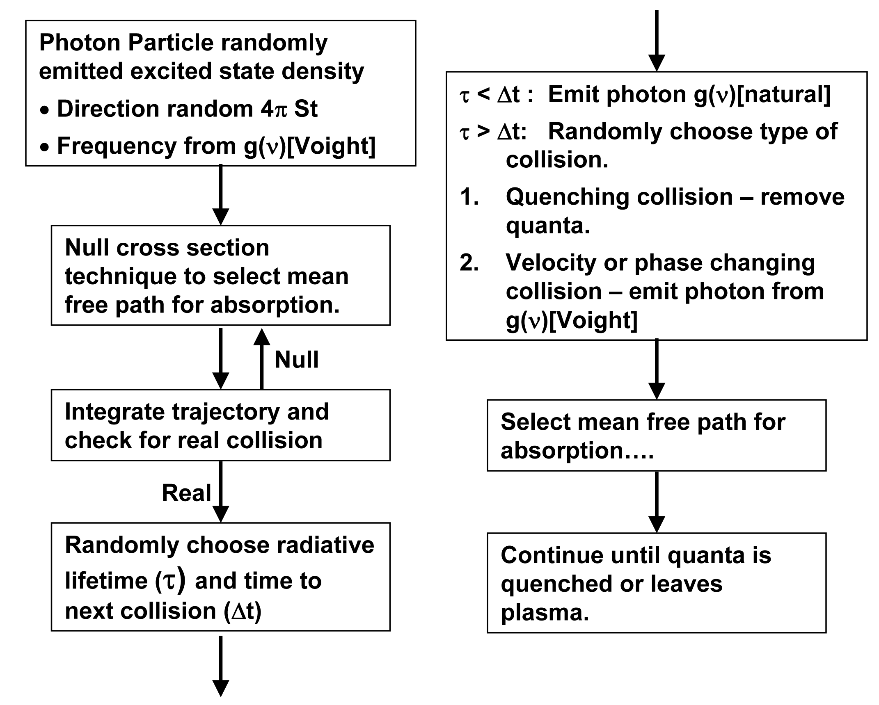
RADIATION TRANSPORT MODEL IN HPEM
Frequency resolved radiation transport in HPEM is modeled using a Monte Carlo simulation that accounts for radiation trapping
MIPSE_2013 P.T.

Slide 9
ELECTRON DENSITY & TEMPERATURE
Electron Density
Electron Temperature
Electron density reaches nearly 10¹⁴ cm⁻³, or an ionization fraction of 1%.
High energy electrons scatter through nozzle due to smaller collision cross section.
Ar, 4 Torr, 3 sccm, 2 W
University of Michigan
Institute for Plasma Science & Engr.
MIPSE_2013 P.T.
Notes:
First, here is the basic plasma properties for a CW base case. The plasma has a diffusive profile, with an electron density close to 10¹⁴ cm⁻³, that is an ionization fraction of 1%. The electron temperature in the cavity is distributed quite uniform, with a relative high te even in the diffusion region, that is because of high energy electron can scatter through the opening, since they have smaller collision cross section.

Slide 10
ION DENSITIES
Ar⁺ Density
Ar₂⁺ Density
Substantial amount of Ar₂⁺ are created by 2 body associative ionization.
Ions driven through nozzle by positive plasma potential.
Ar, 4 Torr, 3 sccm, 2 W
University of Michigan
Institute for Plasma Science & Engr.
MIPSE_2013 P.T.
Notes:
Also, the ions consists of two portion, Ar⁺ and Ar₂⁺ . The have the same order of magnitude, with Ar⁺ a little more. We believe the Ar₂⁺ are mainly formed by 2 body associative ionization. The ion will then be driven to the collection plane on top by the ambipolar electric field.

Slide 11
FLUX TO TOP PLANES
Ion and Photon fluxes
Total Ion and Photon flux
Resonant radiation from Ar excited states is the main photon source, far exceeding the excimer radiation from Ar₂*.
Ar⁺ and Ar₂⁺ fluxes are comparable at the collection plane.
Ar, 4 Torr, 3 sccm, 2 W
Fluxes
University of Michigan
Institute for Plasma Science & Engr.
Notes:
The fluxes collected on the top plane are shown here. The left shows flux of different ions and photons. Photons most from Ar*, Ar dimer radiation is not important. But for ion, Ar excimer ions are important.

Slide 12
POWER/PRESSURE=0.5 W/Torr: ELECTRON DENSITY
Bulk electron densities maintain a diffusive profile due to highly conductive plasma.
Peak electron densities are 10¹³ cm⁻³ with power/pressure=0.5 W/Torr
Electron Density (cm⁻³)
University of Michigan
Institute for Plasma Science & Engr.
MIPSE_2013 P.T.
Notes:
We then trying to gain some control on the photon generation in CW plasma. We change different parameters along the way, but always keeping power/atom constant for all the different conditions.
First, change pressure. Increase power correspondingly, such that power/pressure, i.e. power/atom is constant.
The plasma maintain a diffusive profile, because of its large density and high conductivity. The peak electron density is also maintained fairly steady between 6-10 x 10^13 cm^-3.
We do observe a localization of plasma at higher pressure, a more flat shape of the electron density profile.

Slide 13
POWER/PRESSURE=0.5 W/Torr: Ar(¹s₂)+Ar(¹s₄)
As Pressure increases, mean free path decreases.
The source of photons (Ar(¹s₂, ¹s₄)) is localized above electrodes.
Power efficiency of photon generation decreases.
Ar Radiative States (cm⁻³)
University of Michigan
Institute for Plasma Science & Engr.
MIPSE_2013 P.T.
Notes:
Meanwhile, photon generation changed. Due to smaller MFP at high pressure, source of photons, the radiative states of Ar, is localized above the electrodes. With the peak excited states density unchanged, this profile shows a decreasing photon generation efficiency as pressure increases.

Slide 14
PD (PRESSURE x SIZE) SCALING
Varying the size of cavity, while keeping pd (pressure x size) constant.
The input power is also varied to keep (power/N_{gas}• Volume) constant.
Flow rate adjusted to maintain constant gas residence time.
1
1/2
1/4
University of Michigan
Institute for Plasma Science & Engr.
MIPSE_2013 P.T.
Notes:
Having a split photon source could be a problem at certain cases, so we tried to push it at the center again by shrinking the size of the cavity. In order to maintain a similar operation condition for the microwave source, the pd scaling is kept constant by increasing the pressure at smaller cavity size, such that according to the paschen’s law, breakdown voltage is kept the same. The flow rate of the gas was also adjusted to maintain constant gas residence time. Also, as stated earlier, power/atom is kept constant.

Slide 15
PD SCALING : LIGHT SOURCE SIZE
Photon sources are confined at center of the cavity.
Relative source size (Source/Cavity) decreases at higher pressure (i.e., smaller cavity).
4 Torr
Relative Source Size
8 Torr
16 Torr
Ar(¹S₂)+Ar(¹S₄), Max=8.7 x 10¹³ cm⁻³ [2 dec]
University of Michigan
Institute for Plasma Science & Engr.
MIPSE_2013 P.T.
Notes:
Here are the results. The photon sources (Ar radiative states) have a similar diffusive profile with bulk plasma, even at high pressure due to the confinement of smaller cavity size. These sources are characterized by their sizes, at 50% and 20% of its center value. The size is then compared with its corresponding cavity size, to see how large the source is compared with the cavity. The trend is shown in the 1-d plot. The source is more condensed when the cavity is small.

Slide 16
PD SCALING: EFFICIENCY
As pressure increases (cavity size decreases):
The photon source is more focused at center of the cavity, providing larger viewing angle to top plane.
Power efficiency of photon source increases.
Photon Flux vs. Power
Photon Flux
University of Michigan
Institute for Plasma Science & Engr.
MIPSE_2013 P.T.
Notes:
The efficiency is then characterized by the center photon flux on the top plane vs. input power. At smaller size and higher pressure, the efficiency increases. This could be explained by a larger viewing of the source to the plane, due to a more focused source at higher pressure.

Slide 17
PULSING - GAS MIXTURES: Ar
Bulk Ion Density and Photon Flux
T_{e} and Plasma Potential
Electron temperature over-shoots at the beginning of pulse.
Bulk averaged photon flux and ion density peaked during pulse-on time.
200 kHz PRF, 10% DC, 160 V.
University of Michigan
Institute for Plasma Science & Engr.
MIPSE_2013 P.T.
Notes:
We then do an investigation on pulsing. The RF pulse is implemented using a 200 kHz PRF rectangular pulse, with a 10% duty cycle. This time, the voltage is kept constant at 160 V.
Electron temperature and plasma potential overshoots during pulse, and fall back. Electron temperature is maintained by superelastic collisions.

Slide 18
PULSING - GAS MIXTURES: He/Ar
He/Ar=10/90
He/Ar=70/30
He/Ar=90/10
With more He, larger over-shoot of T_{e} enhanced photon generation during pulse-on period.
University of Michigan
Institute for Plasma Science & Engr.
MIPSE_2013 P.T.
Notes:
Then, Helium is added to the gas mixture. We can observe an increase of peak electron temperature with higher helium fraction during pulse, and similar after-glow temperature. As a result, a larger photon flux over-shoot is generated.

Slide 19
PULSING - GAS MIXTURES: He/Ar
He/Ar=10/90
He/Ar=70/30
He/Ar=90/10
Pening ionization is depleting He radiative states during afterglow.
Ar⁺ is always the dominant ion in plasma.
University of Michigan
Institute for Plasma Science & Engr.
MIPSE_2013 P.T.
Notes:
And it can be seen that Ar⁺ is always the dominant ion in the plasma even with 90% of He, due to charge exchange and penning ionization. Penning ionization also accounts for the fast drop of high energy photon flux in afterglow.

Slide 20
CONCLUDING REMARKS
Modeling of a microwave excited SRR microplasmas as sources of VUV light.
Pure Ar plasma at 4 Torr, 2 W produces peak electron density close to 10¹⁴ cm⁻³, a fractional ionization of 1%.
Shape and position of light source in plasma can be controlled by pressure.
The relative size of light source in plasma and power efficiency of photon flux generation is related to the size of the cavity, with p*d scale kept unchanged.
Pulsing with He addition could increase T_{e} and thus enhanced pulsing effect.
University of Michigan
Institute for Plasma Science & Engr.
MIPSE_2013 P.T.
Notes:
20
20

Slide 21
BACKUP SLIDES

Slide 22
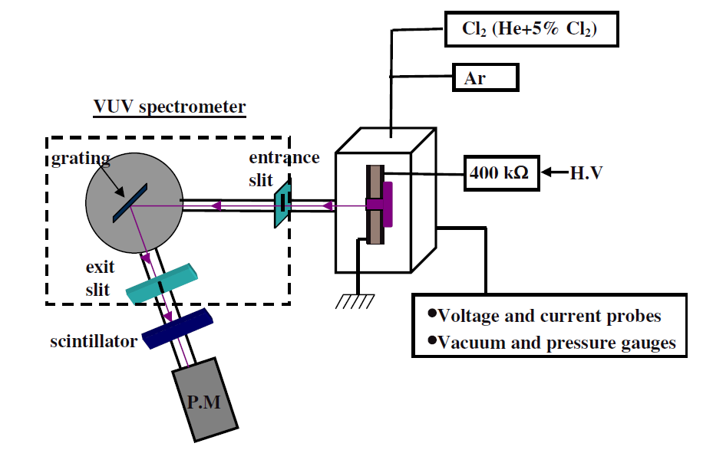
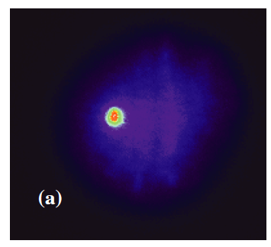
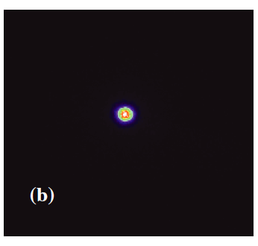
APPLICATION OF MICROWAVE LIGHT SOURCES
Microplasmas as VUV light source for resonance absorption spectroscopy
University of Michigan
Institute for Plasma Science & Engr.
MIPSE_2013 P.T.

Slide 23
HPEM-EQUATIONS SOLVED -
Electron Energy Distributions – Electron Monte Carlo Simulation
Phase dependent electrostatic fields
Phase dependent electromagnetic fields
Electron-electron collisions using particle-mesh algorithm
Phase resolved electron currents computed for wave equation solution.
Captures long-mean-free path and anomalous behavior.
Separate calculations for bulk and beam (secondary electrons)

Slide 24
HPEM-EQUATIONS SOLVED -

Slide 25
VARYING PRESSURE AND POWER: CONDITION
Pressure (Torr) | Power (W)
4 | 2
6 | 3
8 | 4
10 | 5
12 | 6
16 | 8
20 | 10
Based on base case condition, change pressure and power.
Power deposited per particle is kept constant by keeping Power/Pressure = 0.5 W/Torr
MIPSE_2013 P.T.

Slide 26
PULSED PLASMAS
Carrier frequency is modulated by a pulse, a fixed pulsing voltage and duty cycle.
The fast rising edge can “over-shoot” the self sustaining E/N, raising the “hot tail” in EEDF f(ε).
P_{max}
Power(t)
Duty Cycle
P_{min}
Time
τ = 1/υ
University of Michigan
Institute for Plasma Science & Engr.
MIPSE_2013 P.T.

