Slide 1
Development of a Compact Pulse Generator for X-Ray Backlighting of Planar Foil Ablation Experiments*
D.A. Yager-Elorriaga, A.M. Steiner, S.G. Patel, D.A. Chalenski, R.M. Gilgenbach, Y.Y. Lau, and N.M. Jordan
Plasma, Pulsed Power and Microwave Laboratory,
Nuclear Engineering and Radiological Sciences Dept.,
University of Michigan
Ann Arbor, MI 48109-2104 USA
MISPE 2013, Ann Arbor, MI
This work was supported by DoE Award number DE-SC0002590, NSF Grant number PHY 0903340, and by US DoE through Sandia National Labs award numbers 240985, 767581 and 768225 to the University of Michigan. This material is also based upon D.A. Yager-Elorriaga’s work supported by the National Science Foundation Graduate Student Research Fellowship under Grant No. DGE 1256260.
S. G. Patel and A. Steiner were supported by NPSC fellowships through Sandia National Laboratories.

Slide 2
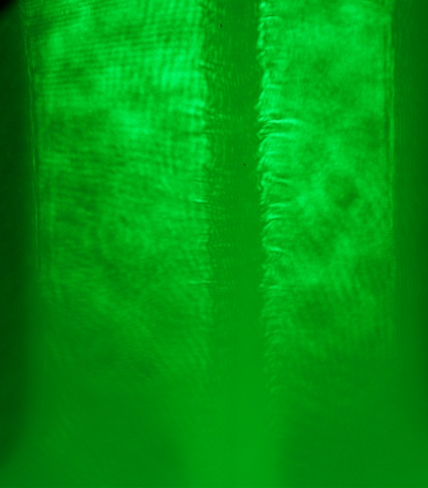
Introduction and Motivation
Compact pulser designed to drive hybrid x-pinch loads to backlight planar foil ablation experiments on the 1-MA LTD at the University of Michigan.[1,2]
Expanding planar plasma
Diagnostics currently installed on 1-MA LTD include 775 nm Ti:sapphire laser that cannot penetrate dense plasma region ($n>{10}^{21}/{cm}^{3}$)
X-rays from x-pinch may be used to probe deeper into the plasma
Laser cut off in plasma

Slide 3
X-pinch Diagnostic
B Field
JxB
B Field
JxB
Current
Traditional X-pinch
Hybrid X-pinch
X-pinch emits x-rays from <~1μm hotspot for ~1ns at cross of wires where JxB is strongest. In hybrid x-pinch, cones produce similar global magnetic field and wire pinch is confined to local (~1cm) region between electrodes.
Traditional x-pinch requires ~40kA-1MA with risetime >1kA/ns.[3] However, sub-ns x-ray bursts have been produced with risetime ~0.25kA/ns.[4] Conditions for hybrid x-pinch not fully explored.

Slide 4
X-pinch Radiography
Planar foil plasma from 1-MA LTD
Sub-ns burst of x-rays
X-pinch may be used for point projection radiography by driving in parallel with 1 MA LTD planar foil plasma or independently using compact pulser.

Slide 5
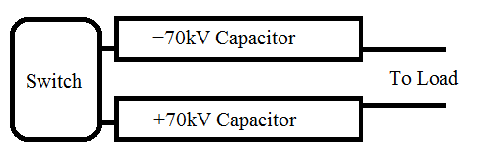
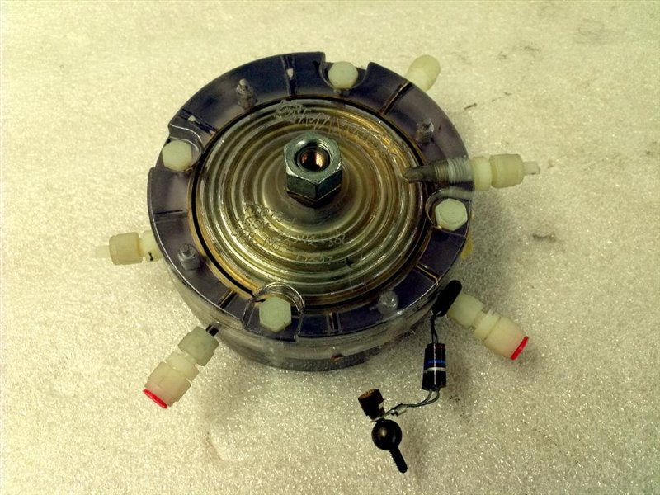
Generator Design Characteristics
6 LTD “bricks”
in parallel
A “brick” is a switch with 2 capacitors at opposite polarities
L-3 Spark gap switch
15 cm
From bmius.com

Slide 6
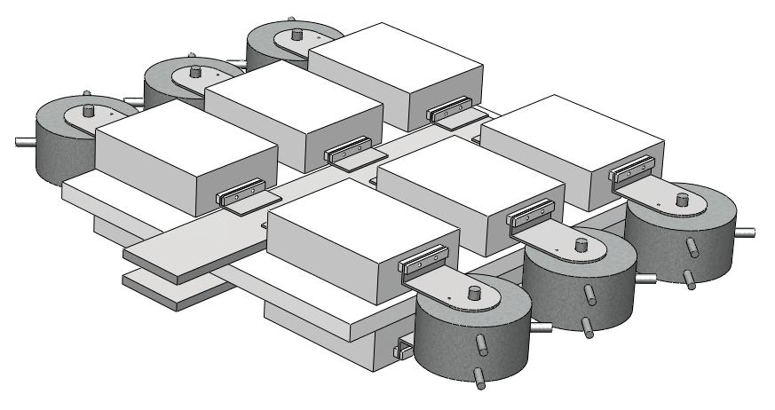
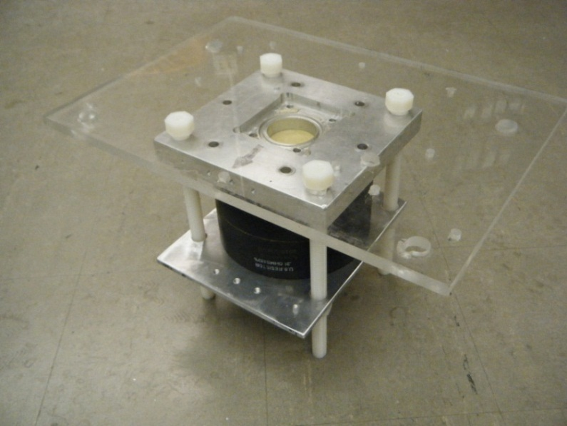
Generator Design Characteristics
Dimensions 70 cm x 90 cm x 16 cm
Volume 0.1 m³
Twelve 40 nF capacitors
Switches triggered with 100kV Maxwell Pulse Generator
1 m
15 cm
Resistive Load (0.62 Ohm, 89 nH)

Slide 7
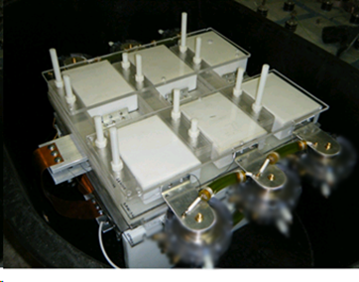
Generator Design Characteristics
Three loads tested:
Resistive load (0.62 Ohm, 89 nH)
X-pinch chamber with resistive load (0.5 Ohm)
X-pinch chamber with wire load (11 μm W and 50 μm Mo)
15 cm
Compact pulser is placed in transformer oil to prevent arcing

Slide 8
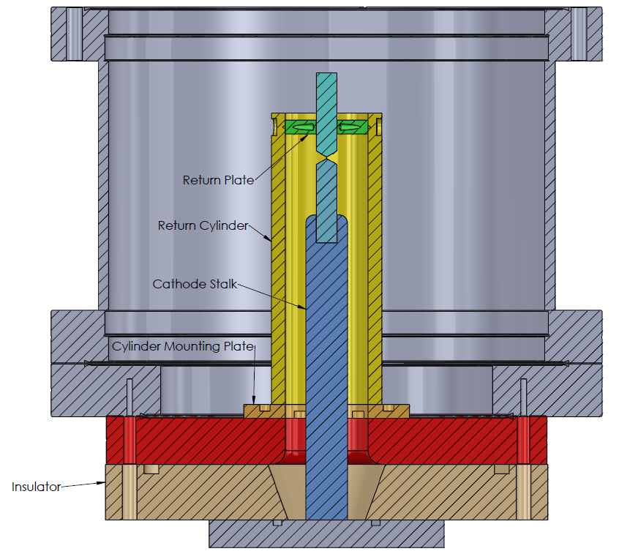
X-Pinch Load Design
Inductance L=86 nH
Coaxial transmission line (L=250 nH) connects pulser to x-pinch chamber

Slide 9
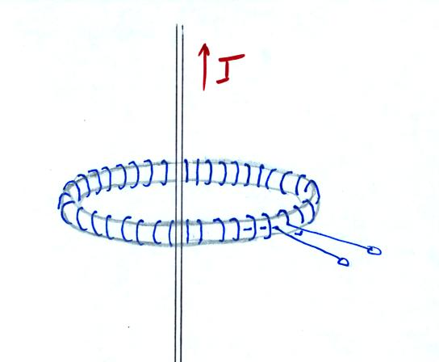
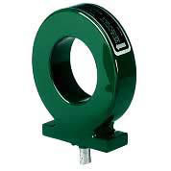
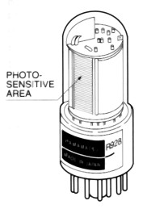
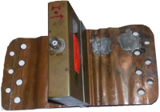
Experimental Setup
Generator pulsed from +30 kV to +70 kV capacitor charge
Current measured using
Pearson coils using four-way current splitting device
Current Viewing Resistor (CVR, R=0.0025 Ω)
Rogowski Coil calibrated with Pearson coil
Fiber optics and photomultiplier tubes used to determine switch breakdown time for diagnosing faulty switches
Pearson Coil
Rogowski Coil
CVR
PMT

Slide 10
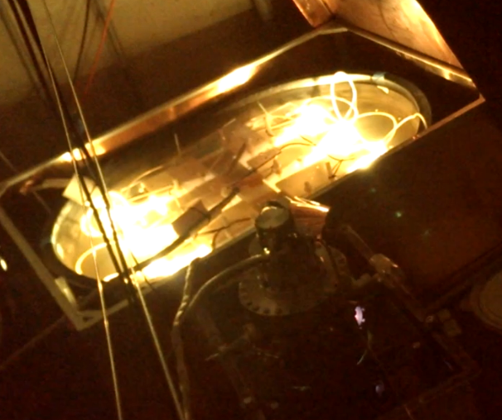
Experimental Setup
Compact pulser
X-pinch chamber
Camera shot of pulser shows bright light from switches due to breakdown (normal operation)

Slide 11
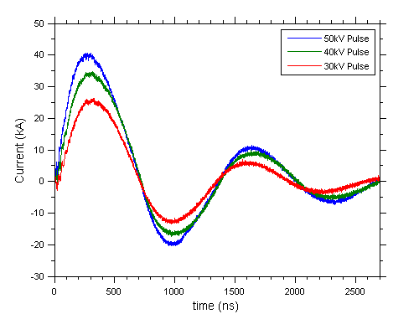
Resistive Load Traces
Measured using Pearson coils and four-way current splitter
Ringing shows that system is underdamped.

Slide 12
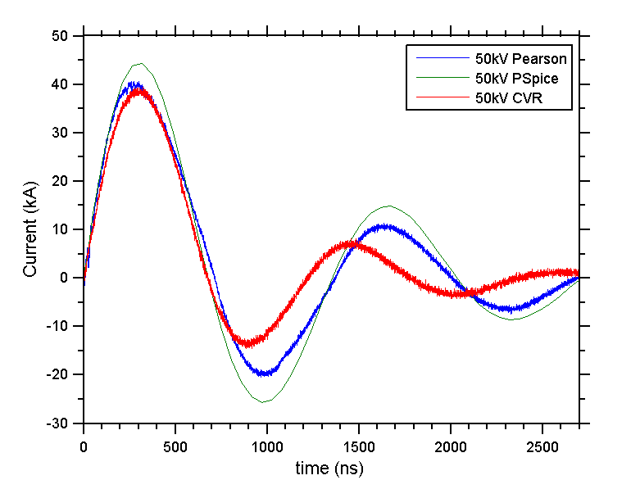
Comparison to Pspice Simulation
Pspice simulation:
L=380 nH
R=0.62 Ω
C=120 nF
CVR signal captures initial trend of pulse but discrepancies increase over time.
External tests found CVR to be out of calibration.

Slide 13
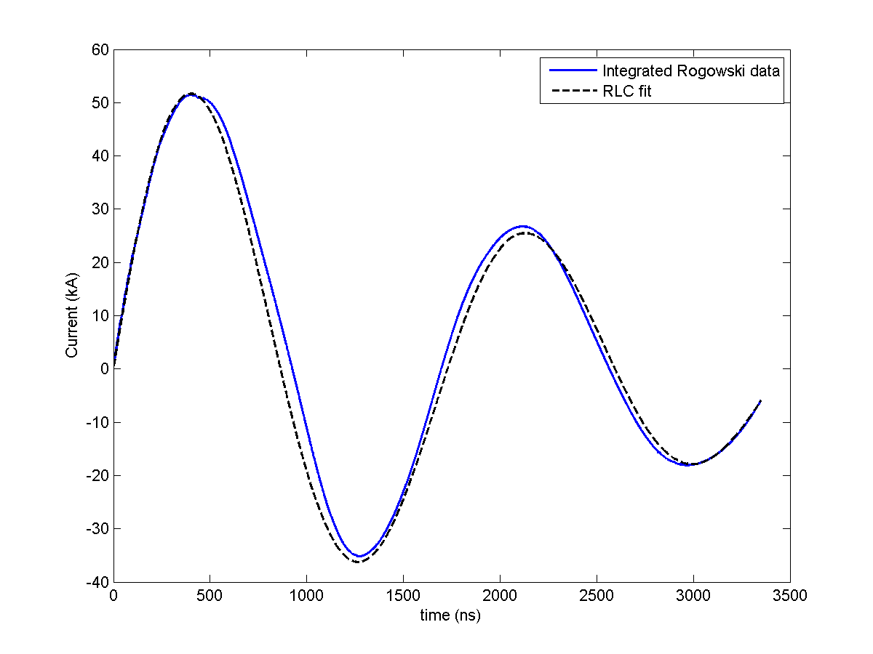
X-pinch Chamber Traces
Max Current = 51.45 kA at 399 ns
10-90% risetime = 266 ns
Risetime dI/dt = 0.15 kA/ns
Resistive Load (0.5 Ohms)
Current trace for charging voltage 70 kV measured using Rogowski coil. RLC fit parameters: L = 623 nH, R = 0.51 Ohms, C = 120 nF

Slide 14
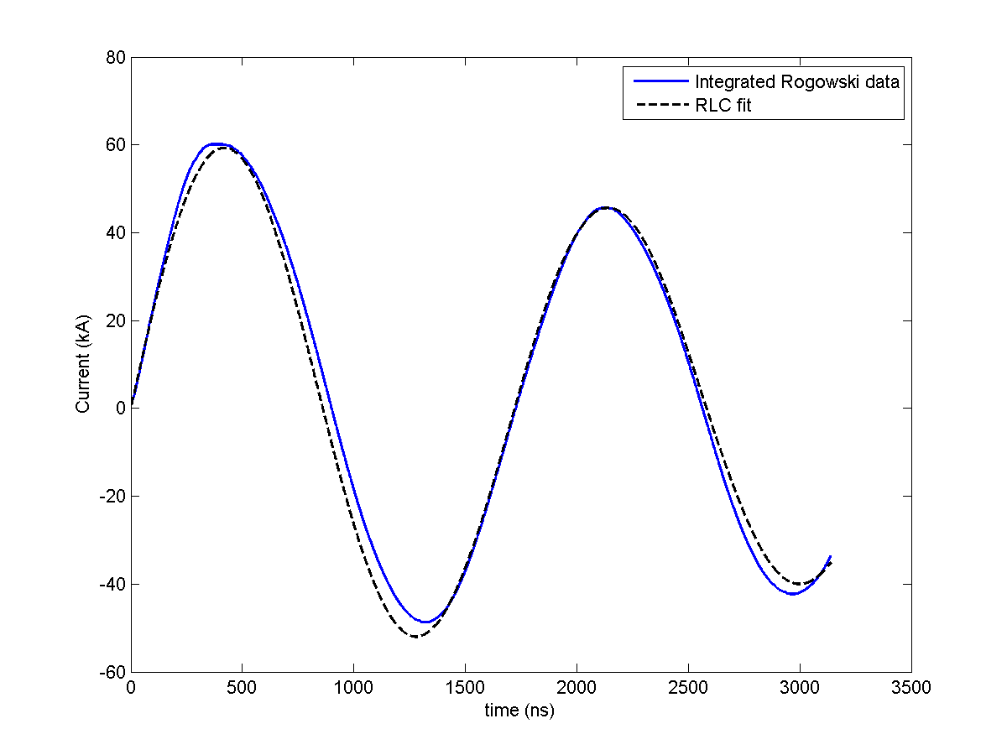
X-pinch Chamber Traces
Max Current = 60.13 kA at 406 ns
10-90% risetime = 236 ns
Risetime dI/dt = 0.20 kA/ns
Wire Load (11μm W)
Current trace for charging voltage 60 kV measured using Rogowski coil. RLC fit parameters: L=625 nH, R=0.19 Ohms, C=120 nF

Slide 15
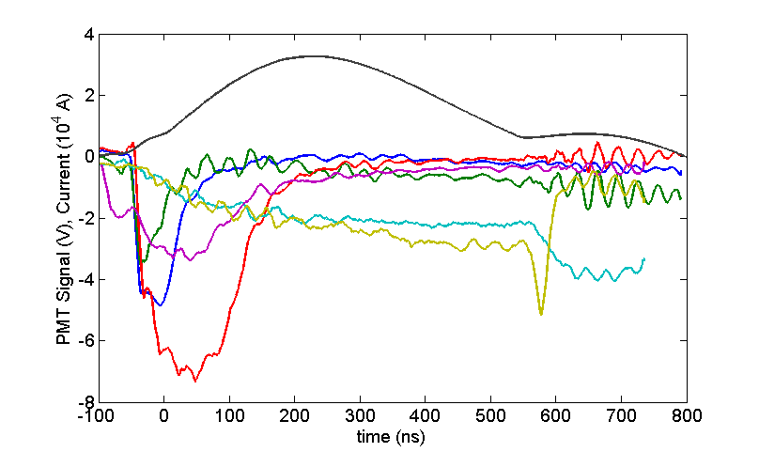
Fiber Optic Diagnostic
Used for determining when switches self-break and if switches are delayed
Switch 2 (purple) breaks down without trigger pulse (self-break) 50 ns before switches 4-6 (blue, green, red) break down. Switches 1 (teal) and 3 (gold) are delayed ~600ns. Current trace reflects this behavior. PMT data smoothed.

Slide 16
Discussion
The pulser inductance (290 nH) is limiting factor in risetime. The system inductance increases to 620 nH by adding coaxial transmission line and x-pinch chamber load.
Current and risetime (60 kA, 0.2 kA/ns) may be sufficient for traditional x-pinch without pulse peaking techniques.[4]
Fiber optics are viable diagnostic for assessing switch behavior and may be applied to 1-MA LTD.
~80% energy delivered to resistive load at 50 kV
$$\int{I^{2}R dt} / \frac{1}{2}CV^{2}$$

Slide 17
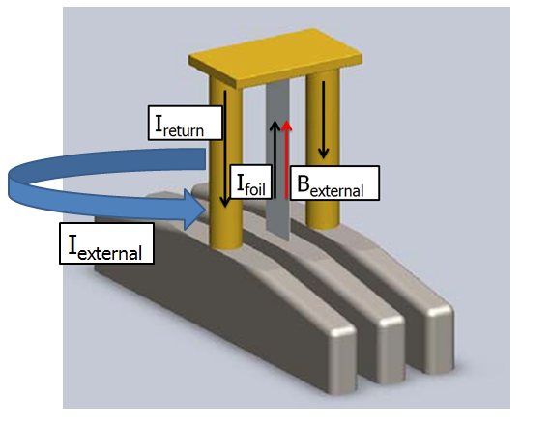
External B Field for MRT Experiments
Pulser can be used to generate an external magnetic field for experiments studying the magneto Rayleigh-Taylor (MRT) instability on the 1 MA LTD at the University of Michigan
B_{external} can be formed from solenoid configuration around return posts (blue current path)
For one loop at radius 0.1 m, B_{external} = 0.3 Tesla at 50 kA

Slide 18
Future Work
Explore techniques to decrease risetime
Add pulse peaking switch
Switch to radial transmission lines
Implement x-ray photodiode (AXUV) to determine if we are producing x-rays
Determine whether traditional x-pinch configuration is able to produce x-ray burst for available current and risetime.

Slide 19
References
[1] J. C. Zier, R. M. Gilgenbach, D. A. Chalenski, Y. Y. Lau, et al, Phys. Plasmas 19, 032701 (2012).
[2] Jacob Zier, “Ablation Dynamics and Instabilities of Metallic Plasmas generated using MA-Scale Current Drivers”, Ph.D. Dissertation, University of Michigan, (2011).
[3] T. A. Shelkovenko, S. A. Pikuz, J. D. Douglass, R. D. McBride, J. B. Greenly, and D. A. Hammer, IEEE Trans. Plasma Sci. 34, 2336 (2006).
[4] Collins, G. W. Valdivia, M. P. Zick, T. Madden, R. E. Haines, M. G. Beg, F. N., Phys. Plasmas 20, 042704 (2013)

