Slide 1
PLASMA DYNAMICS OF MICROWAVE EXCITED MICROPLASMAS IN A SUB-MILLIMETER CAVITY*
Peng Tian^{a)}, Mark Denning^{b)} , Mehrnoosh Vahidpour,
Randall Urdhal^{b)} and Mark J. Kushner^{a)}
^{a)}University of Michigan, Ann Arbor, MI 48109 USA
tianpeng@umich.edu, mjkush@umich.edu
^{b)}Agilent Technologies, 5301 Stevens Creek Blvd, Santa Clara, CA
mark.denning@agilent.com, randall_urdahl@agilent.com
MIPSE 2014, Ann Arbor, MI USA
* Work supported by Agilent Technologies.

Slide 2
AGENDA
Microplasma cavities
Description of model
Plasma dynamics in Ar
Pressure
Power
Plasma dynamics in Ne/Xe
Concluding Remarks
University of Michigan
Institute for Plasma Science & Engr.
MIPSE_2014 P.T.

Slide 3
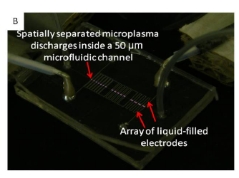
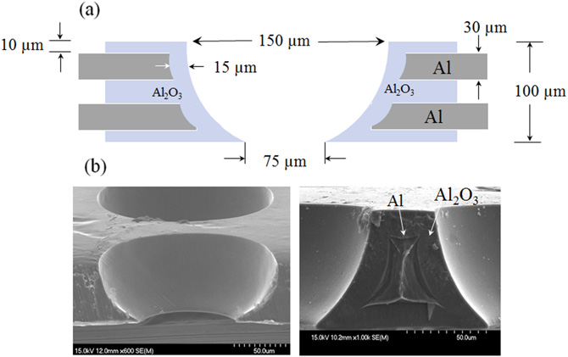
MICROPLASMAS IN CAVITIES
Microplasmas in cavities have a wide range of applications (e.g. ion/photon sources, display panels).
Excitation mechanisms and scaling laws are unclear.
[1],[2]
Ref:
[1] H-J Lee, et al., J. Phys. D: Appl. Phys. 45 (2012)
[2] K.S.Kim, Appl. Phys. Lett. 94 011503 (2009)
[3] Endre J. Szili, et al., Proc. SPIE 8204, Smart Nano-Micro Materials and Devices, 82042J (December 23, 2011);
[3]
University of Michigan
Institute for Plasma Science & Engr.
MIPSE_2014 P.T.

Slide 4
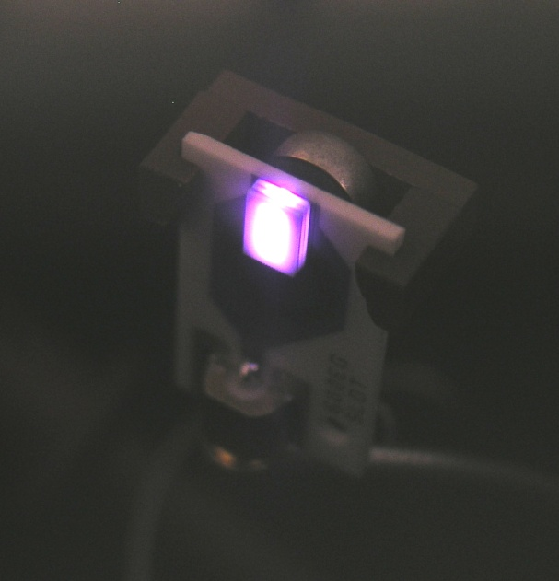
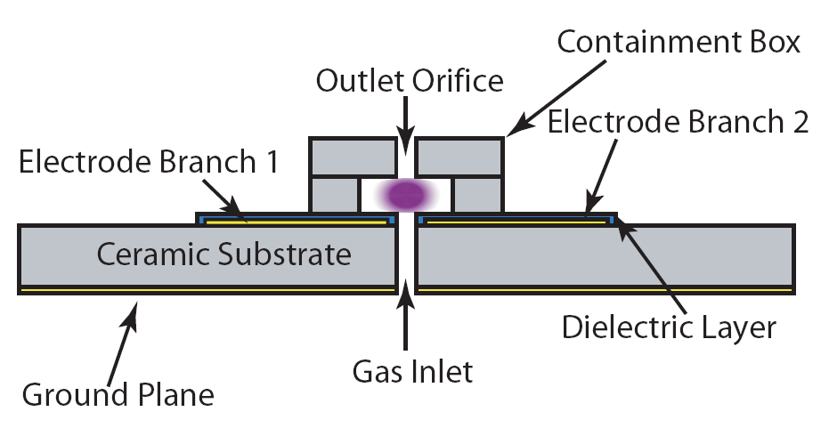
LOW PRESSURE MICROPLASMA CAVITY
Rare gases and rare-gas mixtures with flow rates of 1-10 sccm through a structure ~ 2 mm wide with power of a few watts.
Confined structure enables operation at a few Torr while exhausting into near vacuum.
Microplasmas are used as VUV photon sources.
University of Michigan
Institute for Plasma Science & Engr.
MIPSE_2014 P.T.

Slide 5
MICROPLASMA GEOMETRY
Cavity
Orifice
Diffusion Region
Microwave capacitively coupled plasma in a long microplasma cavity (side view)
Quartz coated electrodes.
In diffusion region, side walls are covered by dielectric.
Base Condition:
Ar, 4 Torr, 1 sccm
2.5 GHz CW power, 2 W.
Cavity width: 2 mm
University of Michigan
Institute for Plasma Science & Engr.
MIPSE_2014 P.T.

Slide 6
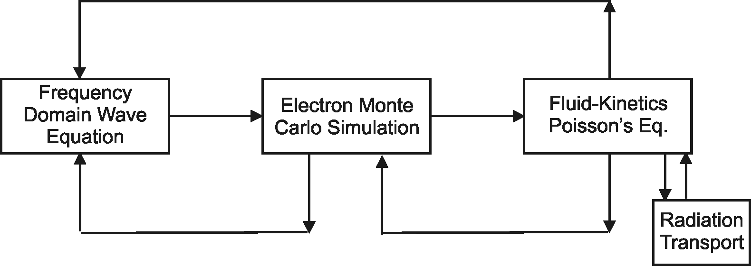
HYBRID PLASMA EQUIPMENT MODEL
Surface
Chemistry
Module
The Hybrid Plasma Equipment Model (HPEM) is a modular simulator that combines fluid and kinetic approaches.
Radiation transport is addressed using a spectrally resolved Monte Carlo simulation.
University of Michigan
Institute for Plasma Science & Engr.
MIPSE_2014 P.T.

Slide 7
ATOMIC MODEL FOR AR
Ar⁺
Argon Species:
Ar(3s), Ar(¹s_{2,3,4,5}),
Ar(4p), Ar(4d),
Ar⁺, Ar₂⁺, e
Electron impact excitation and super-elastic collisions between all levels.
Radiation transport for Ar(¹s₂) (106 nm), Ar(¹s₄) (105 nm) and Ar₂* (121 nm).
Ar(4d)
Ar(4p)
Ar(¹s₂)
Ar(¹s₃)
Ar(¹s₄)
Ar(¹s₅)
λ = 105, 106 nm
Ar(3s)
University of Michigan
Institute for Plasma Science & Engr.
MIPSE_2014 P.T.

Slide 8
BASE CASE – e, T_{e}, Ar(¹s₄)
Plasma density reaches 10¹³ cm⁻³, resonant state density is twice the plasma density. The plasma expands to cover the electrode, behaves like ‘normal glow’.
High energy, long mean free path electrons escape the bulk plasma in axial direction.
Ar, 4 Torr, 1 sccm, 2 W, 2.5 GHz.
Min Max
University of Michigan
Institute for Plasma Science & Engr.
MIPSE_2014 P.T.

Slide 9
BASE CASE – IONIZATION
Major ionization source is from bulk electrons, with the assistance of ionization by sheath accelerated secondary electrons.
Photo-ionization is considerable lower (3 orders lower than beam ionization)
Ionization is most intense at the two ends of plasma.
Min Max
University of Michigan
Institute for Plasma Science & Engr.
MIPSE_2014 P.T.

Slide 10
BASE CASE – POWER, E-FIELD, CHARGE
–
+
–
Power deposition is dominantly at sheath edge.
Electrode covering dielectric charges to produce dc bias.
Ambipolar-like electric field in the axial direction confines plasma. Charging of dielectric beyond the edge of the plasma is non-ambipolar drift of electrons.
University of Michigan
Institute for Plasma Science & Engr.
MIPSE_2014 P.T.
Min Max

Slide 11
BASE CASE – INITIAL CONDITION
If the electrons are seeded at different position, plasma will start expansion from there.
Expansion will stop when plasma receives enough current from the dielectric to dissipate the power. Plasma will not fill the cavity at low power.
Min Max
University of Michigan
Institute for Plasma Science & Engr.
MIPSE_2014 P.T.

Slide 12
POWER – ELECTRON DENSITY
With increased power, plasma expands to the full length of cavity.
Plasma is confined in physical boundaries of cavity with further increase in power. 1 W ~ 12 W.
University of Michigan
Institute for Plasma Science & Engr.
MIPSE_2014 P.T.
Min Max

Slide 13
POWER – PHOTON FLUX
Viewing angle for photons gets larger at high as plasma approaches orifice, producing more divergence flux.
Photon power increases and saturates as input power increases, producing a decrease in efficiency.
Photon efficiency from 0.01-0.03 % in Ar.
Min Max
University of Michigan
Institute for Plasma Science & Engr.
MIPSE_2014 P.T.

Slide 14
POWER – PHOTON FLUX
Viewing angle for photons gets larger at high as plasma approaches orifice, producing more divergence flux.
Photon power increases and saturates as input power increases, producing a decrease in efficiency.
Photon efficiency from 0.01-0.03 % in Ar.
Min Max
University of Michigan
Institute for Plasma Science & Engr.
MIPSE_2014 P.T.

Slide 15
ORIFICE SIZE – ESCAPING PLASMA
By enlarging the orifice, the plasma eventually escapes at high power.
Min Max
University of Michigan
Institute for Plasma Science & Engr.
MIPSE_2014 P.T.

Slide 16
ORIFICE SIZE – POWER, E-FIELD
Power deposition is focused at the orifice and edge of electrode once the plasma escapes and forms a plume.
Min Max
University of Michigan
Institute for Plasma Science & Engr.
MIPSE_2014 P.T.

Slide 17
ORIFICE SIZE – VUV PHOTON FLUX
VUV photon flux to observation plane increases with increasing orifice size, particularly when plume is formed.
VUV flux is not “useful” because it is highly divergent.
Efficiency increased up to 0.1 %.
Min Max
University of Michigan
Institute for Plasma Science & Engr.
MIPSE_2014 P.T.

Slide 18
PRESSURE – ELECTRON DENSITY
Plasma tends to be more confined at high pressure with fixed power. Current density increases with pressure, like a normal glow.
Ar, 1 W, 2.5 GHz. 0.5 – 20 Torr.
Min Max
University of Michigan
Institute for Plasma Science & Engr.
MIPSE_2014 P.T.

Slide 19
PRESSURE – IONIZATION
E-beam ionization is less efficient and more uniform at low pressure, due to a longer MFP for higher energy electrons.
E-beam ionization is limited close to the surfaces at high pressure.
Min Max
University of Michigan
Institute for Plasma Science & Engr.
MIPSE_2014 P.T.

Slide 20
PRESSURE – PHOTON FLUX
Photon power to observation plane peaks at 5 Torr.
Resonant state is increasingly quenched while flux becomes more collimated
Efficiency is still low from 0.01-0.03 %.
Min Max
University of Michigan
Institute for Plasma Science & Engr.
MIPSE_2014 P.T.

Slide 21
Ne/Xe MIXTURE - REACTIONS
Reaction Mechanism: (‘M’ is Ne or Xe)
E-Impact and Recombination
e + M → M* + e, e + M → M⁺ + 2e
e + M* → M⁺ + 2e, e + M⁺ → M*
Spontaneous Emission
M* → M + hv
Penning Ionization, Charge exchange
Ne* + Xe → Ne + Xe⁺, Ne⁺ + Xe → Ne + Xe⁺
M* + M* → M⁺ + M
Photo-Ionization
hv + M → M⁺ + e, hv + M* → M⁺ + e
Dimer Reaction
M* + M +M → M₂* + M, e + M₂* → M₂⁺ + 2e
e + M₂⁺ → M* + M, M₂⁺ + M → M⁺ + 2M
Penning mixture of Ne/Xe, 4 Torr
Xenon Species:
Xe(1s₄), Xe(1s₃), Xe(1s₂), Xe(2p₁₀), Xe(3d₆), Xe(2s₅), Xe(3_{p}), Xe₂*, Xe⁺, Xe₂⁺
Neon Species:
Ne(1s₂₋₅), Ne(2p), Ne₂*, Ne⁺, Ne₂⁺,
Photon Species:
147 nm – Xe(1s₄) 121 nm – Xe(1s₂) 173 nm – Xe₂* 74 nm – Ne(1s_{2,4}) 84 nm – Ne₂*
University of Michigan
Institute for Plasma Science & Engr.
MIPSE_2014 P.T.

Slide 22
Ne/Xe MIXTURE – ELECTRON DENSITY
Ne/Xe=80/20, 4 Torr, 1W.
Plasma density is higher and fills cavity with Ne/Xe mixture. Penning reactions are playing an important role in expansion.
Min Max
University of Michigan
Institute for Plasma Science & Engr.
MIPSE_2014 P.T.

Slide 23
Ne/Xe MIXTURE – Ne⁺, Xe⁺,Ne(¹s_{2,4}),Xe(¹s₄)
Xe excited states are 3 orders of magnitude larger than for Ne.
Ne/Xe=80/20, 4 Torr, 1W, 1sccm.
Min Max
University of Michigan
Institute for Plasma Science & Engr.
MIPSE_2014 P.T.

Slide 24
Ne/Xe MIXTURE – PHOTON FLUX
Photon flux is dominantly due Xe due to its lower resonant energy. Ne emission is over 4 orders lower.
Photon fluxes are more efficiently generated in penning mixture. Efficiency is 5-10 times that of pure Ar.
Min Max
University of Michigan
Institute for Plasma Science & Engr.
MIPSE_2014 P.T.

Slide 25
CONCLUDING REMARKS
A microwave excited micro-cavity microplasma has been computationally investigated.
Pure Ar plasmas operate in a normal-glow like mode, confined in a fraction of cavity volume when power is low.
With increasing power, plasma will expand and fill the cavity. When the orifice size is large enough at certain power, plasma will escape and form a plume.
Ar photon output efficiency is typically low, from 0.01 – 0.03 %.
Ne/Xe mixtures will increase the plasma density due to Penning reactions.
Ne/Xe VUV output efficiency is 5 – 10 times higher than that of Ar, from 0.05 – 0.5 %.
University of Michigan
Institute for Plasma Science & Engr.
MIPSE_2014 P.T.
Notes:
25
25

Slide 26
BACKUP SLIDES

Slide 27
HPEM-EQUATIONS SOLVED -
Electron Energy Distributions – Electron Monte Carlo Simulation
Phase dependent electrostatic fields
Phase dependent electromagnetic fields
Electron-electron collisions using particle-mesh algorithm
Phase resolved electron currents computed for wave equation solution.
Captures long-mean-free path and anomalous behavior.
Separate calculations for bulk and beam (secondary electrons)

Slide 28
HPEM-EQUATIONS SOLVED -

Slide 29
PRESSURE – E FIELD
Higher the pressure, more confined the plasma is.
University of Michigan
Institute for Plasma Science & Engr.
MIPSE_2014 P.T.

