Slide 1
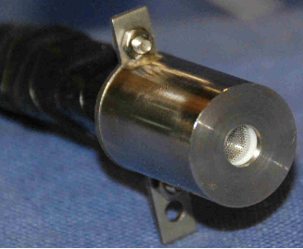
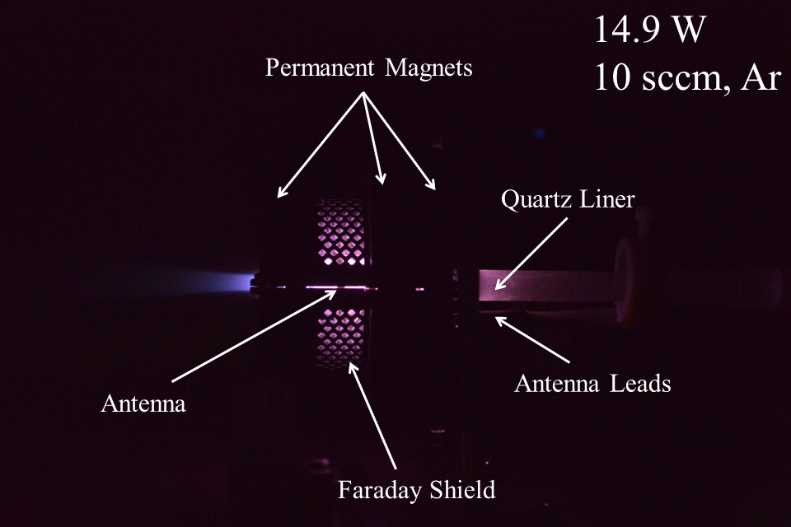
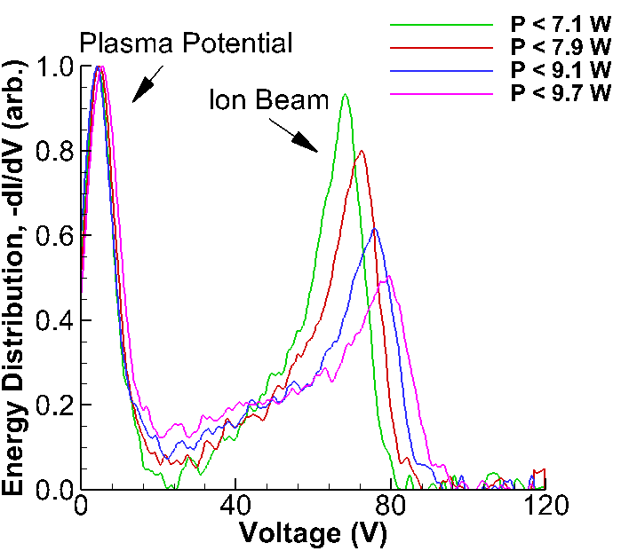
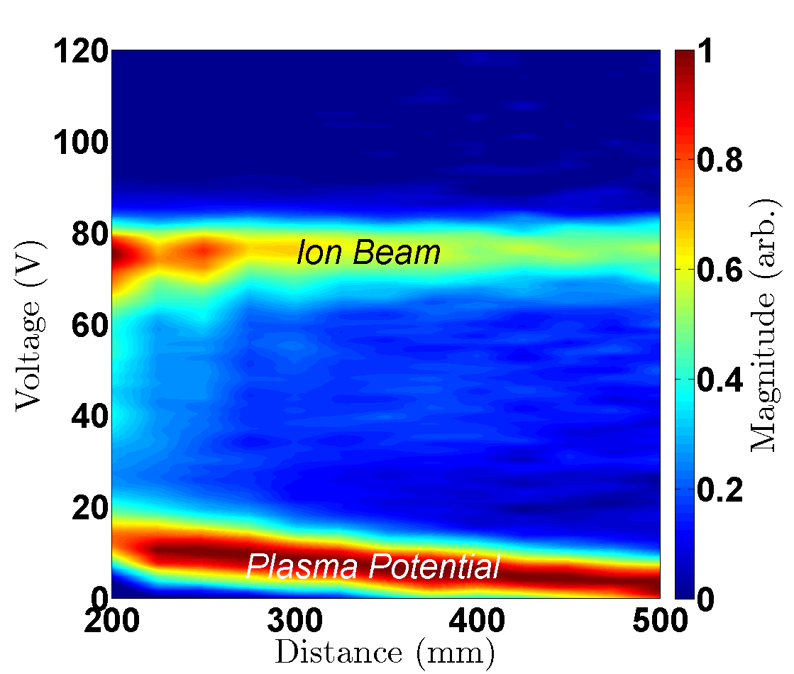
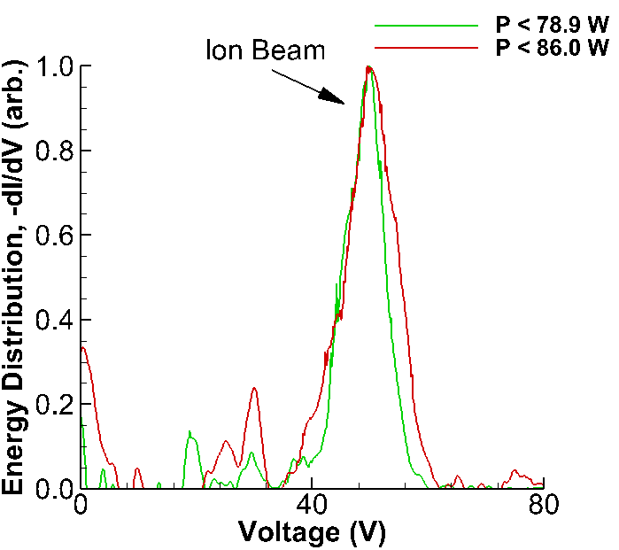
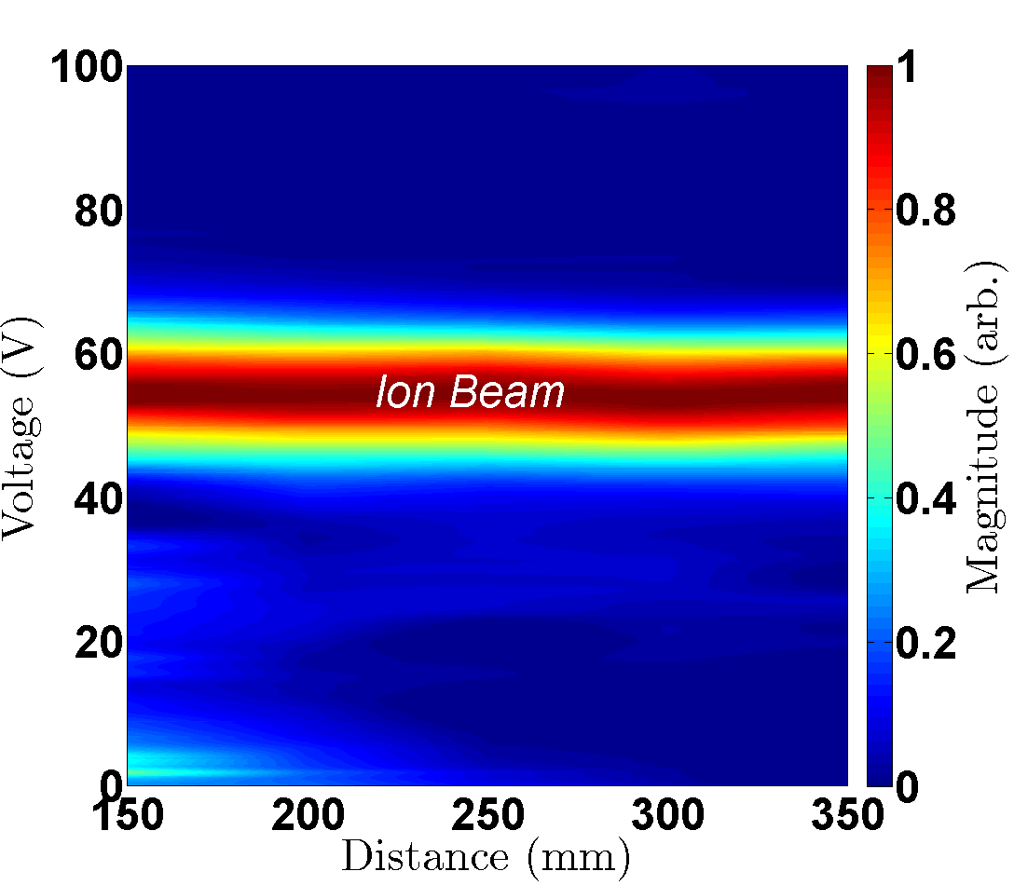
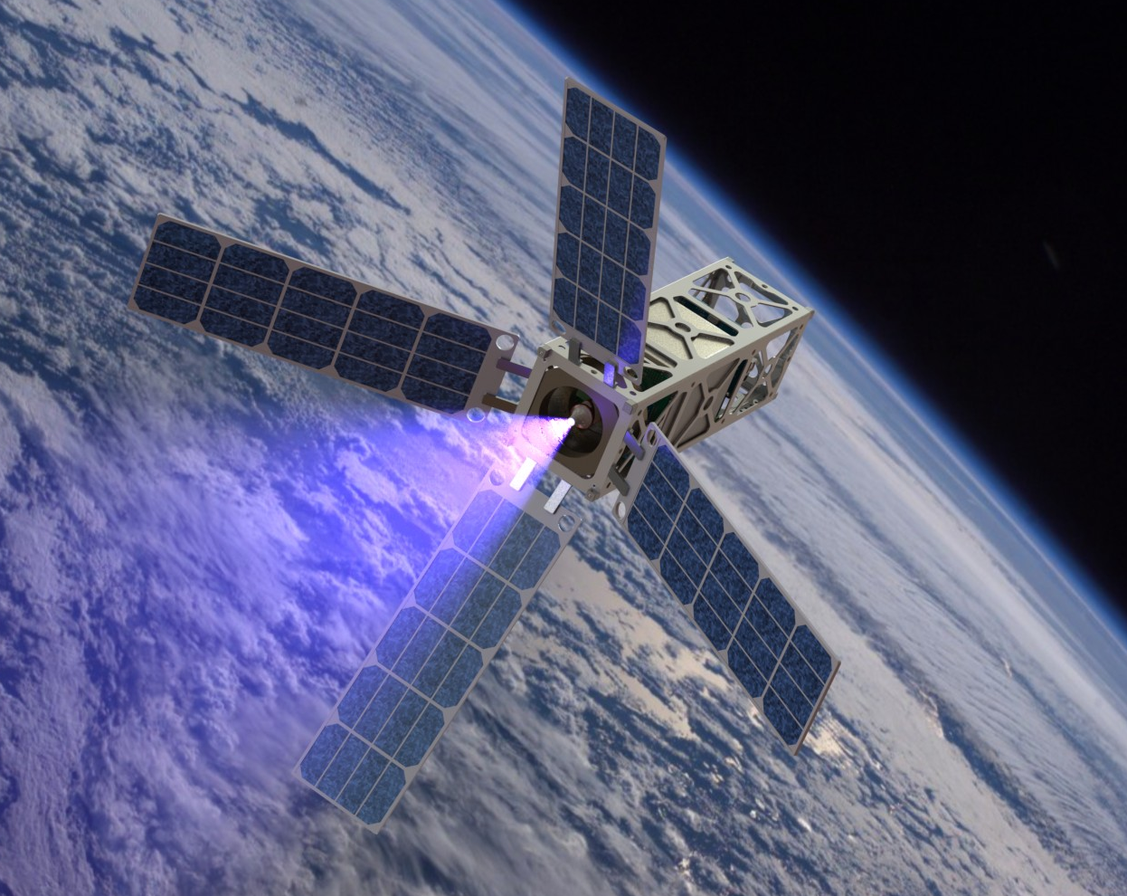
Ion Energetics of the Modes of the CubeSat Ambipolar Thruster Timothy A. Collard¹, J. P. Sheehan¹, and Alec D. Gallimore¹ ¹Aerospace Engineering, University of Michigan
The CubeSat Ambipolar Thruster (CAT)
Experimental Setup
Results – High Flow Rate, Low Power Operation
A state-of-the art nanosatellite helicon thruster that:
is electrodeless
uses permanent magnets
occupies < 1U without a propellant tank
increases the ΔV capabilities of nanosatellites to > 1000 m/s
enables a wide array of new scientific and commercial missions
The ion energy distribution was measured using a Retarding Potential Analyzer (RPA), shown in Figure 3, and the plasma potential was measured with an emissive probe. These measurements were made in a vacuum chamber at the Plasmadynamics and Electric Propulsion Laboratory
The second mode that exhibited an energetic ion beam was a high propellant flow rate, low power mode. CAT operation on argon in this mode is shown in Figure 6.
Important details about this mode:
~ 1 x 10⁻⁴ Torr back pressure
~ 7 cm charge exchange mean free path
Varying power changed ion energy (Figure 7a)
Evidence of ambipolar acceleration (Figure 7b)
.
During testing CAT, shown in Figure 1, exhibited 2 - 3 distinct operational modes on xenon and argon by varying the power and the propellant mass flow rate [1]. An energetic ion population was observed in two of the three modes, while the third mode appeared to simply heat the propellant.
Figure 6. CAT firing in the high flow rate, low power mode.
a)
b)
Figure 3. a) A photograph of the RPA. b) The potential distribution of the grids within the RPA.
Results – Low Flow Rate, High Power Operation
Figure 1. A photograph of CAT, with the major components highlighted.
The first mode that exhibited an energetic ion beam was a low propellant flow rate, high power mode. Figure 4 shows CAT operation on xenon in this mode.
Important details about this mode:
~ 1 x 10⁻⁶ Torr back pressure
Varying power did not change ion energy (Figure 5a)
Evidence of a double layer (Figure 5b)
Motivation
Over the past decade the reduced cost and accelerated mission development cycle of the CubeSat architecture has become an attractive option to commercial and scientific groups that are interested in a wide range of missions, from space weather monitoring to deep space exploration [2]. However, nanosatellites are limited to a narrow range of missions due to the lack of high performance propulsion systems. Current technology is limited to chemical and electric thrusters with ΔV capabilities of < 300 m/s [3]. While this is sufficient for station-keeping and orbit raising many mission-enabling maneuvers require ΔV > 1000 m/s, such as Earth escape and orbit inclination changes.
a)
b)
Figure 7. a) The variation of the ion energy distribution of the high flow rate (12 sccm), low power mode with varied input power. b) The spatial variation of the ion energy distribution with a flow rate of 12 sccm and P < 8.5 W.
Figure 4. CAT firing in the low flow rate, high power mode.
Conclusions
Two of the three modes observed in CAT operation include energetic ion populations, which indicate promising performance characteristics. Testing is underway to directly measure the thrust and specific impulse delivered by CAT while operating in these modes.
Acknowledgements
This material is based upon work supported by the National Science Foundation Graduate Research Fellowship Program under Grant No. DGE 1256260, DARPA under contract number NNA15BA42C, and NASA under Grant No. NNX14AD71G. Thank you to my fellow lab mates at PEPL for their helpful discussions and support.
[1] Sheehan, J. P., et al. (2011). "Initial Operation of the CubeSat Ambipolar Thruster." 33rd International Electric Propulsion Conference. (2015).
[2] Bouwmeester, J. and J. Guo "Survey of worldwide pico-and nanosatellite missions, distributions and subsystem technology." Acta Astronautica 67(7): 854-862. (2010).
[3] Mueller, J., et al. "Survey of propulsion technologies applicable to cubesats." (2010).
a)
b)
a)
b)
Figure 5. a) The lack of variation of the ion energy distribution of the low flow rate (0.2 sccm), high power mode with varied input power. b) The spatial variation of the ion energy distribution with a flow rate of 0.2 sccm and P < 143.7 W.
Figure 2. a) An example Earth observation mission. b) A spiral maneuver to escape Earth.

