Slide 1
Harmonic Generation on the Multi-Frequency Recirculating Planar Magnetron
S. C. Exelby, G. B. Greening, N. M. Jordan, D. Simon, P. Zhang, Y.Y. Lau and R. M. Gilgenbach Plasma, Pulsed Power and Microwave Laboratory Nuclear Engineering and Radiological Sciences Department University of Michigan Ann Arbor, MI 48109-2104

Slide 2
Motivation: High Power Microwaves (HPM) and Multi-Frequency Generation
HPM applications include
Defensive: Radar, Electronic Warfare
Industrial: Heating, Material Processing
Multi-frequency Advantages
Variable coupling primarily for counter IED, vehicle stoppers, and other aspects of electronic warfare
Notes:
The RPM is a high power microwave source so id like to first motivate the development of the RPM by mentioning some of the applications of HPM

Slide 3
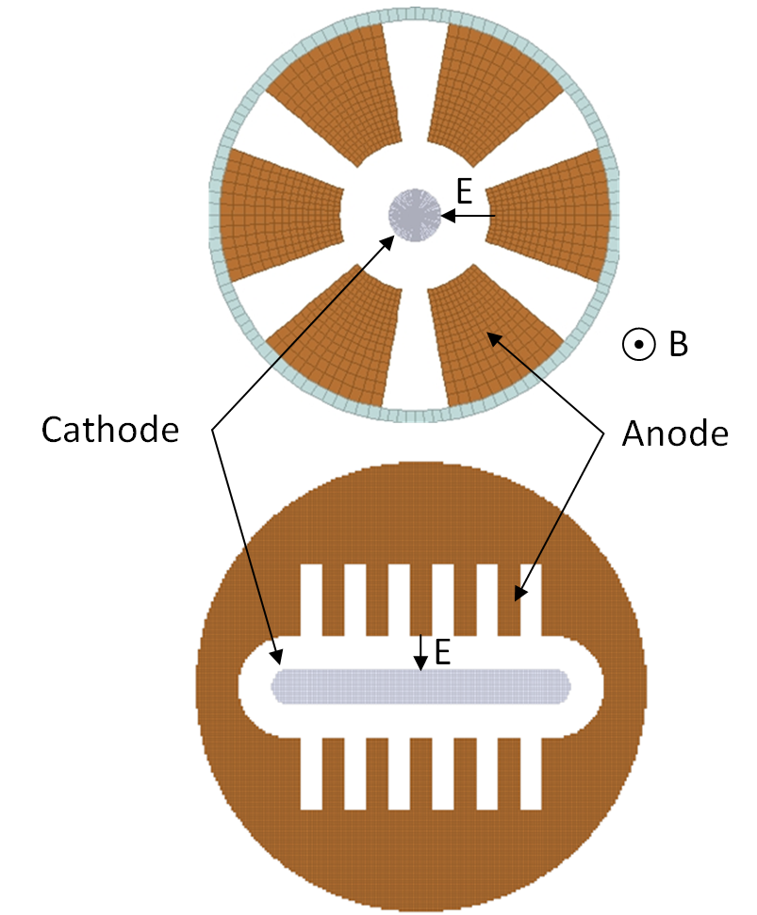
Recirculating Planar Magnetrons¹
Motivation: RPM Advantages
Larger cathode surface area provides higher current
Larger anode area allows for faster heat dissipation
RPM allows for nearly full electron beam recirculation
Magnetic field volume scales linearly with number of cavities (N) instead of (N²) as with cylindrical magnetron
1- Patent Granted- R.M. Gilgenbach, Y.Y. Lau, D.M. French, B.W. Hoff, J. Luginsland, and M.A. Franzi, “Crossed field device,” U.S. Patent US 8 841 867 B2, Sep. 23, 2014
Notes:
The primary purpose of the RPM is to exploit a potentially favorable geometric form factor that in turn will provide several operational advantages over a conventional cylindrical magnetron.
Amongst these geometrical advantages are:
Larger cathode surface area for higher current densities than its purely cylindrical counterpart
Larger anode area for faster heat dissipation (especially in CW devices)
The RPM also allows for nearly full electron beam recirculation from one planar oscillator to the other. This intrinsic feedback mechanism not only reduces the complexity of the structure but can also exceed the return efficiency achieved by some multistage depressed collectors.
Lastly the device is modularly scaleable. That is to say that each planar oscillator could be indefinitely extended to scale output power without significantly impacting the operational conditions of the magnetron

Slide 4
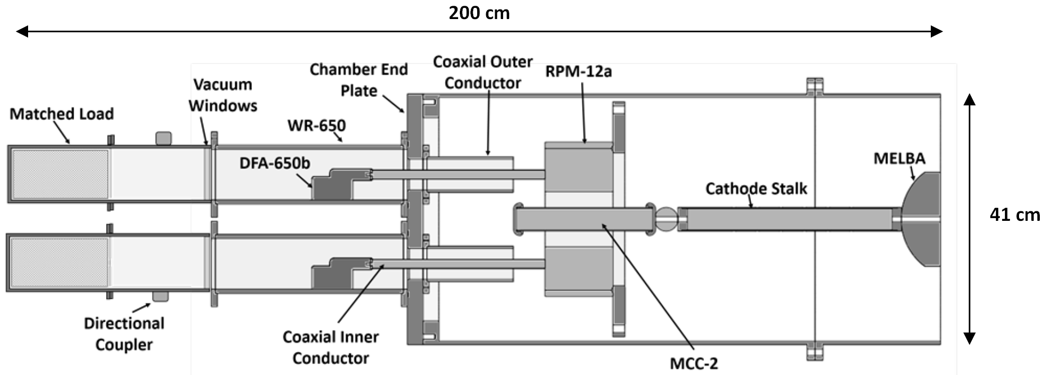
Recirculating Planar Magnetrons
Experimental: Equipment Diagram
Michigan Electron Long Beam Accelerator provides -300 kV voltage pulse to the coaxial transmission line which terminates at the cathode of the RPM
Helmholtz coils surround the RPM providing the 0.1 to 0.32 Taxial magnetic field
B-dots are installed in the front (left) of the magnetron to gather phase information
Notes:
Shown here is axially oriented cross section of our experimental setup. Following this diagram from right to left we have our MELBA which provides a -300kV pulsed voltage to the coaxial transmission line.
The pulse traverses the transmission line which inevitably terminates in the emission primed cathode structure centrally located about the RPM-12a anode block. An axially uniform magnetic field is applied by via a helholtz electromagnet, shown here, providing the necessary cross field configuration for our drifting electron beam to reach synchronism.
RF power that is generated in the open face cavities of the RPM during operation is then able to weakly mode convert to a cylindrical waveguide mode inside the vacuum chamber. Power from the vacuum chamber propagates to the load chamber where it is attenuated by RF absorber. We sample a small amount of the remaining power through a WR650 to type N antenna to diagnose the frequency and relative timing of our HPM pulse.

Slide 5
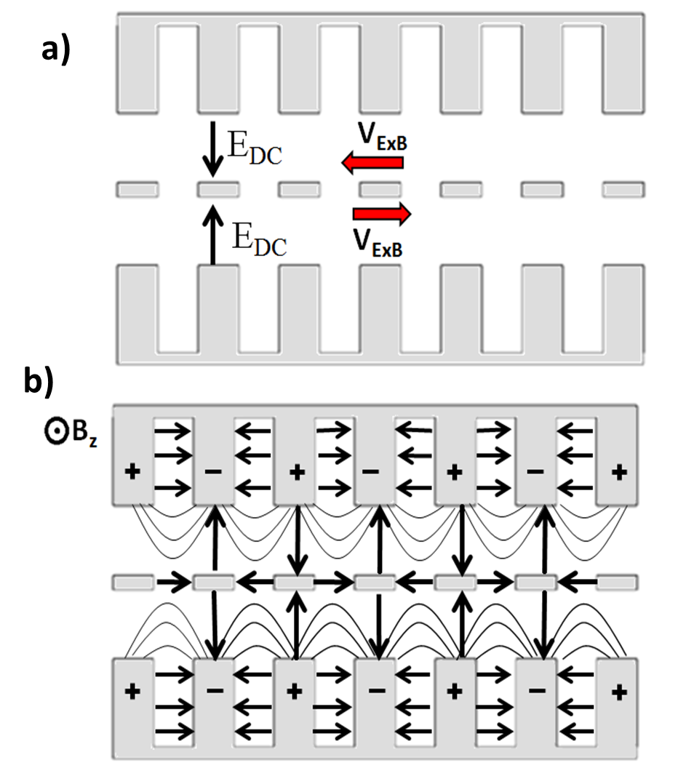
Recirculating Planar Magnetrons
Mode Control Cathode²: Concept
Mode Control Cathode
Geometrically similar to Transparent Cathode (Schamiloglu et al. )
Emission priming structure
Acts as a resonant electromagnetic coupler
Full electron circulation
Cross oscillator self focusing
Independent tuning mechanism
2- Matthew Franzi, Ronald Gilgenbach, Y. Y. Lau, Brad Hoff, Geoff Greening et al., “Passive mode control in the recirculating planar magnetron” Phys. Plasmas 20, 033108 (2013); doi: 10.1063/1.4794967
Notes:
To improve the potential for locking our oscillators we introduce the Mode Control Cathode
Geometrically similar to the transparent cathode developed by Prof. Sgu at the UNM,
The MCC will act as an emission priming structure for both the pi and 2pi modes.
However, instead of acting to only enhance the electrostatic field on the surface of the cathode, the MCC works to resonantly couple RF fields from one side of the device to the other.
The periodically slotted structure also provides full electron beam transport, from one oscillator to the other, throughout the entirety of the planar geometry and may lead to a phenomenon we refer to as “Cross Oscillator Self Focusing” which I will elaborate on shortly.
Additionally the MCC can be utilized as an RF tuning mechanism that is completely independent from the surrounding slow wave structure. Subtle changes to the size and shape of each periodic structure can be analytically shown to shift the frequency of a given mode or increase mode separation (particularly between the closely spaced even-odd modes I identified initially.)

Slide 6
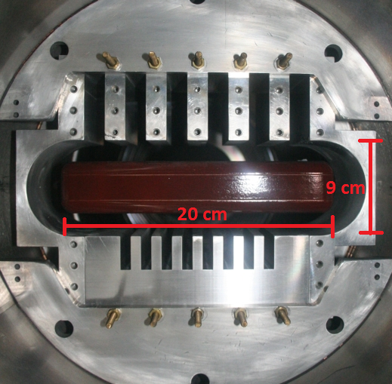
Recirculating Planar Magnetrons
Multi-Frequency Recirculating Planar Magnetron (MFRPM)
MFRPM 6+8 Design:
Replaced one of the original RPM’s 1 GHz slow wave structures (SWS) with a 2 GHz SWS
2 GHz SWS has 8 resonant cavities
Expected to produce the 2 frequencies simultaneously
AK gap is the same for the 1 and 2 GHz oscillators
Power is extracted by antennas threaded into the middle vane on each oscillator
Notes:
Id now like to talk about a recent modification made to the RPM, the Multi-Frequency RPM. (describe MFRPM)

Slide 7
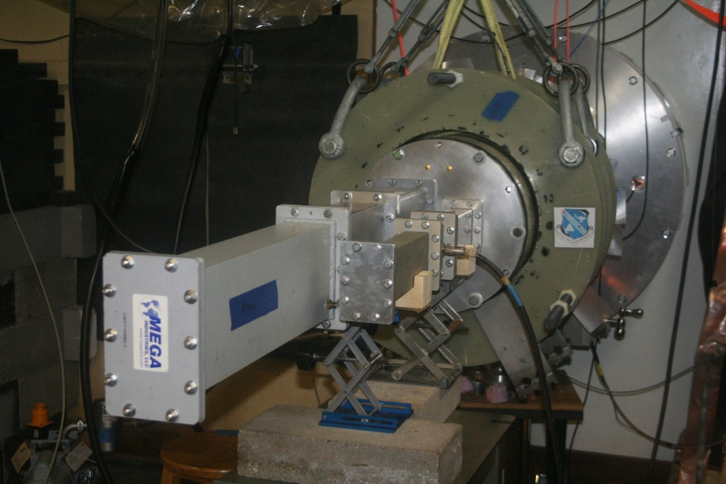
Recirculating Planar Magnetrons
Multi-Frequency Recirculating Planar Magnetron (MFRPM)
Notes:
Here we have a photograph of the MFRPM experiment fully assembled. The power is extracted from each oscillator and directed to appropriately sized waveguide. The signal is measured by a directional coupler in each waveguide

Slide 8
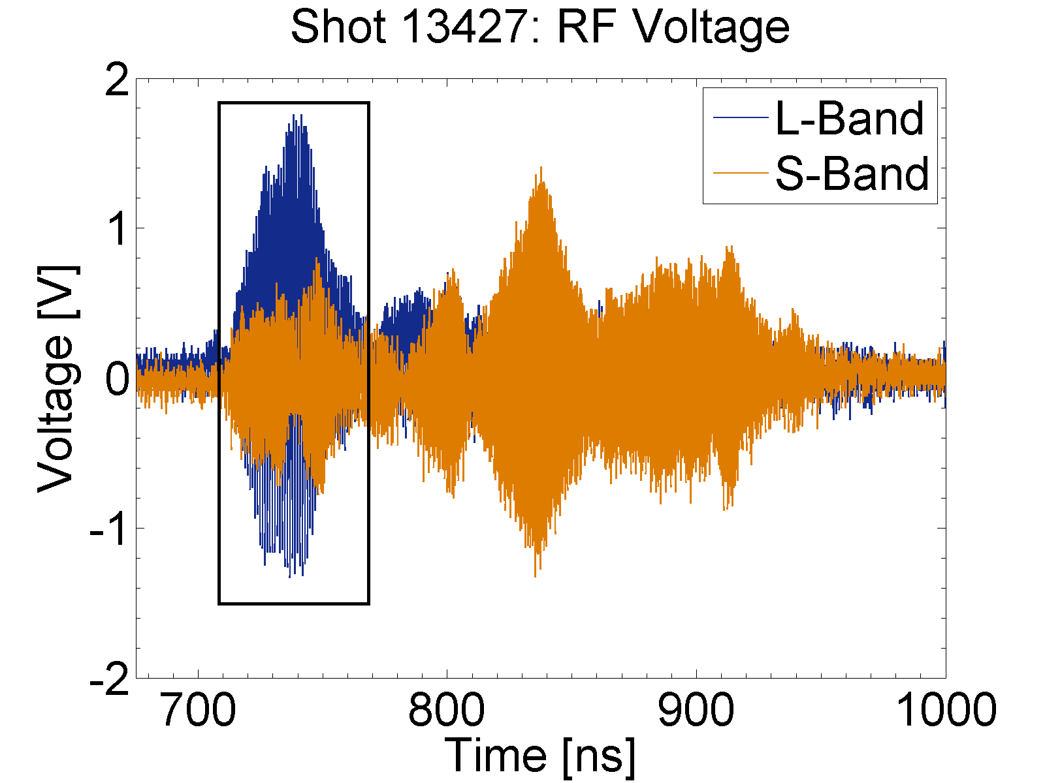
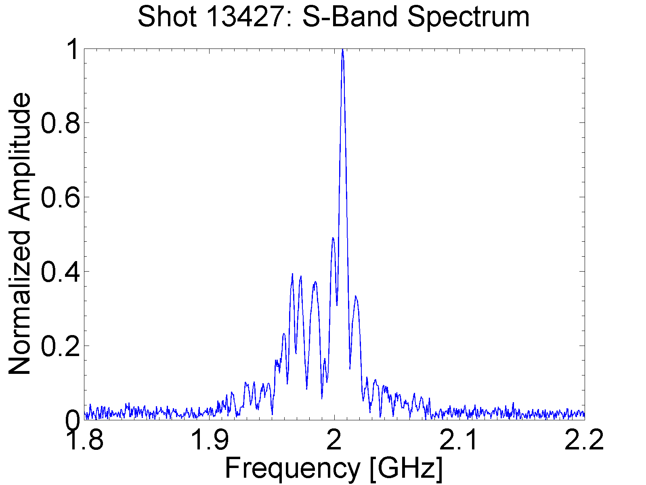
Recirculating Planar Magnetrons
Multi-Frequency Recirculating Planar Magnetron (MFRPM)
MFRPM Experiments
Dual frequency operation achieved
Potentially phase locked operation (boxed) for up to 60 ns
Especially high currents drawn leading to significant voltage droop
Mode competition is evident

Slide 9
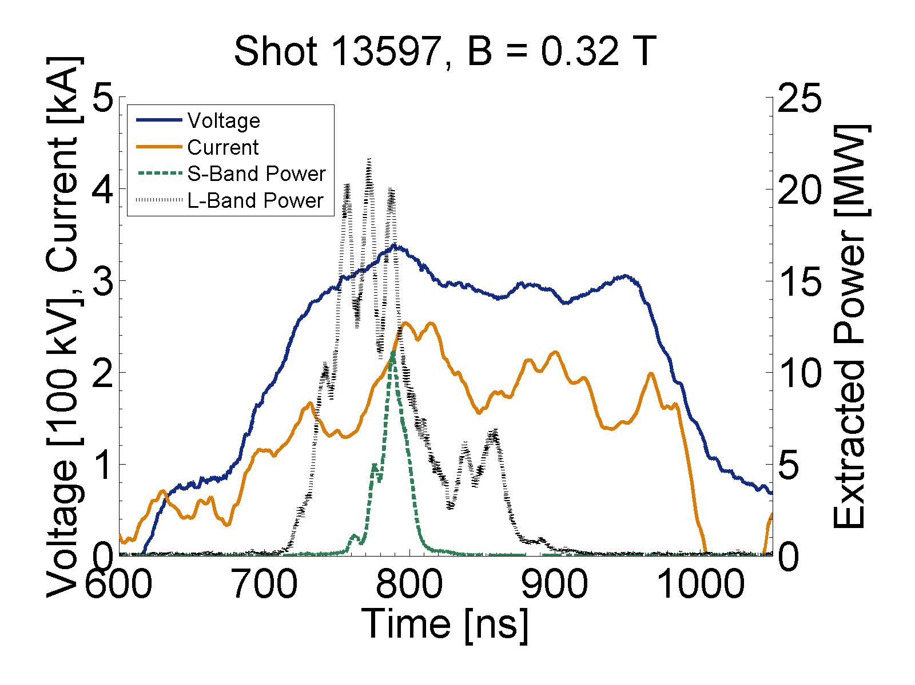
Recirculating Planar Magnetrons
Multi-Frequency Recirculating Planar Magnetron (MFRPM)
MFRPM Results
Approximately 20 MW peak power generated from the L-band and 10 MW from the S-band.
L-band output power fluctuations suggest mode competition
L-band and S-band outputs peak simultaneously
S-band microwaves begin later and end at around the same time, likely due to unfavorable AK gap
Notes:
Here we have some shot data taken from the MFRPM. (Describe)

Slide 10
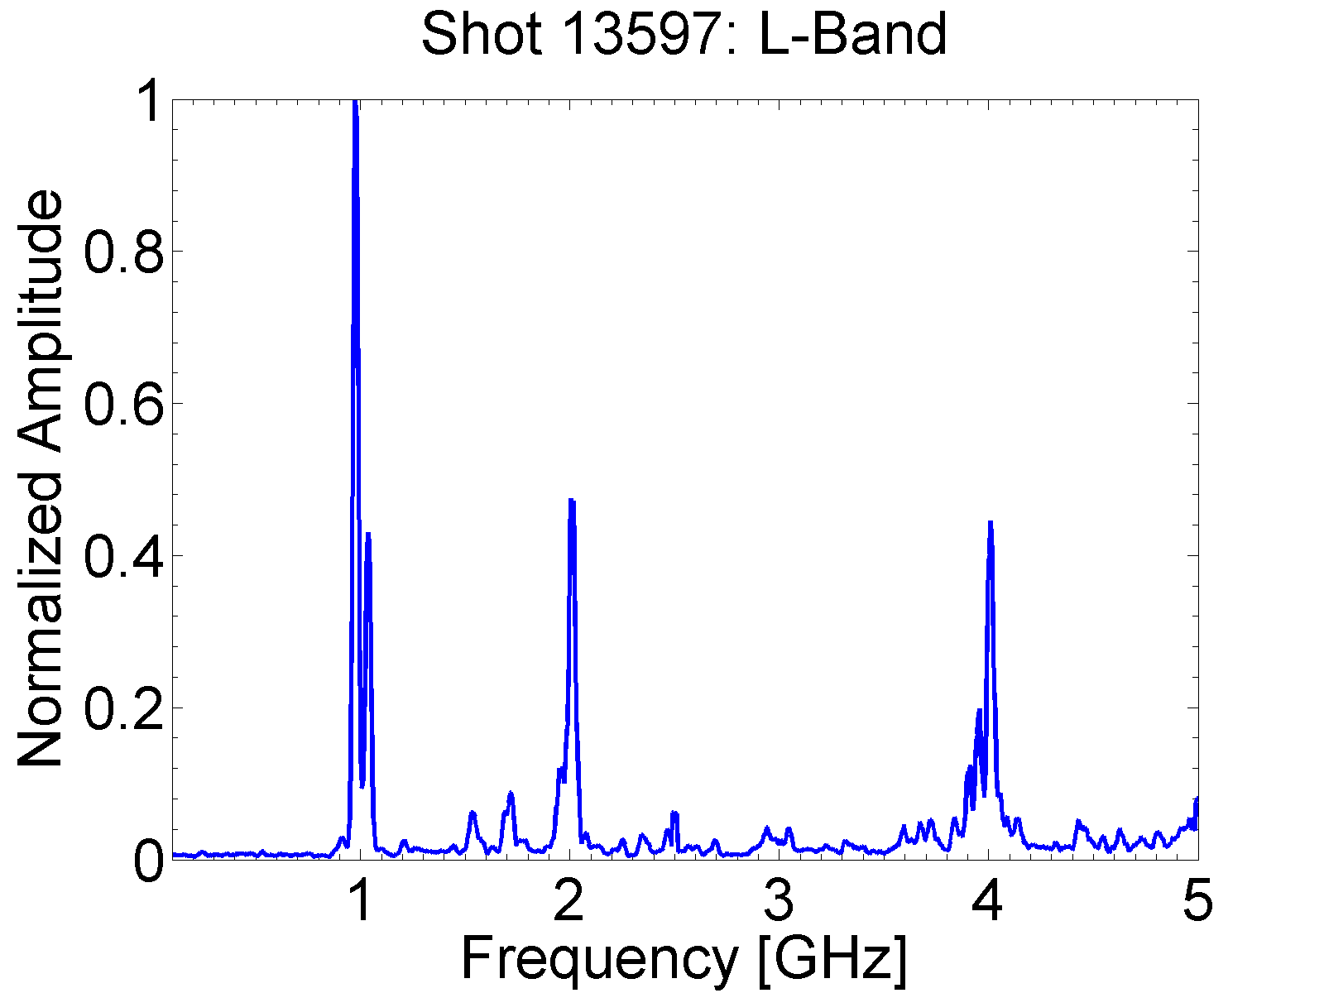
Time Integrated FFT
Mode competition is apparent on both oscillators. The L-Band oscillator also displays significant harmonic generation. It should be noted that the dominant 2.016 GHz signal from the S-Band is not double the frequency of the L-Band Dominant frequency nor the 2.01 GHz first harmonic.
L-Band Frequencies [GHz]:
0.971
0.981
1.039
L-Band Harmonic [GHz]:
2.010
S-Band Frequencies [GHz]:
1.944
2.016

Slide 11
Time-Frequency Analysis
A frequency resolved TFA shows simultaneous oscillation in the competing modes on the oscillators, indicating mode competition rather than mode hopping

Slide 12
Harmonic Content
A time resolved time-frequency analysis shows that the L-Band 1 GHz and its harmonics occur simultaneously for a short time though higher order harmonics persist after the 1 GHz signal

Slide 13
Magnetic Field Dependence
L-Band Frequencies vs. B
S-Band Frequencies vs. B
The 1.04 GHz competing mode is thought to be a chamber oscillation which would explain the insensitivity to magnetic field. Dominant L-Band modes tend to decrease in frequency with increasing magnetic field, as do competing S-Band modes. This behavior is surprising as it opposes the expected frequency shift due to beam loading.

Slide 14
L- and Half S-Band Frequencies vs. B
The Dominant L-Band modes and the half-frequencies of the competing S-Band modes are overlaid and plotted against B. The overlap suggests that the second harmonic of the L-Band excites a competing mode on the S-Band oscillator

Slide 15
Conclusions
The MFRPM produced peak powers of 20 MW at 1 GHz and 10 MW at 2 GHz simultaneously.
Harmonic Generation of 2 GHz and 4 GHz was excited on the L-Band Oscillator.
Harmonic signals are generated concurrently with primary 1 GHz signal and persist after the 1 GHz signal cuts off.
Dominant frequencies tend to decrease with increasing magnetic field.
The 2 GHz harmonic from the L-Band oscillator is thought to excite competing modes on the S-Band oscillator.

Slide 16
Future Work
Proper extraction techniques will be designed to observe and measure the power in the harmonic signals.
Harmonic generation from other cathodes and anodes will be analyzed
Acknowledgements
This research was supported by the Air Force Office of Scientific Research, The Office of Naval Research, and L-3 Communications Electron Devices
G. B. Greening received additional support from the Directed Energy Professional Society.

