Slide 1
DRY ETCHING OF Si₃N₄ USING REMOTE PLASMA SOURCES SUSTAINED
IN NF₃ MIXTURES*
Shuo Huang and Mark J. Kushner
Department of Electrical Engineering and Computer Science,
University of Michigan, Ann Arbor, MI 48109
(shuoh@umich.edu, mjkush@umich.edu)
The 6th Annual MIPSE Graduate Student Symposium
Ann Arbor, Michigan
October 7, 2015
Work supported by Samsung Electronics, DOE Office of Fusion Energy Science and National Science Foundation.
Notes:
1
1

Slide 2
AGENDA
Remote NF₃ sources
NF₃ electron impact cross sections
Gas phase and surface reaction mechanisms
Description of the model
Plasma properties and etch rates
Continuous wave scenarios
Pulsed power scenarios
Different gas mixtures
Concluding Remarks
University of Michigan
Institute for Plasma Science & Engr.
Notes:
2
2

Slide 3
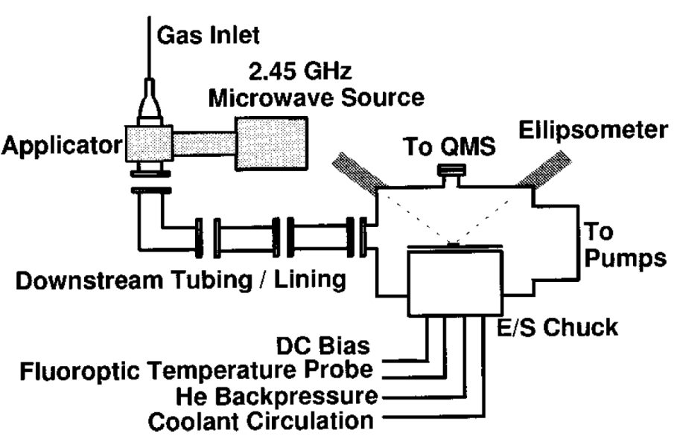
REMOTE PLASMA SOURCES
Remote plasma sources (RPS) for microelectronics fabrication:
Produce dominantly neutral fluxes of radicals for etching, cleaning, surface passivation
Decrease damage by charging and energetic ion bombardment.
Separate plasma production, transport and processing regions.
Small effect of E-field on particle transport near wafer.
Particle transport dominated by convective flow and diffusion.
RPS use distance, grids or other discriminating barriers to limit exposure to plasma.
Schematic of RPS.[1]
[1] Kastenmeier et al., JVSTA 16, 2047 (1998).
University of Michigan
Institute for Plasma Science & Engr.
Notes:
3
3

Slide 4
NF₃ GAS MIXTURES
In NF₃ containing mixtures, F efficiently produced by dissociative processes:
e + NF_{n} (n=1-3) → NF_{n-1} + F⁻
e + NF_{n} (n=1-3) → NF_{n-1} + F + e.
F-containing plasmas used for etching Si-containing materials.
SiF_{m-1}(s) + F(gas) → SiF_{m}(ads, m=1-3)
SiF₃(s) + F(gas) → SiF₄(gas).
Pure NF₃ limits variety of reactive fluxes to F, NF_{n}. Additives (NF₃/O₂, NF₃/H₂) increase variety of reactive species to optimize process.
NO produced in NF₃/O₂ mixtures aids removal of N from Si₃N₄.[2]
N(surface) + NO(gas) → N₂(gas) + O(surface)
→ N₂O(gas).
[2] Kastenmeier et al., JVSTA 19, 25 (2001).
University of Michigan
Institute for Plasma Science & Engr.

Slide 5
ELECTRON IMPACT NF₃ CROSS SECTIONS
Differences in dissociative electron attachment at low energy does impact predictions of RPS efficiency.
Cross sections for NF₃ based on work of V. Lisovskiy et al.[3]
Cross sections for NF₃ calculated using R-matrix method.
[3] V. Lisovskiy et al., J. Phys. D 47, 115203 (2014).
University of Michigan
Institute for Plasma Science & Engr.

Slide 6
REACTION MECHANISM: NF₃/O₂
O, O₂, O₃
N, N₂
NO, NO₂
e, O, NO, M
e,
NF,
M
e
F₂
O
e,
N,
NO,
NO₂,
M
N,
N₂,
FNO
N
e, N, NF₂, O, M
O, FO, NO₂
NF
NF₂
FNO
NF₃
NF₂
O₂
e, N,
NF, M
O, O₂
O₃
F₂, NF₂
e, N
e,
N,
NO,
M
O
NF₂
NF₃
e,
N,
M
F₂
F,
FO,
M
e, N,
NF, M
NO
O
e,
M
F, F₂
O, FO, NO, NF₂, M
FO
O, F, NO
M represents 3rd body.
Electron modified enthalpy (gas heating).
University of Michigan
Institute for Plasma Science & Engr.
Notes:
6
6

Slide 7
PRIMARY SURFACE MECHANISM FOR Si₃N₄ ETCHING
In RPS systems, there are negligible fluxes of ions (with above thermal energies) to substrate.
Mechanism is purely neutral driven.
Si in Si₃N₄ is removed by a sequence of F-passivation steps.
SiN(s) + F(g) → SiNF(s)
SiNF(s) + F(g) → SiNF₂(s)
SiNF₂(s) + F(g) → SiNF₃(s)
SiNF₃(s) + F(g) → SiF₄(g) + N(s)
NO aids removal of N surface sites through 2 channels.
N(s) + NO(g) → N₂(g) + O(s)
O(s) + NO(g) → NO₂(g) +SiN(s)
O(s) + O(g) → O₂(g) + SiN (s)
O(s) + O(s) → O₂(g) + SiN(s)
N(s) + NO(g) → N₂O(g) + SiN(s)
University of Michigan
Institute for Plasma Science & Engr.

Slide 8
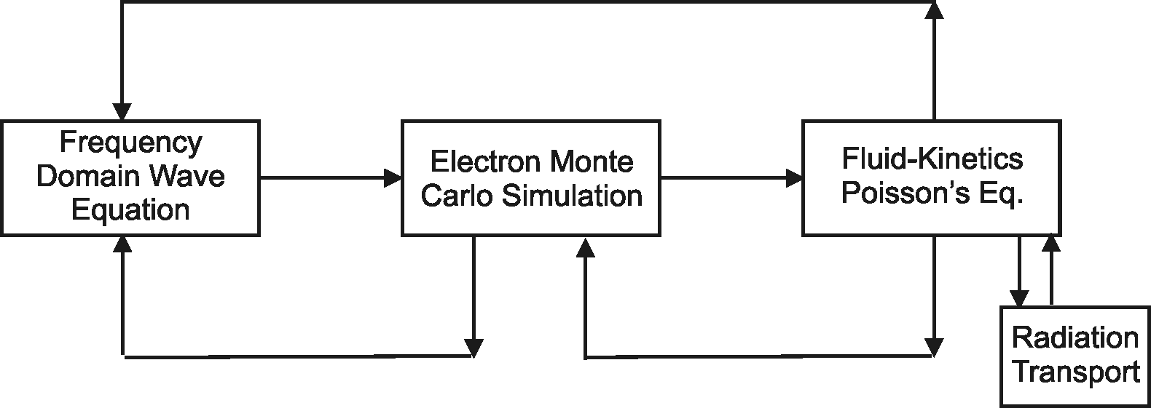
DESCRIPTION OF HPEM
Electron, Ion Cross Section Database
Plasma Chemistry
Monte Carlo Simulation
EETM
FKPM
Surface
Kinetics
Module
Hybrid Plasma Equipment Model – modular simulator that combines fluid and kinetic approaches.
Surface Kinetics Module (SKM) – a surface site balance model addressing etching, deposition and passivation of surfaces.
Fluid-Kinetics Poisson Module (FKPM): Heavy particle and electron continuity, momentum, energy and Poisson’s equations.
University of Michigan
Institute for Plasma Science & Engr.

Slide 9
REMOTE PLASMA SOURCE
Inductively coupled RPS.
Mini-showerheads to isolate ions.
Ar/NF₃/O₂, 50 mTorr, 3000 sccm.
Flow distance: 12 cm.
CW cases:
Power: 100 – 800 W.
Ar/NF₃/O₂=(100-2X)/X/X: X=5-20.
Pulsed cases:
PRF=20, 50, 100 kHz.
Duty cycle=30, 50%
P_{ave} = 300 W.
University of Michigan
Institute for Plasma Science & Engr.

Slide 10
n_{e}, T_{e} : 300 W (CW)
Electron confinement results from highly attaching chemistry and grid of shower-head. (λ_{D} = 0.08 cm at showerhead.)
[e]: 4 × 10¹¹ cm⁻³, T_{e} = 4.5 eV
University of Michigan
Institute for Plasma Science & Engr.
MIN
MAX

Slide 11
IONIZATION SOURCE – ION-ION PLASMA (CW)
Ions are largely confined to source region, however a weak ion-ion plasma persists to lower chamber.
Ion-ion plasma in lower chamber: [F⁻] ≈ [NO⁺] + [O₂⁺] ≈ 10⁸ cm⁻³.
Negligible flux of ions to wafer surface.
University of Michigan
Institute for Plasma Science & Engr.
MIN
MAX

Slide 12
RADICAL GENERATION – 300 W (CW)
F efficiently produced with 50% dissociation of NF₃.
[NO] produced by endothermic processes aided by gas heating:
N₂ + O₂ → NO + NO N₂ + O → N + NO.
Gas temperature in RPS ≈ 750 K.
University of Michigan
Institute for Plasma Science & Engr.
MIN
MAX

Slide 13
ETCH RATE – 300 W (CW)
Si surface sites etched by F, forming SiF₄ and exposing N sites.
N sites etched by NO aided processes:
(I) N(s) + NO(g) → N₂(g) + O(s)
O(s) + NO(g) → NO₂(g) + SiN(s)
O(s) + O(g) → O₂ + SiN(s)
O(s) + O(s) → O₂(g) + SiN(s)
(II) N(s) + NO → N₂O + SiN(s)
For these conditions, limiting factor for etch rate is ratio of NO/F fluxes.
Other possible channel to remove N sites: N(s) + N(g) → N₂(g).
University of Michigan
Institute for Plasma Science & Engr.

Slide 14
FLUXES, ETCH RATE vs. POWER (CW)
• F Flux
• NO Flux
• Etch Rate
F flux increases linearly with power until saturating when NF₃ dissociation becomes significant.
NO flux increases non-linearly with power due to 2-step and/or endothermic formation mechanism, requiring higher radical densities and gas temperature. F/NO ratio decreases with power.
Result is threshold power for significant etching based on availability of NO.
University of Michigan
Institute for Plasma Science & Engr.

Slide 15
SURFACE COVERAGE vs. POWER (CW)
Fractional Si surface sites
Fractional N surface sites
Initial condition: pristine SiN sites containing Si and N "subs-sites".
Si "sub-sites" in SiN almost completely etched by F atoms leaving N "sub-sites". Full etching is rate limited by removal of N sub-sites.
Etching of N sites depends on NO density: higher NO flux leads to removal of N sites and re-exposure of SiN sites.
University of Michigan
Institute for Plasma Science & Engr.

Slide 16
FLUXES, ETCH RATE vs. GAS MIXTURE (CW)
• F Flux
• NO Flux
• Etch Rate
Similar trends when varying gas mixture.
F atom flux increases with NF₃ fraction however, NO flux nearly constant for constant power – due, in part, to endothermic origin and dependence on gas temperature.
Result is limited dependence of etch rate on mixture as long as NO fluxes are critically large.
University of Michigan
Institute for Plasma Science & Engr.

Slide 17
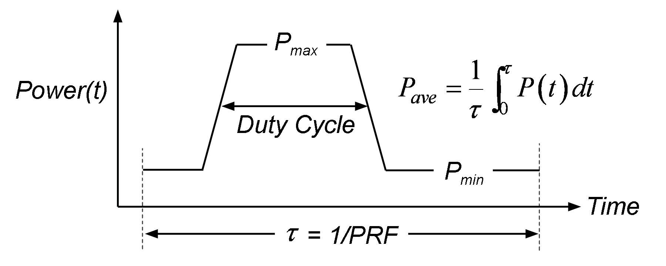
PULSED POWER
Use of pulse power provides a means for modulating electron energy distribution (EED), and so control radical generation.
Pulsing enables both plasma properties and etch properties to be controlled beyond what may be possible with CW excitation.
Pulse repetition frequency: 20, 50, 100 kHz.
Duty Cycle = 30, 50%.
Average power: 300 W.
University of Michigan
Institute for Plasma Science & Engr.

Slide 18
CHARGED SPECIES – 20 kHz, 30% DUTY CYCLE
With a fast rising pulse, over-shoot in E/N and T_{e} above cw values enable more efficient excitation.
Source and loss for e’s balance over 1 pulse period:
Pulse-on: ionization,
Pulse-off: diffusion, attachment, and recombination.
Customizable rate coefficients compared to CW operation.
University of Michigan
Institute for Plasma Science & Engr.

Slide 19
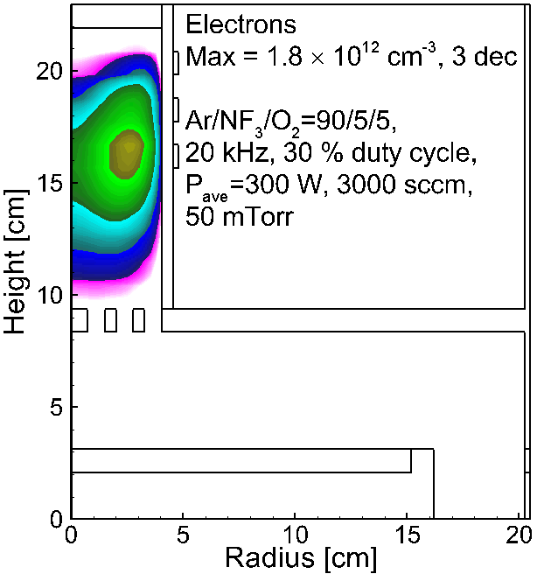
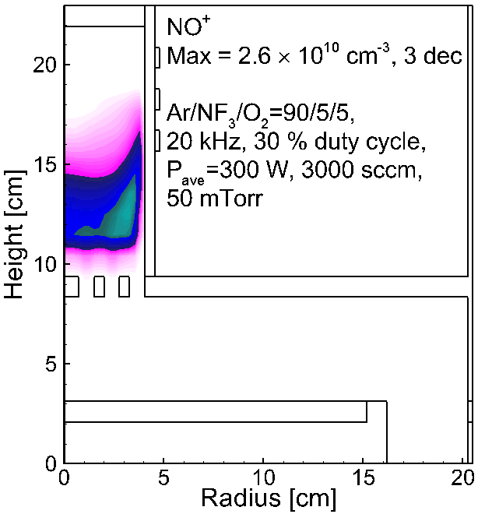
[e], [NO⁺] – 20 kHz, 30% DC
Terminal positive ion is NO⁺ due to favorable charge exchange.
As density of NO increases flowing downstream, NO⁺ density increases.
University of Michigan
Institute for Plasma Science & Engr.
Animation Slide
MIN
MAX

Slide 20
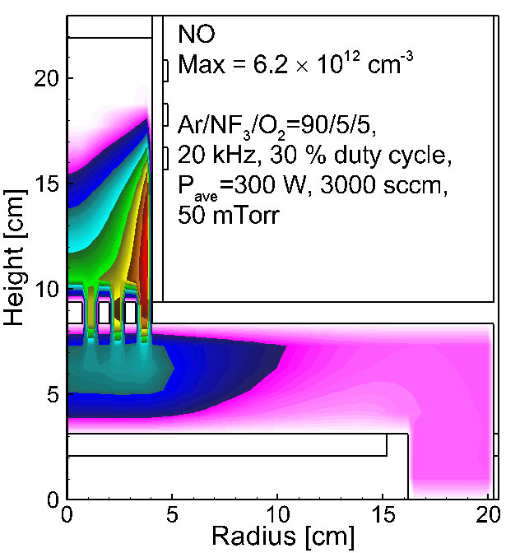
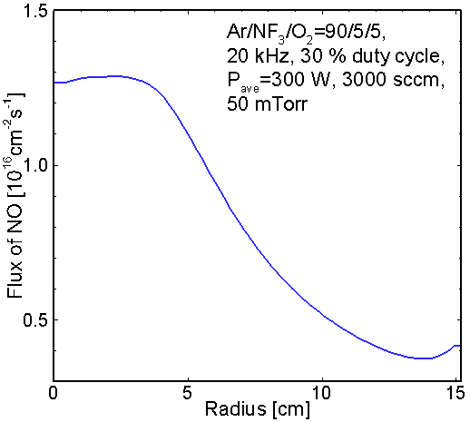
NO DENSITY AND FLUX – 20 kHz, 30% DC
Since radical lifetime and residence time are longer than pulse period, little modulation in NO densities and fluxes.
Lower PRF could be leveraged to sequence fluxes to substrate.
University of Michigan
Institute for Plasma Science & Engr.
Animation Slide
MIN
MAX

Slide 21
ETCH RATE vs. PRF, DUTY CYCLE
PRF: 20 – 100 kHz
Duty cycle: 30 – 50% DC
Etch rate sensitive to PRF and duty cycle for same average power due to production rates of NO.
With increasing PRF, average gas temperature increases.
With decreasing DC, T_{gas} during pulse increases.
University of Michigan
Institute for Plasma Science & Engr.

Slide 22
CONCLUDING REMARKS
RPS has been modeled using ICP operation of HPEM (2-D).
Electron-impact NF₃ cross sections has been calculated using ab initio R-matrix method.
Etch rates correlate with NO flux which produces non-linear scaling with power but weak dependence on mixture.
Etch rate increases with increased PRF and decreased duty cycle:
Over-shoot in E/N and T_{e} above cw values enable more efficient excitation and gas heating.
NO density modulated through gas heating.
University of Michigan
Institute for Plasma Science & Engr.
Notes:
22
22

