Slide 1
  Stochastic Defect Detection for Monte-Carlo Feature Profile Model *
  MIPSE Graduate Symposium 2015
  Chad Huard and Mark Kushner
  University of Michigan, Dept. of Electrical Engineering
  * Work supported by Lam Research Corporation
MIPSE_2015

Slide 2
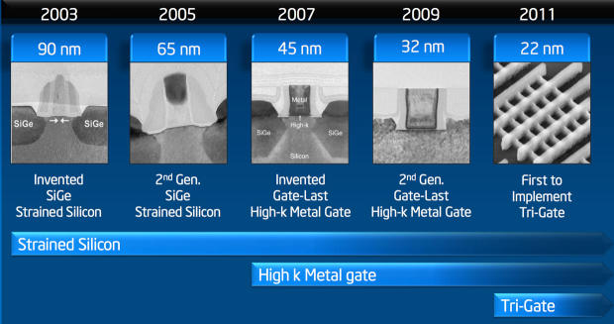
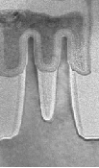
IMPORTANCE OF PLASMA ETCHING
Reactive ion etching in plasma has become indispensable for semiconductor fabrication processes
Each successive technology node puts greater demands on etch techniques in terms of resolution and fidelity
2014
14nm 2nd Gen.
[1] S. Natarajan et al., 2014 IEEE International Electron Devices Meeting, 2014, pp. 3.7.1–3.7.3.
University of Michigan
Institute for Plasma Science & Engr.
MIPSE_2015
Notes:
pictures

Slide 3
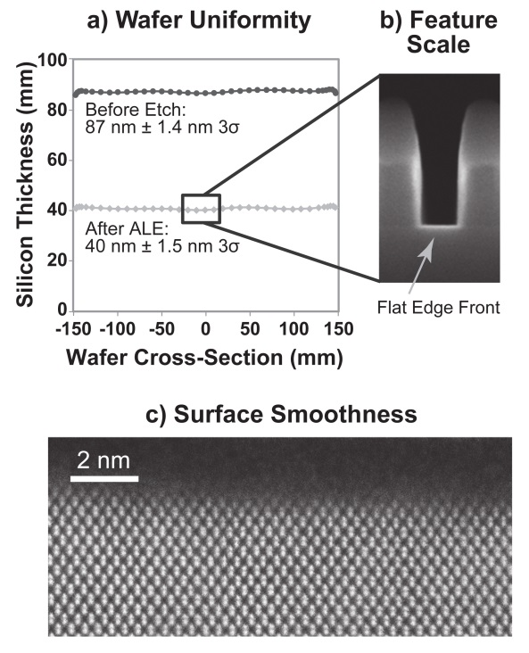
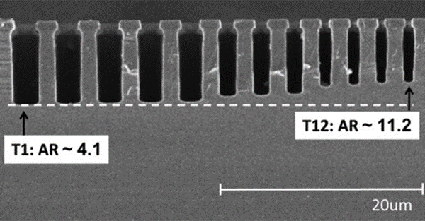
CHALLENGES IN MODELING
High quality simulation techniques are required that can be used to investigate the physics at work in modern etch processes on technologically relevant scales
Atomic Layer Etching
Aspect Ratio Dependent Etch-rate
[1] R. L. Bates, M. J. Goeckner, and L. J. Overzet, J. Vac. Sci. Technol. A Vacuum, Surfaces, Film., vol. 32, no. 5, p. 051302, 2014.
[2] K. J. Kanarik, T. Lill, E. a. Hudson, S. Sriraman, S. Tan, J. Marks, V. Vahedi, and R. a. Gottscho, J. Vac. Sci. Technol. A Vacuum, Surfaces, Film., vol. 33, no. 2, p. 020802, 2015.
University of Michigan
Institute for Plasma Science & Engr.
MIPSE_2015
Notes:
pictures

Slide 4
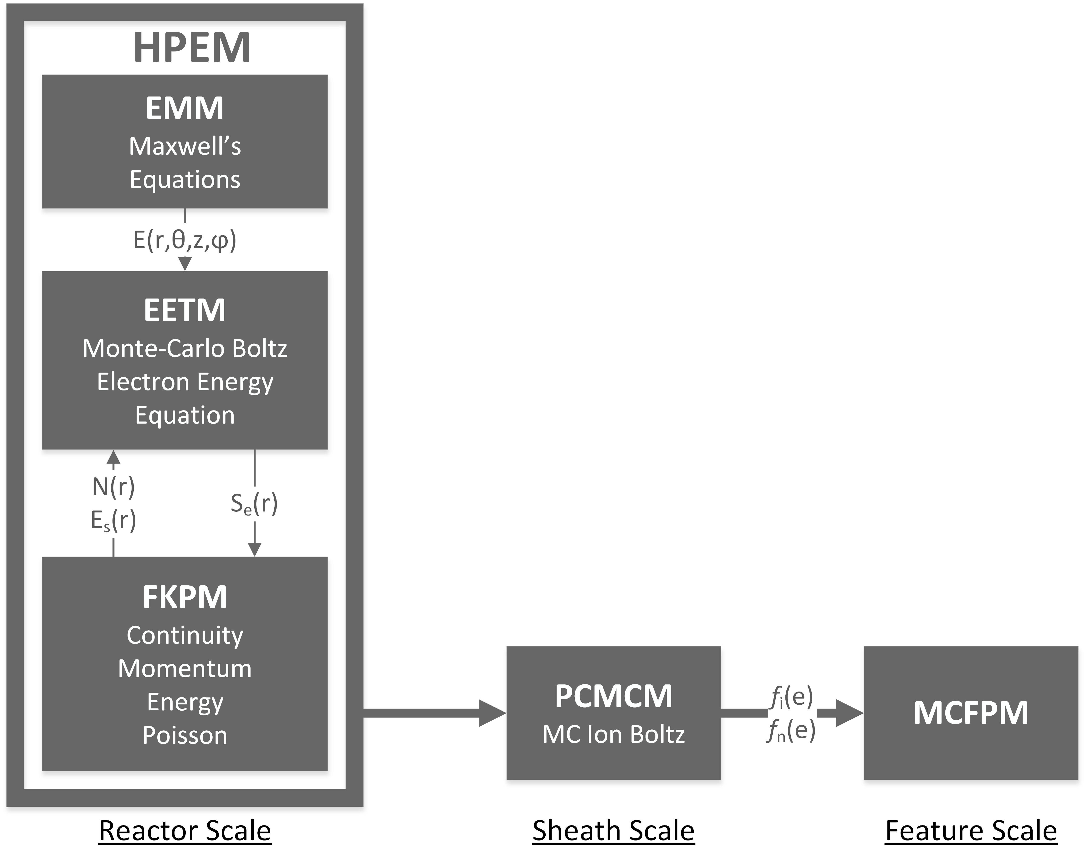
INTEGRATED MODEL HIRERARCHY
Integrated modeling of reactor level plasma physics, sheath dynamics and etch feature evolution is essential to understand the dependency of etch features on process conditions
Our model uses independent modules which exchange information on process dependent time/length scales to simulate the physics at these vastly different scales
University of Michigan
Institute for Plasma Science & Engr.
MIPSE_2015
Notes:
pictures

Slide 5
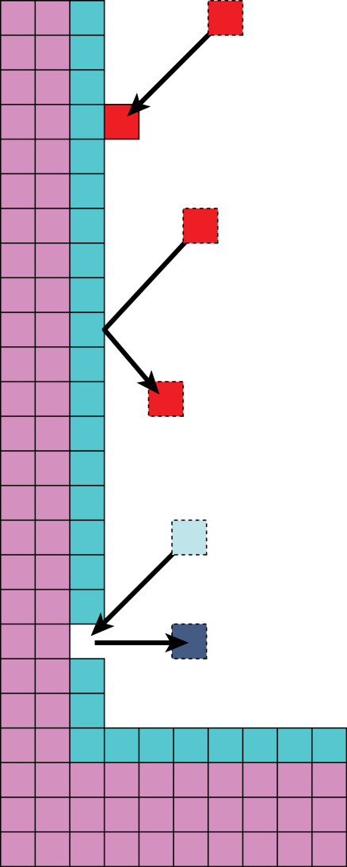
MONTE CARLO FEATURE PROFILE MODEL
Profile geometry is defined on a structured grid
Pseudo-particles are launched with fluxes, energy and angular distributions derived from HPEM data
Particles are tracked through space until they react with the profile
Typical reactions:
    Deposition A(s) + B(g) → A(s) + B(s)
    Reflection A(s) + B(g) → A(s) + B(g)
    Reaction A(s) + B(g) → C(s) + D(g)
All particles, including reaction products, are tracked until they are consumed or leave the simulation domain
Changes made to the profile by particle reactions are tracked as the simulation output
Deposition
Reflection
Reaction
University of Michigan
Institute for Plasma Science & Engr.
MIPSE_2015
Notes:
pictures

Slide 6
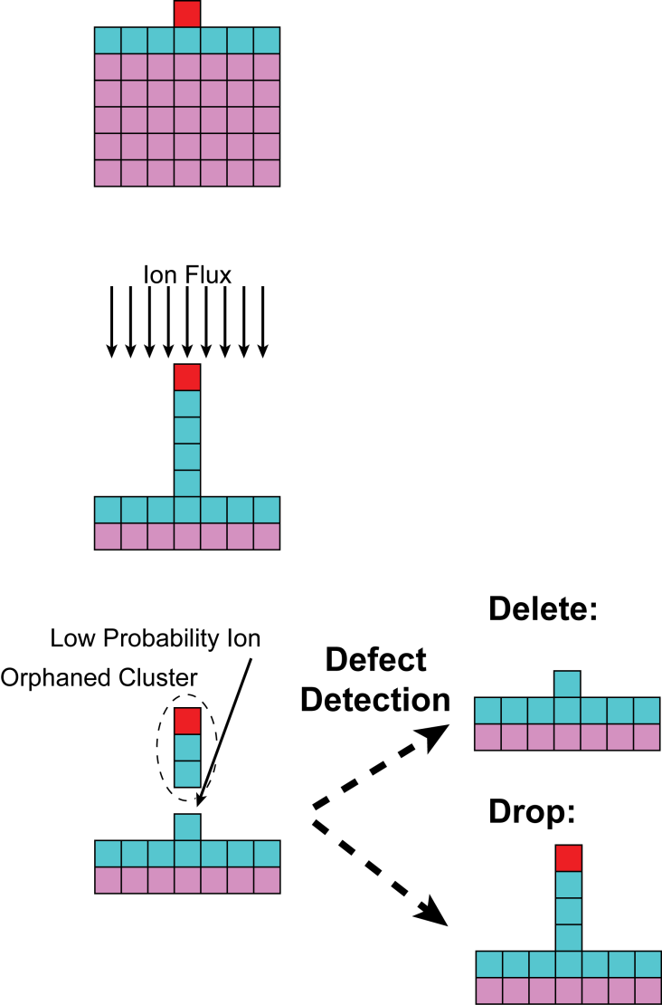
STOCHASTIC DEFECTS
Due to stochastic nature of the Monte Carlo technique, unphysical defects can appear in the etch profile
Clusters of solid cells which have become detached from the main profile can appear during simulation
To avoid these unphysical defects affecting the results of the simulation they must be searched for and resolved separately from the main etch simulation
Two ways to resolve:
    Delete orphaned clusters when detected
    Drop clusters to surface of profile, as by gravity
University of Michigan
Institute for Plasma Science & Engr.
MIPSE_2015
Notes:
pictures

Slide 7
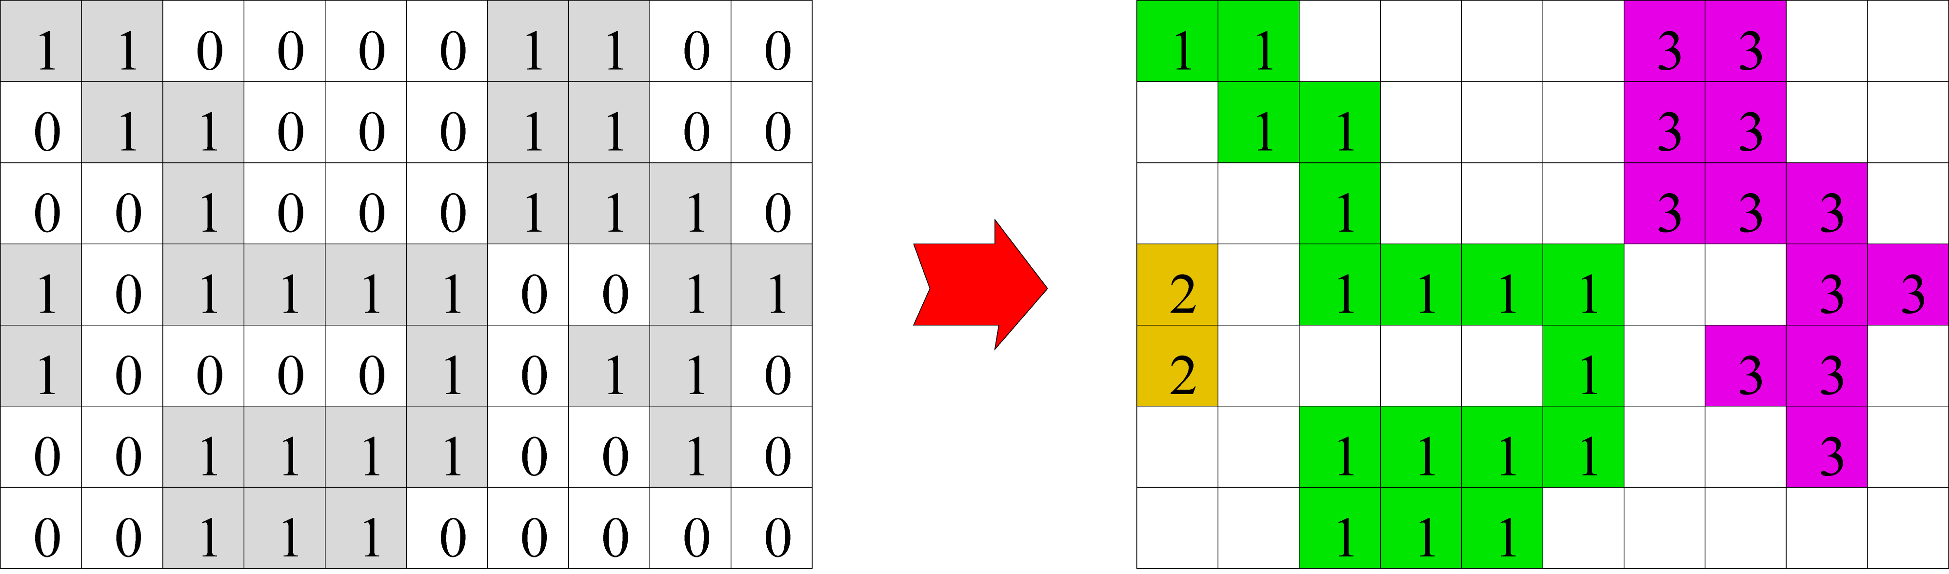
HOSHEN-KOPELMAN (HK) ALGORITHM
Originally conceived to study percolation problems
Algorithm finds ‘clusters’ of connected cells and gives each cluster a unique label
Any two cells that have the same label are connected by a path through other cells with the same label, and any two cells with different labels have no such path between them
[1] J. Hoshen and R. Kopelman, Phys. Rev. B, vol. 14, no. 8, pp. 3438–3445, Oct. 1976.
[2] C. Joas, “Introduction to the Hoshen-Kopelman algorithm and its application to nodal domain statistics,” in Weizmann Institute, Nodal Week, 2006.
University of Michigan
Institute for Plasma Science & Engr.
MIPSE_2015
Notes:
pictures

Slide 8
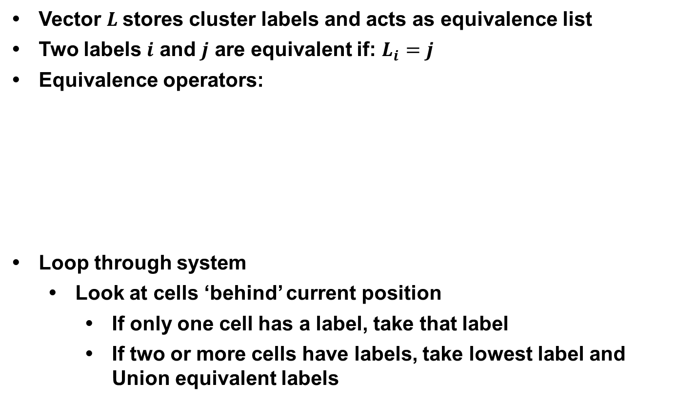
HK PSEUDOCODE
Vector $L$stores cluster labels and acts as equivalence list
Two labels $i$ and $j$ are equivalent if: $L_{i}=j$
Equivalence operators:
Loop through system
    Look at cells ‘behind’ current position
        If only one cell has a label, take that label
        If two or more cells have labels, take lowest label and Union equivalent labels
Find(x):
  while L(x)!=x
  x=L(x)
  return(x)
Union(x,y):
  L(x)=Find(y)
[1] J. Hoshen and R. Kopelman, Phys. Rev. B, vol. 14, no. 8, pp. 3438–3445, Oct. 1976.
[2] C. Joas, “Introduction to the Hoshen-Kopelman algorithm and its application to nodal domain statistics,” in Weizmann Institute, Nodal Week, 2006.
University of Michigan
Institute for Plasma Science & Engr.
MIPSE_2015
Notes:
pictures

Slide 9
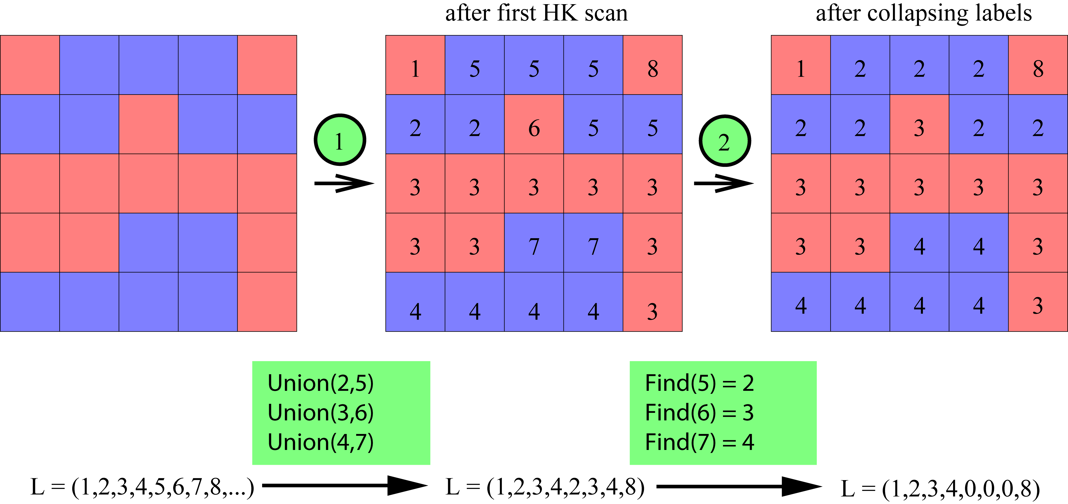
HK ALGORITHM FLOW
HK algorithm requires two passes through system to accurately label all clusters
[1] J. Hoshen and R. Kopelman, Phys. Rev. B, vol. 14, no. 8, pp. 3438–3445, Oct. 1976.
[2] C. Joas, “Introduction to the Hoshen-Kopelman algorithm and its application to nodal domain statistics,” in Weizmann Institute, Nodal Week, 2006.
University of Michigan
Institute for Plasma Science & Engr.
MIPSE_2015
Notes:
pictures

Slide 10
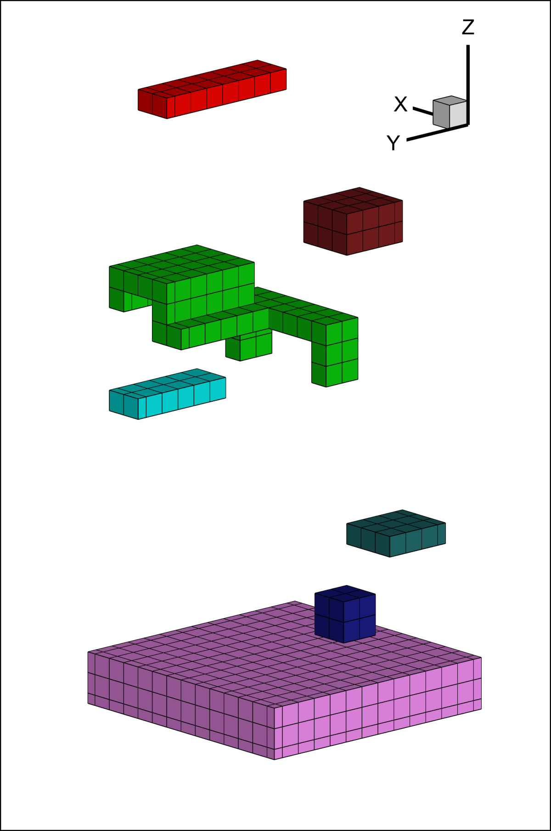
HK IMPLEMENTATION IN MCFPM
In MCFPM the HK algorithm is adopted to identify and label clusters of solid materials
If solid profile is completely connected there will be only one single cluster with only one label
Clusters comprised of fewer than N_{min} cells are considered orphaned and dropped or deleted
HK algorithm is very computationally efficient and robust in this application
Clusters of solid cells: Cells are colored by cluster label using the HK algorithm as implemented in MCFPM
University of Michigan
Institute for Plasma Science & Engr.
MIPSE_2015
Notes:
pictures

Slide 11
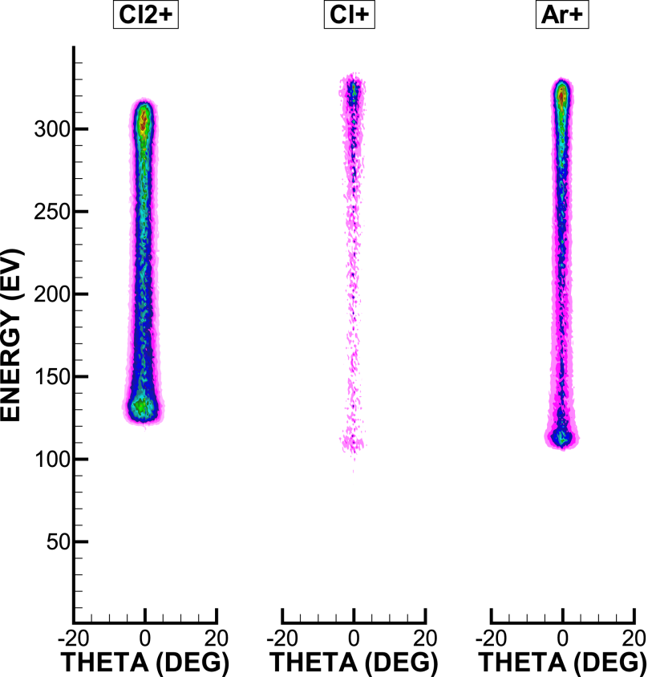
EXAMPLE: SI ETCHING IN CL₂ PLASMA
Silicon etching in Ar/Cl₂ plasma
Main etch mechanism:
    Surface chlorination:
        Si_{(s)} + Cl_{(g)} → SiCl_{(s)}
        SiCl_{(s)} + Cl_{(g)} → SiCl_{2(s)}
        SiCl_{2(s)} + Cl_{(g)} → SiCl_{3(s)}
        SiCl_{3(s)} + Cl_{(g)} → SiCl_{4(g)} (low rate)
    Ion assisted etching:
        SiCl_{x(s)} + M → SiCl_{x(g)} + M
        Where M is an energetic ion
        Sputter rate increases with chlorine coordination and ion energy
Other reactions considered:
    Direct sputtering of Si
    Re-deposition of etch products
    Sputtering / re-deposition of polymer resist (PR)
    Ion energy and angular distributions at etch surface
University of Michigan
Institute for Plasma Science & Engr.
MIPSE_2015
Notes:
pictures

Slide 12
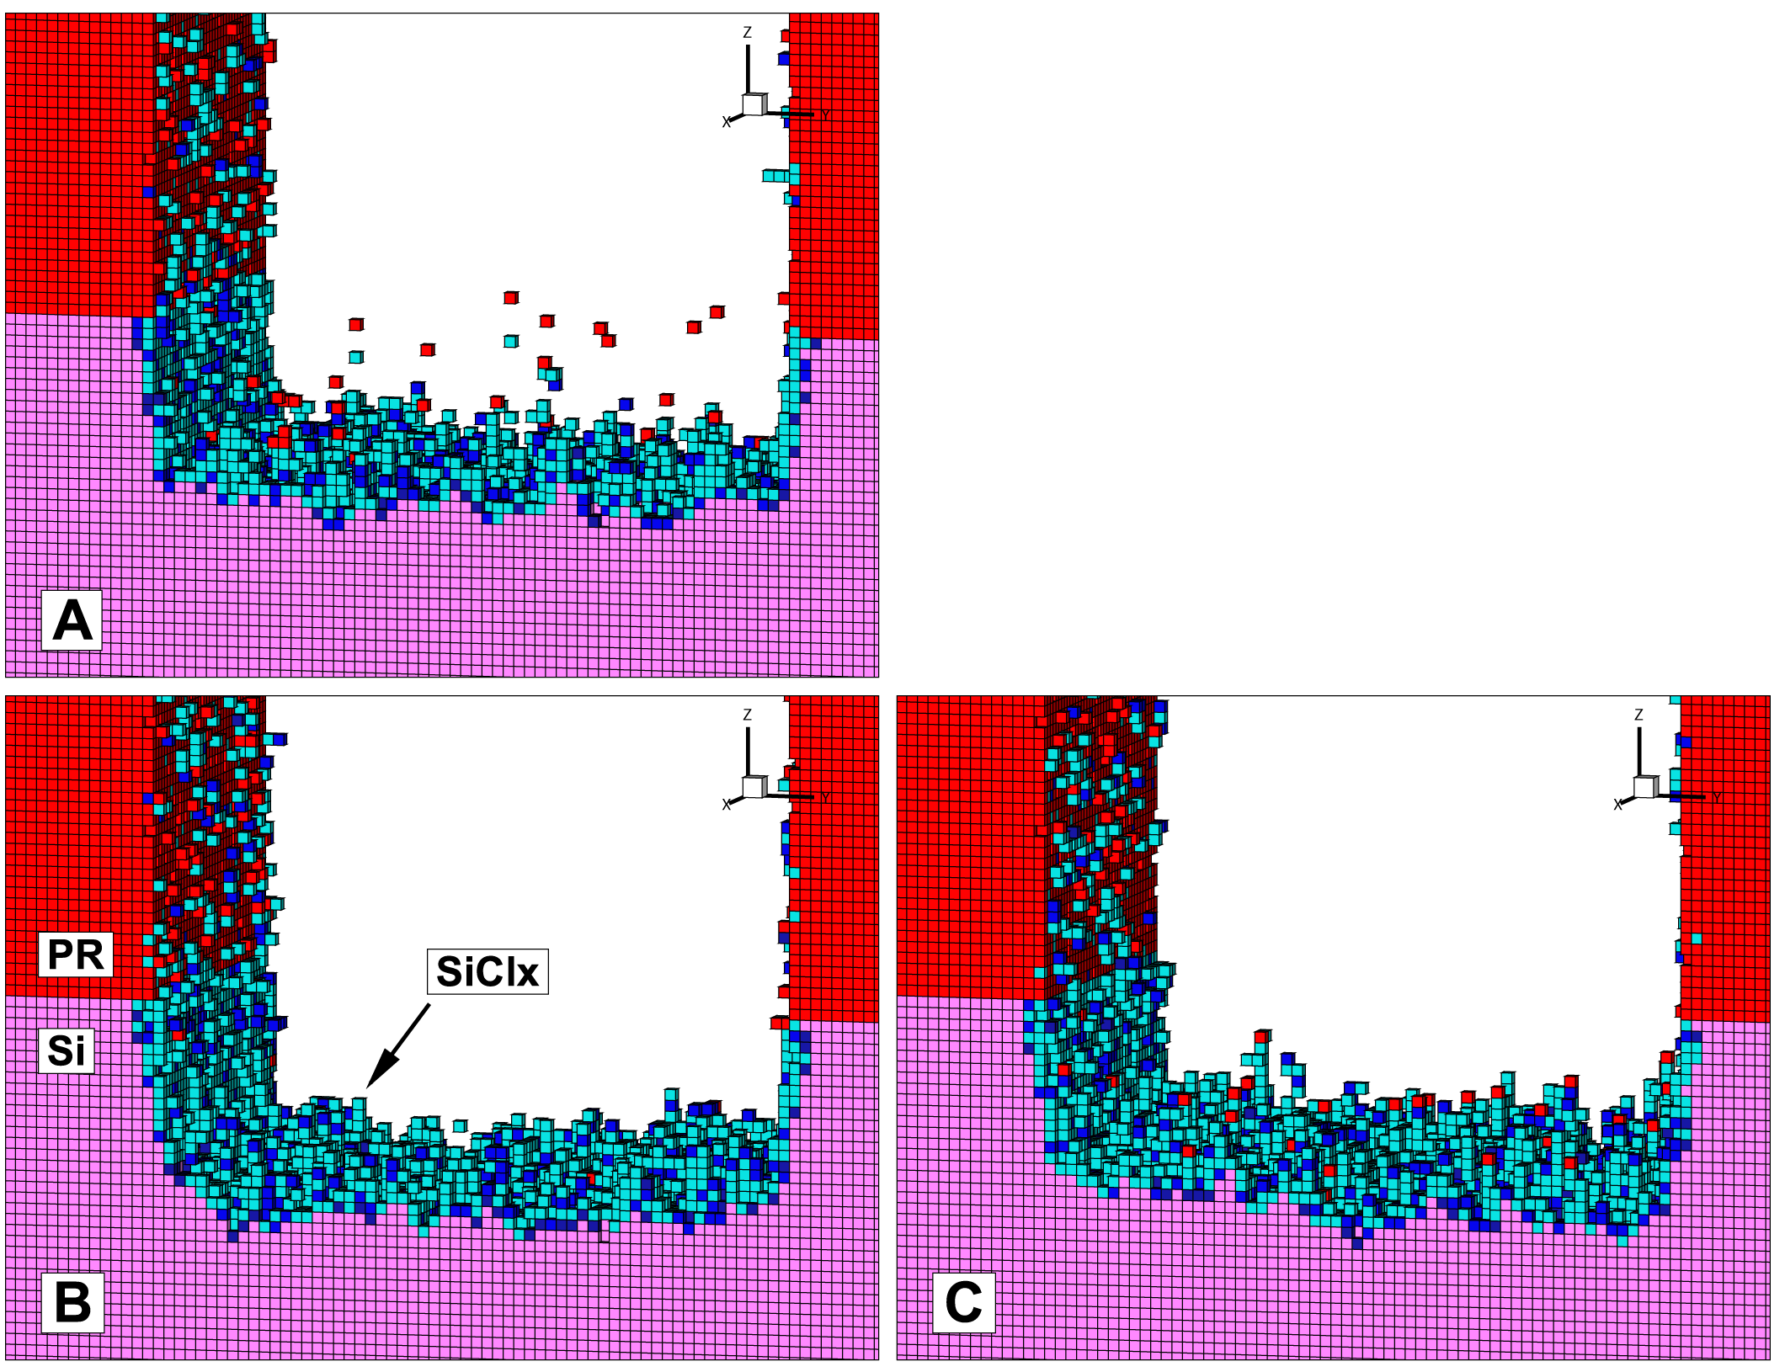
EFFECT ON POLYMER REDEPOSITION
Not using a drop routine leaves a cloud of resist cells floating above the main profile
Delete shows very little re-deposited PR
Drop shows significant “micro-masking” effect
[A] Etch profile with no drop routine
[B] Etch profile with clusters deleted
[C] Etch profile with clusters dropped
University of Michigan
Institute for Plasma Science & Engr.
MIPSE_2015
Notes:
pictures

Slide 13
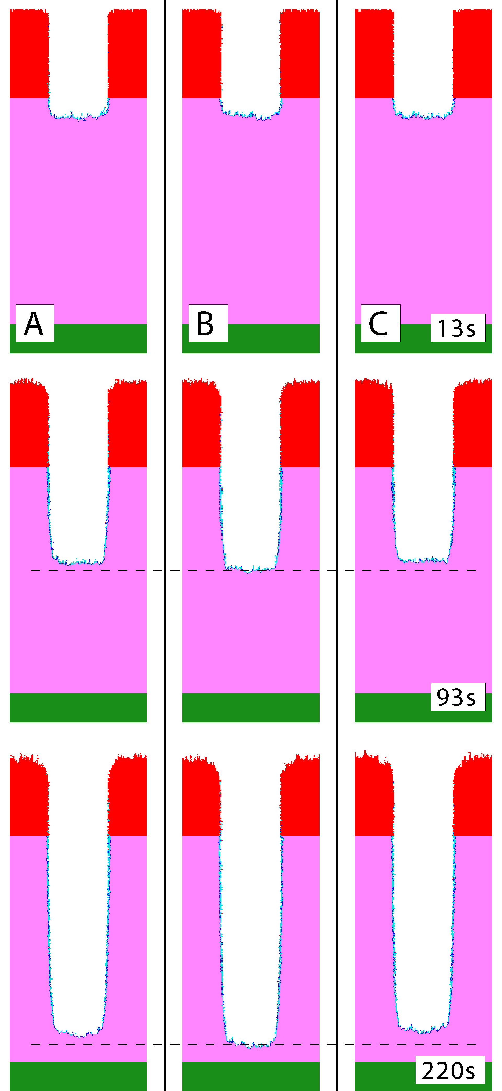
EFFECT ON ETCH RATE
Choosing to delete orphaned clusters increases etch rate
Dropping orphaned clusters to surface slows etch rate slightly
These results are expected due to the relatively low sputtering rate for photoresist in this reaction mechanism
This result, along with unit tests, provides verification of the HK technique as implemented in MCFPM
[A] Etch profiles with no drop routine
[B] Etch profiles with orphaned clusters deleted
[C] Etch profiles with orphaned clusters dropped
University of Michigan
Institute for Plasma Science & Engr.
MIPSE_2015
Notes:
pictures

Slide 14
CONCLUDING REMARKS
Accurate etch profile simulation is essential to modern semiconductor technology
MCFPM provides 2d and 3d etch simulation integrated with reactor simulation through HPEM
Stochastic appearance of orphaned clusters of solid cells can effect etch simulation
Hoshen-Kopelman algorithm provides an efficient method to search for orphaned clusters
Choice of how to handle orphaned clusters can effect simulated profile
In case of etching of Si in Ar/Cl₂ plasma:
    Deleting orphans increases etch rate
    Dropping orphans results in increased micro-masking
Other systems may have different dependencies, and require flexible solution
University of Michigan
Institute for Plasma Science & Engr.
MIPSE_2015
Notes:
pictures

