Slide 1
DBD ON LIQUID COVERED TISSUE: MODELING LONG-TIMESCALE CHEMISTRY*
Amanda M. Lietz^{a)} and Mark J. Kushner^{b)}
^{a)}Department of Nuclear Engineering and Radiological Sciences
^{b)}Department of Electrical Engineering and Computer Science
University of Michigan, Ann Arbor, MI 48109, USA
lietz@umich.edu, bucktian@umich.edu, mjkush@umich.edu,
http://uigelz.eecs.umich.edu
Michigan Institute of Plasma Science and Engineering Symposium
Ann Arbor, MI
7 October 2015
* Work was supported by the DOE Office of Fusion Energy Science and the National Science Foundation

Slide 2
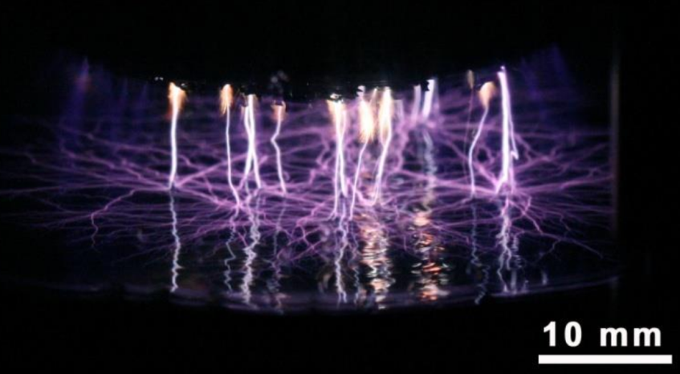
PLASMA LIQUID INTERACTIONS
Use of Dielectric Barrier Discharges (DBDs) in medical applications typically treat tissue covered with liquid.
Sanitizing wounds without tissue damage
Reducing size of tumors
Eradicating bacteria in biofilms
Reactive oxygen and nitrogen species (RONS) produced by plasma and reaching tissue are processed by the liquid.
Efficacy of these systems depends on long-term plasma produced, liquid phase chemistry.
P. Lukes, et al. IEEE Trans. Plasma Sci. 39, 2644 (2009).
S. Kalghatgi, et al. PLoS ONE, 6, e16270 (2011).
University of Michigan
Institute for Plasma Science & Engr.
MIPSE 2015
Notes:
Application for atm discharges

Slide 3
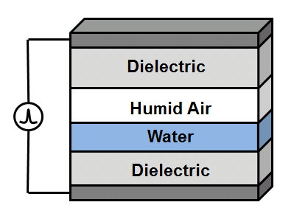
AIR DBD ON LIQUID COVERED TISSUE
Knowledge of RONS present in a liquid layer over a wound at long timescales is critical to understanding the mechanisms involved in plasma medicine.
We will computationally investigate a humid air DBD over water using a global model.
The effect of voltage, gas flow rate, and biomolecules on the RONS in the liquid will be explored.
Gas flow selectively decreases the densities of species, based on Henry’s law constants.
Biomolecules in the liquid rapidly consume ROS in the liquid, increasing the transport into the liquid.
University of Michigan
Institute for Plasma Science & Engr.
MIPSE 2015
Notes:
Application for atm discharges

Slide 4
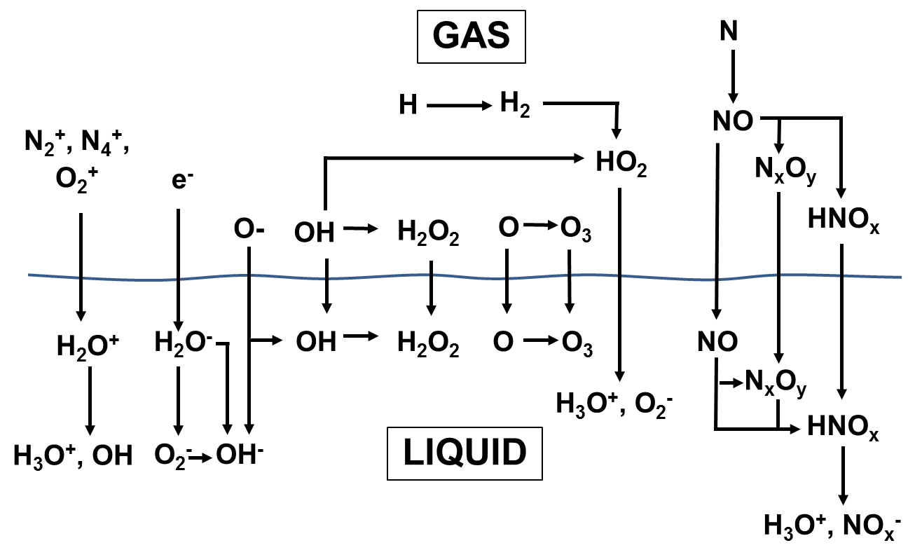
REACTION MECHANISM
In gas, e⁻ impact reactions for ions, H, O, OH, H, N, O₂⁻, O₂*, and O⁻
O₃ and H₂O₂ are relatively stable ROS, formed in 2 steps
N_{x}O_{y} and HNO_{x} are formed in at least 3 steps, often more
University of Michigan
Institute for Plasma Science & Engr.
MIPSE 2015

Slide 5
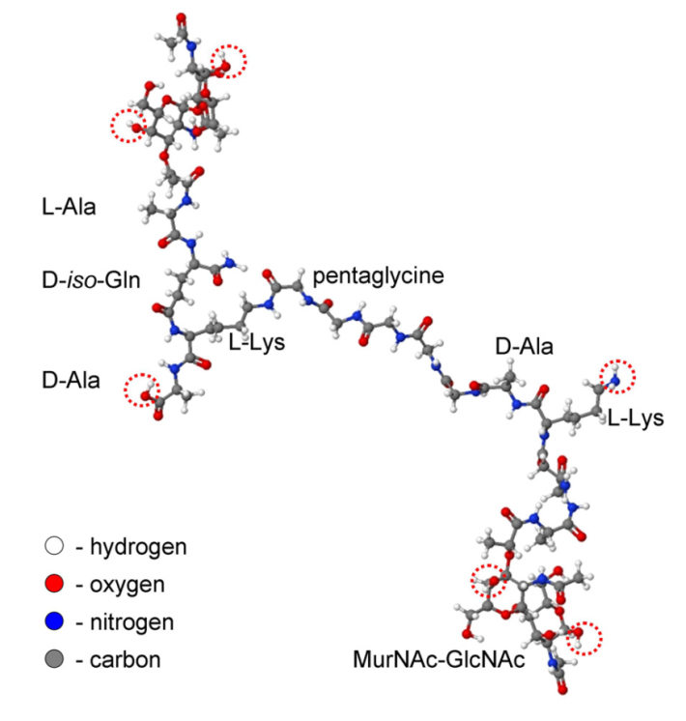
ORGANICS IN LIQUID: PEPTIDOGLYCAN
Chains of peptidoglycan (PG) make up the cell wall bacteria
MD simulations of interactions with O, OH, H₂O₂, and O₃ provide reaction rates (M. Yusupov, et al., J. Phys. Chem. C 117, 5993 (2013))
Reactions with ROS are categorized by bond breaking (C-O,C-C, C-N)
In this study, rates are calculated for pristine PG molecules only, subsequent reactions have higher rates (≈10X).
Peptidoglycan (PG)
Calculated Rate Coefficients for Reactions with Peptidoglycan [cm³/s]
Radical | C-O breaking | C-C breaking | C-N breaking
O | 6.35 × 10⁻¹⁰ | 3.43 × 10⁻¹⁰ | 3.96 × 10⁻¹⁰
OH | 5.42 × 10⁻¹⁰ | 2.92 × 10⁻¹⁰ | 8.20 × 10⁻¹⁰
O₃ | 4.80 × 10⁻¹⁰ | 2.63 × 10⁻¹⁰ | 4.74 × 10⁻¹⁰
H₂O₂ | 2.32 × 10⁻¹⁰ | 1.55 × 10⁻¹⁰ | -
University of Michigan
Institute for Plasma Science & Engr.
MIPSE 2015

Slide 6
MODELING PLATFORM: GlobalKIN
Plasma is a well-stirred reactor
Electron temperature:
Species densities:
Diffusion with multiple surfaces having unique sticking coefficients (S_{im}) and return fractions (g_{ikm}) for each species.
Circuit module, plug flow, and a surface kinetics modules.
University of Michigan
Institute for Plasma Science & Engr.
MIPSE 2015
Notes:
6
6

Slide 7
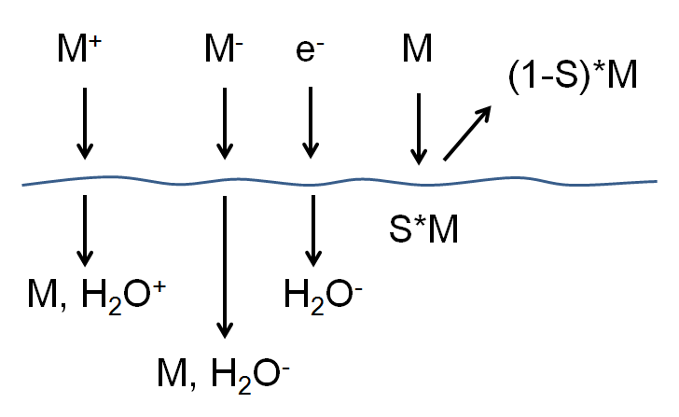
GlobalKIN LIQUID MODULE
Liquid is treated as separate "zone" with its own reaction mechanism.
Transport from gas to liquid is through an interfacial surface.
From gas plasma’s perspective, interface is analogous to a reactive surface, with a sticking coefficient and a return flux.
All charged species diffusing to liquid surface solvate.
Water evaporates into gas phase.
"Sticking" gas phase species enter liquid.
Sticking coefficient, S, based on Henry’s law limited transport into liquid
University of Michigan
Institute for Plasma Science & Engr.
MIPSE 2015
Notes:
7
7

Slide 8
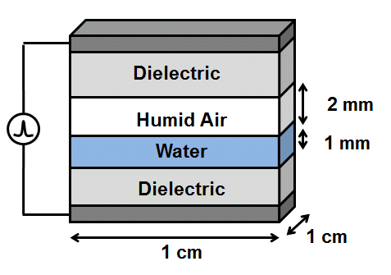
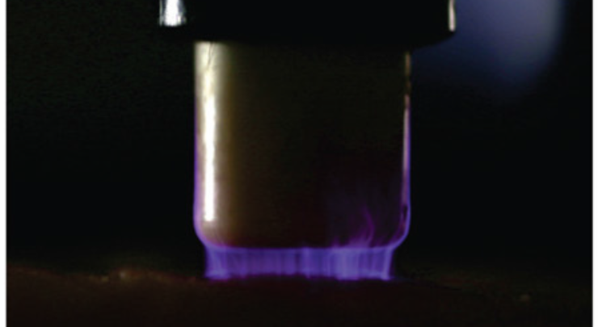
BASE CASE: DBD TREATING TISSUE
Gas reaction mechanism: N₂/O₂/H₂O, 79 species, 1680 reactions
Liquid Mechanism: N₂/O₂/H₂O/Peptidoglycan, 79 species, 168 reactions
Gas: N₂/O₂/H₂O = 77/20/3
Liquid: H₂O with 5 ppm O₂ and 9 ppm N₂
Pulsed DC, 500 Hz, 10 kV
5,000 pulses (10 s) followed by 5 min of chemistry
50 μJ/pulse (249 μJ/cm³).
P_{avg} = 25 mW (1.25 mW/cm³)
Optional gas flow
S. Baldus, et al. J. Phys. D, 48, 275203 (2015).
University of Michigan
Institute for Plasma Science & Engr.
MIPSE 2015

Slide 9
SINGLE PULSE: GAS ROS
O, O₂*, OH, and H are generated by e⁻ impact during the pulse
HO₂, O₃, H₂O₂ are secondary products of H, O, and OH
These more stable species diffuse into liquid in 100s of ms.
O₃ and O₂* become saturated in the liquid
University of Michigan
Institute for Plasma Science & Engr.
MIPSE 2015

Slide 10
SINGLE PULSE: GAS RNS
Gas RNS form later than ROS as multiple reactions required for N_{x}O_{y}, HNO_{x.}
HNO_{x} and NO_{x} accumulate over many pulses, simulation of long timescales is necessary to address RNS liquid chemistry.
HNO_{3aq}, ONOOH_{aq}, and HNO_{2aq} hydrolyze to form H₃O⁺, NO_{x}⁻_{aq}, lowering pH.
University of Michigan
Institute for Plasma Science & Engr.
MIPSE 2015

Slide 11
POST-PULSE CHEMISTRY: GAS
Initially, radical species at high density react with one another, e.g.
Around 2 s after the discharge, the diffusion losses to the liquid dominate the reactive species losses
OH + H₂O₂ → H₂O + HO₂
HO₂ + H₂O₂ → OH + H₂O + O₂
OH + HNO₄ → H₂O + NO₂ + O₂
HNO₂ + NO₂ → HNO₃ + NO
University of Michigan
Institute for Plasma Science & Engr.
MIPSE 2015
Notes:
Humidity:

Slide 12
POST-PULSE CHEMISTRY: LIQUID
NO₃⁻, and N₂O are stable products
Most H₃O⁺ from hydrolysis of HNO₃, final pH ≈ 4.2
HNO₄ thermally decays in about 9 s, delivers reactivity long after treatment time
O₃ has a long lifetime, but begins to thermally decay at long timescales
HNO₄ → HO₂ + NO₂
University of Michigan
Institute for Plasma Science & Engr.
MIPSE 2015
Notes:
Humidity:

Slide 13
LIQUID DENSITIES vs GAS FLOW RATE
500 Hz, 10 kV, 10 s (end of last pulse)
Inlet gas 50% RH: 1 - 5000 sccm (2.4 ms – 12 s res. time (τ_{res} ))
τ_{res}/ τ_{pulse} = avg. number of pulses a gas molecule sees before flowing out
Gas RONS flow out between pulses – decreases NO_{x}, HNO_{y} which require multiple reactions.
[H₂O]_{gas} does not saturate by evaporation. Lower [H₂O] produces higher n_{e}.
H₂O₂, CO, OH, HO₂, O₂* and O₂⁻ do not decrease directly with gas flow – each has a different optimum n_{e} (increases with flow) and τ_{res} (decreases with flow)
University of Michigan
Institute for Plasma Science & Engr.
MIPSE 2015
Notes:
What is residence time for XX sccm
Consider running intermediate sccm. These values of x10 and x100, which are pretty big jumps. Fir exanokem tii gard ti explain 1 jump in O3-

Slide 14
LIQUID DENSITIES vs PULSE REPETITION FREQUENCY
10 kV, 5 minutes
Total energy deposition constant
Values that drop dramatically between 20 and 50 Hz are sensitive to the time since the last pulse
NO₃⁻ decreases with frequency
n_{e} is lower and T_{e} is higher for high frequency because O₃ has solvated
With a higher T_{e}, more energy goes to collisions with O₂ and H₂O and less to N₂
O_{3,} N₂O and H₂ are produced instead
University of Michigan
Institute for Plasma Science & Engr.
MIPSE 2015
Notes:
What is residence time for XX sccm
Consider running intermediate sccm. These values of x10 and x100, which are pretty big jumps. Fir exanokem tii gard ti explain 1 jump in O3-

Slide 15
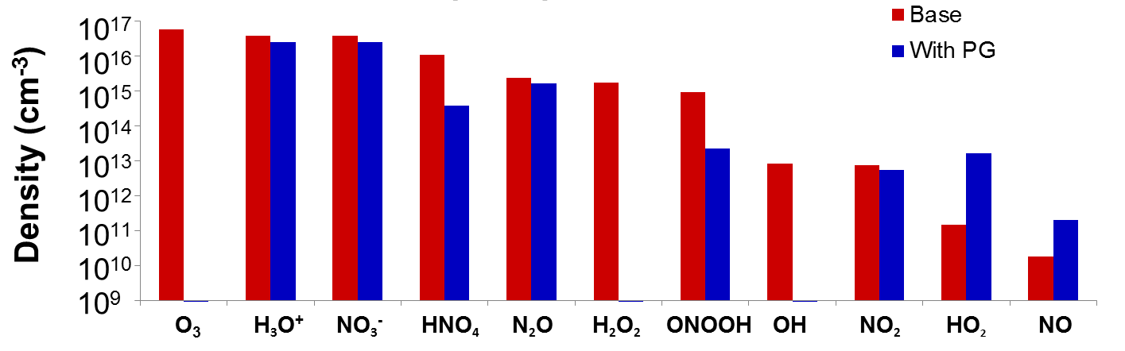
BIOMOLECULES IN LIQUID
500 Hz, 10 kV, 10 s (end of 5,000th pulse), 100 ppm peptidoglycan
Rapid consumption of OH, O₃, O, H₂O₂
All long-lifetime RONS decrease with the addition of PG, their production requires one of the consumed molecules
Decrease in O₃ in the gas phase increases n_{e} at the later pulses, greater gas phase production of HO₂, NO, O, O₂*, HNO₃ with PG at the 5,000th pulse
University of Michigan
Institute for Plasma Science & Engr.
MIPSE 2015

Slide 16
CONCLUDING REMARKS
Plasma-liquid interactions addressed by global model enable the study of long time scales and complete reaction mechanisms appropriate for well-stirred systems.
In a DBD interacting with a liquid water layer:
Gas flow – reduces the H₂O gas density and species flow out between pulses. The liquid density of species with Henry’s law constants low enough to saturate faster than the gas residence time are unaffected by flow.
Frequency – Increasing the frequency does not change energy deposition, but decreases the amount of NO₃⁻ in the liquid and increases O₃, N₂O, H₂. Increasing frequency will reduce the acidity.
Biomolecules – Peptidoglycan rapidly consumes OH, O, H₂O₂, and O₃, indicating in a transfer of reactivity from the plasma to the biomolecule. Most RONS levels decrease because of this, but the lower O_{3gas} density means that adding PG results in a higher n_{e} at later pulses.
MIPSE 2015

Slide 17
BACKUP
University of Michigan
Institute for Plasma Science & Engr.
MIPSE 2015

Slide 18
GlobalKIN LIQUID MODULE
Species solvate into liquid from gas plasma based on gas phase diffusion into a reactive surface
Neutrals:
h - Henry’s law constant
Transport occurs into or out of liquid based on whether density is less than or exceeds equilibrium values.
Charged species:
University of Michigan
Institute for Plasma Science & Engr.
MIPSE 2015
Notes:
18
18

Slide 19
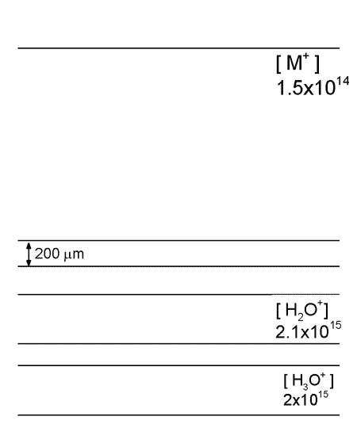
COMPUTATIONAL APPROACHES
Many phenomena require multi-dimensional modeling to address proper scaling.
Complex chemistries and 1000s pulses are computationally challenging in 2-D models.
Global models enable more rapid analysis of reaction mechanisms and scaling laws.
Disadvantages:
Unable to capture mixing between highly non-uniform gas mixtures
Does not easily resolved ionization wave behavior.
• 2-D: Up to days CPU for 10s ns
• Global: 5,000 pulses, 10 s, < 1 day
University of Michigan
Institute for Plasma Science & Engr.
Animation Slide
MIPSE 2015

Slide 20
SINGLE PULSE:
O, O⁻, O₂*, and OH are generated by e⁻ impact during the pulse
O₂⁻, HO₂, O₃, H₂O₂ are secondary products of O, O⁻, and OH
These more stable species diffuse into liquid in 100s of ms.
O₃ and O₂* become saturated in the liquid
O₂⁻ accumulates in the liquid
HO₂ + H₂O → O₂⁻ + H₃O⁺
University of Michigan
Institute for Plasma Science & Engr.
MIPSE 2015

Slide 21
LIQUID DENSITIES vs VOLTAGE
Liquid densities at 60 s
Increase 8 kV to 25 kV is X.X increase in energy.
Most of the RONS_{aq} scale with energy.
O₂⁻ decreases with energy as it reacts with O₂* and O.
HNO₂ is a weak acid which buffers the solution
As H₃O⁺ increases with voltage (from HNO₃), less HNO₂ dissociates into NO₂⁻.
University of Michigan
Institute for Plasma Science & Engr.
MIPSE 2015
Notes:
All gas phase RONS examined increase with energy except O2-
explain why some species decrease with energy or increase at slower rate then increase in energy.

