Slide 1
Field distribution in a vacuum-nano diode
Jinpu Lin, and Peng Zhang
Department of Nuclear Engineering and Radiological Science
University of Michigan, Ann Arbor
$6^{th}$ MIPSE Graduate Student Symposium
Ann Arbor, MI
October 7, 2015
Work Supported by AFOSR Grant No.FA9550-14-0309

Slide 2
Introduction
There is growing interest in miniaturization of anode-cathode (AK) gap by using fine emission tips to realize a vacuum nano-diode, showing great potential for energy harvesting and conversion in solar cells$._{\left[1\right][2]}$
A sharp anode tip sufficiently close to the flat graphene surface induces electron emissions from graphene surface$._{\left[3\right]}$
Existing models usually assume that the emission tip is far away from the anode, whose effect on tip field enhancement is thus ignored.
We study the effects of finite AK gap on the electric field distribution on and around an emission tip, using Schwarz-Christoffel transformation.

Slide 3
Schwarz-Christoffel Transformation$._{\left[4\right]}$
Z
w
Mapping from polygonal boundaries (z-plane) onto real axis of the w-plane.
We can then transform the points on emission tip into points on a straight line.

Slide 4
Schwarz-Christoffel Transformation for AK gap with a trapezoide tip
Z
B
H
A
v
W
-$∞$
-$\sqrt{u_{4}}$
1
$$u_{3}$$
$$u_{3}′$$
$$u_{4}$$
$$∞$$
$$0^{−}$$
$$0^{+}$$
$$E_{1}$$
$$E_{2}$$
d
A’
H’
B’ C’
D’
$E_{1}$’
$E_{2}$’
F’
G’
u
a
h
$$α$$
y
C
D
z
F
G
a= half width of tip
h=depth of tip
d=distance of gap
$α$= acute angle of tip
The transformation formula is given below:
$$\frac{∂Z}{∂W}=k w^{−1}{\left(w−1\right)}^{−\frac{α}{π}}{\left(w−u_{3}\right)}^{\frac{α}{π}}{\left(w−u_{3}′ \right)}^{\frac{α}{π}}{\left(w−u_{4} \right)}^{−\frac{α}{π}}$$

Slide 5
Schwarz-Christoffel Transformation for AK gap with a trapezoide tip
$$z=k\int_{w_{0}}^{w}{\frac{1}{w}\frac{{\left(w−u_{3} \right)}^{\frac{α}{π}}}{{\left(w−1\right)}^{\frac{α}{π}}}}\frac{{\left(w−u_{3}′ \right)}^{\frac{α}{π}}}{{\left(w−u_{4} \right)}^{\frac{α}{π}}}dw+z_{0}$$
${ Z}_{0}$ $W_{0}$
Point B $[−∞, d]$ ($0^{−}, 0$)
Point $C [−∞, 0]$ ($0^{+}, 0$)
Point D $[−a−h\cot{α}, 0]$ (1, 0)
Point $E_{1} [−a, h]$ ($u_{3}, 0$)
Point $E_{2} [a, h]$ ($u_{3}^{′}, 0$)
$$2π\frac{a}{d}=\int_{u_{3}}^{u_{3}′}{\frac{{\left(u−u_{3}\right)}^{α/π}{\left(u_{3}^{′}−u\right)}^{α/π}}{u{\left(u−1\right)}^{α/π}{\left(u_{3}u_{3}^{′}−u\right)}^{α/π}}du}$$
$$\frac{π}{\sin{α}}\frac{h}{d}=\int_{1}^{u_{3}}{\frac{{\left(u−u_{3}\right)}^{α/π}{\left(u−u_{3}′\right)}^{α/π}}{u{\left(u−1\right)}^{α/π}{\left(u_{3}u_{3}^{′}−u\right)}^{α/π}}du}$$
$${ u}_{4}=u_{3}u_{3}^{′}, k=d/π$$
For any given $α, a/{d,h/d}$,
we can calculate $u_{3},u_{3}^{′}, and u_{4}.$

Slide 6
Example: $$U_{3} \& u_{3}’ vs. d/h (α is fixed)$$
$$α=π/2$$
$$u_{3}′$$
$$u_{3}$$

Slide 7
Example: $$U_{3} \& u_{3}’ vs. d/h (a/his fixed)$$
a/h=0.1
$$α=π/2$$
$$α=π/3$$
$$α=π/4$$
$$α=π/6$$
$$α=π/2$$
$$α=π/3$$
$$α=π/4$$
$$α=π/6$$
$$u_{3}$$
$$u_{3}′$$

Slide 8
E-field calculation
$$φ\left(w\right)=ikE_{0}\log\left(w\right)$$
$$E_{x}−iE_{y}=−\frac{dφ}{dz}=−\frac{{dφ}/{dw}}{{dz}/{dw}}$$
$$E_{x}−iE_{y}=−iE_{0}{\left(\frac{w−1}{w−u_{3}}\frac{w−u_{4}}{w−u_{3}′}\right)}^{α/π}$$
As w$→∞, E_{x}−iE_{y}=−iE_{0}$
As w$→0, { E}_{x}−iE_{y}=−iE_{0}$
Far away from the tip, uniform electric field is recovered.

Slide 9
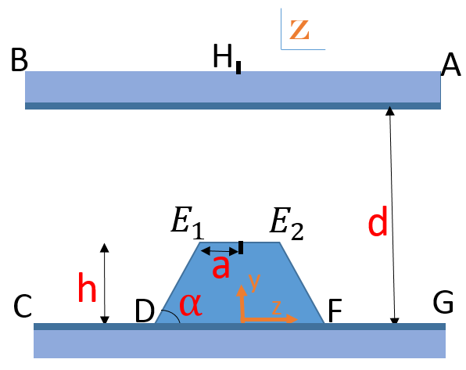
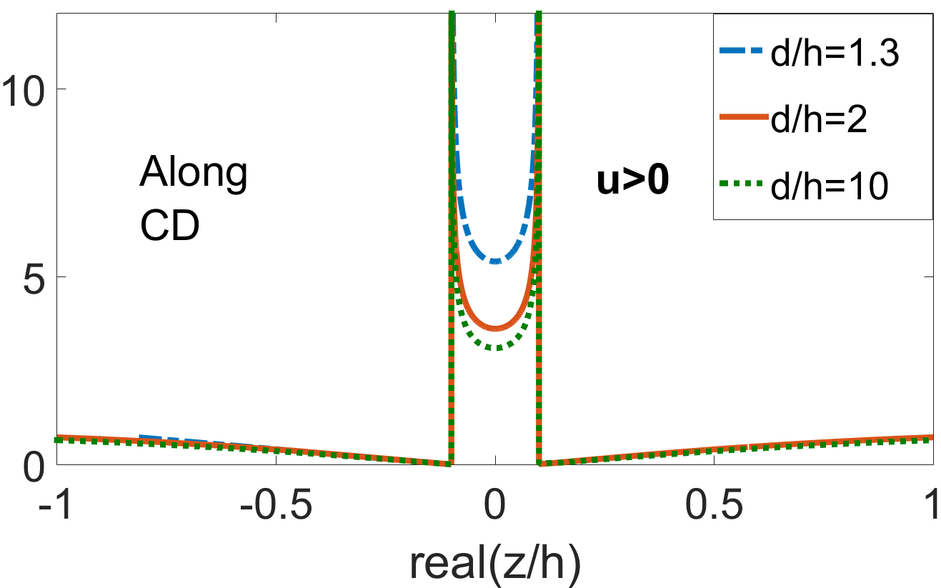
Example: E vs. z/h
$$\frac{a}{h}=0.1, α=\frac{π}{2}$$
$$\left|\frac{E}{E_{0}}\right|$$
$$\left|\frac{E}{E_{0}}\right|$$
Along $CDE_{1}E_{2}FG$
Electric field is enhanced near the tip when d/h is decreased.
Field enhancement is found at both cathode and anode.

Slide 10
Current Emission and Field Enhancement Factor
B₁
A₁
Consider Field Emission induced current:
$J=A_{FN}(β^{2}{\left(E_{0}\right)}^{2}exp(−\frac{B_{FN}}{β E_{0}}))$ [$\frac{A}{m^{2}}$]
${ A}_{FN}=\frac{1.5×{10}^{−6}}{W}exp⁡(\frac{10.4}{\sqrt{W}})$,
$B_{FN}=6.44×{10}^{9}W^{\frac{3}{2}}$,
$$E_{0}=\frac{V_{g}}{α},$$
$$W≡work function \left[ev\right]$$
$$β=field enhancement factor,$$

Slide 11
Current Emission and Field Enhancement Factor
B₁
A₁
Average current emitted from the tip $DE_{1}E_{2}F$ is:
Average current emitted from the flat surface $A_{1}B_{1}$ is:
Field Enhancement Factor is obtained from:
$J_{1avg}=\frac{A_{FN}\int_{DE_{1}E_{2}F}{E_{C}^{2}\left(s\right)\exp\left(−\frac{B_{FN}}{E_{c}\left(s\right)}\right)ds}}{DF}$,
$DF=a+2h\cot{α}, E_{c}(s)$ = local electric field at point s along the surface $DE_{1}E_{2}F$ .
$J_{2avg}=\frac{A_{FN}\int_{A_{1}B_{1}}{E_{C}^{2}\left(s\right)\exp\left(−\frac{B_{FN}}{E_{c}\left(s\right)}\right)ds}}{A_{1}B_{1}}$,
$A_{1}B_{1}$=DF, $E_{c}\left(s\right)$ = local electric field at point s along the surface $A_{1}B_{1}$.
$J_{1,2}=A_{FN}(β_{1,2}^{2}{\left(E_{0}\right)}^{2}exp(−\frac{B_{FN}}{β_{1,2 }E_{0}}))$ $β_{1,2}$

Slide 12
Field enhancement factor $β$vs. d/h
a/h=0.1, $α=\frac{π}{2},E_{0}=3×{10}^{8} \frac{V}{m}, W=4 ev$
$$β_{2}$$
$$β_{1}$$
As the normalized gap space d/h decreases (<2), both $β_{1} and β_{2} increases significantly.$
AS d/h>5, $β_{1} and β_{2}$ converges to constant values, corresponding the case of d/h$→∞$

Slide 13
Field enhancement factor $β$vs. a/h
d/h=2, $α=\frac{π}{2},E_{0}=3×{10}^{8} \frac{V}{m}, W=4 ev$
$$β_{1}$$
$$β_{2}$$
As a/h increases, $β_{1} decreases, but β_{2} increases.$

Slide 14
Field enhancement factor $β$vs. $α$/h
a/h=0.1, $\frac{d}{h}=4,E_{0}=3×{10}^{8} \frac{V}{m}, W=4 ev$
$$β_{1}$$
$$β_{2}$$
As $α$increases, $β_{1} increases, but β_{2} decreases.$

Slide 15
Field enhancement factor $β$vs. $E_{0}$
a/h=0.1$α=\frac{π}{2},\frac{d}{h}=2, W=4 ev$
$$β_{1}$$
$$β_{2}$$
$E_{0}$ [$\frac{V}{m}$]
$E_{0}$ [$\frac{V}{m}$]
As $E_{0}$increases, $β_{1} decreases.$
$β_{2}$ is insensitive to $E_{0}$.

Slide 16
Summary & future work
We calculated the local electric field inside the gap with a single trapezoid tip, by using the Schwarz-Christoffel Transformation.
We evaluated the effective field enhancement factor for field emission, for both electrode with a tip and the flat electrode.
Investigate tips of other shape, like semi-circle.
Investigate multiple tips for electron emission.
Compare the results with experiments.

