Slide 1
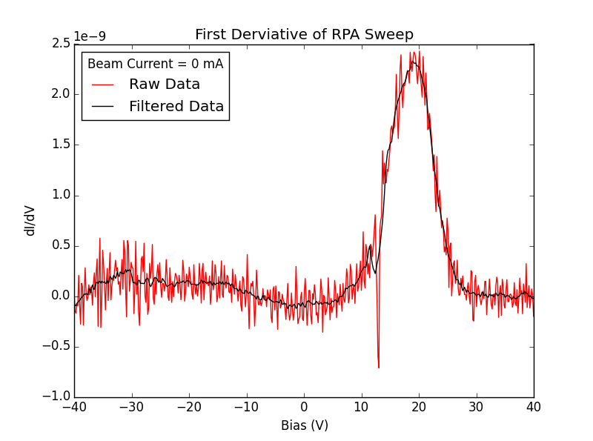
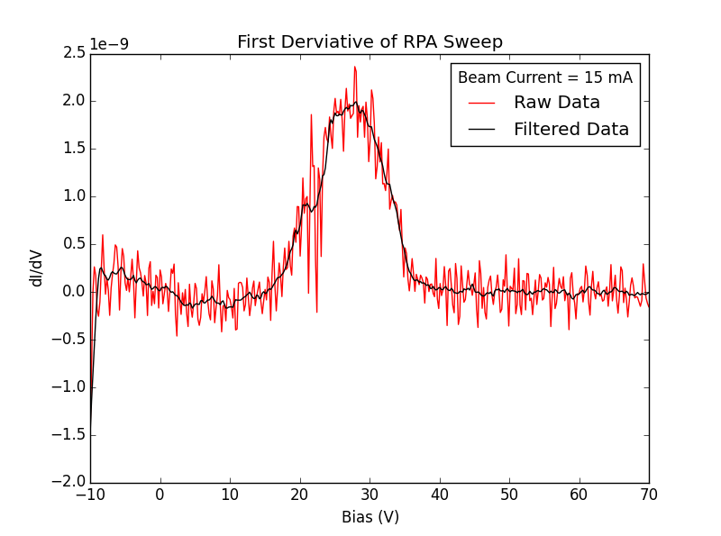
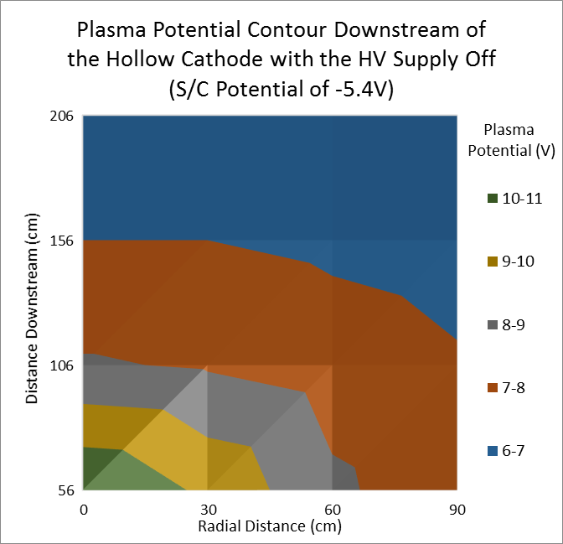
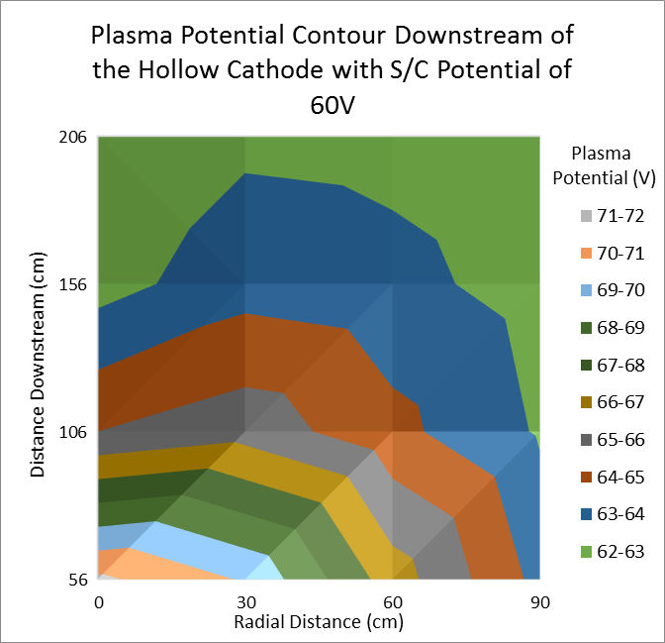
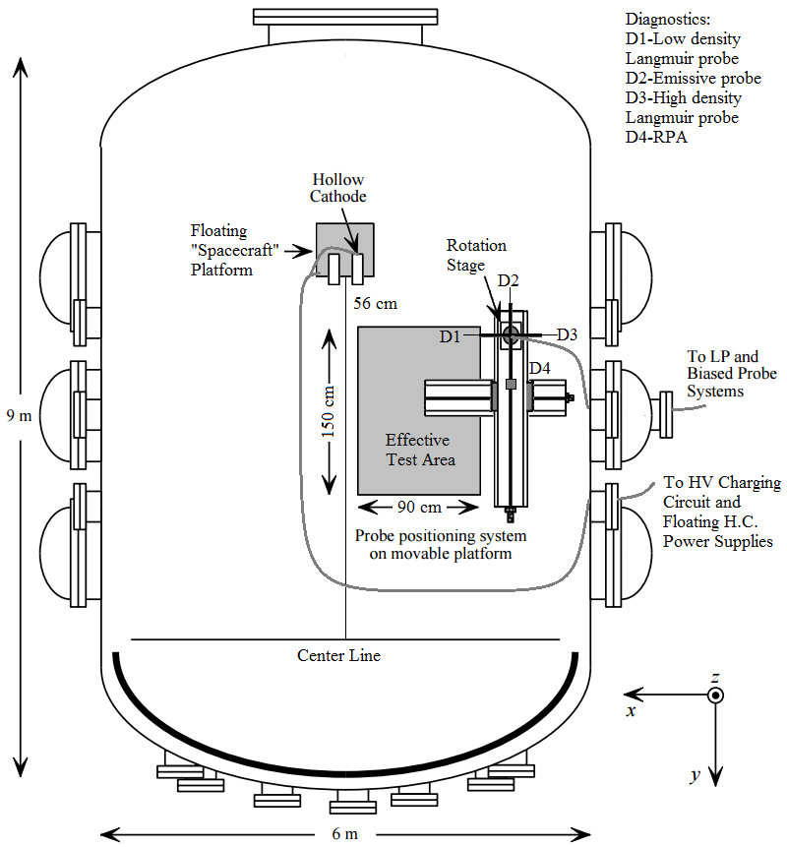
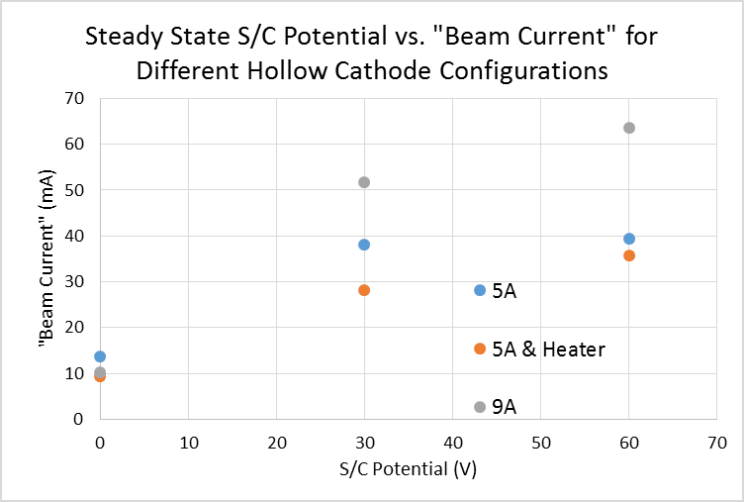
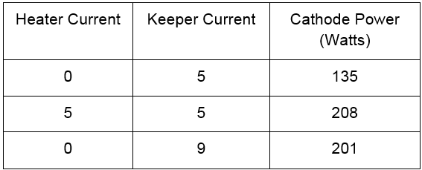
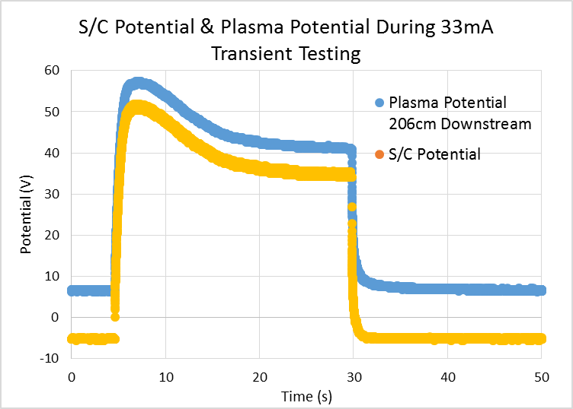
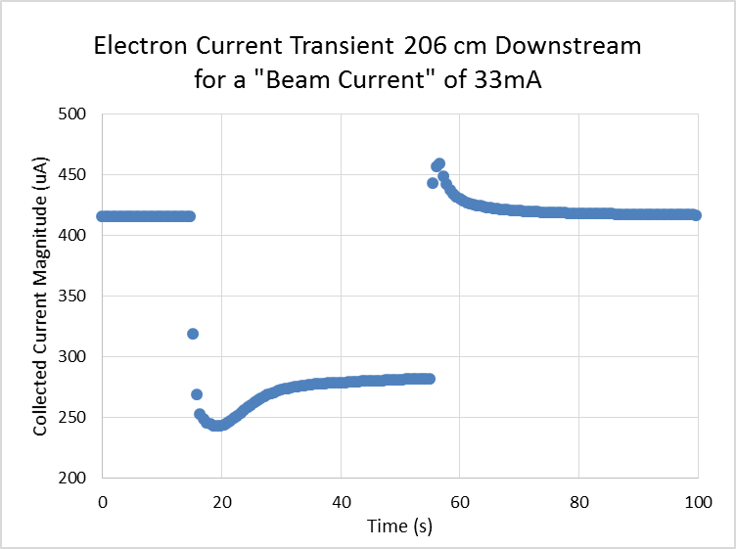
Model validation for plasma contactor mediation of electron beam charged spacecraft
Omar Leon¹, Grant Miars², Dr. Brian Gilchrist²
¹Applied Physics Program, The University of Michigan, Ann Arbor, MI
²Department of Electrical Engineering, The University of Michigan, Ann Arbor, MI
Introduction
CEX Ions
A high power electron beam can be fired from a spacecraft in the magnetosphere to trace the Earth’s magnetic field lines. However, the density of the ambient plasma in this region is too sparse to maintain spacecraft neutrality while the electron beam is operating. PIC simulations suggest that the spacecraft can be neutralized by using a hollow cathode to produce a dense, ion emitting plasma which balances the beam’s electron emission. [1,2] Here we present the results from a series of experiments which were performed at the Large Vacuum Test Facility (LVTF). These experiments were geared towards validating the PIC simulations and improving our understanding of the plasma-spacecraft interactions in this environment.
CEX Ions
Figure 5: Evidence of CEX ions and ion acceleration at higher “spacecraft” potentials.
Materials and Methods
Figure 6: Plasma potential contour maps showing high plasma potential throughout.
Conclusions
Figure 2: Hollow cathode in operation on the “spacecraft”.
The fraction of gas which is ionized is more important than the amount of power supplied to the hollow cathode
Higher keeper discharge currents increase the fraction of gas which is ionized
Long charging transients were observed which were much longer than the plasma response time (on the order of several seconds)
CEX collisions are the dominant collisions in our plasma and produce a small, lower energy ion population in addition to the primary population
Ion acceleration occurs at higher “spacecraft” potentials
The plasma potential stays relatively high throughout the chamber until it drops off at the wall
Figure 1: An aerial view of LVTF.
Results and Discussion
Figure 3: “Beam current” neutralized depends heavily on the keeper discharge current and as opposed to cathode power.
Acknowledgements
We wish to thank Dr. Brian Gilchrist and Dr. Iverson Bell for their guidance and support throughout our research. We would also like to acknowledge the PEPL team for their help during the setup and implementation of the experiment. Also, Dr. Gian Luca Delzanno and Dr. Joe Borovsky of Los Alamos were instrumental in guiding our experiments and increasing our understanding of the problem.
“Beam” fired
“Beam” turned off
References
[1] G.L. Delzanno, J.E. Borovsky, M.F. Thomsen, J.D. Moulton, E.A. MacDonald, Future beam experiments in the magnetosphere with plasma contactors: how do we get the charge off the spacecraft?, to appear in Journal of Geophysical Research (2015) [2] G.L. Delzanno, J.E. Borovsky, M.F. Thomsen, J.D. Moulton, Future beam experiments in the magnetosphere with plasma contactors: the electron collection and ion emission routes, to appear in Journal of Geophysical Research (2015)
Figure 4: Both the plasma and the “spacecraft” potential have long transients before reaching equilibrium when the “beam” is fired.

