Slide 1
PROPERTIES OF UNIPOLAR DC-PULSED MICROPLASMA ARRAYS AT INTERMEDIATE PRESSURES*
Peng Tian^{a)}, Chenhui Qu^{a)} and Mark J. Kushner^{a)}
^{a)} University of Michigan, Electrical Engineering & Computer Science
Ann Arbor, MI 48109-2122 USA
tianpeng@umich.edu, chenqu@umich.edu, mjkush@umich.edu
6th Annual MIPSE Graduate Student Symposium
October 2015
* Work supported by DARPA, the DOE Office of Fusion Energy Science and the National Science Foundation.

Slide 2
AGENDA
Introduction to Microplasma Arrays
Description of the simulation model
Simulation results and analysis
Operating gas are Argon and Ne/Xe
Scaling:
Pressure
Voltage
Pulse Repetition Frequency (PRF)
Mutual effect between plasma regions
Geometry’s influences on plasma
Concluding Remarks
University of Michigan
Institute for Plasma Science & Engr.
MIPSE_2015_Peng&Chenhui

Slide 3
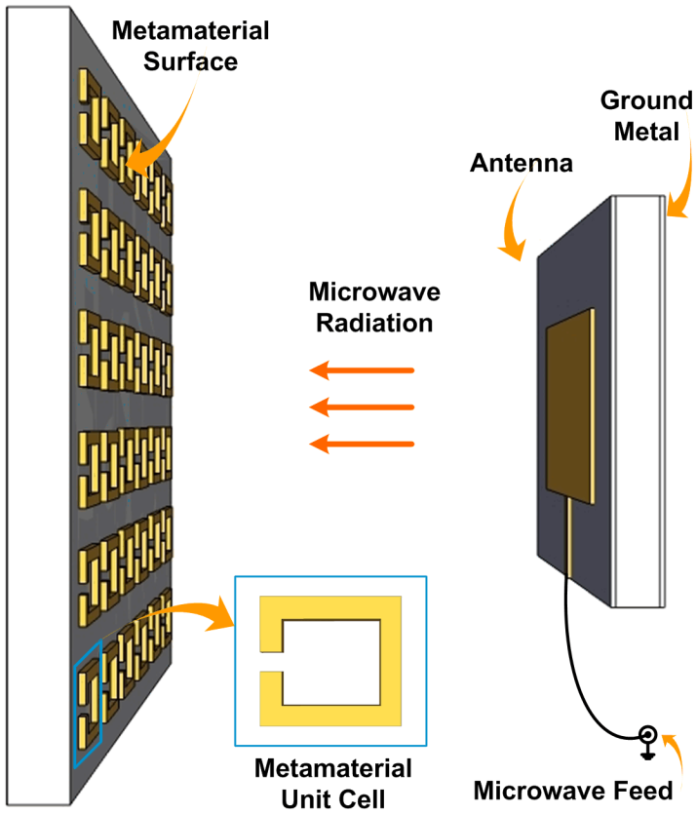
MICROPLASMAS AS METAMATERIAL
Microplasma arrays are being investigated as metamaterials platforms. Optimizing metamaterial performance requires stringent control of microplasma properties.
Results from computational investigation of small arrays of microplasmas will be discussed with goal of metamaterial optimization.
[1]
[2]
[1] Sakai & Tachibana, Plasma Sources Sci. Technol. 21 (2012) 013001
[2] Singh et al. Nature Scientific Reports 4 : 5964 (2014)
University of Michigan
Institute for Plasma Science & Engr.
MIPSE_2015_Peng&Chenhui

Slide 4
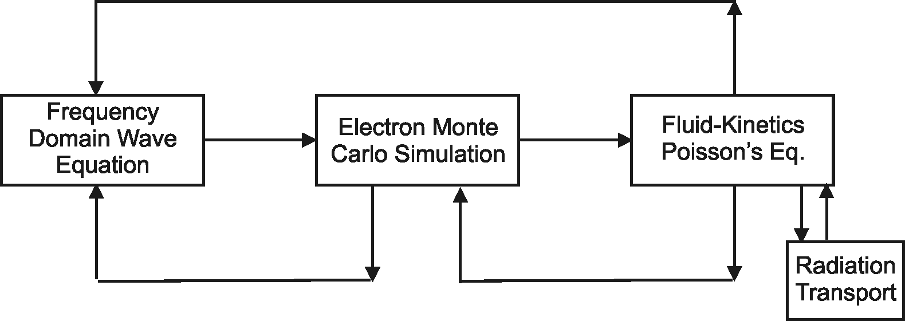
MODELING OF PULSED MICROPLASMAS
The Hybrid Plasma Equipment Model (HPEM) is a modular simulator that combines fluid and kinetic approaches.
Monte Carlo Ion/Neutral Transport
Surface
Chemistry
Module
Monte Carlo Radiation Transport
University of Michigan
Institute for Plasma Science & Engr.
MIPSE_2015_Peng&Chenhui

Slide 5
UNIPOLAR DC-PULSING
Short pulses (~ 10s ns) heat electrons rapidly at leading edges.
Pulsing repetition frequency at several MHz.
University of Michigan
Institute for Plasma Science & Engr.
MIPSE_2015_Peng&Chenhui

Slide 6
2 x 2 ARRAY OF 4 MICROPLASMAS
Sealed plasma cavity (no net gas flow), 2 x 2 symmetric configuration.
Powered electrodes are in the center separated by dielectric
Electrodes are exposed to enable unipolar pulsing.
Higher plasma density enabled through secondary electron emission and beam ionzation
10s of Torr, 10s ns DC pulse with several MHz PRF, unipolar excitation.
Ar and Ne/Xe mixtures.
University of Michigan
Institute for Plasma Science & Engr.
MIPSE_2015_Peng&Chenhui

Slide 7
ELECTRON DENSITY, IONIZATION SOURCES
Base case: Ar, 60 Torr, 10 MHz PRF, 30% duty cycle (30 ns pulse), -300 V
Peak [e]≈1.1 x 10¹⁴ cm⁻³.
Significant "exclusion zone" with expansion of cathode fall during pulse.
Beam ionization by secondary electrons is larger than by bulk.
Bulk ionization peaks where T_{e} and [e] are largest (edge of cathode fall).
MIN MAX
University of Michigan
Institute for Plasma Science & Engr.
MIPSE_2015_Peng&Chenhui

Slide 8
GAS HEATING
Gas heating in microplasmas is a major factor influencing scaling of plasma density
Gas is rapidly heated close to electrodes due to larger ion drift velocity approaching cathode fall.
Rarefaction caused by heating near electrode, decreases local ionization efficiency.
Profiles shown mid-pulse.
Ar, 60 Torr, -300 V, 30 ns pulse length, 10 MHz.
MIN MAX
University of Michigan
Institute for Plasma Science & Engr.
MIPSE_2015_Peng&Chenhui

Slide 9
PRESSURE SCALING
30 Torr
60 Torr
40 Torr
80 Torr
Argon, -300 V, 10 MHz PRF, 30 to 80 Torr
Low pressure, low plasma density has thicker cathode fall excluding bulk plasma. Counter-intuitive result is better uniformity at high pressure.
With higher stopping power, T_{gas} increases with pressure.
Plasma density saturates as heating rarefies gas.
MIN MAX
University of Michigan
Institute for Plasma Science & Engr.
MIPSE_2015_Peng&Chenhui

Slide 10
PRF AND VOLTAGE
Ar, 60 Torr, fixed pulse length (30 ns).
Increasing voltage and power deposition increases T_{gas} which rarefies gas, leading to saturation in peak electron density.
Lower PRF, lower average power reduces gas temperature and regains some loss in efficiency due to rarefaction.
Maximum [e] is largely a function of voltage x pulse width (Vτ) product.
Extending pulse period with constant Vτ then enables control of gas temperature.
University of Michigan
Institute for Plasma Science & Engr.
MIPSE_2015_Peng&Chenhui

Slide 11
INCREASING DUTY CYCLE
PRF constant while increase pulse length.
Increasing pulse length will transfer plasma behavior from pulse like to DC like with lower electron density and larger cathode fall.
The threshold of transition in plasma behavior is when duty cycle D=60%.
MIN MAX
University of Michigan
Institute for Plasma Science & Engr.
MIPSE_2015_Peng&Chenhui

Slide 12
Ne/Xe MIXTURE: PRF
• Ne/Xe=80/20, 60 Torr, -300 V, 5 MHz, 6 x 10¹³ cm⁻³
MIN MAX
Ne/Xe=80/20, 60 Torr, -300 V, constant 30 ns pulse.
Significant modulation of plasma during pulse due to formation of larger cathode fall in smaller electron density.
Electron density slightly decreases with longer pulses. Gas temperature less sensitive to pulse length due to higher thermal conductivity.
University of Michigan
Institute for Plasma Science & Engr.
MIPSE_2015_Peng&Chenhui

Slide 13
Ne/Xe MIXTURE: PRESSURE
30 Torr
60 Torr
40 Torr
80 Torr
Ne/Xe=80/20, -300 V, 10 MHz PRF, 30 Torr to 80 Torr
Higher plasma densities (up to 1 x 10¹⁵ cm⁻³ at 80 Torr) enabled by Penning mixture.
Two quasi-steady state modes of operation
Low pressure, low electron density, low gas temperature
High pressure, high electron density, moderate gas temperature.
MIN MAX
University of Michigan
Institute for Plasma Science & Engr.
MIPSE_2015_Peng&Chenhui

Slide 14
Ne/Xe PRESSURE-2 MODES
Ne/Xe=80/20, -300 V, 10 MHz, 30ns pulse
Longer MFP at lower pressure does not confine secondary beam electrons, resulting in bulk ionization dominant glow mode.
Lower [e] produces a larger exclusion zone of cathode fall.
University of Michigan
Institute for Plasma Science & Engr.
MIPSE_2015_Peng&Chenhui
MIN MAX

Slide 15
STAGGERED VOLTAGES
Interactions between microplasmas may be minimized by staggering pulsing of voltage.
Electron density, bulk and beam ionization are nearly the same as base case.
Interaction between plasmas may not be a strong effect.
Ar, 60 Torr, -300 V, 30 ns pulse length, 10 MHz.
MIN MAX
University of Michigan
Institute for Plasma Science & Engr.
MIPSE_2015_Peng&Chenhui

Slide 16
SHUTTING DOWN ELECTRODES
Electrodes are shut down to investigate their interactions.
Different pair of electrodes produce similar densities with little interactions between pairs.
Drifting electrons from other pairs produce higher electron density but are not critical for sustaining neighbors.
MIN MAX
University of Michigan
Institute for Plasma Science & Engr.
MIPSE_2015_Peng&Chenhui

Slide 17
DIFFERENT ELECTRODE LENGTH
Electrode length: 65 μm, 80μm and 95μm.
Longer electrodes produce more planar cathode fall, producing more uniform plasma.
Longer electrodes increase secondary electron emission which enables an increase in bulk electron density.
The enhancement in secondary electron emission will saturate due to unchanged E/N after electrodes reach a proper length.
MIN MAX
University of Michigan
Institute for Plasma Science & Engr.
MIPSE_2015_Peng&Chenhui

Slide 18
Ar: 2 x 3 ARRAY
Higher peak electron density due to smaller distance between electrodes.
Increased efficiency by additional sharing of metastable atoms between pixels.
Some asymmetry occurs from staggering of anode-cathode.
Ar, 60 Torr, -300 V, 30 ns, 10 MHz
University of Michigan
Institute for Plasma Science & Engr.
MIPSE_2015_Peng&Chenhui
MIN MAX

Slide 19
[e]
3.4 x 10¹³ cm⁻³
[2 dec]
Bulk Ionization
6.8 x 10²¹ cm⁻³s⁻¹
[2 dec]
Beam Ionization
1.9 x 10²¹ cm⁻³s⁻¹
[2 dec]
Ne/Xe: 2 x 3 ARRAY
[e] pools at the center.
Bulk and beam ionization localized near electrodes.
Xe⁺ has similar profile as electrons – Ne⁺ ions localized near electrodes.
Pooling likely the result of diffuse Penning ionization (Ne* + Xe) coincident with confinement by periodic expansion of cathode falls.
Ne/Xe=80/20, 60 Torr, -300 V,10 MHz
University of Michigan
Institute for Plasma Science & Engr.
MIPSE_2015_Peng&Chenhui
MIN MAX

Slide 20
CONCLUDING REMARKS
Microplasma arrays in Ar and Ne/Xe at 10s – 100 Torr in sealed cavities maintained by ns DC pulses were investigated with goal of finding scaling laws of plasma density vs. pressure, PRF and voltage.
Gas heating in microplasmas at such pressures was found to be important in scaling as local rarefaction of the gas will decrease ionization efficiency during the pulse.
In Ar where plasma density saturates at high pressure due to increased gas temperature, longer post-pulse period (lower PRF) can decrease gas temperature while maintaining plasma density.
In Ne/Xe, Penning mixture enables plasma density up to 10¹⁵ cm⁻³ at 80 Torr, while at low pressure, Ne/Xe plasma operates at a bulk-dominated low gas temperature glow mode.
University of Michigan
Institute for Plasma Science & Engr.
MIPSE_2015_Peng&Chenhui

