Slide 1
Characterization of a MA-Class Linear Transformer Driver for Foil Ablation and Z-Pinch Experiments*
A. M. Steiner, S. G. Patel, D. A. Yager-Elorriaga, N. M. Jordan, R. M. Gilgenbach, and Y. Y. Lau
Plasma, Pulsed Power and Microwave Laboratory
Department of Nuclear Engineering and Radiological Science
University of Michigan
Ann Arbor, MI 48109, USA
*This work was supported by the US DoE award DE-SC0012328 and by Sandia National Laboratories. S.G. Patel and A.M. Steiner were supported by NPSC funded by Sandia. D.A. Yager is supported by NSF fellowship grant DGE 1256260.

Slide 2
Overview
Michigan Accelerator for Inductive Z-Pinch Experiments (MAIZE) 1-MA linear transformer driver (LTD) has been used to drive planar foil¹, cylindrical liner², and wire array ablation³ experiments
Current experiments on MAIZE include electrothermal instability growth rate measurements⁴ and thin imploding liner physics²
MAIZE consists of a capacitor section, nonuniform vacuum transmission line, and load
A full LTD model accounting for reactive and resistive loads has been developed to make current and voltage predictions as a function of load; model has been verified against experimental data
Zier et al., Phys. of Plasmas (2012)
Yager-Elorriaga et al., ICOPS (2015)
Safronova et al., APS-DPP (2014)
Steiner et al., APS-DPP (2014)

Slide 3
Motivation
Single-stage LTDs like MAIZE have very low generator-side impedance; Load impedance (both reactive and resistive) determines peak current, risetime, etc.
Designing experiments often requires predictive capability for voltage and current output
  Predict peak current and risetime
  Evaluate insulator stress
  Diagnose losses
  Determine if magnetic insulation is achieved

Slide 4
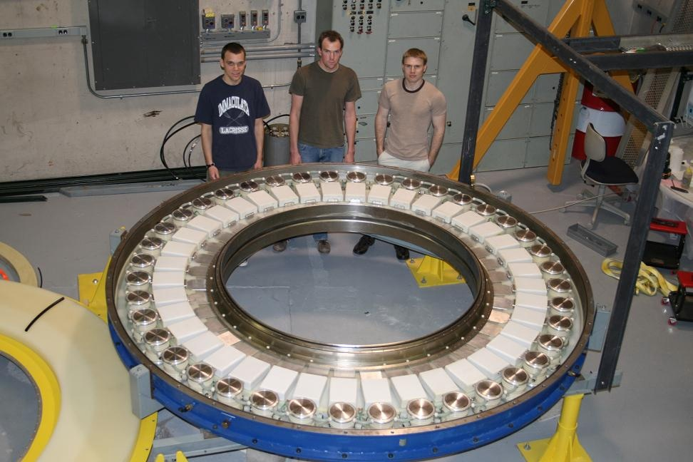
MAIZE LTD Specifications
Built for the University of Michigan by IHCE of Tomsk, Russia
Capacitor section
  80 40-nF capacitors rated for ± 100 kV charge
  40 switches
  2 iron tape isolation cores
  1.6 m ID
  3.06 m OD
  0.22 m Thick
Vacuum transmission Line
  Coaxial section: 1.0 cm gap by 0.2 m height
  Radial section: 1.3 cm height, 1.6 m OD, 0.25 m ID
  Connects to load via triplate (foil loads) or coaxial (resistive or wire array loads) adapter
Load region
  Planar Foils (400 nm)
  Foil Liners (400 nm to 30 μm thickness)
  Wire arrays (single planar, double planar)
Oil cavity of MAIZE with top lid removed to show capacitor-switch bricks

Slide 5
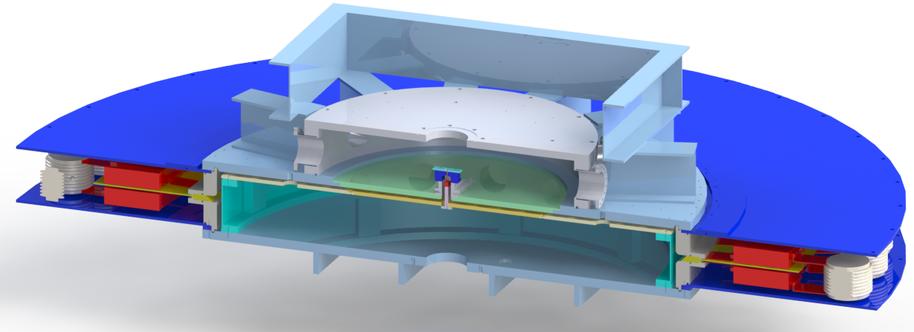
MAIZE LTD Diagram
G
H
A
B
C
D
E
F
I
A: Spark gap switch B: Capacitor C: Iron Core section D: Coaxial Transmission line E: Radial transmission line F: Load hardware (shown with triplate transmission line adapter G: Vacuum Chamber (light blue and gray) H: Oil chamber (dark blue) I: Insulator

Slide 6
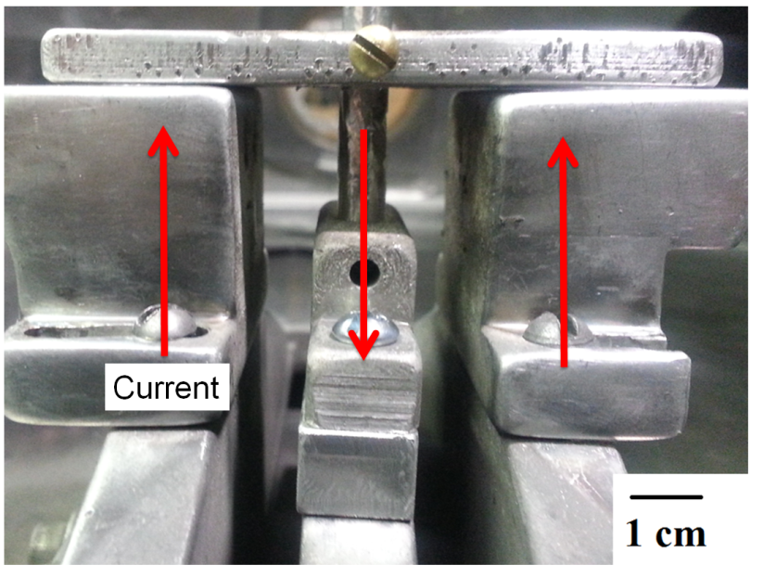
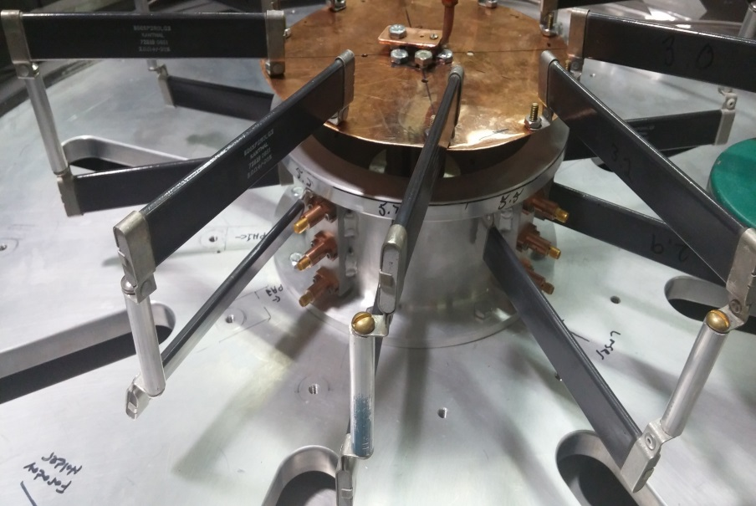
Example Loads
15 cm
Current
Aluminum liner target for ablation experiments
Resistance: 20 to 60 mΩ
Inductance: 5 to 15 nH
Static resistive load used for B-dot calibration with Pearson coil current measurements
Resistance: 130 to 550 mΩ
Inductance: 20 to 60 nH

Slide 7
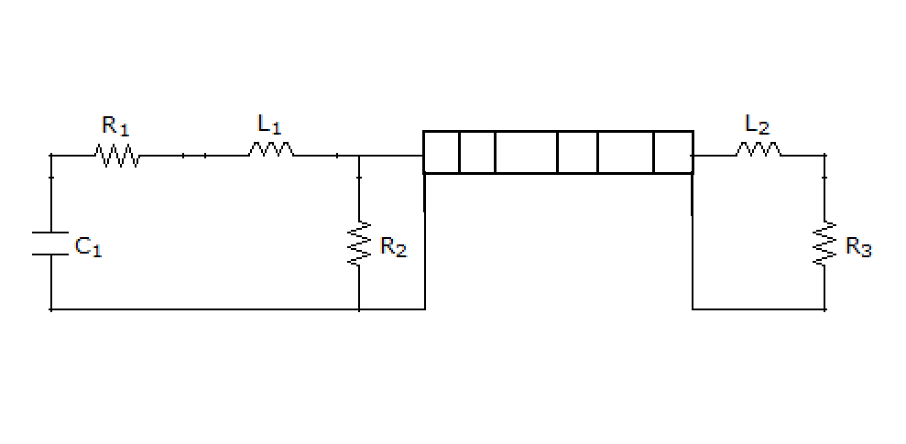
Single-Stage LTD Circuit Model
Adapted from Kim et al.⁵ to include transmission line
Nonlinear transmission line voltage and current were solved from the telegrapher’s equations (discretized in time and space with center differenced spatial derivatives and backward differenced time derivatives)
Current and voltage at other circuit components included as additional nodes in the matrix equation for voltage and current
Magnetic cores were modeled as resistors because eddy current losses dominate core behavior and are nearly constant barring core saturation
Model was used to calculate peak current, risetime, peak insulator voltage, ringback voltage, and time to Hull cutoff current for 10,000 combinations of load resistance and inductance
Z₂
Z_{N}
Z₁
Z_{i}
…
…
Schematic representation of LTD circuit
C₁: Total capacitance of 40 parallel bricks
R₁: Resistance of capacitor section
L₁: Inductance of capacitor section
R₂: Equivalent resistance of cores due to eddy current formation
Z_{1-N}: Transmission line elements
L₂: Load inductance
R₃: Load resistance

Slide 8
Simulated Results: Peak Current
B-dot Calibration Loads
Original resistive load
Wire arrays
Foil/Liner loads

Slide 9
Simulated Results: Risetime
B-dot Calibration Loads
Original resistive load
Wire arrays
Foil/Liner loads

Slide 10
Sample Current Prediction
Aluminum liner (400 nm thickness x 1 cm height x 6.5 mm diameter) load
Excellent agreement with measured current until B-dots fail at ~350 ns
Fit value of load inductance = 15 nH, which was independently confirmed with a Maxwell model of the load geometry for this particular experiment

Slide 11
Resistive Load: With Magnetic Insulation
Magnetic insulation predicted at ~50 ns
Current matches simulated trace until B-dot failure
Reaches predicted peak current at predicted risetime

Slide 12
Resistive Load: No Magnetic Insulation
Current measured with Pearson coil rather than B-dots to examine late-time effects
Current abruptly drops before predicted peak and exhibits ringback associated with a much lower resistance than the resistance accounting for the observed risetime
Voltage also drops suddenly when current drops, supporting evidence of arcing
Arc marks were visible in the transmission line after shots with this resistive load experiment
It is important to anticipate and prevent arcs, as these current features may be mistaken for evidence of Z-pinch or other prompt inductance changes

Slide 13
Dynamic Calculations
If current and voltage are known at any position along the transmission line, the load inductance and resistance can be treated as unknowns and solved for in the matrix calculation
Given only a current measurement, inductance can be estimated by assuming load inductance dominates resistance (a reasonable assumption once the load has ablated and entered Spitzer-like conductivity regime)
Load inductance directly relates to the radius of the current-carrying column, allowing estimation of an effective current-carrying radius from electrical measurements

Slide 14
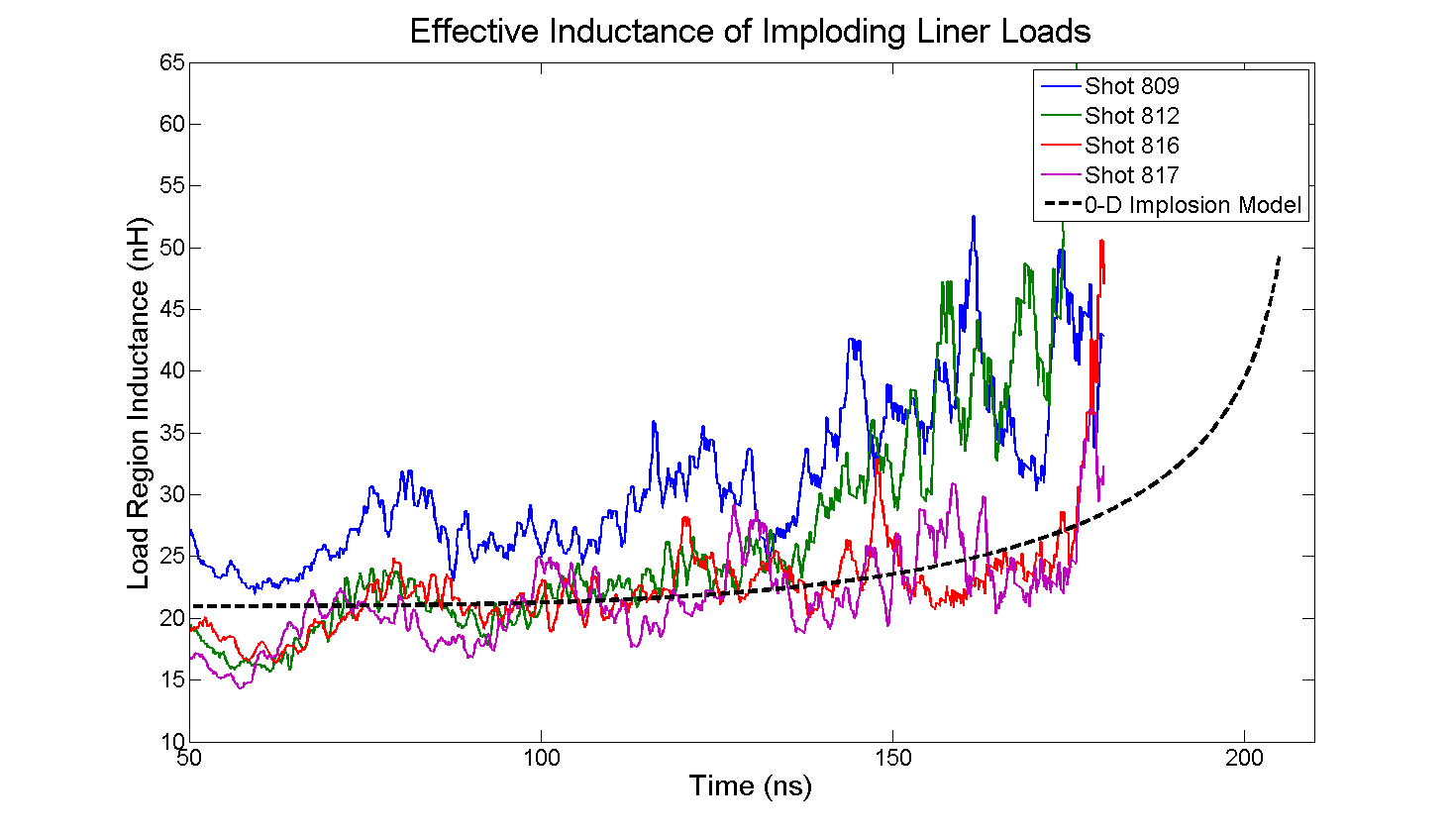
Example Inductance Calculation: Cylindrical Liner
Fit inductance based on inductance of cylindrical plasma column imploding in a 0-D implosion model
Measured inductance follows fit qualitatively but begins to pinch earlier
Calculation of inductance fails at peak current (near 200 ns) because dI/dt goes to 0
Shadowgraphy shows pinches on these liner shots (see poster presentation by D. Yager-Elorriaga)

Slide 15
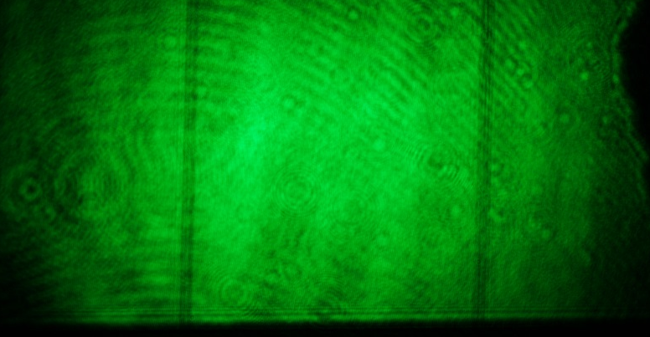
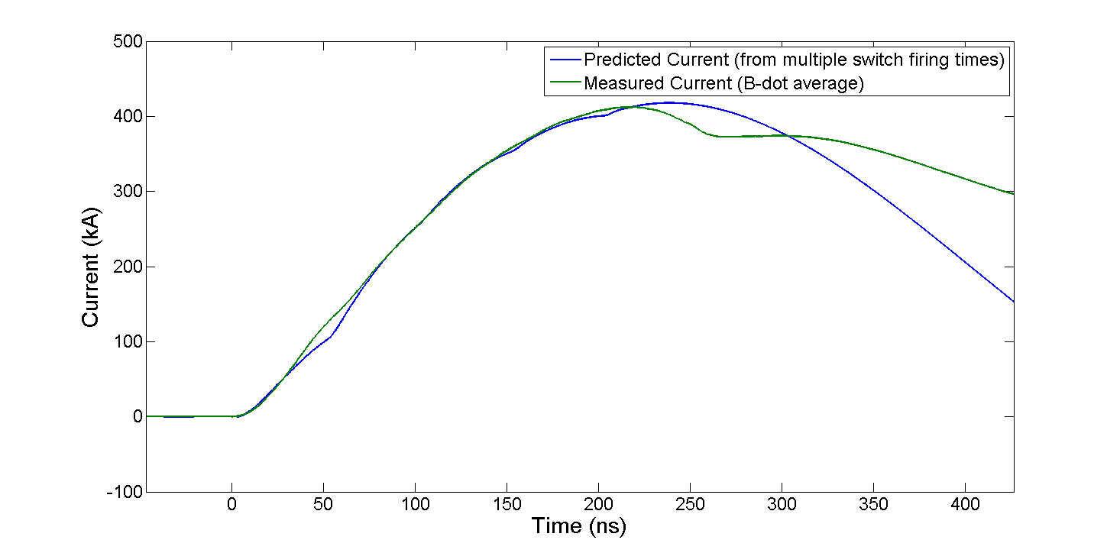
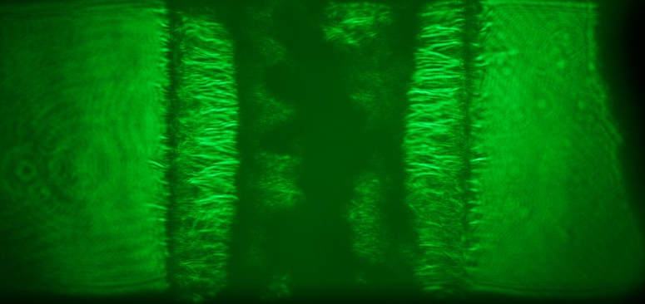
Example Inductance Calculation: Wire Array
Shot 938 Current
6 mm
Preshot image, shot 938
0.8 mm
Shadowgraph 230 ns, shot 938
Drop in current occurs simultaneously with shadowgraph showing pinch of wire array
Current drop corresponds to an inductance change of ~9 nH, which corresponds to a plasma column of radius ~400 μm (indicated on figure)

Slide 16
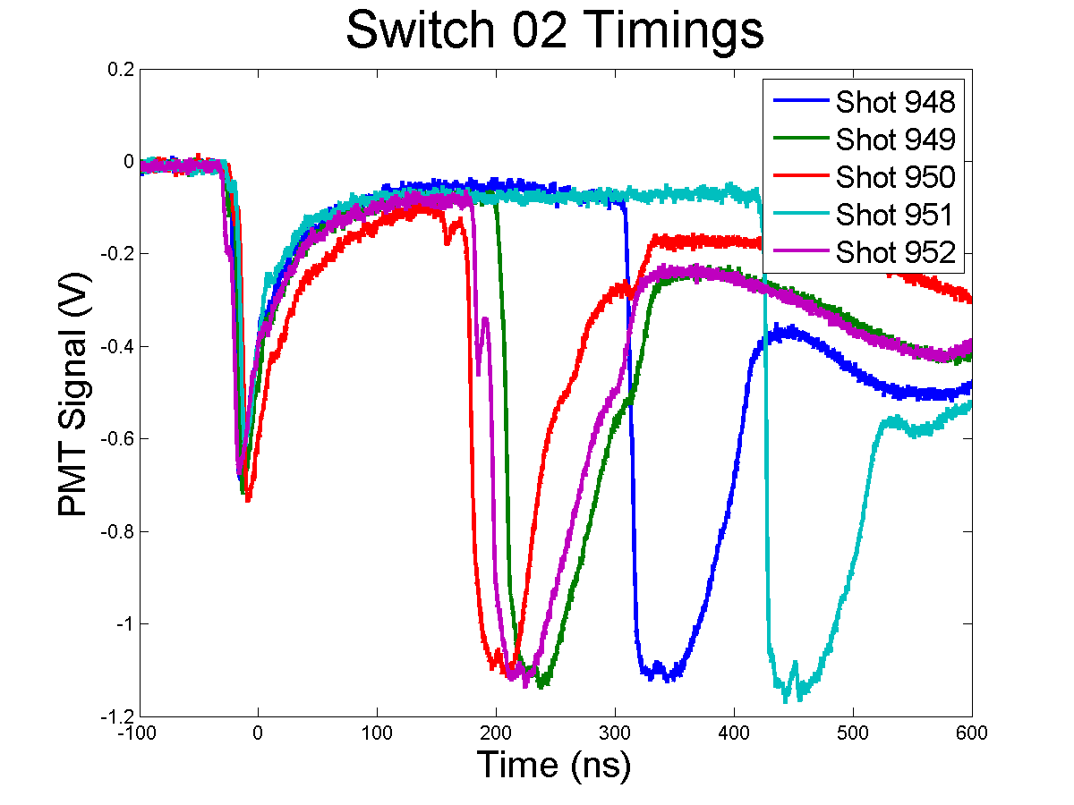
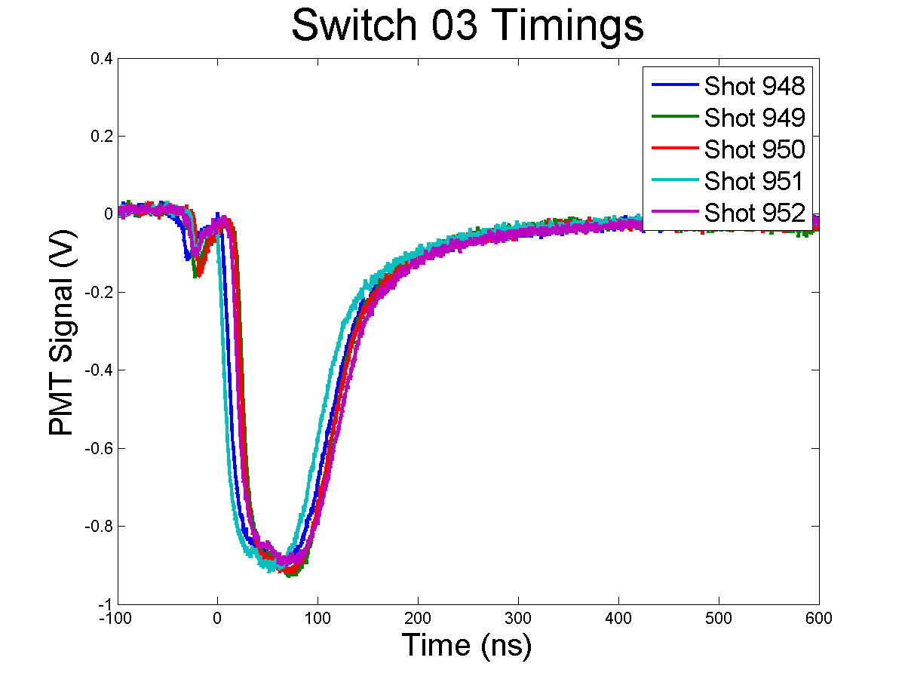
Switch Delay Measurements
High-jitter switch
Low-jitter switch
Fiber optic output from switches is connected to a PMT
Output signal shows switch trigger and closing times
Gives statistical measurement of trigger times to input into circuit model taking into account pulse shaping from switch timings

Slide 17
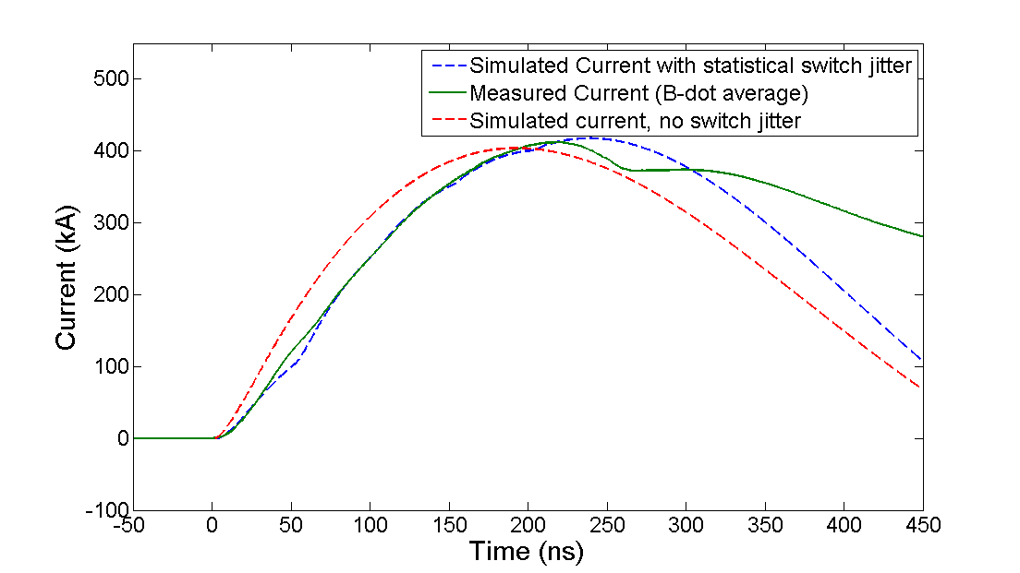
Pulse Shaping and Delay Effects
Shot 938 Current Predictions
LTD bricks firing at different times can have dramatic effects on pulse shaping
The pinch that occurred during this shot sent a reflected pulse, triggering additional switches late in time (>300 ns, around the time when B-dots fail due to charge buildup effects)

Slide 18
Conclusions
A predictive model for LTD current and voltage behavior was developed that can account for any combination of load inductance and resistance to determine current and voltage as a function of time and position
Potential arcing in the transmission line can be anticipated based on whether Hull cutoff condition is satisfied early in the current pulse
Proof-of-principle measurements have been performed showing expected trends in inductance due to changing load geometry with time

Slide 19
Future Work
Improve numerical model to reduce noise in calculation of dynamic parameters
Add voltage measurement to allow simultaneous resistance-inductance measurements
Perform experiments with pulse shaping by deliberately altering switch firing times

Slide 20
References
J. C. Zier, R. M. Gilgenbach, D. A. Chalenski, Y. Y. Lau, D. M. French, M. R. Gomez, S. G. Patel, I. M. Rittersdorf, A. M. Steiner, M. Weis, P. Zhang1 M. Mazarakis, M. E. Cuneo and M. Lopez, Phys. of Plasmas 19, 032701 (2012)
D. A. Yager-Elorriaga, N. M. Jordan, S. G. Patel, A. M. Steiner, Y. Y. Lau, R. M. Gilgenbach, and M. Weis, “Experimental Investigation of the Effects of an Axial Magnetic Field on the Magneto-Rayleigh Taylor Instability in Ablating Planar Foil Plasmas,” 42nd IEEE International Conference on Plasma Science, Antalya, Turkey (May 24-28, 2015)
A. S. Safronova, V. L. Kantsyrev, M. E. Weller, I. K. Shrestha, V. V. Shlyaptseva, M. C. Cooper, M. Lorance, A. Stafford, S. G. Patel, A. M. Steiner, D. A. Yager-Elorriaga, N. M. Jordan, and R. M. Gilgenbach “First Experiments with Planar Wire Arrays on U Michigan’s Linear Transformer Driver,” 56th Annual Meeting of the APS Division of Plasma Physics, New Orleans, LA (October 27-31, 2014)
A. M. Steiner, S. G. Patel, David A. Yager-Elorriaga, N. M. Jordan, R. M. Gilgenbach, and Y. Y. Lau, “Experimental Investigation of the Electrothermal Instability on Planar Foil Ablation Experiments,” 56th Annual Meeting of the APS Division of Plasma Physics, New Orleans, LA (October 27-31, 2014)
A. A. Kim, M. G. Mazarakis, V. A. Sinebryukhov, B. M. Kovalchuk, V. A. Visir, S. N. Volkov, F. Bayol, A. N. Bastrikov, V. G. Durakov, S. V. Frolov, V. M. Alexeenko, D. H. McDaniel, W. E. Fowler, K. LeChien, C. Olson, W. A. Stygar, K. W. Struve, J. Porter, and R. M. Gilgenbach, Phys. Rev. ST–Accel. and Beams 12, 050402 (2009)
M. G. Mazarakis, W. E. Fowler, K. L. LeChien, F. W. Long, M. K. Matzen, D. H. McDaniel, R. G. McKee, C. L. Olson, J. L. Porter, S. T. Rogowski, K. W. Struve, W. A. Stygar, J. R. Woodworth, A. A. Kim, V. A. Sinebryukhov, R. M. Gilgenbach, M. R. Gomez, D. M. French, Y. Y. Lau, J. C. Zier, D. M. VanDevalde, R. A. Sharpe, and K. Ward, IEEE Transactions on Plasma Science 38, 704 (2010)
J. C. Zier, Ph.D. Thesis, University of Michigan (2011)
M. R. Gomez, Ph.D. Thesis, University of Michigan (2011)
Special thanks to Professor Alec Thomas of the University of Michigan for helpful conversations on numerical methods and stability analysis

