Slide 1


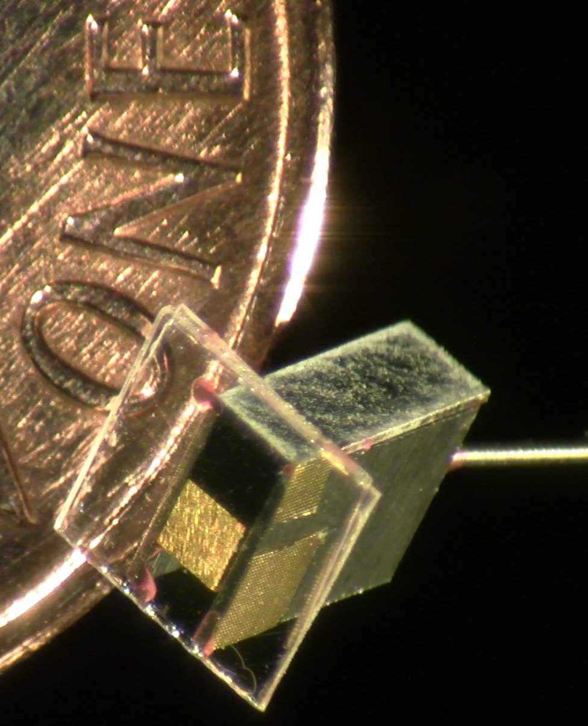
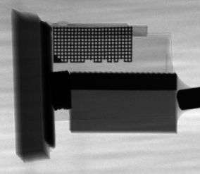
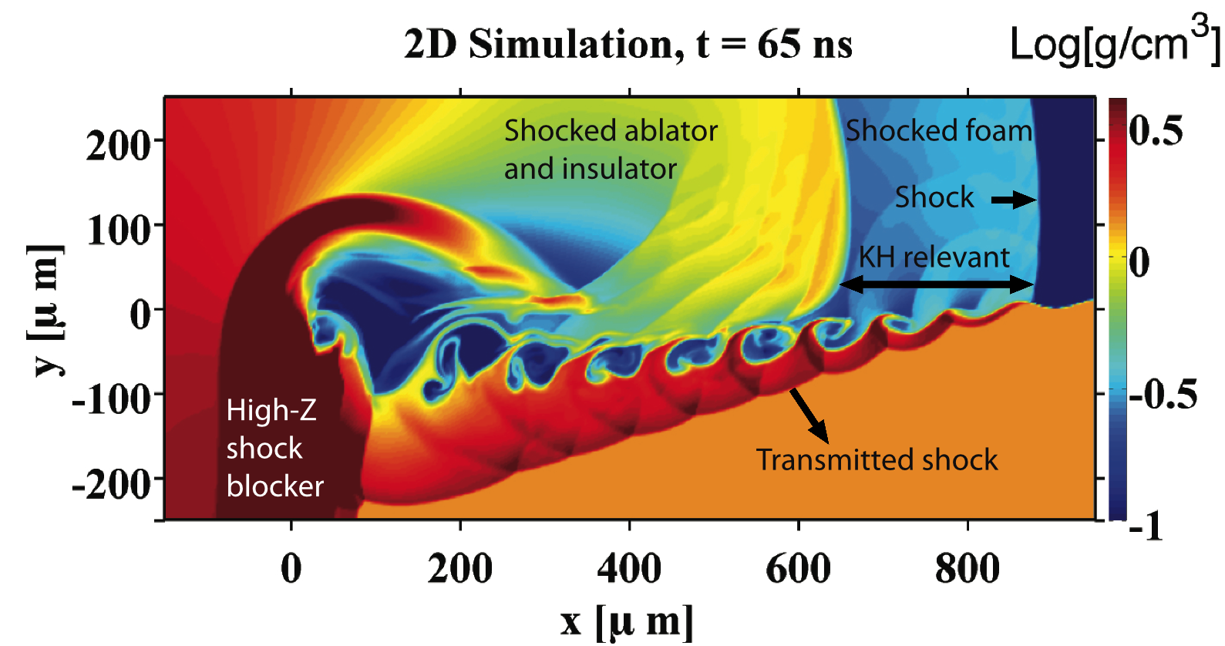
Observations of vortex merger and growth reduction in a dual-mode, supersonic Kelvin-Helmholtz instability experiment
W.C. Wan¹, G. Malamud^{1,2}, A. Shimony^{2,3}, M.R. Trantham¹, S.R. Klein¹, D.Shvarts^{1,2,3,}, C.C. Kuranz¹, R.P.Drake¹
¹Climate and Space Science and Engineering, University of Michigan, Ann Arbor, MI, USA. ²Nuclear Research Center – Negev, Beer Sheva, Israel. ³Department of Physics, Ben Gurion University of the Negev, Beer Sheva, Israel.
Introduction
The Kelvin-Helmholtz instability is a fundamental hydrodynamic process that generates vortical structures and turbulence at an interface with shear flow.
In a supersonic flow, the growth rate of the Kelvin-Helmholtz instability (KHI) is inhibited.
We share the results of laser-driven experiments designed to produce the first observations of the KHI evolving from well-characterized, single-mode and dual-mode initial conditions in a supersonic flow.
Figure 1: We design scaled experiments to study the the behavior of fluids under extreme temperatures and pressures, such as those found in fusion experiments and astrophysical systems.
Photocredit: NASA, Voyager I (1979)
Objectives
Design and develop the experimental platform
Produce the first data of the KHI evolving from single-mode and dual-mode initial conditions in a supersonic flow
Validate or refine simulation codes based on the results
Figure 5:
Top: Single-mode data is in detailed agreement with simulations
Bottom: Preliminary analysis of the dual-mode data shows promising signs of vortex merger
Large scale behavior, such as modulation amplitude growth, has been well-reproduced with 2D simulations.
Fine-scale structures that exist on the edge of the diagnostic resolution limit (~10-15 µm), such as the curled tips of the modulations, also appear to be in reasonable agreement with simulations. It is difficult to determine whether the small discrepancies reflect a real difference, or simply experimental uncertainties. Additional data can provide insights as to whether simulation codes correctly handle the development of structures and turbulence at small scales.
Figure 2: The ratio of the compressible to incompressible growth rate coefficients is reduced by about half for this experiment
Materials and Methods
Conclusions
We developed a novel experimental platform, firing three 10-ns laser pulses in sequence to sustain a shockwave in carbon foam for roughly 70-ns.
We developed an experimental platform that can sustain a steady, supersonic flow for timescales that greatly exceed the characteristic timescale of common hydrodynamic instabilities. This platform can be given well-characterized seed perturbations as part of the tightly controlled initial conditions.
This platform was used to produce the first experimental observations of the Kelvin-Helmholtz instability evolving from well-defined, single-mode and dual-mode initial conditions in a supersonic flow. The data supports an inhibition in the growth rate of the KHI.
Additional analysis will also provide the first measurements of the vortex merger rate of well-characterized seed perturbations evolving under the Kelvin-Helmholtz instability.
CHBr insulator
CRF foam
CHI tracer
PAI plastic
PC ablator
High-Z shock blocker
Figure 3:
Left: Our primary diagnostic is Cu K_{α} x ray radiography. An unshocked target is shown
Right: 2D simulations are used for both design work and data analysis
Results and Discussion
Acknowledgements
The data supports the predicted reduction in the KHI growth rate.
The red line denotes the predicted amplitude vs. time of the seed perturbations evolving under experimental conditions.
The black line is from a simulation with an increased pressure and, hence, sound speed, minimizing the effect of compressibility.
This work is funded by the U.S. Department of Energy, through the NNSA-DS and SC-OFES Joint Program in High-Energy-Density Laboratory Plasmas, grant number DE-NA0001840, and the National Laser User Facility Program, grant number DE-NA0000850, and through the Laboratory for Laser Energetics, University of Rochester by the NNSA/OICF under Cooperative Agreement No. DE-FC52-08NA28302.
References
W.C. Wan et. al., “Observation of single-mode, Kelvin-Helmholtz instability in a super-sonic flow," Physical Review Letters, (Volume 115, Issue 14, Pages 145001) 2015.
G. Malamud et. al., “A design of a two-dimensional, supersonic KH experiment on OMEGA-EP," High Energy Density Physics, (Volume 9, Issue 4, Pages 672-686) 2013.
S.R. Choudhury et. al., “Nonlinear evolution of the Kelvin-Helmholtz instability of supersonic tangential velocity discontinuities,” Journal of Mathematical Analysis and Applications, (Volume 214, Issue 2, Pages 561-586) 1997.
Figure 4: The data supports predictions of growth inhibition, until disturbed by the thermal insulator

