Slide 1
Spatial Amplification in a Disk-on-Rod Traveling-Wave Amplifier
Patrick Y. Wong¹, Brad Hoff², David H. Simon¹, David Chernin³, Peng Zhang¹, Y.Y. Lau¹, Ronald M. Gilgenbach¹
¹ Department of Nuclear Engineering and Radiological Sciences,
University of Michigan, Ann Arbor
² Air Force Research Laboratory, Kirtland AFB, Albuquerque, NM
³ Leidos Corporation, Reston, VA
MIPSE Graduate Student Symposium
October 7, 2015
Work supported by AFOSR Award No. FA9550-15-1-0097, AFRL Award No. FA9451-14-1-0374, and L-3 Communications.

Slide 2
Motivations and Objectives
Motivations:
Many high power microwave devices have narrow bandwidth, concentrating more on high power output
Disk-on-Rod Traveling Wave Tube (TWT) may provide both high power output and wide bandwidth by its use of an annular beam (for high current) and slow-wave structure (for wide bandwidth)
Objectives:
Do an in-depth study of the viability of this Disk-on-Rod TWT
Derive and solve the exact hot-tube dispersion relation to find the spatial amplification rate
Compare against Particle-in-Cell code ICEPIC, MAGIC, and CHRISTINE
Relate to Pierce’s General Theory of TWTs

Slide 3
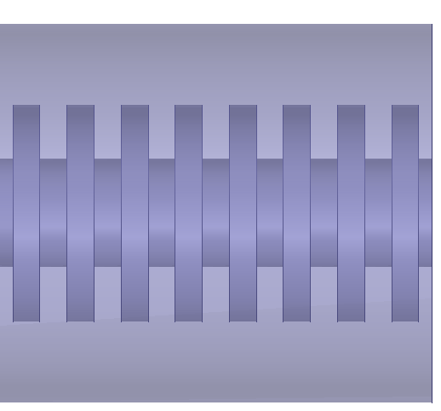
Schematic Diagram: Disk-on-Rod TWT
b
τ
R
a
h
Disk-on-Rod Slow-Wave Structure
w’
w
Electron Beam
L
Outer Shell

Slide 4
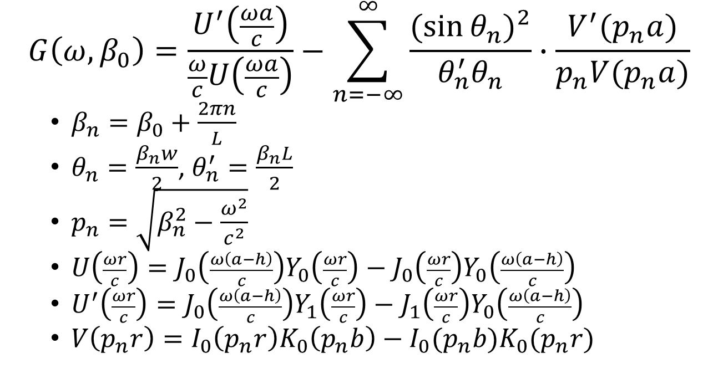
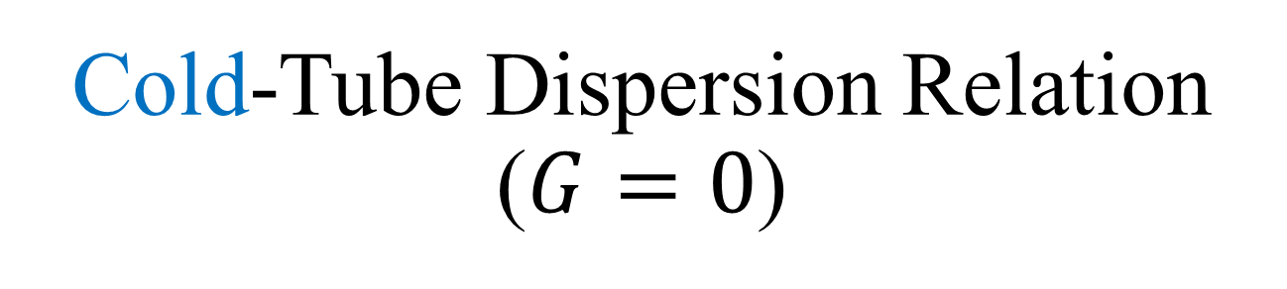
Cold-Tube Dispersion Relation ($G=0$)
$$G\left(ω,β_{0}\right)=\frac{U^{′}\left(\frac{ωa}{c}\right)}{\frac{ω}{c}U\left(\frac{ωa}{c}\right)}−\sum_{n=−∞}^{∞}{\frac{{(sin{θ_{n})}}^{2}}{θ_{n}^{′}θ_{n}}∙\frac{V^{′}(p_{n}a)}{p_{n}V(p_{n}a)}}$$
$β_{n}=β_{0}+\frac{2πn}{L}$
$θ_{n}=\frac{β_{n}w}{2}$, $θ_{n}^{′}=\frac{β_{n}L}{2}$
$p_{n}=\sqrt{β_{n}^{2}−\frac{ω^{2}}{c^{2}}}$
$U\left(\frac{ωr}{c}\right)=J_{0}\left(\frac{ω\left(a−h\right)}{c}\right)Y_{0}\left(\frac{ωr}{c}\right)−J_{0}\left(\frac{ωr}{c}\right)Y_{0}\left(\frac{ω\left(a−h\right)}{c}\right)$
$U^{′}\left(\frac{ωr}{c}\right)=J_{0}\left(\frac{ω\left(a−h\right)}{c}\right)Y_{1}\left(\frac{ωr}{c}\right)−J_{1}\left(\frac{ωr}{c}\right)Y_{0}\left(\frac{ω\left(a−h\right)}{c}\right)$
$V\left(p_{n}r\right)=I_{0}\left(p_{n}r\right)K_{0}\left(p_{n}b\right)−I_{0}(p_{n}b)K_{0}(p_{n}r)$
The cold-tube dispersion relation relates the angular frequency ω to the wavenumber (propagation constant) of the fundamental mode β₀ of the circuit wave in the absence of the electron beam

Slide 5
Cold-Tube Dispersion Relation Comparison
Absolute Instability [1]
Operating Point
Good agreement between the analytic field theory, HFSS, and ICEPIC
[1] D. M. H. Hung, I. Rittersdorf, P. Zhang et al., Phys. Rev. Lett. 115, 124801 (2015).

Slide 6
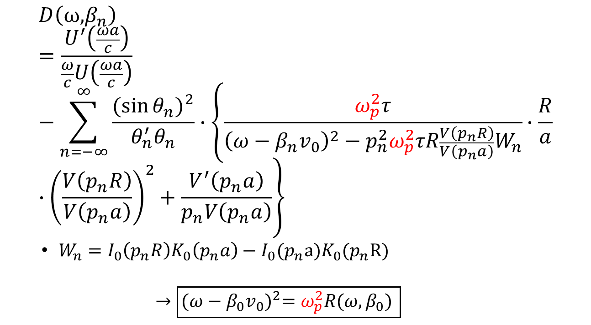
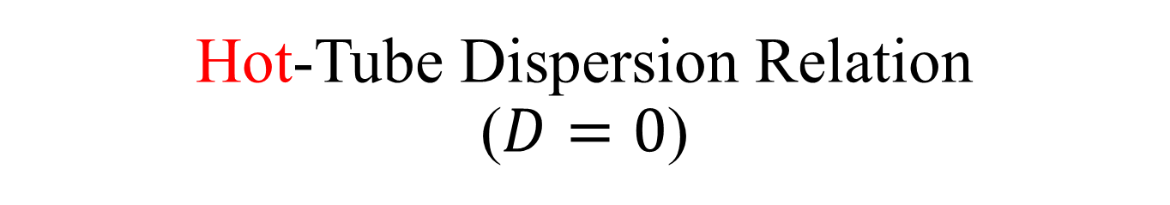
Hot-Tube Dispersion Relation ($D=0$)
$$D\left(\text{ω}\text{,}β_{n}\right)=\frac{U^{′}\left(\frac{ωa}{c}\right)}{\frac{ω}{c}U\left(\frac{ωa}{c}\right)}−\sum_{n=−∞}^{∞}{\frac{{(sin{θ_{n})}}^{2}}{θ_{n}^{′}θ_{n}}∙\left\{\frac{ω_{p}^{2}τ}{{\left(ω−β_{n}v_{0}\right)}^{2}−p_{n}^{2}ω_{p}^{2}τR\frac{V\left(p_{n}R\right)}{V\left(p_{n}a\right)}W_{n}}∙\frac{R}{a}∙{\left(\frac{V\left(p_{n}R\right)}{V\left(p_{n}a\right)}\right)}^{2}+\frac{V^{′}\left(p_{n}a\right)}{p_{n}V\left(p_{n}a\right)}\right\}}$$
$W_{n}=I_{0}\left(p_{n}R\right)K_{0}\left(p_{n}a\right)−I_{0}(p_{n}a)K_{0}(p_{n}R)$
$$→\boxed{{(ω−β_{0}v_{0})}^{2}=ω_{p}^{2}R(ω,β_{0}) }$$
(ω_{p} = beam plasma frequency, R = plasma reduction factor)

Slide 7
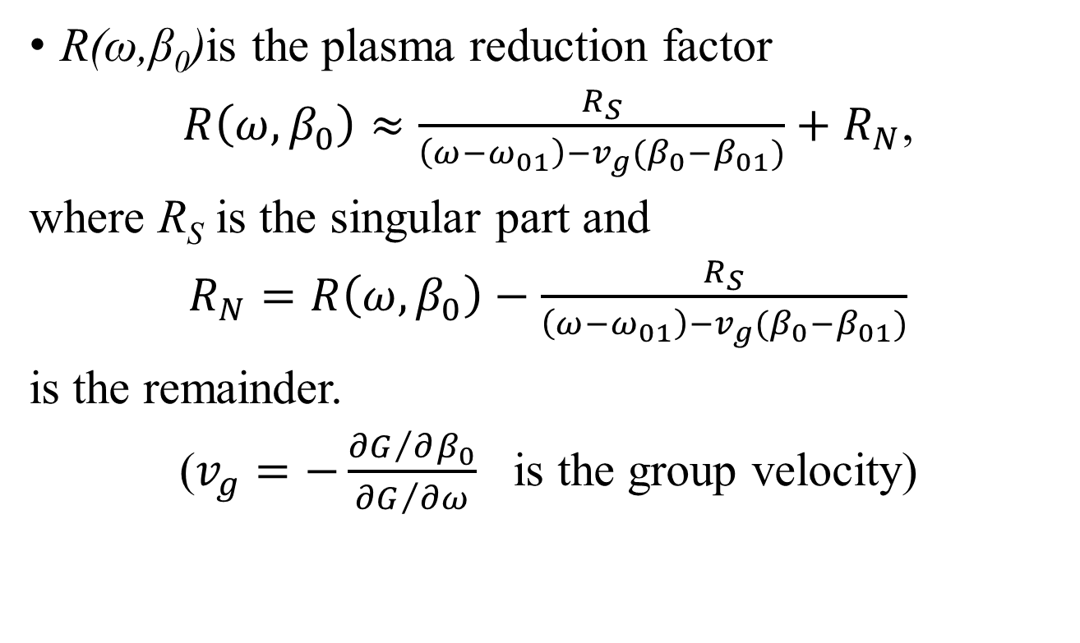
Plasma Reduction Factor
R(ω,β₀)is the plasma reduction factor
$R\left(ω,β_{0}\right)≈\frac{R_{S}}{\left(ω−ω_{01}\right)−v_{g}(β_{0}−β_{01})}+R_{N}$,
where R_{S} is the singular part and
$R_{N}=R\left(ω,β_{0}\right)−\frac{R_{S}}{\left(ω−ω_{01}\right)−v_{g}(β_{0}−β_{01})}$
is the remainder.
($v_{g}=−\frac{{∂G}/{∂β_{0}}}{{∂G}/{∂ω}}$ is the group velocity)

Slide 8
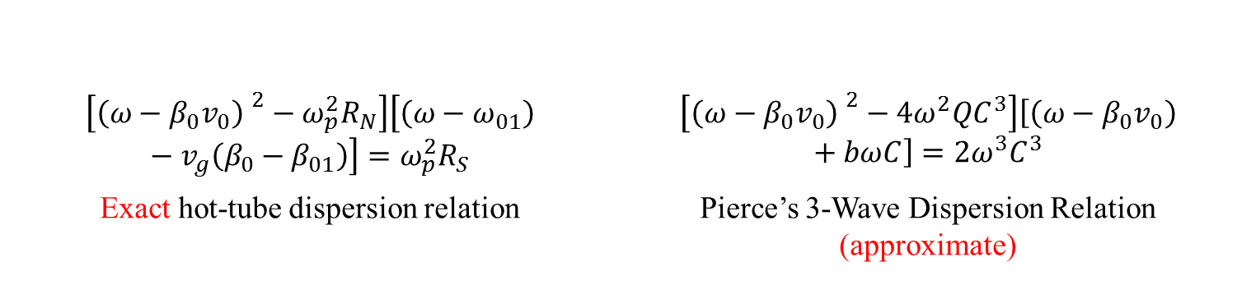
Pierce’s General Three-Wave TWT Theory
$$\left[{\left(ω−β_{0}v_{0}\right) }^{2}−ω_{p}^{2}R_{N}\right]\left[\left(ω−ω_{01}\right)−v_{g}\left(β_{0}−β_{01}\right)\right]=ω_{p}^{2}R_{S}$$ | $$\left[{\left(ω−β_{0}v_{0}\right) }^{2}−4ω^{2}QC^{3}\right]\left[\left(ω−β_{0}v_{0}\right)+bωC\right]=2ω^{3}C^{3}$$
Exact hot-tube dispersion relation | Pierce’s 3-Wave Dispersion Relation (approximate)
General form of dispersion relation, exact or approximate:
[Beam Mode] [Circuit Mode] = [Coupling Constant]
C = coupling constant (proportional to R_{s})
QC = “space charge effect” (proportional to R_{N})

Slide 9
Test Case Parameters
Dimensions [cm]
b | 3.5
R | 2.8
a | 2.3
h | 1.3
w’ | 0.3
w | 0.3
τ | 0.1
b
τ
R
a
h
Operating Parameters
V [kV] | 123.847
β₀₁ [m⁻¹] | 100
f₀₁ [GHz] | 2.832
w’
w
L

Slide 10
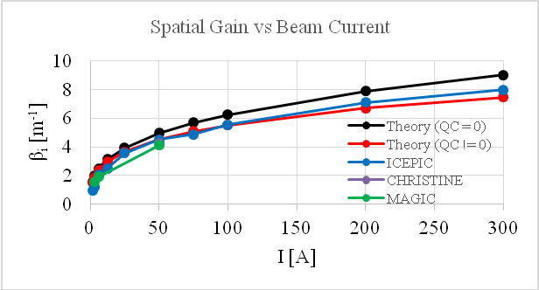
Spatial Amplification Rate vs Beam Current using Pierce Theory
The analytic theory, ICEPIC, CHRISTINE, and MAGIC all show general agreement

Slide 11
Frequency Response at 50 A DC beam current
There is fair agreement between theory and ICEPIC

Slide 12
Absolute Instability Simulated
For the given test case parameters, there is an absolute instability at upper band edge [1].
The MAGIC simulations confirm this:
Signal
Absolute
Instability
Absolute
Instability
Signal
Signal
[1] D. M. H. Hung, I. Rittersdorf, P. Zhang et al., Phys. Rev. Lett. 115, 124801 (2015).

Slide 13
Summary & Future Work
The hot-tube dispersion relation for a Disk-on-Rod TWT driven by an annular electron beam is obtained.
The cold-tube limit is verified by HFSS and ICEPIC
The theoretical spatial amplification rate as a function of beam current agrees well with ICEPIC, MAGIC, and CHRISTINE for synchronous interaction.
The agreement in the frequency response from the theory and ICPIC is only fair, a subject for future study.
A possible absolute instability at upper band edge is observed in ICEPIC, also a subject for future study.

