Slide 1
Plasma Packed bed reactor discharge characteristics as a function of pressure
Kenneth W. Engeling, John E. Foster,
Juliusz Kruszelnicki, and Mark J. Kushner
University of Michigan, Ann Arbor, MI, 48109, USA
kenengel@umich.edu, jefoster@umich.edu,
jkrusze@umich.edu, mjkush@umich.edu
MIPSE Symposium
October 2017
* Work supported by the Department of Energy Office of Fusion Energy Science and the National Science Foundation.

Slide 2
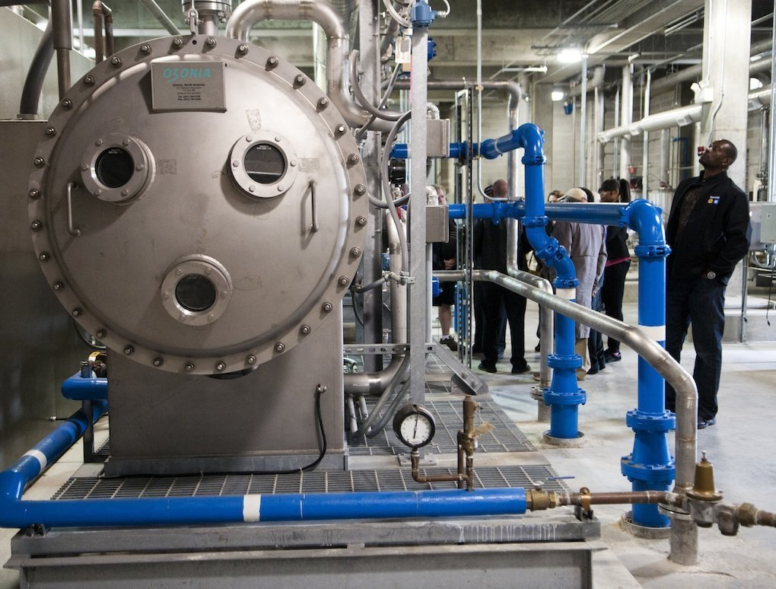
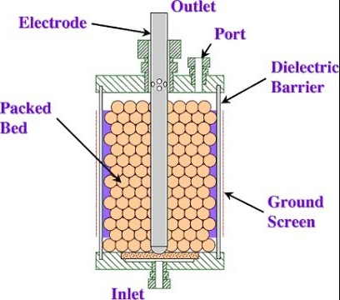
INTRODUCTION TO PACKED BED REACTORS
Applications
Environmental remediation practices
Ozone generation
Catalytic particles for enhanced reactivity
Dry-reforming of methane
Agriculture
Operation sensitive to many
parameters
Voltage
Packing Fraction
Dielectric constant value of media
Media geometry
Pressure and gas type
Complicated reaction processes
Ozone generator at the Flint water treatment facility – mlive.com photo
Sample of packed bed reactor schematic
University of Michigan
Institute for Plasma Science & Engr.
1
MIPSE_2017
Notes:
Image of discharge and schematic

Slide 3
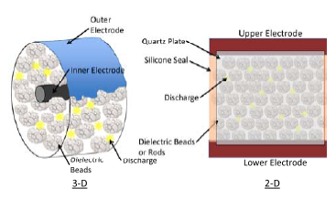
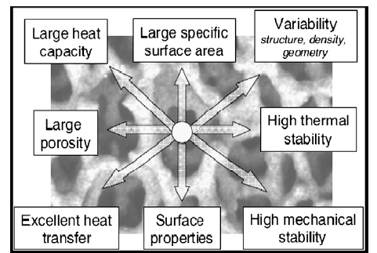
POORLY UNDERSTOOD PHENOMENA
Unknown plasma formation and propagation modes through media
Structured and randomly-structured porous media
What surface properties enhance or limit the plasma propagation?
What is the role of plasma surface phenomena in determining the behavior of catalytic material?
To what degree does these plasma damage or effect the media (sputtering, aging, surface oxidation, biomaterial modification, etc.)?
3-D PBR (left) and 2-D simulated PBR (right)
Porous Media for Combustion,
Mujeebu, Appl. Eng., 2009
University of Michigan
Institute for Plasma Science & Engr.
2
MIPSE_2017

Slide 4
UNDERSTANDING THE PBR
Why?
Improve upon current applications
Gain further insight into plasma propagation
Highly packed media
Varying Dielectric constants
Microporous material
Structured and randomly pored
Further control plasma chemistry
How?
2-Dimensional Cell PBR
Modeling comparison
nonPDPSIM
ICCD image capture
Time-resolved imaging
Macro/Microscopic views
Soybeans in a packed bed reactor
Example of an excerpt of the possible reactions
of humid air, atmospheric plasma
University of Michigan
Institute for Plasma Science & Engr.
3
MIPSE_2017

Slide 5
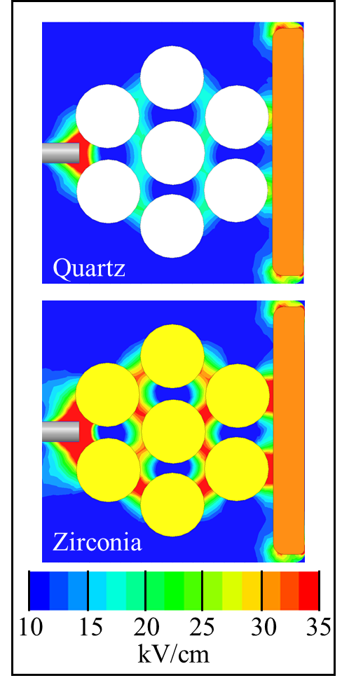
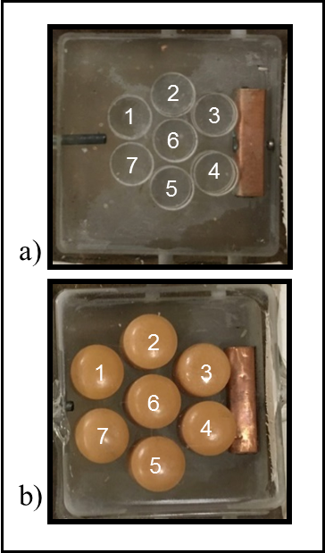
DISCHARGE EVOLUTION:
EFFECTS OF DIELECTRICS
Dielectrics locally enhance the electric field
Manipulation of media allows for varying discharge characteristics
Highest enhancement at closest dielectric-dielectric contact points
University of Michigan
Institute for Plasma Science & Engr.
4
MIPSE_2017
Notes:
5
5

Slide 6
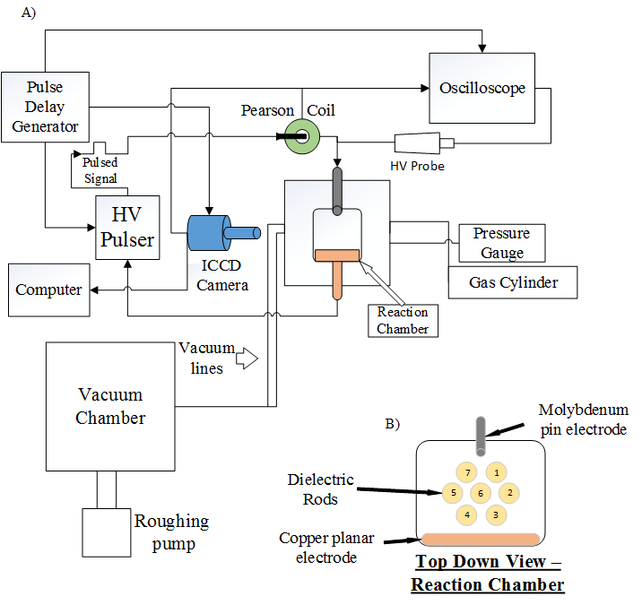
EXPERIMENTAL SETUP
Nanosecond, pulsed discharge
20 kV atmosphere
12 kV partial pressure
Natural air gas composition
Atmosphere
Sub-atmosphere
ICCD image capture
Pulse Delay Generator Timing
5 nanosecond integration
University of Michigan
Institute for Plasma Science & Engr.
5
MIPSE_2017
Notes:
Unexplained phenomenon
Greater than the sum of individual contributions

Slide 7
SYSTEM AMENABLE TO MODELING
2-Dimensional
Allows for modeling in nonPDPSIM
Cuts modeling time down
Allows for direct comparison with model via optics
Time-resolved imaging
Allows for step-by-step walkthrough of discharge for comparison
Experiment
1 ms, integrated
Model, nonPDPSIM
University of Michigan
Institute for Plasma Science & Engr.
6
MIPSE_2017
Notes:
Humidity:

Slide 8
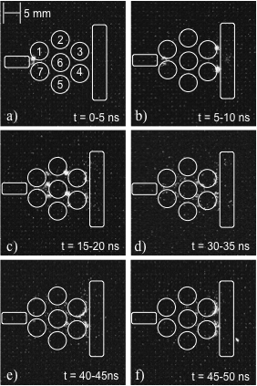
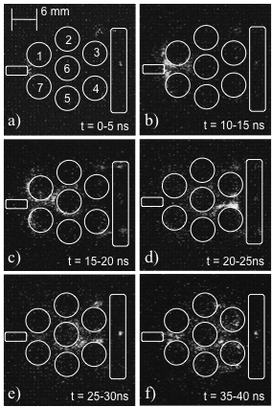
MACROSCOPIC VIEW: 1 Atmosphere
Zirconia
Localized, intense microdischarges
Stochastic
Highest E/N
Quartz
Initial, filamentary microdischarges
Wave-like propagation
Differences
Intense FMs vs. more diffuse plasma
Zirconia
(ε/ε_{o} = 28.8)
Quartz
(ε/ε_{o} = 3.8)
University of Michigan
Institute for Plasma Science & Engr.
7
MIPSE_2017

Slide 9
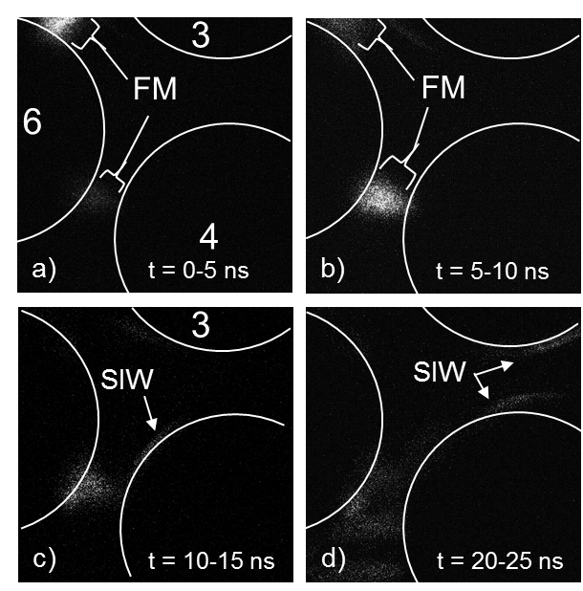
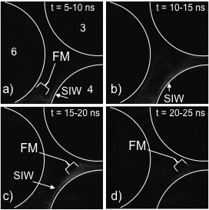
MICROSCOPIC VIEW
Zirconia (ε/ε_{o} = 28.8)
Intense, localized FMs
SIW formation
Quartz (ε/ε_{o} = 3.8)
Weak FM plasma
More diffuse discharge
University of Michigan
Institute for Plasma Science & Engr.
8
MIPSE_2017
Notes:
Dielectric relaxation time of catalysts ~ 9e-15 s.

Slide 10
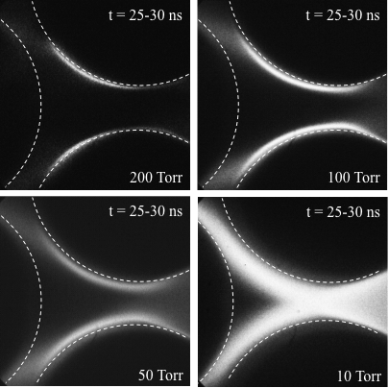
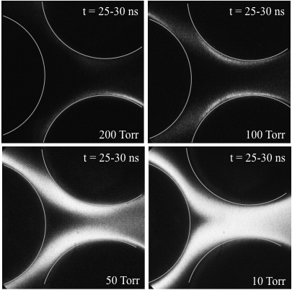
DISCHARGE SENSITIVITY TO PRESSURE CHANGE
Zirconia
Quartz
Pressure significantly effects discharge characteristic length scale
University of Michigan
Institute for Plasma Science & Engr.
9
MIPSE_2017

Slide 11
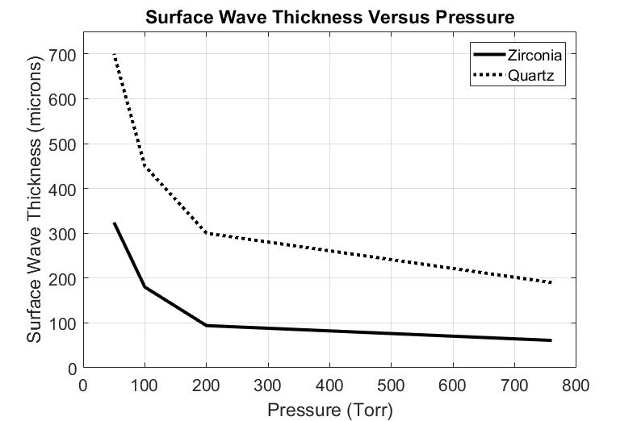
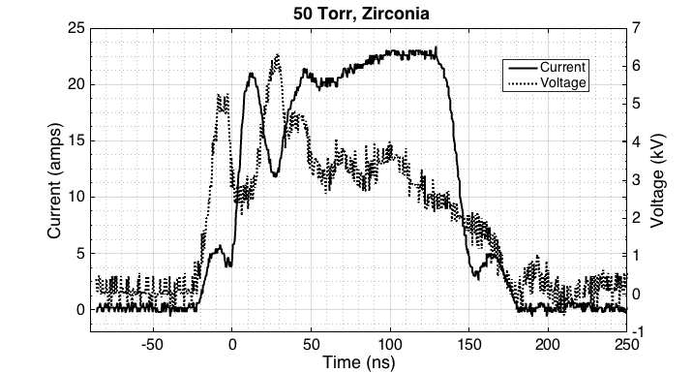
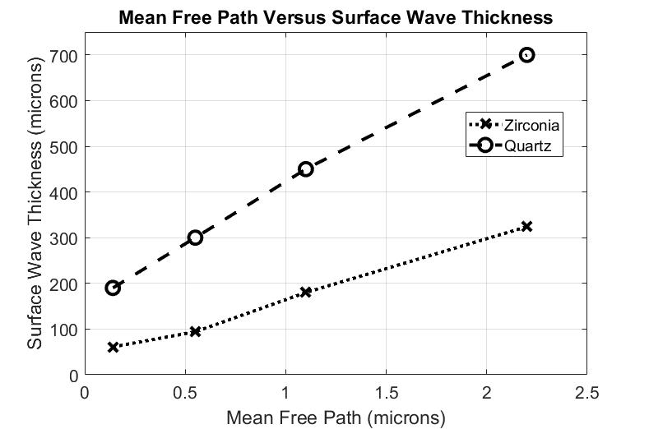
PBRs in SUB-ATMOSPHERIC ENVIRONMENTS
a)
Current
Voltage
b)
Surface discharge thickness increases with decreasing pressure
Complex IV Waveform
Current waveform may give insight on discriminating discharge lifetime and intensity
University of Michigan
Institute for Plasma Science & Engr.
10
MIPSE_2017

Slide 12
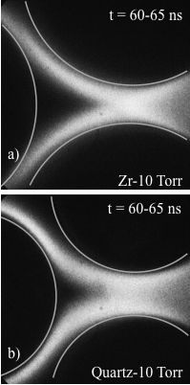
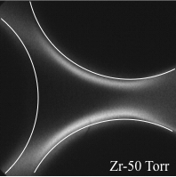
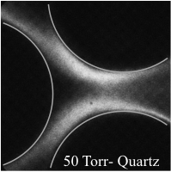
POTENTIAL CHARGING EFFECTS
Possible surface charge buildup on the dielectric materials
Zirconia
Charging effects not seen
Quartz
Charging not seen at 50 Torr
Redirects propagation path
Possible plasma chemistry effects
Modification of plasma spatial distribution
No visible Charging
Effect
Charging Effect
Quartz- 50 Torr
University of Michigan
Institute for Plasma Science & Engr.
11
MIPSE_2017

Slide 13
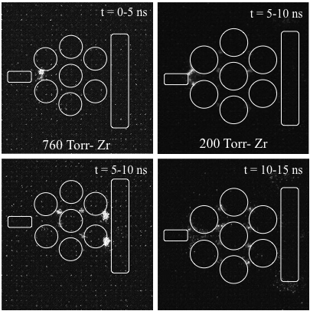
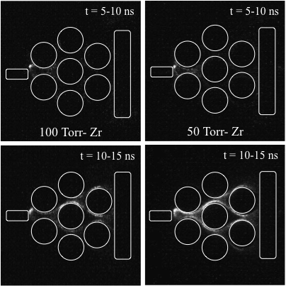
CONCLUSIONS OF PRESSURE VARYING DISCHARGES
Zirconia
Higher plasma density
Smaller sheath thickness
Quartz
Charging effects seen
Lower dielectric, less influence
Overall
Higher E/N throughout system
Volume-filling plasma at low pressures
University of Michigan
Institute for Plasma Science & Engr.
12
MIPSE_2017

Slide 14
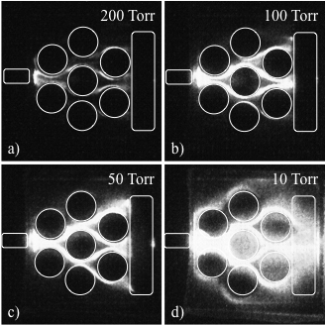
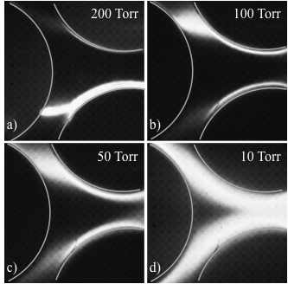
“LONG”, TIME-INTEGRATED IMAGES
Zirconia, 1 ms integrated images
Repeatable, volume filling plasma
FMs -> SIWs -> FMs
University of Michigan
Institute for Plasma Science & Engr.
13
MIPSE_2017

Slide 15
CONCLUDING REMARKS
Plasma through packed beds travels as an ionization wave
Dielectric constant influences plasma discharge and propagation mode
Zirconia
Localized, intense microdischarges with higher value
Stochastic, then volume filling wavelike propagation
Highest E/N
Quartz
Initial, filamentary microdischarges
Wave-like propagation
Pressure variations influence volumetric plasma formation
Lower pressure leads to larger plasma volumes
Higher dielectric leads to enhanced surface hugging plasma
Dielectric material has the potential to influence plasma characteristics for remediation/catalytic applications
Novel application for biological material such as seeds
University of Michigan
Institute for Plasma Science & Engr.
14
MIPSE_2017

