Slide 1
Interactions between plasmas and microscopic metal particles in
packed bed reactors*
Juliusz Kruszelnicki, Kenneth W Engeling, John E. Foster, and Mark J. Kushner
University of Michigan, Ann Arbor, MI, 48109, USA
jkrusze@umich.edu, kenengel@umich.edu, jefoster@umich.edu, mjkush@umich.edu
MIPSE Symposium
October 2017
* Work supported by the Department of Energy Office of Fusion Energy Science and the National Science Foundation.

Slide 2
AGENDA
Introduction to Plasma Catalytic Packed Bed Reactors for Gas Reprocessing
Model Description
Description of Discharge Evolution – Base Case
Addition of Catalyst
Discharge morphology
Location of Catalyst
Electron Field Emission
Fluxes Incident on Catalysts
Spatial Flux Profile
Species of Interest
Concluding Remarks
MIPSE_2017
University of Michigan
Institute for Plasma Science & Engr.
Notes:
Application for atm discharges

Slide 3
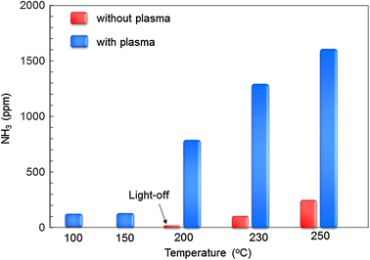
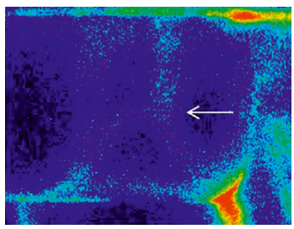
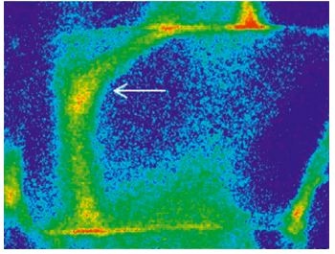
SYNERGY IN PLASMA CATALYSIS
Plasma/catalytic synergy has been observed, but yet unexplained.
Conversion rates are highest when both plasma and thermal catalysis take place.
Plasma provides electrons, ions, radicals, UV → heating, surface modification, self-cleaning.
Presence of metallic catalysts impacts plasma formation.
ICCD image
Zeolite, no catalyst
ICCD image
Zeolite with Ag catalyst
Kim et al. Eur Phys J Appl Phys 55:13806 (2011)
Kim et al. Plasma Chem Plasma Process (2016) 36: 45
University of Michigan
Institute for Plasma Science & Engr.
MIPSE_2017
Notes:
Unexplained phenomenon
Greater than the sum of individual contributions

Slide 4
RESEARCH ISSUES:
Plasma discharge dynamics: How does presence of metallic particles affect DBD discharges in PBRs?
Formation of surface discharges: What processes are produce additional plasma structures in catalyst-impregnated systems?
Surface fluxes: What species are delivered to the catalyst surface?
Surface heating: How is energy transferred to the catalyst and what are the sources?
MIPSE_2017
University of Michigan
Institute for Plasma Science & Engr.
Notes:
Application for atm discharges

Slide 5
MODEL:
nonPDPSIM
Plasma Hydrodynamics
Poisson’s Equation
Gas Phase Plasma
Bulk Electron Energy
Transport
Kinetic “Beam”
Electron Transport
Unstructured mesh.
Fully implicit plasma transport.
Time slicing algorithms between plasma and fluid timescales.
Neutral Transport
Navier-Stokes
Neutral and Plasma
Chemistry
Radiation Transport
Surface Chemistry
and Charging
Ion Monte Carlo
Simulation
MIPSE_2017
University of Michigan
Institute for Plasma Science & Engr.
Notes:
5
5

Slide 6
MODEL GEOMETRIES
Mesh, geometry, and initial electric field.
Reaction mechanism: N₂/O₂/H₂O (78/21/1), 70 species, 1800 reactions.
Photoionization of O₂ by radiation from N₂**
Mesh sizes:
Full-scale: 13,000 nodes.
Gap close-up: 8,500 nodes.
Dielectric rods: alumina (ε_{r} = 8)
MIPSE_2017
University of Michigan
Institute for Plasma Science & Engr.
Notes:
Humidity:

Slide 7
CATALYST PROPERTIES
Catalysts: modeled as dielectrics (ε_{r} = 10) with metal like high conductivity (σ = 100 Ω⁻¹-cm⁻¹). Nominal properties of silver:
Work function = 5 eV
Thermal conductivity = 4.06 W-cm⁻¹-K⁻¹
Thermal capacity = 0.023 J-cm⁻³-K⁻¹
Surface reactions:
Recombination (e.g., O + O → surface → O₂)
De-excitation (e.g., N₂* → surface → N₂)
Recombination/charging (e.g., NO⁺ → surface → NO)
Secondary electron emission
Heat Sources: ionization potential, ion kinetic energy, neutral de-excitation, surface reactions (non-catalytic), conduction, convection.
Other possible sources: surface electron emission, UV fluxes.
$$J\left(\frac{W}{cm^{2}}\right)=Γ_{ion}∗\left(Φ_{drop}+\sum_{j=1}^{\# surf react}{\left(H_{ion}−H_{j}\right)}\right)+Γ_{neut}∗\sum_{j=1}^{\# surf react}{\left(H_{neut}−H_{j}\right)}$$
MIPSE_2017
University of Michigan
Institute for Plasma Science & Engr.
Notes:
Dielectric relaxation time of catalysts ~ 9e-15 s.

Slide 8
TYPES OF PLASMAS IN PBRs
Three main discharges:
Positive restrikes.
Filamentary microdischarges (FMs).
Surface ionization waves (SIWs).
Experiment
Model
MIPSE_2017
University of Michigan
Institute for Plasma Science & Engr.
Notes:
Humidity:

Slide 9
ADDITION OF CATALYSTS
Metal catalysts strategically added to MD/SIW region.
Initial evolution mirrors base case.
Two microdischarges develop near catalysts.
The discharge propagation direction changes – from right to left.
No surface ionization wave develops near catalysts.
University of Michigan
Institute for Plasma Science & Engr.
MIPSE_2017
Notes:
Humidity:

Slide 10
CATALYSTS – MICRODISCHARGE REGION
E-field vector guides streamers toward catalysts
Ion fluxes to catalyst increase
No Surface Ionization Waves
Locally E-field vector points into the surface of the dielectric
MIPSE_2017
University of Michigan
Institute for Plasma Science & Engr.
Notes:
Humidity:

Slide 11
CATALYSTS –MICRODISCHARGE FORMATION
Charges are free to flow through metallic catalysts, accumulate on surfaces and produce additional field enhancement, and direct streamers towards the triple points.
Electric field between the head of the streamer (+, red on the left) and catalyst (-, blue on the left) continues increasing (peak≈250 kV/cm).
MIPSE_2017
University of Michigan
Institute for Plasma Science & Engr.
Notes:
Humidity:

Slide 12
CATALYSTS LOCATION
Catalysts placed in surface ionization wave region.
Initial evolution mirrors base case.
SIW sweeps over the catalysts.
The discharge propagation direction changes – from right to left.
University of Michigan
Institute for Plasma Science & Engr.
MIPSE_2017
Notes:
Humidity:

Slide 13
CATALYSTS – SIW REGION
Electric field vector parallel to the surface as SIW sweeps across catalysts.
VUV photoionization allows plasma to ‘jump’ over catalysts.
MIPSE_2017
University of Michigan
Institute for Plasma Science & Engr.
Notes:
Humidity:

Slide 14
CATALYSTS –FIELD EMISSION
Further electric field enhancement (1< β <1000s) due to surface roughness (Fowler-Nordheim).
Fields (up to 1000s of kV/cm) overcome the catalyst work function (≈ 5 eV), leading to field emission.
Field emission from catalysts leads to partial surface discharges observed in experiments.
• Kim et al. J. Phys. D. 42, 135210 (2009)
MIPSE_2017
University of Michigan
Institute for Plasma Science & Engr.
Notes:
Humidity:

Slide 15
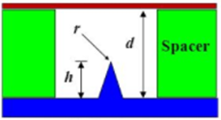
ELECTRIC FIELD EMISSION OF ELECTRONS
β determined by nano-to-microscopic surface features:
$$β=\frac{2h}{ln\left(4\frac{h}{r}\right)−2} ·\frac{1}{rd}$$
Discharge formation super-linearly becomes driven by surface processes as a function of β.
MIPSE_2017
University of Michigan
Institute for Plasma Science & Engr.
Notes:
Beta is the analogous to surface roughness.

Slide 16
FLUXES TO THE SURFACES
Metal catalyst replaced with dielectric – same mesh, only material properties change.
Single filament of plasma forms, no longer attracted to the triple points.
Lower peak electron density due to decreased Electric Field in the proximity of the catalytic particles.
MIPSE_2017
University of Michigan
Institute for Plasma Science & Engr.
Notes:
Humidity:

Slide 17
FLUX PROFILES
Profiles of principle positive and negative charged species to the surface of the catalyst (left) and dielectric (right) at t = 3.3 ns.
Metal catalyst attracts up to 100 X greater peak fluxes.
Distribution more peaked – fluxes concentrate on triple point.
MIPSE_2017
University of Michigan
Institute for Plasma Science & Engr.
Notes:
Humidity:

Slide 18
SURFACE HEATING
Instantaneous energy deposition to all surfaces due to single microdischarge.
Plasma forms at t ≈ 1 ns, energy due to ions increases rapidly. Neutrals follow. Voltage turns off at t ≈ 3 ns.
97% of energy to surface due to ion impact processes.
MIPSE_2017
University of Michigan
Institute for Plasma Science & Engr.

Slide 19
CONCLUDING REMARKS
Charge redistribution within the metal leads to catalysts providing additional field enhancement, guiding discharges toward triple points.
Field strengths are high enough to induce field emission.
Field emission may explain surface plasmas observed in experiments.
Flux profiles of charged species to the surface of the catalyst are peaked, focusing on gas/metal/dielectric triple points leading to localized heating.
MIPSE_2017
University of Michigan
Institute for Plasma Science & Engr.

