Slide 1
ARGON AND AIR IN 2-D BUBBLE TEST CELL FOR STUDYING ACTIVE SPECIES TRANSPORT ACROSS PLASMA-LIQUID INTERFACE
Janis Lai
University of Michigan
janislai@umich.edu
John E. Foster
University of Michigan
jefoster@umich.edu
8th Annual Graduate Student Symposium (MIPSE)
October, 2017
DOE Plasma Science Center
Control of Plasma Kinetics
Notes:
1

Slide 2
PLASMA-LIQUID INTERACTIONS
MOTIVATION
Plasma medicine and plasma-based water purification technologies rely on the production and transport of plasma-derived reaction species into bulk liquid, such as water and blood
Gas-phase plasma is well-understood, but its transport through the interface is not. This interface region is between the gas-phased plasma and the bulk liquid
Studies have shown that the interface is active. However, the exact mechanisms of physical and chemical reactions at the interface are not well-understood
Gaining a better understanding of the various forces at play at the interface will be beneficial in designing and implementing technologies using low temperature atmospheric plasma for various environmental and medical applications
DOE Plasma Science Center
Control of Plasma Kinetics
Notes:
2

Slide 3
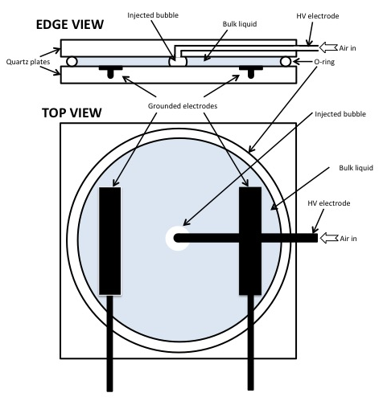
2-D BUBBLE EXPERIMENT
EXPERIMENTAL SET UP
The quartz plates are mounted onto a supporting structure made with 80/20 T-slotted aluminum beams
Plane of view is illuminated with a white light transmitted via optical fiber
Camera is mounted above the supporting structure to capture images
Interface region is accessible for interrogation
(Left) Top and side view of schematics of experimental set-up
DOE Plasma Science Center
Control of Plasma Kinetics
Notes:
3
Add a photo and a why 2D apparatus

Slide 4
2-D BUBBLE EXPERIMENT
EXPERIMENTAL SET UP
HV Electrode
Plasma
To access the plasma-liquid interface, 2 quartz plates are used to trap a relatively thin layer of fluid, where gas is injected through a small bored hole
Interface is accessible using optical diagnostics
Potential 2-D irrotational inviscid flow in bulk liquid can be studied
Microdischarges and streamers discharges can be initiated in the trapped bubble
Microdischarges: diffused plasma that does not make contact with interface
Streamers: direct ionized path from electrode to interface
Ground electrodes
Chemical front
(Above) Photograph of 2-D Hele-shaw cell with KI-starch solution.
DOE Plasma Science Center
Control of Plasma Kinetics
Notes:
4
Add a photo and a why 2D apparatus

Slide 5
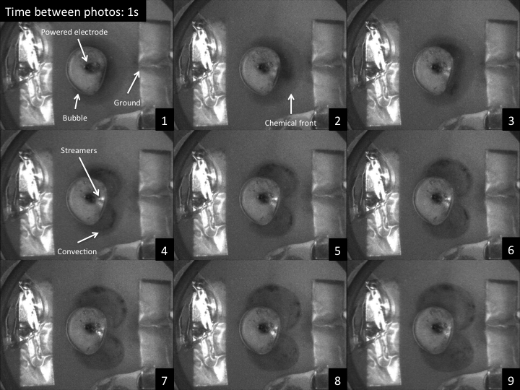
PREVIOUS RESULTS
METHYL ORANGE
Methyl orange is a pH indicator, appears yellow when pH > 4.4, red when pH < 3.1, and orange in between
Color change measured is attributed to generation of nitrous (HNO₂) and nitric (HNO₃) acid, from NO₂ in plasma reacting with water.
Chemical reactions are initiated at the interface where streamers make contact
Swirl-like fluid flow is observed in bulk liquid
(Above) Time-lapsed images of colorimetric reactions induced by air plasma in methyl orange (tap water) solution.
DOE Plasma Science Center
Control of Plasma Kinetics
Notes:
5

Slide 6
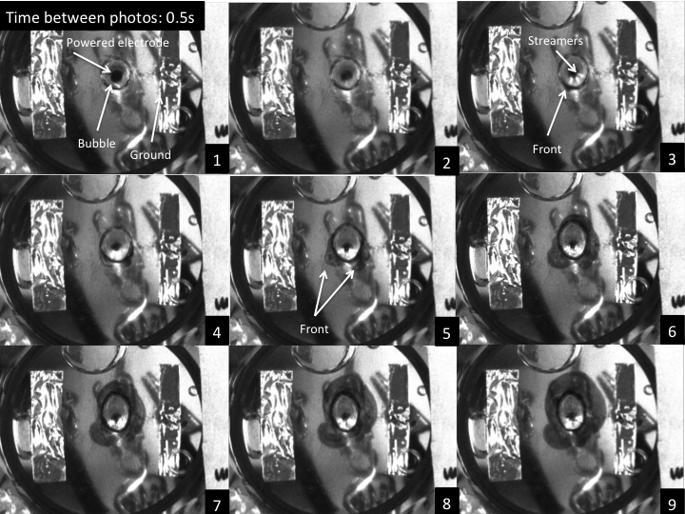
PREVIOUS RESULTS
KI-STARCH
Iodide is oxidized into iodine via advanced oxidation processes initiated by ROS generated by air plasma
Iodine is trapped inside starch molecule, forming a blue complex
Chemical reactions are initiated at the interface where streamers make contact
Swirl-like fluid flow is observed in bulk liquid
(Above) Time-lapsed images of colorimetric reactions induced by air plasma in KI-Starch (tap water) solution.
DOE Plasma Science Center
Control of Plasma Kinetics
Notes:
6

Slide 7
COMPARING ARGON AND AIR RESPONSE
IN 2-D CELL
Air as a composite gas contains 78.09% nitrogen, 20.95% oxygen, 0.93% argon, 0.04% carbon dioxide, and other gases
Air plasma contains an extensive variety of excited and charged species
Reactive oxygen nitrogen species (RONS), e.g. NO_{x} and OH radicals, can initiate chemical reactions at the interface
It is likely that complex chemistry is at play at the interface
Using argon as a feed gas limits the variety of gas-phase active species in the plasma, thus reducing the amount of reactions initiated at the interface
This can provide significant insight to the forces and chemistry at the interface
DOE Plasma Science Center
Control of Plasma Kinetics
Notes:
7

Slide 8
REACTIVE OXYGEN SPECIES GENERATION
KI-STARCH SOLUTION (AIR)
Air plasma generates ROS that oxidizes iodide into iodine
Iodine is trapped by starch molecules, turning into a blue complex
Streamers initiate fluid flow in bulk liquid that aids transport of active species
Chemical front
Bubble boundary
Streamers
(Above) Time-lapsed images of colorimetric reactions induced by air plasma in KI (DI water)-Starch (tap water) solution.
DOE Plasma Science Center
Control of Plasma Kinetics
Notes:
8

Slide 9
REACTIVE OXYGEN SPECIES GENERATION
KI-STARCH SOLUTION (ARGON)
Argon does not generate ROS in gas-phased plasma
Electrons from streamers impact water to generate OH radicals that combine to form hydrogen peroxide
Peroxides and OH radicals oxidize iodine that forms a blue complex when trapped in starch
Lack of ROS in plasma leads to less peroxide production thus lighter color density observed
(Above) Time-lapsed images of colorimetric reactions induced by argon plasma in KI (DI water)-Starch (tap water) solution.
DOE Plasma Science Center
Control of Plasma Kinetics
Notes:
9

Slide 10
REACTIVE OXYGEN SPECIES GENERATION
KI-STARCH SOLUTION: REACTIONS
Electron impact dissociation
e⁻_{(g)} + H₂O_{(l)} ➔ OH•_{(aq)} + H•_{(aq)} + e⁻_{(g)}
e⁻_{(g)} + H₂O_{(l)} ➔ O•_{(aq)} + H•_{(aq)} + H•_{(aq)} + e⁻_{(g)}
Impact combination
OH•_{(aq)} + OH•_{(aq)} (+ Ar_{(g)}, O_{2(g)}, H₂O_{(l)}) ➔ H₂O_{2(aq)} (+ Ar_{(g)}, O_{2(g)}, H₂O_{(l)})
O•_{(aq)} + H•_{(aq)} + Ar_{(g)} ➔ OH•_{(aq)} + Ar_{(g)}
O•_{(aq)} + H•_{(aq)} + H₂O_{(l)} ➔ OH•_{(aq)} + H₂O_{(l)}
Charge exchange
Ar⁺_{(g)} + H₂O_{(l)} ➔ Ar_{(g)} + H₂O⁺_{(aq)}
H₂O⁺_{(aq)} + H₂O_{(l)} ➔ H₃O⁺_{(aq)} + OH•_{(aq)}
Oxidation of iodide
2 I⁻_{(aq)} + 2 H₃O⁺_{(aq)} + H₂O_{2(aq)} ➔ I_{2(g)} + 4 H₂O_{(l)}
DOE Plasma Science Center
Control of Plasma Kinetics
Notes:
10

Slide 11
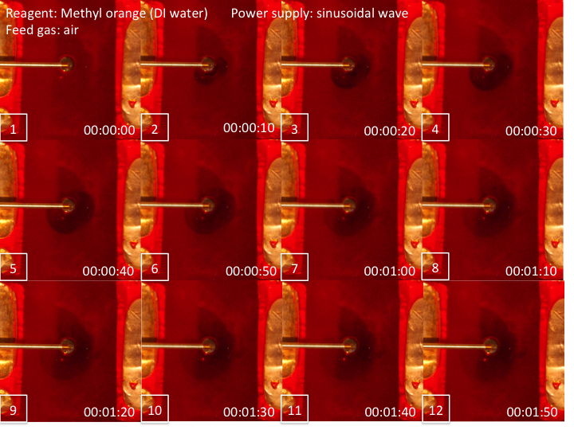
ACIDIC FRONT GENERATION
METHYL ORANGE (AIR)
Chemical front
NO_{x} species are generated in air plasma
Hydrogen peroxide formed at interface via electron impact produced OH radicals and their recombination
NO₂ reacts with both water and hydrogen peroxide to forms nitrous (HNO₂) and nitric (HNO₃) acids
Color change indicates reaction between acid and methyl orange
Bubble boundary
(Above) Time-lapsed images of colorimetric reactions induced by air plasma in methyl orange (DI water) solution.
DOE Plasma Science Center
Control of Plasma Kinetics
Notes:
11

Slide 12
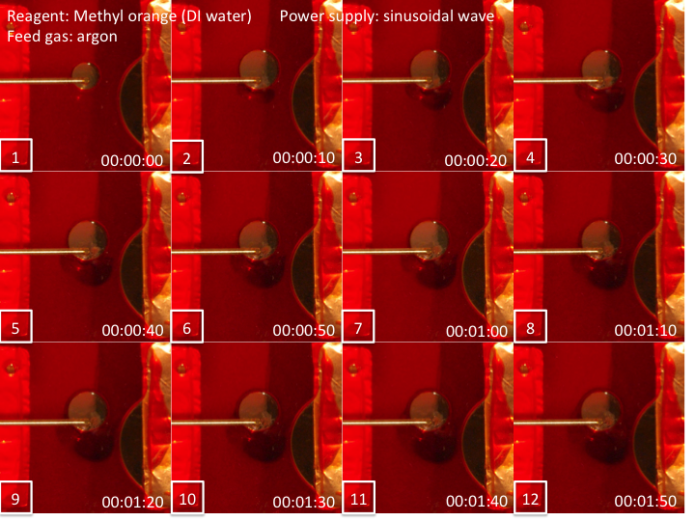
ACIDIC FRONT GENERATION
METHYL ORANGE (ARGON)
Positive ions strike water, generating water ions H₂O⁺_{aq} by charge exchange and photoionization¹
H₂O⁺_{aq} also charge exchange with water molecules to generate hydronium ions H₃O⁺_{aq} and OH_{aq} radicals
H₃O⁺_{aq} attacks the nitrogen bond in the yellow form of methyl orange, turning it red
(Above) Time-lapsed images of colorimetric reactions induced by argon plasma in methyl orange (DI water) solution.
¹J. Phys. D: Appl. Phys. 47 (2014) 475203
DOE Plasma Science Center
Control of Plasma Kinetics
Notes:
12

Slide 13
REACTIVE OXYGEN SPECIES GENERATION
METHYL ORANGE: REACTIONS
Electron impact dissociation
e⁻_{(g)} + H₂O_{(l)} ➔ OH•_{(aq)} + H•_{(aq)} + e⁻_{(g)}
e⁻_{(g)} + H₂O_{(l)} ➔ O•_{(aq)} + H•_{(aq)} + H•_{(aq)} + e⁻_{(g)}
Impact combination
OH•_{(aq)} + OH•_{(aq)} (+ Ar_{(g)}, O_{2(g)}, H₂O_{(l)}) ➔ H₂O_{2(aq)} (+ Ar_{(g)}, O_{2(g)}, H₂O_{(l)})
O•_{(aq)} + H•_{(aq)} + Ar_{(g)} ➔ OH•_{(aq)} + Ar_{(g)}
O•_{(aq)} + H•_{(aq)} + H₂O_{(l)} ➔ OH•_{(aq)} + H₂O_{(l)}
Charge exchange
Ar⁺_{(g)} + H₂O_{(l)} ➔ Ar_{(g)} + H₂O⁺_{(aq)}
H₂O⁺_{(aq)} + H₂O_{(l)} ➔ H₃O⁺_{(aq)} + OH•_{(aq)}
Oxidation of iodide
MO⁻_{yellow(aq)} + H₃O⁺_{(aq)} ➔ MO_{red(aq)} + H₂O_{(l)}
DOE Plasma Science Center
Control of Plasma Kinetics
Notes:
13

Slide 14
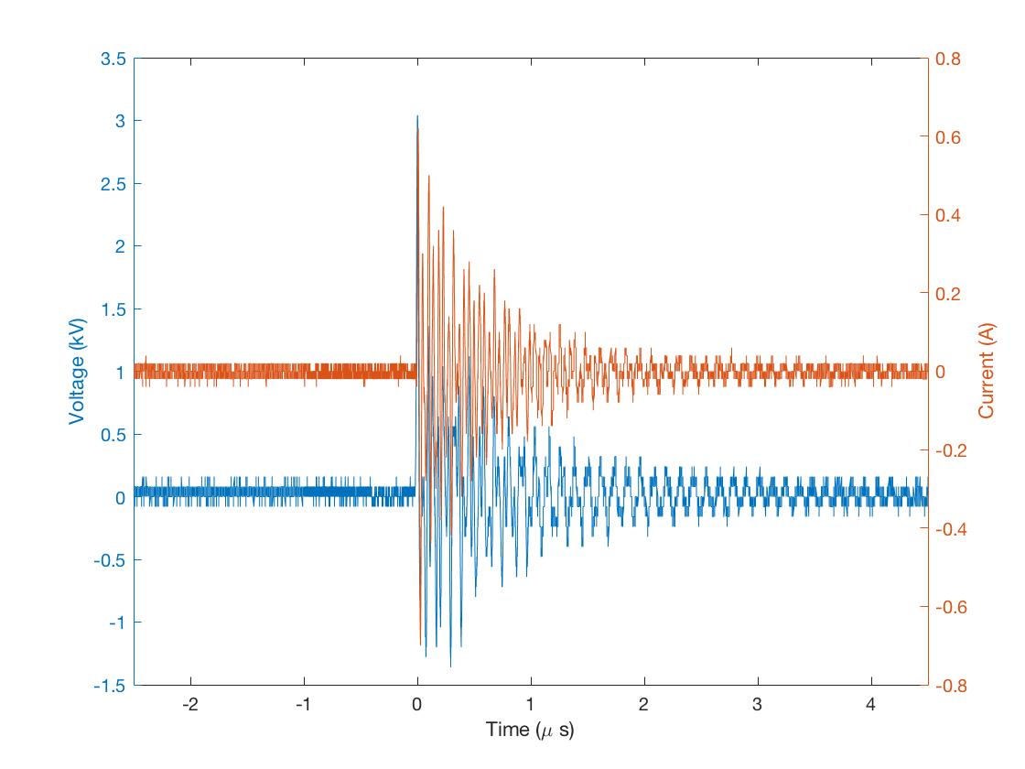
REACTIVE OXYGEN SPECIES DIFFUSION
KI-STARCH
No visible streamers are present
Gas-phase plasma formed at the high voltage electrode can only diffuse to the plasma-liquid interface
Voltage and current measured using an oscilloscope, identical in both air and argon measurements, showing presence of microdischarges.
DOE Plasma Science Center
Control of Plasma Kinetics
Notes:
14

Slide 15
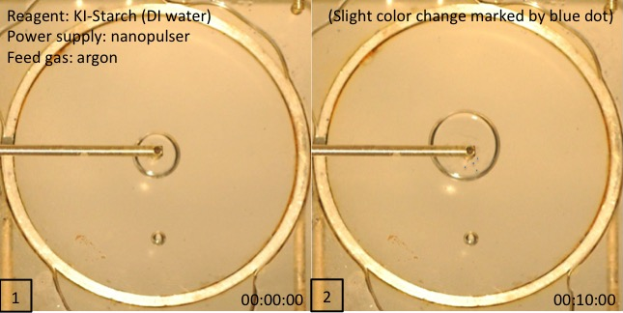
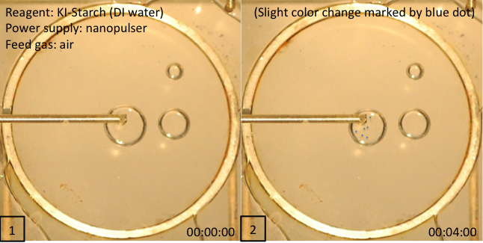
REACTIVE OXYGEN SPECIES DIFFUSION
KI-STARCH
Microdischarge: no streamers were observed.
Thin film of reagent can cling to surface of quartz plates, where tiny droplets can form and color change can be observed
Color change was observed on tiny droplets but not in bulk liquid
Indicates that streamers in contact with interface enhances reactivity in bulk liquid
(Above) Time-lapsed images of colorimetric reactions induced by argon plasma in KI-starch (DI water) solution.
(Below) Time-lapsed images of colorimetric reactions induced by air plasma in KI-starch (DI water) solution.
DOE Plasma Science Center
Control of Plasma Kinetics
Notes:
15

Slide 16
CHEMICAL REACTIONS
AT THE INTERFACE
Acidic and ROS propagation fronts are originally attributed mainly to gas-phase plasma transporting via streamers and diffusing across the interface, initiating chemical reactions at the interface and in bulk liquid
Argon plasma removes production of ROS and NO_{x} in gas-phase plasma, data shows that electrons and ions impact dissociation and charge exchange may play an important role in initiating chemical reactions, such as acidic front generation and peroxide production, at the interface
This suggests that if the targeted bulk liquid contains water, active species such as hydrogen peroxide and OH radicals can be generated in situ at the interface by streamers, regardless of the feed gas of the plasma
DOE Plasma Science Center
Control of Plasma Kinetics
Notes:
16

