Slide 1
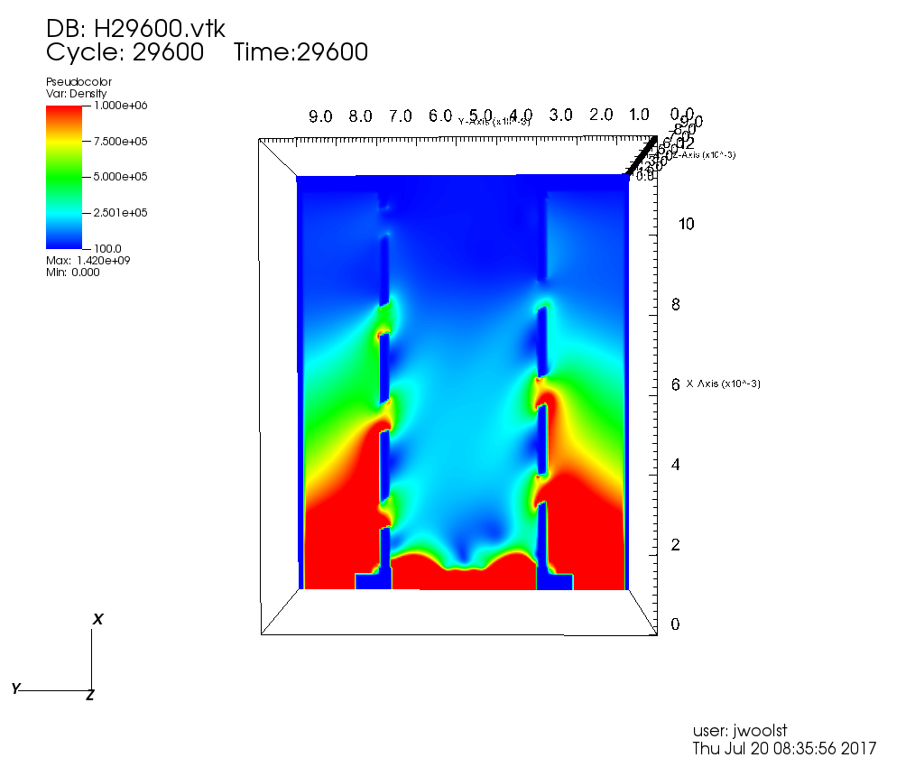
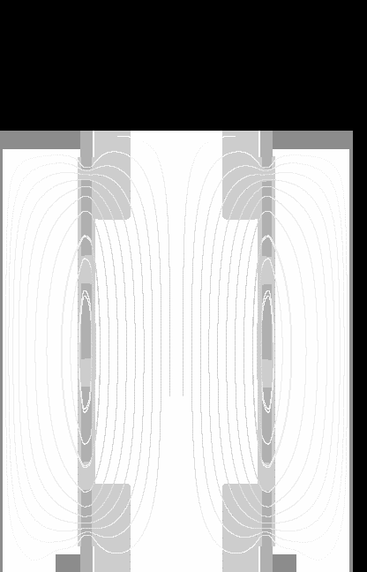
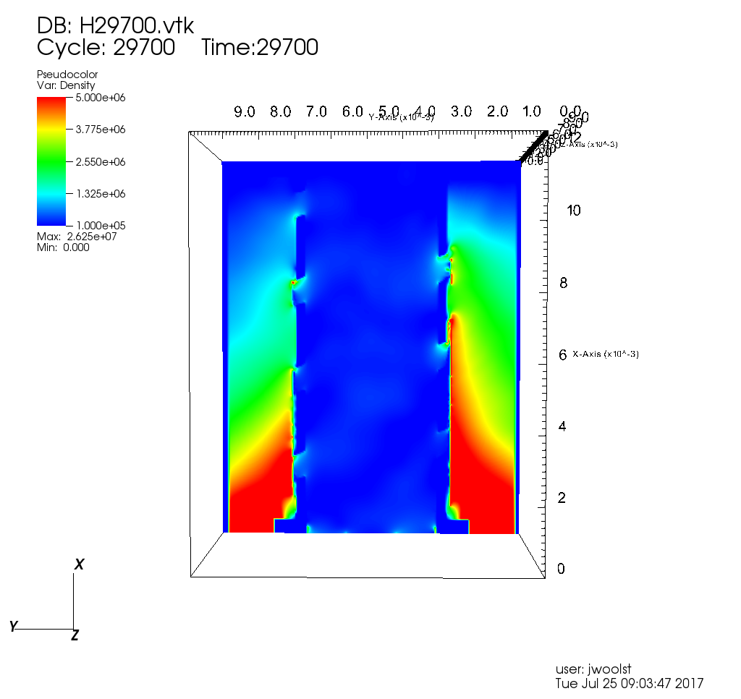
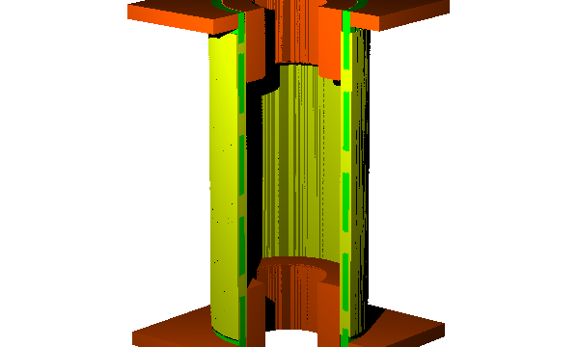
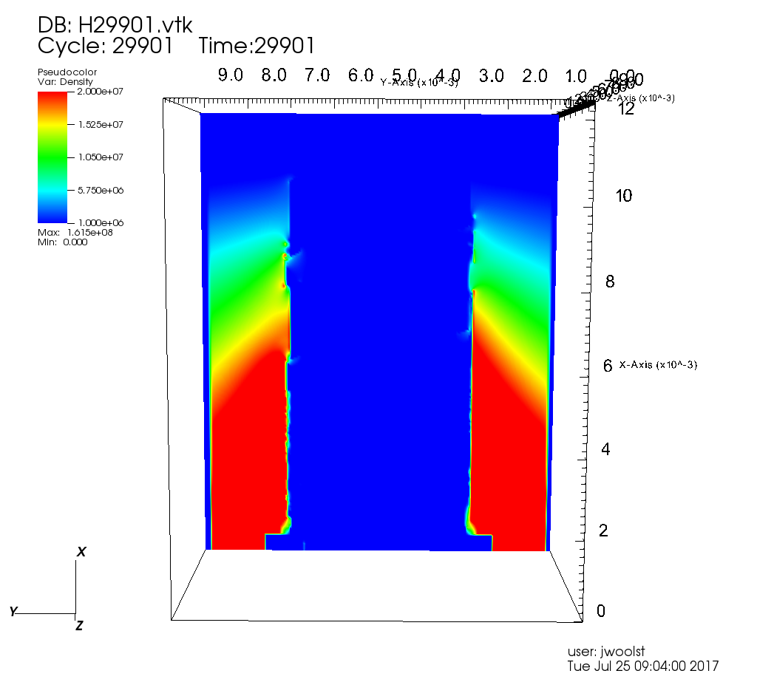
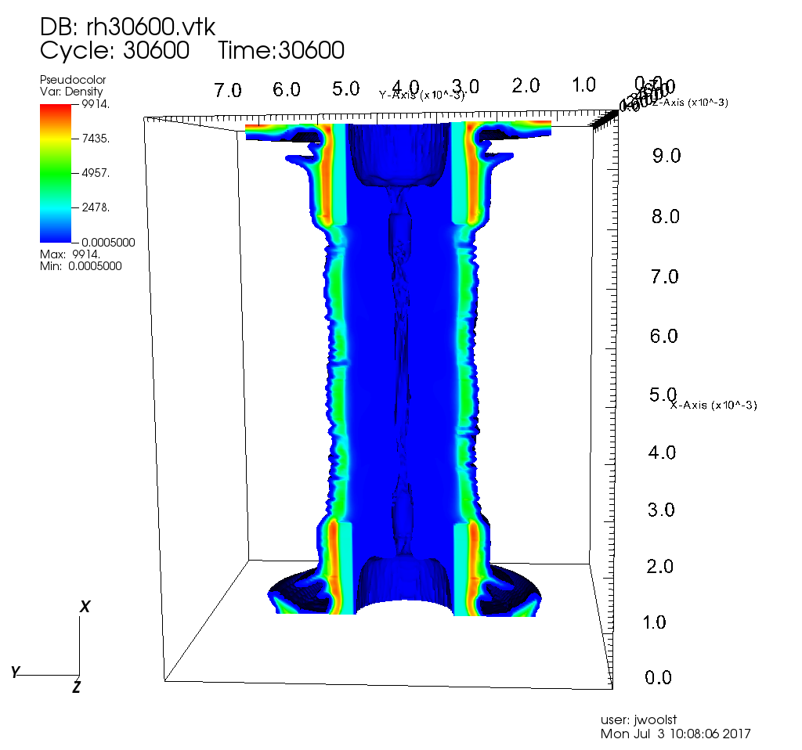
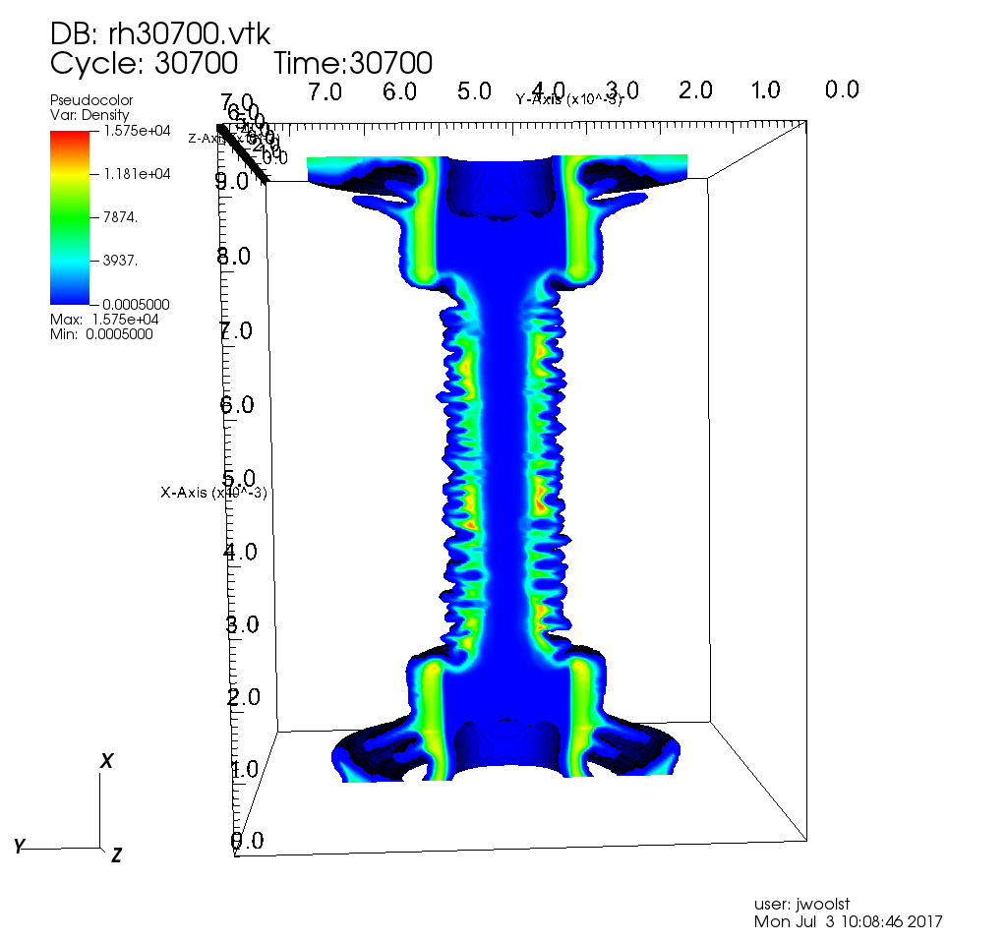
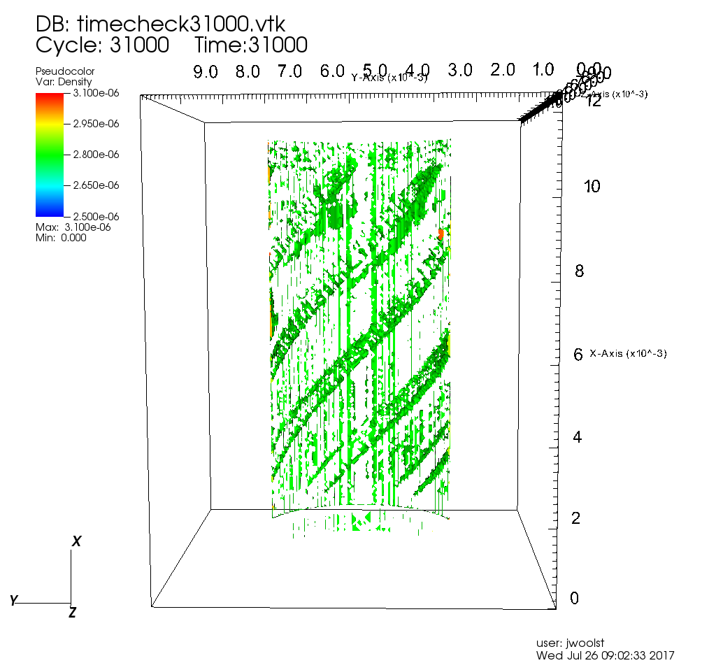
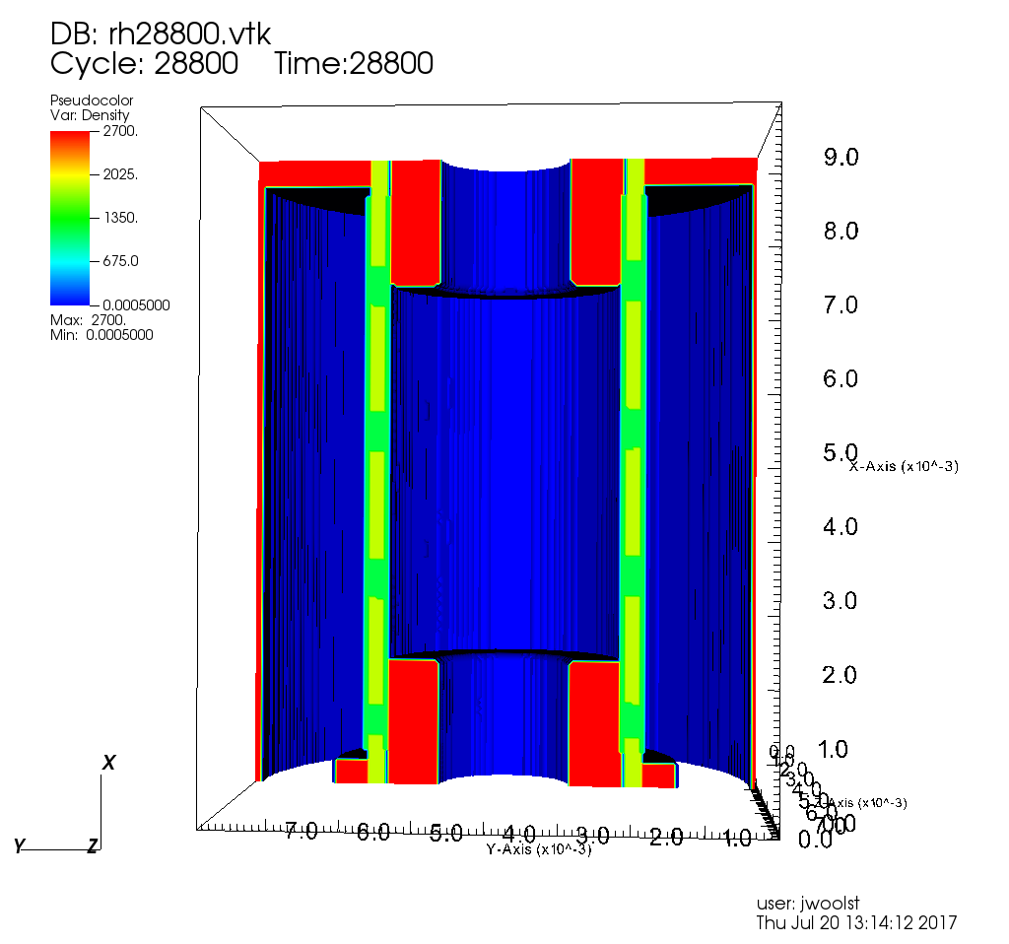
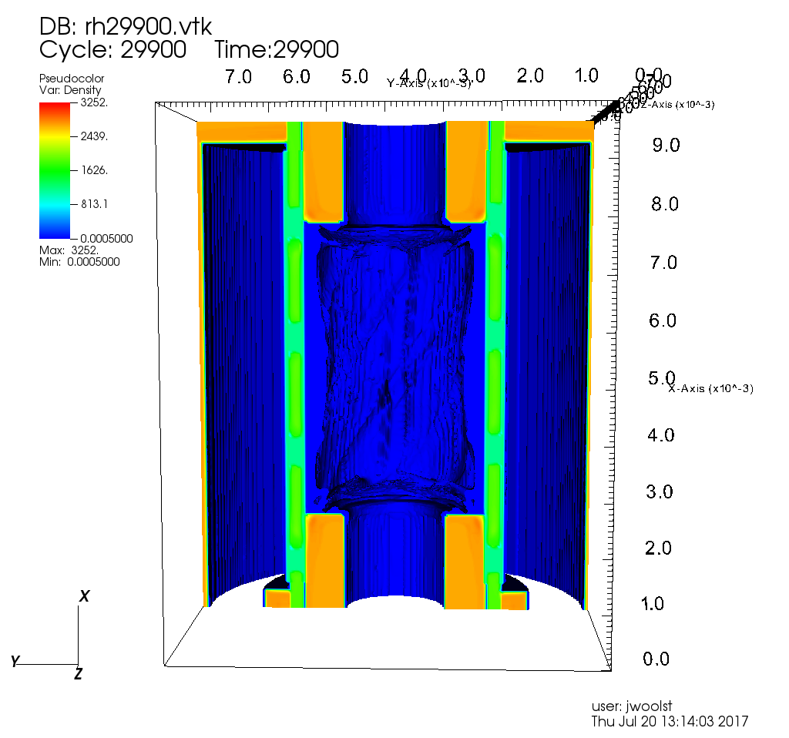
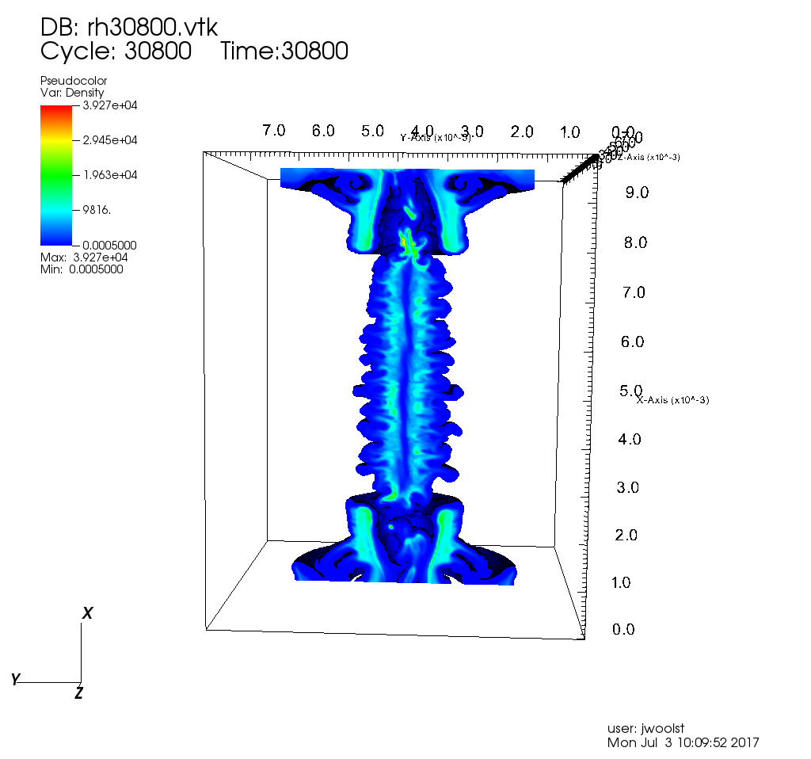
3D MHD Simulations of Auto-Magnetizing Imploding Liners for ICF
J.M. Woolstrumª, C.A. Jennings^{b}, G.A. Shipley^{b}, T.J. Awe^{b}, S.A. Slutz^{b}, N.M. Jordanª, Y.Y. Lauª, K.J. Peterson^{b}, R.D. McBrideª,
(a) University of Michigan, (b) Sandia National Laboratories
Auto-Magnetizing Liners As a Possible Next Step in MagLIF/ ICF
Magnetic Field and Electric Field Analysis of an Automag Liner
Breakdown Electric Field Strength Maps at Two Relevant Times with Dielectric Breakdown Routine
Automag Liners replace the need for external ABZ coils
In Automag, helical slots are cut into the liner and filled with dielectric
This produces an axial magnetic field from the drive current until dielectric breakdown occurs
Without the need for ABZ coils, a much lower inductance power feed can be used with greater diagnostic access
With the addition of ABZ coils, a potential Field Reversed Configuration can be setup
Electric Field at 700kA and 1.17x10^13 A/s Magnetic Field with on axis Bz of 31.2T Unimploded Liner Showing Epoxy Layout
810 kA
1.3MA
r_{L}=diameter of liner
f_{con}=a factor based vane/dielectric ratio
r_{R}=diameter of outer return can
ψ=pitch angle of vanes
With a metal cushion:
At 2MA, the average magnetic field in the liner was ~50.7T in simulation. This matches well with simulation results from Gabe Shipley and Tom Awe. The magnetic field at 10MA also matched well (~83.1T)
With a Nylon cushion:
At 1.3MA the Bz on axis in simulation was 51.75T while analytic methods calculate on axis Bz of 50.6T
Also at 1.3MA electric field was between 20 to 50 MV/m in simulation, while analytic calculations suggest 44 MV/m
Experiments on Mykonos have shown that Automag liners with a bulk epoxy setup have a dielectric breakdown point between 15-17MV/m
With epoxy shear to the face of the liner, breakdown occurs between 5-8MV/m [Gabe Shipley, Tom Awe]
Currently, GORGON does not have a specific routine to handle dielectric breakdown
[Slutz et al., Phys. Plasmas 24, 012704 (2017)]
3D Simulation of an Automag Liner in GORGON
Timing of Dielectric Cell Breakdown During Simulation
Comparison of Starting Structure and Structure at Breakdown Conditions in a Full MHD 3D Simulation with No Dielectric Breakdown Routine
References
[1] S.A. Slutz, C.A. Jennings, T.J. Awe, G.A. Shipley, B.T. Hutsel, D.C. Lampa. Auto-magnetizing Liners for Magnetized Inertial Fusion. Physics of Plasma. Volume 24 Issue 1.
[2] G.A. Shipley, S.A. Slutz, T.J. Awe, D.C. Lampa, C. A. Jennings, R.D. McBride. Auto-magnetizing Liners for MagLIF Experiments. Plasma Science (ICOPS), 2016 IEEE. DOI: 10.1109/PLASMA.2016.7533969

