Slide 1
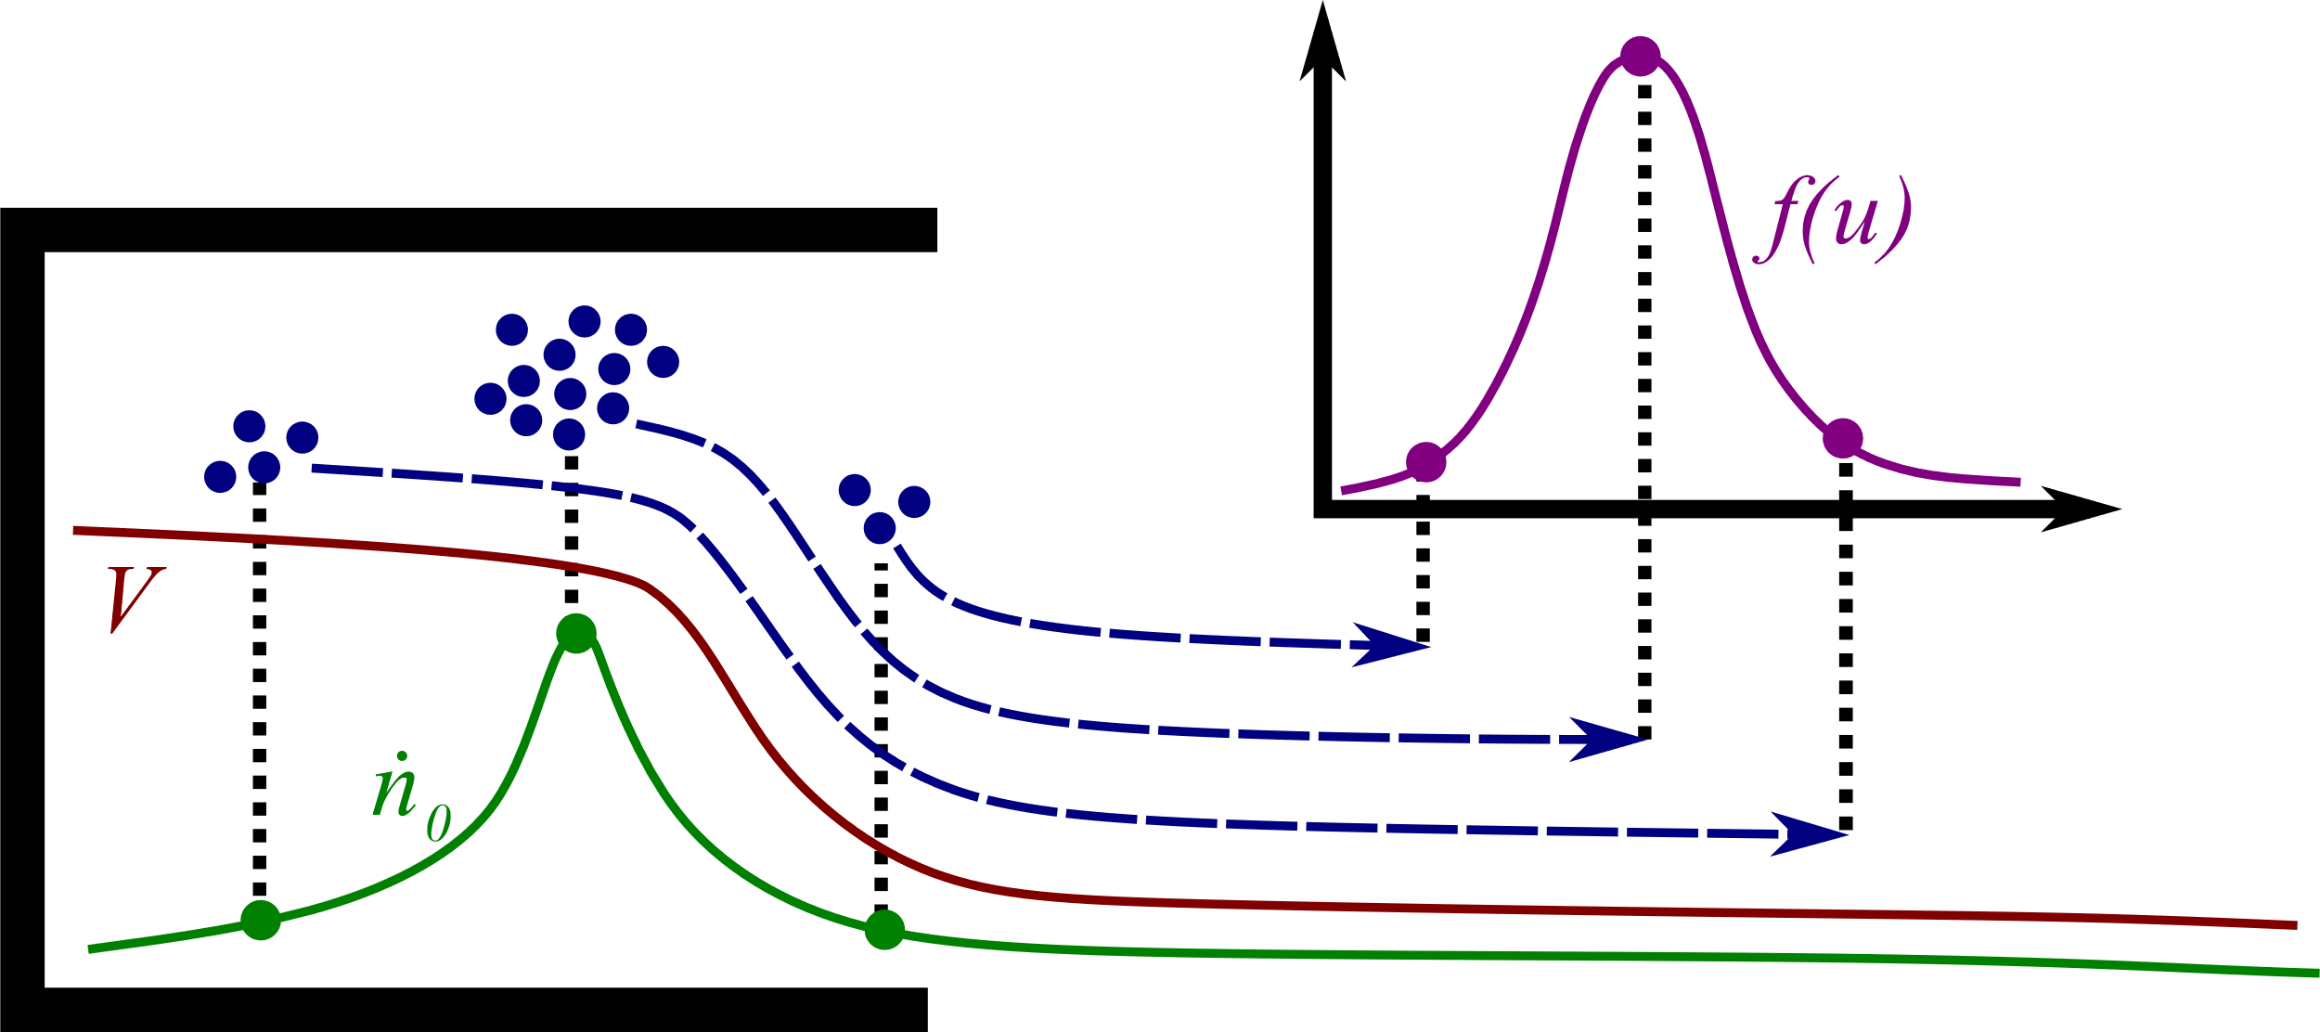
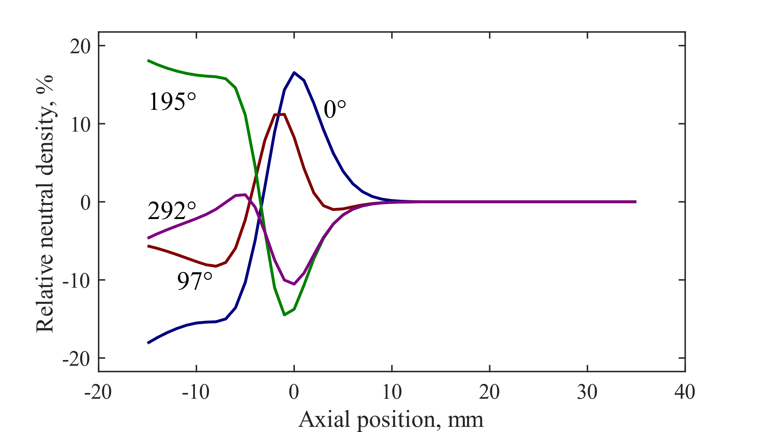
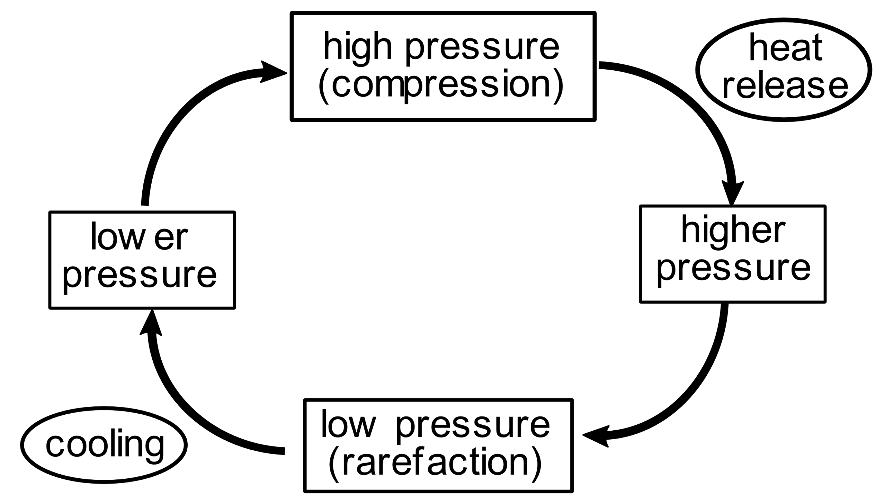
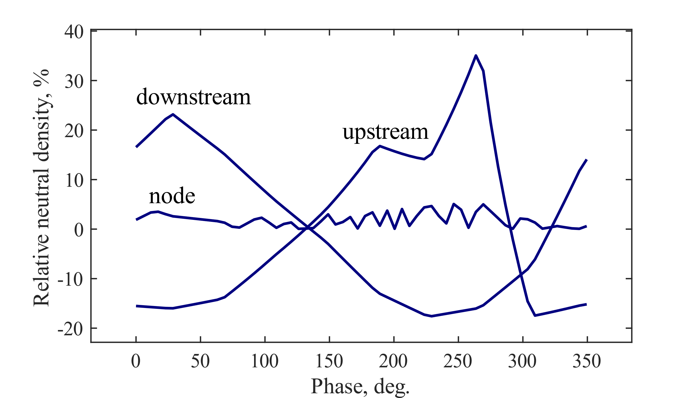
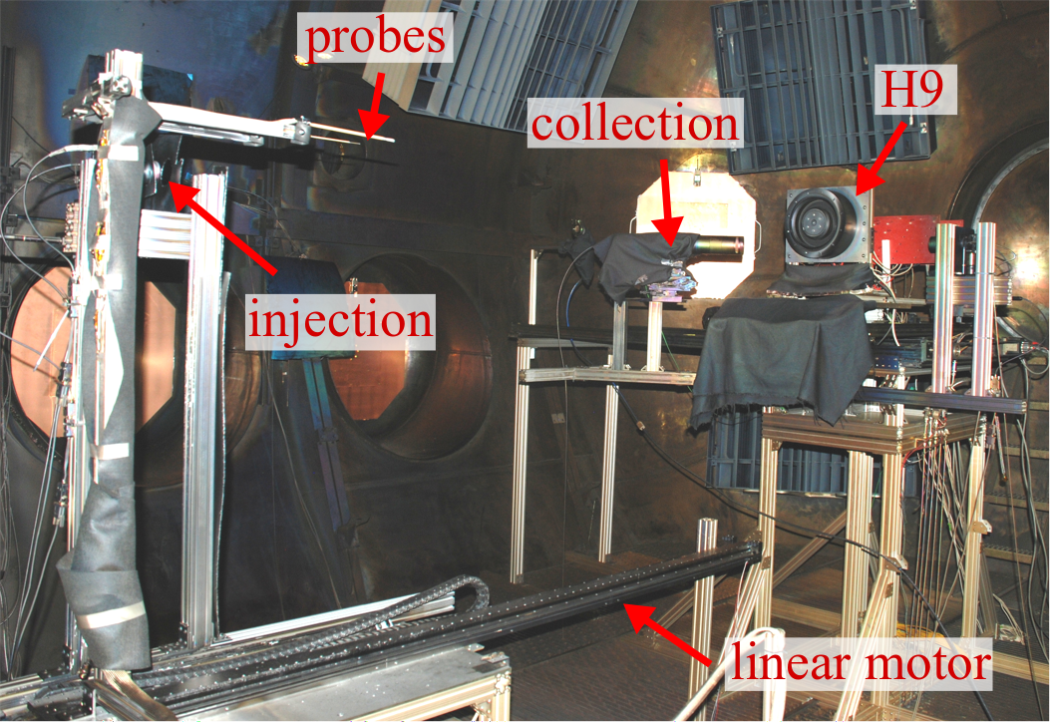
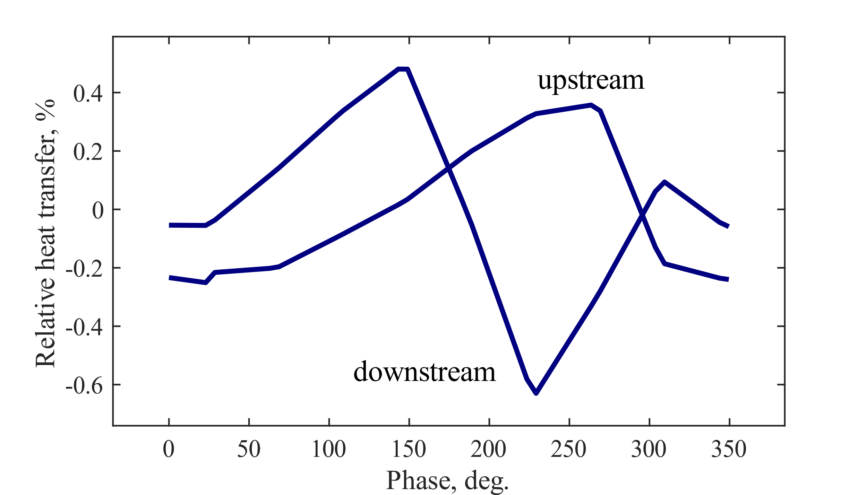
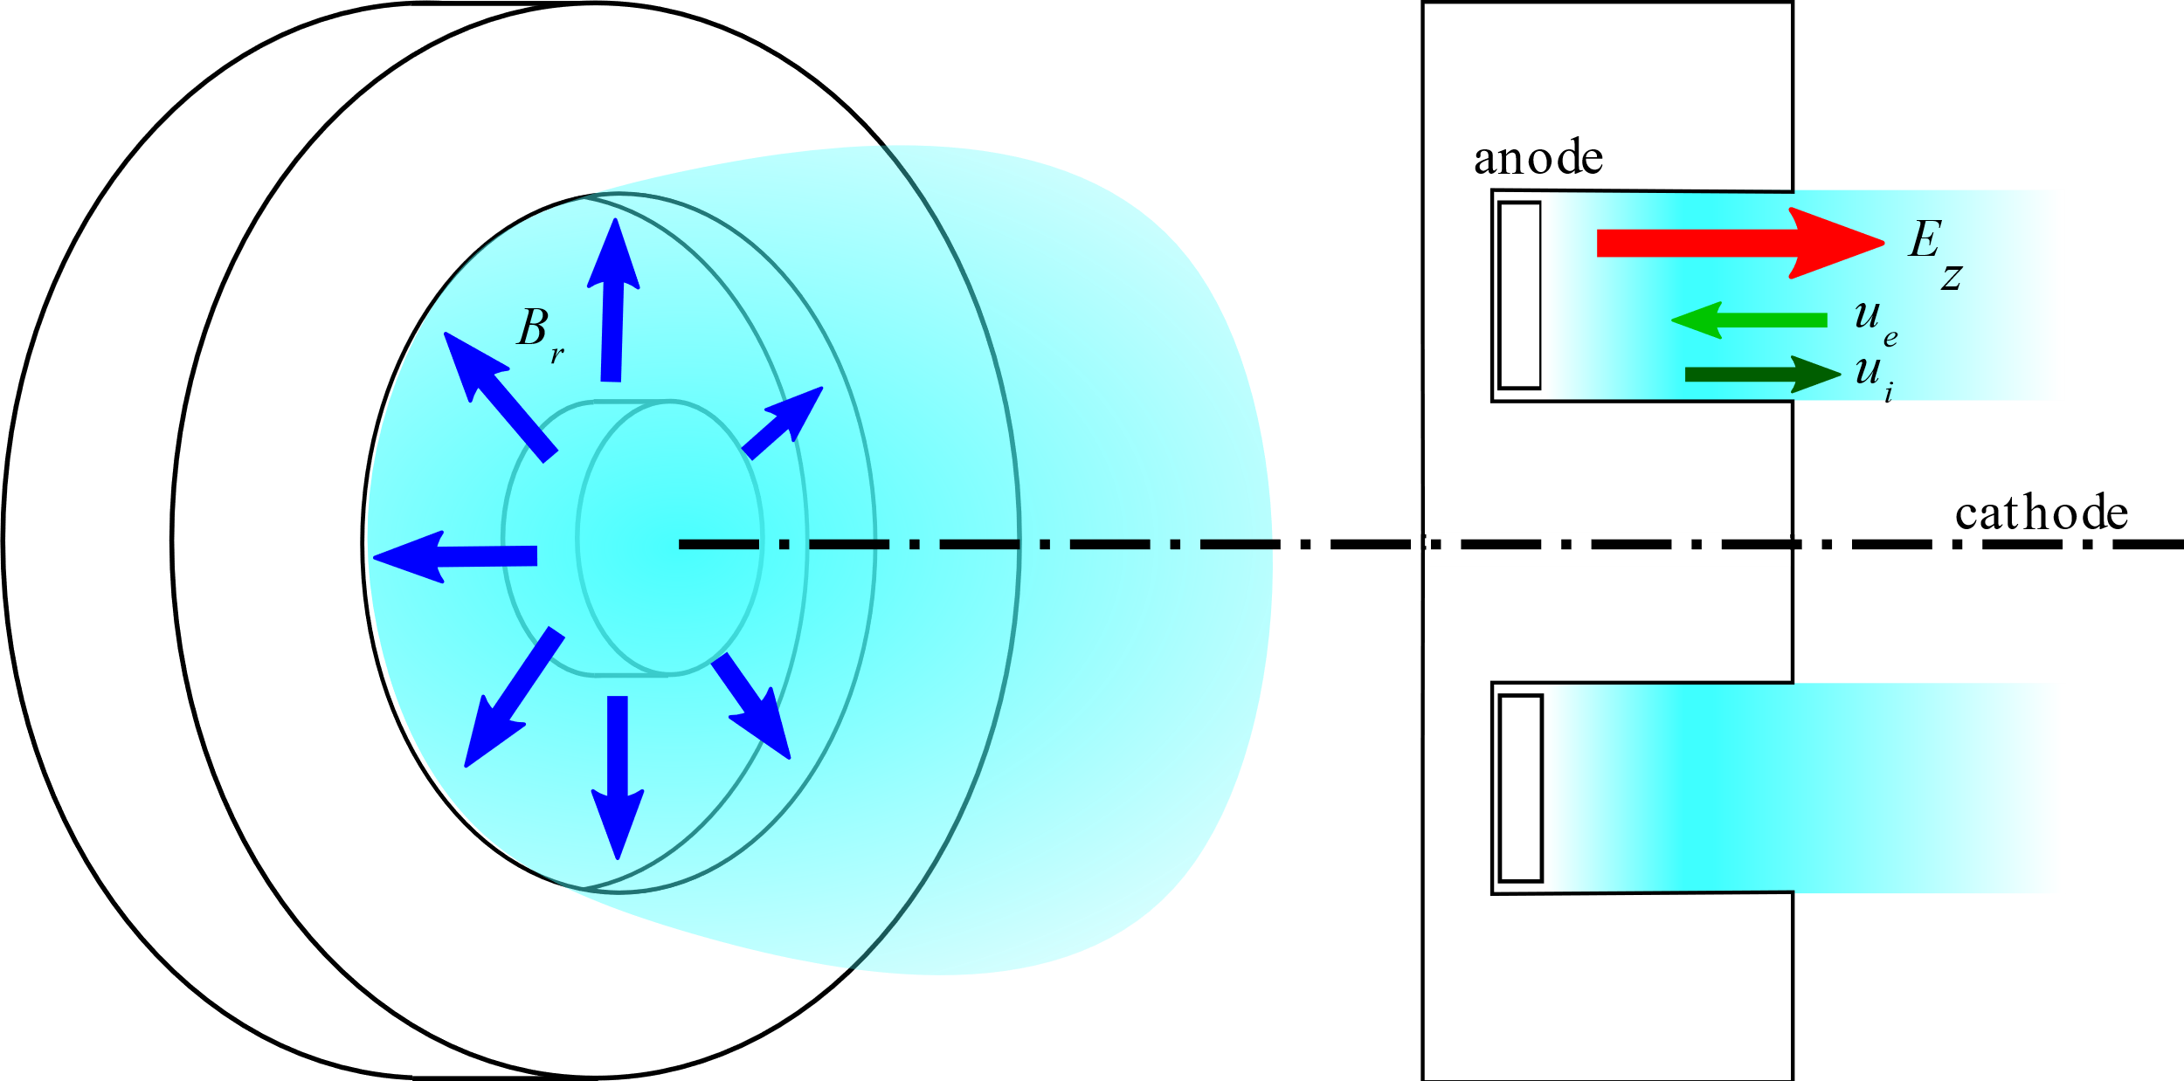
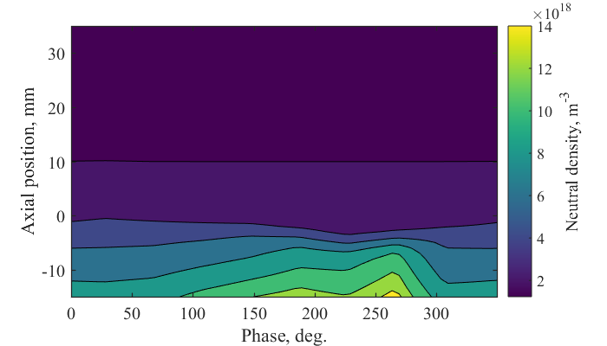
Non-Invasive Characterization of the Hall Thruster Breathing Mode
Ethan T. Dale and Benjamin A. Jorns
University of Michigan, Department of Aerospace Engineering, Ann Arbor, MI 48109
Motivation
Methodology
Analysis
Hall thrusters are an in-space electric propulsion technology now often used for near-Earth applications but increasingly targeted for long-duration deep space missions.
Designing and verifying for flight requires self-consistent simulation. One aspect of Hall thruster operation that is poorly understood are large-scale low-frequency oscillations called the “breathing mode”.
Left: Moments of the 1D ion Boltzmann equation give the plasma density, electric field strength, and ionization rate to the ion velocity distribution function moments. Fluid equations can be used to estimate neutral gas properties based on this information. This is a non-invasive approach to characterizing a Hall thruster during breathing.
Left: The neutral density fluctuations at an upstream point and downstream point vary 180° out of phase with a node between them. This suggests that there may exist a neutral standing wave. An instability that is consistent with this is the thermoacoustic instability. The onset of this phenomenon is governed by the Rayleigh criterion: if heat is added during neutral compression or removed during rarefaction, the wave grows.
Right: A radial magnetic field is applied to trap electrons streaming from the cathode to the anode, between which a voltage is applied. A strong, narrow electric field is set up in the plasma that accelerates ions to produce thrust.
Right: The IVDF was measured with time-resolved laser-induced fluorescence, and boundary conditions were provided with a Faraday probe.
Objectives
Results
Conclusions
What is the energy source for this instability? What are the criteria for its onset? To answer this, consider:
Can the breathing mode be characterized non-invasively?
What instability is consistent with this experimental characterization?
Time-resolved LIF with a Boltzmann moment analysis can be used to non-invasively characterize the breathing mode.
Neutral properties are estimated and evidence of a standing wave is found.
A thermoacoustic instability is consistent with the existence of this wave.
This work was partly supported by NASA Space Technology Research Fellowship grant NNX14AL65H. Thanks to Matt Byrne for assisting with the experiment described herein.
9th Annual MIPSE Graduate Student Symposium

