Slide 1
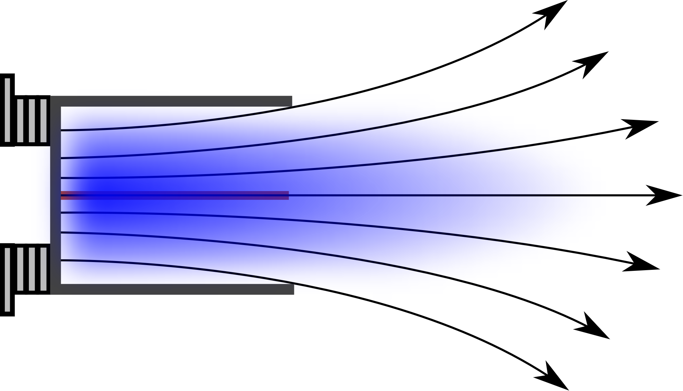
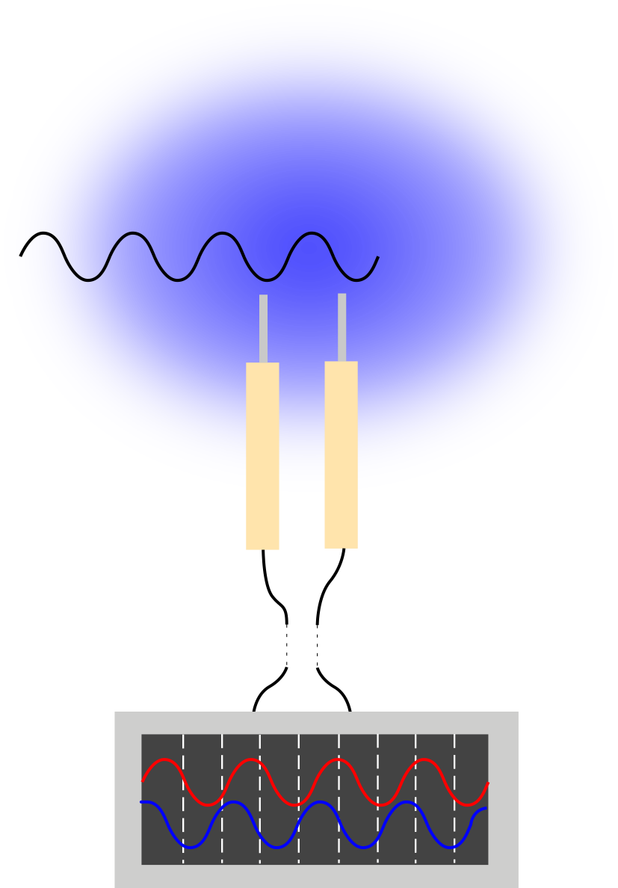
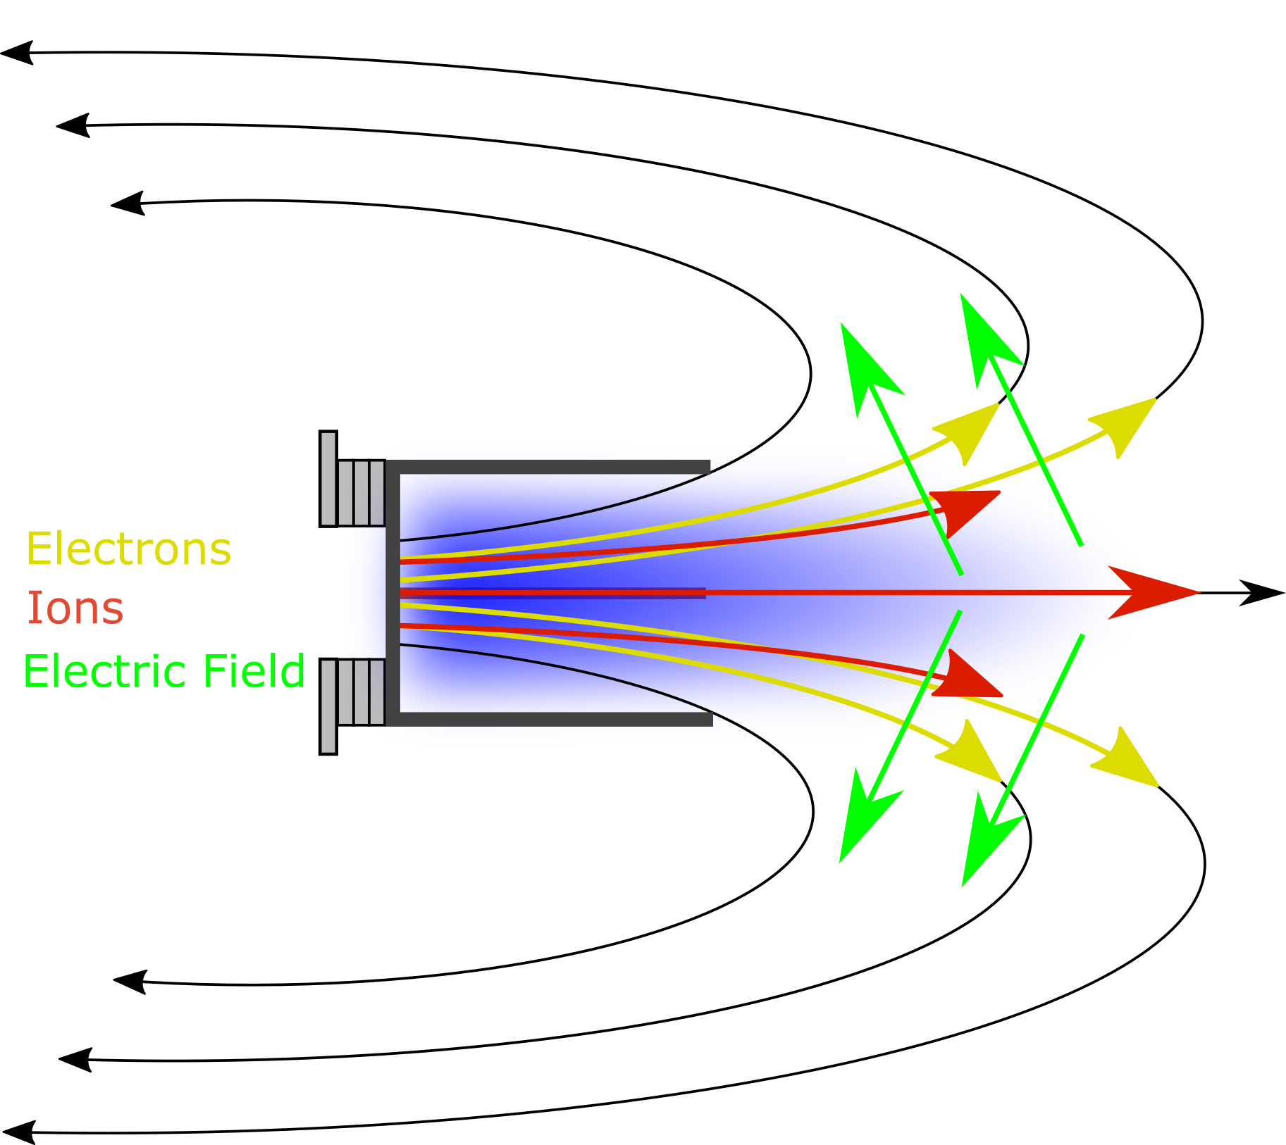
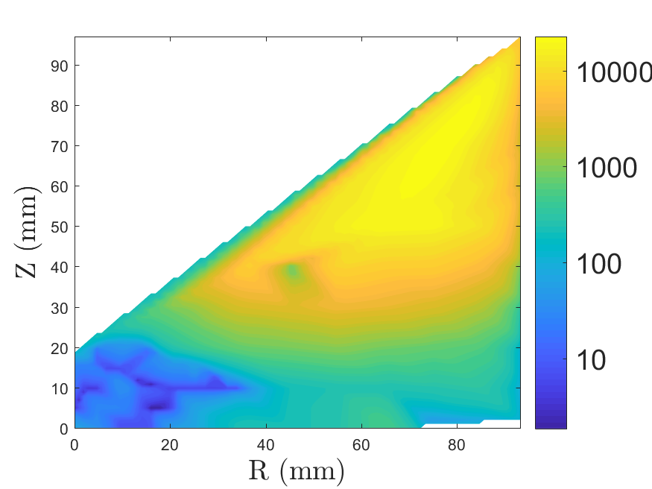
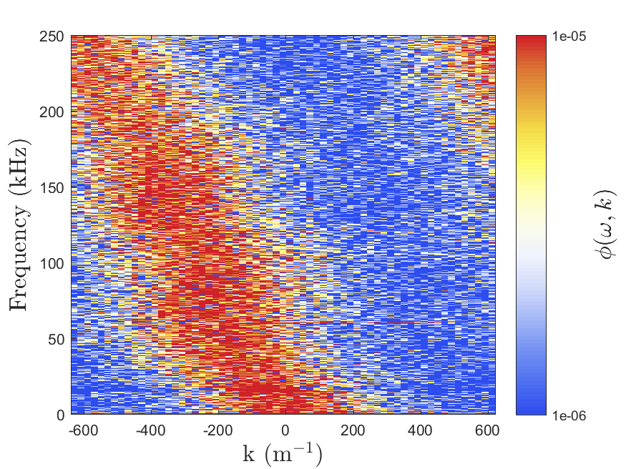
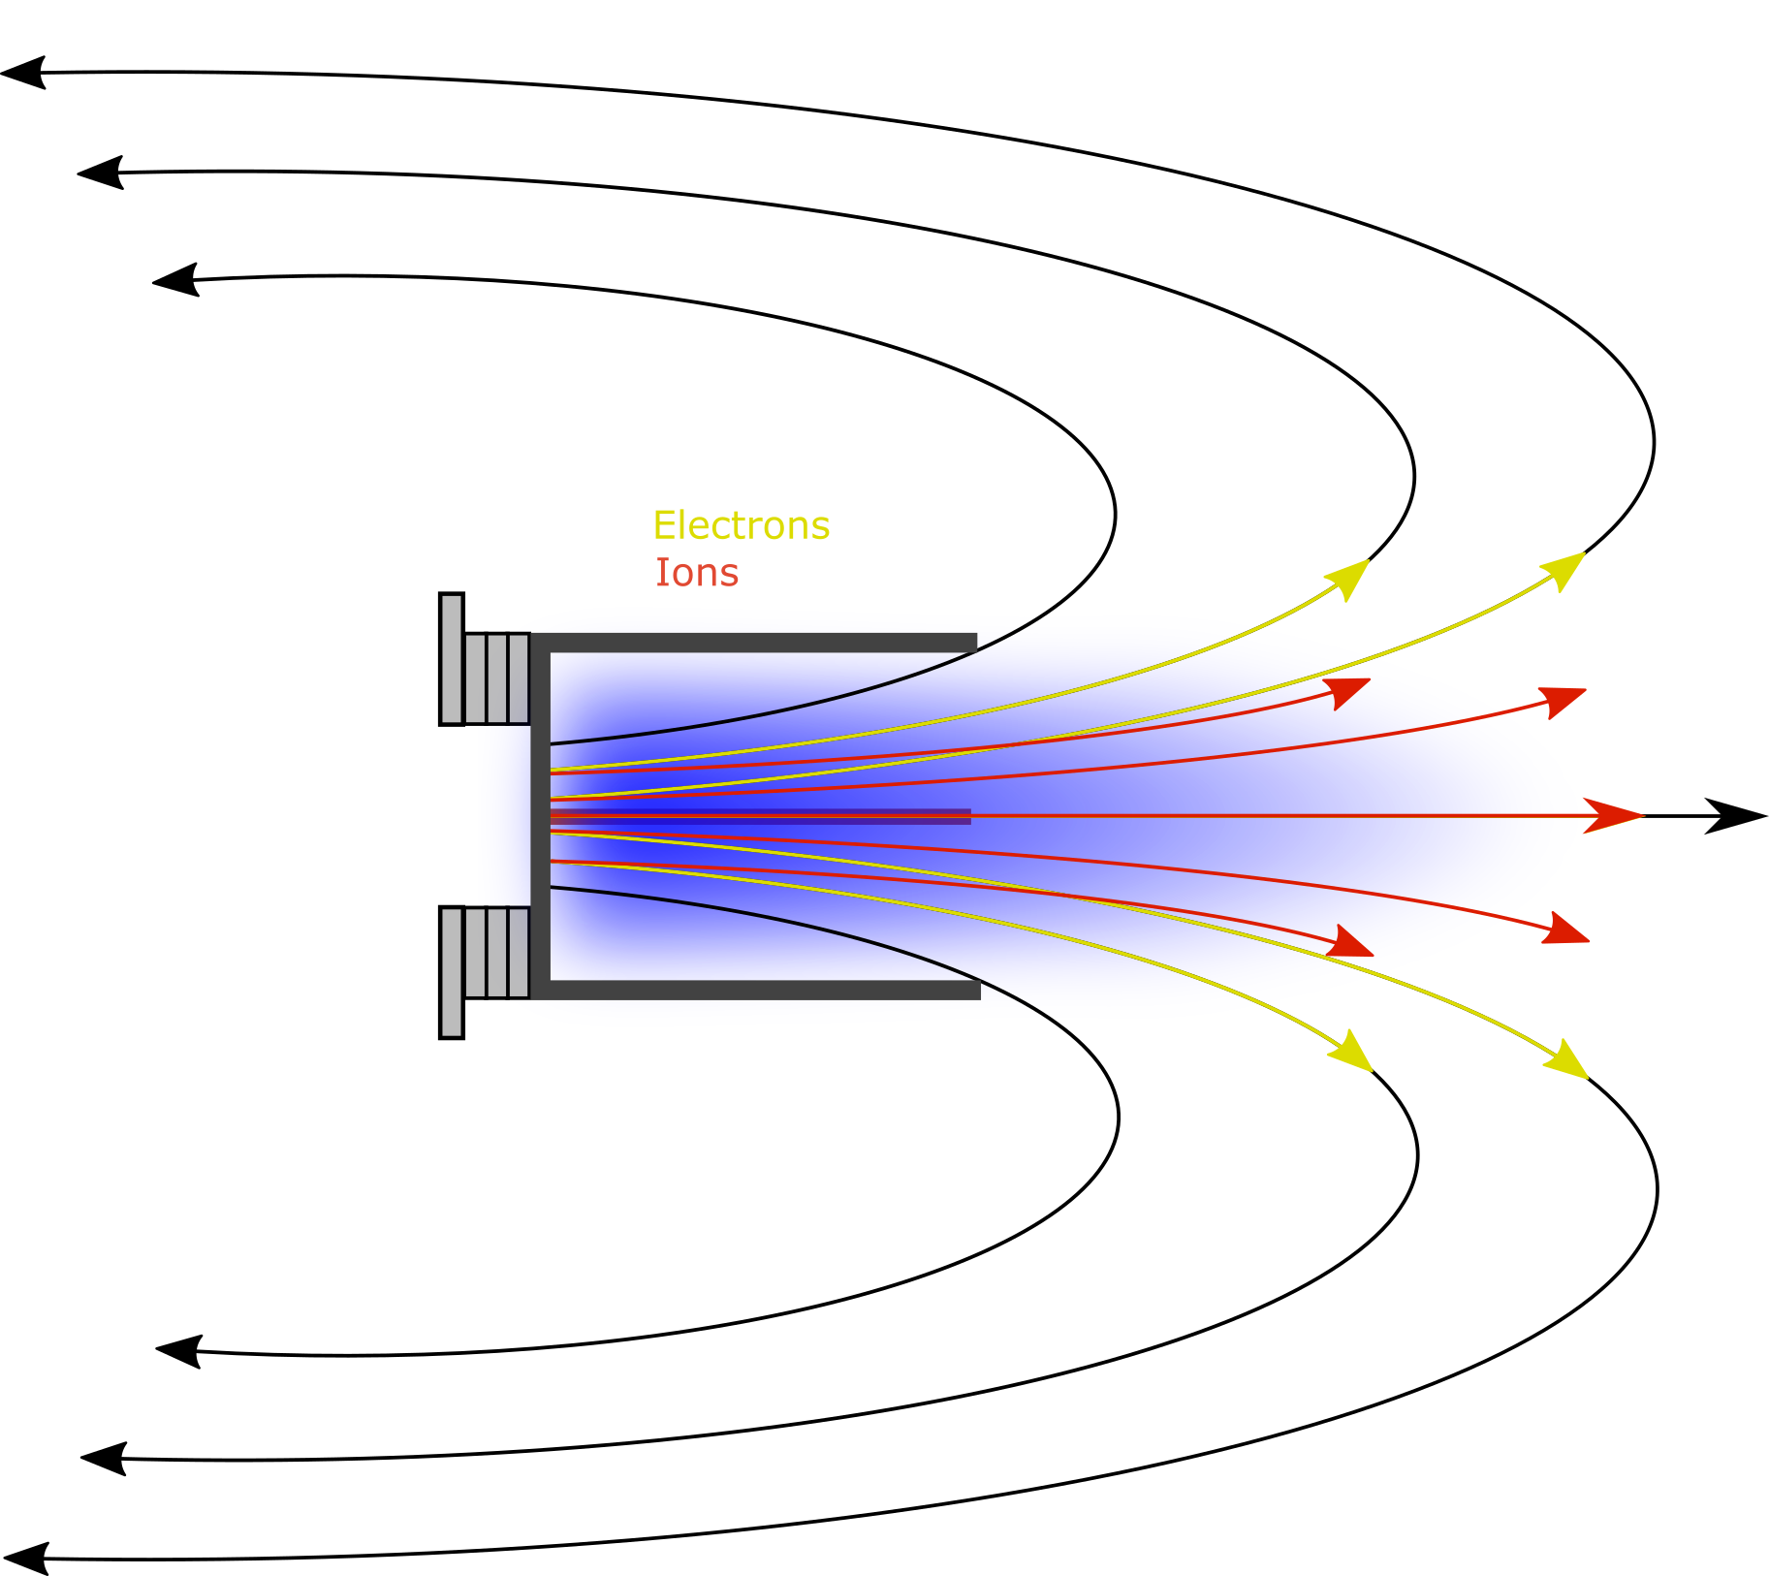
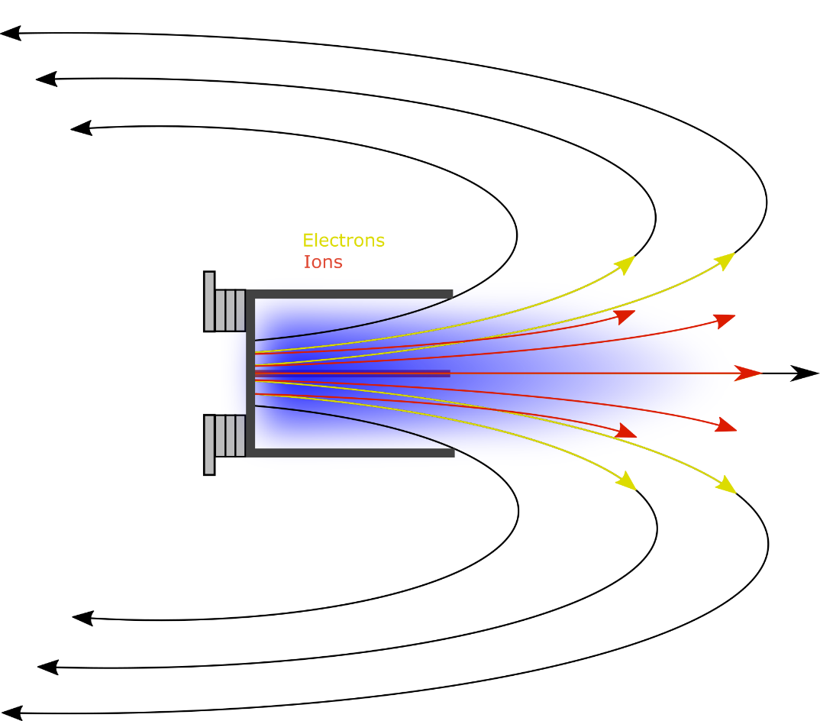
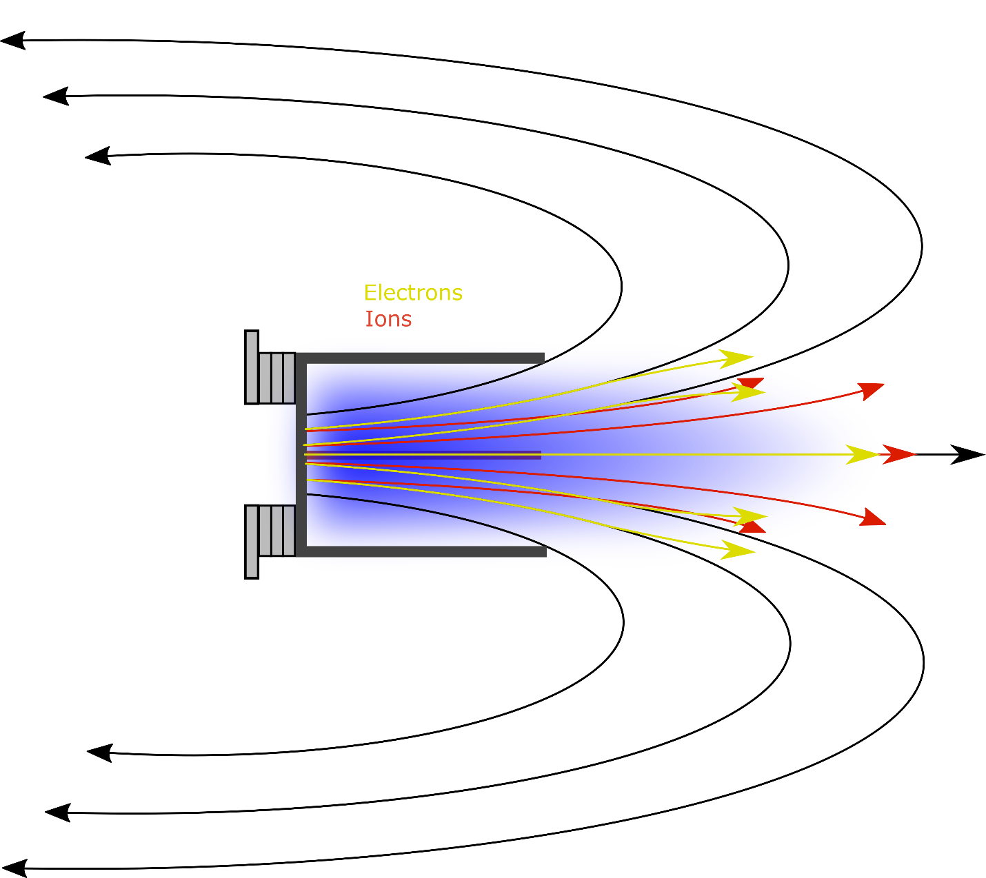
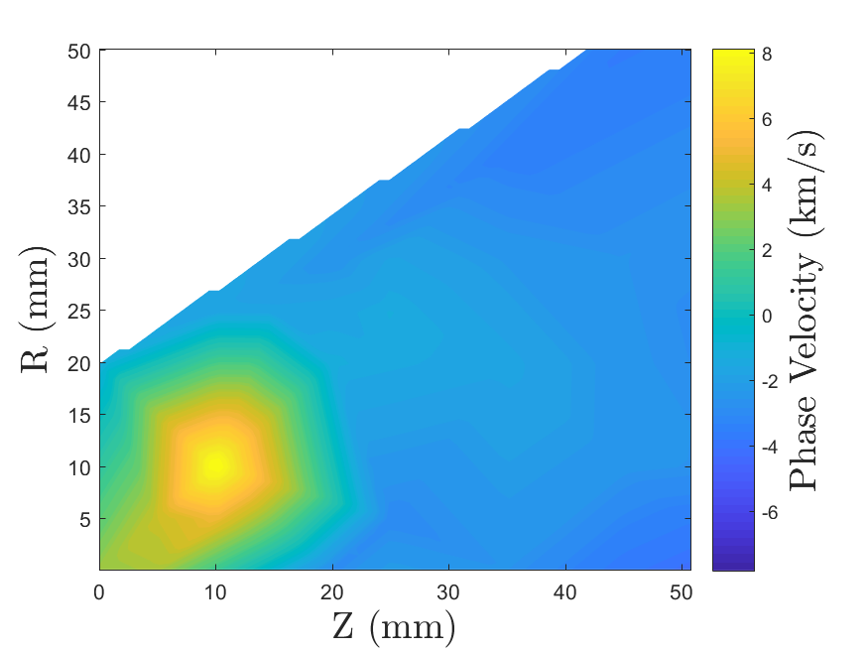
Instability-Induced Cross Field Transport in a Magnetic Nozzle
Shadrach Hepner, Benjamin Wachs, and Benjamin Jorns
Department of Aerospace Engineering, University of Michigan, Ann Arbor, MI.
Introduction
Methods
Discussion
Propulsive magnetic nozzle: Diverging magnetic fields used to expansively accelerate a plasma and generate thrust
The process put forward by Beall et al.¹:
We conjecture these measured waves are the Electron Cyclotron Drift Instability. In the presence of finite propagation parallel to the magnetic field, they take the form of an ion acoustic wave² with phase velocity equal to the ion sound speed, $v_{φ}=\sqrt{T_{e}/m_{i}}$. For electron temperatures of 20 eV, the sound speed is 4 km/s, which is within the range of phase velocities that we measure downstream.
Employing quasilinear theory, we can estimate an effective collision frequency caused by the drag between the wave and electron drift³,
$ν_{AN}=ω_{pi}\sum_{ω}{{\left(\frac{\tilde{i}}{\overline{i}}\right)}^{2}}$ , $ω_{pi}=\sqrt{\frac{n e^{2}}{ε_{0}m_{i}}}$ , $\left(\frac{\tilde{i}}{\overline{i}}\right)$= oscillation magnitude
1. Measure time-varying ion number density with two probes. Applying a Fourier transform and Boltzmann equation provides the plasma potential $\tilde{φ}$($ω$) at both locations.
2. Use the phase difference between each term of the Fourier transform to find the corresponding wave number:
where $θ(ω)$ is the phase offset of each element and $Δx$ is the physical separation between the probes.
$$k(ω)=\frac{tan\left(θ(ω)\right)}{π Δx}$$
$$\tilde{φ}$$
$n=$plasma density, $e=$electron charge magnitude,
$ε_{0}=$ permittivity of free space, $m_{i}=ion mass$
Problem of detachment: electrons tend to remain attached to field lines. Electron-ion separation induces electric fields that pull ions back towards the thruster, negating thrust.
3. Associate the intensity in $ω$ space with a point in $(ω, k)$ space. Repeating this measurement and analysis produces an intensity plot in $(ω, k)$ space.
Ratio of anomalous to Spitzer collision frequencies
We can compare this value to an estimated Spitzer collision frequency. Here we present the ratio of the anomalous collision frequency to estimates of classical collision frequency. The anomalous collision frequency is larger everywhere, often by several orders of magnitude.
Wave measurement method
Results
$$ν_{AN}/ν_{c}$$
Wave intensity Plot observed in plume
Hypothesis: instabilities in plasma may cause enhanced resistivity that allows electrons to cross field.
We perform Beall’s procedure with probes separated azimuthally to yield wave intensity plots, shown here. The high intensity (red) regions represent the dispersion relation. We observe a linear pattern.
1. Gradients form
2. Drifts develop
Conclusion
$$∇P$$
$$\vec{E}$$
$${\vec{v}}_{e,θ}$$
We have presented here detection of unstable behavior in the plume of a magnetic nozzle. Describing these waves as acoustic-like propagation perpendicular to the magnetic fields yields an anomalous collision frequency that exceeds that predicted classically. In low density and high temperature plasmas, classical resistivity becomes insignificant, but these instabilities may increase resistive drag on the electrons, allowing for detachment nonetheless. Further understanding of these instabilities will allow us to predict electron dynamics in these devices. Since ion dynamics are dictated by the electric fields resulting from electron motion, a better understanding of electron detachment will allow more accurate prediction of thrust production throughout the nozzle.
3. Instabilities form, taking energy from electron motion
4. Effective drag
enhances transport
Phase Velocity
With the observation of linear dispersion, we can define a phase velocity, defined by $v_{φ}=ω/k$, the slope of the high-intensity region.
We note here downstream values between 3 and 6 km/s, while phase velocity increases upstream.
$$\tilde{φ}$$
References
[1] Beall, J. M., Y. C. Kim, and E. J. Powers. “Estimation of Wavenumber and Frequency Spectra Using Fixed Probe Pairs.” Journal of Applied Physics 53, no. 6 (1982): 3933–40. doi:10.1063/1.331279.
[2] Gary, S Peter, and J J Sanderson. “Longitudinal Waves in a Perpendicular Collisionless Plasma Shock I. Cold Ions.” J. Plasma Physics 4, no. 4 (1970): 739–51. doi:10.1017/S0022377800005390.
[3] Sagdeev, R., and A. Galeev. Nonlinear Plasma Theory. Edited by T.M. O’Neil and D.L. Book. Frontiers in Physics. New York: W.A. Benjamin, 1969.
Goals of this investigation:
1) Do waves exist?
2) Can we estimate how they compare to classical resistivity?
This work was funded under the NASA Space Technology and Research Fellowship grant number 80NSSC17K0156.

