Slide 1
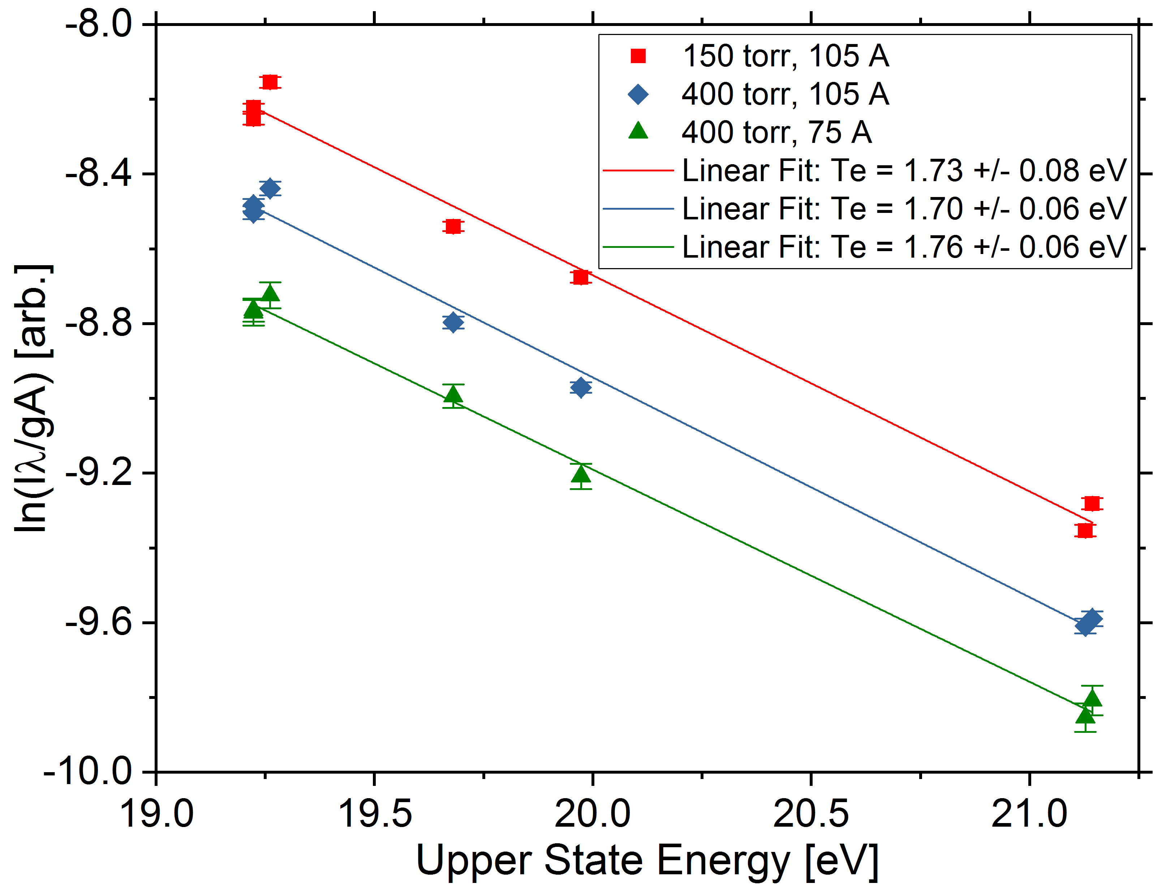
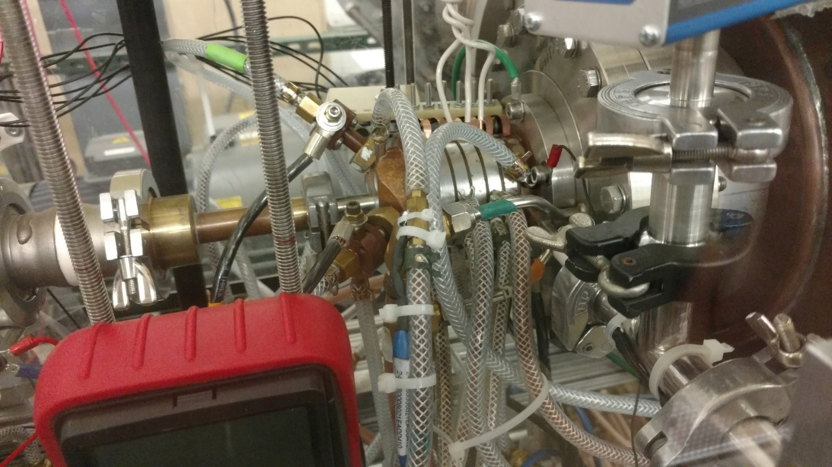
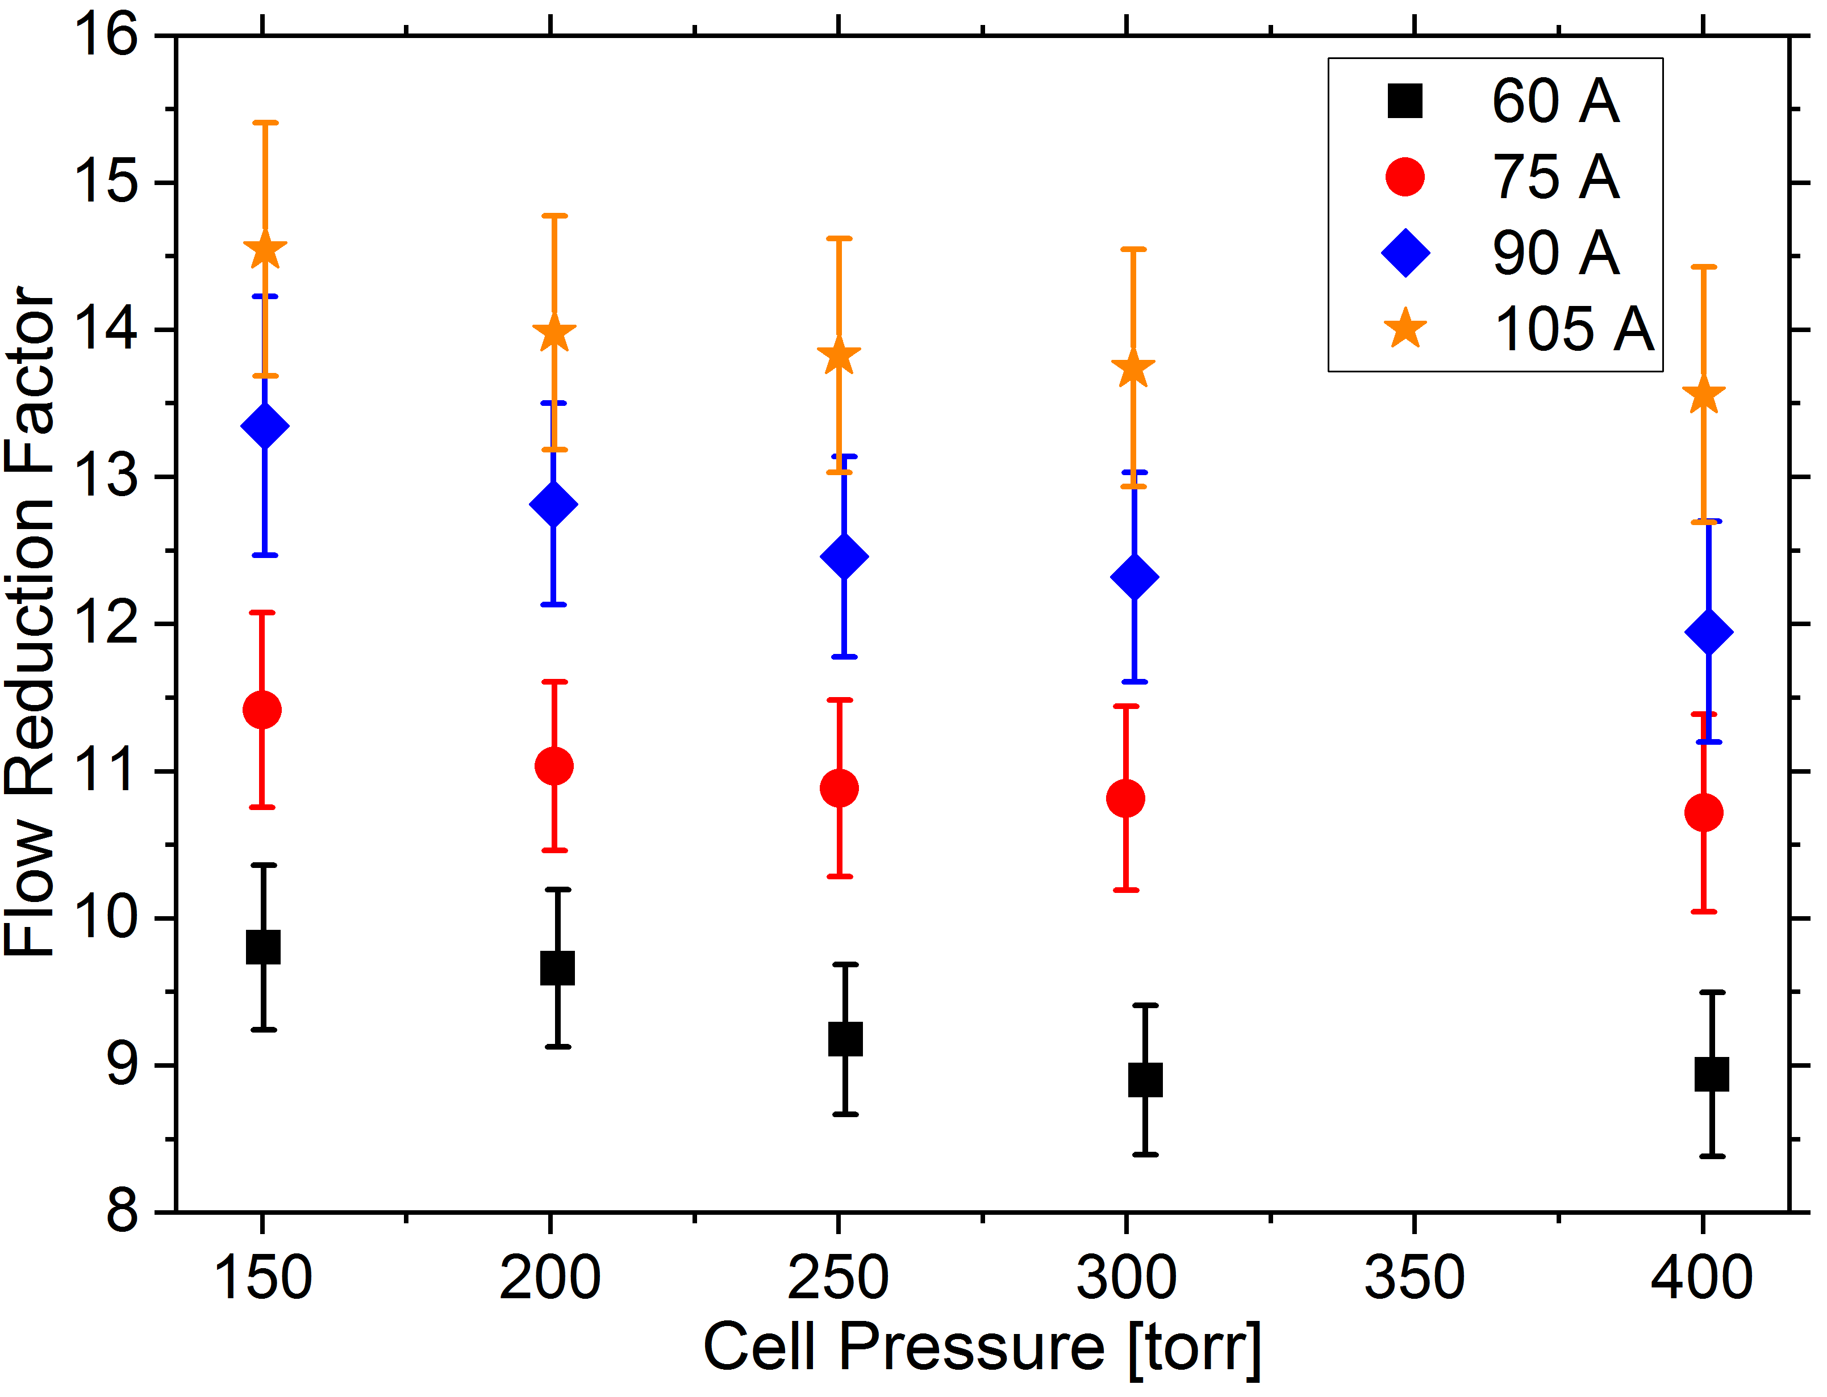
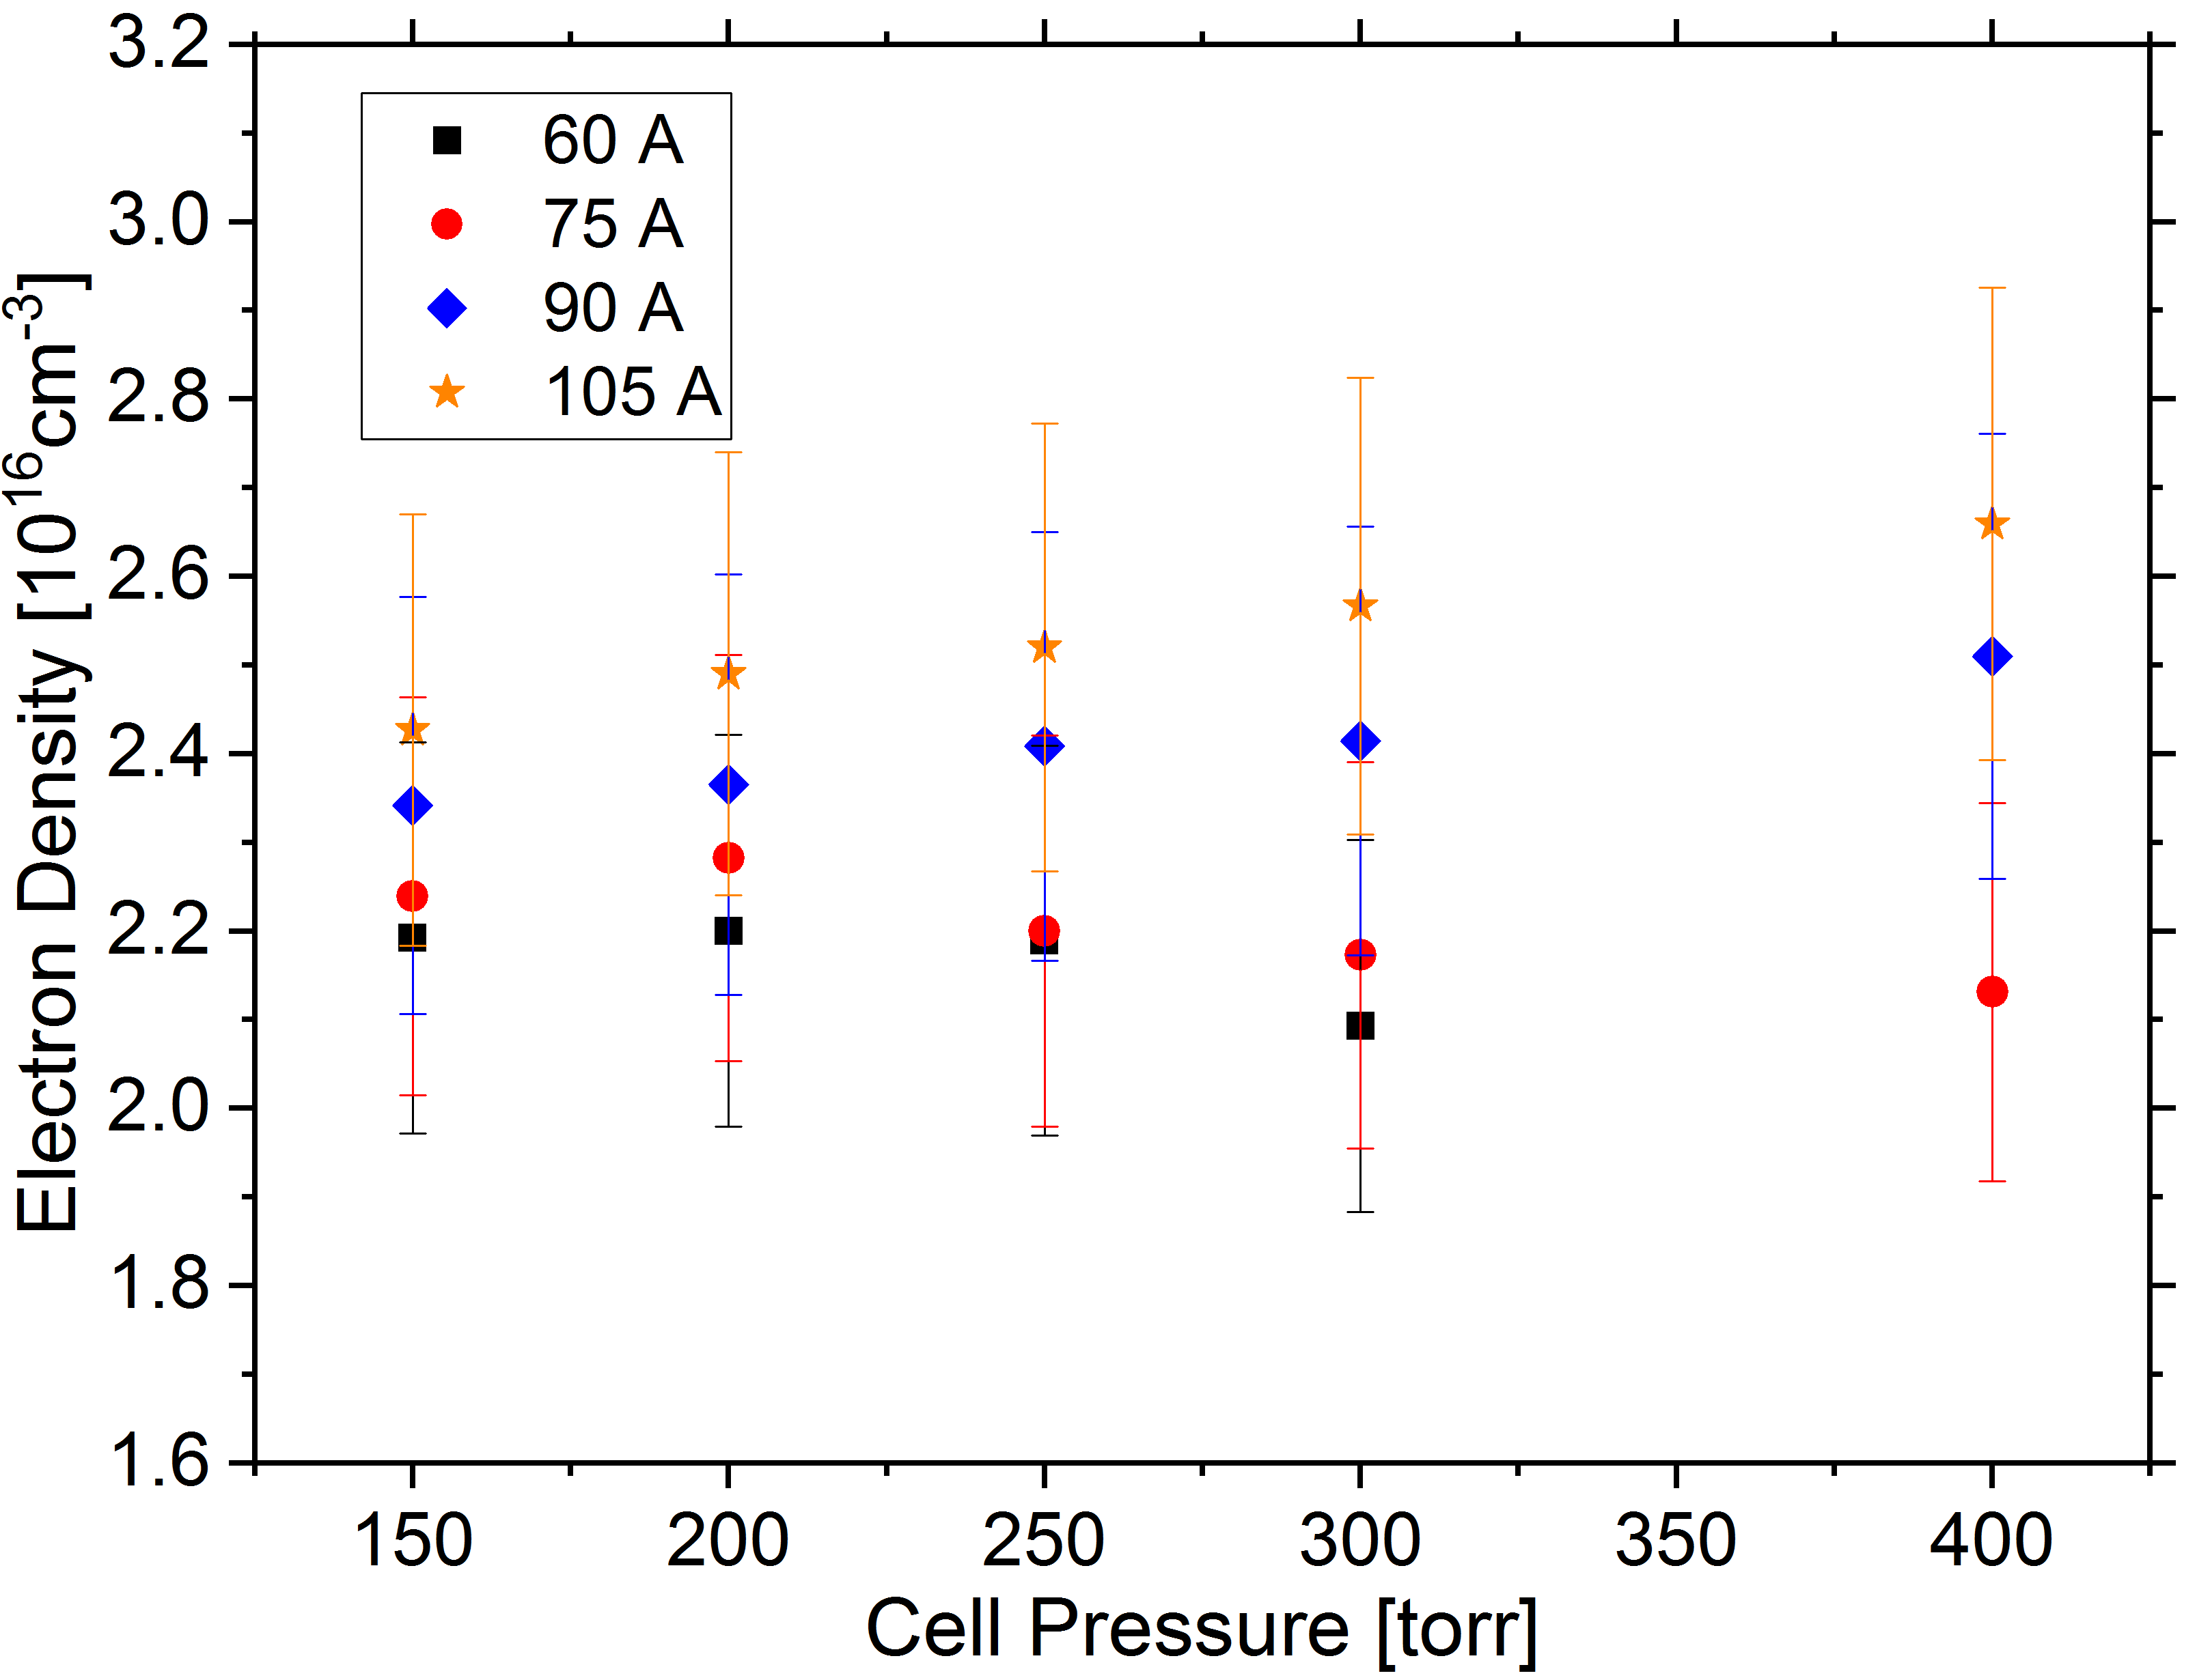
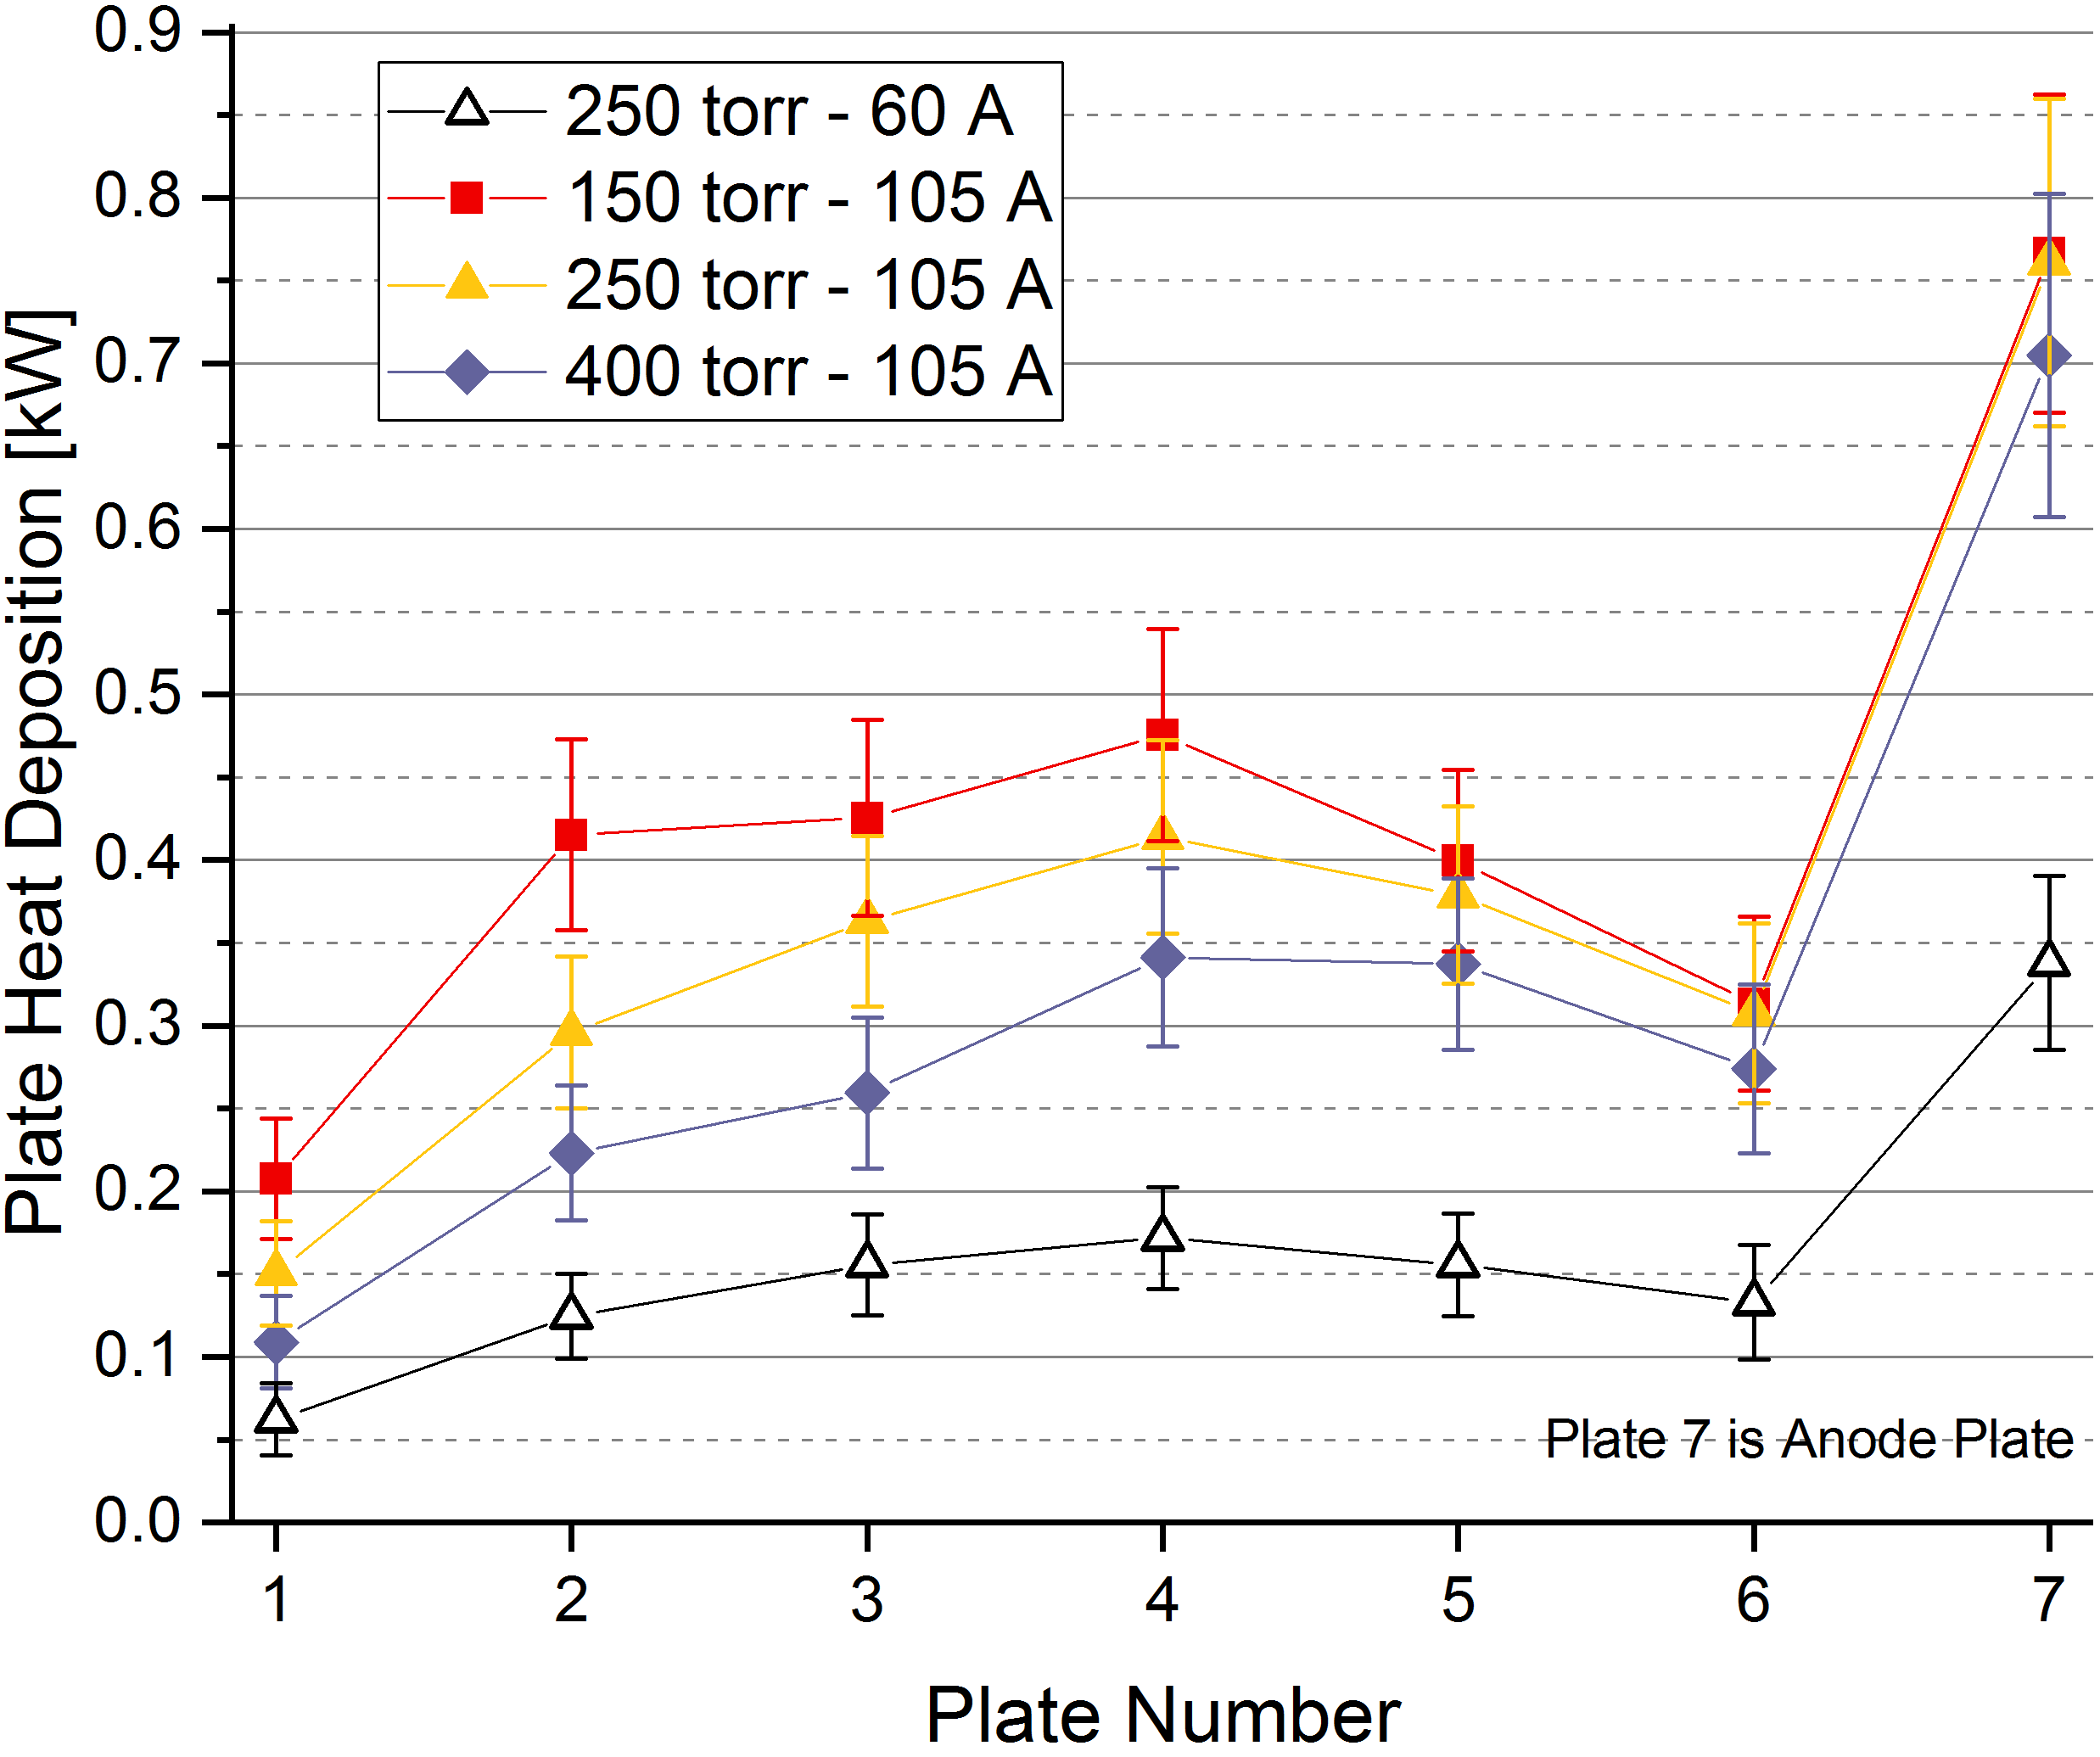
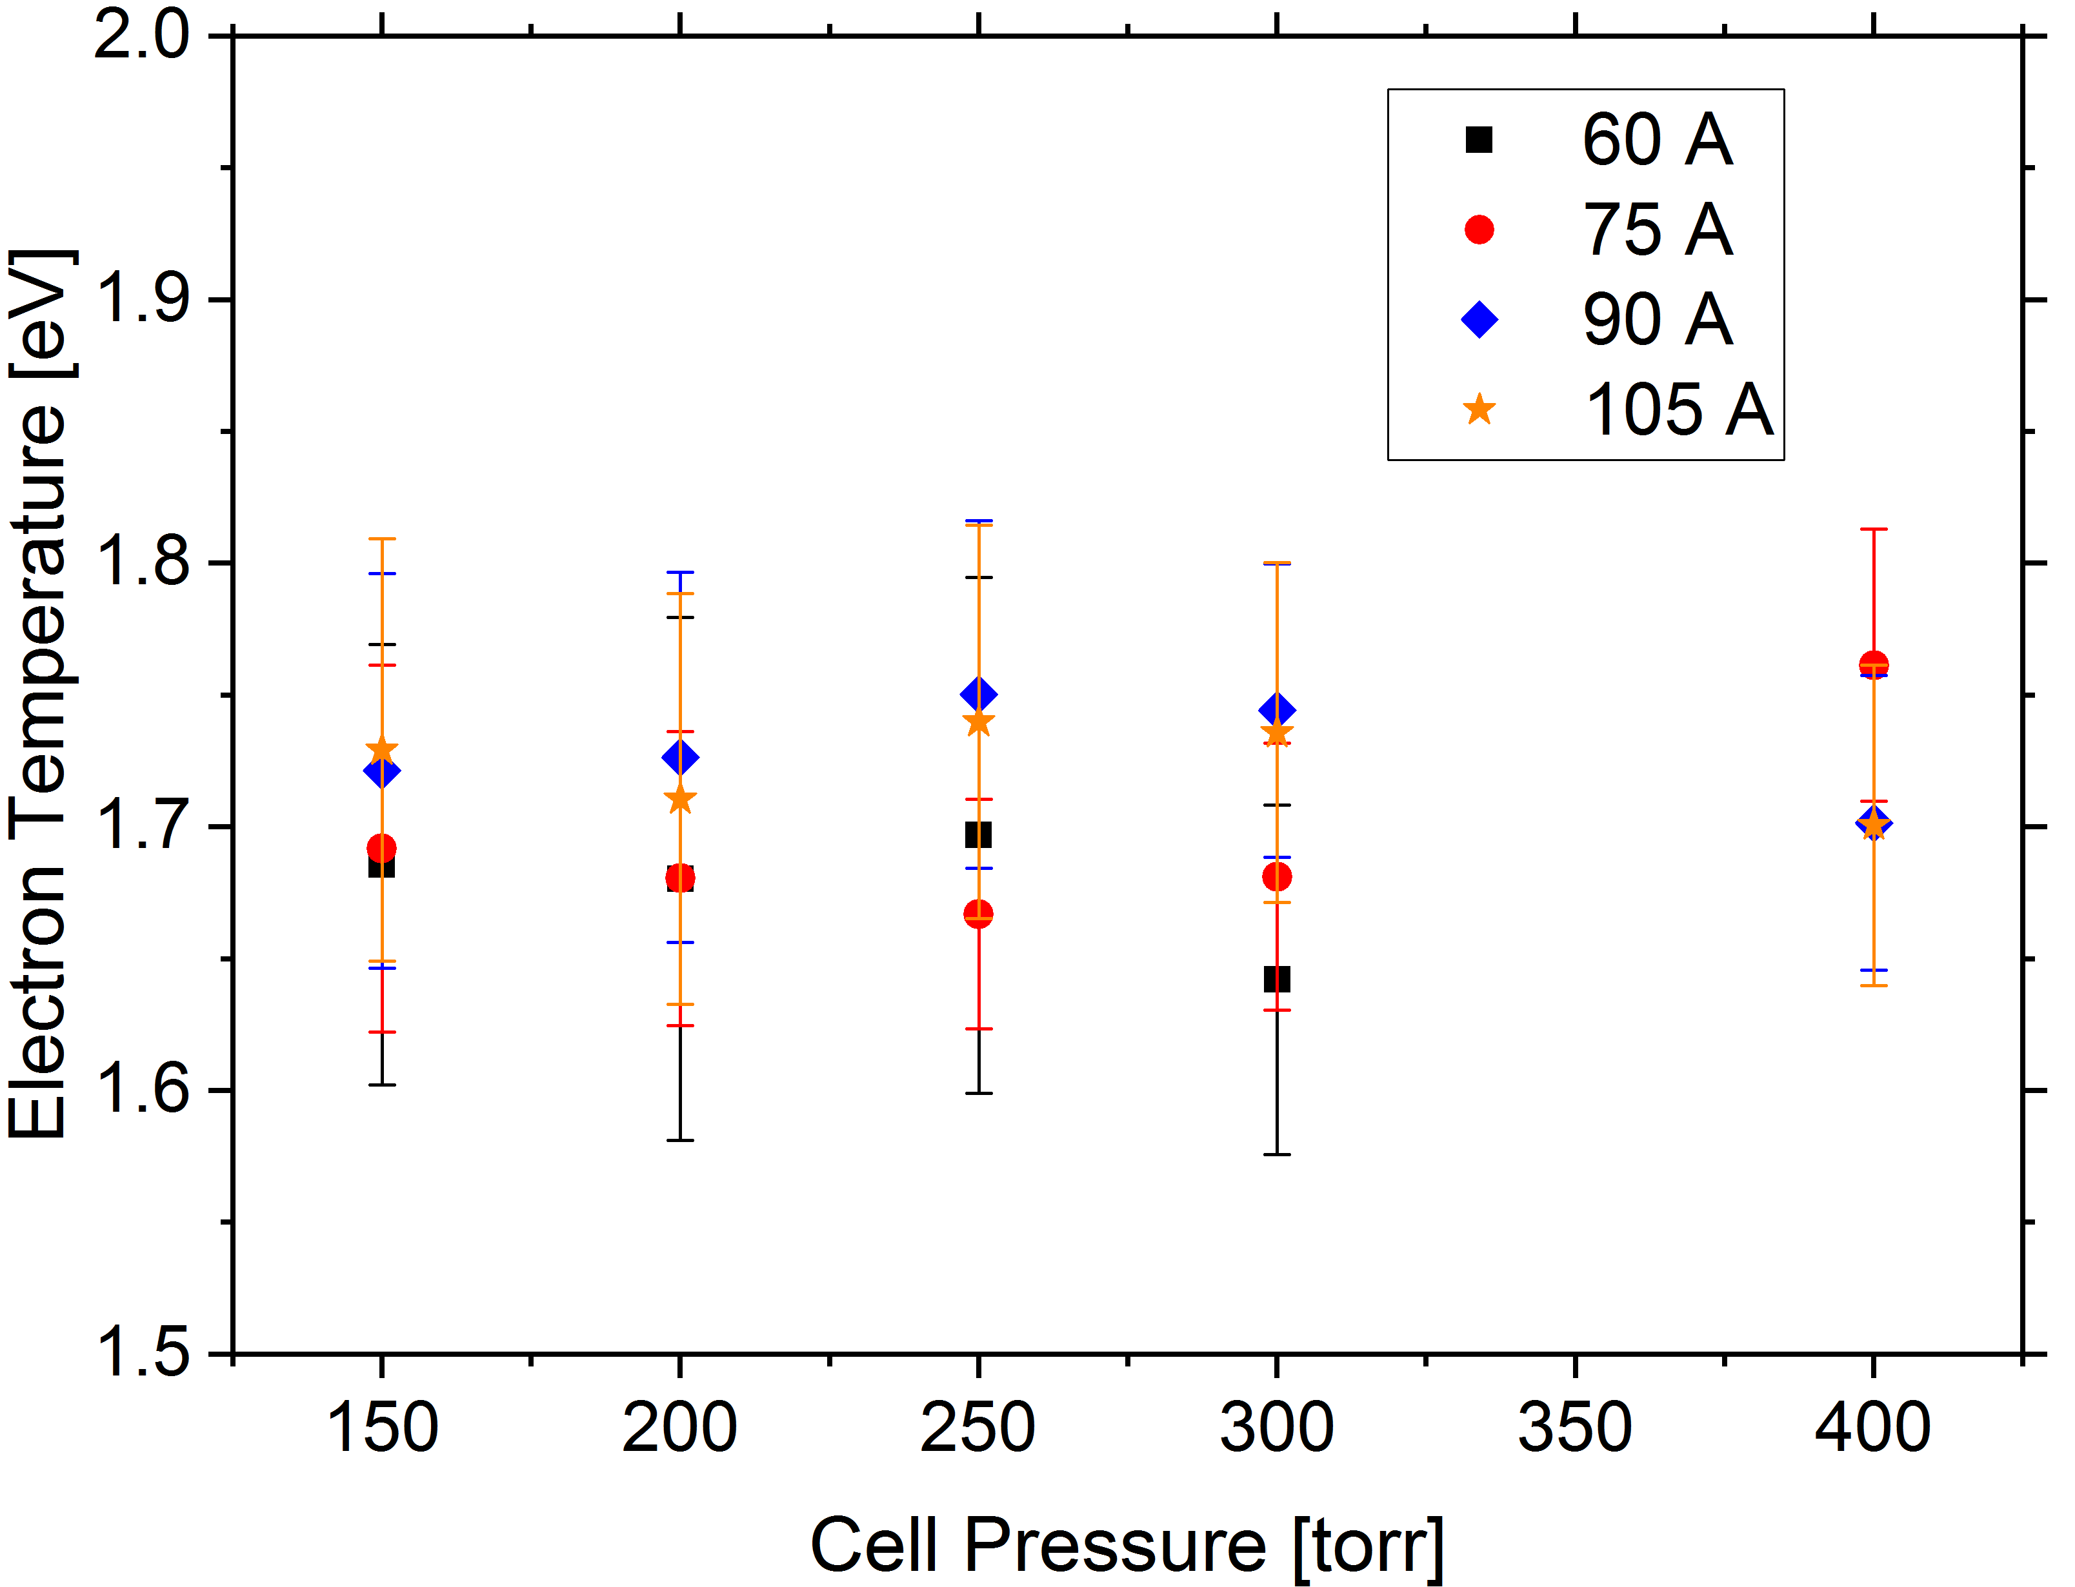
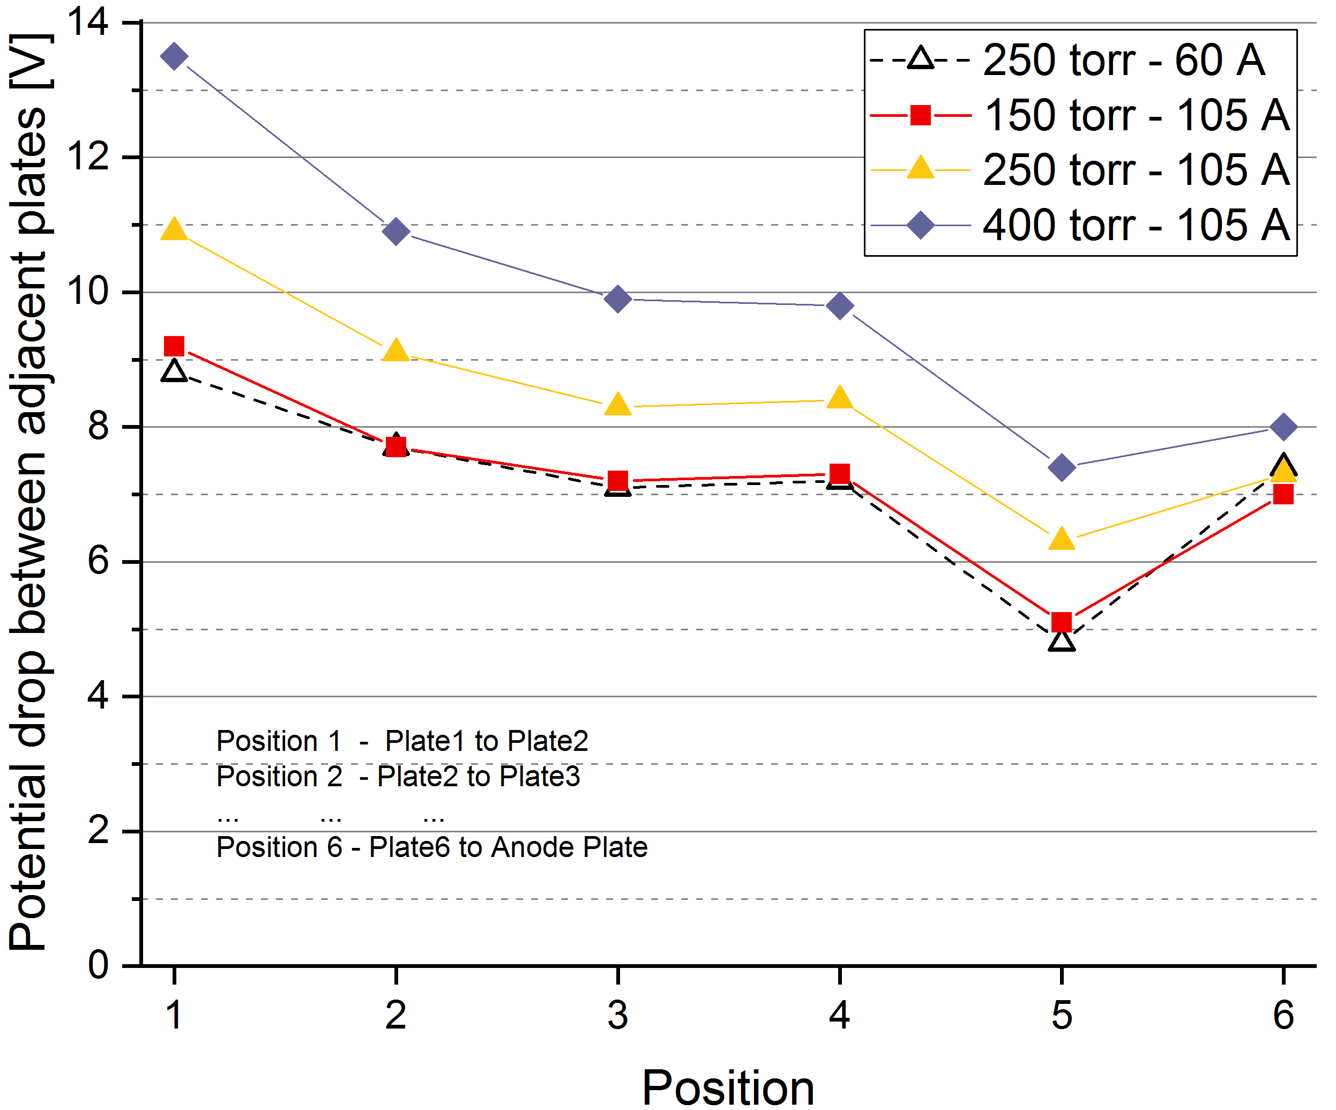
Overview of Experimental Determinations of Plasma Properties in Ar gas in a Plasma Window
Introduction
A. L. LaJoie, J. Gao, and F. Marti
National Superconducting Cyclotron Laboratory, MSU, East Lansing, MI 48824, USA
A gas charge stripper is an attractive option for high intensity heavy ion accelerator facilities due to its degradation immunity, as opposed to conventional carbon foil charge strippers that suffer radiation damage. The main difficulty is maintaining a high pressure (~300 torr) in a windowless charge stripping gas chamber, yet also preventing excessive gas flow from this high pressure chamber to the connected low pressure (~10⁻⁸ torr) beamline region. The Plasma Window is an option for allowing a better compromise between those two conditions than would otherwise be possible [1].
Experiment: Setup
Experiment: Diagnostics
The window is comprised of six 7 mm thick floating voltage metal plates separated by O-rings, aluminum-nitride spacers, and G10 insulating spacers all 2 mm thick.
All the initial plates have an inner hole of diameter 6 mm, with the exception the anode plate and the cooling plate immediately preceding it, both of which have a hole of 10 mm diameter. Each plate, cathode, cathode-holding structure, and anode are water cooled.
The present study is on Argon gas, and a similar study of Helium gas will follow.
Gas flowrates are also obtained for both no-arc (just gas) and with-arc conditions as a function of the Gas Cell pressure. The ratio of these two flowrates at a given Gas Cell Pressure is termed the Flowrate Reduction Factor and is shown below.
Power Deposition for each plate is calculated via a calorimetric analysis using the water temperature difference between supply and return side, and the water’s flowrate.
Floating Voltage of each component relative to grounded anode is measured. Differences of these floating voltage values between adjacent components are shown below.
Relative irradiance of emission lines from ArII in the plasma allow determination of electron temperature via the Boltzmann Line Method for optically thin transitions, a sample determination of which is shown.
Electron density is obtained by Stark Broadening analysis, through determining values of line shape parameters, the electron impact width and the ion broadening parameter [4,5].
Water Coolant – flowrate and temperature measured on supply and return
Cathode (3x)
O-Ring
Cooling Plates
Anode Plate
Line of Sight to Spectrometer (fiber optic)
Gas Outlet
Low Pressure Chamber
The Plasma Window is a wall stabilized DC arc discharge [2] that greatly inhibits the flow of gas. The cause of this is frequently attributed to an expected very high gas temperature in the arc channel. Suggested mechanisms for this are an increase in viscosity in the plasma [3], and/or the establishment of a choked flow condition.
High Pressure Cell
AlN insulator
Gas inlet
G10 spacer
Floating Voltage measured relative to grounded anode by DMM
Calculation: Electron Density
Calculation: Electron Temperature
Fitting to peak profile yields parameters α (ion-broadening parameter), W_{j} (Stark broadening width [nm]), and W_{t} (overall FWHM [nm]).
Broadened Profile
NIST tabulated values
Electric Microfield Strength Distribution
g_{u} = upper state degeneracy
A_{ul} = transition strength
E = state energy
I_{ul} = line intensity
$$W_{t}≈W_{j}\left[1+1.36{\left(\frac{α^{2}}{σ}\right)}^{1/3}\right]$$
Plasma Window
Empirical relation between fitted parameters and Ne
Measured via Spectrometer
Ion Relevance Parameter
Calculated α and W_{j} for 425.9 nm Ar I line at Ne = 10¹⁶ cm⁻³ and 15000 K are
α = 0.065
W_{j} = 0.0142 [nm]
$$W_{j}\left(N_{e},T_{e}\right)∝N_{e}$$
$$α\left(N_{e},T_{e}\right)∝N_{e}^{3/{16}}$$
Electron Density Dependencies and Reference Point [5]
Sample: Ar Specrum
Ar I line used in density calculation
Ar II lines used in electron temperature calculation
Results: Argon data with MSU Test Stand – 6 Plates (5x6mm, 1x10mm Plate)
Flowrate Data
Spectral Analysis
Wall Interaction Profiles
The Flowrate Reduction Factor plot illustrates the utility of the Plasma Window in reducing gas flow. The Reduction Factor is nearly constant with changing pressure, but depends more strongly upon the arc current.
Plasma-wall interactions are characterized with two profiles: between-plate potential drops and plate heat deposition profile. Voltage drop between plates increases with both pressure and current, though changing pressure appears to have an added effect of shaping the profile, whereas current changes primarily result in just an overall magnitude shift. Higher arc current increases power deposited onto the plates. However, increasing pressure causes a suppression of power deposited in the plates, despite the higher pressures also causing higher arc power input.
Conclusions
The amount of utility one can get out of the Plasma Window, the Flowrate Reduction Factor, depends primarily on the supplied current, however, this is at the cost of an increase in the amount of power going into the gas, that must be dissipated somewhere in the system via cooling. Correspondingly, Plate Heat Deposition profiles show increased power deposited at higher currents, but decreased power deposited at higher pressures. However, at this point, it’s important to note that Arc Power increases with both current and pressure, as indicated in the Plate Voltage Profiles, so the increased power from pressure must be taken up by other cooled components (the expansion chamber or the pumps). We observe that the electron density and electron temperature are curiously constant across the explored parameter space. One might expect that while a pressure setting is kept constant and current is changed, that electron density would change. More exploration, and confirmation that the above electron densities are reasonable is needed to provide more confidence in this result.
[1] J. Nolen and F. Marti, “Charge Strippers of Heavy Ions for High Intensity Accelerators,” Rev. of Accel. Sci. and Technol., vol. 6, pp. 221-236, 2013.
[2] H . Maecker, Z. Naturforsch., 11 a, pp. 457-459, 1956.
[3] A. Hershcovitch, A plasma window for transmission of particle beams and radiation from vacuum to atmosphere for various applications,” Phys. of Plasmas, vol. 5, no. 5, p. 2130, 1998.
[4] V. Milosavljević and G. Poparić, “Atomic spectral line free parameter deconvolution procedure,” Phys. Rev. E, vol. 63, 2001.
[5] H.R. Griem “Spectral Line Broadening by Plasmas,” Academic Press, 1974.
[6] A.L. LaJoie et al, “Plasma Window as Charge Stripper Complement,” LINAC2016 Proceedings, pp. 836-838, 2016.
This work was supported by NSF Award PHY-1565546 .

